Slide 1
AI and the meaning crisis
How to bring value into AI
— By Balazs Kegl, Head of AI Research, Noah's Ark Research Lab, Paris

Slide 2
AI is highly valuable but value is exogenous, often implicit.
Value = meaning = guides how we act

Slide 3
Outline
A couple of current examples of amazing AI successes and their subtle deficiencies
My meaning crisis: the two worlds and their collision in the Center for Data Science
John Vervaeke's 4P ways of knowing: an integrative metacognition framework
The foundational role of reinforcement learning, and what's still missing of it

Slide 4
Would you like that self-driving cars 1: drive like humans, or 2: obey all vehicle code?

Slide 5
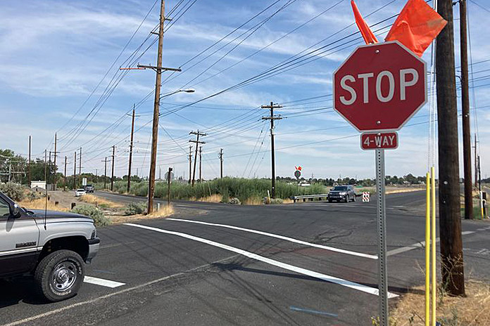
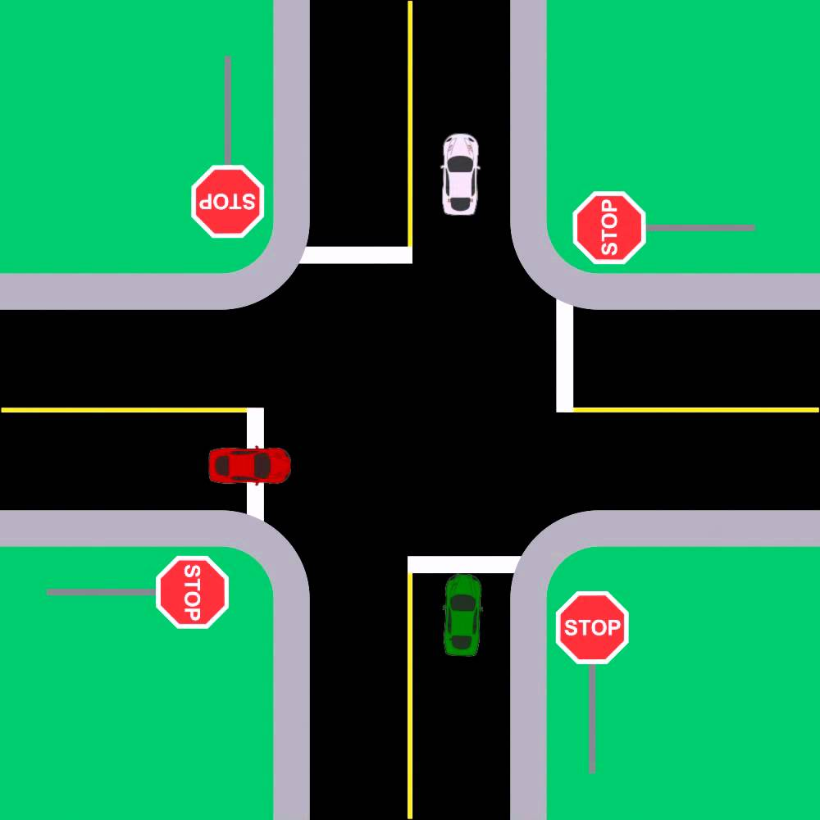

Slide 6
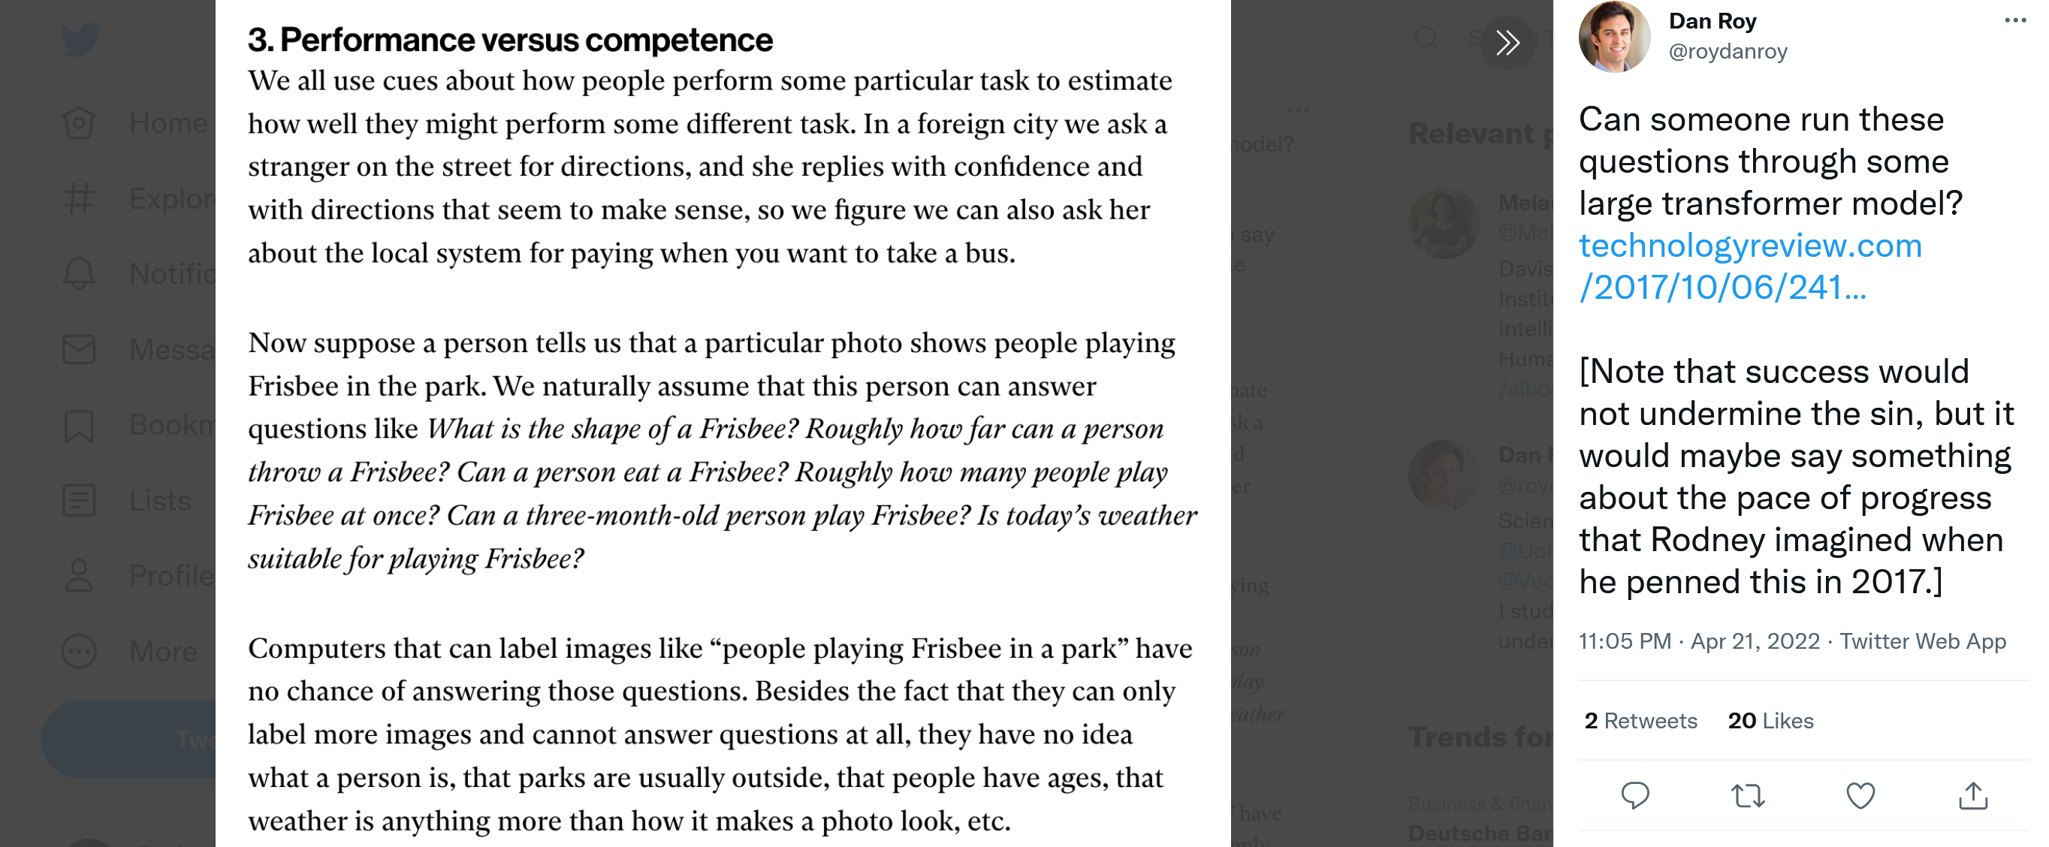

Slide 7
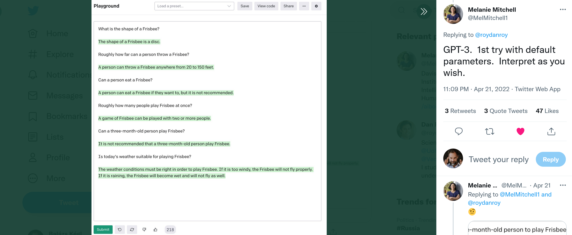

Slide 8
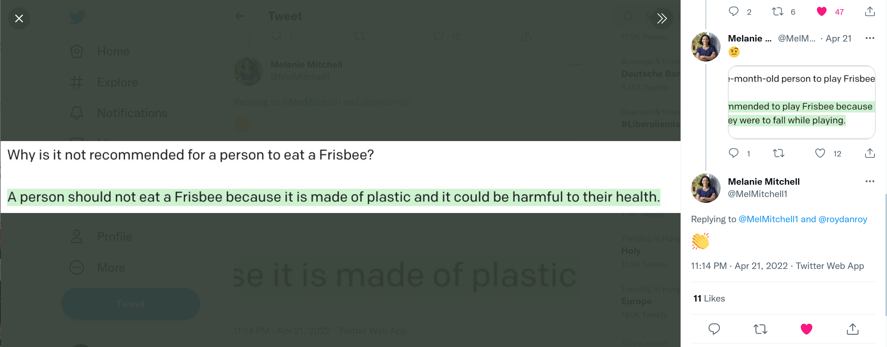

Slide 9
But it lives in a "flat" world, every statement has the same value, every bit of information the same saliency
GPT-3 knows everything there is to know propositionally

Slide 11
My scientific training gave me no tools to decide which project is more valuable, worthy of our limited resources

Slide 12
John Vervaeke's 4P ways of knowing
Propositional: answers to "what is true"
Set of statements, written language (mostly), science, no notion of value/meaning other than implicit: what is. Labels and raw data contains implicit value for AI. Sense of truth.
Procedural: answers to "how to do"
Set of skills to do something valuable, action and value oriented. Value/meaning is explicit but still extrinsic. Engineering, sports, ecosystem of transformative practices. In AI, reinforcement learning is the formalism. Even when it exists, typically we are AI's actors today. Sense of power.
Perspectival: answers to "what is it to be like here, now"
Situational awareness, what skills to apply (and learn!) contextually. What values are in play, driven by internal state but also the environment, What values are more important than others. What's relevant/salient for those values. Trouble: it is pre-inferential. Sense of presence.
Participatory: answers to "what is it to be like me", knowing by being
What identities and roles are we assuming and what identities and roles we assigning to the external world. It's a dance. Gives us a set of affordances that guide salience. Deeply embodied. Defines what's knowable. Sense of connectedness.

Slide 13
The foundational role of reinforcement learning
When we know what's salient (state - both internal and external), what actions are available to us, and what states are valuable (reward), RL (best action sequence to reach a state) is the right formulation
In supervised learning (and even more in self-supervised learning):
Value is implicit, propositional what is, present in the data collected and the categories to predict.
Data collection is external, any bias in data reflected in the learned function, hard to negotiate and to codify.
In reinforcement learning
Value is explicit, can be argued about, inserted into the political process.
Data collection is part of what the algorithm should optimize.
Saliency and value arbitration is still outside of the scope.

Slide 16
Conclusions
Current AI is the baby of the scientific world, its realm is propositional where value is only implicitly represented in the collection of the data
Reinforcement learning gets us in the procedural realm where value is explicit and can interface with human processes and structures
Participatory value realization and perspectival saliency detection and value arbitration are currently out of the scope of AI research
Embodied engineering systems will need it
Integrating AI into human society in this deep sense requires the same move as integrating me, the scientist, into my scientific worldview

