Slide 1
Semi-Digital Hadronic Calorimeter
SDHCAL Status
I.Laktineh
for
IP2I, LPC,OMEGA
CIEMAT,GWNU,SJTU

Slide 2
Outline
SDHCAL technological prototype
Description
Test Beam results
Towards Module0
New readout scheme
Ongoing developments:
-Timing-SDHCAL
Motivation
Progress

Slide 3
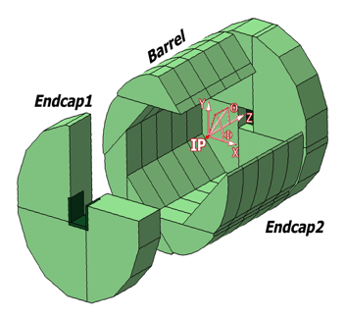
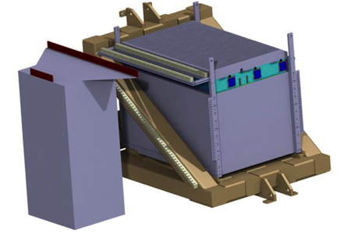
SDHCAL
The SDHCAL-GRPC is one of the two HCAL options based on PFA and
Proposed for ILD of ILC/CEPC. Modules are made of 48 RPC chambers (6λ_{I})
equipped with semi-digital, power-pulsed electronics readout and placed
in self-supporting mechanical structure to serve as absorber
as well.
The structure proposed for the SDHCAL :
very compact with negligible dead zones
Eliminates projective cracks
Minimizes barrel / endcap separation
(services leaving from the outer radius)
SDHCAL Technological Prototype should
be as much as possible similar to the ILD module
and able to study hadronic showers
Challenges
-Homogeneity for large surfaces
-Thickness of only few mms
-Lateral segmentation of 1 cm X 1 cm
-Services from one side
-Embedded power-cycled electronics
-Self-supporting mechanical structure

Slide 4
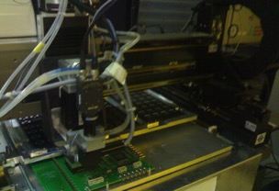
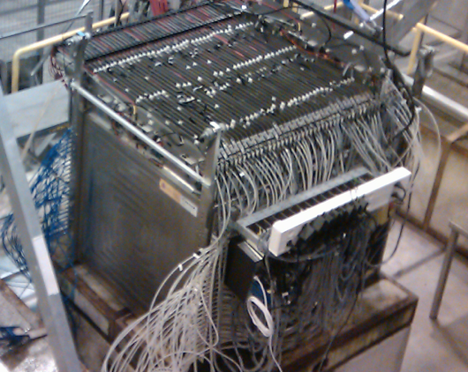
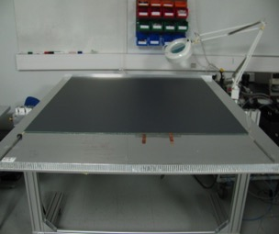
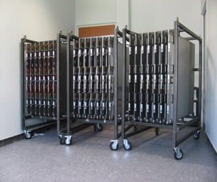
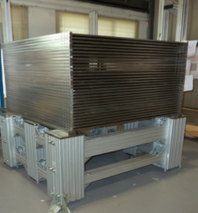
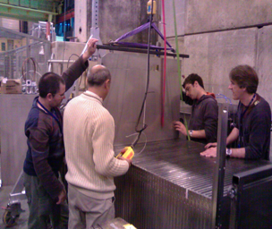
SDHCAL prototype construction
10500 64-ch ASIC were tested and calibrated using a
dedicated (ASICs layout : 93% ).
Funded by ANR-blanc
310 PCBs were produced, cabled and tested.
They were assembled by sets of six to make 1m² ASUs
170 DIF, 20 DCC were built and tested.
50 detectors were built and assembled with
their electronics into cassettes.
Self-supporting mechanical structure.
DAQ system using both USB and HTML protocol
was developed and used.
Full assembly took place at CERN.
Published: JINST 10 (2015) P10039

Slide 5
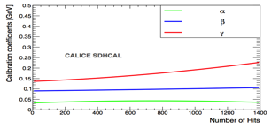
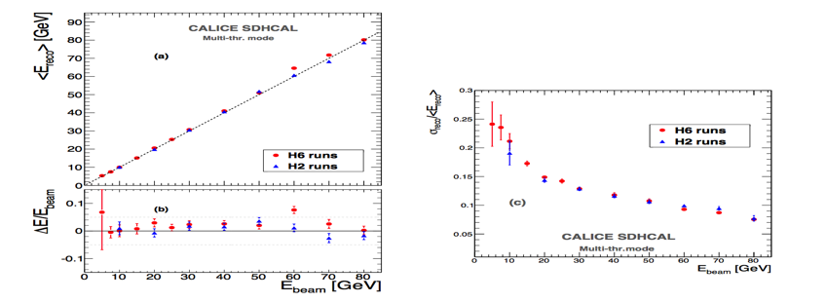
Energy estimation
The thresholds weight evolution with the total number
of hits obtained by minimizing a χ²
Χ² = (E_{beam}-E_{rec})²/E_{beam}
E_{rec =} α (N_{tot}) N₁ + β(N_{tot}) N₂ + γ(N_{tot}) N₃
N₁,N₂ and N₃ : exclusive number of hits associated to first,
second and third threshold.
α, β, γ are quadratic functions of the total number of hits (N_{tot})
Events of H2 runs corresponding to energies : 5, 10, 30 , 60
and 80 GeV were used to fit the 9 parameters.
Then the energy of hadronic events in
both H2( only pions) and H6 (presence of protons)
Published: JINST 11 (2016) P04001

Slide 6
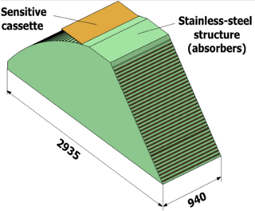
SDHCAL R&D towards ILD
GRPC
Glass Resistive Plate Chambers
Detectors as large as 3m X 1m need to be built
Electronic readout should be the most robust with
minimal intervention during operation.
DAQ system should be robust and efficient
Mechanical structure to be similar to the final one
Envisage new features such timing, etc..
SDHCAL
ILD Module
Goal: to build new prototype with few but large GRPC with the new components
→ ILD Module0

Slide 7
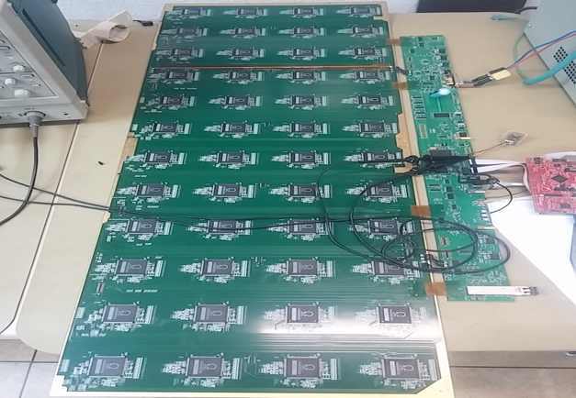
New readout electronics
HR2→ HR3 (larger dynamic range, zero suppression, I2C)
PCB (50 cm x 33 cm) → PCB(100 cm x 33 cm) to reduce the number of connectors
DIF (3/ 1 m²) → DIF ( 1/ 3 m²)
We have the needed material to equip 2 GRPC detectors of 2 m X 1 m each since 2017
Funded by AIDA
100 cm
6 cm
33 cm

Slide 8
Recent development for SDHCAL
New synchronization board
DAQ Hardware
Motherboard:
  FPGA (Intel 10CL120)+ Ethernet 10/100
  MCU (Microchip PIC32MZ2048)+ Ethernet 10/100
  120 LVDS IOs from/to daughterboard
Daughterboard: Versatile to accommodate several front ends
  12 HDMI (SDHCAL compatible)+NIM/TTL IOs
  8 Optical (SFP modules)+NIM/TTL IOs
  PMT interface
  Designed to fit in a NIM module (requires +/-5Vdc to +/-6Vdc 1A)
DAQ software
  Drivers for zdaq, initially developed on Debian (buster), tested on Debian and under WSL windows 10

Slide 9
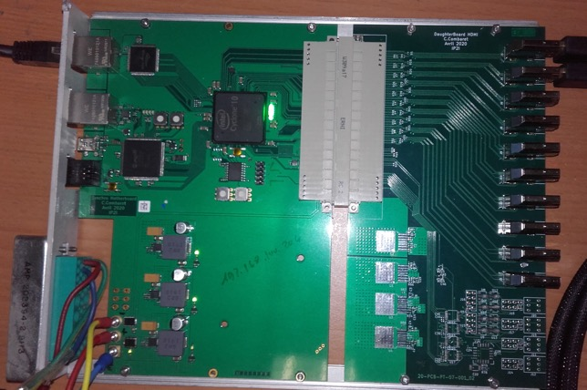
Motherboard + HDMI Daughterboard
FPGA ethernet
IOs to/from daughterboard
MCU ethernet
MCU
IP add.
FPGA
MCU
12 HDMI connectors
FPGA
IP address
Local voltage regulators
8 NIM/TTL IOs

Slide 10
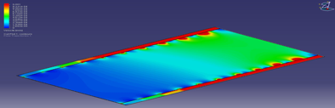
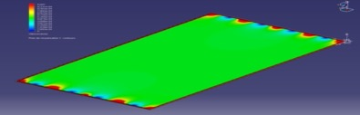
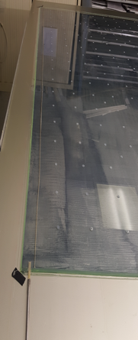
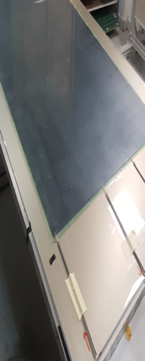
Recent development for SDHCAL
New large RPC design
Construction and operation of large GRPC necessitate some improvements with respect to the present scenario.
Gas distribution: new scheme is proposed
Gas gap thickness: better control
Coating: new paints are tested
Prototype circulation system
New circulation system
inlet
outlet
1 m
2 m
Cassette conception to ensure good contact between the detector and electronics is to be improved

Slide 11
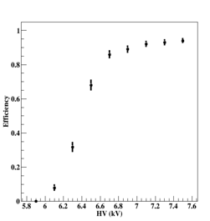
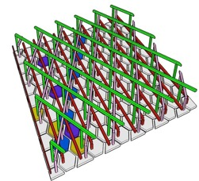
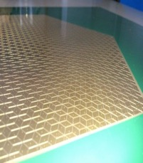
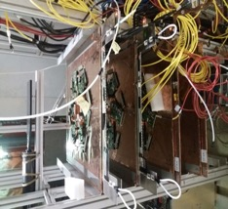

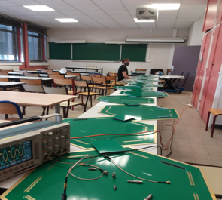

New readout scheme
Woven strips: interconnected pads using strips along three durections
Electronic channels number : NXN → 3 N

Slide 12
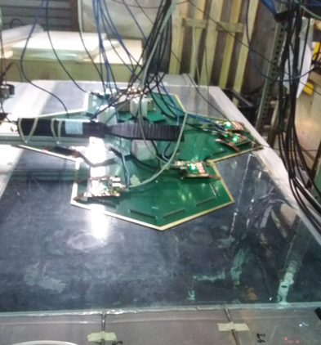
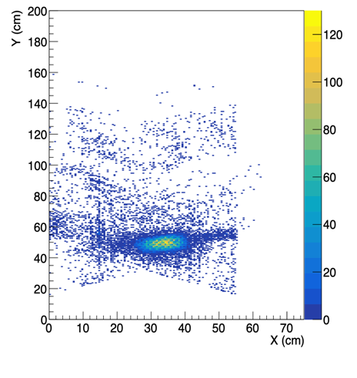
New readout scheme
The new scheme is being tested on large GRPC with several PCBs
Reconstruction efficiency is around 90%
Next step: study the possibility to use this scheme for tail catcher

Slide 13
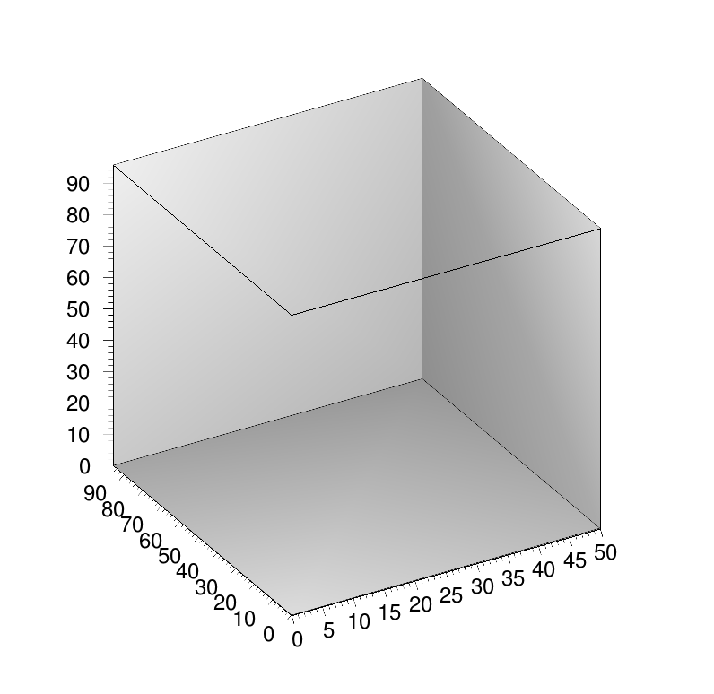
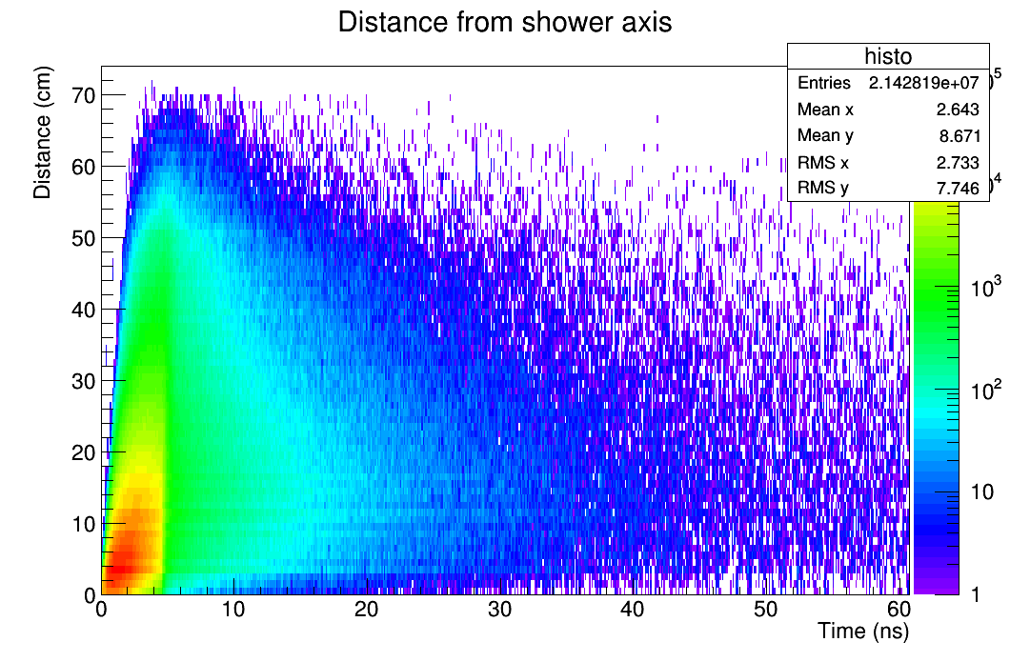
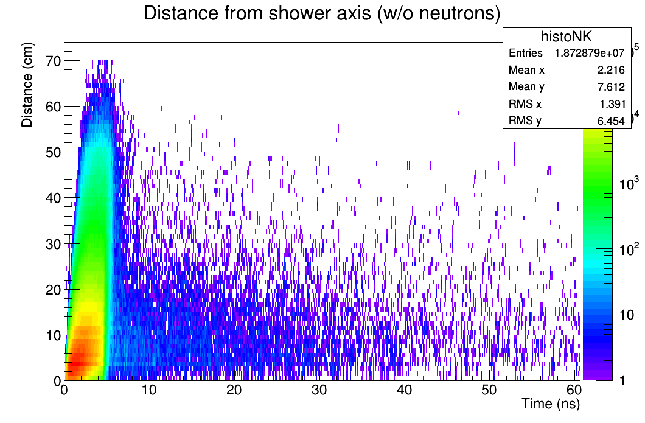
T-SDHCAL
Timing could be an important factor to identify delayed neutrons and better reconstruct their energy

Slide 14
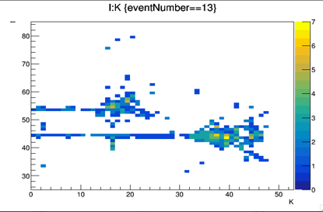
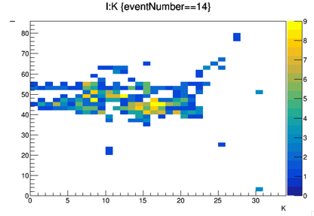
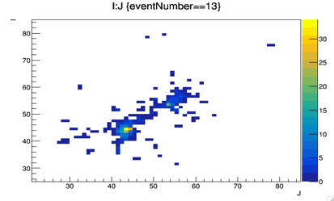
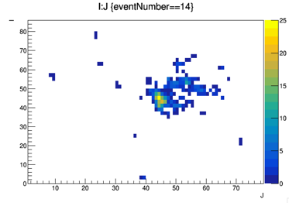
Time information can help to separate closeby showers and reduce the confusion for a better PFA application. Example: pi-(20 GeV), K-(10 GeV) separated by appox. 15 cm.
DIFFICULT
EASY

Slide 15
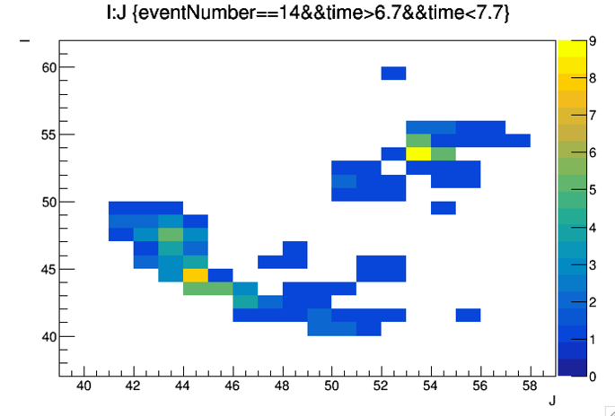
If we have 1 ns resolution

Slide 16
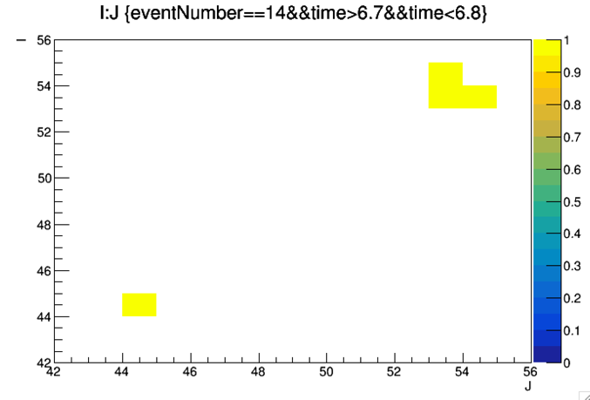
If we have 100 ps resolution

Slide 17
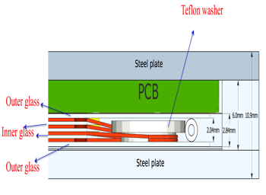
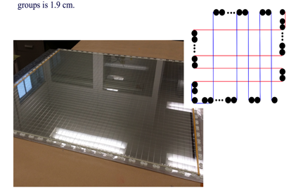
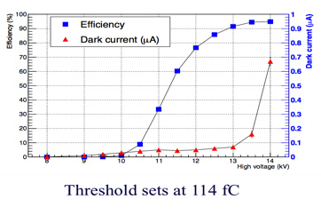
How to achieve an excellent time resolution:
Large Multi-gap RPC were conceived and built by IP2I and GWNU.
NIMA, volume 871, November 2017,113-117

Slide 18
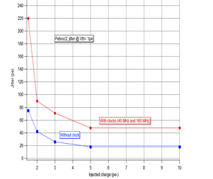
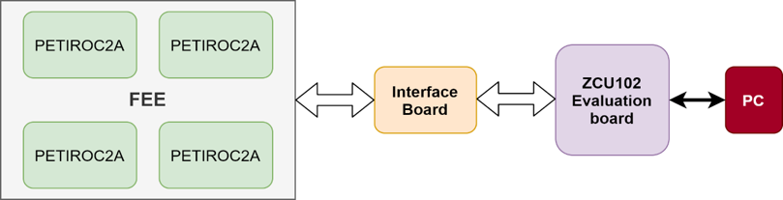
How to achieve an excellent time resolution:
An ASIC with a fast preamplifier, precise discriminator and excellent TDC
is needed
→PETIROC 32-channel, high bandwidth preamp (GBWP> 10 GHz), <3 mW/ch, dual time and charge measurement (Q>50 fC)
jitter < 20 ps rms @ Q>0.3 pC
TDC either internal or external (delay-line, Vernier,.etc on FPGA as for iRPC CMS upgrade project)
Proposed scheme:

Slide 19
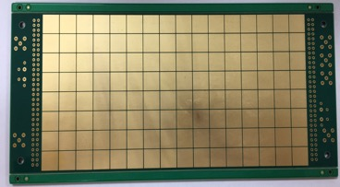
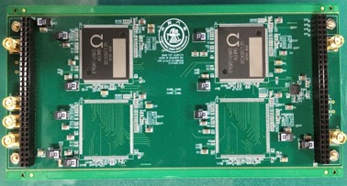
Development by SJTU in collaboration with IP2I and OMEGA
DAQ system is being tested

Slide 20
Development strategy of the French groups (IP2I, LPC, OMEGA):
Develop large MRPC (1 m x 1 m) with excellent time resolution ( in collaboration with the Korean group of GWNU DONE
Develop large pickup pads PCB hosting the PETIROC and TDC in collaboration with the Chinese group of SJTU→ Later use ToT if possible for “analog” readout. DONE
Develop DAQ boards in collaboration with the Spanish group of CIEMAT DONE
Build several detectors and several electronics board to equip them
Partially DONE
Develop a DAQ system allowing to read out both SDHCAL electronics (HR2) and the new ones that use PETIROC DONE
Replace some of the SDHCAL layers with the timing ones and check the G4 model validity for what concerns time information not YET
Replace all of the SDHCAL layers with timing ones (ANR,…etc) not YET

