Slide 1
PICMIC status
I.Laktineh
E. Bechetoille, H. Pham, Y. Zhao, H. Mathez, L. Zhang, I. Vallin, G. Dozière
Ch. Hu, C. Colledani, S. Callier
D. Charlet, J-P. Cachemiche, Ch. Combaret
Journées R&T, IJCLAB, October 2021

Slide 2

MCP is considered as the best timing device with a few
picoseconds of time resolution.
Most often there are two plates with the channels oriented in a slightly tilted way (chevrons) to increase the gain and at the same time reduce the ions return impact.
Photo-cathode
200 V
1st gap
pores in
glass
with 2dry
emitter
2d gap
1- 2kV
vacuum
a few mm
200 V
Anodes (1.6 x 1.6mm² pixels)
Courtesy: J-F. Genat

Slide 3
Readout scheme
  To exploit MCP and similar sensors we propose the following scheme:
  A transparent grid placed downstream, read out by sensors with excellent time resolution
  An original detection matrix with micrometric pixels to measure with great precision the position of the avalanche while requiring limited number of electronic channels.
MCP
T₃
T₂
T₄
T₁
Time + position
Grid
T₅
T₆
Pixels
Position+ time
X,Y
Patent: PCT/2020/050058

Slide 4
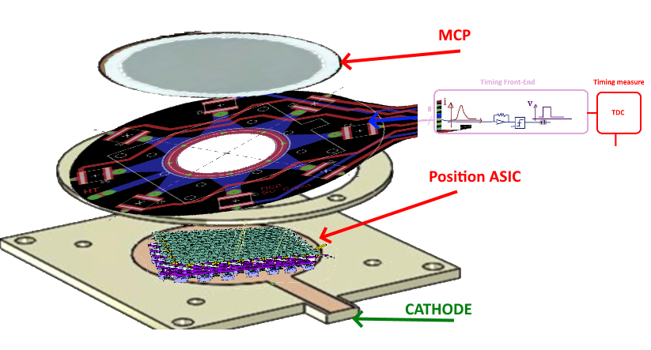
Setup structure
⍺ source

Slide 5
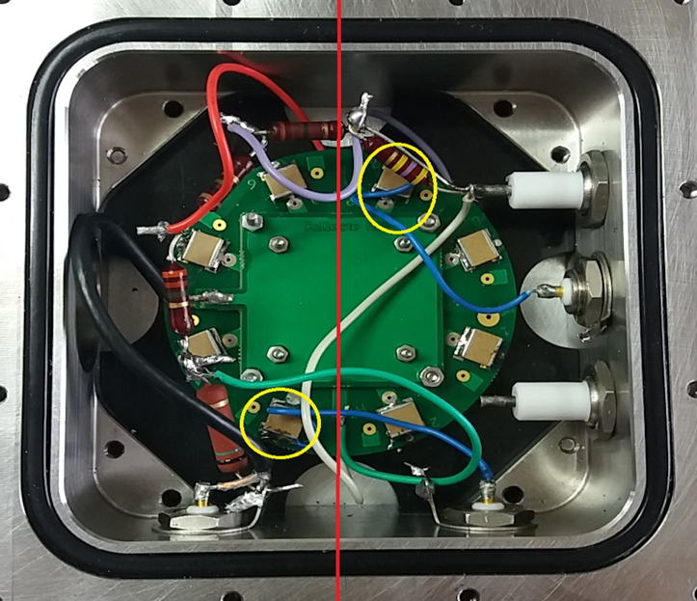
Current setup: Timing sensors+1 pad position

Slide 6
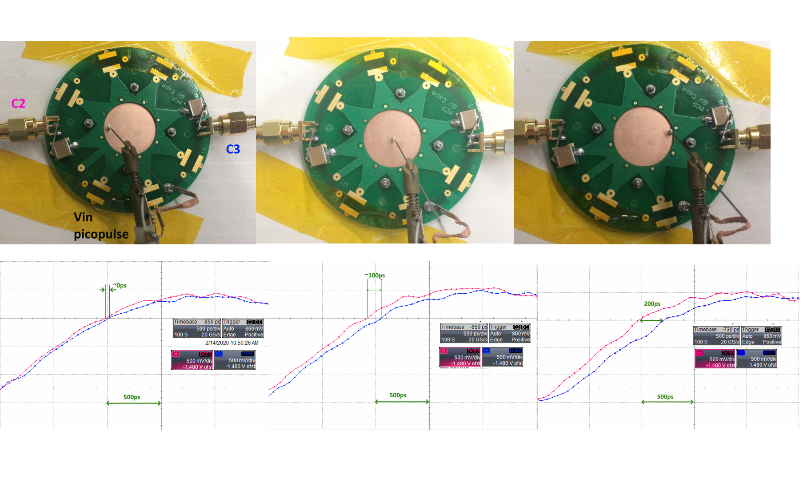
Time Measurement
Octopus-PCB

Slide 7
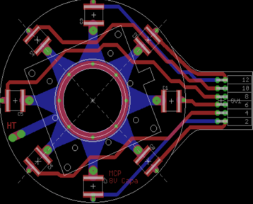
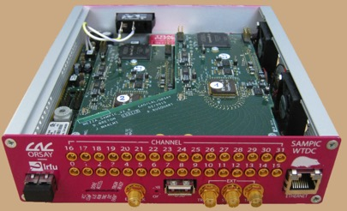
Time Measurement
Principle components for this measurement already exist.
8-point PCB for the time measurement.
SAMPIC: TDC ASIC allowing to reach 3 ps time resolution

Slide 8
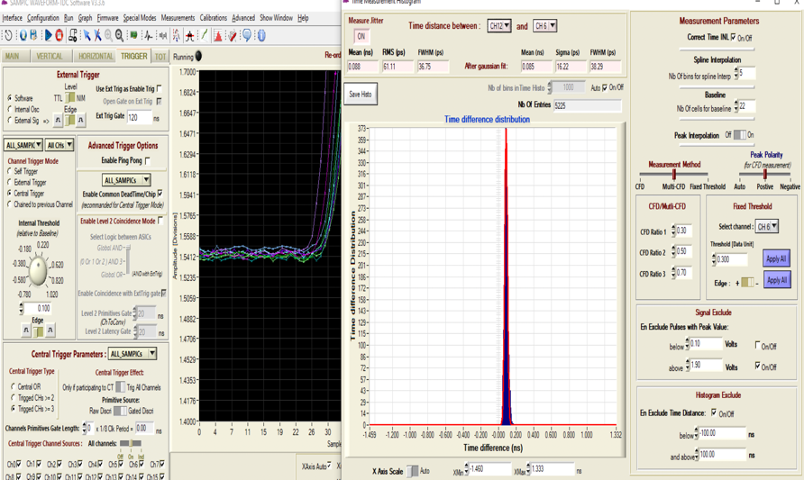
ΔT

Slide 9
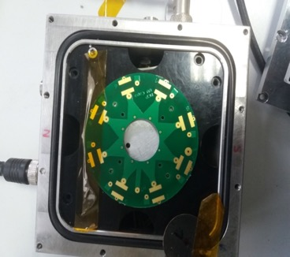
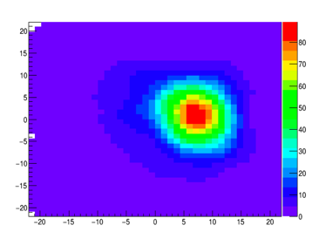
La triangulation seems to work quite well
(4-channel configuration)
Y(mm)
X(mm)

Slide 10
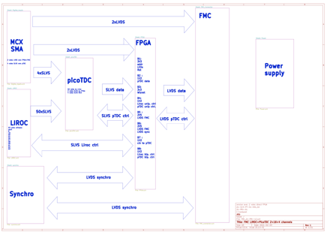
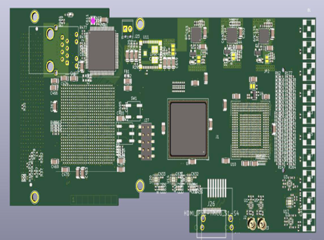
Time Measurement
A board integrating a low-jitter timing preamplifier and discriminator (LIROC-OMEGA) as well as a precise TDC (picoTDC-CERN) was conceived.
The board will allow the communication with the position electronics through a dedicated DAQ board (IDROGEN)

Slide 11
Position measurement
To reach few microns resolution with a limited number of electronic channels, a genuine concept was developed, successfully tested and patented.
Patent:PCT/EP2018/053561
Connect the pixels in woven strips
Two neighboring pixels are connected to two different strips
Each strip is connected to one electronic channel
Share the charge among a few ones
Crossing the fired strip to determine the position
NXN → 3N : Reduction of electronic channels, power consumption and occupancy

Slide 12
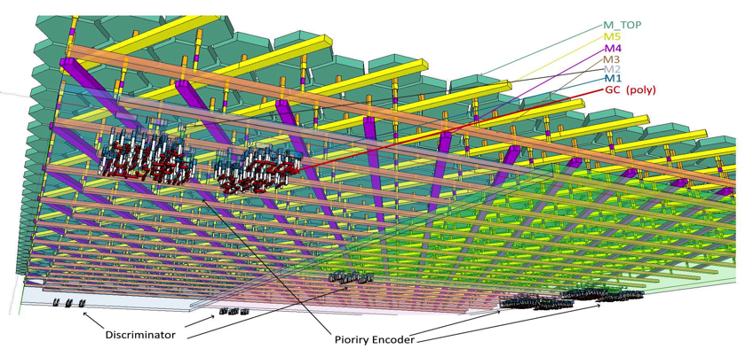
Position Measurement
Exploiting the expertise IN2P3 in µelectronics, we propose to read out the connected pixels by CMOS discriminators in TJ 180 nm (6 metal layers) technology.

Slide 13
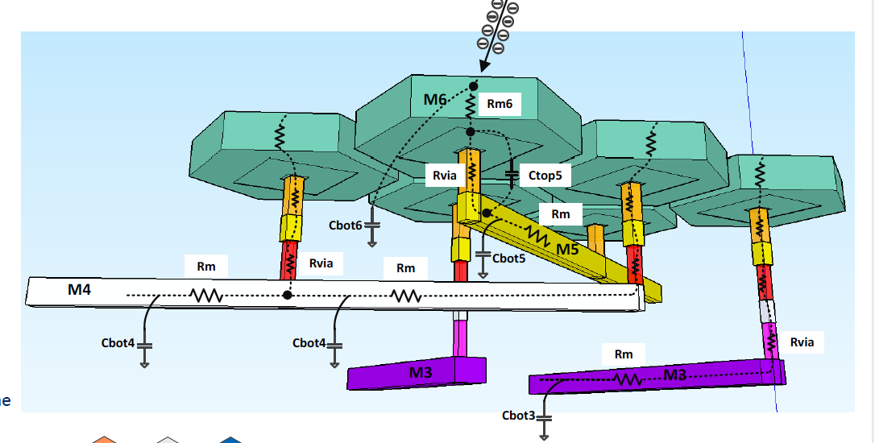
X-talk study was performed taking into account the technology, the geometry of the circuit, and the nature of the signal and its amplitude→ with the expected current (0.17-1.7 mA) the X-talk < 10%
Current mirror + Current discriminator were proposed and carefully studied to check the stability and performance of such a FE electronics

Slide 14
PICMIC Architecture
Parameters | Value
Design Flow | Cadence DoT flow
Technology | TJ CIS 180nm
Power supplies | 1.8V
Power density | >172mW/cm² (only analog static current)
Die dimension | ~7.5x7.5 mm² (6.5x7.5mm² active)
Anode dimension | ~22µ²(5µm hexagonal pitch)
Readout pixel dimension | 50µmx140µm
Readout matrix | 128x54 cells (only 2556 active)
Input clock | 40MHz
Read-out port | 13-bit parallel, 1 sync clock out, 1 marker (programmable 1clk cycle resolution)
I/O Pad | CMOS
Slow control | I2C
Max data rate (1Mhz hit rate) | 390Mbps
Priority Encoder

Slide 15
PICMIC Layout
Only 2556 RO cells are active among the 6912
The active RO cells are placed in a way to improve heating dissipation
The 2556 RO cells allow reading out the
2 216 000 pixels

Slide 16
Front End lock
VDD
Out_EN
Internal
VDD
VDD
Out_EN
ENA_CM
D2
PWR
D1
I_gain<0:1>
VDD
ENA_CC
TOCHECK
ENA_D1P
VBP
Vref_P
Pulsing
ENA_CM
ENA_CM
ENA_D2P
Vin
Ith1 (S3)
Current
Comparator
Current
Mirror
To DFF
S1
VBN
S2
Iadj
MUX
Idet
(Idet < 0)
ENA_CM1
Vref_N
VBNadj
GND
S3
Ith2 (S1,S2)
ENA_CM
I_adj<0:2>
GND
GND
Column lines
ENA_IP
Vref_P
Vref_N
VBN
VBP
ENA_D2P
Vin
ENA_D1P
ENA_CM1
VBNadj
GND
VDD
Dac_P
1-200µA
8 bits
E
VDac_BP
Cible 700mV
8 bits
ENA_IPb
ENA_IN
VDD
Dac_N
1-200µA
8 bits
Pad
ENA_INb
F
Pad
A
GND
B
C
D
Dac_CM
3-7µA
8 bits
Pad
Pad
Dac_Iadj
0-5µA
8 bits

Slide 17
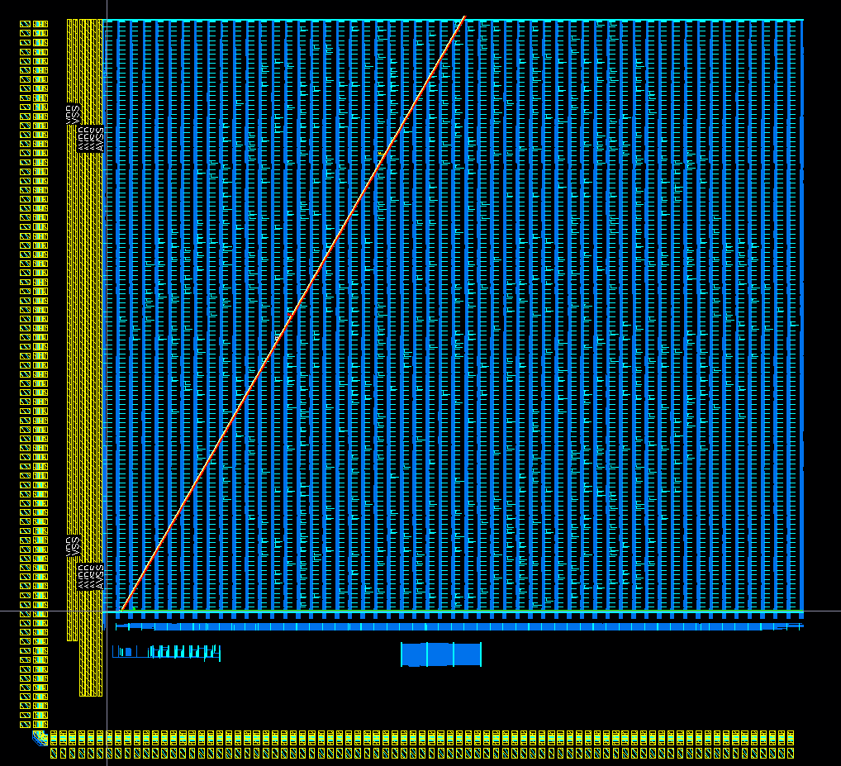
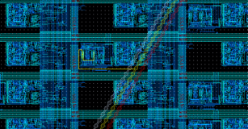
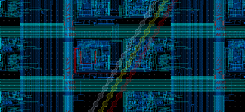
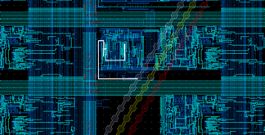
Connections
Connection between the detection pixels and the 3-direction strips
Connection between the 3-direction strips and the RO cells
Interconnected by skill-script routing

Slide 18
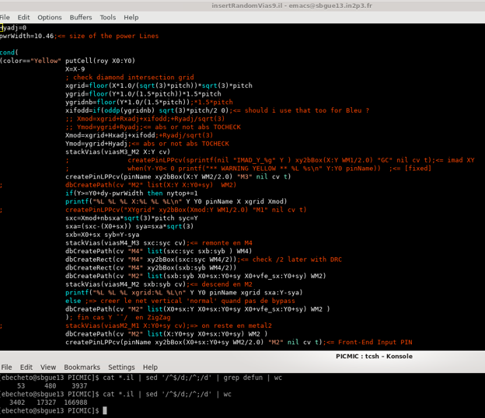
Part of the script that generates the random interconnection
Connections
Connection between the detection pixels and the 3-direction strips
Connection between the 3-direction strips and the RO cells
~3400 coded lines
~50 functions
for placement, visualisation, layout/schematic generation, etc.

Slide 19
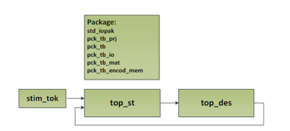
PIMIC Simulation (Digital Matrix + Peripheral)
The simulation validates:
  I2C Register R & W
  Analog matrix output by different hit patterns
  Output data stream with CTS
Write Configuration Registers
Output data stream
Read Configuration Registers

Slide 20
Development Progress
Task/Bloc | RTL/schematic | Simulation | Implementation | Validation | Task repartition
Analog FE + Metal Anode |  |  |  |  | IP2I
FE Testability |  |  |  |  | IP2I
RO Digital matrix (PE+Config+Memories) |  |  |  |  | IPHC + IP2I
Col PE Readout |  |  |  |  | IPHC
I2C+Registers |  |  |  |  | IPHC
Analog DAC |  |  |  |  | IPHC
DATA Emulation |  |  |  |  | IPHC
SEQUENCER |  |  |  |  | IPHC
Power routing & floor planning |  |  |  |  | IPHC + IP2I
Pad ring |  |  |  |  | IPHC+IP2I
Full digital data flow simulation with emulation analog input |  |  |  |  | IPHC
Full circuit integration |  |  |  |  | IPHC+IP2I
Chip/sensor submission is foreseen for the 15/10/2021
Next step: to design a DAQ board

Slide 21
Acquisition
We need to associate the timing information with the position information to provide the final output.
Grid time (ps)
Pixels time (ns)
This requires a board that allows the configurations of the timing and the position electronics, their synchronization and to transmit the data to PC.
Pixel board
Det.
IDROGEN
PC
Time board

Slide 22
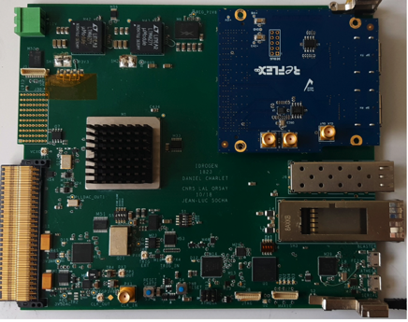
Acquisition
A generic board (IDROGEN) developed within the DAQGEN of the IN2P3
does exist. We propose to use it.
To be able to exploit the IDROGEN board we need:
develop appropriate interface/mezzanine boards between the IDROGEN and the timing and position boards.
develop appropriate firmwares

Slide 23
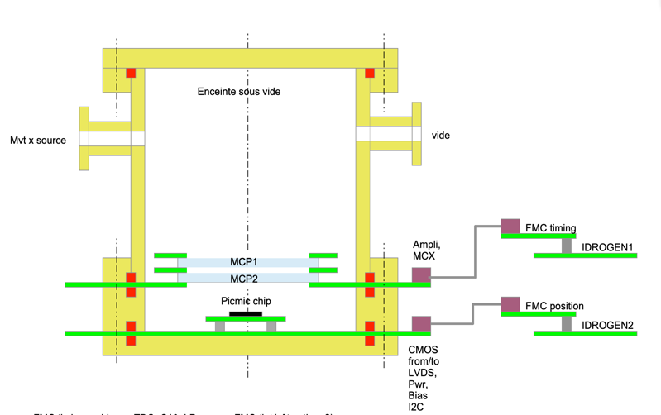
Demonstrator
The work to conceive a full demonstrator of the PICMIC has started

Slide 24
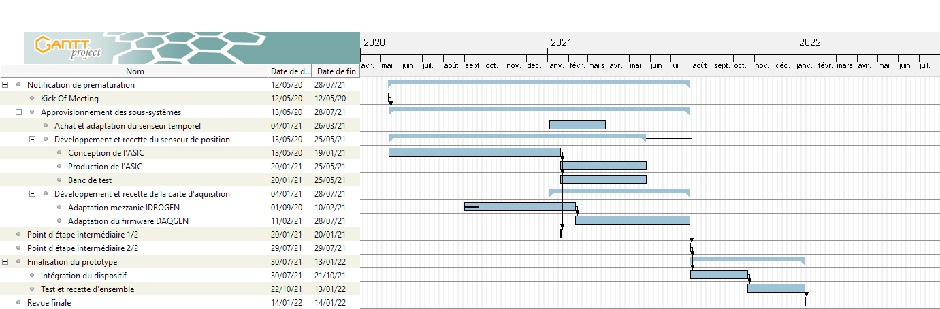
The project to build a PICMIC demonstrator with MCP was recently selected as a laureate for the Pre-Maturation CNRS projects → 150 k€
This, with IN2P3 spport, will allow the construction of a demonstrator in 18-24 months.
+6m
+6m
+6m

Slide 25
Conclusion
A great enthusiasm
Excellent collaboration among the different actors
Great help from the DAT (many thanks Rodolphe)
We are slightly behind the schedule but we foresee to have our demonstrator and test it in 2022.
Next step is to replace the MCP by NCP and do better

Slide 26
Backup

Slide 27
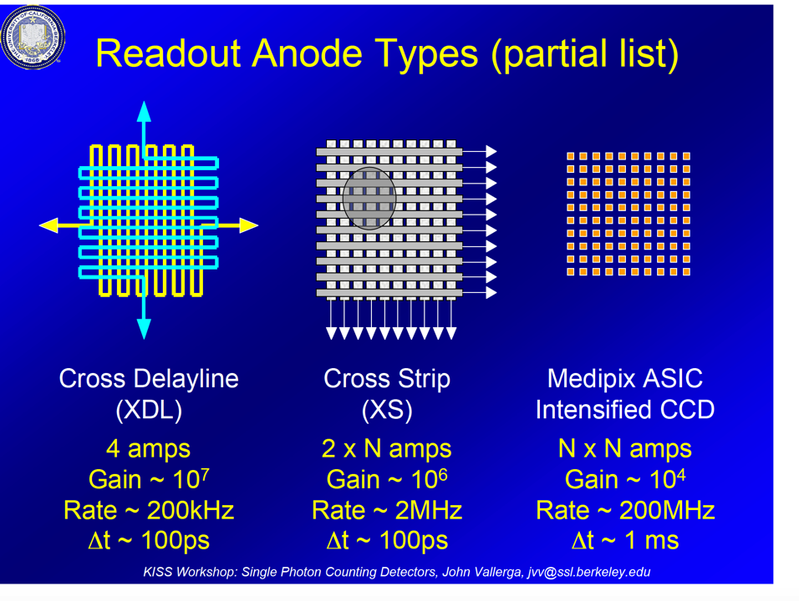
Courtesy J.Vallegra

Slide 28
Matrix data taking (internal signals)

Slide 29
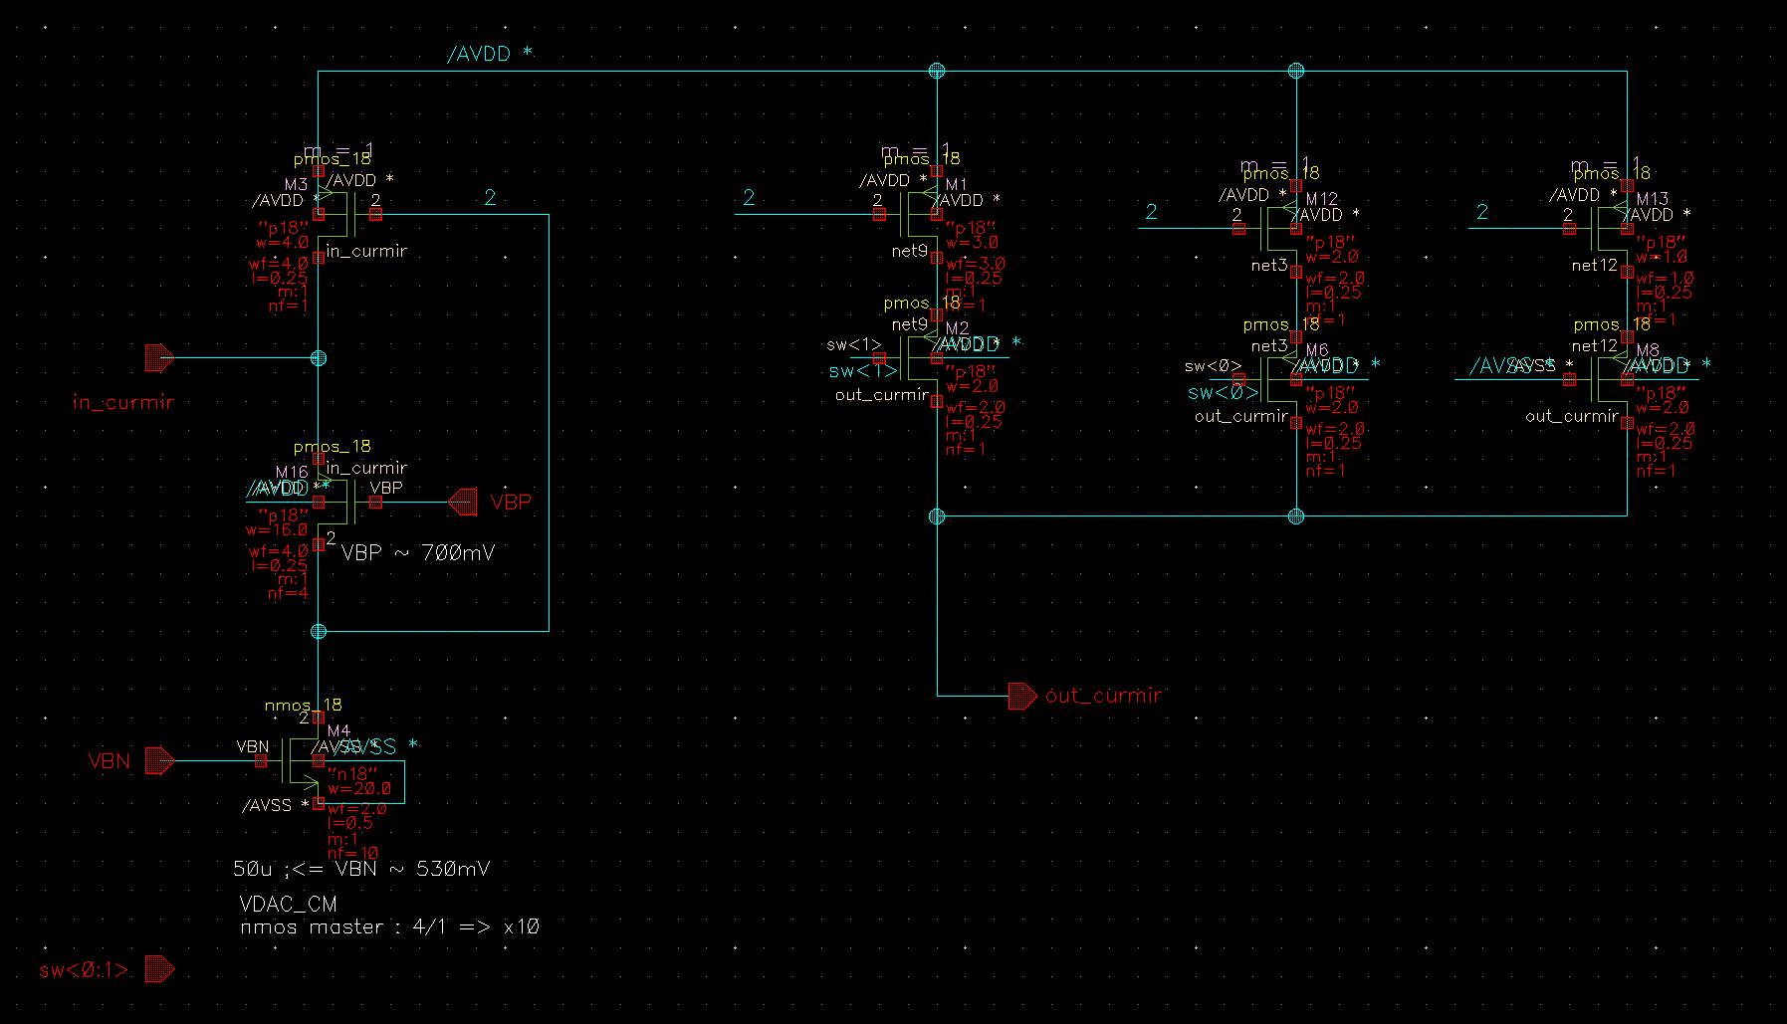
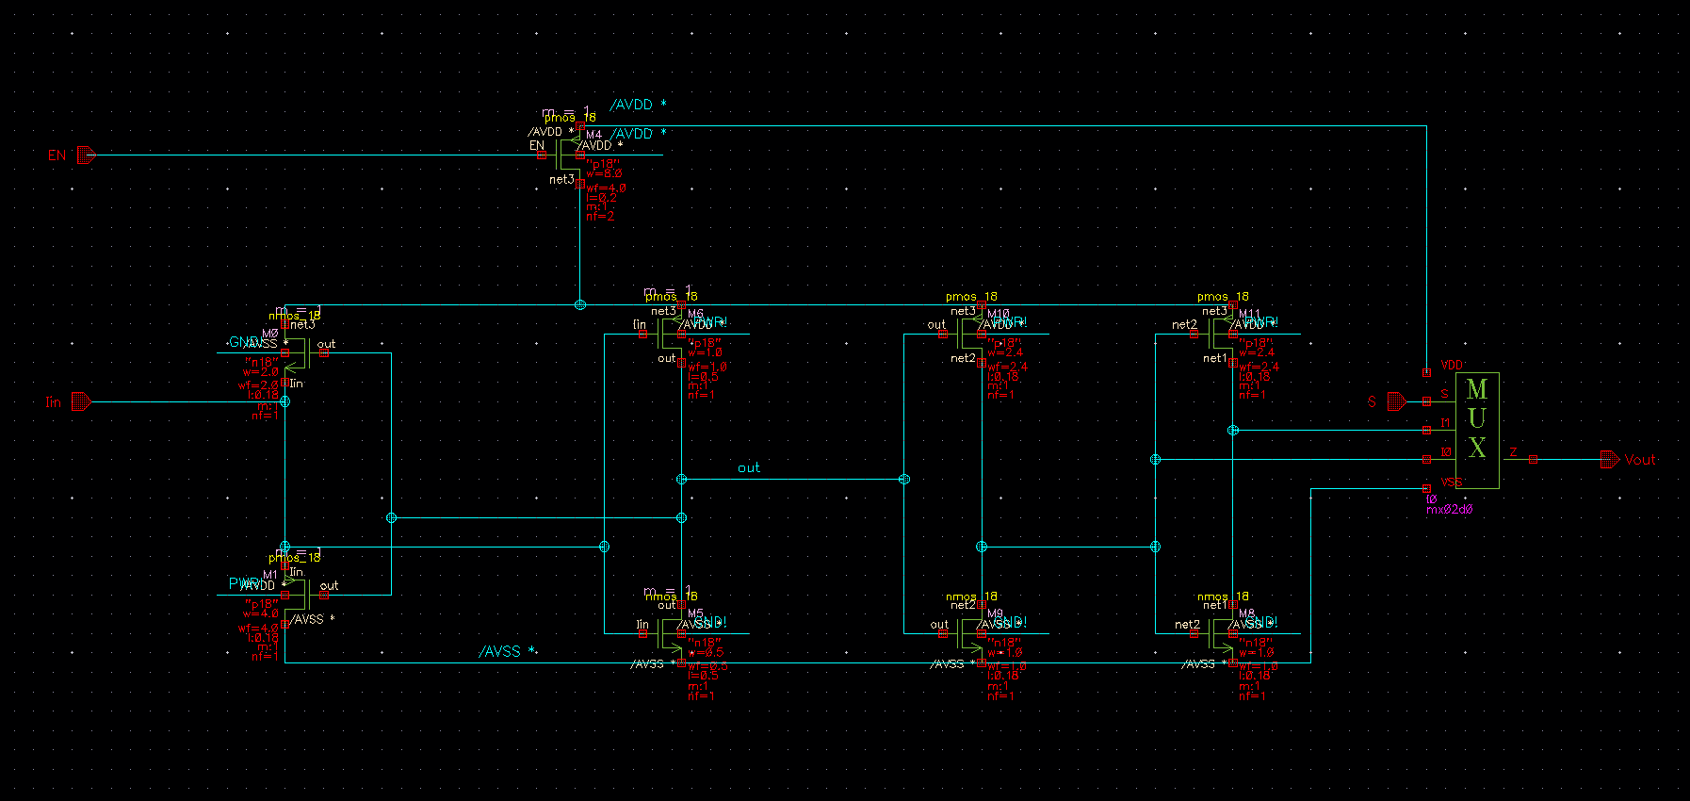
Current Mirror
Gain Stage
Input Current
Input transistor
Output Current
Current Comparator
Shaping Stage
Comparator stage
Mux Stage :
Same polarity in both cases
Current mirror + Current Comparator
Current Comparator Only

