Slide 1
PERLE injector design review
16/12/20
Ben Hounsell

Slide 2
Overview
PERLE injector specification and design considerations
ALICE electron gun re-optimisation
Injector optimisation (Cathode to booster exit)
Merger optimisation

Slide 3
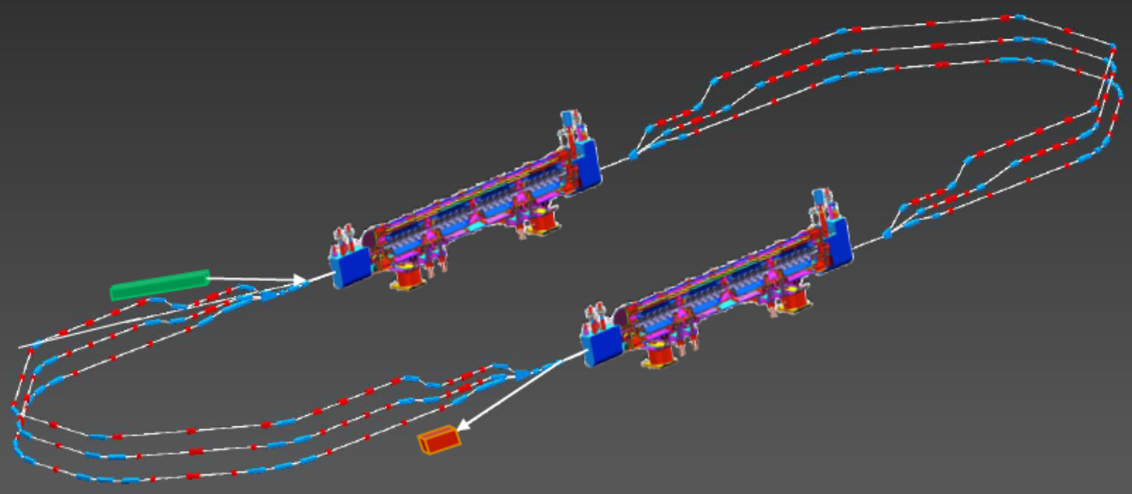
PERLE (Powerful Energy Recovery Linac for Experiments)
A 3 turn, 500 MeV, 20 mA beam current ERL.
Has a number of applications including as a test facility for the LHeC. Its role as a test facility for the LHeC is the origin of several of the requirements in the specification.
Uses the same 802 MHz SRF cavities as the LHeC.
Planned to be located at IJCLab in Orsay.

Slide 4
PERLE injector specification
 | PERLE Parameters
Injection energy | 7 MeV
Bunch charge | 500 pC
Bunch repetition rate | 40.1 MHz
Average current | 20 mA
RMS bunch length | 3 mm
Emittance | < 6 π∙mm∙mrad
Uncorrelated energy spread | < 10 keV
Notes:
The current requirements that the injector is being designed for are as follows An injection energy of 7 MeV although there is some potential for that number to change. A bunch charge of 500 pC which will mean a beam current of 20 mA. An rms bunch length of 3 mm. The multi-objective optimisation does however provide some indication of the trade off between bunch length and transverse emittance so some idea of how changing this value would change the emittance can be seen. The goal for the emittance is for it to be less than 6 mm mrad. Finally the uncorrelated energy spread should be less than 10 keV.

Slide 5
PERLE injector layout
The PERLE injector consists of:
350 kV DC photoemission electron gun. Using an alkali antimonide photocathode for unpolarised operation.
A bunching and focusing section consisting of a solenoid, a normal conducting buncher cavity and then another solenoid.
A superconducting booster linac with 802 MHz cavities with individual control of the amplitudes and phases.
Merger to transport the beam into the main ERL.
Notes:
So the general overview of the injector is that it uses a modified ALICE upgrade type DC electron gun. Followed by a solenoid, an 802 MHz buncher and then another solenoid. The solenoids control transverse beam size and are used for emittance compensation. The buncher cavity compresses the bunchs longitudinally. The next step is the booster linac which in this case consists of five single cell 802 MHz cavities with individually controllable amplitudes and phases. This allows for further bunch compression in the first couple of cavities in the booster. The cavities in the booster will either be all beta equals 0.8 or beta equals one these options are in the process of being studied. The results presented in later in this presentation are for beta equals 0.8 cavities.

Slide 6
ALICE electron gun re-optimisation

Slide 7
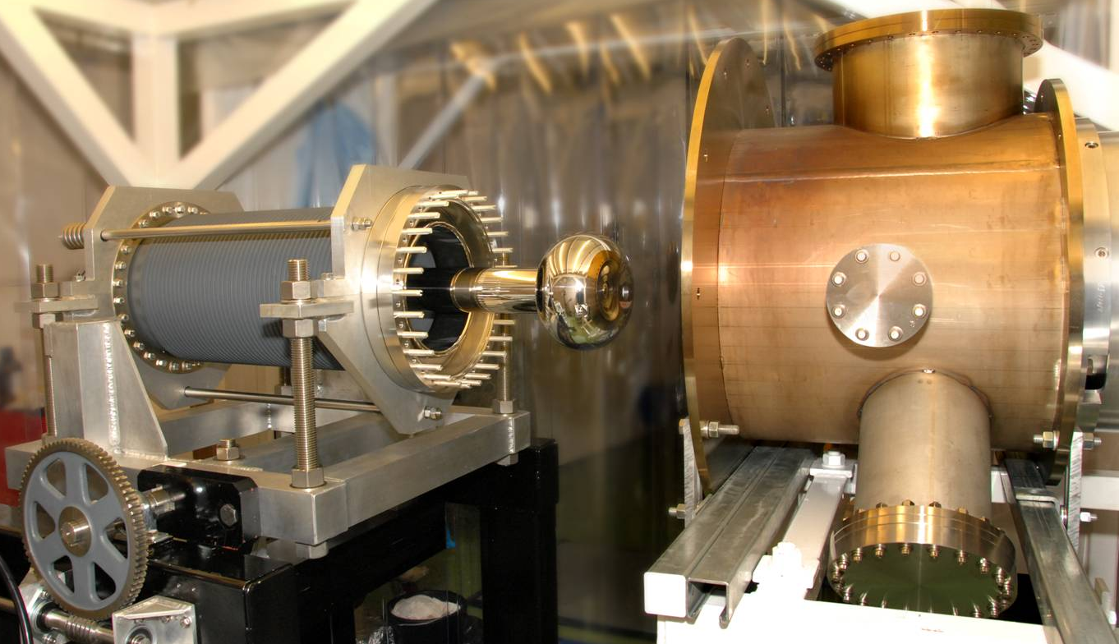
Re-optimisation of the ALICE electron gun
Further work was done to re-optimise the ALICE electron gun.
This is necessary for two reasons:
PERLE operates with a much higher bunch charge of 500 pC compared to the 80 pC of ALICE.
For polarised operation the gun needs to be operated at a lower voltage, 220 kV, so the gun should be effective at both 220 kV and 350 kV.
Finding a compromise solution between 350 kV and 220 kV operation was the main goal of the additional work here.
An image of the ALICE ERL gun

Slide 8
Re-optimisation procedure
The electron gun electrode geometry, laser parameters and first solenoid were optimised together.
The optimisation had four objectives. To minimise the average slice emittance and rms beamsize for both voltages 220 kV and 350 kV.
The optimisation had four constraints to keep the electrode surface electric field below 10 MV/m (to prevent field emission) and to have no particle losses. These two objectives applied for both voltages.
The electron gun electrostatics were simulated with POISSON and the beam dynamics with ASTRA.
The optimisation was performed with the many objective optimisation algorithm NSGAIII.

Slide 9
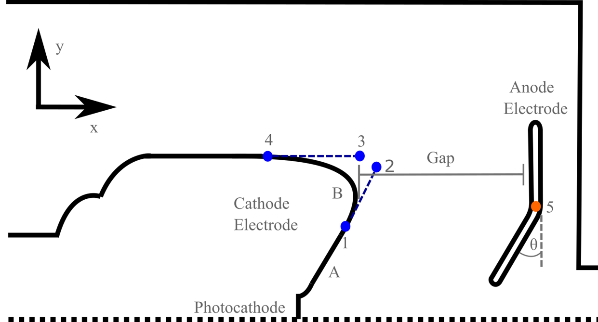
Geometry parameterisation
The cathode and the anode electrodes geometry could both be varied.
The cathode consisted of a flat focusing section and then a curved section modelled as a Bezier curve. It was described by 5 variables.
The anode consisted of two straight sections with an angle between them and was described by 2 variables.

Slide 10
Pareto front projections

Slide 11
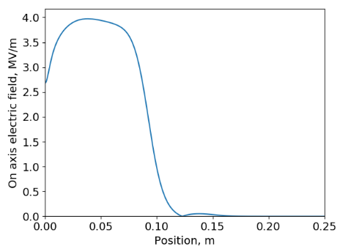
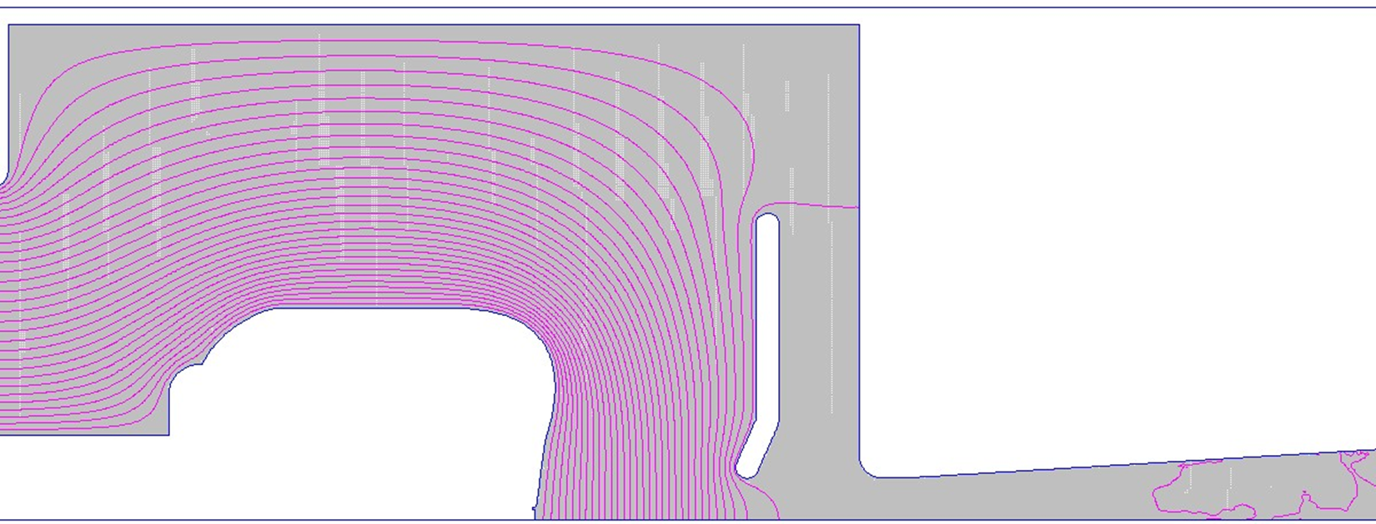
Selected electron gun
The selected electron gun has a much low focusing angle than the 20 degree angle of the original design.
The anode has been moved slightly in.
These changes increase the cathode surface electrode field.

Slide 12
Injector cathode to booster exit optimisation

Slide 13
Injector optimisation
The new gun design was then used as part of an optimisation of the injector up until the booster exit
The optimisation had 5 objectives to minimise at the booster exit:
Transverse emittance
Longitudinal emittance
RMS energy spread
X halo parameter
Z halo parameter
Constraints were used to keep the beam size below 6 mm as well as to achieve a final beam energy of 7 MeV and a final bunch length of 3 mm.
The optimisation was performed using NSGAIII.

Slide 14
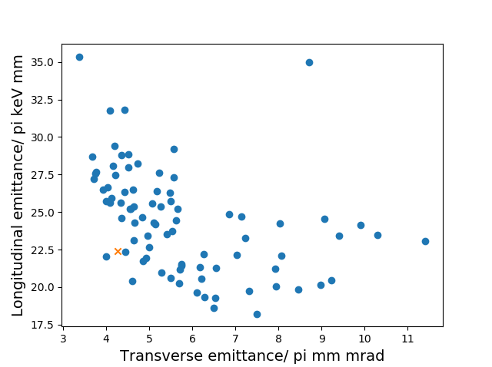
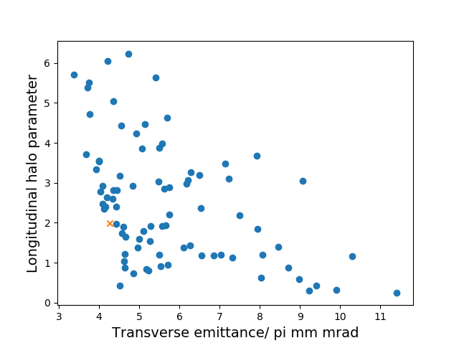
Pareto Front projections

Slide 15
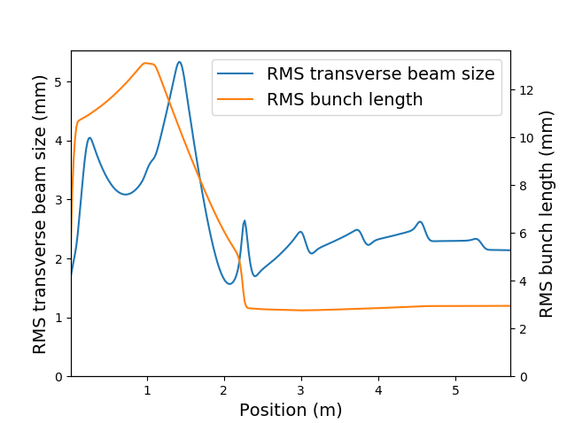
RMS beam sizes

Slide 16
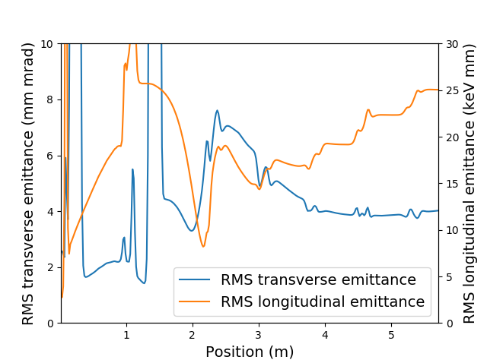
RMS emittances

Slide 17
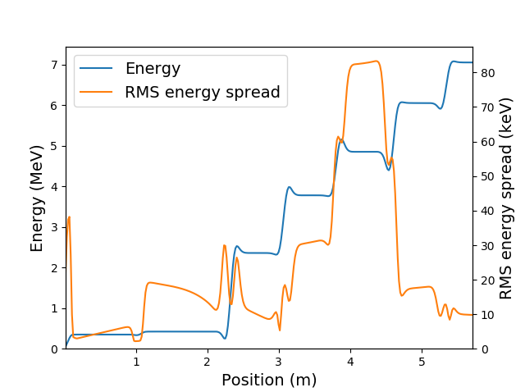
Energy gain and energy spread

Slide 18
Transverse phase space evolution
px
x (m)

Slide 19
Longitudinal phase space evolution
pz
z (m)

Slide 20
Intrabunch particle motion
x (m)
x (m)
z (m)
z (m)

Slide 21
Ultimate parameters of the current injector design
The unpolarised PERLE injector is capable of meeting the required specification at the booster exit.
The transverse emittance and phase space are satisfactory.
The Longitudinal phase space is less linear than would be desired. The possibility of linearization will be investigated.
Achieved bunch parameters
Transverse emittance/ mm mrad | 4.0
Longitudinal emittance/ keV mm | 25.1
Bunch length/ mm | 3.0
Energy/ MeV | 7.0

Slide 22
Merger scheme selection and optimisation

Slide 23
ERL mergers
Booster linac
Main linac
Once the beam has been accelerated up to the injection energy it needs to be merged into the main ERL loop. The merger is the beamline which does this.
This must be done in a way that allows the higher energy beams that have already recirculated one or more times to continue to circulate.
The high repetition rate of ERLs means that this is done with fixed magnetic elements rather than kickers.
One dipole is common to both the injected beam and the recirculated beam. Before this dipole is the re-injection chicane so that the common dipole bends the recirculated beams back on axis through the main linac.
Recirculated beam
Booster linac
merger
Main linac
Re-injection
chicane
Common dipole

Slide 24
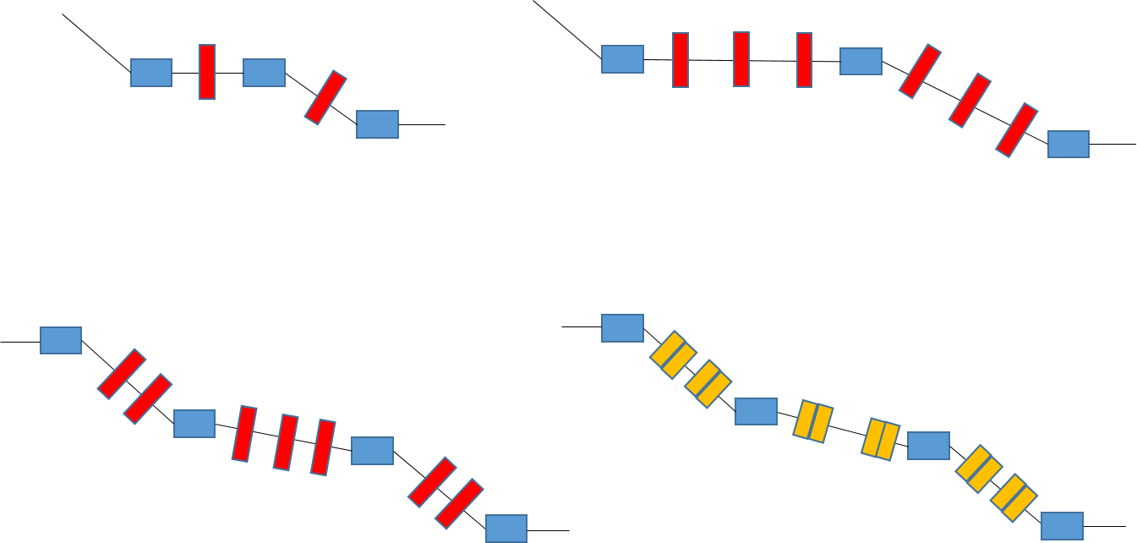
Merger schemes investigated

Slide 25
A some design philosophies
PERLE is a test facility and consequently will need more flexibility than a facility built for a specific purpose and mode of operation.
Use adjustable elements where ever possible. This is to try and keep as much flexibility in operation as possible and to avoid building an assumption about the amount of space charge force present into the physical system. As it may be desirable to operated with different bunch charges, different bunch sizes, different injection momentums.
Avoid having matching quadrupoles in the main loop between the merger and the main linac. These quadrupoles would be seen by the recirculating beams which may pose a problem. In addition the current PERLE lattice doesn’t have a lot of space between the merger and main linac.

Slide 26
3 possible sources of emittance growth
Transverse space charge effects: This is the standard projected emittance growth mechanism seen earlier in the injector.
Ideal solution: Emittance compensation, not trivial in non-axisymmetric beamlines, needs laminar flow (no crossovers, so no strong focusing)
Mitigation: Compensate through the booster prior to the bending section and keep the merger as short as possible to limit the time for emittance growth.
Longitudinal Space Charge effects: The longitudinal space charge changes the energy of the particles and changes how the dispersion behaves leaving some residual dispersive emittance growth.
Ideal solution: Meet the decoupling conditions (zig-zag or similar)
Mitigation: Keep the bending angles in the dispersive section as small as possible and keep it as short as possible. This requires accepting that there will be some residual dispersion.
CSR (Coherent Synchrotron Radiation): This also changes the energy of the particles in the bending magnets and consequently has an effect on the cancellation of the dispersion.

Slide 27
Motivation for four dipole schemes
The purpose of the four dipole schemes is to mitigate the effects of the energy change of the particles, due to longitudinal space charge, on the dispersion.
In the paper on the zig-zag merger four conditions for achromaticity in the presence of a generalised dispersion are given. Mergers with bilateral symmetry meet two of these conditions automatically.
The zig-zag meets the other two by its geometry.
The four dipole schemes presented here attempt to meet the last two conditions by simply having enough free parameters in the focusing elements.

Slide 28
Merger optimisation
Four merger schemes were optimised so that they could be compared.
The optimisation had 2 objectives:
Minimise transverse emittance at the entrance to the main linac.
Minimise twiss mismatch at the entrance to the main linac.
Defined as: $max\left(\frac{abs(β_{x, solution }−β_{x, target })}{β_{x, target }},\frac{abs(β_{y, solution }−β_{y target })}{β_{y, target }},\frac{abs(α_{x, solution }−α_{x, target })}{α_{x, target }},\frac{abs(α_{y, solution }−α_{y, target })}{α_{y, target }}\right)$
The optimisation was done using NSGAII
The variables were different for the different optimisations but included things such as magnet positions, dipole bend angles, focusing magnet settings and input twiss parameters.

Slide 29
Merger schemes investigated

Slide 30
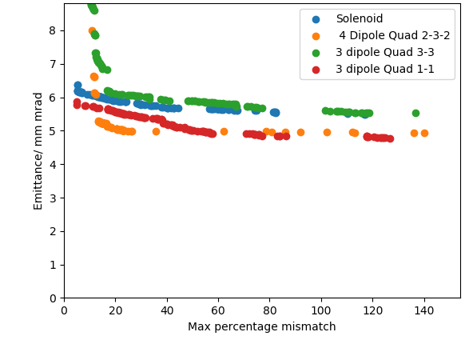
Comparison of merger pareto fronts

Slide 31
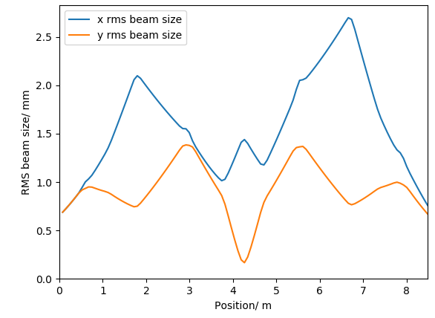
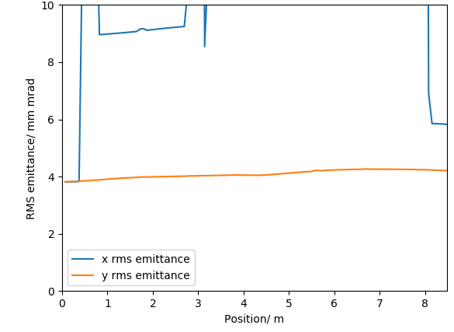
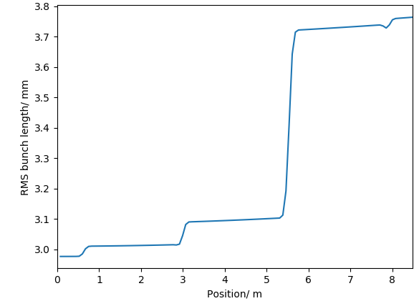
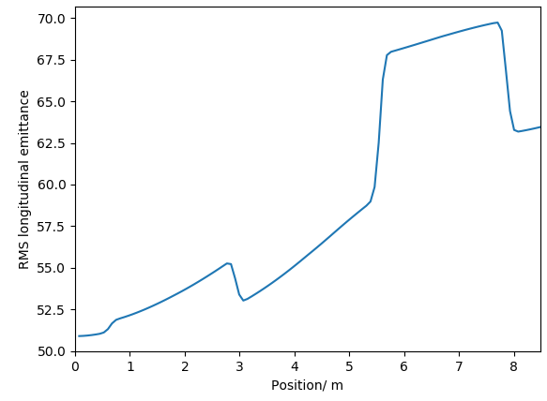
RMS beam parameters

Slide 32
RMS beam sizes
z (m)
x (m)

Slide 33
RMS transverse emittance
px
x (m)

Slide 34
RMS longitudinal phase space
pz
z (m)

Slide 35
Current status and general plans
There is currently a functional gun optimisation as well as the tools to redo that optimisation if it becomes neccesary.
A 5 cavity injector optimisation exists and meets the requirements. A possible change to a 4 cavity cryomodule would mean that a new optimisation will be needed. The tools for doing that re-optimisation are in place.
A merger solution does exist although further work is needed. The CSR and phase slippage should be investigated. Either the implications of the current optimisation on the beam dynamics in the main lattice should be investigated or possibly modifying some of the requirements on the merger which might open up alternative schemes.

Slide 36
Additional material

Slide 37
Injector transverse phase space evolution
px
x (m)

Slide 38
Injector longitudinal phase space evolution
pz
z (m)

Slide 39
Injector charge distribution evolution
x (m)
z (m)

Slide 40
Injector charge distribution slices evolution
x (m)
z (m)

Slide 41
Injector charge distribution evolution
x (m)
z (m)

Slide 42
4 dipole merger charge distribution evolution
x (m)
z (m)

Slide 43
4 dipole merger x transverse phase space evolution
px
x (m)

Slide 44
4 dipole merger longitudinal phase space evolution
pz
z (m)

Slide 45
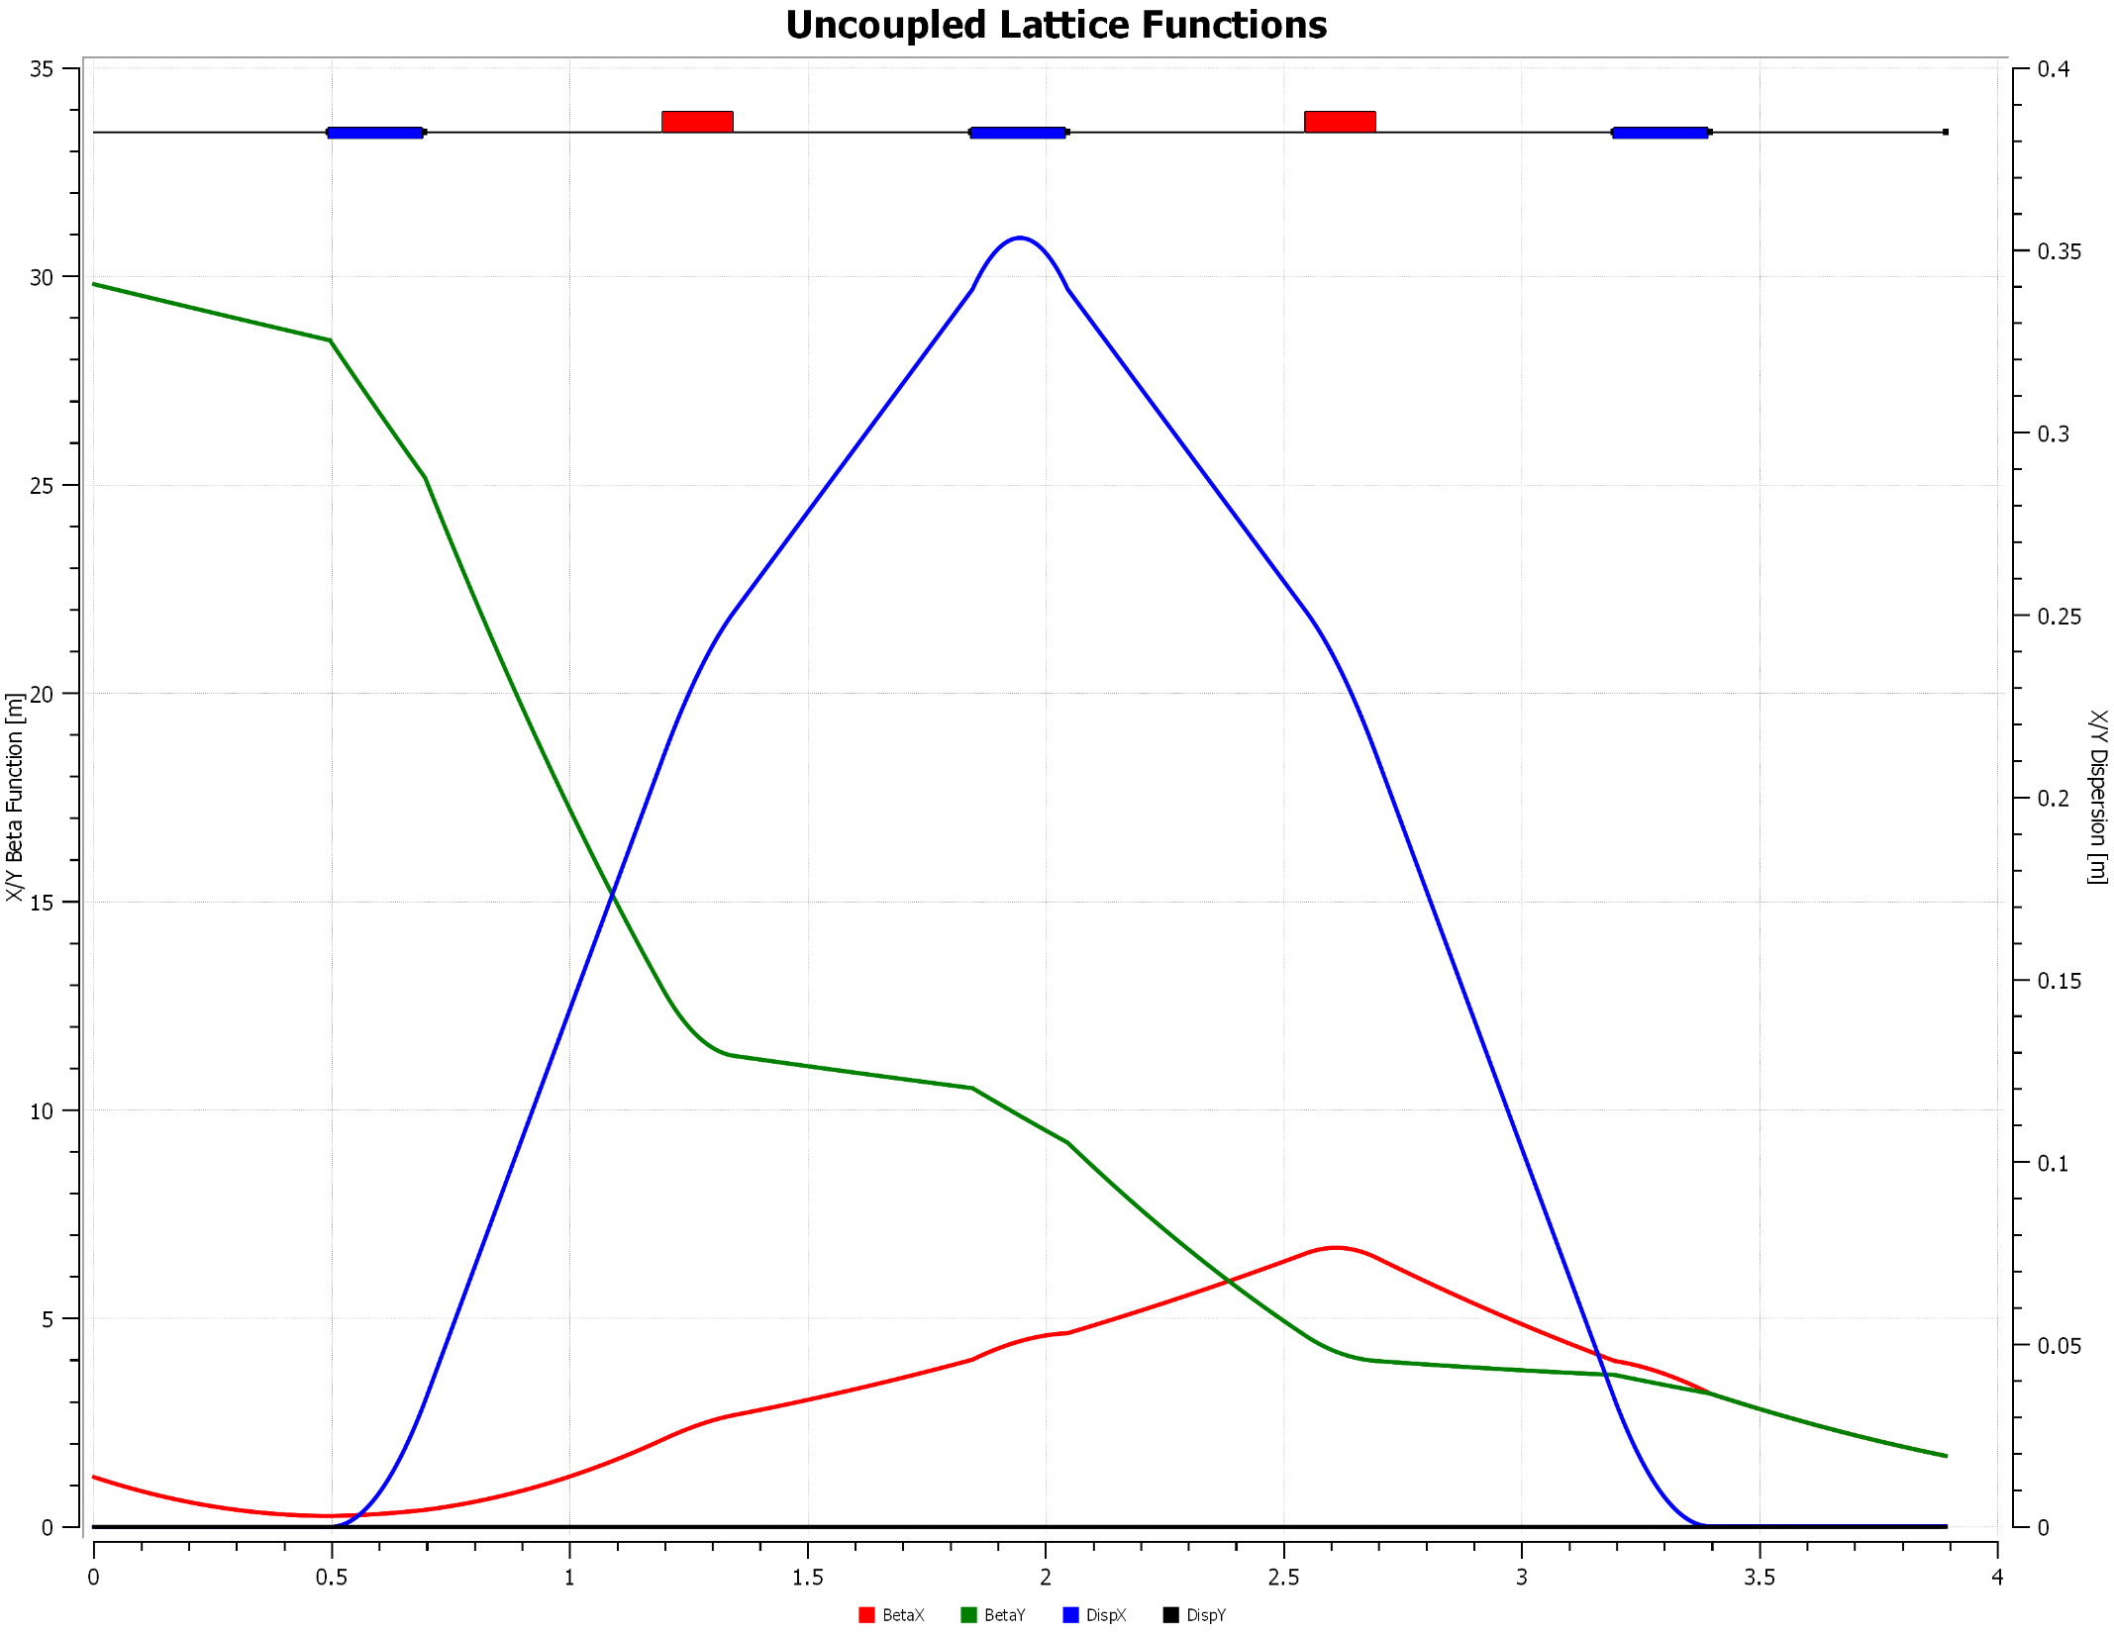
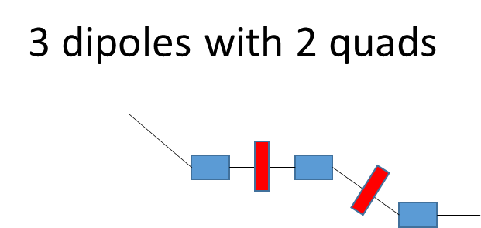
3 dipoles with 2 quads

Slide 46
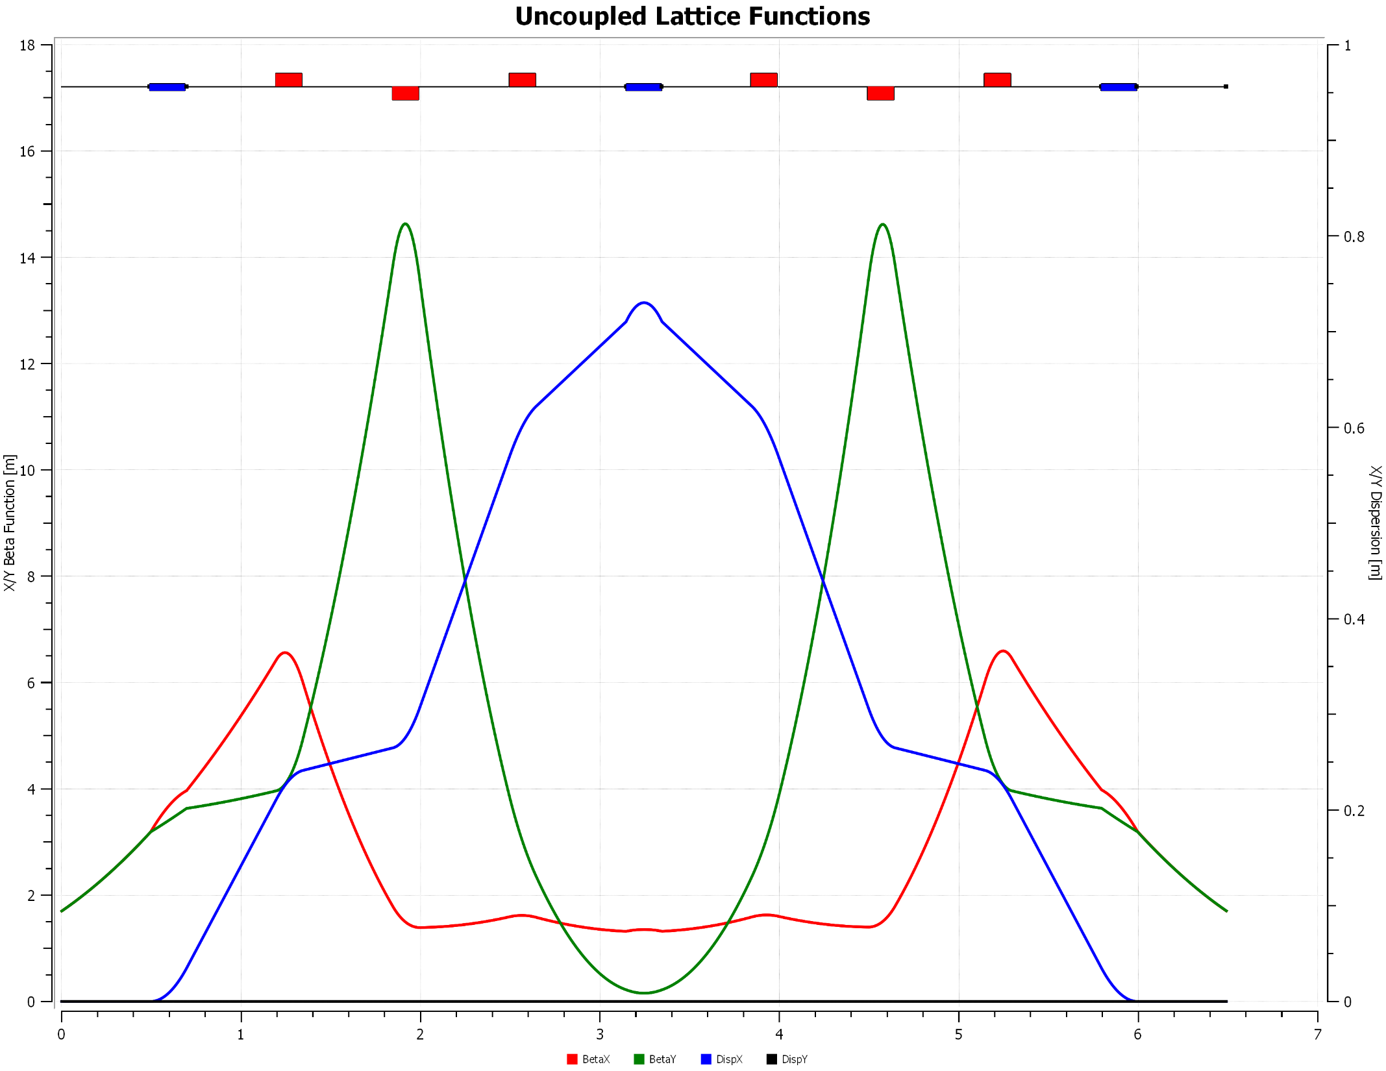
3 dipoles with 6 quads
3 dipoles with 6 quads

Slide 47
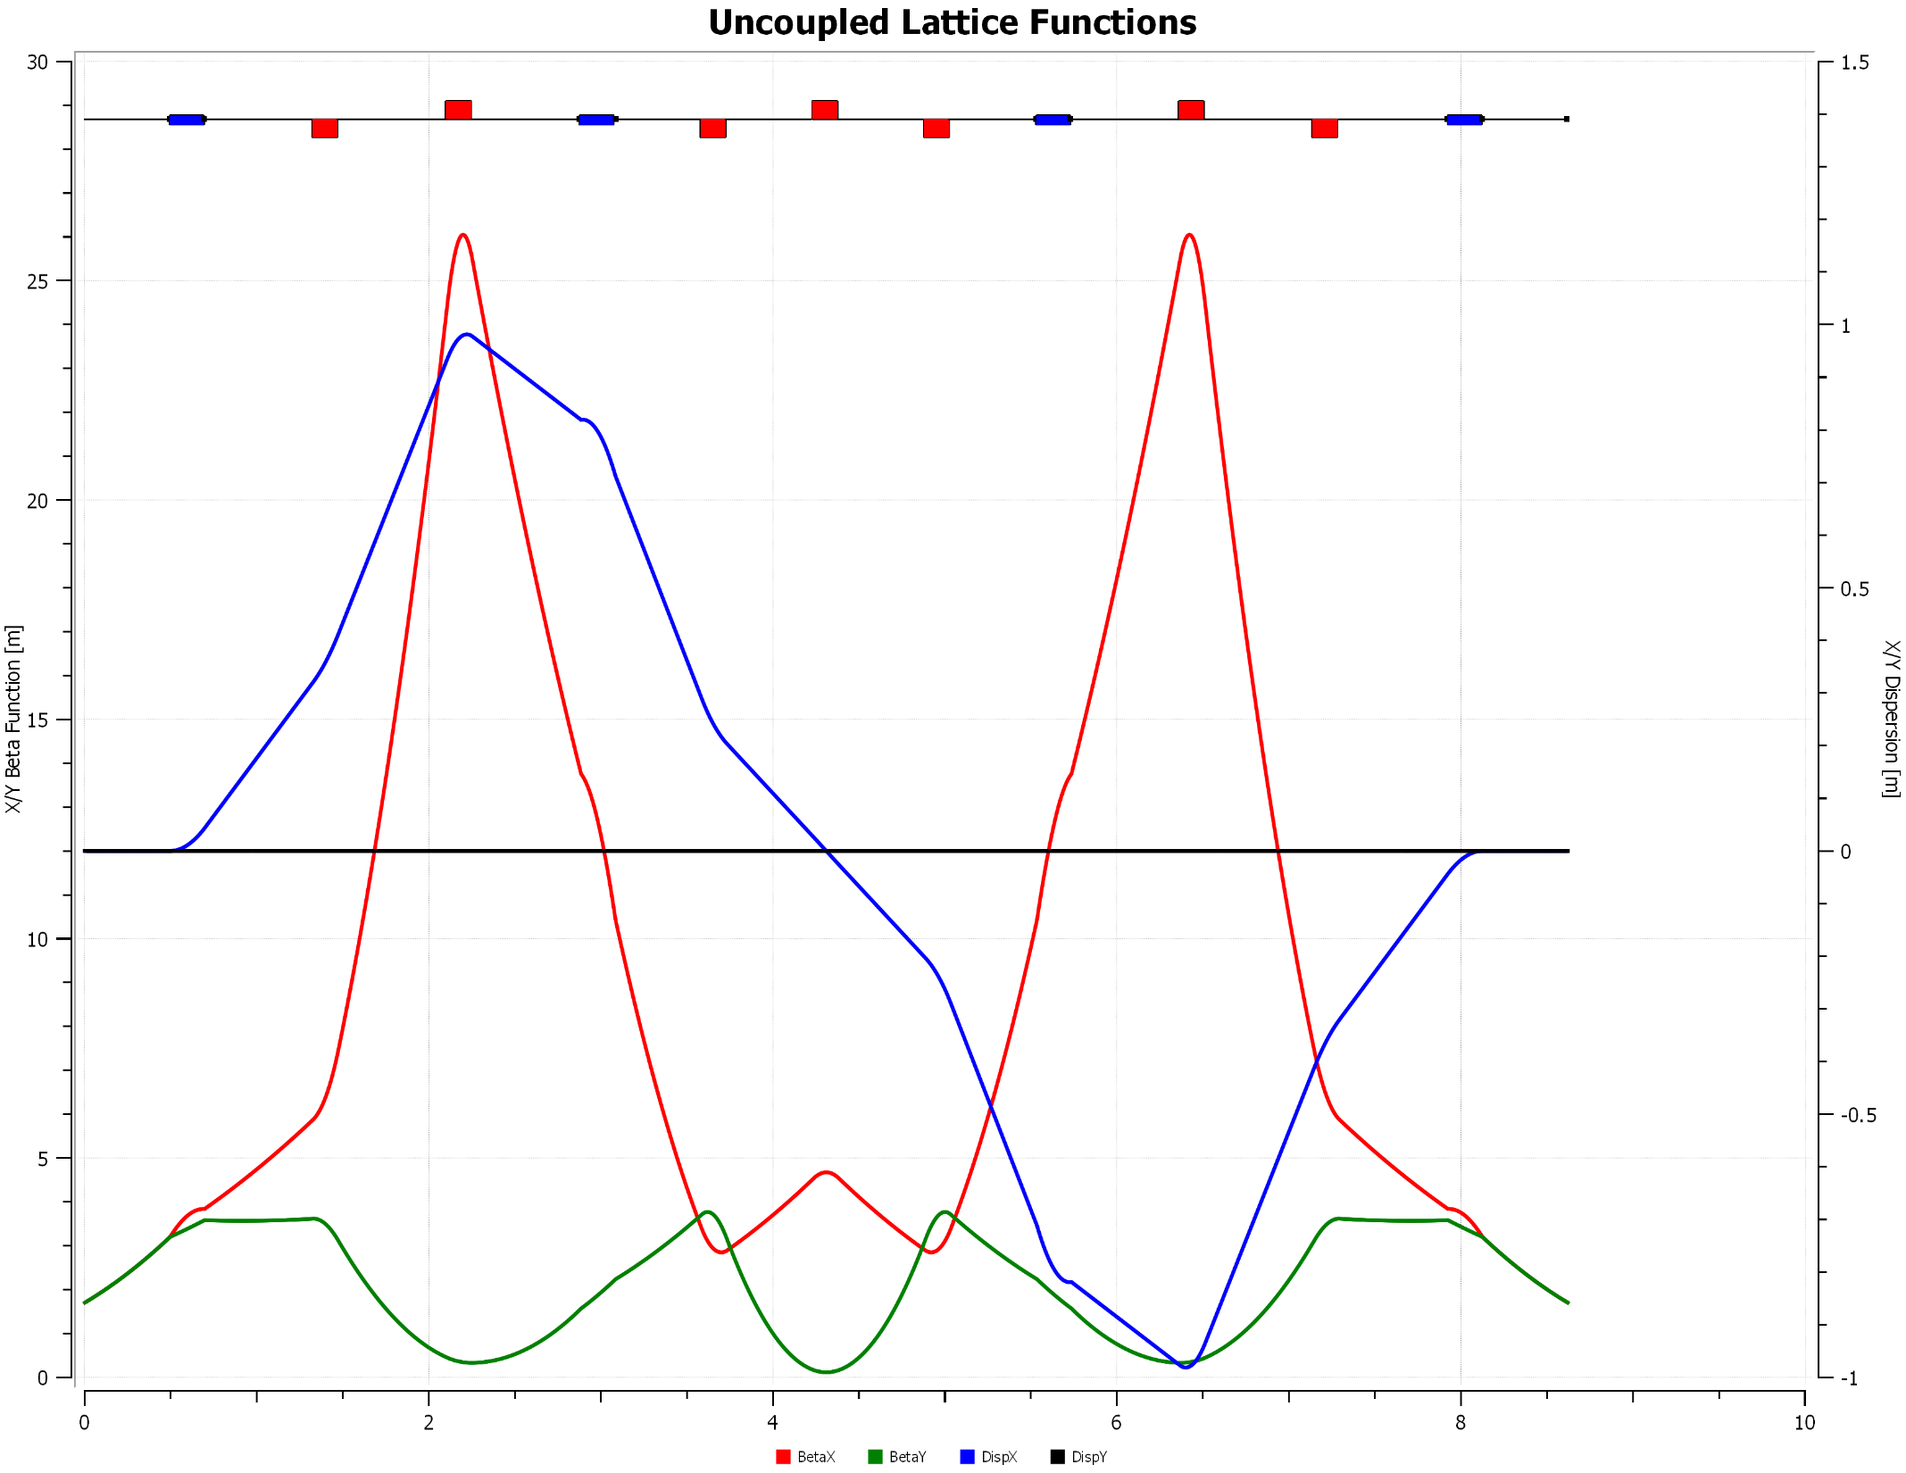
4 dipole staircase
4 dipole Staircase

Slide 48
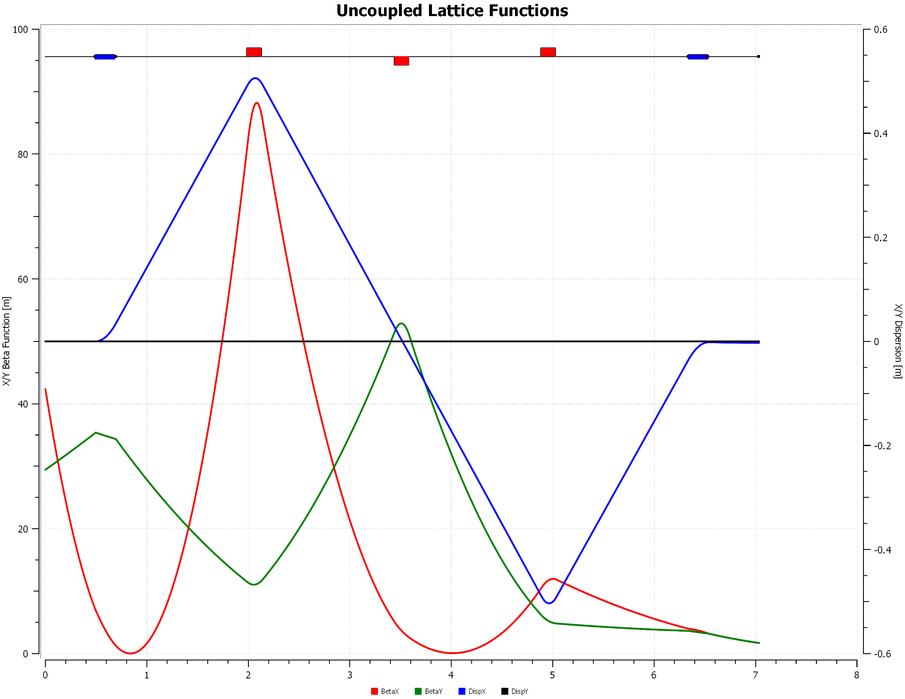
Dogleg 3 quads
Dogleg with 3 quads

Slide 49
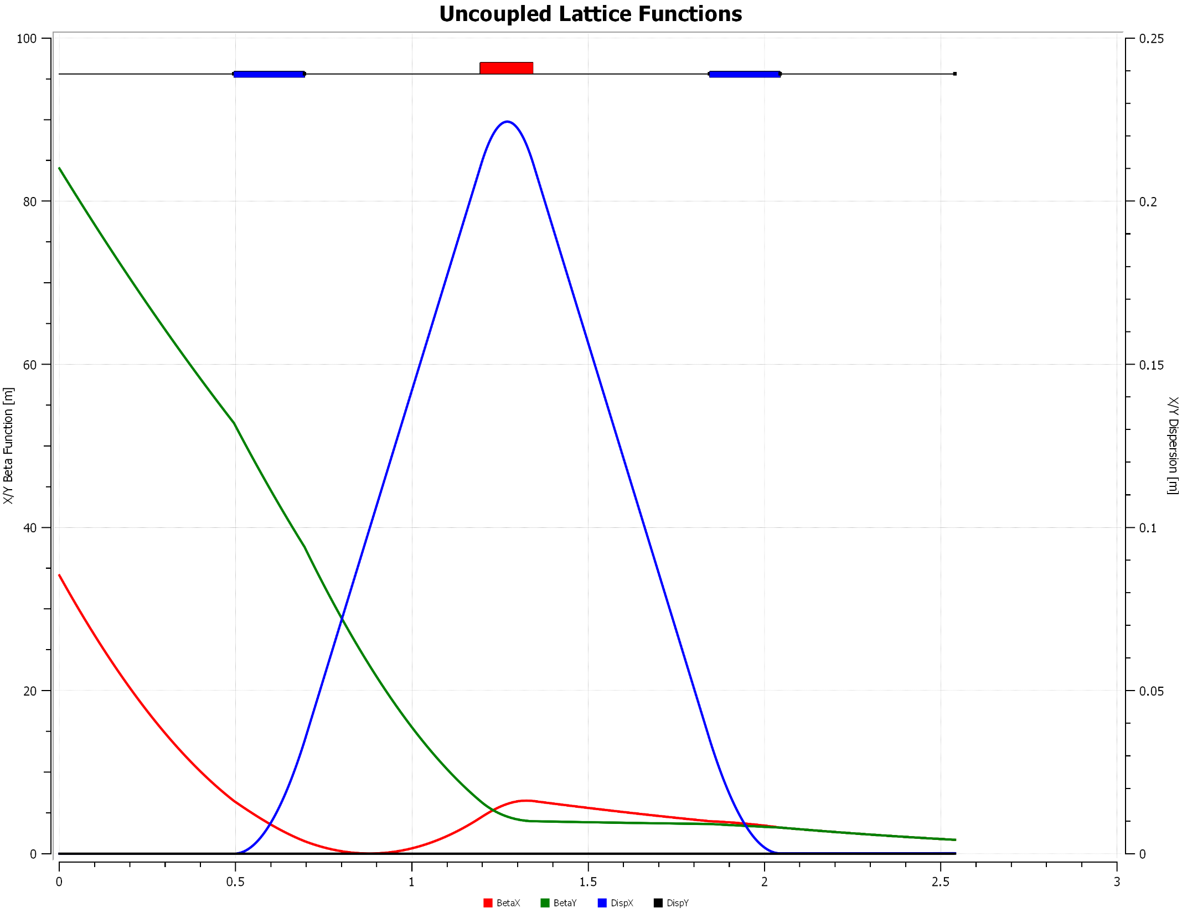
U-bend 1 quad
Ubend with 1 quad

Slide 50
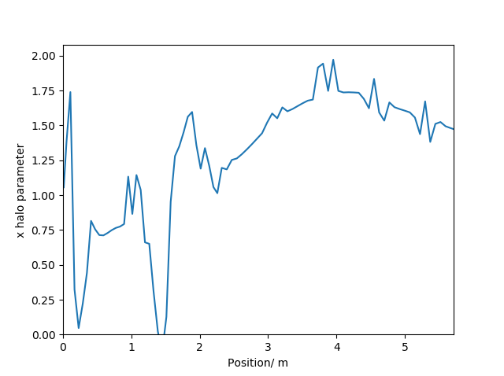
Transverse (x) halo parameter evolution

