Slide 1
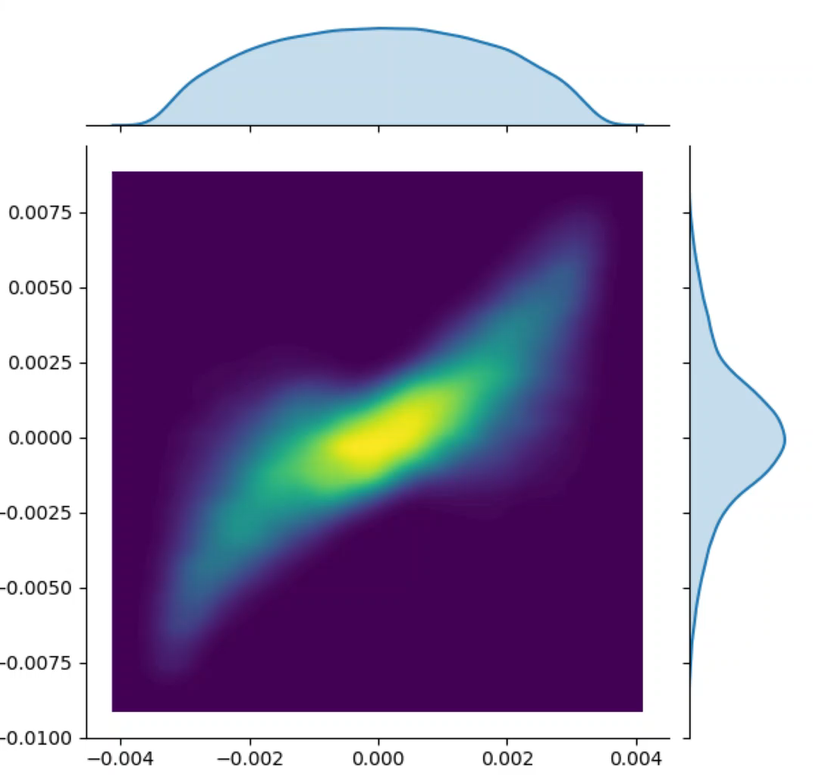
Injector transverse phase space evolution
px
x (m)

Slide 2
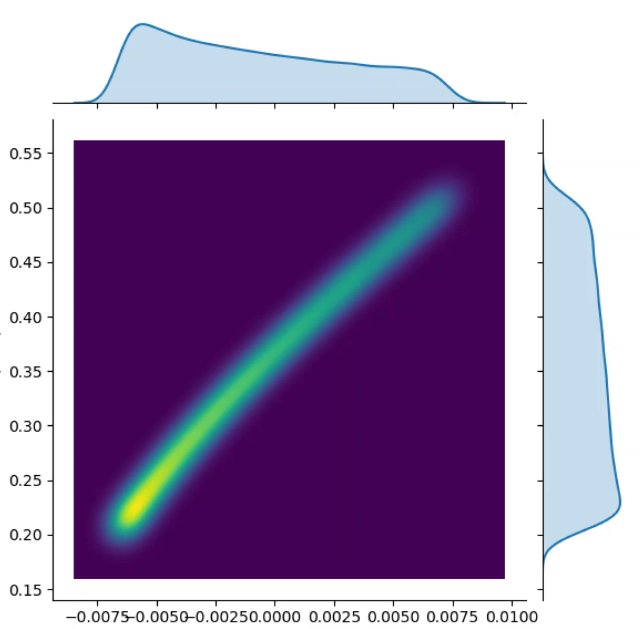
Injector longitudinal phase space evolution
pz
z (m)

Slide 3
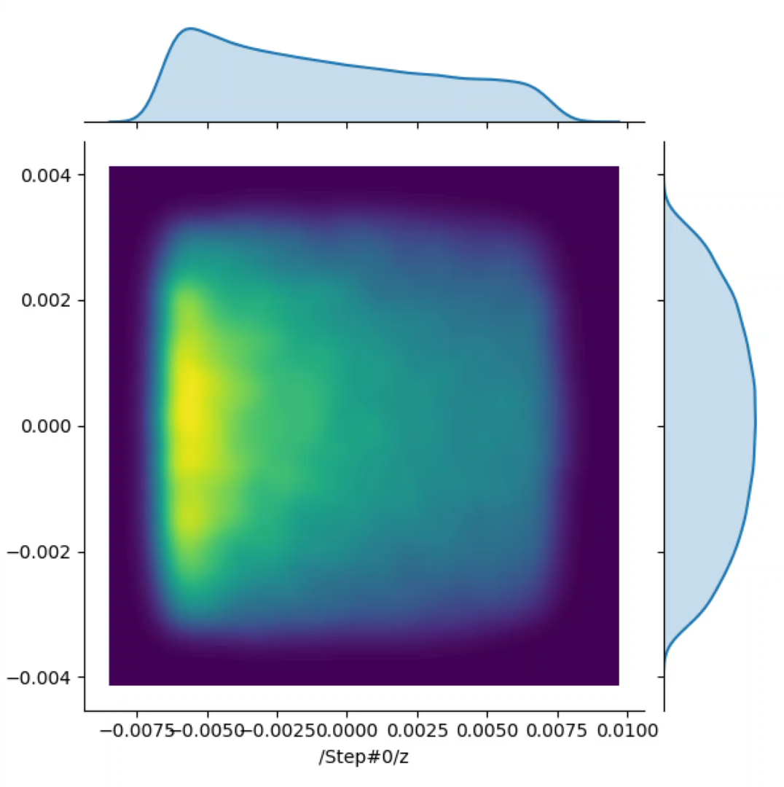
Injector charge distribution evolution
x (m)
z (m)

