Slide 1
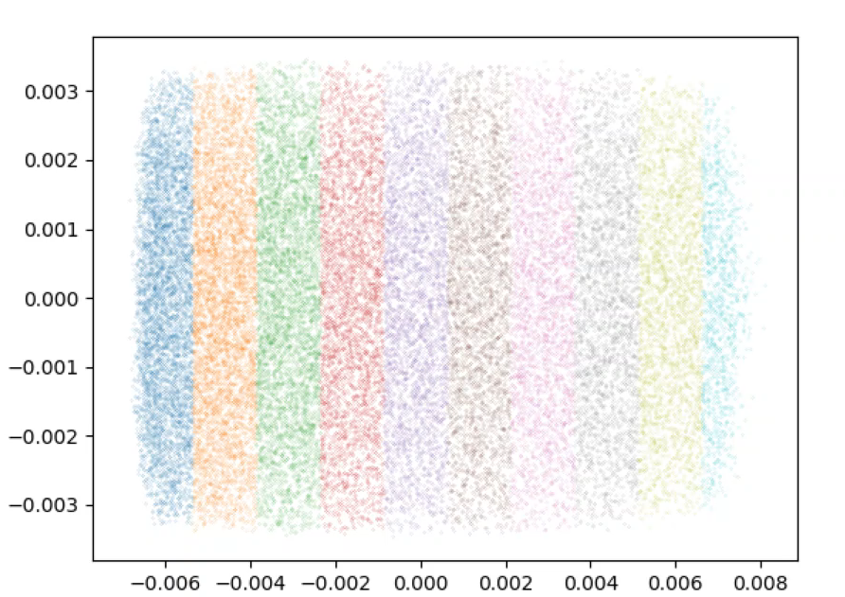
Injector charge distribution slices evolution
x (m)
z (m)

