Slide 1
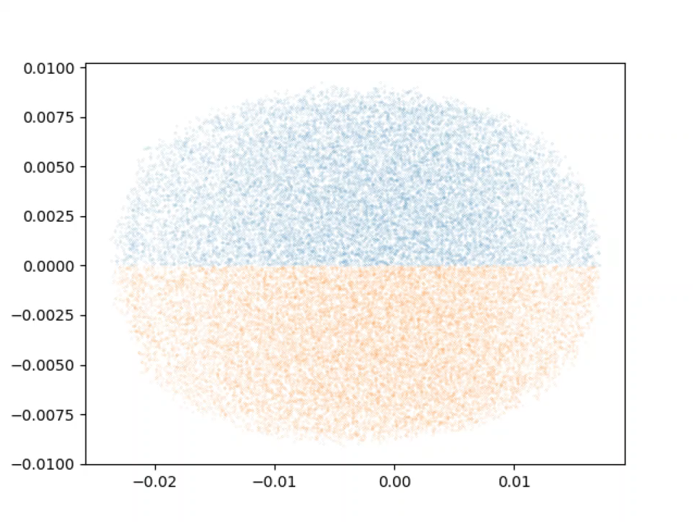
Injector charge distribution evolution
x (m)
z (m)

Slide 2
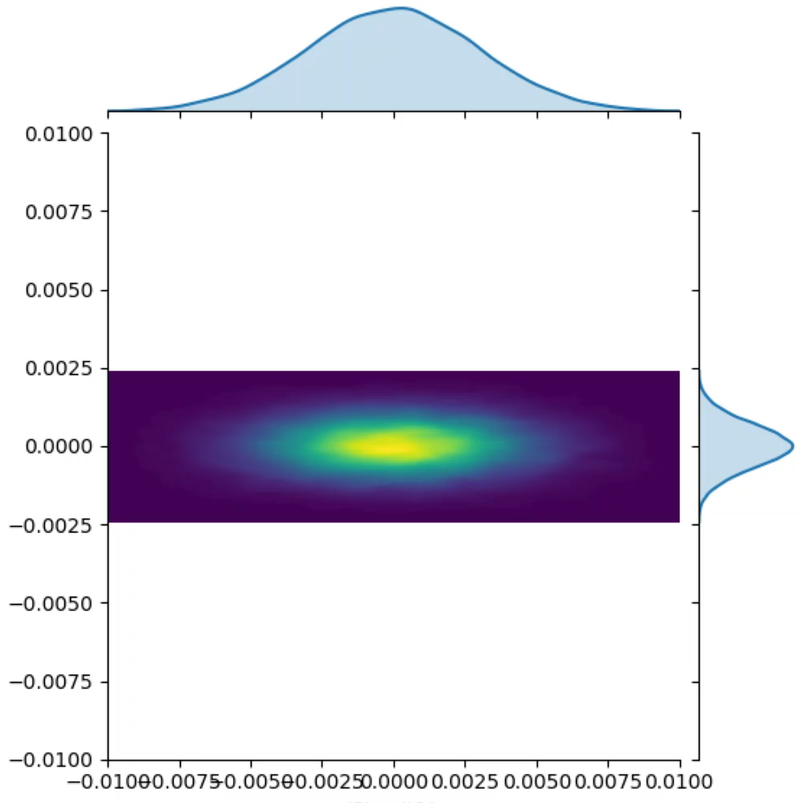
4 dipole merger charge distribution evolution
x (m)
z (m)

Slide 3
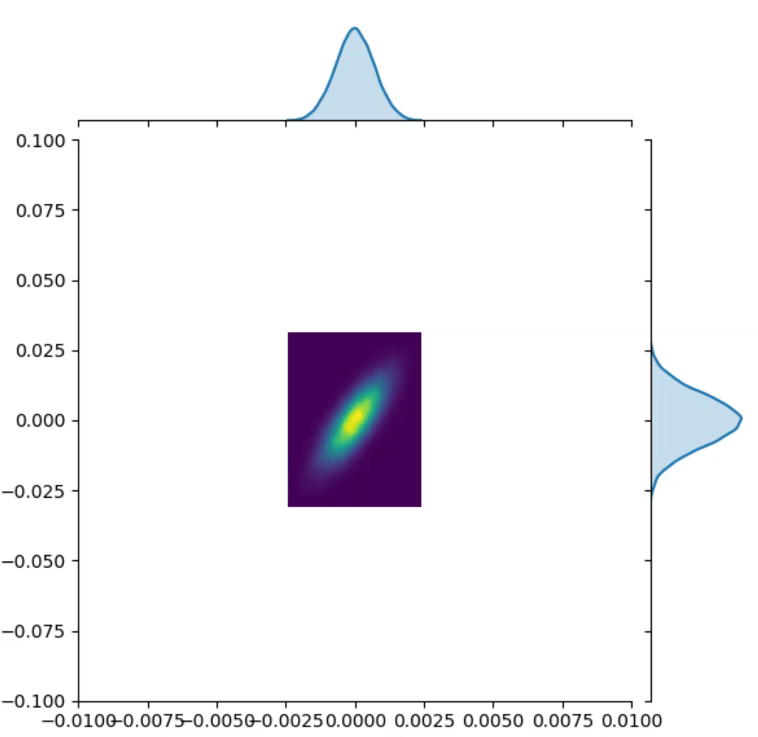
4 dipole merger x transverse phase space evolution
px
x (m)

