Slide 1
4 dipole merger longitudinal phase space evolution
pz
z (m)

Slide 2
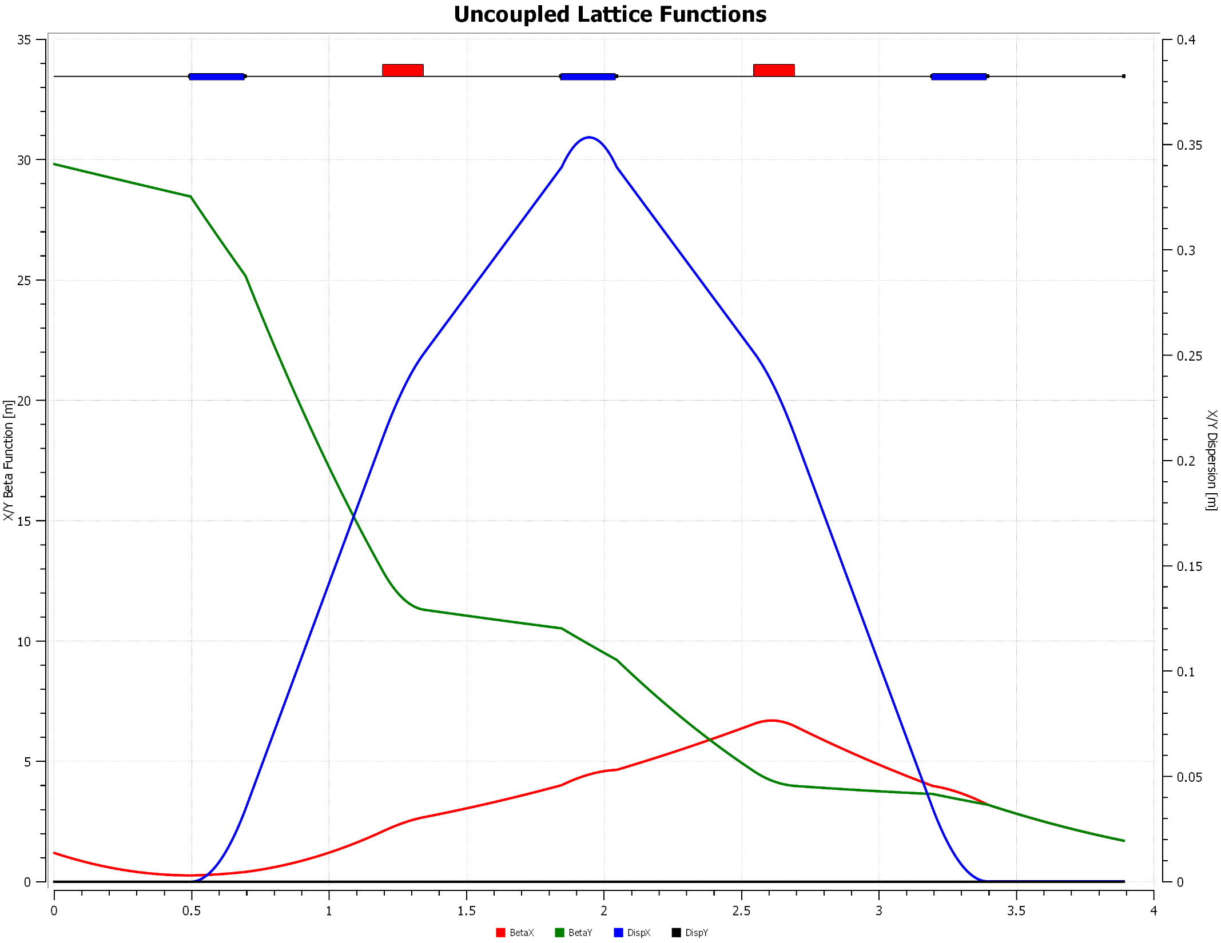
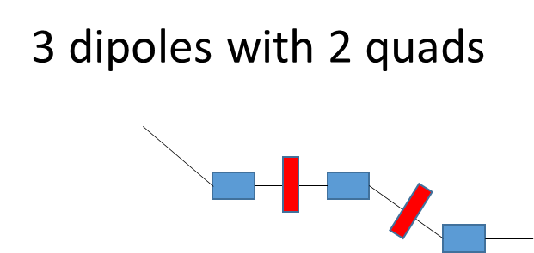
3 dipoles with 2 quads

Slide 3
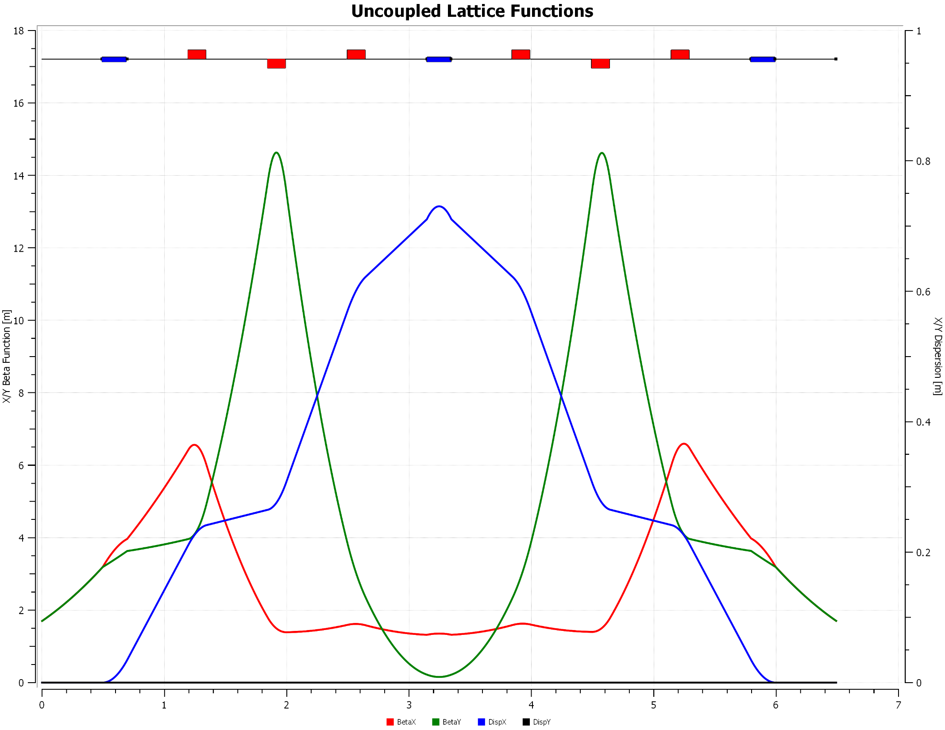
3 dipoles with 6 quads
3 dipoles with 6 quads

Slide 4
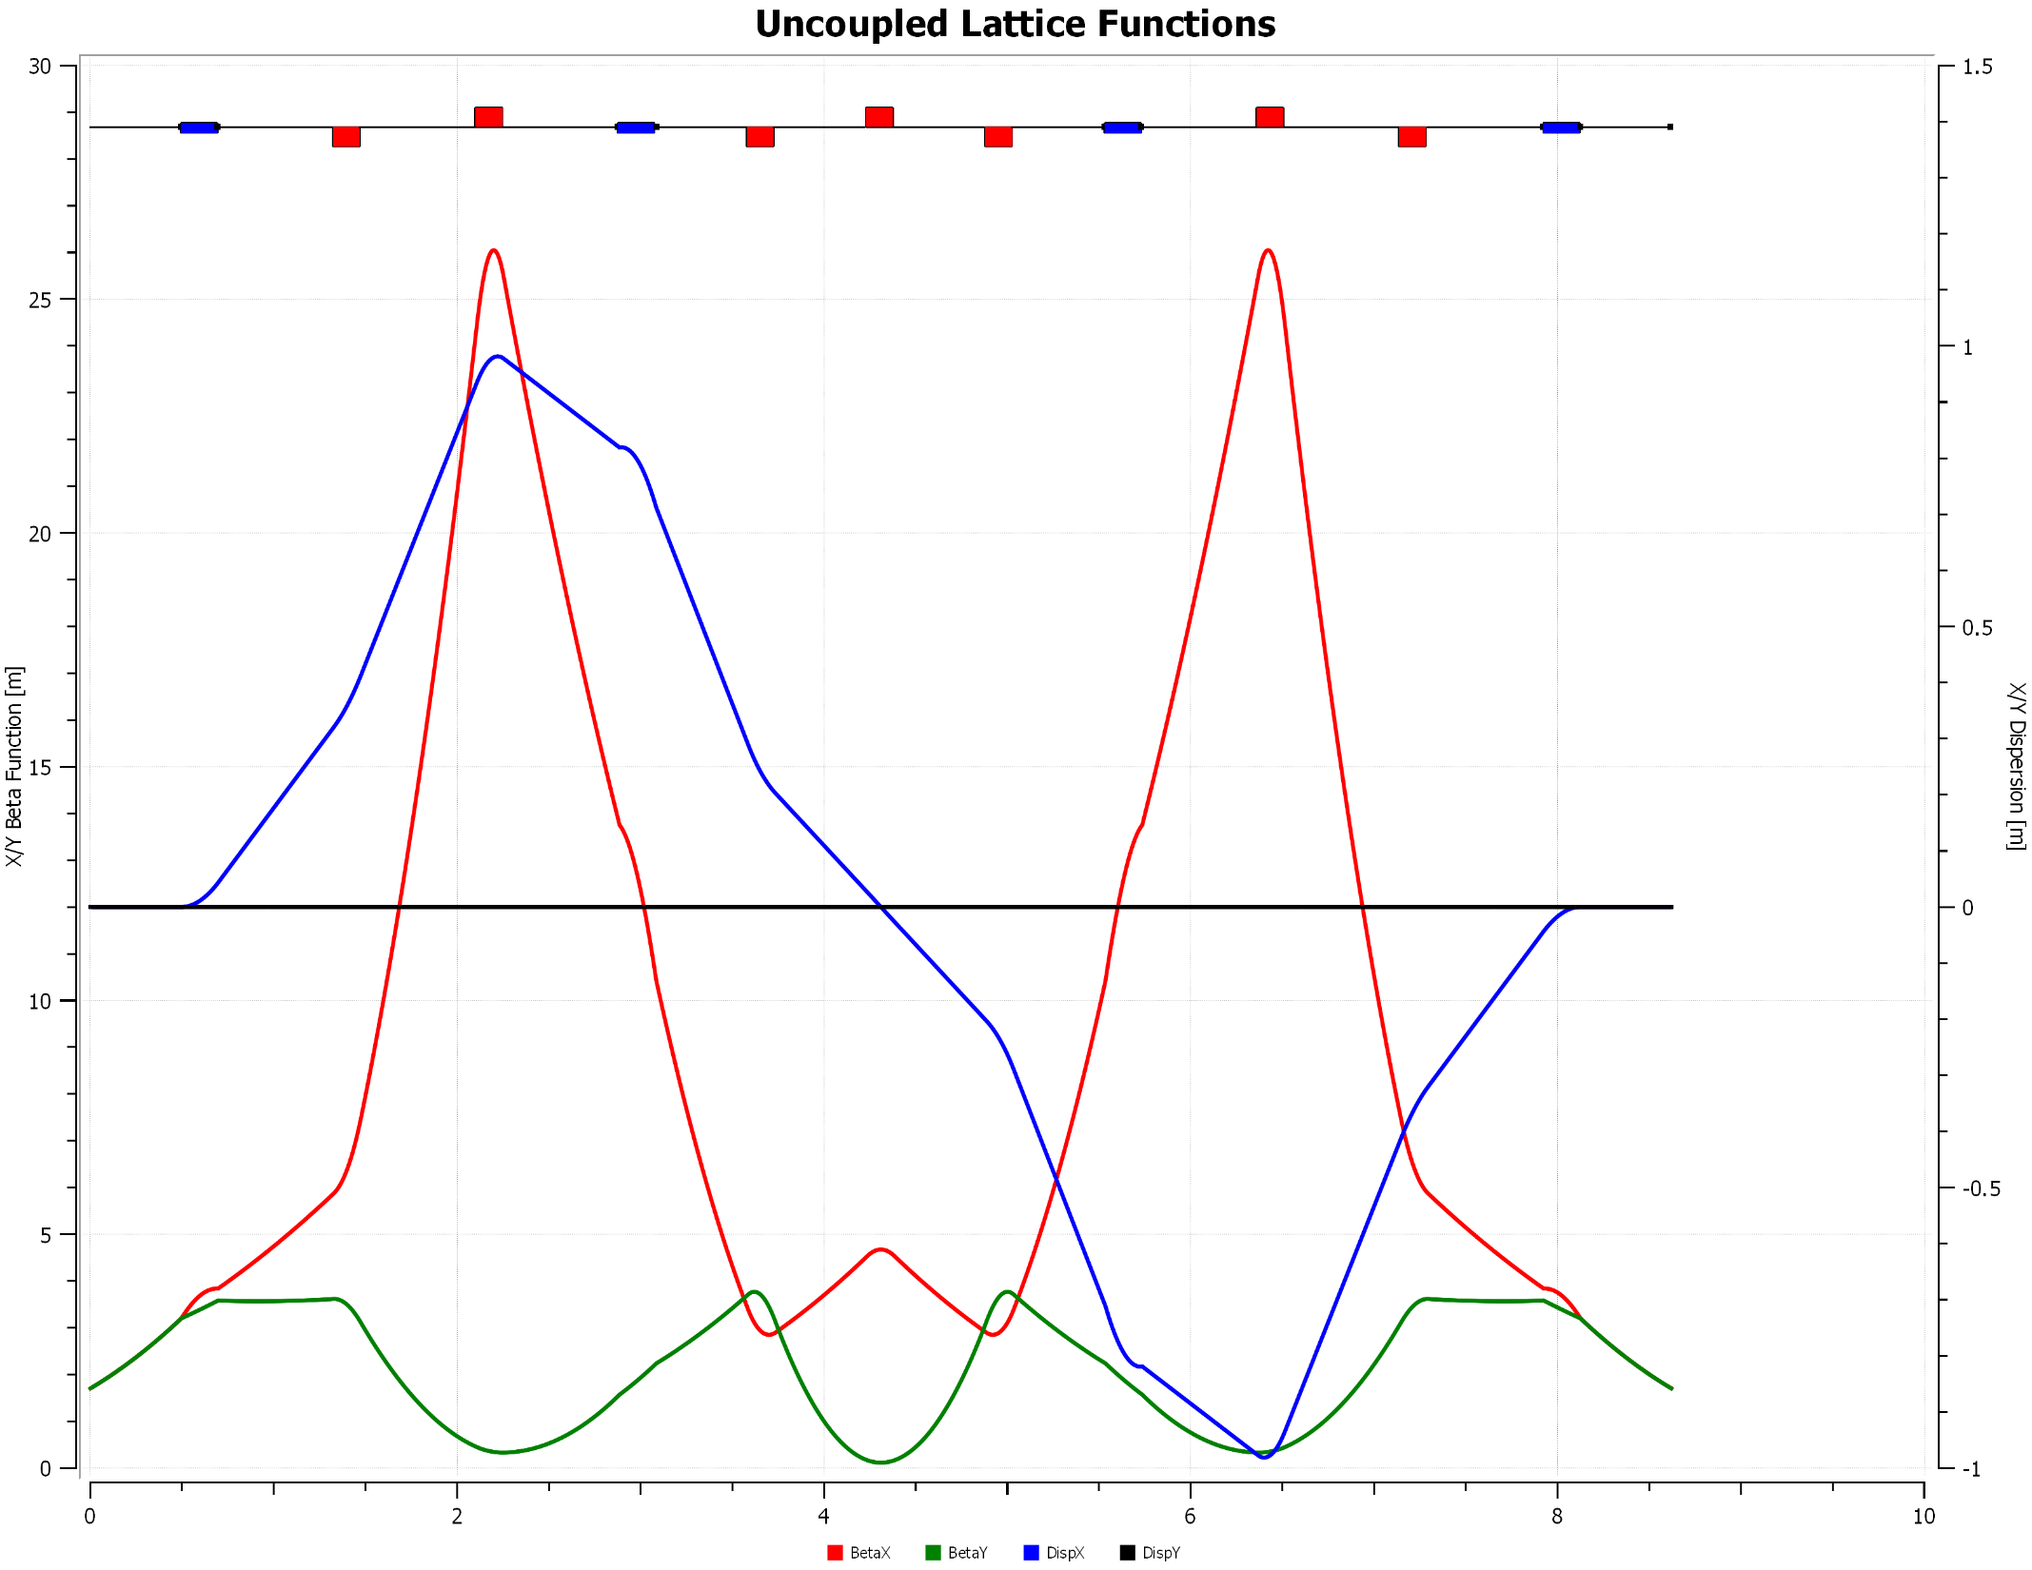
4 dipole staircase
4 dipole Staircase

Slide 5
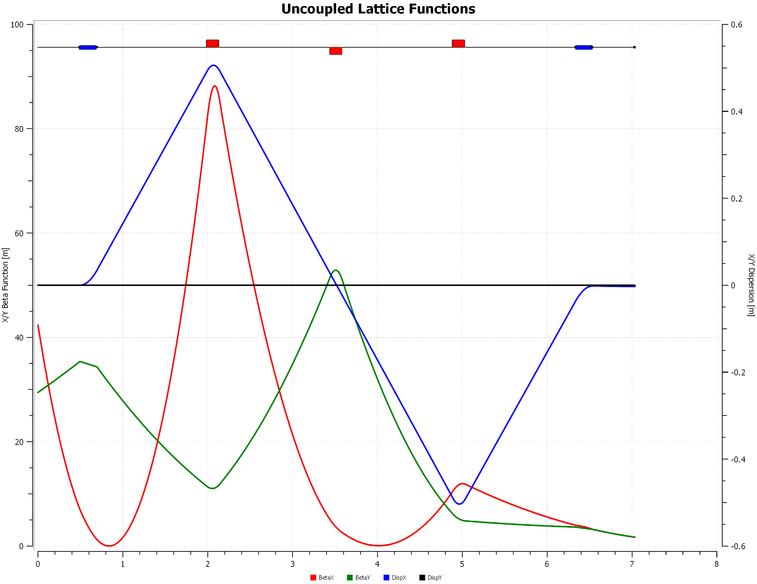
Dogleg 3 quads
Dogleg with 3 quads

Slide 6
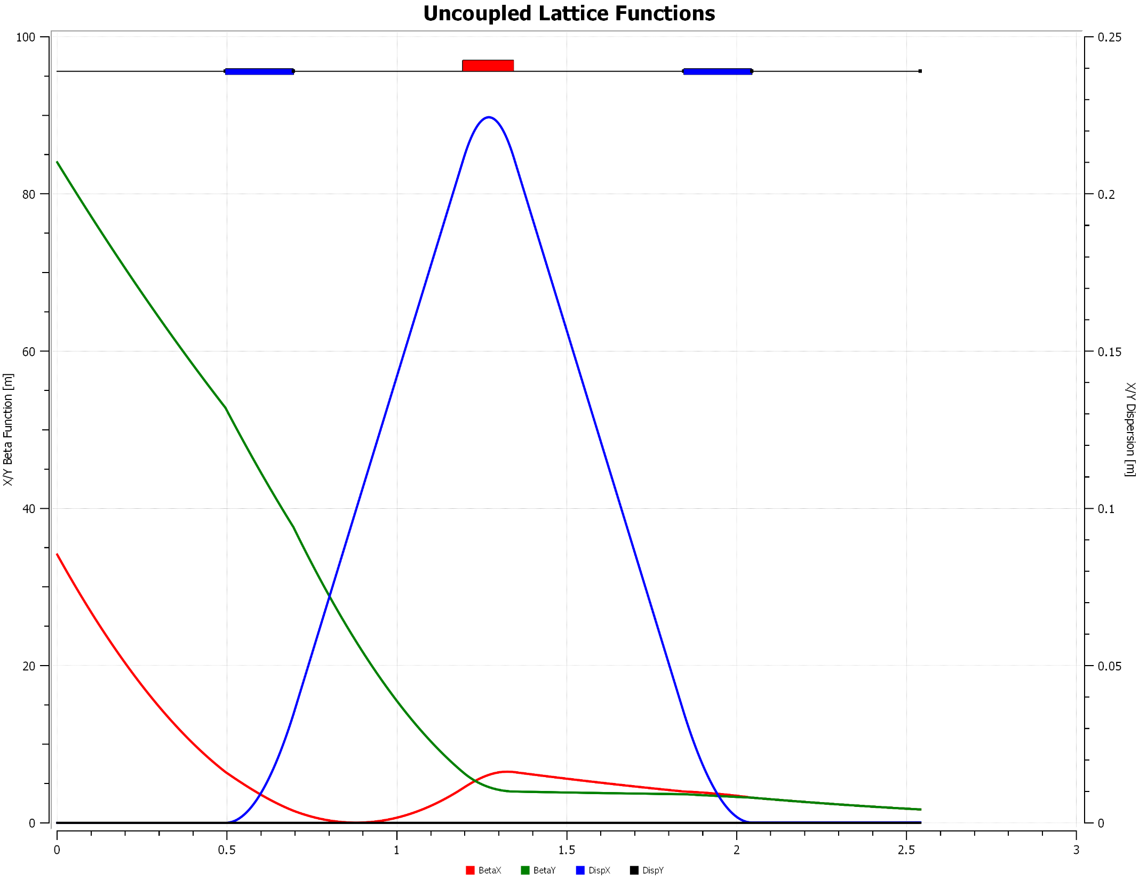
U-bend 1 quad
Ubend with 1 quad

Slide 7
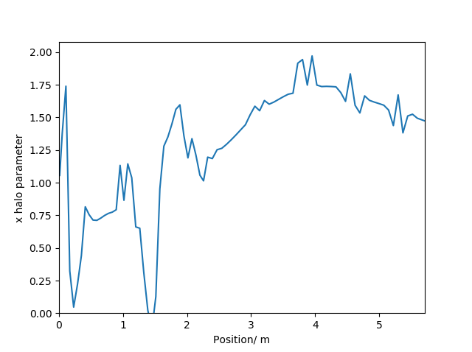
Transverse (x) halo parameter evolution

