Slide 1






PERLE Injection Line Design Review
Introduction
Walid Kaabi- IJCLab/CNRS
16 December 2020

Slide 2
Introduction to PERLE
PERLE: A proposed 3 turns ERL, based on SRF technology, to serve as testbed for studying, testing and validating a broad range of accelerator phenomena & technical choices for future projects.
Target Parameter | Unit | Value
Injection energy | MeV | 7
Electron beam energy | MeV | 500
Normalised Emittance γε_{x,y} | mm mrad | 6
Average beam current | mA | 20
Bunch charge | pC | 500
Bunch length | mm | 3
Bunch spacing | ns | 25
RF frequency | MHz | 801.58
Duty factor |  | CW
[2] J.L. Abelleira Fernandez et al, “ A Large Hadron Electron Collider at CERN: Report on the Physics and Design Concepts for Machine and Detector “, J.Phys. G39 (2012) 075001, arXiv:1206.2913

Slide 3
Global ERL landscape
legacy, decommissioned
legacy, decommissioned
Operating (SC, NC)
Operating (SC, NC)
planned
planned
potential future machine
potential future machine
PERLE
cERL-KEK

Slide 4
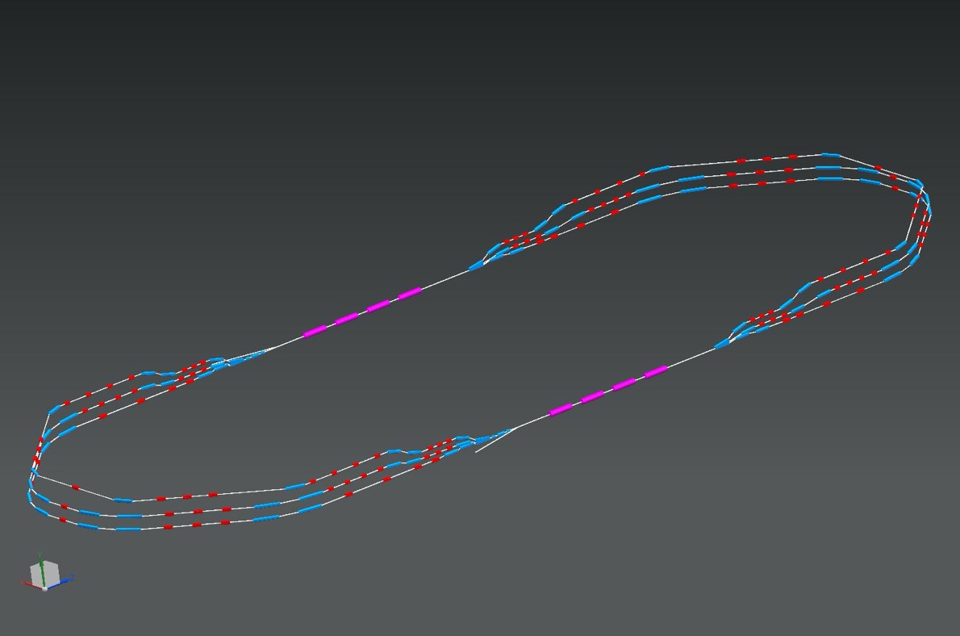
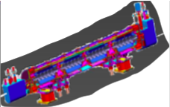
PERLE Configuration
2 Linacs (Four 5-Cell 801.58 MHz SC cavities)
3 turns (160 MeV/turn)
Max. beam energy 500 MeV
1 : 3 : 5
DE = 80 MeV
injector
7 MeV
DE = 80 MeV
2 : 4 : 6
7 MeV
dump
DC = l_{RF}/2

Slide 5
PERLE Timeline
The Collaboration is currently developing a detailed time schedule. Currently it is foreseen to complete the TDR by 2022, Phase 0 by 2025, Phase 1 by 2028 and Phase 2 by 2030. A scheme of milestones will be worked out and agreed upon with emphasis on the accelerator but including a timeline for future experiments.
2025
End Phase 0: Injection line
2030
End Phase 2: PERLE @ 500MeV
2022
PERLE TDR
2028
End Phase 1: PERLE @ 250MeV

Slide 6
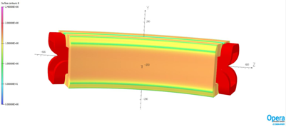
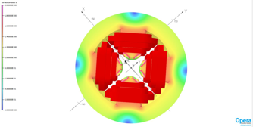
Lattice design optimisation of switchyards and circulating arcs
Courtesy to A. Bogacz and C. Vallerand
Design and prototyping of main magnets for arcs and switchyards

Slide 7
R&D toward PERLE TDR
Lattice design: optimization of arcs and switchyards lattice, study of optics tolerances, magnets specifications, start to end simulation.
BBU study in high average current environment: cavity design optimization for an efficient extraction of HOMs considering PERLE parameters: bench pattern recombination, current threshold, cryogenic efficiency…
Collective effects study: effects of Coherent Synchrotron Radiation (CSR) and Longitudinal Space Charge (LSC) on beam quality, microbunching instability and ion cloud mitigation.
Particle tracking studies of halo formation and control of beam loss.
LLRF and feedback system development: RF control and stability under maximum practical Q_{Load}, development of multi-bunch BBU feedback systems.
Beam diagnostics development

Slide 8
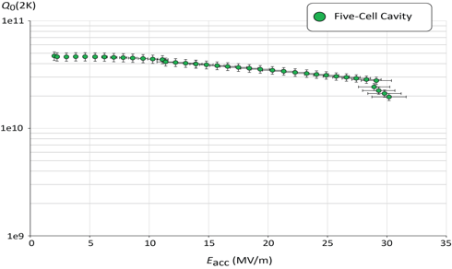
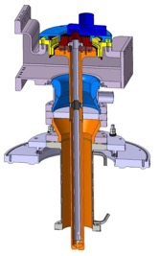
PERLE SRF System development
Courtesy to F. Marhauser
Design and prototyping of a full dressed SRF cavity: demonstration of level of SRF performance required in CW operation, high-average current environment, adequate damping of HOM.
HOM coupler study
Linac cryomodule design: study the possibility of SPL cryomodule adaptation to PERLE need, complete design of a cryomodule for PERLE later.
Q₀ (2k) = 3 e10 @ ~27 MV/m
DQW HOM Coupler
Quench @ E_{acc} ~ 30 MV/m
Design and prototyping of an input power coupler

Slide 9
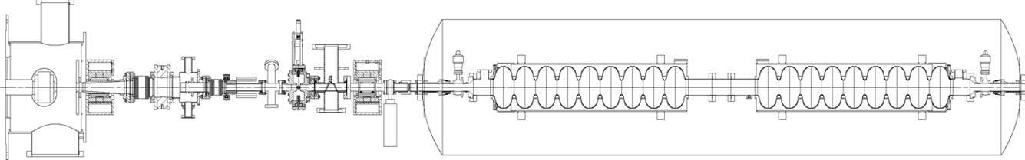
PERLE injection line
Courtesy to B. Militsyn & B. Hounsell
It consist of:
A DC photoemission electron gun (The ALICE DC gun to be upgraded).
A bunching and focusing section: 401 MHz normal conducting buncher cavity placed between two solenoid.
A superconducting booster with five 802 MHz cavities individually supplied and controlled on amplitudes and phases.
Merger to transport the beam into the main LINAC,
Beam diagnostics to be placed between components.
Photocathode gun
Buncher
SRF booster
Light box
Focusing solenoids
Photocathodes choice:
Sb-based photocathodes (unpolarized electrons) operated at 350 kV
GaAs photocathodes (polarized electrons) operated at 220 kV
Photocathode laser choice:
Nd:YAG laser (532 nm) or Ti:Sapphire laser (400 nm).

Slide 10
Thank you for your attention!
MESA ERL simulation©

