Slide 1
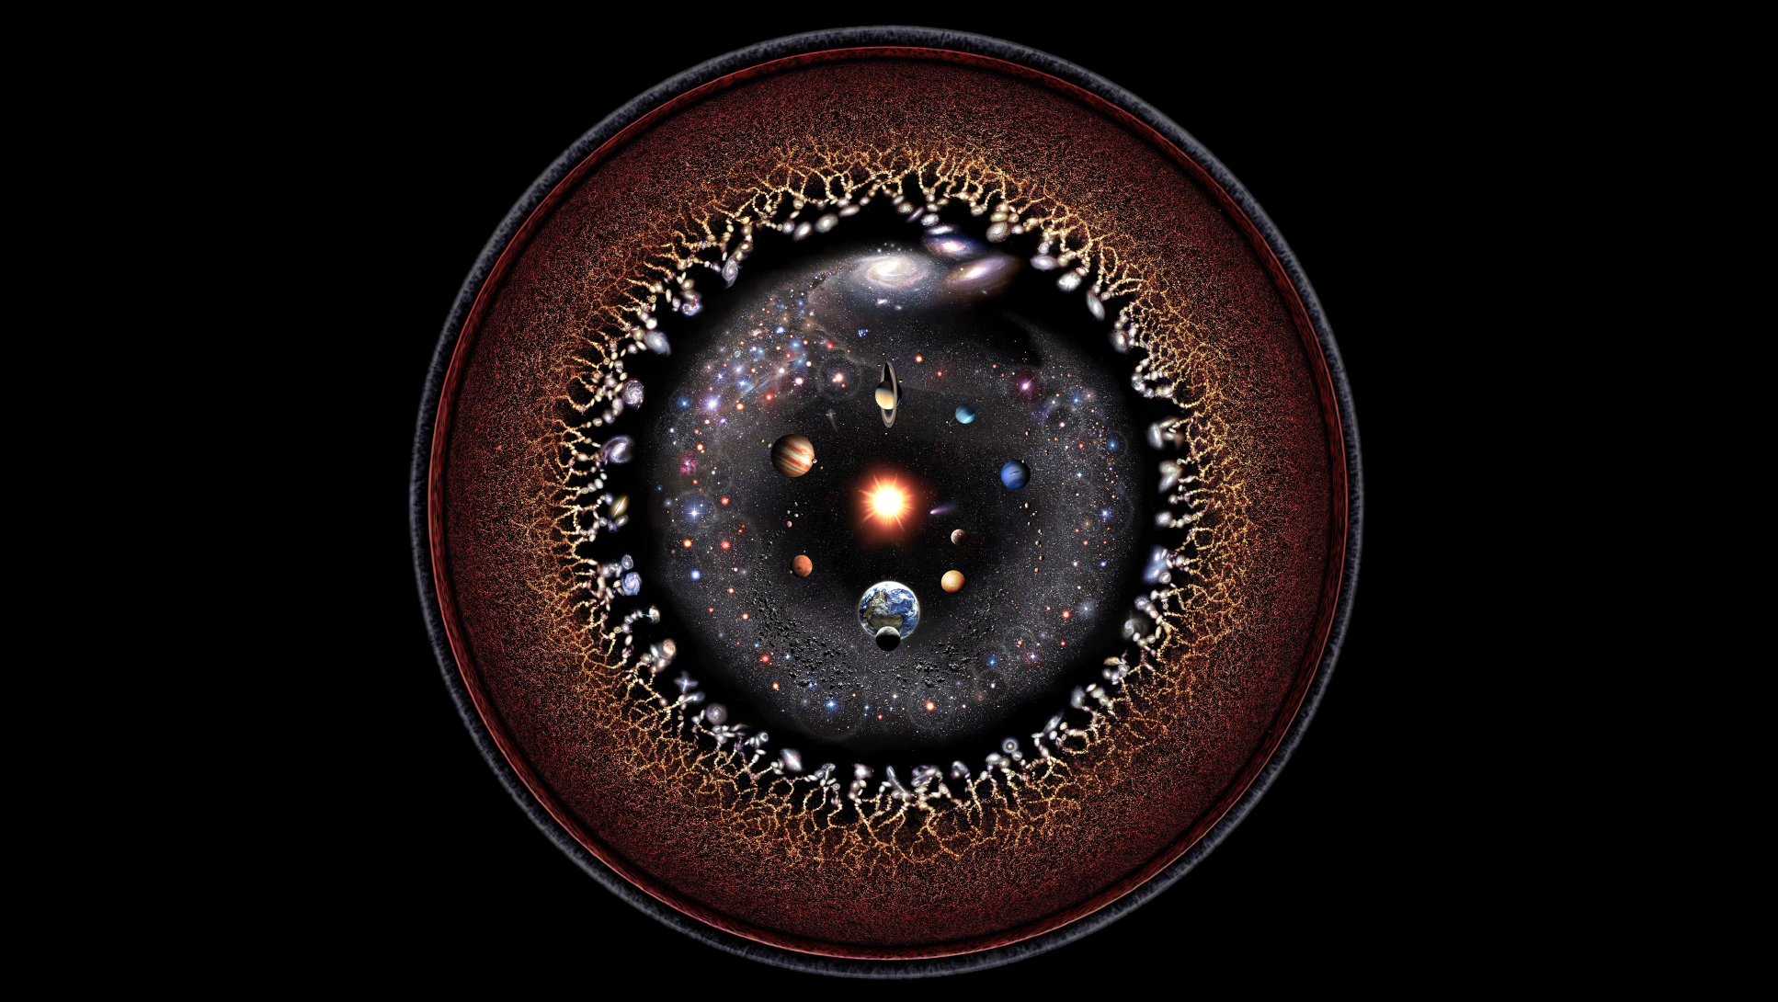
How does our universe work ?
Credit : Ruth Pöttgen

Slide 2
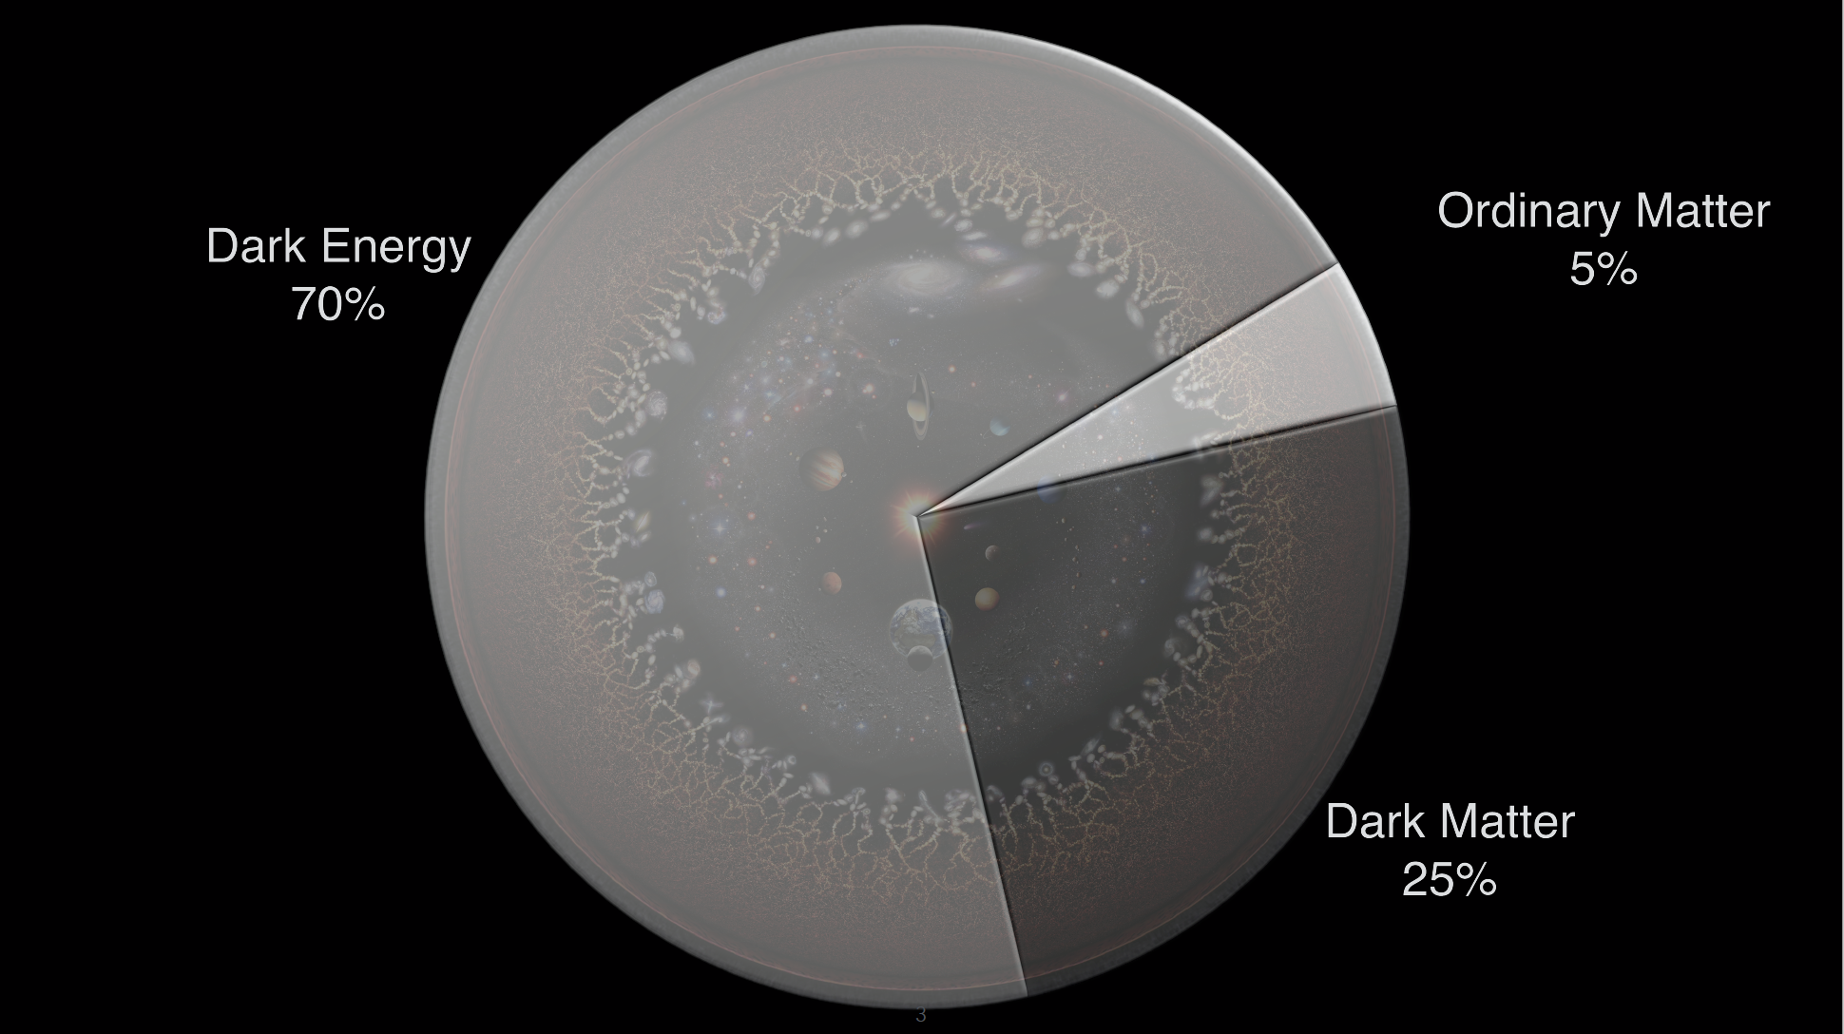
We know quite a lot but there is much more that we don’t understand?
How nuclear physics can help ?
Notes:
Evidence is based on gravitational effects

Slide 3
The neutron lifetime puzzle
Counting emitted protons :
$$τ_{n}^{beam}=888.0±2.1 s$$
Counting remaining neutrons :
W. Pattie Jr. et al, Science Science 11 May 2018 vol. 360 no. 6389 627-632
$$τ_{n}^{bottle}=879.3±0.75 s$$
$$\frac{∆τ_{n}}{τ_{n}}≈1\%$$
Discrepancy
Remaining 1%
n → SM particles (other than p) : excluded
n → dark matter : Fornal and Grinstein, PRL120(2018)191801
n → dark particle(s) + SM particle(s) : e⁺e⁻ UCNA ILL (PRC 97, 052501 (2018)), PERKEO II (PRL 112, 222503 (2019) or photon UCN Los Alamos (PRL121, 022505 (2018)) excluded so far
n → dark particle(s)
Notes:
Voir les manipes UCNA et UCN

Slide 4
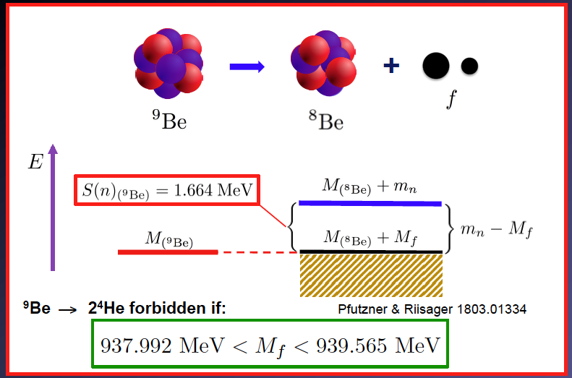
Nuclear Physics bound to fix energy constrains
Neutrons loosely bound in nuclei may decay by the dark channel
Lighter than neutron to decay
Greater than the difference of mass between ⁹Be and ⁸Be
(2x⁴He) as ⁹Be is stable
Dark particle χ cannot decay in SM particles :
p + e⁻ + ν_{e}: mχ < m_{p} + m_{e} = 938.783 MeV
937.992 MeV < mχ < 938.783 MeV
Few candidates proposed recently by Pfutzner and Riisager :
PRC 97, 042501(R) (2018)
¹¹Be, ¹¹Li, ¹⁷C and ⁶He

Slide 5
¹¹Be β-delayed proton emission
AMS Technique
Riisager et al. : ¹¹Be in a catcher, let it decay and analyzed the ratio of ¹⁰Be/¹¹B with AMS technique
¹¹Be → ¹⁰Be branching ratio was 8.3(9) ×) 10⁻⁶ (PLB 732, 305 (2014))
Unexpected high number of ¹⁰Be nuclei produced : « decay goes through a resonnace in ¹¹B J. Okolowick PRL 124, 042502 (2020) - impossible to explain with the best and the most reliable theoritical models ∼ 10⁻⁸, A. Volya EPL 2020 »
Very recently tried to reproduce their observation : upper limit of 2.2 × 10⁻⁶ with huge errors and large incoherence on the various samples (EPJA 56, 100 (2020))
Direct identification of p decay
Mittig et al. : directly measured β⁻ p⁺ decay in ¹¹Be with a prototype Active Target Time Projection Chamber
Unambiguously assign a branching ratio to this specific proton decay channel.
Deduced that ¹¹Be → ¹⁰Be + p branching ratio was 12(3) × 10⁻⁶ (PRL 123, 082501 (2019))
Not conclusive → new candidate for clear signature, without relying on another experiment.
Notes:
A voir : unexpected rate : narrow resonance or dark decay

Slide 6
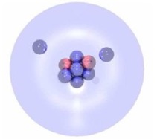
⁶He quasi free neutron decay : unique signature
⁶He cannot decay by neutron except through dark decay
n
χ
n + ⁴He
⁶He
⁵He
If a dark decay of one neutron of the ⁶He halo occurs, the allowed energy window : Mχ < Mn - 975.45 keV
Probe the optimum dark matter mass range : 937.992 MeV < Mχ < 938.589 MeV
The half-life of ⁶He, T_{1/2} = 807 ms, leads to the estimated branching ratio of Bχ = 1.2 × 10⁻⁵, using the assumptions Bχ = T_{1/2} / T_{1/2} ^{nχ} (Pfutzner and Riisager, PRC 97, 042501(R) (2018)) with BRχ = 1%
Recent analysis (D. Dubbers Phys. Lett. B 791, 6 (2019)) from new beta asymmetry measurements (PERKO III) :
SM prediction is closest to the bottle experiment and set a limit below what is required to explain the neutron lifetime discrepancy
→ Calculated BRχ < 0,3 % → estimated branching ratio in ⁶He of Bχ = 10⁻⁶
What is the upper limit for loosely neutron decay - We should do better than 0.3%
Notes:
Travailler sur le branching ratio

Slide 7
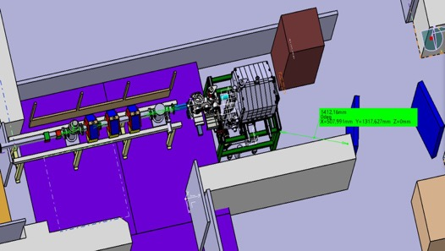
Experimental technique
Beam : ⁶He¹⁺ SPIRAL1 at low energy (LIRAT) and at the maximum intensity (10⁸ pps).
Experimental technique : detection of an excess of neutrons with the apparent lifetime of ⁶He (T_{1/2} = 0.8s)
Experimental setup :
4π ³He neutron counter TETRA (Dubna) : 60 % efficiency E_{n} <1MeV
Beam on (0.1s) / Beam off technique
⇒ 60 neutrons within few decay periods for Bχ = 10⁻⁵
TETRA
Background :
Correlated :
⁶He → ⁶Li*→ ⁴He + ²H and deuteron break up ≈ 10⁻³ n/cycle
¹⁸N³⁺ contaminants in the beam : n < 0,002/cycle
X-rays from ⁶He decay : MCMP simulation (X. Ledoux, GANIL)
Threshold : E > 0,1MeV ⇒ 2,8 × 10⁻⁶ counts/beta decay
Threshold + PSD ∼ 10⁻⁷ counts/beta decay ⇒ digital electronics
Time independent :
Cosmic radiation : n ∼ 1/s (measured with TETRA)
Neutron flux in the cave
MCMP simulation (X. Ledoux, GANIL) : n < 4/s
Measurements E777S SPIRAL1 experiment : 10-20% than cosmic
⇒ < 10 n/s (conservative number)
Integration in the LIRAT Cave

Slide 8
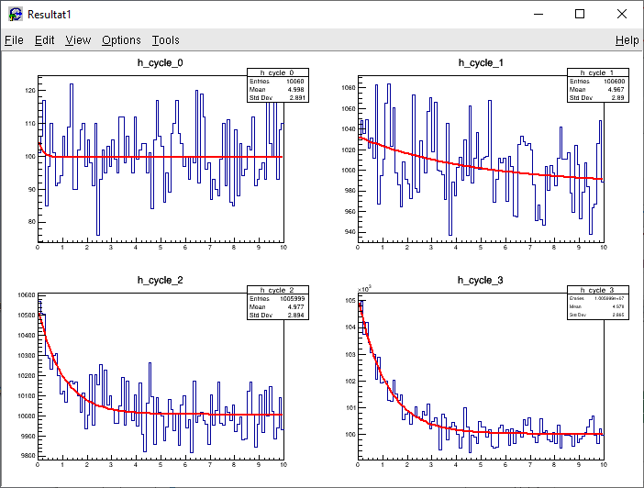
Experimental technique
Goal : Set the most stringent limit for loosely bound neutron decay
Beam on 0.1s / Beam off 10 s - Bχ ∼ 10⁻⁷
∼0,27h
∼2,7h
∼27h
∼270h
X. Fléchard (LPC Caen)
⇒ Clear signature for Bχ ∼ 10⁻⁷ (statistical uncertainty ∼ systematic error from X-rays ∼ 10⁻⁷)
with ⁶He apparent lifetime ∼ 20% uncertainty within 3UT

Slide 9
Experiment accepted at GANIL : E819S_20 @ SPIRAL1/LIRAT
Decay of quasi-free neutrons as possible
window to observe a dark decay branch
n
χ
Is there a dark decay of neutrons in ⁶He?
Goal : Set the most stringent limit ⇒ Bχ ∼ 10⁻⁷ (statistical uncertainty ∼ systematic error from X-rays ∼ 10⁻⁷)
Spokespersons : H. Savajols (GANIL), W. Mittig (NSCL/DRIB), Yu. E. Penionzhkevich (JINR Dubna)
Collaboration : GANIL, NSCL, JINR DUBNA, LPC Caen, IJC Lab, IPHC
Installation of the setup : 2021
Experiment :June 2021

Slide 10
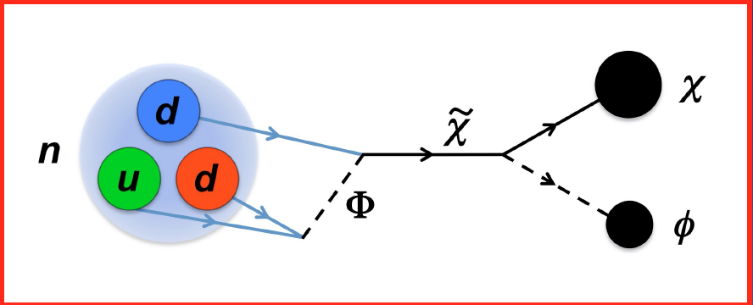
It would be truly amazing if the good old neutron turned out to be the particle enabling us to probe the dark matter sector of the universe
Thank you !

