Slide 1
Physics beyond the Standard Model
and the beta decay of ¹⁰C
B. Blank, M. Aouadi, P. Ascher, M. Gerbaux, J. Giovinazzo,
S. Grévy, T. Kurtukian Nieto
CENBG - CNRS/IN2P3 - Université de Bordeaux
M.R. Dunlop, R. Dunlop, A.T. Laffoley
University of Guelph
G.F. Grinyer
Univeristy of Regina
P. Finlay
KU Leuven

Slide 2
• • • Nuclear beta decay
0⁺
0⁺ → 0⁺ :
T_{1/2}
K
Ft = ft (1 + δ_{R}’ ) (1 – δ_{c} + δ_{NS} ) = = cnst
2
(1 + Δ_{R})
2
G
M
f(Z, Q_{EC}) ~ 1.5%
V
F
Q_{EC}
f(nucl. structure) ~ 0.3-1.5%
BR
f(weak interaction) ~ 2.4%
0⁺
Precision measurements required: 10⁻³
Q_{EC} → mass measurements: f ~ Q_{EC}⁵
T_{1/2}, BR → β-decay studies: t = T_{1/2} / BR

Slide 3
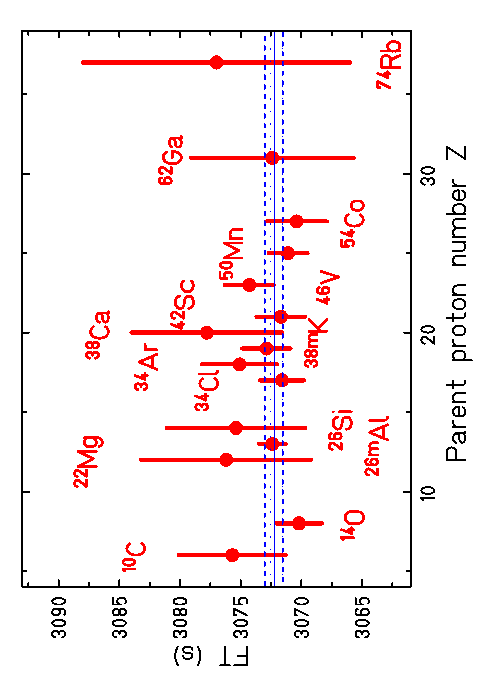
• • • 0⁺ → 0⁺ decays: present status
15 nuclei
other nuclei under study:
¹⁸Ne
³⁰S
⁴²Ti
⁵⁸Zn
+ heavier to come
Error budget:

Slide 4
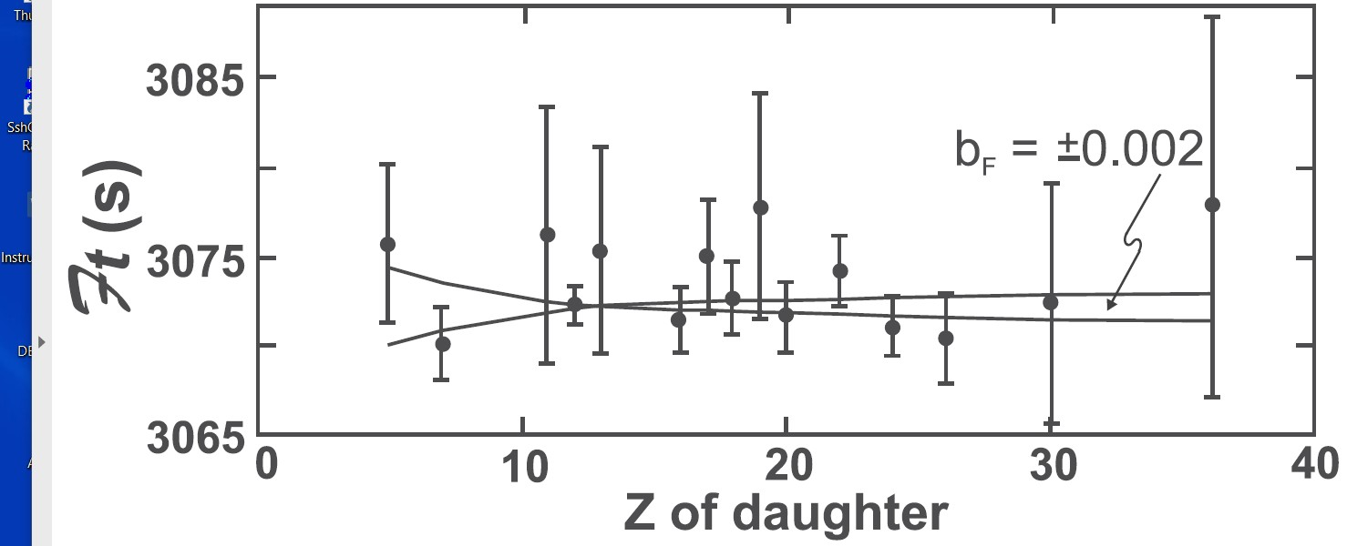
• • • 0⁺ → 0⁺ decays: limits on exotic currents
standard model assumption: only vector current
limit on scalar current from term in f function: (1+b_{f} * γ₁ / <E>)
from β decay: b_{F} = 0.0000 ± 0.0020
➔➔ improve on low-Z nuclei
Hardy & Towner, 2020

Slide 5
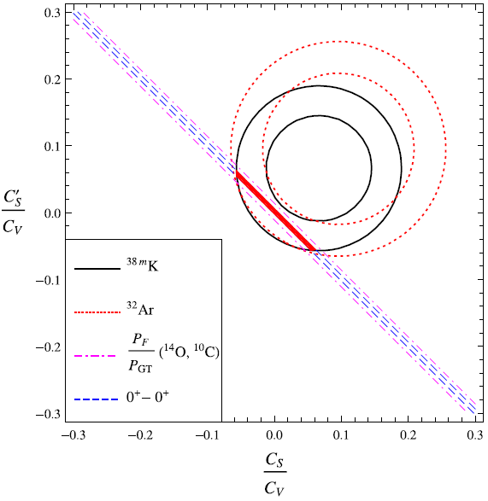
• • • 0⁺ → 0⁺ decays: limits on exotic currents
³²Ar: Adelberger et al., PRL 83 (1999) 1299
^{38m}K: Gorelov, Behr et al., PRL 94 (2005) 142501
with:
Hardy & Towner, Phys. Rev. C 91 (2015) 025501
B. R. Holstein, J. Phys. G 41 (2014) 114001

Slide 6
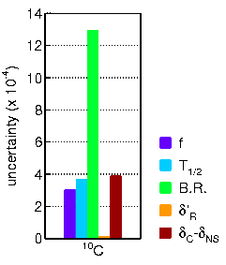
• • • 0⁺ → 0⁺ decays: ¹⁰C error budget
BR by far largest error
two precise measurements:
Savard et al.: 1.4625(25)%
(PRL 74 (1995) 1521)
Fujikawa et al.: 1.4665(38)%
(PLB 449 (1999) 6)
measurements with Ge
multi-detector array
our approach:
remeasuring the BR of ¹⁰C
with out precisely calibrated
Germanium detector

Slide 7
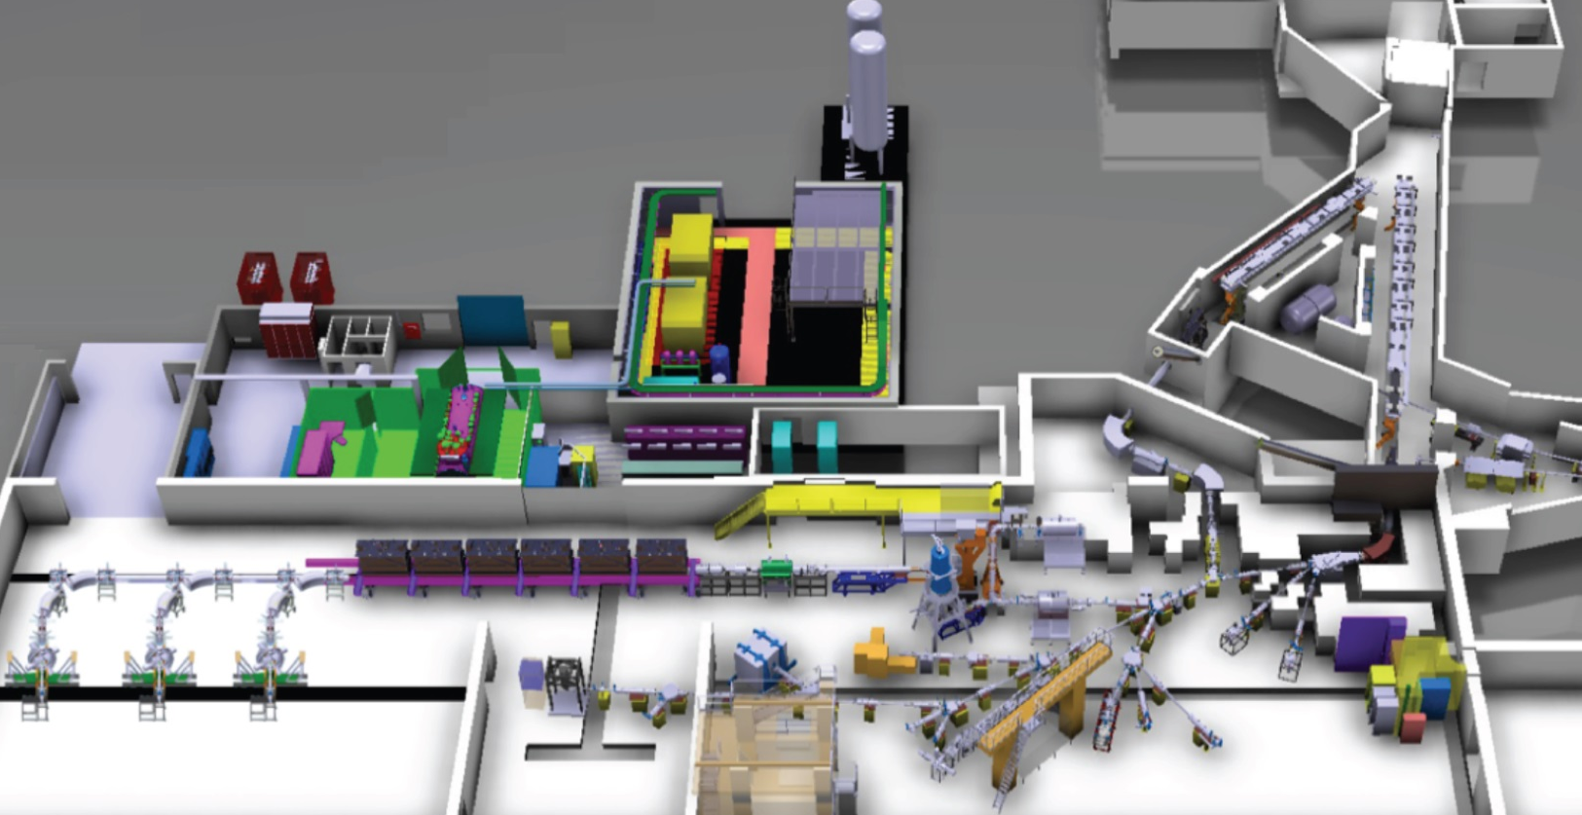
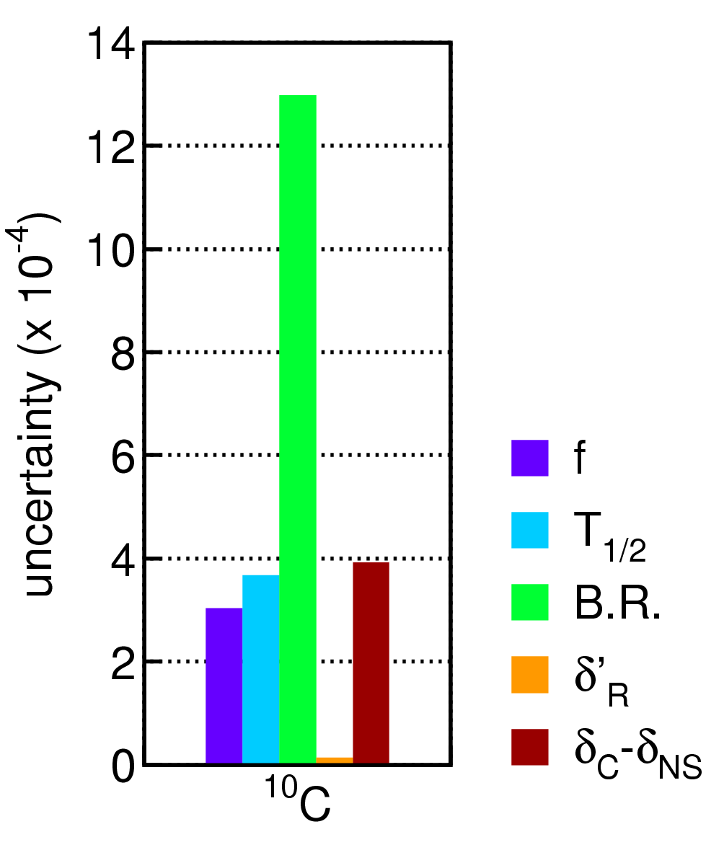
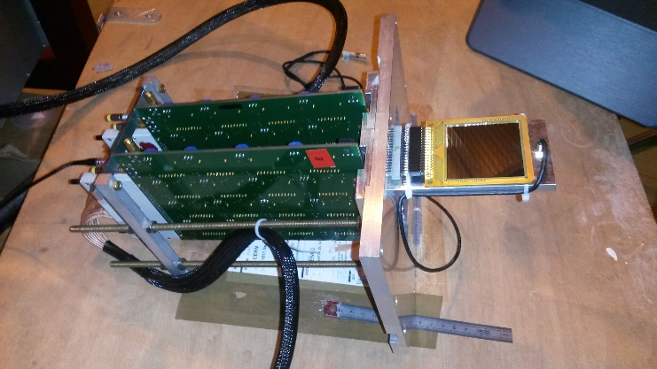
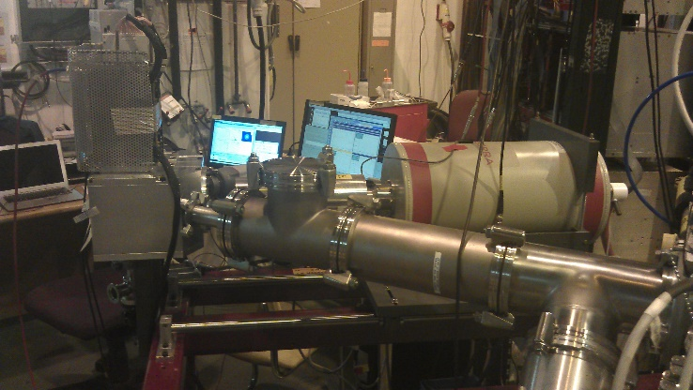
• • • ¹⁰C measurement at ISOLDE
Proton beam at 1.4 GeV and 2μA
Target: CaO
Source: VADIS
catcher
profiler

Slide 8
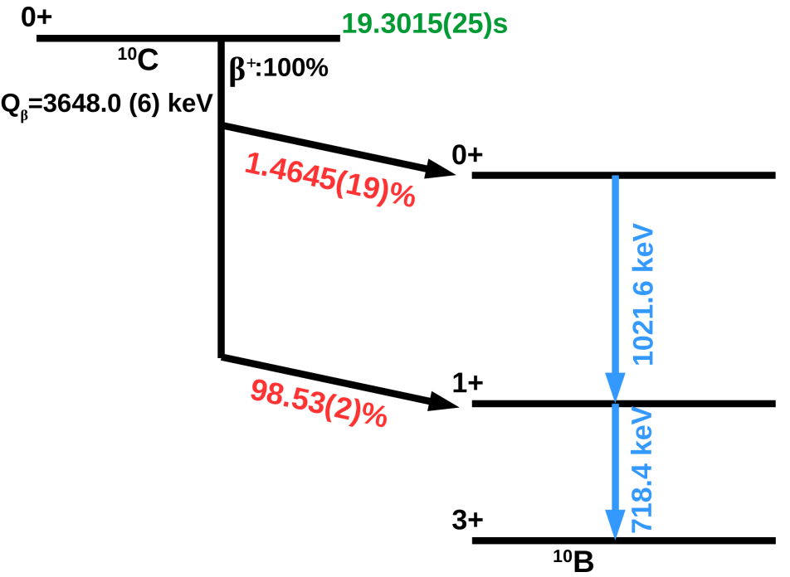
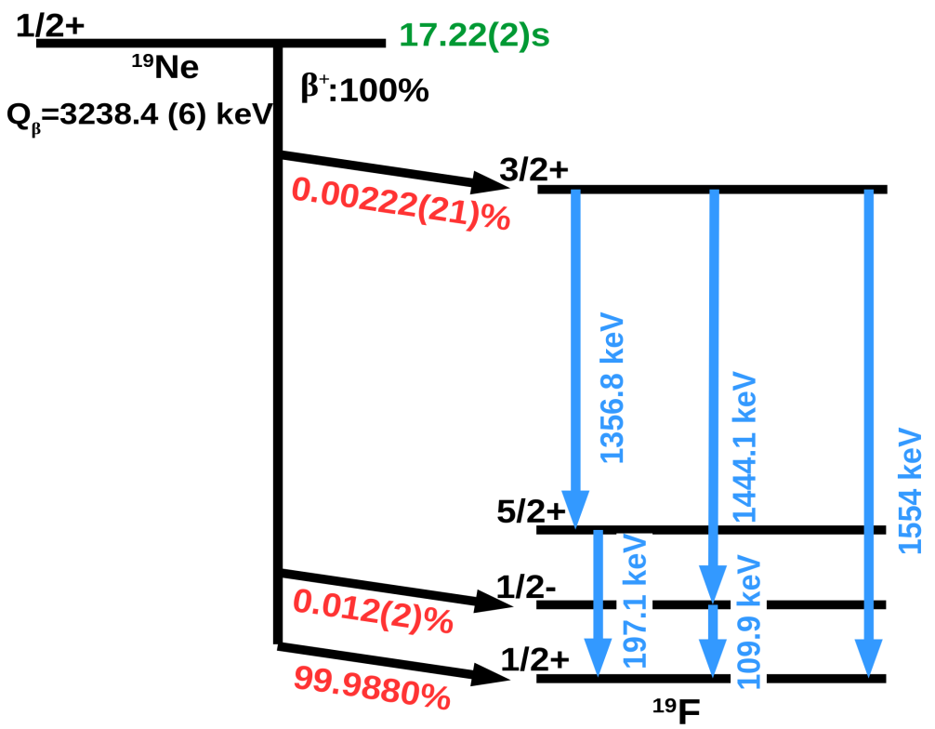
• • • ¹⁰C/¹⁹Ne decay scheme
¹⁰C
⬅ to determine the BR
¹⁹Ne
to evaluate pile-up ➔
N₁₀₂₂ = N₅₁₁² * τ

Slide 9
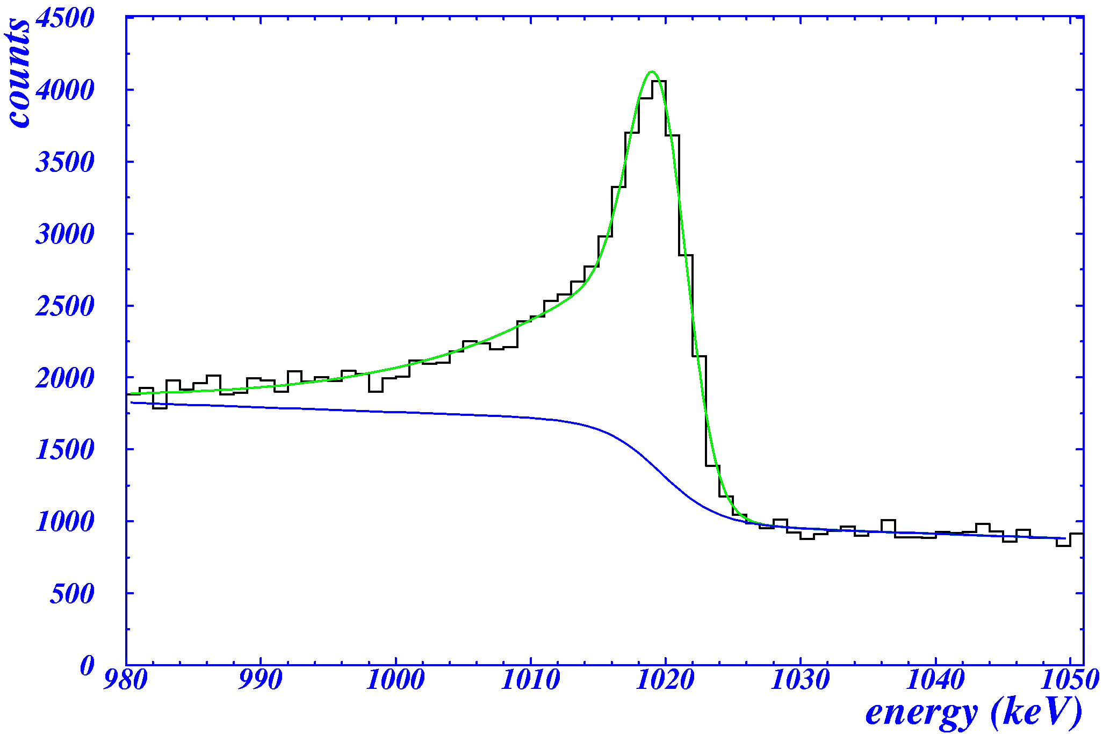
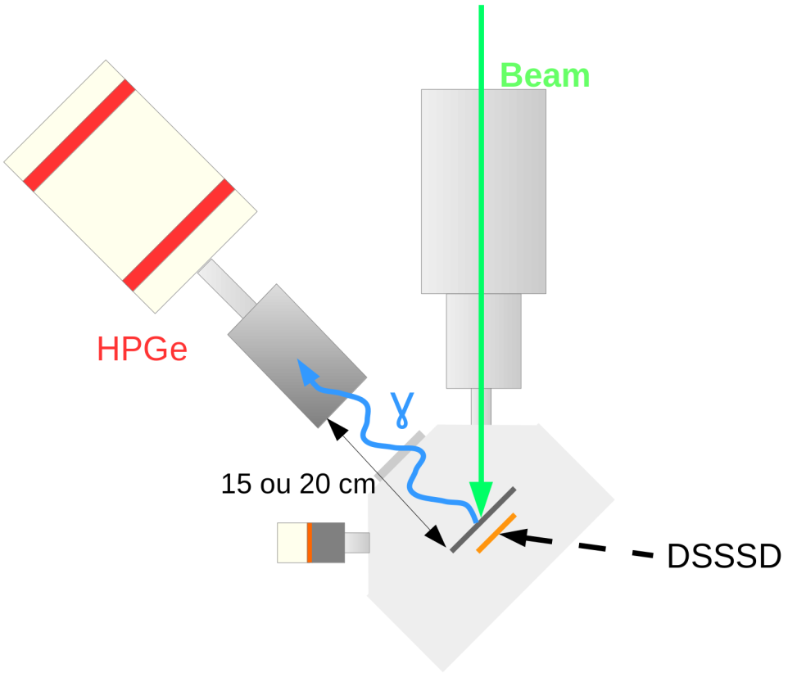
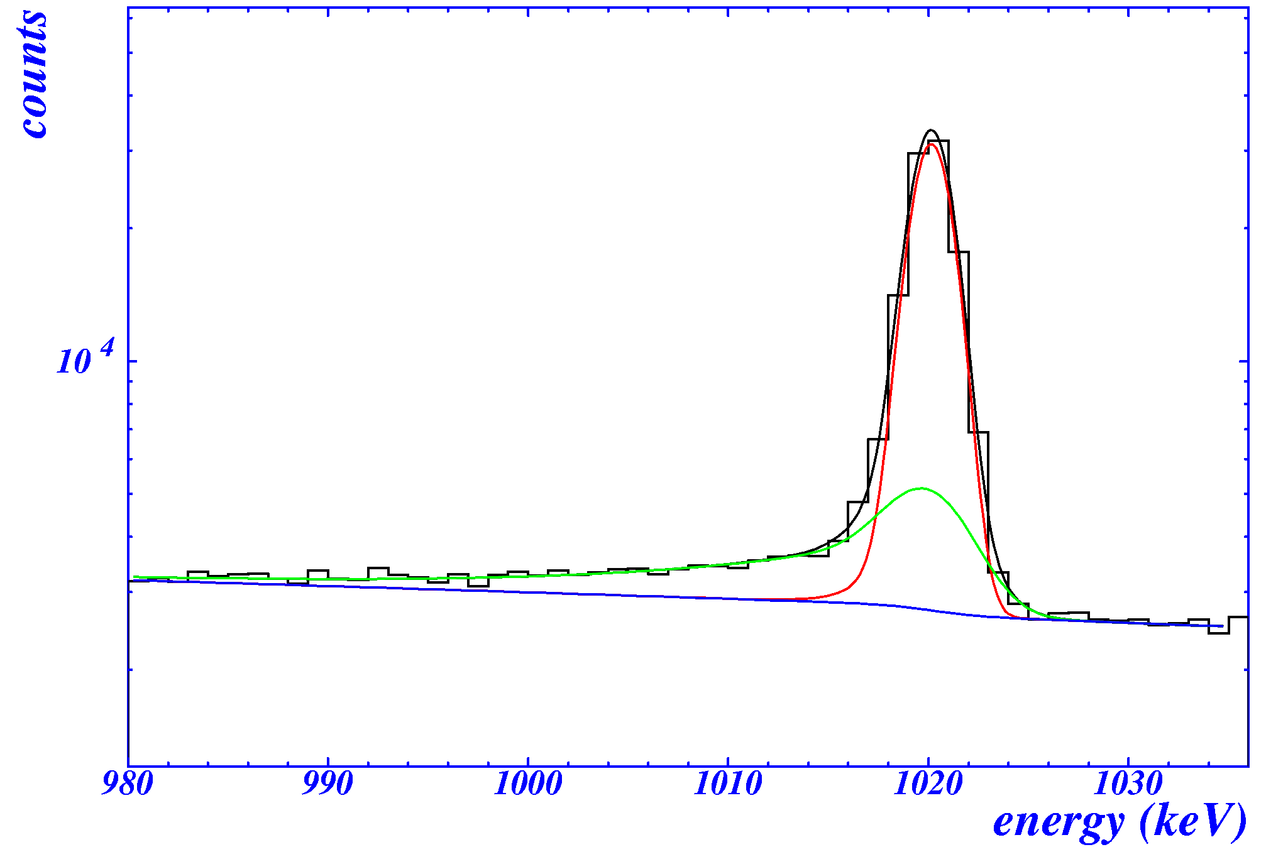
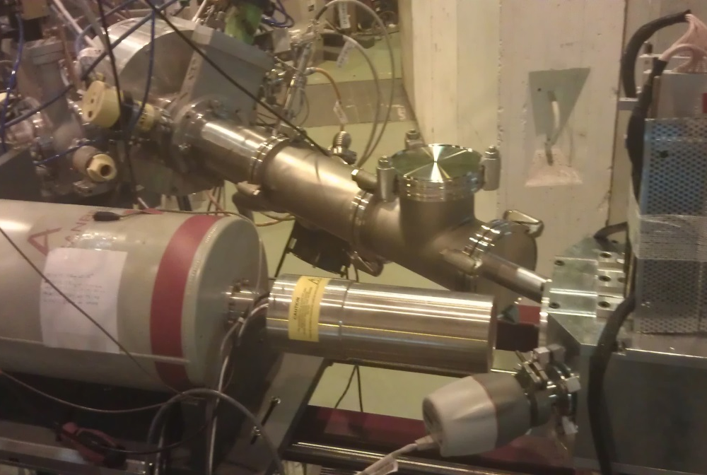
• • • ¹⁰C experimental set-up and analysis procedure
¹⁹Ne:
similar T_{1/2}
similar Q_{EC}
no 1022 keV peak, only 511-511 pile-up
¹⁰C: 1022 keV line + 511+511 pile-up
N(1022) =
N(511)² * τ
pile-up shape
and intensity adjusted with 511keV peak,
¹⁹Ne + sim.

Slide 10
• • • ¹⁰C analysis procedure
selection of runs: constant intensity over full run
determination of pile-up with ¹⁹Ne: N(1022) = N(511)² * τ
⎝ all parameters of pile-up peak (including intensity) fixed

Slide 11
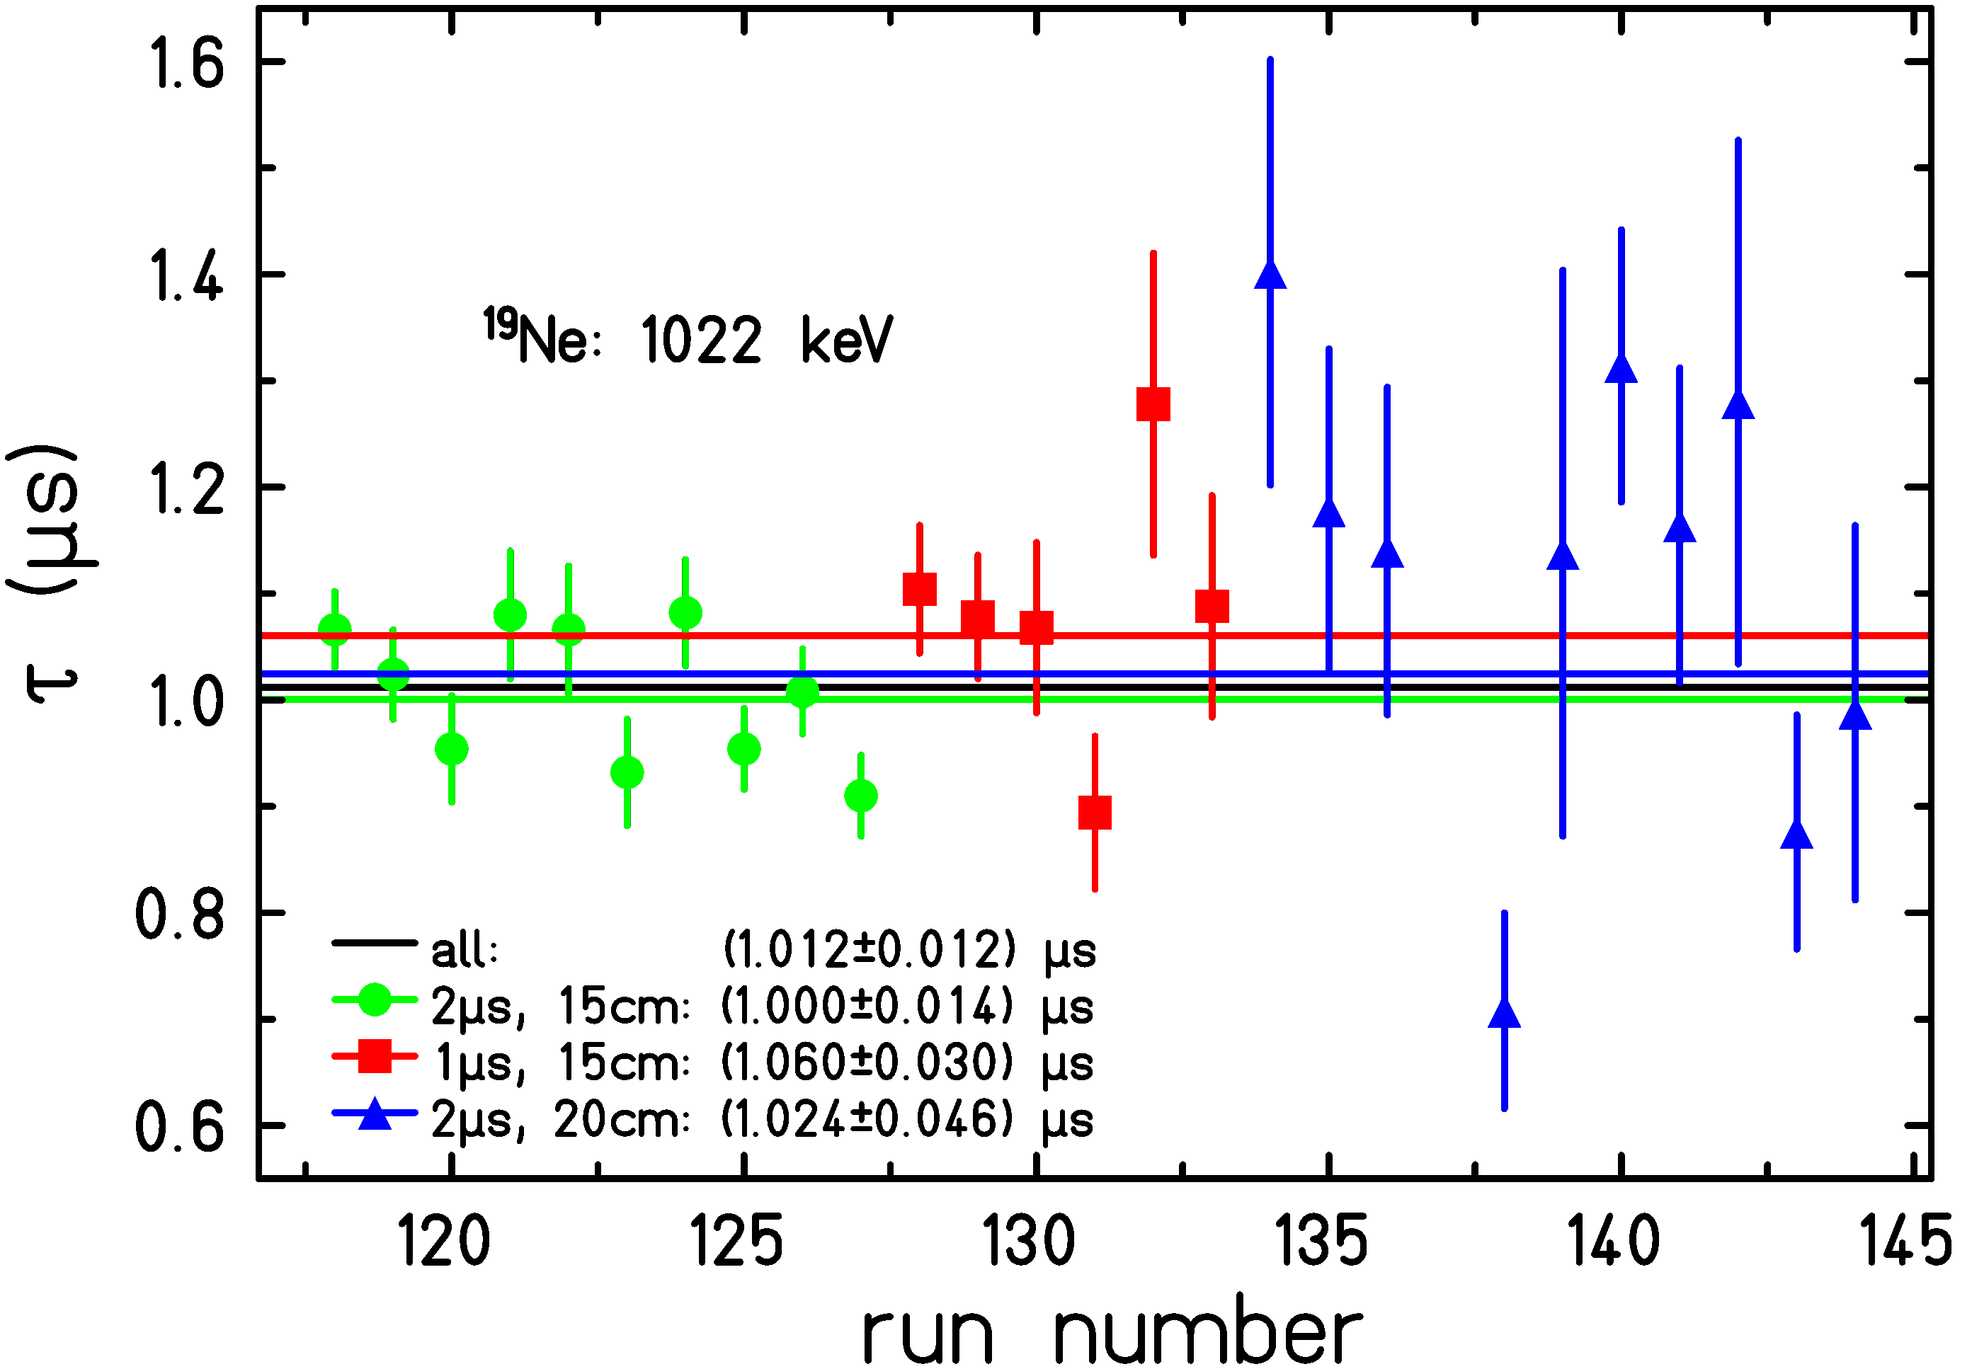
• • • ¹⁹Ne: pile-up of two 511 keV γ rays
Pile-up analysis: 511 keV ➔ 1022 keV
N₁₀₂₂ = N₅₁₁² * τ

Slide 12
• • • ¹⁰C analysis procedure
selection of runs: constant intensity over full run
determination of pile-up with ¹⁹Ne: N(1022) = N(511)² * τ
⎝ all parameters of pile-up peak (including intensity) fixed
beam time structure influences pile-up

Slide 13
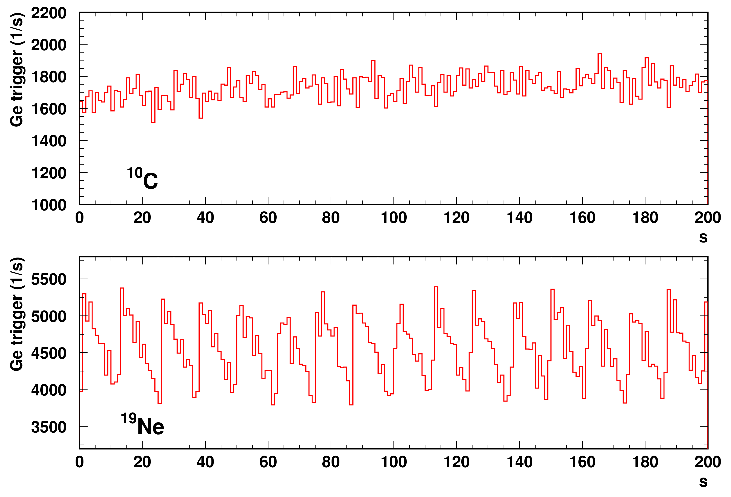
• • • ¹⁰C and ¹⁹Ne release
Release time
much longer
for ¹⁰C¹⁶0
Contaminants:
¹³N₂ (T_{1/2} = 10 min)
¹⁴O¹²C (T_{1/2} = 70 s)
➔ increase of rate
¹⁰C
Run = 94
¹⁹Ne
Run = 118
➔ use ¹⁹Ne to study pile-up conditions
use MC simulations for ¹⁹Ne and ¹⁰C to determine pile-up contribution

Slide 14
• • • ¹⁰C analysis procedure
selection of runs: constant intensity over full run
determination of pile-up with ¹⁹Ne: N(1022) = N(511)² * τ
⎝ all parameters of pile-up peak (including intensity) fixed
beam time structure influences pile-up
MC procedure to evaluate pile-up

Slide 15
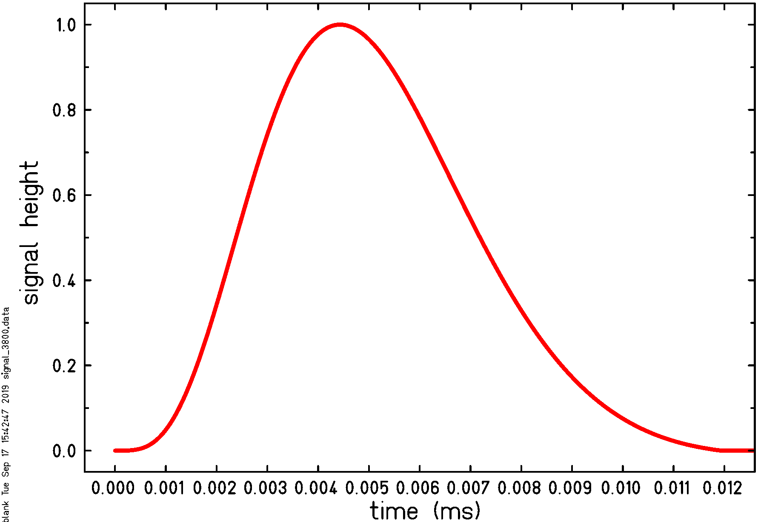
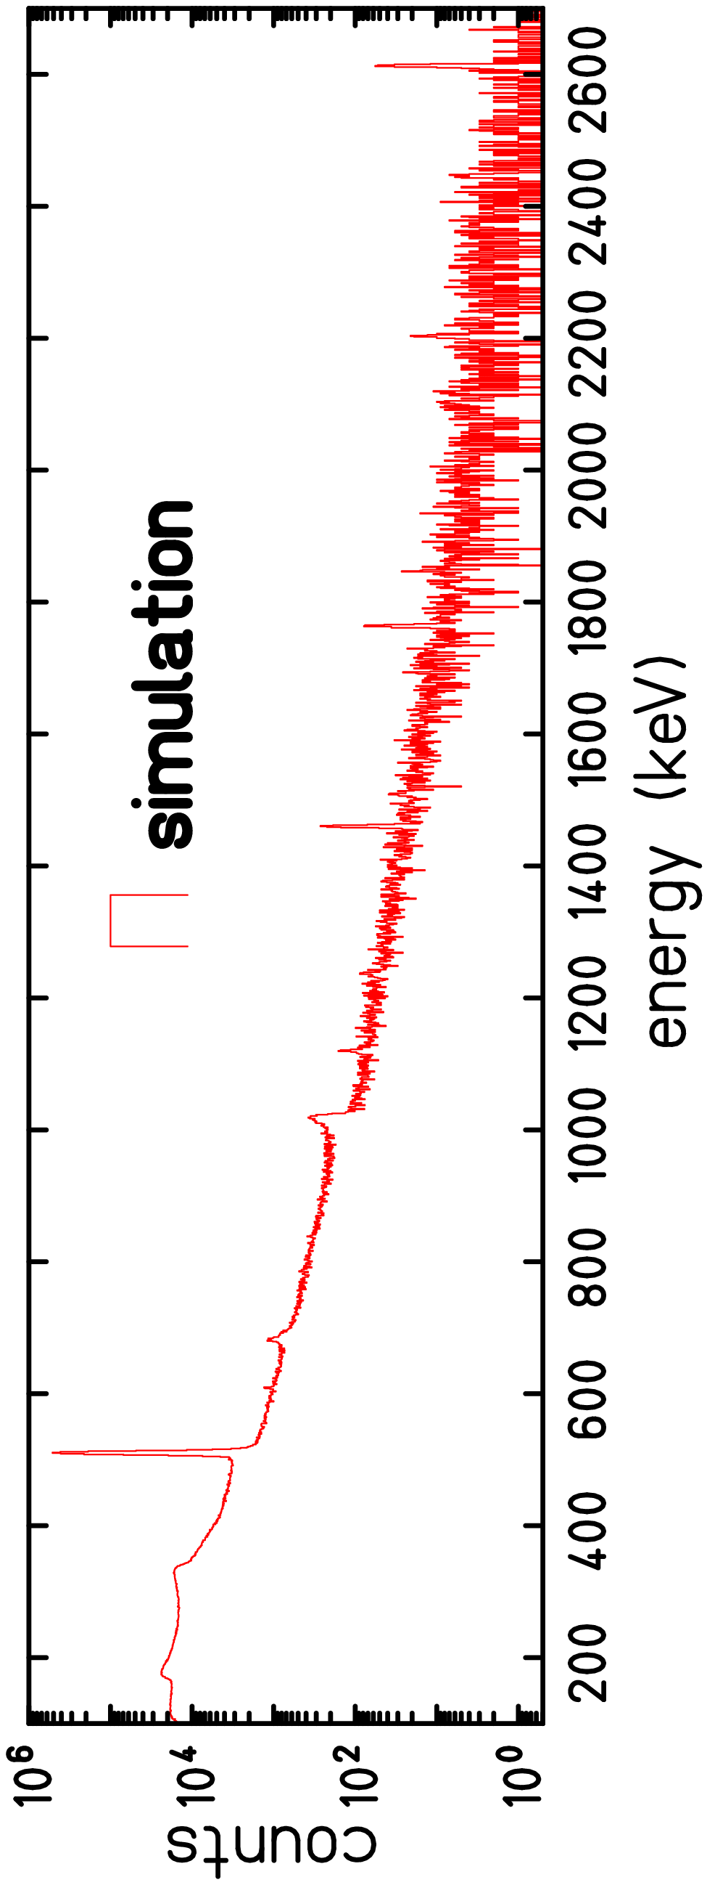
• • • ¹⁹Ne: MC simulation results
+ time
distribution
sim.
spectrum

Slide 16
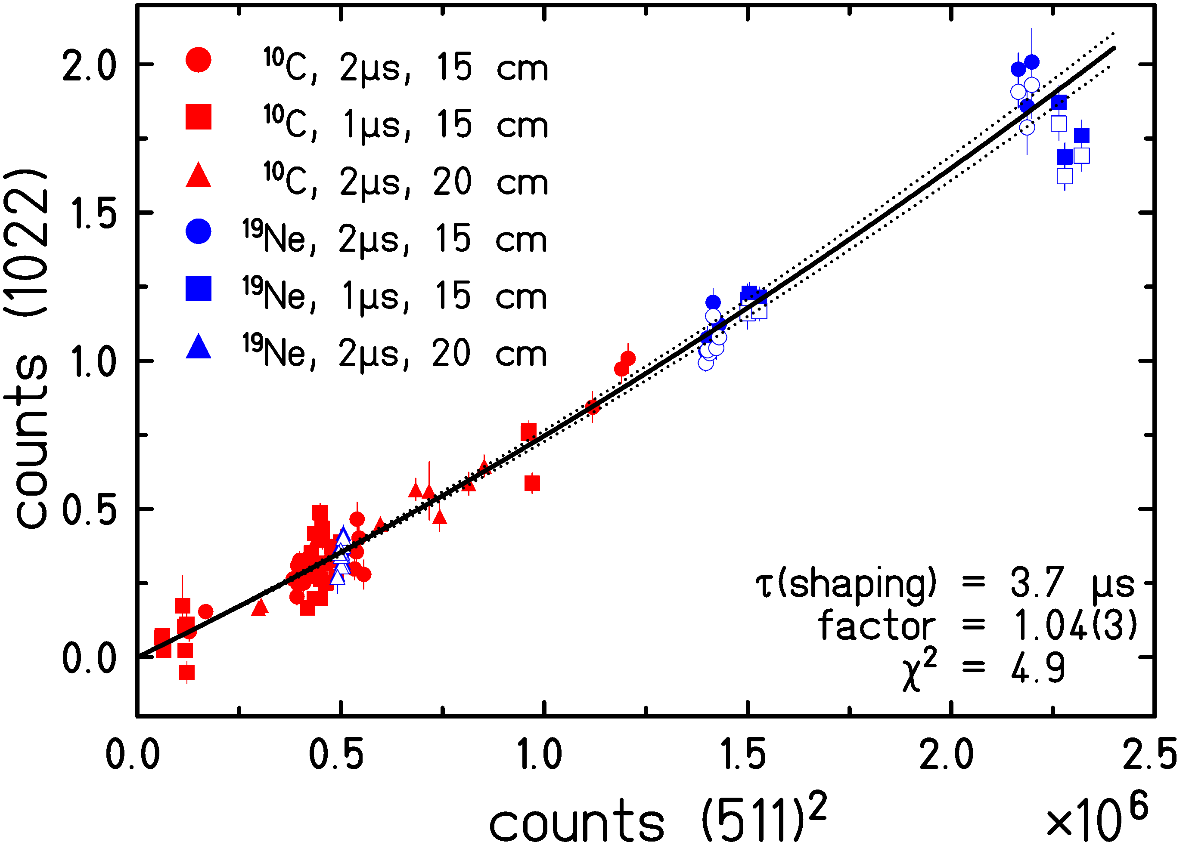
• • • ¹⁰C ^{/ 19}Ne simulation results
Pile-up simulations: 1022 keV counts versus 511 keV counts

Slide 17
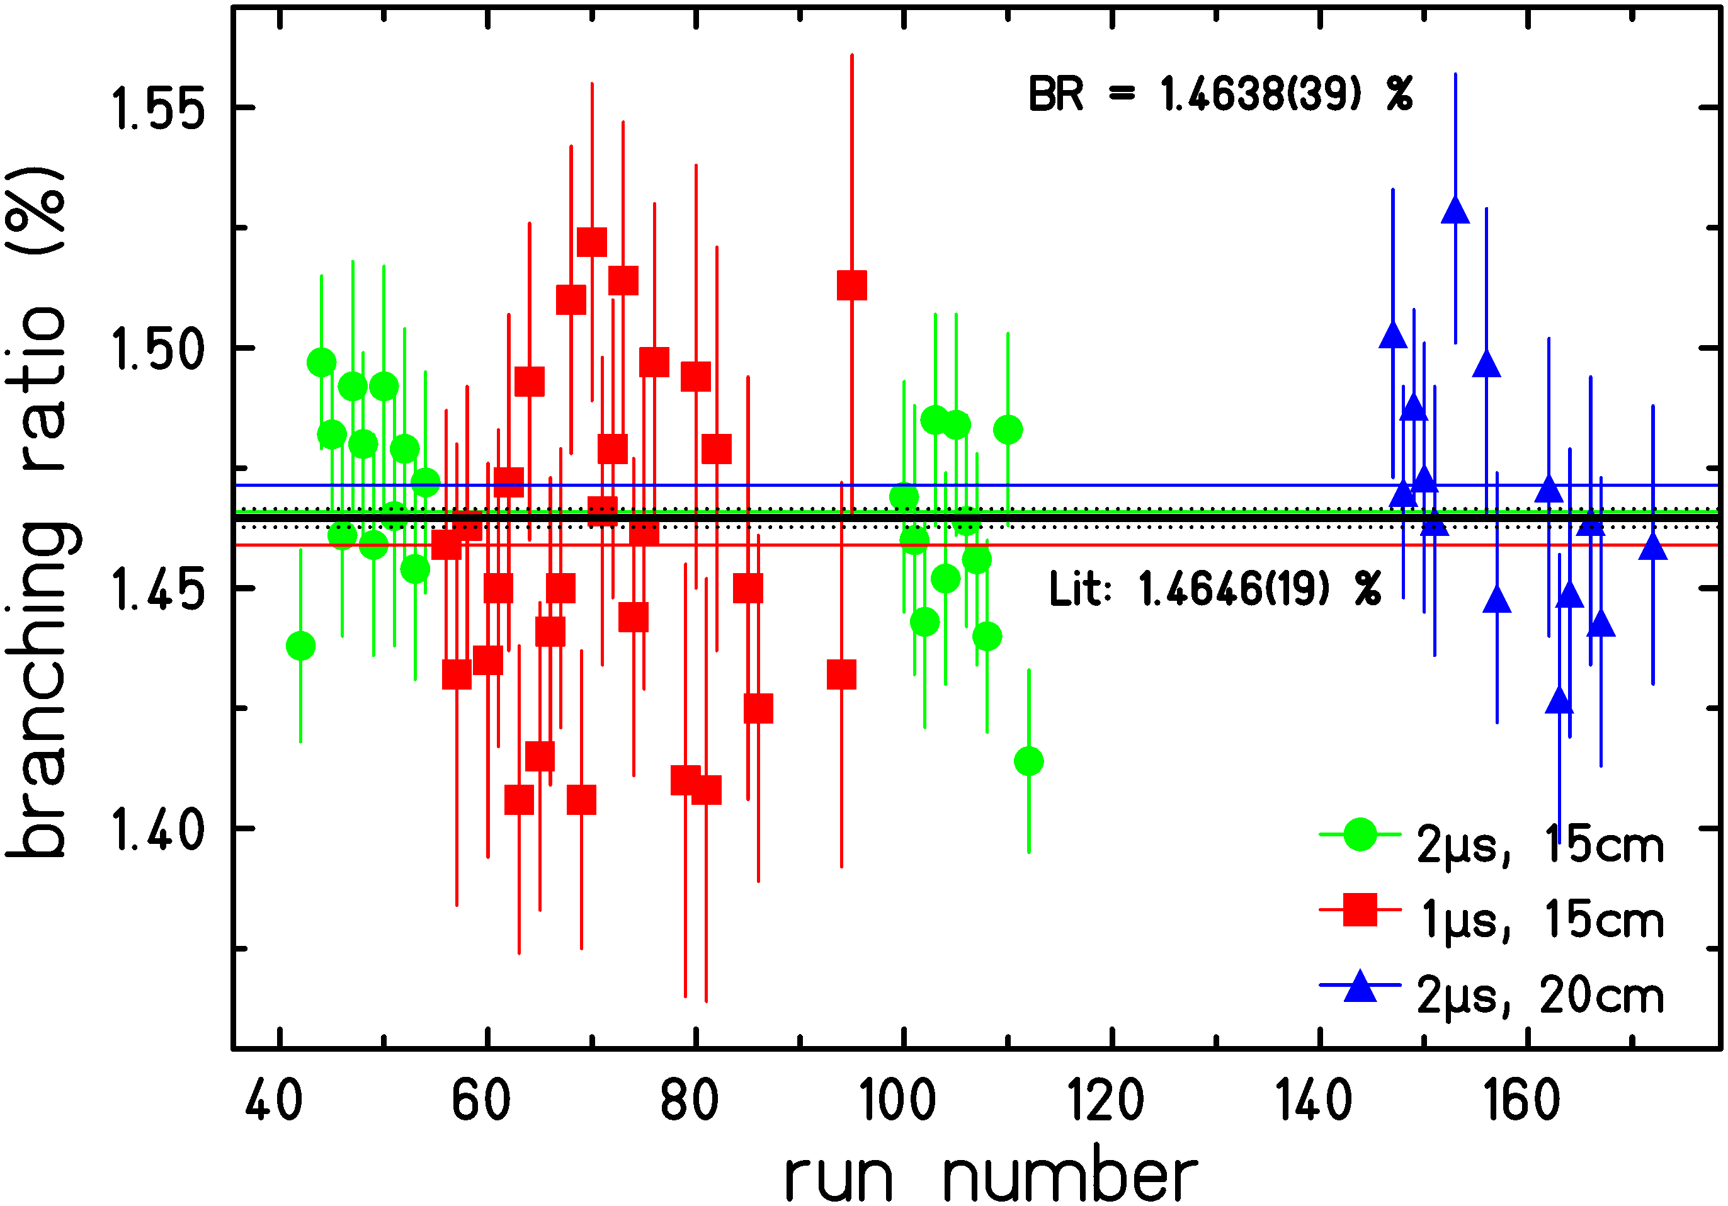
• • • Super-allowed ranching ratio of ¹⁰C
Final result: 1.4638(50) %; Savard: 1.4625(25)%; Fujikawa: 1.4665(38)%

Slide 18
• • • How to improve?
Error budget:
Statistics 0.0039 %
Efficiency simulations 0.0009 %
Pile-up correction 0.0030 %
-------------------------------------------------------------------
Total: 0.0050 %
more beam (time): ➔ we already had 2μA
but only 2-5 * 10⁴ pps of ¹⁰C
ISOLDE production rate:
➔ 7 * 10⁵ pps with CaO target
but we were limited by total γ rate
2/3 of 511 keV quanta from contaminants
➔ MR-ToF to separate ¹⁰CO and ¹³N¹³N

Slide 19
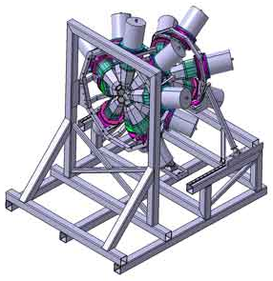
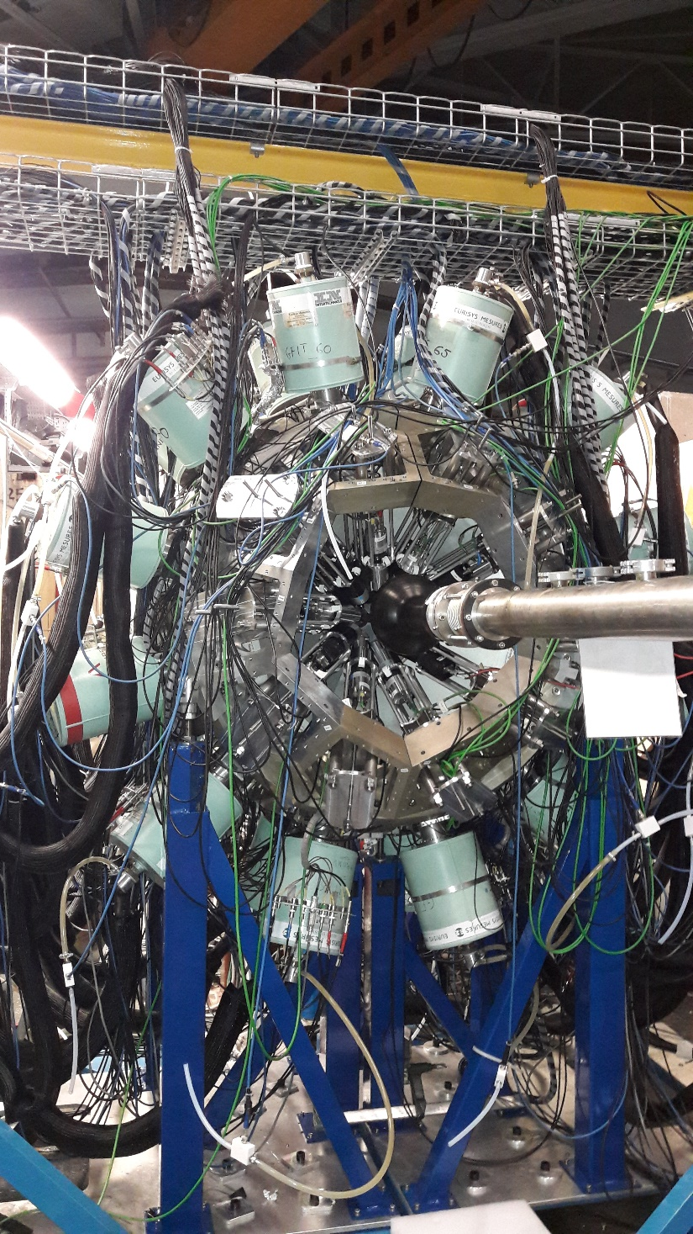
• • • Experimental set-up: Nu-ball at ALTO (2017-18)
24 Germanium clover detectors
10 Germanium coaxial detectors
10 LaBr₃ detectors
Results to come….

Slide 20
• • •
Thanks for
your attention

