Slide 1
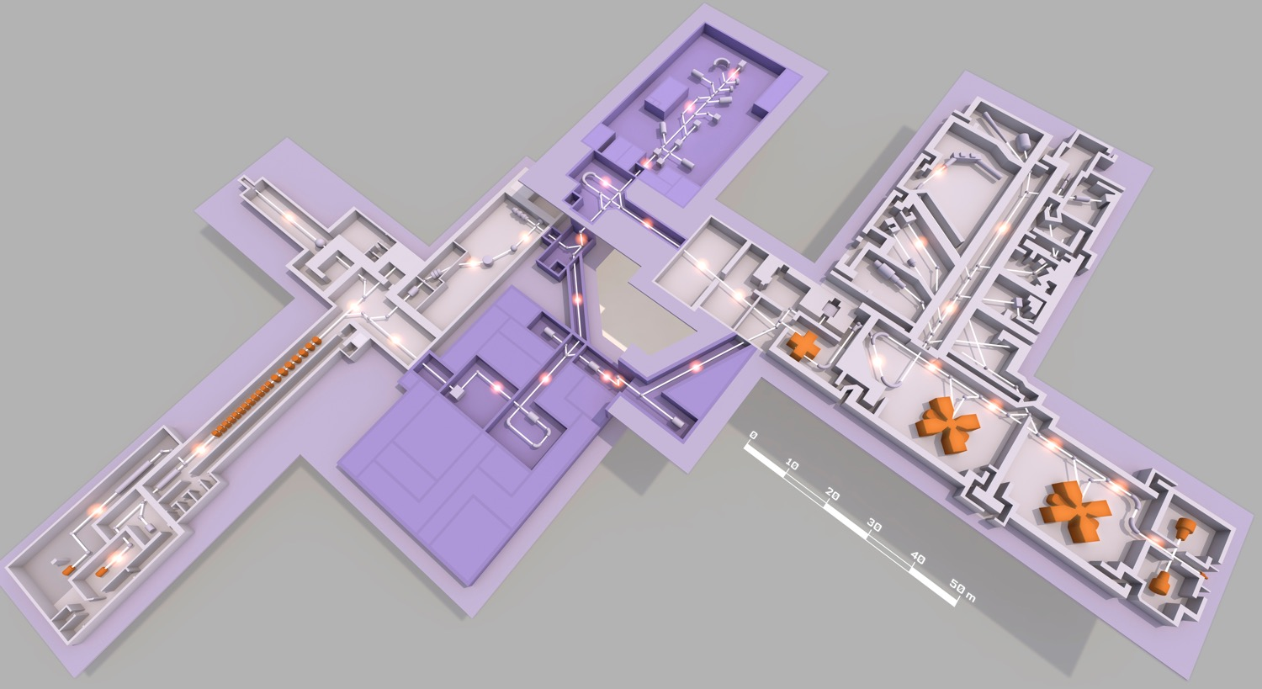
Super Separator Spectrometer
H. Savajols (GANIL)
DESIR
NFS
SC LINAC
Fundamental research in Nuclear & Atomic physics
High selectivity > 10¹³
High efficiency 50%
Mass resolution > 1/350
Versatility
Unique instrumentation (SIRIUS – LEB – FISIC)
1

Slide 2
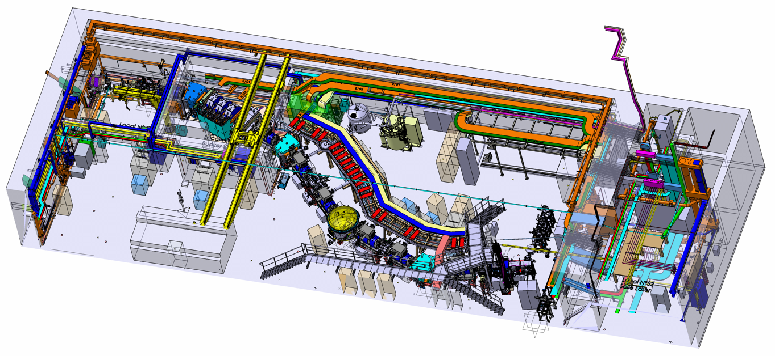
S³-Spectrometer
Target station
Beam Dump
Superconducting Multipole Triplets
and Power-Supply Systems (x7)
Cryogenics
Dipole 1
Dipole 2
Open RT Triplet
Electric Dipole
Dipoles 3
Level of completion
2

Slide 3
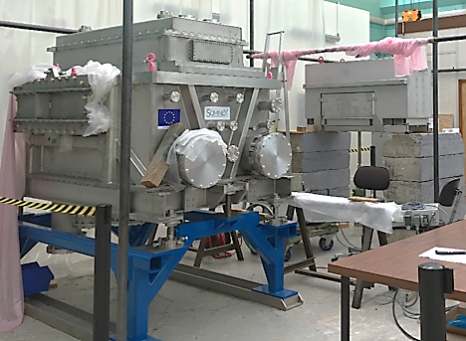
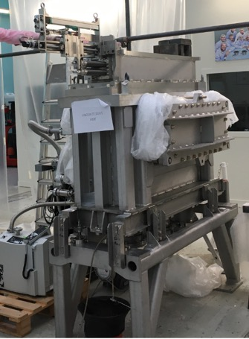
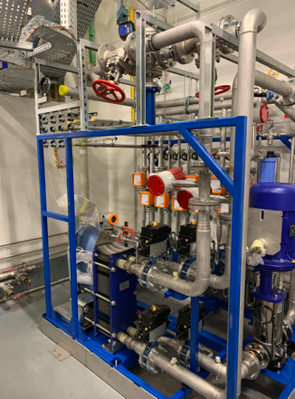
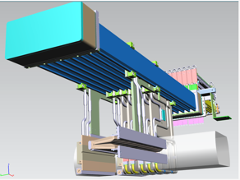
Beam dump
Downstream
Upstream
Cooling system
Cooling system completed
Upstream and downstream beam dump chamber completed
Next steps
Chambers installed on S³ line in Q1 2021 with vacuum tests
Translation mechanisms & 11 dump parts
(5 fingers, 4 shutters, 2 stationary plates) & shielding integration
planned in Q4 2021 at Irfu and Q1 2022 at GANIL
3

Slide 4
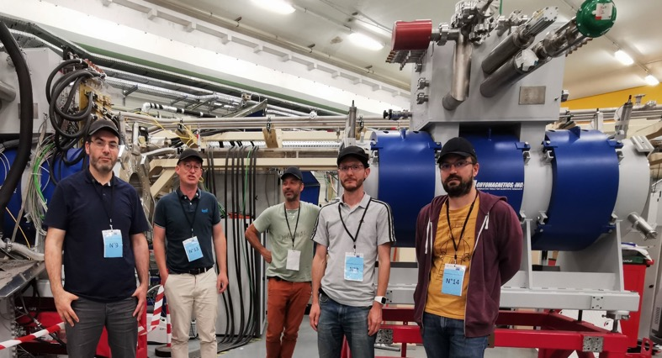
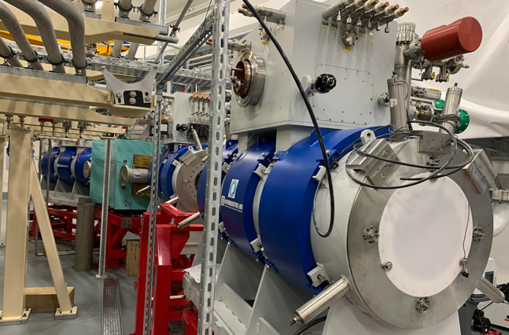
SMT's, PSS and Cryogenics
3 SMT tested end 2020
4 SMT installed in the cave end 2020
All 7 Power Supplies Systems (PSS) installed on the beam line
PSS commissioning (90% completed) to be finalized in 2021
Nest steps
Second cryogenic test station in Q1 2021
3D mapper ready in April 2021 for magnetic field measurement & alignment
All SMT delivery by end 2021
4

Slide 5
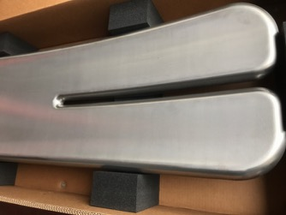
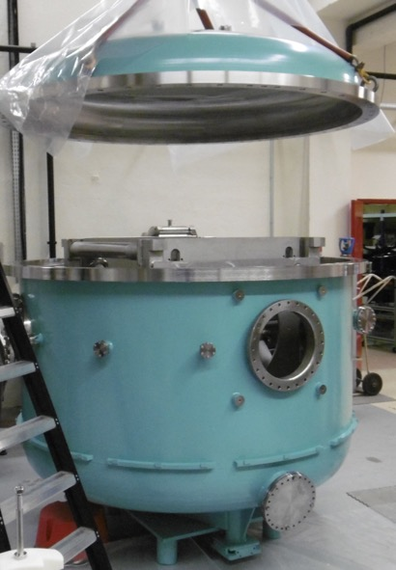
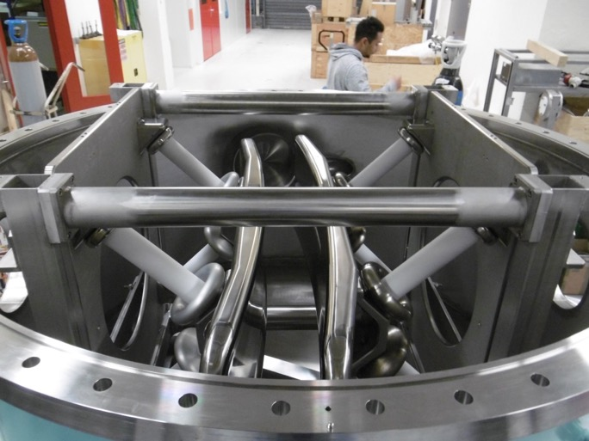
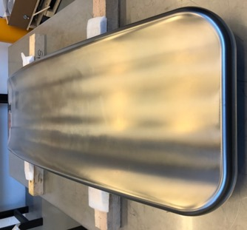
Electric dipole
Dipole horizontal gap 20 cm
Radius of curvature ρ = 4 m
Bend angle θ = 22 degrees
Vertical acceptance 25 cm
Chamber, Ti electrodes and all hardware completed at IJCLab
New strategy for the ED with industrial +/- 300 kV high voltage with no impact on the scientific program
E-Dipole on the spectro line Q2 2022
5

Slide 6
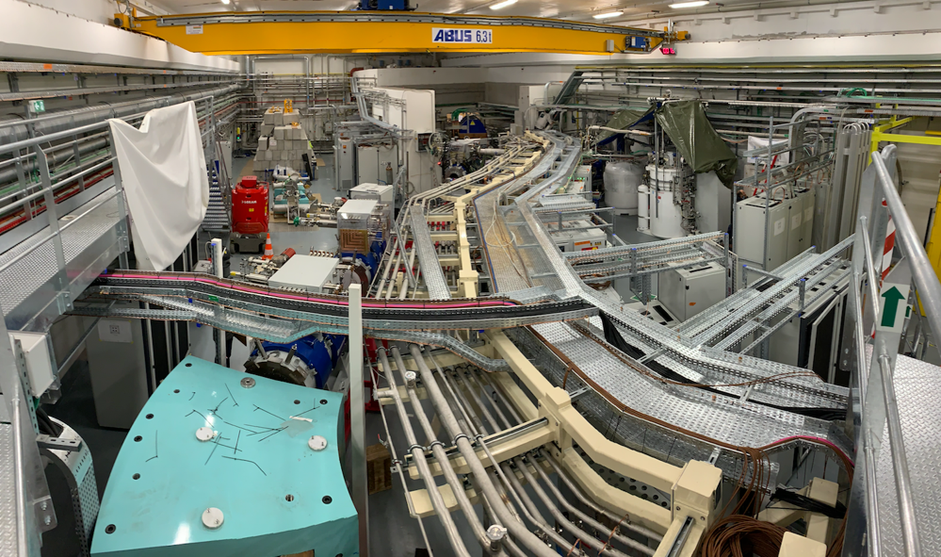
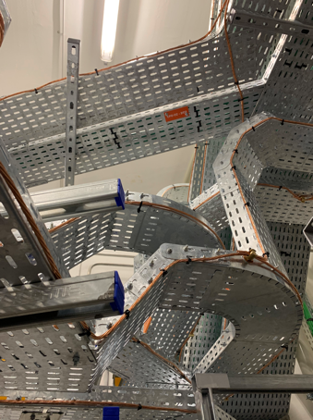
Installation & final tests
Installation and tests are progressing well
All cable trays and electrical panels installed, cable connections on cabinets and part of S³ ongoing (35 over 74km done)
Vacuum tests of first section done
Work in progress to optimize the planning :
Installation process to be adapted to minimize risk to work beyond 40m with the end of the exemption in 2023 without emergency exit
6

Slide 7
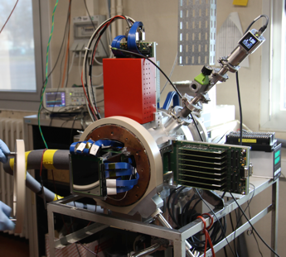
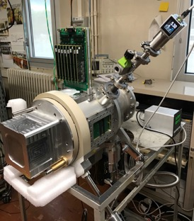
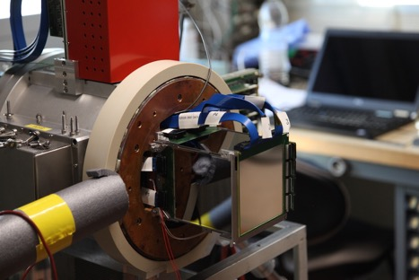
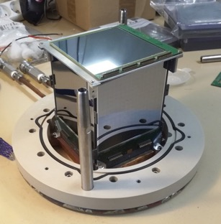
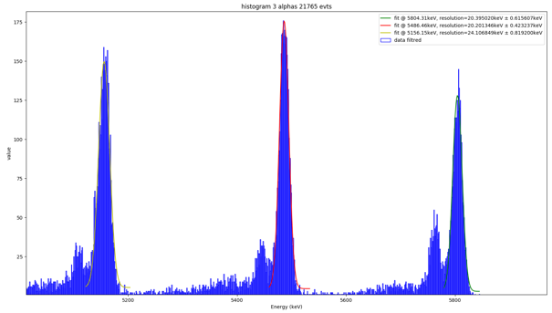
SIRIUS: highlights and next milestones
Zoé Favier talk
Resolution measurement of the detector installed in the SIRIUS chamber with the final electronics and the complete acquisition system (V6 SIRIUS + V5 and NARVAL acquisition from GANIL).
Resolution obtained (20.5 keV) meet the specifications
Next steps :
Test of all electronics channels at Irfu Q1 2021
Reception of all the part of SIRIUS at GANIL (Q2 2021). Source commissioning and in-beam tests in a realistic implantation-decay experiment ➔ ¹⁷⁴Yb(⁴⁰Ar,4-5n)²⁰⁹⁻²¹⁰Ra
7

Slide 8
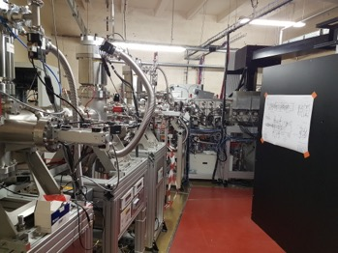
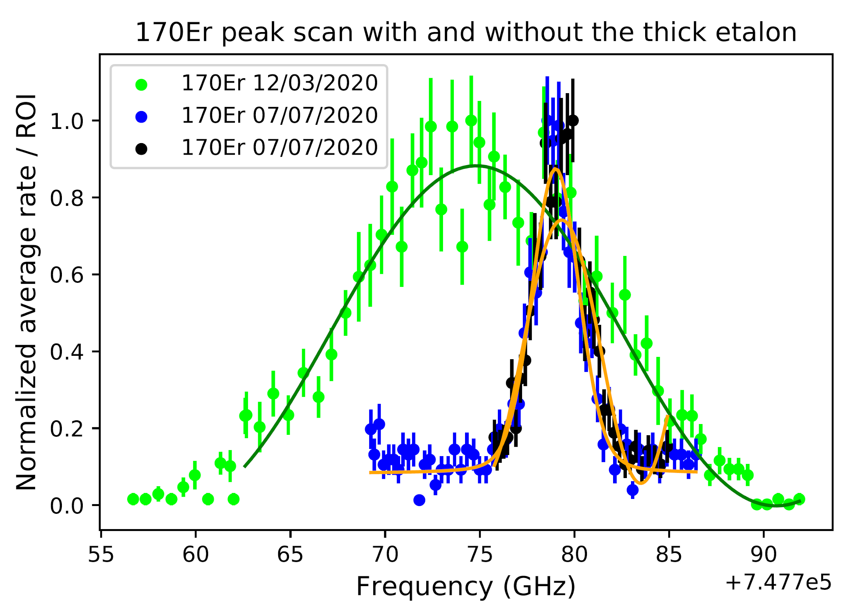
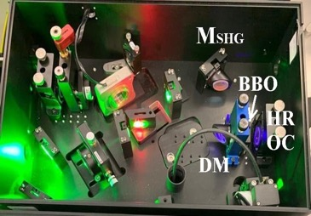
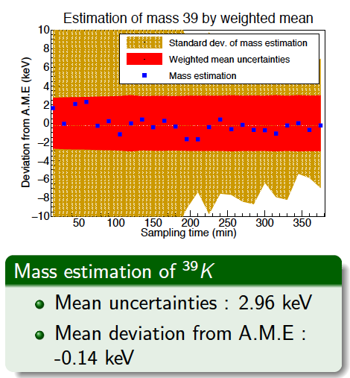
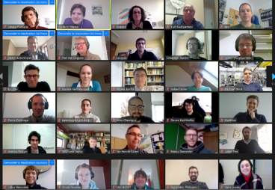
LEB : highlights and next milestones
Jekabs Romans talk
LEB@LPC
Er spectra @ GISELE
NB CW TiSa
PILGRIM
Worshop
S³LEB commissioning @ LPC: RFQ series transmission tests done in 2020
Laser spectroscopy of Er with GISELE: Spectral resolution improved (5 GHz -> 1,5 GHz)
Narrow bandwidth cw TiSa developments with a new collaboration (Nagoya University–Mainz University)
New PhD Student within LISA network (Marie Curie Initiative Training Network): Anjali Ajayakumar
PILGRIM (MR-Tof-MS) precision improved (δm/m ≈ 10⁻⁷)
Laser room : call for tender launched (Nov 2020)
S³Leb Technical Workshop (72 participants) in December 2020
Next steps:
Development of narrow bandwidth laser system and test at GISELE : end Q3 2021
Development of efficient ionisation scheme for day one experiment
Test in gas cell @ LPC with Er : Q2 2021
Test in gas jet high resolution @ LPC with Er : Q4 2021
8

Slide 9
Conclusion
Development of the S³ project is progressing well
Spectrometer : ready for beam commissioning mid 2023
SIRIUS : tests of all the system planned in 2021 at GANIL
LEB : In jet laser spectroscopy of Er planned end 2021 at LPC
New strategy for the ED with industrial +/- 300 kV high voltage with no
impact on the scientific program
New strategy for FISIC : first installation at CRYING/FAIR
Scientific co-organization between S³ and DESIR :
working document prepared by collaboration representatives 29/01/2021
Common scientific steering committee 23/02/2021
Scientific program and campaigns setting
3 months day1 campaign selected for each set-up (SIRIUS & LEB) in 2018 and presented to the GANIL SC in 2019
Choice for the first set-up to be done beginning 2022
9
Notes:
Question to the management/evaluation commitee :need for an official channel to submit proposals/LoIs – a clear time plan for the management

