Slide 1
Status of DESIR
ISOL France Meeting
March 18 2021
J.-C. Thomas, on behalf of the DESIR collaboration and project management
DESIR : Desintegration, Excitation and Storage of Radioactive Ions - EQUIPEX (2012-2022)

Slide 2
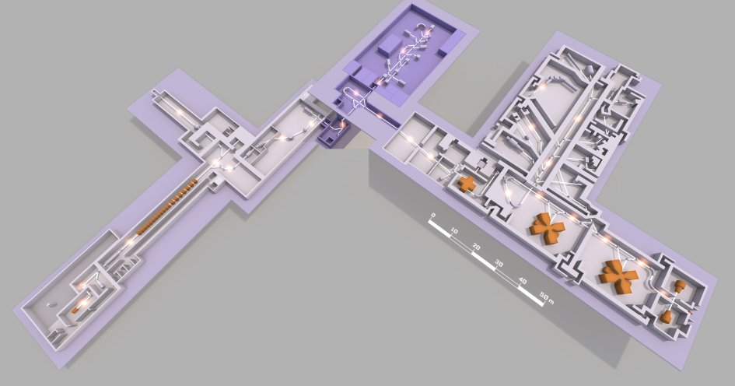
Facility layout
A new facility dedicated to high-precision studies with very low-energy RIBs (2026)
DESIR
Fusion-evaporation / DIT
Refractory elements
→ S³-LEB
ESR/EquipEx+
NEWGAIN
Fragmentation
→ SPIRAL1
ARTELIA
Expected 1+ RIB intensities: https://u.ganil-spiral2.eu/chartbeams/

Slide 3
1 – DESIR Scientific program
2 – Status of the SPIRAL2-DESIR project
3 – Planning

Slide 4
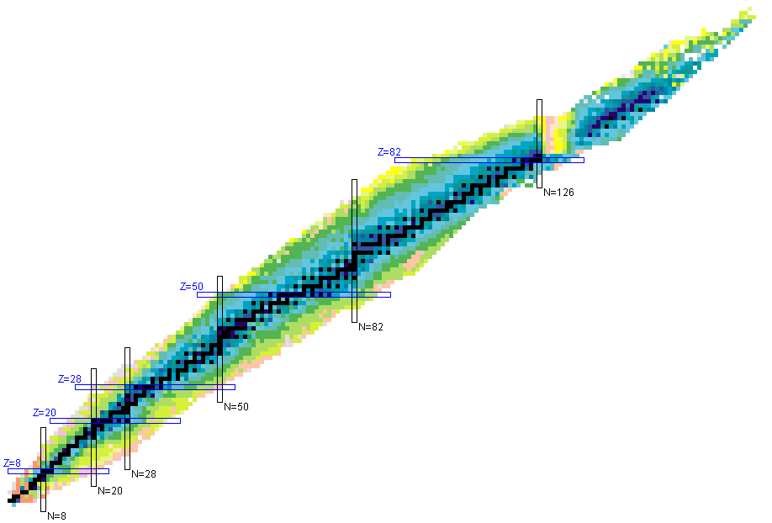
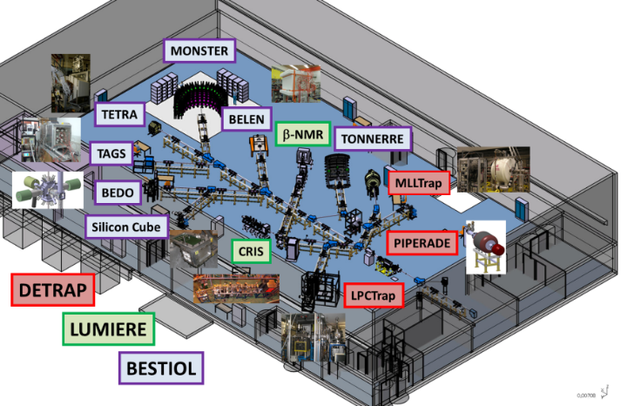
DESIR Scientific program
High precision nuclear physics studies with high quality low-energy RIBs
-> nuclear structure, exotic decay modes, fundamental interactions
-> interdisciplinary research?
User facility: DESIR Collaboration Council - GANISOL - ISOL France
Physics program (LoIs) driven by RIBs expected from SPIRAL1 and S³-LEB
-> Talks by O. Bajeat and V. Bosquet (SPIRAL1 dev.)
-> by J. Romans (S³-LEB commissioning)
-> by V. Manea, S. Grevy (fast gas cells for S³-LEB)
S³-LEB
VHE-SHE
n-deficient
N~Z
SPIRAL1
medium mass nuclei

Slide 5
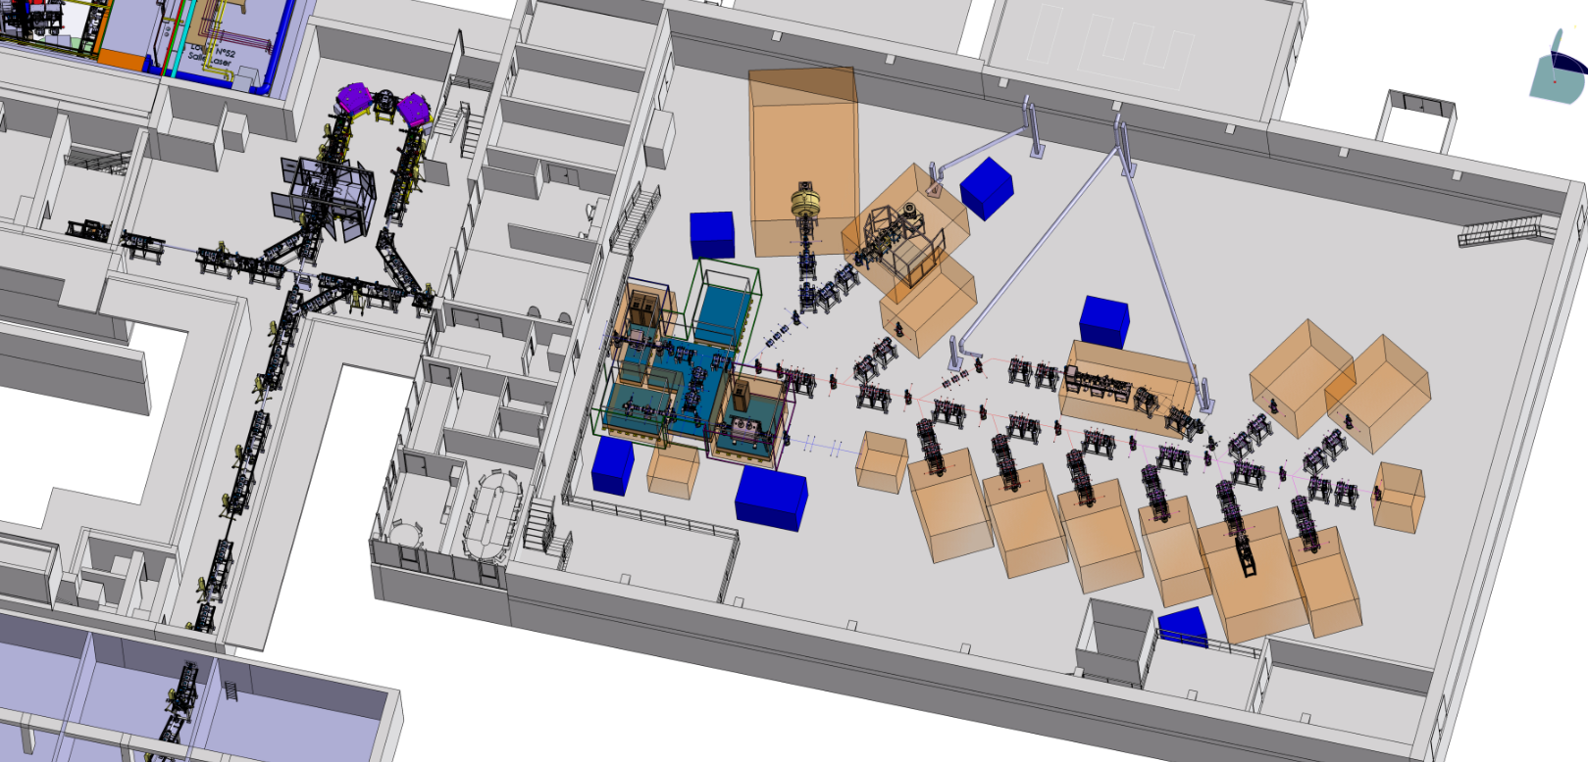
DESIR Physics program
Physics program performed with high-precision measurements using ultra-pure samples of (trapped-) ions
Ion trapping
DETRAP
Precise mass measurements
In-trap decay spectroscopy
β-ν angular correlations
S³-LEB
Collinear laser spectroscopy
Laser polarization (decay spectroscopy, β-NMR, …)
Laser
Spectroscopy
LUMIERE
Decay
Spectroscopy
BESTIOL
Beam purification
and preparation
(Cooling/Bunching/Trapping)
β-delayed charge part.
Full absorption spectroscopy
(Trap/Laser-assisted) decay spectroscopy
SPIRAL1

Slide 6
DESIR Physics program
Beam purification and preparation
-> talks by J. Michaud (HRS) and A. Husson (GPIB + PIPERADE), CENBG
LUMIERE
Workshop held in Nov. 2019 at CSNSM
-> physics cases addressed by collinear laser spectroscopy
-> LINO developments
-> DESIR laser room(s) technical specifications, L. Maunoury, GANIL
DETRAP
Workshop held in June 2020
-> MLLTrap (see talk by E. Morin), MORA (talk by N. Goyal), LPCTrap (talk by R. Combe) and WISArD (talk by M. Pomorski)
BESTIOL
Workshop scheduled in Oct. 2020 - postponed to 2022 (?)
Notes:
Elodie
Victoria
Federica
Marcin

Slide 7
DESIR Physics program
Collaboration Management
Synergies with S³
First joint S3-DESIR Steering Committee meeting in Feb. 2021
-> towards a common collaborative structure “GANILSOL”
– talk by H. Savajols, GANIL (Friday afternoon session)
Synergies with ALTO
Complementary: n-rich nuclei produced by photofission
LINO and MLLTrap expected to move to DESIR “at some point”
Future: possible evolution of ALTO towards a “National platform”
-> What does it change for LUMIERE and DETRAP at DESIR?

Slide 8
1 – DESIR Scientific program
2 – Status of the SPIRAL2-DESIR project
3 – Planning

Slide 9
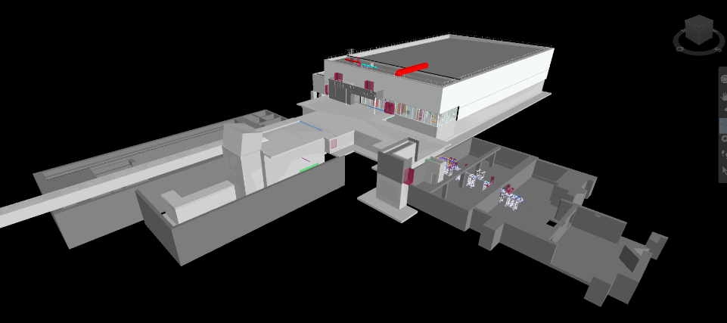
Status of the project : Building
DESIR HALL
S3
SPIRAL
LIRAT
Building study and construction: current planning
Tender Call
ESQ
SDB
APS
APD
PRO
DCE
ACT
EXE
SYN
DET
AOR
2017
2018
2019
2020
2021
2022
2023
2024
Design studies
Contracts
Construction

Slide 10
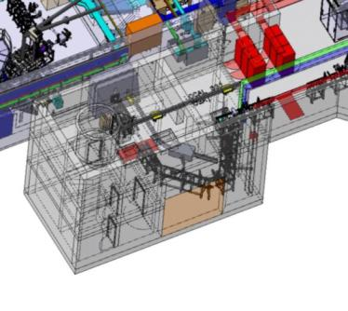
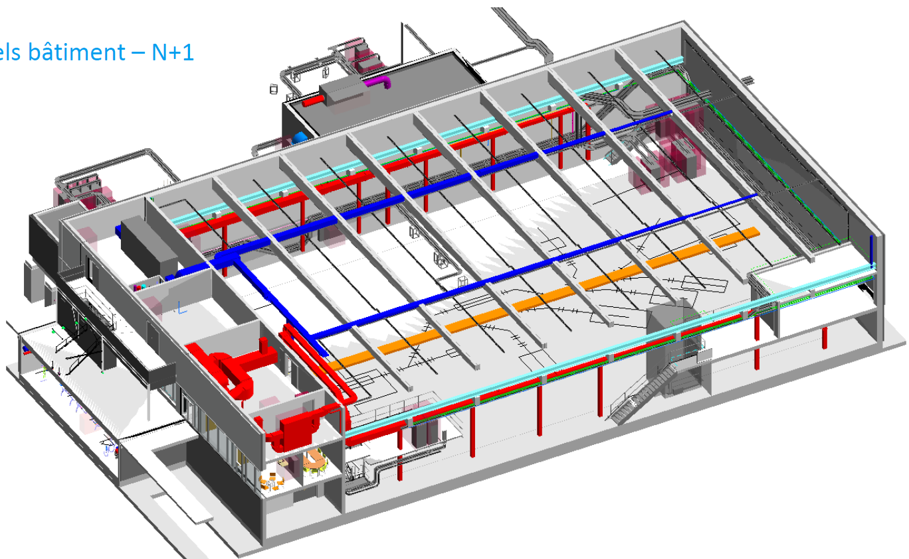
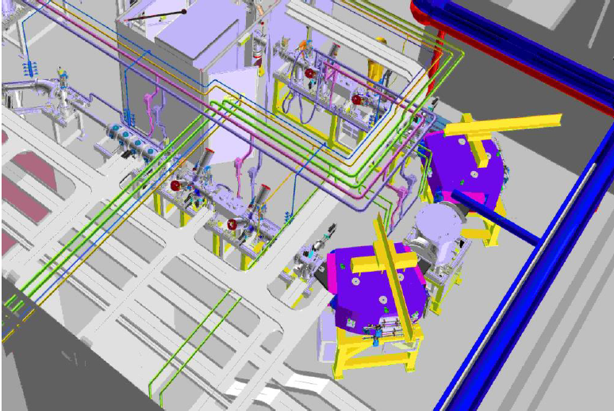
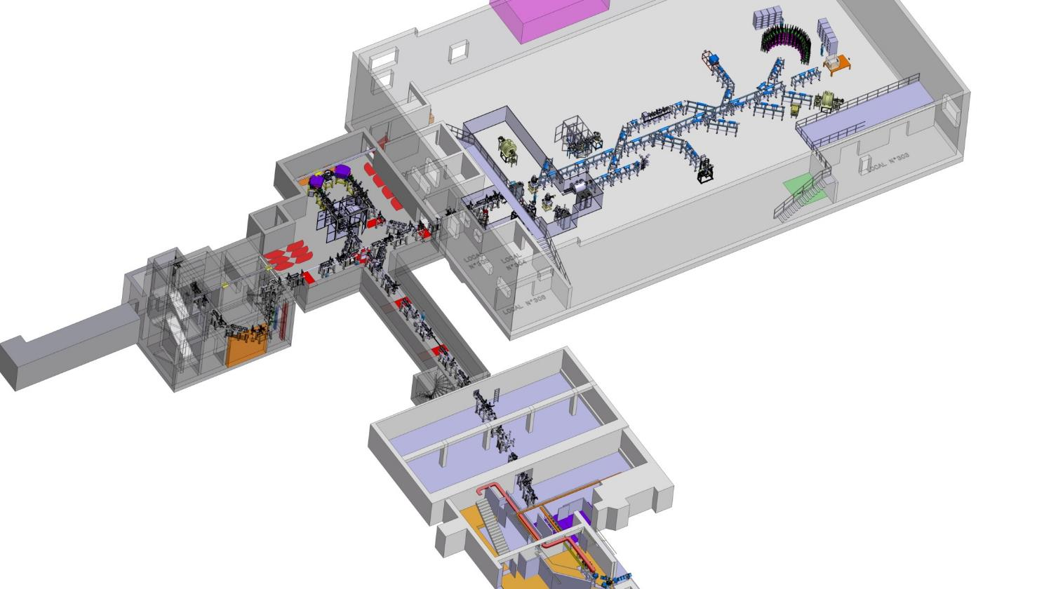
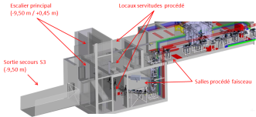
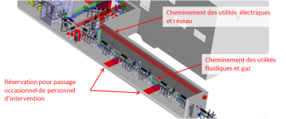
Process integration
HRS Zone
-3.5 m
Experimental Hall
S3 -> DESIR transfer line
-3.5 m
SPIRAL1 -> DESIR transfer line
-9 m
S3/SPIRAL1 -> DESIR transfer line

Slide 11
Beam line process
Transfer beam lines towards the experimental hall
Almost all equipment delivered
-> First section to be implemented at GANIL (SPIRAL -> DESIR junction)
and CENBG: C/C and equipment tests
HRS commissioning at CENBG: 2nd order characterization – Talk by J. Michaud, CENBG
Experimental Hall beam lines and beam preparation
Detailed optical studies: from the beam preparation zone (GPIB+PIPERADE) to the DETRAP Zone (MLLTrap + MORA/LPCTrap2) and up to the LINO area – L. Perrot, IJCLab
-> Beam lines layout fixed
-> Ongoing integration studies (equipment supplies)
Preliminary schematics of the HV area (GPIB+PIPERADE) – L. Maunoury, C. Michel, GANIL
Ongoing Cooling/Bunching/Trapping tests with GPIB+PIPERADE – Talk by A. Husson, CENBG
Experimental setups integration in the DESIR Hall and beam requirements
-> GANIL contact person: L. Maunoury, GANIL
-> Equipment installation/commissioning: 2024/2025

Slide 12
1 – DESIR experimental hall
2 – Status of the project
3 – Planning

Slide 13
Master planning
Construction (+12 m) and Licensing (+24 m)
Infrastructure
-> Study phase 2021, March. (+4m)
-> Construction phase 2022 Jul. - 2024, Feb. (+12m)
-> Reception phase 2024 March - 2025 Feb.
-> Equipment installation: 2024 (+12m)
Safety licensing
-> DAM deposit 2020, Dec (+13m)
-> Administrative building autho. 2022, Aug. (+11m)
-> DMES deposit 2023, June (+8m)
-> Operating authorization decree 2026 (+24m)
-> Commissioning (stable beams): 2025
-> First experience with RIBs: 2026
=> Project objectives:
- do our best to shorten the safety licensing procedure
- secure the budget (EQUIPEX prolongation) and construct the building asap

Slide 14
Thanks for your attention

