Slide 1
Olivier BAJEAT
Development of new fragmentation targets for the SPIRAL1 upgrade
and proposed release time measurement at LISE
1
ISOL-France meeting. 17-19 march 2021 – O. Bajeat

Slide 2
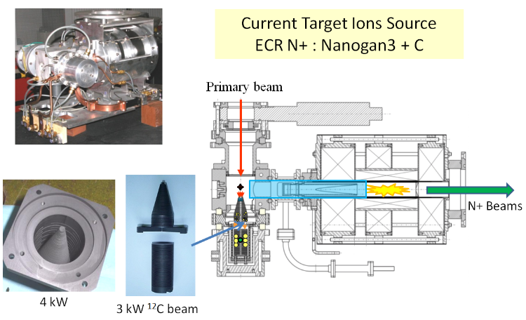
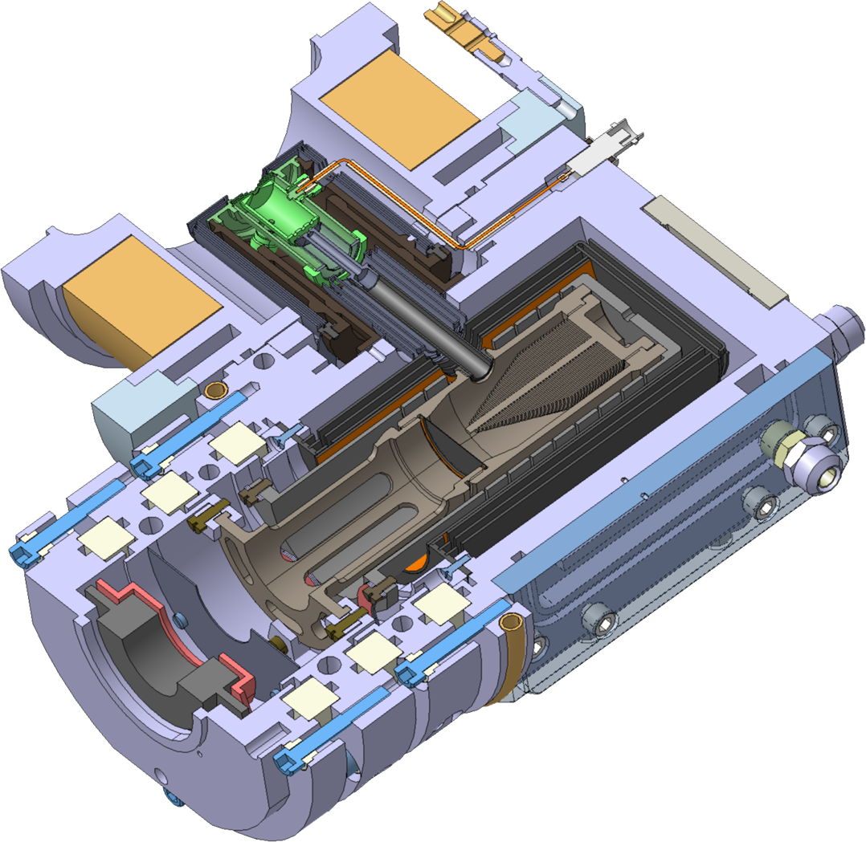
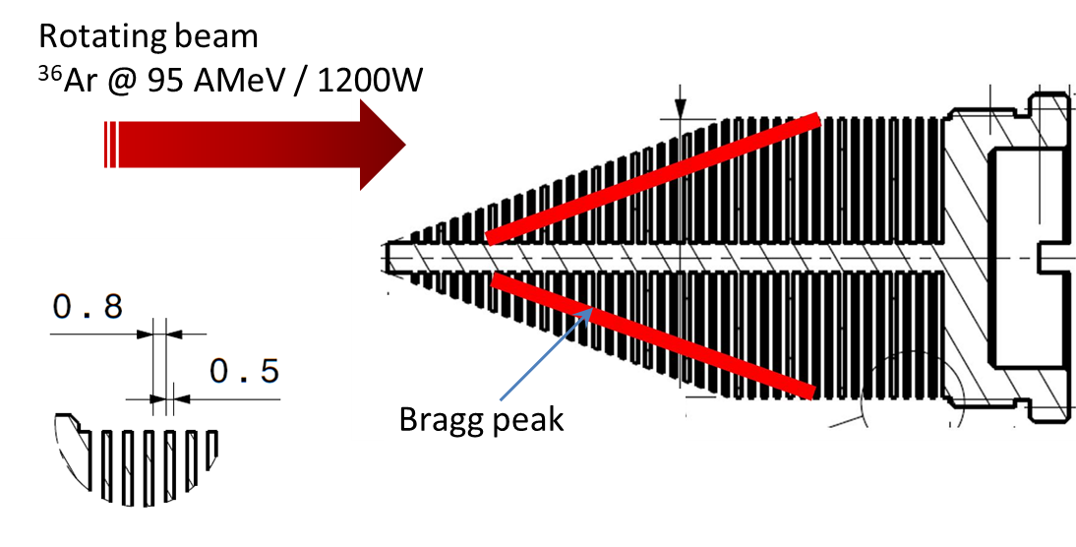
The current targets in Carbon for projectile fragmentation
Current Febiad TISS with C Target
Ar, Ne, O… primary beams
Kr, Ni, Ca… primary beams
Several version of targets made in POCO graphite ZXF-5Q1 (grain size 1 µm)
2
ISOL-France meeting. 17-19 march 2021 – O. Bajeat

Slide 3
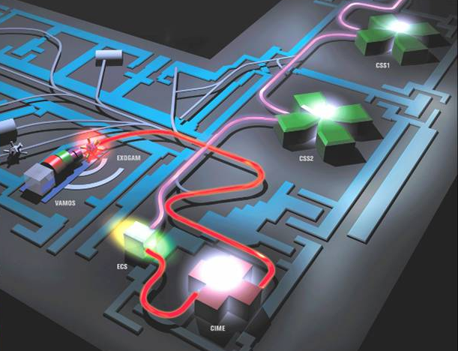
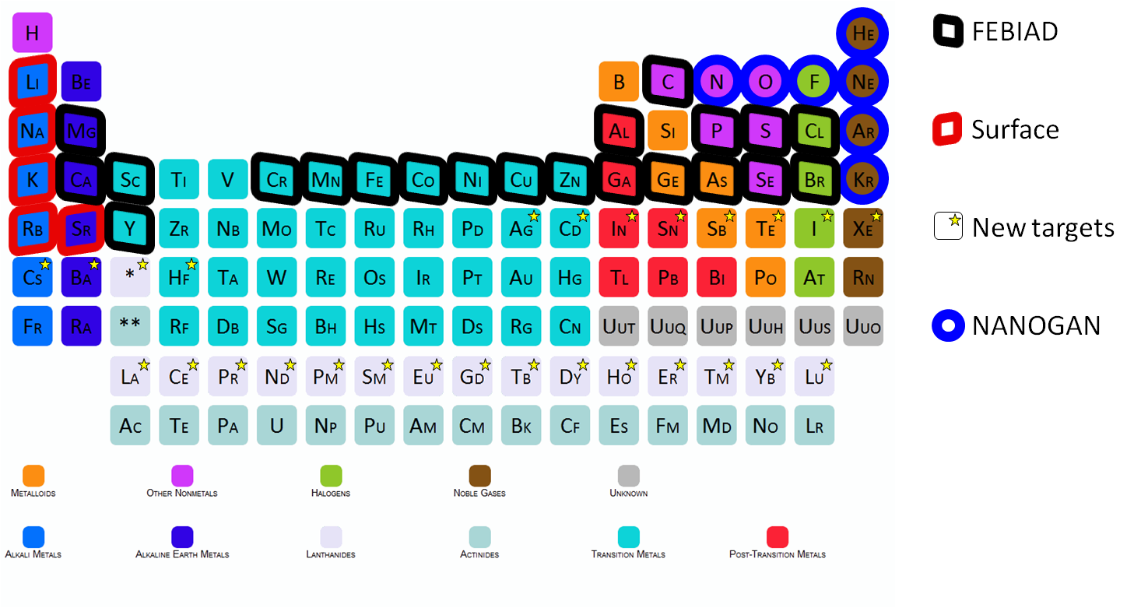
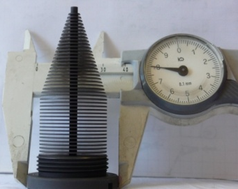







SPIRAL 1 Upgrade
New beams from the SPIRAL 1 upgrade
Operation of new targets with other material than ¹²C is allowed since 2018 for Z ≤ 41 (up to Niobium)
Expected yields for targets such as SiC, CaO, NiO and Nb, with ¹²C, 95 AMeV 2∙10¹³ pps as primary beam were investigated on the basis of approximate release efficiencies or parametrizations [1]
 | In target production Nb target (C Beam 3600W) [1] | Estimation 1+ beam intensities [1] | Yield at Isolde ion/µC [2]
⁶⁰Zn | 1.4E7 | 7.9E5 | 2.1E5
⁶³Ga | 9.7E7 | 3.5E6 | 1,2E6
⁶⁶Ge | 4.6E8 | 2.9E7 | 3,6E5
⁶⁷As | 4.5E7 | 1.5E5
⁶⁸Se | 2.0E6 | 7.4E3
⁷¹Br | 2,1E7 | 1.2E6 | 7,5E4
⁷⁴Kr | 1.3E8 | 8.4E6 | 6.3E6
[1]: P. Delahaye. List of RIB intensities. GANIL Internal report.
[2]: http://isoyields-classic.web.cern.ch/
explorated
Measured, X2 possible
3
ISOL-France meeting. 17-19 march 2021 – O. Bajeat

Slide 4
Beam requests
Many experiments with reaccelerated beams would benefit from the development of a A~90 target
RIBs discussed during a workshop held in Feb. 2016 with Nb (A=93) target
rp process studies with ⁶⁰⁻⁶⁴Zn using ACTAR TPC (G.F. Grinyer et al.)
Shape coexistence with ⁷²Kr and ⁷⁴Rb using lifetime measurements and Coulomb excitation (N. Singh et al.)
Deformation studies with ⁶⁷As and ⁶³Ga using transfer reaction with MUGAST and AGATA (D. Mengoni et al.)
Cluster formation from fusion reaction with ⁷⁴Kr using AGATA and SPIDER (E. Bonnet et al.)
LoIs for MUGAST from 2016 to 2019
⁷¹Br, ⁷⁴Kr, ⁶⁶Ge, ⁷⁴⁻⁷⁶Ge, ⁷⁸Sr, ⁷⁹Se for nuclear structure and astrophysics from transfer reactions (Beaumel et al., Assié et al., Mengoni et al., de Angelis et al. …)
4
ISOL-France meeting. 17-19 march 2021 – O. Bajeat

Slide 5
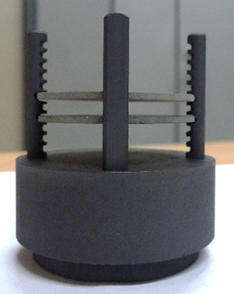
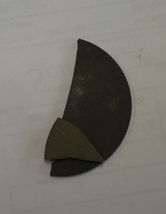
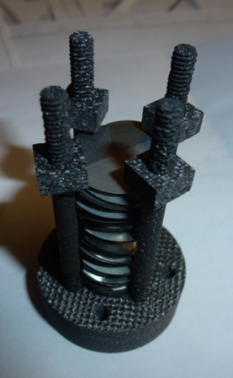
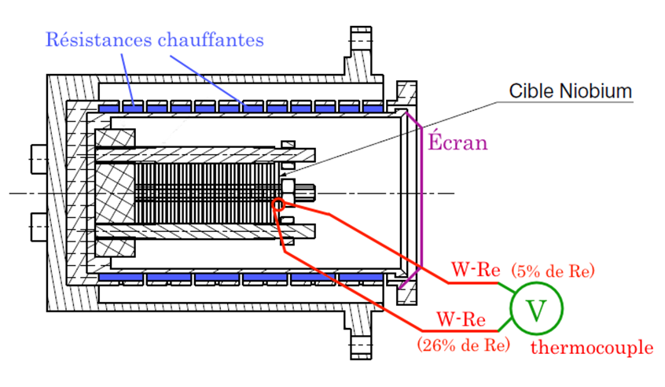
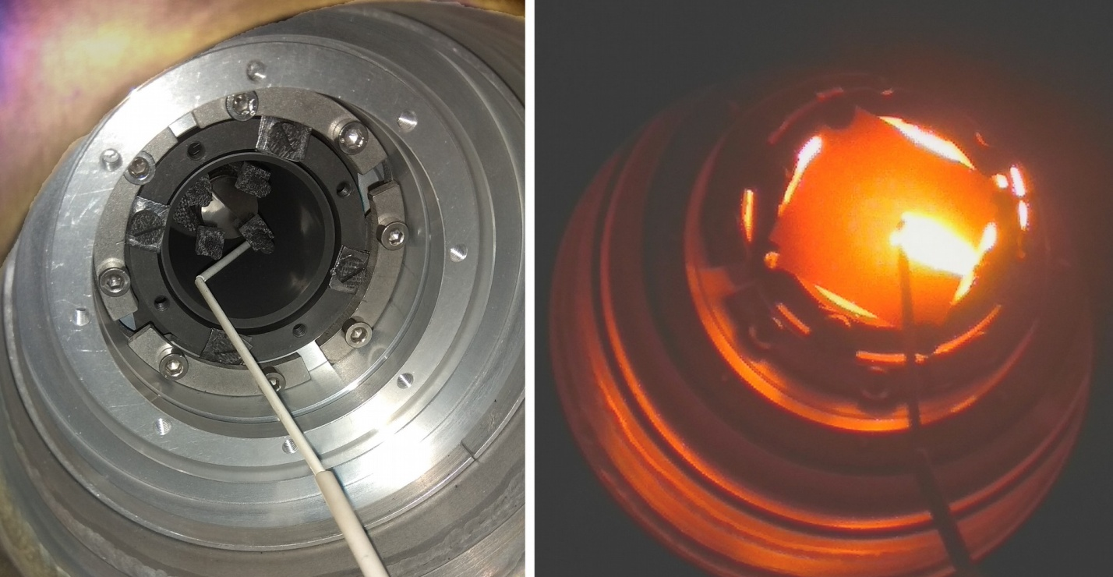
Investigation on SiC and Nb targets
Numerous targets could be considered for the Spiral1 upgrade:
  Metallic foils: Nb, Zr
  Porous ceramics : Al₂O₃, ZrO₂, ZrC, Y₂O₃…
  Coating or infiltration deposited onto a reticulated-vitreous-carbon-foam (RVCF)
  Woven fibers…
SiC, Nb and Zr are under study at GANIL.
Off-line heating test in a dedicate oven up to 2000°C
Porous SiC sample (POCO/SUPERSiC®)
Niobium foils
5
ISOL-France meeting. 17-19 march 2021 – O. Bajeat

Slide 6
Comparison of in target yields for Z > 29 in C, Nb, and Zr
Best production in C target with existing or possible primary beams and in Nb and Zr targets with C beam
⁶⁰Zn, ⁶⁴Ge, ⁶³Ga, ⁶⁷As, ^{72,74,76}Kr, ⁶⁸Se…
⁶⁸Se (⁷⁸Kr 70,4 MeV/A 1000W) → X 6
25
12C @95 MeV/u 3600W on Zirconium target
24
12C @95 MeV/u 3600W on Niobium target
ISOL-France meeting. 17-19 march 2021 – O. Bajeat
6

Slide 7
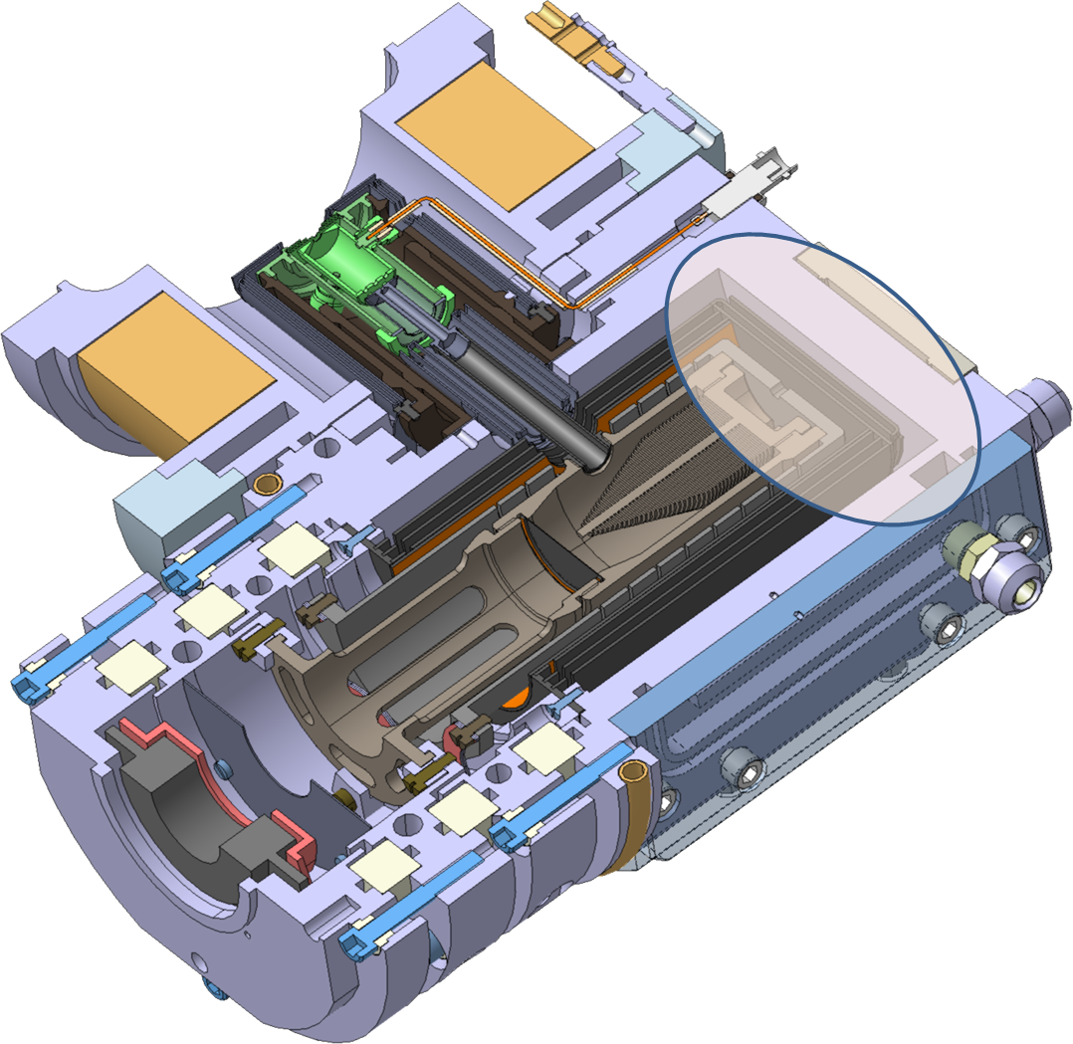
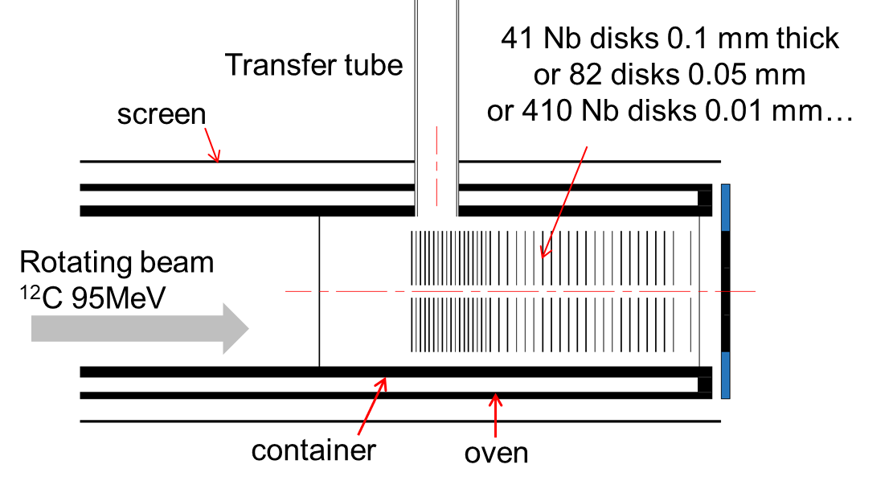
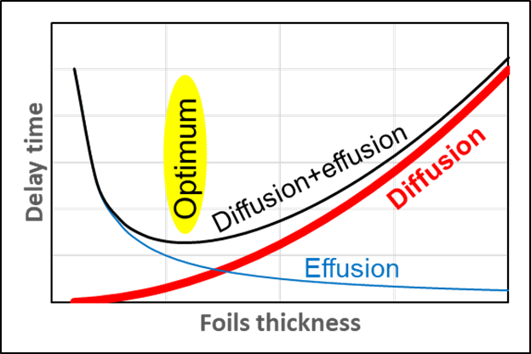
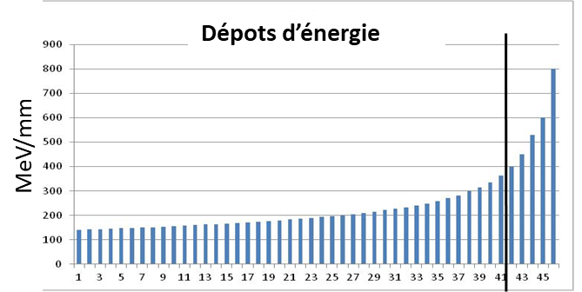
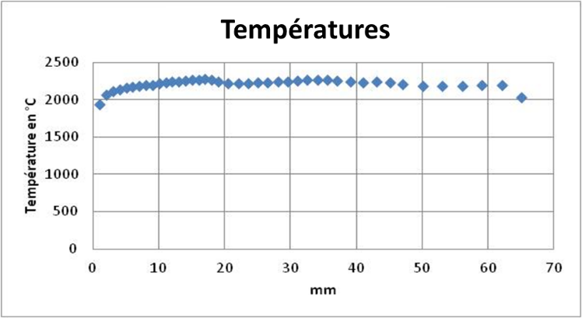
Spiral 1 Nb or Zr targets under study
Cooled part to be designed (beam stopper)
Diffusion inside the foil
Effusion from the surface of the foil to the ion source
Before the construction a qualification test is in preparation:
→ data on diffusion (Arrhenus coefficients)
→ data on sticking times
  Optimization of target design
ANSYS simulation
ISOL-France meeting. 17-19 march 2021 – O. Bajeat
7

Slide 8
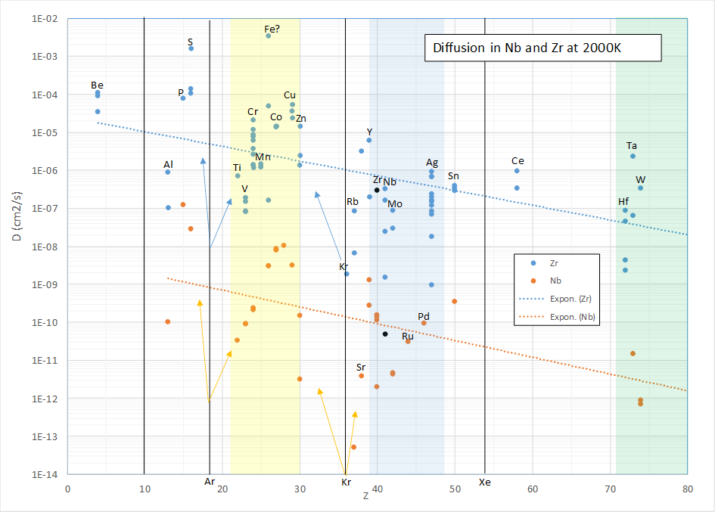

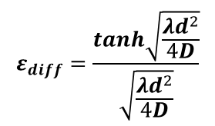

Diffusion coefficients
Some data is available in littérature (with disparities).
But nothing for Ge, Ga, As, Kr, Se in Niobium and Zirconium.
$$D=D_{0}e^{−\frac{E_{a}}{kT}}$$
 | Melting T
Niobium | 2458°C
Zirconium | 1852°C
Zn in Zirconium
Diffusion efficiency
Fick’s law → diffusion efficiency can be calculated from D:
$$ε_{diff}=\frac{tanh\sqrt{\frac{λd^{2}}{4D}}}{\sqrt{\frac{λd^{2}}{4D}}}$$
(d=thickness)
$$Release time τ_{D}=\frac{d^{2}}{{4π}^{2}D}$$
⁶⁰Zn (143s) | D From [3] | Thickness mm | τ_{D} (s) | Diffusion efficiency
Zn in Niobium 2000°C | 2,1.10⁻⁹ | 0,01 | 12 | 0,84
 |  | 0,1 | 1200 | 0,13
Zn in Zirconium 1700°C | 1,1.10⁻⁵ | 0,01 | 2,3.10⁻³ | 1
 |  | 0,1 | 0,23 | 0,99
Zn in Niobium
[3] G.J. Beyer et al., Nucl. Instr. and Meth. B 204 (2003) 225.
ISOL-France meeting. 17-19 march 2021 – O. Bajeat
8

Slide 9
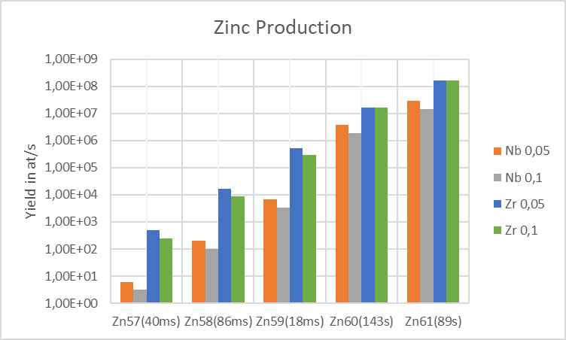
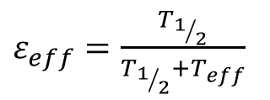


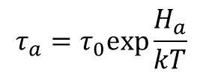


Total efficiency of a Nb and Zr Spiral1 target
Effusion
 | Mean sticking time in s Niobium 2000°C | Mean sticking time in s Zirconium 1800°C
Zn | 1,4.10⁻¹⁰ | 9,3.10⁻¹⁰
Ga | 6,3.10⁻⁷ | 0,13
Ge | 0,13 | 81
As | 0,22 | 250
$$τ_{a}=τ_{0}exp\frac{H_{a}}{kT}$$
$τ_{0}$ ~ 10⁻¹³ s (Frenkel theory)
Sticking time:
Experimental data from [4] → τ₀ = 2,4.10⁻¹⁵ s for Tantalum.
Sticking times calculated with τ₀ = 2.4 10⁻¹⁵ s and Ha values extracted from [4]
$τ_{f}$: time of fligth between 2 collisions
$T_{eff}= N_{collisions}×(τ_{a}$+$τ_{f}$)
Approximative calculation
$ε_{eff}=\frac{T_{1/2}}{T_{1/2}+T_{eff}}$
Yield$=production×ε_{diff}×ε_{eff}$
[4] R. Kirchner, NIM B70 (1992) 186-199
Zn isotopes yield in niobium and zirconium targets 0.1 mm thick (41 disks) and 0.05 mm (82 disks).
ISOL-France meeting. 17-19 march 2021 – O. Bajeat
9

Slide 10
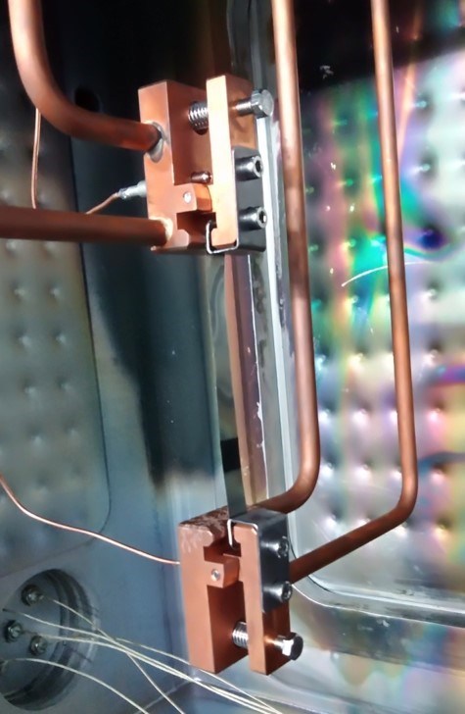
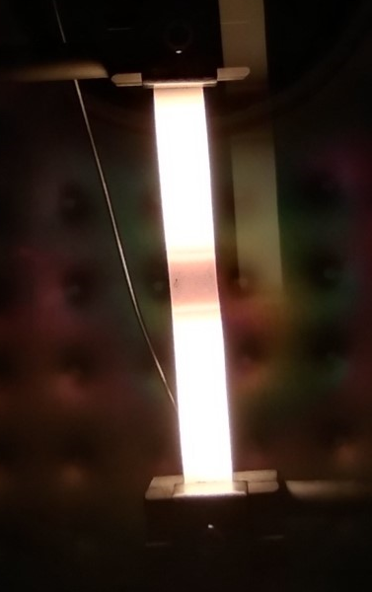
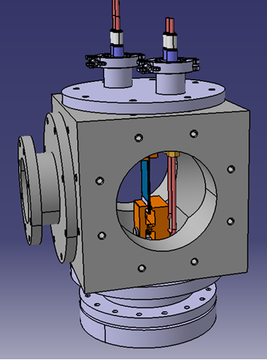
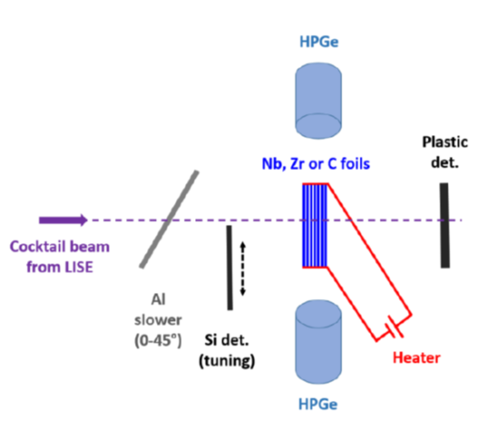

The qualification test
Implantation of radioactive isotopes from LISE and online measurements of the implanted sample activity at low and high temperature without handling the active sample → release time and D
Samples
Niobium and Zirconium → 1 foil 70 µm and stack of several thinner foils.
Carbon → 0.5 mm (standard thickness for Spiral1)
The chamber
Cooled connection for heating the foils.
Power: up to 2400 W (145 to 225 A / 5,4 to 10 V)
Sticking time will be refined from additional delay time when comparing several foils and one (knowing the number of collision by Molflow calculation)
Skim of the reaction chamber
10
ISOL-France meeting. 17-19 march 2021 – O. Bajeat

Slide 11
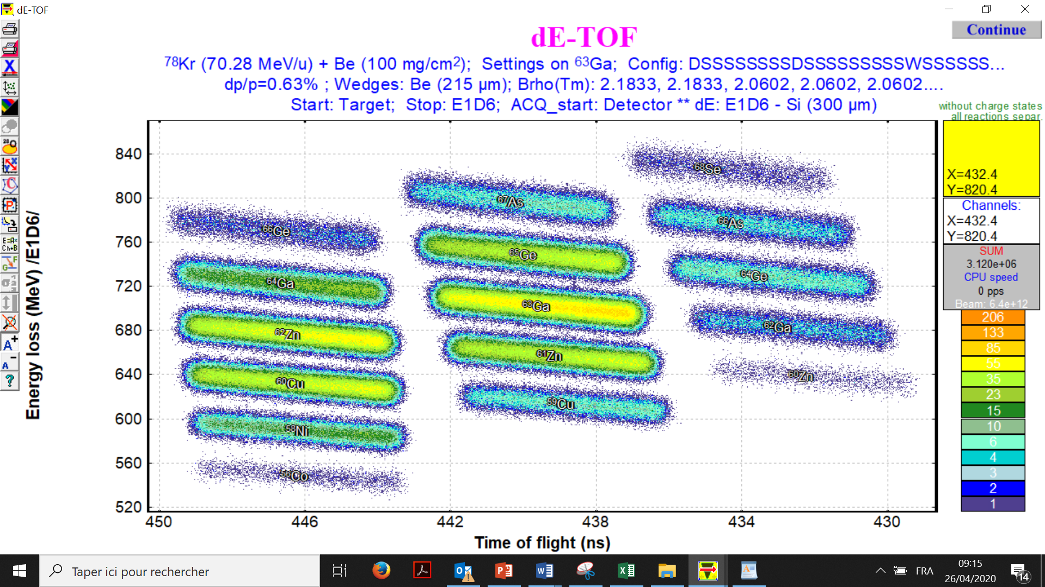
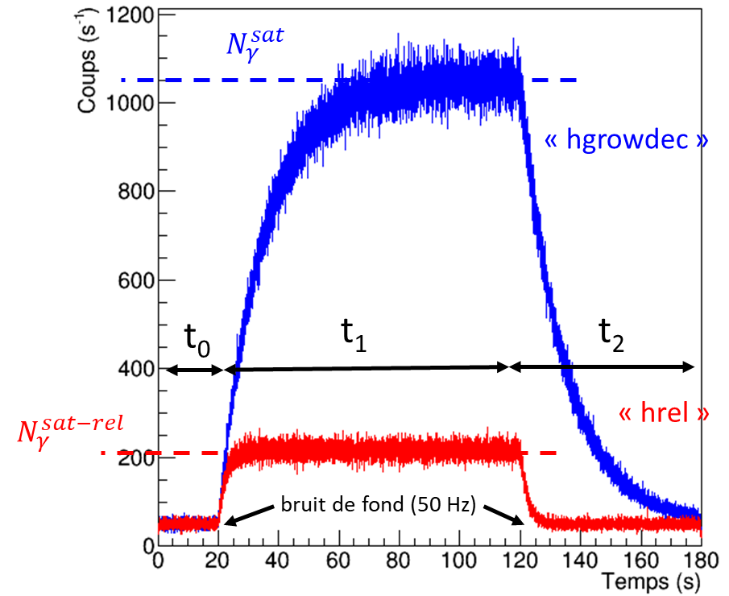
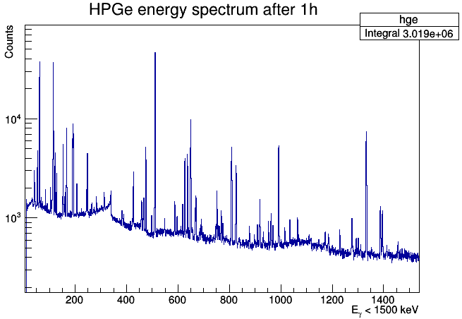


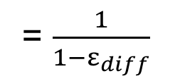

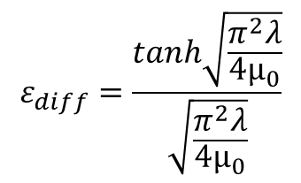
Radioactive isotope production and selection with LISE (⁷⁸Kr @ 70 MeV/u + 500 µm Be)
Example of LISE setting -> As to Cu
Temperature dependent release time measurements (beam on/off)
-> Extraction of diffusion coefficients
⁶⁷As
^{65,64}Ge
Φ⁰
Φ⁰=λN⁰
^{63,64}Ga
Low T
N₀
⁶²Zn
⁶¹Zn
⁶⁰Cu
⁵⁹Cu
Φ^{T}
Φ^{T}–Φ^{rel} = λN^{T}
High T
N_{T}
Φ^{rel}
$$ε_{diff}=\frac{Φ^{rel}}{Φ^{T}}$$
= $\frac{1}{1−ε_{diff}}$
$$ε_{diff}=\frac{tanh\sqrt{\frac{π^{2}λ}{{4µ}_{0}}}}{\sqrt{\frac{π^{2}λ}{4µ_{0}}}}$$
JC Thomas
→ µ₀ →$D=D_{0}e^{−\frac{E_{a}}{kT}}$
For Nb and Zr (pure diffusion):
Geant4 simulations at 5 cm for 100 enA, i.e. ~10⁴ implantations/s
R. Kirchner, NIM B70 (1992) 186-199.
Measurement at different temperatures → D₀ and E_{a}
ISOL-France meeting. 17-19 march 2021 – O. Bajeat
11

Slide 12
Condensation on cold surfaces
After release atoms can be deposited on cold surfaces (chamber walls, aluminium sockets in front of detectors…).
→ The contribution of stuck atoms on the γ detection will be deducted from simulations.
Cooled chamber
12

Slide 13
Budget
Qualification test : ~ 6 k€ (under construction)
New Febiad/Niobium TISS : ~ 35 k€ included ~ 12 k€ for the target and the new T-box with cooled beam catcher
ISOL-France meeting. 17-19 march 2021 – O. Bajeat
13

Slide 14
Conclusion
Targets in Niobium or Zirconium are easy to manufacture and production rates should be interesting for 29<Z<40 isotopes.
The qualification test will give us quite precise data on diffusion and indication on sticking times for the elements of interest.
Then, the TISS will be optimized in term of material (Niobium or Zirconium), foil thickness and geometry.
Refined rate estimates for each element of interest will be possible knowing that only online tests of the TISS will give the effective production.
Thank you for your attention.
ISOL-France meeting. 17-19 march 2021 – O. Bajeat
14

