Slide 1
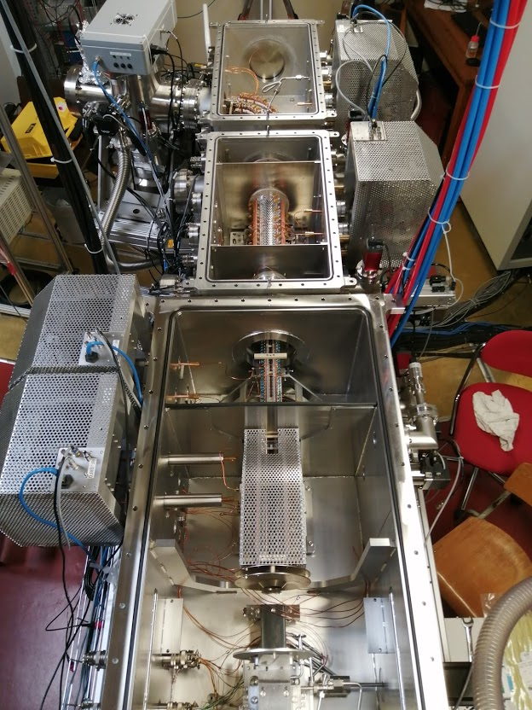
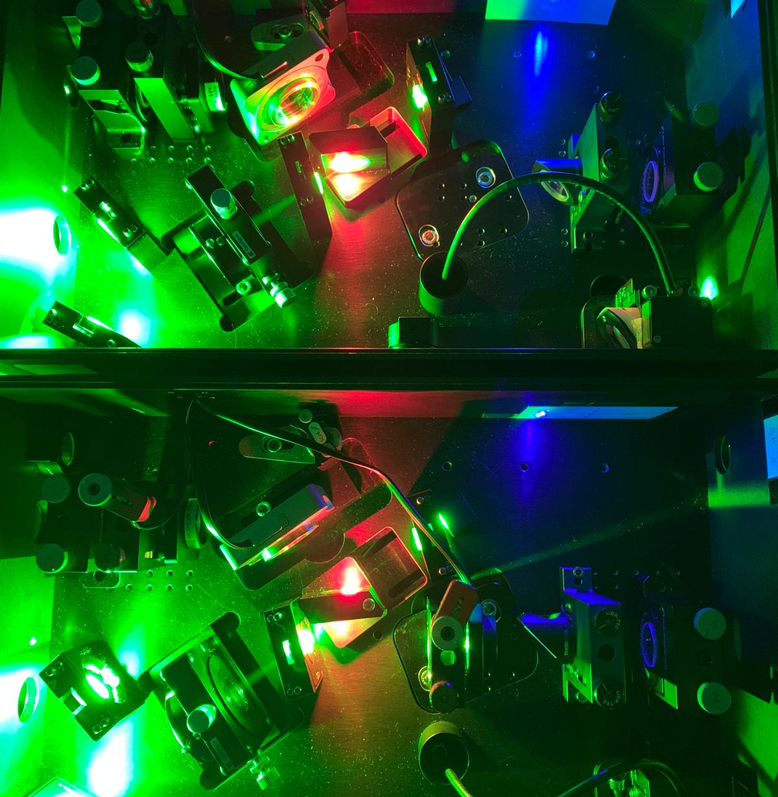
Status of the commissioning of S3-LEB
ISOL France meeting
Jekabs Romans

Slide 2
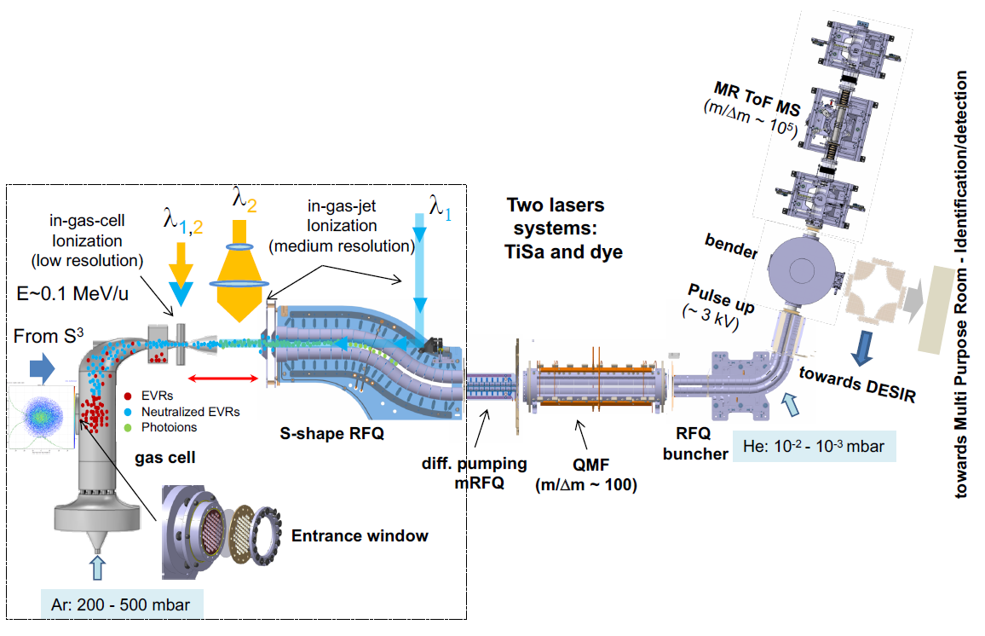
S³-LEB at LPC
Talk by P. Delahaye
[1,2]
PILGRIM
PU
QMF
RFQ_{cb}
From S³
SEASON
Talk by E. Rey-Herme
S-RFQ
mRFQ
[1] R. Ferrer et al. Nucl. Instrum. Meth. Phys. Res. B 317 (Dec. 2013), pp. 570-581. doi: 10.1016/J.NIMB.2013.07.028.
[2] N. Lecesne. S³ Workshop talk (June 2018)
Faculty of Science, IKS, Nuclear and Radiation Physics

Slide 3
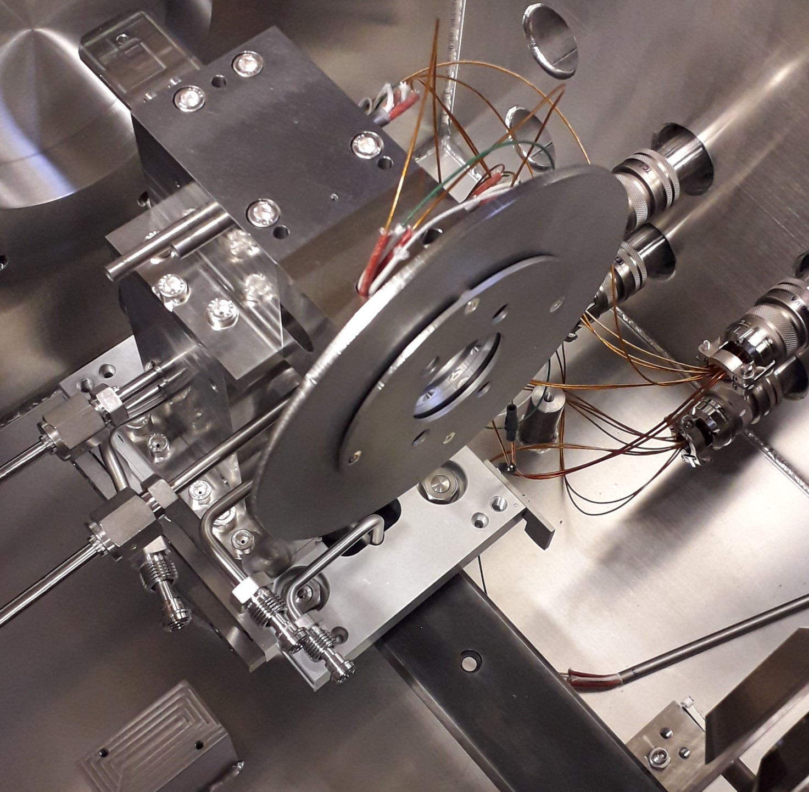
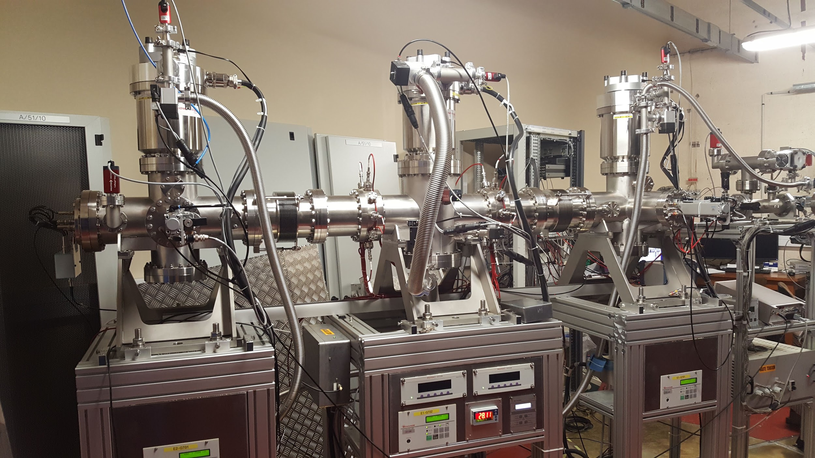
Activity summary
HFS measurements of ¹⁵¹Er during the S³ commissioning run of ¹⁵²Er [6]
GISELE lab development and recent results
Er I RIS tests (Day 1 experiment case)
Broadband RIS ( 5<𝝙𝜆<7 GHz )
Mid-range linewidth RIS ( 1<𝝙𝜆<2 GHz )
Narrow bandwidth RIS ( 10<𝝙𝜆<100 MHz )
S3-LEB setup
Gas cell assembly
Separate tests of RFQ/MR-TOF MS systems
S-shape RFQ & mini RFQ
Quadrupole Mass Filter/RFQ_{Cooler/Buncher}
MR-TOF MS (P. Delahaye & B. Mael [3,4,5])
No technical problem with either of the separate systems has been found
Coupling of the full RFQ chain
A | Rate/pps
^{TOTAL} | 2,11E+6
¹⁵²Er | 1,12E+03
¹⁵¹Er | 3,99E+04
[3] P. Chauveau. PhD thesis. Université de Caen Normandie (2016). doi: http://hal.in2p3.fr/tel-01469429
[4] P. Chauveau et al. Nucl. Instrum. Meth. Phys. Res. B 376 (2016), pp 211-215. doi: https://doi.org/10.1016/j.nimb.2016.01.025
[5] B.-M. Retailleau. PhD thesis. Université de Caen Normandie (2021)
[6] H. Savajols. Expected Day-one experiment productions (2019)

Slide 4
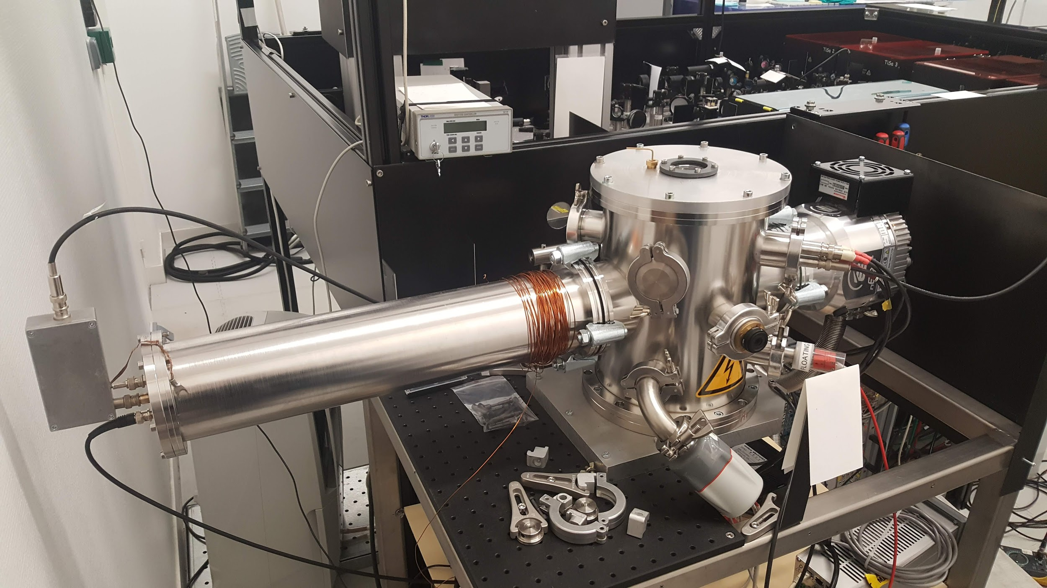
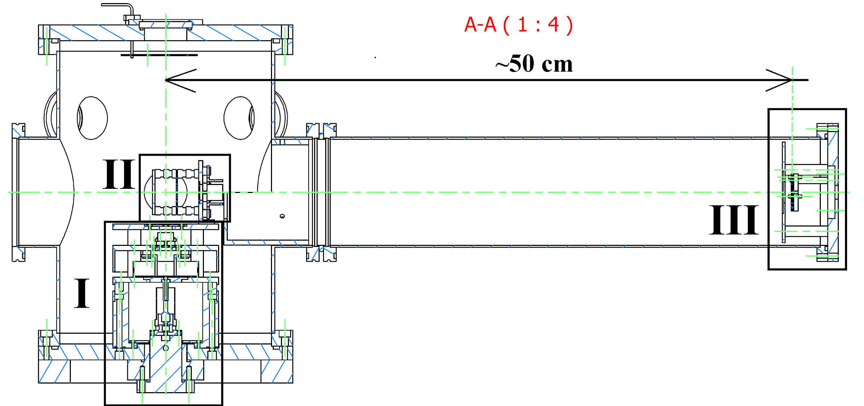
Atomic
Beam
Unit
GISELE laboratory
Ti:Sa BRF #1
SHG/THG/FHG unit
[7]
Photonics #2 @ 532 nm, 10 kHz
Ti:Sa grating
NB SM Ti:Sa
Control electronics
Ti:Sa BRF #3
Ti:Sa BRF #2
Seed Laser
[7] G. Vinck. Masters thesis. KU Leuven (2014)

Slide 5
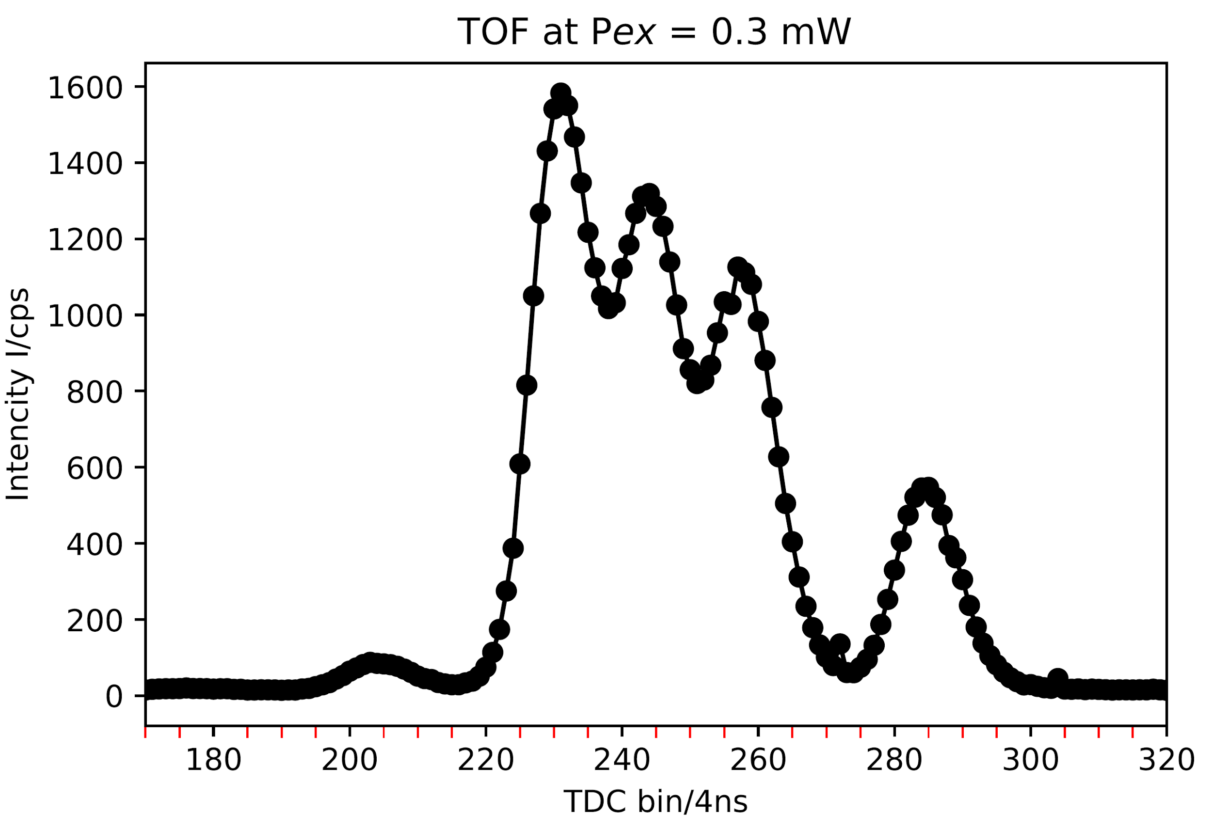
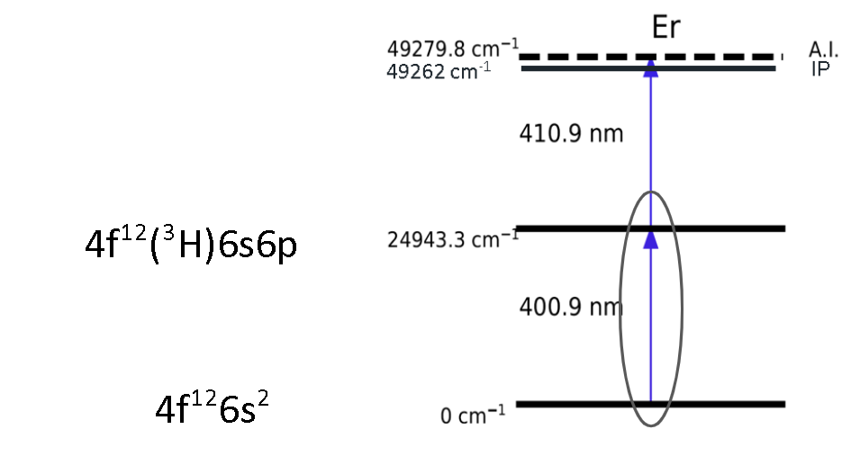
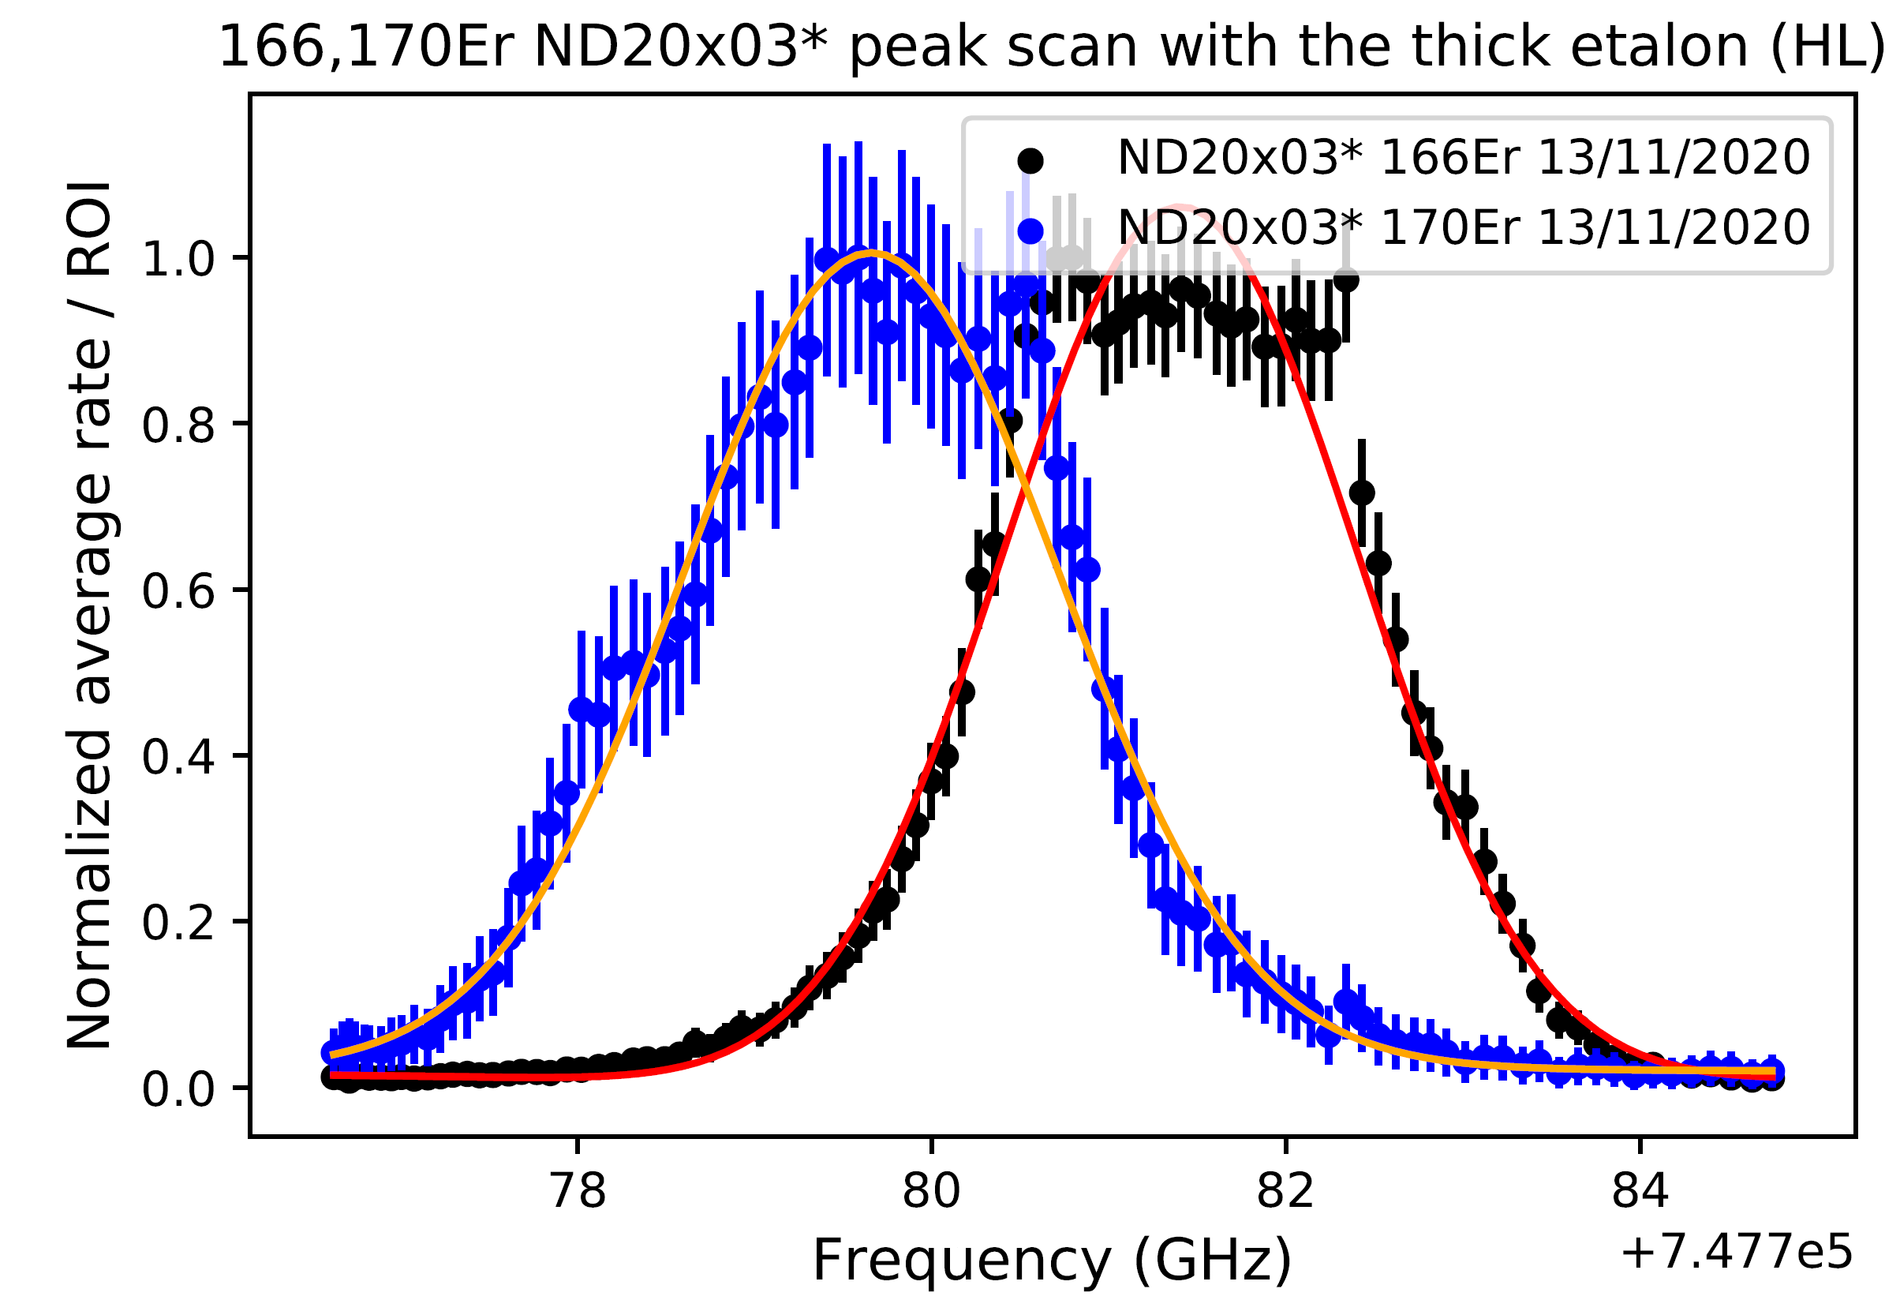
GISELE Results
¹⁶⁶Er
¹⁶⁷Er
[8]
¹⁶⁸Er
Er I RIS (IS measurements)
¹⁷⁰Er
A_{ki} = 1.73e+8 s⁻¹
¹⁶⁴Er
Important issues
Measurable influence from neighboring peaks
Multimode-structure
No normalization on power
Varying linewidth 𝝙𝜆
𝞭𝞶_{FS}^{AA’} = F𝞭<r²>
[8] D. Studer. PhD Thesis. Johannes Gutenber-Universitaet Mainz (2015)
[9] Albert Frisch et al. Phys. Rev. A88.3 (Sept. 2013), p. 032508. doi:10.1103/PhysRevA.88.032508
‹#›
Faculty of Science, IKS, Nuclear and Radiation Physics

Slide 6
S³-LEB at LPC
[1,2]
PU
QMF
RFQ_{cb}
From S³
S-RFQ
mRFQ
Faculty of Science, IKS, Nuclear and Radiation Physics

Slide 7
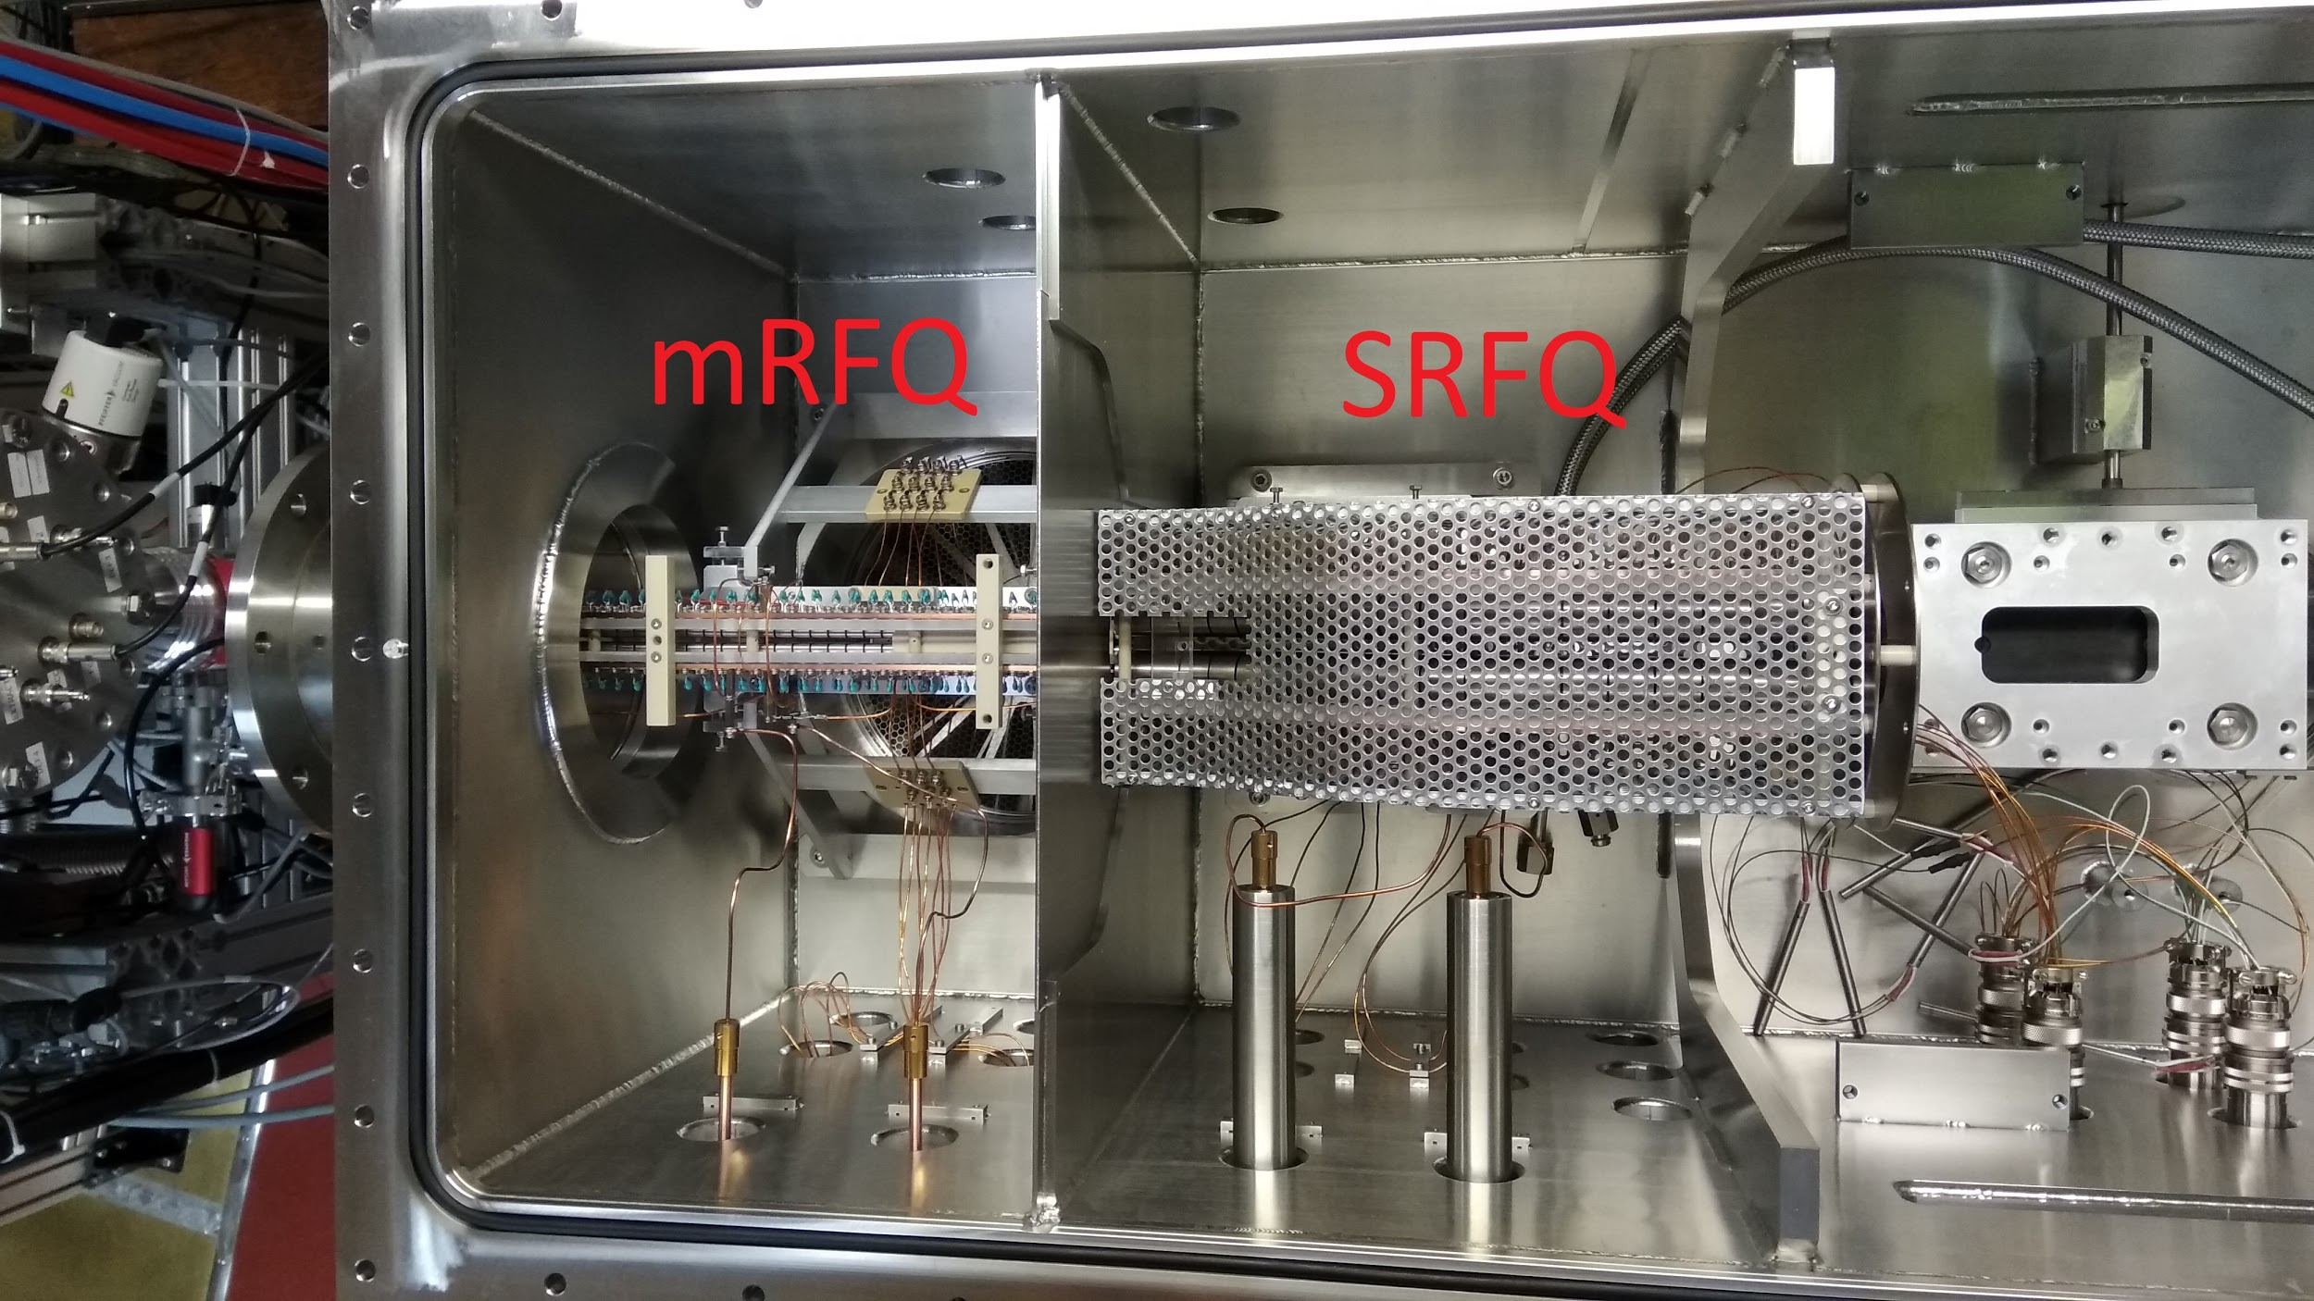
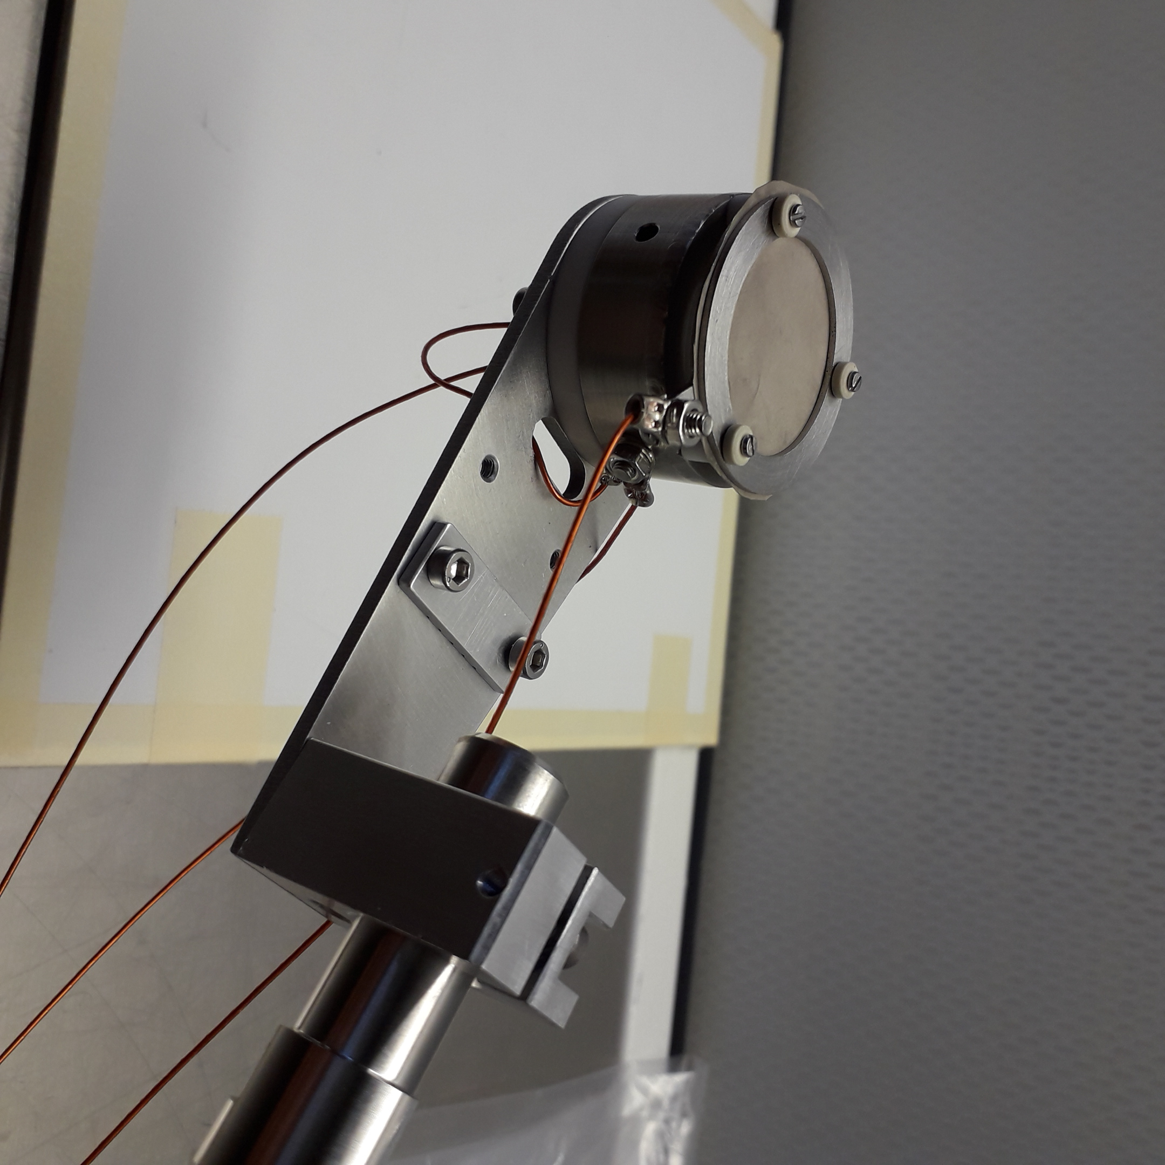
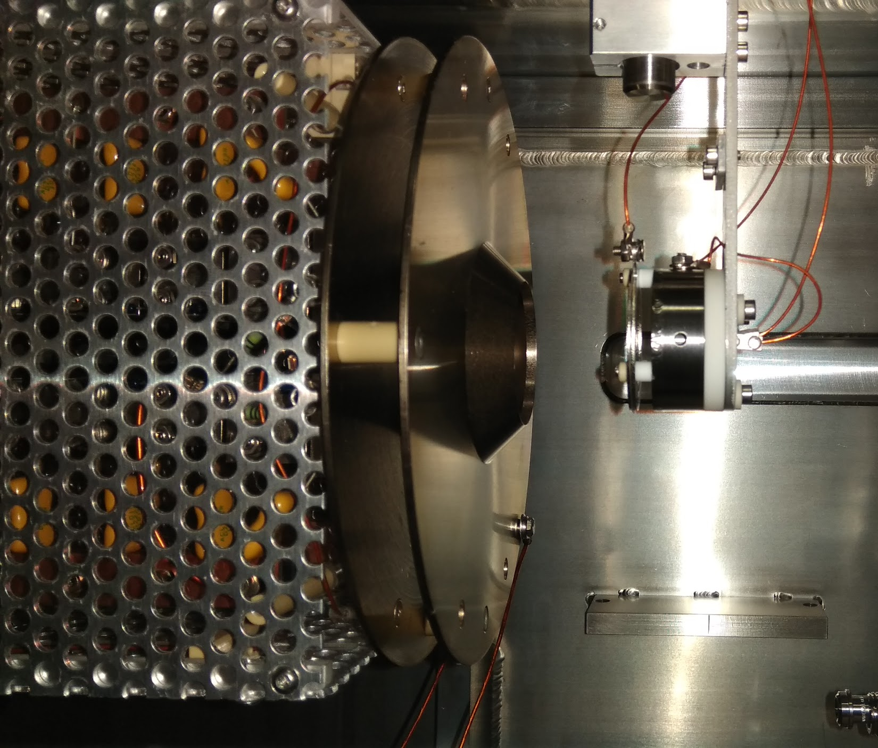
Gas cell chamber
Assembly and installation of surface ion source (¹³³Cs)
SRFQ & mRFQ tests

Slide 8
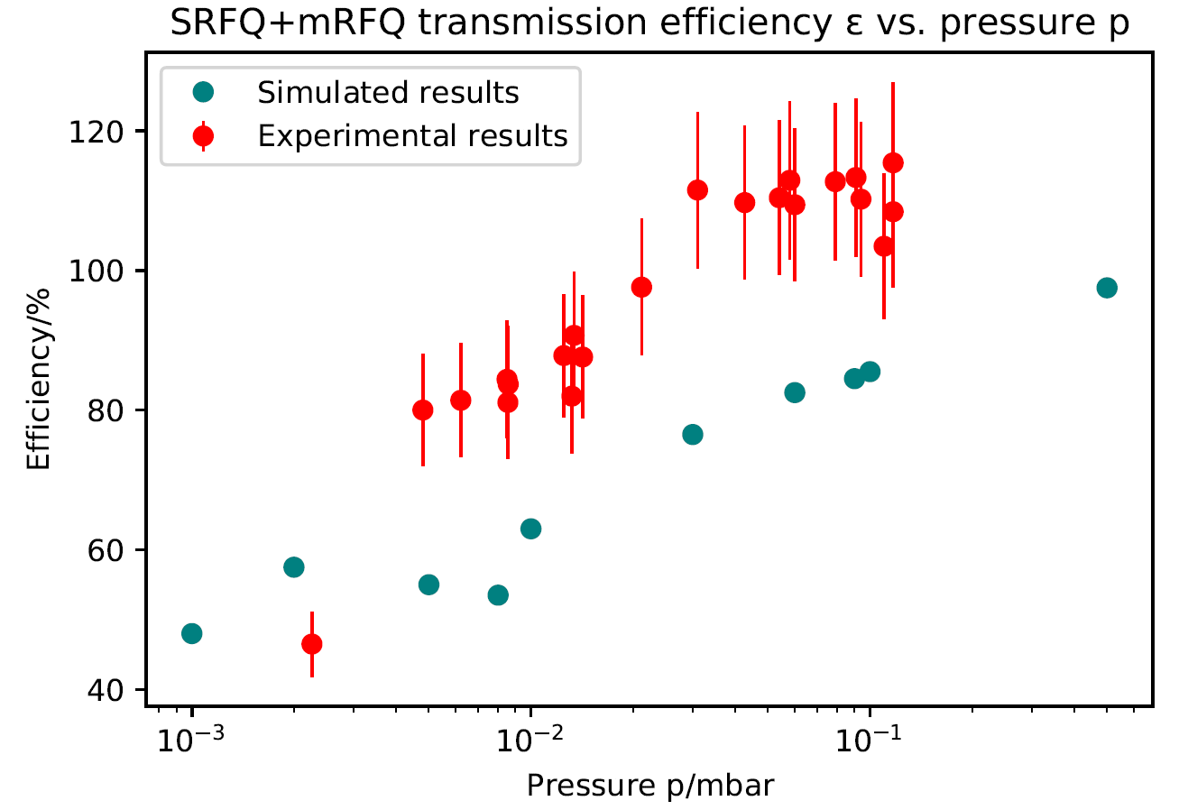
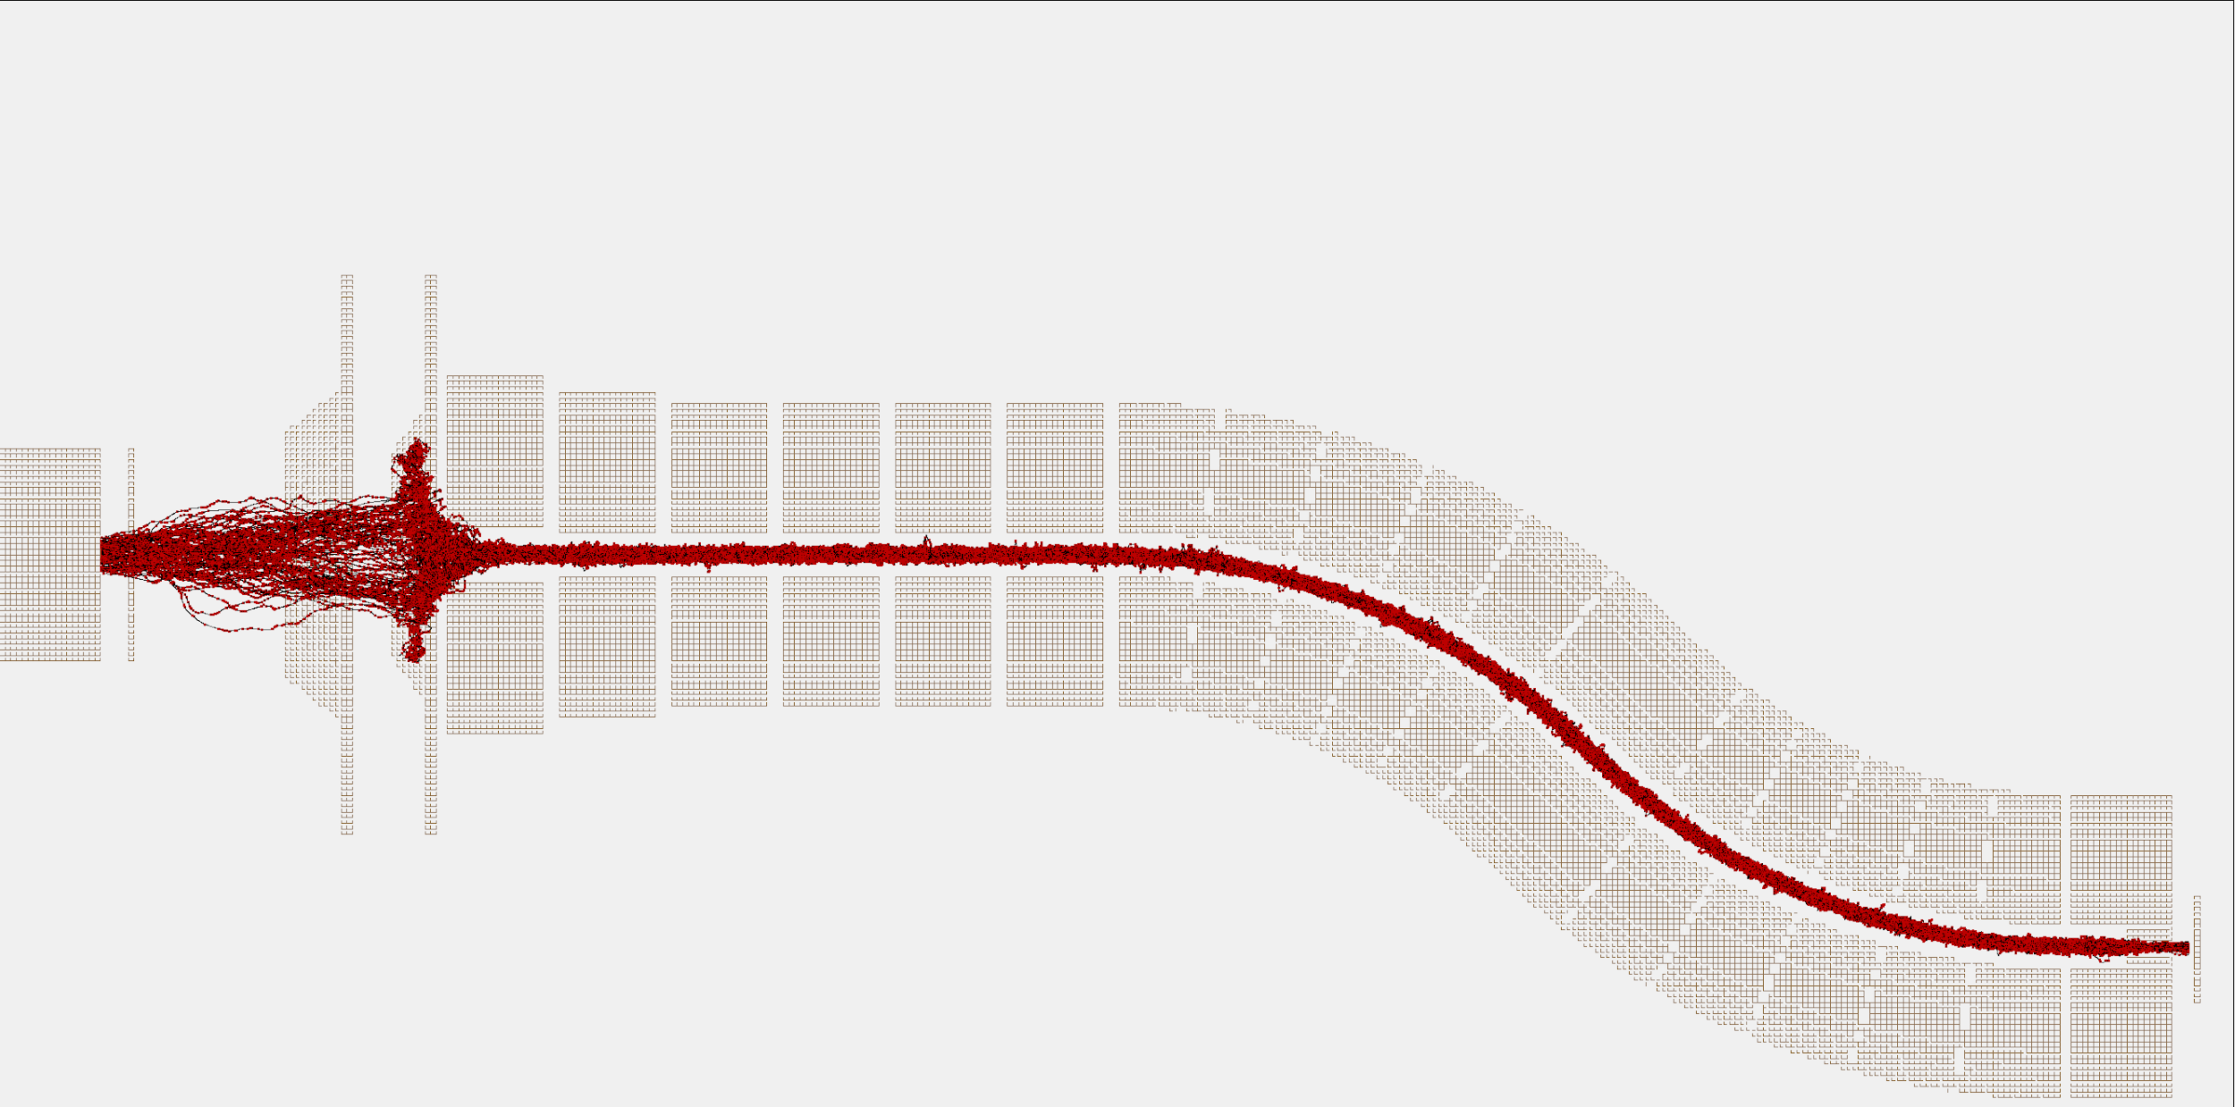
Gas cell chamber
𝞰_{SRFQ+mRFQ} =I₂/I₁
𝝈 = 10 %
Transmission tests
S-shape + mini RFQs
Comparison with SIMION simulations
Working area
for matched hypersonic jet creation

Slide 9
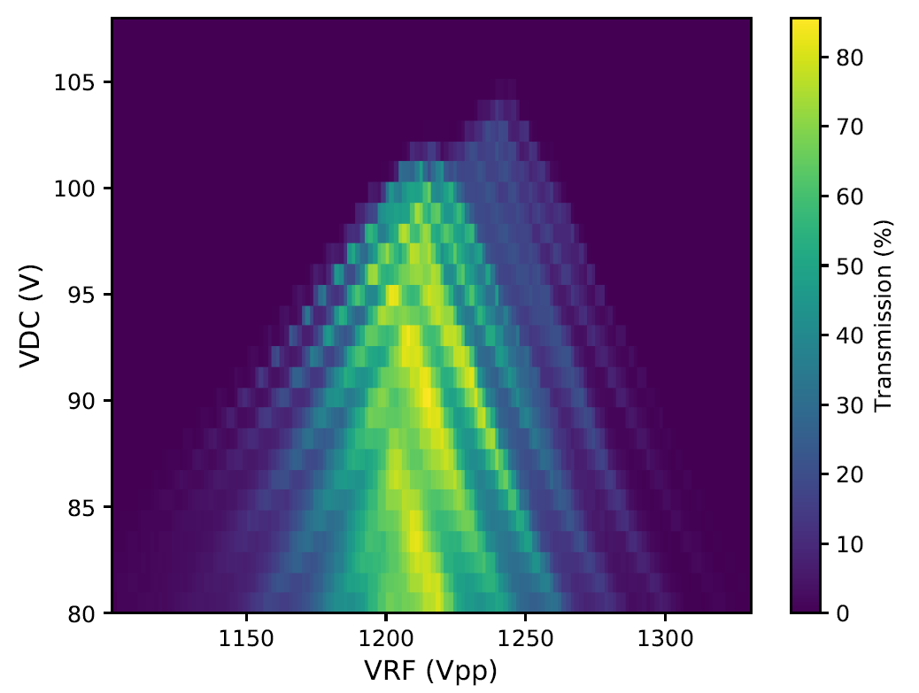
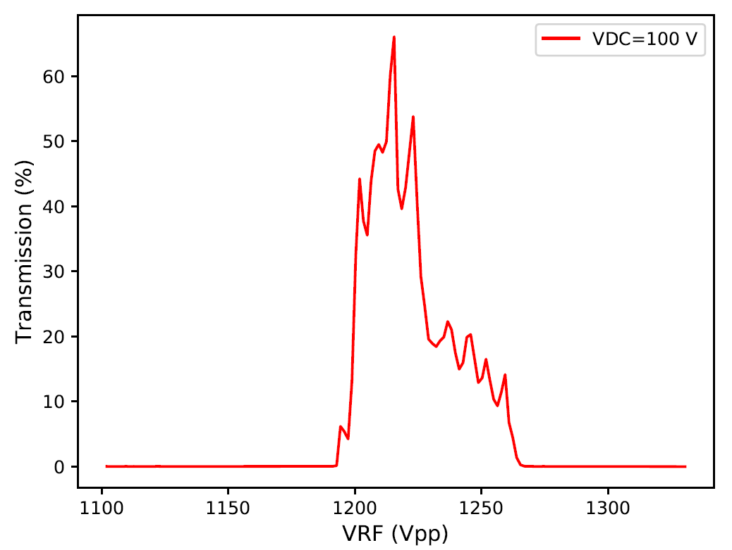
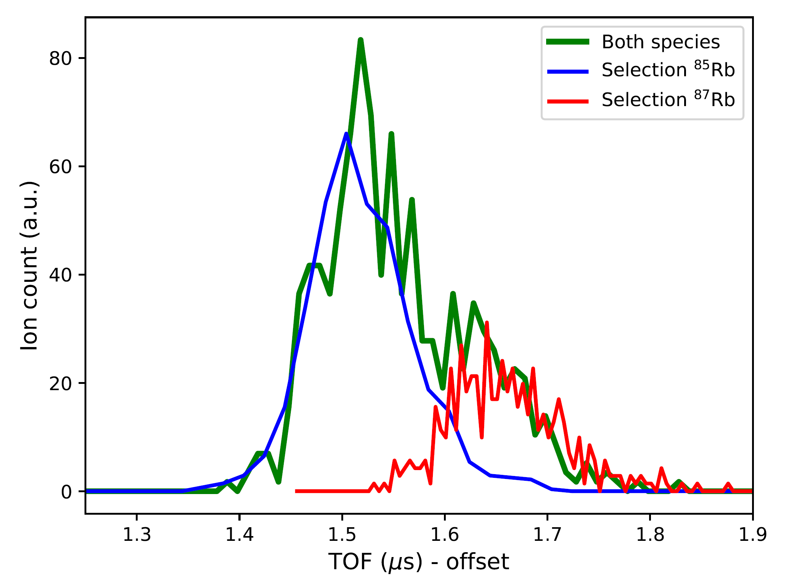
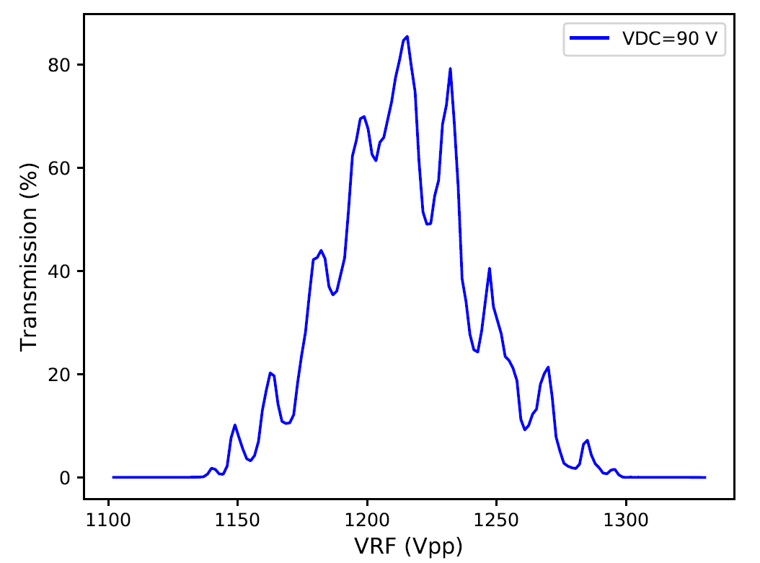
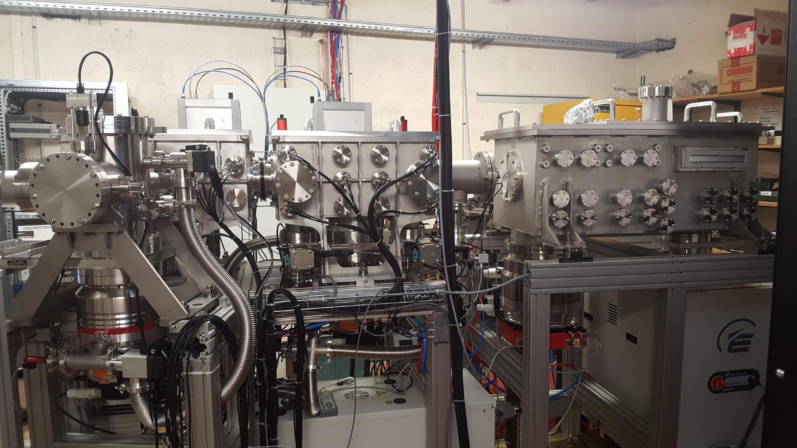
QMF/RFQ_{cb}
⁸⁷Rb
⁸⁵Rb
Beam gate + bunching mode
(normalized histogram)
𝞰_{QMF} ⪭ 90 % (I_{MCP2}/I_{MCP1})
^{85,87}Rb QMF 2D scan
Scan step size: 1 V_{DC} & 1 mV_{RF}
R = m/2𝝙m_{FWHM} ~ 40 (𝞰_{QMF}~ 40 %)
Work with buncher and beam gate
Continuous regime 𝞰_{RFQcb(c)} ~ 80 % (I_{MCP1}/I_{PU})
Injection time: 2 ms
Cooling: 9 ms
Switch freq.: 50 Hz
QMF
Fil
MCP PU
MCP2
MCP1
V_{DC} = 0

Slide 10
S³-LEB at LPC
Full RFQ chain
Faculty of Science, IKS, Nuclear and Radiation Physics

Slide 11
S³-LEB at LPC
Losses at extraction electrodes (w.r.t. grid)
MCP₃
grid
13.5 %
PU electrode
2.5 %
1.5 %
Full RFQ chain tests
p_{GC chamber} = 3e-2 mbar
~15 % beam loss during at the QMF apertures
Expected full RFQ chain efficiency: 80-90 % @ MCP₃ / MR-TOF MS (based on simulations) [1]
MCP₁
MCP₂
𝜂_{SRFQ+mRFQ} (Source - MCP₁)
𝜂_{QMF} (MCP₁-MCP₂)
~55 % - 70 %
~80 % - 100 %
𝜂_{SRFQ+mRFQ+QMF} (Source - MCP₂)
𝜂_{RFQcool/bunch+PU} (MCP₂-MCP₃)
~55 %
~65-70 %
𝜂_{SRFQ+mRFQ+QMF+RFQcool/bunch+PU} (Source - MCP₃)
~36 - 44 %
Faculty of Science, IKS, Nuclear and Radiation Physics

Slide 12
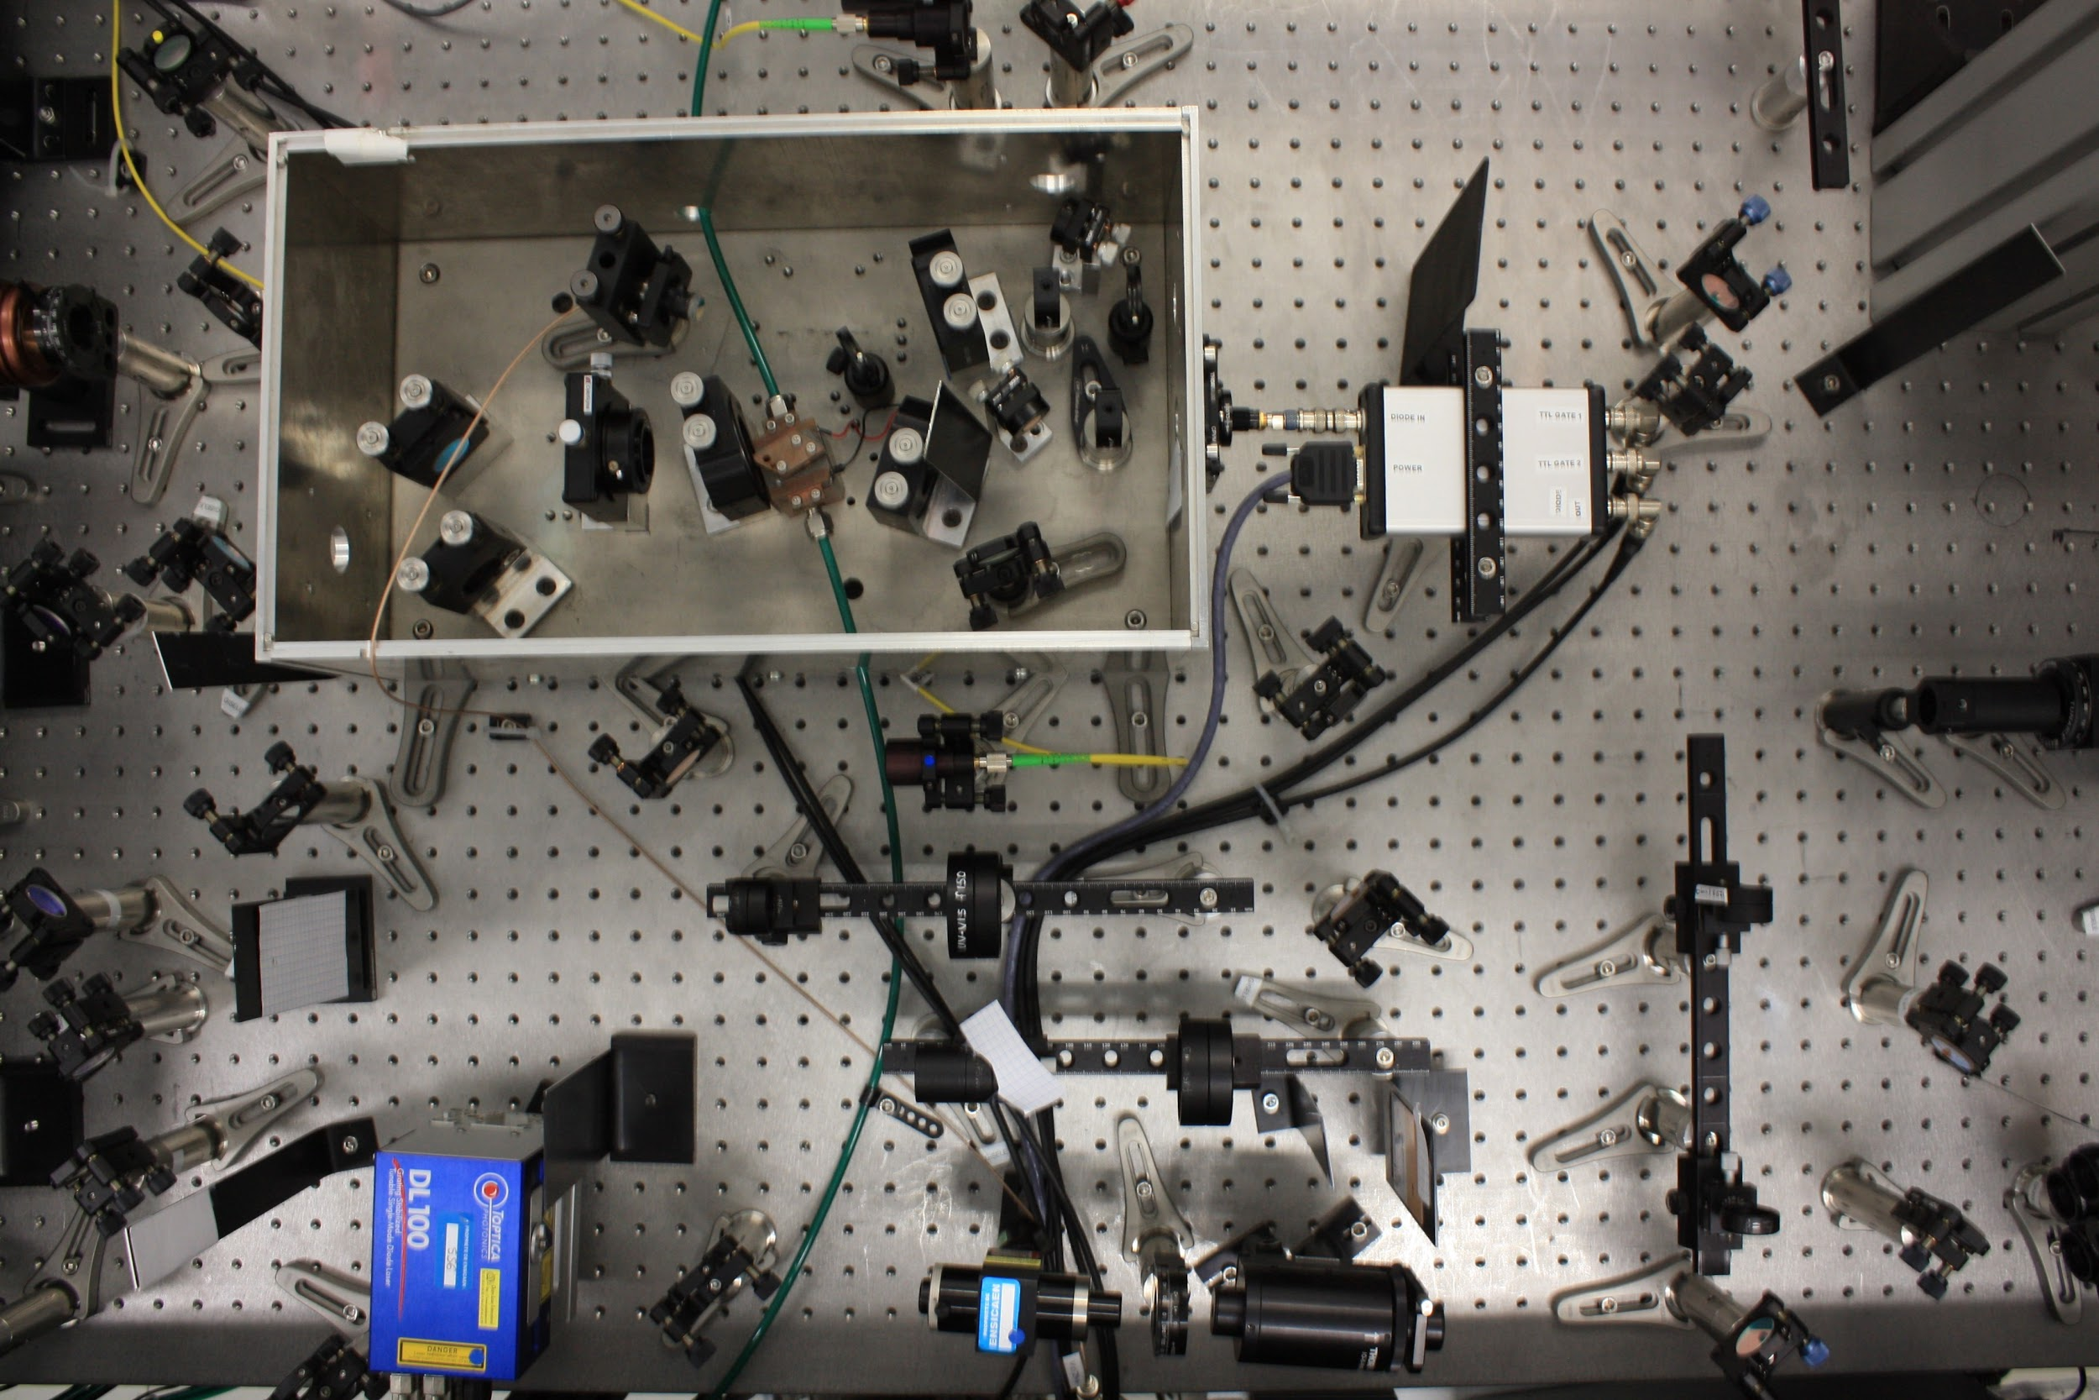
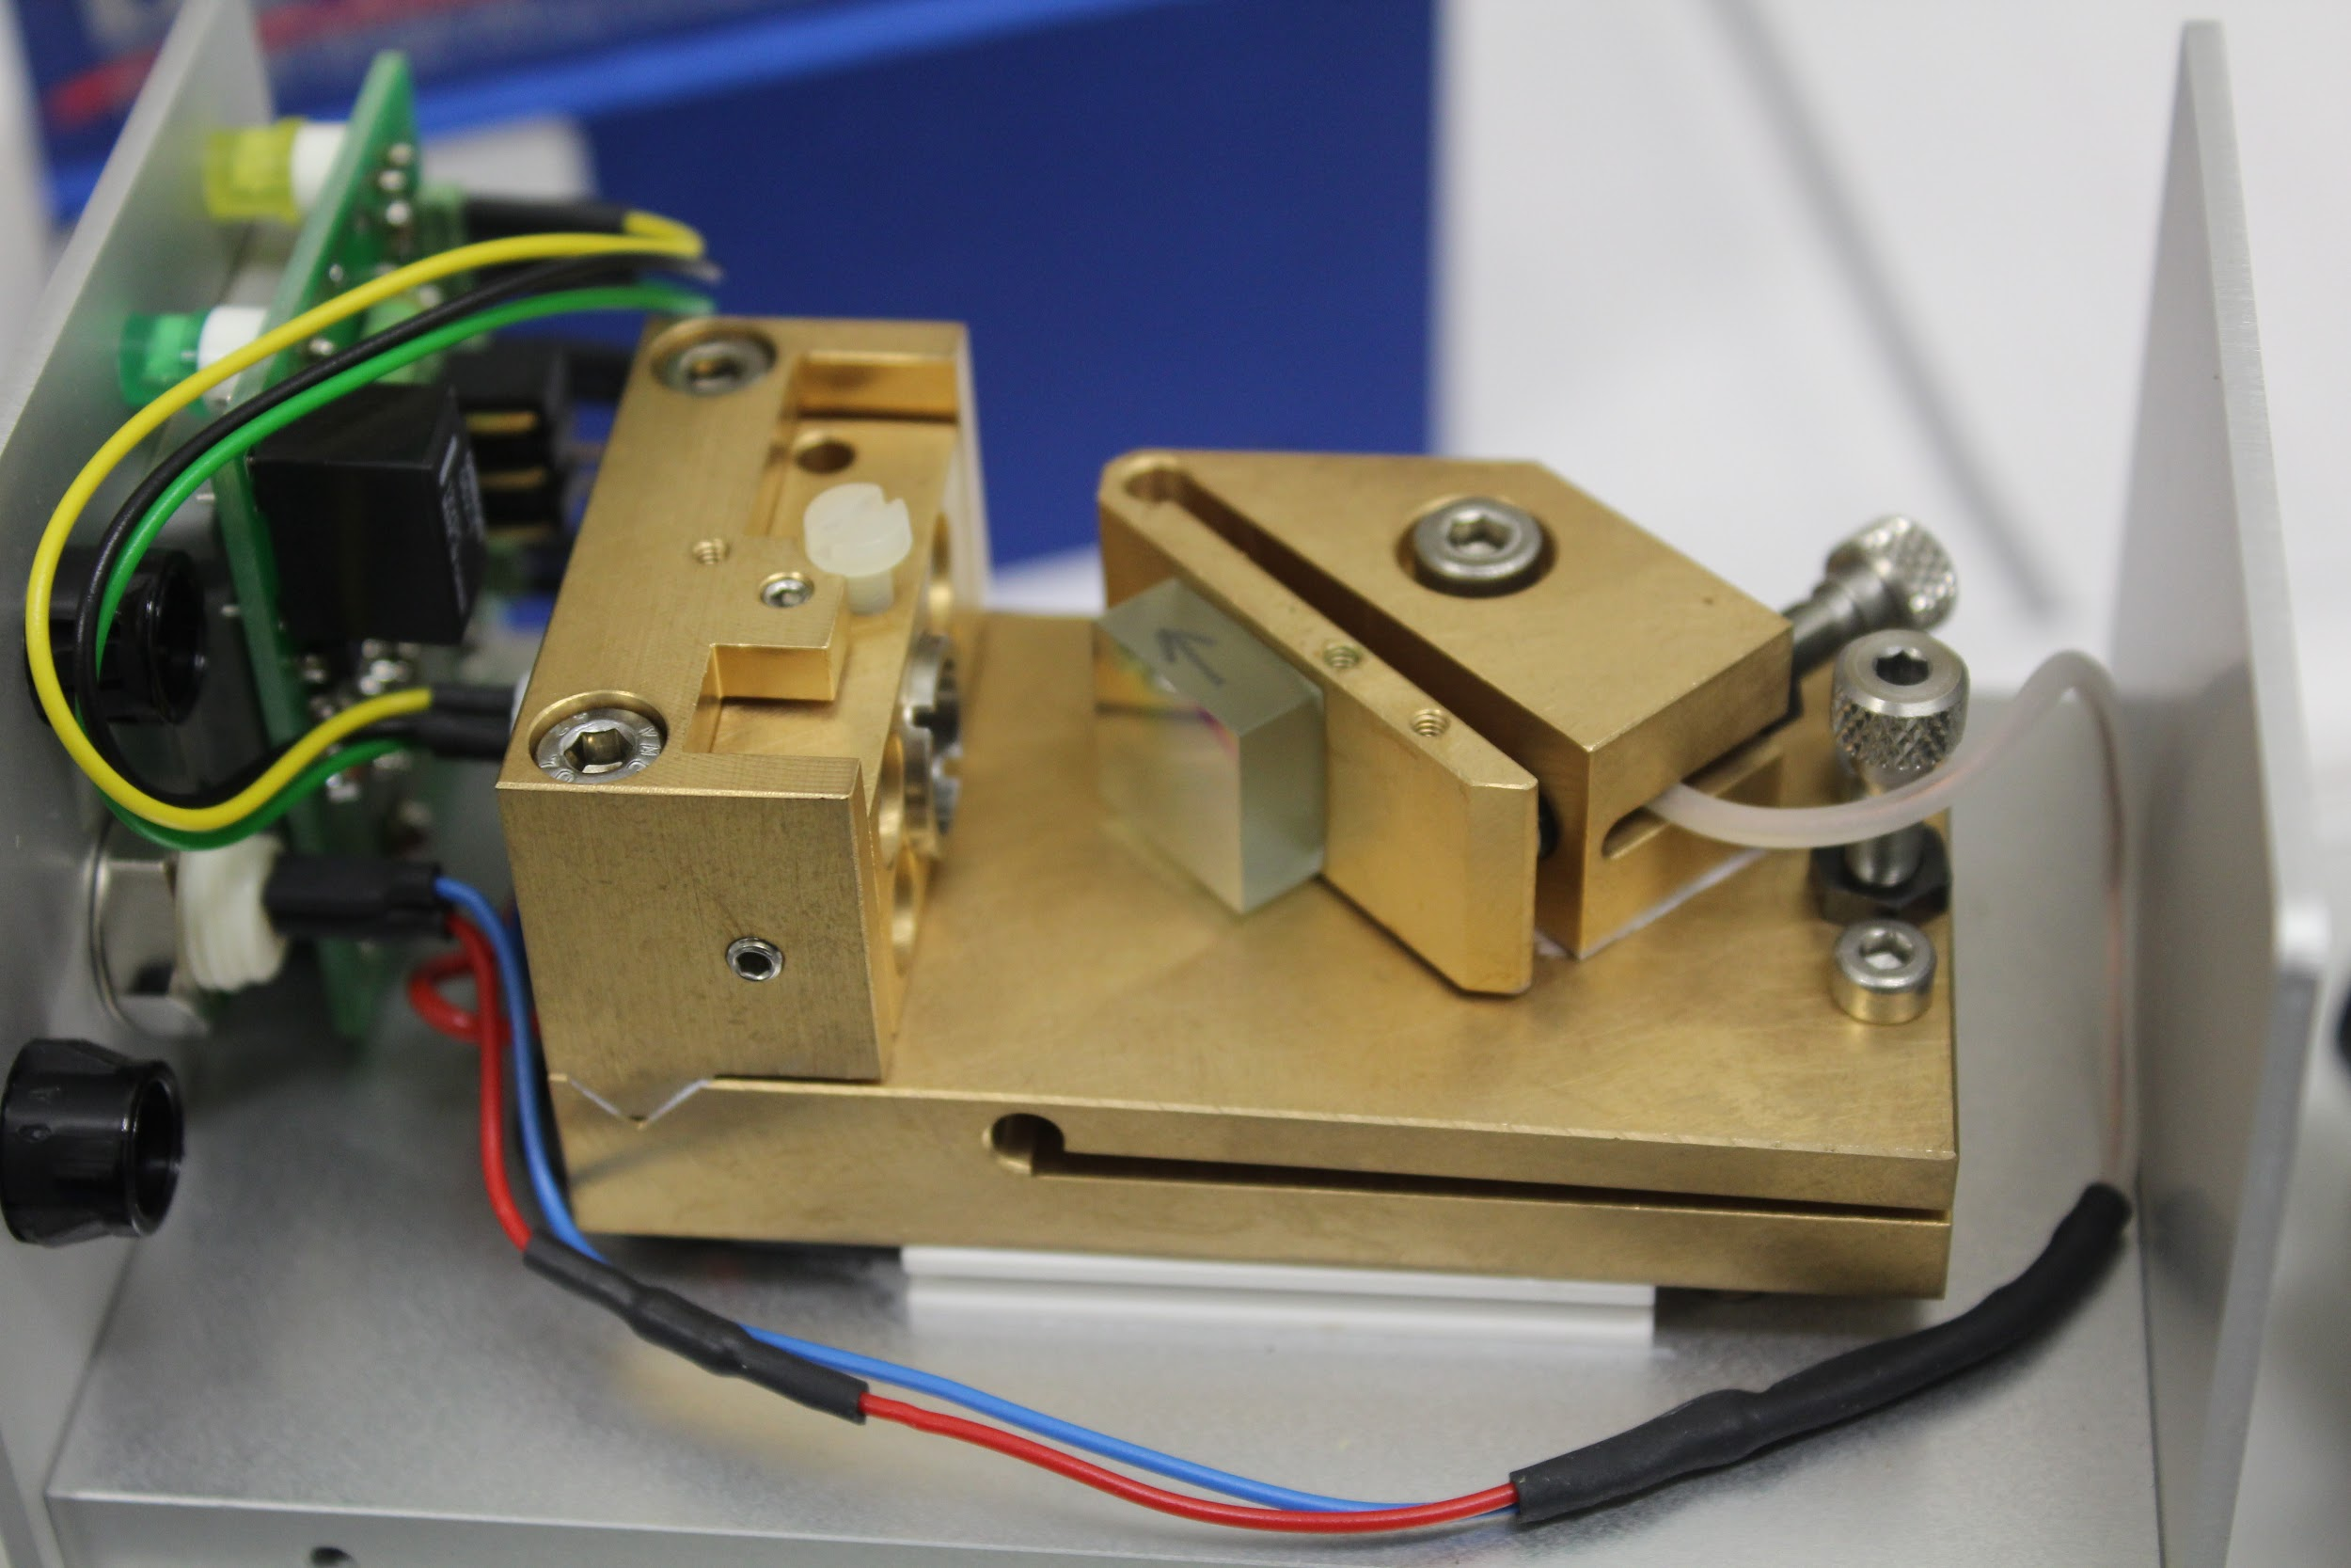
Outlook (GISELE)
Injection locked system
Capabilities to resolve HFS
Work on cw seed system (A. Ajayakumar)
Output
Piezo
pump
PD amp & switch
Seed Laser
Faculty of Science, IKS, Nuclear and Radiation Physics

Slide 13
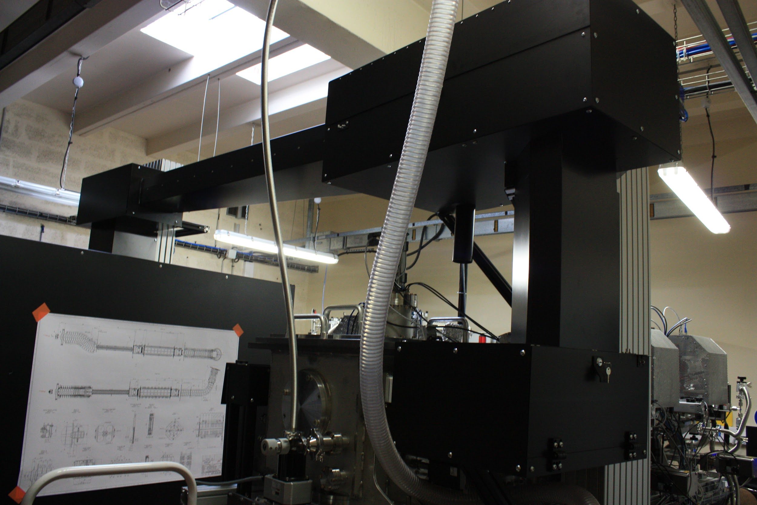
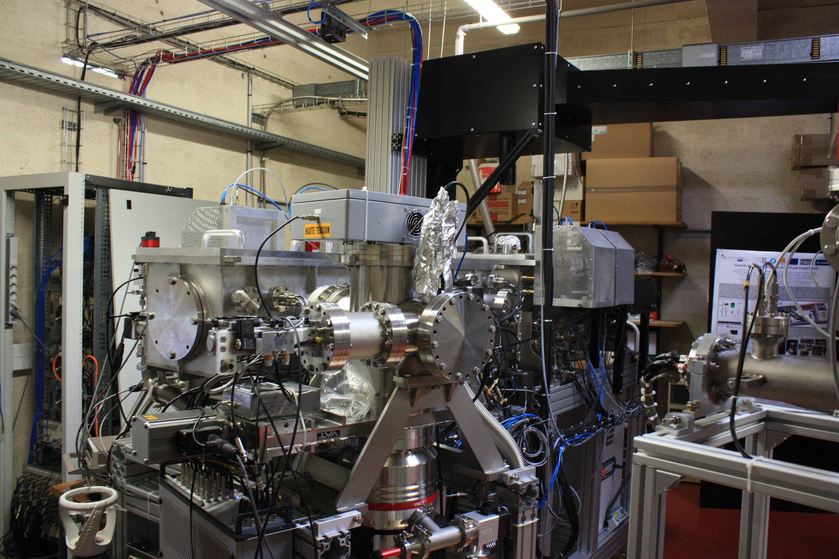
Outlook (LPC)
Maximizing transmission efficiency up MR-TOF MS
Injecting the beam in the MR-TOF MS
Coupling the gas cell and the laser system with the setup
Tests with laser ions

Slide 14
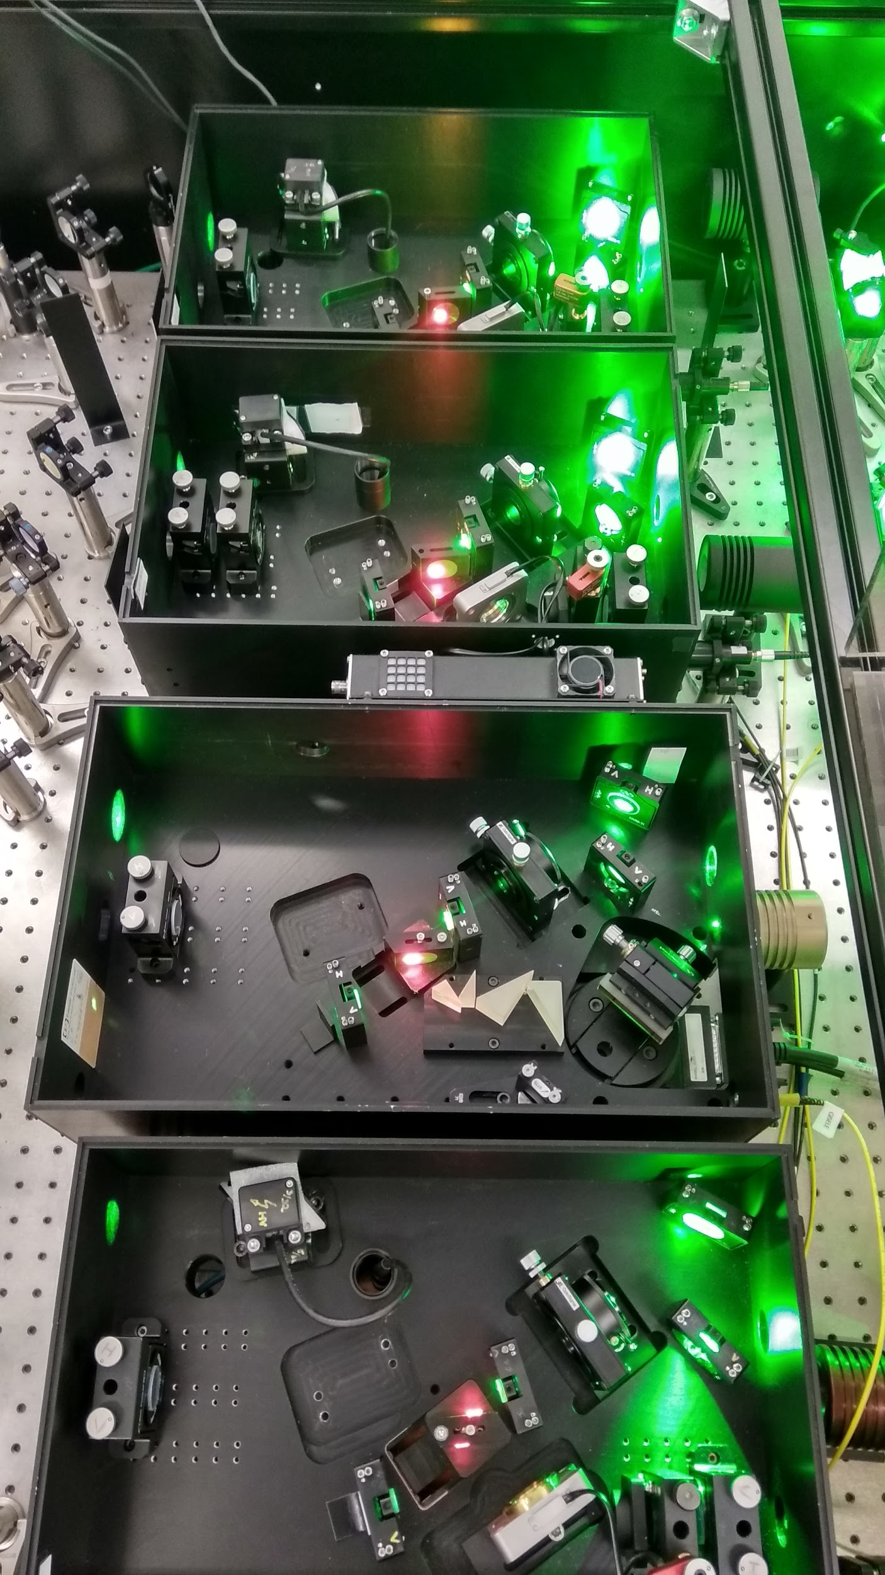
Thank you for you attention!

Slide 15
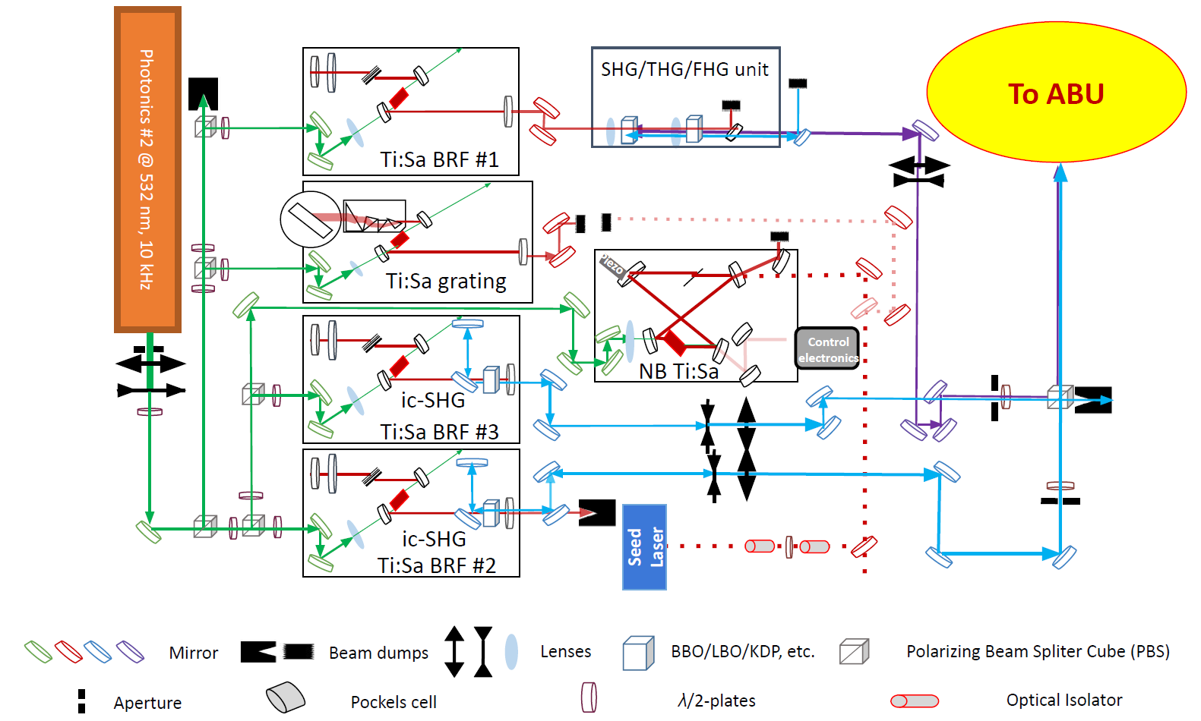
GISELE laboratory

Slide 16
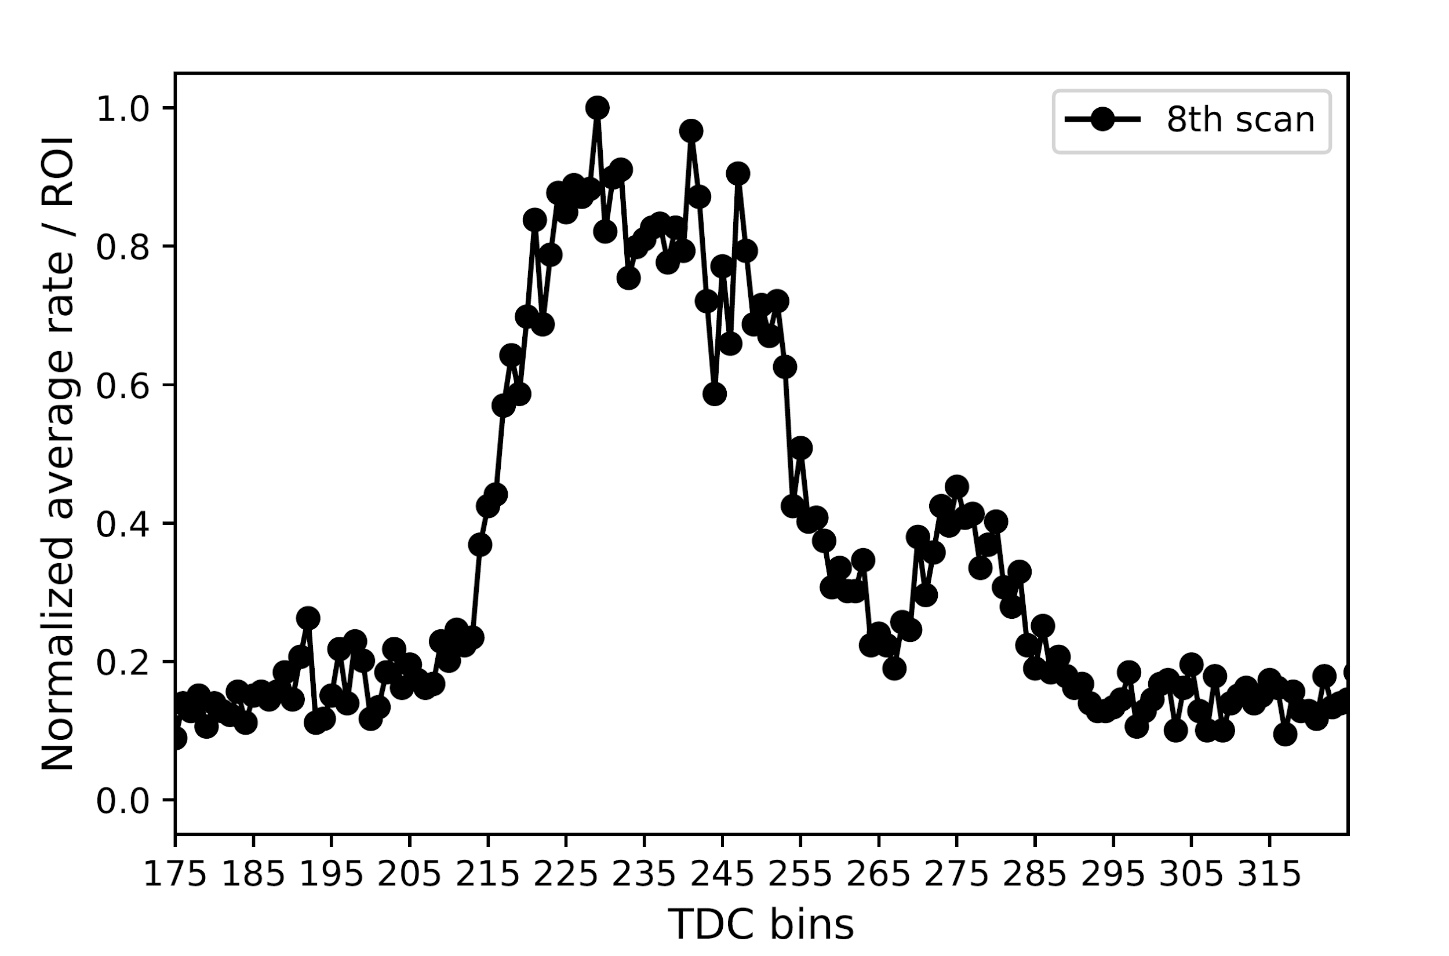
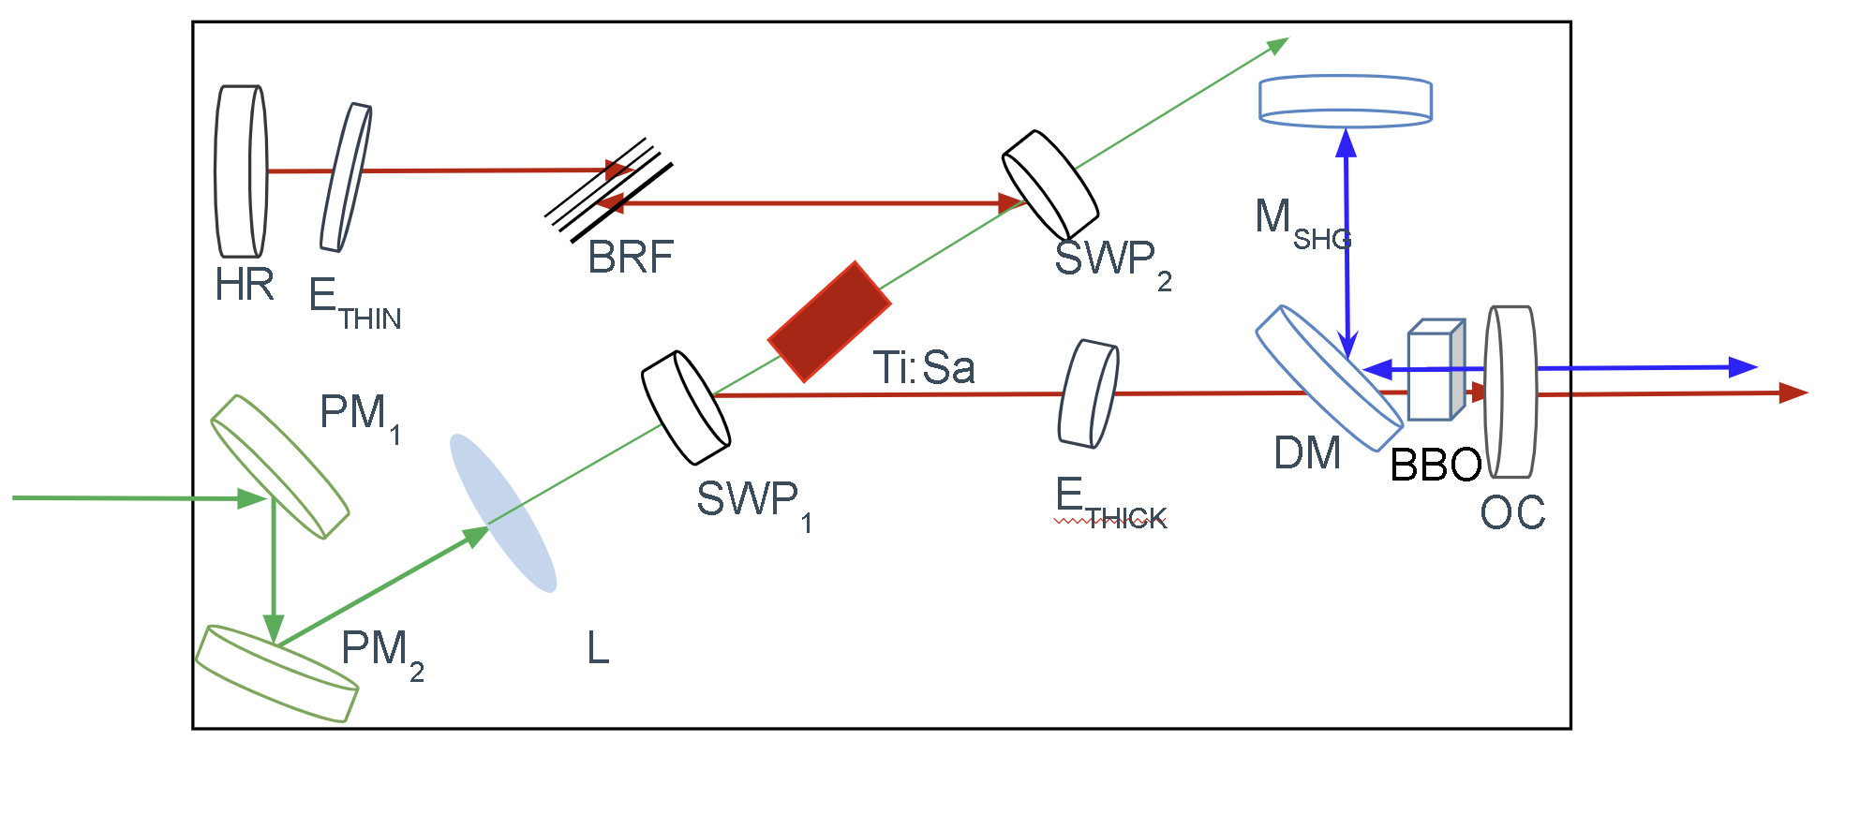
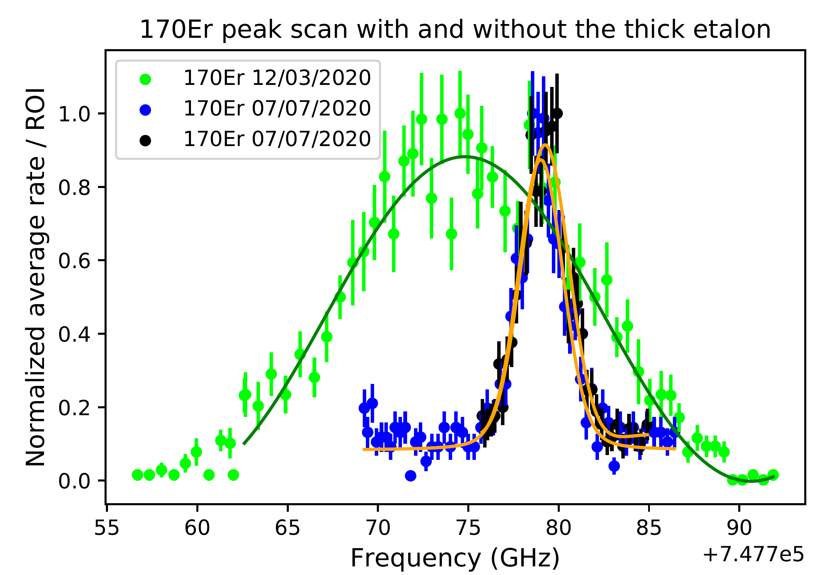
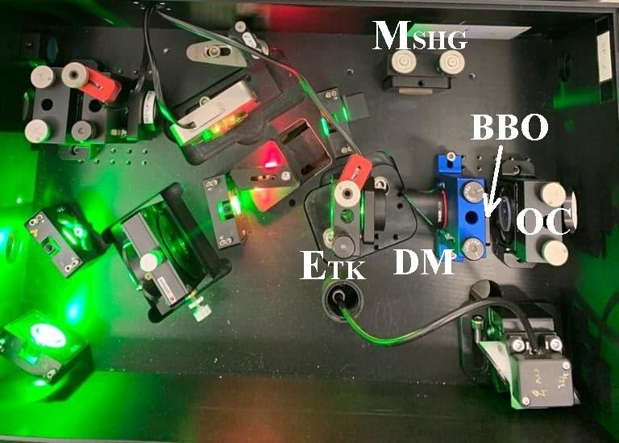
GISELE Results
¹⁶⁷Er
¹⁶⁶Er
¹⁶⁸Er
[8]
Improved FWHM
¹⁷⁰Er
A_{ki} = 1.73e+8 s⁻¹
90 cps
FWHM170Er = 13.4±0.5 GHz
FWHM170Er = 3±0.1 GHz
P_{ex} = 1 - 1.5 mW
(P_{sat}⪬1.5 mW)
5 cps
[8] D. Studer. Masters thesis. Johannes Gutenber-Universitaet Mainz (2015)

Slide 17
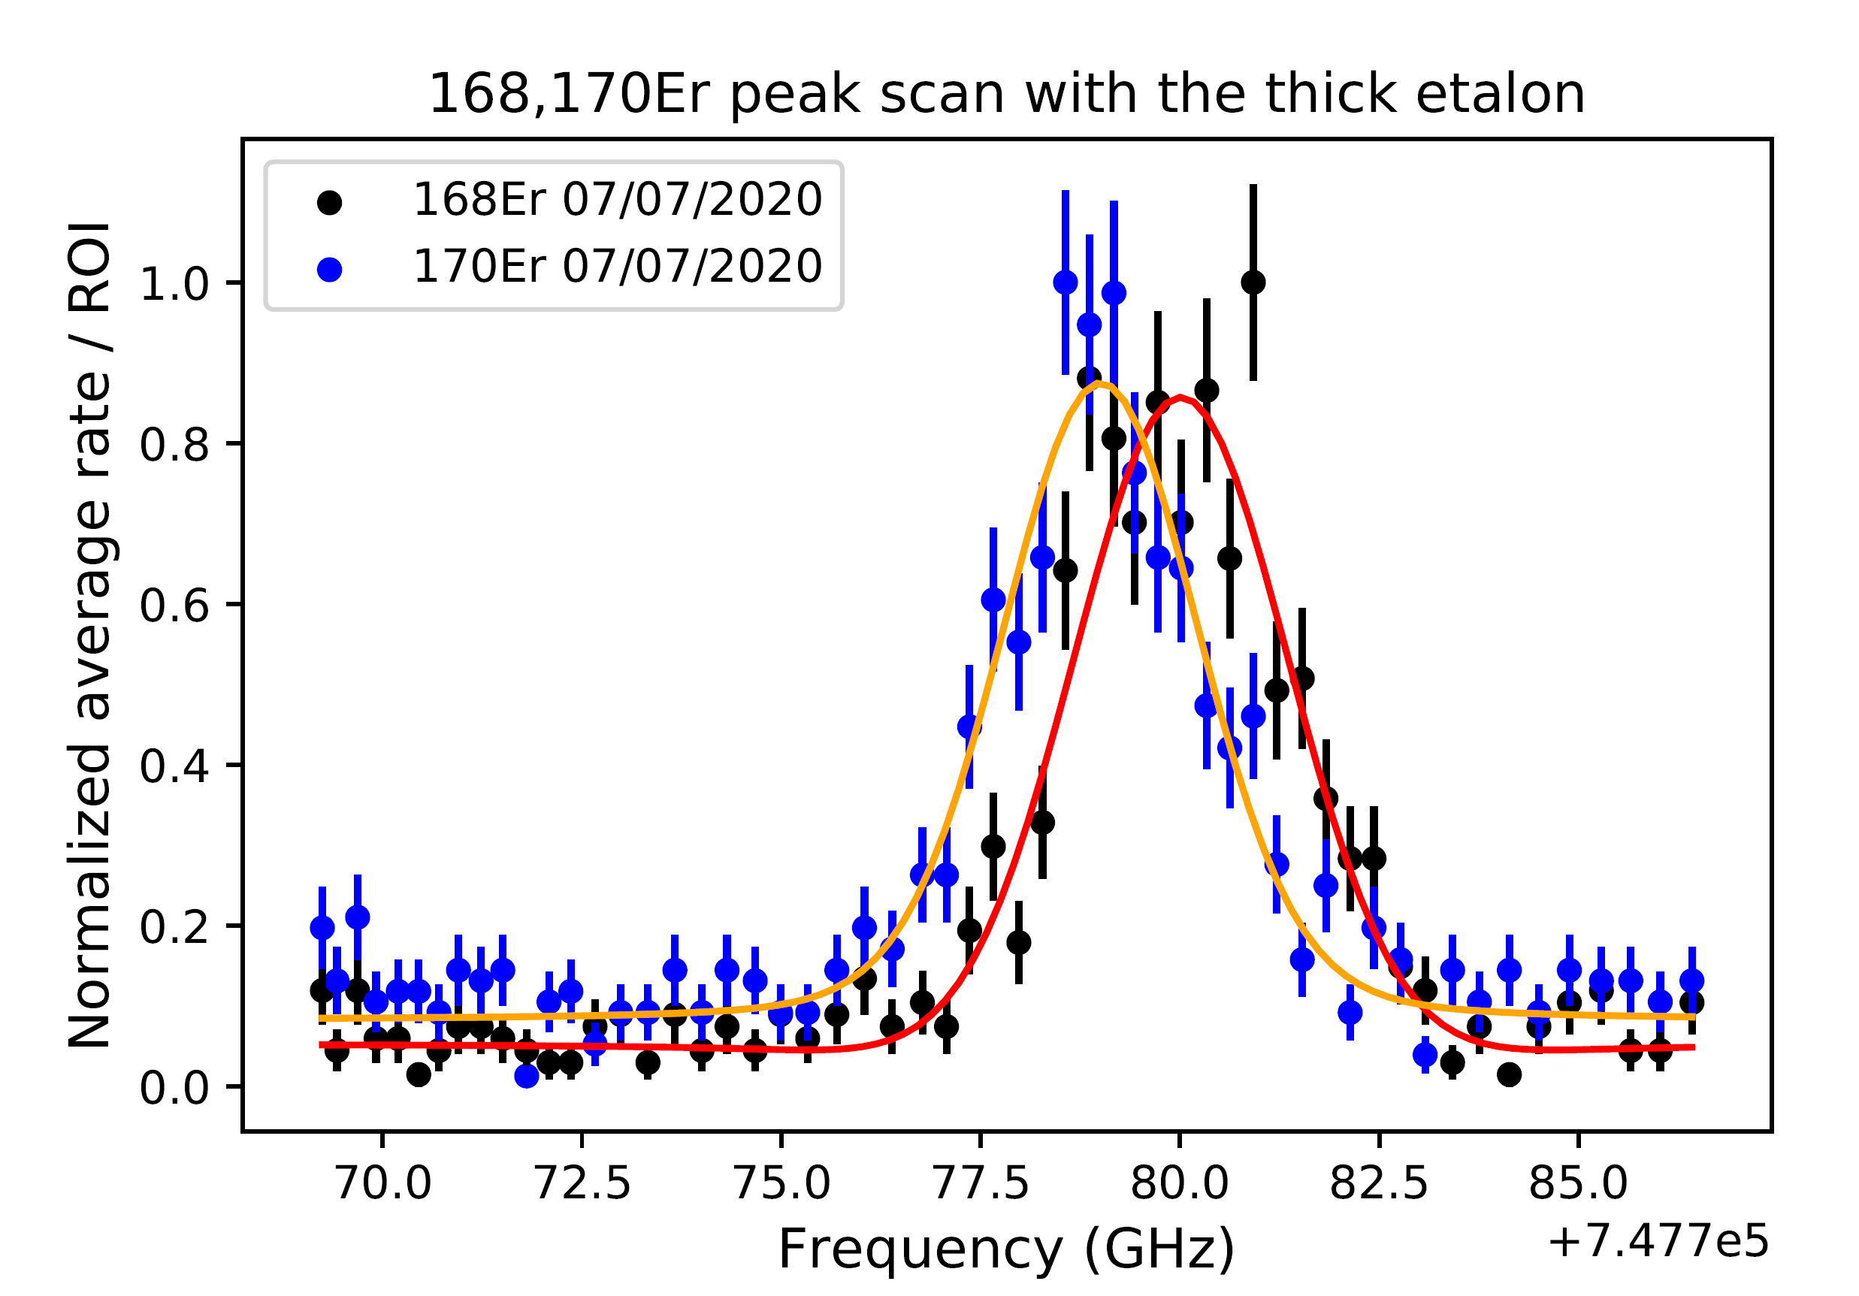
GISELE Results
¹⁶⁷Er
¹⁶⁶Er
¹⁶⁸Er
[8]
¹⁷⁰Er
Er I RIS (IS measurements)
Measurable influence from neighboring peaks
No normalization on power
Varying linewidth 𝝙𝜆 during the scan
A_{ki} = 1.73e+8 s⁻¹
100 cps
 | Thin + Thick etalon |  |  | [9]
𝛥𝛎(¹⁶⁶⁻¹⁷⁰Er)/GHz | 1.34+/-0.06 (0.03) |  |  | 1.681±0.014
 | 1.40+/-0.08 (0.03)
𝛥𝛎(¹⁶⁸⁻¹⁷⁰Er)/GHz | 0.78+/-0.06 (0.03) |  |  | 0.84±0.014
 | 0.87+/-0.07 (0.03)
90 cps
𝞭𝞶_{FS}^{AA’} = F𝞭<r²>
[9] Albert Frisch et al. Phys. Rev. A88.3 (Sept. 2013), p. 032508. doi:10.1103/PhysRevA.88.032508
‹#›
Faculty of Science, IKS, Nuclear and Radiation Physics

Slide 18
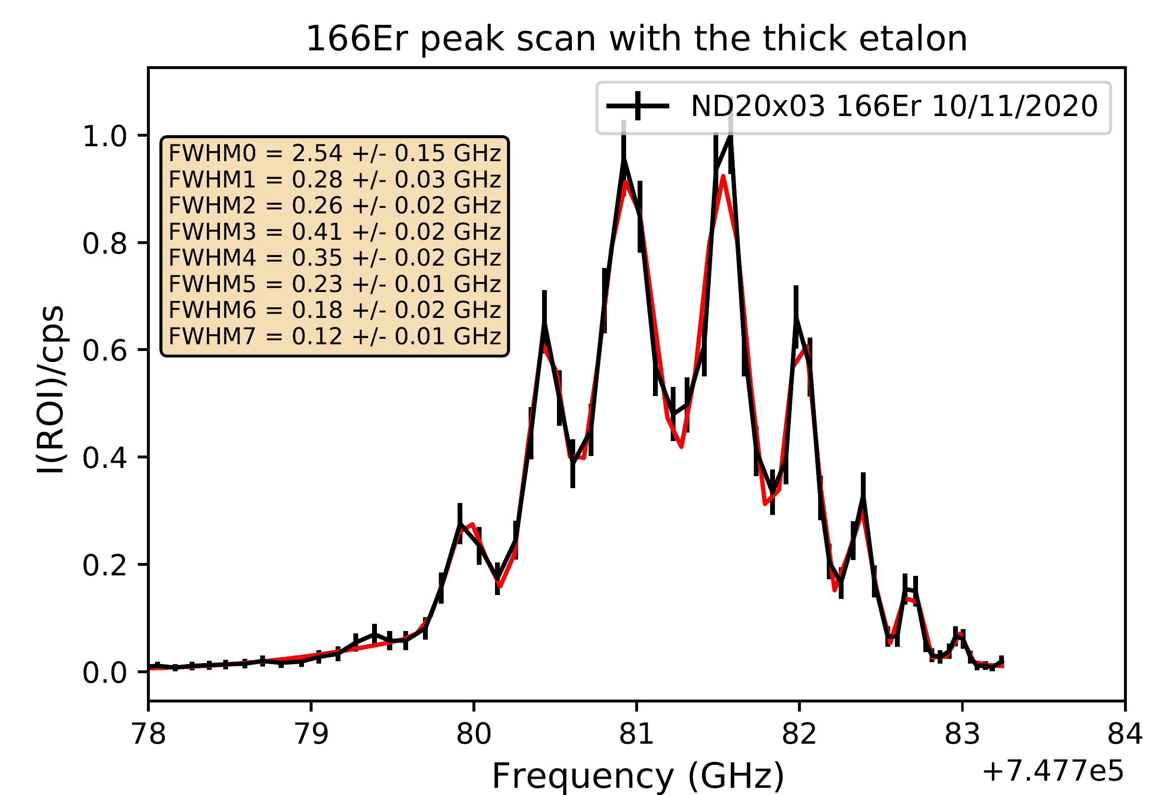
Z-type cavities (further considerations)
Excitation step
Necessary etalon 2D scans
I
III
Thick etalon transmission curve
II
Thick etalon transmission curve
Thin etalon transmission curve
Thick etalon transmission curve
cavity modes
(FSR = 290 MHz)
Thin etalon transmission curve
cavity modes
(FSR = 290 MHz)
Thin etalon transmission curve
cavity modes
(FSR = 290 MHz)
f/Hz
f/Hz
𝞶₁
𝞶₀
𝞶₁
f/Hz
𝞶₁
𝞶₀
𝞶₁
𝞶₁
𝞶₀
𝞶₁
[10]
𝝼/cm⁻¹
12462.88
12459.4
[10] S. Rothe et al. Nucl. Instrum. Meth. Phys. Res. B. 317. PART B (2013), pp. 561–564. doi:10.1016/j.nimb.2013.08.058

Slide 19
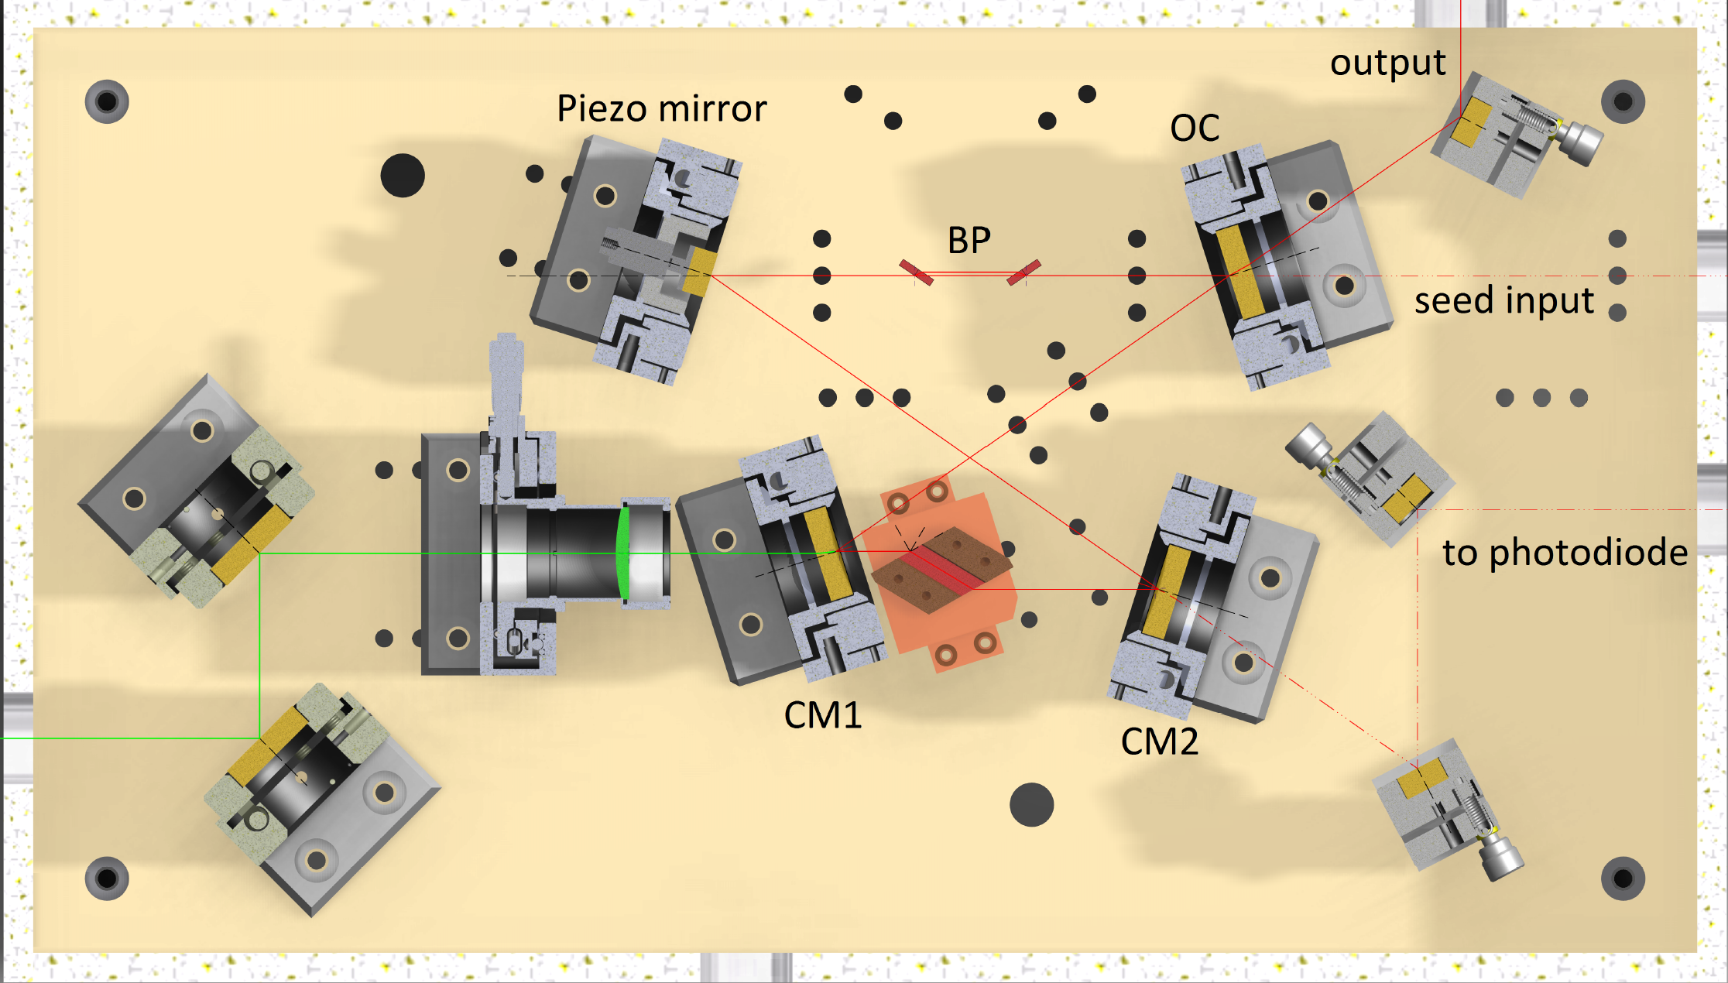
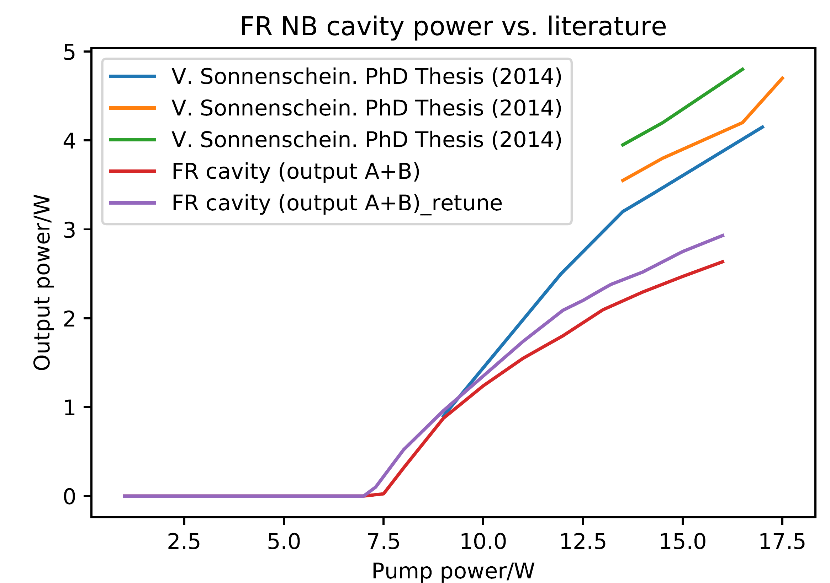
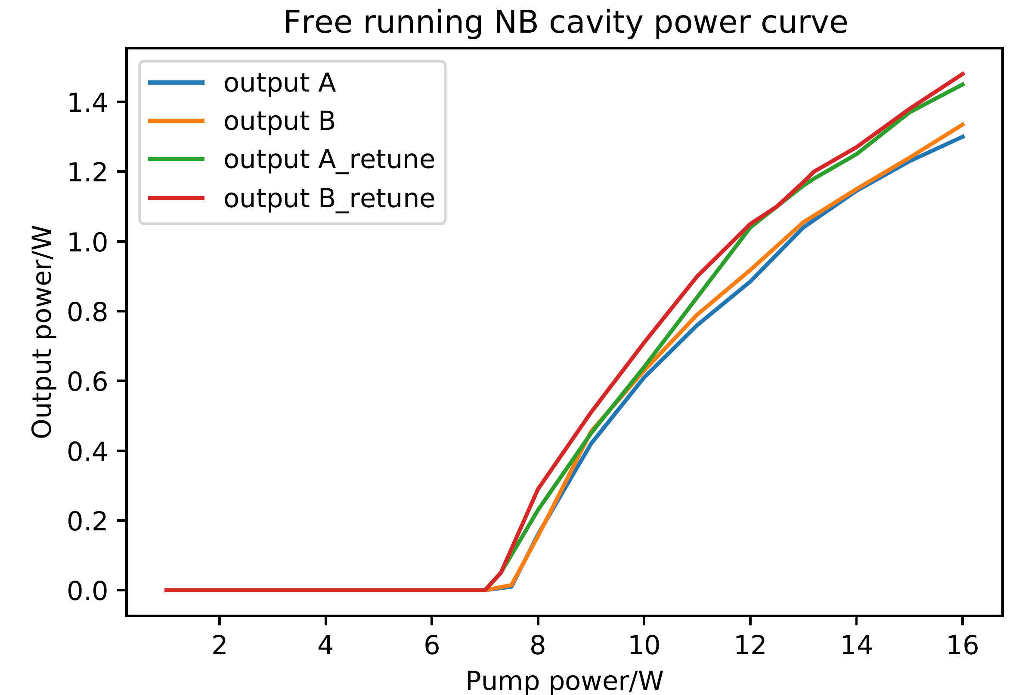
NB Amplifier cavity
Free running cavity alignment work
A
B
[11]
𝝺_{seed} = 780 nm
𝝺_{seed} = 780 nm
Cavity | Etalon config. | SHG config. | Output coupler | Bandwidth/GHz | P_{1νmax}/W | P_{2νmax}/W
NB | - | EC | R = 70 % | 0.01-0.025 [5] | 1.5 [5] | ⪬0.15
BRF | E_{Thin} + E_{Thick} | IC | R = 70 % | 1.5 – 2.5 | 2 | 0.15 -0.6
BRF | E_{Thin} | IC | R = 99.9 % | 3 - 5 | -
[11] V. Sonnershein. PhD Thesis. University of Jyväskylä (2014)
P_{pump} = 10.5 W
Faculty of Science, IKS, Nuclear and Radiation Physics

Slide 20
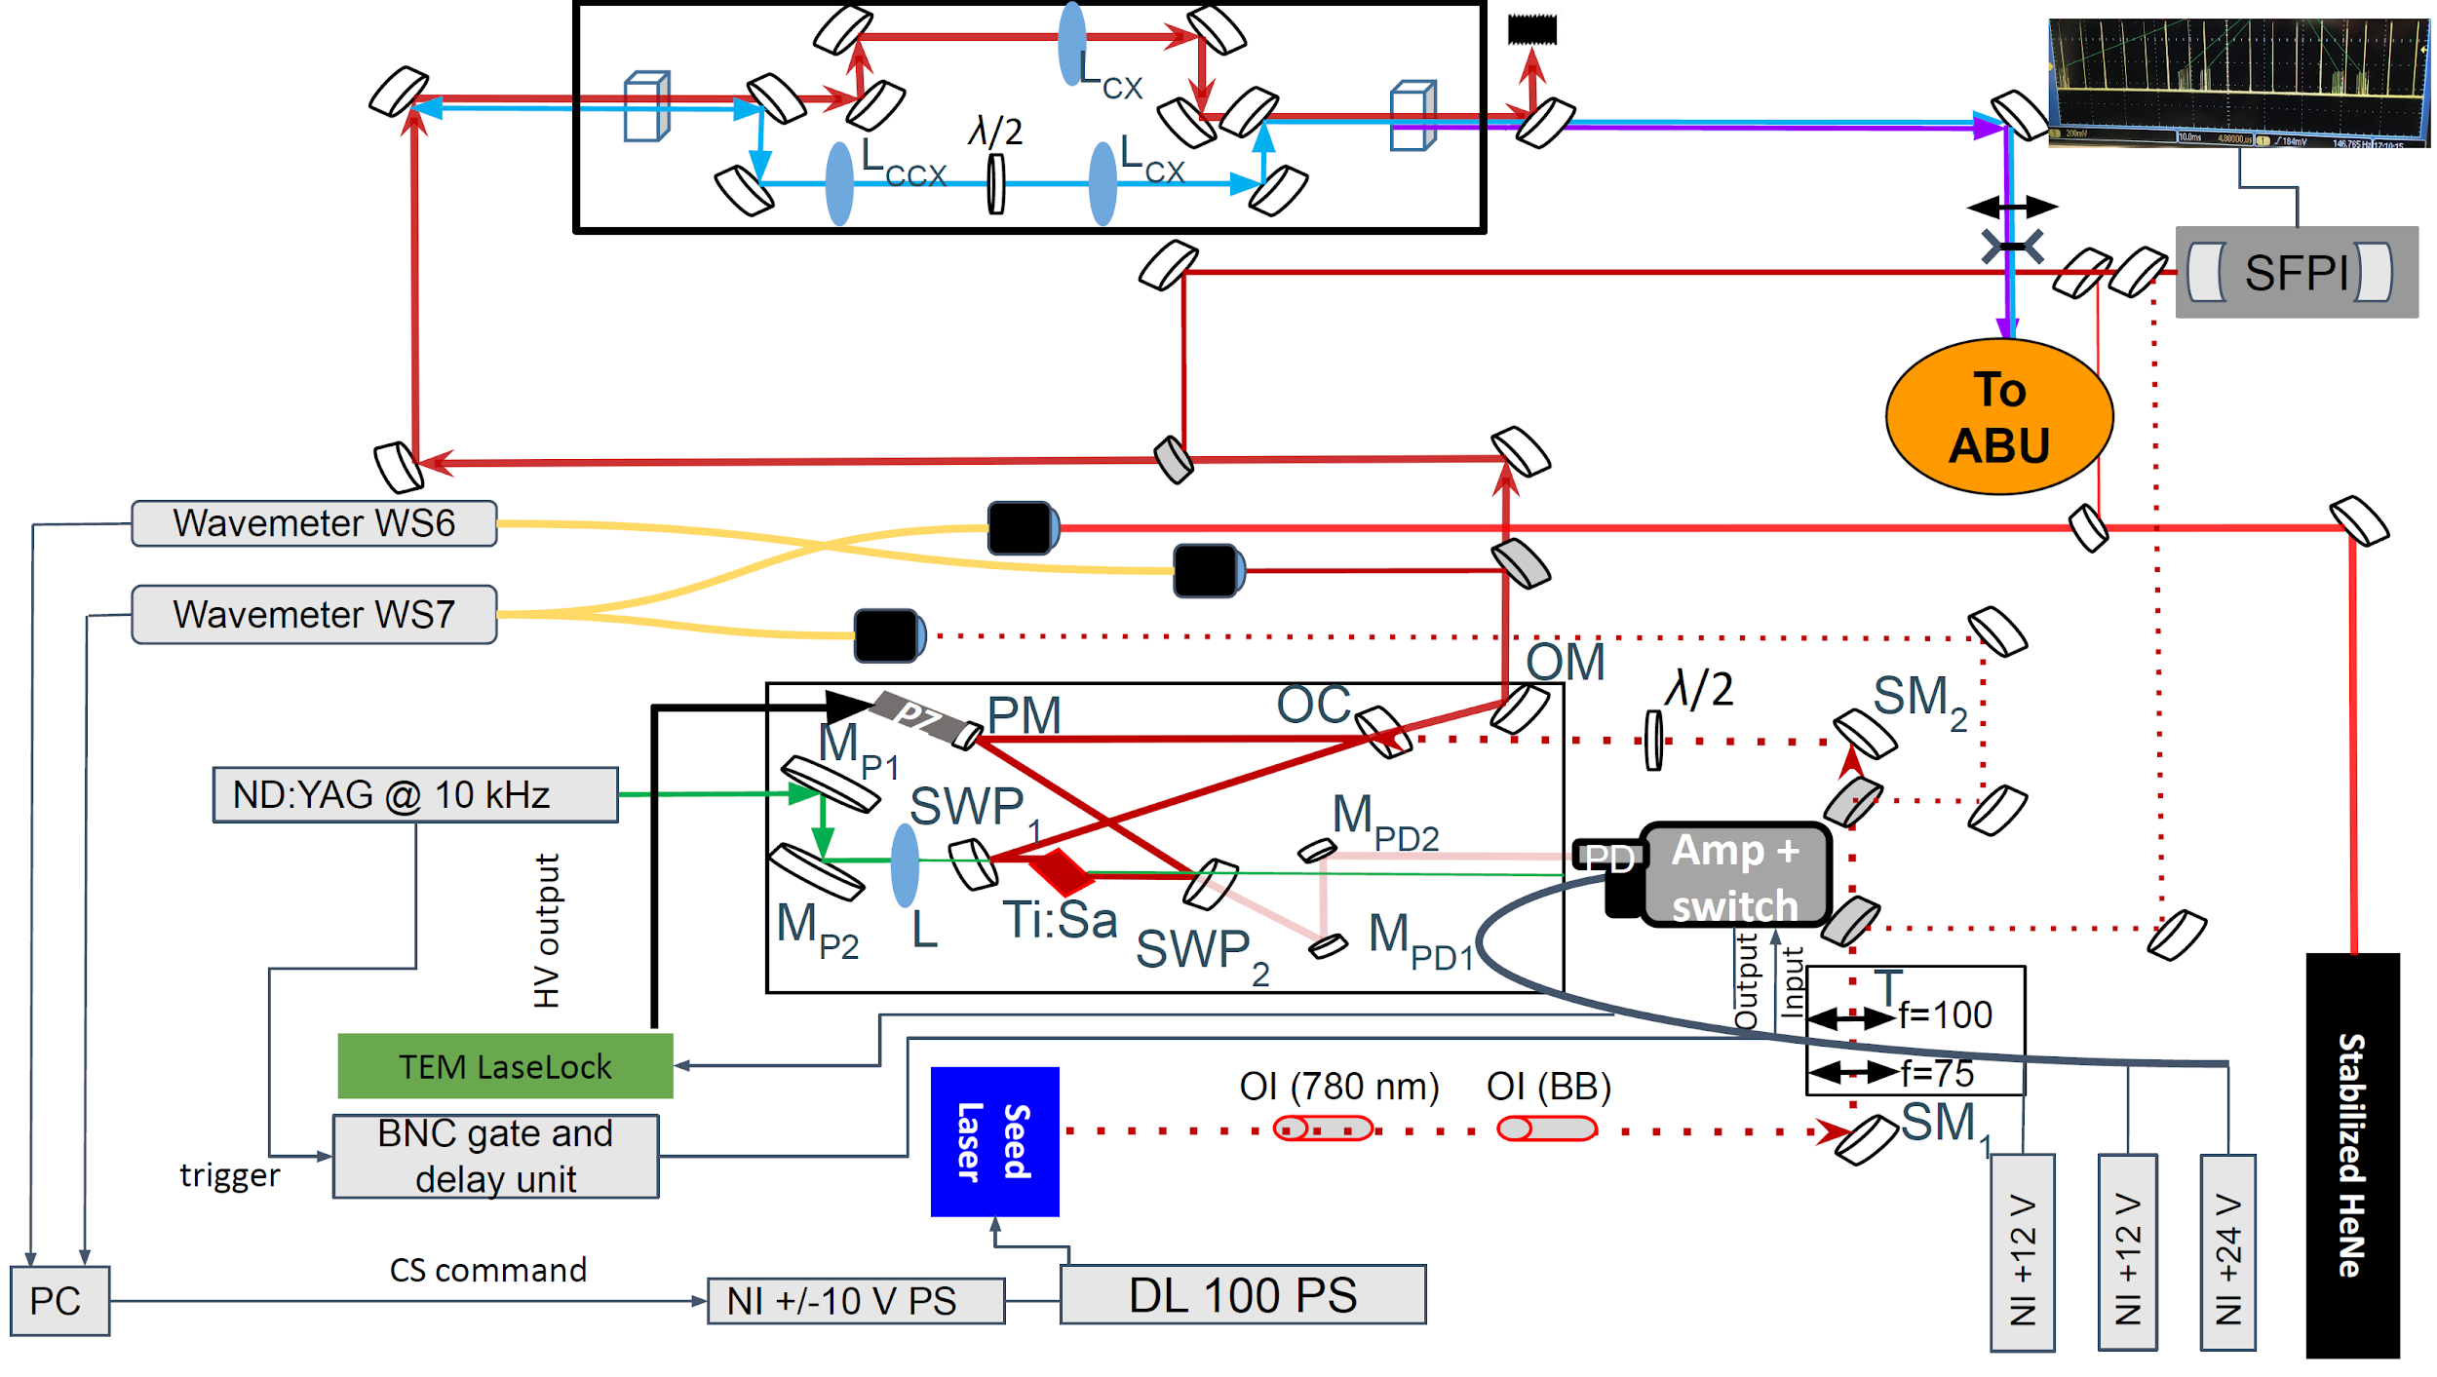
NB Amplifier cavity

Slide 21
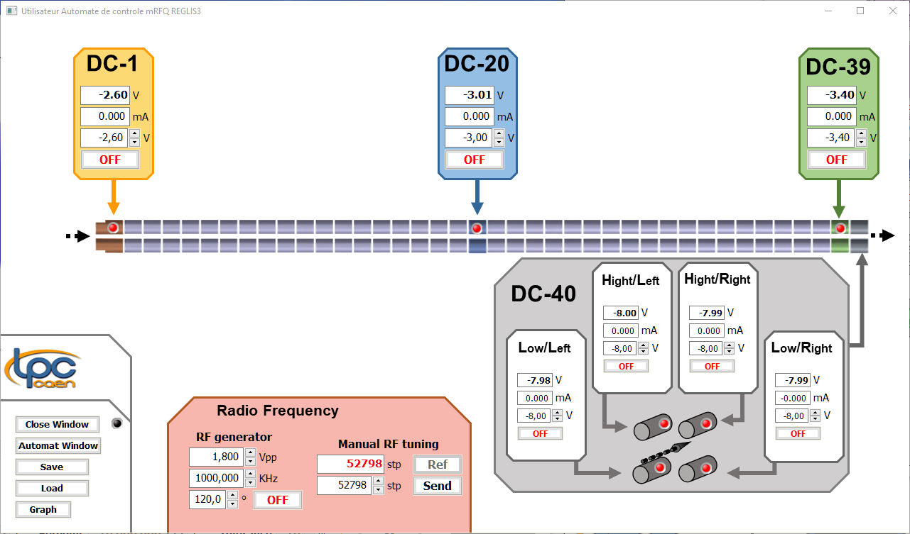
Gas cell chamber
𝞰_{SRFQ+mRFQ} =/I₂/I₁
𝝈 = 10 %
Transmission tests
S-shape + mini RFQs
Simulations
Hard-sphere collision model
Source diffusion half angle (deg): 90 (filled)
KE: 0.1 eV (T_{source} = 1200° K )
Up until 1st mRFQ rods
Working area
for matched hypersonic jet creation
1
2

Slide 22
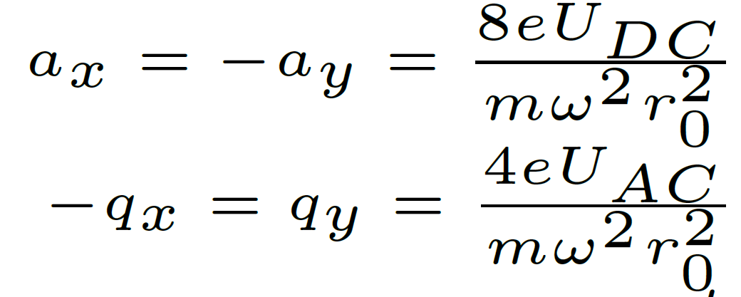
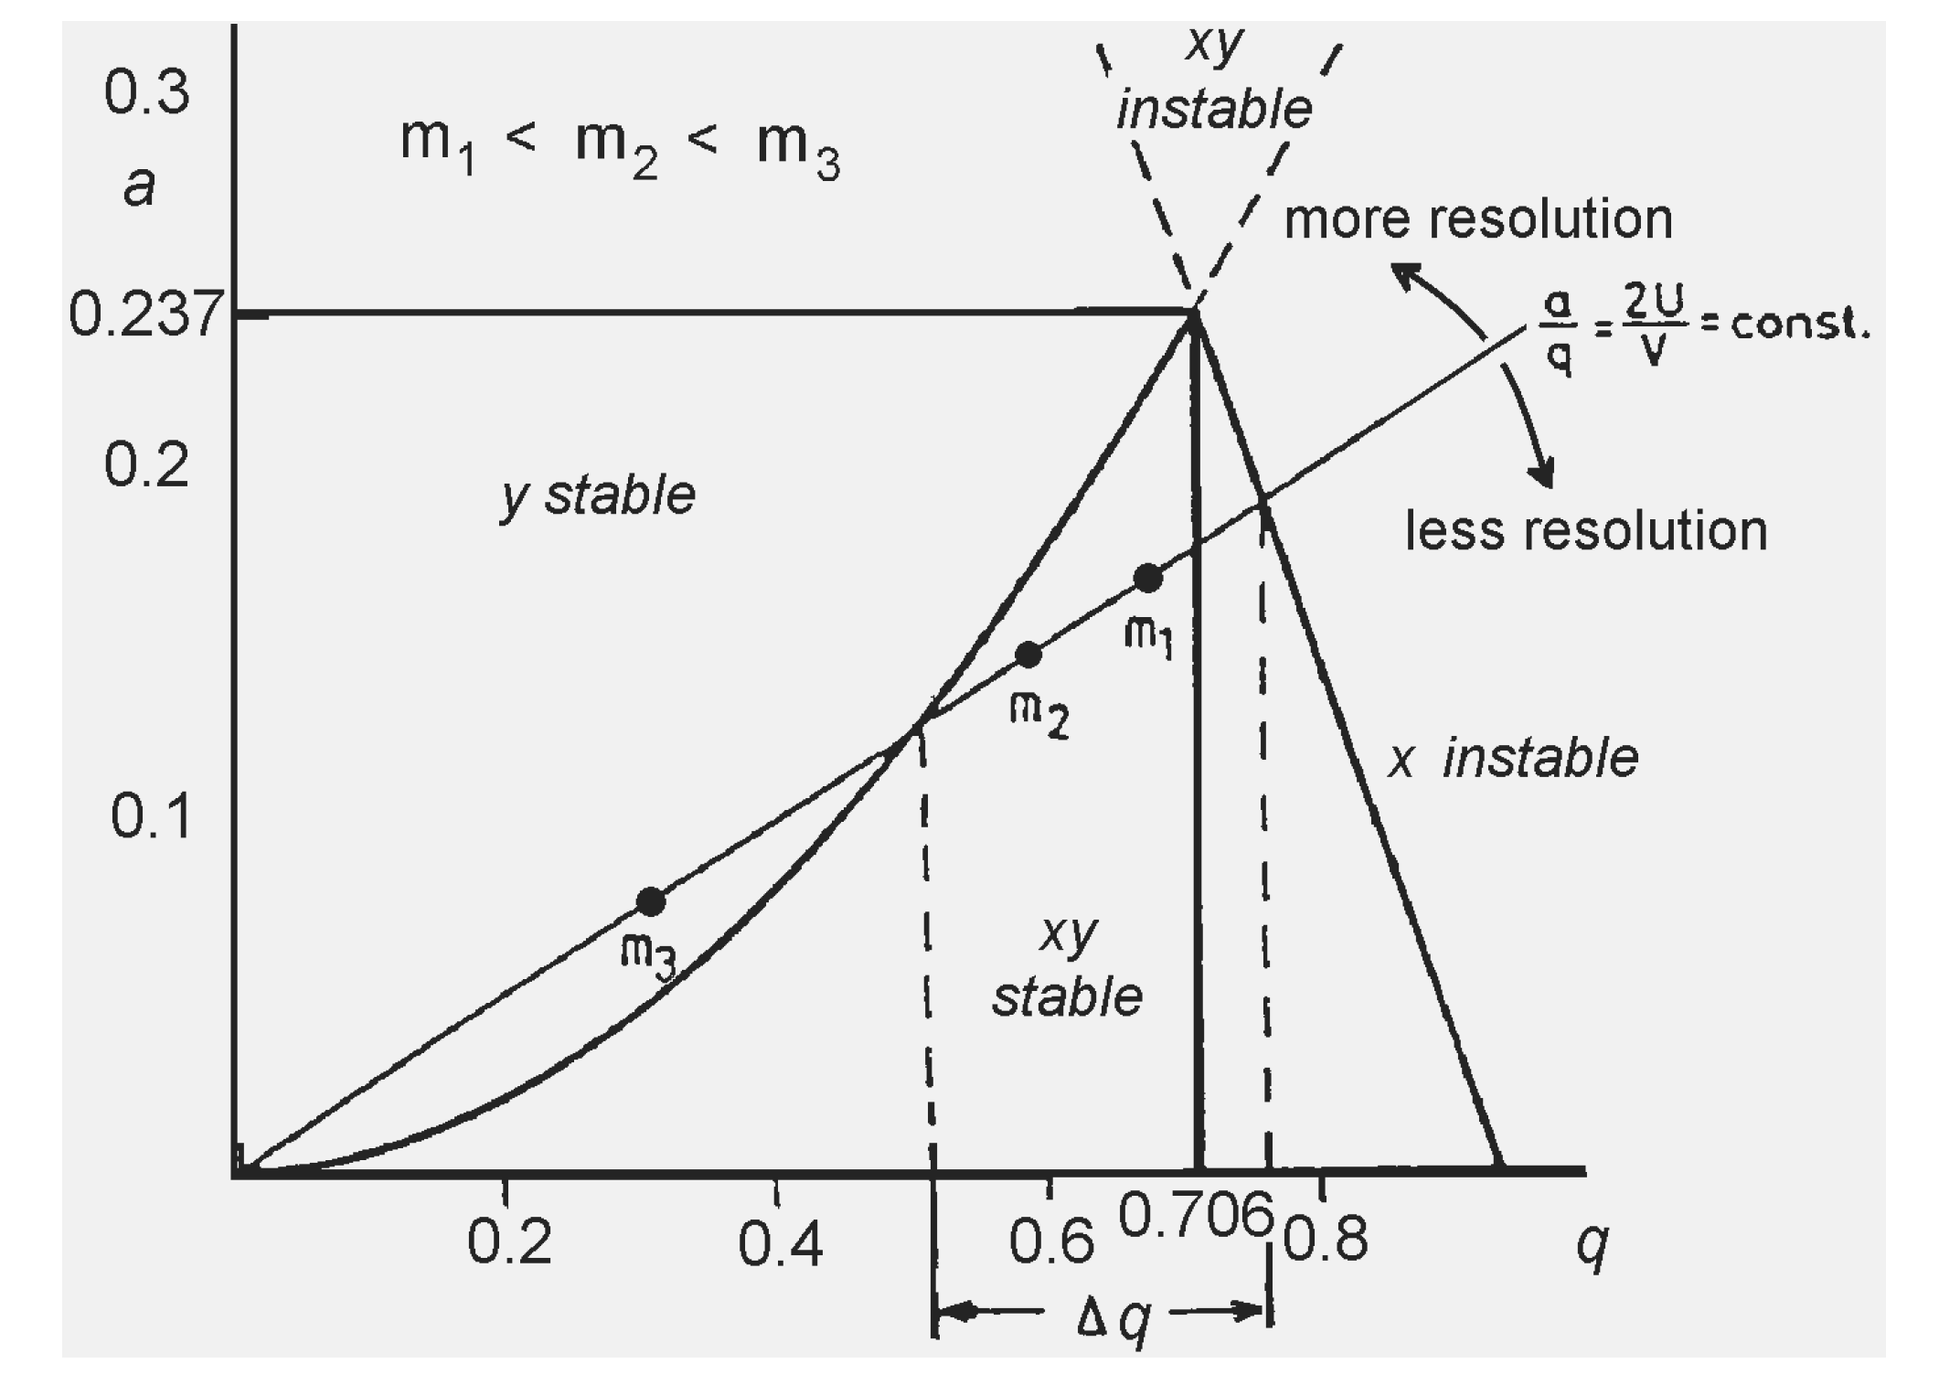
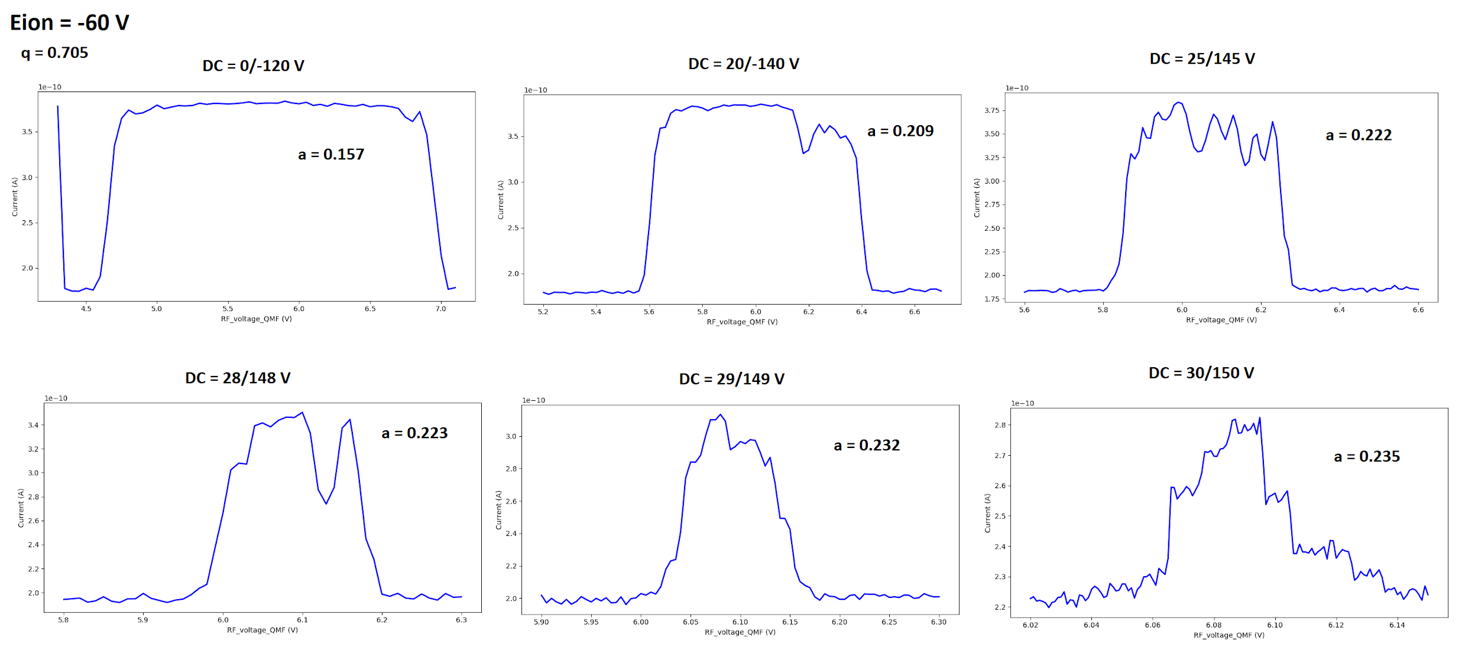
QMF
f_{QMF} = 750 kHz
Reproducible 80-100 % transmission efficiency (guiding mode)
Filtering mode scans for ¹³³Cs
R = m/2𝝙m_{FWHM} = 115 (at stability tip, 𝜂_{T} ⪭ 30 %)

