Slide 1
The EPIC proposal @ ISOLDE
G. Georgiev
A personal view and a collection of presentation from the EPIC workshops

Slide 2
Exploiting the Potential of ISOLDE at CERN
Take advantage of LIU upgrades: proton BOOSTER energy (1.4 GeV → 2 GeV) and intensity increase
  Gain a factor of 1-20 in radioactive beam intensity
Install additional target station(s): allow parallel beams
  double the beam time for an increasing amount of users
  (more than 80 accepted experiments, typically 30 new per year coming)
An upgrade of HIE-ISOLDE – reaching 10 MeV/u for all masses
Install a ‘Storage Ring’ for short-lived (low-energy) isotopes – unique worldwide new opportunities in atomic, nuclear and fundamental (new) physics
A new experimental hall (new experiments coming – mostly low-energy for searching new symmetries/interactions)

Slide 3
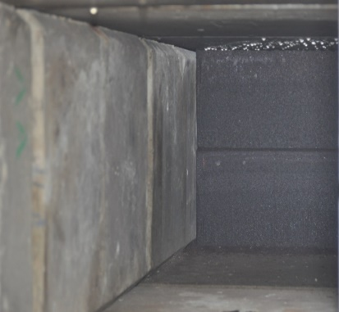
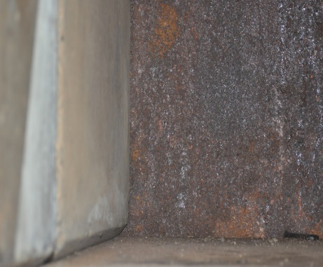
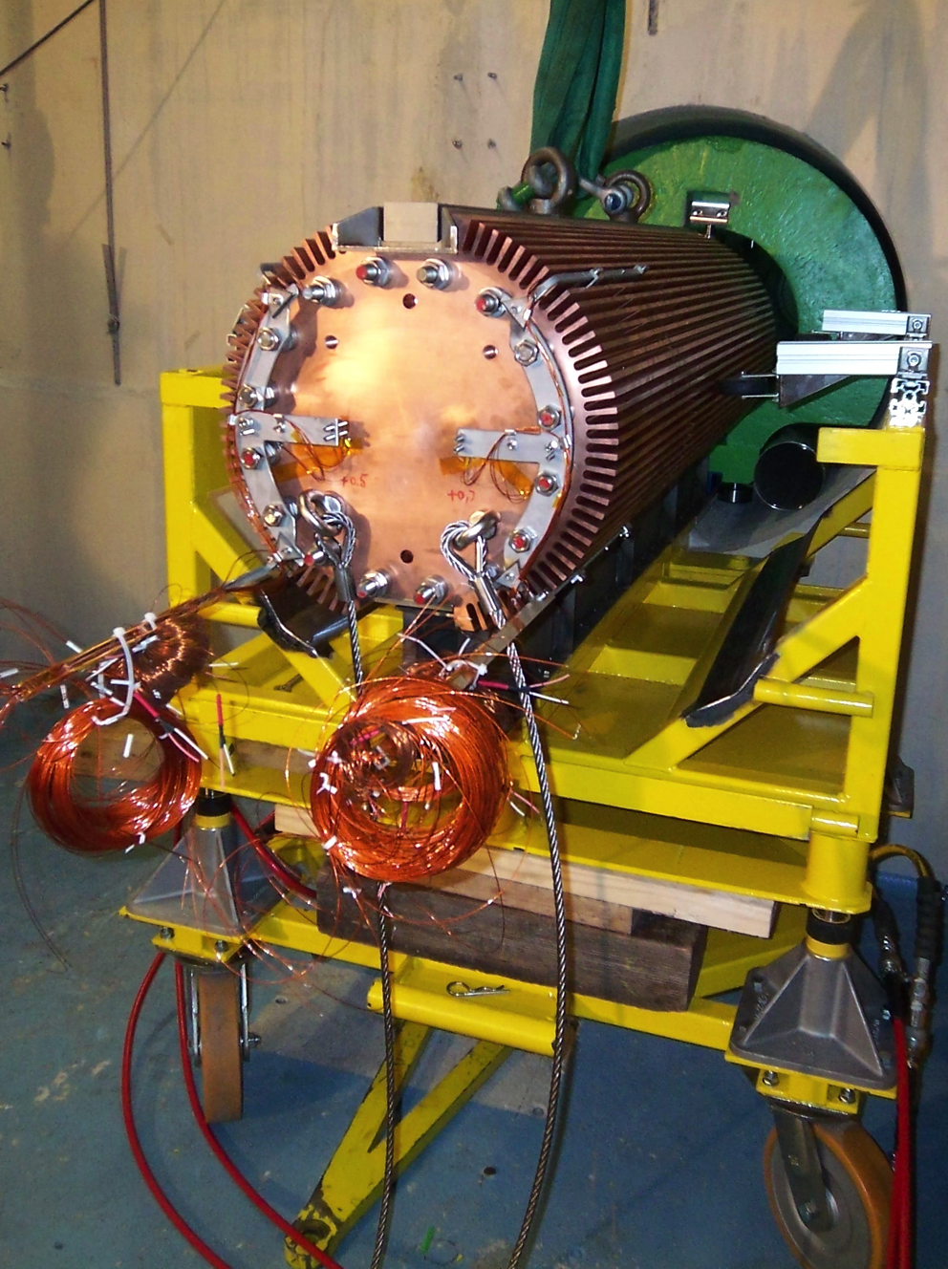
2 GeV energy upgrade
Beam dumps replacement
  Material not conform to standards
  Unknown condition and signs of corrosion
  Required for Energy and Intensity upgrade
Beam dump exchange will be complex process and should take place during LS3 – preparations have started in 2020
Upgrading BTY line to transfer 2 GeV protons to ISOLDE
  It is feasible and there are two potential routes
  Will require statement from ATS Sector management before studies can commence.

Slide 4
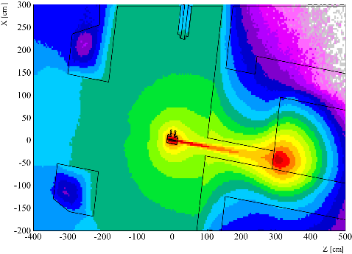
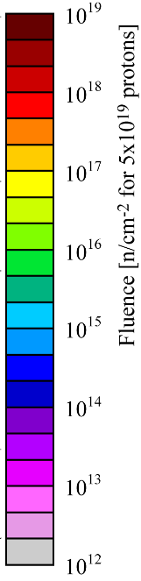
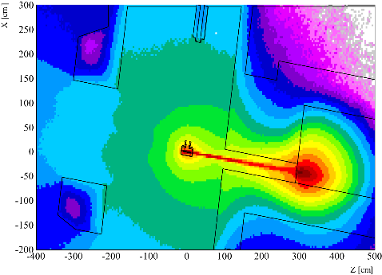
2 GeV and Intensity upgrade
Increase of p-intensity ( x2)
Fluence mapping (All particles)
1.4 GeV 3.5g/cm³
The yield will scale with intensity
Increase the target dose and frontend dose
Peak power and shocks may impact on target lifetime.
2.0 GeV 1.3g/cm³
Higher beam energy combined with target development may help reduce dose and increase target and frontend lifetime at higher intensities.
The possibility to maintain both energies (1.4 GeV and 2 GeV) should be kept!

Slide 5
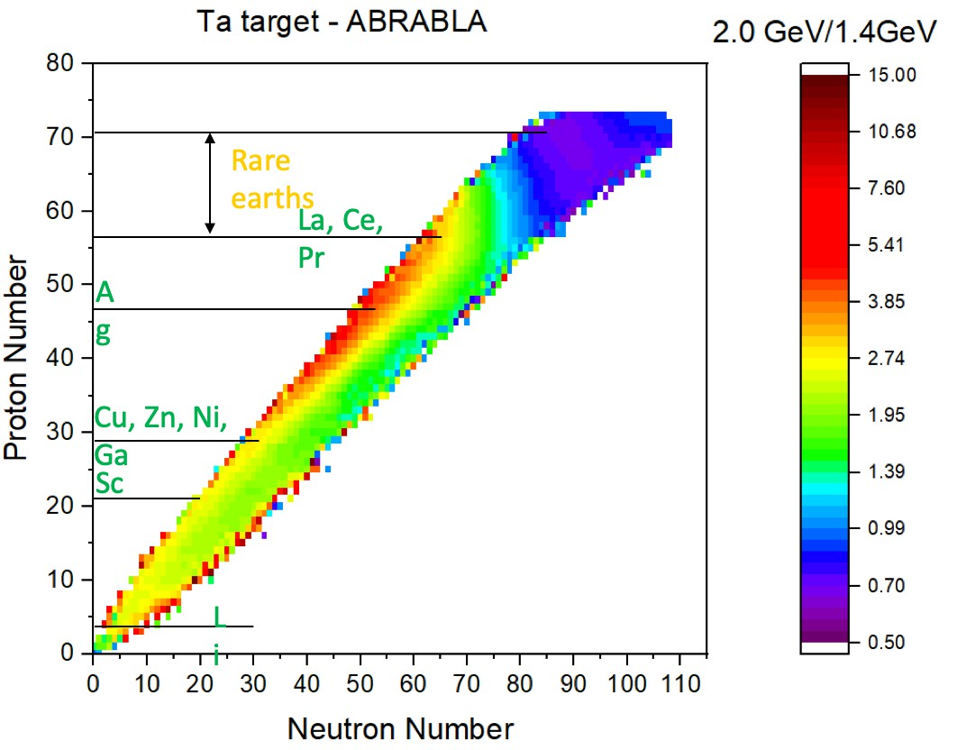
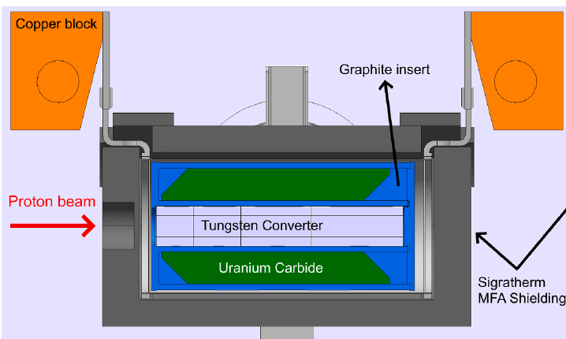
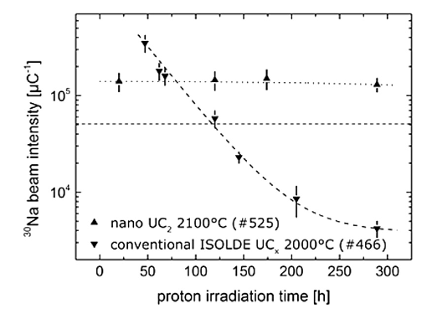
2 GeV and Intensity upgrade
Increase of PS-BOOSTER energy (1.4 to 2 GeV)
Largest increase for the exotic n-deficient isotopes
(Z_{isotope} = Z_{target} – (10 to 30)) →factors of 2 to 40 predicted
Low Z isotopes (fragmentation):
  Increase in factors of 2 to 4
For neutron induced fission there is potentially higher contamination induced by scattered protons (but they will also scatter less) requires design considerations.
DB

Slide 6
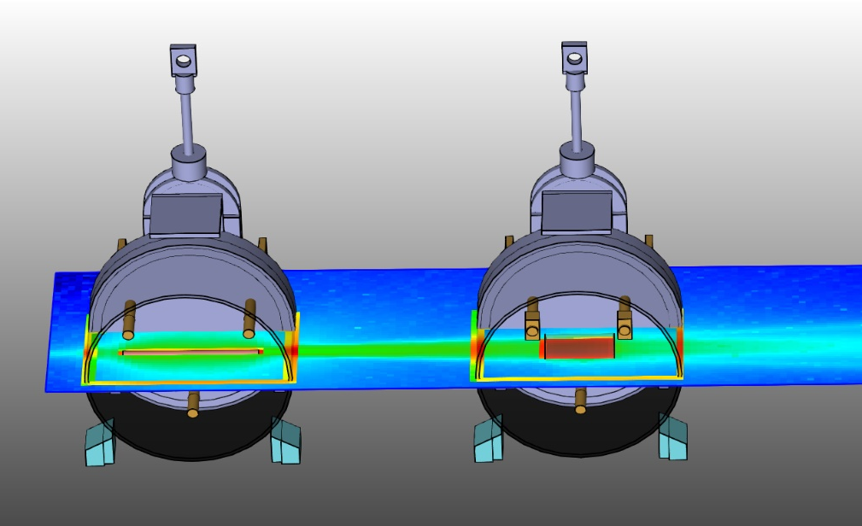
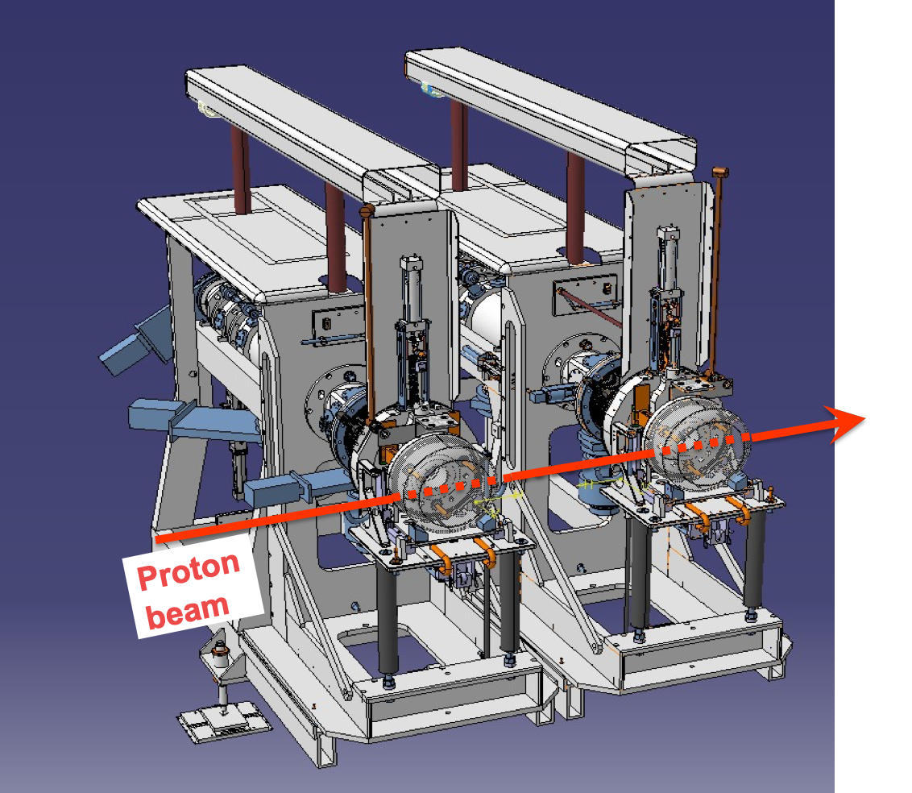
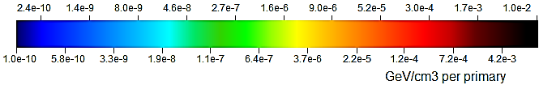
Higher energy - double front end?
M. Lozano
ISOLDE Target #1
UC₂ 3.5 g/cm³
19.6 cm length
0.7 cm radius
ISOLDE Target #2
UC₂ 7.0 g/cm³
10.0 cm length
2.5 cm radius
25 cm
1.4 GeV protons
FLUKA Simulation: Ch. Duchemin
Two targets installed in series in a single front-end area profiting from the full proton current simultaneously.
Significant cost reduction in civil engineering
Overall RIB production would increase significantly.

Slide 7
Upgrade of REX-ISOLDE
REX/HIE-ISOLDE today:
RFQ
Buncher
IHS
7GP1
7GP2
7GP3
9GP
CM1
CM2
CM3
CM4
Room temperature upgrade of REX + fifth high-beta cryomodule:
RFQ
Buncher
ST1
ST2
ST3
ST4
ST5
ST6
CM1
CM2
CM3
CM4
CM5
Ideally 10 MeV/u for all masses (some experiments not possible at lower energies)
Priority from the users to allow A/Q to be extended to 5.5
Upgrading the EBIS:
  Higher charge states and faster breeding time.
  Reduce pressure on the accelerator
Bunched beams for TOF measurements

Slide 8
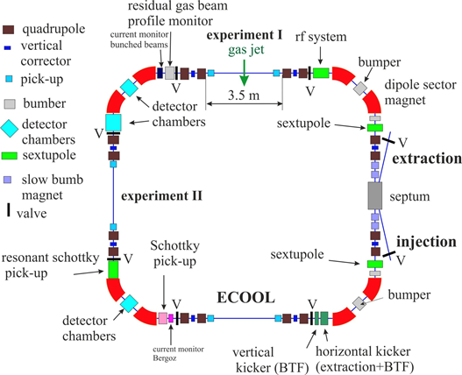
A new compact storage ring
Stored radioactive beams have many advantageous
Uniqueness: injection at the required energy (fast – shorter lifetimes accessible)
Can be used multiple times in an in-ring detector (luminosity increase!)
Can be cooled to deliver excellent quality beams to external experiments for high-precision studies
10 m
Talks given by:
Manfred Grieser (a new design)
Yuri Litvinov (physics)

Slide 9
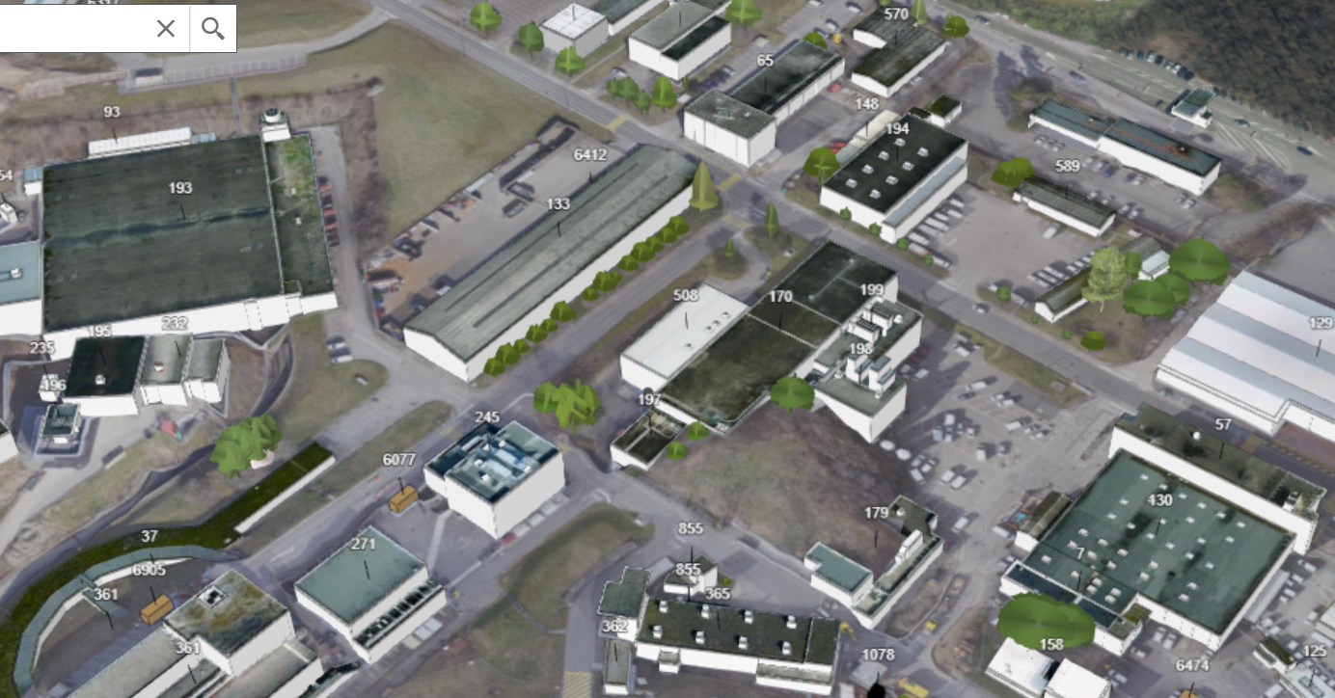
A new ISOLDE experimental hall and target stations
E. Siesling, J.A. Rodriguez - 2020 EPIC Workshop
Fire Brigade
CERN goods reception
Recuperation site building 133
Potential for a new ISOLDE Low Energy Nuclear Physics facility at CERN
AD pbar facility
ISOLDE experimental hall 170,
control & user building 508 and cryo buildings 198, 199
ISOLDE target area, Class A lab,
MEDICIS and nano-lab
PS Booster
BTY proton line from PSB to ISOLDE target area

Slide 10

Facility Layout (general idea):
Beam dump
Slow released isotopes
Mass separator dipoles
Time separator kickers
Experimental stations
Target
01
Fast released isotopes
Beam
switchyard
High-resolution separator
Target
02
Experimental stations
Beam dump
Time separator kickers
Target
03
High-resolution separator
Proton beam
Beam characterization lines
Fast released isotopes
Target
04
Slow released isotopes
Experimental stations
Mass separator dipoles
Proton beam
J.A. Rodriguez, E. Siesling – EPIC Workshop – 2020/11/25

Slide 11
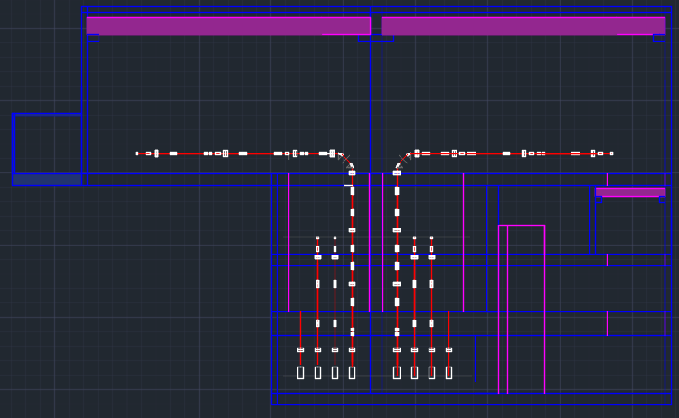

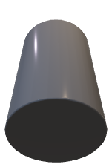
Cross-section of the Proposed Hall and Underground Area:
Surface:
New experimental Hall
Access to
beam distribution level from the 508 side
15 m ?
Surface Level 0:
Experimental Hall
SAS Area
Rutherford road
Vertical beamlines
Underground Level -1:
Beam distribution and purification
5 m span crane
Underground:
Target zone, Services and beam preparation
Underground Level -2:
HT/RILIS/CV
17 m
TT70 tunnel use to transfer protons from the PSB
Underground Level -3:
Target/Separator

Slide 12
Cross-section of the Proposed Hall and Underground Area:
Surface:
New experimental Hall
Access to
beam distribution level from the 508 side
15 m ?
Surface Level 0:
Experimental Hall
SAS Area
Rutherford road
Vertical beamlines
Underground Level -1:
Beam distribution and purification
6 m
5 m span crane
Underground Level -2:
HT/RILIS/CV
4 m
Underground Level -3:
Target/Separator
5 m
90 deg. separator magnets
Separator areas
Elevator/stairs shaft
1-3 m thick concrete shielding floor
Shaft to lower equipment

Slide 13
Cross-section of the Proposed Hall and Underground Area:
25 m span, 15+ ton cranes
Access to
beam distribution level from the 508 side
15 m ?
Surface Level 0:
Experimental Hall
Beamline level: 1.75 m
SAS Area
Rutherford road
Vertical beamlines
Underground Level -1:
Beam distribution and purification
5 m span crane
Underground Level -2:
HT/RILIS/CV
4 m
Underground Level -3:
Target/Separator
5 m
90 deg. separator magnets
Separator areas
Elevator/stairs shaft
1-3 m thick concrete shielding floor
Shaft to lower equipment

Slide 14
Cross-section of the Proposed Hall and Underground Area:
Surface:
New experimental Hall
Access to
beam distribution level from the 508 side
15 m ?
Surface Level 0:
Experimental Hall
SAS Area
Rutherford road
Vertical beamlines
Underground Level -1:
Beam distribution and purification
5 m span crane
Underground area
Underground Level -2:
HT/RILIS/CV
17 m
TT70 tunnel use to transfer protons from the PSB
Underground Level -3:
Target/Separator

Slide 15
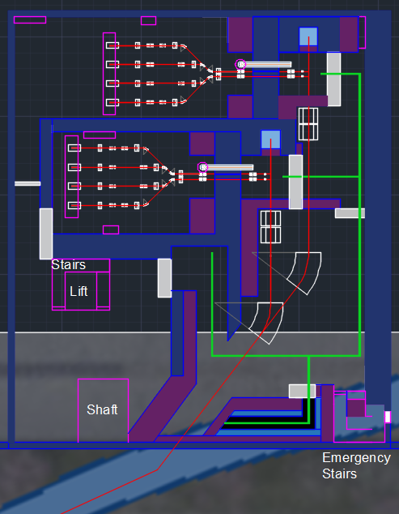
Layout of Underground Level -3: Target/Separator Zones:
30m
34m
Underground Level -3:
Target/Separator
Surface: 1020m²

Slide 16
Layout of Underground Level -3: Target/Separator Zones:
Cooling, ventilation and cable trays shafts
Beam dumps
Faraday cage of Target area 1
Boris tube
Faraday cage of Target area 1
Separator area 1
Double target front-ends
90 deg. separator magnets
Faraday cage of Target area 2
Separator area 2
Laser injection points
Robot rail
Access lift and stairs
Bending dipoles
Target exchange point
Robot parking area
Cooling and ventilation
Underground Level -3:
Target/Separator
Shaft to lower equipment
Emergency exit to TT70
Emergency stairs
Robot control room
2 GeV proton beamline
Used target storage
TT70 tunnel
Used target storage

Slide 17
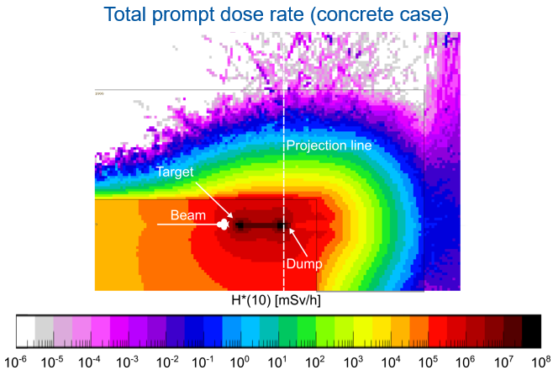
Radiation shielding of Underground Level -3: Target/Separator Zones:
Separator area 1
Concrete + iron walls (2 m thick)
Beam dumps
Concrete blocks
Concrete movable door (1 m thick)
Concrete wall (2 m thick)
Courtesy F. Pozzi
ISOLDE beam dump study preliminary nrs
Concrete blocks (0.75 m thick)
Concrete wall (1 m thick)
Concrete movable door (0.75 m thick)
Separator area 2
Bending dipoles
Concrete movable door (1 m thick)
Access to target area
Underground Level -3:
Target/Separator
Concrete wall + blocks (1+1 m thick)
Emergency exit to TT70
Concrete blocks (2 m thick)
Emergency stairs
Concrete blocks (1 m thick)
Used target storage

Slide 18

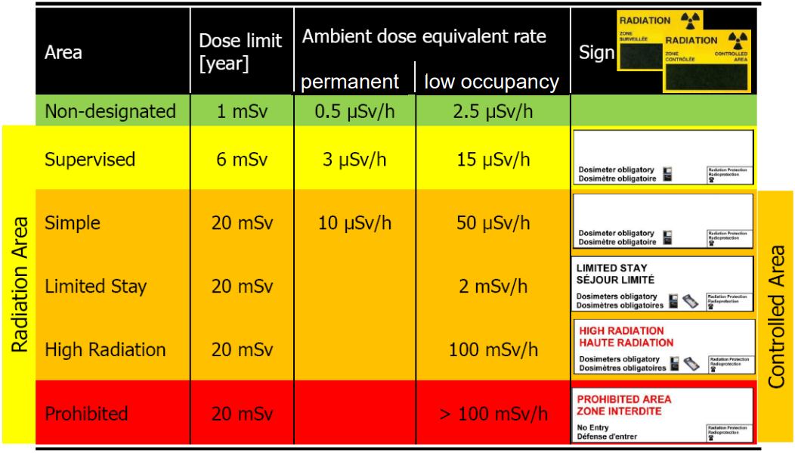
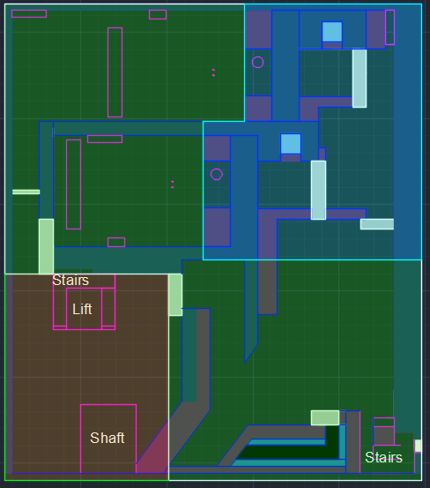
Target/Separator Ceiling Thickness:
Shielding blocks behind building
Courtesy F. Pozzi
ISOLDE beam dump study preliminary nrs
~5 m thick ceiling
blocks above dump area increasing total to >7 m
2 m thickness
Standard thickness
1.0 m ?
2 m thickness
Underground Level -3:
Target/Separator

Slide 19
Cross-section of the Proposed Hall and Underground Area:
Surface:
New experimental Hall
Access to
beam distribution level from the 508 side
15 m ?
Surface Level 0:
Experimental Hall
SAS Area
Rutherford road
Vertical beamlines
Underground Level -1:
Beam distribution and purification
Underground area
5 m span crane
Underground Level -2:
HT/RILIS/CV
17 m
TT70 tunnel use to transfer protons from the PSB
Underground Level -3:
Target/Separator

Slide 20
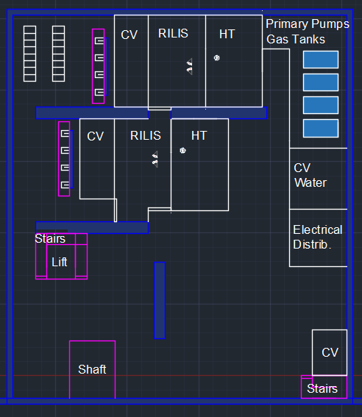
Layout of Underground Level -2: HT/RILIS/CV Zones:
30m
34m
Underground Level -2:
HT/RILIS/CV
Surface: 1020m²

Slide 21
Layout of Underground Level -2: HT/RILIS/CV Zones:
Laser rooms for targets in both separators
~37m2 each
High tension rooms
Vacuum primary pumps
Gas storage tanks
Electronic racks for equipment at the separator level
Water station for target/beam dump
Vertical beamlines shaft
Boris tube
Laser injection points
Underground Level -2:
HT/RILIS/CV
Access lift and stairs
Shaft to lower equipment
Target/separator areas filtering and ventilation
Emergency stairs to target area
Regular stairs to upper levels

Slide 22
Cross-section of the Proposed Hall and Underground Area:
Surface:
New experimental Hall
Access to
beam distribution level from the 508 side
15 m ?
Surface Level 0:
Experimental Hall
SAS Area
Rutherford road
Vertical beamlines
Underground Level -1:
Beam distribution and purification
5 m span crane
Underground Level -2:
HT/RILIS/CV
Underground area
17 m
TT70 tunnel use to transfer protons from the PSB
Underground Level -3:
Target/Separator

Slide 23
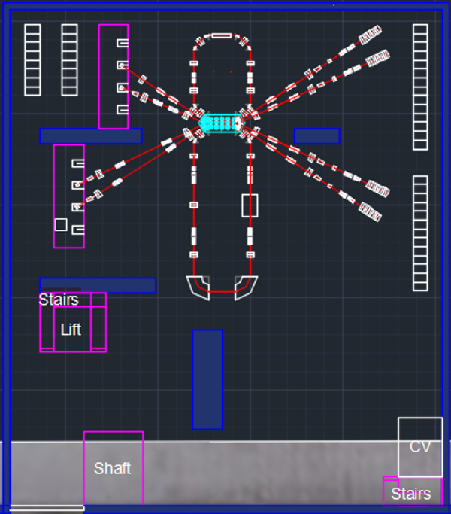
Layout of Underground Level -1: Beam Distribution and Purification:
30m
34m
Underground Level -1:
Beam distribution and purification
Surface: 1020m²

Slide 24
Layout of Underground Level -1: Beam Distribution and Purification:
Electronic racks for equipment
Beam characterization lines (triplet + BI + tape station)
Vertical beamlines shaft
Underground Level -1:
Beam distribution and purification
Vertical beamlines to experimental hall
Access lift and stairs
HRS purification area
Ventilation for lower levels
Stairs to upper and lower levels
Shaft to lower equipment

Slide 25
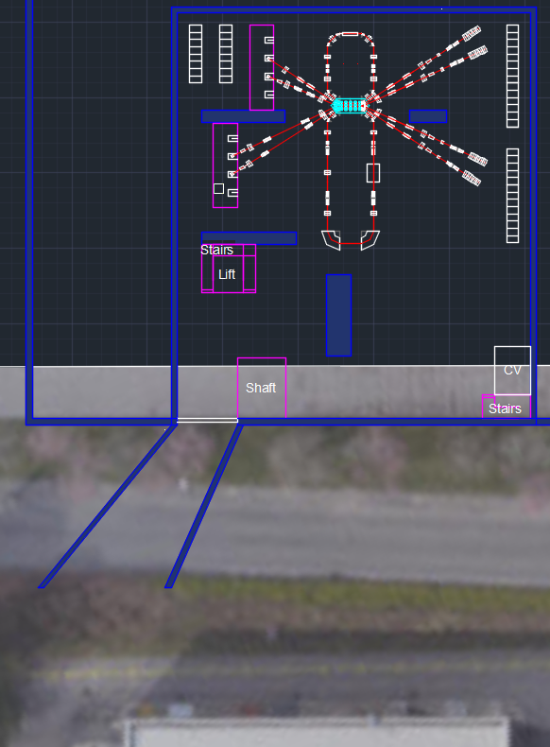
Layout of Underground Level -1: Beam Distribution and Purification:
Access lift and stairs
Underground Level -1:
Beam distribution and purification
Shaft to lower equipment
Stairs to upper and lower levels
Route Rutherford
Side access to
beam distribution level (under Route Rutherford)
Building 508
Control room and user building

Slide 26
Cross-section of the Proposed Hall and Underground Area:
Surface:
New experimental Hall
Access to
beam distribution level from the 508 side
15 m ?
Surface Level 0:
Experimental Hall
SAS Area
Rutherford road
Vertical beamlines
Underground Level -1:
Beam distribution and purification
5 m span crane
Underground:
Target zone, Services and beam preparation
Underground Level -2:
HT/RILIS/CV
17 m
TT70 tunnel use to transfer protons from the PSB
Underground Level -3:
Target/Separator

Slide 27
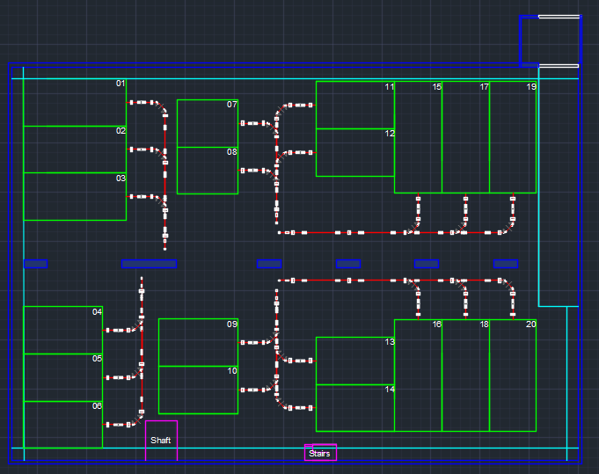
Layout of the experimental hall:
72m
Surface Level 0:
Experimental Hall
Surface: 3600m² Low E dedicated
50m

Slide 28
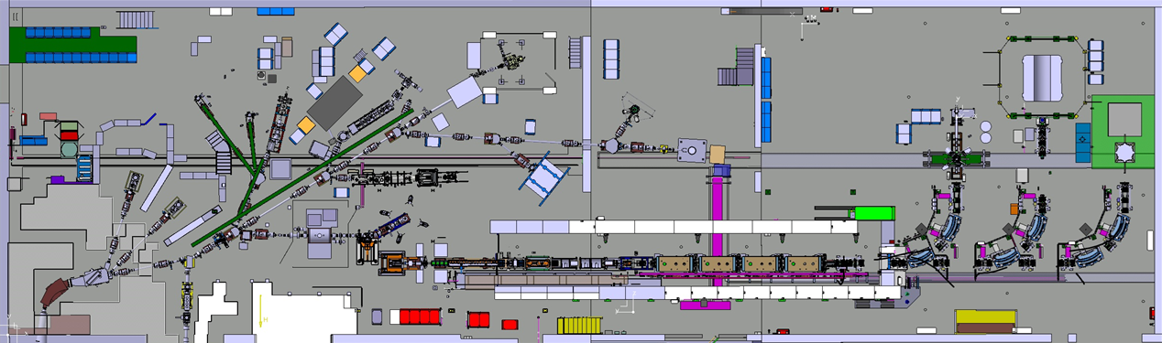
Layout of the experimental hall:
72m
Surface Level 0:
Experimental Hall
Surface: 3600m² Low E dedicated
50m
69m
Surface existing hall: 1380m²
Of which half is occupied by the GPS separator zone, the REX/HIE ISOLDE post-accelerator and HEBT lines
20m

Slide 29
Layout of the experimental hall:
SAS area
Beam distribution lines
13 m
7.7 m
14 m
Surface Level 0:
Experimental Hall
6 m
5 m wide passage
Vertical beamlines from lower levels
Structural pillars (crane + roof)
Experimental stations (6 without high-resolution separation)
10 m
1.5 m wide passage
Shaft to lower equipment
Stairs to lower levels
Experimental stations (14 with high-resolution separation)

Slide 30
Layout of the experimental hall:
SAS area
Beam distribution lines
13 m
7.7 m
14 m
Experimental areas:
9: 6x10m (each 60m²)
6: 6x14m (each 84m²)
3: 6x13m (each 78m²)
2: 6x7.7m (each 46m²)
20 stations with a total surface: 1370m²
Comfortability large areas for housing setup + possible laser setup barrack and exp. infrastructure
Surface Level 0:
Experimental Hall
6 m
Experimental stations (6 without high-resolution separation)
Shaft to lower equipment
Stairs to lower levels
Experimental stations (14 with high-resolution separation)

Slide 31
Layout of the experimental hall:
SAS area
Beam distribution lines
13 m
7.7 m
14 m
Experimental areas:
9: 6x10m (each 60m²)
6: 6x14m (each 84m²)
3: 6x13m (each 78m²)
2: 6x7.7m (each 46m²)
20 stations with a total surface: 1370m²
Comfortability large areas for housing setup + possible laser setup barrack and exp. Infrastructure
Surface Level 0:
Experimental Hall
6 m
11+ Low E experimental stations in the existing hall:
To compare: The new GLM/GHM zone is 57m2
10 m

Slide 32

Summary (on the proposed new building)
The concept of the building - feasible from the Civil Engineering point of view. A study and implementation has started (Eliseo Perez-Duenas (SMB/SE))
The building and underground areas will be able to house the proposed machine with all its capabilities to fulfill the (future) needs of the nuclear physics community (talk by Alberto Rodriguez) as well as 20 sufficiently large footprints for the experiments
Advantages:
- construction and commissioning can take place in parallel to running physics at the existing facility, securing nuclear physics at CERN
- in terms of geographical position it opens the possibility for interconnection with the AD and even n-TOF, enabling promising future physics (talks by Michael Doser and Alberto Mengoni)
- the existing ISOLDE facility would become fully available for HIE physics, MEDICIS and TID development as well as a possible storage ring
Staged approach can be used for the installation of the machine, however, the building with (most of) its infrastructure should be fully build at a first stage
Further possibilities to extend over a large area towards the west (Heli-port) securing another 50 years of ISOLDE Physics at CERN

Slide 33
Next Steps
Preliminary feasibility study of a new building (civil engineering) looks promising – more detailed study is planned with the support of the ISOLDE Collaboration.
Current designs meant to be a starting point and to trigger discussions that could help refining the concept! Nothing is set in stone (yet).
Define what we want in a conceptual design report of the project, covering:
  The key physics cases and new scientific opportunities.
  The technical conceptual details of the project with input from CERN and ISOLDE collaboration communities.
The goal is to converge to a feasible concept that could serve the current and future community of users on 10-30 years time scale

Slide 34
More details on EPIC
For more details on EPIC please visit the web pages of the 2 workshops held in
  2019: https://indico.cern.ch/event/838820/overview
  and
  2020: https://indico.cern.ch/event/928894/overview
To finish with a question:
What could be the approach of this (ISOL-France) community towards EPIC?

Slide 36
Uniqueness of different European facilities
(as seen from ISOLDE)
SPIRAL-II (d,p 40 MeV, 5 mA and stable heavy ions up to 14 MeV/u, 1 mA)
  + S3 heavy elements and n-deficient regions from fusion-evaporation
    S3/REGLIS low-energy ISOL-type studies (direct or in DESIR)
    Post-acceleration of RIB’s with CIME up to 25 MeV/u
  + Ucx/ISOL clean beams of fission fragments (p and n-induced fission)
    To DESIR or for post-acceleration with CIME or …
SPES (p at 35-70 MeV, 0.2-0.5 mA)
  UCx/ISOL clean beams of fission fragments (p and n-induced fission)
    Post-acceleration with ALPI SC-Linac up to 10 MeVu
    ISOL low energy beams for applications (isotope production)
ISOLDE (p at 2 GeV, 2-4 μA)
  Multiple targets + ISOL intense RIB’s from spallation (Z_{target} – 10 to 30)
  and fragmentation
    Low-energy ISOL-type precision studies and applications
    Large variety of post-accelerated RIBs with HIE-ISOLDE up to 10 MeV/u

