Slide 1
PERLE “Friday’s” Meeting
Agenda:
PERLE News (W. Kaabi and M. Klein)
Unveiling PERLE 2.0 Lattice Design (A. Bogacz)
AoB

Slide 2
PERLE News
PERLE was evaluated by IN2P3 Scientific Council on February, 9th 2021.
→ PERLE according to the scientific contexts:
International: recommendations of the European strategy update→ ERL Roadmap to be settled by expert Panel
National: increasing interest of the nuclear physics community to use ERL for electron-Radioactive Ions Collision Facility (e-RI) at GANIL-France → PERLE foreseen as a perfect facility for ion trap R&D.
→ Progress on PERLE collaboration setup
CA final version sent to partners by IN2P3- Last feedbacks needed before signing process (mid-march).
PERLE Management Board setup and work progress on WBS preparation.
→ PERLE Plan and needed resources
Fund and manpower involvement → current situation and evolution in the upcoming years.
Staging strategy starting with TDR and prototyping phase.

Slide 3
PERLE News
The Collaboration Board meeting was held 26 February 2021:
- Project progress and news.
- Report on the PERLE Management Board work progress.
- Status of the Collaboration Agreement process.
- Funding opportunities.
Next CB Meeting is foreseen on March 26th 2021.

Slide 4
PERLE News
PERLE injection line design Review (16 December 2020):
We invited international panel of expert:
Olga Tanaka (KEK)
Alex Bogacz (Jlab)
Christopher tennant (Jlab)
Peter Williams (STFC)
Boris Militsyn (STFC)
Colwyn Gulliford (Cornell university)
Max Klein (UoL)
Walid Kaabi (IJCLab)
→ Fruitful review with very good advises with some paths to explore for next remaining steps, especially on merger design and understanding/controlling of beam shape before matching into the main loop.

Slide 5
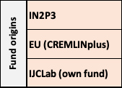
PERLE News
Non-Permanent positions by task in 2021 and beyond
We applied also to 2 other PhD positions (fall 2021-2024):
Optics and beam dynamics (Paris-Saclay University and P2IO)
Electron source and injection line (IJCLab and STFC)

Slide 6
Report on Management Board meetings
2 meetings were held up to now (mid-October and mid-November) and the third is foreseen next week (March 10th)
A. Bogacz (JLAB)
P. Duthil (IJCLab)
F. Gerigk (CERN)
E. Levitchev (BINP)
F. Marhauser (JLAB)
B. Militsyn (Daresbury)
C. Vallerand (IJCLab) → left the lab beginning on November 2020.
and
M. Klein (UoL)
W. Kaabi (IJCLab)
Work was mainly focussed on WBS preparation.

Slide 7
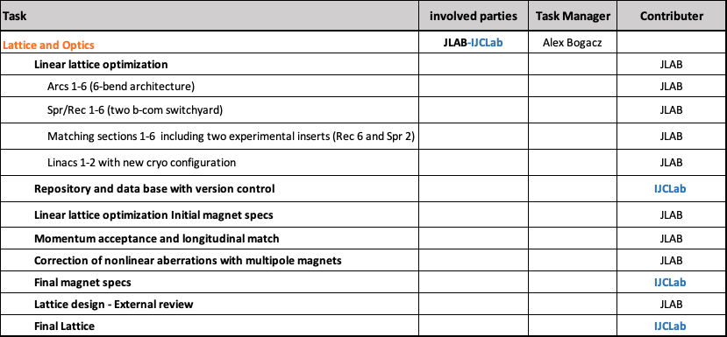
Report on Management Board meetings
Lattice Design Optimisation
T-COM magnets prototyping WBS part will be settled up between IJCLab, BINP and CERN (Magnetic design, mechanical design…)

Slide 8
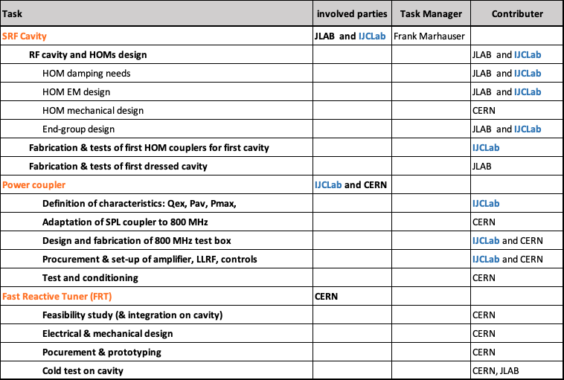
Report on Management Board meetings
PERLE SRF System Development

Slide 9
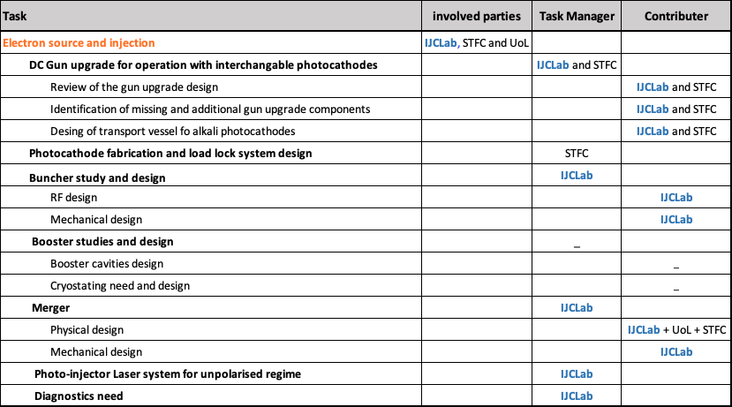
Report on Management Board meetings
PERLE Injection Line

Slide 10
Thank you for your attention

