Slide 1
Longitudinal beam dynamics at high accelerating fields,
what changes ?
Dynamique longitudinale à fort champs accélérateurs,
changement de paradigme
Beam physics - Light and heavy ion superconducting linacs
Jean-Michel Lagniel, GANIL, Caen, France
JM. Lagniel Journées Accélérateurs de la SFP 13-15 octobre 2021

Slide 2
MENU
1- Low fields - ΔW(z) << W - Panofsky equation
2- Paramount importance of Φs (synchronous phase) and T (TTF)
3- What changes at high accelerating fields
4- Φs and TTF computations (to be “right” at high accelerating fields)
5- Resonances and damping at high accelerating fields
6- Summary
JM. Lagniel Journées Accélérateurs de la SFP 13-15 octobre 2021

Slide 3
1- Low fields - ΔW(z) << W - Panofsky equation 1/2
Just 70 years ago (1951), Wolfgang Kurt Hermann Panofsky published a paper opening the way to study and understand the “linear accelerator beam dynamics” building an analytical treatment using simplifying assumptions
Introduction of the main basic concepts still in use in linac beam dynamics studies today
Still taught in accelerator books and accelerator schools
Drift tube linac, accelerating field in the gaps
E_{o} L_{n} = accelerating voltage
Φs = rf phase when particle at gap electrical center
T = Transit Time Factor, f(βs) only at low field
Complexity hidden in T !
JM. Lagniel Journées Accélérateurs de la SFP 13-15 octobre 2021

Slide 4
1- Low fields - ΔW(z) << W - Panofsky equation 2/2
From Panofsky equation to longitudinal beam dynamics
Low field ⇒ Low β variation
field map ⇒ T
Longitudinal beam dynamics (around Φs) function of E_{o}L (cavity voltage), Φs and βs through T
mapping
JM. Lagniel Journées Accélérateurs de la SFP 13-15 octobre 2021

Slide 5
1- Low fields - ΔW(z) << W - Panofsky equation 2/2
From Panofsky equation to longitudinal beam dynamics
Low field ⇒ Low β variation
field map ⇒ T
Longitudinal beam dynamics (around Φs) function of E_{o}L (cavity voltage), Φs and βs through T
mapping
Smooth approximation → large amplitude motions + separatrix shapes
JM. Lagniel Journées Accélérateurs de la SFP 13-15 octobre 2021

Slide 6
1- Low fields - ΔW(z) << W - Panofsky equation 2/2
From Panofsky equation to longitudinal beam dynamics
Low field ⇒ Low β variation
field map (shape) → T
Longitudinal beam dynamics (around Φs) function of E_{o}L (cavity voltage), Φs and βs through T
mapping
small amplitude motions
Smooth approximation → large amplitude motions + separatrix shapes
longitudinal phase advance
= longitudinal focalization
JM. Lagniel Journées Accélérateurs de la SFP 13-15 octobre 2021

Slide 7
2- Paramount importance of Φs and T 1/3
Acceleration and longitudinal focalization
Smooth approximation
without damping
Choice of Φs for the cavities
Low Φs
↓
large acceptance (low losses)
but low acceleration efficiency (long linac)
High Φs
↓
small acceptance (risk for operation @ beam losses)
but high acceleration efficiency (lower cost)
Compromise between
efficiency (then construction cost)
and risk for operation (beam losses)
Separatrix shapes f(Φs) = longitudinal acceptances
(From Panofsky paper … Joël LeDuff CAS…)
Φs = -20° → -15° → acceptance / 2
JM. Lagniel Journées Accélérateurs de la SFP 13-15 octobre 2021

Slide 8
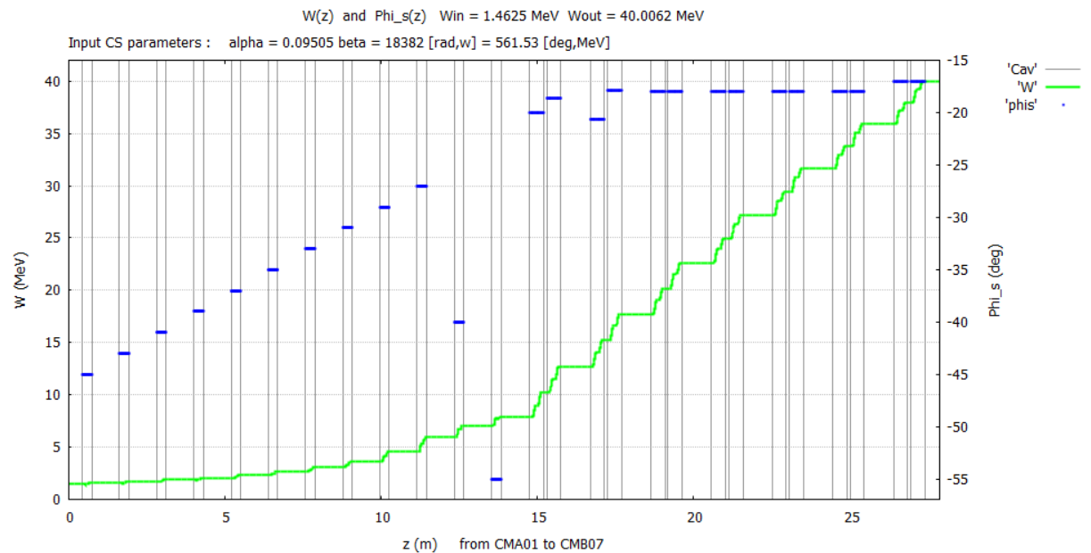
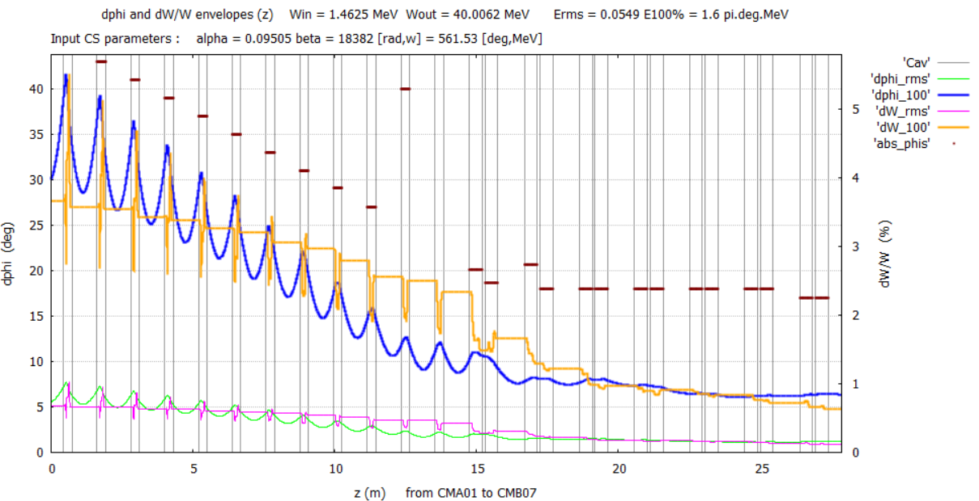
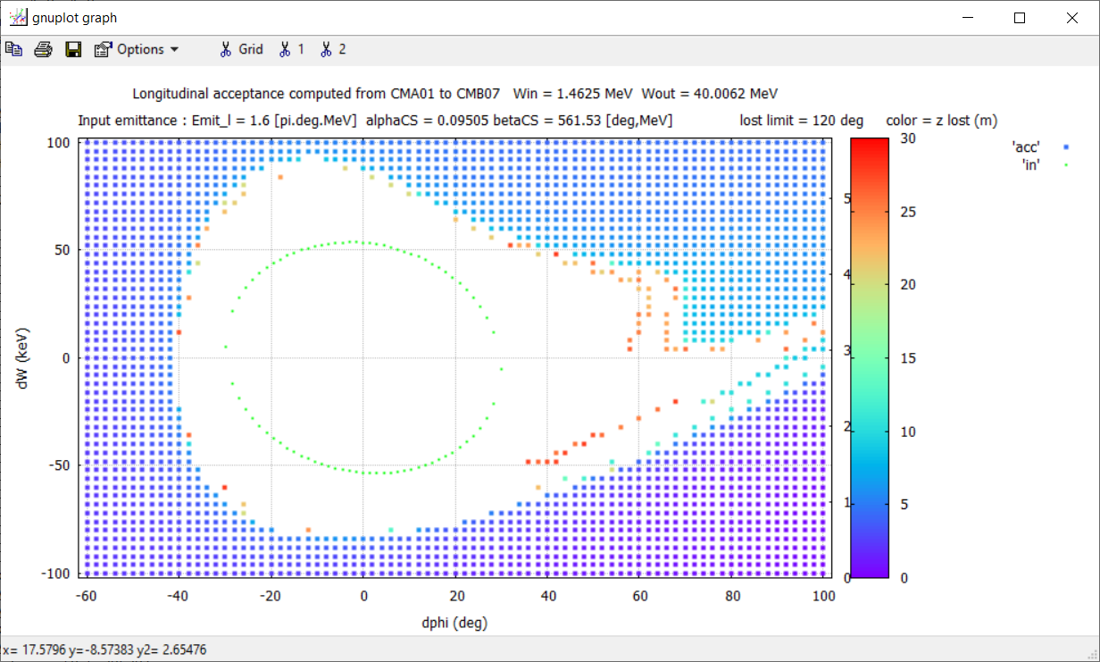
2- Paramount importance of Φs and T 2/3
SPIRAL2 linac
matching
acceptance
Φs = Main parameter for linac design
Φs = Main parameter for linac tuning
Φs (and E) choice for each cavity
Important to compute Φs correctly !!!
Linac
acceptance
JM. Lagniel Journées Accélérateurs de la SFP 13-15 octobre 2021

Slide 9
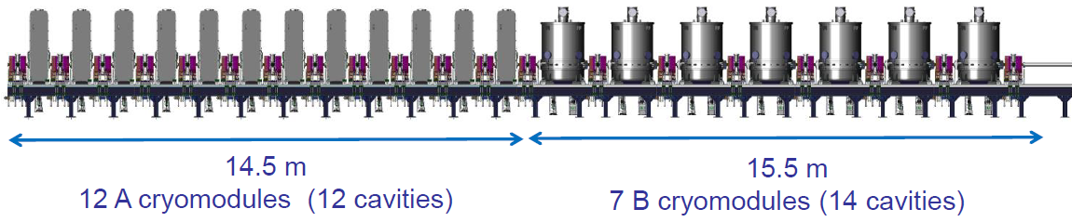
2- Paramount importance of Φs and T 3/3
E_{O} L T = cavity effective voltage
→ T = cavity efficiency
T = Important parameter for linac design
(choice of the β families)
T = Important parameter for cavity design
(geometry)
Important to compute T correctly !!!
JM. Lagniel Journées Accélérateurs de la SFP 13-15 octobre 2021

Slide 10
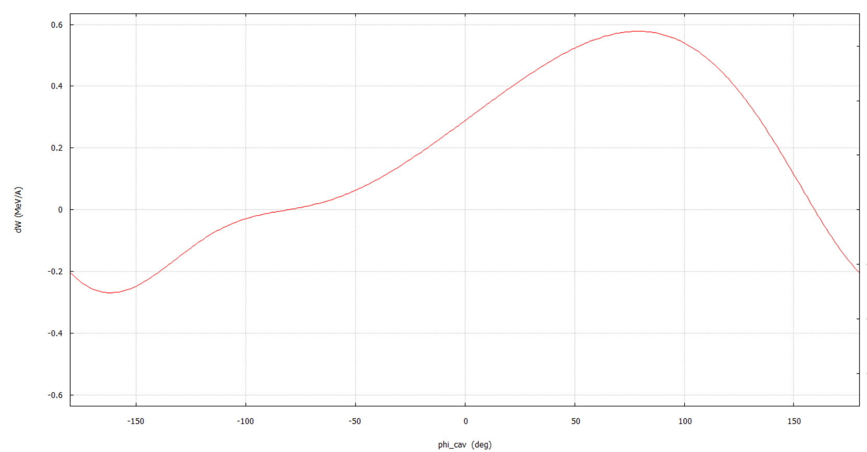
3- What changes at high accelerating fields 1/1
dW no longer ∝ cos (Φ) !
732 keV/A
dW max ~ 600 keV
dΦcav ~ 160°
dΦcav ~ 240°
587 keV/A
Energy gain for a -180 / +180° cavity phase scan
SPIRAL2 cavity A at 3.25 MV/m (half nominal)
protons, W_in = 732 keV (RFQ output energy)
Energy evolution in buncher mode
SPIRAL2 cavity A at 3.25 MV/m (half nominal)
deuterons, W_in = 732 keV/A (RFQ output energy)
High accelerating field → large evolution of β in the cavities
→ ΔW no longer = e T Eo Ln cos(Φs) with low field approximation Φs and T (as said by Panofsky in his 1951 paper)
→ Φs and T must be computed from tracking in cavity field maps How ?
JM. Lagniel Journées Accélérateurs de la SFP 13-15 octobre 2021

Slide 11
4- Φs and TTF computations 1/3
Compute 1: ΔW @ tracking 2: Φs @ Φs definition 3: T = ΔW / q Eo L cos(Φs)
TraceWin “Historic model” Φs definition
Ok at low accelerating field, several issues at high accelerating field discovered working on SPIRAL2
JM. Lagniel Journées Accélérateurs de la SFP 13-15 octobre 2021

Slide 12
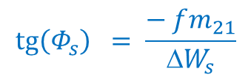
4- Φs and TTF computations 1/3
Compute 1: ΔW @ tracking 2: Φs @ Φs definition 3: T = ΔW / q Eo L cos(Φs)
TraceWin “Historic model” Φs definition
Ok at low accelerating field, several issues at high accelerating field discovered working on SPIRAL2
SPIRAL2 codes : (Φs ,T) definition to obtain the correct ΔW_{s} and longitudinal focalization around Φs
$$\operatorname{tg}\left(Φ_{s}\right) = \frac{− fm_{21}}{{ΔW}_{s}}$$
${fm}_{21}$ = ‘21’ coefficient of the cavity (field map) transfer matrix
$W$ and $fm_{21}$ computed tracking the reference particle in field map (very fast, fm transfer matrix for σ_{0l})
JM. Lagniel Journées Accélérateurs de la SFP 13-15 octobre 2021

Slide 13
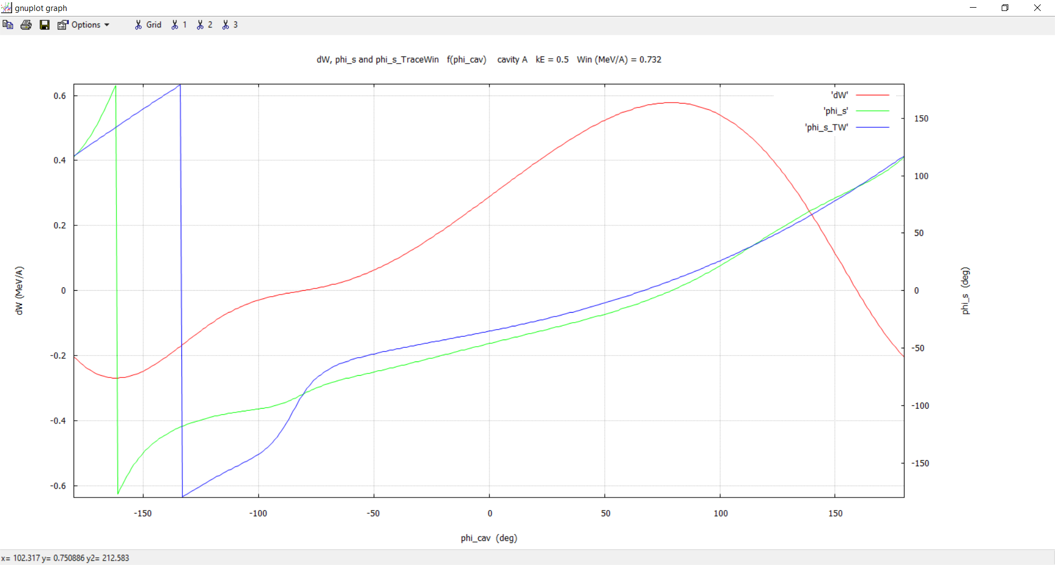

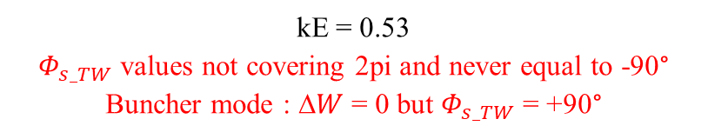


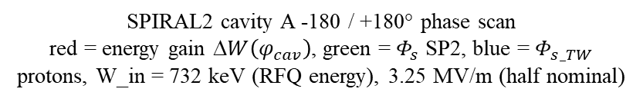

4- Φs and TTF computations 2/3
$Φ_{s_TW}$ « Historic model »
$$Φ_{s_TW}$$
$$Φ_{s_SP2}$$
$$Φ_{s_SP2}$$
SPIRAL2 cavity A -180 / +180° phase scan
red = energy gain $W\left(φ_{cav}\right)$, green = $Φ_{s}$ SP2, blue = $Φ_{s_TW}$
protons, W_in = 732 keV (RFQ energy), 3.25 MV/m (half nominal)
kE = 0.53
$Φ_{s_TW}$ values not covering 2pi and never equal to -90°
Buncher mode : $W$= 0 but $Φ_{s_TW}$ = +90°
$W$min and max not at $Φ_{s_TW}$ = 180° and 0° (17° shift)
Large phi_cav shifts (up to ~30°) between $Φ_{s_TW}$ and $Φ_{s_SP2}$ → not the same linac tuning
JM. Lagniel Journées Accélérateurs de la SFP 13-15 octobre 2021

Slide 14
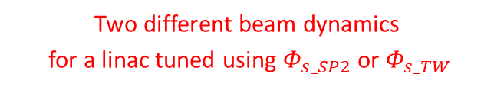

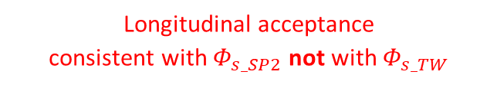
4- Φs and TTF computations 3/3
A/Q = 7 (U238) SPIRAL2 linac tuning (NewGAIN studies)
Two different beam dynamics
for a linac tuned using $Φ_{s_SP2}$ or $Φ_{s_TW}$
-32°
+64°
Longitudinal acceptance
consistent with $Φ_{s_SP2}$ not with $Φ_{s_TW}$
$Φ_{s_SP2}$ definition = “New model” in TraceWin
Merci Didier !
JM. Lagniel Journées Accélérateurs de la SFP 13-15 octobre 2021

Slide 15

5- Resonances and damping at high accelerating fields 1/4
JM Lagniel, “Zero-current longitudinal beam dynamics”, LINAC14, Aug 2014, Genève, Switzerland.
F_{z} ∝ cos (Φ) → longitudinal focalization done by a series of nonlinear “lenses” (cavities)
high at high accelerating rate
and low energy
high at high cavity field and low energy
Resonance excitation by the rf field
Even without space charge forces !
(zero-current longitudinal dynamics)
Period = period of the gaps/cavities
Not the transverse focusing period !
unstable areas
$$\text{Landau} \text{damping}$$
$4th order resonance$excitation ($σ_{0l}$ = 90°)
Resonance studies @ longitudinal phase advances / period of the cavities or accelerating gaps
Not the period of the transverse focusing system !
Distance L between 2 gaps, e.g. not 4L for a DTL with FFDD transverse focalization (GSI mistake !)
JM. Lagniel Journées Accélérateurs de la SFP 13-15 octobre 2021

Slide 16


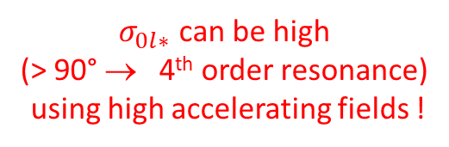
5- Resonances and damping at high accelerating fields 2/4
Which resonances ?
Longitudinal phase advance / period
(small amplitude oscillations around the synchronous particle)
Particle longitudinal phase advance / period
$σ_{0l}$= 360/n
Resonance position
$σ_{0l}$= 360/(n+1)
$σ_{0l∗}$ can be high
(> 90° → 4th order resonance)
using high accelerating fields !
JM. Lagniel Journées Accélérateurs de la SFP 13-15 octobre 2021

Slide 17
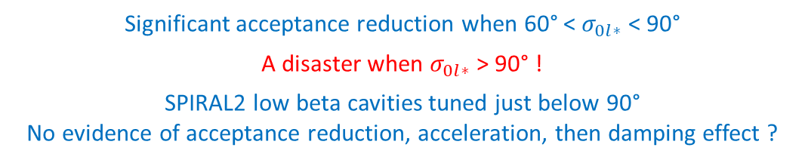
5- Resonances and damping at high accelerating fields 3/4
Longitudinal dynamics without damping (no acceleration, $Φ_{s}$ = -90°)
Resonance identification making “Poincaré surface of section” (1 point / period)
Significant acceptance reduction when 60° < $σ_{0l∗}$ < 90°
A disaster when $σ_{0l∗}$ > 90° !
SPIRAL2 low beta cavities tuned just below 90°
No evidence of acceptance reduction, acceleration, then damping effect ?
smooth
approximation
mappings → with nonlinear kicks (octupole + …) → resonances
$σ_{0l∗}=50°$ $σ_{0l∗}$ > 60° (n = 6) $σ_{0l∗}$ > 90° (n = 4)
JM. Lagniel Journées Accélérateurs de la SFP 13-15 octobre 2021

Slide 18
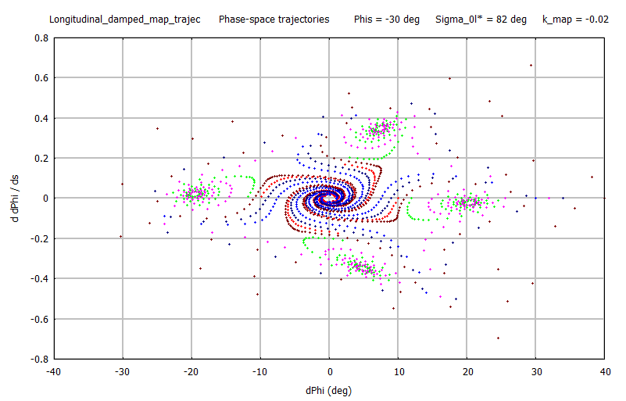
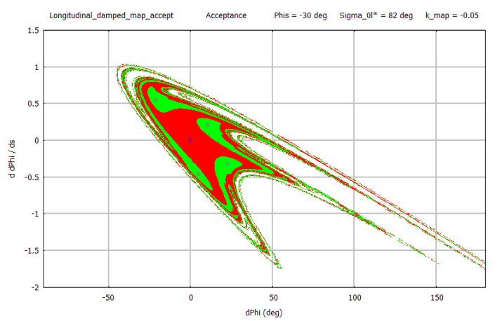
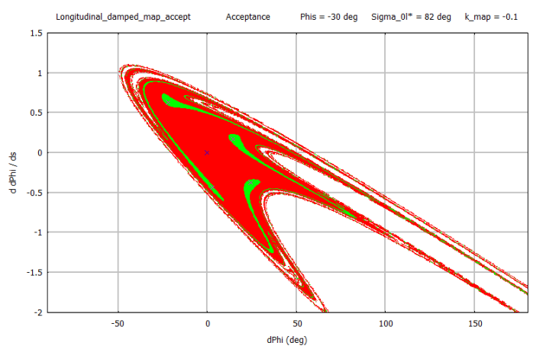
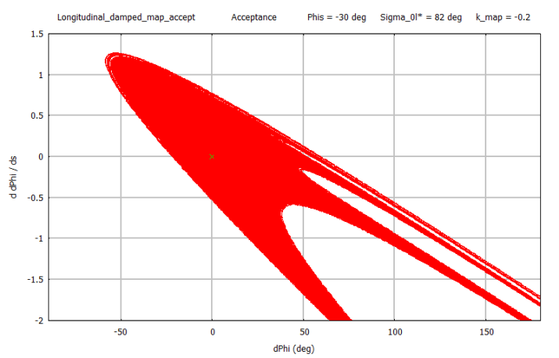
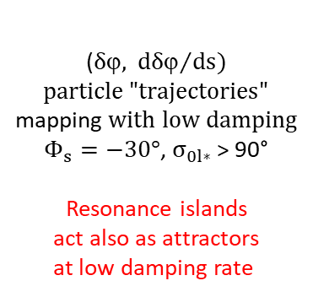
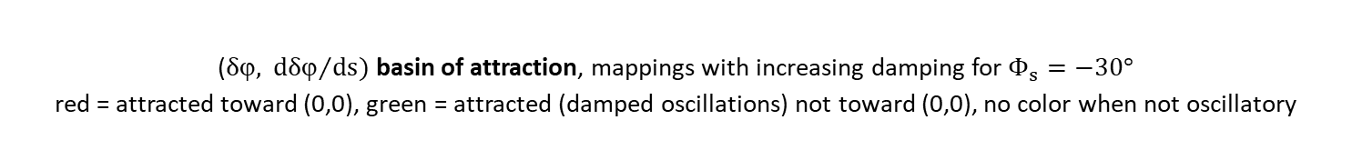
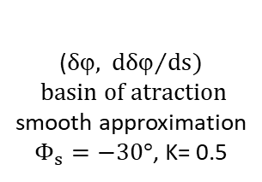
5- Resonances and damping at high accelerating fields 4/4
Longitudinal dynamics with damping (with acceleration)
($δ,$ ${dδ}/{ds})$
particle$"trajectories"$
mapping $with low damping$
$Φ_{s}=−30°$, $σ_{0l∗}$ > 90°
Resonance islands
act also as attractors
at low damping rate
($δ,$ ${dδ}/{ds})$
$$basin of atraction$$
smooth approximation
$Φ_{s}=−30°$, K= 0.5
($δ,$ ${dδ}/{ds})$basin of attraction, mappings with increasing damping for $Φ_{s}=−30°$
red = attracted toward (0,0), green = attracted (damped oscillations) not toward (0,0), no color when not oscillatory
Decreasing effect of the resonances as the damping increases
JM. Lagniel Journées Accélérateurs de la SFP 13-15 octobre 2021

Slide 19
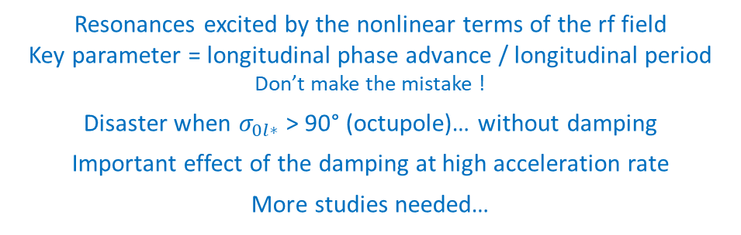
6- Summary
Longitudinal beam dynamics at high accelerating fields, what changes ?
All… nearly all !
Low field ΔW_{s} = q E₀ L T cos(Φ_{s}) Φ_{s} = Φ_{cav} + ΔΦ
High field ΔW_{s} = q E₀ L T(E₀) cos(Φ_{s}(E₀))
tg(Φ_{s}) = -fm21/ΔW_{s} for right beam dynamics (SPIRAL2)
The « New model » in TraceWin
kE= 0.01
kE= 0.50
Resonances excited by the nonlinear terms of the rf field
Key parameter = longitudinal phase advance / longitudinal period Don’t make the mistake !
Disaster when $σ_{0l∗}$ > 90° (octupole)… without damping
Important effect of the damping at high acceleration rate
More studies needed…
Ion linac longitudinal beam dynamics much more complex than what we learn at school and in books !
Especially at high accelerating fields… a very good subject for a PHD Thesis or PostDoc work (?)
JM. Lagniel Journées Accélérateurs de la SFP 13-15 octobre 2021

Slide 20
MERCI à Michel Olivier et Joël LeDuff
MERCI aux organisateurs
MERCI pour votre attention
JM. Lagniel Journées Accélérateurs de la SFP 13-15 octobre 2021

Slide 21
BONUS SLIDES
Merci qui ? Merci J-M !
JM. Lagniel Journées Accélérateurs de la SFP 13-15 octobre 2021

Slide 22
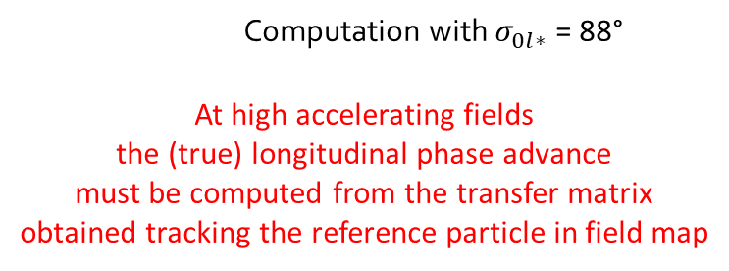
True value of the longitudinal phase advance : $σ_{0l}$ and μ
Computation with $σ_{0l∗}$ = 88°
At high accelerating fields
the (true) longitudinal phase advance
must be computed from the transfer matrix
obtained tracking the reference particle in field map
JM. Lagniel Journées Accélérateurs de la SFP 13-15 octobre 2021

Slide 23
True value of the longitudinal phase advance : ${\text{}}_{p}$ and μ
JM. Lagniel Journées Accélérateurs de la SFP 13-15 octobre 2021

Slide 24
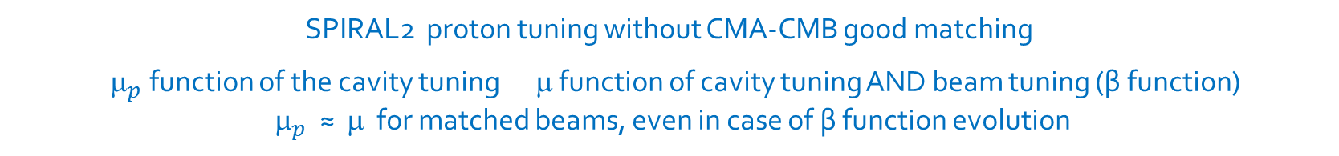

${\text{}}_{p}$ and μ, difference in case of envelope evolution / mismatch
SPIRAL2 proton tuning without CMA-CMB good matching
${\text{}}_{p}$ function of the cavity tuning μ function of cavity tuning AND beam tuning (β function)
${\text{}}_{p}$ ≈ μ for matched beams, even in case of β function evolution
Envelope evolutions
${\text{}}_{p}$ and μ evolutions
JM. Lagniel Journées Accélérateurs de la SFP 13-15 octobre 2021

Slide 25
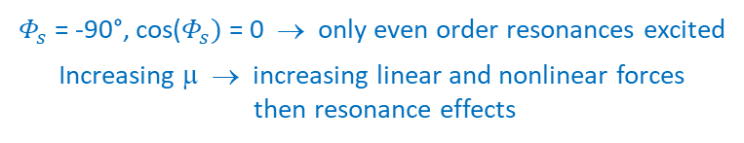
Resonance excitation by the cavity rf field
nonlinear cavity rf field
μ = 49° Qres = 1/8 1/10 1/12
$Φ_{s}$ = -90°, cos($Φ_{s})$ = 0 → only even order resonances excited
Increasing μ → increasing linear and nonlinear forces
then resonance effects
μ = 73° Qres = 1/6
μ = 94° Qres = 1/4
JM. Lagniel Journées Accélérateurs de la SFP 13-15 octobre 2021

Slide 26
Resonance excitation
Sextupole → 3rd order res.
Resonance excitation
Unstable motions
Infinite amplitudes
Octupole → 4th order res.
Resonance excitation
+ nonlinear detuning
Resonance islands + KAM → stable motions
Resonance overlap
→ destruction of the KAM tori
→ chaotic areas
Particles at large amplitudes
Halo, lost particles
Best readings Lichtenberg & Lieberman book, “Regular and Chaotic Dynamics”, Second edition (1992)
B. Chirikov, “A universal instability of many-dimensional oscillator systems”, Physics Reports, 52,263 (1979)
H. Bruck book, “Accélérateurs circulaires de particules : Introduction à la théorie“ (1966)
G. Leleux, “Compléments sur la physique des accélérateurs”, Cours DEA “Grands instruments” (1986)
JM. Lagniel Journées Accélérateurs de la SFP 13-15 octobre 2021

Slide 27
Mapping (Panofsky) vs Tracking phase space portraits
Mapping with Panofsky hypothesis Tracking in cavity field map
30° / lattice
60°+ / lattice
JM. Lagniel Journées Accélérateurs de la SFP 13-15 octobre 2021

