Slide 1
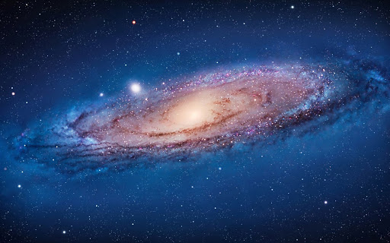
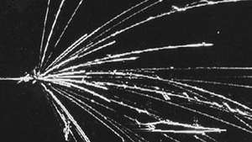
PSAP 2021 – 19/10/2021
The role of cross sections in the evaluation of GCR propagation
$$CR$$
$$Nuc$$
χ
q
q
χ
Pedro de la Torre Luque Stockholm University pedro.delatorreluque@fysik.su.se

Slide 2
Talk outline
The role of cross sections in the evaluation of GCR propagation
Main secondary cosmic rays
Possible primary origin of cosmic rays B, Be, Li and F
Propagation parameters from different secondary cosmic-ray nuclei and different cross sections parametrizations
Antiproton excesses
Is it possible to reproduce simultaneously all secondary CRs, including antiprotons?
How cross sections uncertainties can affect our constraints of WIMP candidates
Beyond antiprotons: preliminary analyses including positrons

Slide 3
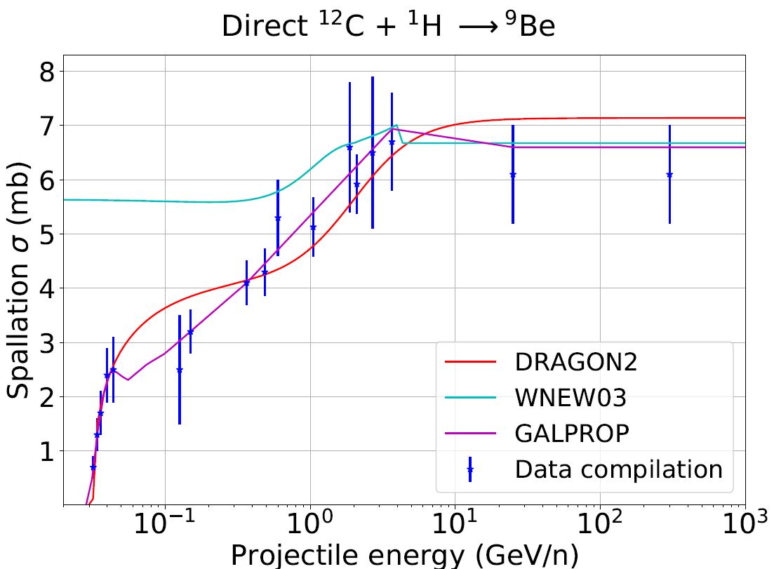
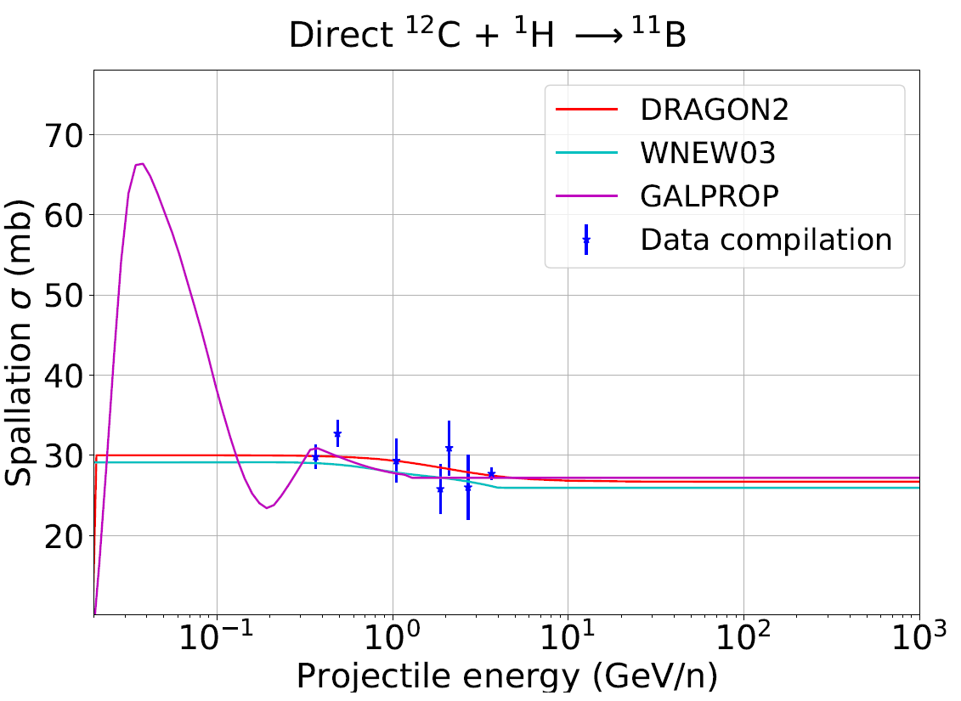
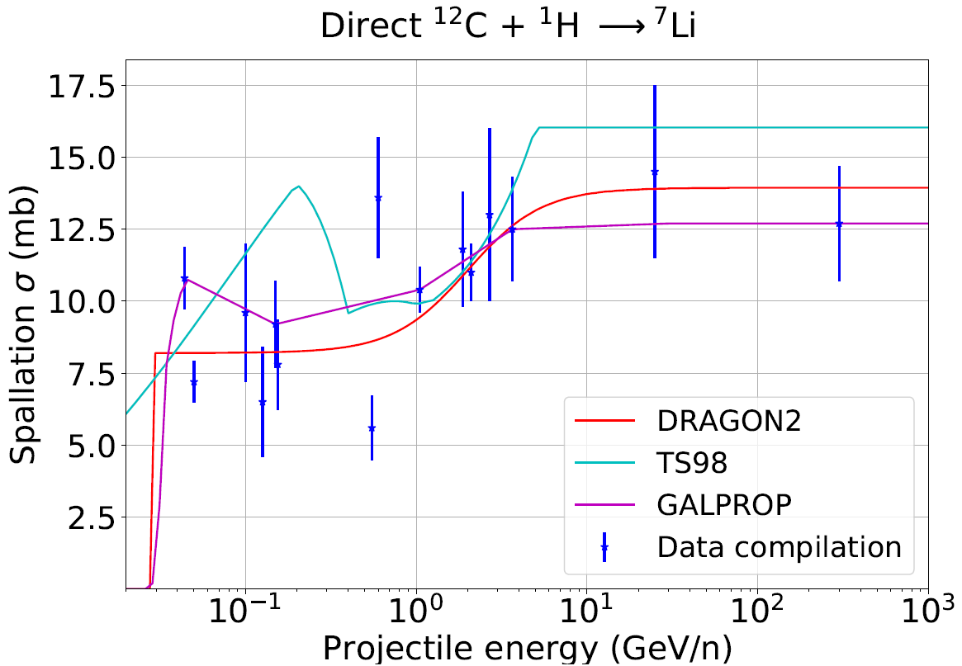
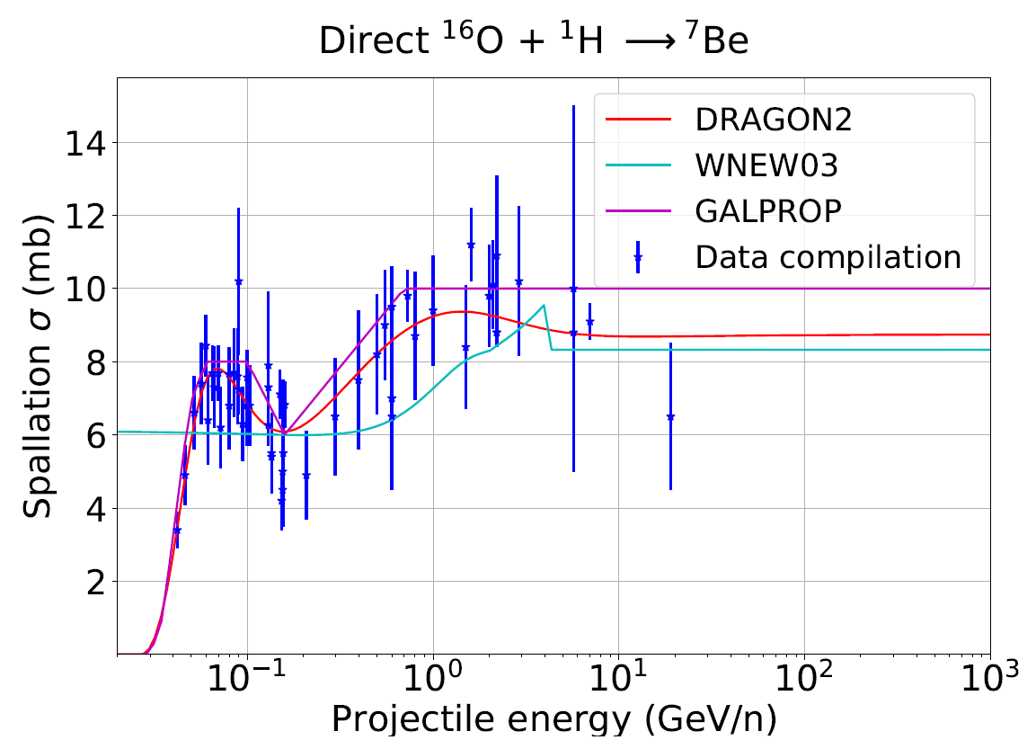
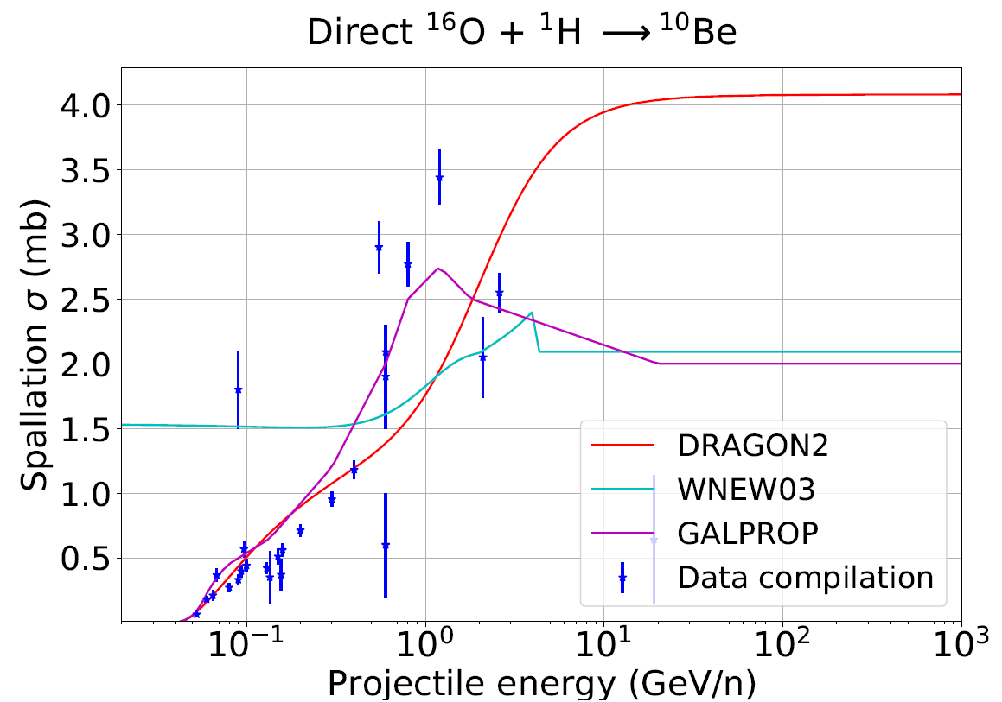
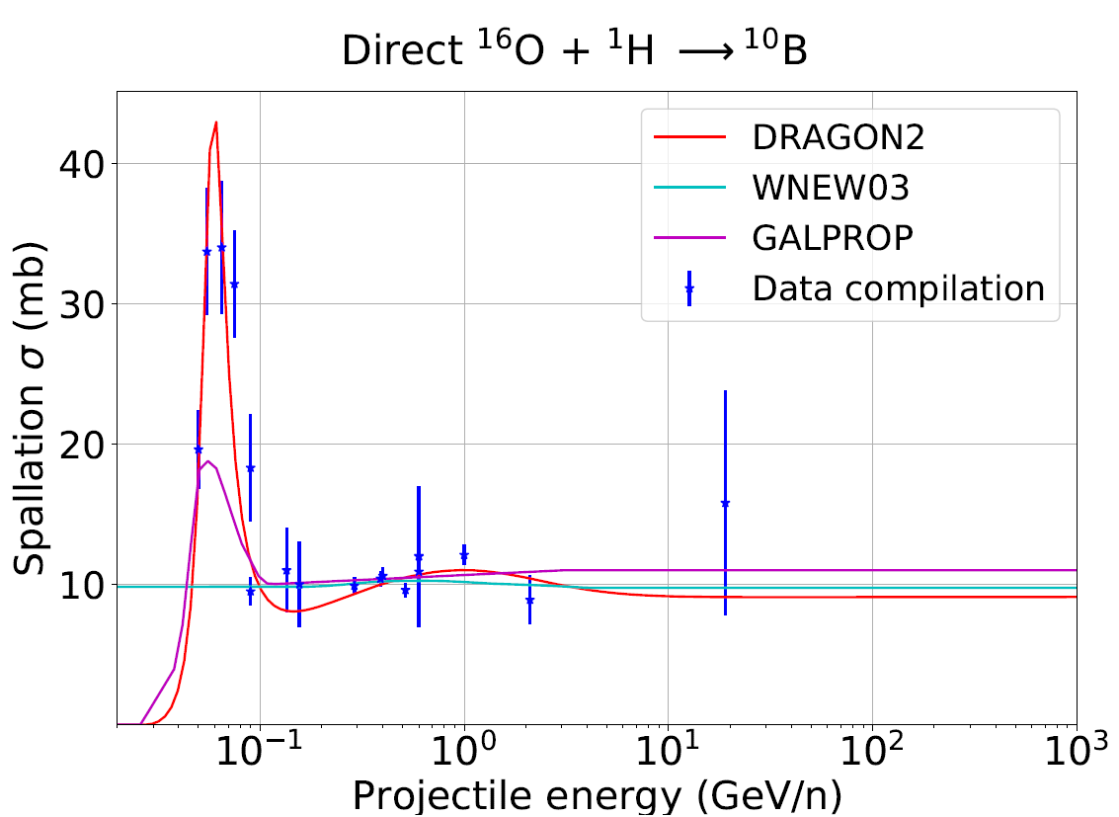
Cross sections parametrizations

Slide 4
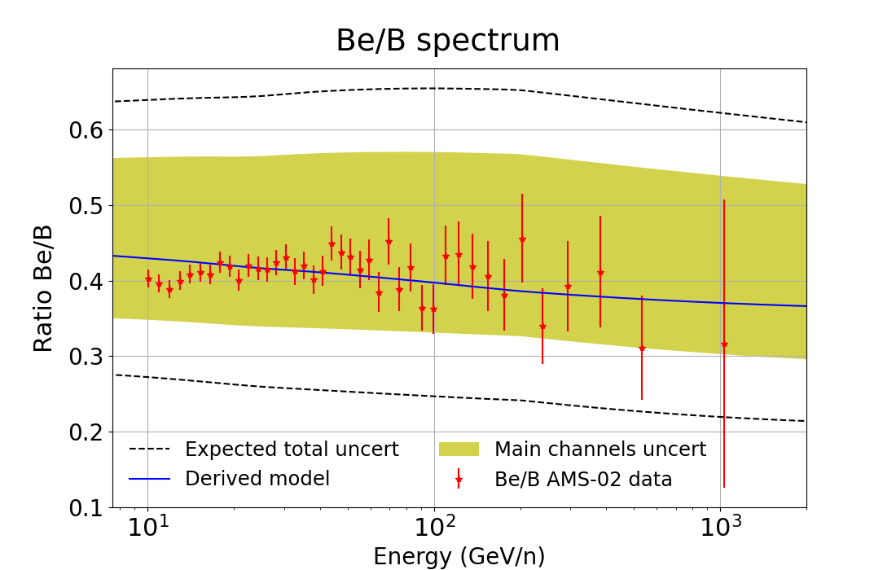
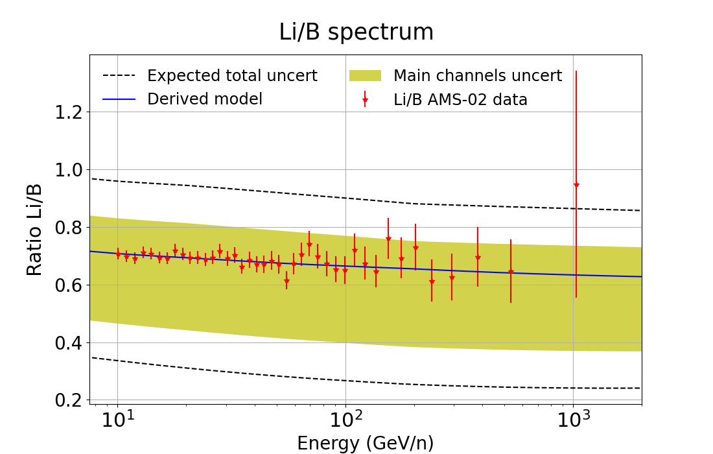
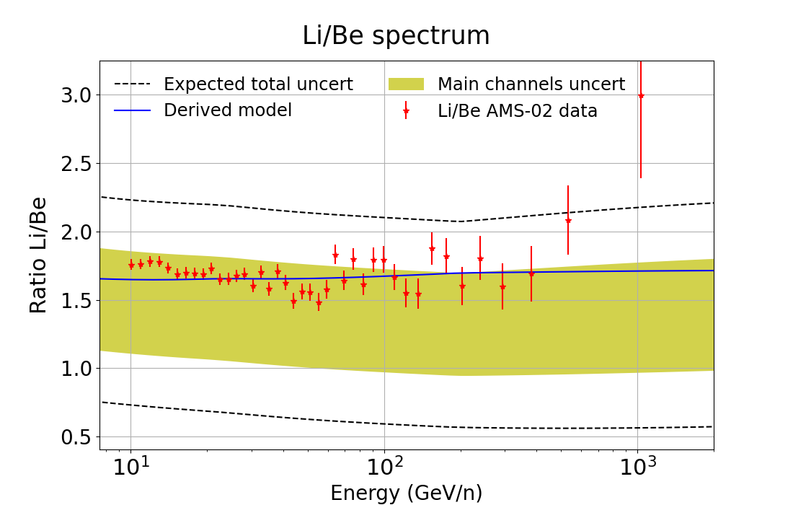
Primary origin of secondary CRs
De la Torre et al. JCAP 03, 099 (2021)
Sec/Sec ratios allow us to easily propagate the cross sections uncertainties revealing that Li, Be and B can be explained at the same time without need of any (extra) primary sources
Combination of different CR species provide a way to reduce the effect of uncertainties
Ratios among secondary cosmic rays offer a sensitive tool to compare between different cross sections models
GALPROP cross sections can lead to the conclusion that an extra component of (primary) lithium is needed: Li problem
Any clear hint of primary production of B, Be or Li?
Different parametrizations lead to different conclusions…

Slide 5
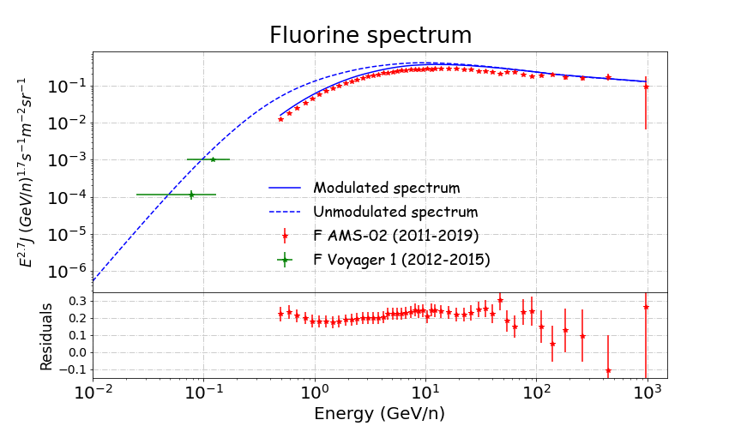
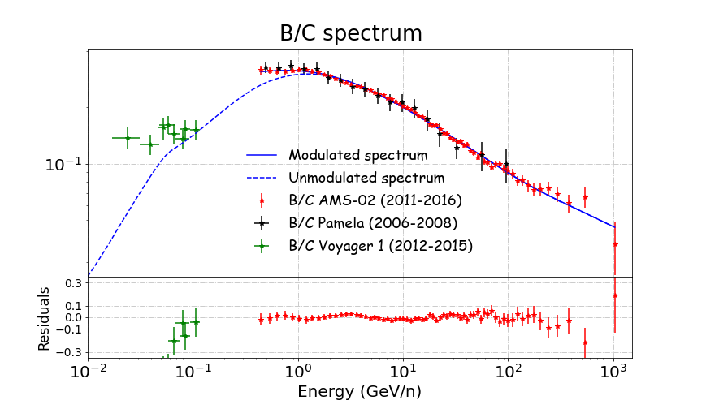
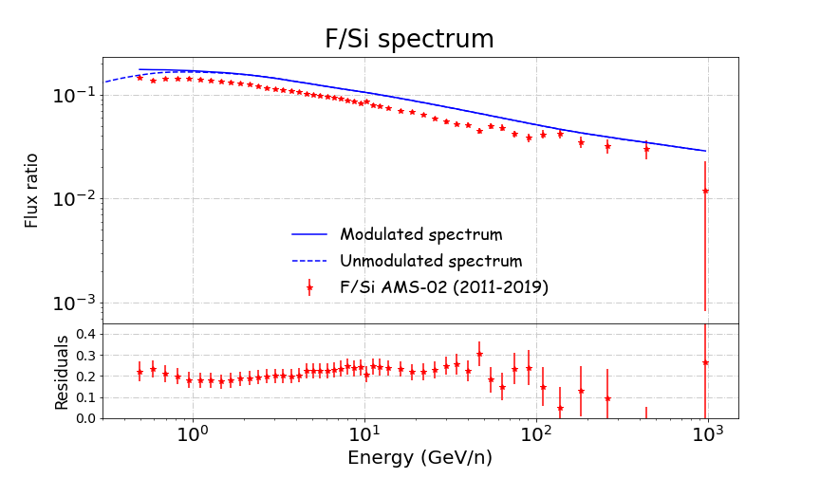
Fluorine spectra
¹⁹F mainly produced from Ne, Mg, Si group
Uncertainties are higher and difficult to quantify
Compatible with AMS-02 data considering a cross sections scaling of ~20%

Slide 6
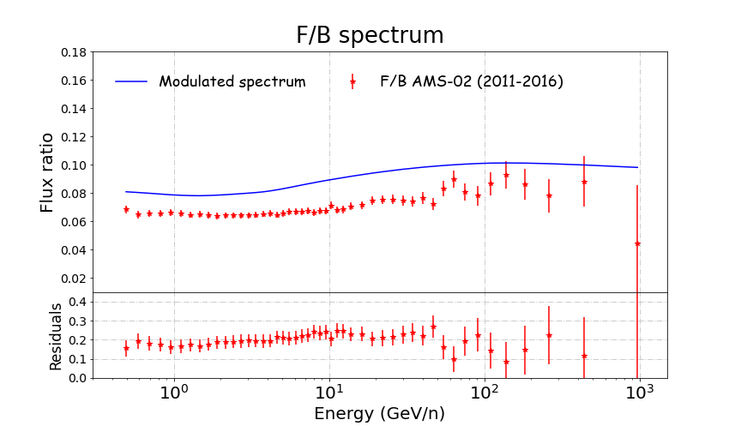
Fluorine spectra
¹⁹F mainly produced from Ne, Mg, Si group
Uncertainties are higher and difficult to quantify
Compatible with AMS-02 data considering a cross sections scaling of ~20%

Slide 7
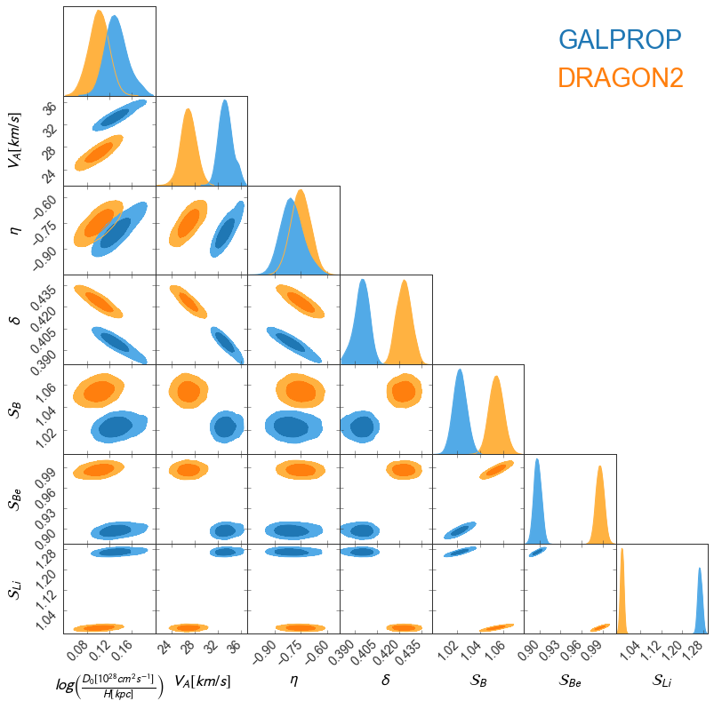
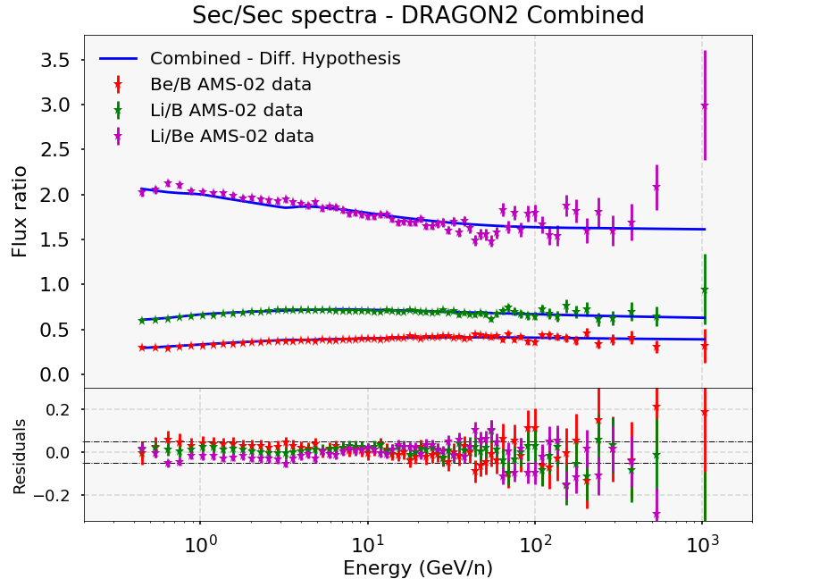
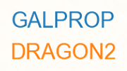
Diffusion parameters
P. De La Torre Luque et al JCAP07(2021)010
Prop. parameters seem to be well constrained by ratios of different secondary CRs and even compatible for different cross sections parametrizations
The spectra of all these ratios become compatible (within 1 σ uncertainties) with experimental data for scale factors S_{X} < 1.06 (< 6% scale) for DRAGON2
Combined analyses:

Slide 8
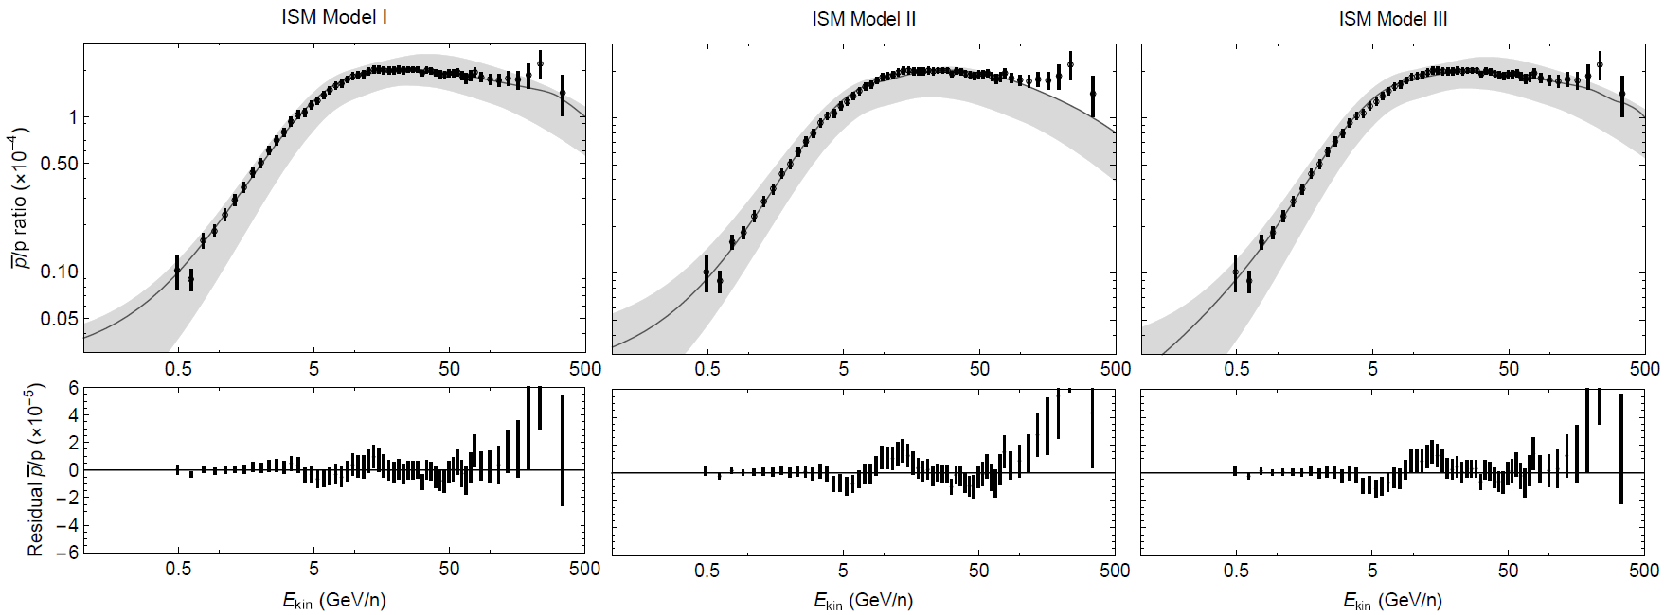
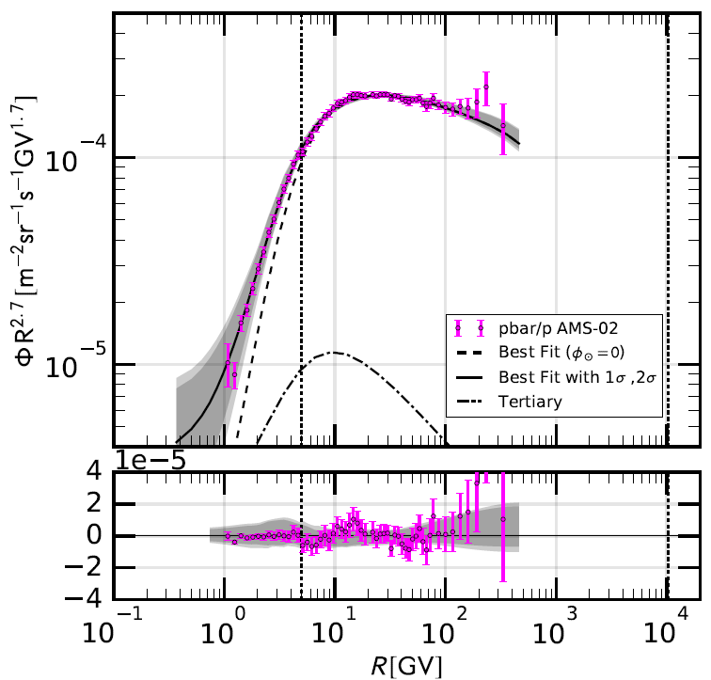
Antiproton excesses
I. Amount of grammage predicted by the flux-ratios of B, Be and Li underpredicts the antiproton flux by a 10-20%→ Grammage tension
II. Recent studies have claimed the possibility of an excess of data over the predicted flux at around 10-20 GeV, which can be the signature of dark matter annihilating or decaying into antiprotons
Cuoco et al PRL 118, 191102
Cholis, Linden, Hooper Phys. Rev. D 99, 103026

Slide 9
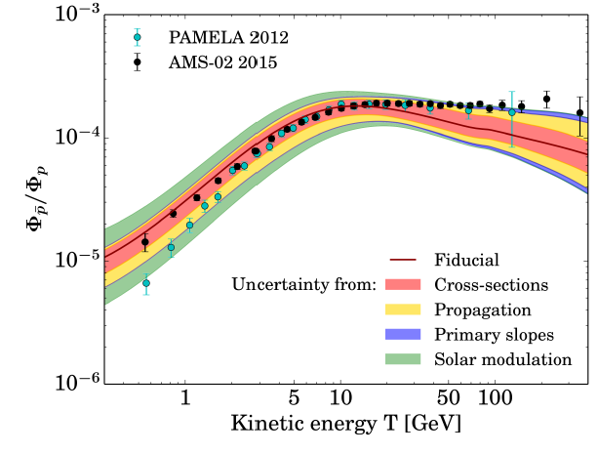
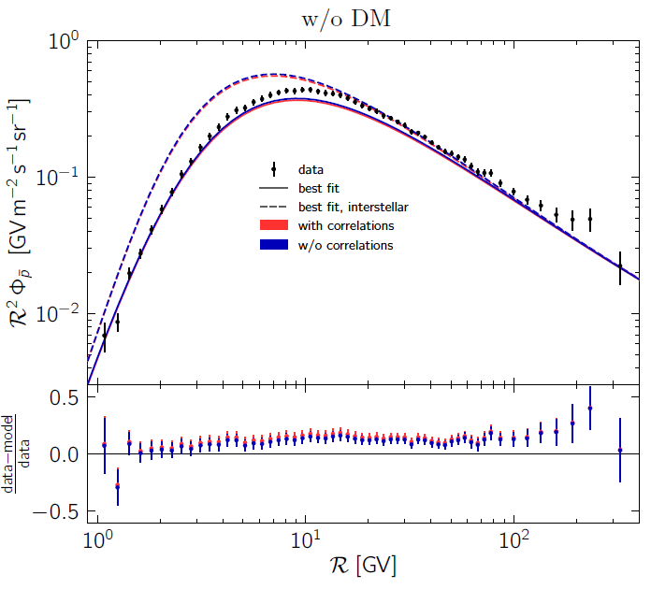
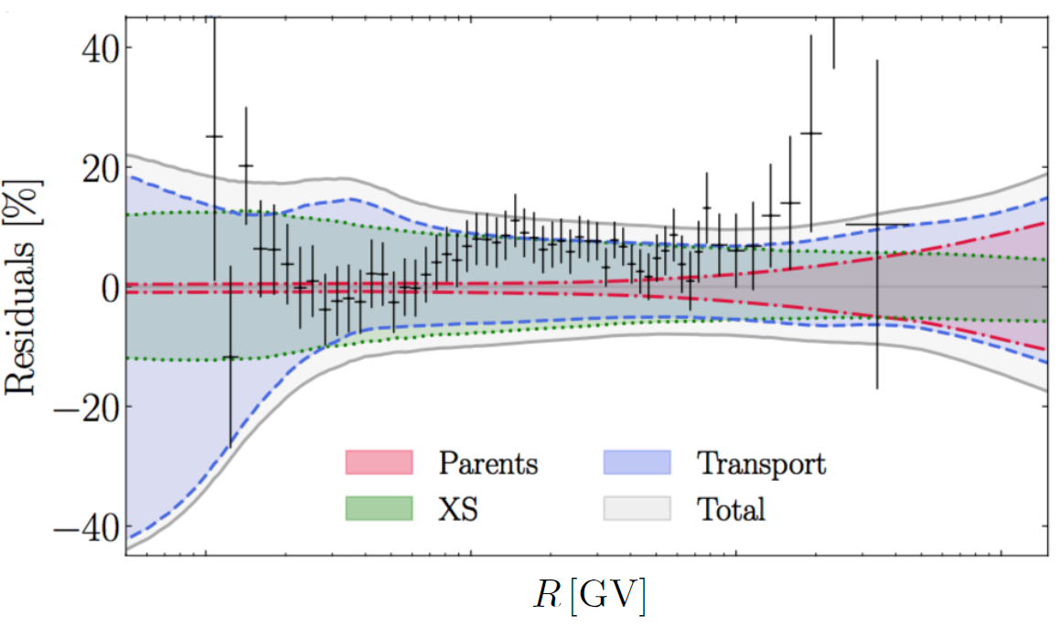
Antiproton excesses
Tension in the amount of grammage predicted from the secondary CRs B, Be and Li and that predicted from antiprotons
No one has shown a set of propagation parameters that allow us to reproduce at the same time B, Be, Li and antiprotons
G. Giesen et al JCAP09(2015)023
Data is at the edge of the uncertainty bands, and the slope is too soft
Good significance (χ² ~ 1),
but median parameters underpredict the spectrum
Boudaud et al Phys. Rev. Research 2, 023022
Heisig, Korsmeier, Winkler Phys. Rev. Research 2, 043017

Slide 10
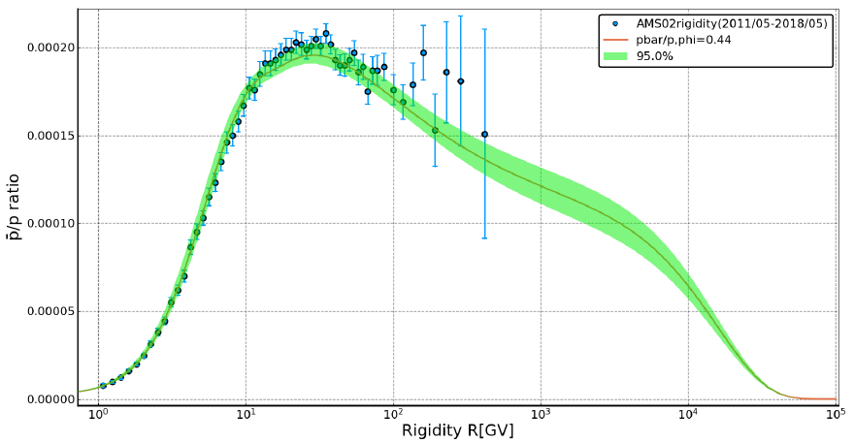
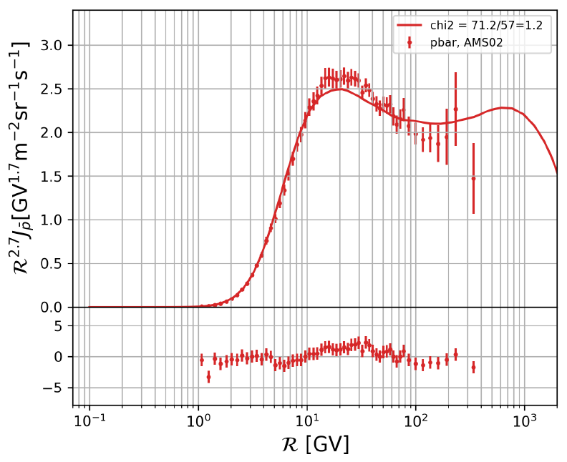
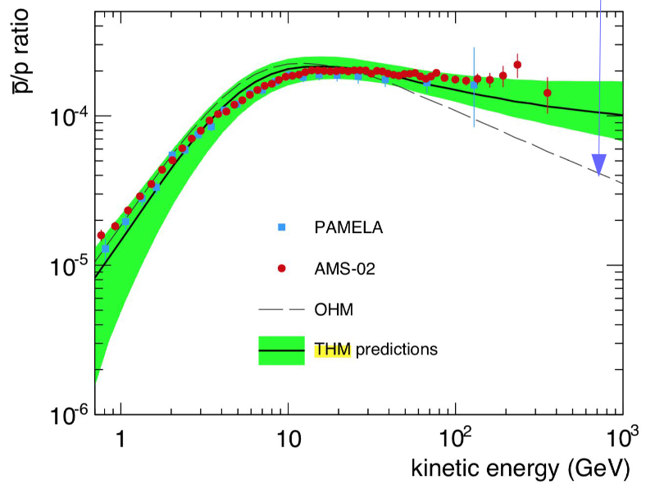
Antiproton excesses
P. Mertsch et al. 2020 arXiv: 2021.12853
Zhao et al 2021 arXiv:2109.04112v1
Inhomogeneous diffusion coefficient
It would explain the coincident high-energy slopes of e⁺ and Ap
Caveat: predicted δ not compatible with MHD theory
Feng et al PRD 94, 123007 (2016)
It can offer an explanation for the dipole anisotropy
Nearby source accelerating antiprotons
Caveat: Antiproton spectrum not well reproduced

Slide 11
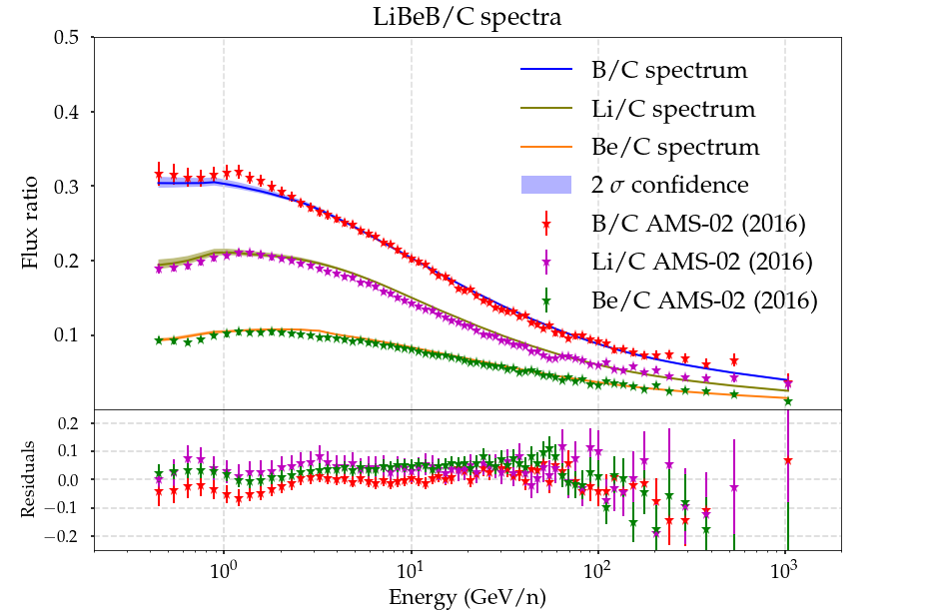
De la Torre Luque et al. (2021) ArXiv: 2107.06863
There is a set of propagation parameters that reproduce the energy dependence of the antiproton and the other secondary CRs (B, Be and Li)
Crucial role played by the cross sections scale factors → S_{B} ~ 0.97 S_{Be} , S_{Li} ~ 0.90
- DRAGON2 cross sections for heavy secondary CRs
- Winkler (2017) cross sections for antiprotons
- Diffusion Coefficient
B/C, B/O, Be/C, Be/O, Ap/p (Propagation parameters)
¹⁰Be/⁹Be, ¹⁰Be/Be (H), Be/B, Li/B, Li/Be (Scale factors, S_{X})
Ap/p spectrum included at E > 4 GeV to avoid the impact of systematic uncertainties associated to solar modulation

Slide 12
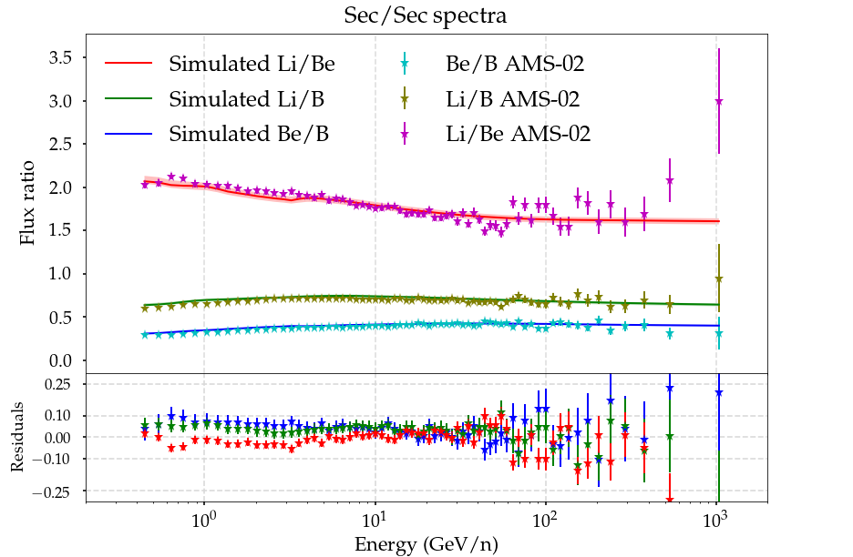
De la Torre Luque et al. (2021) ArXiv: 2107.06863
There is a set of propagation parameters that reproduce the energy dependence of the antiproton and the other secondary CRs (B, Be and Li)
Crucial role played by the cross sections scale factors → S_{B} ~ 0.97 S_{Be} , S_{Li} ~ 0.90
- DRAGON2 cross sections for heavy secondary CRs
- Winkler (2017) cross sections for antiprotons
- Diffusion Coefficient
B/C, B/O, Be/C, Be/O, Ap/p (Propagation parameters)
¹⁰Be/⁹Be, ¹⁰Be/Be (H), Be/B, Li/B, Li/Be (Scale factors, S_{X})
Ap/p spectrum included at E > 4 GeV to avoid the impact of systematic uncertainties associated to solar modulation

Slide 13
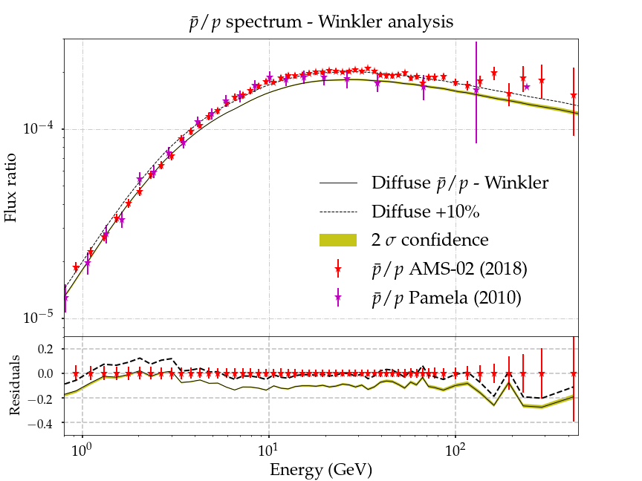
De la Torre Luque et al. (2021) ArXiv: 2107.06863
There is a set of propagation parameters that reproduce the energy dependence of the antiproton and the other secondary CRs (B, Be and Li)
Crucial role played by the cross sections scale factors → S_{B} ~ 0.97 S_{Be} , S_{Li} ~ 0.90
- DRAGON2 cross sections for heavy secondary CRs
- Winkler (2017) cross sections for antiprotons
- Diffusion Coefficient
B/C, B/O, Be/C, Be/O, Ap/p (Propagation parameters)
¹⁰Be/⁹Be, ¹⁰Be/Be (H), Be/B, Li/B, Li/Be (Scale factors, S_{X})
Ap/p spectrum included at E > 4 GeV to avoid the impact of systematic uncertainties associated to solar modulation

Slide 14
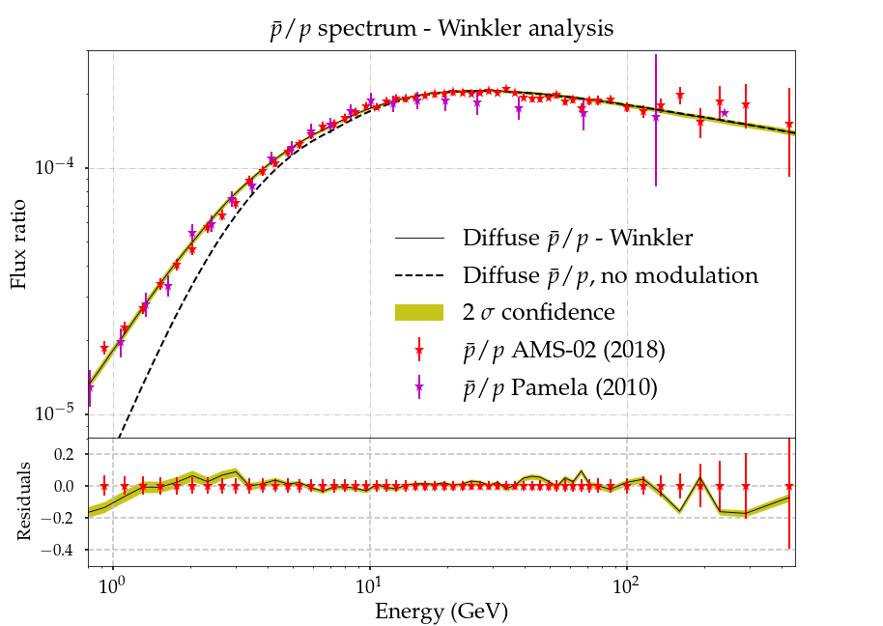
Combined antiproton analysis
PRELIMINARY
- Included Ap/e⁺ and Ap/e⁻ as well as a scale factor (S_{Ap}) to renormalize cross sections of Ap production
B/C, B/O, Be/C, Be/O, Ap/p (propagation params)
¹⁰Be/⁹Be, ¹⁰Be/Be (H), Be/B, Li/B, Li/Be (S_{X})
Ap/e⁺, Ap/e⁻ → S_{Ap}, propagation params
- Prior constrains on the Ap cross sections impact on the predicted grammage:
Different tests are performed for different prior constrains
I. Propagation parameters that best describe the spectra of all these secondary CRs
II. Scaling needed to reconcile the antiproton data with B, Be and Li data
III. Is there room for any WIMP contribution on the antiproton spectrum?

Slide 15
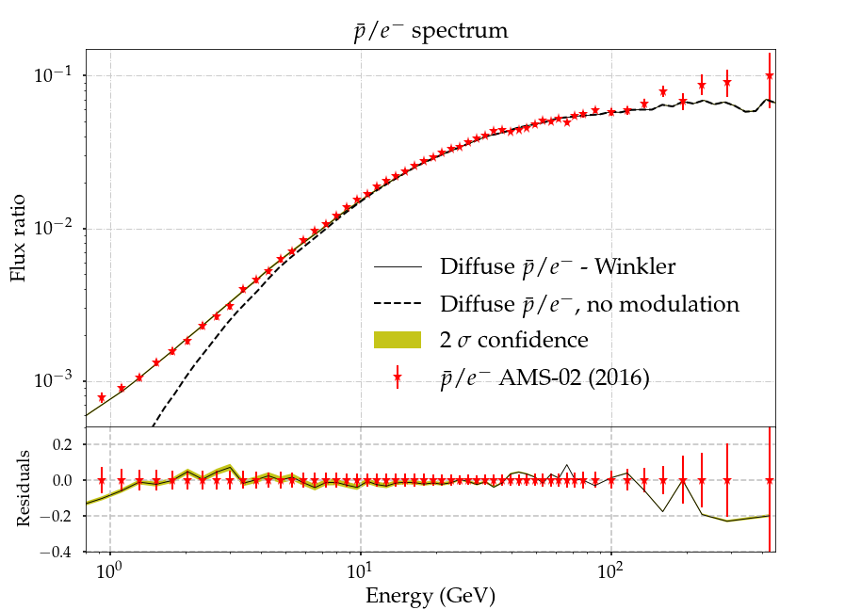
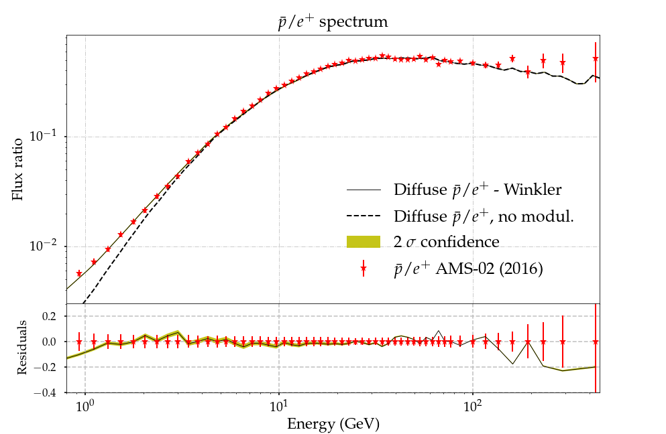
Combined antiproton analysis
B/C, B/O, Be/C, Be/O, Ap/p (propagation params)
¹⁰Be/⁹Be, ¹⁰Be/Be (H), Be/B, Li/B, Li/Be (S_{X})
Ap/e⁺, Ap/e⁻ → S_{Ap}, propagation params
Very good agreement to data found in the antiproton ratios, at the same time as reproducing B, Be and Li (even F!)
PRELIMINARY
PRELIMINARY

Slide 16
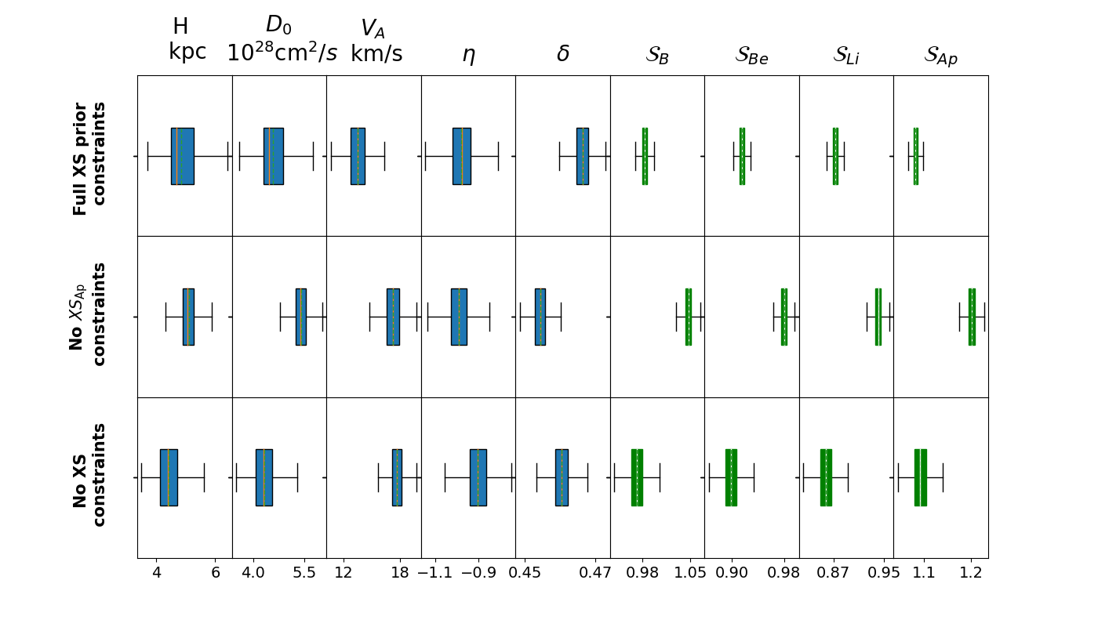
PRELIMINARY
Predicted parameters are compatible even within 1σ uncertainty
Main change is found in the normalization of the diffusion coefficient and H parameters → Prior constrains in cross sections only affect the normalization of the predicted grammage

Slide 17
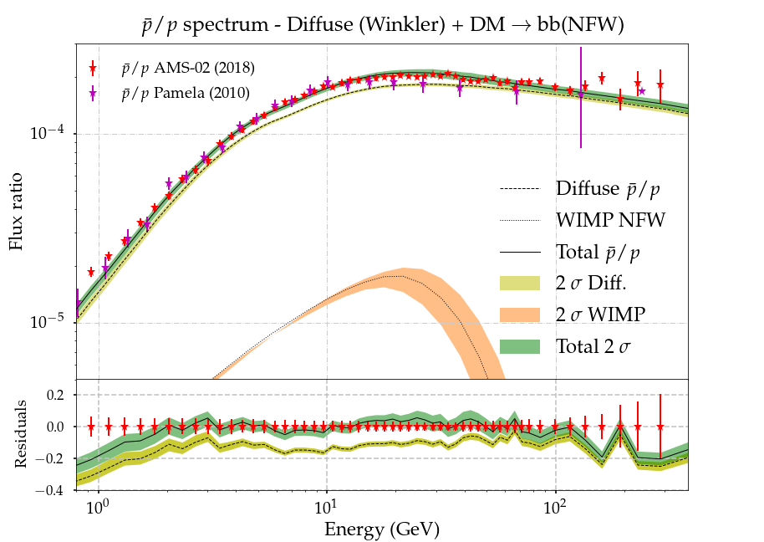
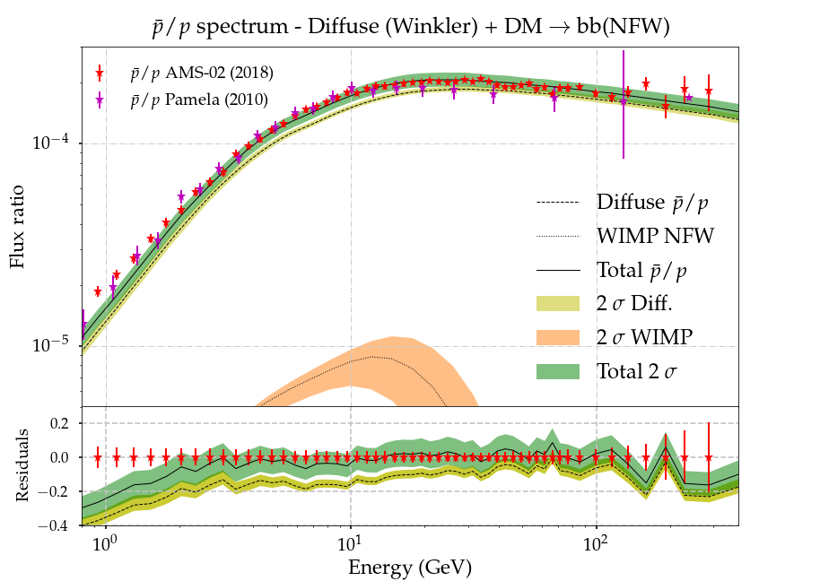
χ
b
Analyses including dark matter component
χ
b
Same three analyses as for the case without dark matter component.
Differences found in the spectra for the analysis considering prior constraints and not considering them (which predict a 3 times smaller <σv> value too)
Normal analysis (with prior constraints)
Analysis without prior constraints
PRELIMINARY
PRELIMINARY

Slide 18
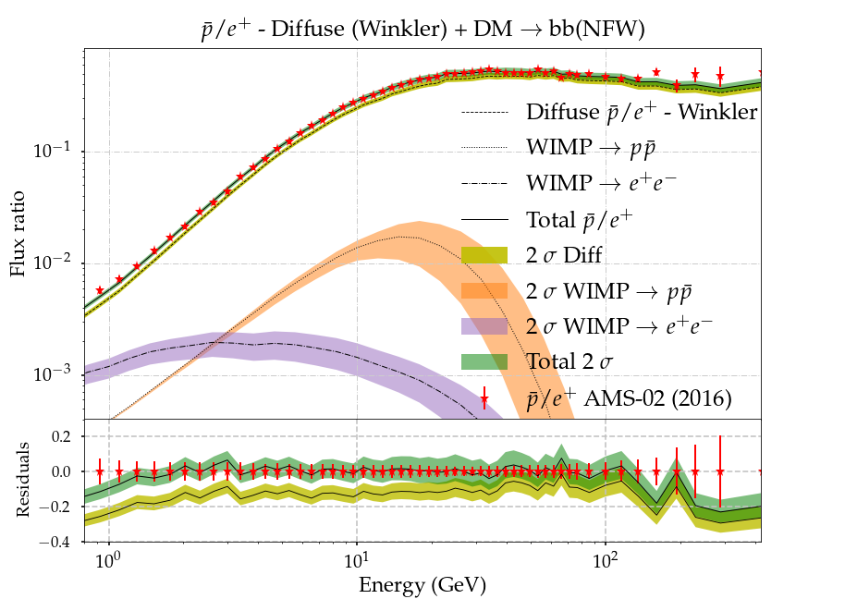
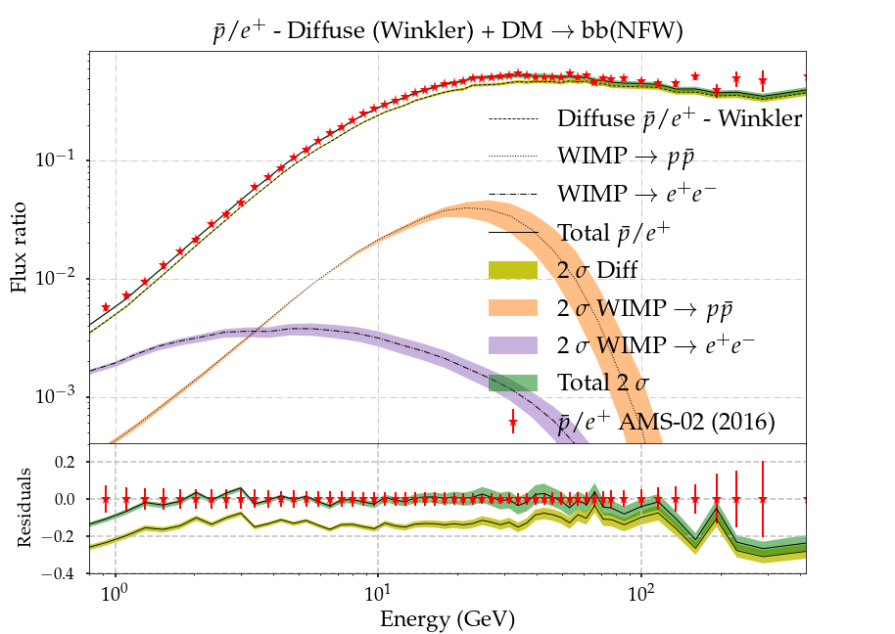
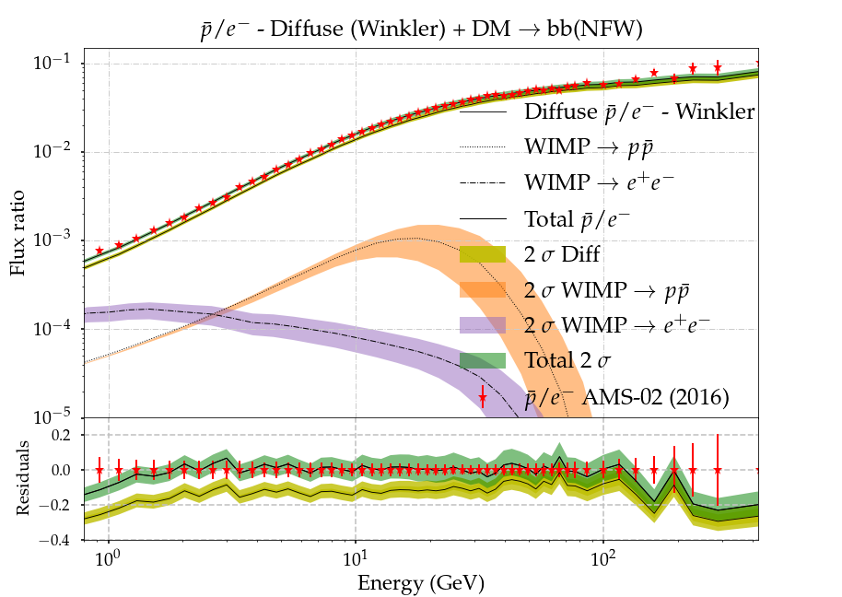
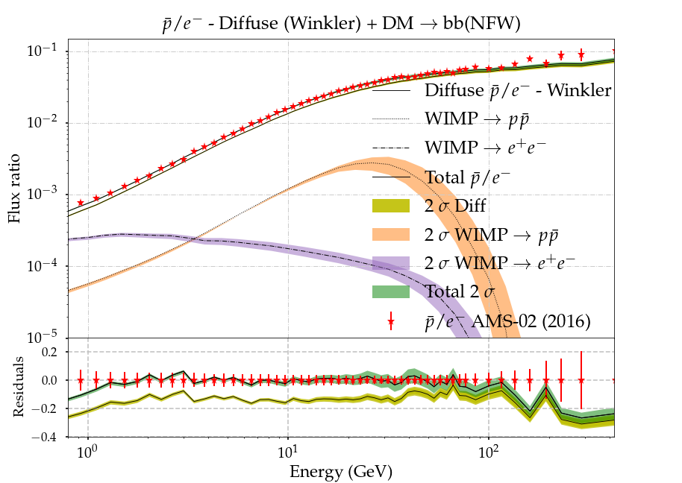
χ
b
Analyses including dark matter component
χ
b
Same three analyses as for the case without dark matter component.
Differences found in the spectra for the analysis considering prior constraints and not considering them (which predict a 3 times smaller <σv> value too)
Normal analysis (with prior constraints)
Analysis without prior constraints
PRELIMINARY
PRELIMINARY

Slide 19
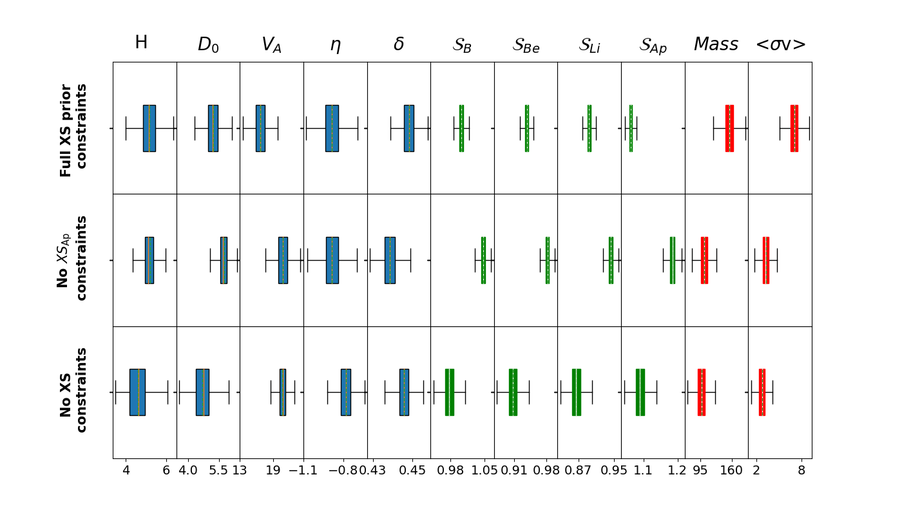
PRELIMINARY
x ${10}^{−26}$
Propagation parameters are again very similar in every analysis and similar to the parameters found in the analyses without including dark matter component.
A larger <σv> implies less scaling of the antiprotons, which increases the total value of the likelihood.
DM masses are slightly bigger than usually reported, due to the use of 2018 data-set

Slide 20
PRELIMINARY
x ${10}^{−26}$
Scale factors are statistically needed. The case with no cross sections prior constrains finds (unsurprisingly) similar results as earlier analyses taking into account the full uncertainty bands
The hypothesis of a dark matter component is disfavoured against the hypothesis of Ap cross sections scale (Δχ² ~ 160 – over around 600 points). However, the hypothesis with dark matter + cross sections scale is favoured against only Ap cross sections scale (Δχ² ~ 38)

Slide 21
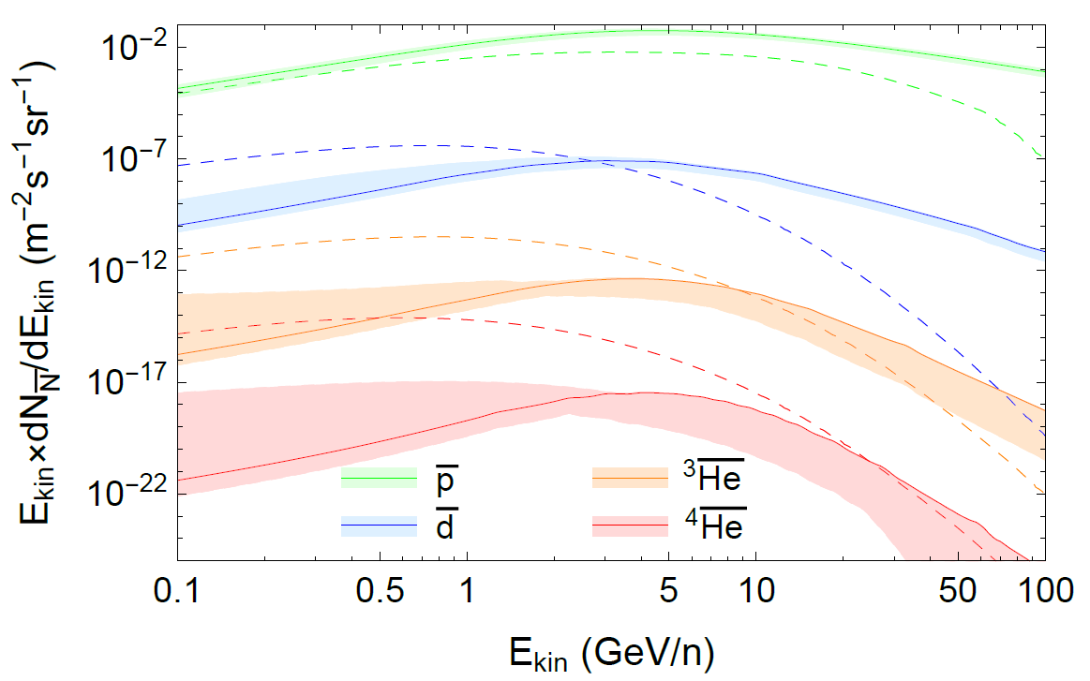
Dark matter constraints from antinuclei
The fact that scale factors seem to be statistically needed will also affect significantly our capability to distinguish the possible existence a dark matter signal against the anti-nuclei produced from CR interactions with ISM gas
Cholis, Linden, Hooper Phys. Rev. D 102, 103019
The grammage predicted by combined models including antiprotons is significantly larger than that predicted only by B, Be and Li (it leads to an increase in the production of antiprotons of order 10% )
Work in progress for computing new cross sections for the production of anti-D and anti-³He and study the significance of DM detection. Coming soon…
See also Kachelrieß et al JCAP08(2020)048
Linden, Winkler PRL 126, 101101

Slide 22
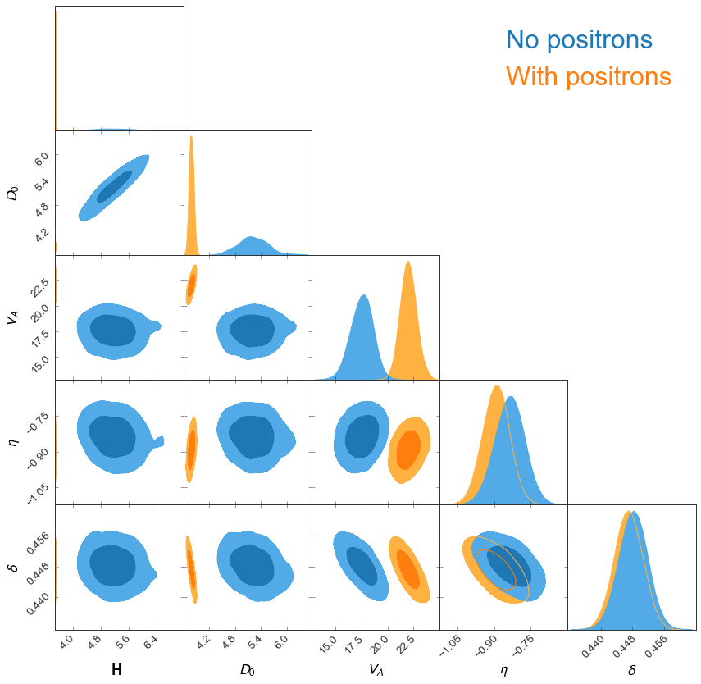
BONUS: Secondary and primary positrons
No convergence is found even for renormalizations of e⁺ cross sections of up to 50%
Other diffusion parameters are affecting positrons? is the diffusion coefficient locally different? or is it simply an issue with positron cross sections?
This slightly affects the parameters of extra sources (pulsars) producing primary leptons too!

Slide 23
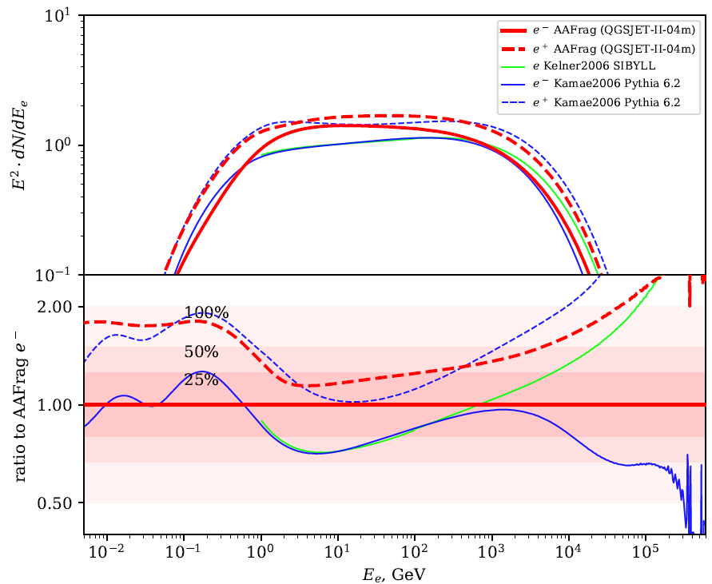
BONUS: Secondary and primary positrons
Positron cross sections could suffer from important uncertainties in their energy dependence even above 10 GeV
Koldobskiy et al 2021
arXiv:2110.00496v1

Slide 24
PSAP 2021 – 19/10/2021
The role of cross sections in the evaluation of GCR propagation
To summarize…
The spallation cross sections are the main concern for precise studies on CR propagation. These uncertainties significantly affect our conclusions on the nature and production of secondary CRs, our evaluation of the diffusion process, the galactic environment and the possible signals of dark matter.
The most updated parametrizations are able to reproduce all the spectra of secondary CRs simultaneously, just by scaling the cross sections suitably. This combination of secondary CRs is needed to reduce the effect of systematic uncertainties.
Important improvements on nuclear codes are needed for the study of anti-nuclei. Isotopic measurements of CRs would also allow us improve the current cross sections parametrizations.
Pedro de la Torre Luque Stockholm University pedro.delatorreluque@fysik.su.se

Slide 25
BACK UP

Slide 26
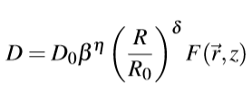
Diffusive transport of Galactic cosmic rays
Propagation equation is solved with the DRAGON2 code
https://github.com/cosmicrays/DRAGON2-Beta_version
$\frac{\text{J}\text{sec}}{\text{J}\text{pr}} \sim$σ(E)/ $D\left(E\right)$

Slide 27
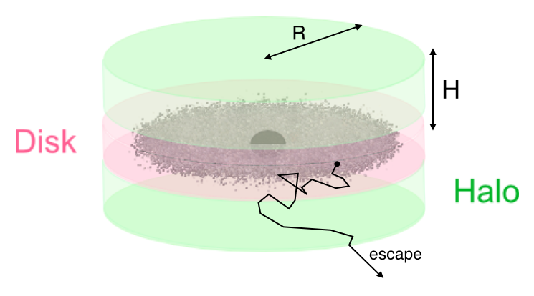
Diffusive transport of Galactic cosmic rays
Secondary-to-primary ratios are key to evaluate the diffusion coefficient
Diffusion coefficient (D ∝ 1/τ^{diff})
N_{pr} ∝ Q_{pr}(E)/D(E)
N_{sec} ∝ Q_{sec}(E)/D(E)
Q_{sec} ∝ N$\text{pr}$(E) σ(E)
$\frac{\text{N}\text{sec}}{\text{N}\text{pr}}= \frac{\text{Q}\text{sec}}{\text{Q}\text{pr}} \sim$σ(E)/$D\left(E\right)$
$\frac{\text{N}\text{sec}}{\text{N}\text{pr}}= \frac{\text{Q}\text{sec}}{\text{Q}\text{pr}} \sim$σ(E)/$D\left(E\right)$
Complexity of cross sections measurements and the amount of interaction channels involved in the CR network obey us to employ parametrizations

Slide 28
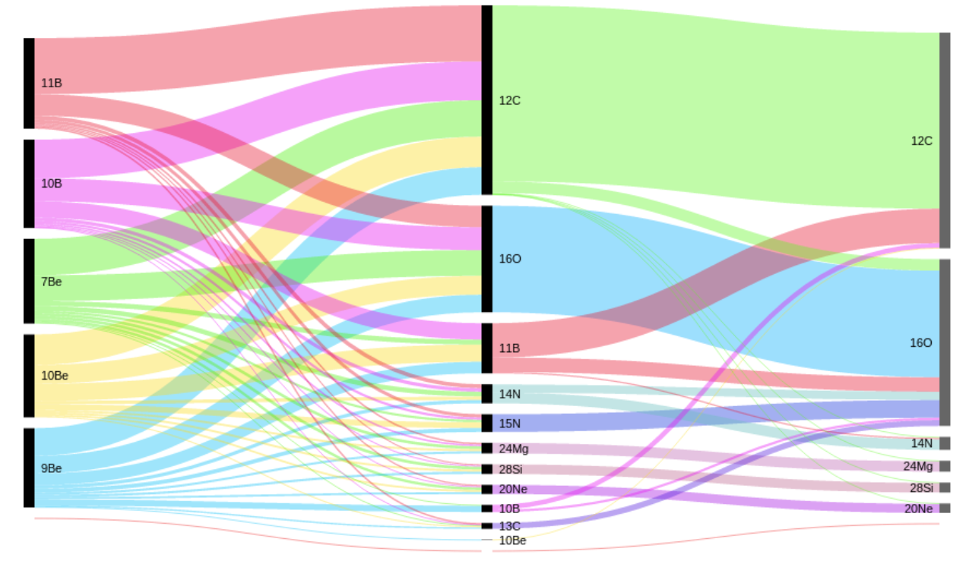
High uncertainties in XSecs → High uncertainties in the secondary CRs
Q_{sec}$(E)$∝ $\sum^{pr}{\text{J}\text{pr}\text{(}\text{E}\text{) }\text{σ}\text{pr}\text{→ }\text{sec}}(E)$
Complexity of the XS network
Assessment of XSec errors in sec. CRs
· Main spallation channels: O and C
· Secondary channels (N, Ne, Mg, Si & Fe) . are very important for Li and Be (< 50%)
· Tertiary channels also matter:
e.g. ¹¹B + gas → ¹⁰B + X
Genolini et al. 2019 ; arXiv:1803.04686
Tomassetti, 2018 ; arXiv:1707.06917
Tomassetti, 2018

Slide 29
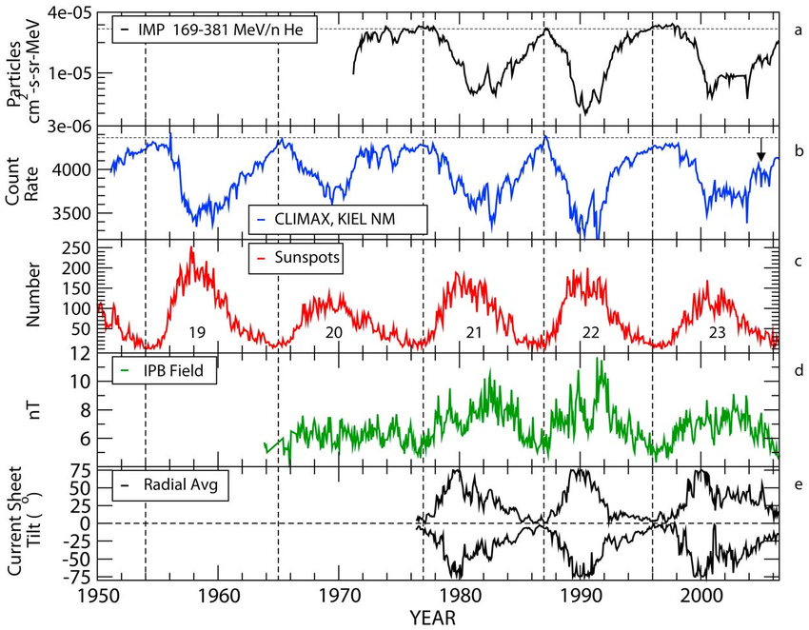
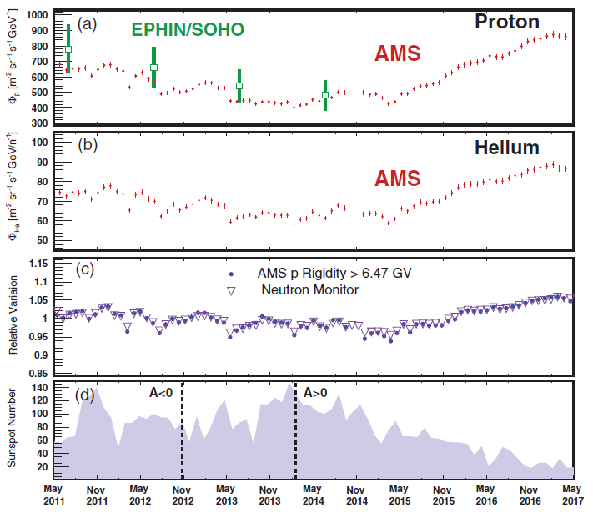
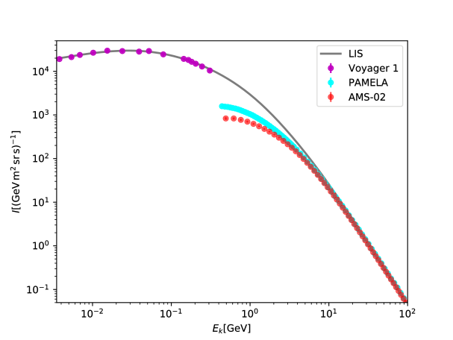
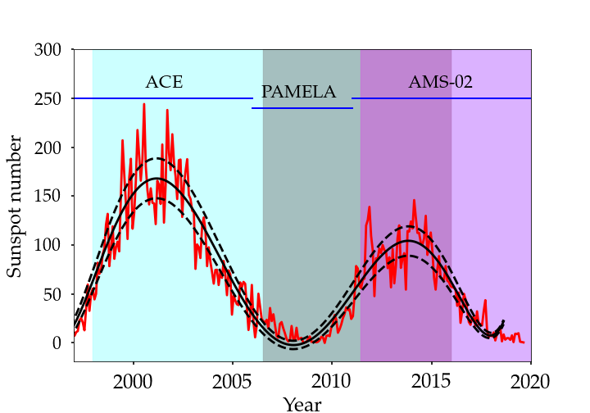
Solar modulation
Detailed heliospheric simulations or Force-Field approximation
Neutron monitor experiments + Voyager-01 data

Slide 30
Antiproton cross sections
$·(2+ ΔIS+2$ $Δ$_{Λ})
Kappl & Winkler, 2019 ; arXiv:1408.0299
A. Reinert, M. W. Winkler, 2017 ; arXiv:1712.00002

Slide 31
Extra contributions of secondary CRs?
M. J. Boschini et al 2021 arXiv:2106.01626
M. J. Boschini et al 2020 ApJ 889 167

Slide 32
PRELIMINARY
PRELIMINARY
PRELIMINARY
PRELIMINARY

Slide 33
Impact of spallation uncertainties on the halo height determination
Best combined fit: H = 6.8 ± 1 kpc
Spallation uncertainties imply uncertainties around 40% in this ratio
Including these uncertainties we can only constraint the value of the halo height to be 3 kpc < H < 20 kpc

Slide 34
Determination of propagation parameters
P. De La Torre Luque et al JCAP07(2021)010
Combined analyses are needed!
Negative η values → Wave dissipation
V_{A} compatible with ~ 20-30 km/s
Large dispersion of δ: 0.39 – 0.46,
(specially hard for Li ratios)
Δδ=0.14, R_{b}=312 GV, R₀=4GV

Slide 35
Monte Carlo analysis: Combination of the ratios of secondary CRs
P. De La Torre Luque et al JCAP07(2021)010
Combined analyses:

Slide 36
Combined DRAGON2
Compatible with all ratios for scale factors S_{X} < 1.06 (< 6% scale)
Predicted δ = 0.42 (0.38-0.44)

Slide 37
Combined GALPROP
Need of more degrees of freedom
S_{B} = 1.01, S_{Be} = 0.9, S_{Li} = 1.25 (±1%)
Predicted δ = 0.39 (0.35-0.42)

Slide 39
Antiproton spectra (Old data - 2015)
Adding also p/p spectrum above 4 GeV
Residuals at 10 GeV are ~17%
Cross sections of p production 12-20% (1 σ)
WIMP mass = 133^{+8.4}_{-7.3} GeV <σv> = (12.2 ± 0.5) 10⁻²⁶ cm³/s
bb channel

Slide 40
Combined antiproton analyses

Slide 41
Combined antiproton analyses with DM component

