Slide 1
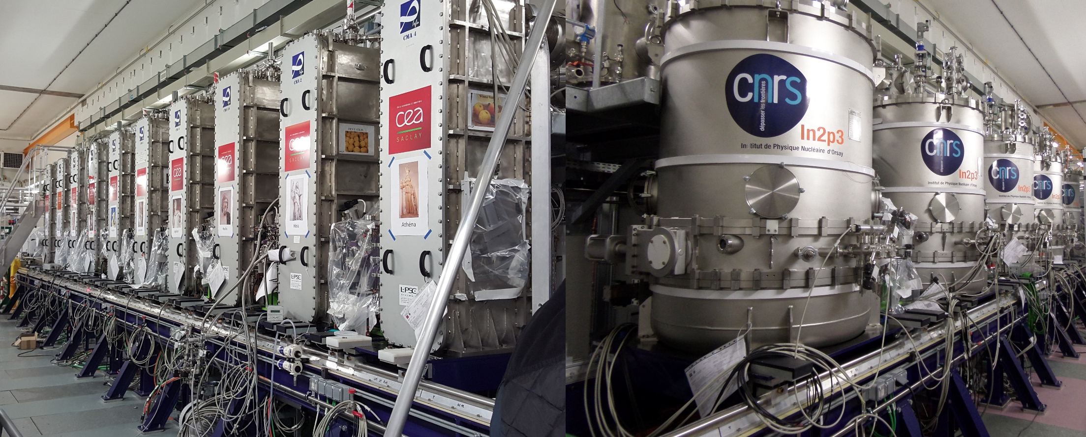
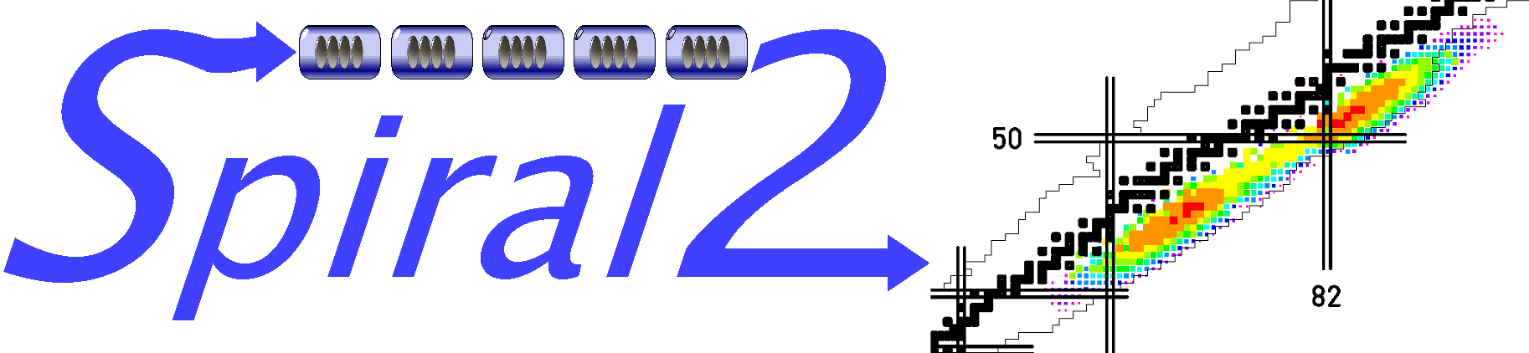
SPIRAL2 commissioning
Robin FERDINAND on behalf of the GANIL teams and SPIRAL2 collaborations

Slide 2









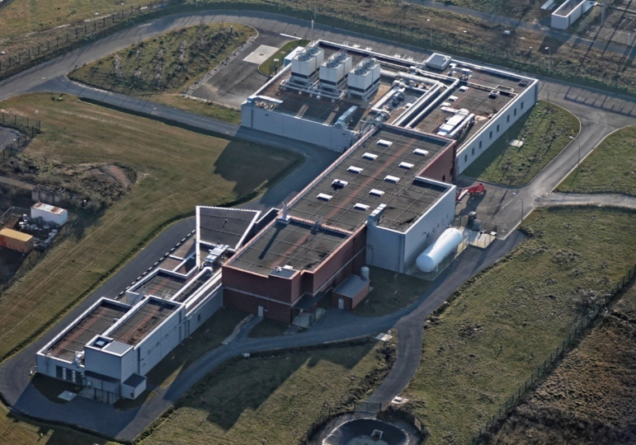









Partner labs for SPIRAL2 – accelerator project
UNION EUROPEENNE
DP2I (DAM)
BARC (India), INFN (Italia)
IFIN-HH (Romania), IFJ-PAN (Poland)
SOREQ (Israel), INRNE-BAS (Bulgaria)
Arial view of the SPIRAL2 building
=

Slide 3
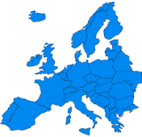
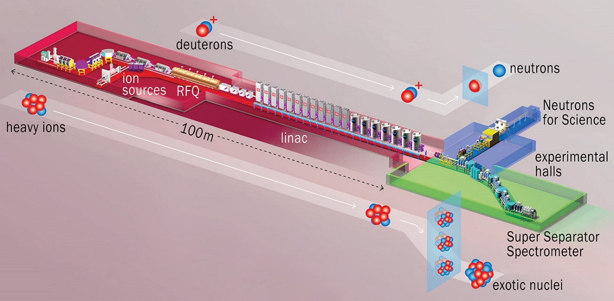
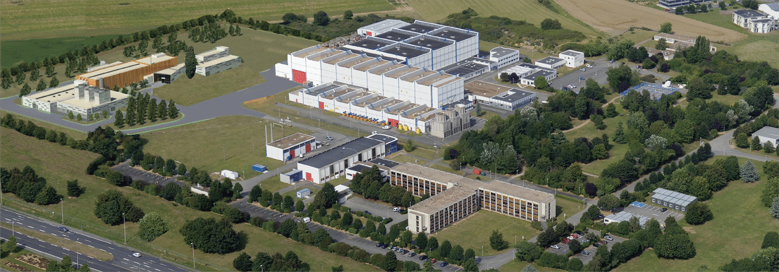

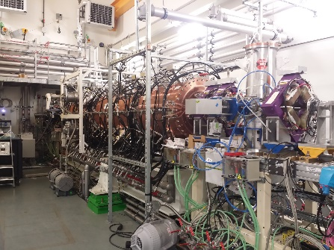
SPIRAL2 accelerator
GANIL
Particles | H⁺ | D⁺ | ions | option
A/Q | 1 | 2 | 3 | 7
Max I (mA) | 5 | 5 | 1 | 1
Max energy (MeV/A) | 33 | 20 | 14 | 7
Max beam power (kW) | 165 | 200 | 44 | 49
[5 mA]
0.75 MeV/A
20 MeV/A
[1 mA]
A versatile machine to provide high intensity beams
14 MeV/A
Built by several French Labs
Collaboration with International labs
July 8th , 2019 : Administrative authorization to operate SPIRAL2
RFQ
88 MHz
Superconducting cryomodule A [β=0.07]
Superconducting cryomodule B [β=0.12]

Slide 4
Main commissioning dates and milestones

Slide 5

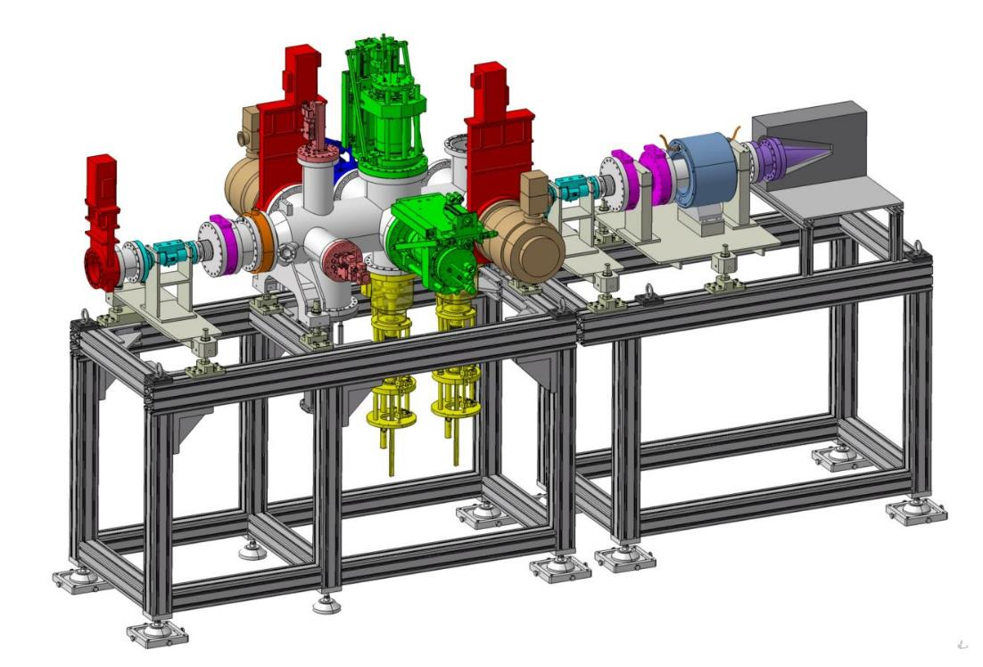
Commissioning time line
ECRIS
A/Q=3
1mA
ECRIS
H⁺, d⁺
5 mA
MEBT
LINAC
RFQ
D-plate
LEBT
2014
P/D source: first beam 2 mA H⁺.
December.
2015
Phoenix V2: first beam 230 µA Ar⁹⁺.
July.
RFQ: first beam H⁺. December.
2018
Diagnostic plate commissioning end.
April-November.
2019
MEBT @5 mA H⁺.
SBS* @ 0.2 mA H⁺
SC LINAC @ 0.2 mA H⁺
33MeV H⁺
July-December
2020
SBS @ 5 mA H⁺. July
SBS* @1.3 mA ⁴He²⁺
SC LINAC @ 5 mA H⁺
16kW H⁺
July – December
^{SBS*= Single Bunch Selector}

Slide 6
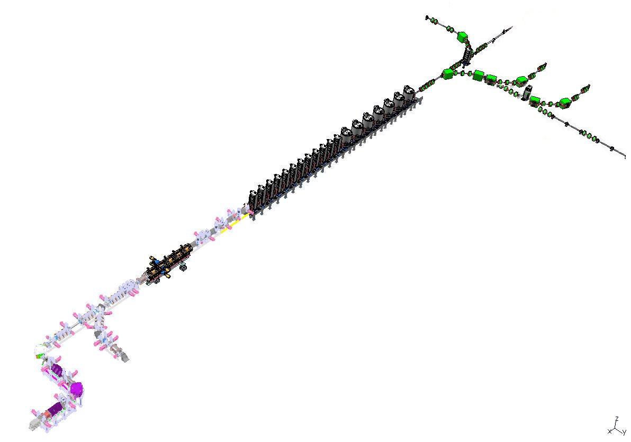

Injector commissioning results
Nov 2018 – July 2019
  D-plate removal
  Connection to LINAC
July 15, 2019
  First proton beam in Medium Energy Beam Transport Line
June 29 - July 31, 2020
  5mA tuning, with Single Bunch Selector

Slide 7
Beam commissioning in 4 phases
Qualification of the ion sources and LEBT in the laboratories in charge of the development (LPSC-Grenoble and CEA-Saclay)
  2009-2012
Qualification of the injector on a Diagnostic Plate (GANIL)
  Reproduce the results from the pre-commissioning
  Validate the RFQ performances
  Provide a development platform for various diagnostics
  Measure the beam characteristics at the RFQ exit.
  2014-2018
SC linac beam commissioning up to the main beam dump
  Progressive cool down – started in 2016
  RF validation of all cavities - 2019
  Beam commissioning – Started 2019
“day-1” experiments to NFS and S3 experimental halls, including commissioning –
  first test experiments in NFS in 2019 and 2020
Notes:
Reproduce the results from the pre-commissioning of the ion sources, i.e. validate the source performances on SPIRAL2 site,
Validate the RFQ performances for the various main reference particles (see below): transmission, beam energy, output emittances in the three planes, and bunch extension,
Provide a development platform for various beam diagnostics required either to validate the RFQ beams or later to tune and validate the linac beams,
Measure the beam characteristics at the RFQ exit, to serve as input parameter for the next stage.
RF to validate the cold tuning system, the automations, the dynamics RF consumption and so on

Slide 8
Strategy for a multi beam commissioning
Injector commissioning time
Increasing stress for the RFQ cavity and later for the linac
  ❶ : H⁺ beam, Light ion source and LEBT, 50kV on RFQ vanes, up to 5mA
  ❷ : ⁴He²⁺ beam, heavy ion source and LEBT, 80kV, up to 2mA, mimic the D⁺
  ❸ : ultimate injector performances (A/Q=3, 114 kV, up to 1mA) : ➔ The optimum (1mA) was ¹⁸O⁶⁺
  ❹ : 20 µA Ni ion beam to facilitate the future tuning of the accelerator
  ❺ : D⁺ beam, up to 5mA
    Required the final authorization from the Nuclear Safety Authority
    Activation
    Has been discarded after the injector review
  25 µA ⁴⁰Ar¹⁴⁺ ion beam
Notes:
He set at 2mA for the previous Phoenix V2 source, and set to 3mA (tbd) with the optimized phoenix v3.

Slide 9
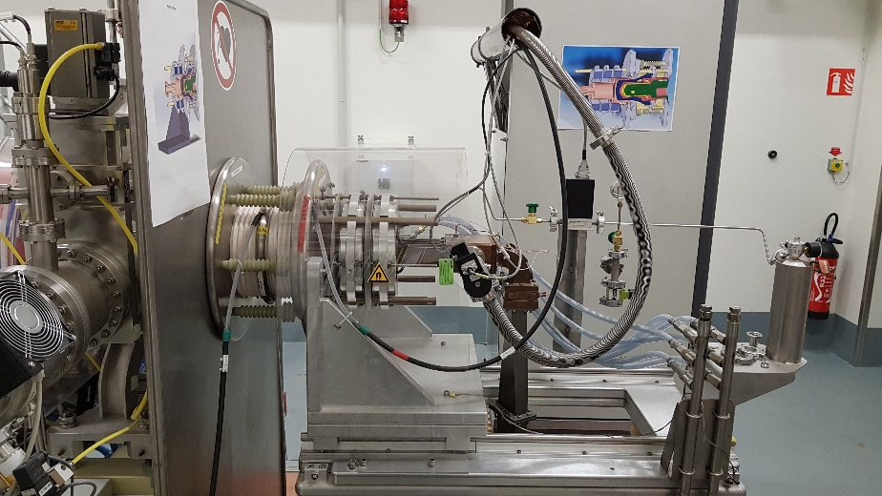
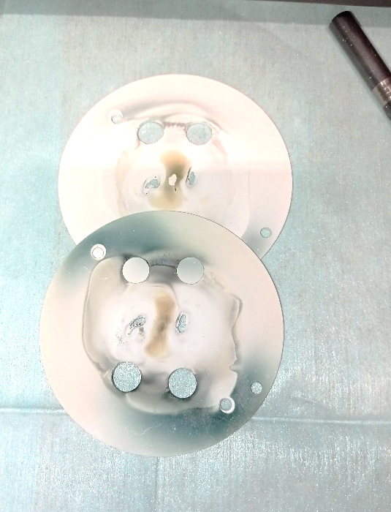
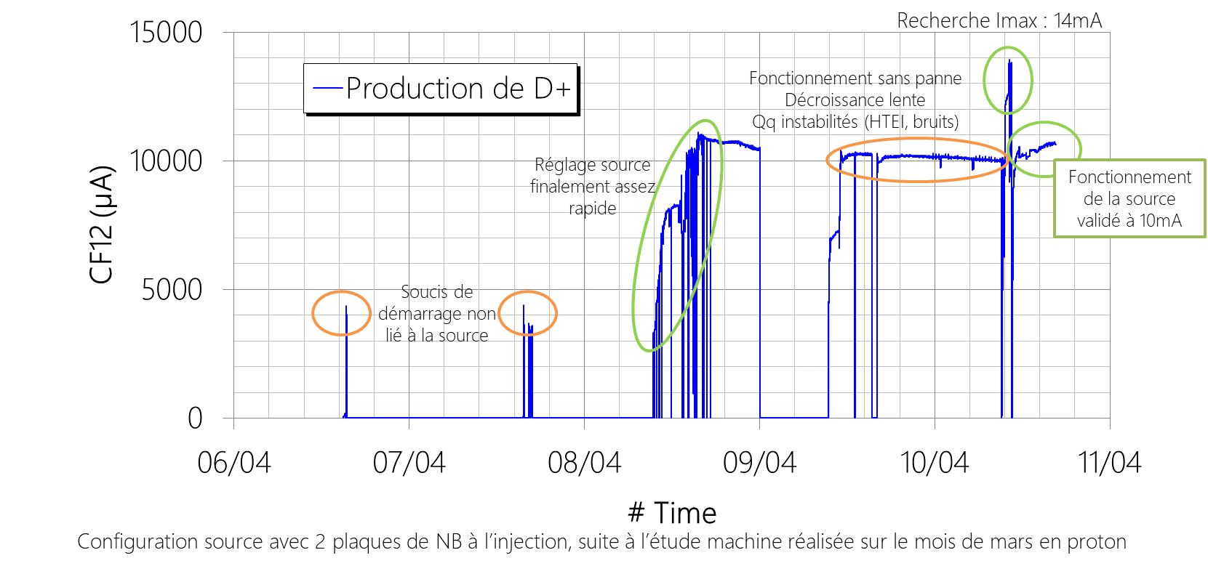

Deuterium source
875 G
Boron Nitride
disks
Source and extraction are optimized for D⁺ production
 | GANIL H⁺ | IRFU D⁺ (2012) GANIL (April 2021)
Extraction voltage | 20kV | 40kV
Source intensity (all species, 1st CF) | <12mA | ≈14,5mA
H⁺/D⁺ intensity | <8mA | 12mA
Reliability Availability | 1000h BN disk 150h H₂ gas | 3 months data's with D⁺
Deuterium operation:
No technical modification on the source
Deuterium bottles available
Availability upgrade
Increase to 70l H₂/D₂ in bottle volume
Optimization of BN disk lifetime
M. Dubois and F. Lemagnen

Slide 10
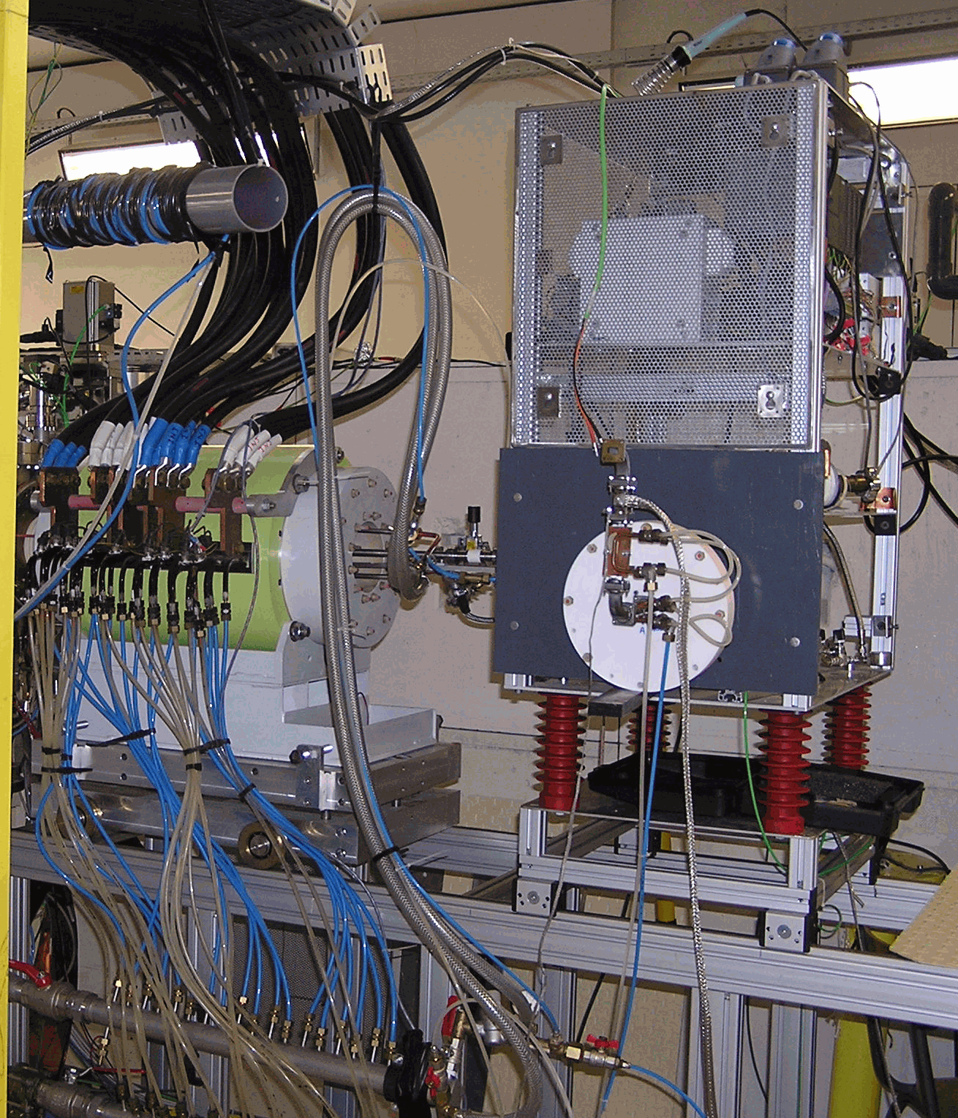
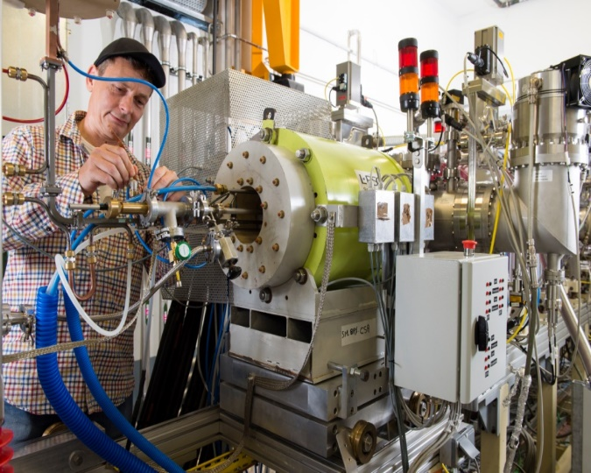
Heavy ion source: Phoenix V2
Main parameters
Design criteria | LPSC Grenoble
Ratio charge to mass | > 1/3 Heavy ions/gaz/metallics
Extraction voltage (max.) | 60 kV
Operating frequency | 18 GHz
V2 has been used for commissioning
2018
Phoenix V2 | Maximum Intensity (µA) | Intensity (µA)
⁴He²⁺ | 2800 | 2000
⁴⁰Ar¹⁴⁺ | 45 | 25
¹⁶O⁶⁺ | 1200 | 800
¹⁸O⁶⁺ | 1200 | 650

Slide 11
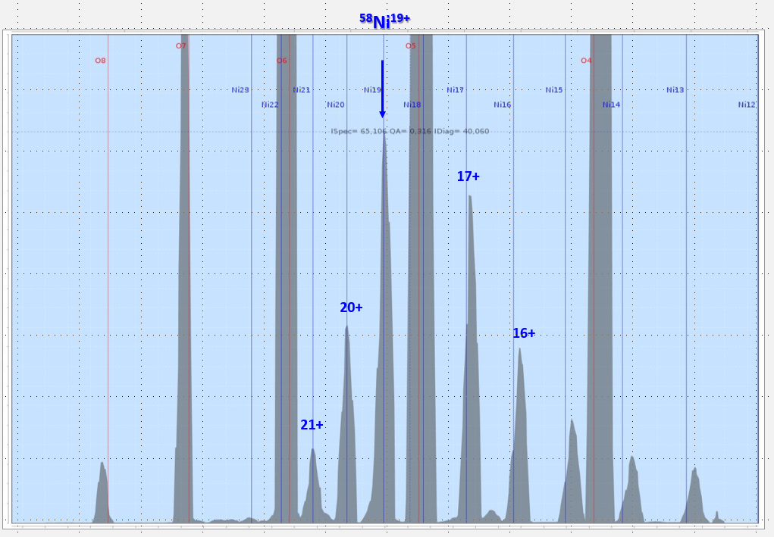
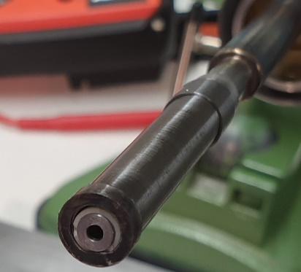
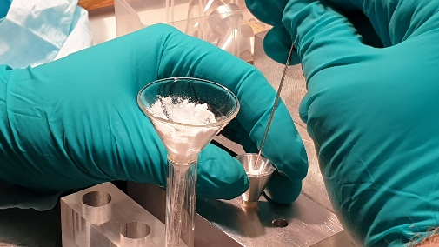
Phoenix V3 – results, source developments
M. Dubois and F. Lemagnen
 | Achievements
⁴He²⁺@40kV | 4mA @ GANIL
⁴⁰Ar¹⁴⁺@40kV | 100µAe
HV @60kV | extraction pb
⁴⁰Ca¹⁴⁺@60kV | Not yet done (4µAp objective)
S3 (2023) and ANR REPARE (2022)
S3 COMMISSIONING : ⁵⁸Ni
S3 PHYSIQUE LEB : ⁴⁸Ca, ⁵⁰Cr, ³⁶⁻⁴⁰Ar, ²²Ne, ¹⁸O
S3 PHYSIQUE SIRIUS : ⁴⁸⁻⁵⁰Ti, ⁵⁴Cr, ¹⁸O
ANR REPARE : ⁷Li³⁺
⁵⁸Ni¹⁹⁺ @40kV - Octobre 2020 - 40µAe (>2µAp), ×2 better than phoenix-V2
Stability ±15%
2020
⁷Li³⁺ @40kV – Novembre 2020
First test with LiF (comparison with GSI method)
Unsuitable molecule for A/Q=3
Looking for the right compound (vapor pressure for T<1500°, …)
Source spectrum. ⁵⁸Ni ¹⁹⁺ = 40µAe
Sample preparation at the source lab
for evaporation improvement

Slide 12
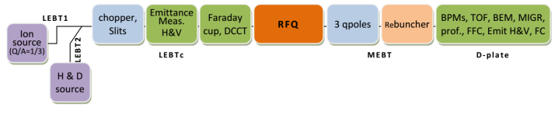
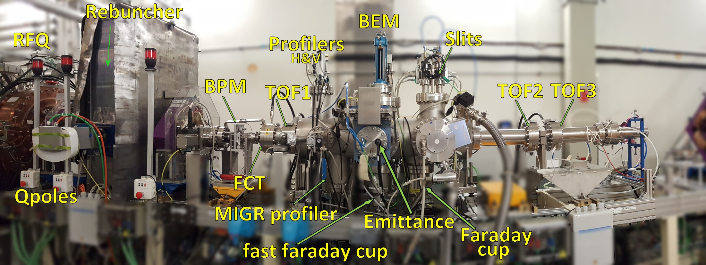
Test Bench
Tests completed
D-plate removed in November 2018

Slide 13
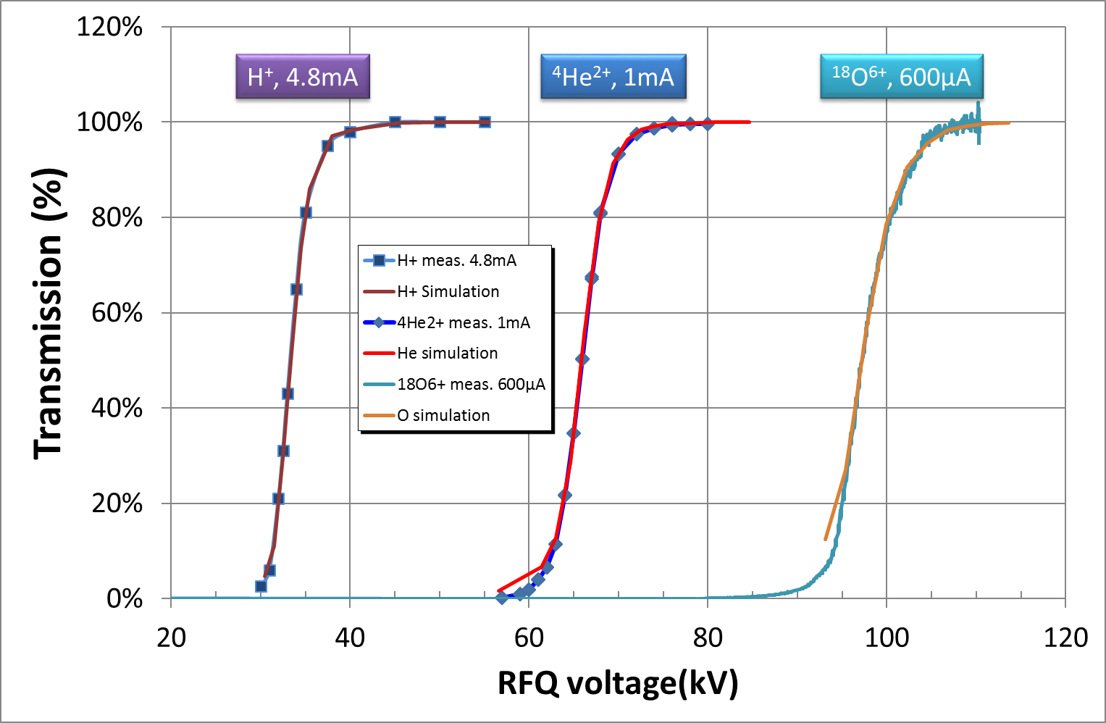
Injector commissioning
Objectives:
  RFQ validation
  Obtain beam parameters after the cavity
    Transmission
    Beam energy
    Output emittances in the three planes,
    Bunch extension
  Test bench for diagnostics
  (physical separation with the linac)
Validation with beam
  Max beam current
    5mA
    1mA => 800µA
CW mode
D⁺ : preparation with ⁴He²⁺
+ ⁴⁰Ar¹⁴⁺
RF operation stable and reliable for Proton/Helium/Oxygen

Slide 14
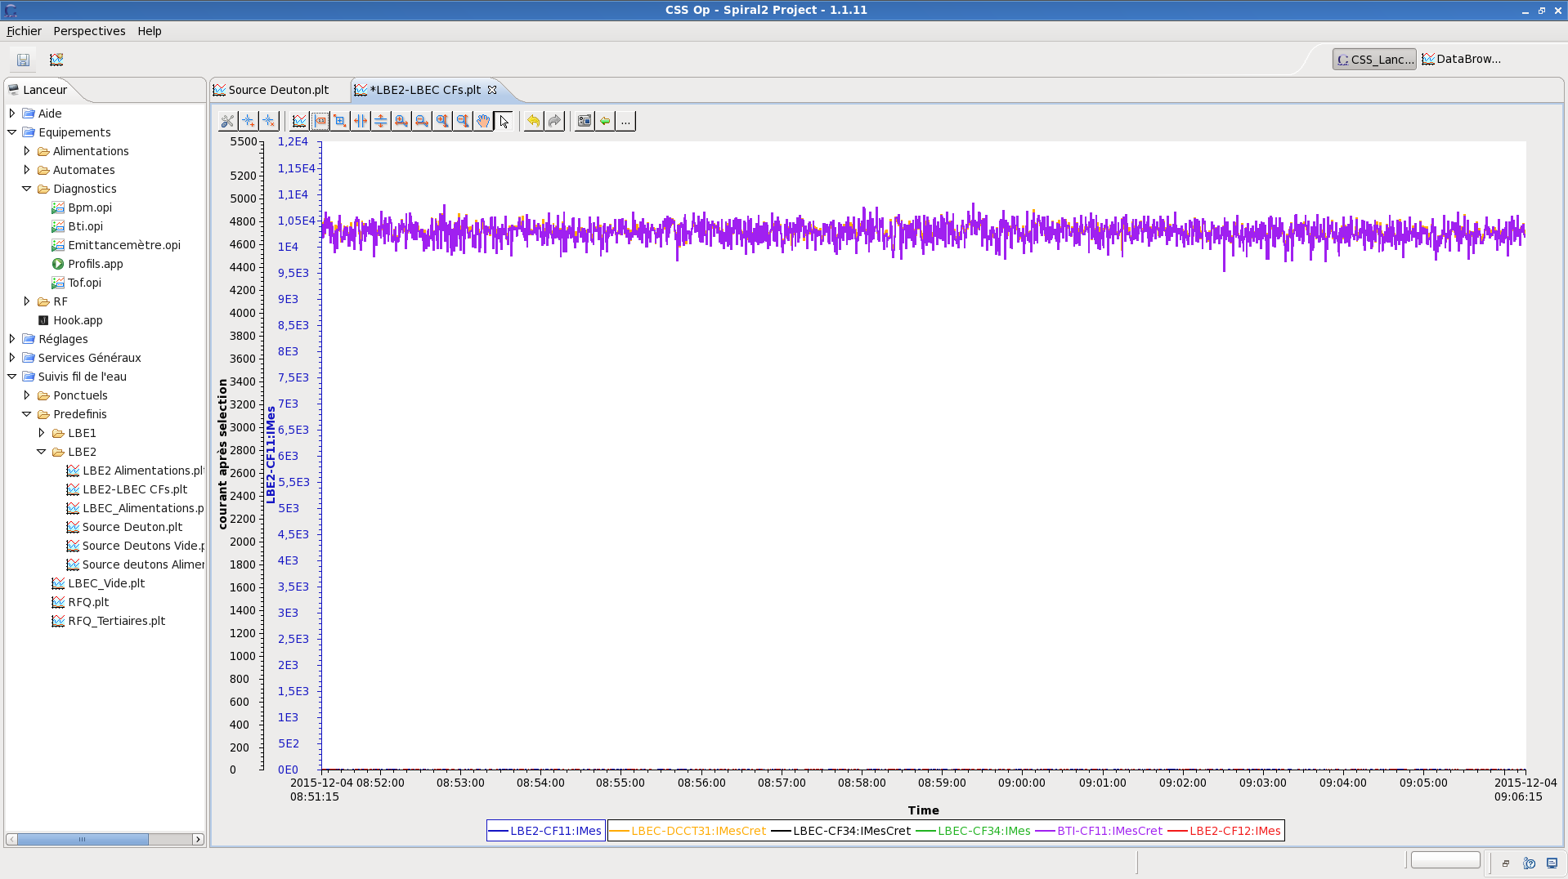
Beam commissioning :
Nominal beam out of the RFQ
5mA Out
5mA In
H⁺

Slide 15
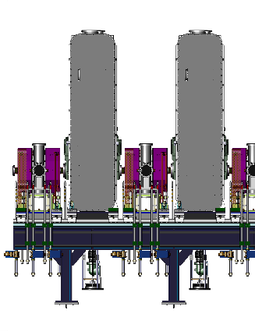
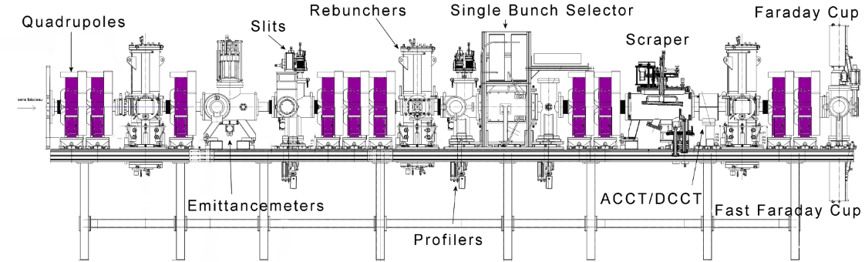
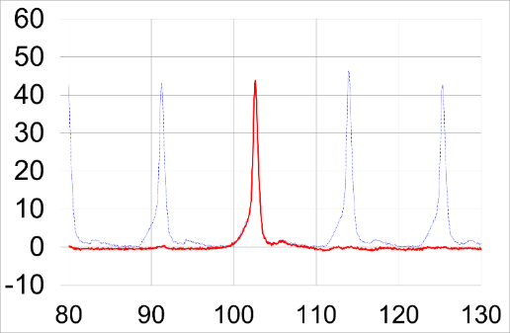
Medium Energy Beam Transport line
Phase pickup
RFQ
RFQ has been validated at nominal 114kV operation
Good beam transport agreement between simulation and measurement (with measured emittance)
Single Bunch Selector
  Required for Physics (Time of Flight), and HEBT tuning (limitation of power deposition)
    From 1/100 to 1/10000 bunch selection
  Separation and injection and transport have been validated at all intensities (5mA, 1mA, 0.2mA) in pulsed and CW mode.
Problem of DCCT temperature elevation for high beam current
  Limitation to 1 hour operation
  Solution(s) under evaluation
u.a.
ns
Rejection better than 10⁻⁴ to 10⁻⁵ in NFS
Notes:
Our newly installed Medium Energy Transport Line is a long 8 m line, to allow us to match the beam into the linac, but also to allow the insertion of a single bunch selector and its scraper here.
The transport is in good agreement with the simulation at 5mA and 0.2mA, but we observe a small variation in the transverse output emittance that we try to understand.

Slide 16
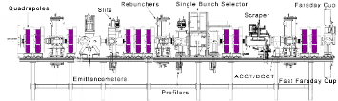
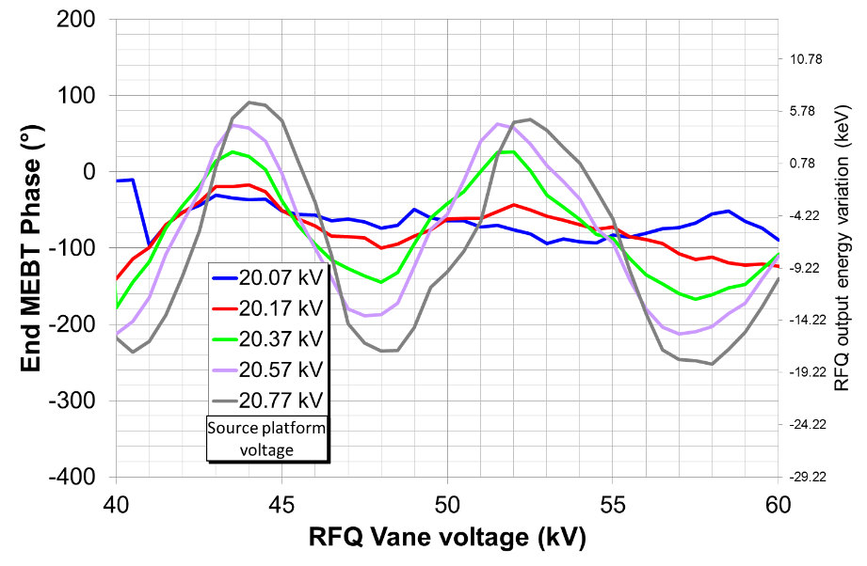
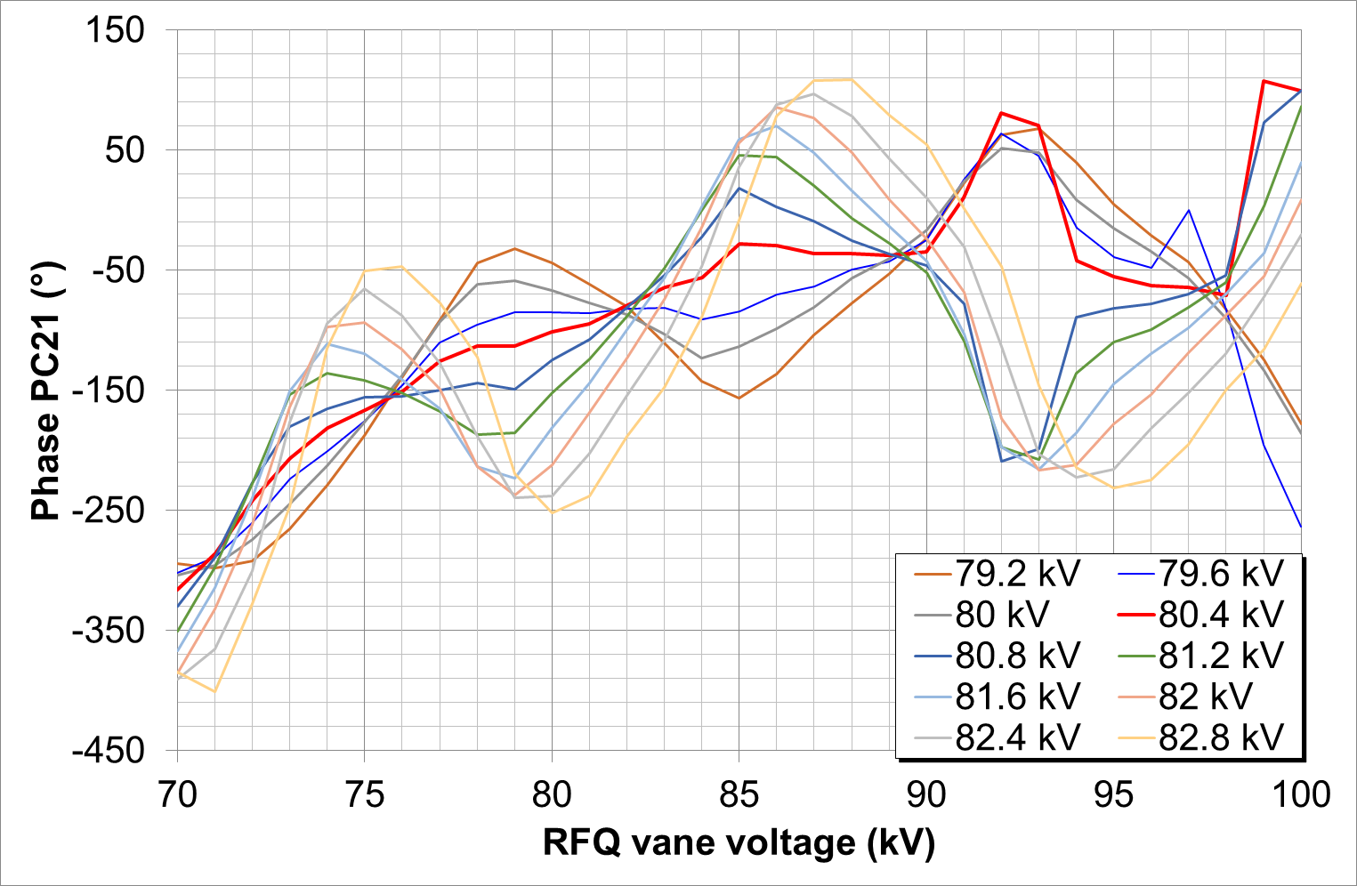
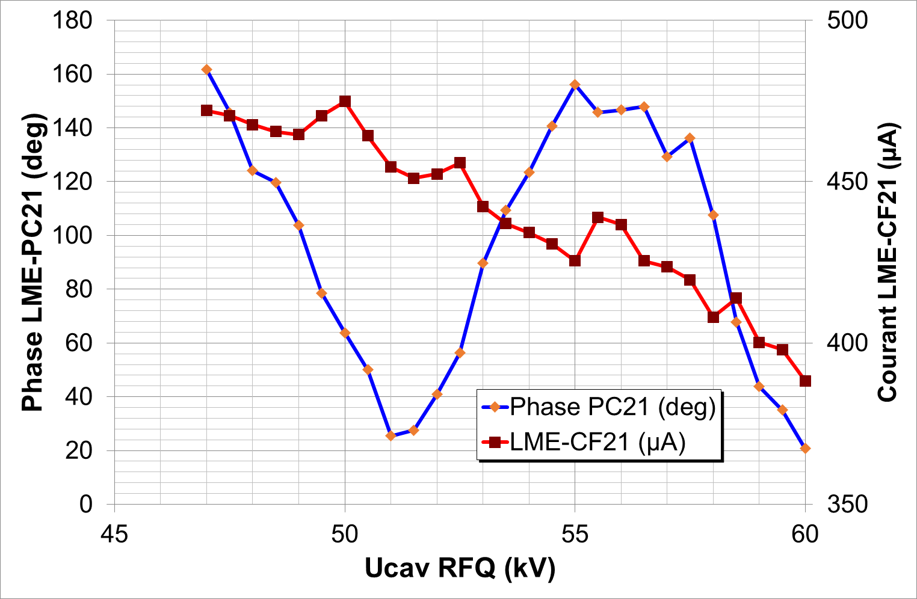
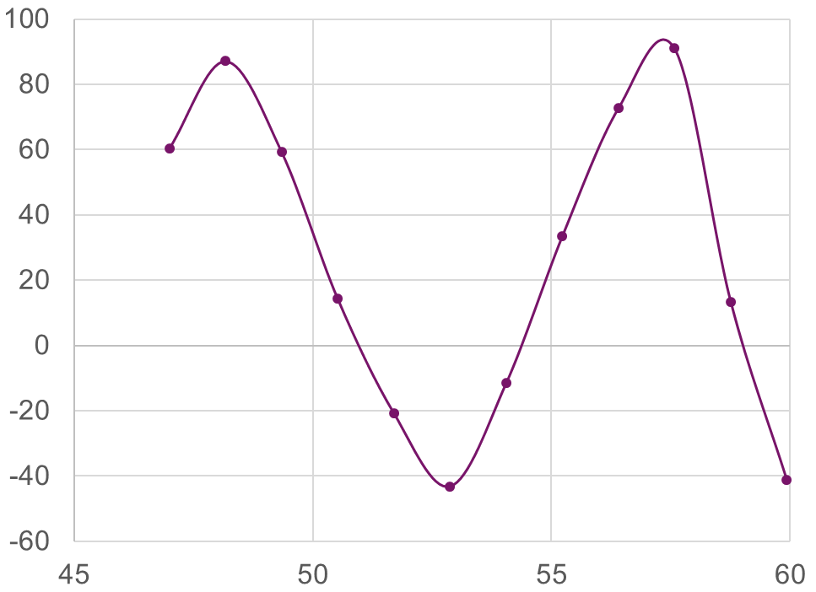
RFQ output phase/energy variations
Phase variation at MEBT end (mostly RFQ energy shift, up to ±1.5%) with RFQ voltage variation => explained by synchrotron oscillation due to input energy error
Allowed to optimized the source platform voltage
Phase measurement (PC21)
RFQ
Beam Phase vs U_{RFQ} RFQ
H⁺
Fluctuations reduction at RFQ output
⁴He²⁺
Experimental
Simulation
Phase LME-PC21 (deg)
U_{RFQ} (kV)
U_{RFQ} (kV)
Notes:
For the RFQ, I would like to highlight the phase variation we have observed with various parameters like the beam current or the RFQ vane voltage. If we use the phase measurement at the end of the long line, we have a very large lever arm that amplifies the fluctuations.
On that particular one, phase was changing with the RFQ vane voltage from 47 to 60kV. It has been nicely simulated on the right, and is attributed to synchrotron oscillation due to bad input energy.
So we have use this to optimize the source platform voltage, and you can see here that we are able to suppress the fluctuation
Tension source optimum déterminée
Tension RFQ ajustée
4.2mA à 4.9mA en bout de ligne moyenne énergie

Slide 17

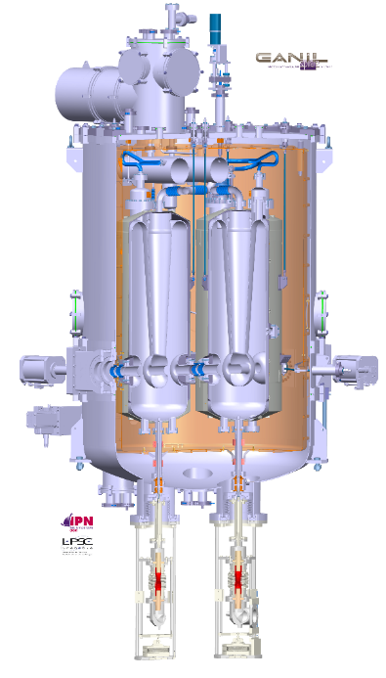


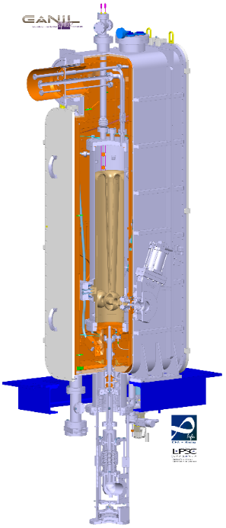

LINAC commissioning
A project revue with international experts was organized in March 2021

Slide 18
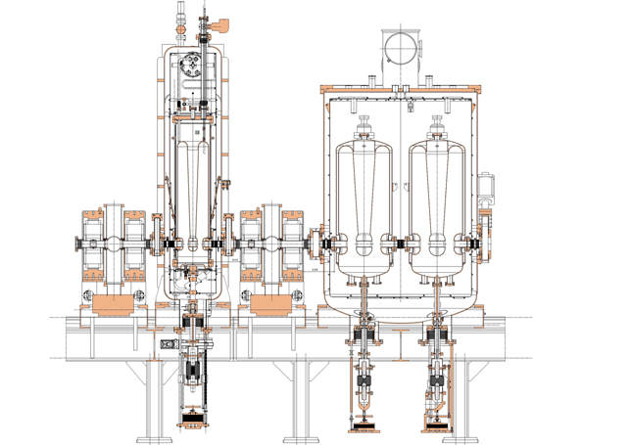

SC LINAC
All cavities and cryomodules qualified @ partner lab premise
SACLAY : From May 2012 to July 2015
ORSAY : From April 2013 to March 2015
CMA
CMB
  26 Nb cavities QWR at 88 Mhz
  T : 4.5K operation.
  E _{acc} : 6.5 MV/m
  two cavity families :
12 Beta = 0.07 (1 cavity / cryomodule type A)
14 Beta = 0.12. (2 cavities / cryomodule type B)
20 warm sections (quadrupoles/diagnostics/TMP)
Beta 0.07 energy section
Beta 0.12 energy section
L~35 m
RF couplers

Slide 19
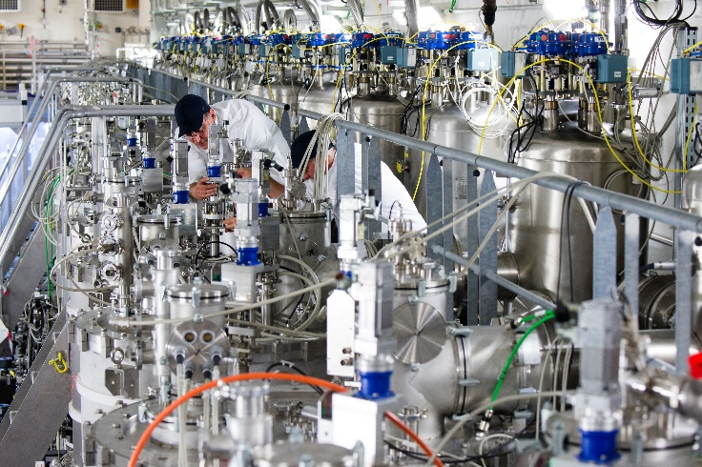
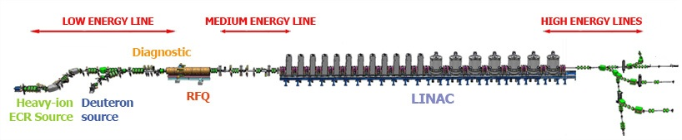
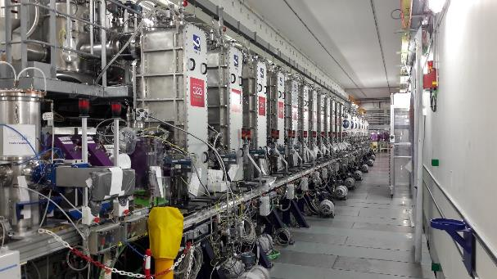
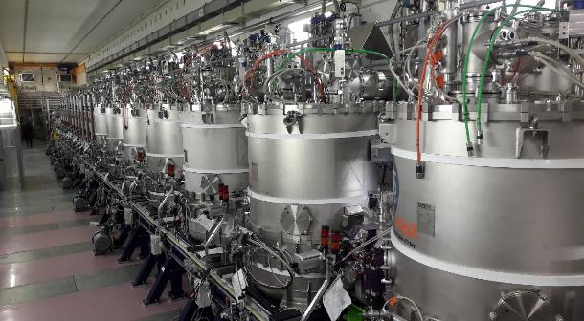
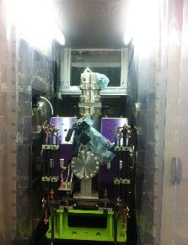
SC LINAC
01/2017: SC LINAC installation completed
Cryogenics (LHe – 4.5k) at -2 level, 19 CM and valve boxes
(SNS 23 CM)
Towards experimental
halls
12 low beta cryomodules (A)
20
‘warm sections’
7 high beta cryomodules (B)

Slide 20
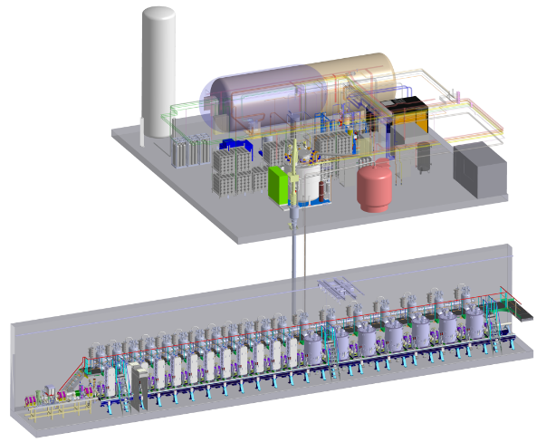
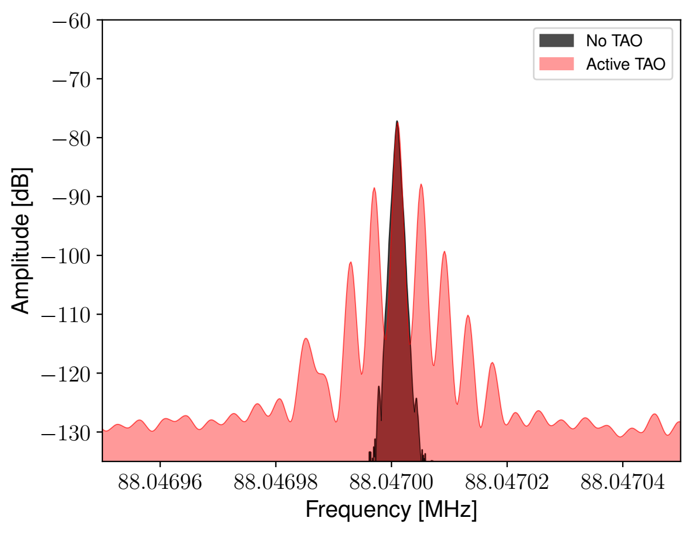
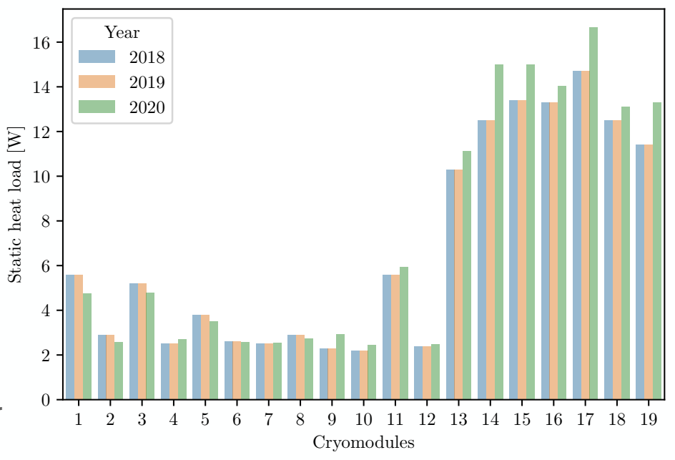
Cryogenics
11/2017 : Linac cool down (26 cavities @ 4.5K)
issues
  A few DP He fluctuations resulting in Df perturbations
  Vacuum leaks at low temp
Additional instrumentation
Pressure regulation upgrade
Dynamic vacuum system for isolating vacuum
The cryogenic system has been fully transparent in 2020
The helium pressure damping through a LQ advance regulation system
  Better regulation (<±5mBar)
  CMA11 has now a limited impact on the other cryomodules
The thermo acoustic oscillation control (Taconis) is working perfectly
RF frequency spectra with and without Thermo Acoustic Oscillation reduction
Comparison since 2018 – static measurement

Slide 21
2019 – linac validation
Proton tuning up to the
nominal 33MeV energy

Slide 22
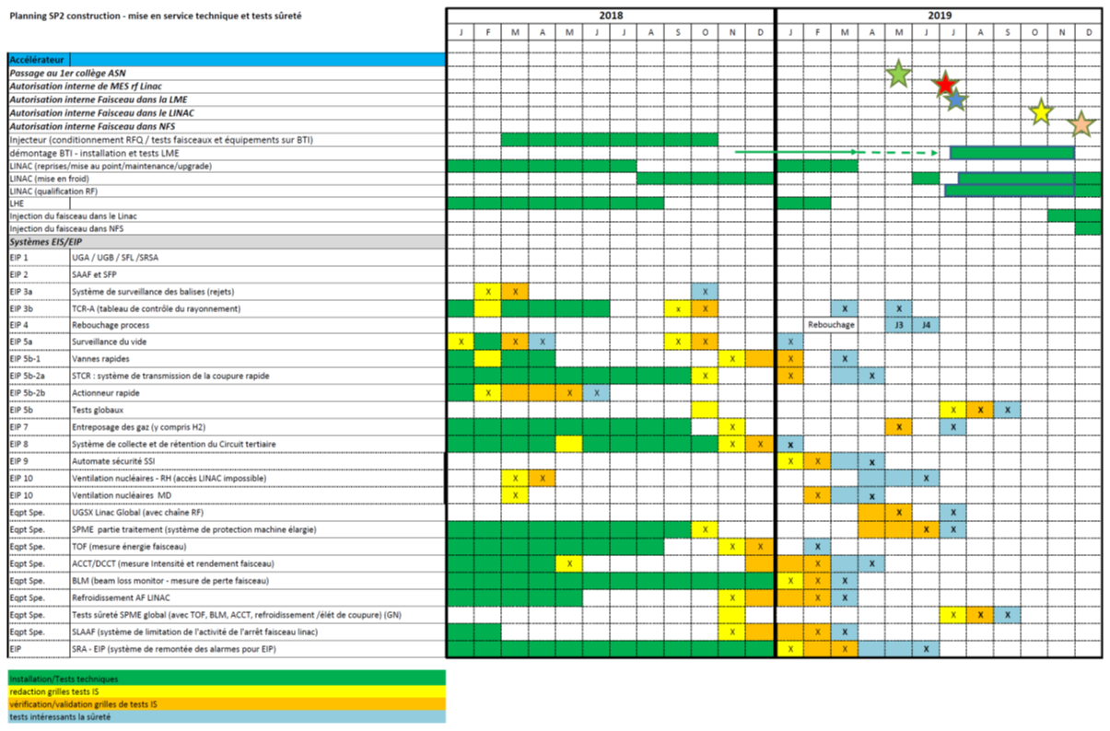
Safety Systems
SPIRAL2 safety regulations
Follow up and commissioning safety sytems
22 specific systems required for nuclear safety
Technical commissioning
Written procedures for safety tests
Validation of Safety tests
(=> syst. in operation)
Periodic checks
of this equipment
=> all these classified systems are now in operation

Slide 23
RF commissioning of the LINAC
July 8 2019 : ASN authorization !! .. FINALLY
  Beginning of the RF qualification of the accelerator (J3)
  Second objective : beam into the linac (J4)
Staged commissioning :
  Coupler conditioning at room temperature
  Coupler conditioning at low temperature
  Cavity conditioning in open loop and without frequency controls at 6.5 and 8MV/m (demonstration of the performance of the cavities)
  Close loop operation at nominal field (LLRF operation, RF stability)
Strong involvement of partner labs @ the key dates
Our apprehensions:
  Lack of experience of the GANIL team for the SC LINAC
  Performances of the cavities after storage period (5 to 7 years) and its consequences

Slide 24
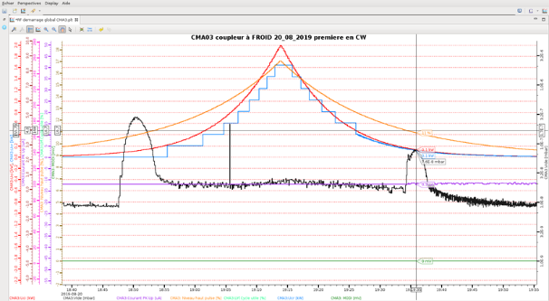
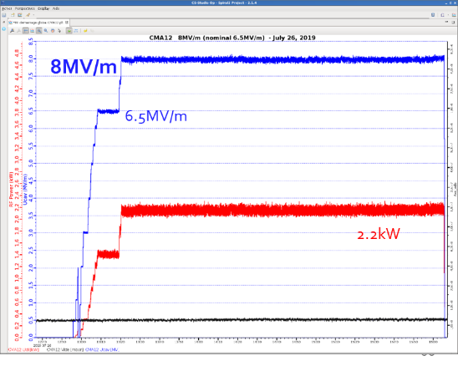

RF LINAC commissioning
September : all couplers conditioned at room and low temperature
Forward power
reflected power
3e-7mBar
Acceptation Criteria :
  Vacuum : <5.10⁻⁷ mBar
  Pick Up current : <100µA
% command
Pick up current
vacuum
July 25, 2019 : first field rise of the SPIRAL2 CMA12 cavity : 8MV/m reached in 20 min (6.5MV/m nominal)
  First test to reassure ourselves
  (Validation of installation procedures of the LINAC )

Slide 25
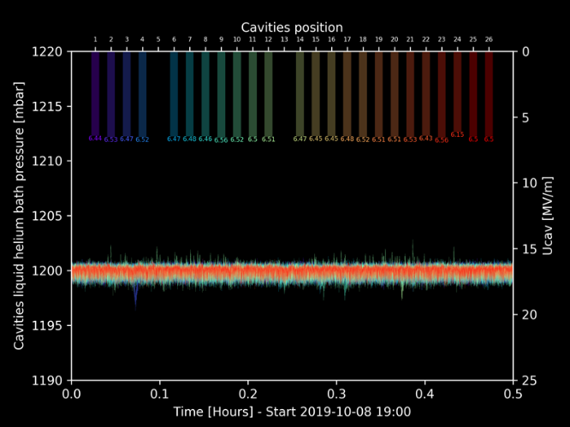
RF and cryogenic LINAC commissioning
J3 : September 24, 2019
All LINAC cavities ramped up to their nominal fields
RF : Validation and comparison with earlier performances at the partner labs
  Cavity field vs RF power
  Two multipactor barriers
  X-ray (µSv/h)
=> Same values except for CMA11
Cryogenics :
  He bath pressure regulation < ±5mBar for all cavities with full RF power
  Dynamic RF consumption <10W @6.5MV/m, except for CMA11 (>50W)
all LINAC cavities at nominal fields
and cavities L_{He} bath pressure
(Values of c5 & c13 were not saved)

Slide 26
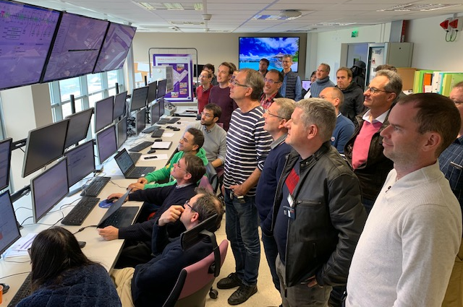
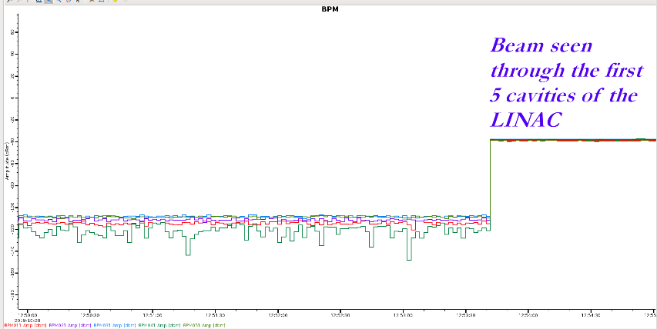
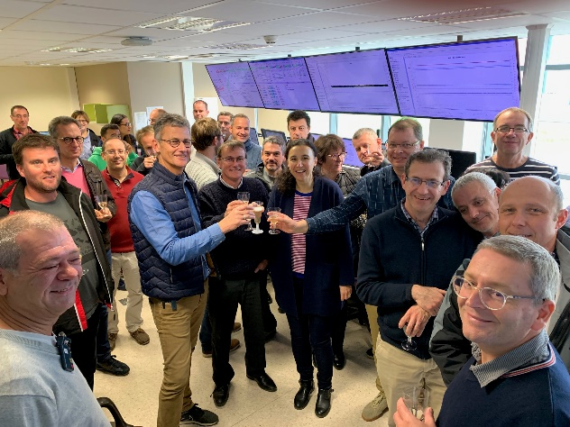
2019 Second objective : beam in LINAC (J4)
October 28, 2019 : internal safety authorization for the first linac beam
Very strong GANIL teams involvement to reach this milestone
(122 prerequisites, 22 safety systems validated for operation according to safety requirements)
Oct. 28, 2019
1st beam in the LINAC
(H⁺, 250µA, 730keV,1W)

Slide 27

Proton beam in the SPIRAL2 LINAC
Max beam power
Space charge matching
October 28, 2019 : lift of the MEBT Faraday Cup
November 15, 2019 : All cavities tuned in rebuncher mode (RFQ energy: 0.73MeV)
  250µA, 5.44ms/s, 1W
November 27, 2019 00h33 : nominal acceleration, 33MeV
  200µA, 960µs/s, 6.44W
October 10, 2020
  End of phase 3, 4.8mA, 1ms/s
November 18, 2020
  16kW
RFQ beam, low DC
Energy tuning, zero current matching
Full losses possible
Required control on losses
≈1W
≈1-10W
≈100W
200kW
Energy
Tuning of the
26 cavities
Intensity
Space charge
tuning
Duty cycle
High power tuning
Oct 28, 2019
1
2
3
4
5
Phases
Nov 15, 2019
Nov 27, 2019

Slide 28
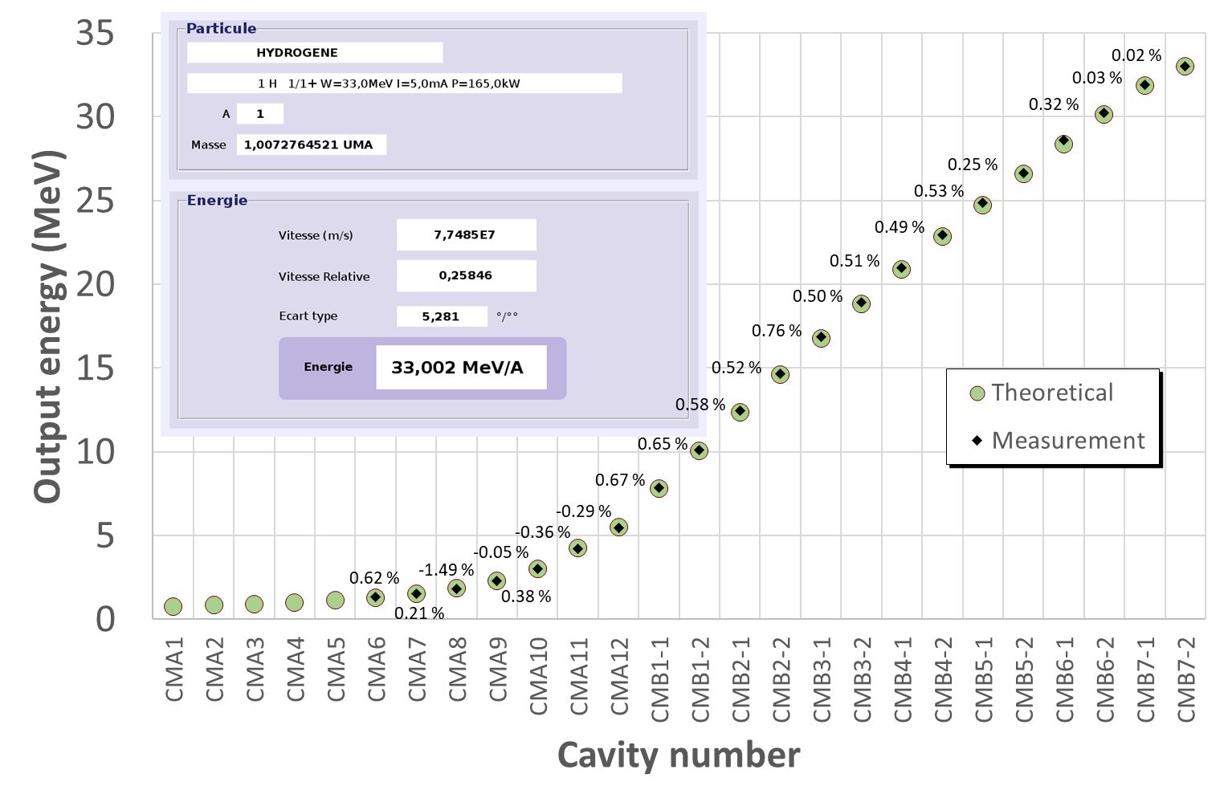
Linac tuning in proton
The final energy shows a very small error for the proton beam
  Measured with a precise TOF monitor in the high energy beam transport line
The tuning to any energy in the range 10-33MeV takes about 2h.

Slide 29
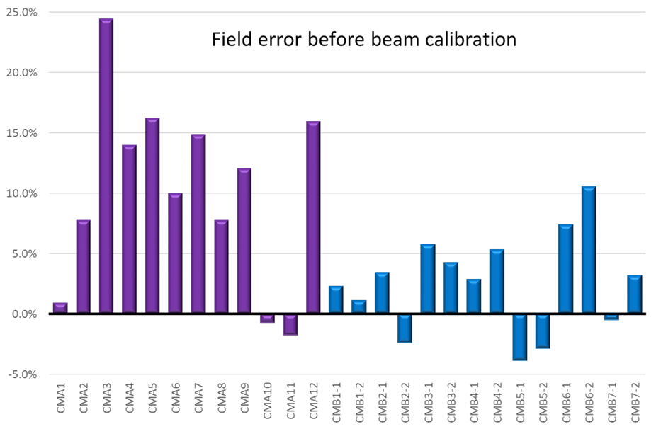
Cavity field calibration with beam
% Field correction with the beam
First correction with low fields and all cavities in rebuncher mode
+ Second correction with fields for 33 MeV proton beam (minor adjustments)

Slide 30
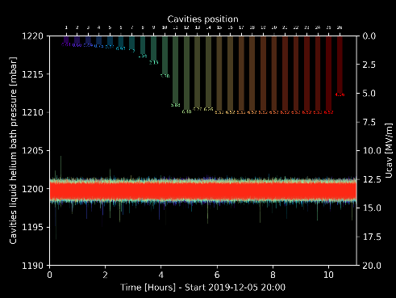



1st acceleration to nominal energy
November 27th 2019 : H⁺ nominal acceleration, 33MeV
  200µA, 960µs/s, 6.34W
December 17, 2019 => LINAC warm up
Pressure stability over 10 hours, LINAC tuned for 33MeV proton
December 11, 2019 : H⁺ beam injected into NFS experimental hall (milestone J5)
33 MeV p + Fe
A GREAT END FOR A WONDERFUL YEAR!
First test experiment in NFS
Irradiation set up (Collab with NPI, Czech.)
Successful measurement
● NFS measurements
E. Simeckova
J. Mrazek
NPI, Rez
decay spectrum (gamma rays/copper target)

Slide 31
2020 – Power rise

Slide 32
Proton beam in the SPIRAL2 LINAC
Max beam power
Space charge matching
October 28, 2019 : lift of the MEBT Faraday Cup
November 15, 2019 : All cavities tuned in rebuncher mode (RFQ energy: 0.73MeV)
  250µA, 5.44ms/s, 1W
November 27, 2019 00h33 : nominal acceleration, 33MeV
  200µA, 960µs/s, 6.44W
October 10, 2020
  End of phase 3, 4.8mA, 1ms/s
November 18, 2020
  16kW
RFQ beam, low DC
Energy tuning, zero current matching
Full losses possible
Required control on losses
≈1W
≈1-10W
≈100W
200kW
Energy
Tuning of the
26 cavities
Intensity
Space charge
tuning
Duty cycle
High power tuning
Oct 28, 2019
1
2
3
4
5
Phases
Nov 15, 2019
Nov 27, 2019
Oct 10, 2020
Nov 18, 2020

Slide 33


Power increase to 16 kW
2 kW
10/11/2020
Transmission study in function of the last MEBT quadrupoles. 12/11/2020.
Study of longitudinal dynamics as a rebunchers function 16/11/2020.
Feedforward study 16/11/2020
10 kW
12/11/2020
16 kW
18/11/2020
LLRF PIDs improvement in all cavities. 05/10/2020.
Increase rebuncher (N° 3) voltage from 29.6 kV to 35.6 kV. 06/11/2020
31.9 MeV
4.35 mA
1 Hz
14.5 ms
DC = 1.45 %
31.9 MeV
4.10 mA
10 Hz
7.66 ms
DC = 7.66 %
Alignment of the LEBT line.
Optimisation of the last quadrupoles in the LHE line by controlling the amount of correlating segmented loss ring and SAFARI temperatures.
31.9 MeV
4.00 mA
10 Hz
12.6 ms
DC = 12.6 %
CMA1 cavity field
Main losses improvement due to LLRF regulation improvement and use of feed forward.
634kV/m

Slide 34


Operational experiences
Cavities and coupler conditioning requires significant time for good operation (up to 40hours/cavities, at room temperature and at 4K).
Bad contact lead to RF amplifier destruction.
  Limited to 31.9MeV from October to December
BLM were out of order for about 10 days
  Limitation to 20W beam power.
CMA11 still has an important cryogenic consumption, but a significant progress was achieve with the discover of the circulator degradation
Lots of lessons learned
  Spare part policy has been strongly reinforced
  Need time with beam off to be able to anticipate the management of the difficulties
RF amplifier (top) and Circulator (bottom) degradation

Slide 35


Power rise - 16kW on November 18, 2020
Major project milestone
Duty cycle @ I_{max} from 1% to 12.6% - no Single Bunch Selector
Demonstration of capability to run at 100% duty cycle, I_{max}, W_{max} (160kW)
16 minutes at 16 kW limited by beam dump “SAFARI” activation.
4mA, 10Hz, 12.6ms/100ms, 31.9MeV

Slide 36


2020 Power rise
SAFARI
main beam
dump
Power rise in NFS room for physic was linked to our capability demonstrated on SAFARI main beam dump
1350 W achieved in NFS

Slide 37

LLRF tuning example 1/3
With Single Bunch Selector 1/200 – pulse 200ms
Beam
1s
200ms, SBS
Notes:
I will try to highlight one of the optimization achieved last year.
Many improvements:
Tuning of the rebunchers
Feed forward on the LLRF
Matching to SAFARI
Matching to the linac, alignment
And the most efficient one the Settings of the feedback loops of LLRF
Our main tool for the optimization are the Beam Loss Monitor, located here along the high energy line, and their comparison with the simulations.
What you see here, are the BLM counts, a measured expression of the losses, for a beam settings of 200ms/s with the single bunch selector ON. (2.27µs between bunches)
We were able to accelerate and transport the nominal beam current without being limited by the losses

Slide 38
LLRF tuning example 2/3
Without SBS – 1ms/s – same # particles
Beam
1s
1ms
Threshold for full beam power operation
Notes:
We have done the same without the SBS, 11ns between bunches. Pulse width was reduced to 1ms/s, so it is the same # of particle than the previous cases
We were unable to accelerate beyong 2mA, limited by the BLM saturation, linked to the losses.

Slide 39
Situation back with LLRF optimization 3/3
Beam
1s
1ms
Threshold for full beam power operation
Commissioning
Phase 3
achievement
Notes:
Once the settings of the feedback loops were fully optimized, then we were able to recover a “normal” acceleration of the full beam intensity, and the phase 3 of the commissioning was achieved.
The losses here are lower than the famous 1w/m threshold, the red line here gives you this limitation

Slide 40


MEBT-LINAC matching
Match the MEBT beam to the linac to reduce the losses observed.
  Transmission
  BPMs
  BLMs
  Vacuum pressure
Slowly increase the beam power (first beam intensity, then DC).
MEBT
LINAC
Notes:
After we did the Adjust quadrupoles and steerers
Tune the first linac cavity (amplitude & phase) with pencil beam (BPMs)
Then all the following cavities
Re-adjust all following linac and HEBT magnets at each modification

Slide 41






MEBT-LINAC matching
Transverse matching
Longitudinal Matching
Transmission study as a function of the quadrupoles before the first cavity.
Linac beam position.
Beam loss dependent on rebuncher 3 tuning
Study of longitudinal dynamics as a function of rebunchers
Longitudinal acceptance study.
Linac longitudinal acceptance 5 mA
Measurement
5*70°~360°

Slide 42




Results
Spiral2 has been validate with proton beam @16 kW.
  Demonstration of 165kW possibility
BLMs measurement confirm losses below 1W/m.
Pressure variation measurement is a good probe for the low energy section of the linac.
Linac transmission is 100% within diagnostic precision.
Good agreement between simulations and measurements.
Actions taken to reduce losses were validated.
Notes:
We have carefully validated that the measured losses at 10% DC operation are compatible with CW operation.
Neutros back from the beam dump.

Slide 43

NFS layout
Collimator
TOF area
Converter
cave
LINAC
Beam
● Neutron Beam at 0°
● Collimator ↔ beam quality
● Size (Lⅹl) ≃ (28m ⅹ 6m)
- TOF measurements
- free flight path
● Ion and neutron induced reactions
● Beam line extension
● Irradiation station (n, p, d)

Slide 44

NFS: The converter room
Rotating
converter
Pneumatic transfer system
Li converter
Irradiation station

Slide 45



1st Neutron production @ GANIL
2020 : 6 tests periods from September to November, all with H⁺ beam
Tests required to produce and characterize the neutron beam at the Neutron for Science facility :
  Thin convertor test -> for quasi-mono energetic neutrons
  Thick convertor -> for continuous neutron spectrum (using max proton beam power available in 2020)
Peak ratio (E>28.5 MeV) / total (E>2 MeV):
p + Li (1.5 mm) : 51% (1.77E9 n/sr/µC)
p + Be (0.5 mm) : 32%
p + Be (thick) E> 10 MeV
NFS 31.9 MeV : 1.81E10 n/sr/µC
Milestone J5D
  Gradual increase in power in the thick Be convertor (200 to 1350 W)
  Temperature measurements with 3 probes for a comparison with simulations
1350 W

Slide 46
Next milestone : 50µA D⁺ beam for physics
The proton beam allowed a complete demonstration of acceleration control (emittance and space charge)
  We have understood a few things for the tuning difficulties and control of halo
  It is a high power machine, and therefore cannot be push button
    The Machine Protection System is a key system
    Optimization of settings using mobile and fixed BLMs heavily depend on it.
The path to full deuteron beam in 2021 is :
  Reproduce the proton learning curve with the new particles (⁴He²⁺, then D⁺)
  ⁴He²⁺ : Optimization of settings with limited activation, tuning of the linac
  6 months of linac operation with about 7 weeks for physics
  Objective #1 of the project : 50µA deuteron beam for physics
    Physics will be the priority.
Notes:
The use of the Single Bunch Selector should allow easier tuning.

Slide 47


Helium beam in 2020 – preparation of 2021
Use of the Source Phoenix v3
  Up to 4mA
  1.3mA within 0.2 π.mm.mrad in the linac
Optimization of the source voltage
Optimization of the RFQ voltage
Tuning of the MEBT line with the reference He beam
  1.3mA
  Improvement of the rebunchers voltage
  Single Bunch Selector validated in the MEBT
    Demonstration to be confirmed in HEBT and NFS room.
Unfortunately we were unable to tune the LINAC with helium beam
  Divergence on Linac output energy > 5%
Optimization of the source voltage for the RFQ
10ns
Measured helium Single bunch Selected

Slide 48
2021 Provisional schedule
Organization of
NFS Beam schedule
done with GANIL
beam coordinators.
Notes:
Time slots will be defined jointly with NFS coordinator.

Slide 49
Conclusion
All 2019 and 2020 milestones have been met
  LINAC has been qualified in proton operation in nominal beam conditions
  Beam sent to NFS hall for convertors qualification and experimental test
  strong involvement of all GANIL teams to get these results despite the situation and HR
16kW produced (10% proton beam power)
Objectives for 2021
  Nominal deuteron beam current with Single Bunch Selector at nominal energy
  Availability improvement – strong involvement.
  Safety constraints management
  Share time with priority Physics in NFS
  Achieve a good transition to operation
Become a stable neutron facility at NFS

Slide 50

Thank you for your attention
Thanks to GANIL teams
and SPIRAL2 collaborations

Slide 51



Special thanks to the SPIRAL2 commissioning team
R. Ferdinand (Commissioning leader)
G. Normand (Deputy commissioning leader)
B. Jacquot
M. Di Giacomo
O. Kamalou
J-M. Lagniel
A. Orduz (post doc)
A. Savalle (Operation Group leader)
D. Uriot (CEA-Saclay)
The operators
The week engineers
Accelerator Physic Group
Notes:
Savalle : Cyclo + linac operation

Slide 52

Bunch length and longitudinal matching 2019
(phase 2: 33 MeV)
No optimization for the longitudinal matching has been done in the machine:
not needed for this tuning and not possible with BEM due to their slowness.

Slide 53


Matching – Ellipticity 2019
Phase 2: 33 MeV
One of the first tuning (MEBT not well tuned)
Ellipticity (mm²)
BPM number
Last tuning
Ellipticity (mm²)
Parameters in the MEBT and LINAC come directly from simulation. No additional matching.
BPM number

Slide 54

Alignment in the Linac
Phase 2: 33 MeV
Position (mm)
BPM number

Slide 55

Transverse Phase advance
Phase 2: 33 MeV
Position (mm)
5*70°~360°
Phase advance per period expected in this area : 70°
BPM number

Slide 56






Profiles in MEBT
MEBT profiles PR21/PR22/PR23
( Simulation - Measurement)
(Reminder of the injector talk)

Slide 57



Profiles in HEBT
Simulation - Measurement
Phase 2: 33 MeV

Slide 58


Single bunch selector ON/OFF
Bunch selector mistuned @ 1000V
Phase 2:
33 MeV
HEBT Profiles
Bunch selector mistuned @ 1400V
No effect on Horizontal plane

Slide 59

Single bunch selector ON/OFF
Phase 2: 33 MeV
Bunch selector @ 1200V
Green envelope : beam profile without bunch selector
Perfect match with and without bunch selector in the HEBT profiles
No retuning of the accelerator needed when bunch selector is well tuned

