Slide 1


Bond polarons
Nikolay Prokof’ev (UMass, Amherst)
Paris, September 10, 2021
Advancing Research in Basic Science and Mathematics

Slide 2
Collaborators:
Chao Zhang (UMass → East China Normal University, Shanghai) and Boris Svistunov (UMass Amherst)
arXiv:2108.06725
PRB ‘21
M. Berciu, D. Marchand, P.C.E. Stamp (UBC, Vancouver)
G. De Filippis, V. Cataudella (Università di Napoli)
N. Nagaosa, A.S. Mishchenko (Uniuversity of Tokyo, RIKEN-Saitama)
PRL ‘2010
J. Sous, A, Millis, D. Reichman (Columbia)
In progress

Slide 3
Polaron: One impurity in the environment
Bi-Polaron: Two impurities in the same environment forming a bound state
… What is next?
Main question: Can bi-polarons provide the high-T_{C} mechanism?
Bi-polaron effective mass
Bi-polaron
radius

Slide 4
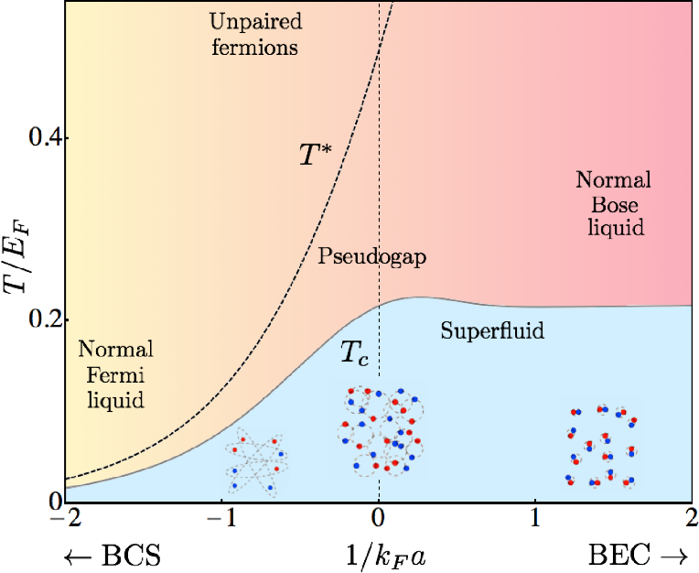
Recall BCS-BEC crossover
Why ?
Bi-polaron effective mass
Bi-polaron
radius
Similar, but in
absolute terms
Push the bi-polaron density to the limit

Slide 5
estimate is very robust against repulsive interactions between bi-polarons!
3D:
Barely any dependence on interactions.
(even in He-4 the ideal gas formula is only 30% wrong)
2D:
Double-logarithmically weak dependence!
NP, O. Ruebenacker, B. Svistunov, PRL ‘01
Hard spheres
Soft spheres
Hard disks
P. Gruter, D. Ceperley, F. Laloe, PRL ’97 ; K. Nho and D.P. Landau, PRA ’04 ; S. Pilati, S Giorgini, NP, PRL ‘08

Slide 6
Standard polarons with density-displacement coupling:
electron density
oscillator displacement
e
e
Holstein model (on-site coupling):

Slide 7
Bond polarons or PSSH (Peierls-Su-Schrieffer-Heeger) polarons with
displacement modulated hopping:
e
e
Model A
Model B

Slide 8
Can bi-polarons be responsible for the high-T_{C} mechanism?
No, because Holstein bi-polarons are exponentially heavy when they form
[Chakraverty, Ranninger, Feinberg, PRL ’98]
Take tight-binding Hamiltonain with bandwidth
(cubic lattice) phonon frequency
Band perturbation theory:
“Localized” electron:
overlap integral
between phonon clouds
Light-to-heavy crossover at with

Slide 9
Sharp crossover from light to heavy polarons
light polaron branch
Heavy polaron branch

Slide 10
Can bi-polarons be responsible for the high-T_{C} mechanism?
No, because the are exponentially heavy when they form.
Two band polarons:
Crossover to bi-polaron at
“Localized” bi-polaron:
with as heavy effective mass
For in d=2 we get
Realistically even is hard to get …

Slide 11
One-dimensional Model A
Berciu, Marchand, Stamp, Filippis, Cataudella,
Nagaosa, Mishchenko, NP, PRL ’10
Sous, Chakraborty, Krems, Berciu, PRL ‘18
e
leads to sign-alternating diagrammatic expansion both
in real and momentum space
In momentum space sign-problem is not as severe. But in 1D one can also afford other methods, e.g. controlled truncation of Hilbert space for diagonalization.

Slide 12
One-dimensional Model A
e
Ground state shifts to
non-zero momentum
Effective mass is
NOT
exponentially suppressed at
strong coupling
in 1D

Slide 13
Zang, Svistunov, NP arXiv:2104.14044
2D Model A
2D Model B
e
e
Standard Diagrammatic Monte Carlo
for Green’s function diagrams.
Always convergent for finite τ, but sign-problem kicks in for large expansion orders.
Look similarly in momentum representation
but have rather different properties …

Slide 14
2D Model A
Ground state shifts to
non-zero momentum along the diagonal in BZ
Effective mass is NOT
exponentially suppressed as yet
for this coupling range
Effective mass is slightly anisotropic after the transition

Slide 15
2D Model B
Ground state is always at k=0
Effective mass is NOT
exponentially suppressed here
(at least not yet ☺)
What about bi-polarons and prospects for high BEC temperature?

Slide 16
D Model B
Has sign-positive diagrammatic expansion in real space
e
is easy to generalize to dispersive phonons
and account for inter-particle interactions (for bi-polarons)

Slide 17
D Model B
Math. to simulate:
phonon propagator
Potential energy of interparticle interactions
1. Change imaginary time:
2. Increase/decrease the number of kinks:
3. Add/remove phonon lines between kinks:
4. Add more (if necessary for better decorrelation … )
MC updates:

Slide 18
Results for bi-polarons in 2D Model B
e
Very robust against
Hubbard U
But are far more heavy than single polarons!

Slide 19
Radial profile of the bound state
The bi-polaron radius goes up with U but remains relatively small
Large repulsive U helps s-wave
superconductivity!

Slide 20
Relatively shallow states to begin with
have much lighter effective masses
and the radius effect dominates:
T_{C} is suppressed with U

Slide 21
In between two extremes:
T_{C} maximum at U=8t from compromise between the bi-polaron mass and size

Slide 22
Main question: Can bi-polarons be responsible for the high-T_{C} mechanism?
Yes, this is very high Tc estimate!

Slide 23
McMillan’s [Phys Rev 167, 331 (1968) ] expression utilizing Eliashberg theory [Sov. Phys. JETP 11 696 (1960) ]
with
There is no Eliashberg theory for
because a localized bi-polaron state has much better energy

Slide 24
Just a curious fact: for (particles are “slower” than phonons)
bi-polarons are lighter than twice the polaron mass …

Slide 25
Conclusions and questions:
Bond polarons and bi-polarons appear to be much lighter than Holstein polarons
Bond bi-polarons are robust against local repulsive interactions
High T_{C} is not automatic because compact bi-polarons are heavy and light bi-polarons have large size. Best estimates of bi-polaron Tc are significantly higher
than the best predictions based on Eliashberg (Fermi-liquid) formula
Will phonon dispersion help to reduce ?
Is the large problem more severe for ? (likely yes)
How all results change in 3D when finite coupling is required for bound states to exist?

