Slide 1
Impurities in quantum baths
T. Giamarchi
http://dqmp.unige.ch/giamarchi/
TexPoint fonts used in EMF.
Read the TexPoint manual before you delete this box.: AAAAAAA

Slide 2
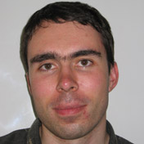
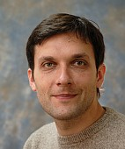
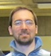
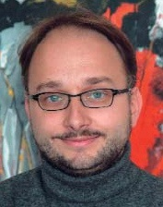



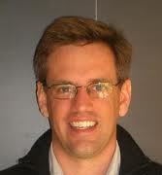

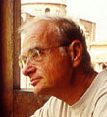
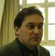




V. Cheianov
U. Schollwoeck
M. Zvonarev
Kantian
N. Kamar
F. Massel
P. Torma
P. LeDoussal
A.M. Visuri
A. Daley
B. Horovitz
F. Minardi
T. Fukuhara
S. Kuhr
I. Bloch

Slide 3
Problem
One impurity coupled to a 1D quantum bath
Equilibrium physics: ``polaron’’
Not so ``simple’’ if out of equilibrium: Anderson orthogonality catastrophy

Slide 4


Global vs local quench
Local quench
X-ray edge problem
M finite: destroyed by recoil, but not in 1D !

Slide 5
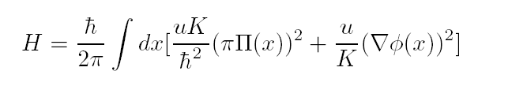
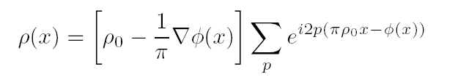
How to treat ?
Bosonization
u,K : depend on interactions, density

Slide 6
``Bosonic’’ type behavior (K >1)

Slide 7

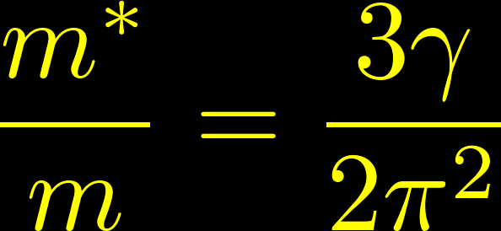


Mobile impurity
M. B. Zvonarev, V. V. Cheianov, TG, PRL 99 240404 (2007);
Single spin down particle

Slide 8
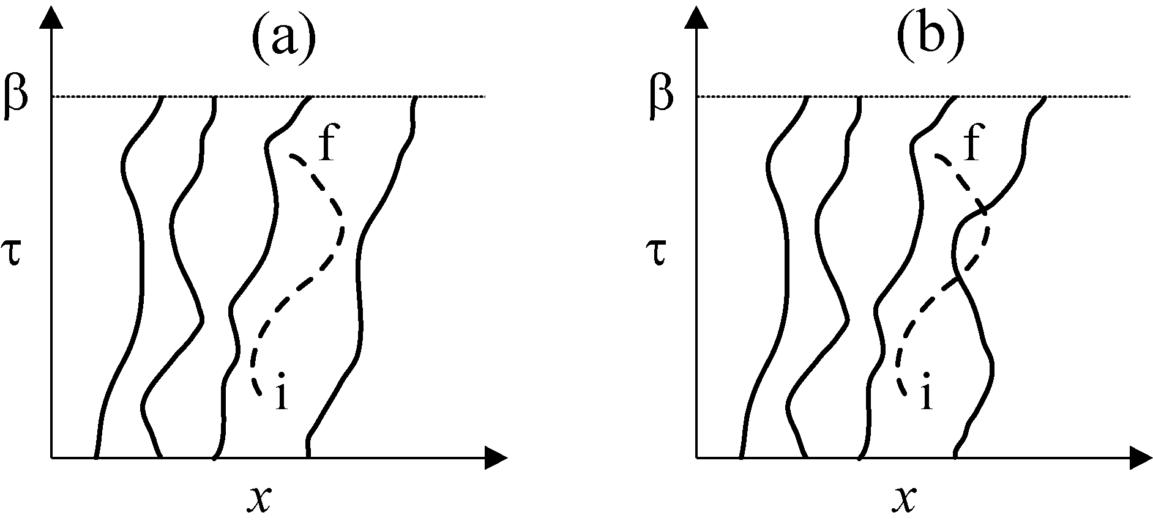
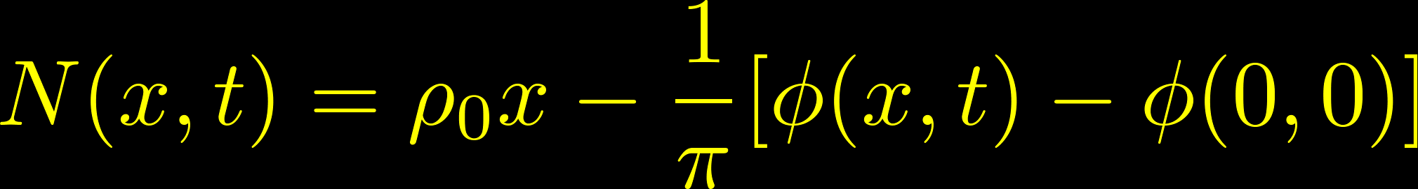
Trapped regime
U large: particle cannot cross

Slide 9

Trapped regime
Subdiffusive behavior
No power law or Lorentz invariance
No light cone singularity

Slide 10


Full solution
No exact solution available
Set of minimal assumptions on the theory

Slide 11
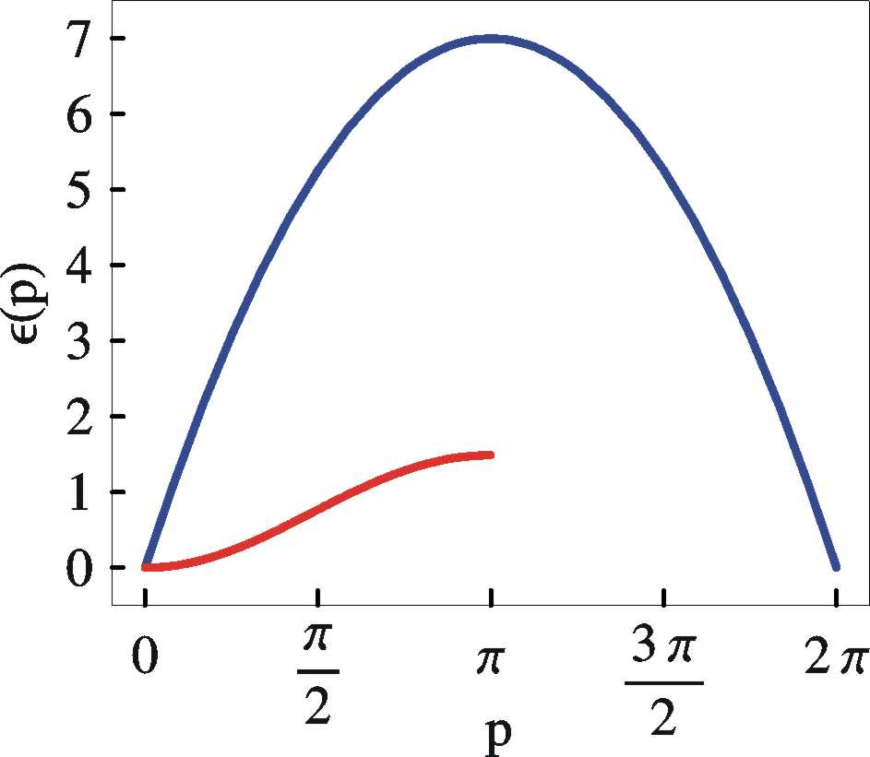

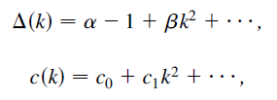
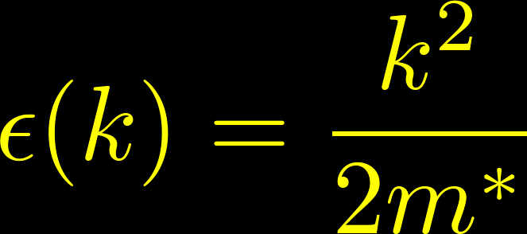
1D: minimum in the spectrum
supported by exact solutions
A(k,ω) is scale free close to threshold

Slide 12
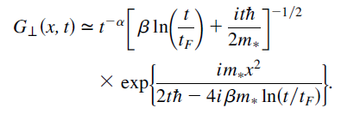

General result
Comparison with trapped regime:
Exponent depends only on K, new universality class : Ferromagnetic liquid

Slide 13

Propagation of the impurity
Trapped/open regimes
Light cone of spinless bosons

Slide 14
Theories: Akhanjee, Tserkovnyak, Matveev, Furusaki, Kamenev, Glazman, Gangardt, Lamacraft, ……
Experiments: Cambridge, Florence, Innsbruck, Munich, …

Slide 15



Hubbard model
M. B. Zvonarev, V. V. Cheianov, TG, PRL 104 110401 (2009)

Slide 16


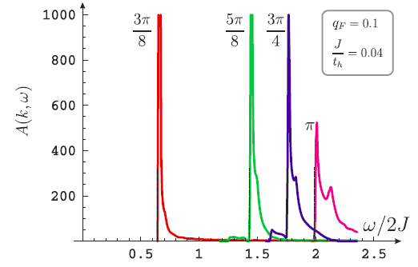
Obeys:

Slide 17




Yang-Gaudin model
M. B. Zvonarev, V. V. Cheianov, TG, PRB 80 201102® (2009)
Effective field theory :

Slide 18
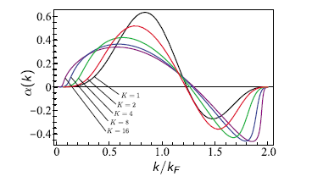


Slide 19
Experiments

Slide 20


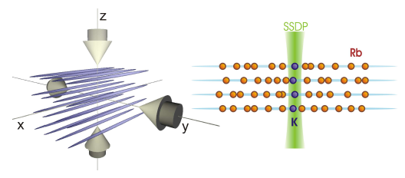
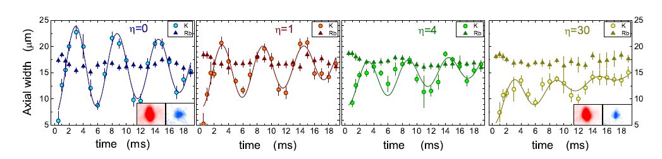
Diffusive impurity
J. Catani, G. Lamporesi, D. Naik, M. Gring,
M. Inguscio, F. Minardi, A. Kantian, TG
PRA 85 023623 (2012)

Slide 21

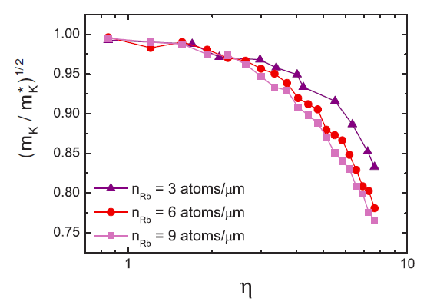
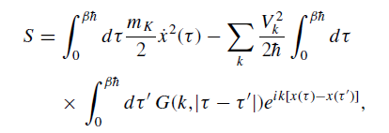
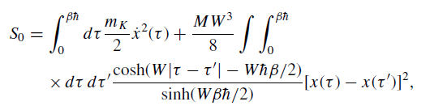
Polaronic effect

Slide 22
Mobile impurity
T. Fukuhara, A. Kantian, M. Endres, M. Cheneau,
P. Schauss, S. Hild, D. Bellem, U. Schollwock, TG,
C. Gross, I. Bloch, S. Kuhr , Nat. Phys. (2013)

Slide 23
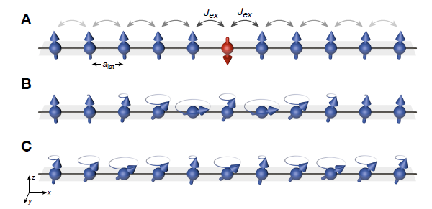
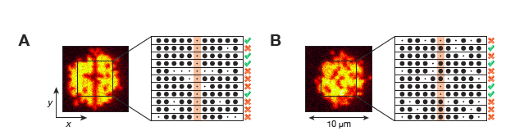
Ferromagnetic Heisenberg

Slide 24
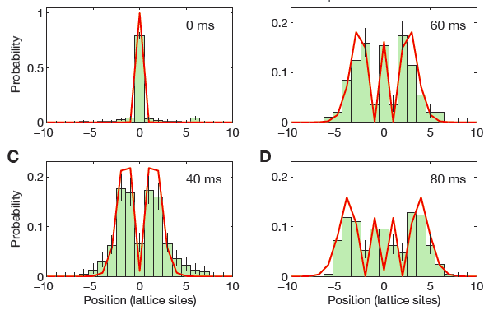
Coherent propagation of a magnon
Heisenberg model :
Notes:
J/U = 0.053

Slide 25
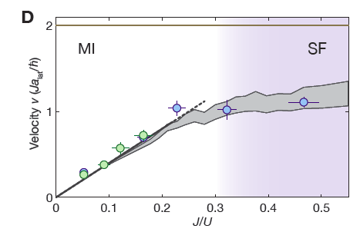
Beyond the Mott insulator
Notes:
J/U = 0.47

Slide 26
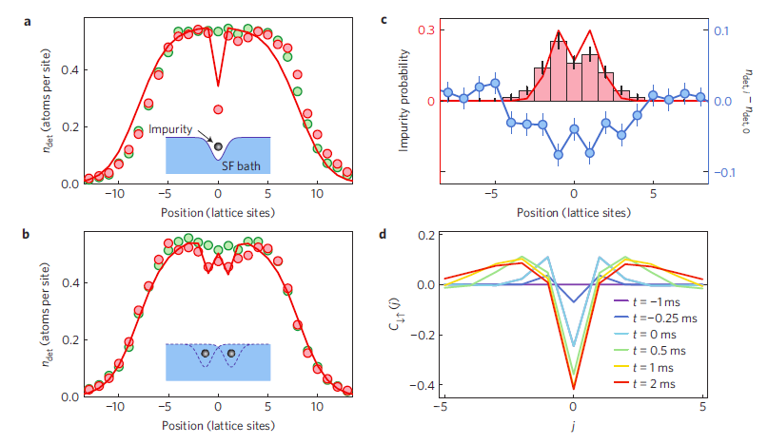
Polaronic effect

Slide 27
Note
Theory: two body correlations
Experiment: more complex correlations
Calculation ??

Slide 28
Many remaining problems/questions

Slide 29
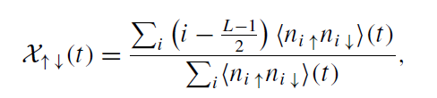
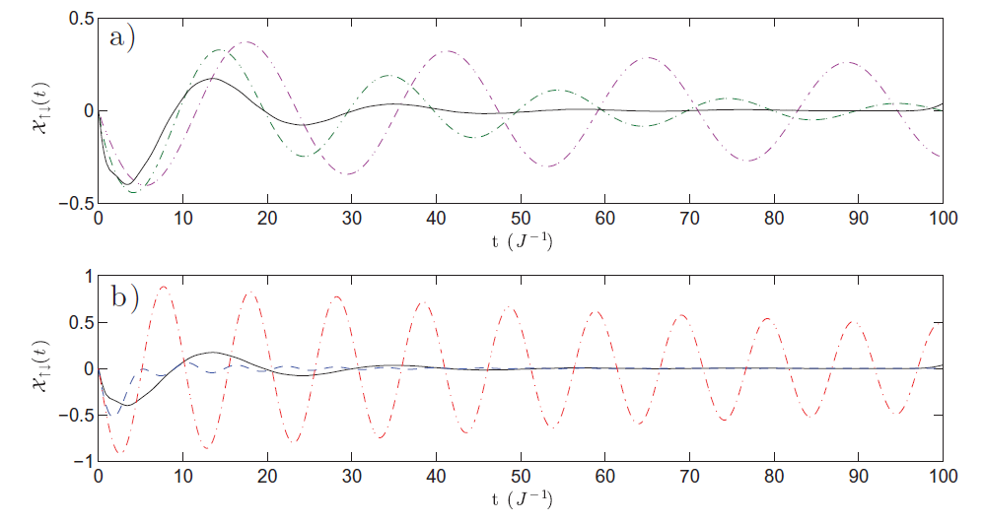
Kicked impurity
F. Massel, A. Kantian, A.J. Daley, TG, P. Torma, NJP 15 045018 (2013)

Slide 30
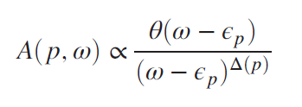


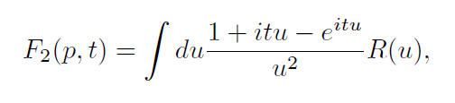

Two regimes:
Infrared dominated vs polaronic
A. Kantian, U. Schollwoeck, TG, PRL 113 070601 (2014)
Very efficient method: linked cluster expansion

Slide 31
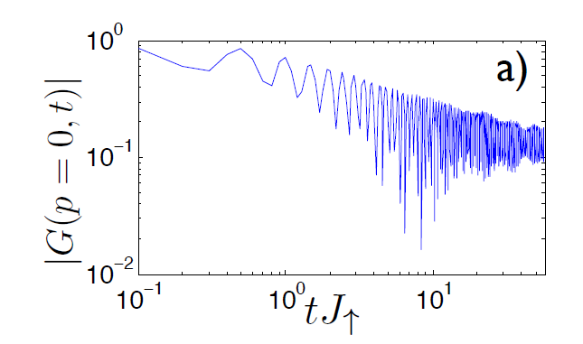
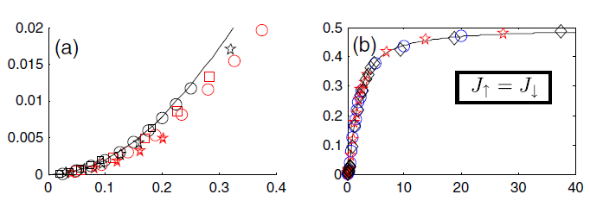
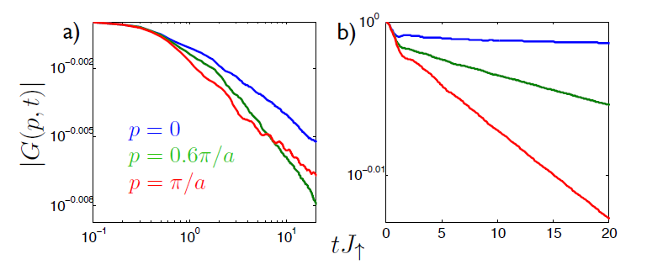
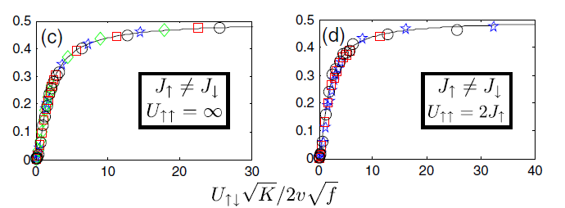
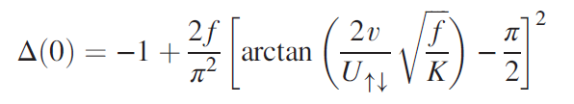
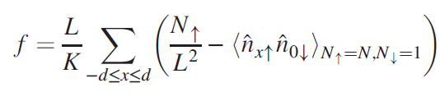
DMRG and LCE
Two regimes: quasiparticle and infrared dominated
Interpolating formula

Slide 32
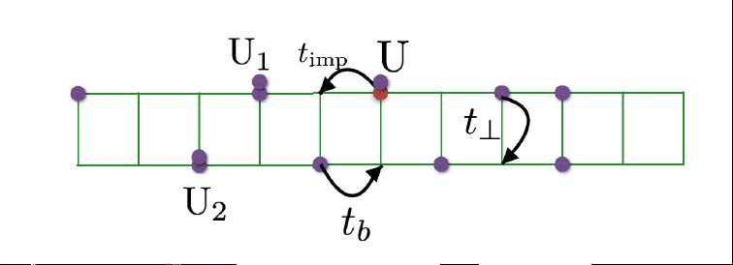
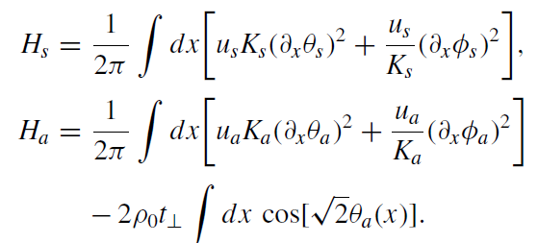




Towards 2D: ladders
N.A. Kamar, A. Kantian, TG, PRA 100 023614 (2019)
Mixture of massive and massless modes

Slide 33
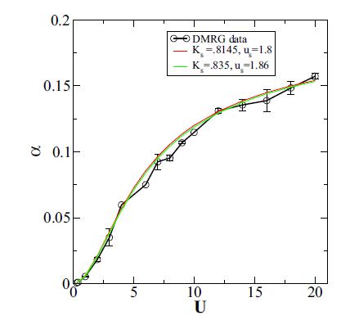
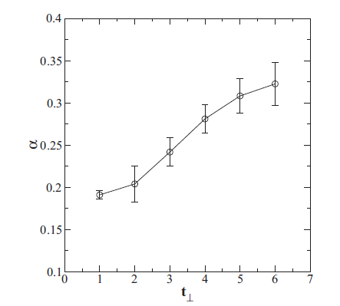
Increase of the exponent even if Ks decreases
Two regimes for impurity as for a single chain
Hopping of the impurity between the legs:
N.A. Kamard Phd thesis (2019)
https://archive-ouverte.unige.ch/unige:128219

Slide 34
``Fermionic’’ type behavior (K <1)

Slide 35
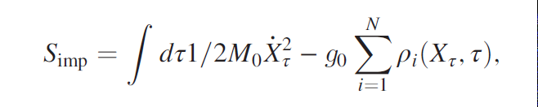
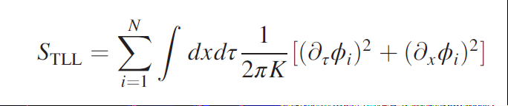
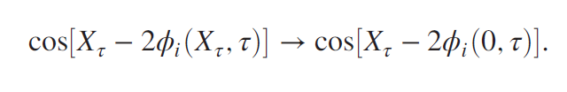
Fermionic quantum bath
Impurity coupled to N baths

Slide 36
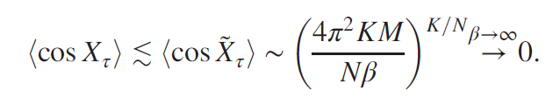
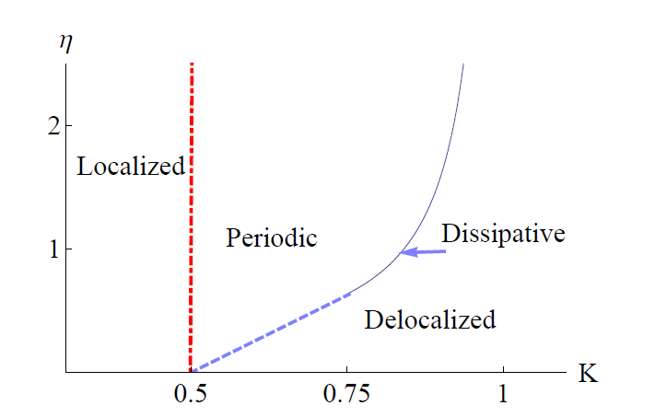
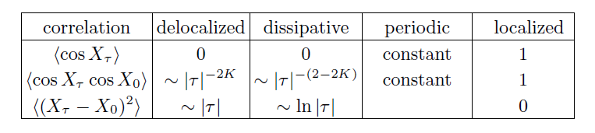
RG analysis, N large
B. Horovitz, TG, P. Le Doussal, PRL 111 115302 (2013)

Slide 37
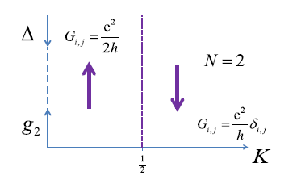
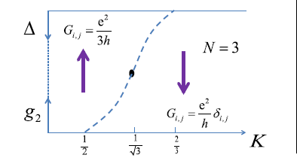
N small
g irrelevant, but coupling g2 between the modes generated
B. Horovitz, TG, P. Le Doussal, PRL 121 166803 (2018)
Coupling between modes: sharp jump in transconductance

Slide 38




Bath with a ``structure’’
(K small)
A.M. Visuri, P. Torma, TG, PRB 93 125110 (16); PRA 95 063605 (17)

Slide 39
Conclusions and perspectives
Fascinating problems for impurities in 1D correlated systems
Many open questions !!
We need experiments both on the bosonic and the fermionic side

