Slide 1
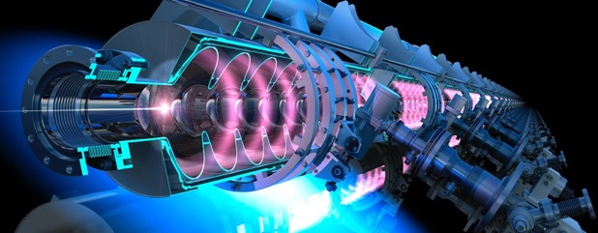
French-Ukrainian Workshop
PERLE: A powerful Energy Recovery Linac @ Orsay
Walid Kaabi
October 27th, 2021

Slide 2
ERLs: The Best of Two Worlds
LINEAR ACCELERATOR
ID
X-Rays
STORAGE
Source
ID
RING
IP
IP
X-Rays
Beam parameters defined by the source
High flexibility – single pass
Limited average beam power (<< mA)
Possible short bunches (sub psec)
Low number of user stations
Beam parameters defined by equilibrium
Limited flexibility – multi-pass
High average beam power (A, multi GeV)
Typically long bunches (20 ps – 200 ps)
Many user stations
            Linac-like beam quality
            Easy to upgrade (add linac section or recirculation passes)
            Tolerate more “damage” to the beam from collisions with another beam (the beam is dumped soon after)
ENERGY RECOVERY LINAC
  High beam current possible (RF power limit removed)
  Reduced power bill (RF power recovered)
  Reduced cost of RF amplifiers (smaller RF power amplifiers)
  Reduced beam power and energy in beam dump (less shielding / activation issues)
IP
ID
X-Rays
Main Linac
Source
High average beam power in compact machine, excellent beam parameters with high flexibility

Slide 3
Introduction- Energy Recovery in RF Fields
λ_{Rf}
E_{Out} = E_{Inj}
E = E_{inj} +ΔE
E = E_{inj} +2 ΔE
E_{Inj}
E = E_{inj} +ΔE
E = E_{inj} +ΔE
(β ~ 1)
L = n · λ + λ / 2
L = n · λ
RF energy supply → beam acceleration
Deceleration = “loss free” energy storage (recovery) in accelerating sections allowing acceleration of following bunch
W. KAABI
Journées FCC France - LPNHE, 15 novembre 2019
3

Slide 4
First ERL Concept
ERL concept was proposed first in 1965 by Maury Tigner ¹
¹ M. Tigner: “A Possible Apparatus for Electron Clashing-Beam Experiments”, Il Nuovo Cimento Series 10, Vol. 37, issue 3, pp 1228-1231,1 Giugno 1965
First test was done at SCA@ Stanford in 1986 (interesting concept for FELs, Compton light sources and high current electron cooler)
Concept become only viable with recent advances in SRF technology.

Slide 5
Scientific International Context
H. Abramowicz, secretary of the European strategy update- June 2020

Slide 6
Scientific International Context
CERN Council mandated the Laboratory Directors Group (LDG) to define and maintain a prioritised accelerator R&D roadmap towards future large-scale facilities for particle physics.
The LDG suggested to invite expert panels to each of the areas and has very recently endorsed their tentative composition. Among the selected few key areas is the development of ERLs.
We (IJCLab) will be represented in this ERL world wide expert panel (including US and Asia), to support this joint attempt for advancing the coordinated development of the ERL technology. The initial task of this panel is to develop a roadmap for presentation to CERN Council, in December 2021.

Slide 7
PERLE in the Global ERL Landscape
A. Hutton, Report from the ERL Roadmap Panel- July 9, 2021
Funding Limited
Technology Limited

Slide 8
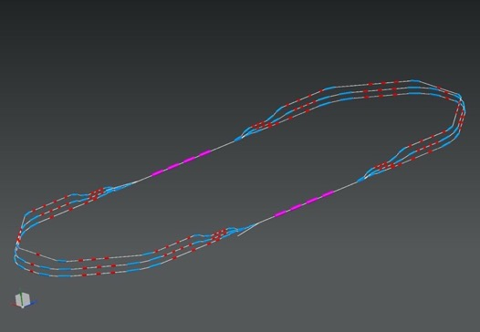

PERLE Configuration and Beam Parameters
PERLE: A proposed 3 turns ERL, based on SRF technology, to serve as testbed for studying, testing and validating a broad range of accelerator phenomena & technical choices for future ERL projects.
7 MeV
2 : 4 : 6
1 : 3 : 5
ΔE = 82.2 MeV
2 Linacs (Four 5-Cell 801.58 MHz SC cavities)
3 turns (164 MeV/turn)
Max. beam energy 500 MeV
5.5 m
Top view
29 m
1 : 3 : 5
ΔE = 82.2 MeV
10 m
7 MeV
10 m
9 m
DE = 82.2 MeV
45 cm
Side view
45 cm
ΔC = λ_{RF}/2
IP
injector
7 MeV
Target Parameter | Unit | Value
Injection energy | MeV | 7
Electron beam energy | MeV | 500
Normalised Emittance γε_{x,y} | mm mrad | 6
Average beam current | mA | 20
Bunch charge | pC | 500
Bunch length | mm | 3
Bunch spacing | ns | 25
RF frequency | MHz | 801.58
Duty factor |  | CW
DE = 82.2 MeV
2 : 4 : 6
7 MeV
dump
DC = l_{RF}/2
Footprint: 29 m × 5.5 m × 0.9 m

Slide 9
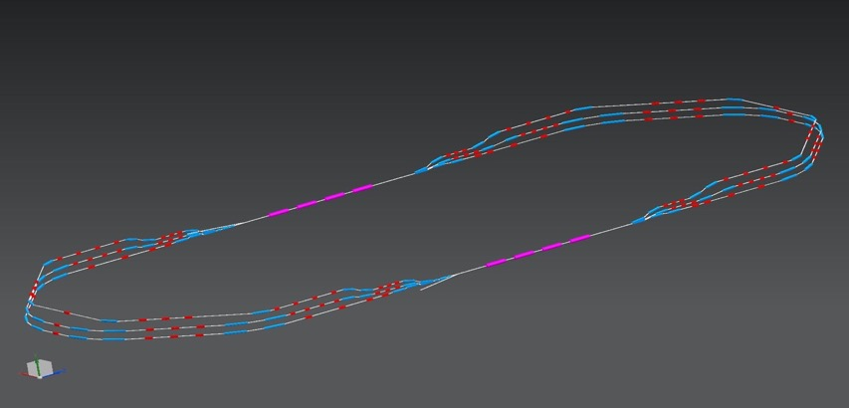
PERLE Configuration
Three passes ‘up’ to reach the maximum energy
1 : 3 : 5
ΔE = 82,2 MeV
injector
7 MeV
ΔE = 82,2 MeV
x
2 : 4 : 6
x
7 MeV
dump
ΔC in arc 6 = λ_{RF}/2
Electron beam at maximum energy could be used for:
Elastic electron-proton scattering with polarised beam (Particle physics)
Exploration of proton densities in exotic nuclei by electron scattering (Nuclear physics)
Gamma ray production between 0.2 and 5 MeV (wide applications in Photo-nuclear physics),

Slide 10
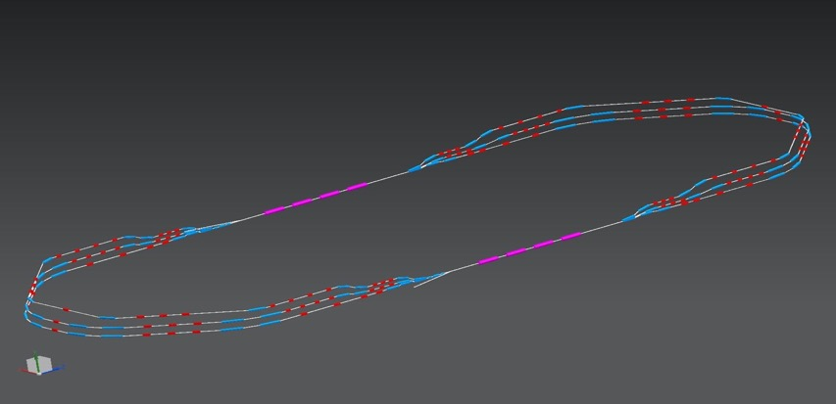
PERLE Configuration
Three passes ‘down’ for energy recovery
1 : 3 : 5
ΔE = 82.2 MeV
injector
7 MeV
x
ΔE = 82.2 MeV
2 : 4 : 6
x
7 MeV
dump
Several benefits from this manipulation:
The required RF power (and its capital cost and required electricity) is significantly reduced to that required to establish the cavity field and make up minor losses.
The beam is constantly renewed: never reach equilibrium state --> provides flexibility to adapt beam properties for specific applications.
The beam power that must be dissipated in the dump is reduced by a large factor.

Slide 11
Main challenges imposed by PERLE configuration
High current electron source operation: DC gun option chosen.
Beam quality preservation with:
  Space charge (both transverse and longitudinal)
  Coherent Synchrotron Radiation (CSR), microbunching and other collective effects
Power flow management and multiple beams undergoing common transport:
  Halo formation and control (development of new algorithme of control)
  BBU and HOMs handling (new SRF development)
  RF heating and mitigation of resistive wall
  Development of specific diagnostics and measurement methods

Slide 12
Toward PERLE Realisation
Given the challenges imposed by PERLE design and technical choices, we plan to go through two main phases toward PERLE realisation :
A design and prototyping phase that ends with the PERLE TDR:
  Study the main phenomena imposed by the challenging design choices (Lattice optimisation, BBU study, collective effects study, particle tracking studies, beam diagnostics development…)
  Prototyping and test of the critical components (dressed cavity with HOM coupler(s), power coupler, B-Com dipoles…)
  Design completion of the main sub-systems (booster, main cryomodule, DC gun upgrade…)
Three staged construction, commissioning and exploitation phase, sketched as the following:

Slide 13
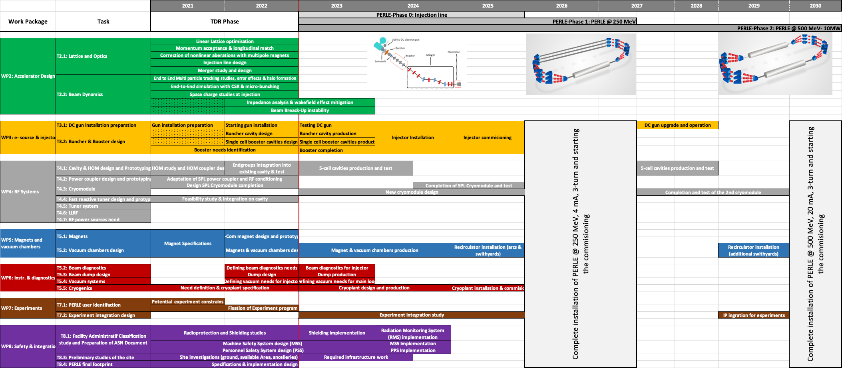
PERLE Timeline and Phases

Slide 14






The PERLE Collaboration
PERLE international collaboration leaded by IJCLab involves today:
A Collaboration Agreement (CA) is now signed by all the partners.
The collaboration aims at performing a technical detailed study of the PERLE facility and at preparing the ground at its construction and operation phase.
The effort of the collaboration is currently focused on the work toward the publication of the PERLE Technical Design Report (TDR) by fall 2022.

Slide 15
PERLE Injection Line
Courtesy to B. Hounsell and B. Militsyn
It consist of:
A DC photoemission electron gun (The ALICE DC gun to be upgraded).
A bunching and focusing section: 401 MHz normal conducting buncher cavity placed between two solenoid.
A superconducting booster with five 802 MHz cavities individually supplied and controlled on amplitudes and phases.
Merger to transport the beam into the main LINAC,
Beam diagnostics to be placed between components.
Photocathode gun
Buncher
SRF booster
Light box
Focusing solenoids
Photocathodes choice:
Sb-based photocathodes (unpolarized electrons) operated at 350 kV
GaAs photocathodes (polarized electrons) operated at 220 kV
Photocathode laser choice:
Nd: YAG laser (532 nm) or Ti: Sapphire laser (400 nm).

Slide 16
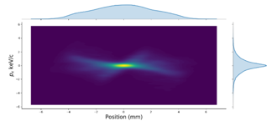
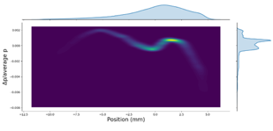
PERLE Injection Line
Achieved bunch parameters
Transverse emittance/ mm mrad | 4.0
Longitudinal emittance/ keV mm | 25.1
Bunch length/ mm | 3.0
Energy/ MeV | 7.0
Electron source to booster exit optimisation:
The ALICE electron gun electrode geometry has been re-optimised for PERLE’s new requirements.
An optimisation with a 5 cavity booster linac, from the cathode to the booster exit, was done and meets the specification.
If booster will be switched to a 4 cavity design, The tools for performing the re-optimisation are in place.

Slide 17
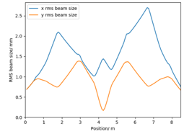
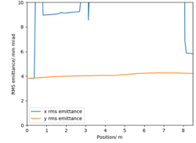
PERLE Injection Line
Merger tentative design:
Several merger schemes are investigated.
Design philosophy: use adjustable elements where ever possible to keep as much flexibility in operation as possible and to avoid building an assumption about the amount of space charge force present into the physical system. possibility to operated with different bunch charges, bunch sizes, injection momentums
Space charge is still significant and will need to be managed to prevent significant degradation to the emittance.
4 dipole schemes are currently being investigated as they have the potential to mitigate the effects of space charge on the dispersion and the consequent emittance growth.
Implications of the current optimisation on the beam dynamics in the main lattice should be investigated or possibly modifying some of the requirements on the merger which might open up alternative schemes.

Slide 18
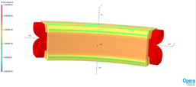
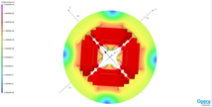
Lattice Design Optimisation
Courtesy to A. Bogacz and C. Vallerand
Design and prototyping of main magnets for arcs and switchyards

Slide 19
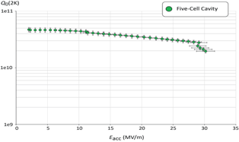
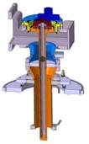
PERLE SRF System Development
Courtesy to F. Marhauser, N. Hu & G. Olivier
Design and prototyping of a full dressed SRF cavity: demonstration of level of SRF performance required in CW operation, high-average current environment, adequate damping of HOM.
HOM coupler study
Linac cryomodule design: SPL cryomodule adaptation to PERLE need, complete design of a cryomodule for PERLE later.
Q₀ (2k) = 3 e10 @ ~27 MV/m
DQW HOM Coupler
Quench @ E_{acc} ~ 30 MV/m
Design and prototyping of an input power coupler

Slide 20
Thank you for your attention!
MESA ERL simulation©

