Slide 1


Franch-Ukrainian workshop
Instrumentation development for high-energy physics
October 27th – 29rd, 2021
Proof of concept for a scintillator powder calorimeter
G. Hull¹, J. Lefrançois¹, N. Semkiv², A. Kotenko², S. Barsuk¹, M.-H. Schune¹, D. Breton¹, A. Cabrera¹
¹ Université Paris-Saclay, CNRS/IN2p3, IJCLab, 91405 Orsay, France
² Kyiv National Taras Shevchenko University, 01033 Kyiv, Ukraine

Slide 2
Outline
The LiquidO detection technique
Powder calorimeter
The proof of concept
  Simulation results
  Experimental results
Future work
1

Slide 3
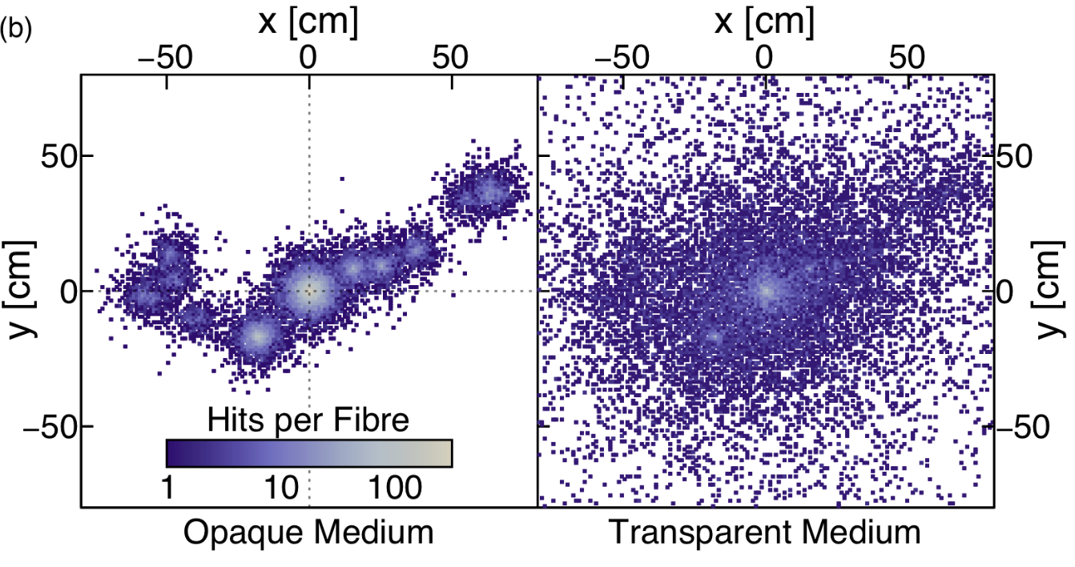
The LiquidO technology
LiquidO is a new detection technique making use of opaque liquid scintillator read-out by means of WLS fibers
Opaque detection medium
Stochastic light confinement
LiquidO concept:
TPC-like detector with « light drfiting »
2

Slide 4
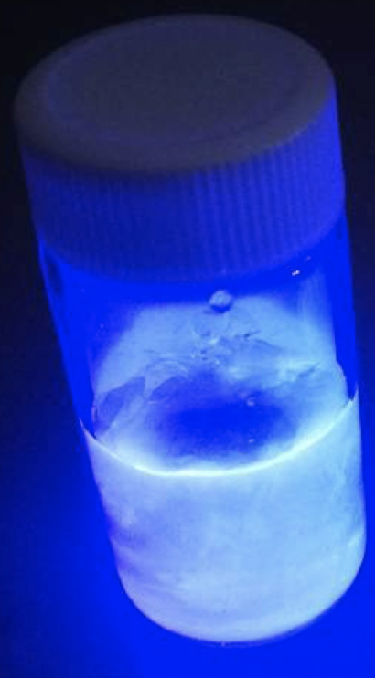
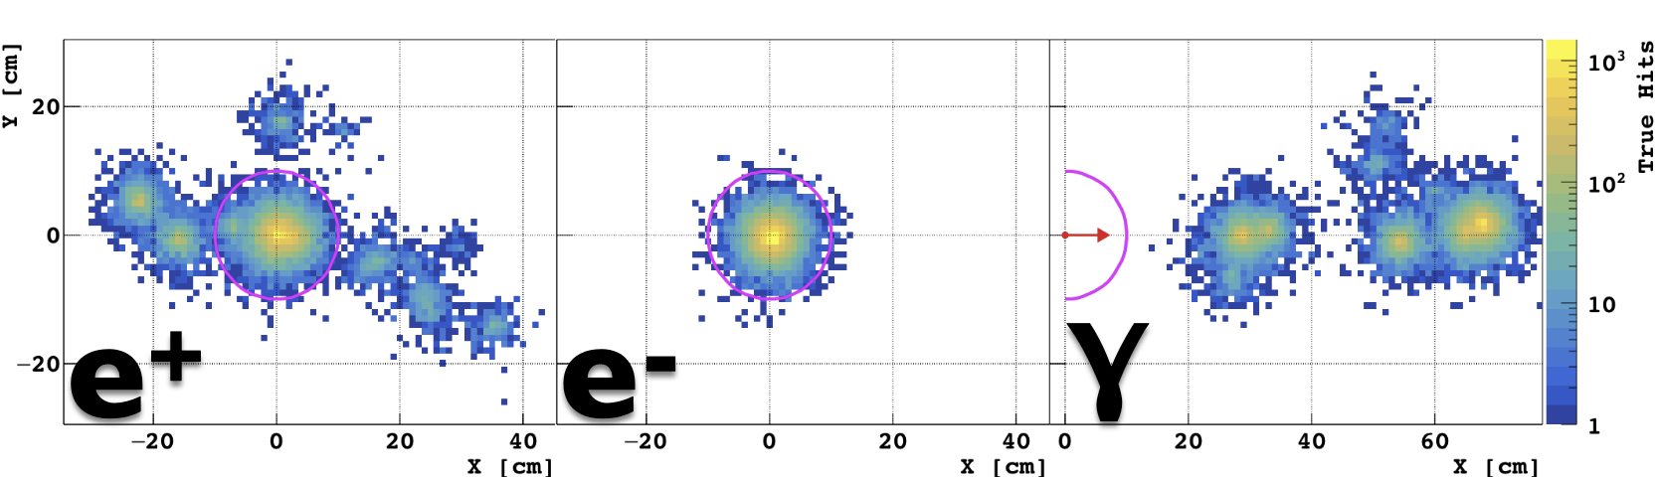
The LiquidO technology
LiquidO is a new detection technique making use of opaque liquid scintillator read-out by means of WLS fibers
Excellent PID is expected
2 MeV
Possible application for:
Neutrino physics
Medical imaging
High energy physics
…
A. Cabrera et al. LiquidO First Publication [arXiv1908.02859]
C. Buck et al. LiquidO First Opaque Scintillator [arXiv:1908.03334]
S. Wagner et al. Micro-Crystal Opaque Scintillators [arXiv:1807.00628]
3

Slide 5
Detectors for e+e- colliders
For future e+e- colliders: EM calorimeters based on sampling technique (CALICE, Dual Read-out Calorimeter)
Good granularity at limited cost 😏
Rather poor photon energy resolution 😒
  ➥ at small energies: R ~ 10%/sqrt(E)
Proof of concept for a next-generation calorimeter with extremely fine sampling: PowderO
→ For improved photon energy resolution while maintaining a good jet energy resolution
4

Slide 6
The PowderO concept
Scintillator powder calorimeter
Scintillator
Absorber
WLS fibers
Shashlyk Calorimeter: alternate layers of scintillators and absorbers
PowderO: mix of scintillator and absorber grains in the same volume
High granularity
Modest energy resolution
High granularity
Good energy resolution
Proof of concept: simulation and experiment
5

Slide 7
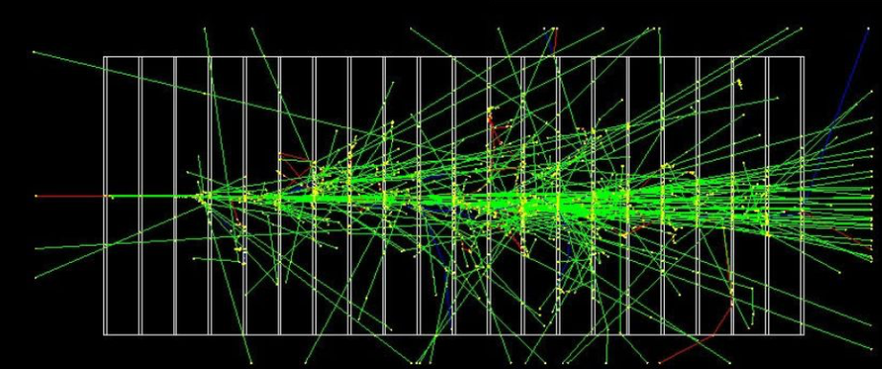
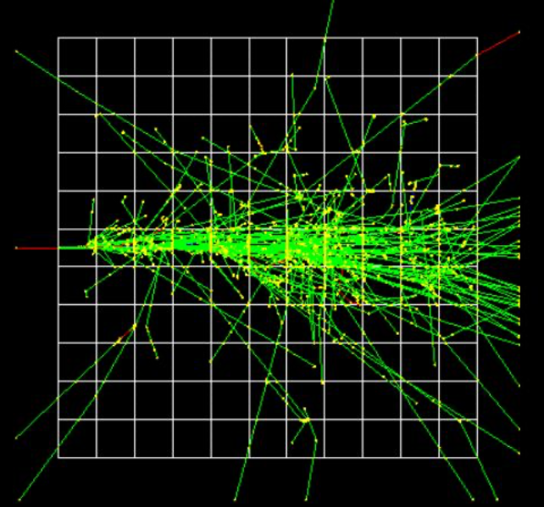
Simulation for 1 GeV photons
Geant4 MC simulation: shower produced by a 1 GeV photon in a conventional Shashlyk and in a PowderO calorimeter
Shashlyk: alternate plates of Pb and CH
Same geometry as LHCb: 150×150×2 mm³ plates
PowderO: ZnWO₄ grains + CH₂I₂ distributed with two different geometries
    Alternating cubes
    Randomly distributed cubes
2 and 3 mm-side cubes
150×150 mm² lateral dimension
Total length: 25 X₀ in the absorber material (127 in Pb and 201 in CH₂I₂)
6

Slide 8
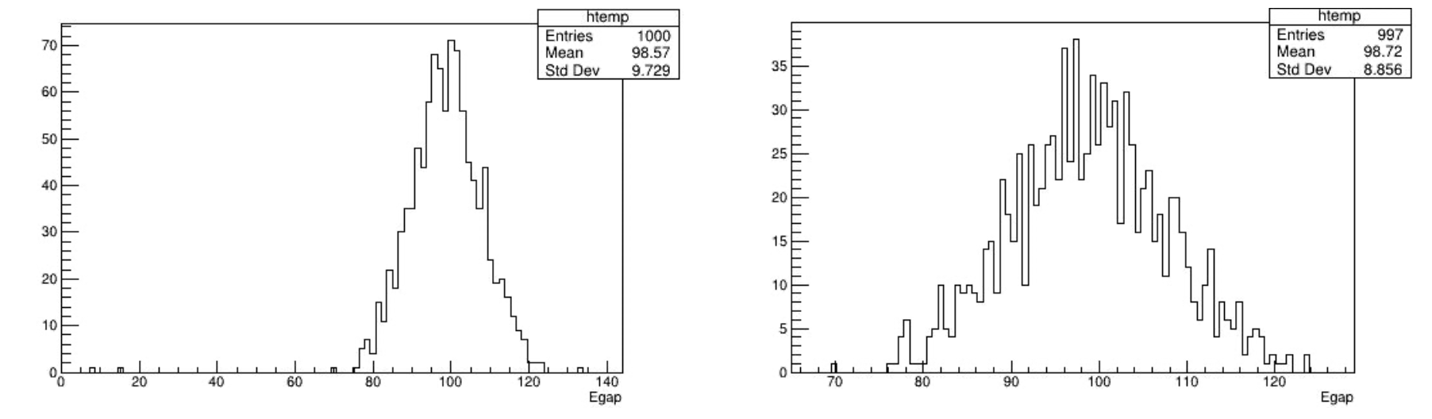

Simulation results
Total energy deposit in the absorber: E_{abs}
Total energy deposit in the scintillator: E_{scint}
Energy deposit in the scintillator
$$\left|x−μ\right|<3σ$$
E_{scint}
E_{scint}
Shashlik calorimeter: $\frac{ΔE}{E}≈8.9\%$
7

Slide 9
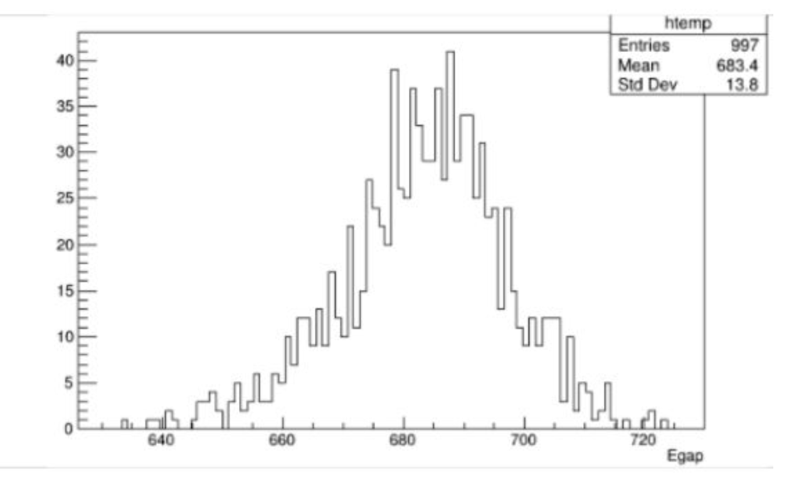
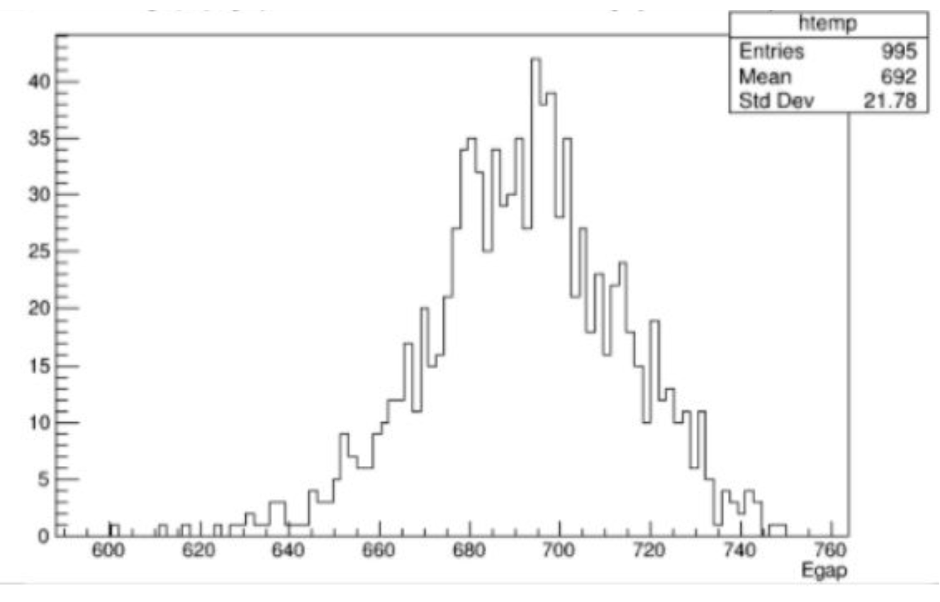
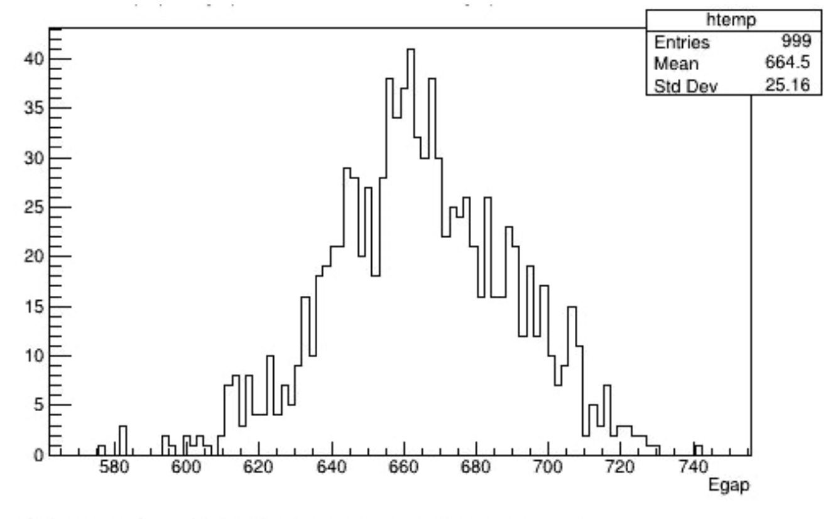
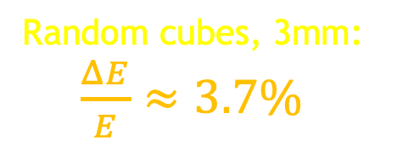
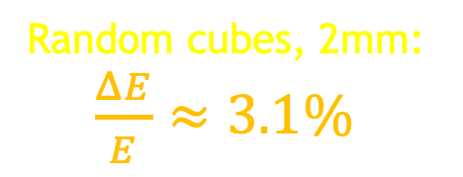
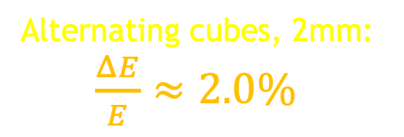

Simulation results
Alternating cubes, 2mm:
$\frac{ΔE}{E}≈2.0\%$
E_{scint}
The energy resolution scales as the sqrt of the cubes linear dimension:
$$\frac{3.7\%}{3.1\%}=1.2\sim \sqrt{\frac{3}{2}}$$
expected 1.5% energy resolution for 0.5 mm cubes
Random cubes, 2mm:
$\frac{ΔE}{E}≈3.1\%$
E_{scint}
Random cubes, 3mm:
$\frac{ΔE}{E}≈3.7\%$
E_{scint}
8

Slide 10
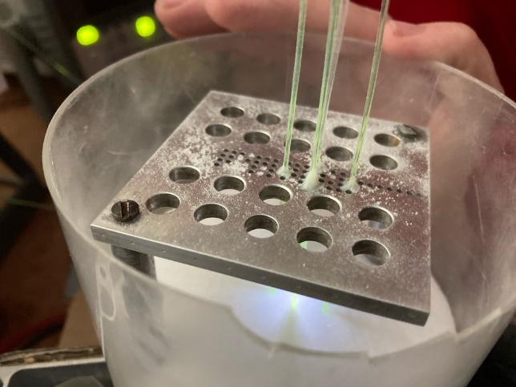
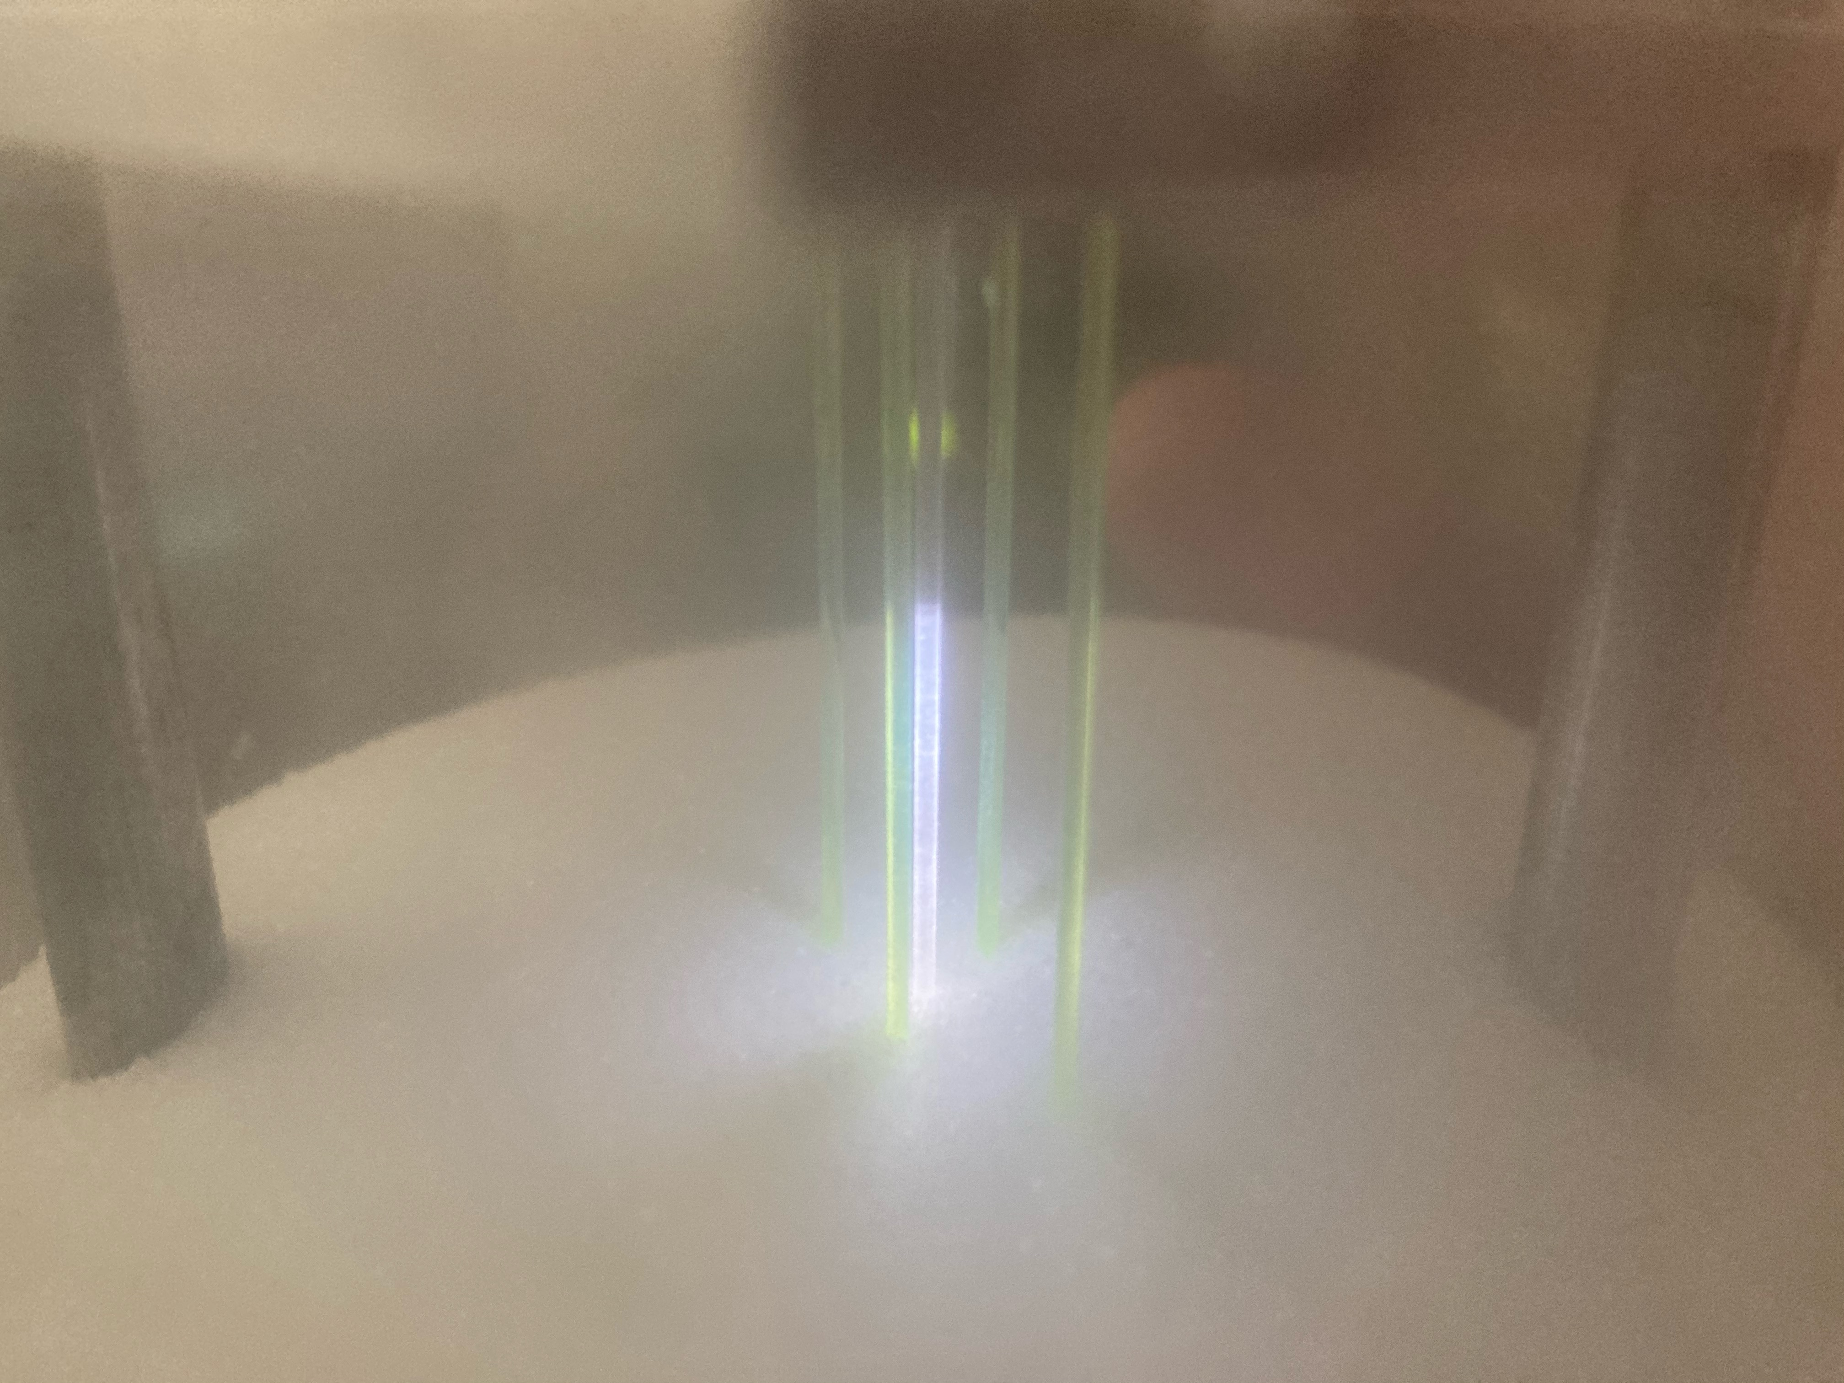
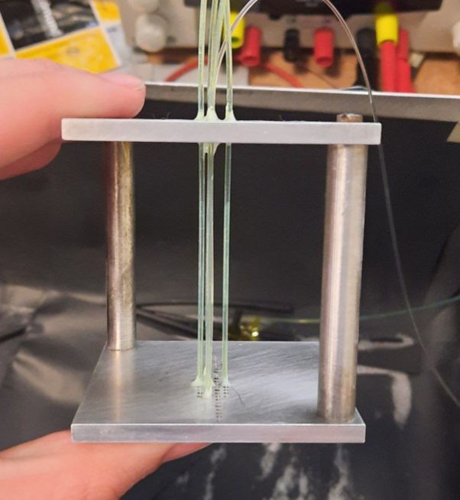
The experimental set-up
WaveCatcher digitizer @ 3.2GS/s
60-cm long Saint Gobain BCF9929A WLS fiber
Blue LED
Clear fiber unpolished on 2 cm
9

Slide 11
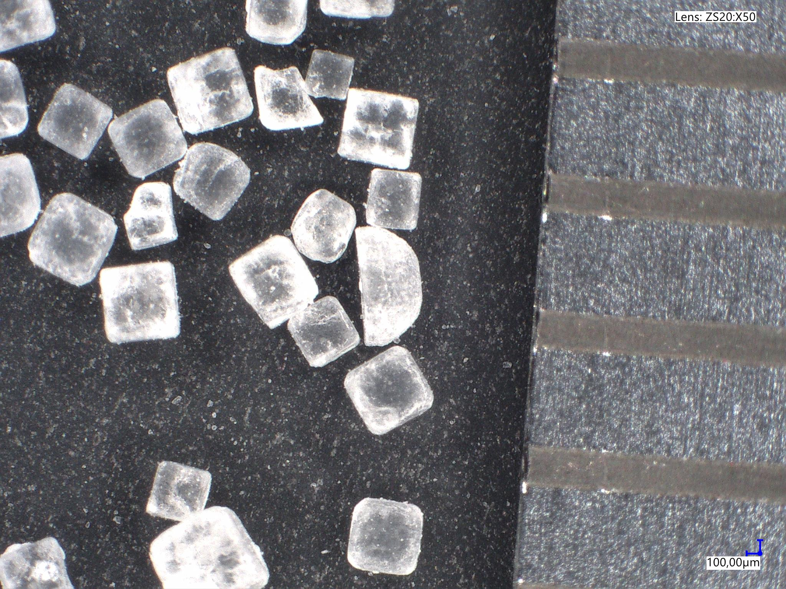
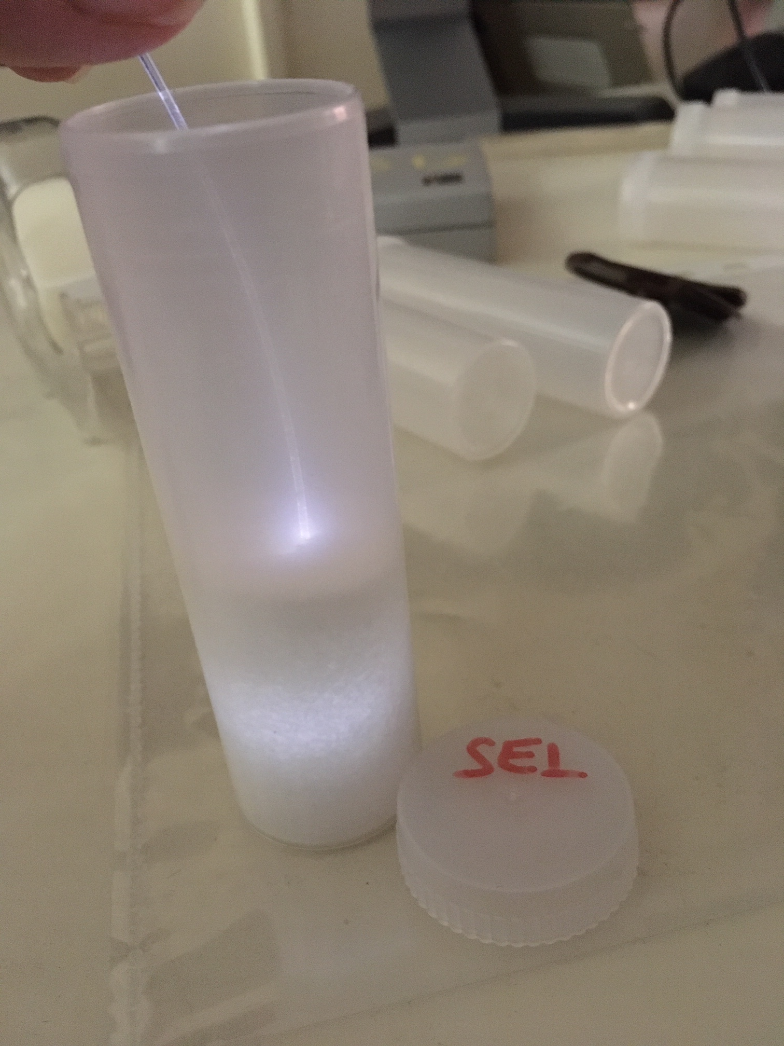
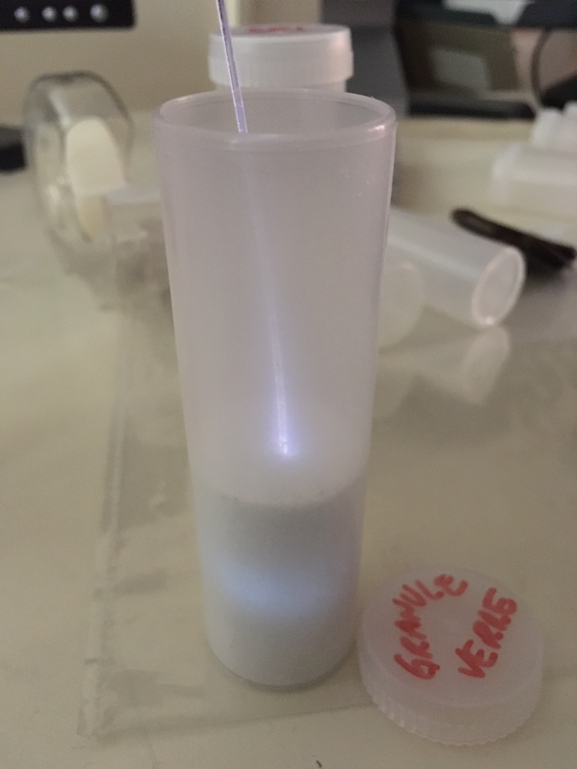
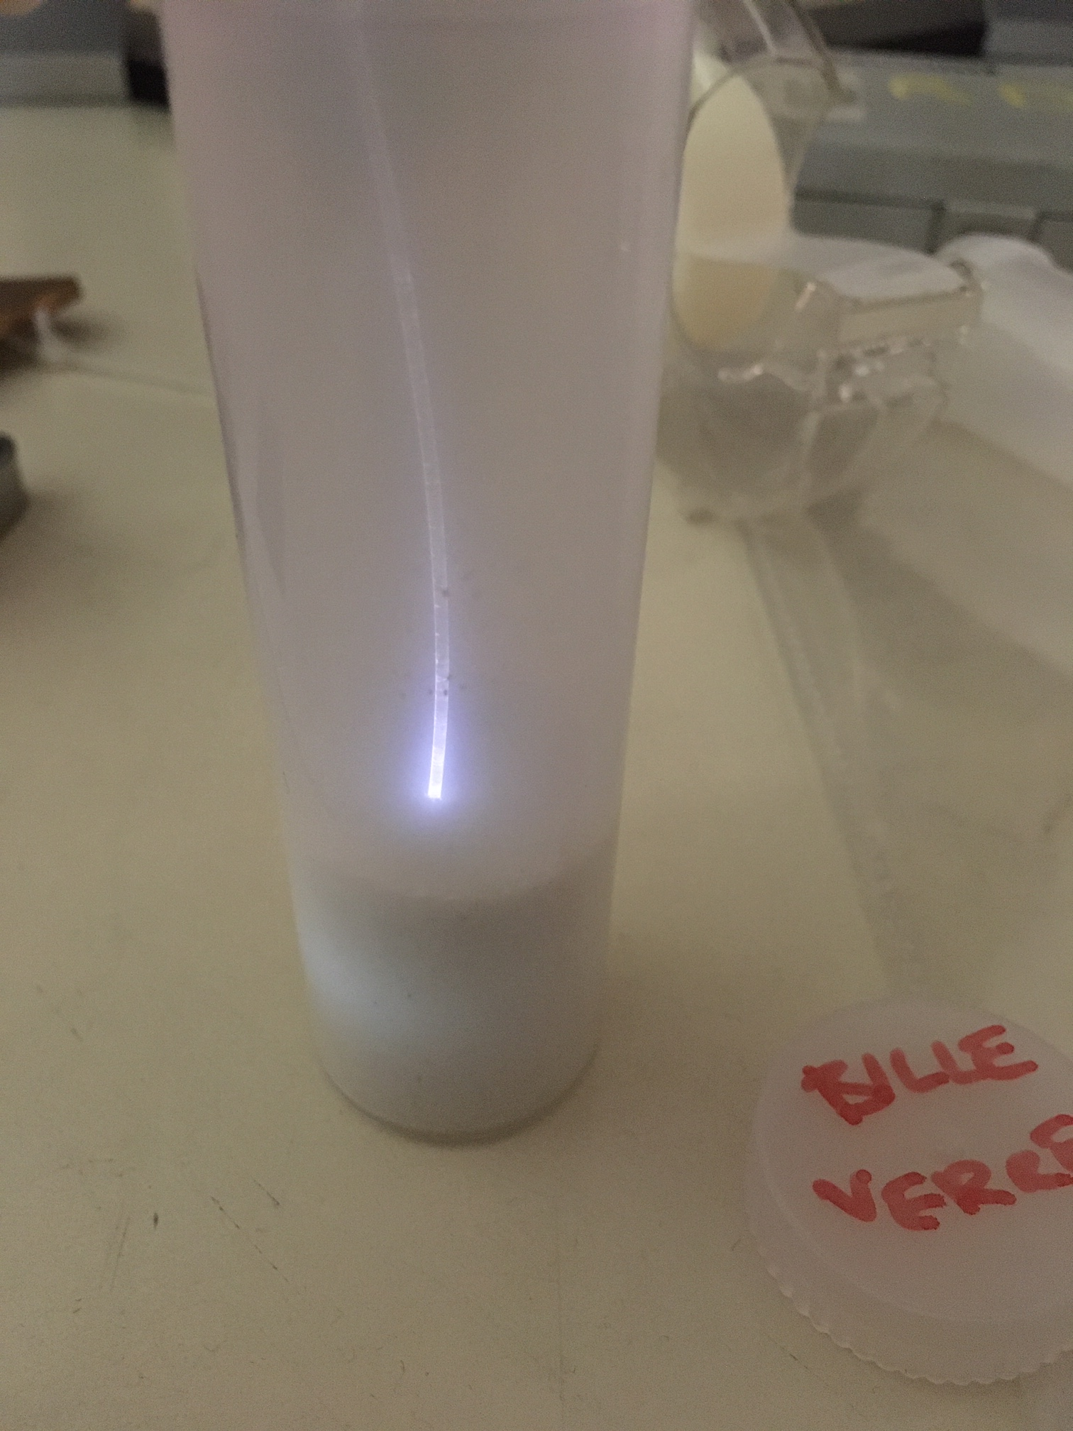
The experimental set-up
For the proof of principle we used kitchen salt
Injection of the light with a clear fiber and comparison of the signals acquired by the WFS fibers located and increasing distance from the light injection, in three different conditions:
  In air
  In salt (grain size ~ 0.5 mm)
  In salt + isopropanol
For each configuration we acquired 10k signals and we estimated the mean WF
Salt
Glass grains
Glass spheres
10

Slide 12
Results
1. With salt we collect more light than in air
11

Slide 13
Results
2. If we add isopropanol to salt, the signal amplitude decreases next to the light injection but increases at 6 and 8 mm from it
12

Slide 14
Results
6 mm
6 mm salt
6 mm mixture
Linear fit on the rising edge and
estimate of t @ peak/2
Δt_{m}
Δt_{s}
3. The time difference between the signals acquired in air and salt is is always bigger than the time difference in air and salt+isopropanol
→ with isopropanol there is less light scattering
→ the light has to travel less to be collected on the WLS fiber
At 6 mm:
Δt_{s} ~ 1.4 ns → Δl_{s} ~ 28 cm
Δt_{m} ~ 0.6 ns → Δl_{m} ~ 12 cm
13

Slide 15
Conclusion and future work
We demonstrated the feasibility of PowderO
Geant4 shower simulation predicts an energy resolution of about 1.5%/sqrt(E) for 0.5 mm size ZnWO₄ grains + CH₂I₂
Powder (kitchen salt) = Light confinement
Mix = Powder + liquid (isopropanol) = higher total density and better optical coupling
From salt to inorganic crystal grains: possible collaboration with ISMA (Ukraina) to produce 1 kg of ZnWO₄
Test of a 16-fibers device to study of the uniformity response of the detector
Characterization of a full length and fully equipped 16-fibers prototype
Development of a 14 cm x 14 cm demonstrator
14

Slide 16
Backup slides

Slide 17
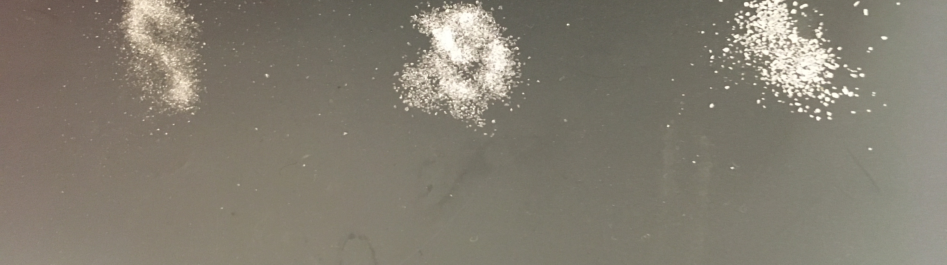
Tested powders
Sea-salt
Glass grains
Glass spheres

