Slide 1
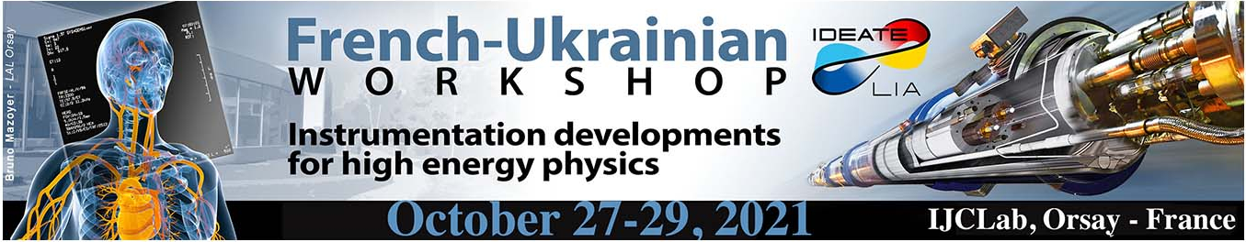
PLUME PROJECT
Probe for LUminosity MEasurement in LHCb
Olivier Duarte
On behalf of the PLUME group
Olivier Duarte

Slide 2
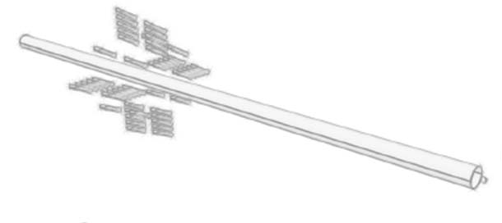
PLUME PROJECT
Probe for LUminosity MEasurement in LHCb
Introduction : working principle
Elementary detection module
Electronic and readout
Monitoring
Mechanical part
PLUME Phase 1
Conclusion : PLUME Phase 2
Olivier Duarte

Slide 3
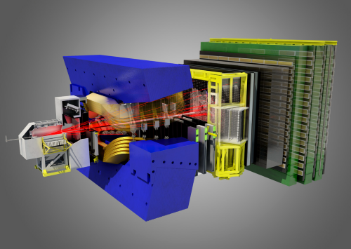
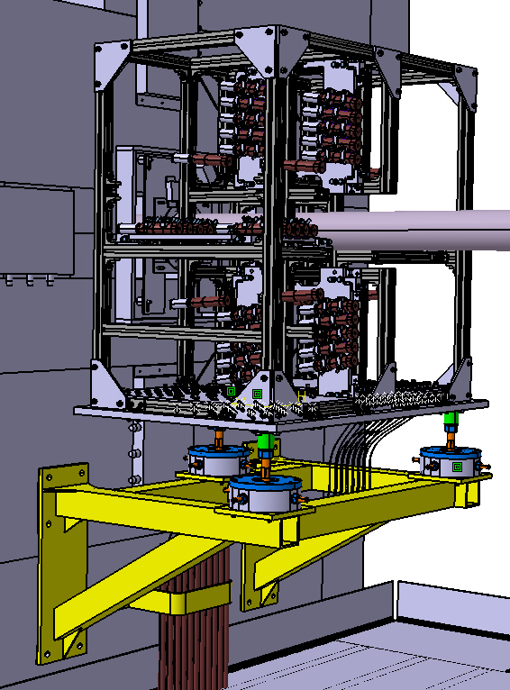
PLUME : Luminometer for LHCb run 3
Main goal(s):
  Producing fast alarm for LHCb and/or LHC
  On(off)line luminosity measurement
  Feedback to LHC for luminosity levelling
  Contribute to centrality determination and veto for heavy-ion and fixed-target programme
  Limited time : need to be installed for Run 3 (beginning 2022)
  Hostile radioactive environment: 80 .. 200 kGy; ~5x10²³ n/cm2
  Restricted space available
Constraints:
  Integration in the LHCb detector and DAQ
Olivier Duarte
Notes:
This first slide is just to remind you the different mechanical elements of PLUME
PLUME that means Two box
:
Bottom up :
Then the patch panel for High Voltage, Signal and Optical Fiber
I continue on the next slide

Slide 4
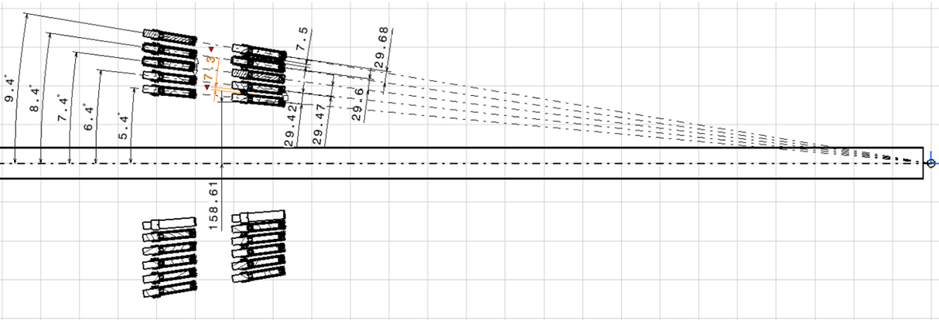
PLUME : Working principle
Build a detector based on the measuring of Cherenkov radiation from charged particles going upstream of LHCb
  Two projective planes of elementary modules detecting Cherenkov light emitted by charged particles going in the upstream direction
  Each elementary detection module
  Measure integrated charge
  Small-size elementary counters, yes/no response.
  For Calibration and monitoring
  Tracks reconstructed with upstream VELO stations and/or coincidences between matching counters
  Light from LED delivered to PMTs with quartz fibers
Olivier Duarte

Slide 5

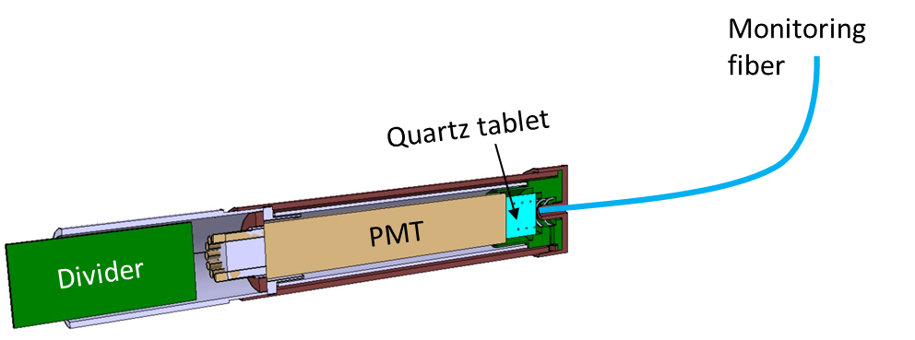
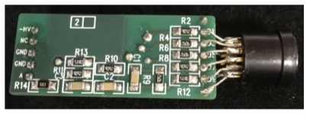
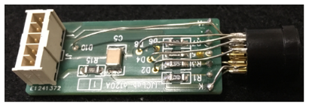
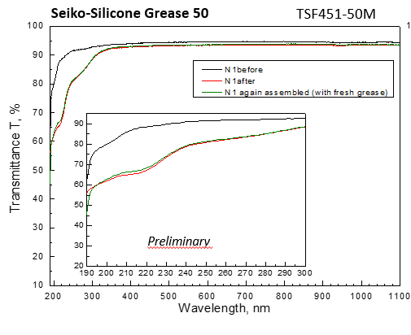
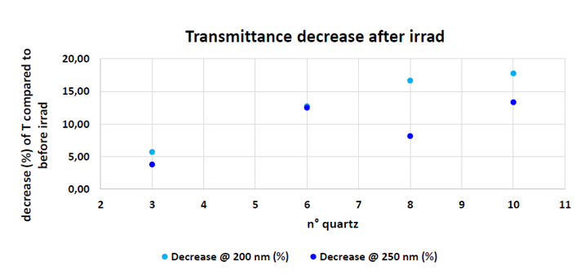
Elementary detection module
  PMT with quartz window and attached quartz tablet, both acting as radiator
optical grease
Divider circuit
  All components chosen for their radiation hardness
R760
  PMT HAMAMATSU R760 already in used in LUCID and tested with neutrons and gamma
  Optical contact (quartz-tablet) : optical grease
  Quartz transmitance decrease after irrad with
  neutrons (10¹⁴ n/cm²)
  Optical grease transmitance after irrad with neutrons (10¹⁴ n/cm²)
See next talk
Olivier Duarte
Notes:
The detection module is composed by :
- Quartz windows attached with a quarts tablet, Both acting as a radiator and produce light when crossing by a particule
- All the components of the module are radiation hard :
The optical contact between the quartz round tablet and the PMT window is assured by an optical grease.
The Hamamatsu PMT R760 which is used in LUCID had proven to keep its performances after an irradiation of 10e14 neutron/cm2, only its dark current is increased by an order of magnitude.
As for the quartz and the grease, they were tested under irrad in Ukraine and showed a good resistance for a dose equivalent to 4 years of running
The PMT divider circuit was developed to cope with the current that will be delivered by particles crossing the quartz tablet with a high gain of operation of the detector.
As the PMT will age with time and 40 MHz of operation, its HV will have to be increased to compensate for the loss of gain.
The PMT will be biased to obtain a gain of 1.5 10e5. With this gain the charge produced when a particle passes through the module is around 3 pC corresponding to around 140 photons. This value was determined by Geant4 simulation and confirmed by test beams at H8.

Slide 6
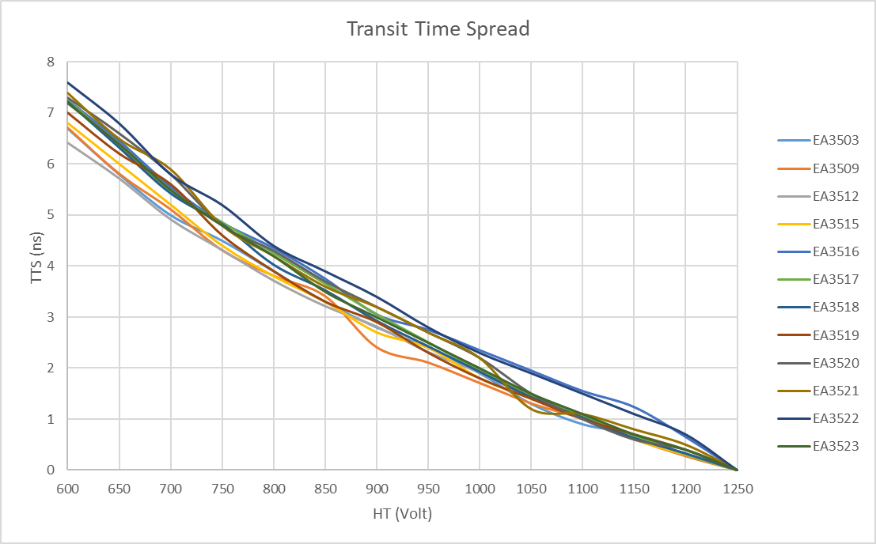
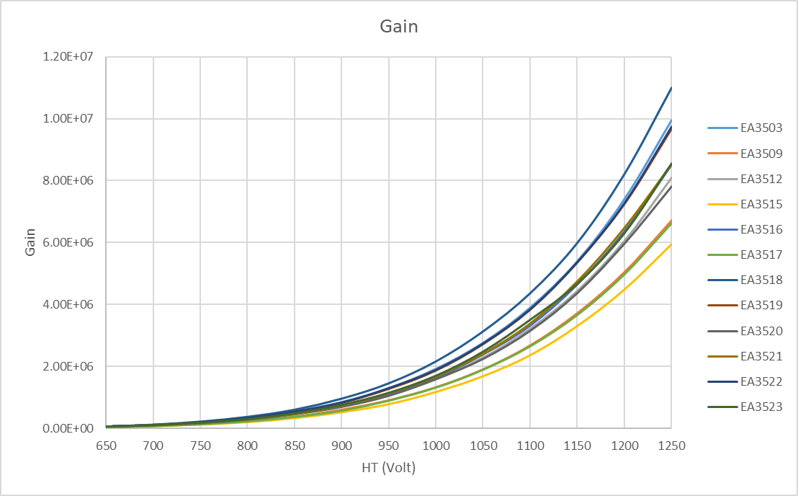
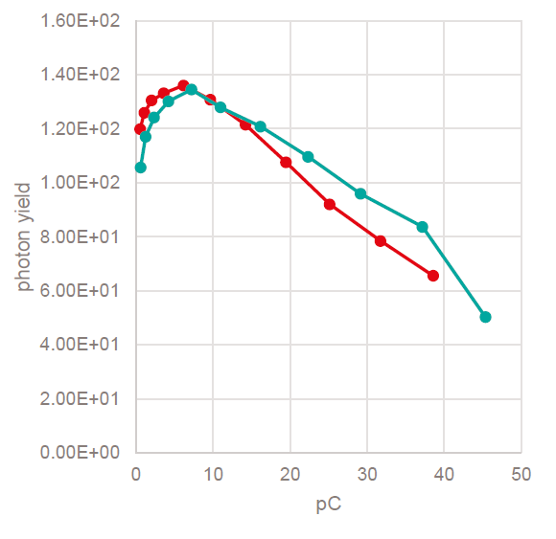
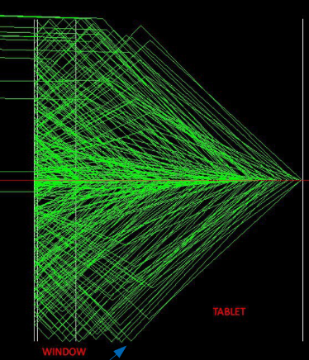
Elementary detection module characterization
  PMT characterization : gain, linearity, transit time spread
GEANT4 simulation
particle
  Good agreement between the simulation ~ 140 photons/particles in the linear range of the PMT (3 – 6 pC)
Olivier Duarte

Slide 7
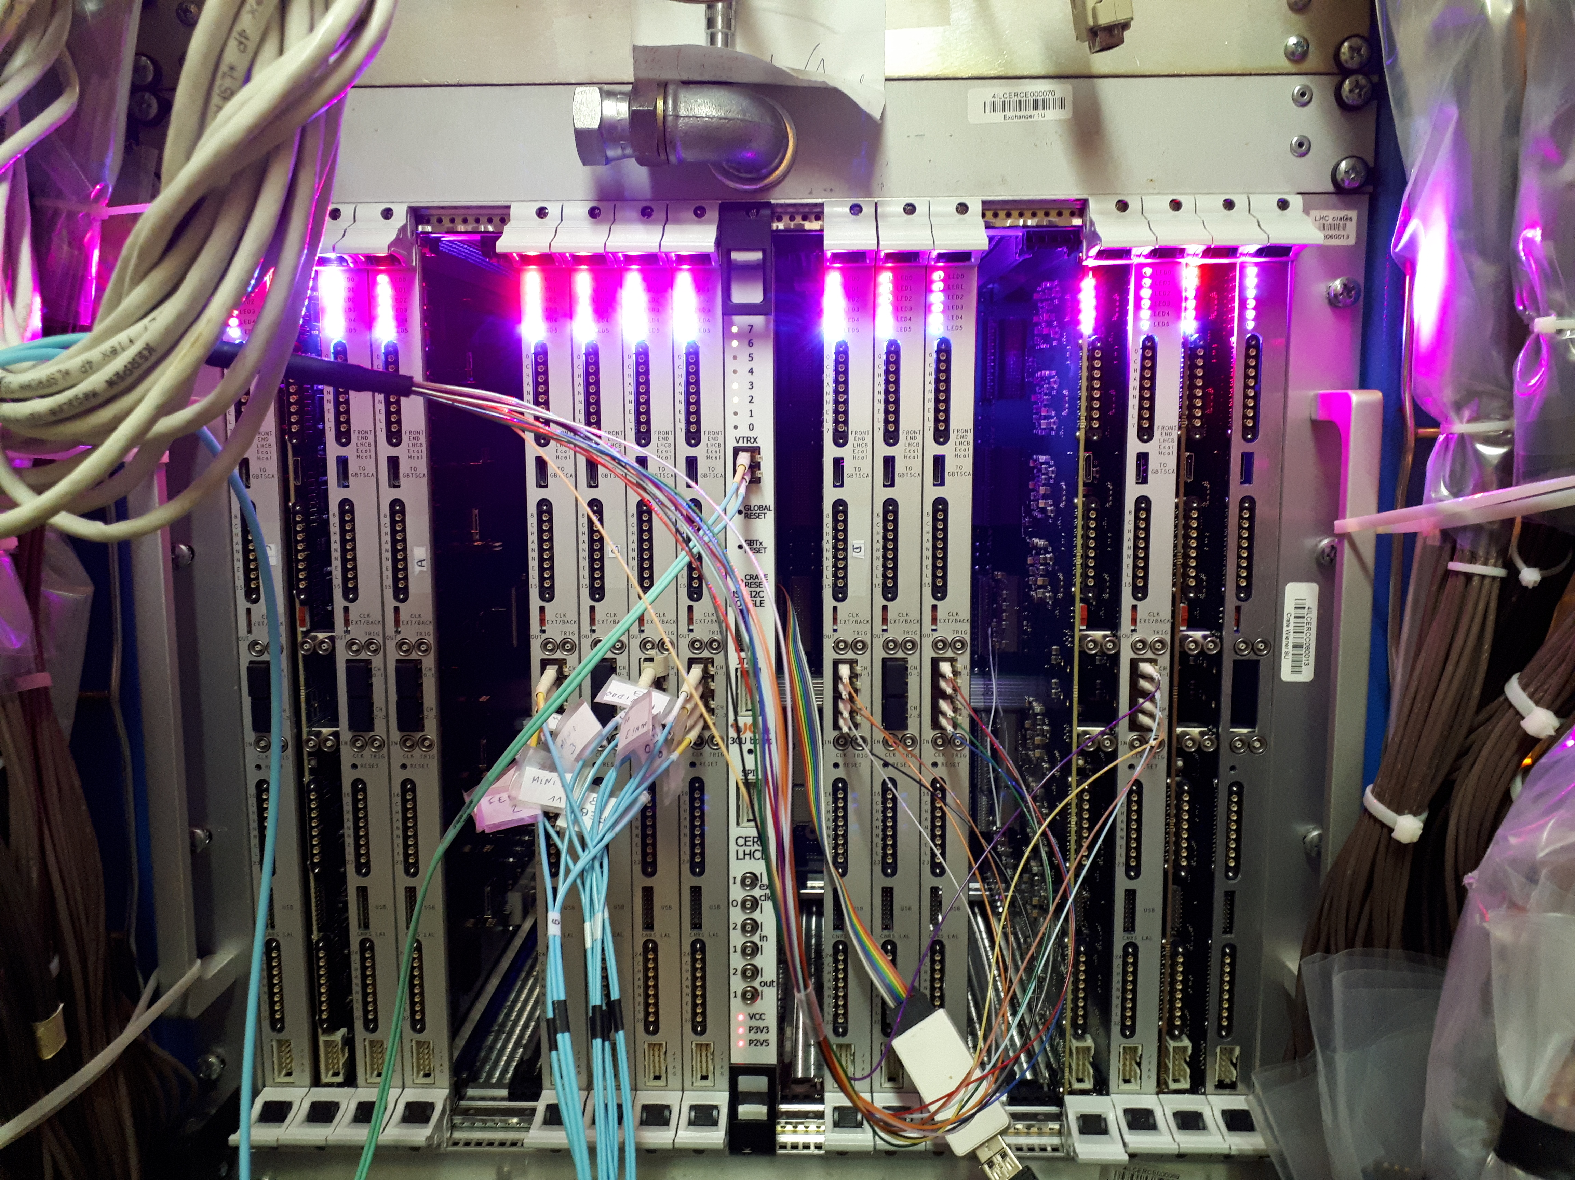
PLUME : Electronics and readout Front-end electronics
  It was decided to use and adapt the electronics developed for the calorimeter
  It’s already adapted to the LHCb calorimeter data format and event building
  A preliminary test showed that ECAL FEBs can readout the expected signal
  No need to produce a special board (long), the existing ones are adaptable (firmware modifications)
  We can measure at LHC rate the individual hits and hodoscope coincidences. Also measure integrated charge
  The signals are transmitted to TELL 40 and processed by PCIe 40
  Generate fast alarm, determine online luminosity from hits and integrated charge information, including luminosity levelling
  A custom firmware to be developed to provide instantaneous luminosity to the LHCb control system
  Information available offline (as other subdetectors)
Olivier Duarte

Slide 8
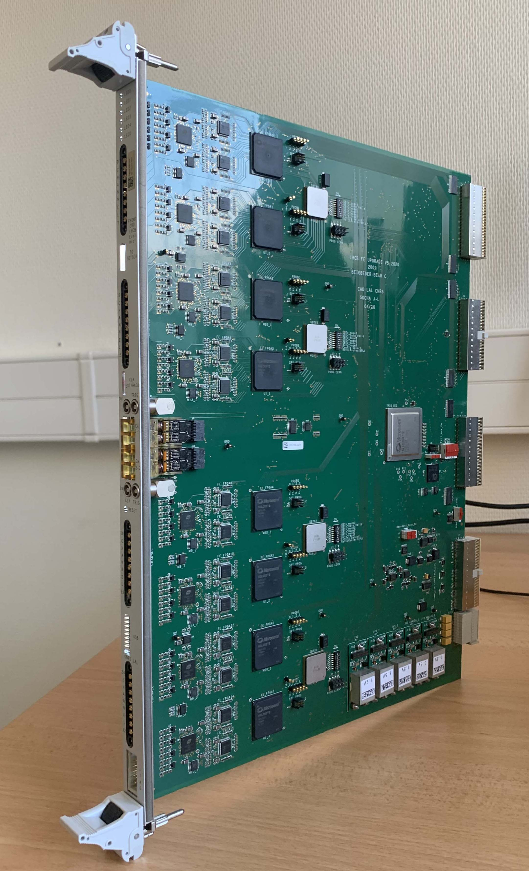
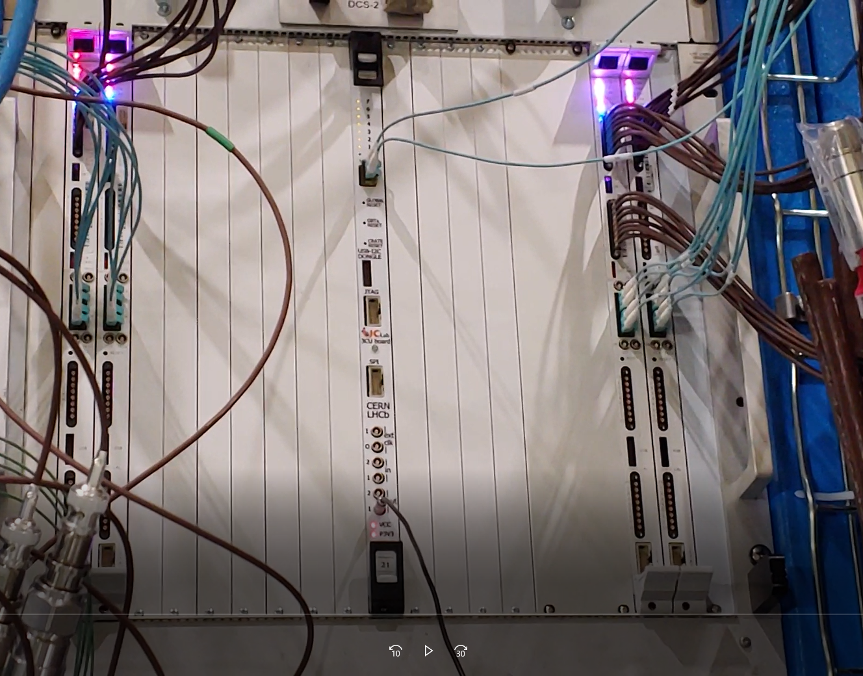
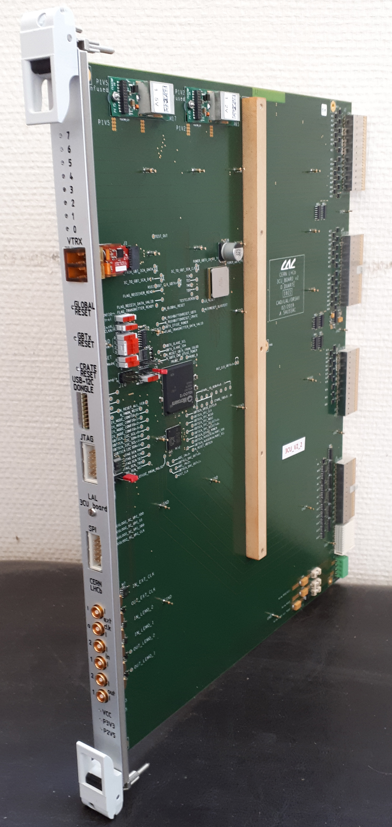
PLUME : Front-end electronics
  FEB
  Treats 32 channels (4 blocks of 8 channels)
  ICECAL chip for the analog part
  12 bits Analog to digital Converter
  8 FPGA Front-End
  GBT output to send data on the optical fiber
  4 optical fiber for the readout (TELL40)
  3CU
  One bi-didirectionnal optical fiber for clock, fast and slow control (SOL 40)
  Clock distribution
  PLUME Crate
  9U crate with a custom backplane
  MARATON power supply configured for the calorimeter
  4 optical fibers for the data readout of one board
Olivier Duarte

Slide 9
PLUME : Backend electronics
  TELL40 (PCIe40) : dedicated to data processing
  Receive RAW data from the detector with one word of 12 bits ADC per channel
  A custom firmware to be developed to provide instantaneous luminosity to the LHCb control system
  Count the number of channels with no activity
  Using Bunch Crossing information from RAW data ➔ possible to obtain the luminosity per bunch (histograms of empty events as a function of the BCId)
  SOL40 (PCIe40), dedicated to :
  Handling configuration
  Timing and control commands
  No specific modification needed for PLUME
Olivier Duarte

Slide 10
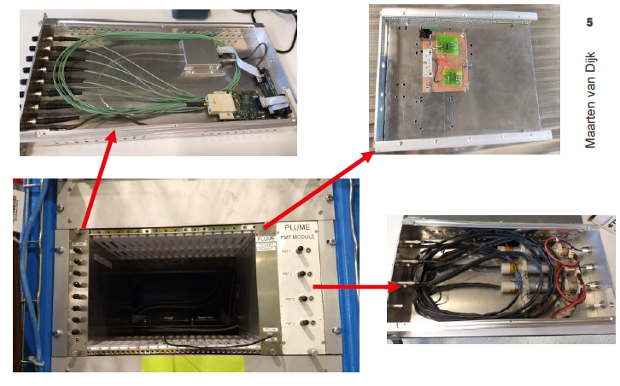
Monitoring system and calibration
  PMT gain expected to vary depending on occupancy, time and radiation dose
    ➔ monitor the gain and apply HV correction to recover the reference value on a fill-by-fill basis
  LED light transported to the PMTs by radiation-hard fibers
  ➔ monitor LED stability using PIN photodiode (LHCb calorimeter-like system, LEDTSB board)
  Calibration tracks coming from the interaction point and reconstructed with VELO
  Perform calibration at beginning + EOF (=End Of Fill) + during empty BX
  Amplitude histograms saved every 15 minutes
  EOF ⟶ analysis task updates DB with new recipes
  WinCC daemon applies new recipes at beginning of fill
Olivier Duarte

Slide 11
Mechanical part
Just to remind you
  PLUME = Two boxes
  Box C : it contains ≈ 2/3 of the modules (32)
  Box A : it contains ≈ 1/3 of the modules (16)
  Phase 1 “demonstrator": installation of 8 modules at CERN
  Phase 2 : For the winter installation of 48 modules at CERN
C
A
  The different mechanical elements of PLUME
  MK light Structure
  PM support plate with adjustment
  Patch panel (HV, signal, optical fiber )
  Adjustment feet
Carrier Structure
  Alignment requirements: 100 µm
Olivier Duarte

Slide 12
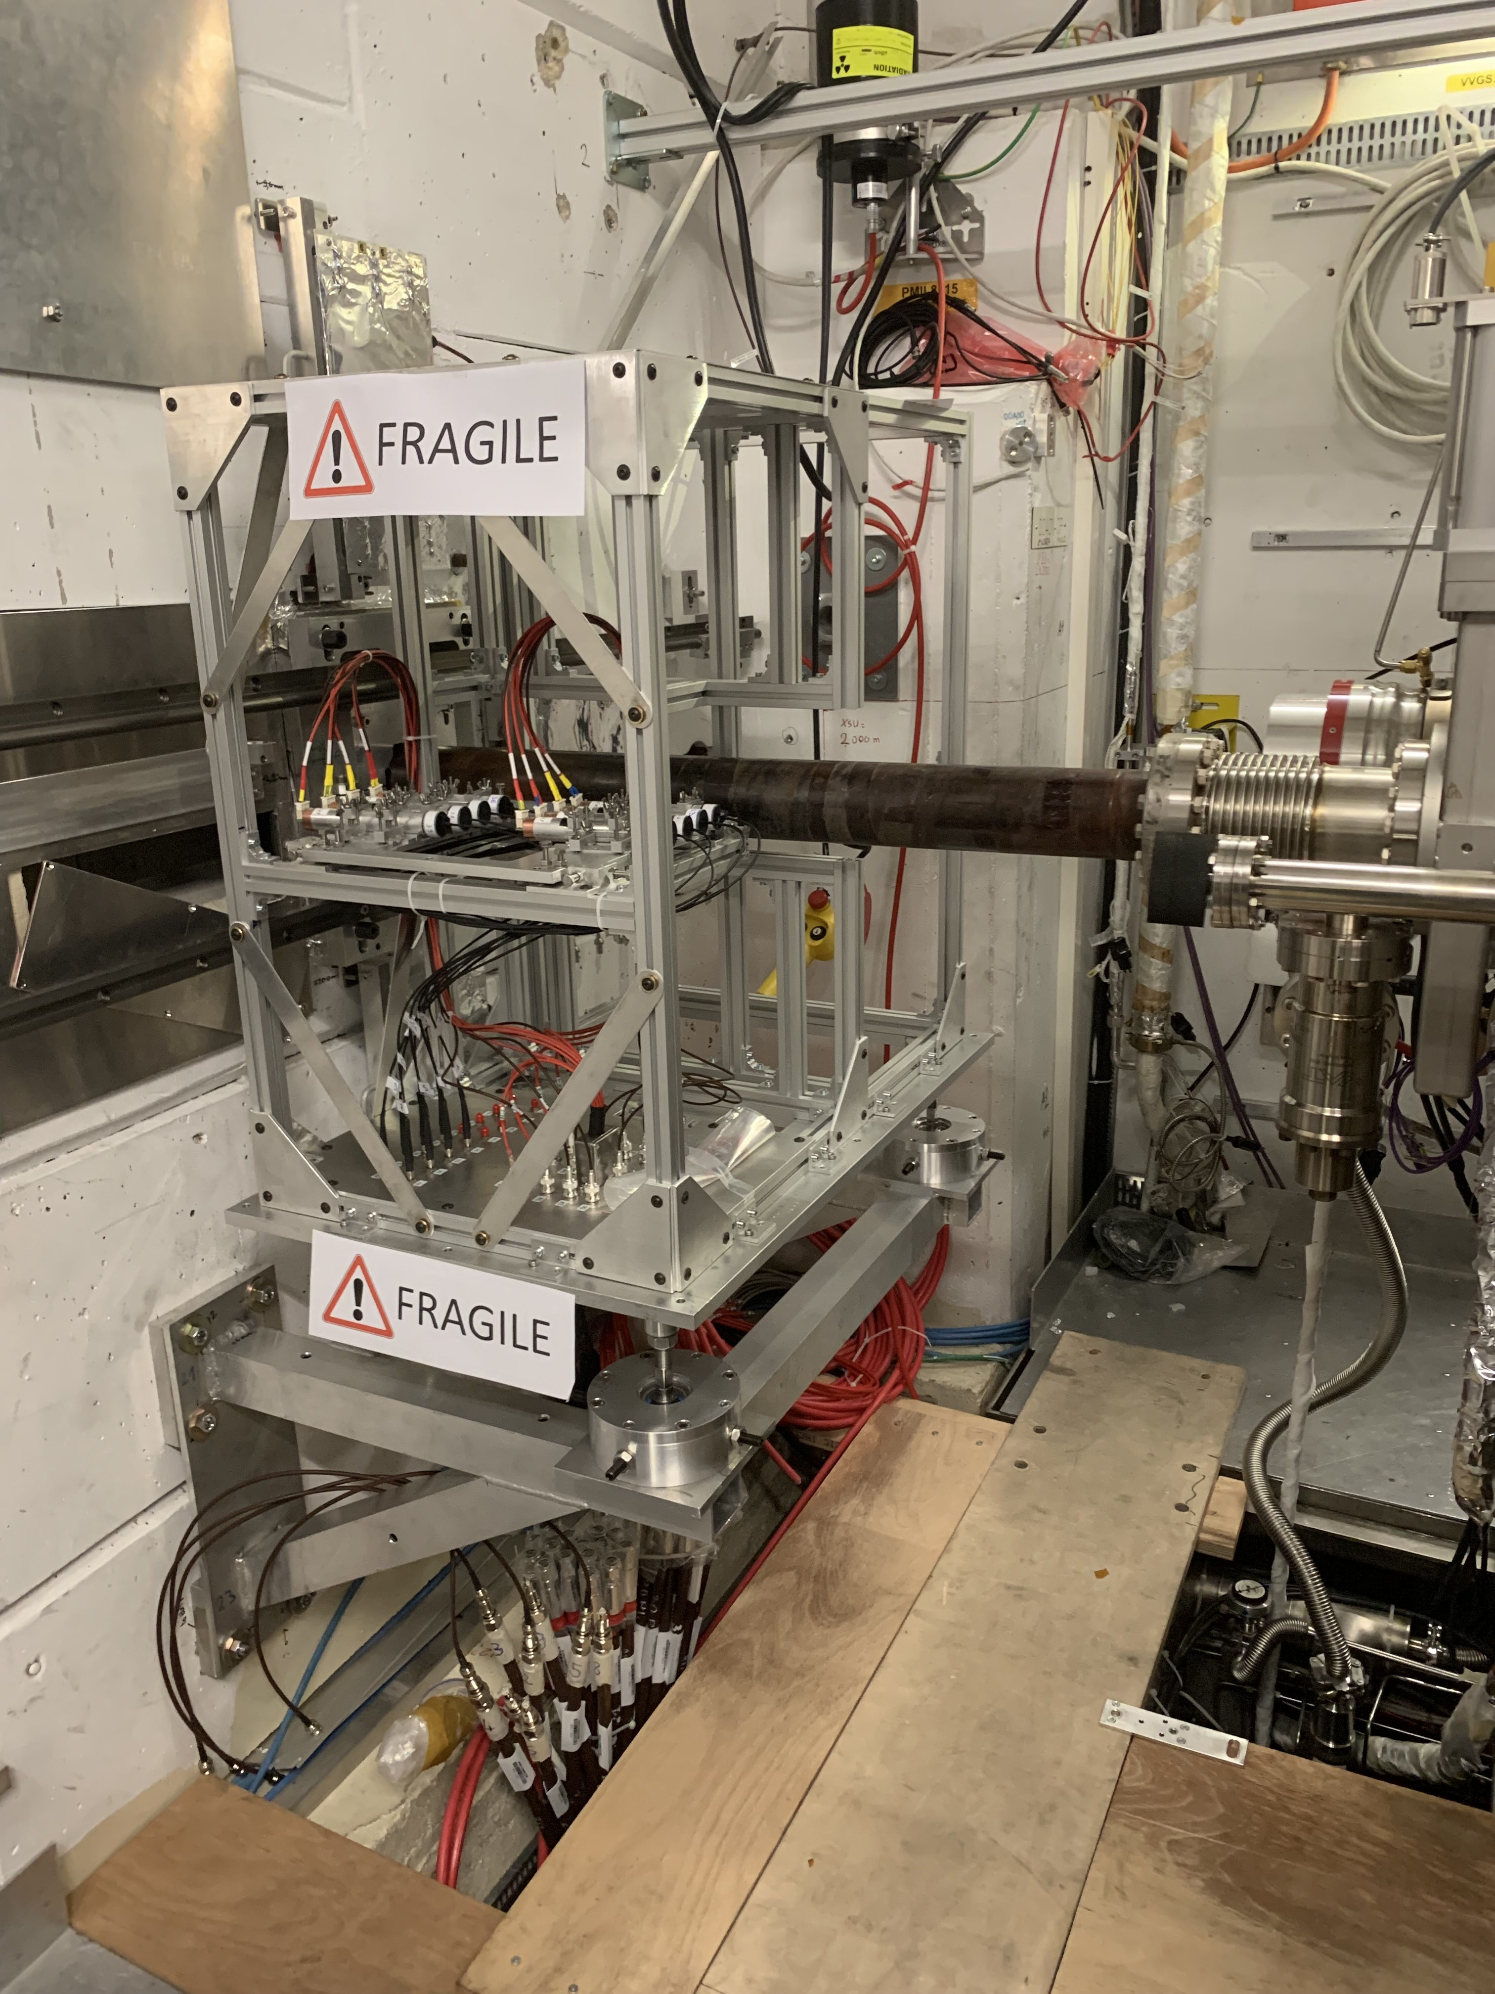
PLUME PHASE 1 (installed at CERN) : 8 modules
  Detection unit
  8 PMT installed and tested (light-tightness, charge measurement under led illumination)
Mechanical structure
  Mounted tested and aligned
  A precision of 100µm has been demonstrated
Electronics part
  Front-End : debug in progress, ready to take data soon
  Back-end : ready, and final version of firmware (in TELL40) should be ready for phase 2
  DAQ : debug in progress, ready to take data soon
  Monitoring system
  A temporary solution has been implemented due to delay on optical fiber orders. The final implementation should be ready for phase 2
  We hope to take data during the LHCb pilot run
Olivier Duarte

Slide 13
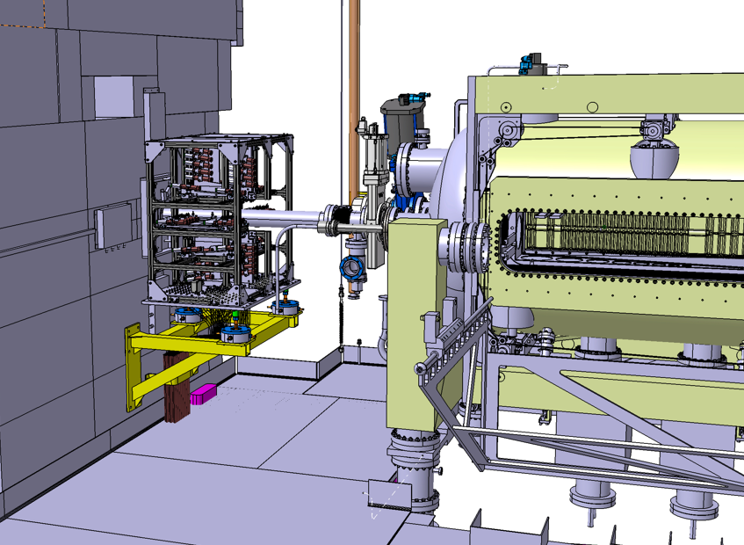
PLUME PHASE 2 : 48 modules
  PLUME phase 2
  48 PMT will be installed and tested
  We have updated the mechanical design
  Mechanical structure manufacturing ongoing
  Cabling ongoing
Schedule
  Planning tight but feasible
  We are ready to install and operate PLUME Phase 2 at the end of the year !
Olivier Duarte

Slide 14
PLUME
Thank you for your attention
Olivier Duarte

