Slide 1
Study of neutron and g-ray irradiation effect on optical components for new luminometer of LHCb experiment
M. Ayzatsky², S. Barsuk¹, O.Bezshyyko⁵, A. Boyaryntsev⁴, Ia. Boiaryntseva⁴,. L.Burmistrov¹ , V.Chaumat¹, M. Van Dijk³, B. Grynyov⁴, L.Golinka-Bezshyyko⁵, V.Kushnir², V. Mytrochenko², T. Nepokupna⁴, V. Orlov⁵, S. A. Perezhogin², V. Puill¹, T.Sibilieva⁴, P. Zhmurin⁴
¹Universite Paris-Saclay, CNRS/IN2P3, IJCLab, Orsay, France
²Research and Development Complex Accelerator of NSC KIPT, Kharkiv, Ukraine
³ Institute of Physics, Ecole Polytechnique Fédérale de Lausanne (EPFL), Lausanne, Switzerland
⁴Institute for Scintillation Materials of National Academy of Sciences (ISMA), Kharkiv, Ukraine
⁵Taras Shevchenko National University of Kyiv (TSNUK), Kyiv, Ukraine.
French-Ukrainian Workshop 29/10/2021 IJCLab

Slide 2
PLUME elementary detection module
The radiation hardness is the most demanding requirement as the dose values in the considered area range between 80 and 200 kGy and the neutron fluence is around 1×10¹⁴ neutrons/cm²
French-Ukrainian Workshop 29/10/2021 IJCLab

Slide 3
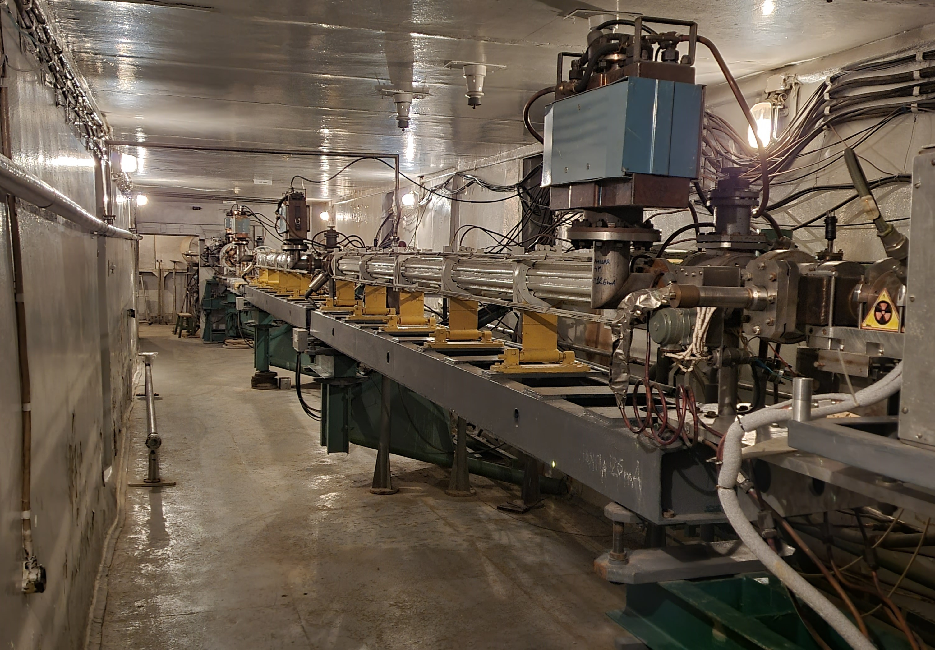
LUE-40 electron linac
Parameter | Mean
Beam energy | 35 … 95 MeV
Energy spread (70% of beam) | < 3 %
Beam current | 70 mA
Angular divergence (90 MeV) | <0.1 mrad
Average beam current | <6 μA
Beam pulse duration | 1.5 μs
Repetition rate | 50 Hz
French-Ukrainian Workshop 29/10/2021 IJCLab

Slide 4
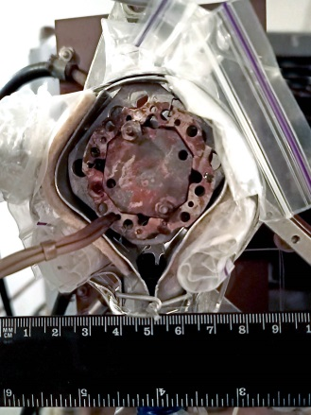
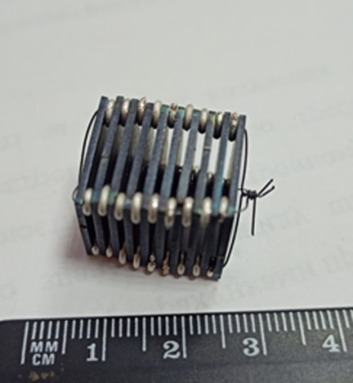
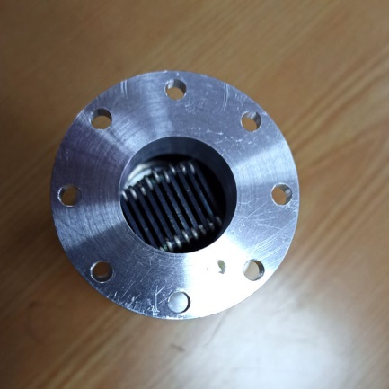
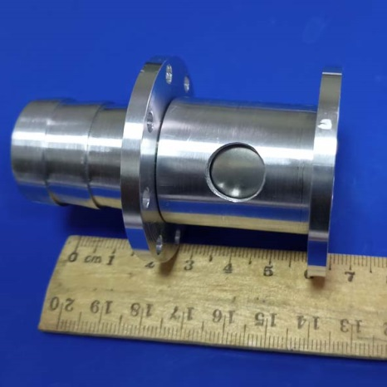
Converter: e⁻ → gamma → neutrons
Energy ∼ 80 MeV
Average beam current ∼ 4.7 μА
Beam size on the converter < 2.7 mm
Exposure time up to 11 h
Electron fluence up to 1.2⋅10¹⁸ е⁻
Converter #1
Tantalum 30x30x1 mm 8 plates
Converter #2
Tungsten 16х16х1 mm 10 plates
French-Ukrainian Workshop 29/10/2021 IJCLab

Slide 5
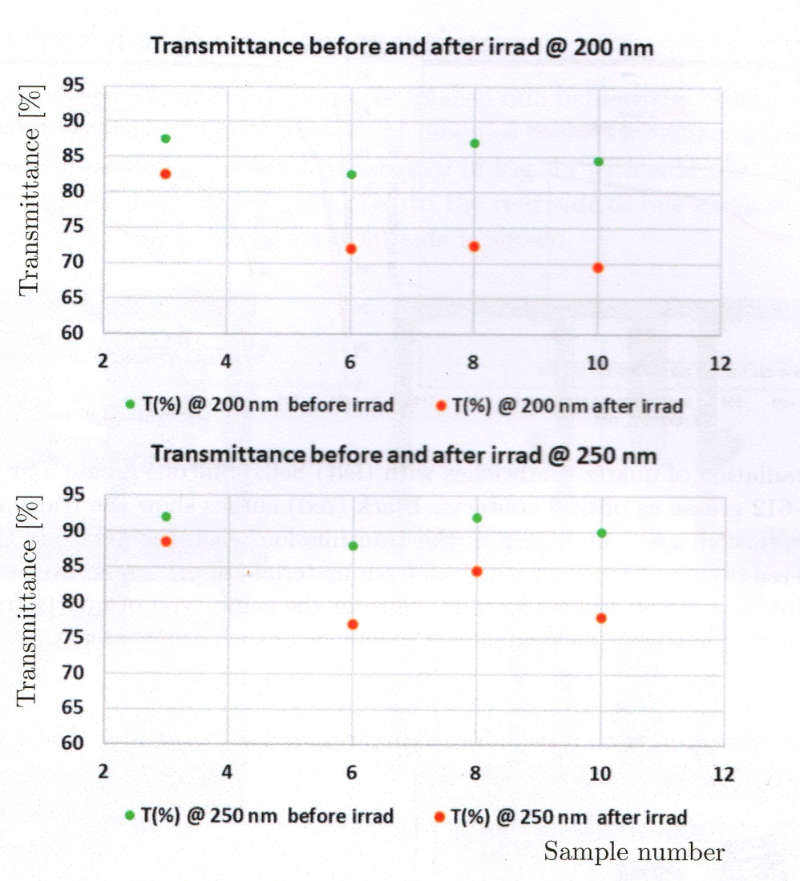
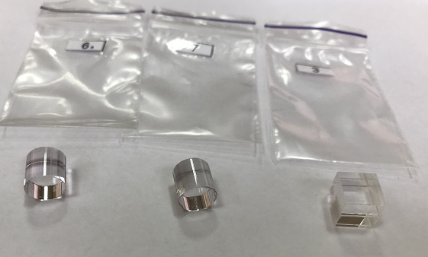
Radiation hardness of the Corning HPFS 7980 quartz
Converter #1
10¹⁴ neutrons/cm²
Transmittance (%) before (green dots) and after (red dots) irradiation of Corning HPFS 7980 quartz tablets at (above) 200 nm and (below) 250 nm. Only shown are the samples (numbers 3, 6, 8 and 10), which correspond to Corning HPFS 7980.
French-Ukrainian Workshop 29/10/2021 IJCLab

Slide 6
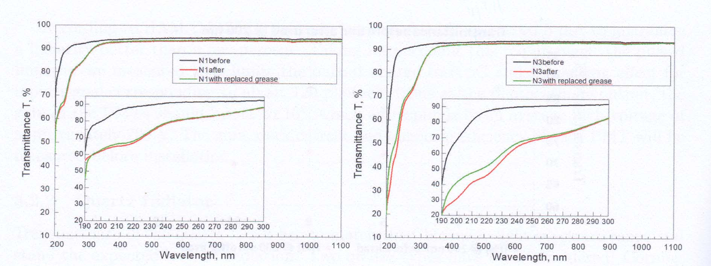
Radiation hardness of the Corning HPFS 7980 quartz
Sandwiches of two quartz plates with optical contact material candidates (grease and glue) have been prepared at ISMA and irradiated at NSC KIPT. The results are shown i for two promising candidates, the Seiko-Silicone Grease TSF451-50M and SilGel-612. Black curves show the transmission before irradiation; red curves show the transmission after irradiation; and green curves show the transmission when the grease in the irradiated sandwiches is removed and replaced with fresh material. The difference between the corresponding green and red curves reflects the effect of radiation-induced degradation of the optical contacts. The Seiko-Silicone Grease TSF451-50M grease is chosen as the baseline candidate for PLUME detector.
French-Ukrainian Workshop 29/10/2021 IJCLab

Slide 7
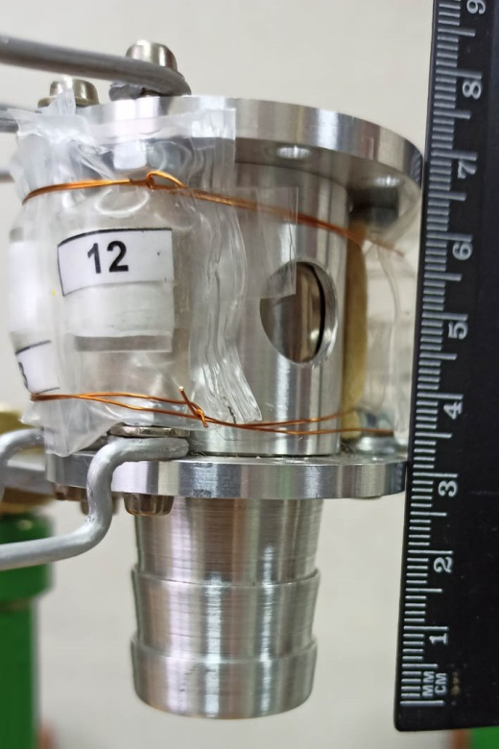
Radiation hardness of the Corning HPFS 7980 quartz
Converter #2
9x10¹⁴ neutrons/cm²
BEAM
Transmittance:
42% at 200nm
37% at 250nm
88% at 300 nm
Quartz - 4 samples
Distance from samples centre to the converter centre is 22 mm
French-Ukrainian Workshop 29/10/2021 IJCLab
Cooling air

Slide 8
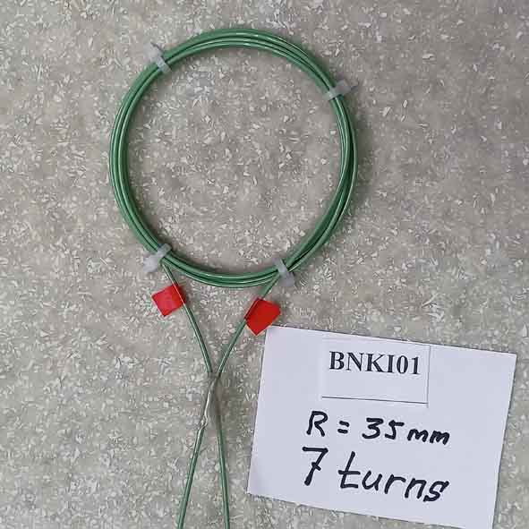
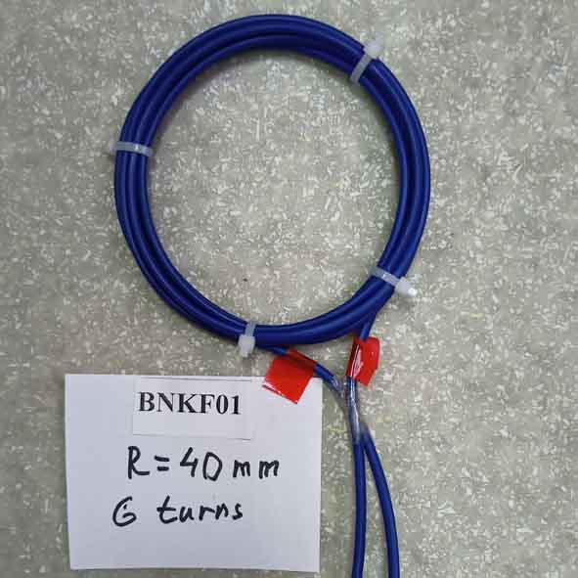
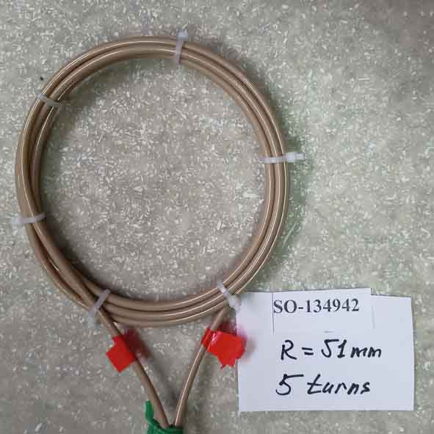
Irradiation of fiber cables
A role of quartz fibers in PLUME is to transport the LED light for the PMT gain monitoring to the PMT window entrance. Close to the PLUME detector units, the fibers need to withstand a fluence of a few 10¹⁴ neutrons/cm² and a gamma dose of several 10 ⁵ Gy. However, only a relatively short length of the fiber is exposed to the harshest level of radiation, and the remaining distance covered receives a much lower dose.
Five fiber samples (FBP, FVP and UVNSS) were irradiated by mixture of gamma and neutrons using LUE-40 linac with converter #2. FBP is low-OH fiber from Polymicro, FVP is high-OH fiber from Polymicro, UVNSS is from OBS fiber and has some additives
FBP050
FBP100
UVNSS
L≈150 cm
French-Ukrainian Workshop 29/10/2021 IJCLab

Slide 9
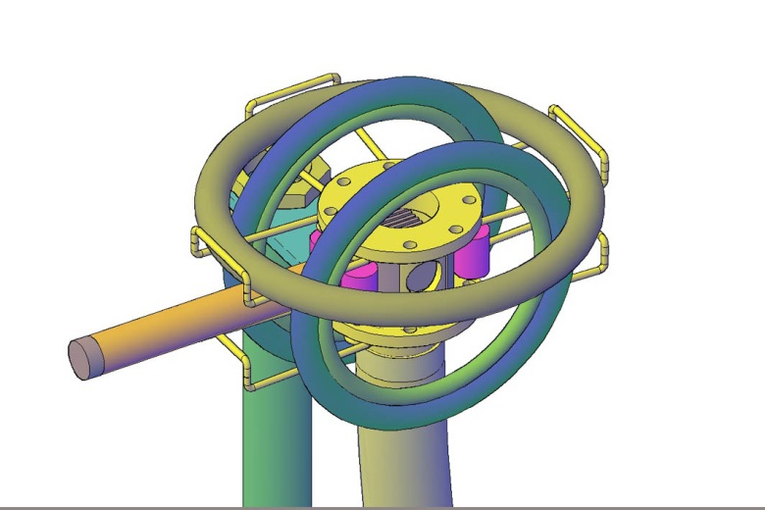
Irradiation of fiber cables
5 fibers, distance to the converter centre:
FBP100 4.4 cm
FVP050 4.4 cm
FBP050 3.9 cm
FVP100 3.9 cm
UVNSS 5.6 cm
PMT input is located at a distance of 27 mm from the converter centre
Converter #2
French-Ukrainian Workshop 29/10/2021 IJCLab

Slide 10
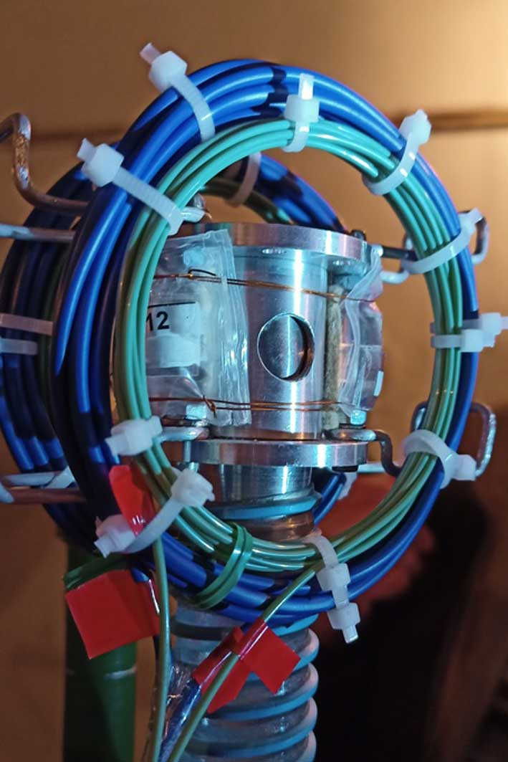
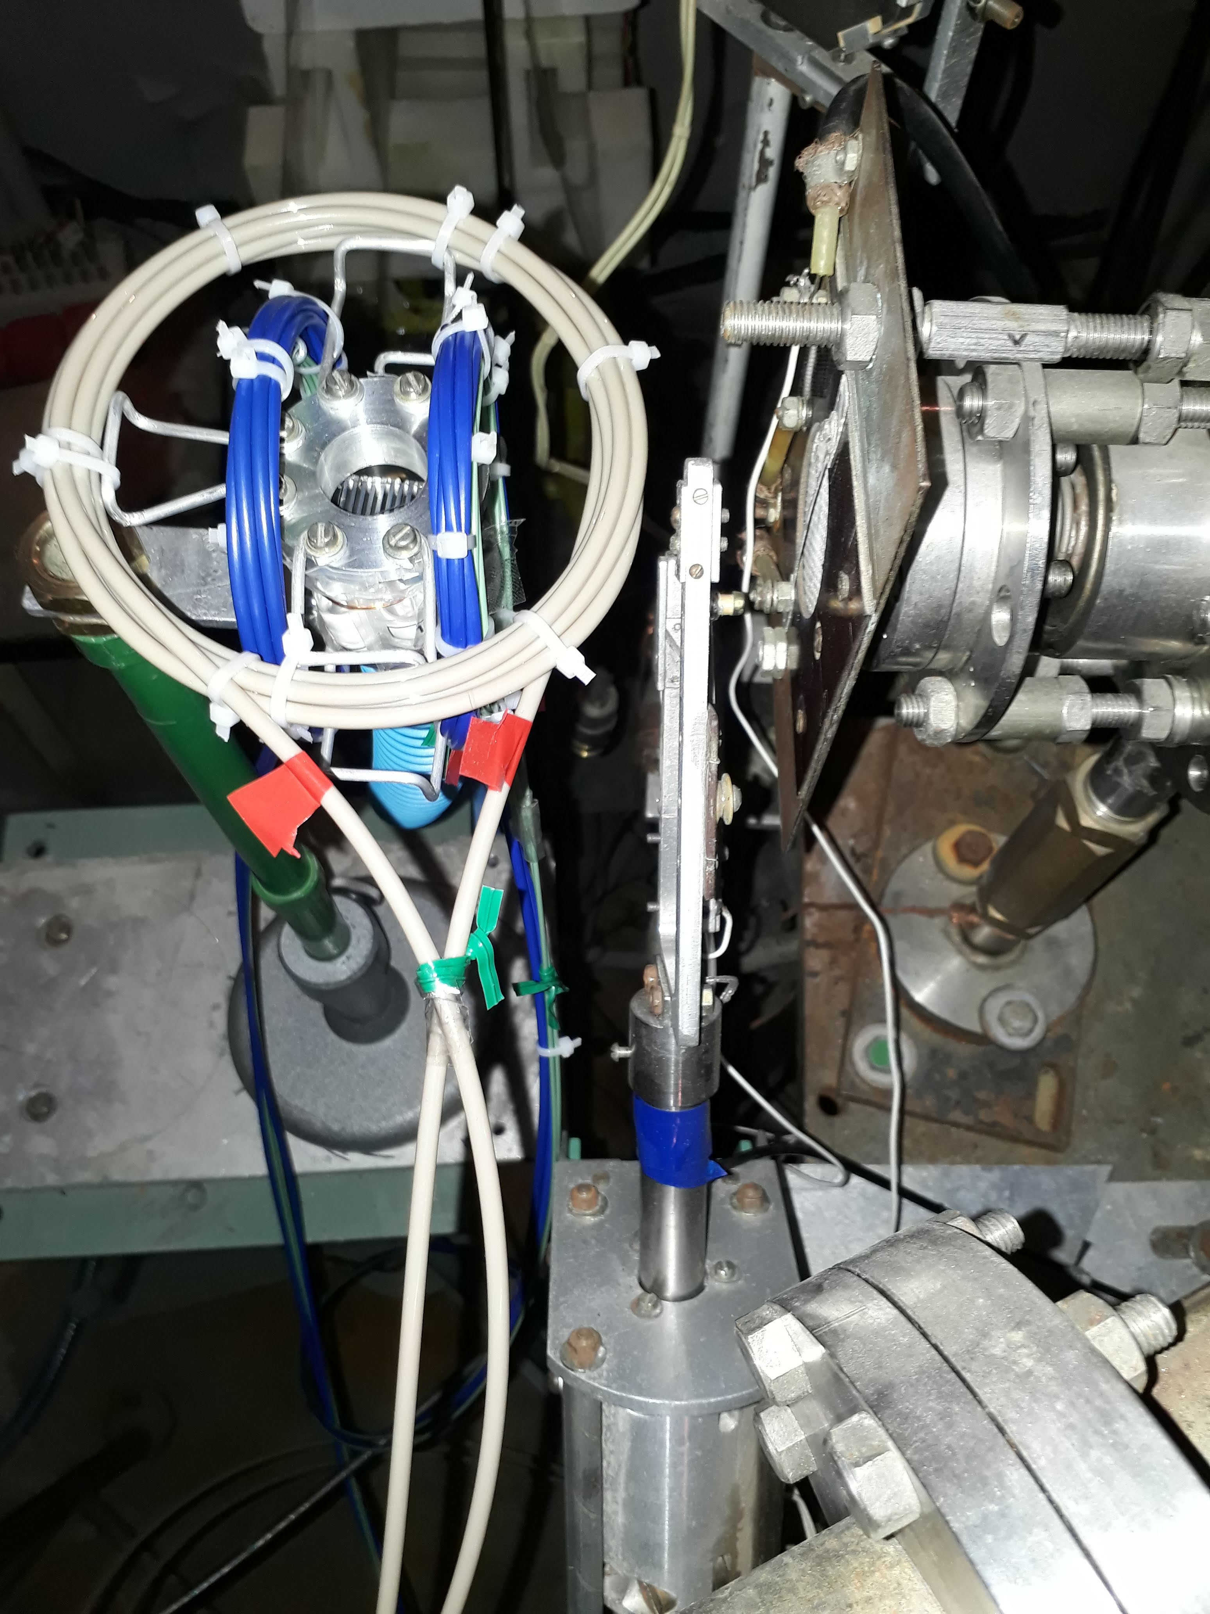
Irradiation of fiber cables
French-Ukrainian Workshop 29/10/2021 IJCLab

Slide 11
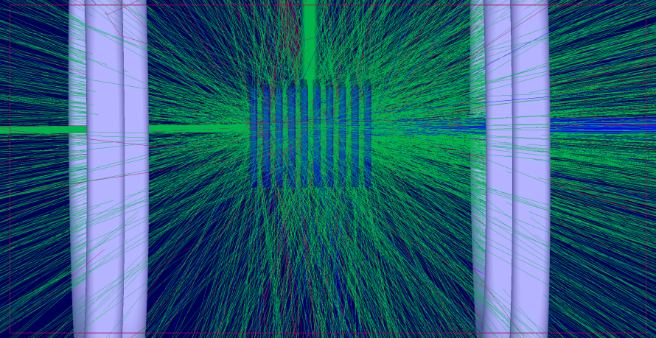
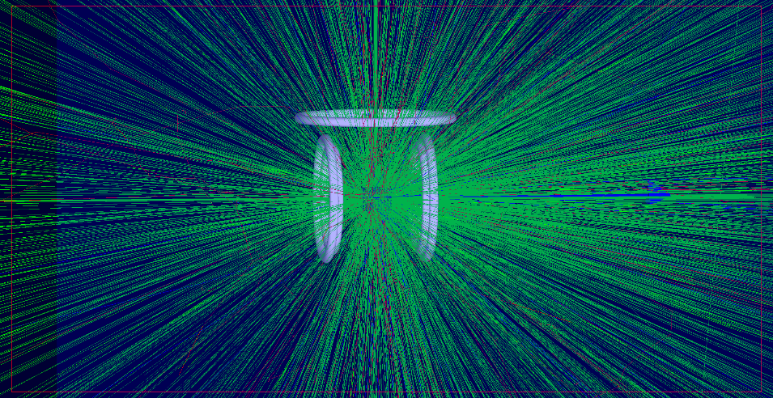
Irradiation of fiber cables
Neutron fluxes and doses
Simulations
Geant4 (V 10.6)
French-Ukrainian Workshop 29/10/2021 IJCLab

Slide 12
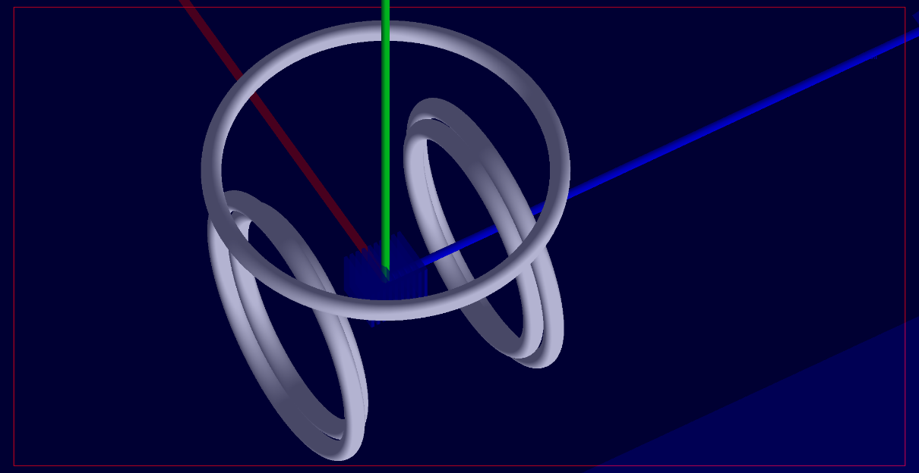
Irradiation of fiber cables
Doses (total – gamma+e-) with aluminum detail of converter
FVP050 - 2.4 ⋅ 10⁵ Gy
FVP100 - 3.99 ⋅ 10⁵ Gy
FBP100 - 6.35⋅ 10⁵ Gy
FBP050 - 8.68 ⋅ 10⁵ Gy
UVNSS - 2.20 ⋅ 10⁵ Gy
FVP050
FVP100
UVNSS
FBP050
FBP100
Neutron fluence -1-2⋅10¹⁴ cm⁻²
The measurements showed that fibers of the both suppliers are acceptable in PLUME. Preference was given to Polymicro. The irradiated section of he FBP100 from Poliymicro gave rise to radiation induced attenuation of 0.50±0.14 dB/m.
French-Ukrainian Workshop 29/10/2021 IJCLab

Slide 13
SUMMARY
Radiation hardness of the Corning HPFS 7980 quartz, several optical contact materials and quartz fibers have been studied at NSC KIPT using the LUE-40 electron accelerator. Measurements have shown that irradiation of the Corning HPFS 7980 quartz by a mixture of gamma and neutrons with doses of gamma ∼ 10⁵Gy and neutron fluence of 9 10¹⁴ neutrons/cm² leads to significant transmittance loss. After irradiation of 42% at 200nm, 37% at 250nm and 88%at 300 nm was measured. However, with neutron fluence of 1 10¹⁴ neutrons/cm² a transmittance loss factor not exceed 18%. As a result of the tests, the optical contact material (the Seiko_Silicon Grease TSF451-50M grease is chosen as the baseline candidate for PLUME detector. Five fibre samples were irradiated by gamma and neutrons (more than 2x10⁵ Gy and 1-2x10¹⁴ neutrons/cm²). The irradiated section of the FBP100 from Poliymicro gave rise to radiation induced attenuation of 0.50±0.14 dB/m. This fibers are acceptable for use in PLUME detector.
French-Ukrainian Workshop 29/10/2021 IJCLab

Slide 14
Thank You for attention
French-Ukrainian Workshop 29/10/2021 IJCLab

