Slide 1
Long-term prospects with a polarized electron beam at Belle II: context and IJClab activities
Aurélien MARTENS

Slide 2
Why ?

Slide 3
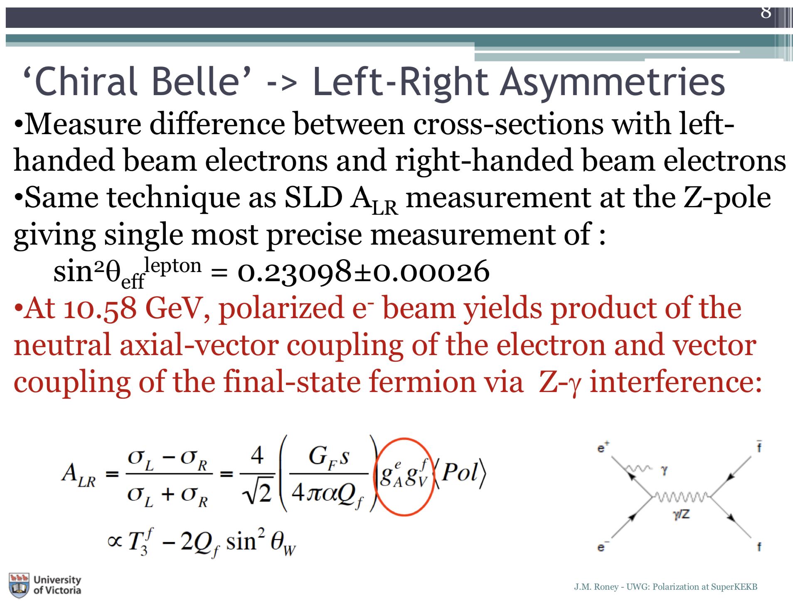
Physics case

Slide 4
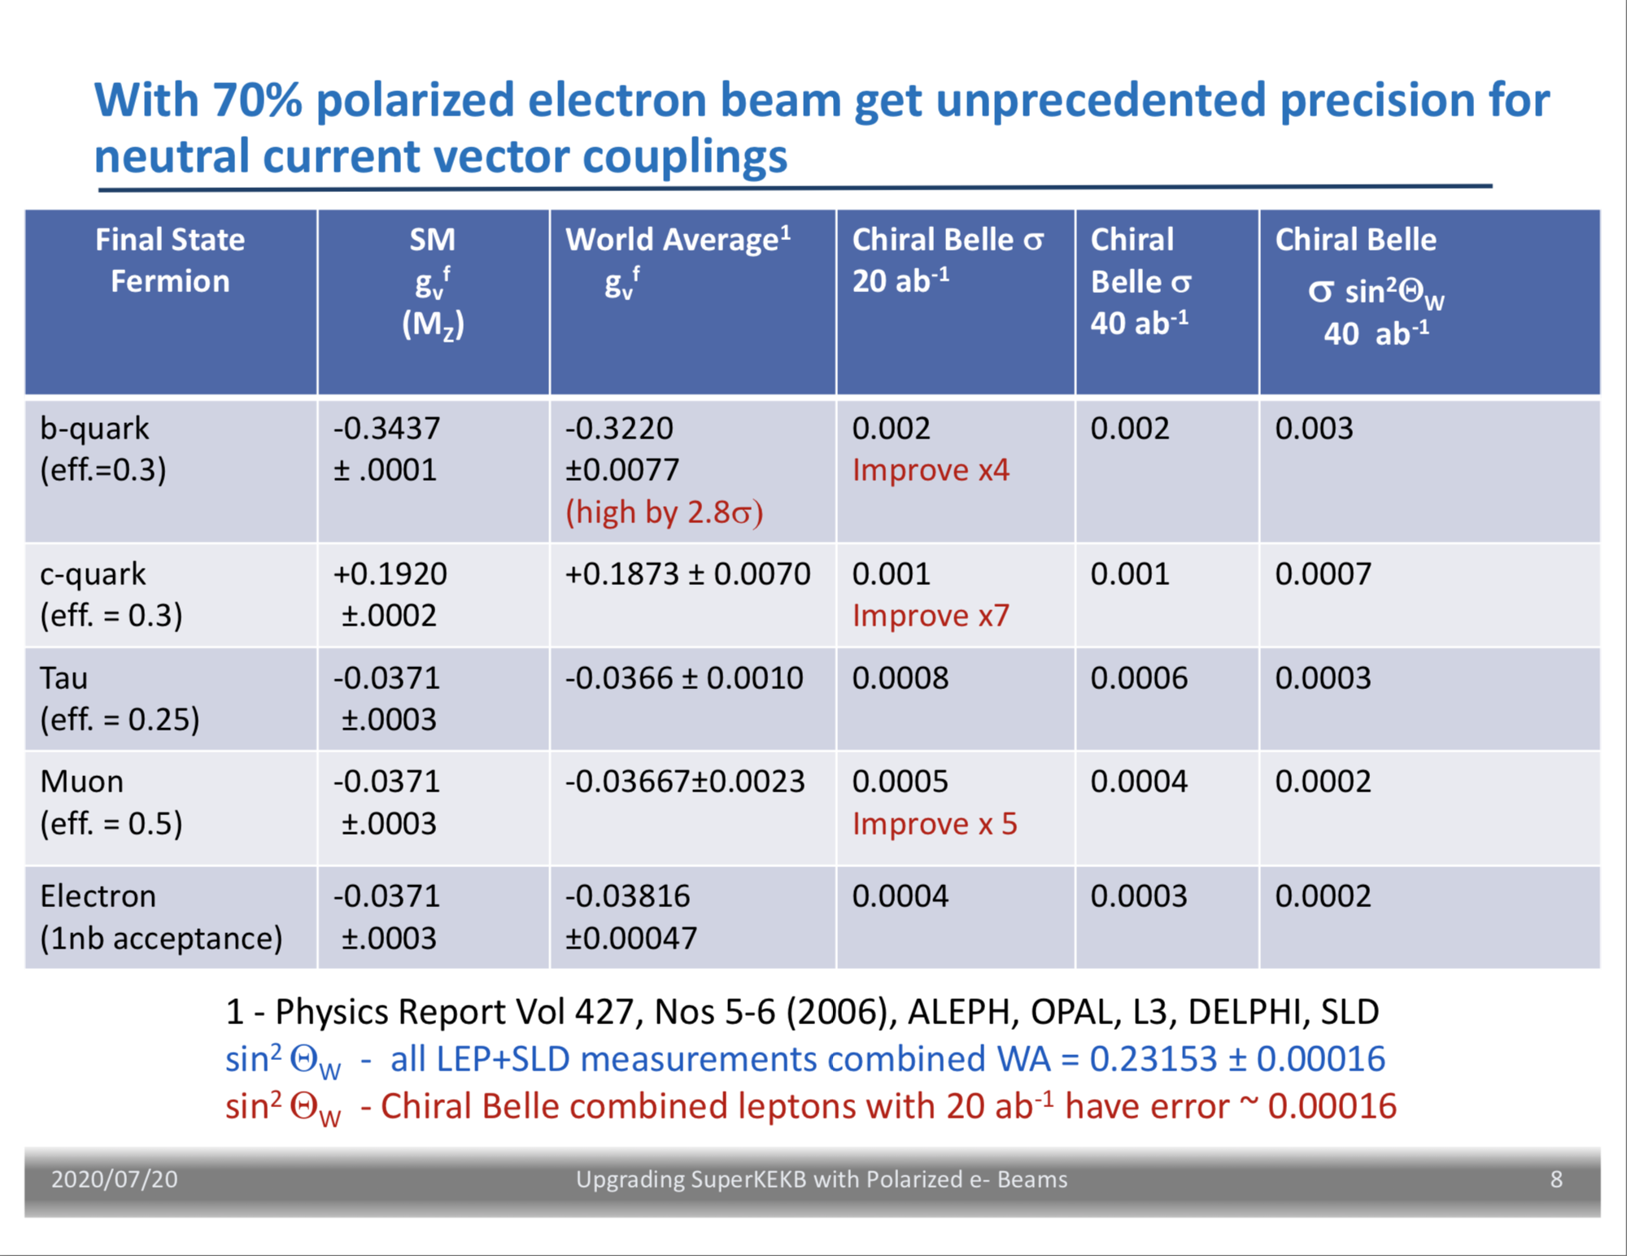
Physics case
More sensitivity compared to EIC: Eur. Phys. J. A 53, 55 (2017)

Slide 5
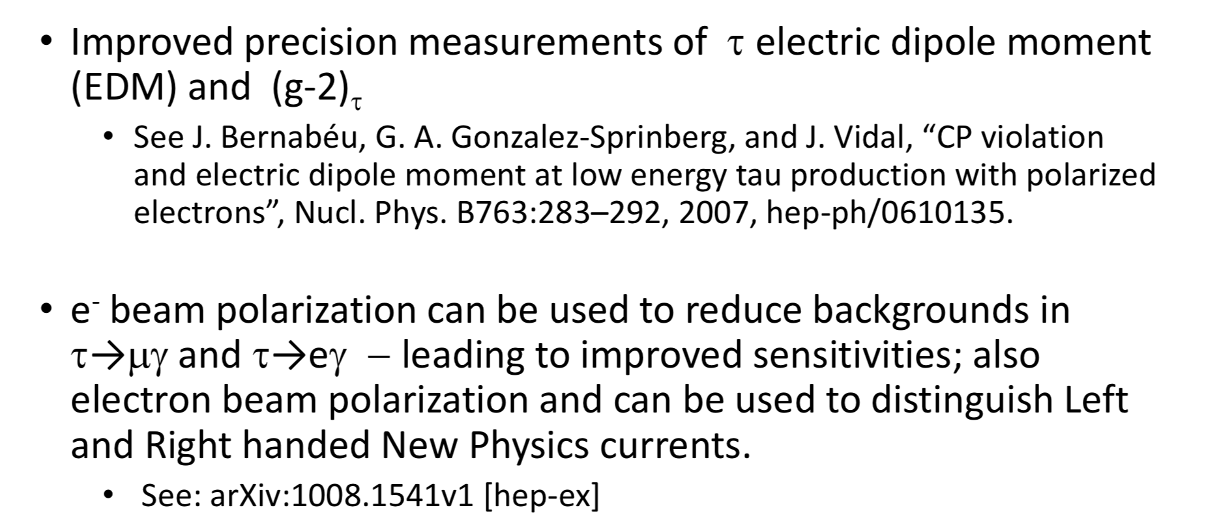
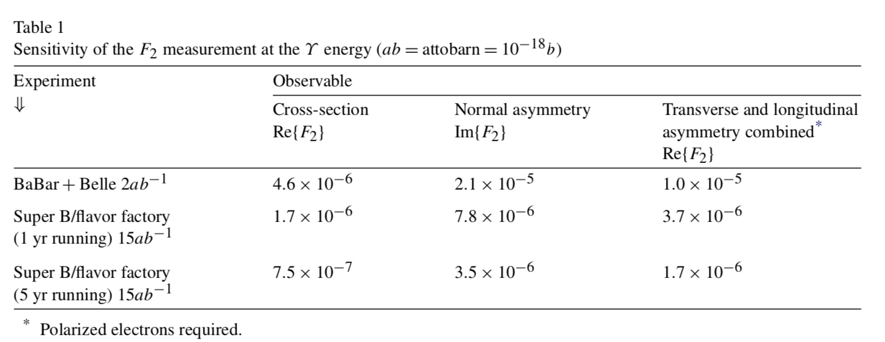
Additional topics
cf. SuperB physics case w/ polarized electrons (1306.5655)
New bosons below ELW scale
Phys. Rev. D 92, 055005
Phys. Rev. D 99, 055016

Slide 6
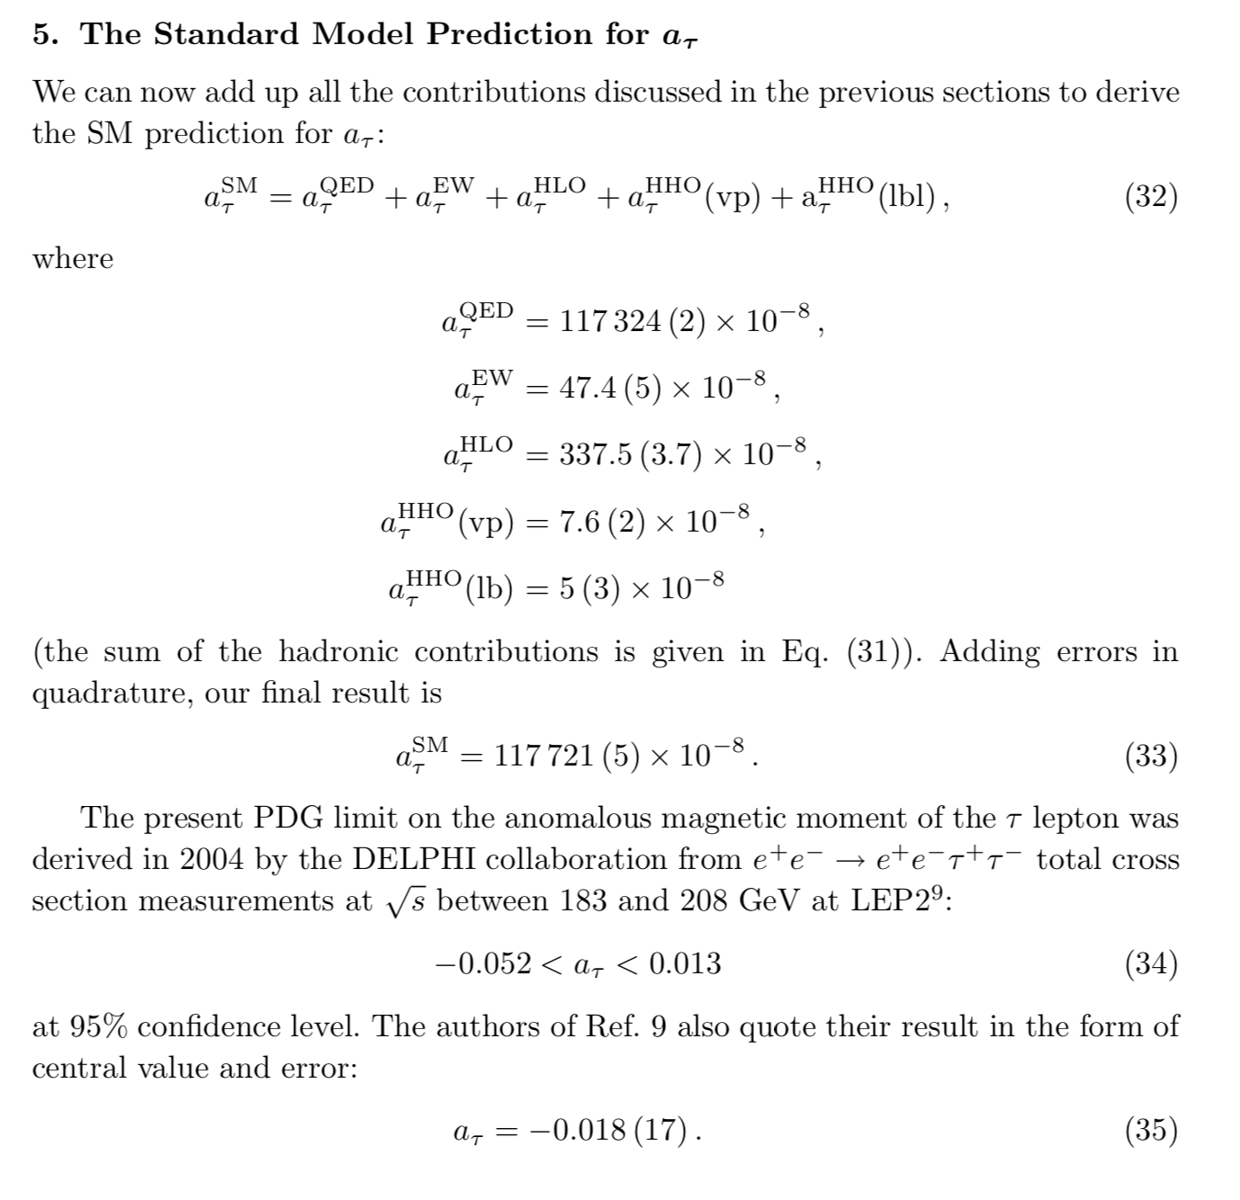
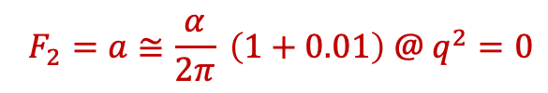
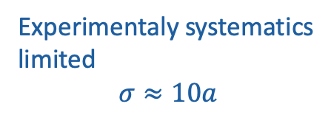
Anomalous magnetic moment in SM
$$F_{2}=a≅\frac{α}{2π} \left(1+0.01\right) @ q^{2}=0$$
S. Eidelman, M. Passera Mod. Phys. Lett. A22 (2007) 159
Experimentaly systematics limited
$$σ≈10a$$

Slide 7
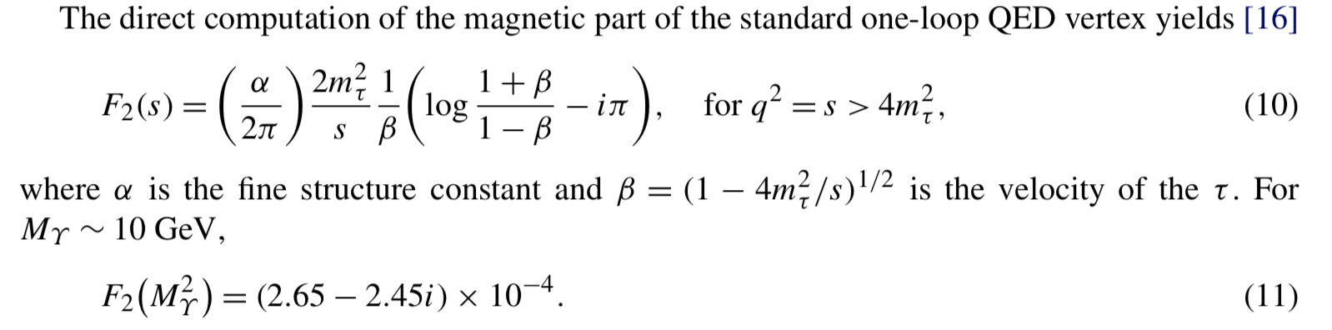
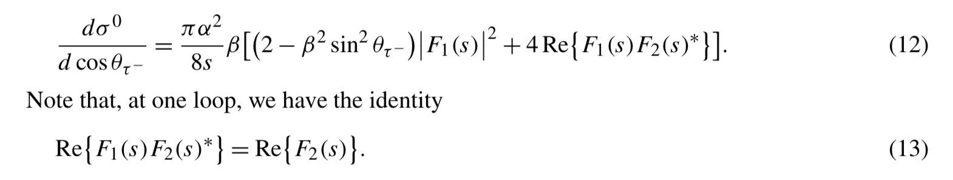
Evolution of F₂
J. Bernabeu et al., Nuclear Physics B 790 (2008) 160–174, Berends, Greco, Altarelli
Z-gamma interference and Box diagrams canceled by averaging tau+/tau- angular disitrubtions
Discussion at 2-loop in Mastrolia et Remiddi, arxiv:0302162

Slide 8
How ?

Slide 9
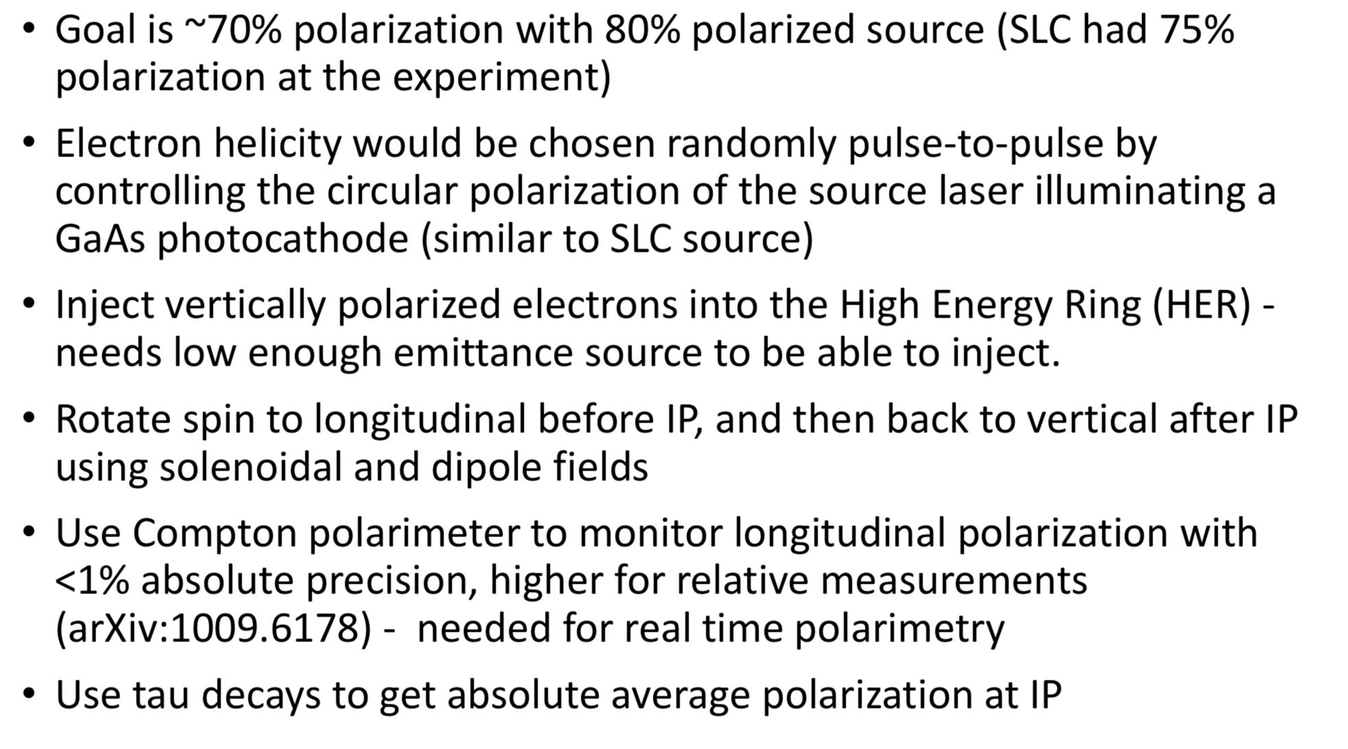
Upgrade contents

Slide 10
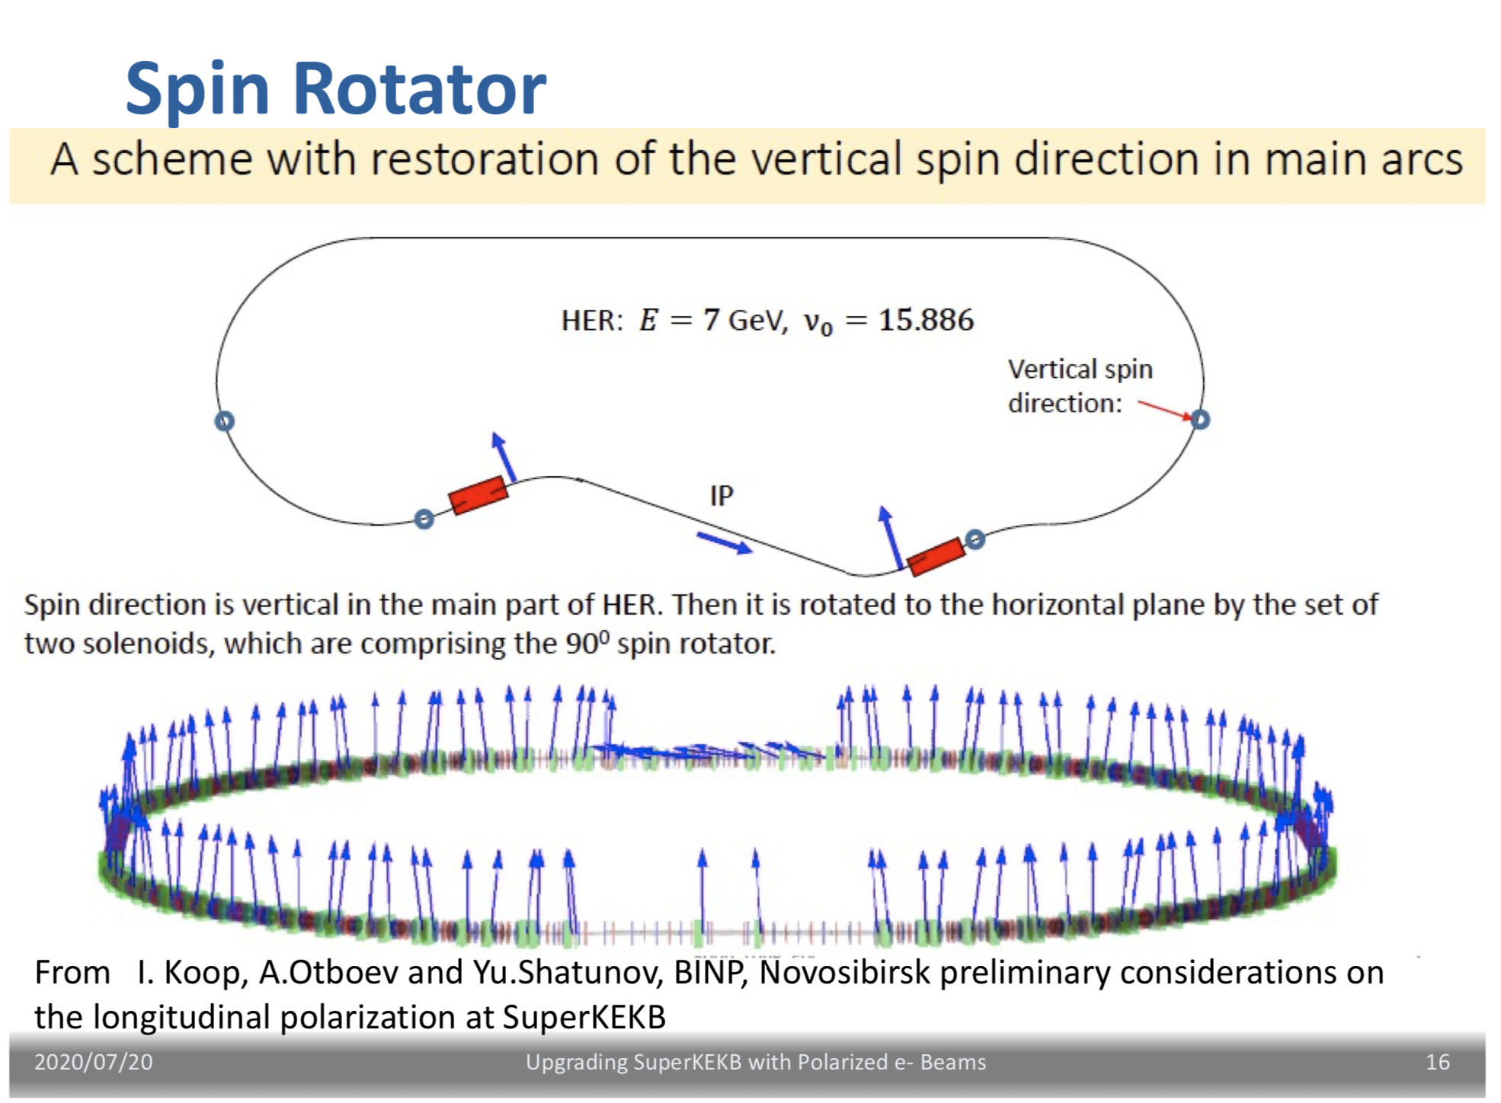

Slide 11

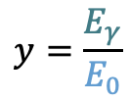
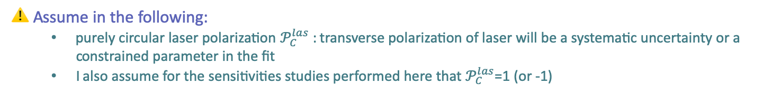
Compton cross-section
$$x=\frac{2E_{0}ω_{0}}{m^{2}}\left(1+\cos{θ_{0}}\right)$$
$$y=\frac{E_{γ}}{E_{0}}$$
The Compton cross-section averaged over scattered particles spins:
Differential cross-section
Transverse laser polarisation: nuisance parameter to minimize and keep under control
Transverse electron beam polarisation: intervenes as an asymmetry in the transverse plane
$$\frac{dσ}{dydφ_{obs}}\left(x,y\right)=\frac{dσ_{0}}{dy}\left(x,y\right)+\frac{dσ_{⊥}}{dy}\left(x,y\right)\cos\left(2\left(φ_{obs}−φ_{las}\right)\right)𝒫_{⊥}^{las}+\frac{dσ_{∥}}{dy}\left(x,y\right)𝒫_{C}^{las}(P_{T}f_{T}\left(x,y\right)\cos\left(φ_{obs}−φ_{elec}\right)+P_{L}f_{L}(x,y))$$
Electron beam polarization independent
Electron beam polarization dependent
⚠️ Assume in the following:
  purely circular laser polarization $𝒫_{C}^{las}$ : transverse polarization of laser will be a systematic uncertainty or a constrained parameter in the fit
  I also assume for the sensitivities studies performed here that $𝒫_{C}^{las}$=1 (or -1)

Slide 12
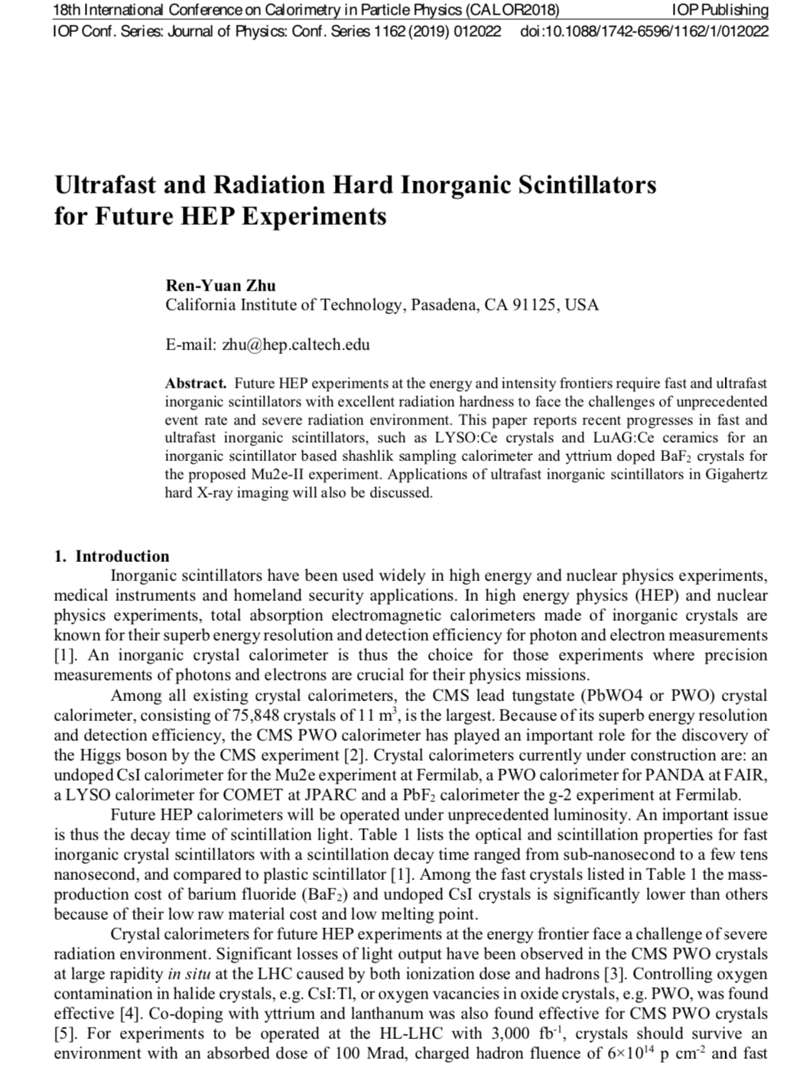
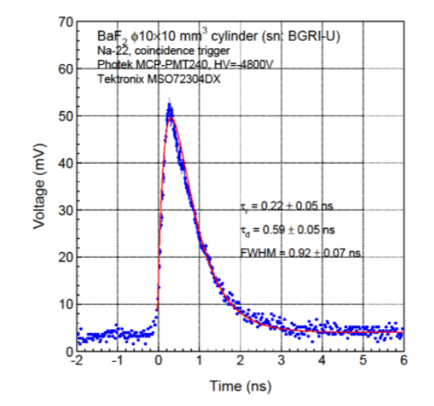
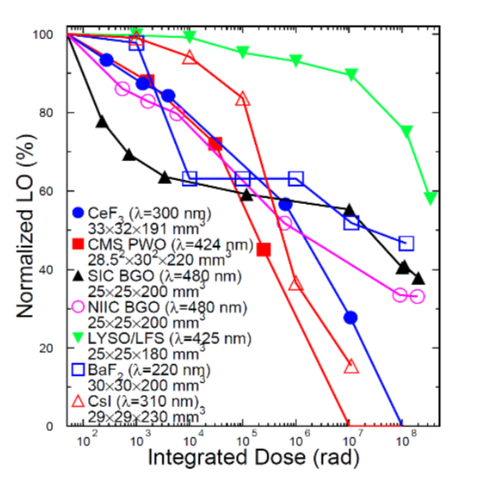
Basic idea of photon detector
Basic elements
  a VERY FAST (4ns bunch spacing) radhard scintillating crystal → BaF2, the only solution ?
    Need to filter out the slow component
    ☺ Interesting: Y doping reduces the slow component, but is it commercially available ?
  a PMT with low transit time dispersion AND solar blind → commercially available ?
  Associated electronics

Slide 13
Conclusion
Interesting prospects for polarizing electrons in SuperKEKB
  Extends physics case of Belle II
  Challenge: preserve high lumi and high polarization at IP
Design is progressing towards White Report (Snowmass document)
IJCLab contributes to Compton polarimetry and tau physics studies

Slide 14
backup

Slide 15
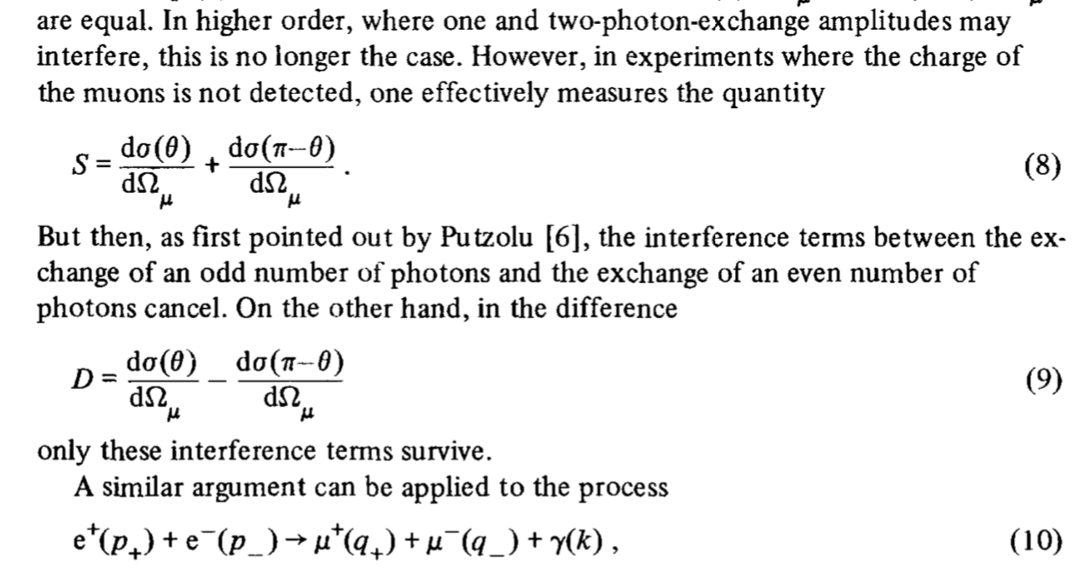
Charge-symmetric measurement
Topic studied in a series of papers by Berends et al., Greco et al, Altarelli et al. In the 70’s right before and after J/Psi discovery.
It applies to :
ISR/FSR interference (even after exponentiation)
Born/Box interference

Slide 16
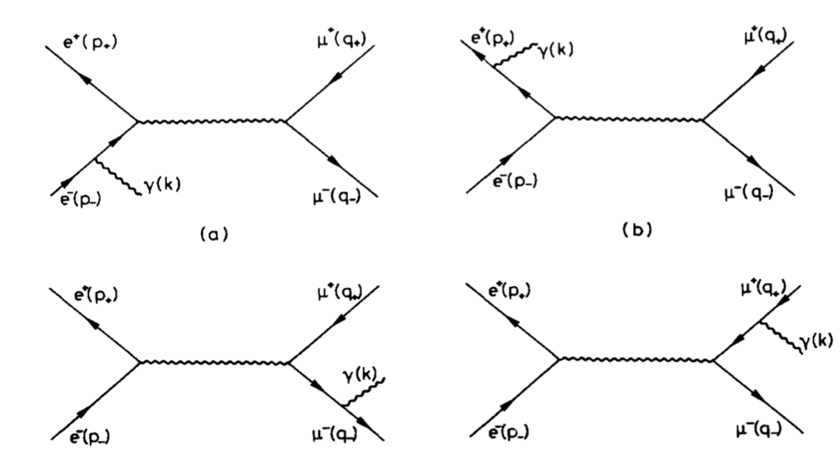
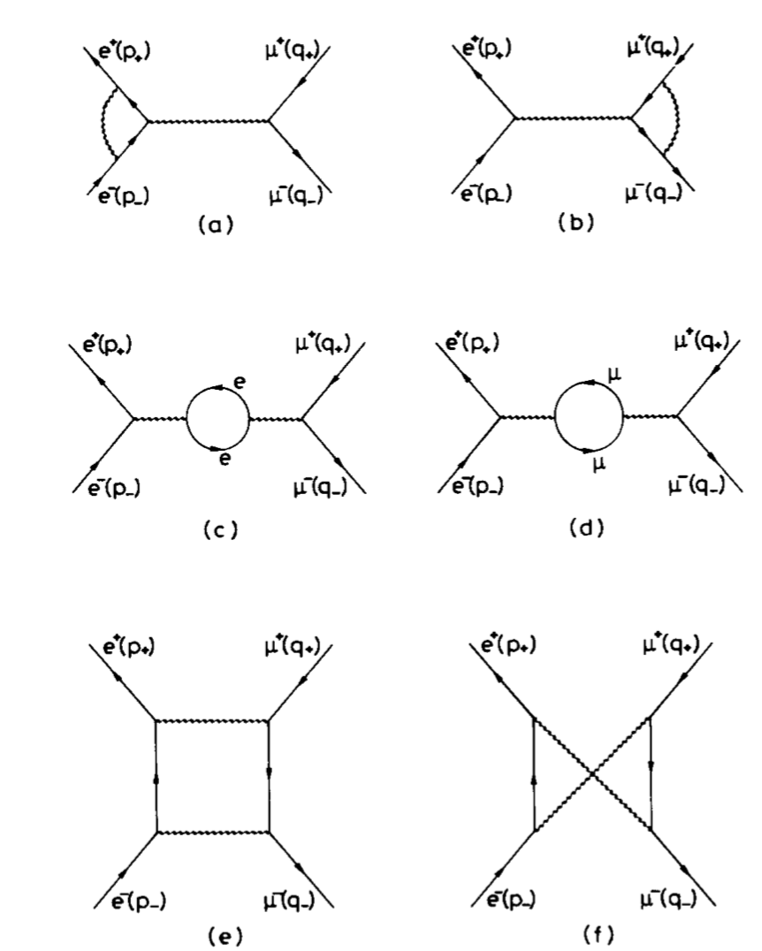
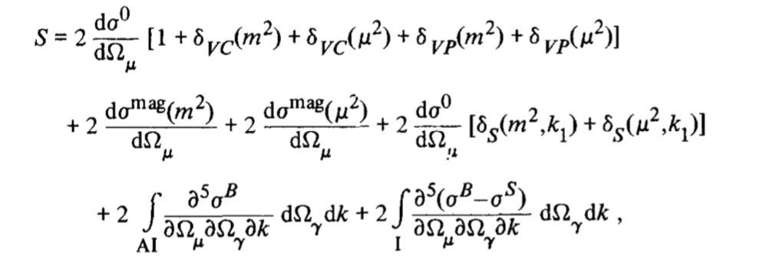
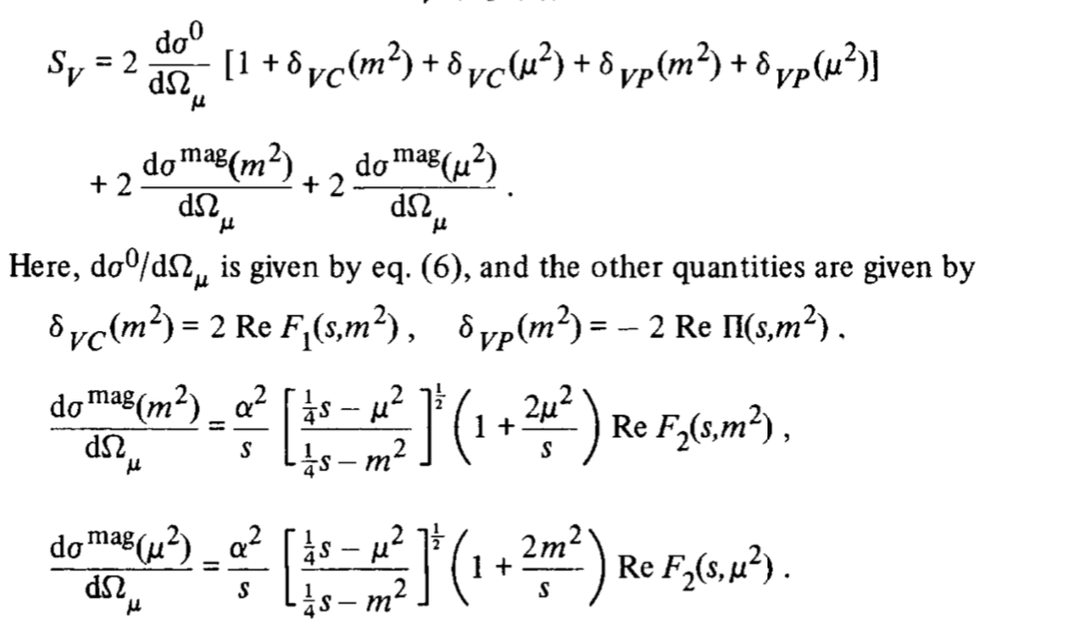
NLO summary
Angular structure is preserved up to NNLO
Hard photon emission to be evaluated numerically

Slide 17
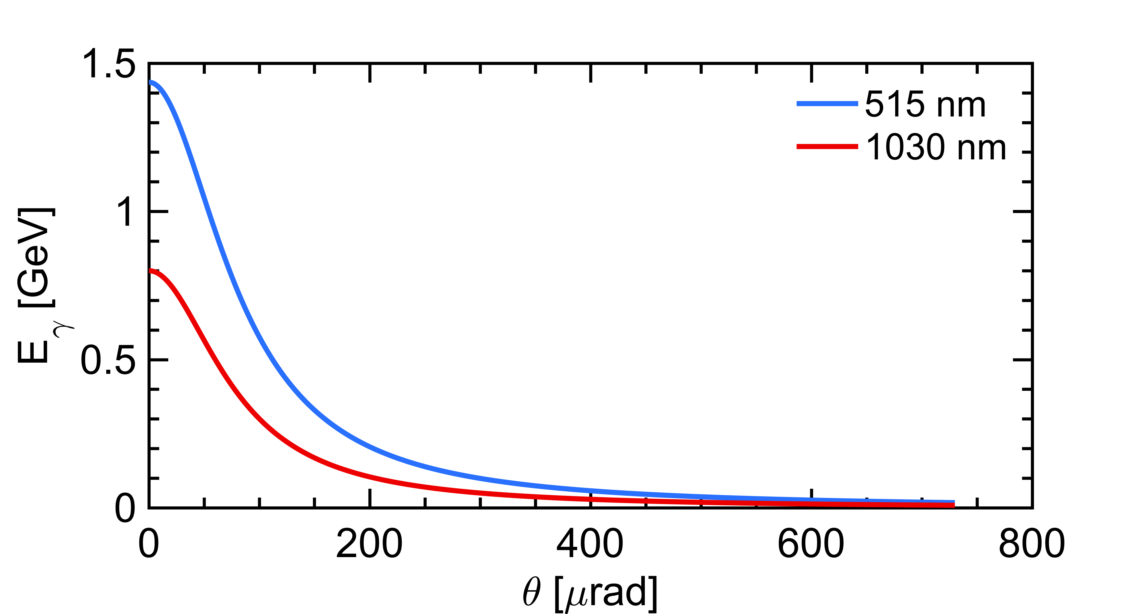


A first look at the unpolarized term
laser (E_{λ})
Initial electron energy (7 GeV)
Initial photon energy (1.2eV at 1030nm)
Crossing angle of beams
Emitted photon energy
$$θ_{0}$$
θ
e⁻ beam $Ee$
energy vs emission angle correlation
Landau-Lifshitz QED book paragaphs 86 and 87
Conical emission:
98% of photons within 730𝜇rad
⚠️ Remember:
  Photons (electrons too) are scatterred in the forward direction, in a narrow cone around the electron beam axis
  I further implicitely assume that detection of photons require to clear a line of sight of about L=30m

Slide 18
Basic idea of detector
Basic elements
  a VERY FAST radhard scintillating crystal → BaF2, the only solution ?
    Need to filter out the slow component
    ☺ Interesting: Y doping reduces the slow component, but is it commercially available ?
  a PMT with low transit time dispersion AND solar blind → commercially available ?
  Associated electronics
…
2500 bunches → 2500 histograms
About 1000 bins each (or less ?)
12 bits dynamics ?
30Mb (3.75MB) to transfer every minute
Two options
  Embarked ADC and data processing in the accelerator bay w/transfer link to storage, needs clock (laser also needs it) and bunch identification
  Deported electronics ‘à la’ lumi Belle II with diamonds ?

Slide 19
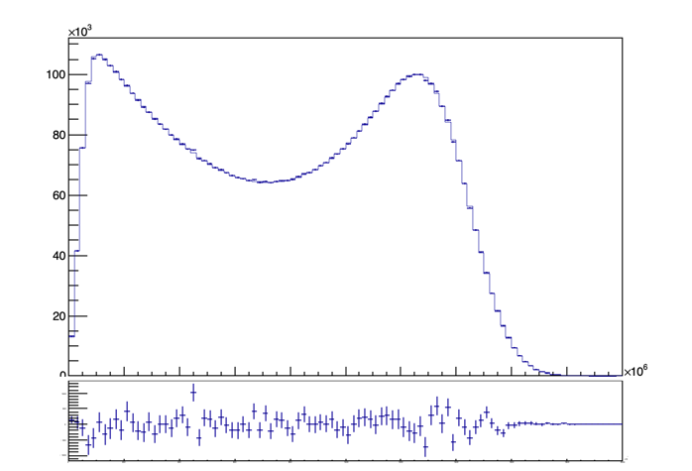
Example of simulation
Stage M1: Farah Mawas
Perfectly aligned, calibrated, known average beam energy, known e-beam phase-space parameters
Chi2=101
Ndf = 98
6M entries (1minute data taking)

Slide 20
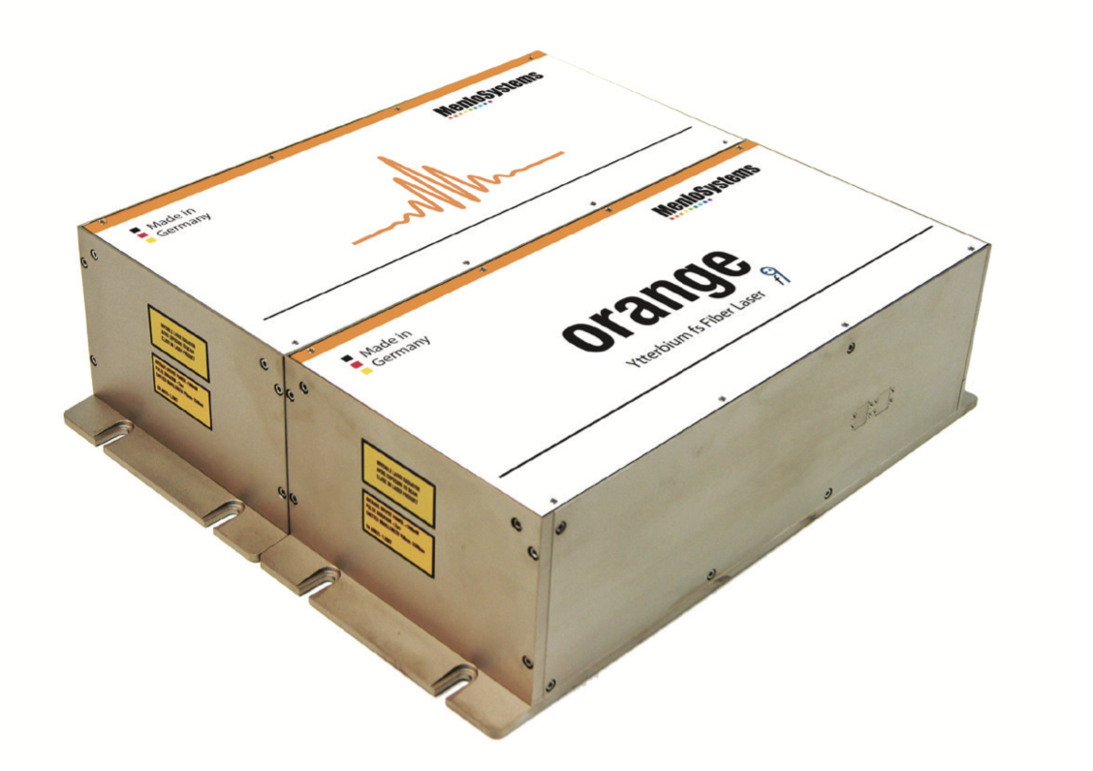
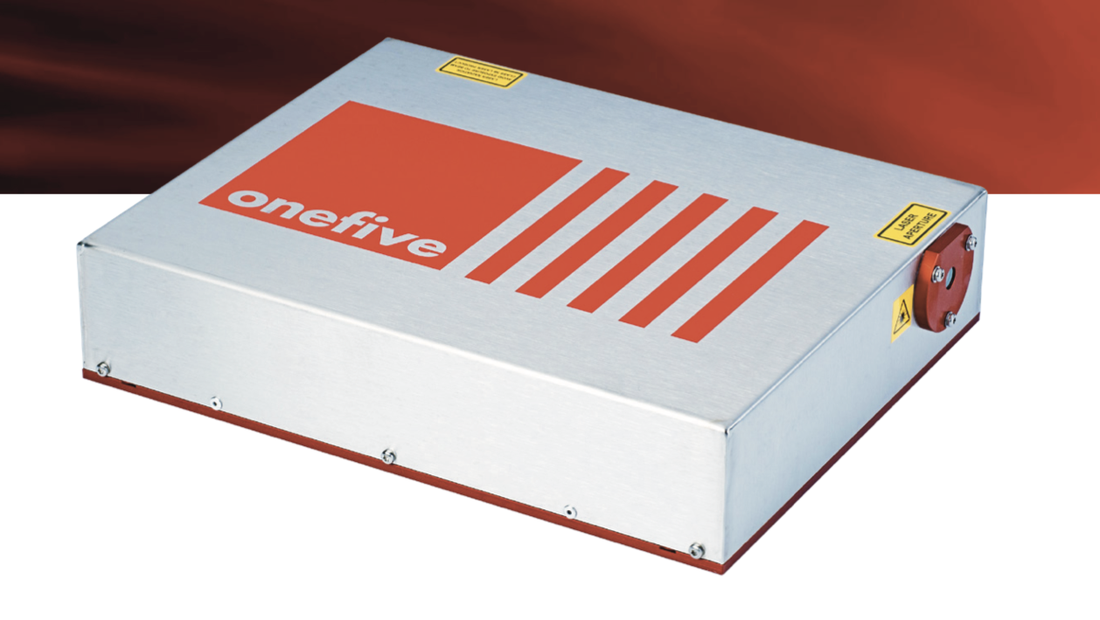
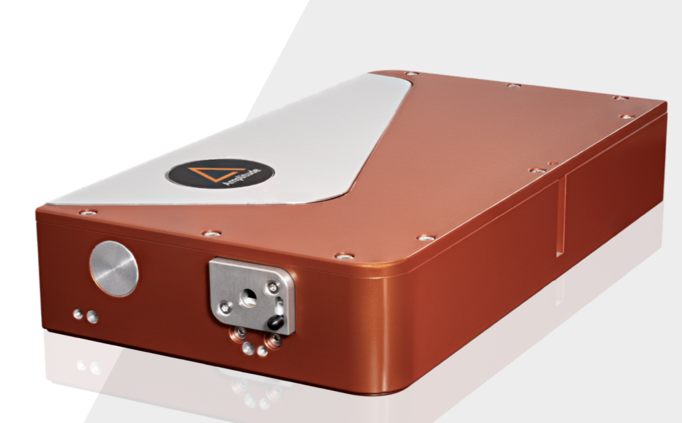

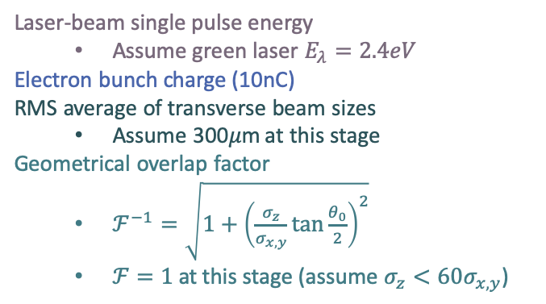
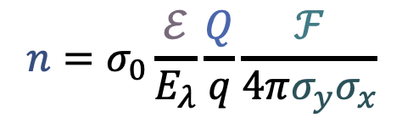
Laser system design
Laser-beam single pulse energy
  Assume green laser $E_{λ}=2.4eV$
Electron bunch charge (10nC)
RMS average of transverse beam sizes
  Assume 300𝜇m at this stage
Geometrical overlap factor
  $ℱ^{−1}=\sqrt{1+{\left(\frac{σ_{z}}{σ_{x,y}}\tan{\frac{θ_{0}}{2}}\right)}^{2}}$
  $ℱ=1$ at this stage (assume $σ_{z}<60σ_{x,y}$)
$$n=σ_{0}\frac{ℰ}{E_{λ}}\frac{Q}{q}\frac{ℱ}{4π{σ_{y}σ}_{x}}$$
Photon rate
A few Watts green laser @ 250MHz provides about 2.5 photons in average per bunch crossing
www.menlosystems.com, www.amplitude-laser.com, www.nktphotonics.com, www.afs-jena.de
Many commercial products:
laser oscillator + small amplifier

Slide 21
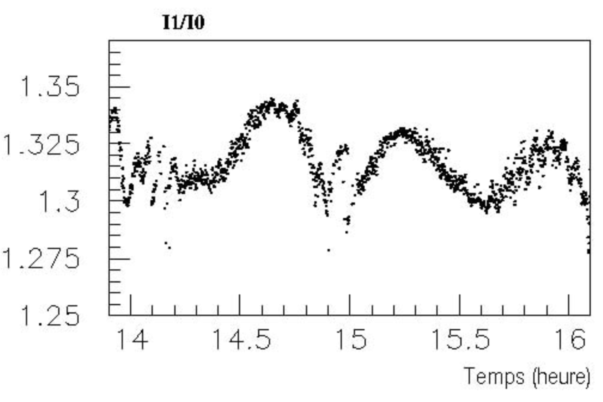
Laser diagnostics R&D
PDe
Thermalized electronics
IP
QWP2
PD2
LASER
GLAN
Beam transport
Beam transport
HBS
Wollaston
PD1
QWP
PDi
Polarisation independent Holographic Beam Sampler
Careful suppression of laser intensity fluctuations
Use of balanced photodiodes and differential electronics
Brisson JINST 5 P06006 (2010), Zomer HDR (2003), Jacquet HDR (2009), Baudrand PhD thesis (2007)
Example of measurements @ HERA
Temporal fluctuations → precision 0.3% (HERA)
More frequent measurements ?
Modulation of circular polarisation to avoid DC fluctuations ?
R&D required to improve/ease operations

Slide 22
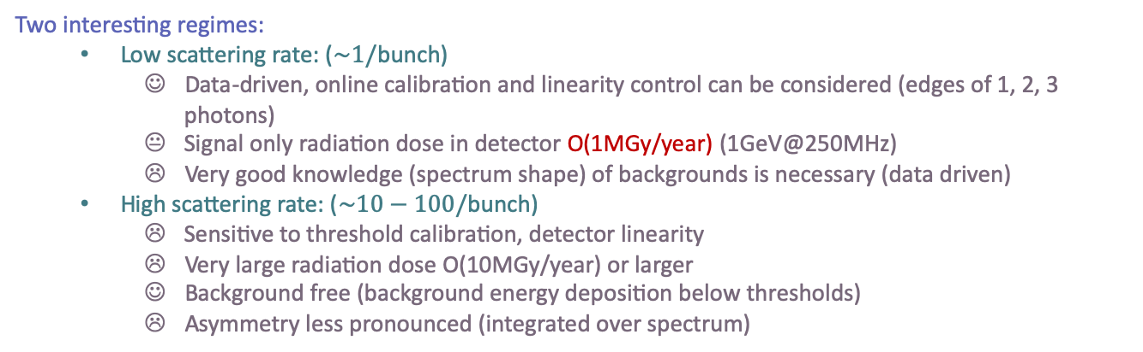
Detection of photons: requirements
Energy of photons (~1GeV) in a narrow cone
Distinguish each bunch at 250MHz (4ns)
Two interesting regimes:
  Low scattering rate: ($\sim 1/$bunch)
    Data-driven, online calibration and linearity control can be considered (edges of 1, 2, 3 photons)
    Signal only radiation dose in detector O(1MGy/year) (1GeV@250MHz)
    Very good knowledge (spectrum shape) of backgrounds is necessary (data driven)
  High scattering rate: ($\sim 10−100/$bunch)
    Sensitive to threshold calibration, detector linearity
    Very large radiation dose O(10MGy/year) or larger
    Background free (background energy deposition below thresholds)
    Asymmetry less pronounced (integrated over spectrum)
Concentrate on this strategy

Slide 23
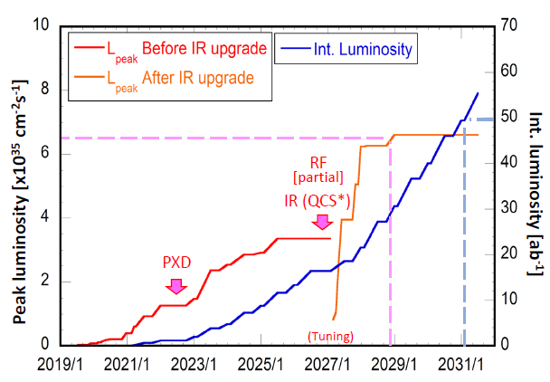
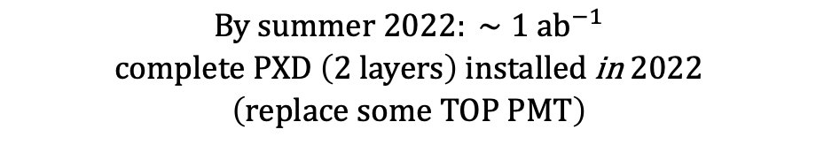

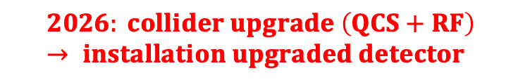
Timeline
Polarization upgrade discussed in the KEK Roadmap document
Aim at installation for 2026
$$\begin{matrix}By summer 2022: ∼1 {ab}^{−1} \\ complete PXD \left(2 layers\right) installed \text{in} 2022 \\ \left(replace some TOP PMT\right)\end{matrix}$$
$$2026: collider upgrade \left(QCS+RF\right) → installation upgraded detector$$
$$2031: 50 {ab}^{−1}$$

Slide 24
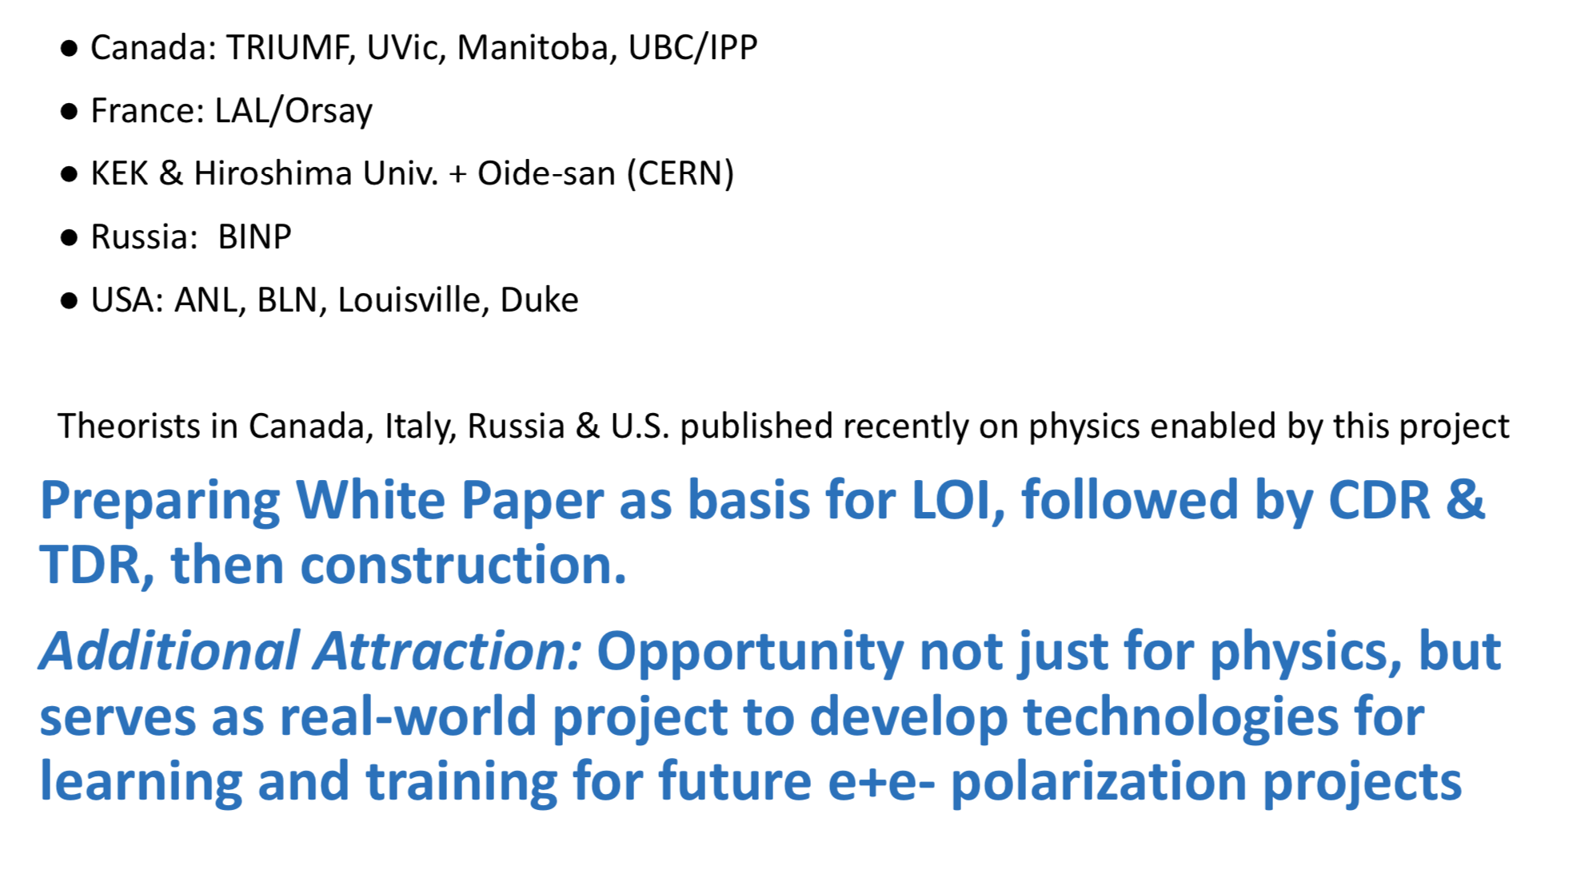
The collaboration
Lead by Mike Roney (UVic)
←→ Already receiving founds to start R&D
IJCLab Orsay
(KEK)
Phys.Rev. D101 (2020) no.5, 053003
Phys. Atom. Nucl. 83, no.2, 307-333 (2020)
M. Roney @ ICHEP20, LeptonPhoton19
In-line with Snowmass process
Snowmass contribution
ESPP Belle2 contribution
Canadian strategic plan

Slide 25
Laser-beam ellipsometry
PDe
IP
QWP2
PD2
LASER
GLAN
Beam transport
Beam transport
HBS
Wollaston
PD1
QWP
PDi
Minimal optical components to generate (pure) circular laser beam polarisation
Poirson et al. Applied Optics 34 6806 (1995), Brisson JINST 5 P06006 (2010), Zomer HDR (2003), Jacquet HDR (2009), Baudrand PhD thesis (2007)
Residual wrong polarisation vs tilt angle
About 1 per mille wrong polarisation
Extremely difficult to remove wrong polarisation <0.1%
Fine modeling of beam transport is required

Slide 26
A journey into the form factors of the 𝜏-vertex: could we measure the 𝜏 (g-2) with Belle II ?
Aurélien MARTENS (IJCLab)

Slide 27
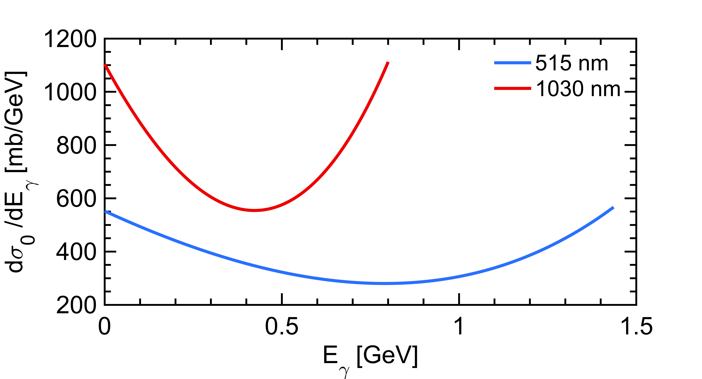
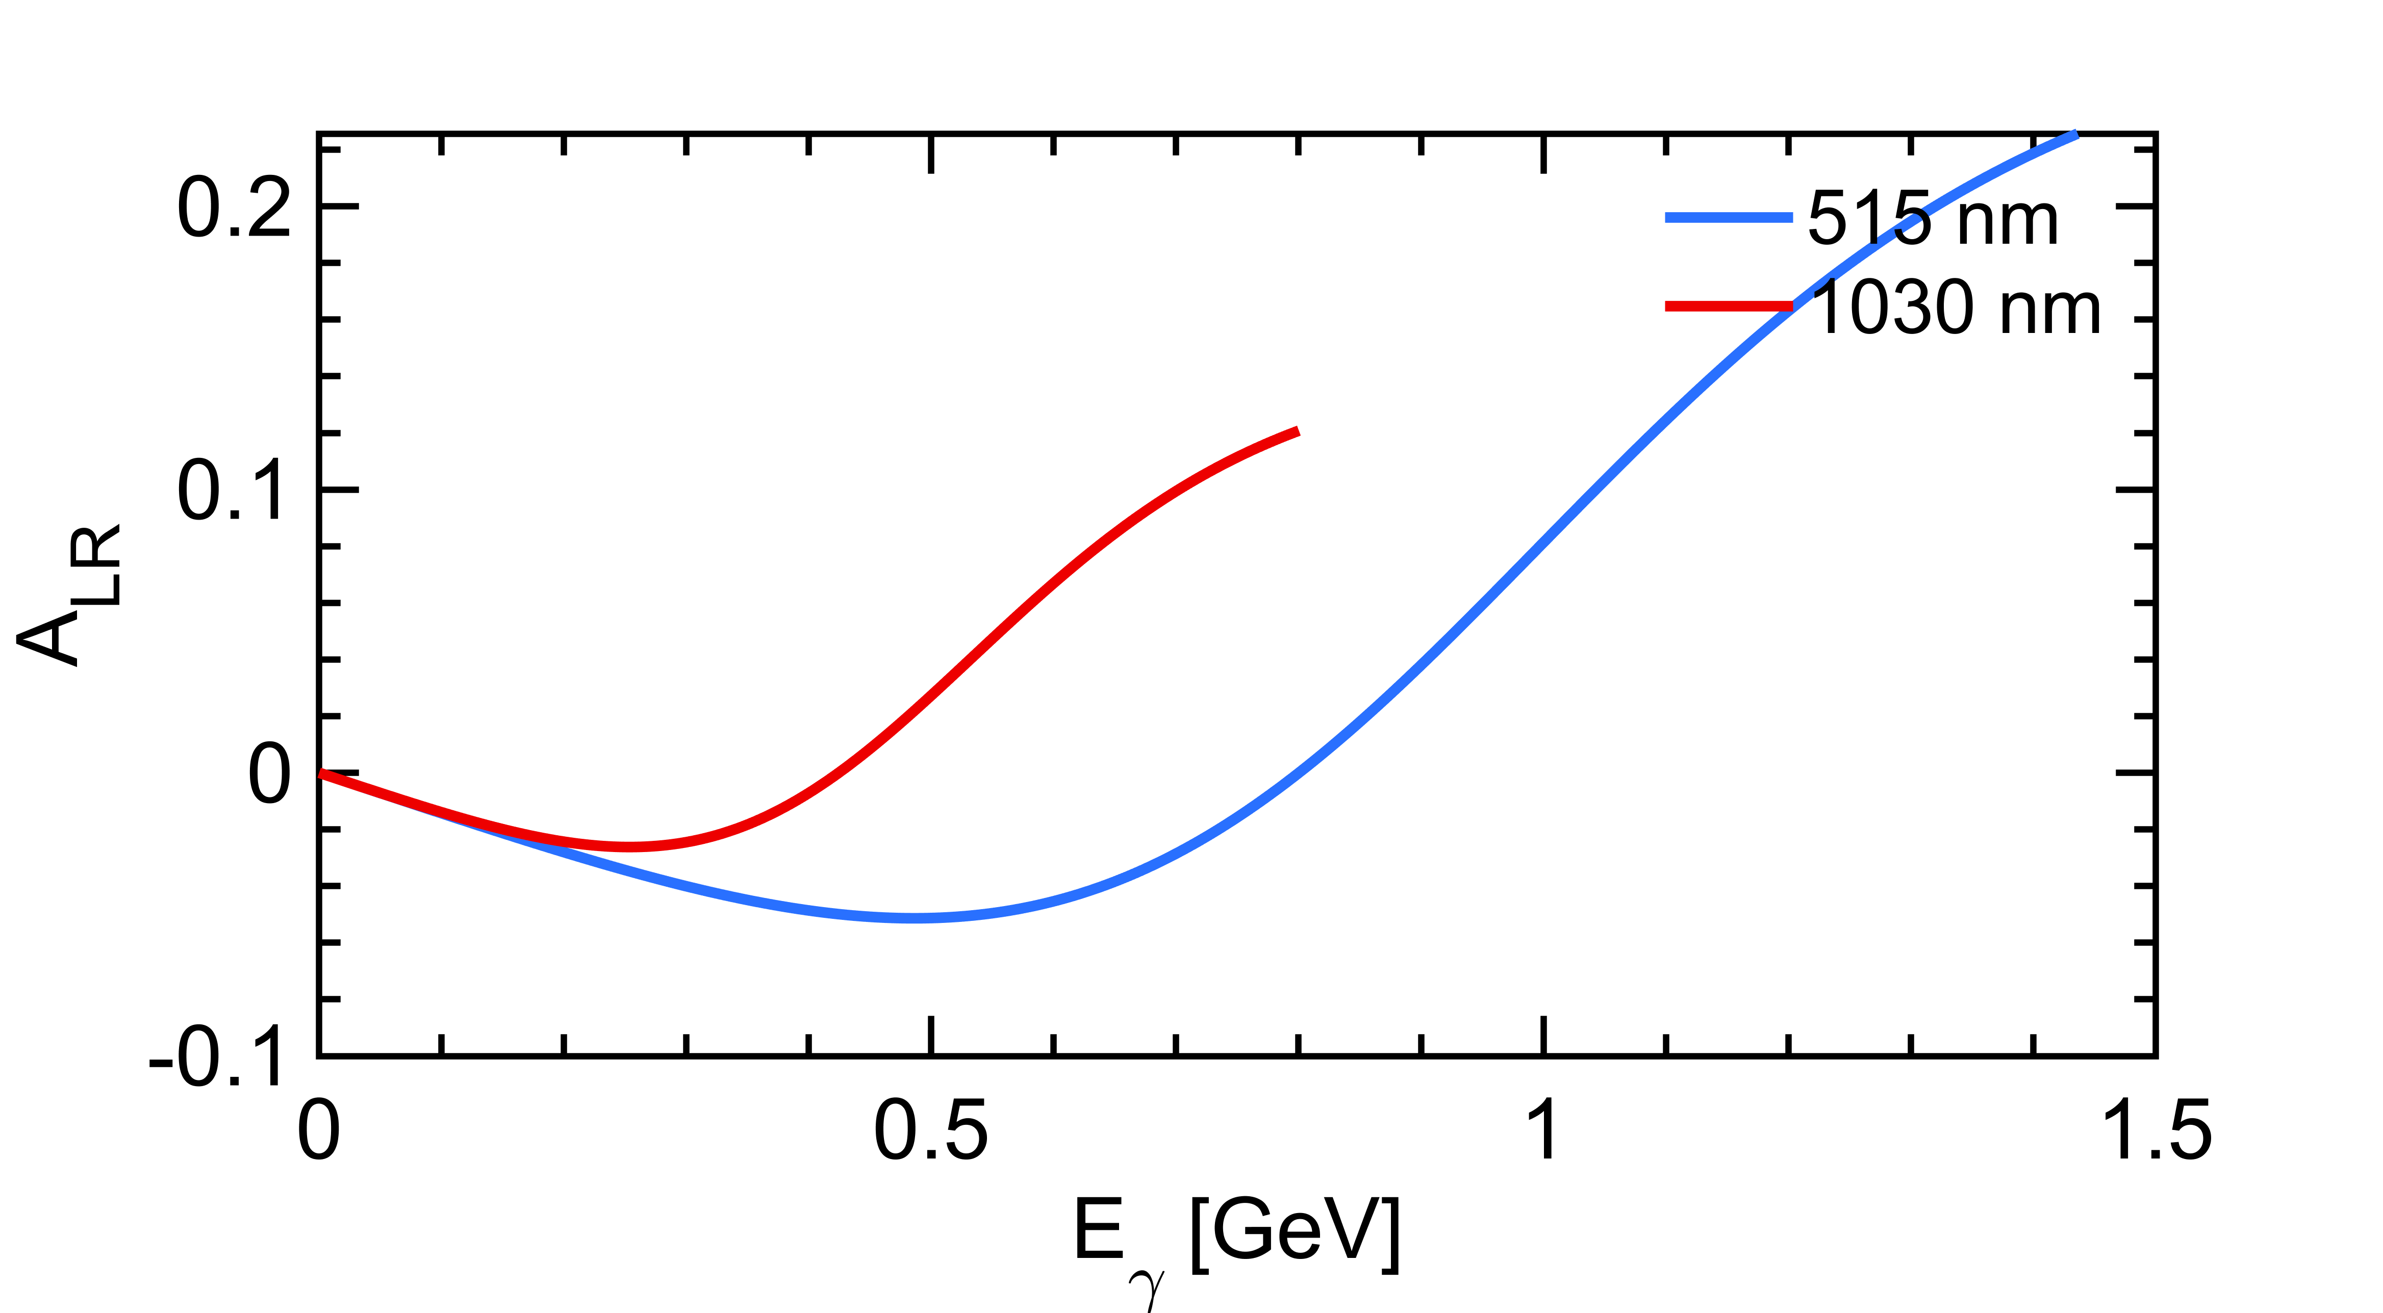
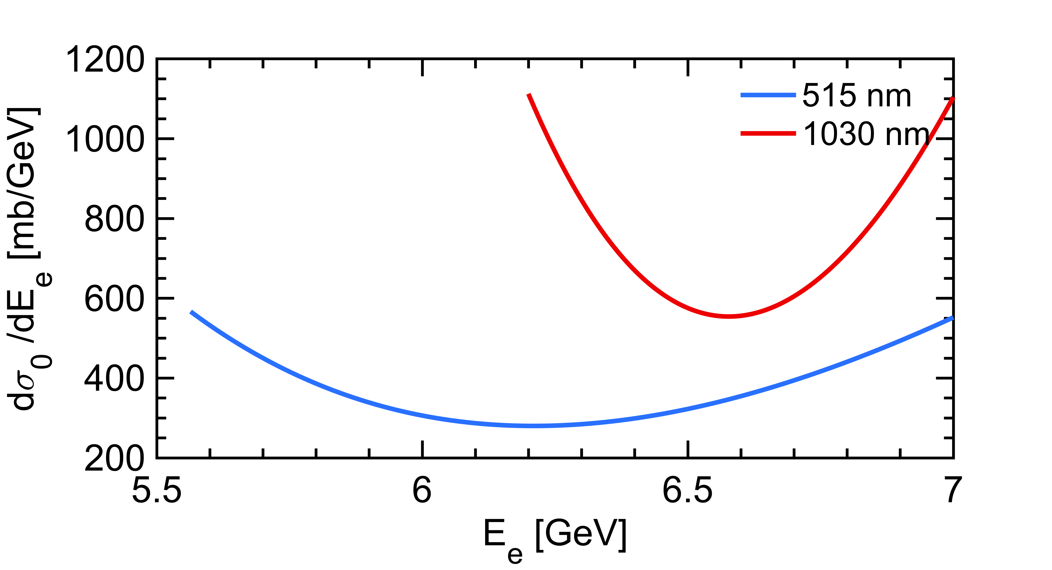
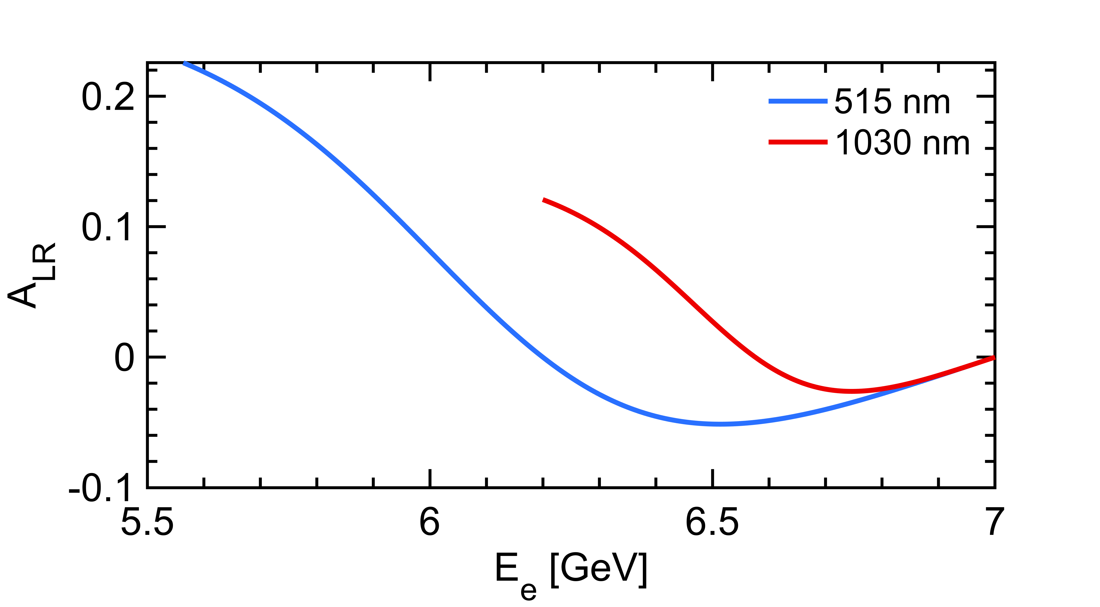
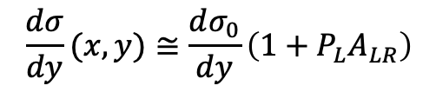
A slightly more detailed look
$$\frac{dσ}{dy}(x,y)≅\frac{dσ_{0}}{dy}\left(1+{P_{L}A}_{LR}\right)$$
Polarization dependent term generates a left-right asymmetry function of $E_{γ}$
Landau-Lifshitz QED book paragaphs 86 and 87
that reflects also as a function of the energy of the emitted electron
Green light provides higher sensitivity

Slide 28
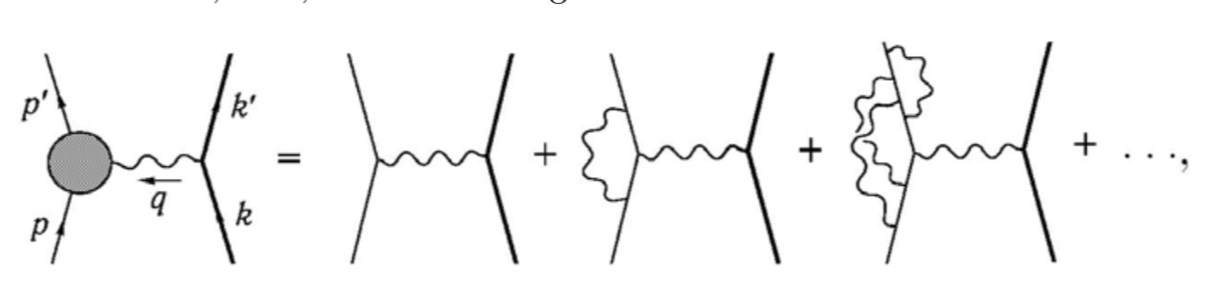
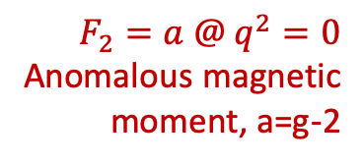

QED vertex contributions
M. Peskin & D. Schroder, Intro to QFT; Eidelman et al., arxiv:1601.07987v1
$$F_{1}=1 @ q^{2}=0$$
$$F_{2}=a @ q^{2}=0$$
Anomalous magnetic moment, a=g-2
P,T-violating
Electric dipole moment
P-violating
anapole moment
Electric charge
IR divergent contribution to the cross-section is cancelled at any order by corresponding soft real photon emission
Skip these today

Slide 29
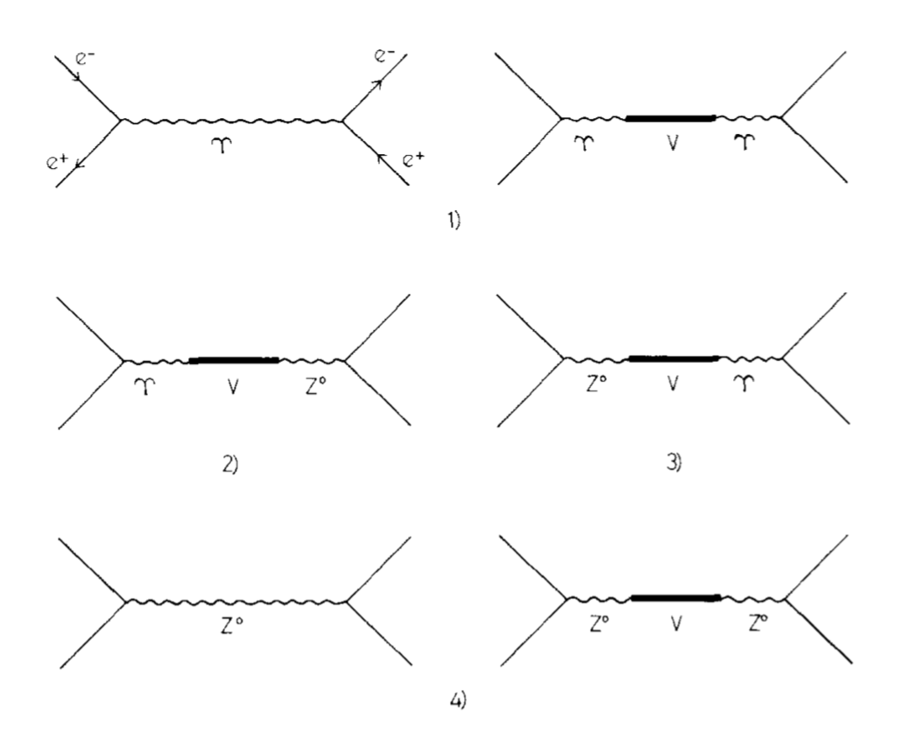
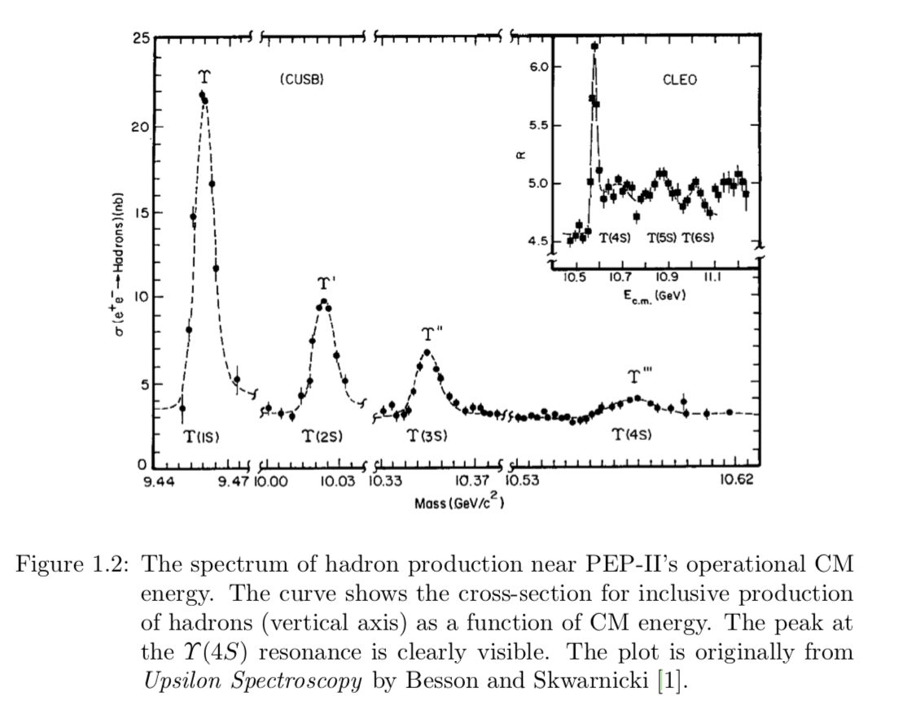
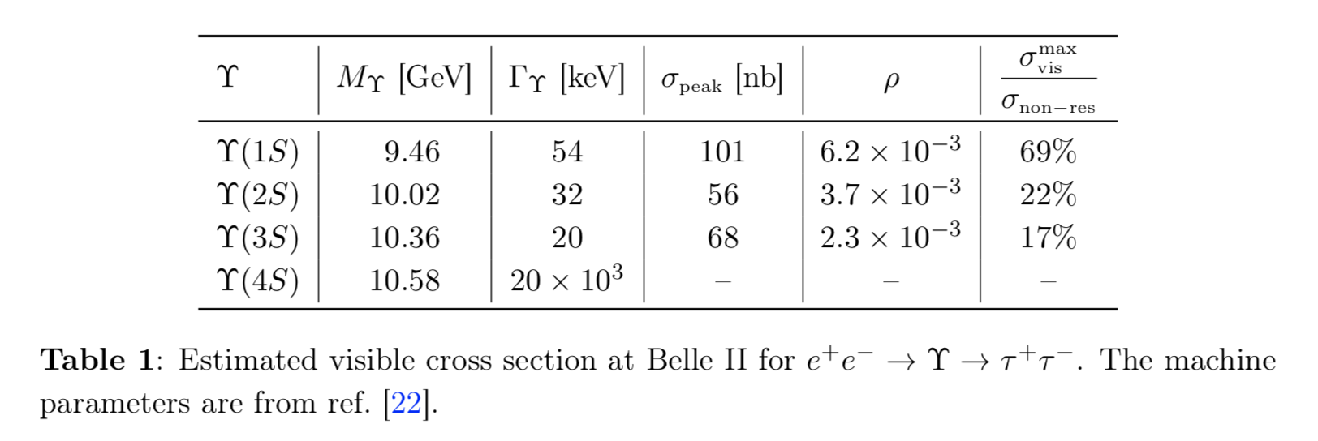




At Born level at a B-factory
The cross-section is an admixture of contributions from « continuum » and resonant contributions
$$γ$$
$$γ$$
$$γ$$
$$γ$$
$$γ$$
J. Bernabeu & P. Pascual, Nuclear Physics B172 (1980) 93; Eidelman et al., arxiv:1601.07987v1
Uspilon(4S)→l⁺l⁻ is cancelled (BR~10⁻⁵)

Slide 30
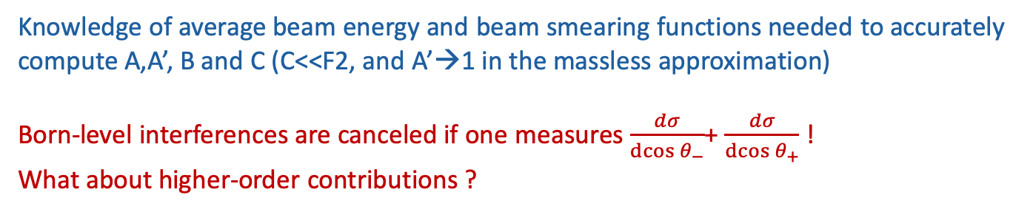
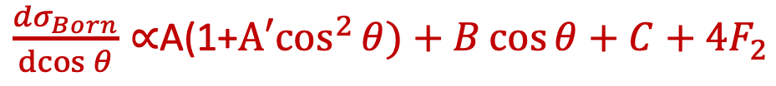
Born-level cross-section
This is in fact not a very accurate formula: interference of gamma-Z and gamma(Z)-Upsilon-Z(gamma) diagrams provide cos(theta) + constant terms to the differential cross-section
NB: we want to extract an overal constant of order 10⁻⁴
J. Bernabeu & P. Pascual, Nuclear Physics B172 (1980) 93; Zykunov, Physics of Atomic Nuclei, 2006, Vol. 69, No. 9, pp. 1522–1537
$\frac{dσ_{Born}}{\operatorname{dcos}{θ}}∝$A(1+${A′cos}^{2}{θ)}+B\cos{θ+C+{4F}_{2}}$
Knowledge of average beam energy and beam smearing functions needed to accurately compute A,A’, B and C (C<<F2, and A’→1 in the massless approximation)
Born-level interferences are canceled if one measures $\frac{dσ}{\operatorname{dcos}{θ_{−}}}$+ $\frac{dσ}{\operatorname{dcos}{θ_{+}}}$ !
What about higher-order contributions ?

Slide 31
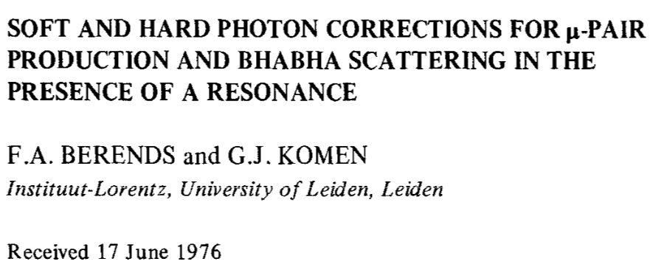

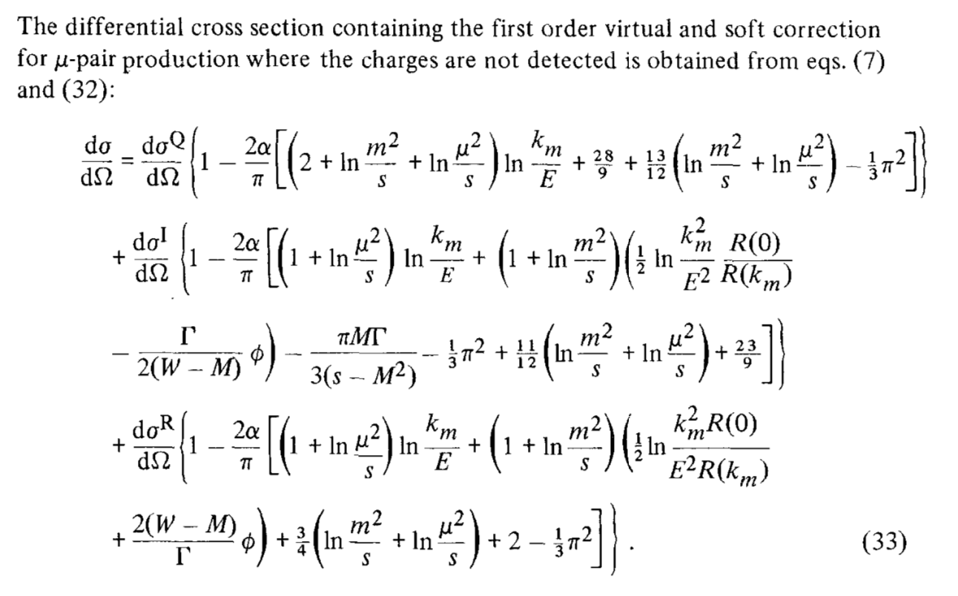
Resonance contributions
Right after discovery of narrow resonance, the NLO contributions were revisited
Angular structure is preserved up to NNLO and hard photon emission, even in presence of narrow resonance.
Not a big issue since Uspilon(4S)→l⁺l⁻ is cancelled (BR~10⁻⁵)

Slide 32
Expected sensitivity (stat only)
A lot of work ahead to check the feasibility…
and these claimed sensitivities…

Slide 33
Spin-observables
Sensitivity to F2 and F3 (EDM) also arise as linear and bilinear terms in tau-spins
Im(F2) sensitive tau-spin linear terms are forward-backward asymmetric
→ Control of NLO SM contributions is absolutely critical !
→ Electron-beam polarization provides further controls (and sensitivity)
These sensitivities need to be estimated with a realisitc analysis…

Slide 34
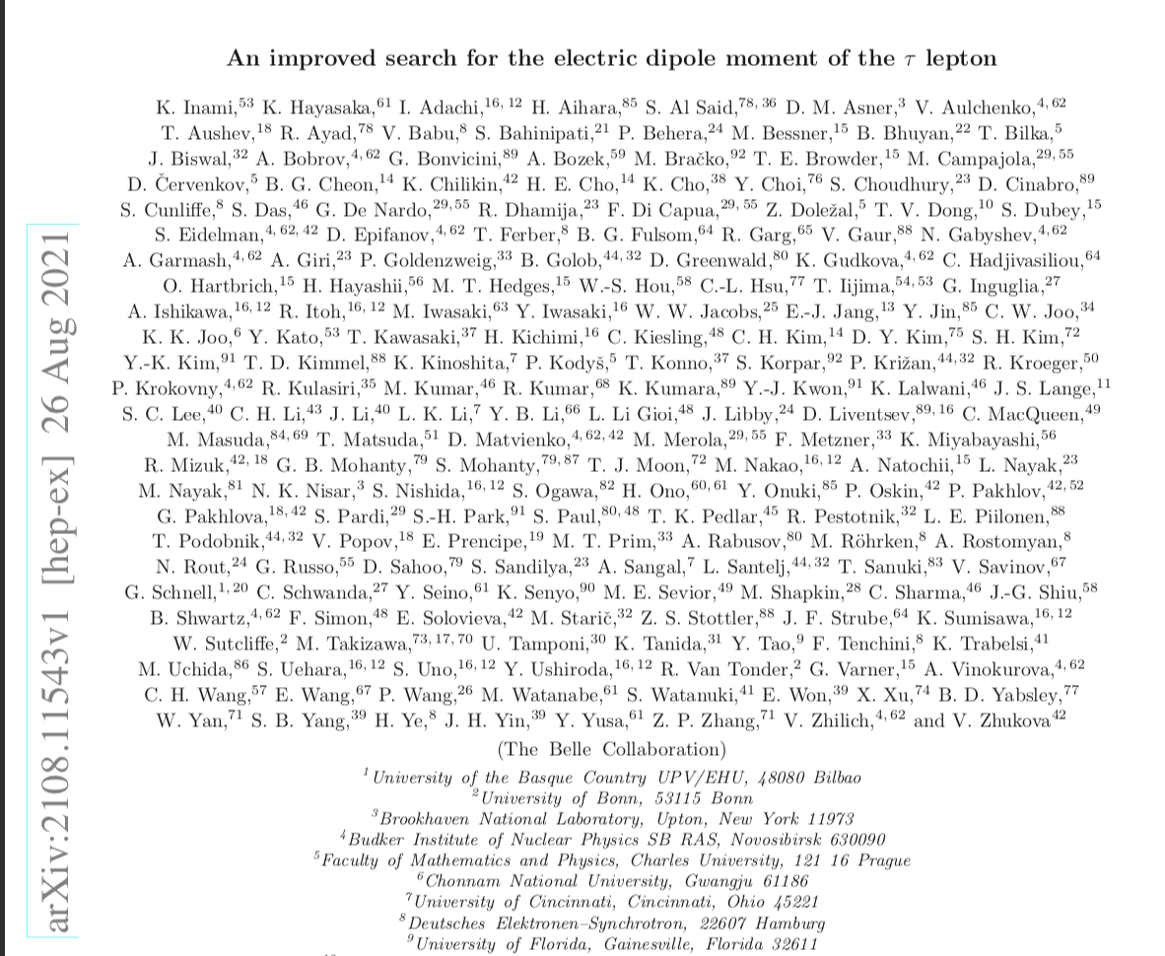
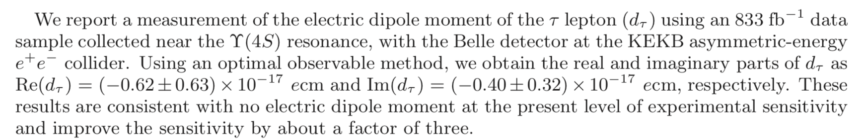
Current EDM measurements
Also, sensitivity to F3 (EDM) can be obtained with an angular analysis but bilinear in tau-spins…
Analysis exists in Belle (Inami), but intrinsically relies on MonteCarlo to extract sensistivity:
Systematically limited...

Slide 35


Reco-ed MC (mumu)
strategy:
  Use ½ of sample to estimate efficiencies from MC (their cos(theta) dependance)
    Tag (muonID>0.99) and probe (muonID>0.9, dr<2cm, |dz|<5cm)
  Use other half, ‘data’ driven corrected to measure cos(theta) distribution
    ½ of this for cos(theta+) the other for cos(theta-)
  Keep only events with 2 tracks and
$${|E}_{μ+, CMS}+E_{μ−, CMS}−m(4S)|<3GeV$$
MC
MC 10fb-1
Consistent with 1+cos(theta)^2 distribution.
Constant term known within about 10⁻³, cos2 term 5 10⁻³

Slide 36
Conclusion
Tau-F2 measurement is of interest
  a difficult subject barely studied at B-factories
  long-term, risky, project
Activity on the subject just started :
  Slowly but surely growing
  Fabian Zomer started contributing to the subject
  First feasibility studies are ongoing
Support requests:
  IN2P3-funded thesis
  ANR funding request is being prepared

Slide 37
backup

Slide 38

Testing with KKMC
  KKMC includes ISR/FSR interference, with a high precision (evolved exponentiation technique)
  QED/EWK contributions included
  Narrow resonance missing however

Slide 39





MC-truth mumu sample
Hard photon contributions
Fit restricted to +-0.85 cos(theta) range
$${|E}_{μ+, CMS}+E_{μ−, CMS}−m(4S)|<4GeV$$

Slide 40




efficiency
Efficiencies for mu-
Efficiencies for mu+

Slide 41
Upsilon(2/3S)->𝜋𝜋[Upsilon(1S)->mumu]
Pure Upsilon candle
No continuum pollution
Channel | Yield/(fb-1) w/o reco
ee(Y(4S))->tautau | 0.9M
Y(3S)->Y(2S)pi+pi, Y(2S)->tautau | 2.5k
Y(3S)->Y(1S)pi+pi, Y(1S)->tautau | 4.9k
Y(2S)->Y(1S)pi+pi, Y(1S)->tautau | 30k
If boxes are indeed under control in Upsilon decays, we have a very clean and copious sample with 1ab⁻¹ at Y(1S)
Could provide a cross-check with a precision of 10⁻⁴

