Slide 1
PERLE Longitudinal Match
Gustavo Pérez Segurana
Lancaster University & The Cockcroft Institute

Slide 2
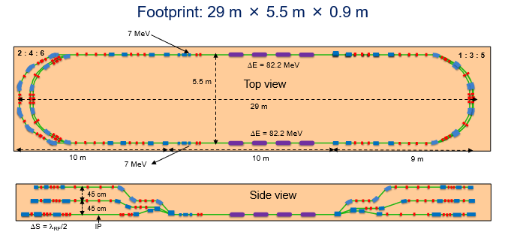
Layout
First order lattice, baseline for our studies.
Define arc parameters (pathlength & up to 3rd order longitudinal dispersions) for longitudinal match.

Slide 3
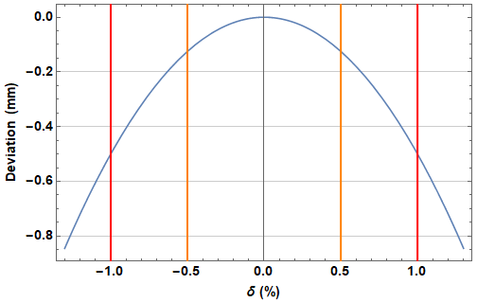
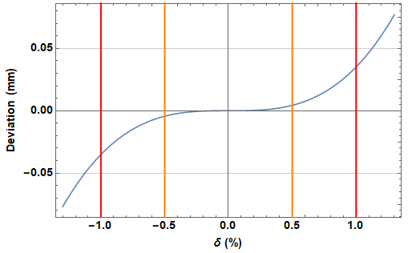
Longitudinal Match – Current design
Impact of $T_{566}$ & $U_{5666}$
 | $R_{56}$ (m) | $T_{566}$ (m)* | $U_{5666}$ (m)*
Arc 1 | 0 | -5.33829 | 35.3535
Arc 2 | 0 | -5.31989 | 35.3827
Arc 3 | 0 | -4.55781 | 51.9653
Arc 4 | 0 | -4.65502 | -20.3696
Arc 5 | 0 | -4.35709 | 14.5504
Arc 6 | 0 | -4.1607 | 12.7206
$R_{56}=0$m, $T_{566}=5$m, $U_{5666}=0$m
*initial design values obtained with elegant
Starting from our linear solution, $T_{566} \& U_{5666}$ should have no significant impact since the beam is accelerated on crest.
$R_{56}=0$m, $T_{566}=0$m, $U_{5666}=$35 m

Slide 4
Semi-analytical model
Approximate initial energy distribution as a polynomial where $s$ is the longitudinal position of the particles in the bunch, and assuming the reference particle is always at design energy.
Arcs are defined as drifts where the index $i$ indicates the i^{th} element.
$r_{56i}=R_{56}^{(i)}$ $t_{56i}=T_{566}^{(i)}$ $u_{56i}=U_{5666}^{(i)}$
RF cavities are approximated as thin lenses.
I. Zagorodnov and M. Dohlus, Semianalytical modeling of multistage bunch compression with collective effects, Phys. Rev. ST Accel. Beams 14, 014403 (2011).

Slide 5
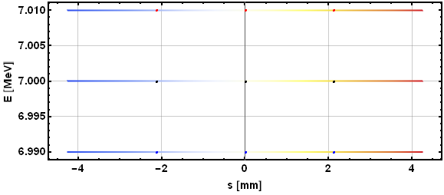
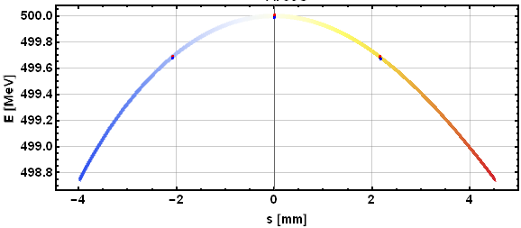
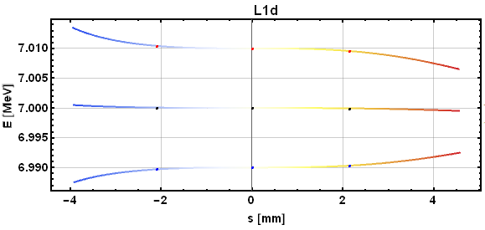
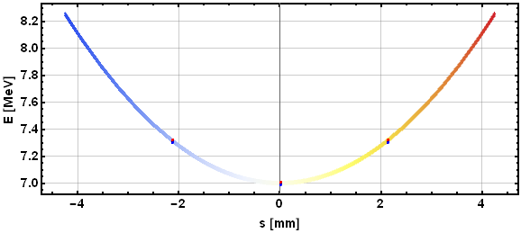
Longitudinal Match – Current design
Initial
IP1&2
Tail
Head
Dump
Choose simplest initial bunch to observe transport effects.
Energy spread at interaction points limited by RF curvature (and initial bunch length).
Tuning the initial bunch LPS such that it has a curvature opposite to the RF imprinted one this is probably far from possible.
“Ideal” Injector LPS

Slide 6
Longitudinal Match Considerations
Injector
RF1 – Pass 1
Arc 1
RF2 – Pass 1
Arc 2
RF1 – Pass 2
Arc 3
RF2 – Pass 2
Arc 4
RF1– Pass 3
Arc 5
RF2 – Pass 3
Arc 6 Spreader
IP1
Arc 6
Dump
RF2 – Pass 6
Arc 1
RF1– Pass 6
Arc 2
RF2 – Pass 5
Arc 3
RF1– Pass 5
Arc 4
RF2 – Pass 4
Arc 5
RF1– Pass 4
Arc 6 Recombiner
IP2
Good match criteria:
Minimal energy spread at IP1 & IP2
At each arc, energy accelerating equals energy decelerating.
Correct energy recovery
-2°
-4°
-2°
-4°
-2°
Common transport restrictions:
Same pathlength for same arc passes accelerating and decelerating.
i.e. Arc 3 is 2° short. Rf phases will change from RF2 Pass 2 and from RF2 Pass 5.
Same longitudinal parameters for every arc accelerating and decelerating.
i.e. Arc 3 $T_{566}=20$m. Beam will see the effects of this $T_{566}$ accelerating and decelerating.
-4°
-2°
-2°
-2°
-2°
-2°
-2°

Slide 7
Longitudinal Match Considerations
Injector
RF1 – Pass 1
Arc 1
RF2 – Pass 1
Arc 2
RF1 – Pass 2
Arc 3
RF2 – Pass 2
Arc 4
RF1– Pass 3
Arc 5
RF2 – Pass 3
Arc 6 Spreader
IP1
Arc 6
Dump
RF2 – Pass 6
Arc 1
RF1– Pass 6
Arc 2
RF2 – Pass 5
Arc 3
RF1– Pass 5
Arc 4
RF2 – Pass 4
Arc 5
RF1– Pass 4
Arc 6 Recombiner
IP2
Good match criteria:
Minimal energy spread at IP1 & IP2
At each arc, energy accelerating equals energy decelerating.
Correct energy recovery
Common transport restrictions:
Same pathlength for same arc passes accelerating and decelerating.
i.e. Arc 3 is 2° short. Rf phases will change from RF2 Pass 2 and from RF2 Pass 5.
Same longitudinal parameters for every arc accelerating and decelerating.
i.e. Arc 3 $T_{566}=20$m. Beam will see the effects of this $T_{566}$ accelerating and decelerating.

Slide 8
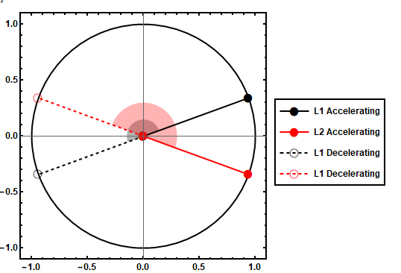
Dealing with RF curvature
In order to compensate RF curvature while having a zero chirp bunch at top energy our solution must have a chirp – (pre)linearize – dechirp sequence.
How?
Set Linac 1 and Linac 2 to run at opposite sides of crest and keep arcs 1 to 5 pathlengths with integer multiples of RF wavelength.
Bunch will be chirped by Linac 1 into all odd arcs and dechirped by Linac 2.
Choose the respective signs of the phase such that the natural $T_{566}$ of the arcs helps our linearization.
On Trough
Tail above head
On Crest
Head above tail
Deceleration
Acceleration
RF load (arb. units)

Slide 9
Dealing with RF curvature
We must accelerate far enough from crest such that there are no repeated locations in our bunch with the same energy deviation. i.e. the whole bunch must be on the same side of crest.
So, with an RF frequency of 802 MHz and end to end bunch length $≈8$ mm
$${ |φ}_{min}|≈3.8°$$
On the other hand, $|φ_{max}|$ will be determined by energy acceptance and overhead RF power available.
The absolute energy spread is the same in Arc 1, 3 and 5. Therefore the greatest relative energy spread is at the lowest centroid energy, Arc 1.
As we go off-crest RF power must increase in order to achieve the same centroid energy at IP.

Slide 10
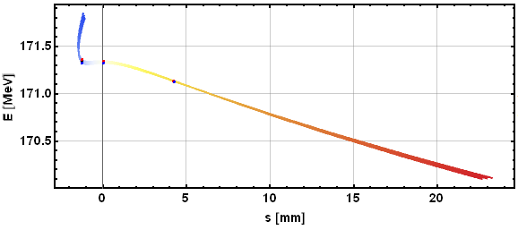
Dealing with RF curvature
How it goes wrong
Very difficult to eliminate the energy spread of the hook.
Long tail susceptible to increased energy spread.
Sample LPS after arc 2.
Pre-linearization in arc 1 of the centre of the bunch has resulted in a very long tail and a hook with fixed absolute energy spread.

Slide 11
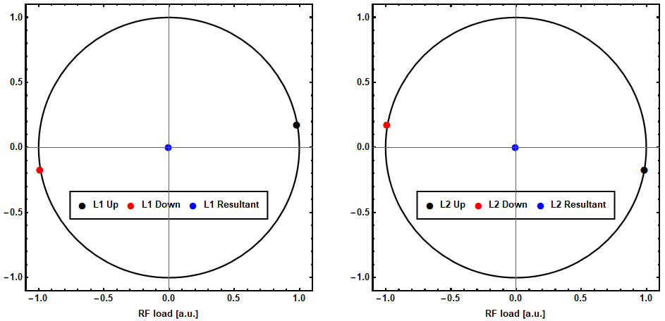
Phase options
$Δφ_{1}=Δφ_{3}=$ $Δφ_{5}=$ $−Δφ_{2}=$ $−Δφ_{4}$
$$Δφ_{6}=180−Δφ_{1}$$

Slide 12
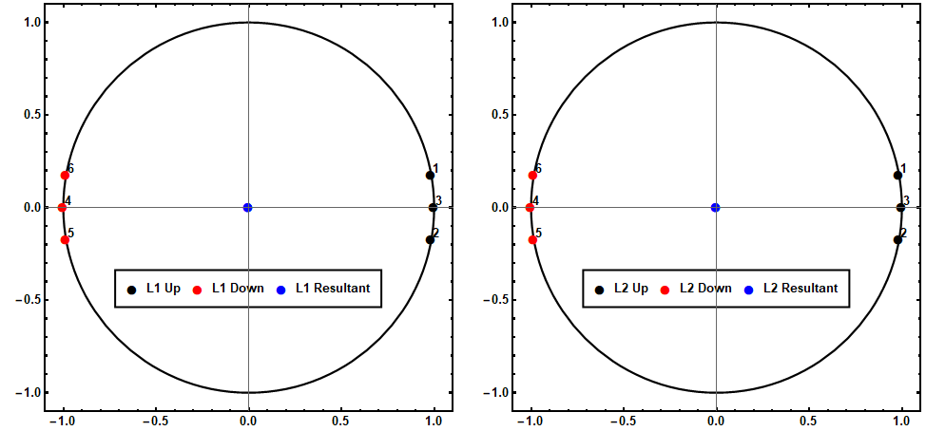
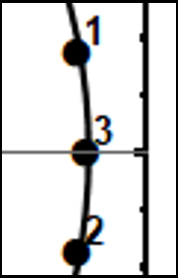
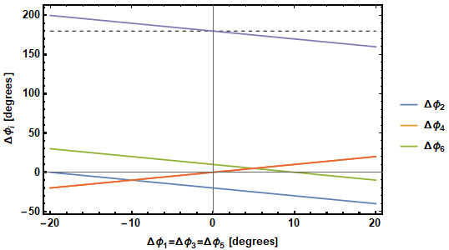
Other phase options
Passes with different phases result in changes to energy ratios between arcs.
Retune magnets seen by different energy beams
(Linac quadrupoles and spreader/recombiners).

Slide 13
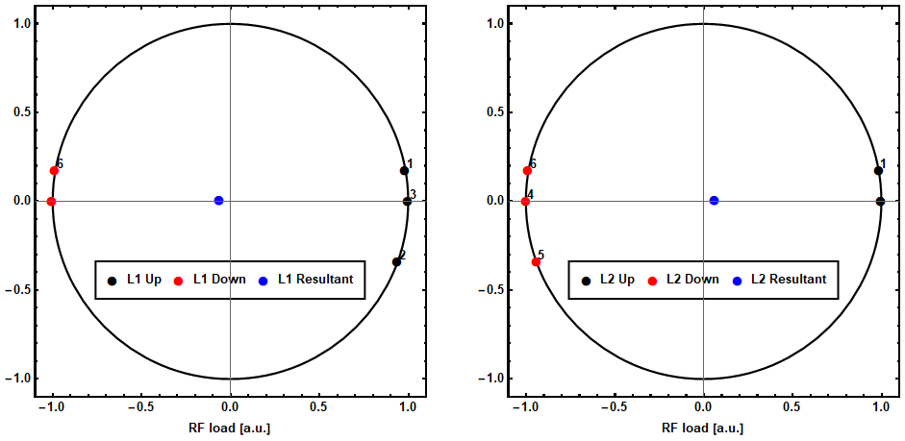
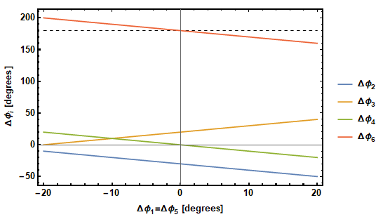
Other phase options
$$6\%$$

Slide 14
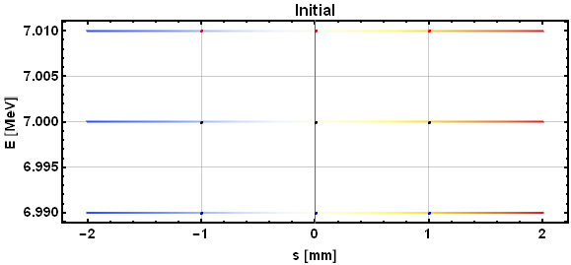
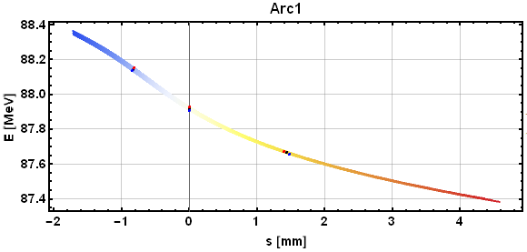
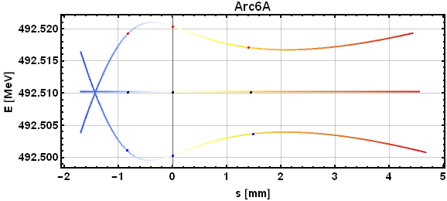
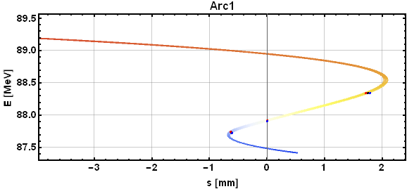
Longitudinal phase space solutions
Top left: Initial LPS
Top right: Bunch after 2nd and 3rd order corrections in arc 1 optimizing for minimum energy spread at IP
Bottom left: Bunch at IP2
Bottom right: Bunch after traversing Arc 1 decelerating
Again, common transport corrections must be taken into account while decelerating.
Linearization efforts significantly lengthen the low energy tail.

Slide 15
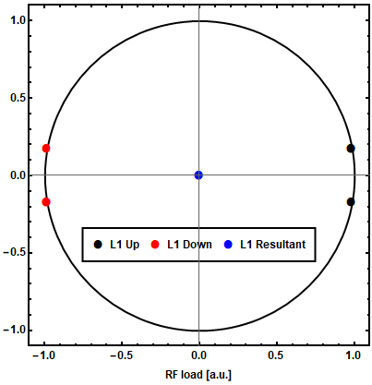
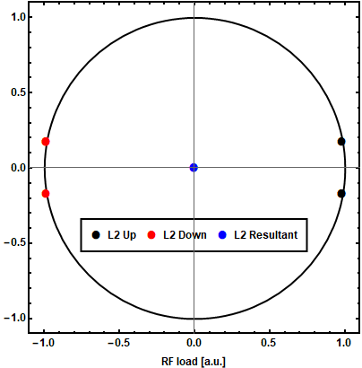
Longitudinal phase space solutions
4
1,3
4, 6
3
5, 6
2
5
1, 2
RF phase sequence: $+,−,−,−,+,+,(+,+,−,−,−,+)$
During transport, the beam has different chirp signs.
By linearizing in two arcs where the beam has opposite chirp, we can control the lengthening of the tails.
This will require changing the sign of $T_{566}$ in one of the arcs.

Slide 16
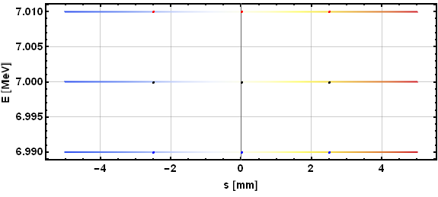
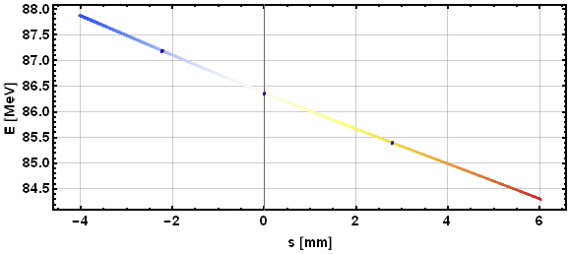
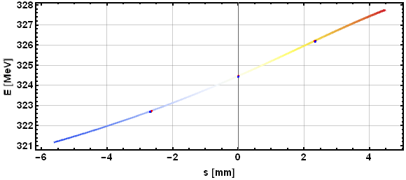
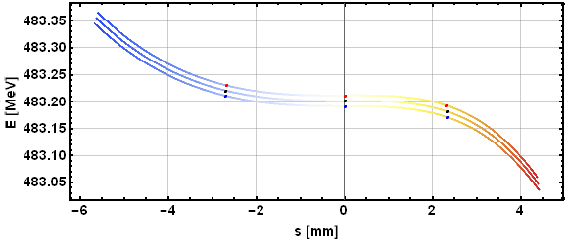
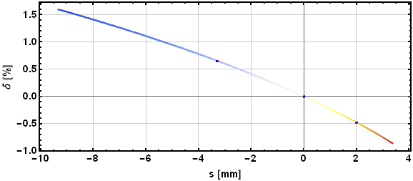
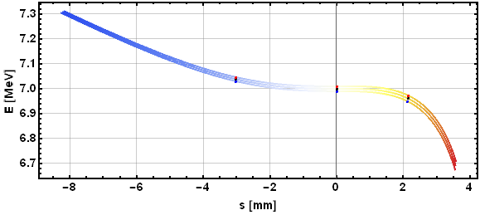
Longitudinal phase space solutions
Initial
Arc 1 Exit
Arc 4 Exit
IP
Arc 4 Decelerating Exit
Dump
Use arcs 1 and 4 to get linearized bunches into arc 4 accelerating and IP.
Largest energy spread at arc 4 decelerating. Related to bunch length, if longer bunches are needed, consider compressing in low energy arcs to stay within energy acceptance.
Chirp differences accelerating and decelerating result in linearization during both acceleration and deceleration.
Arc 1 $T_{566}:−5.3m→ +2.6m$
Arc 4 $T_{566}:−4.6m→−13.4m$

Slide 17
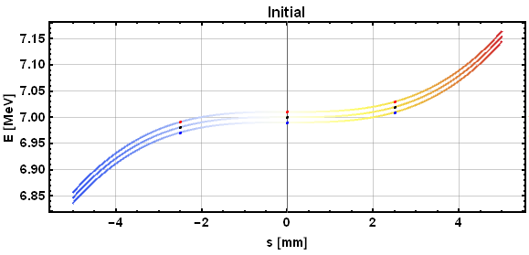
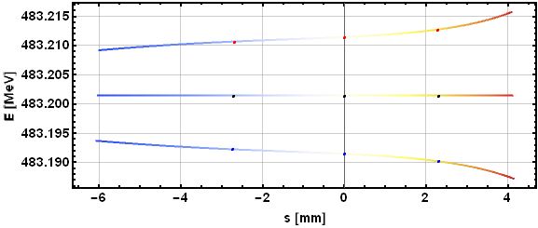
Initial bunch optimization
Initial
IP
Optimize initial bunch parameters to minimize energy spread at the IP. Use LPS at the exit of first pass of linac 1 to incorporate space charge effects.
Note that this analysis does not take into account any collective effects and their impact on slice energy spread growth.
Reduction of arc linearization requirements thanks to initial bunch LPS will result in reduction of necessary chirp and/or higher order corrections of the arcs.
Any 2nd order correlation in the LPS of the initial bunch is of help. Between linear and this.
$$δ$$
$$δ$$
Small 1st order correlations can be handled by changing arc 1 $R_{56}$, or shifting all the phases to compensate.
s
s
Higher order correlations would require matching them with higher order longitudinal dispersion controls.

Slide 18
Conclusions and further work
We’ve shown how we can choose the RF phases in a common transport ERL where we don’t have to compensate for energy losses.
Set some limits on how far off-crest we must accelerate in order to minimize energy spread at the interaction point.
Explored different linearization schemes and found how to keep bunch tail lengths under control.
Determined initial bunch longitudinal phase space to minimize energy spread at the interaction point.

