Slide 1
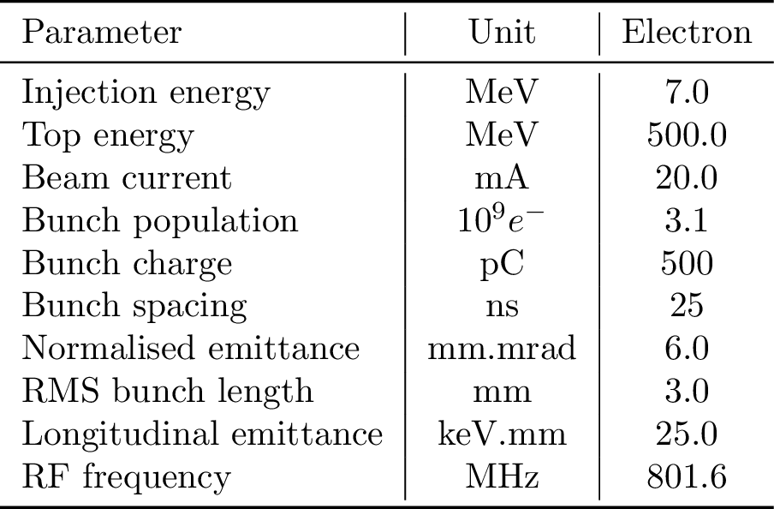
Single and multi-bunch tracking for PERLE
K. André - k.andre@cern.ch
Outline :
ERL lattice splitting
Optics design
RF curvature
Tracking including CSR
Multi bunch tracking
Effect of LRW
Combined with bunch recombination pattern
PERLE collaboration meeting - 16/07/21 - https://indico.ijclab.in2p3.fr/event/7444/

Slide 2
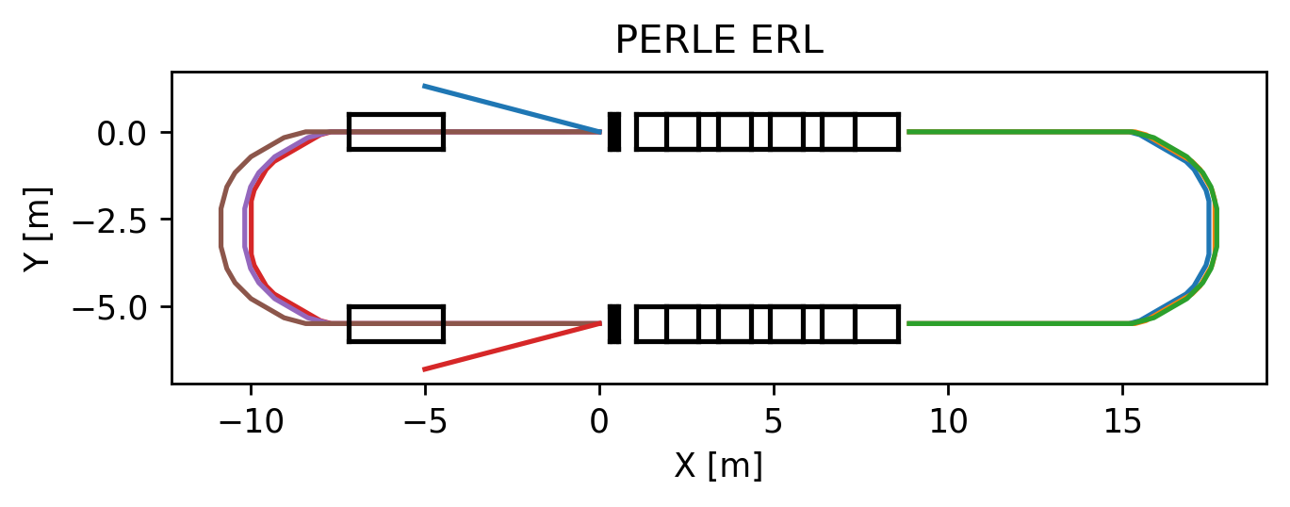
ERL construction - Lattice splitting for the timing in PLACET2
The linac is 27 λ_{RF} including the injection chicane, the injection chicane was included into arc 2, 4, 6 such that only the cryomodule and the doublet of quadrupole are in the “linac lattice” like LHeC.
The linac is now 24 λ_{RF} long,
The injection chicane is 3 λ_{RF} (merged in the arcs)
The arcs 2, 4, 6 are respectively 63, 63, 66.5 λ_{RF}
while arcs 1, 3 & 5 are all 56 λ_{RF}.

Slide 3
Optics - individual arcs
Momentum compaction factor is < 2e-5 in all 6 arcs according to Optim,
but it doesn’t take into account the injection/extraction chicane contributions ?

Slide 4
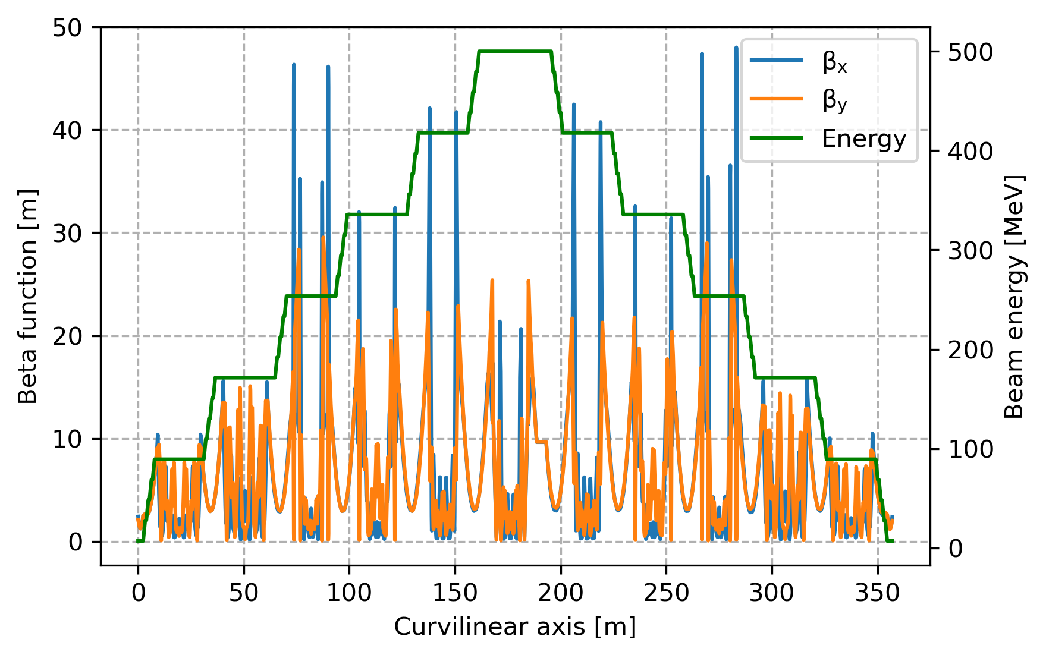
Optics - multi turn
Magnets apertures
Quadrupoles : 40 mm diameter aperture
Cavities : 130 mm diameter aperture
H/V dipoles : 40 mm aperture for the smallest direction & 90 mm aperture for the other one.
PLACET2 tracking code has been used, since it features CSR and wakefields

Slide 5
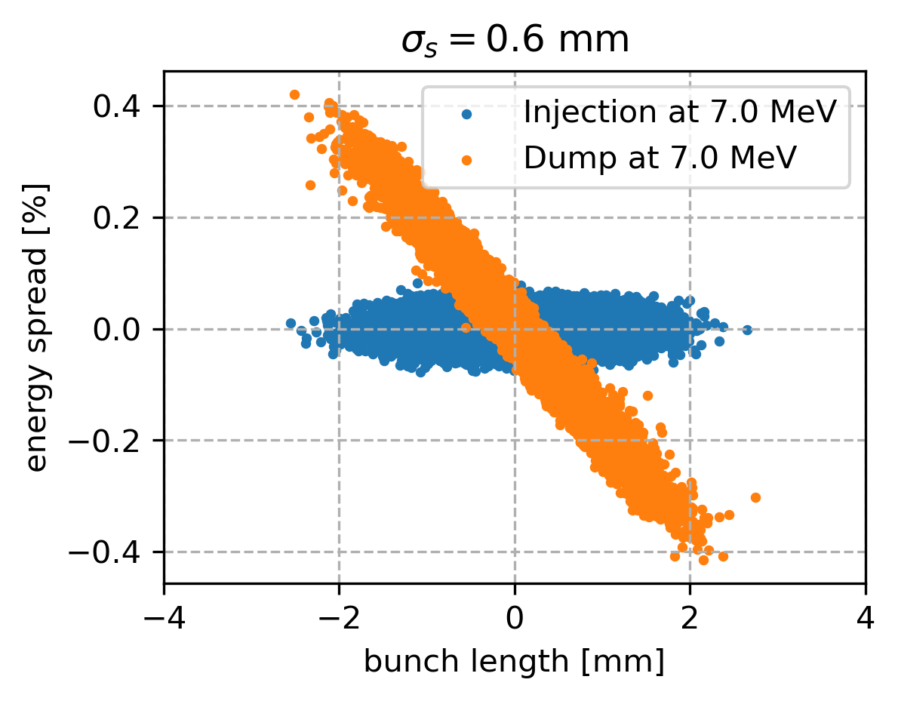
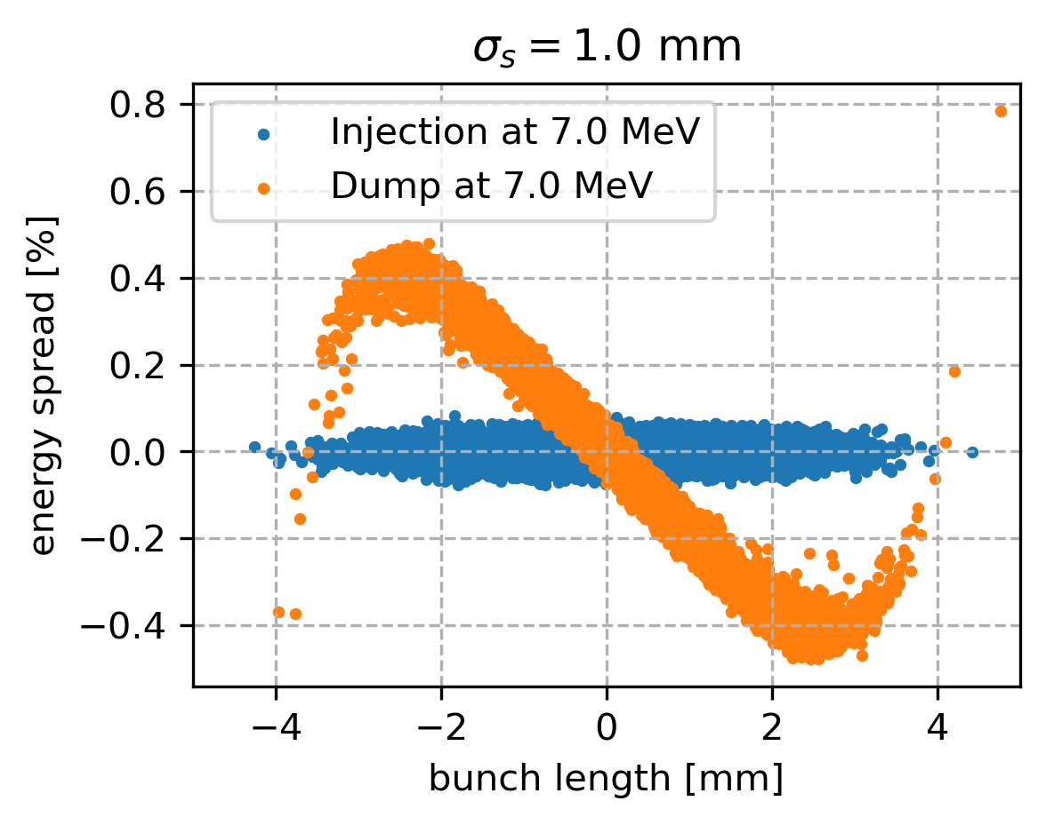
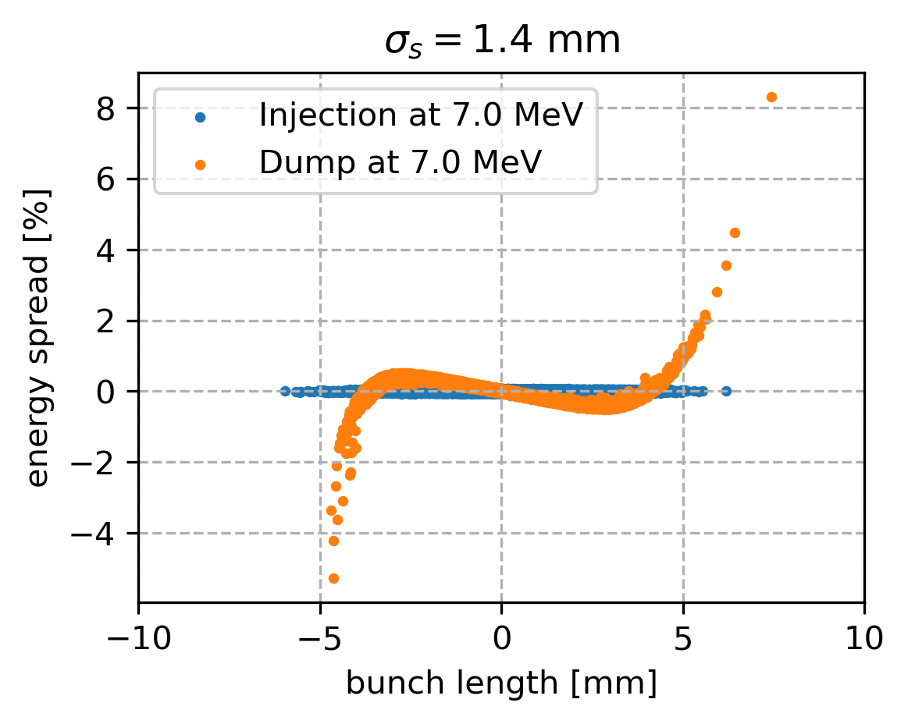
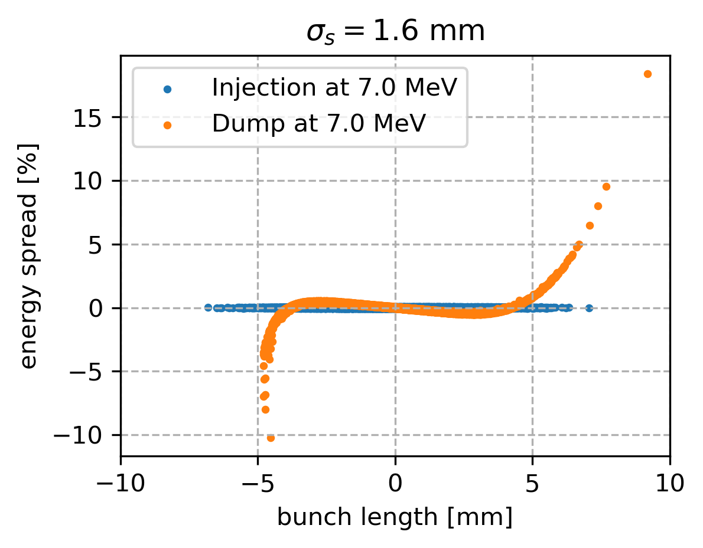
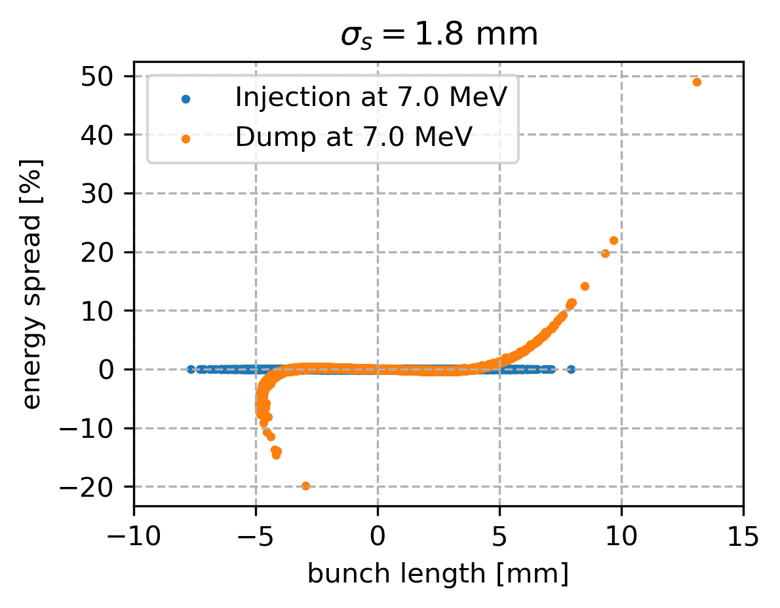
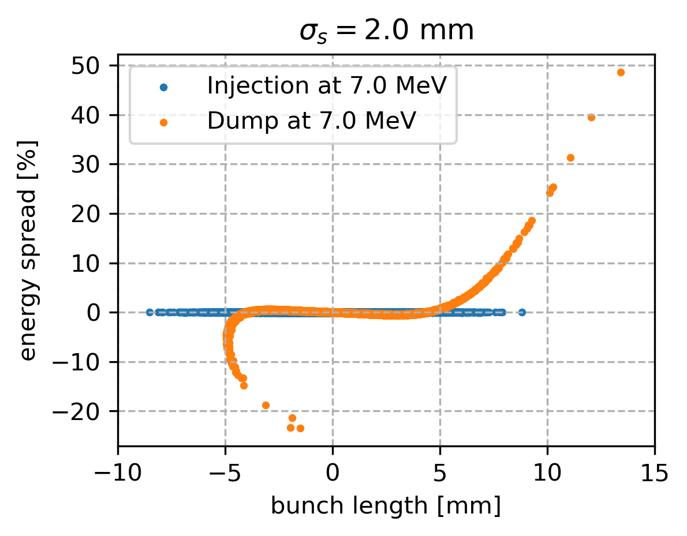
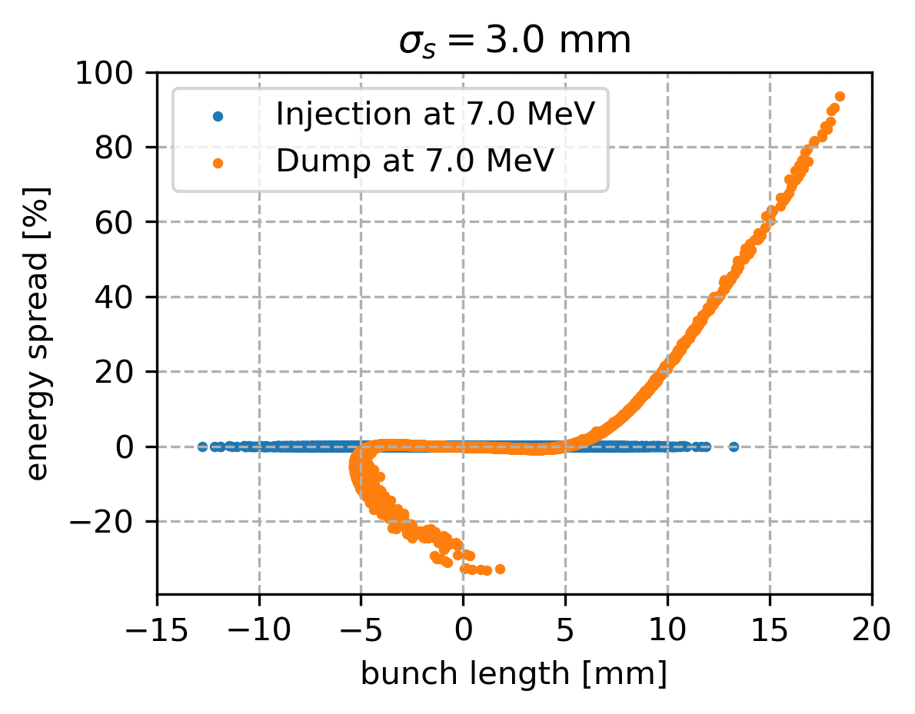
RF curvature effects with bunch length ẟ_{ini} = 2 10⁻⁴
The hook and bunch elongation are visible as Gustavo showed last time.

Slide 6
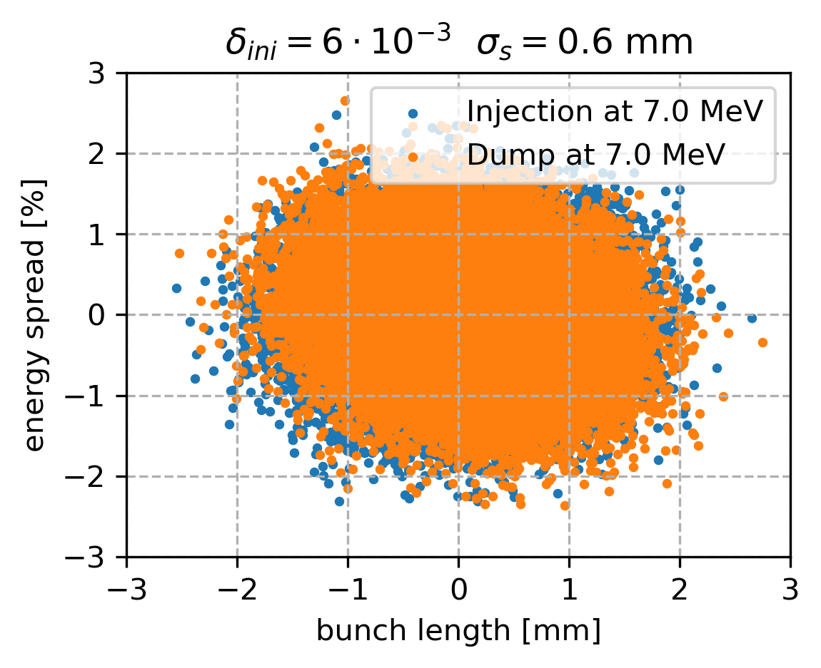
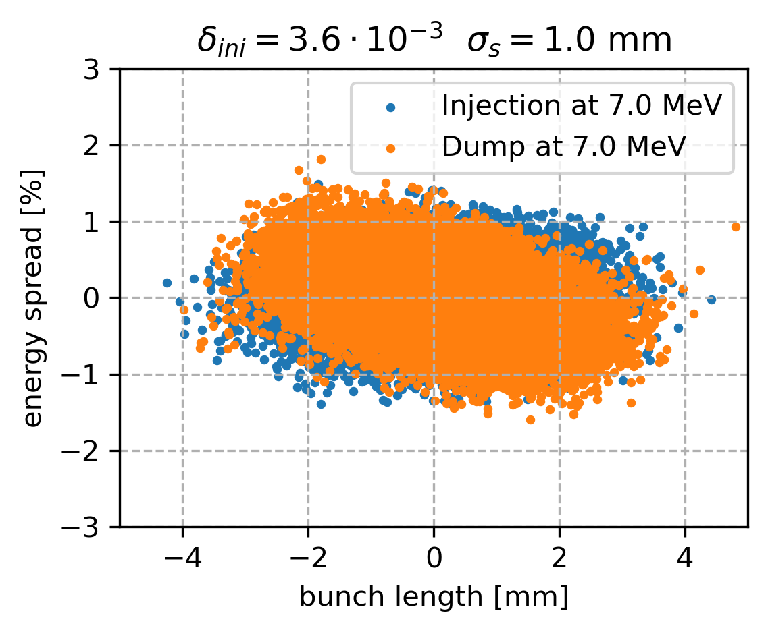
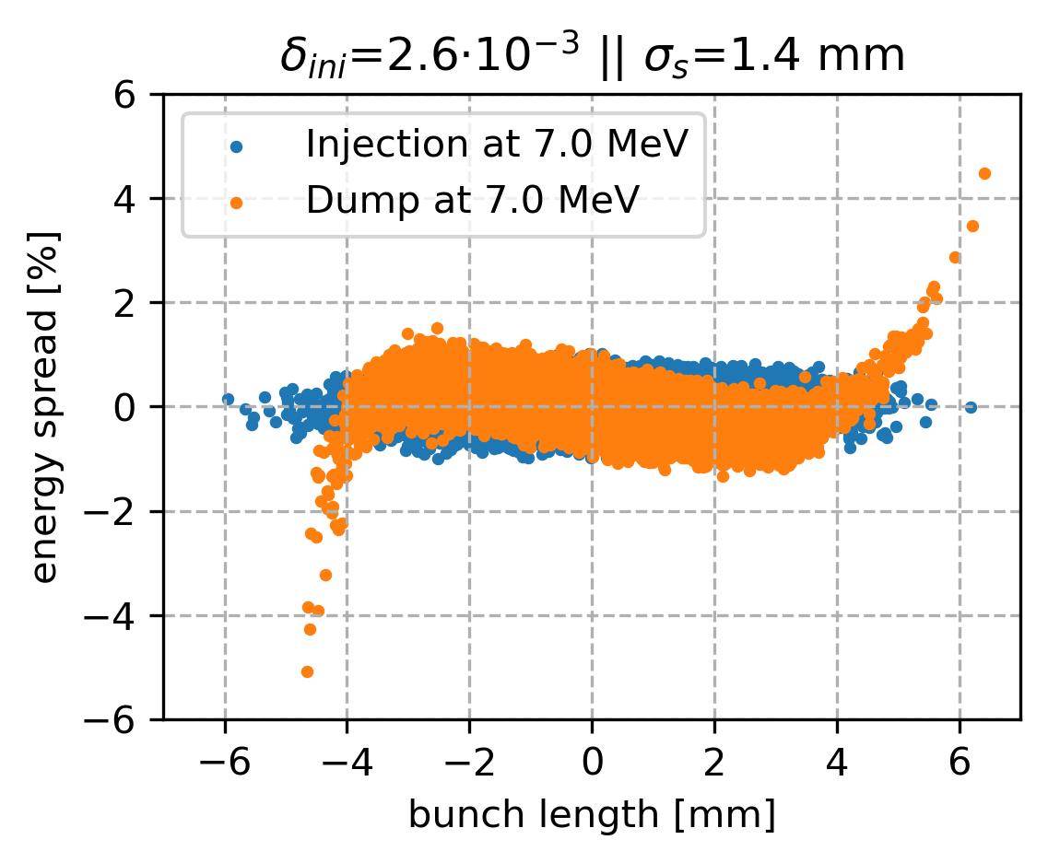
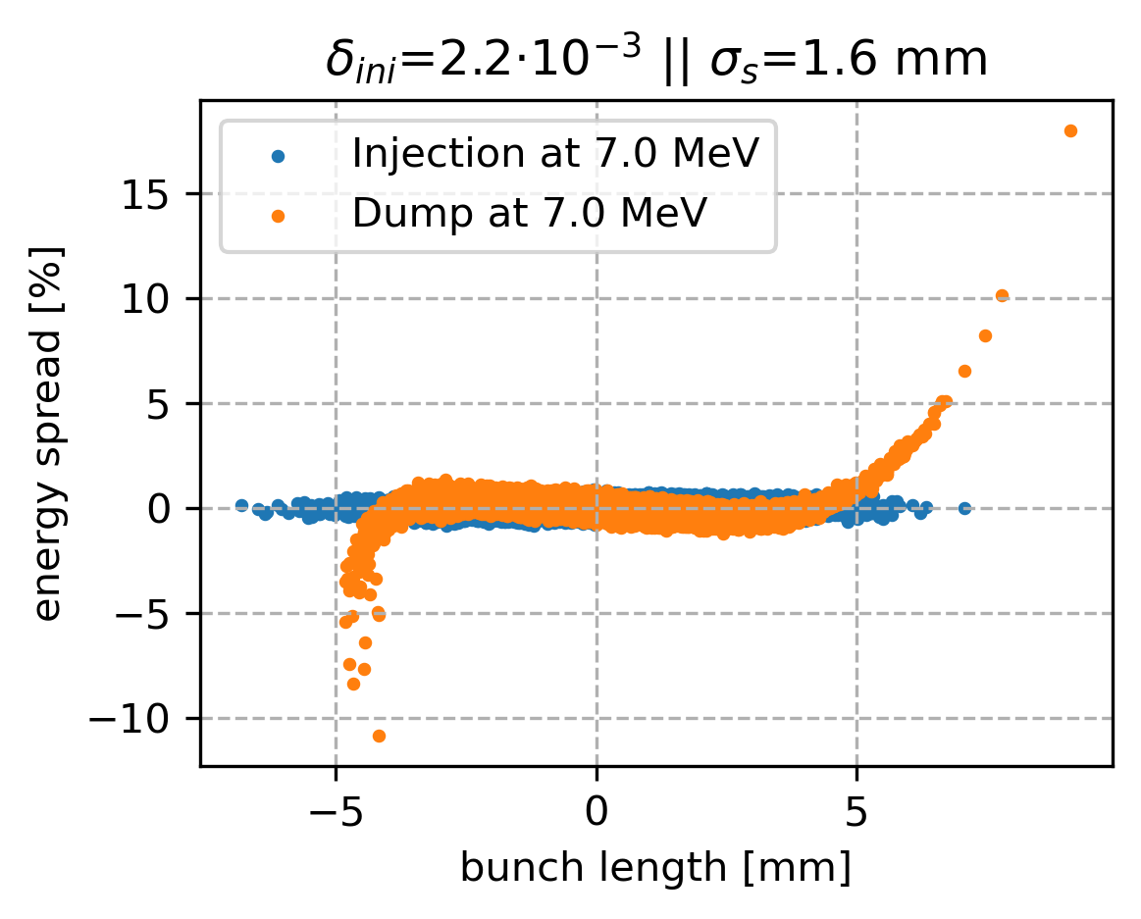
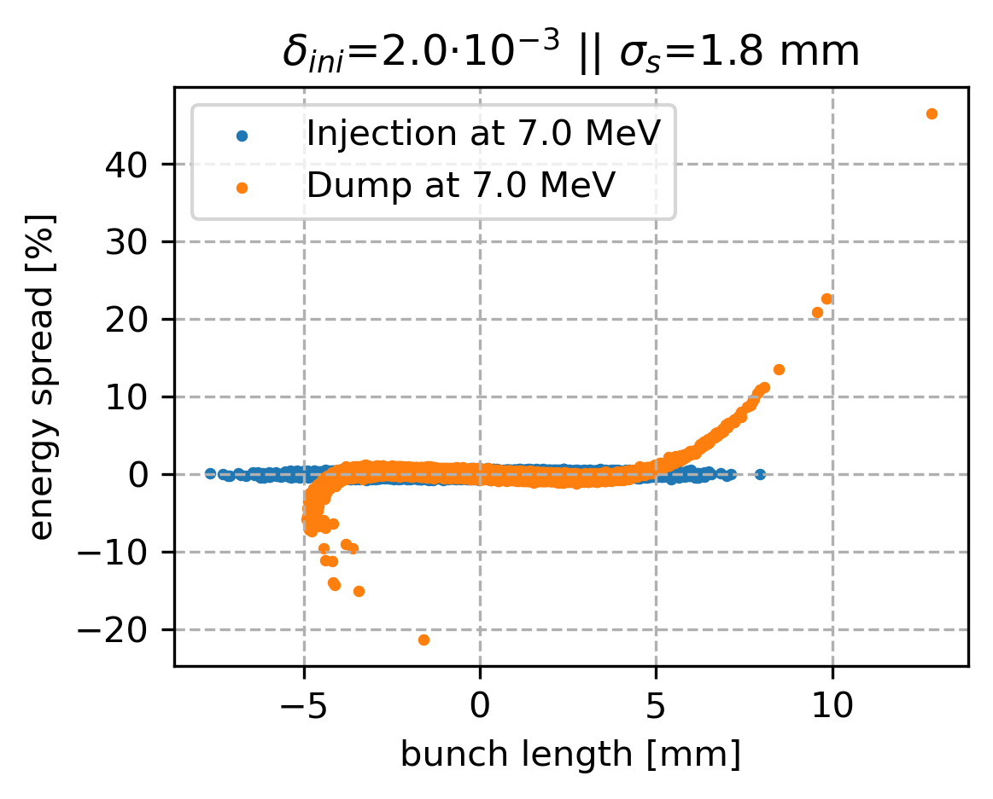
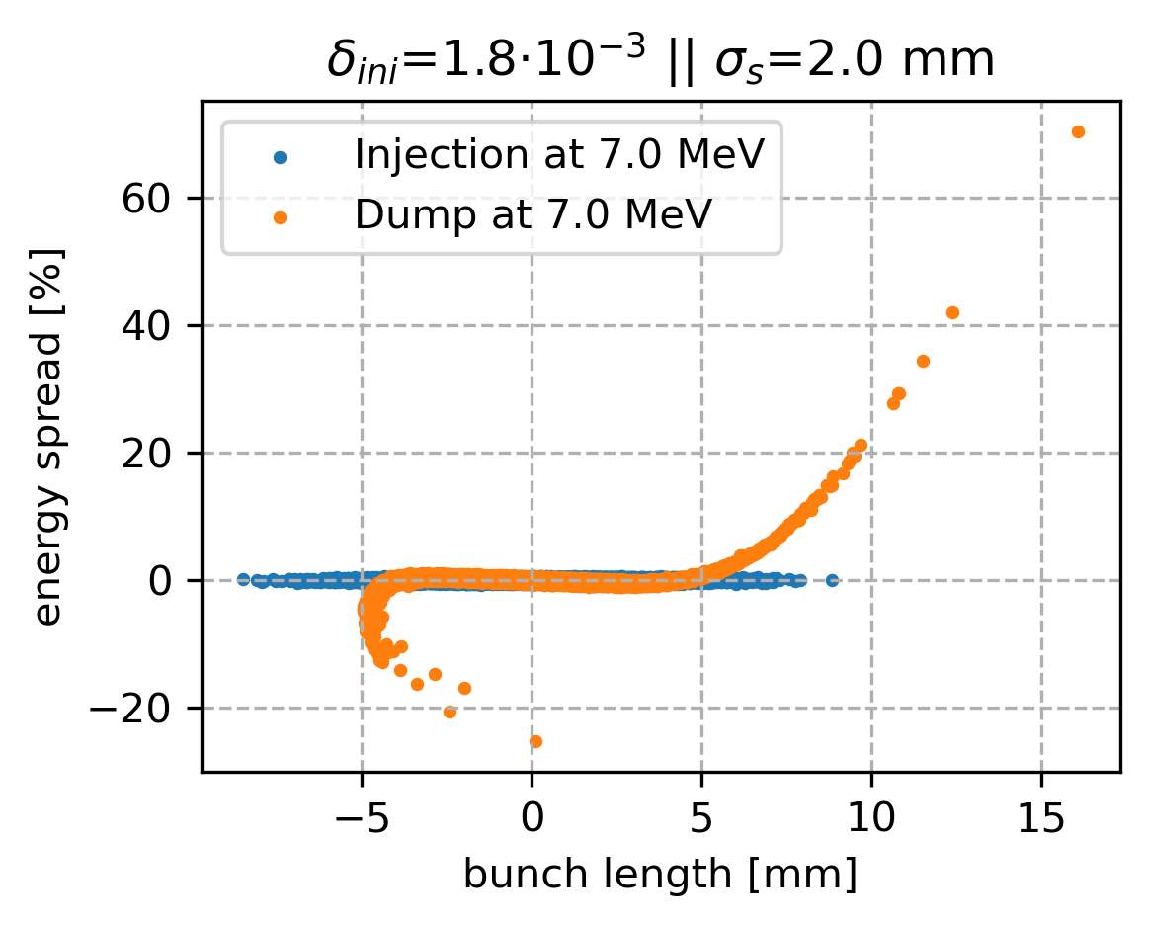
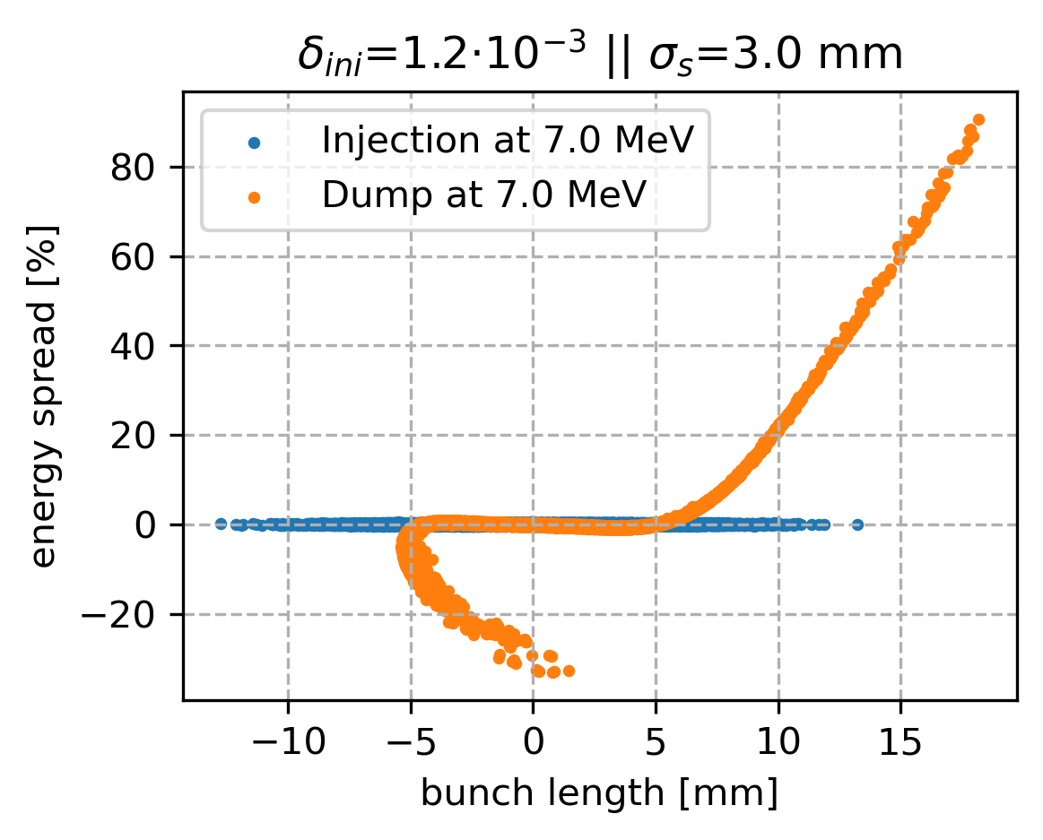
RF curvature effects with conserved longitudinal emittance
The hook and bunch elongation are visible as Gustavo showed last time.

Slide 7
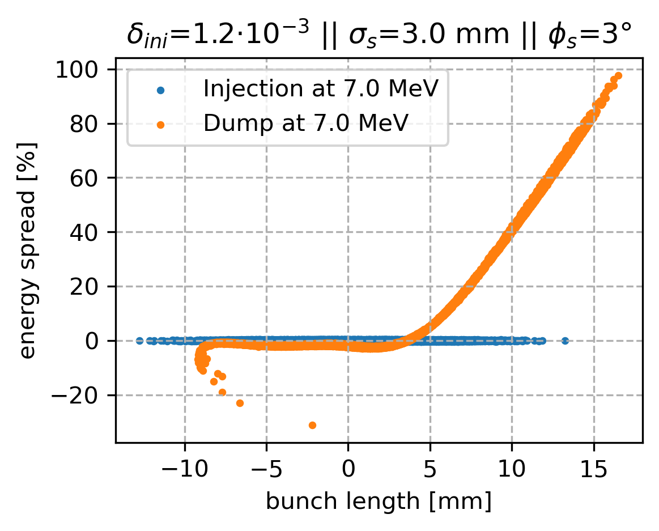
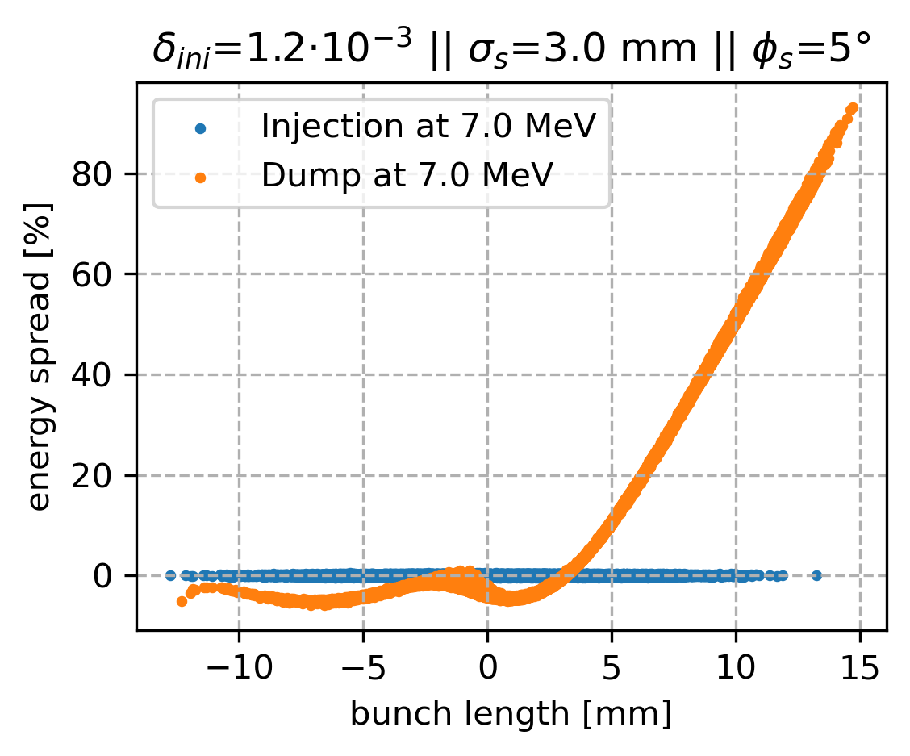
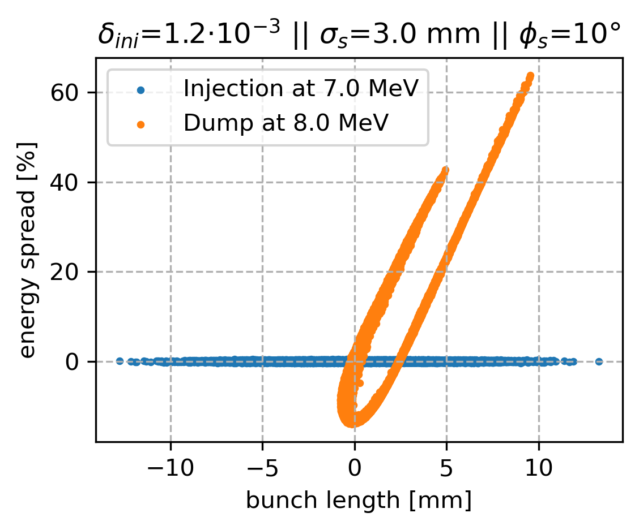
RF phase effects & solution ?
Arc 1: T566 = 2.6
'k2_1': 136.84 m⁻³ 'k2_2': 281.04 m⁻³ 'k2_3': 118.11 m⁻³
Need to modify T566 in arc 1 and 4 (c.f. last Gustavo’s presentation)
Arc 4: T566 = -13.4
'k2_1': 536.97 m⁻³ ‘k2_2':-1459.68 m⁻³ 'k2_3':-180.66 m⁻³

Slide 8
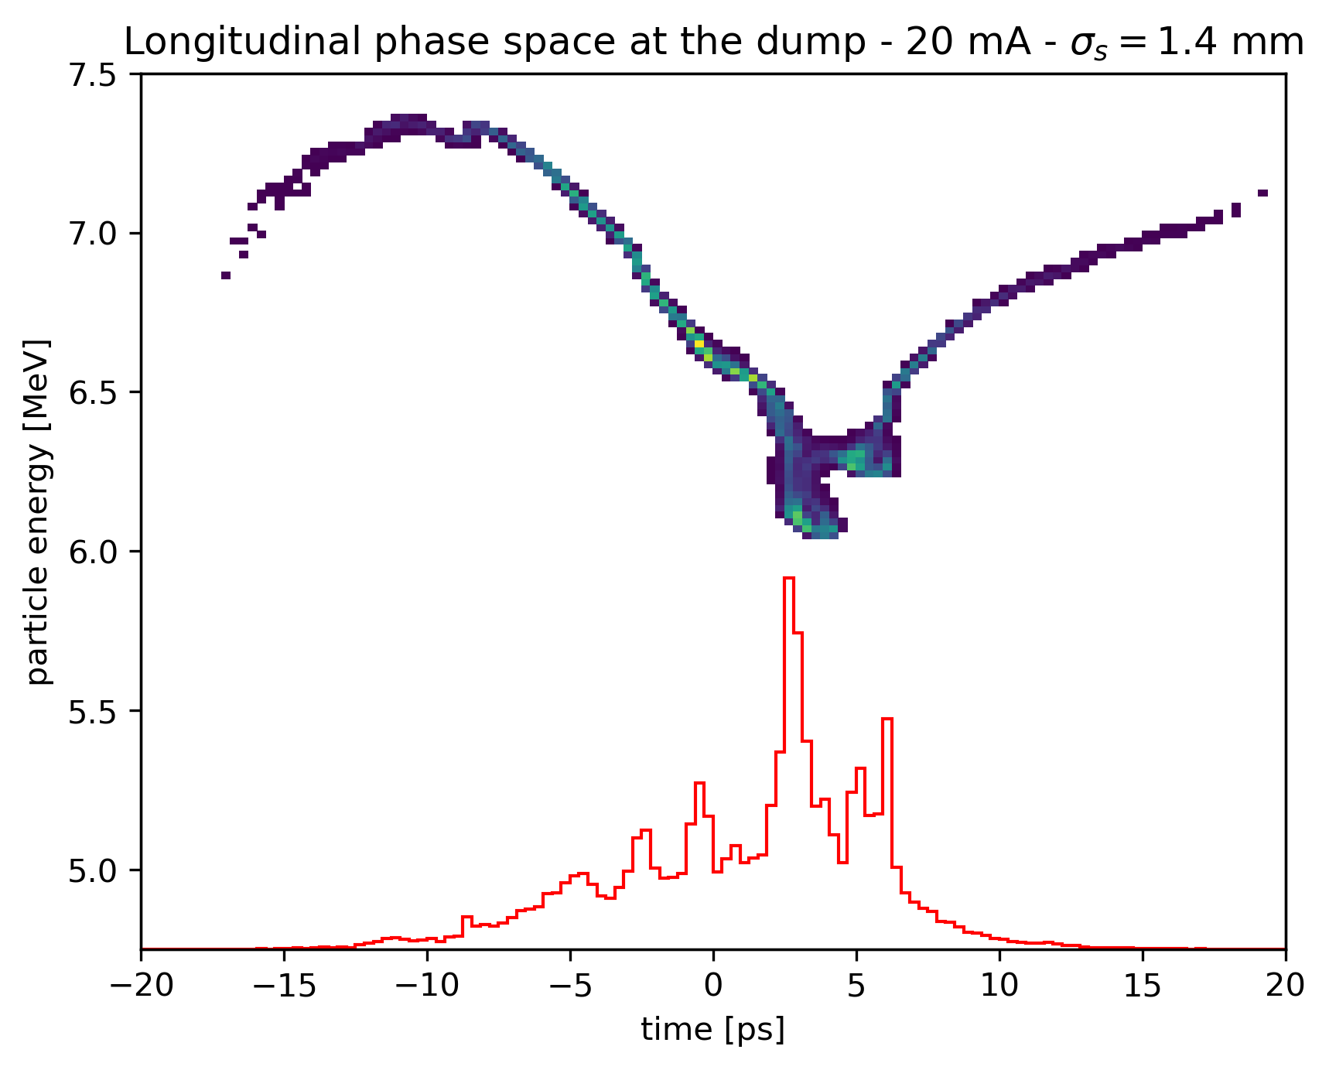
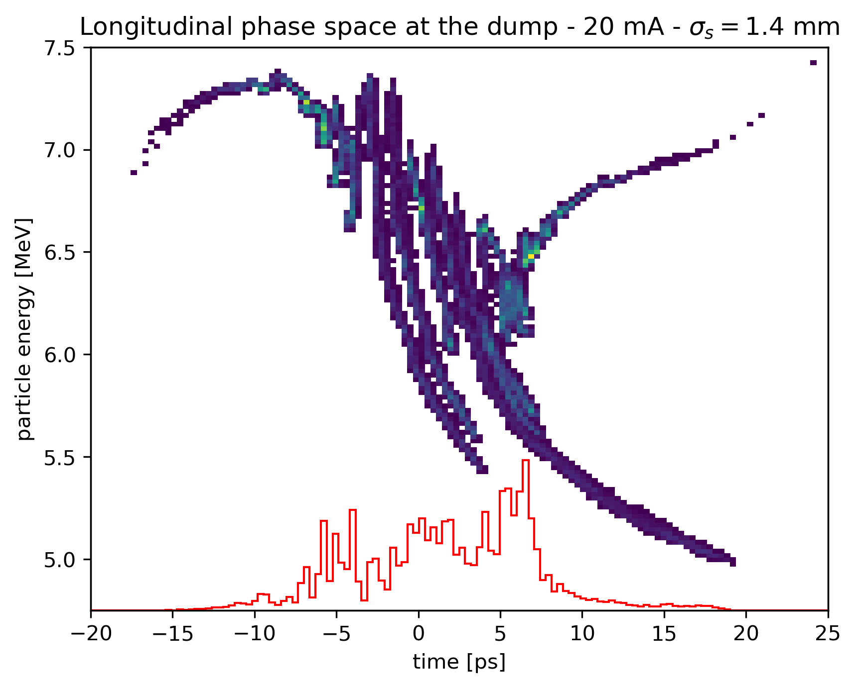
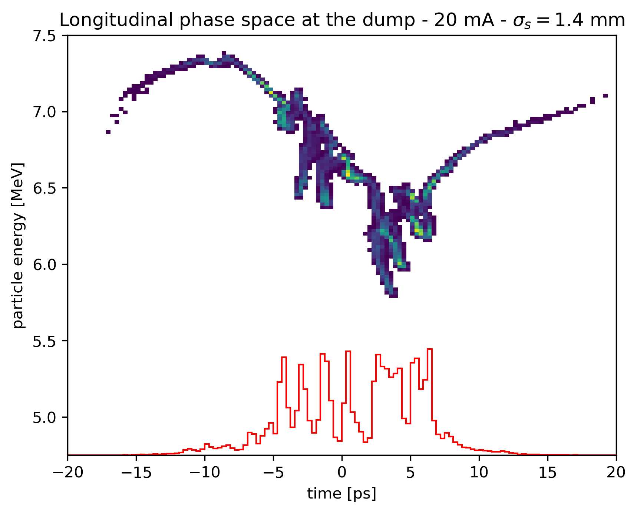
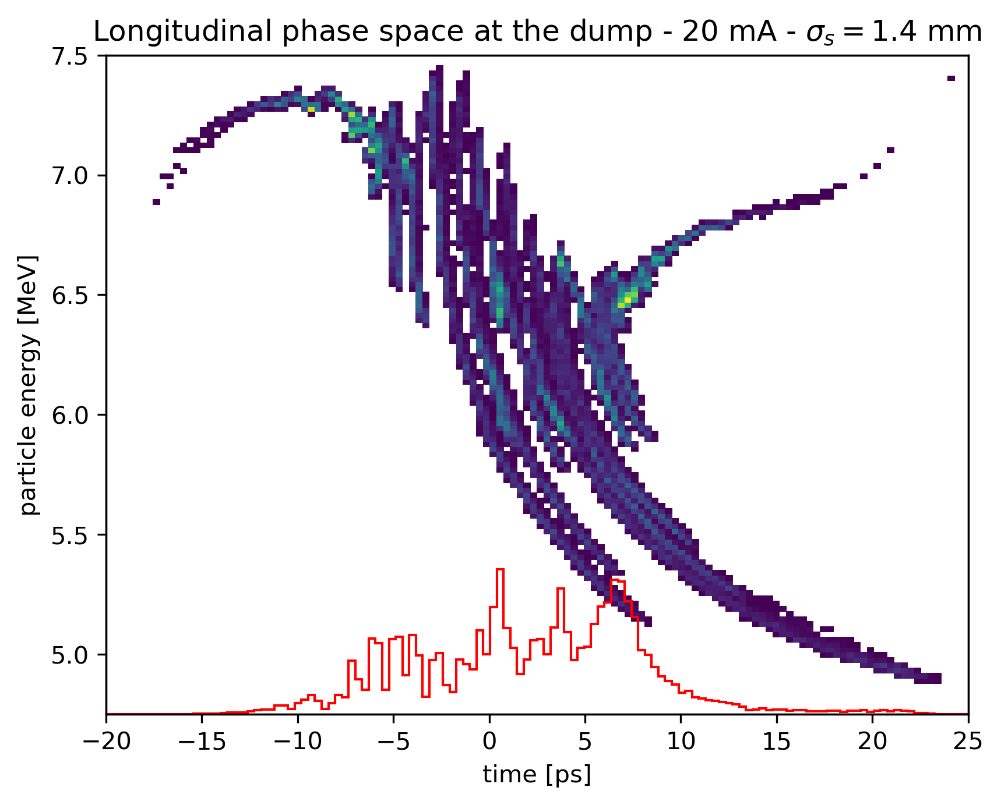
CSR effects
with binning
50 bins
256 bins
The number of nodes in the dipole doesn’t change the behavior.
However the binning of the beam along the longitudinal axis does.
128 bins
512 bins

Slide 9
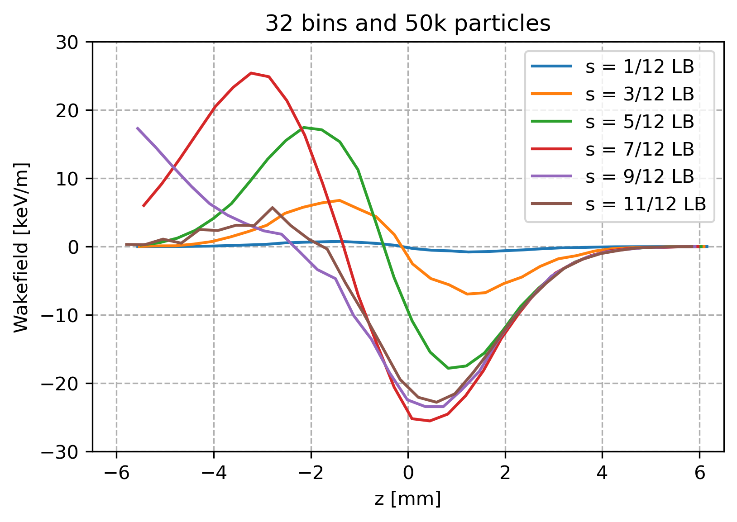
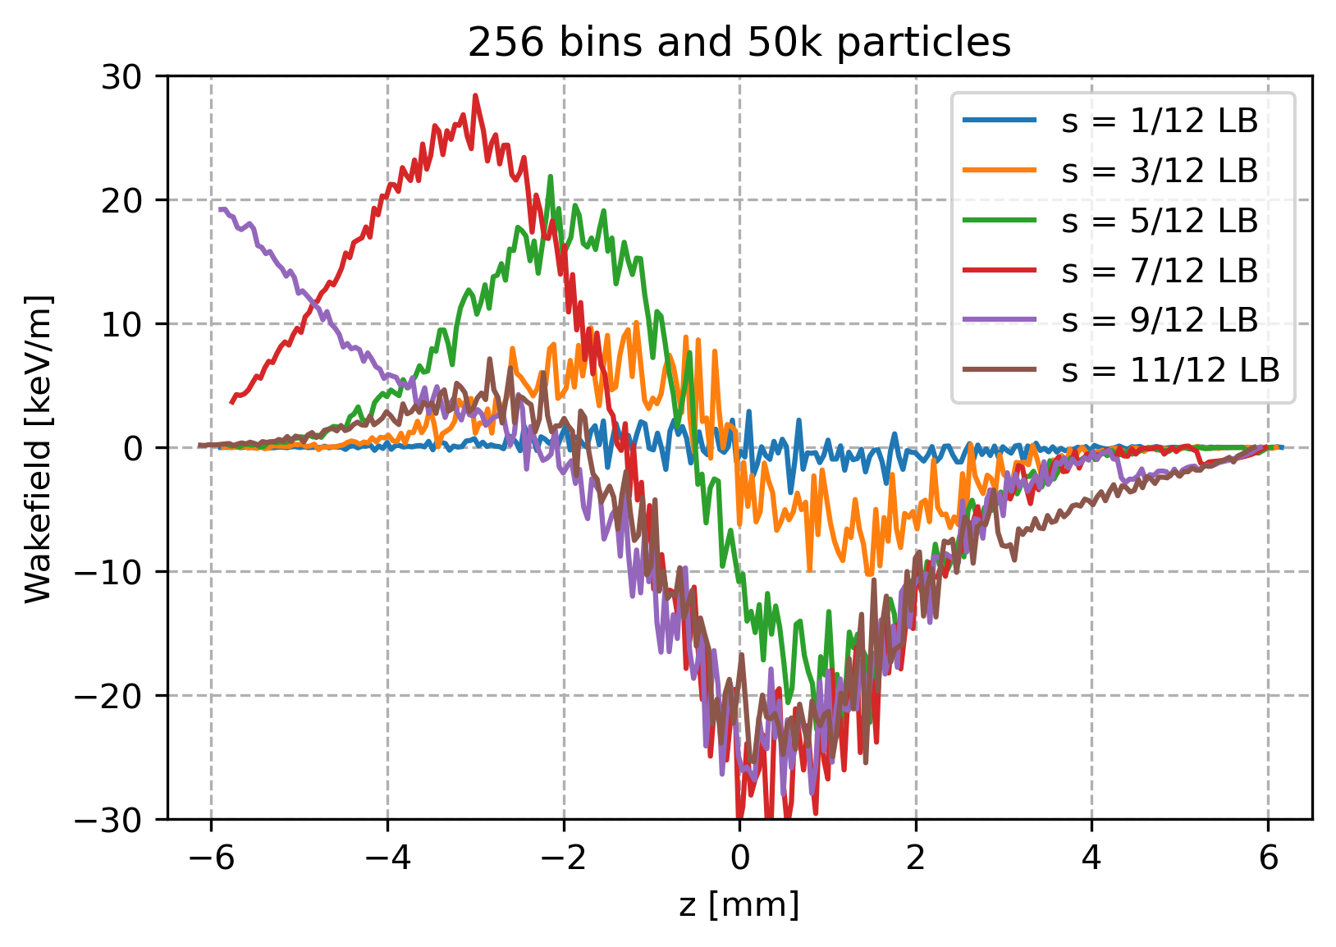
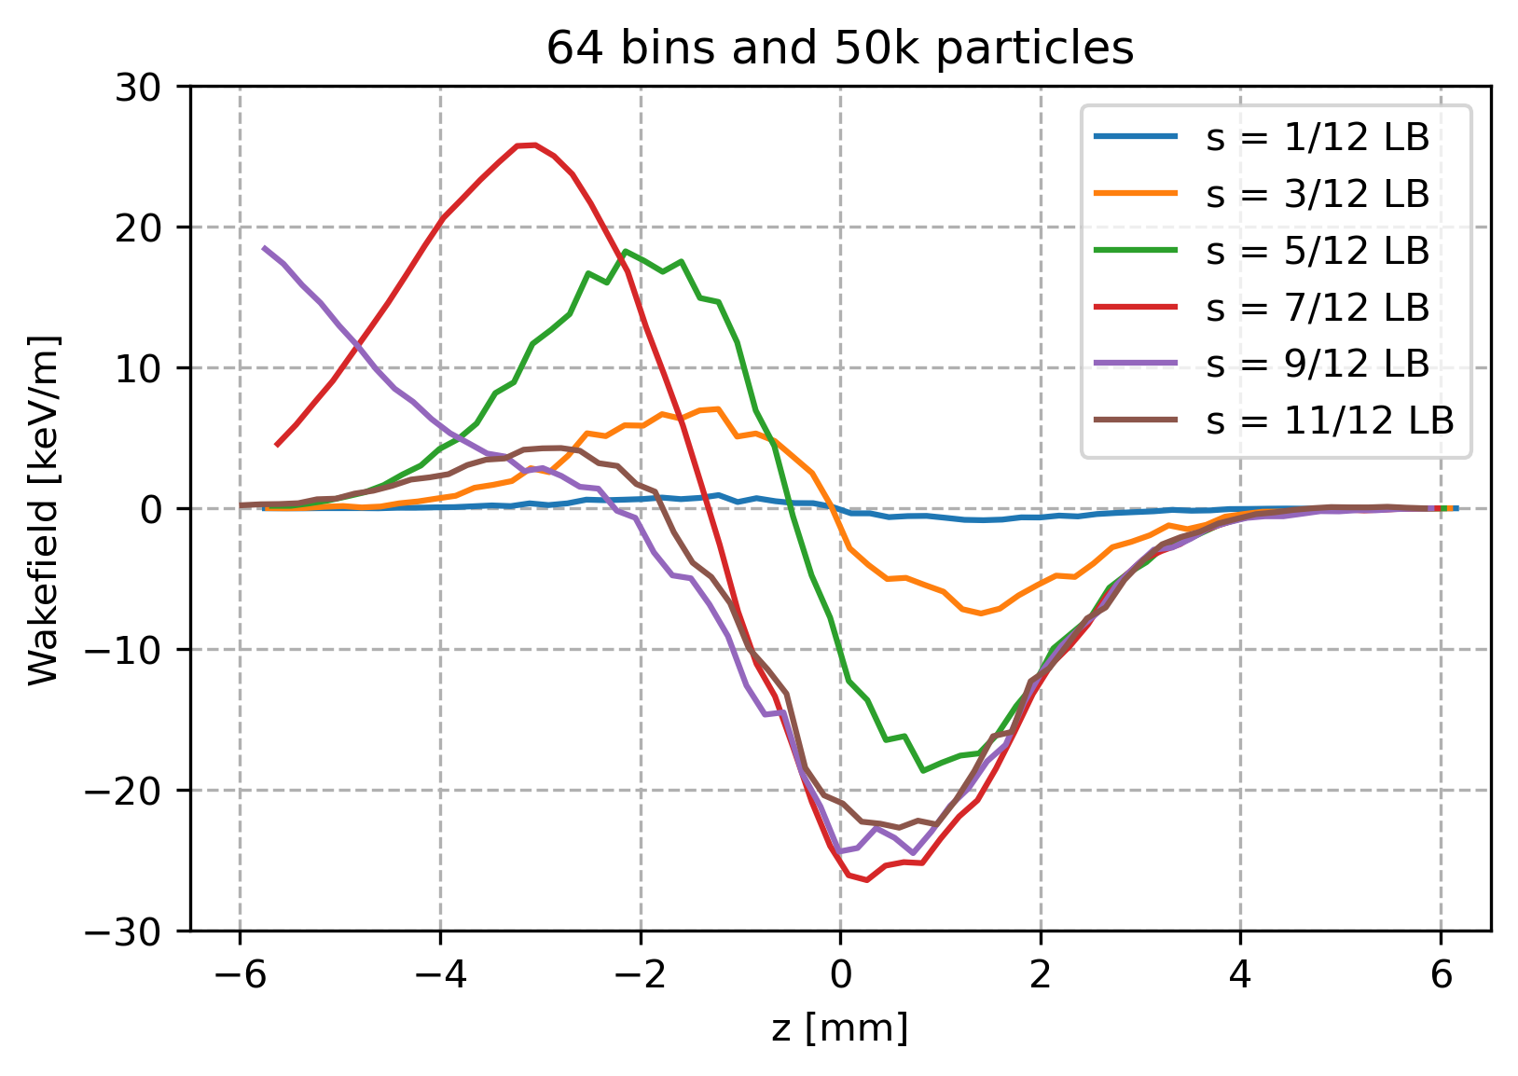
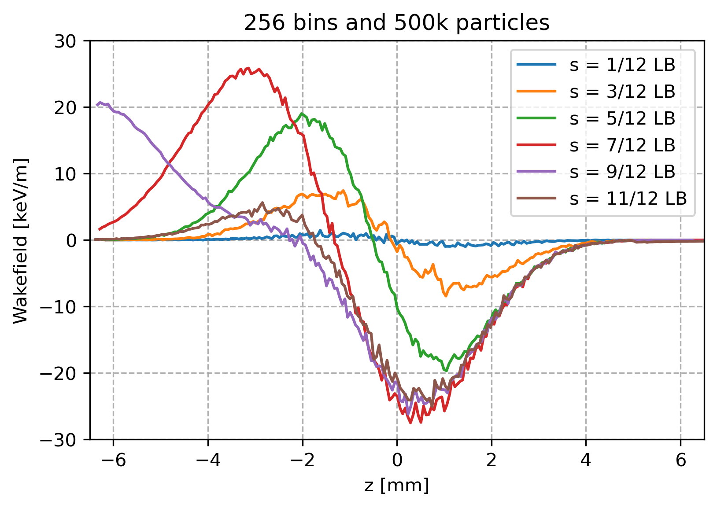
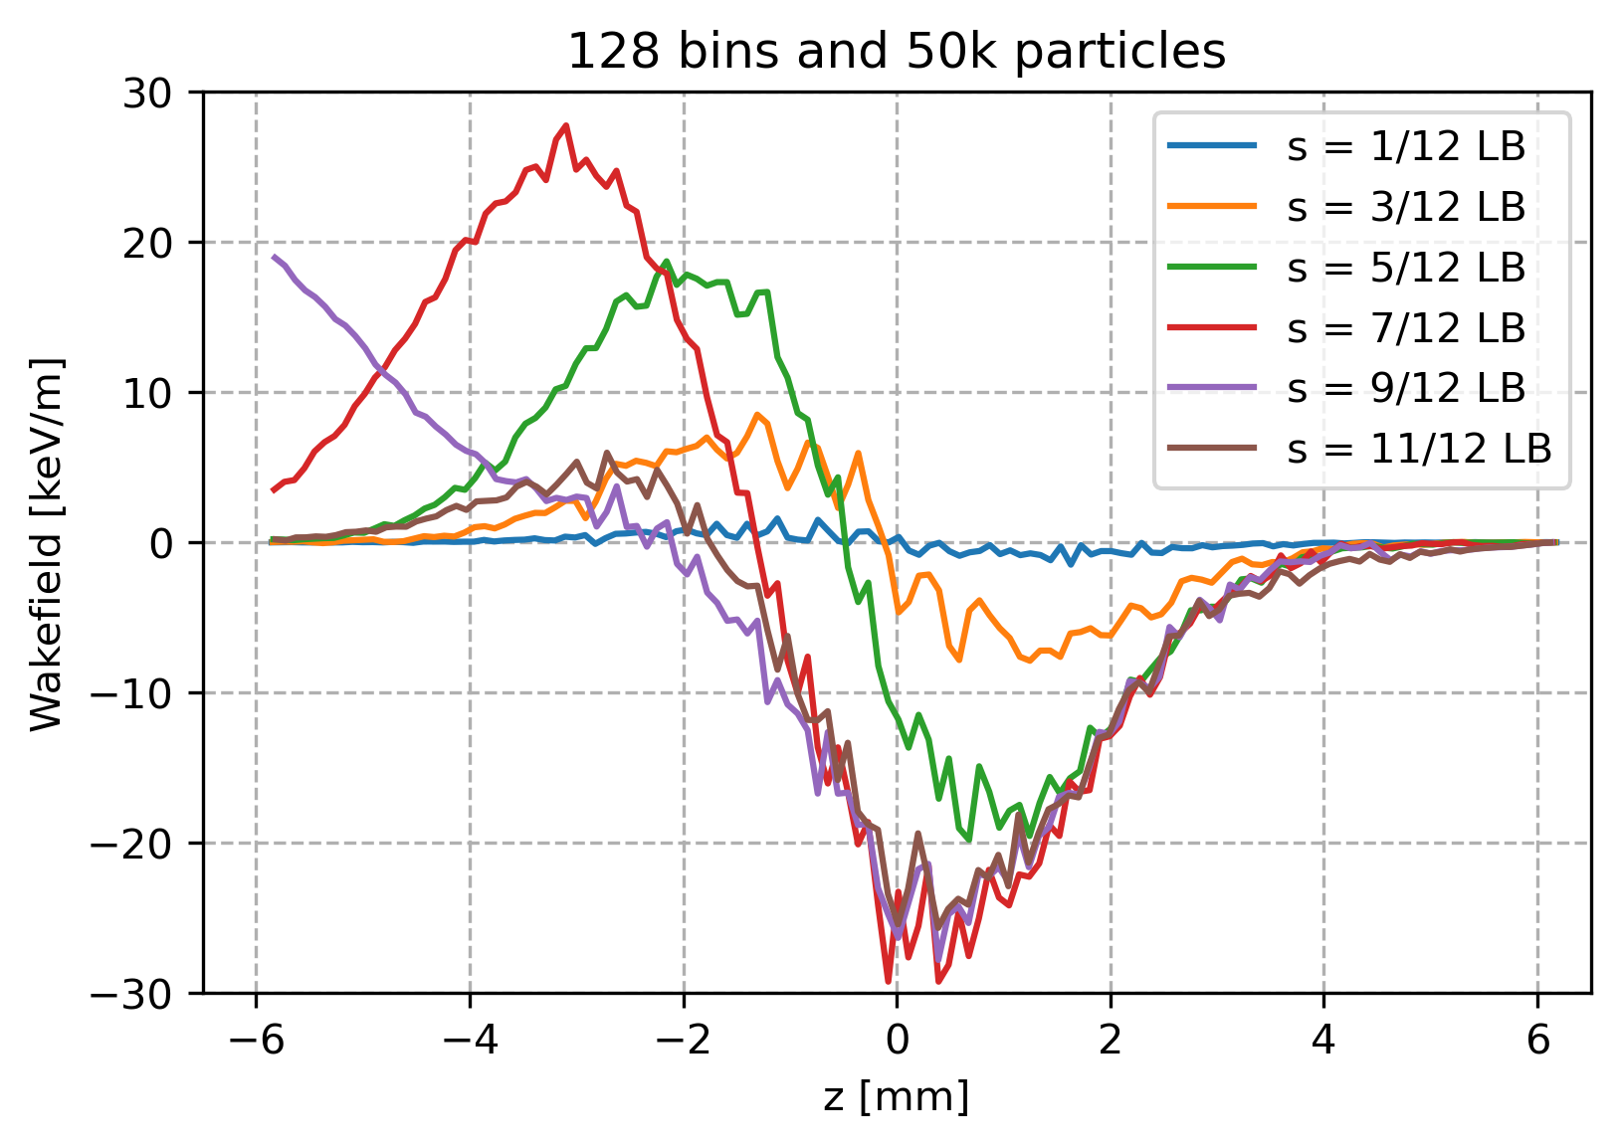
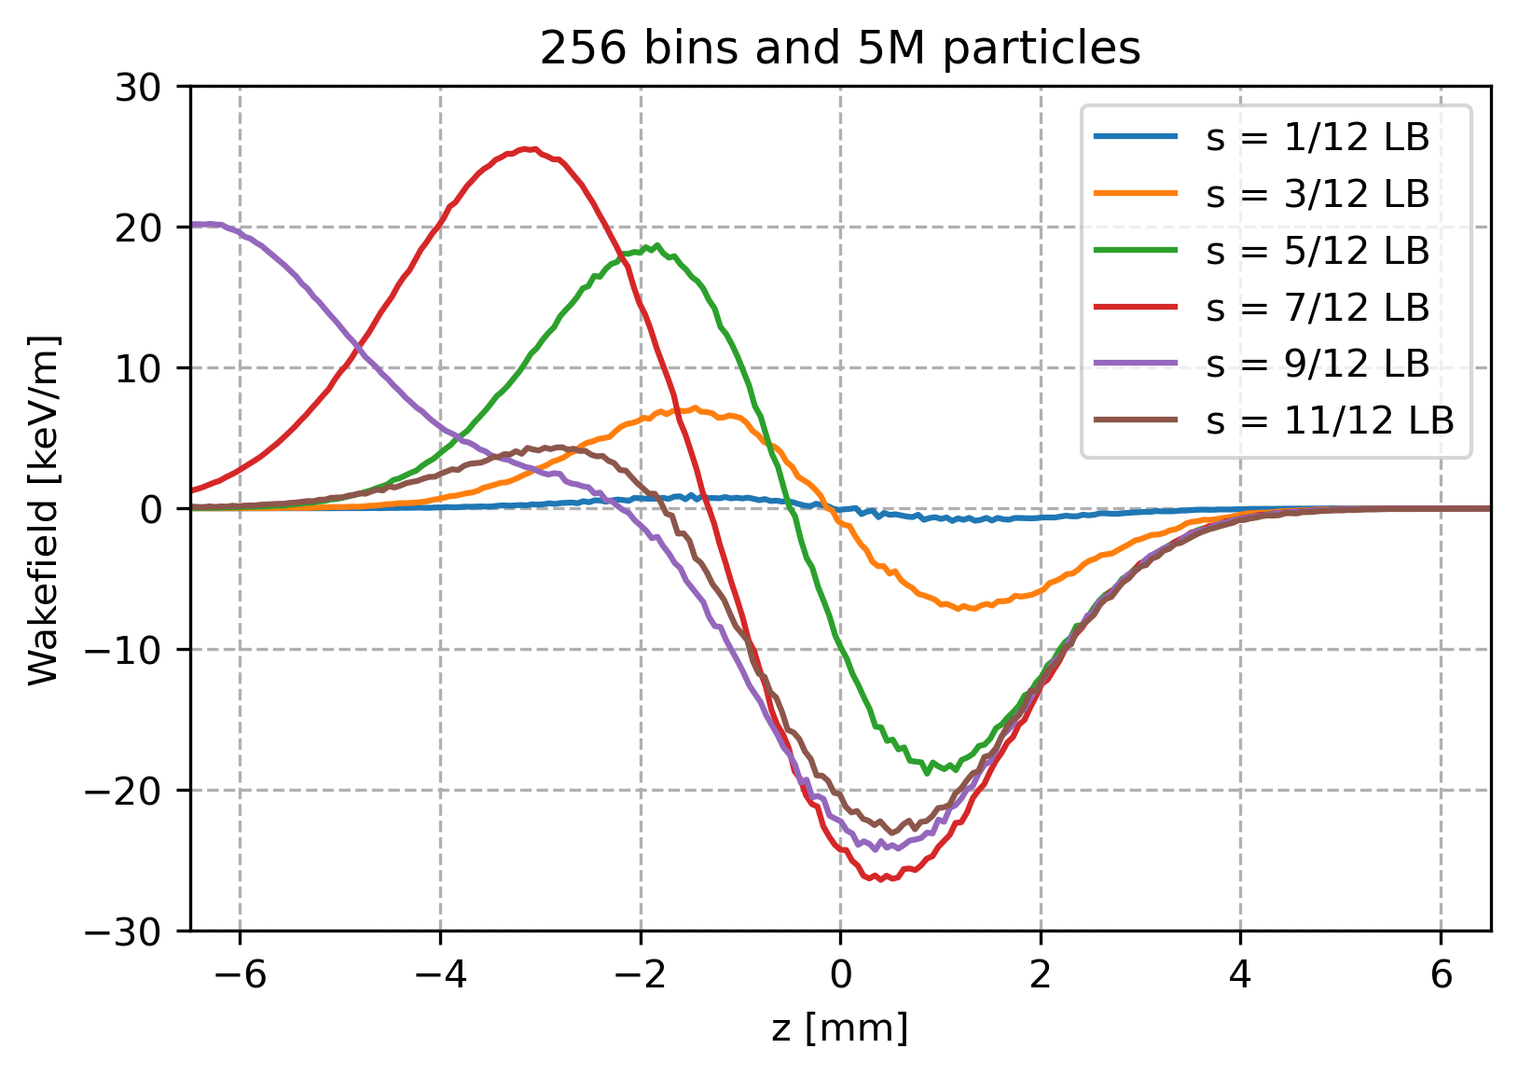
CSR effects
with binning
The number of nodes in the dipole doesn’t change the behavior.
However the binning of the beam along the longitudinal axis does.

Slide 10
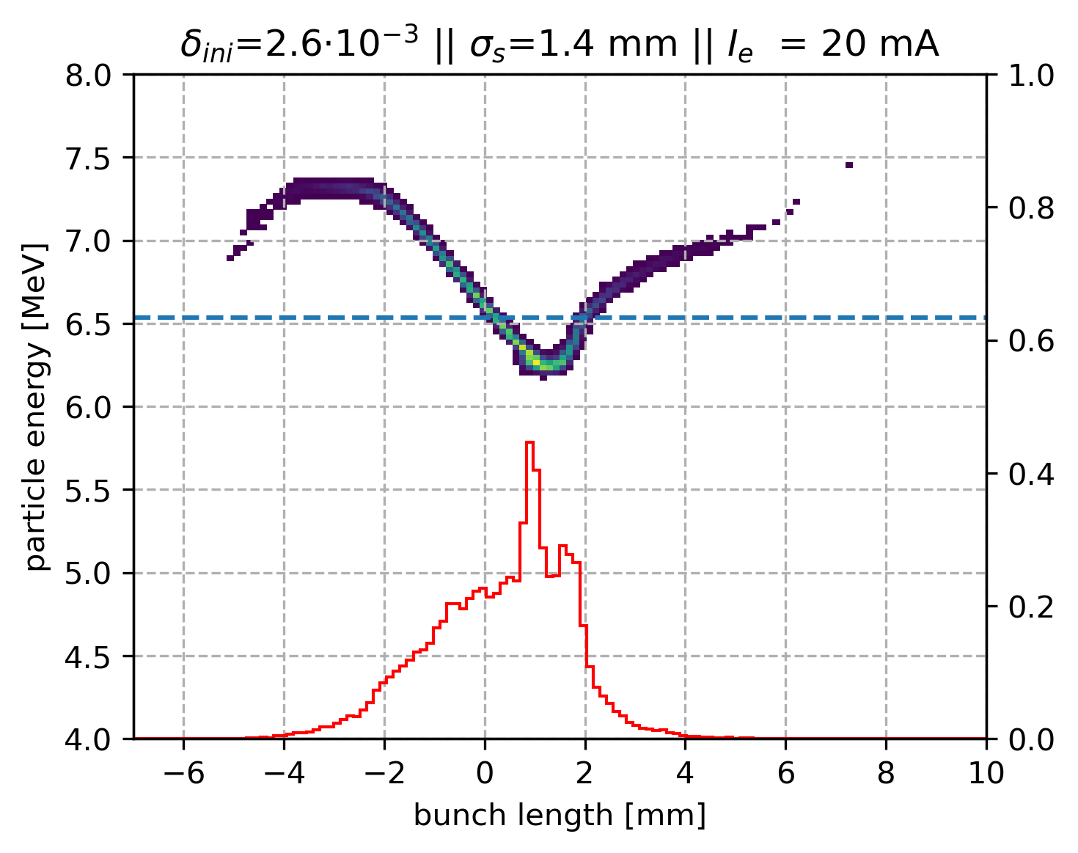
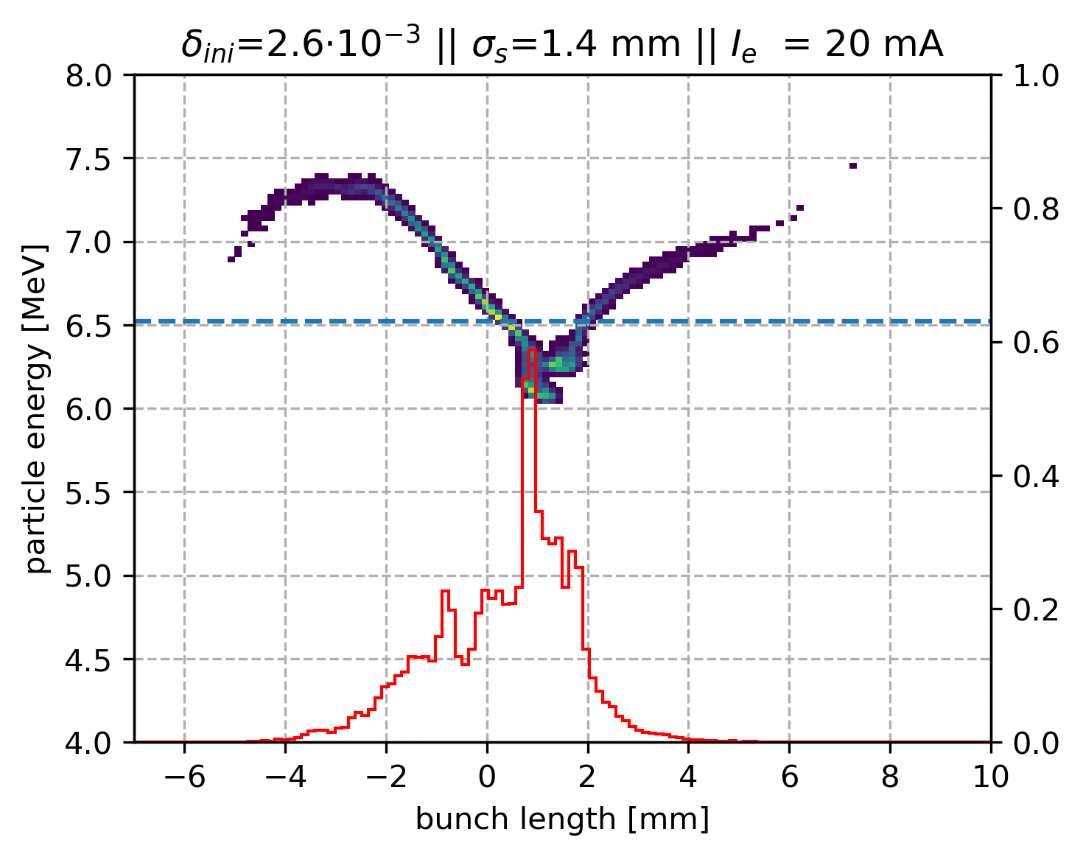
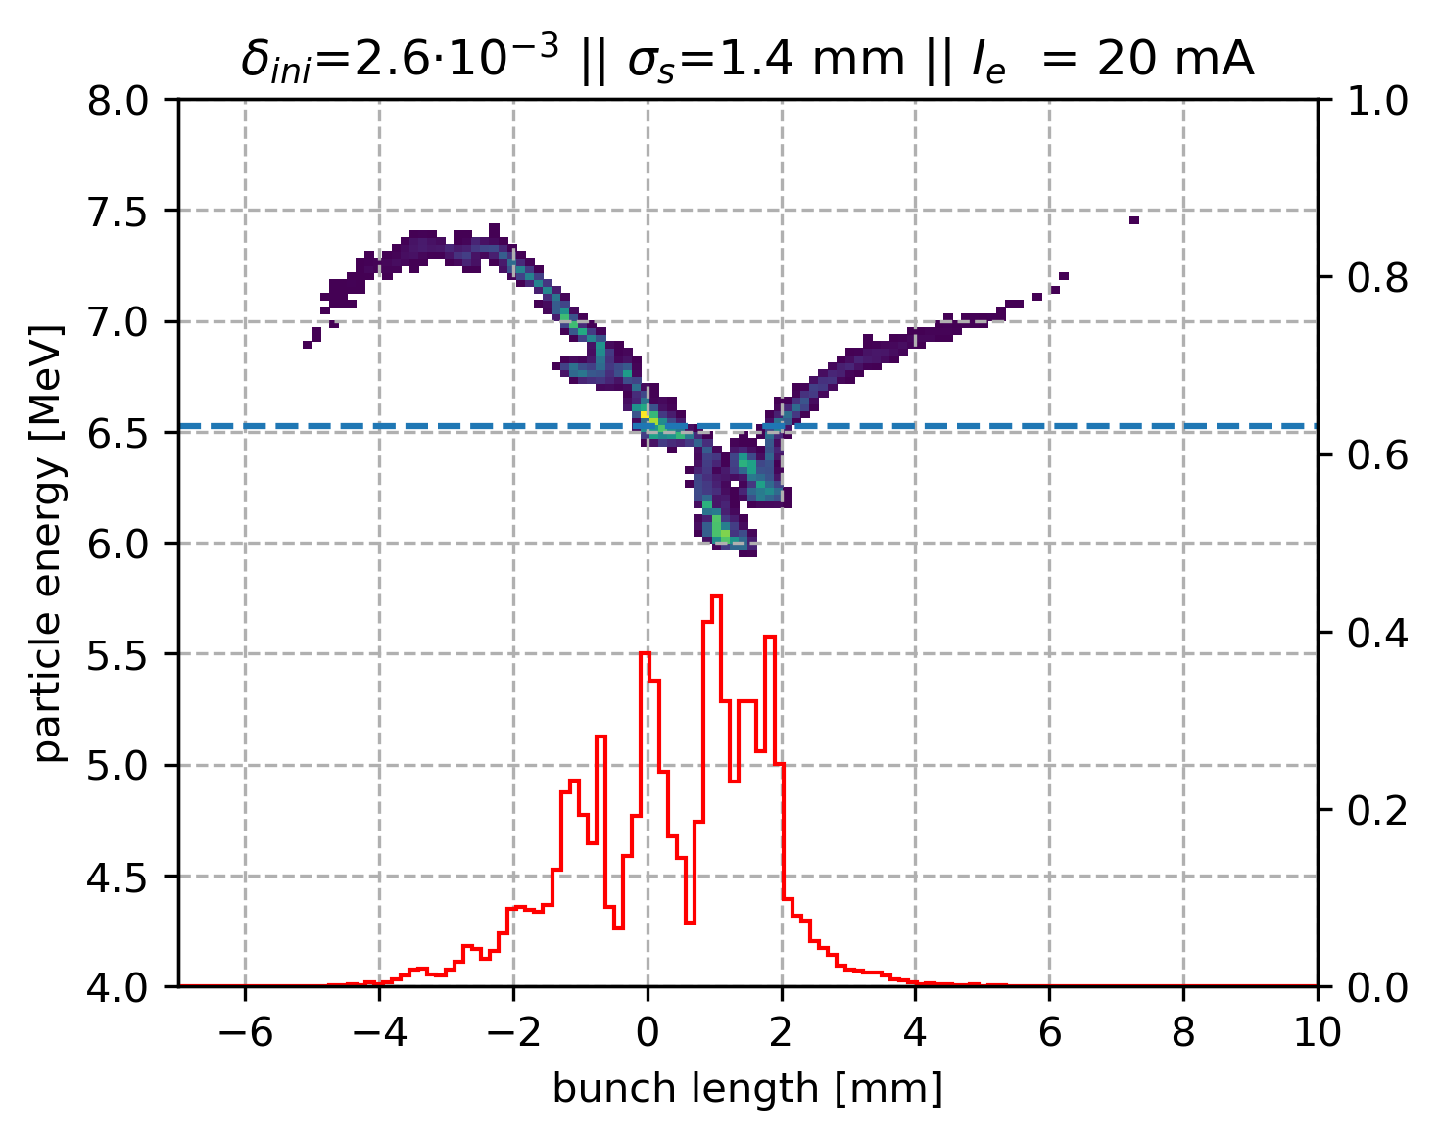
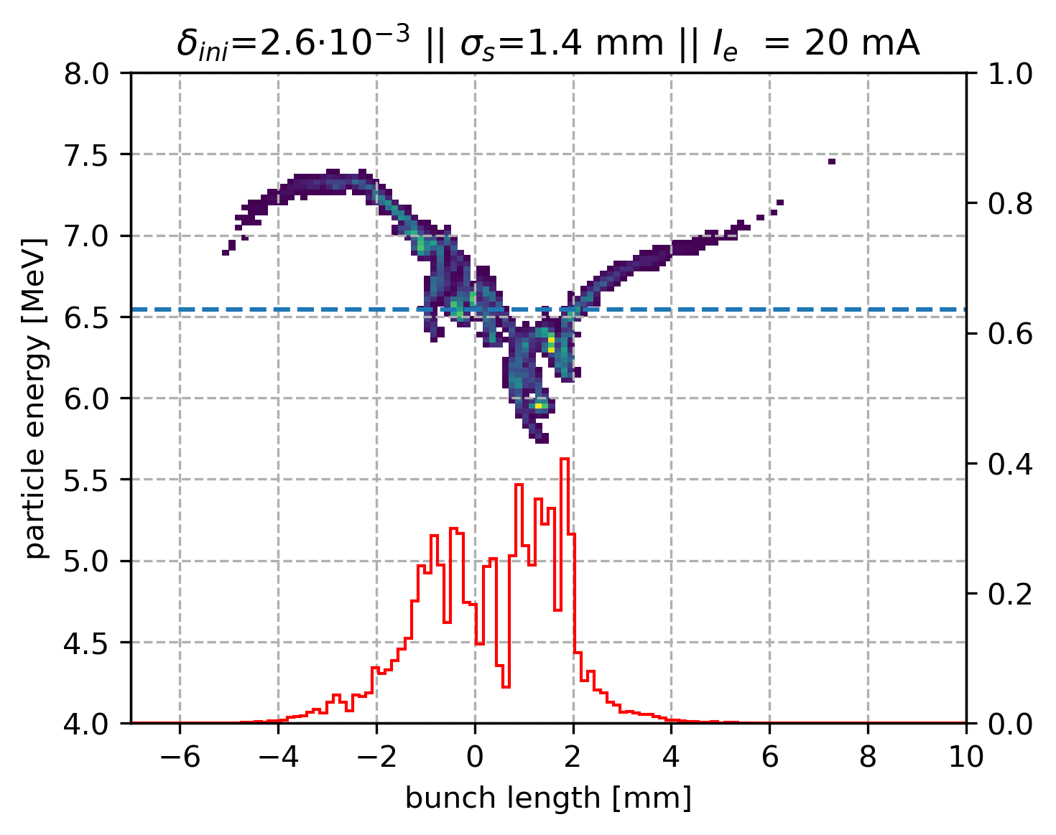
CSR effects
with binning

Slide 11
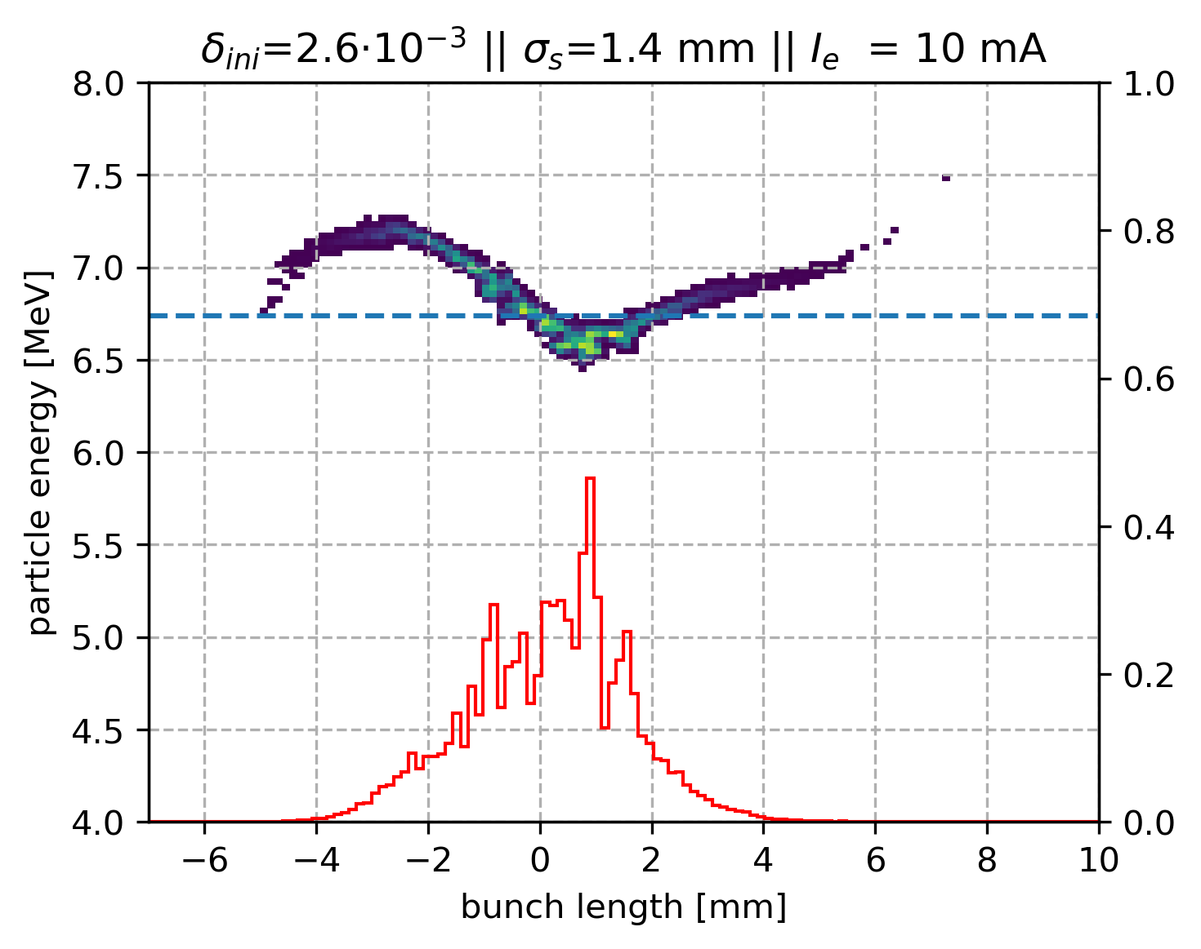
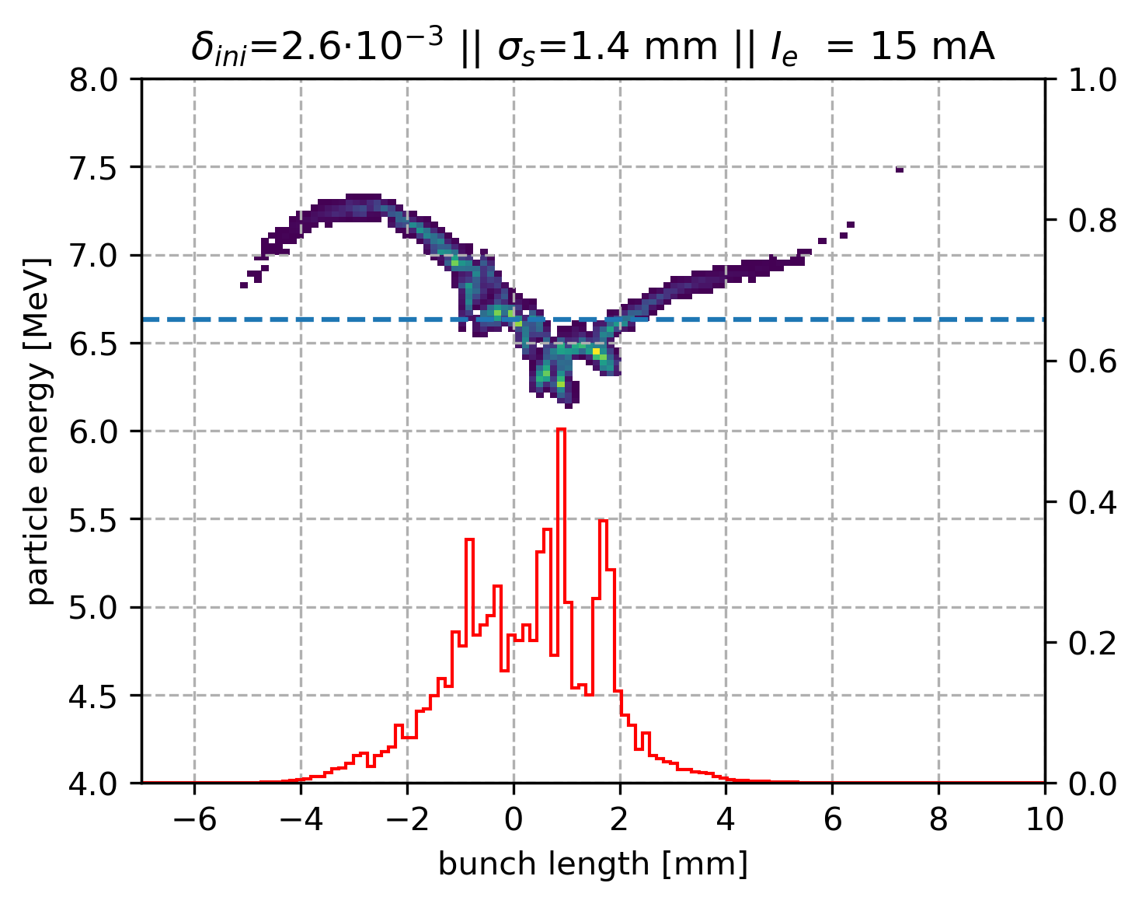
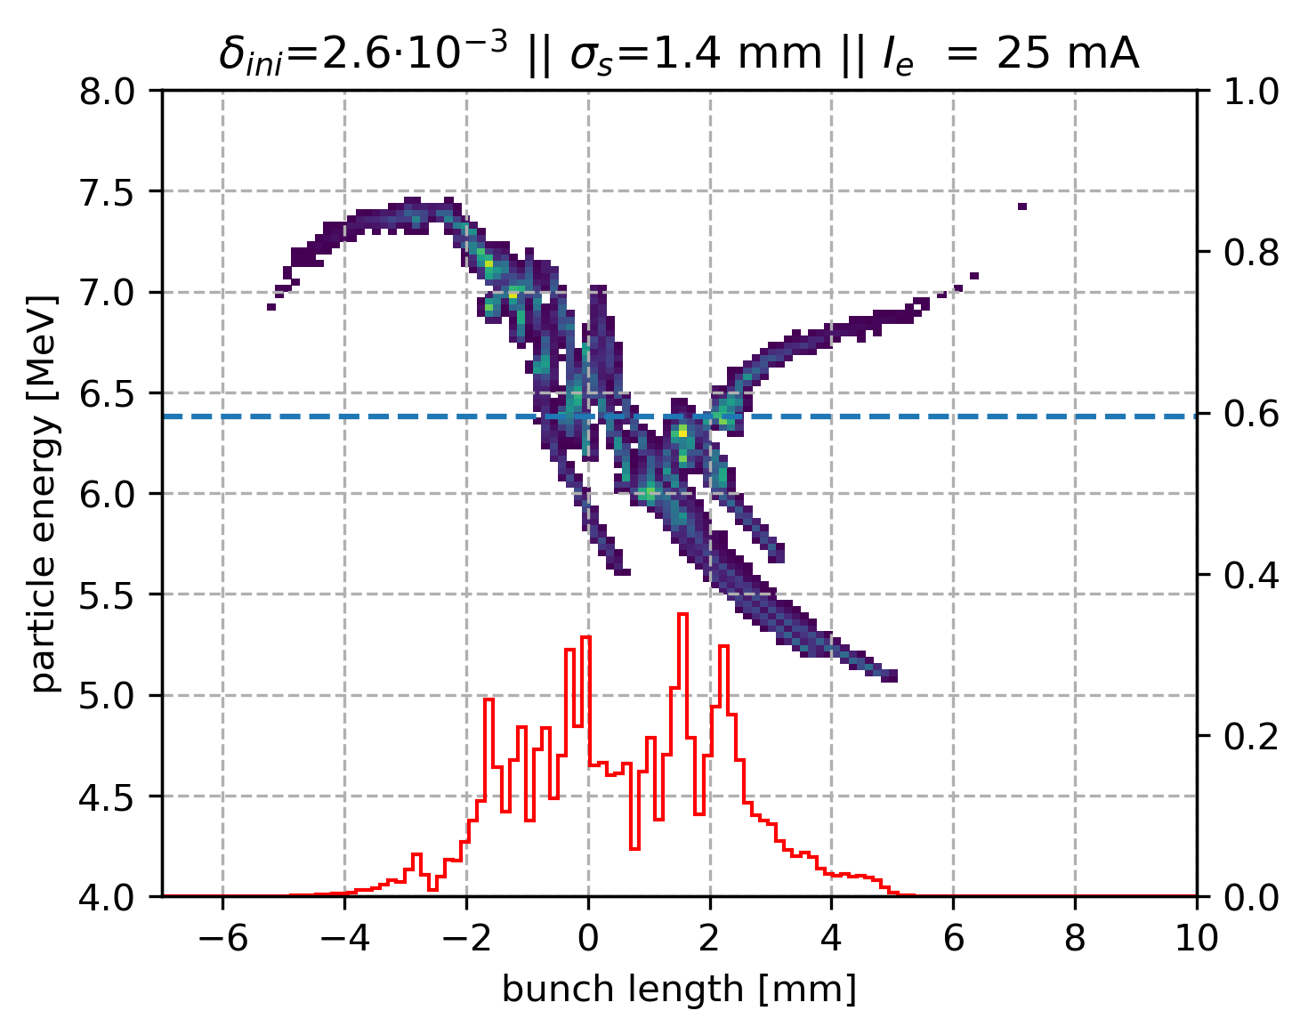
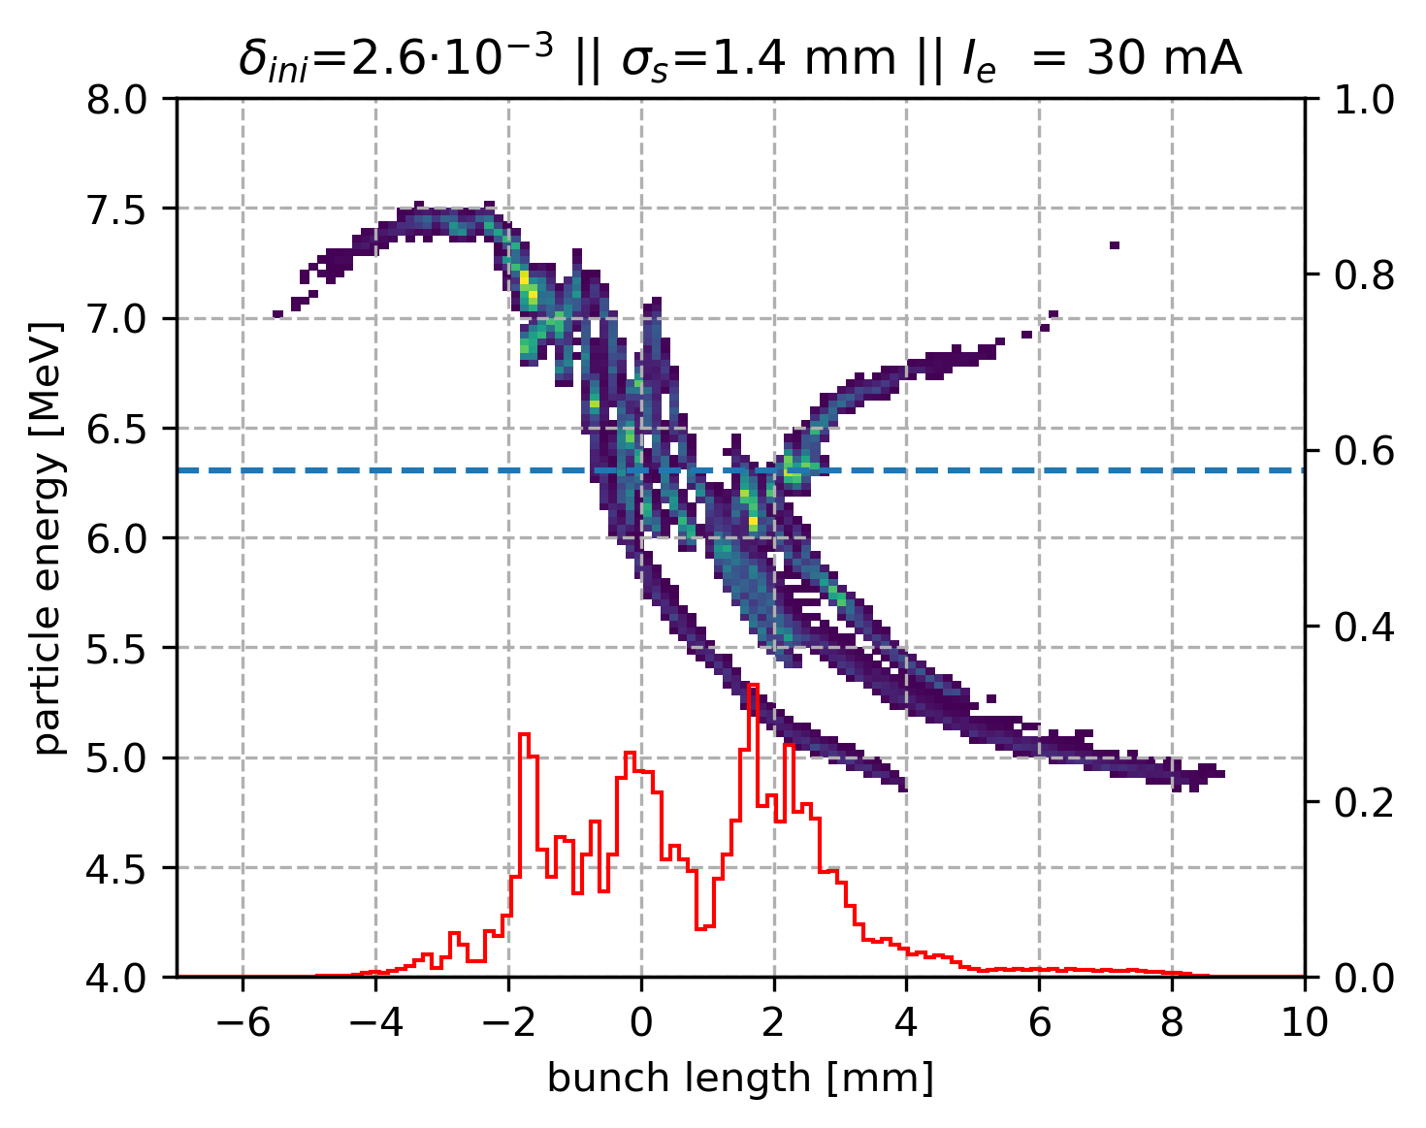
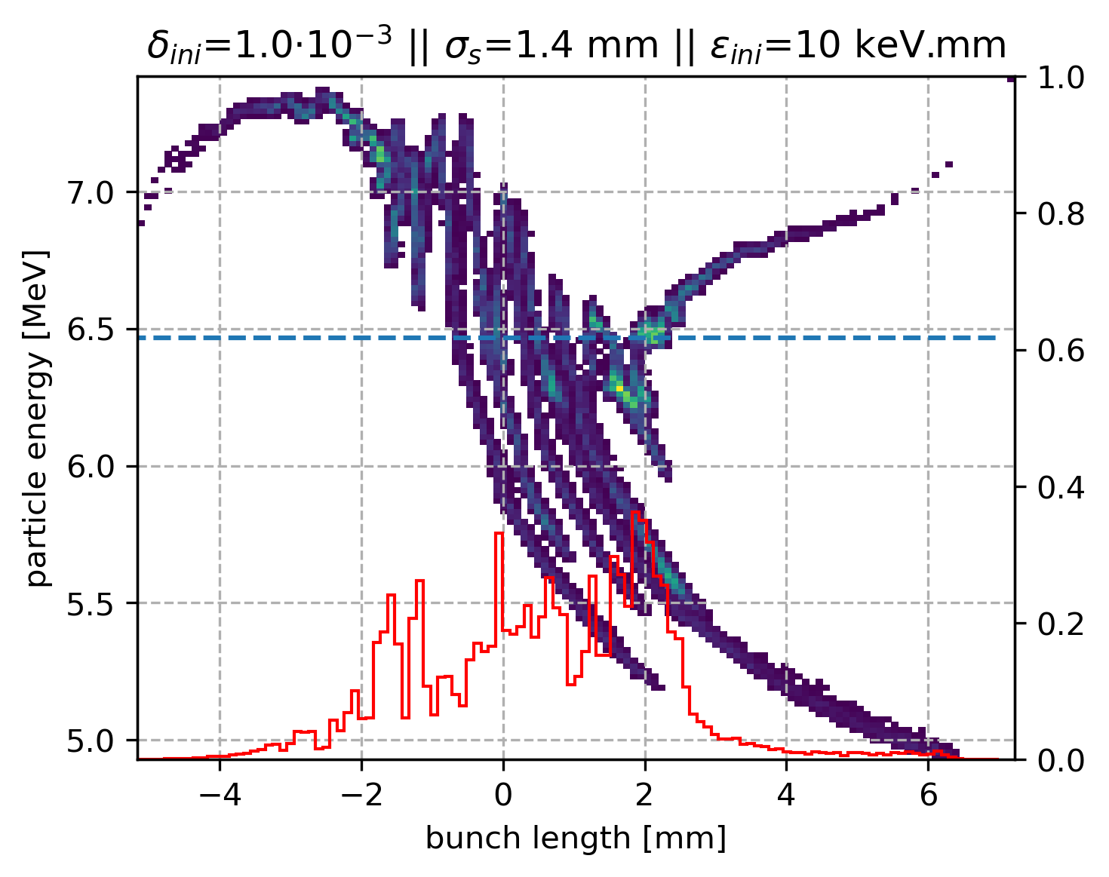
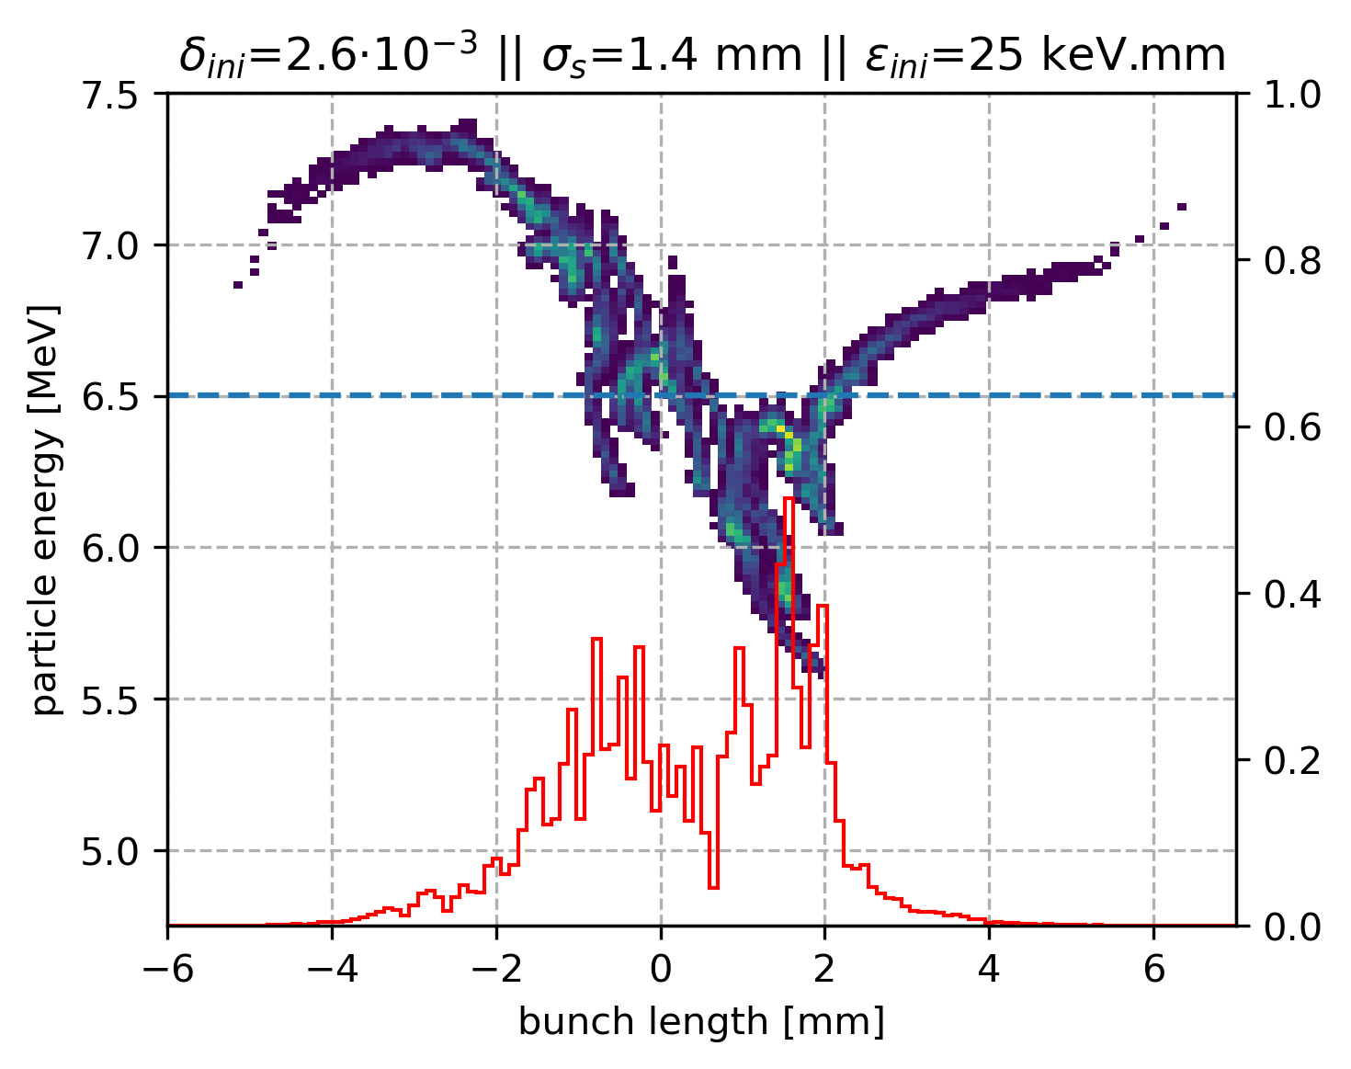
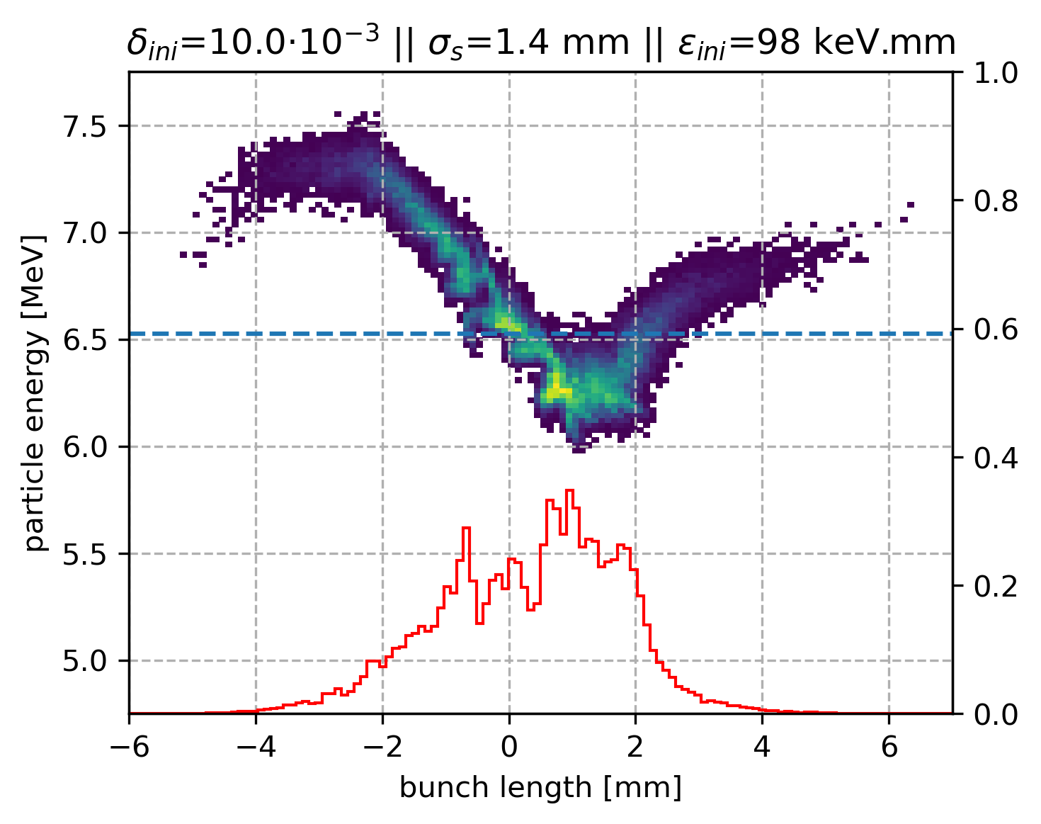
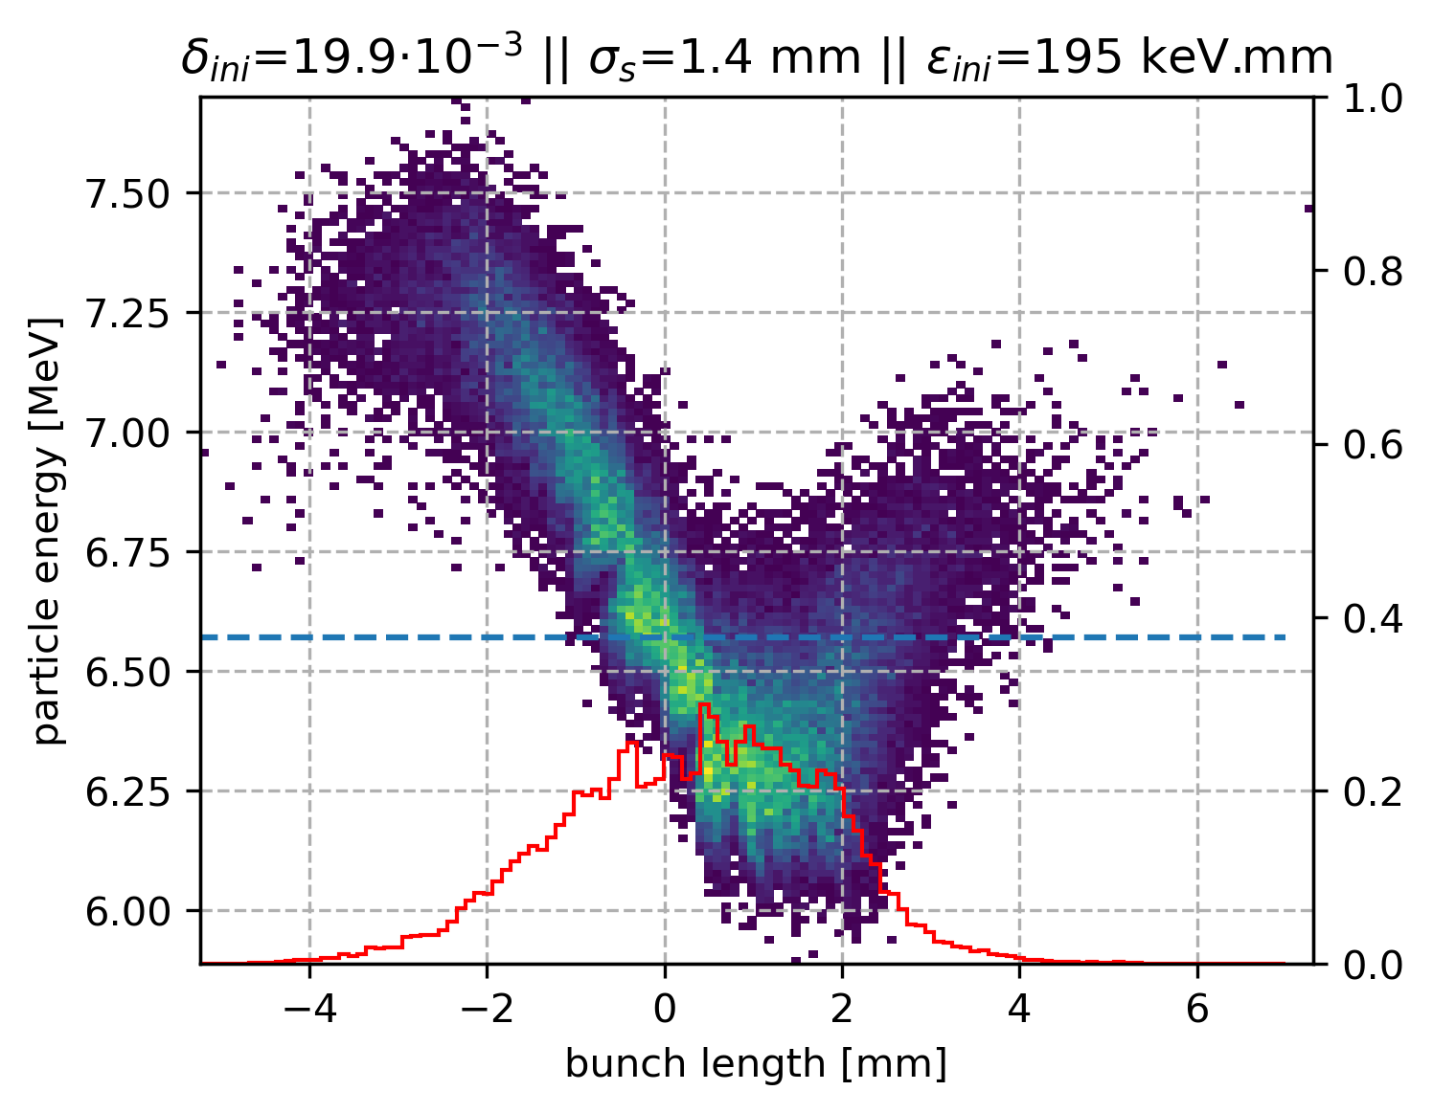
CSR with beam current
CSR with initial energy spread (and 20 mA)
256 bins

Slide 12
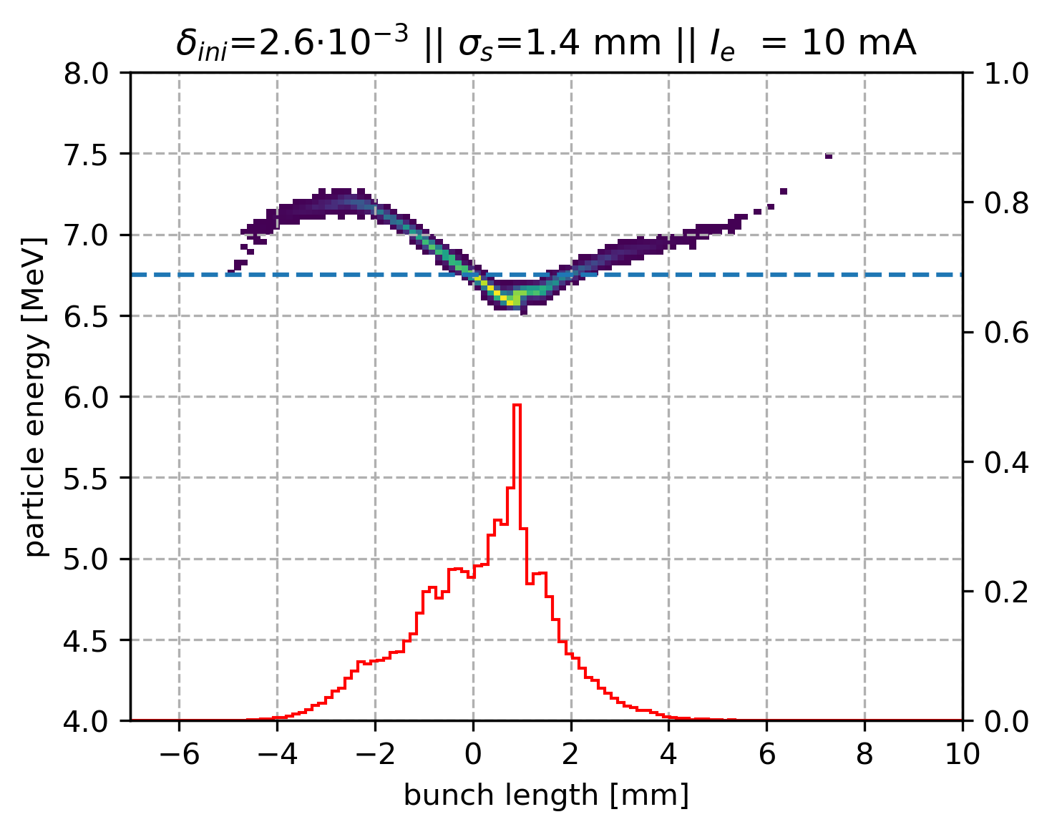
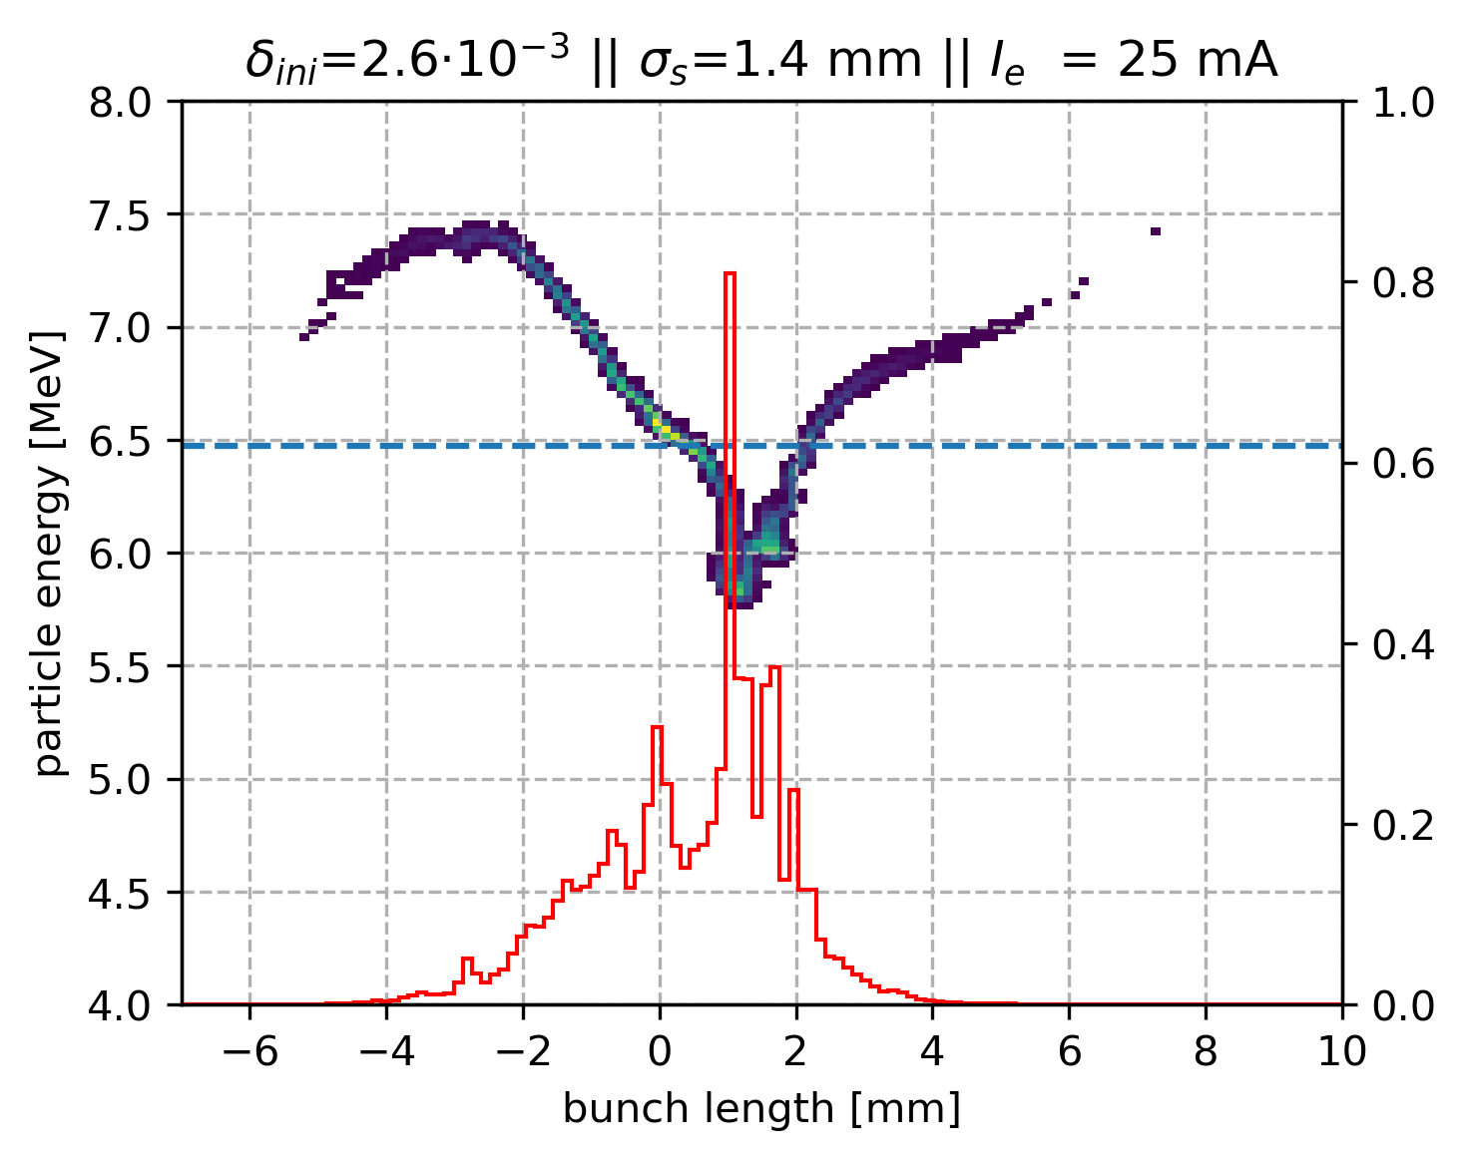
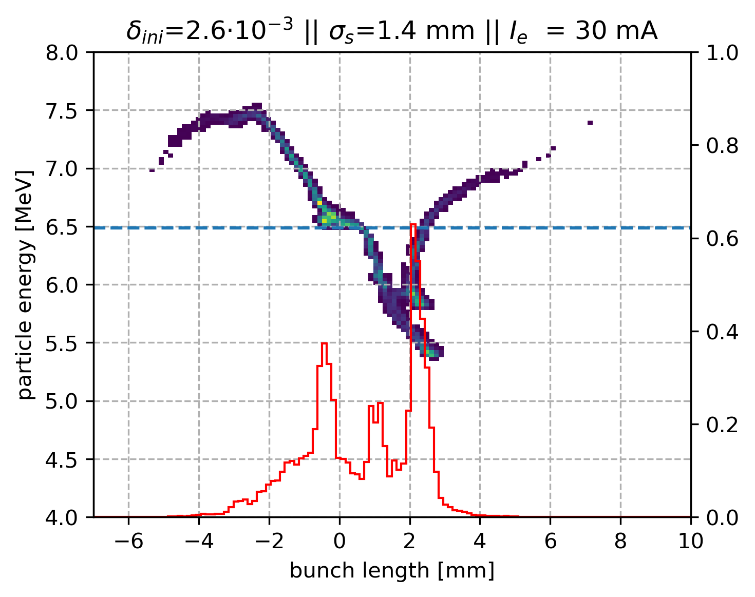
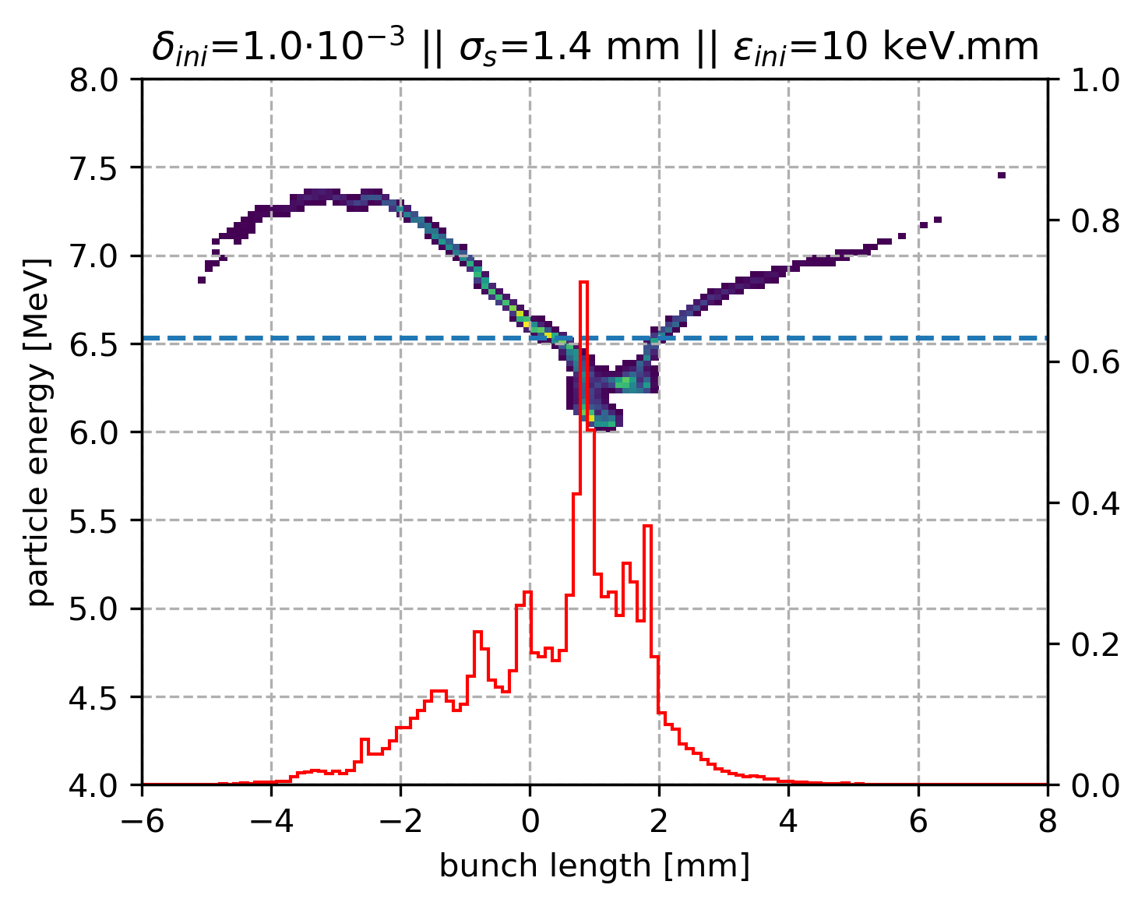
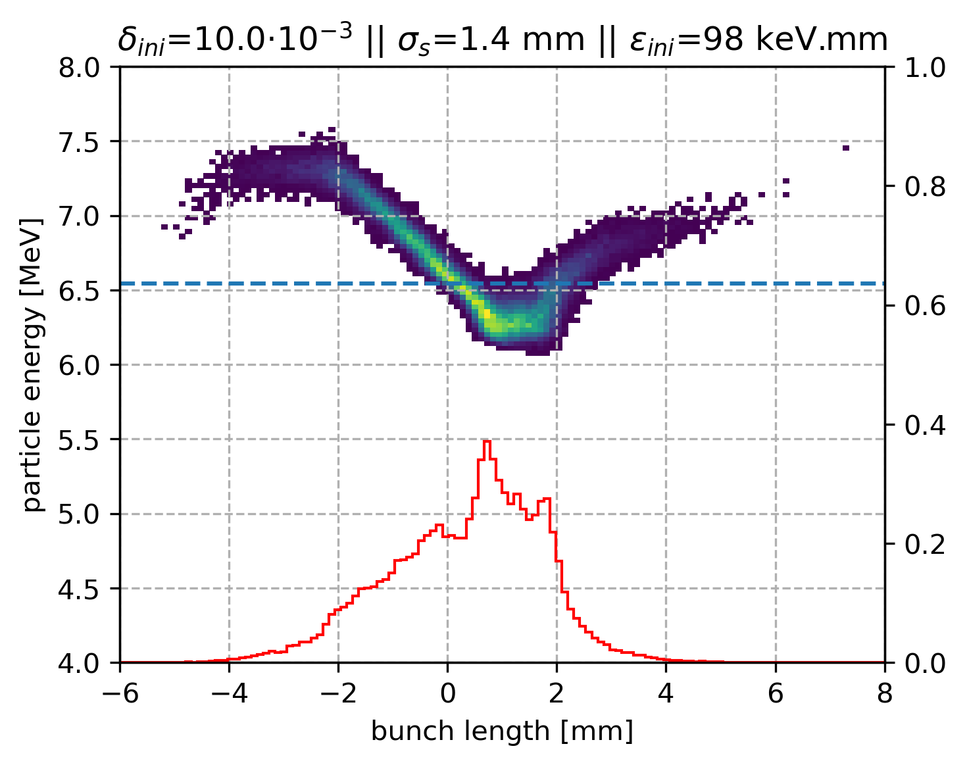
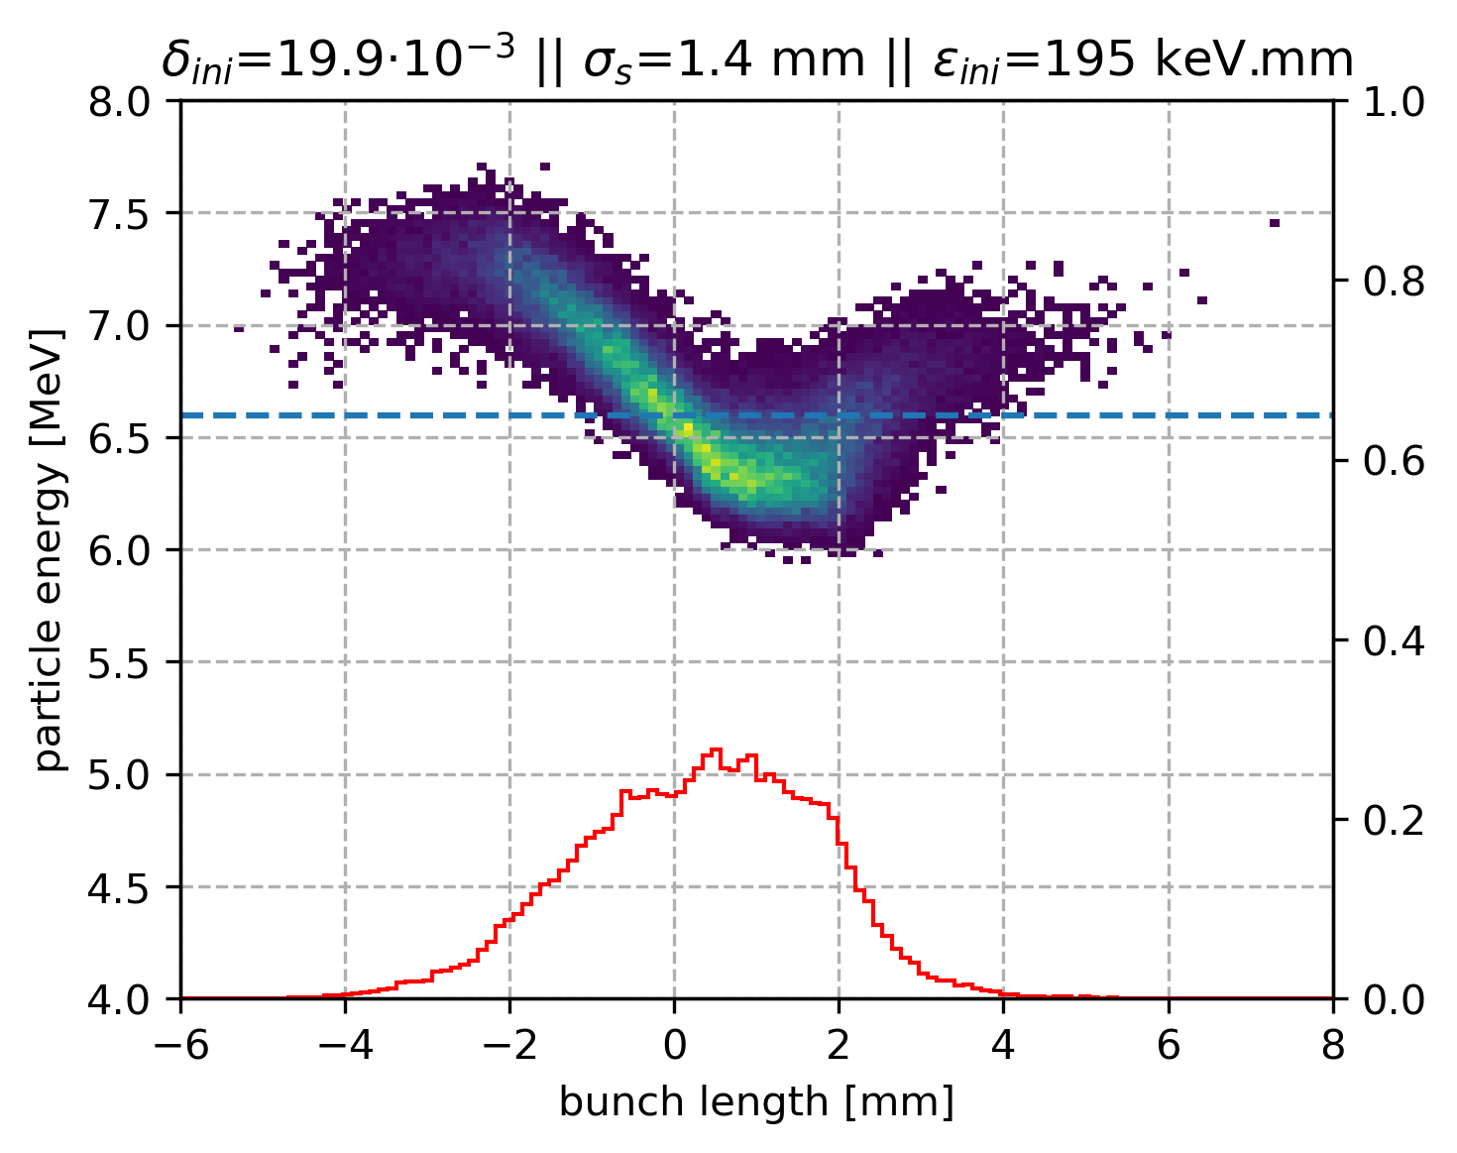
CSR with beam current
CSR with initial energy spread (and 20 mA)
64 bins

Slide 13
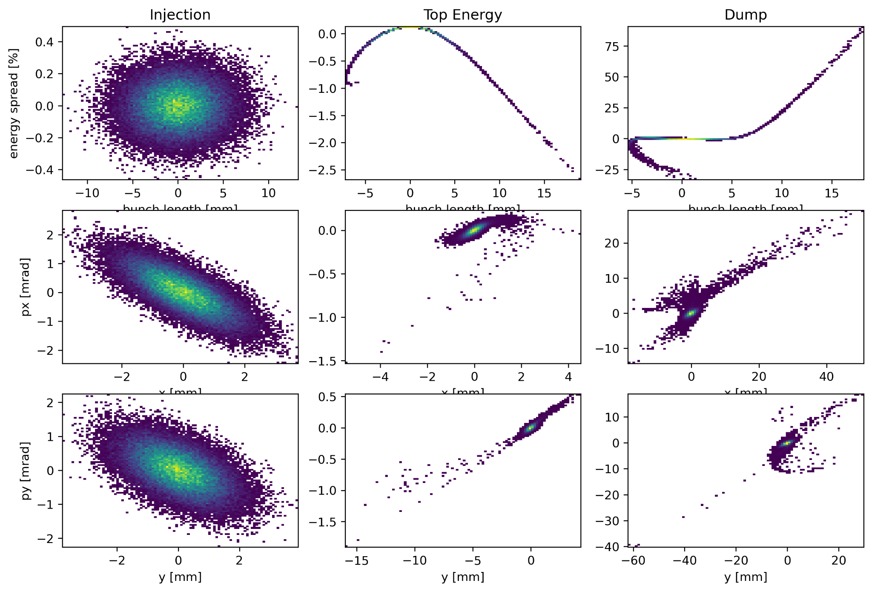
Plain tracking - bunch length of 3.0 mm - 20 mA
Normalised emittance at injection is
6 mm.mrad
longitudinal emittance
is 25 keV.mm
≣ δ_{ini} = 1.2 10⁻³ σ_{s}= 3 mm
99.49% transmission without CSR

Slide 14
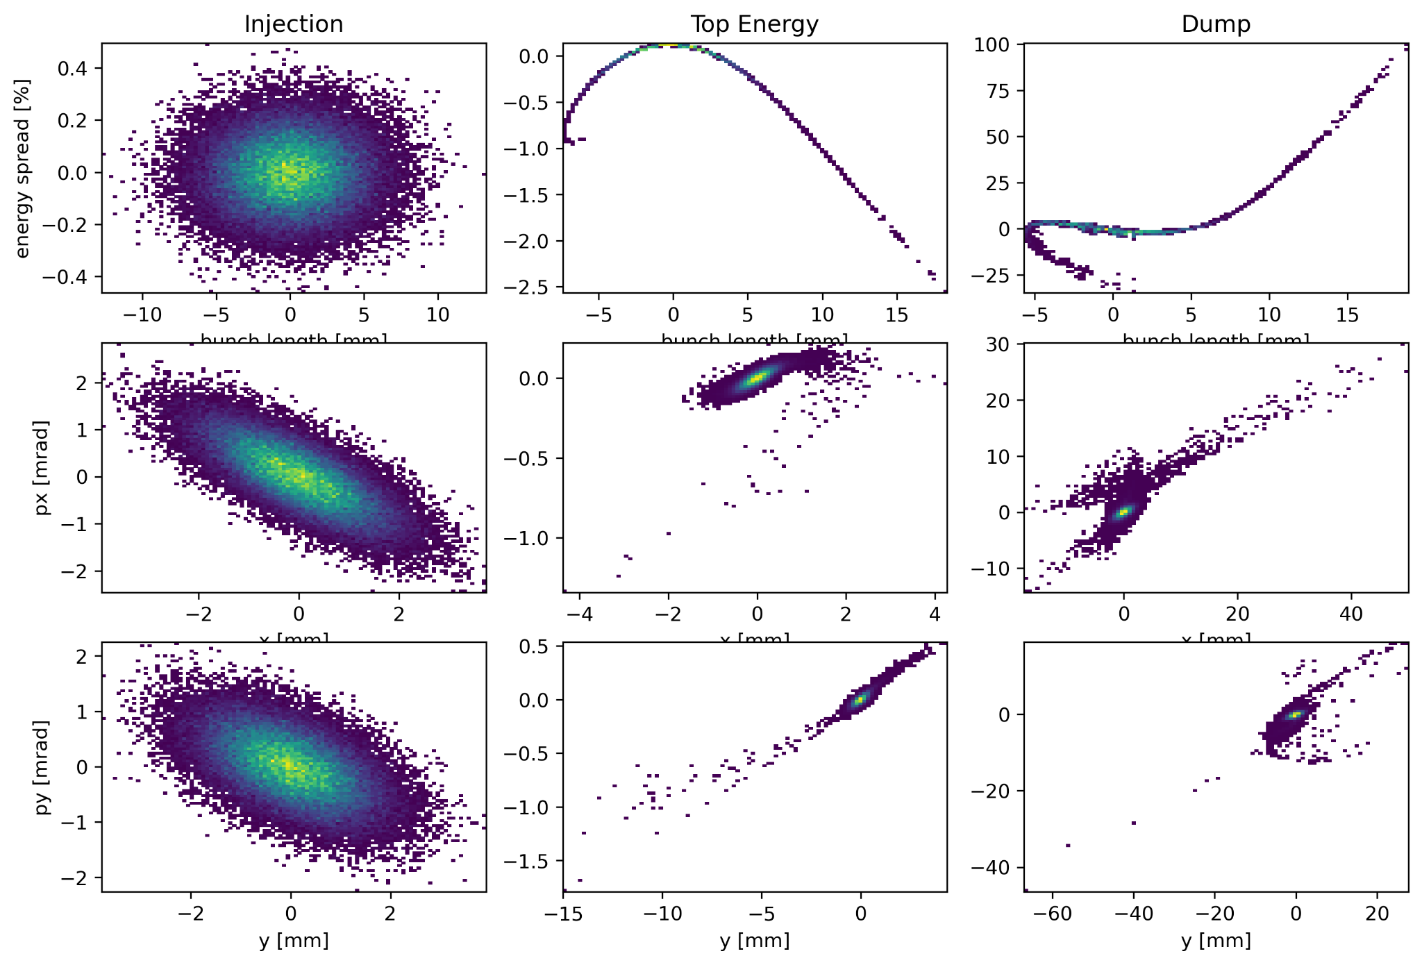
Tracking including CSR - bunch length of 3.0 mm - 20 mA
Normalised emittance at injection is
6 mm.mrad
longitudinal emittance
is 25 keV.mm
≣ δ_{ini} = 1.2 10⁻³ σ_{s}= 3 mm
99.54% transmission with CSR

Slide 15
Tracking including CSR - bunch length of 1.4 mm - 20 mA
Normalised emittance at injection is
6 mm.mrad
longitudinal emittance
is 25 keV.mm
≣ δ_{ini} = 2.6 10⁻³ σ_{s}= 1.4 mm
256 bins

Slide 16
Tracking including CSR - bunch length of 1.4 mm - 20 mA
Normalised emittance at injection is
6 mm.mrad
longitudinal emittance
is 25 keV.mm
δ_{ini} = 2.6 10⁻³, σ_{s}= 1.4 mm
64 bins

Slide 17
Plain tracking - bunch length of 1.4 mm - 20 mA
Normalised emittance at injection is
6 mm.mrad
longitudinal emittance
is 25 keV.mm
δ_{ini} = 10⁻², σ_{s}= 1.4 mm

Slide 18
No CSR
CSR
Run with Ben’s distribution (after the merger) in the ERL in order to see the possible additional issues.
So far the issue is the RF curvature for 3 mm bunch length more than the CSR even for 1.4 mm bunch length.
Transmission of 97.8 %

Slide 19
Multi bunch tracking - PERLE studies from Dario’s PhD
Study from Dario on PERLE, no CSR, only long range wakefields and BBU threshold appears at around 12e9 electrons per bunch ≣ 77mA.
Detuning in the cavities of 0.001 .. seems very large since the modes are around the GHz it means a std variation of the order of the MHz

Slide 20
BBU tracking with the current recombination pattern
LHeC :
PERLE :
1
4
2
5
3
6
1
PERLE :
1
4
2
5
3
6
1
The current recombination pattern is 7-7-10.5
and not 7-6-10.5.
The last decelerated bunch needs to be in the middle for long range wakefields mitigation (cf. Dario’s PhD) need to re-tune the arc path-lengths.

Slide 21
BBU tracking with the current recombination pattern
1e11 ppb = 645 mA
1.5e11 ppb = 968 mA

