Slide 1
PERLE Collaboration Board Meeting
Meeting Agenda:
Minutes Approval
Status of Collaboration Agreement and Composition (Oliver Bruening)
Status of Funding Opportunities (Achille Stocchi, Carsten Welsch)
News on PERLE Development (Walid Kaabi)
News from ERL Roadmap (Max Klein and Andrew Hutton)
AoB

Slide 2
Progress on PERLE
PERLE collaboration Meetings are organized to present the progress on PERLE studies:
Updated version of PERLE Lattice proposed by Alex Bogacz
Momentum acceptance and longitudinal match in PERLE Lattice (Gustavo Perez- Lancaster Univ- STFC).
Single and multi-bunch tracking for PERLE- CSR study (Kevin André- UoL and CERN).
Optimisation of PERLE injector physical design (Ben Hounsell- UoL and IJCLab).
Progress on HOM study for PERLE Cavity (Carmelo Barbagallo- IJCLab).

Slide 3
Progress on PERLE
A new PhD student at IJCLab will start on October 2012 working on collective effects.
2 post-doc positions will be published soon for a hiring in October 2021:
1st profile: DC- gun installation and RF design.
2nd profile: Optics and beam dynamics.

Slide 4
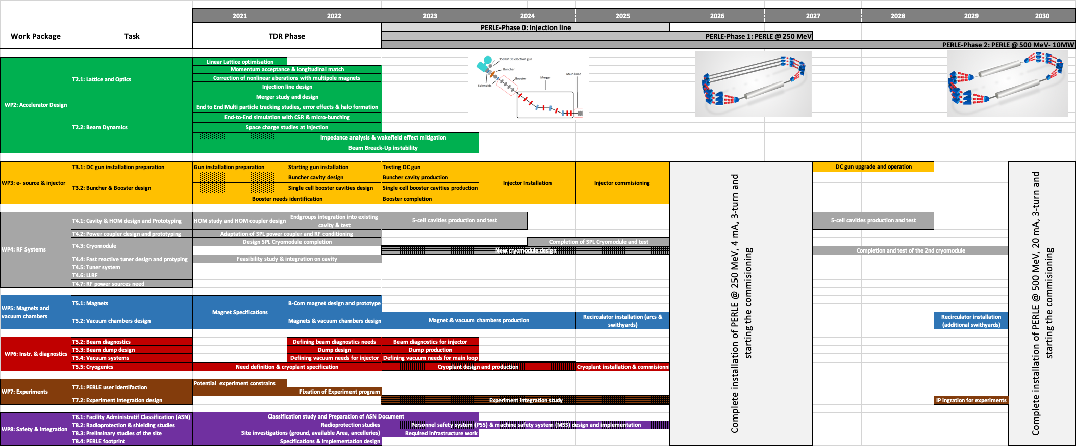
Progress on PERLE

