Slide 1
Updates- Fahad
1)CNRS website : Translation of the documents : Done
2)Finishing the internship letter : Done
3) Apply for the PhD on Saudi Cultural bureau: DONE
4) Submit my application to KACST : DONE, Scientific committee.
5) diplôme/attestation de réussite :Done

Slide 2
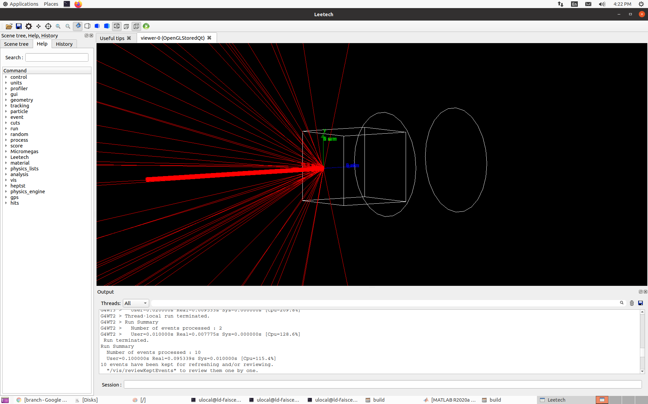
New G4 geometry without rotations:

Slide 3
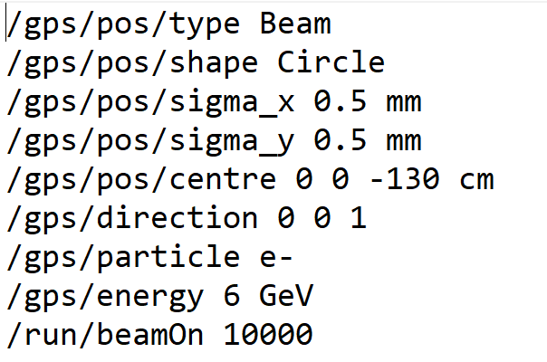
PEDD results:
6GeV electron beam with sigma = 0.5mm
Ne- =10000
Beam position (0, 0, -130*cm)
N bunch = 2
f = 100 Hz
Ne- /bunch = 1.8e10
1GeV*cm^-3 = 8.30e-12 J/g
Mesh Size [mm] | Max Edep [MeV] | Max Edep/e- [MeV/e-] | PEDD/e- [GeV/cm3/e-] | PEDD [J/g]
(0.5, 0.5, 0.5) | 39053 | 3.9053 | 31.2424 | 9.3611
(0.25, 0.25, 0.25) [sigma/2] | 5702 | 0.57 | 36.4933 | 10.9344
(0.16, 0.16, 0.16) [sigma/3] | 1530.97 | 0.153 | 37.3772 | 11.1993
(0.04, 0.04, 0.8750) | 588.08 | 0.0588 | 42.0057 | 12.5861

Slide 4
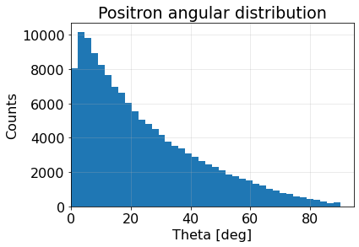
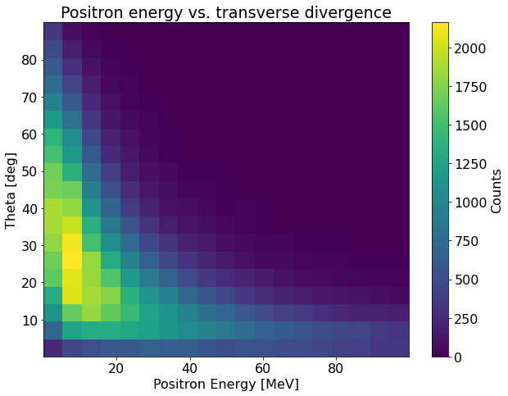
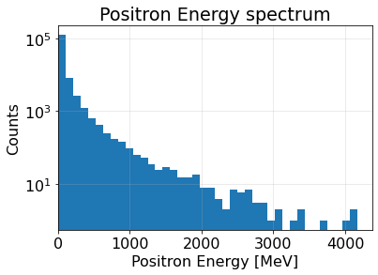
Positron production simulation
6GeV electron beam with sigma = 0.5mm
Ne- =10000
Beam position (0, 0, -130*cm)
89% of positrons have energy < 100MeV, ~14positron/e-

