Slide 1

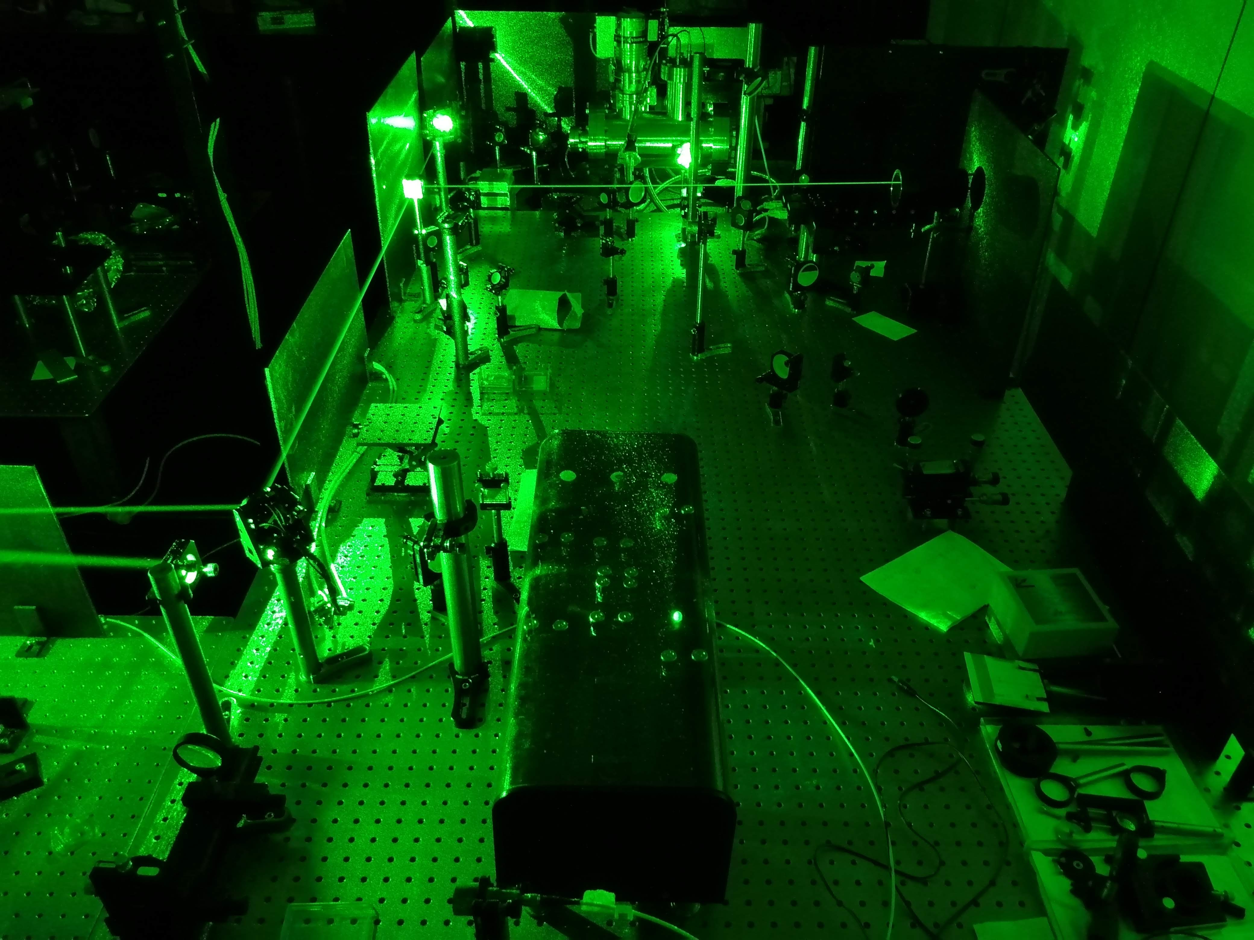

RIALTO : the laser ion source for ALTO

Slide 2
Outline
Laser Resonance Ionization Technique
RIALTO facility
Recent upgrade
Future upgrade

Slide 3
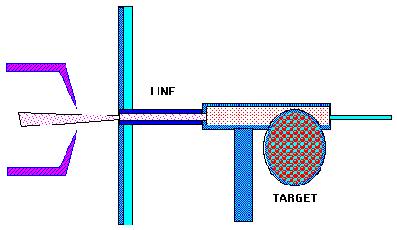
Pourquoi une source laser ?
ALTO
Uranium fission
Neutron rich radioactive nuclei beams well separated in mass A
LASER ION SOURCE
Beams of high purity and high selectivity
Notes:
ALTO is an accelerator based on uranium fission that produces neutron rich nuclei.
They can be well separated in mass thanks to the magnet but
To avoid isobaric contaminations a laser ion source is more appropriate to produce pure beams.
The ion beams produced by a laser combination adapted to the element under study is of high purity,
High selectivity with a reasonable efficiency : some 10%

Slide 4
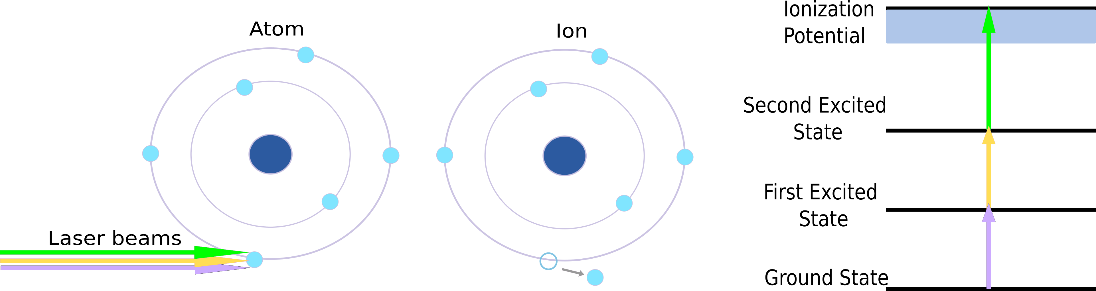
Laser Resonance Ionization
Notes:
Pure ion beams
Efficient and selective way to ionize exotic isotopes

Slide 5
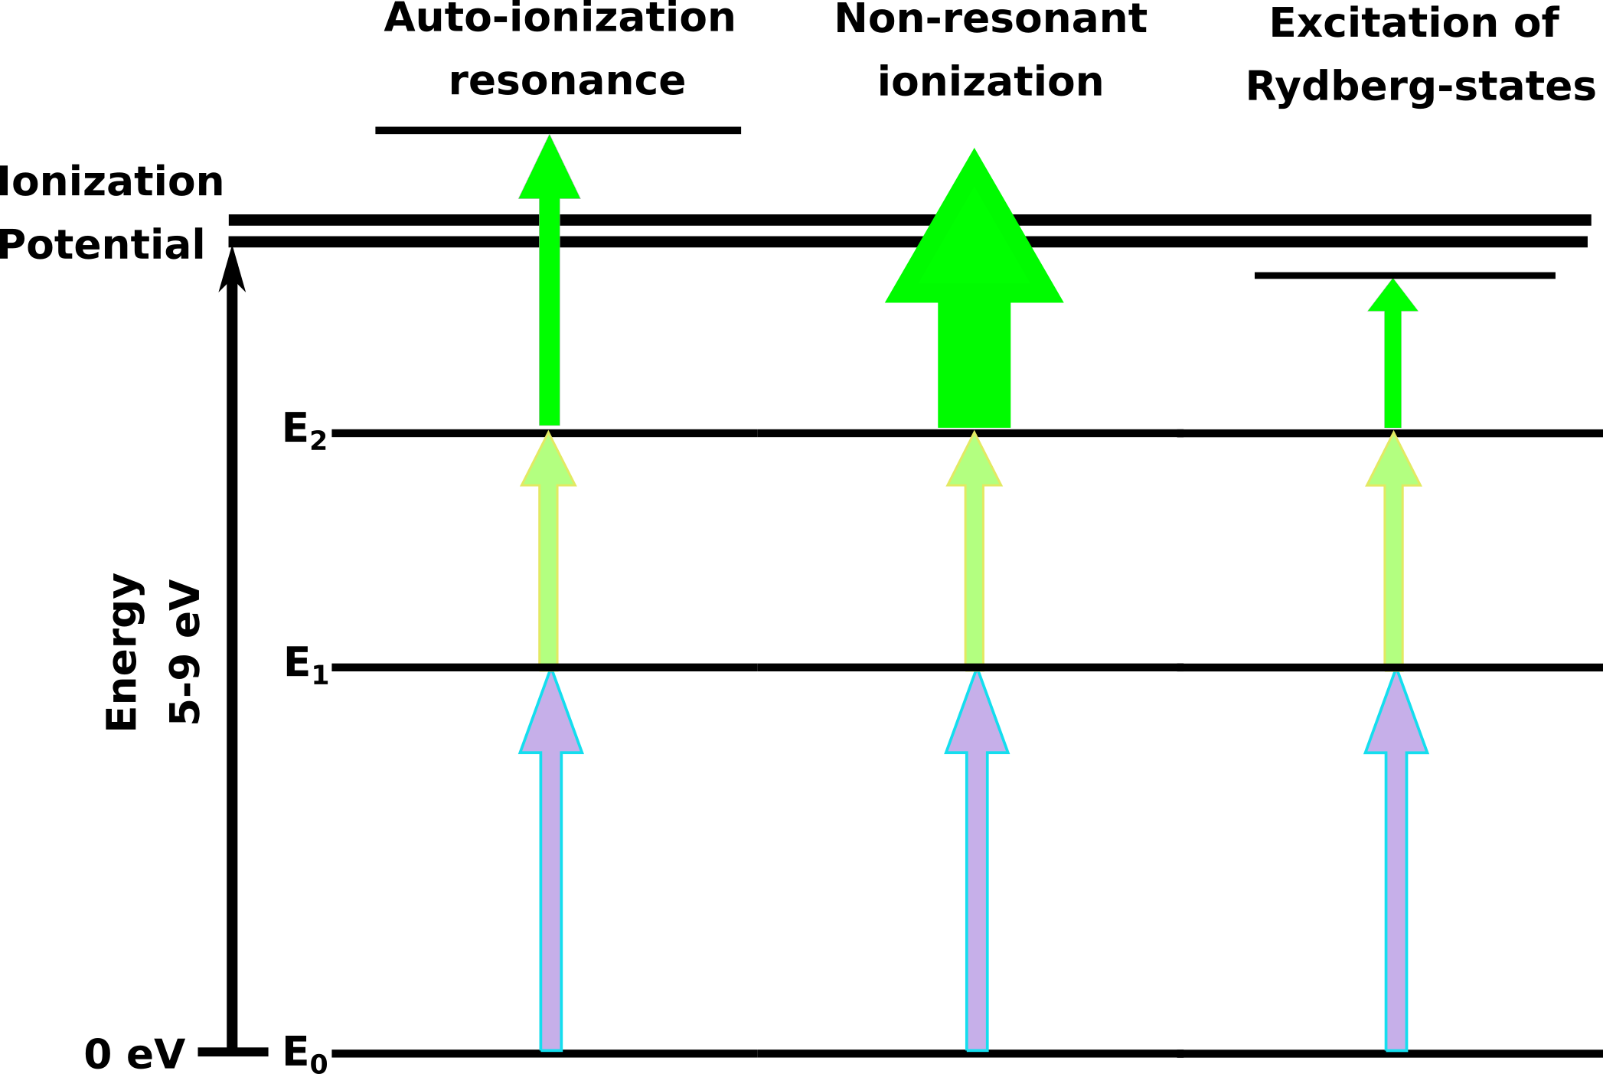
Laser Resonance Ionization

Slide 6
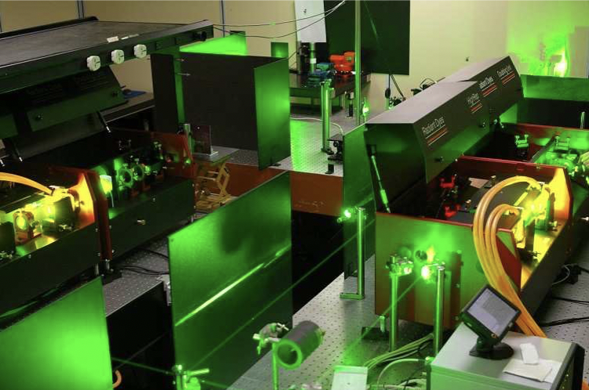
The laser setup for ALTO
Edgewave Nd:YAG pumping laser (532 nm, 100W, 10 kHz rep rate, 10 ns pulse width)
2 Radiant Dyes + 1 Lioptec dye laser (540-850 nm), up to 5 W@20 W pumping, 10 ns pulse and 3 GHz linewidth
2 BBO doubling and tripling units (200- 475 nm), < 1 W
Notes:
At ALTO now, we have a laser setup composed of a pumping YAG laser, …..

Slide 7
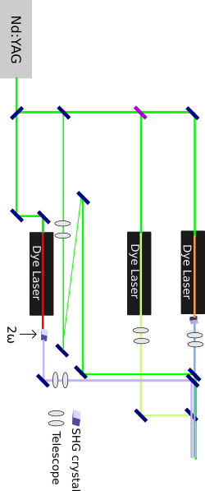
RIALTO first layout
100W max
Distance salle laser – ion source : 16 m dont 8 m sous vide
Taille tube ionisation : 3mm de diamètre

Slide 8
Source Laser On line
Indium
532 nm
Novembre 2018 : 10 jours de run à
ALTO avec un faisceau d’Indium
304 nm
Efficacité : facteur 50/ionisation de surface
Brève IN2P3
Gallium
532 nm
288 nm
Juin 2019 : 15 jours de run à
ALTO avec un faisceau de Gallium
Efficacité : facteur 42/ionisation de surface

Slide 9
RIALTO upgrade in 2020
Improving the quality of the non resonant step (gaussian instead of top-hat)
  2nd YAG laser and external trigger unit
Beam Distribution System that allows changing schemes.
  Cube beam splitters and waveplates.
Beam Stabilization System.

Slide 10
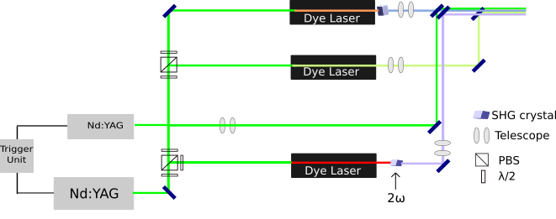
RIALTO upgraded layout
Improving non resonant step
Nd:YAG 35W max
Nd:YAG 100W max
Beam Stabilization system
Improving beam distribution

Slide 11
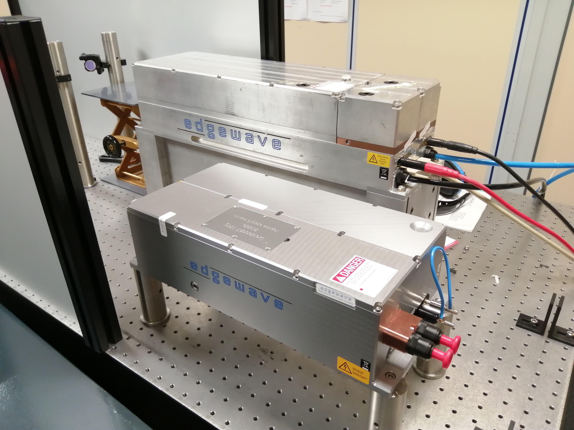
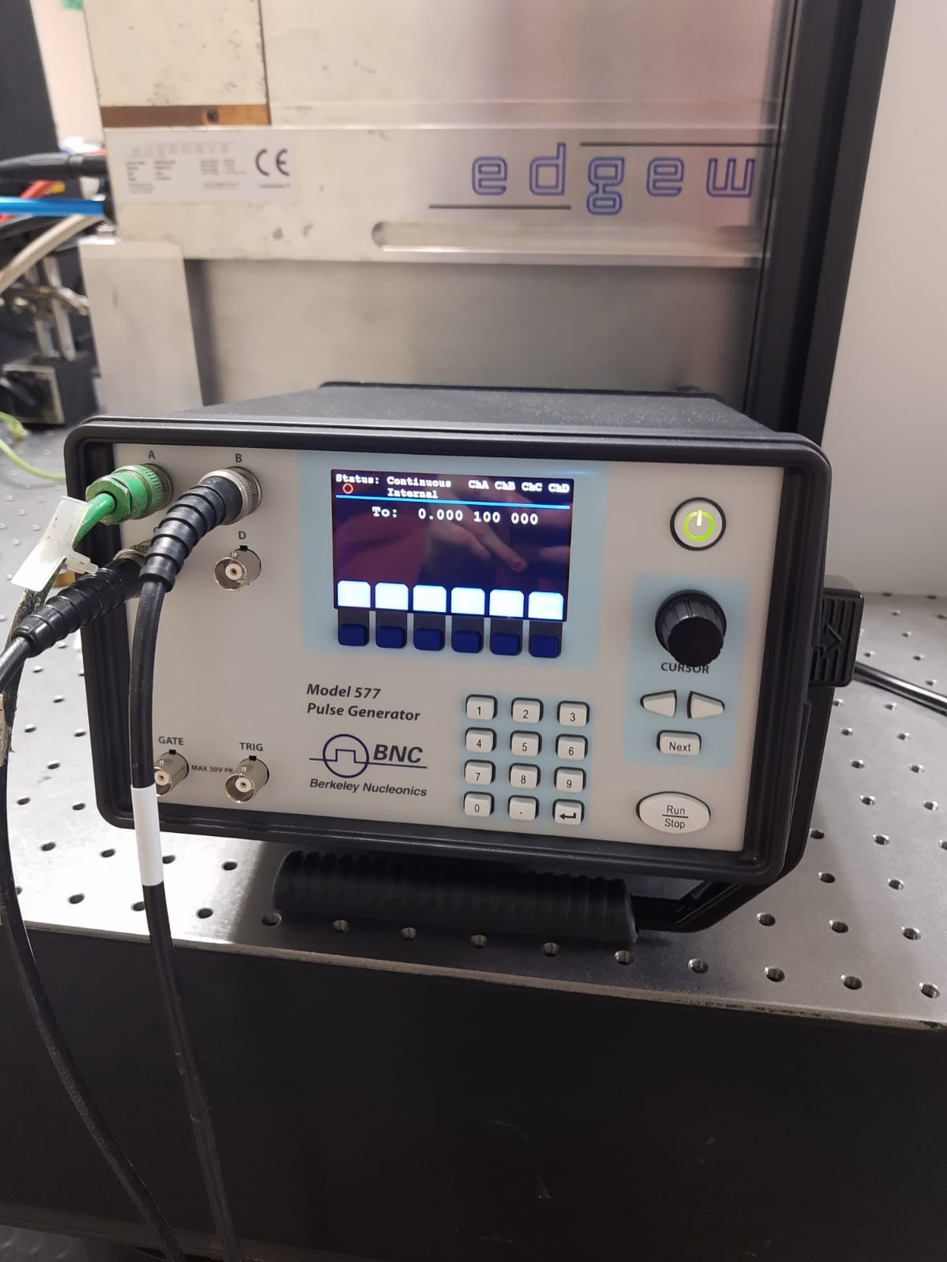
RIALTO Upgrades. YAG laser and trigger unit
Up to 35 W (63 A)
Gaussian profile for ionization step
Temporal synchronization with
new trigger unit

Slide 12
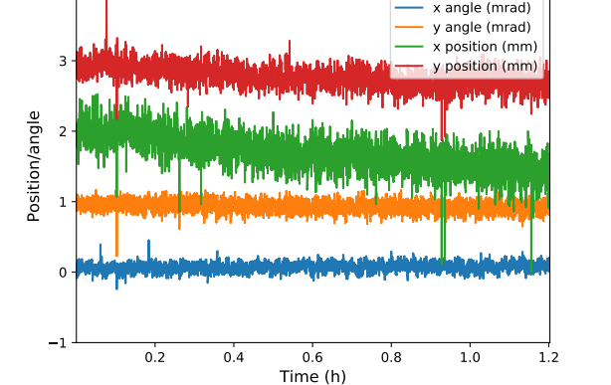
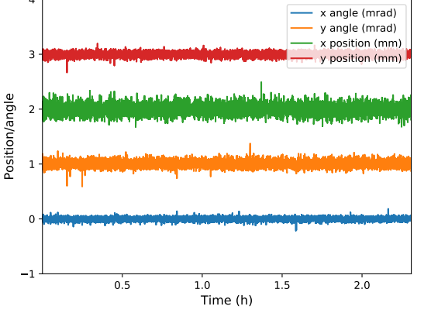
Beam Stabilization System
Source
YAG position without stabilization system
Position
Angle
Salle laser
YAG position with stabilization system

Slide 13
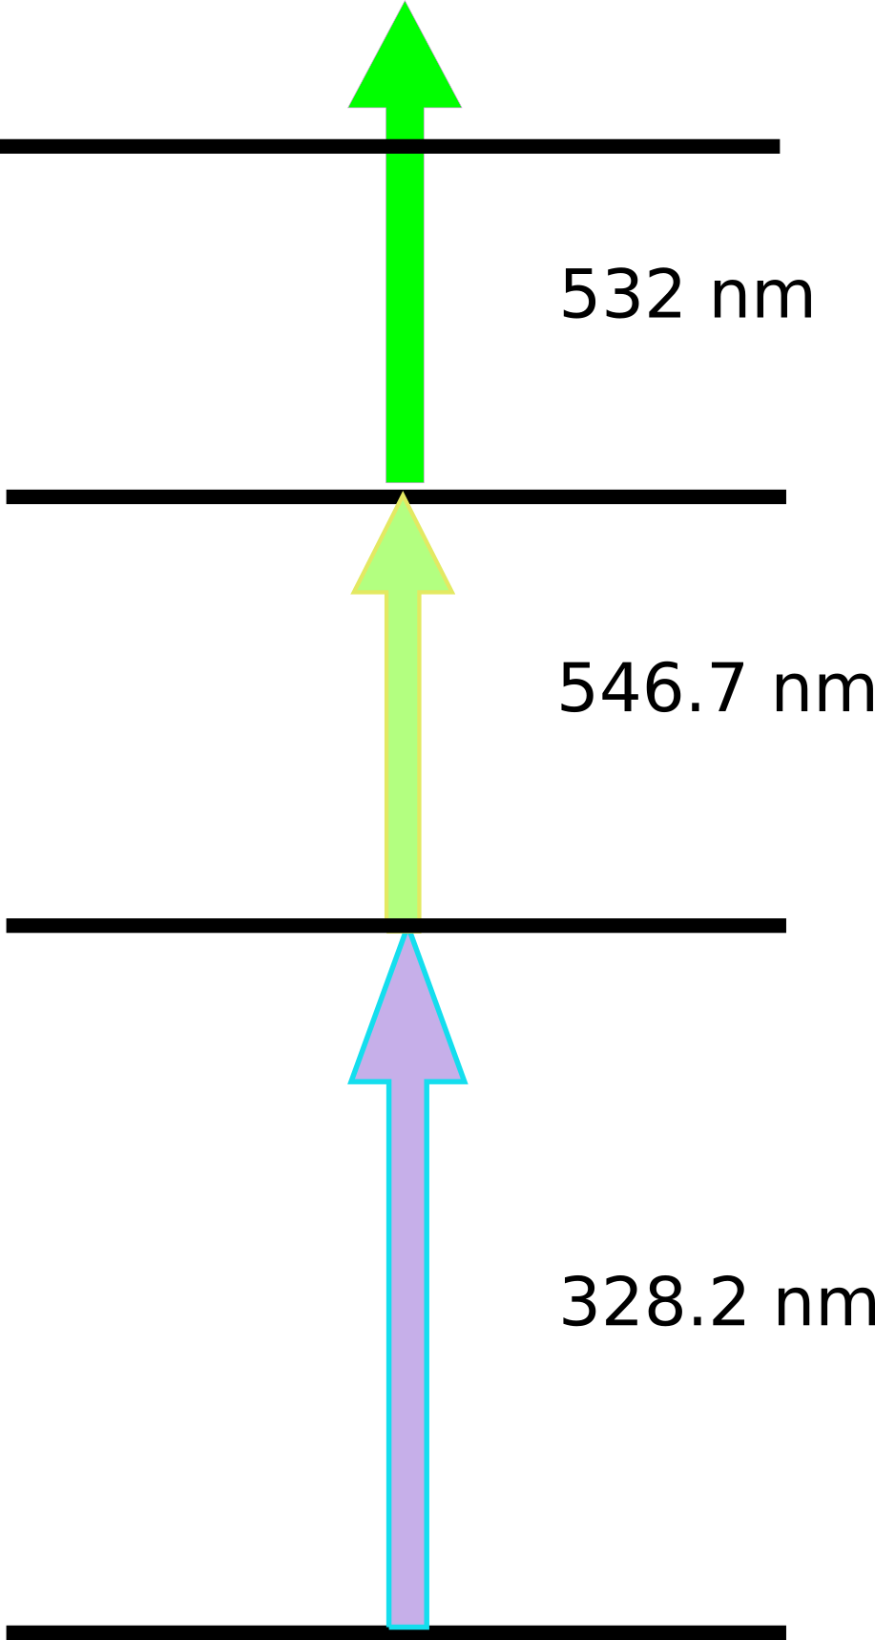
Right now : development of a Silver Ionization Scheme
Challenging Scheme
  3 step-3 color scheme
  with non resonant last step
  Green laser (second step)
  UV first step
Motivation
  POLAREX (LTNO)
  MLLTrap
  LINO
  BEDO

Slide 14
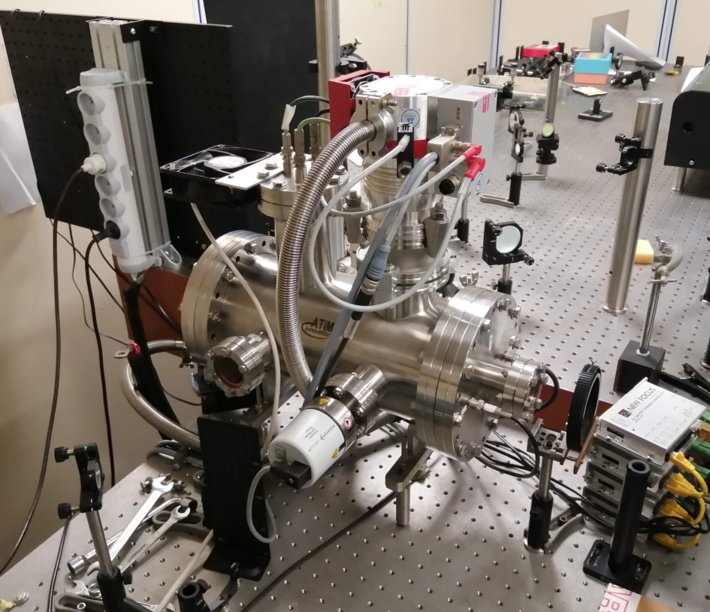
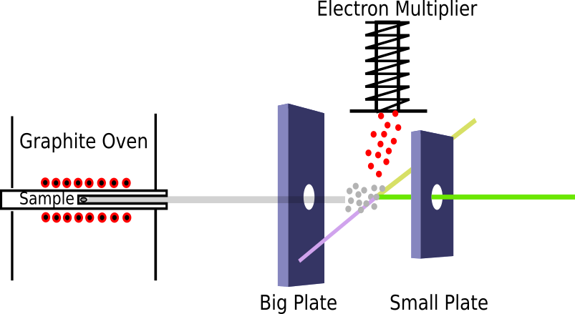
Atomic Beam Unit (ABU)

Slide 15
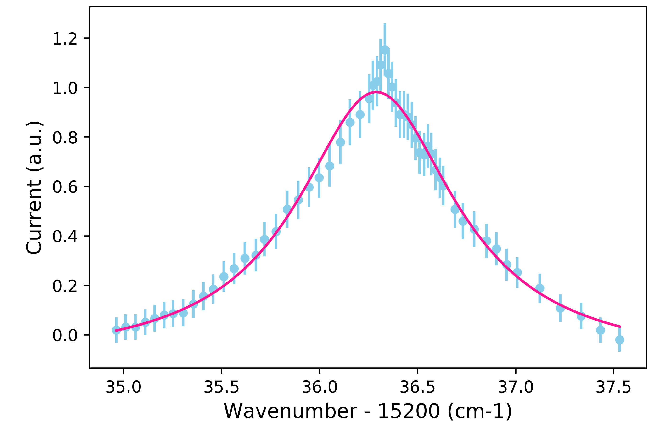
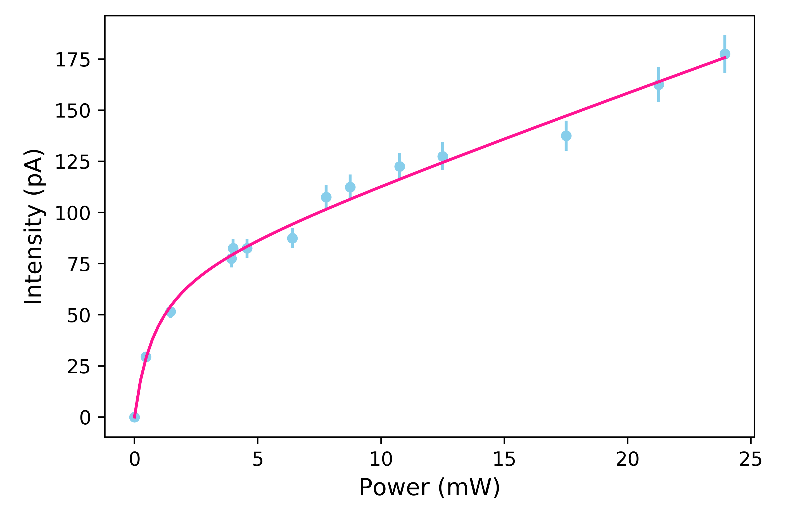
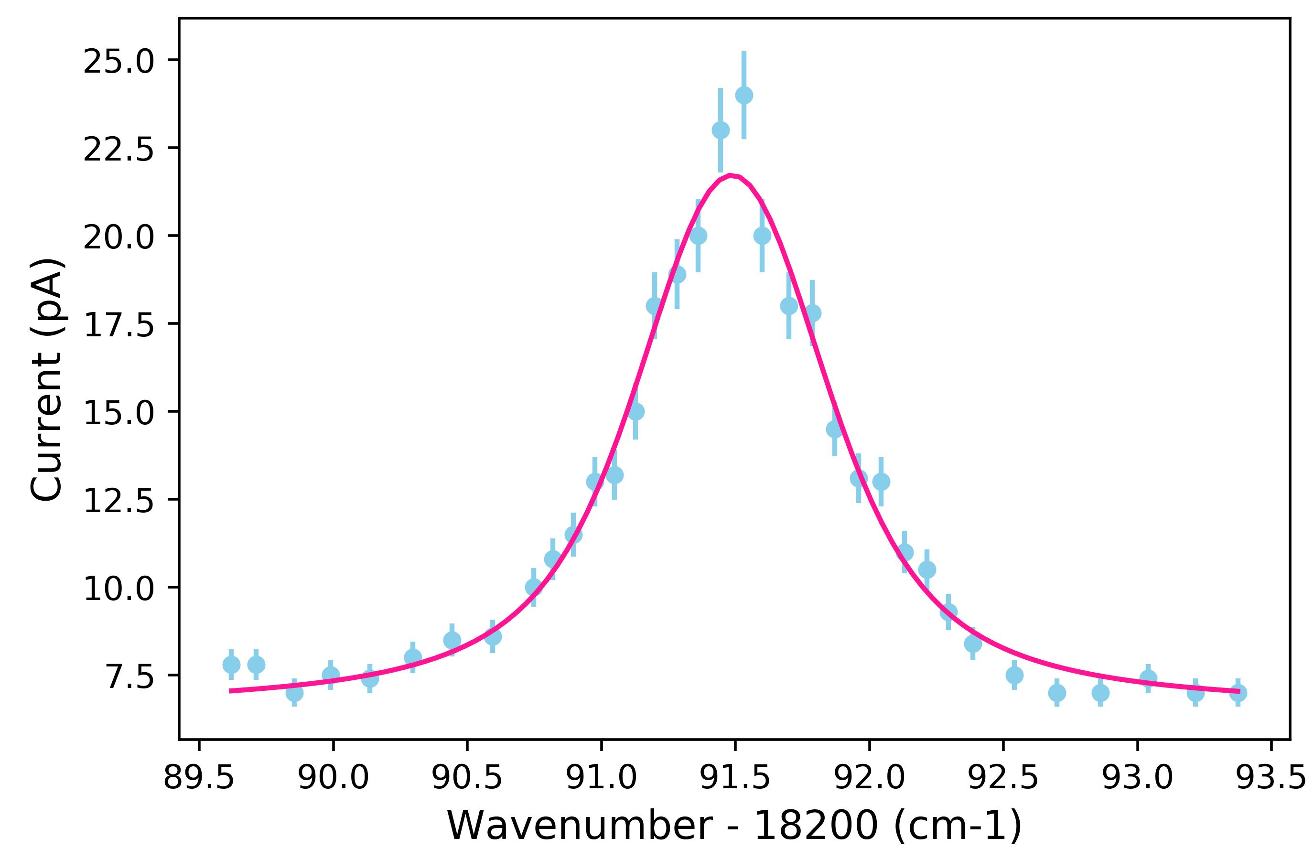
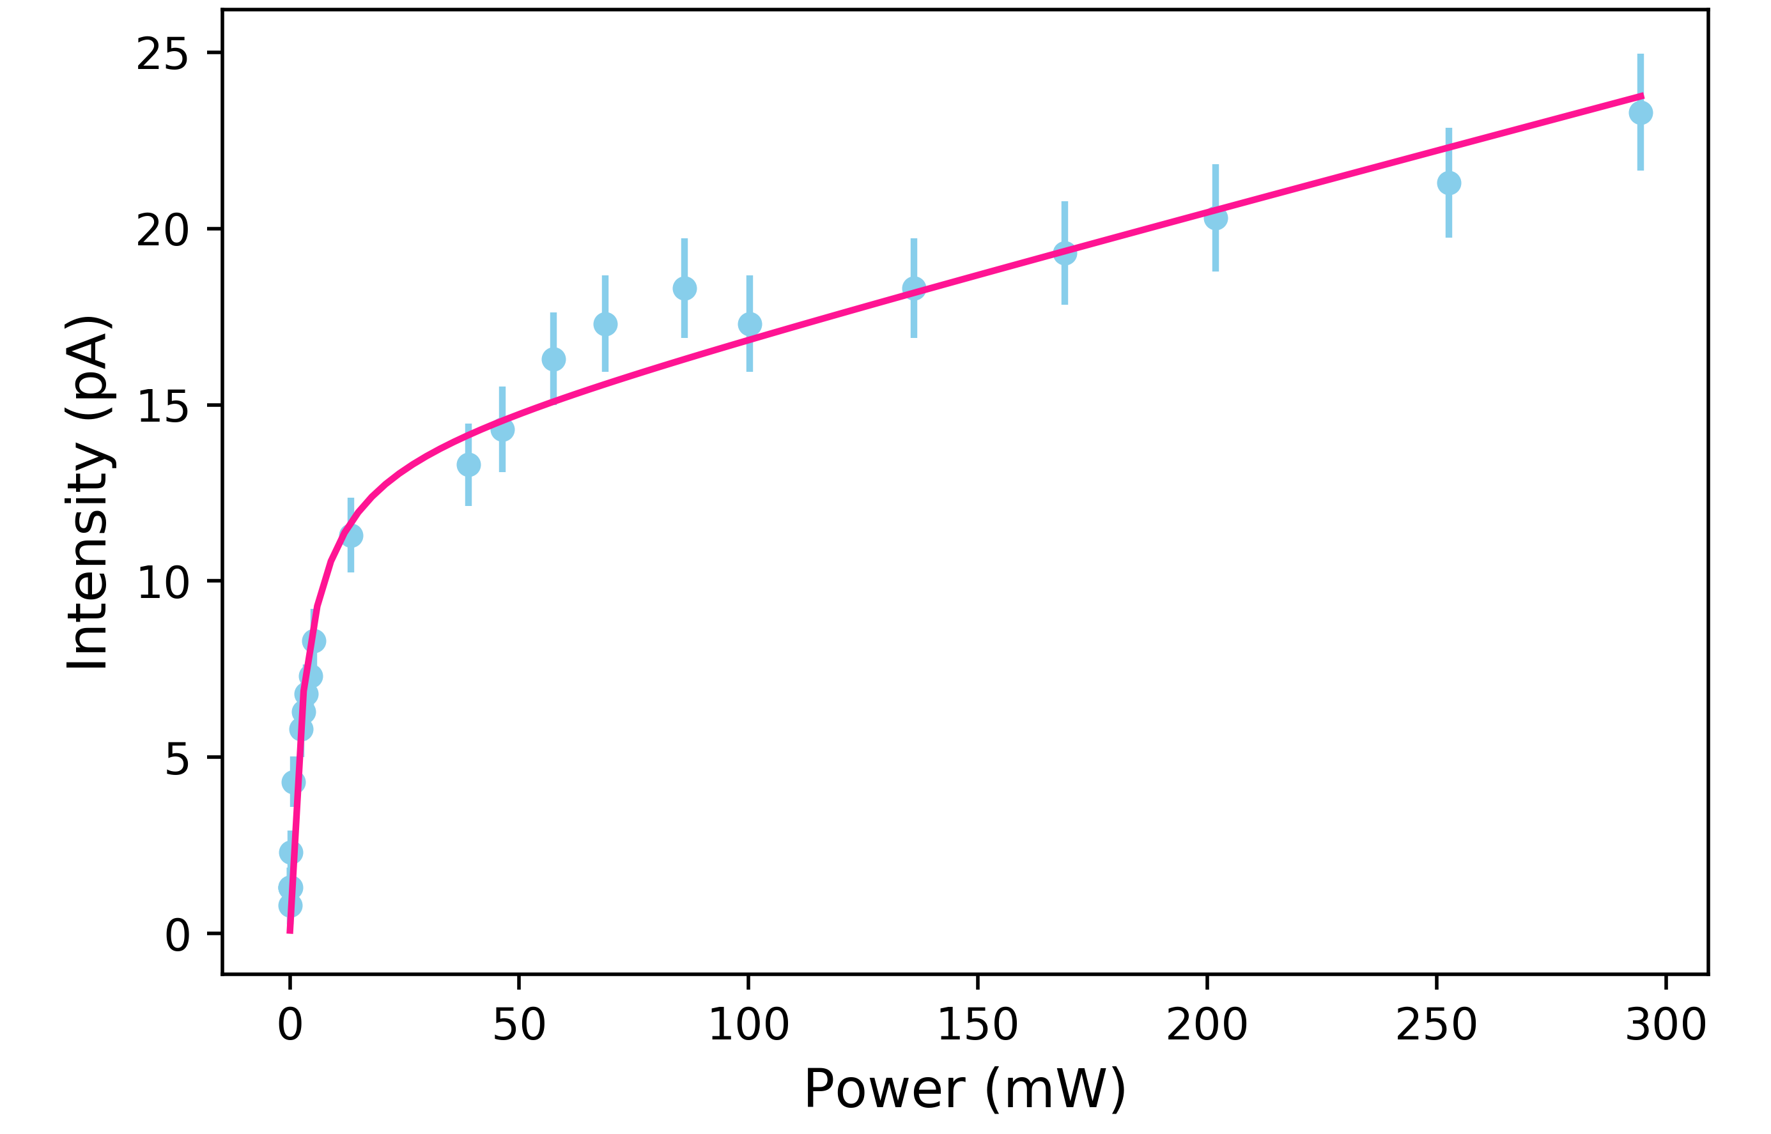
Wavelength scan and saturation power
Wavelength scan for the first excitation step.
First step saturation curve. Saturation power .83 mW ± 0.12
Second step saturation curve. Saturation power 3.28 mW ± 0.81
Wavelength scan for the second excitation step.

Slide 16
Summary
RIALTO : powerful tool for nuclear beam production and purification (cf In and Ga)
Upgrade of RIALTO
  New YAG with external trigger unit
  Beam distribution
  Stabilization System
Ag off-line production (part of thesis of A. Segovia-Miranda)
  Wavelength scan
  Saturation curves

Slide 17
Outlook
Beam production
  Online Ag and Ga beams.
  Stabilisation system for UV
  Tripling frequency for Sb
  Sb production in ABU
  Zn, Cu, beams...
Next upgrade
  Request to P2IO for the replacement of the old 100 W with an UV outing at 355nm (100 k€)
  -> pumping of green dye for frequency doubling instead of tripling (more power)
  Stabilisation system for UV

Slide 18
RIALTO team : A. Segovia-Miranda (PhD), V. Manea, FLB
Demande d’IR Laser depuis 5 ans.
Thank you !

Slide 19
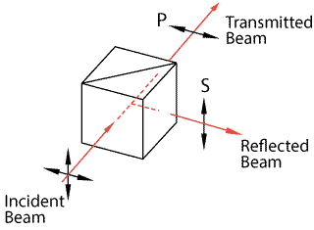
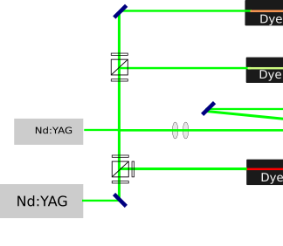
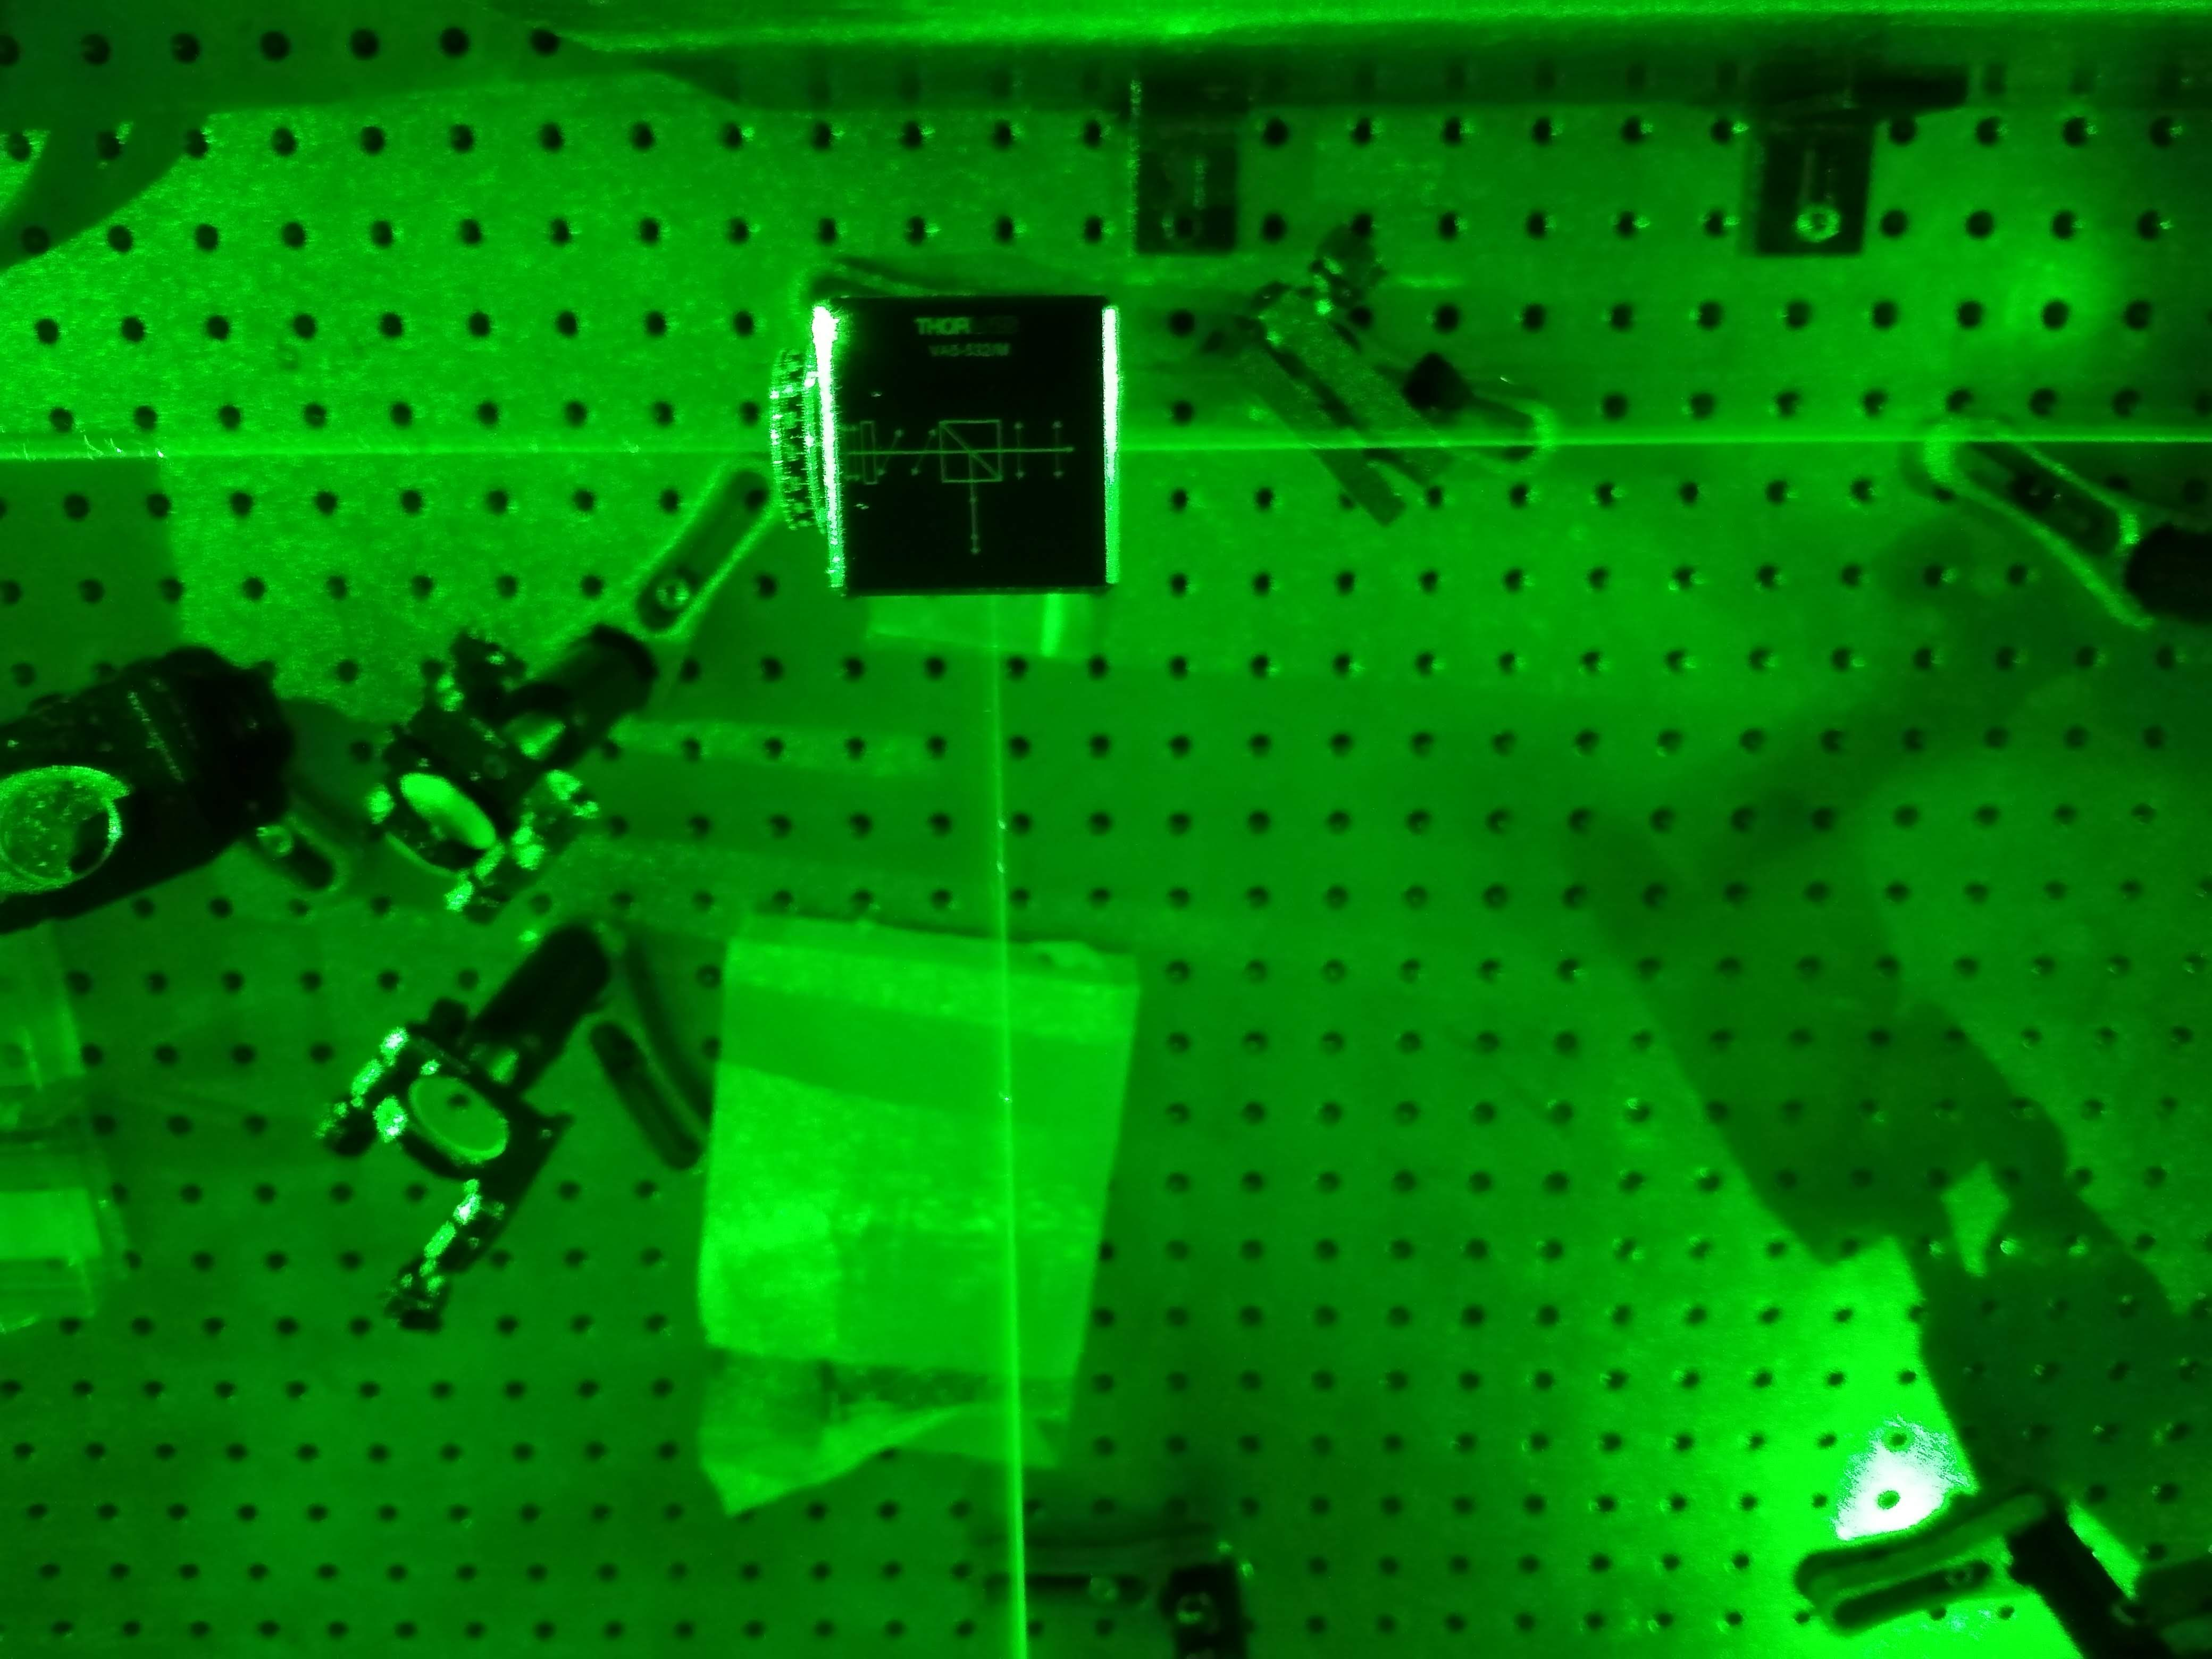
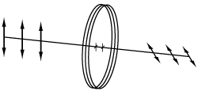
RIALTO Upgrades. Beam Distribution
Polarazing Beam Splitter (PBS)
Waveplate

Slide 20
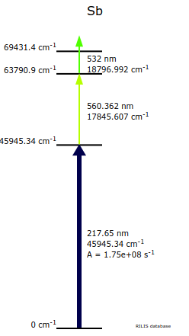
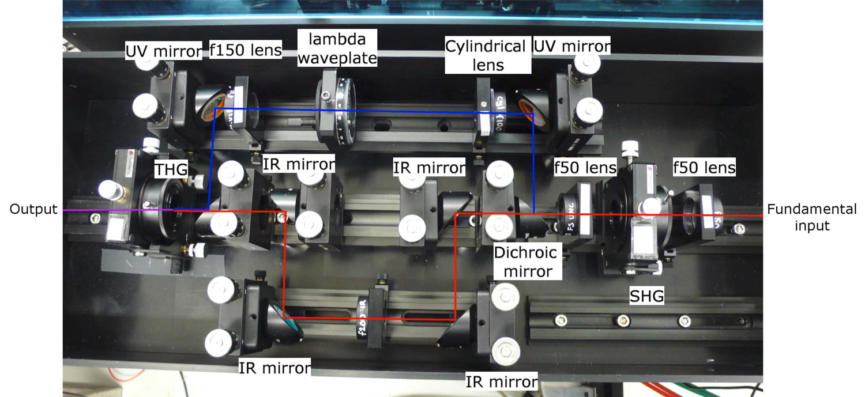
Back-up

Slide 21
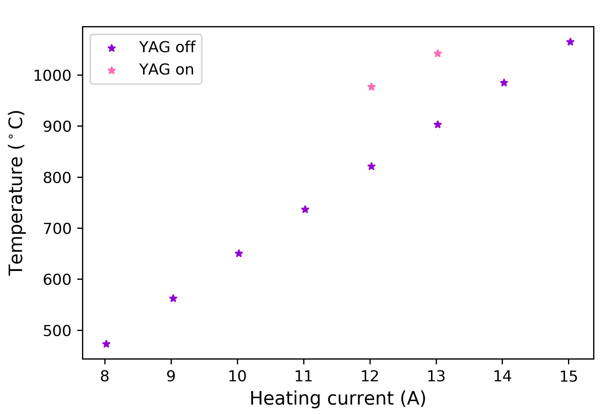
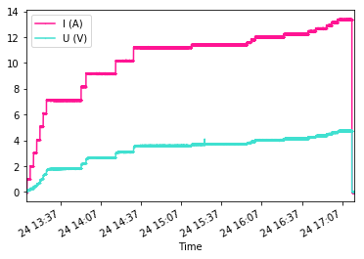
Heating Cycle and YAG heating

Slide 22
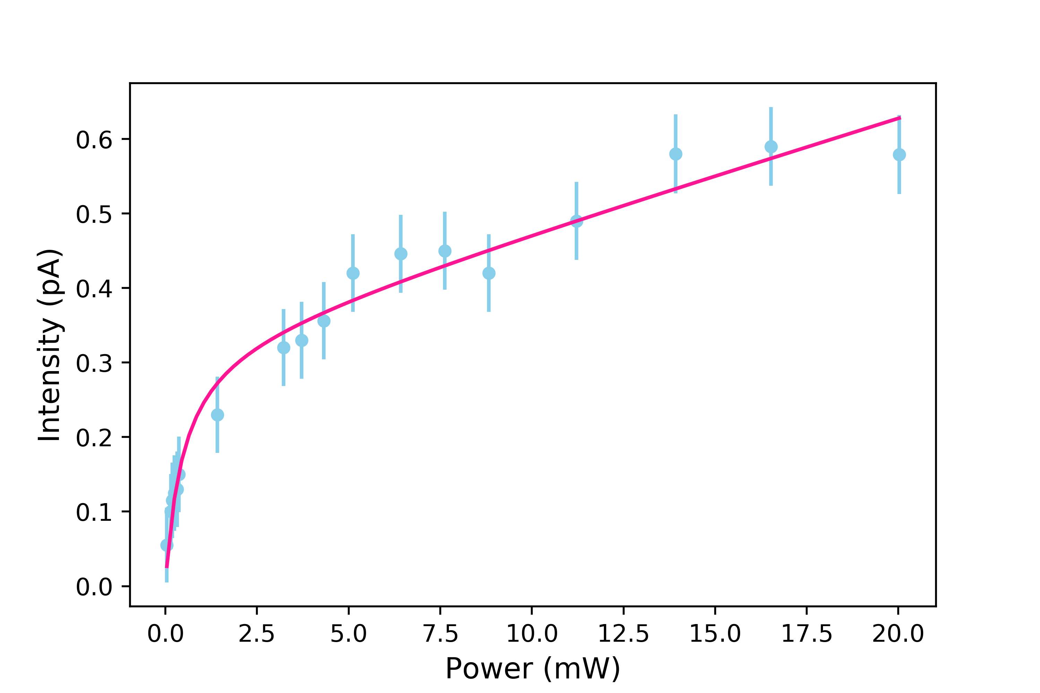
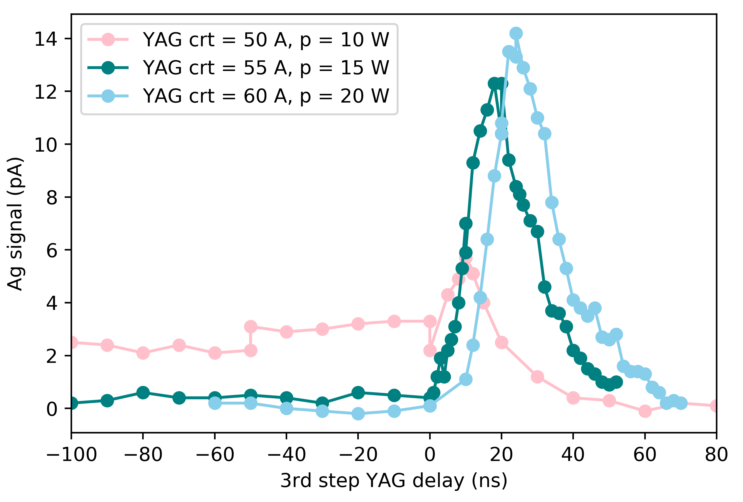
First step saturation curve. Saturation power 4.74 mW

Slide 23
