Slide 1
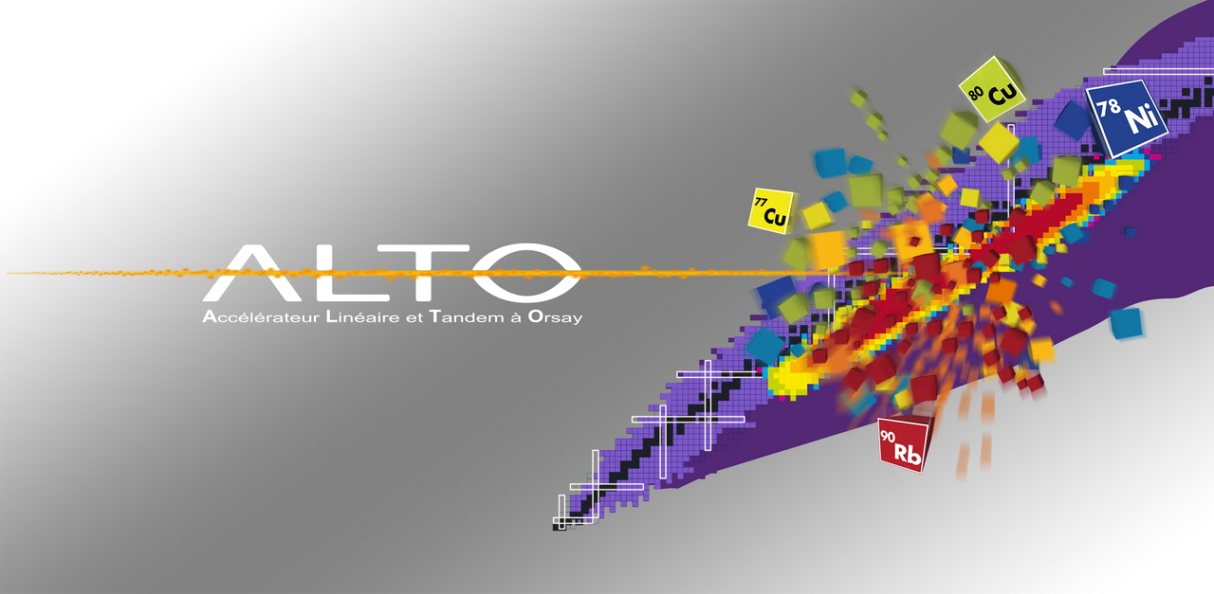
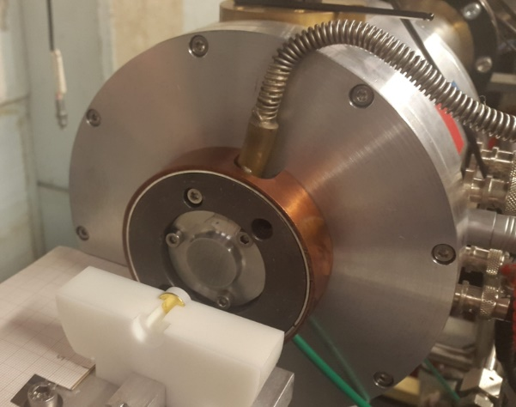
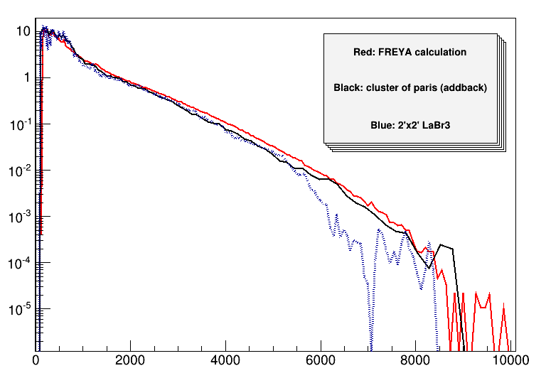
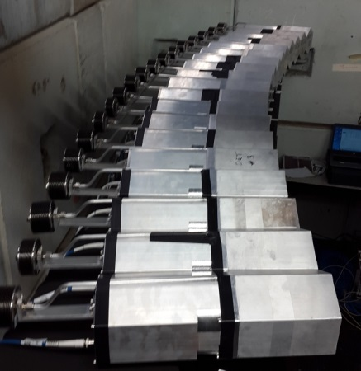
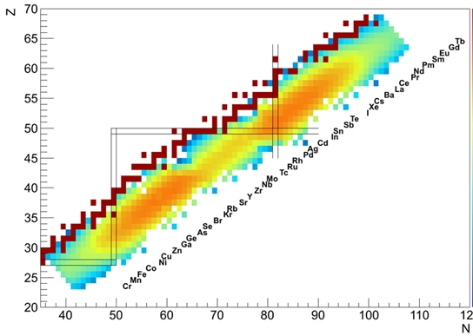
Irradiations with neutrons at ALTO

Slide 2
The LICORNE neutron convertor at ALTO
Sample
Target H₂
Kinematic focusing
Low room background
γ
n
n
n
1000 nA ⁷Li
13-17 MeV
n
γ
Lithium Inverse Cinematiques ORsay NEutron source
Reaction p(⁷Li,⁷Be)n using inverse kinematics
Source of fast focused neutrons (between 0.5 and 4 MeV )
Natural directionality and high fluxes: 10⁸ n/cm²/s on target

Slide 3
LICORNE (H₂ gas version) chamber design 2014

Slide 4
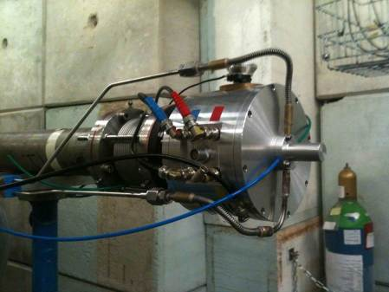
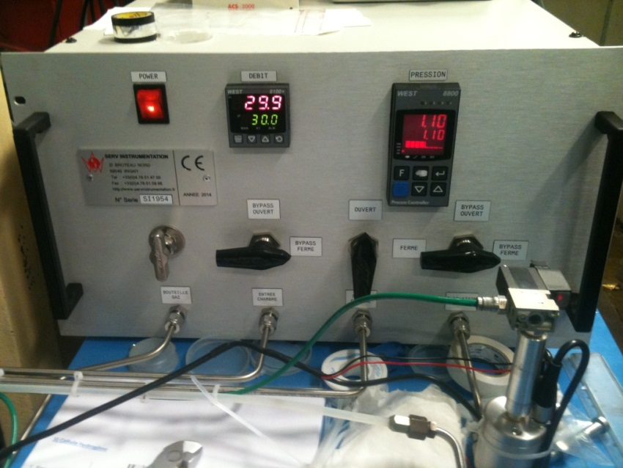
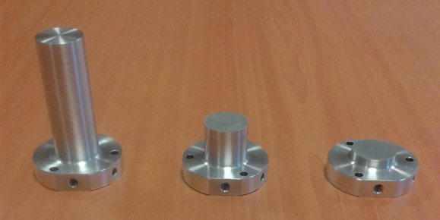
LICORNE (H₂ gas version)
H₂ pressure and flow control system
+ automatic shutdown
Hydrogen gas cells

Slide 5
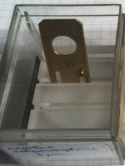
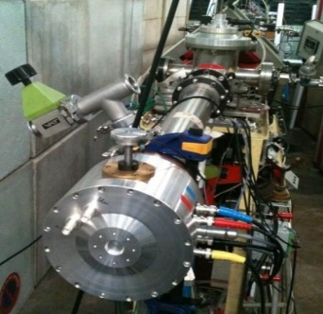
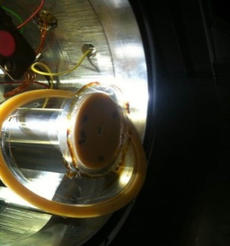
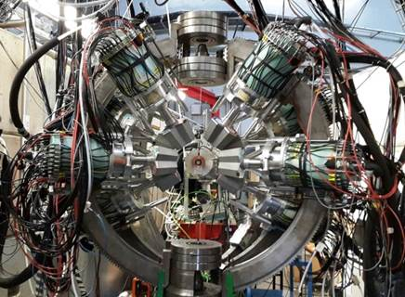
LICORNE development timeline
First fixed polypropylene
target test experiment
Commissioning
LICORNE II
H₂ gas target
First ν-ball/LICORNE
experiment
First Phys. Rev. C
First expt.
²³⁵U/²³⁸U
Fission γ’s
Max flux
>10⁷ n/cm²/s
Extension to
7 MeV with ¹¹B
First in2p3
funding
First Phys. Rev. Lett.
2013
2014
2015
2016
2017
2018
Coupling LICORNE
+ MINIBALL spectrometer
First use of
²³⁹Pu targets
ν-ball
installation
Commissioning of LICORNE I
Rotating polypropylene target

Slide 6
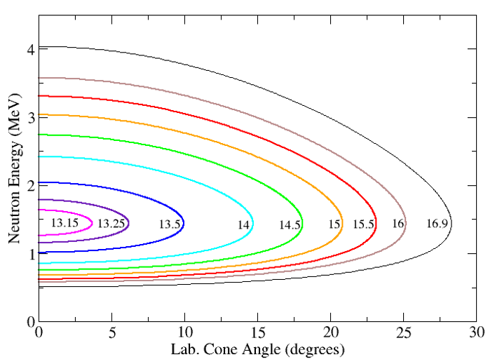
LICORNE: Quasi-monoenergetic mode
2 cm gas cell, 1.1 atm pressure
Neutron spectrum at zero degrees

Slide 7
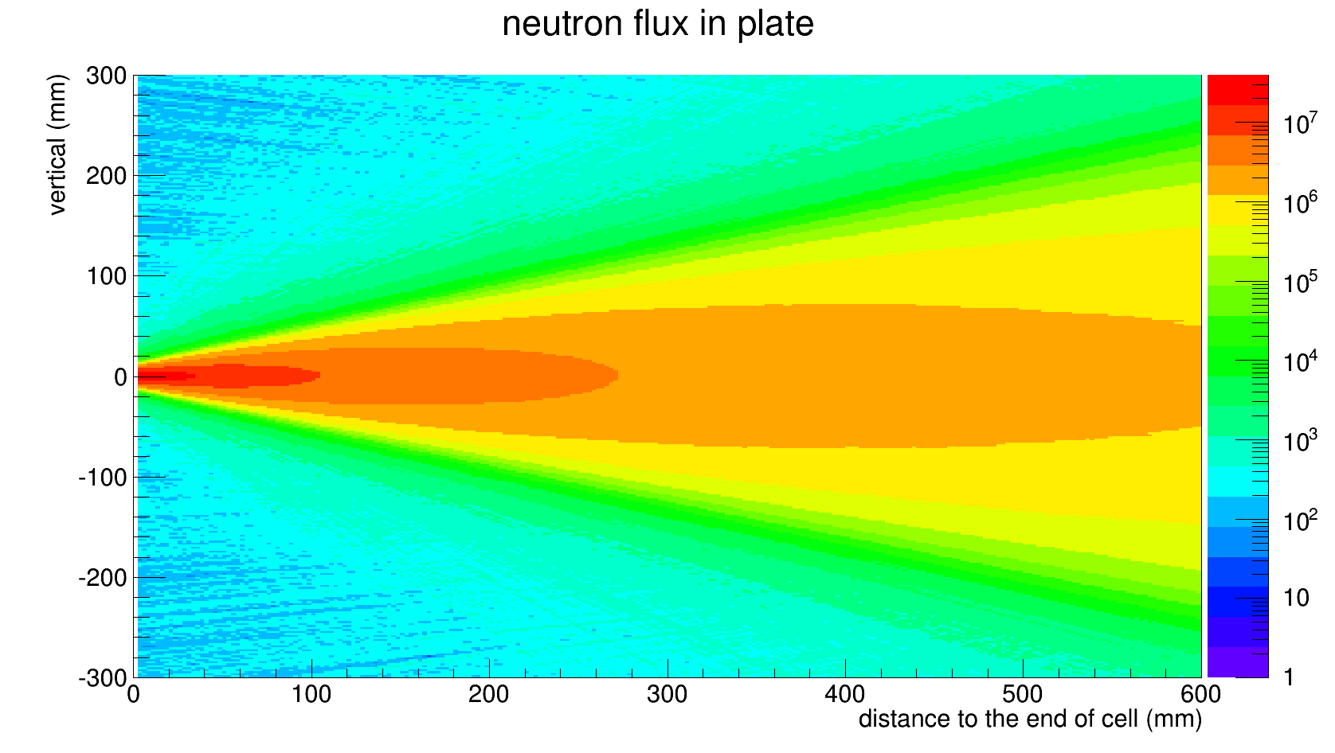
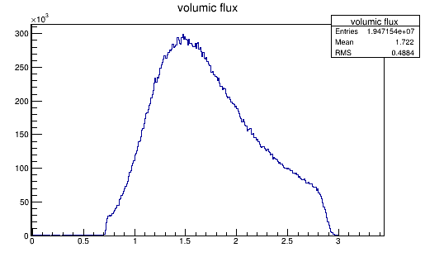
LICORNE: White source mode
3.5 cm gas cell, 1.6 atm pressure
Neutron spectrum at zero degrees

Slide 8
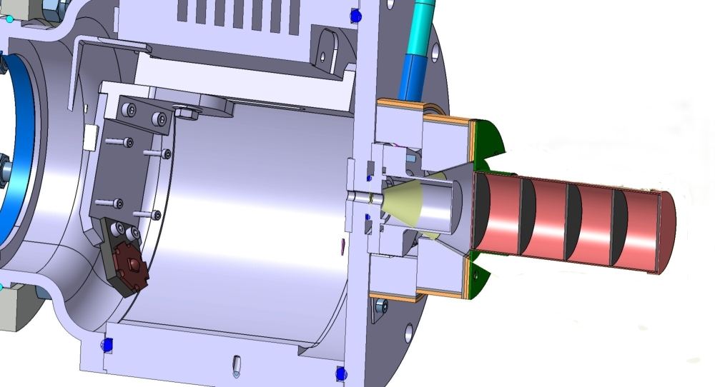
LICORNE irradiation in white source mode
LICORNE chamber
Ultra-thin Ta
window
H₂ gas cell
²³⁸U or ²³²Th disks
(~80 grams total)
Pb collimator

Slide 9
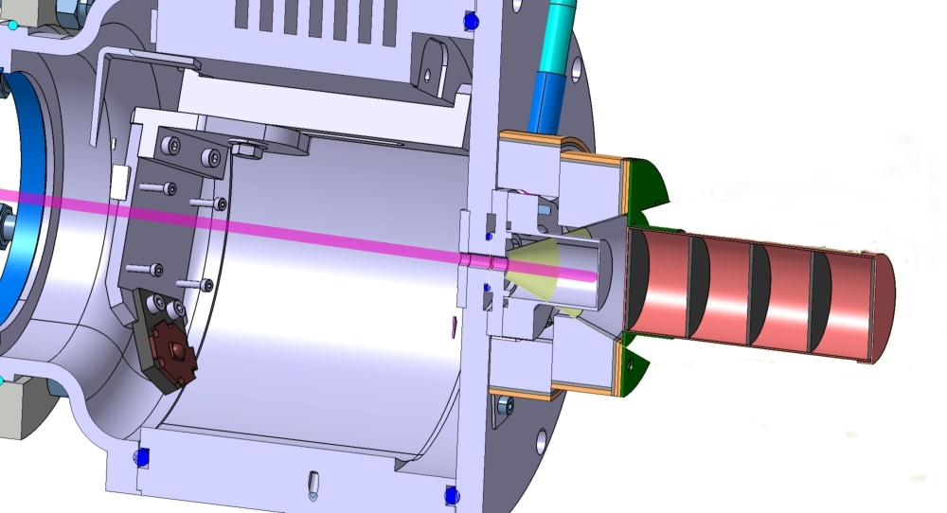
LICORNE irradiations in white source mode
Up to 100 nA 7Li
Primary Beam
H₂ gas cell
²³⁸U or ²³²Th disks
(~80 grams total)

Slide 10
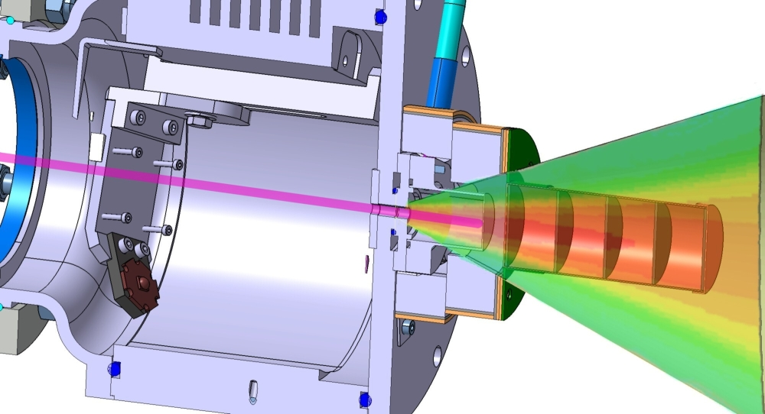
LICORNE irradiations in white source mode
H₂ gas cell
²³⁸U or ²³²Th disks
(~80 grams total)
Fission rates:
238U – 100 kHz
232Th – 20 kHz

Slide 11
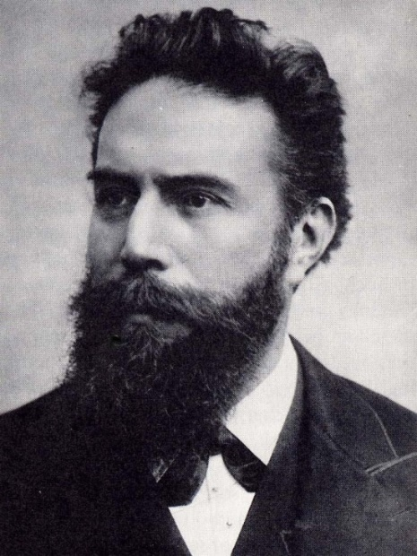
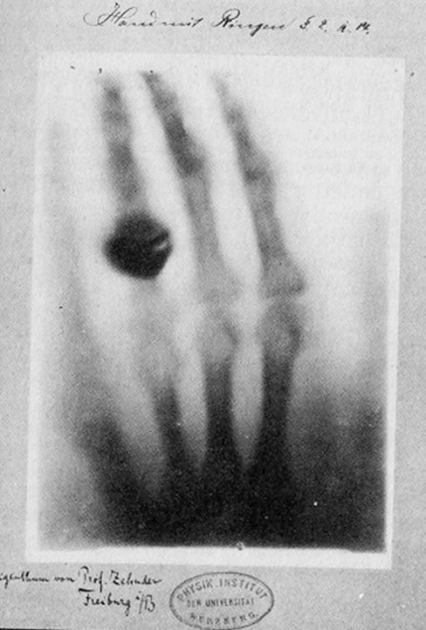
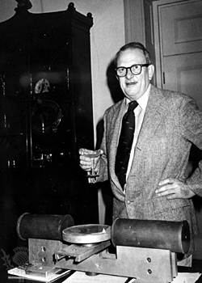
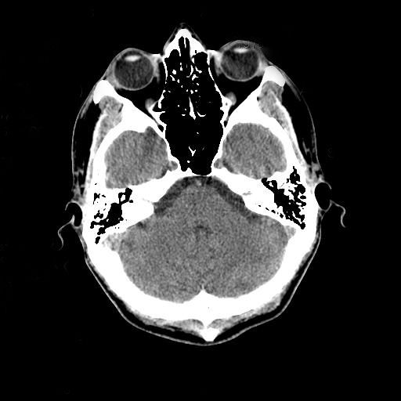
Irradiations (imaging applications)
First x-ray Images
Willhelm Röntgen (1895)
1st ever Nobel Prize (1901)
First x-ray Computed
Tomographic Images
Allan M. Cormack &
Godfrey N. Hounsfield
Nobel Prize in Medicine (1979)

Slide 12
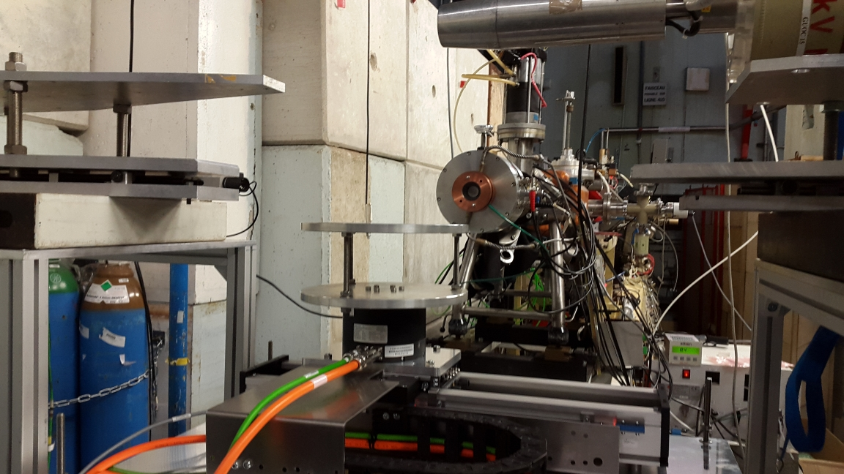
Fast neutron tomography with LICORNE @ ALTO

Slide 13
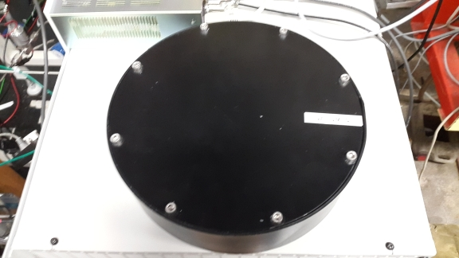
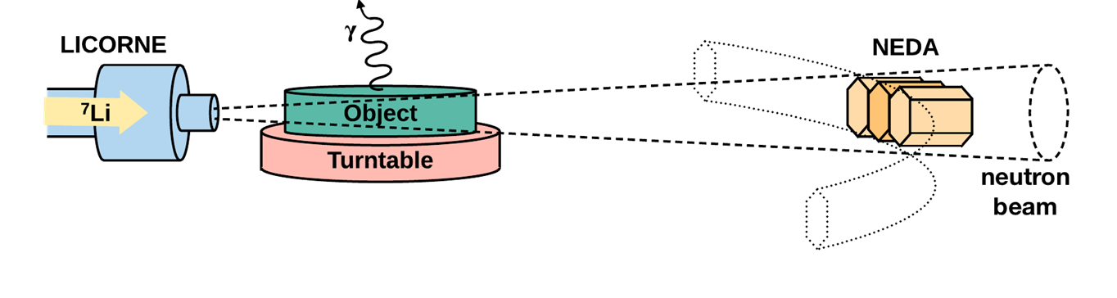
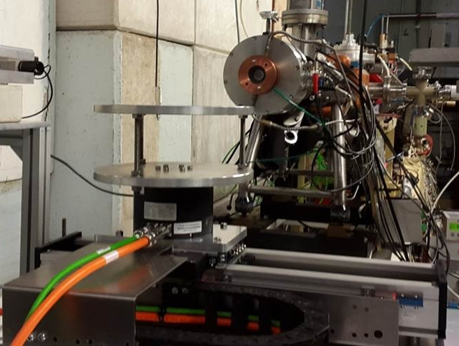
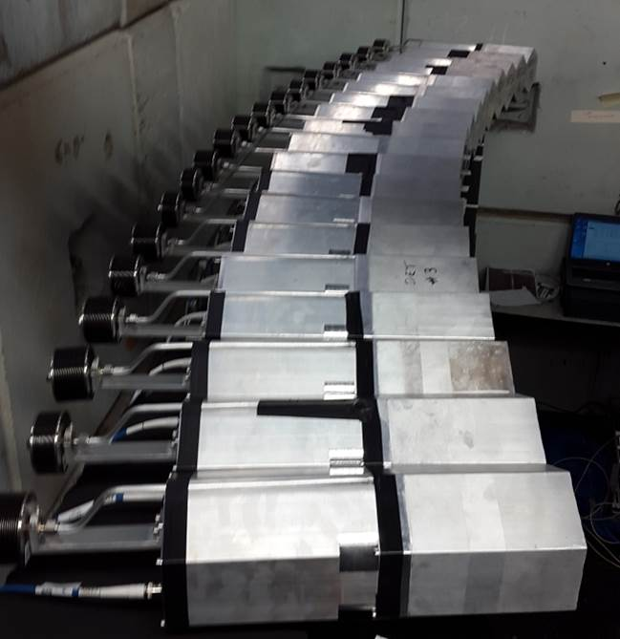
Fast neutron tomography with LICORNE @ ALTO
5 m
First Use of NEDA with FASTER
BC501A

Slide 14
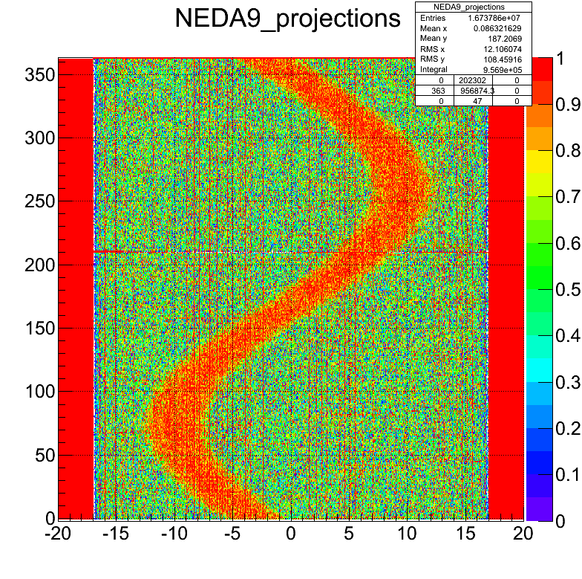
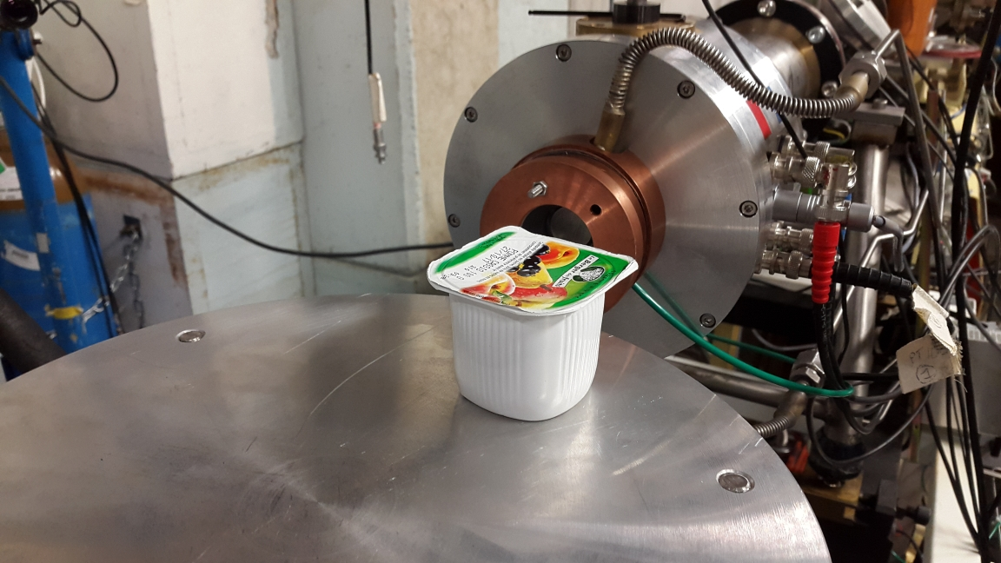
Fast neutron tomography: Simple objects
Courtesty of B. Wasilewska

Slide 15
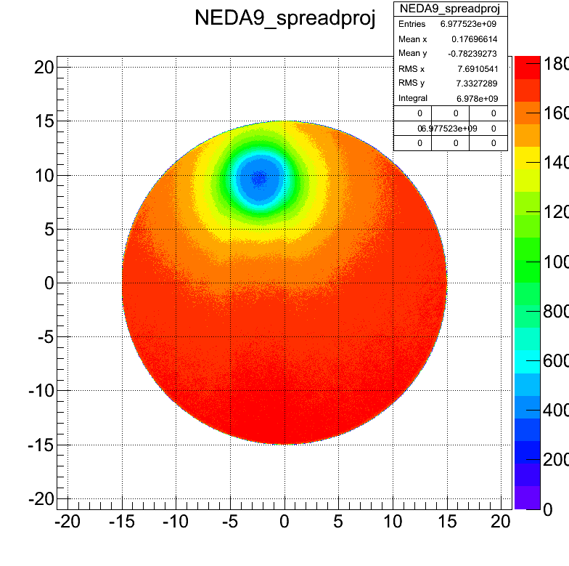
Fast neutron tomography: Reconstruction simple objects
cm
Courtesty of B. Wasilewska
cm

Slide 16
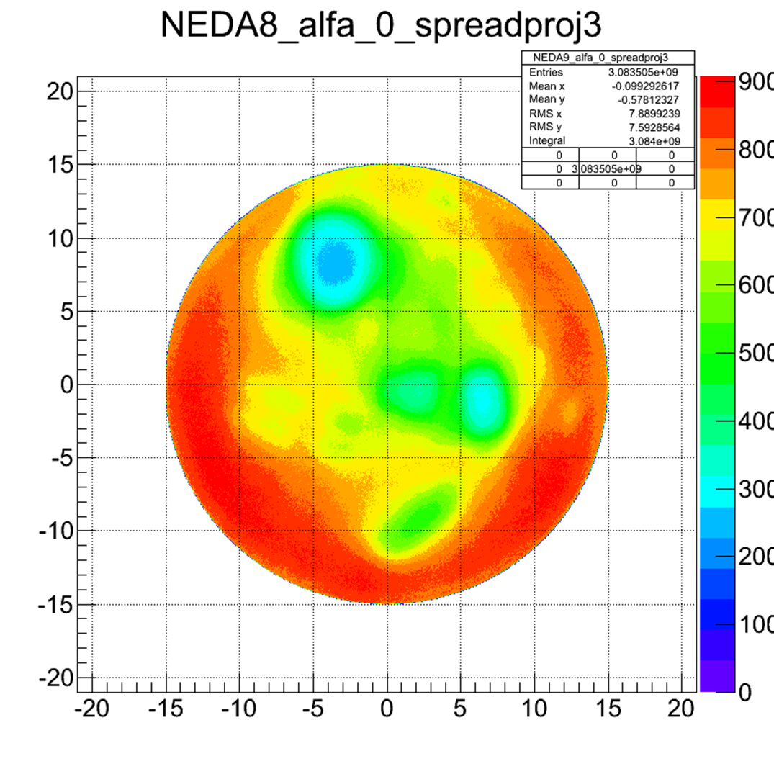
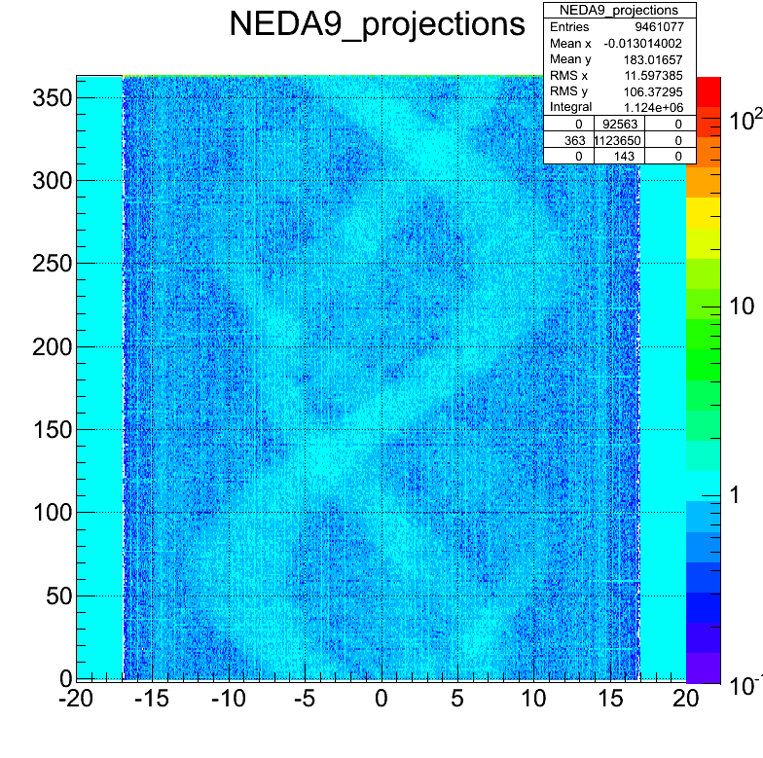
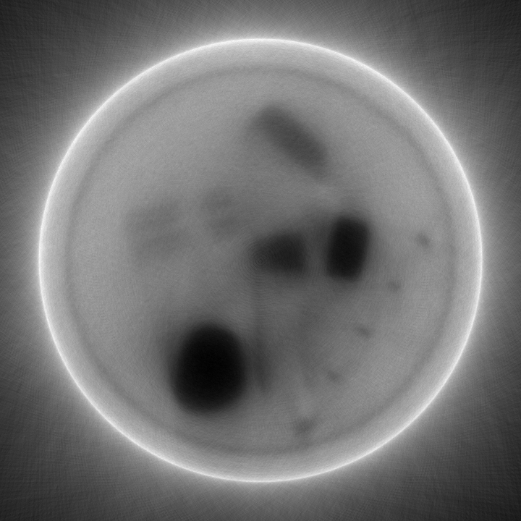
Fast neutron tomography: Reconstruction complex objects
Courtesty of B. Wasilewska

Slide 17
LICORNE publications (2013 – 2017)
14) Studies of fission fragment yields via high-resolution γ-ray spectroscopy
J.N. Wilson, M. Lebois, L. Qi, et al., Proceedings of the Theory-4 international workshop, Varna, Bulgaria (2017)
13) Neutron-rich isotopes from 238U(n,f) and 232Th(n,f) studied with the nu-ball spectrometer coupled to the LICORNE neutron source
J.N. Wilson, M. Lebois , and L. Qi, Proceedings of the FISSION-2017 international conference, Chamrousse (2017)
12) Anomalies in the charge yields of fission fragments from the 238U(n,f) reaction
J.N. Wilson, M. Lebois, L. Qi et al.,, Phys. Rev. Lett. 118, 222501 (2017)
11) Production and study of neutron-rich nuclei using the LICORNE directional neutron source
J.N. Wilson, M. Lebois, L. Qi et al., Proceedings of the Zakopane international conference, Acta Physica Polonica B Vol.48 395 (2017)
10) Studies of γ-ray emission in the fission process with LICORNE
M. Lebois, J.N. Wilson, et. al , Proceedings of the CNR*15 international conference , EPJ Web of Conferences 122, 01010 (2016)
9) Comparative measurement of prompt fission gamma-ray emission from fast neutron induced fission of 235U and 238U
M. Lebois, J.N. Wilson, et al, Phys. Rev. C 92 034 618 (2015)
8) Prompt Emission in Fission Induced with Fast Neutrons
J.N. Wilson, M. Lebois, P. Halipré, S. Oberstedt, A. Oberstedt, Physics Procedia, Volume 64, Pages 107–113 (2015)
7) Future research program on prompt gamma-ray emission in nuclear fission
S. Oberstedt, R. Billnert, F. -J. Hambsch, M. Lebois, A. Oberstedt and J. N. Wilson , Eur. Phys. J. A, 51 12 (2015) 178
6) Development of a kinematically focused neutron source with the p(7Li,n)7Be inverse reaction
M. Lebois, J.N. Wilson, P. Halipre, B. Leniau, I. Matea, A. Oberstedt, S. Oberstedt, D. Verney, Nucl. Instrum. Meth. A 735 46 (2014)
5) The LICORNE neutron source and measurements of prompt gamma rays emitted in fission
J.N. Wilson, M. Lebois, et al., Proceedings GAMMA-2 International Workshop, Sremski Karlovci, Serbia (2013)
4) Prompt fission gamma-rays from fast neutron-induced fission of 238U, 232Th and 235U with LICORNE
M. Lebois, J.N. Wilson et al., Proceedings GAMMA-2 International Workshop, Sremski Karlovci, Serbia (2013)
3) Measurements of prompt gamma-rays from fast-neutron induced fission with the LICORNE directional neutron source
J.N. Wilson, M. Lebois, P. Halipre, A. Oberstedt, S. Oberstedt, Proceedings of the final ERINDA meeting, CERN, Geneva (2013)
2) The LICORNE neutron source
J.N. Wilson, M. Lebois et al., Proceedings of the International Conference, FISSION2013, Caen, France (2013)
1) Nuclear Research with Quasi Mono-Energetic Neutrons at the IPNO LICORNE Facility
S. Oberstedt, J.N. Wilson, R. Billnert, G. Georgiev, P. Halipre, M. Lebois, B. Leniau, J. Ljungvall, I. Matea, A. Oberstedt, D. Verney, International Atomic Energy Agency (IAEA), Proceedings technical meeting IAEA-F1-TM-42752 (2013)
95 users from 34 different institutions in 13 different countries

