Slide 1
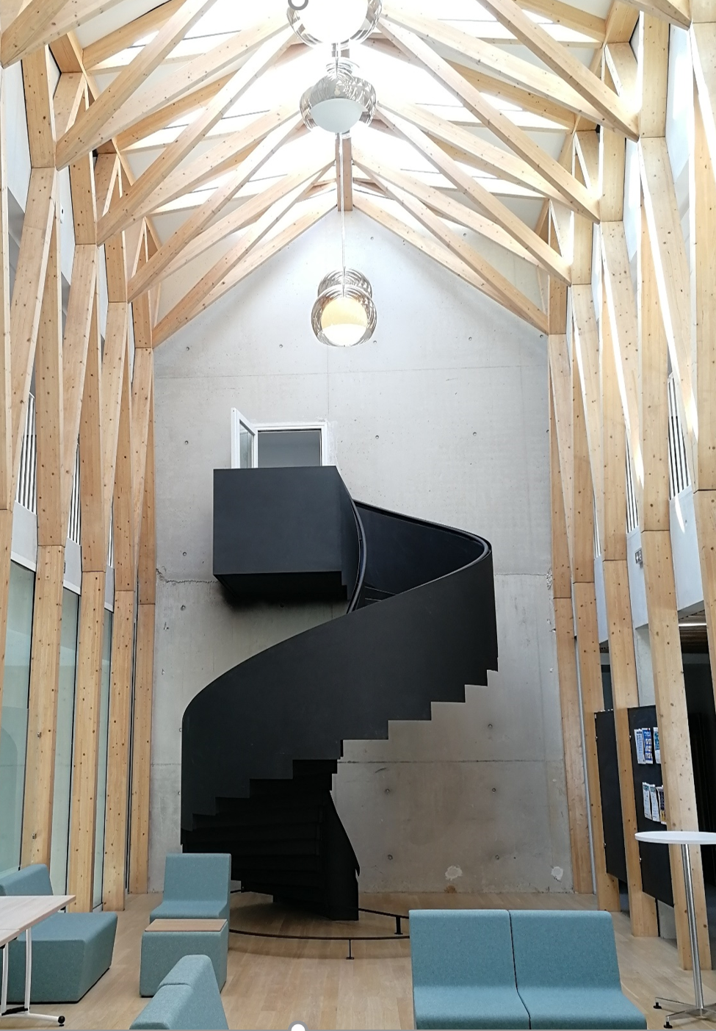
L’Institut Pascal (IPa)
« Si la recherche ne se planifie pas, elle se nourrit par contre de multiples rencontres.. »
[J.P. Aubin, 20e anniversaire de l’IHP]

Slide 2
The Institut Pascal purpose
The main mission of the Institut Pascal is to provide a platform making it possible to organize thematic programs gathering a scientific community for a significant duration, to promote the emergence of new scientific topics and original scientific initiatives.
The specificity of IPa, is to cover a very wide thematic range, which includes all of “hard sciences” (and even a little bit of soft sciences).

Slide 3
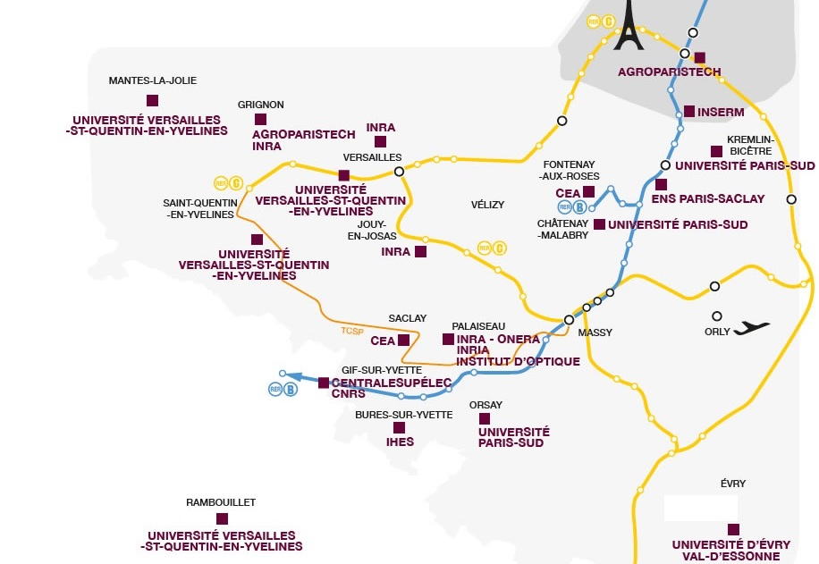
The IPa context and timeline
Contexte : The Paris-Saclay University (dob : January 2019)
➔ 3 universities + 4 higher education institutions + 7 research institutions
65 000 students
9 000 Master
5 500 Ph.D.
350 laboratories
10 000 researchers and professors
Notes:
Did well at the last Shanghai ranking

Slide 4
The IPa context and timeline
Timeline :
A long time process (started ten years ago in 2010-2011)
But a young institution:
The official birthdate of the IPa is January 1st 2018 [creation by the Paris-Saclay university, together with 7 other supervising institutions (CNRS, CEA, INRIA, IHES, CentraleSupélec, ENS-PS,IOGS)].
The first series of thematic programs within the “Pascal” building took place between May 2019 and March 2020.
Notes:
Started at the same time as the gestation of the University

Slide 5
Le bâtiment Pascal (IPa/LPTMS/FAST)
Notes:
5

Slide 6
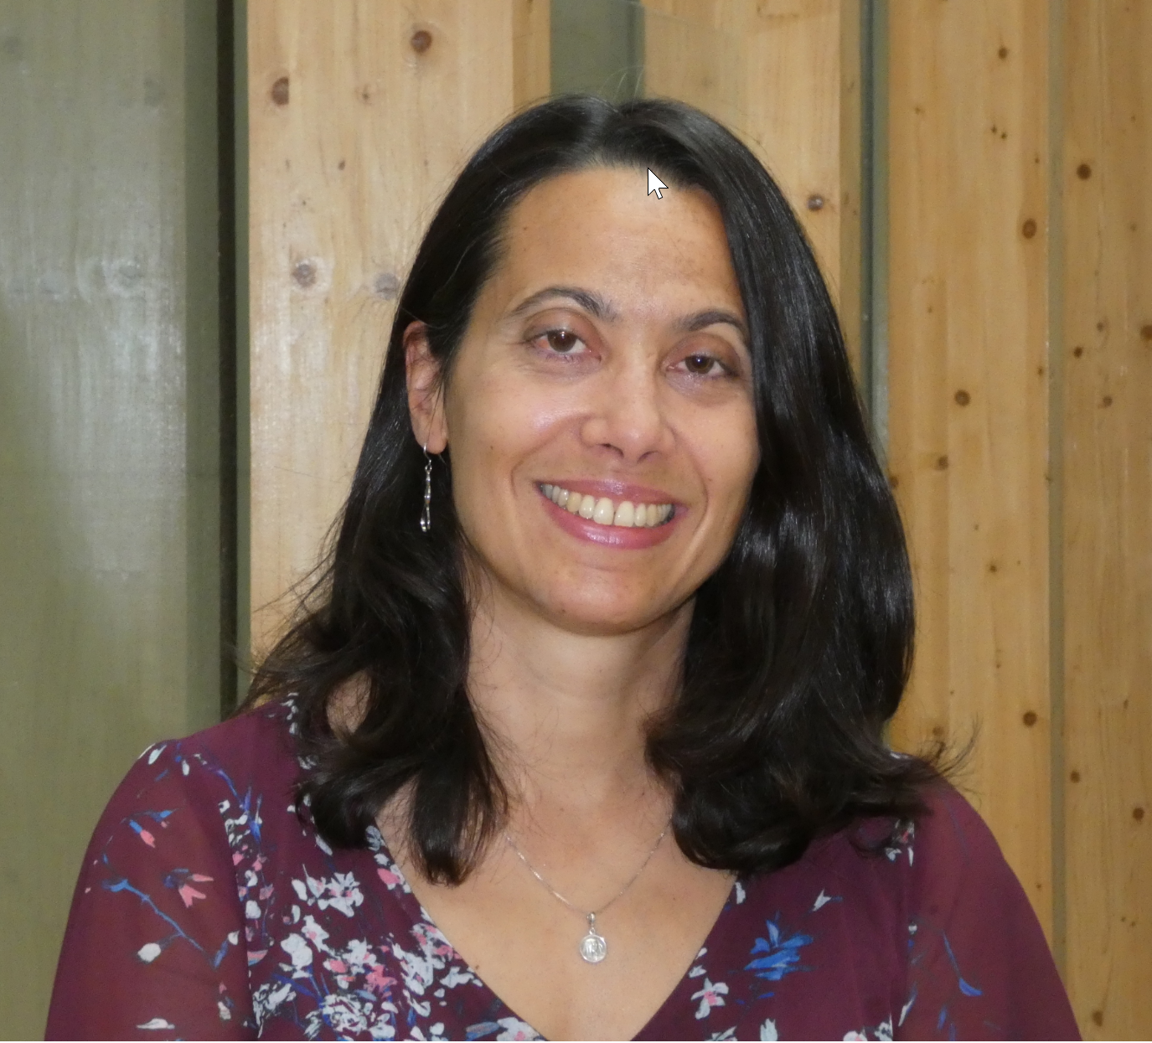
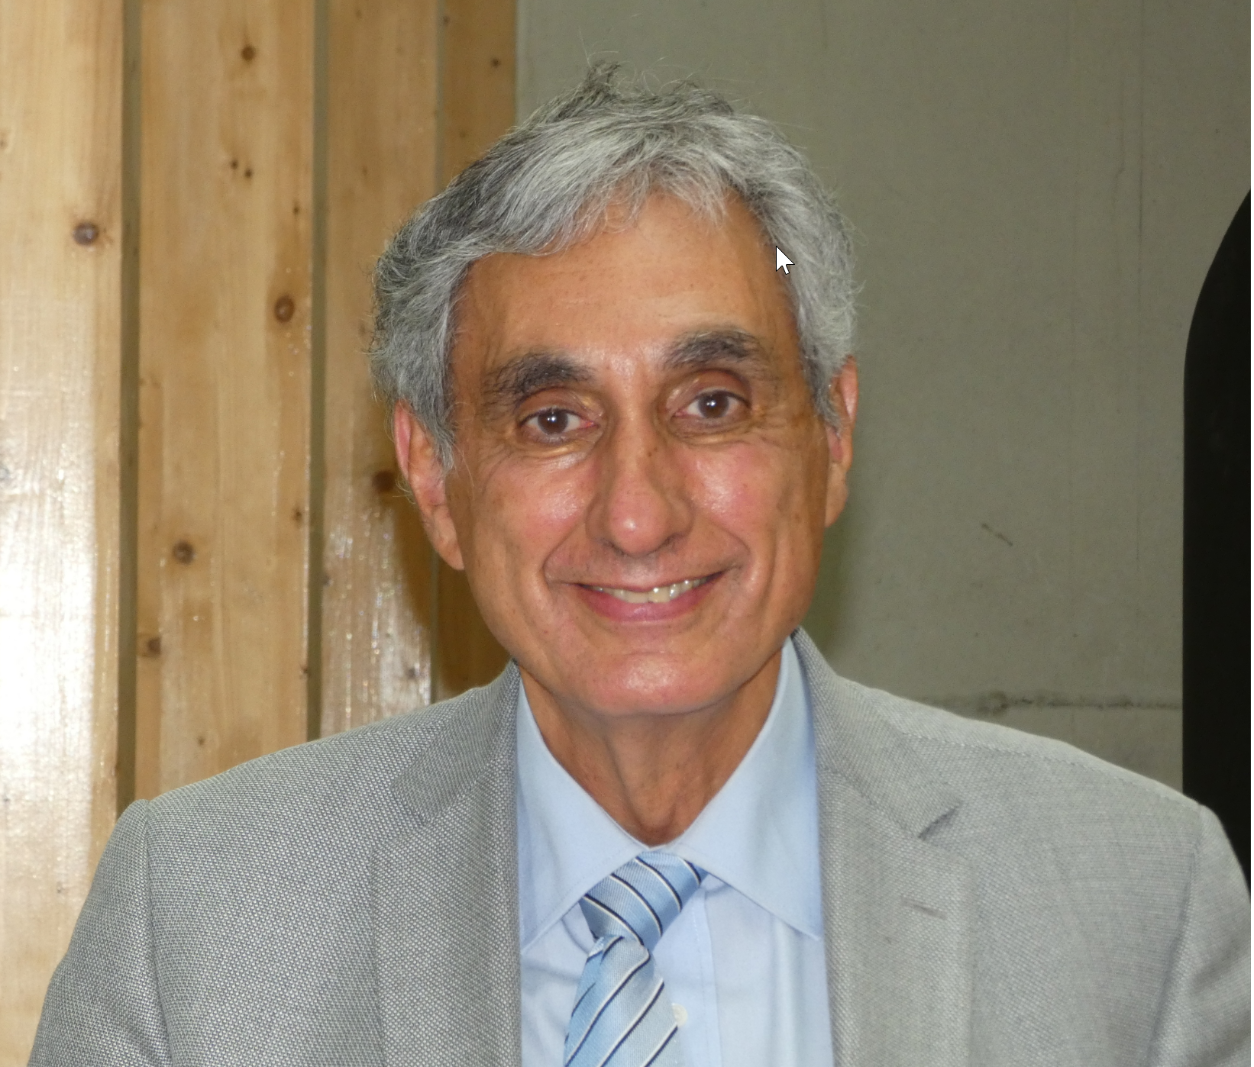
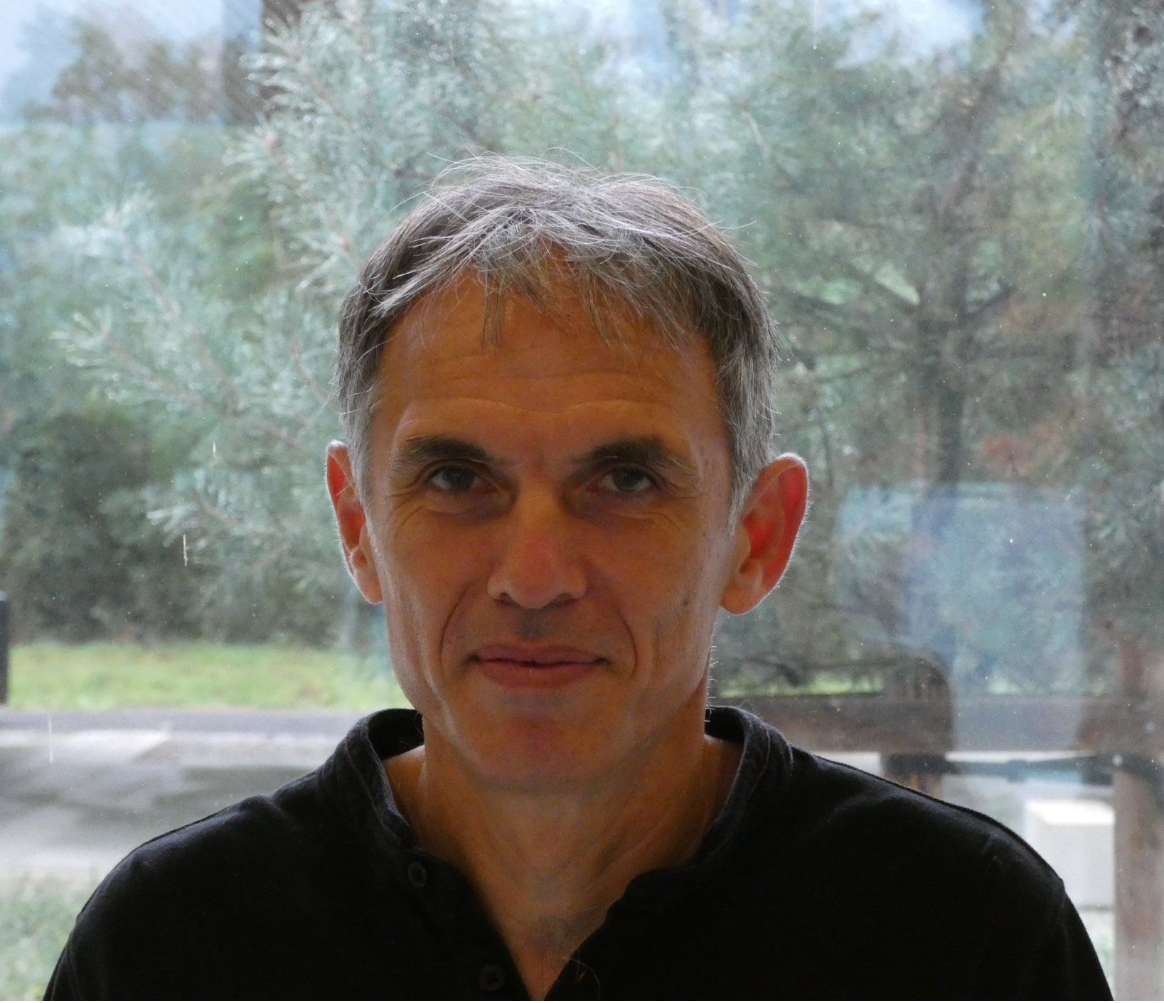
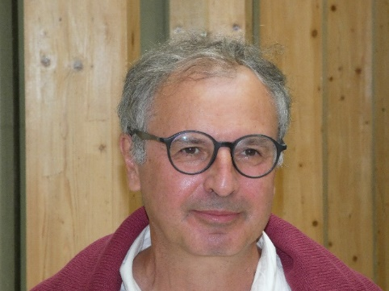
The Institut Pascal « structure »
The Board
Aurélie Lando
Administrative Director
Jacques Bittoun
Deputy Director
(Life Science)
Yves Balkanski
Deputy Directeur
(earth and climat science)
Denis Ullmo
Director
(physics)

Slide 7
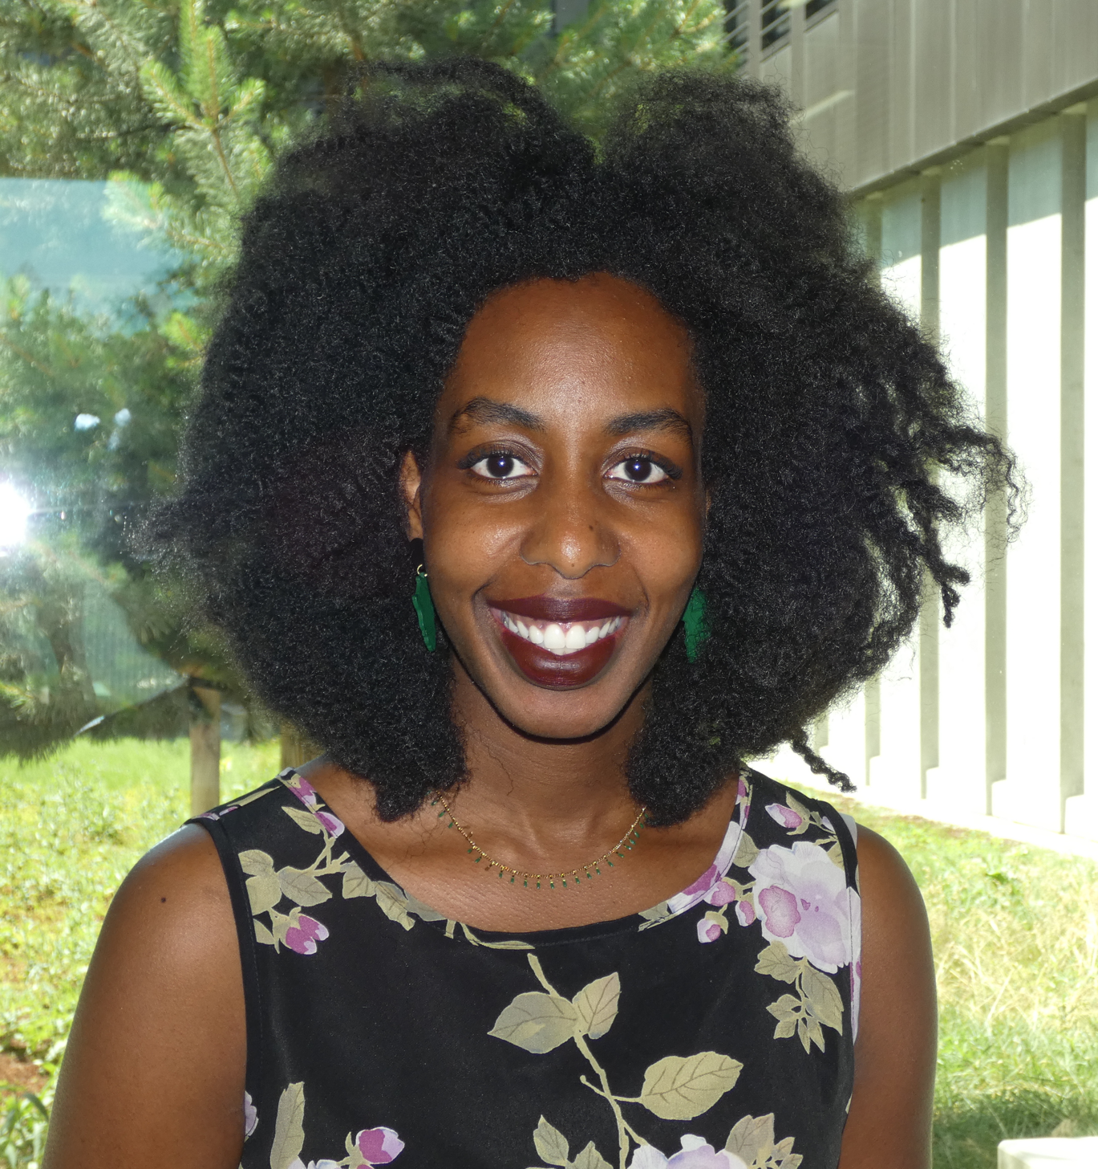
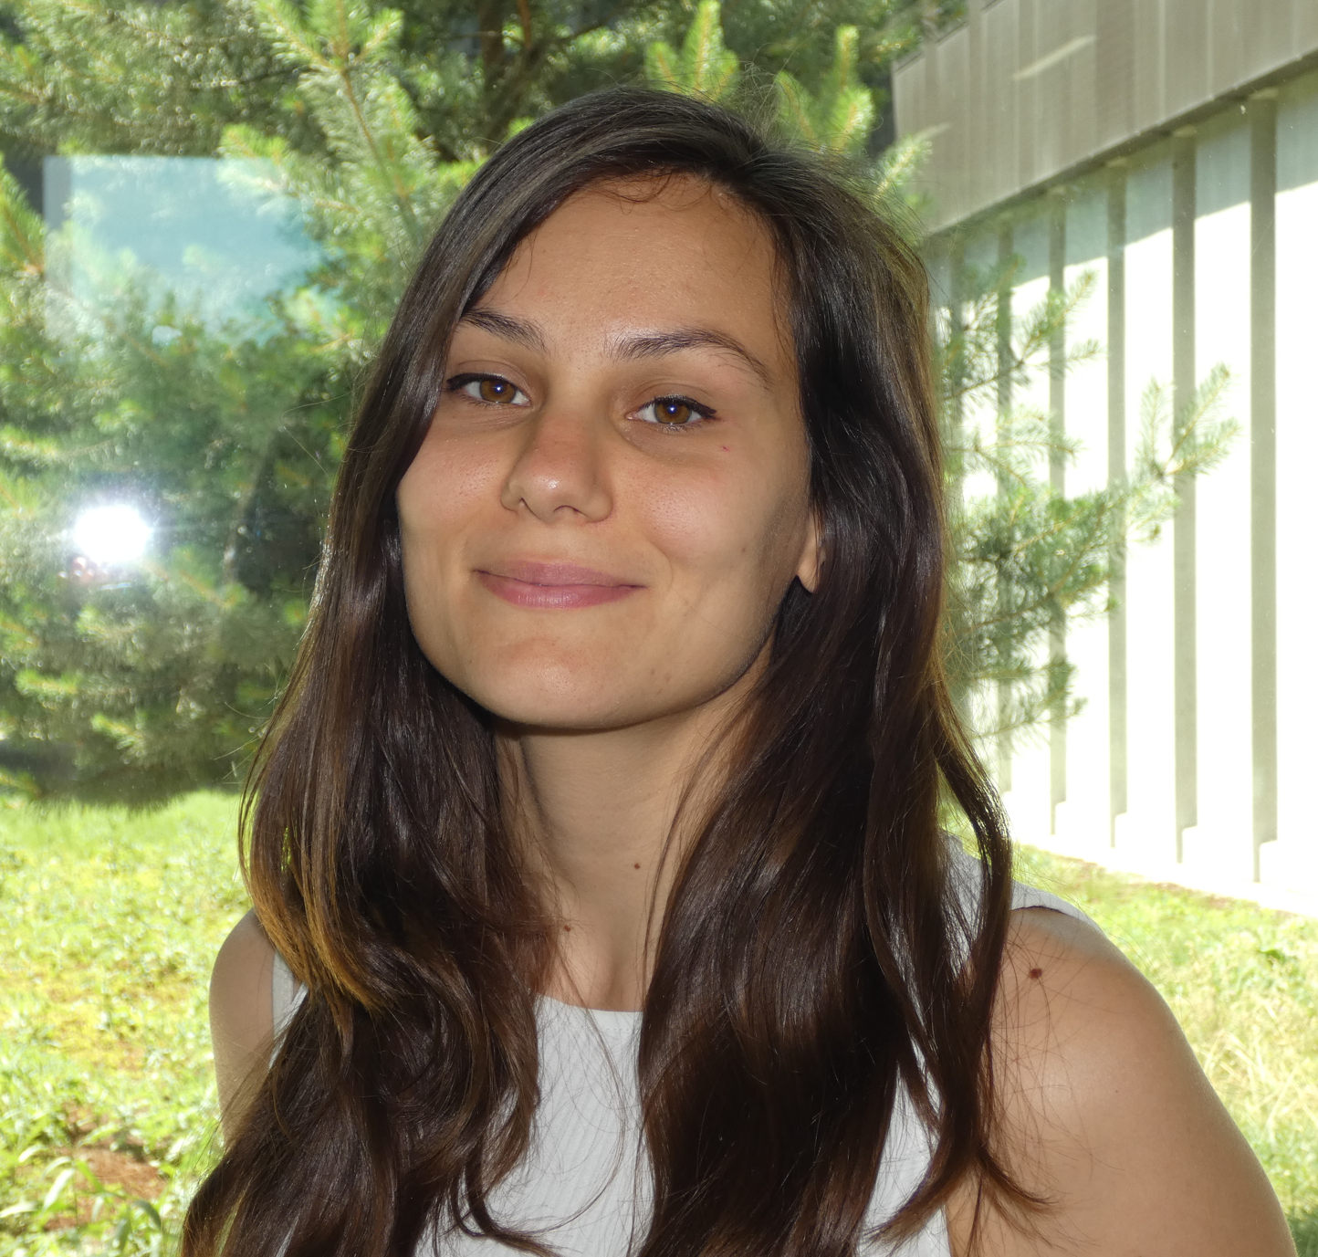
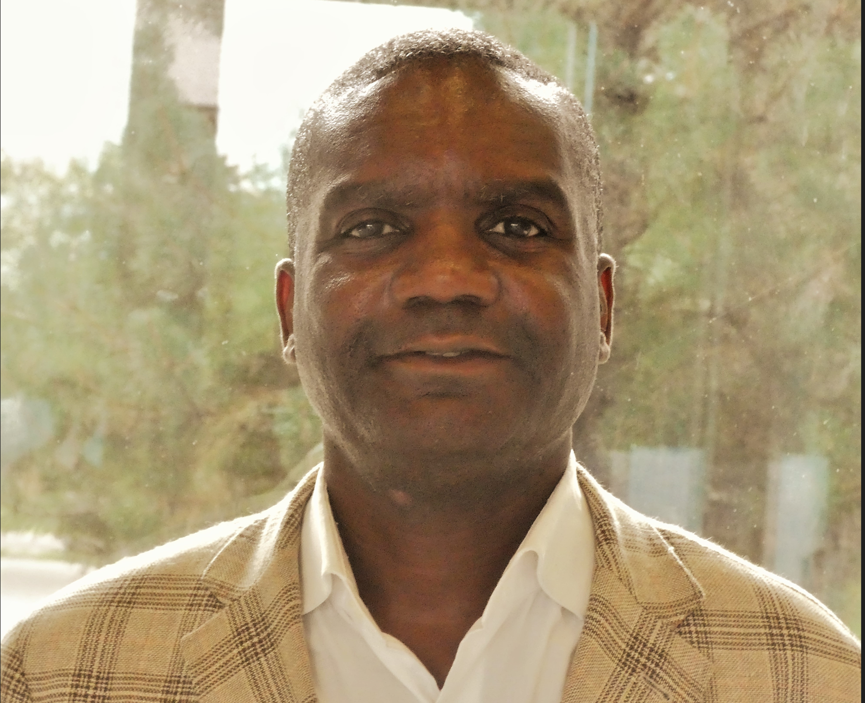
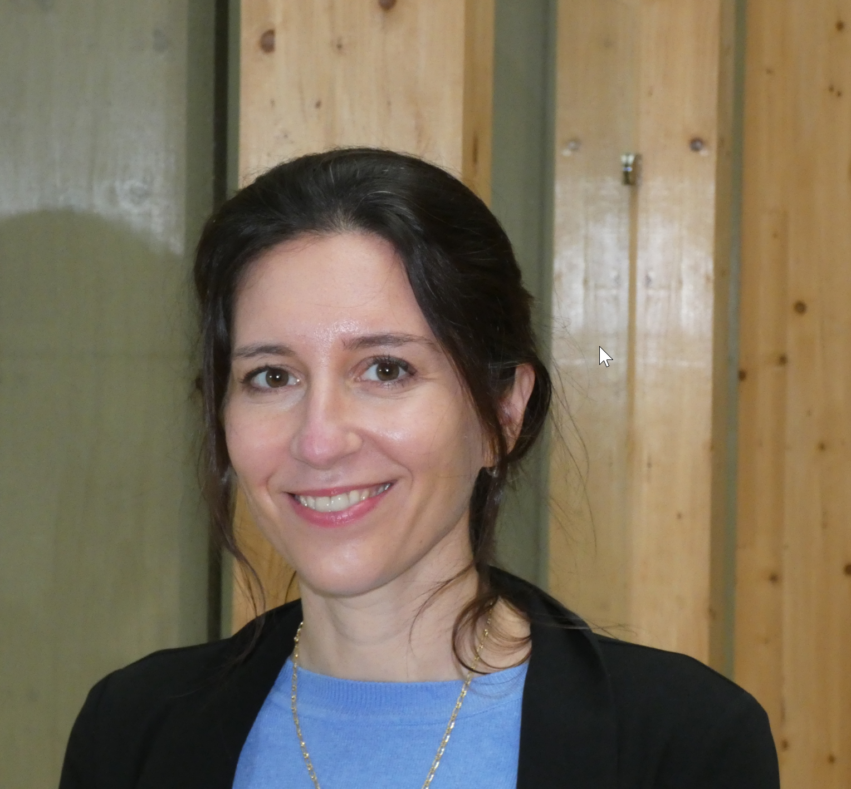
The administrative team
Bamissa Sangaré
(program manager)
Anna Guerreschi
(program manager)
Landry Kibinza
(IT manager)
Francesca Sconfienza
(program manager)

Slide 8
The Scientific Council
Alain Aspect (Physique atomique)
Jean Braun (Sciences de la terre)
Irène Buvat (Interface médecine/physique)
Catherine Cesarsky (Astrophysique)
Dominique Costagliola (Epidemiology)
Anne-Laure Dalibard (Mathematics)
Odile Eisenstein (Chimie théorique)
Albert Fert (Phys. de la matière condensée)
Patrick Flandrin (Traitement du signal)
Catherine Jessus (Life Sciences)
Jean-François Joanny (Interface biologie)
Sylvie Joussaume (Climat Sciences)
Christel Laberty-Robert (Chimie, Energie)
Philippe Lambin (Nano sciences)
Marek Lewitowicz (Nuclear Physics)
Sylviane Muller (Health Sciences)
Stéphane Nonnenmacher (Mathématiques)
Christine Paulin (Informatique)
Michel Spiro (Hautes énergies)
Pierre Guibentif (MSH Paris-Saclay)
Xavier Reboud (Agro-ecology)
Agnès Roby-Brami (Neurosciences)
Michèle Sebag (Computer Sciences)

Slide 9
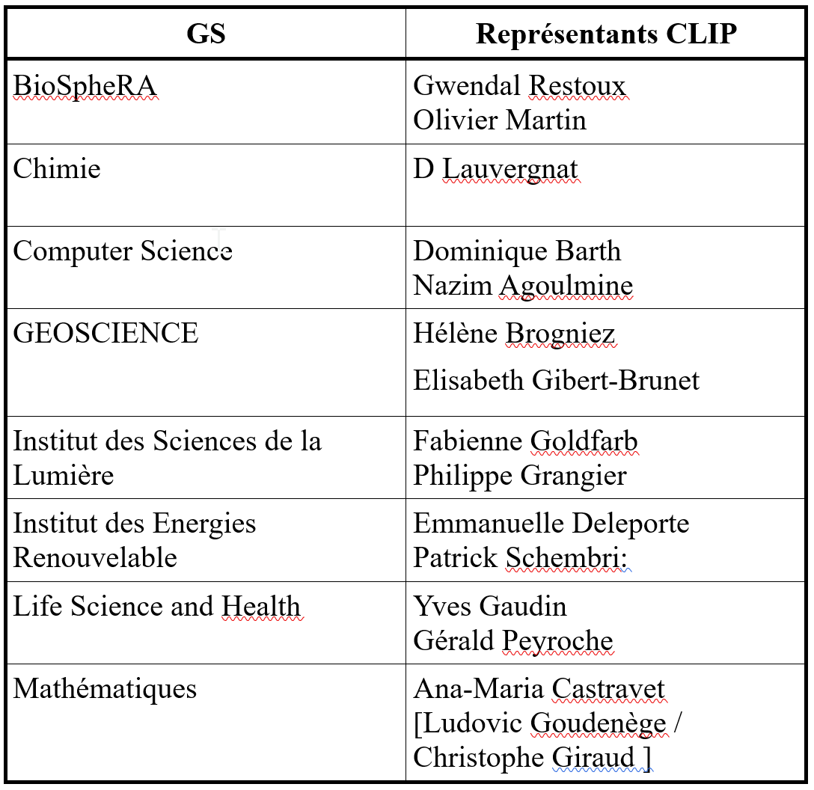
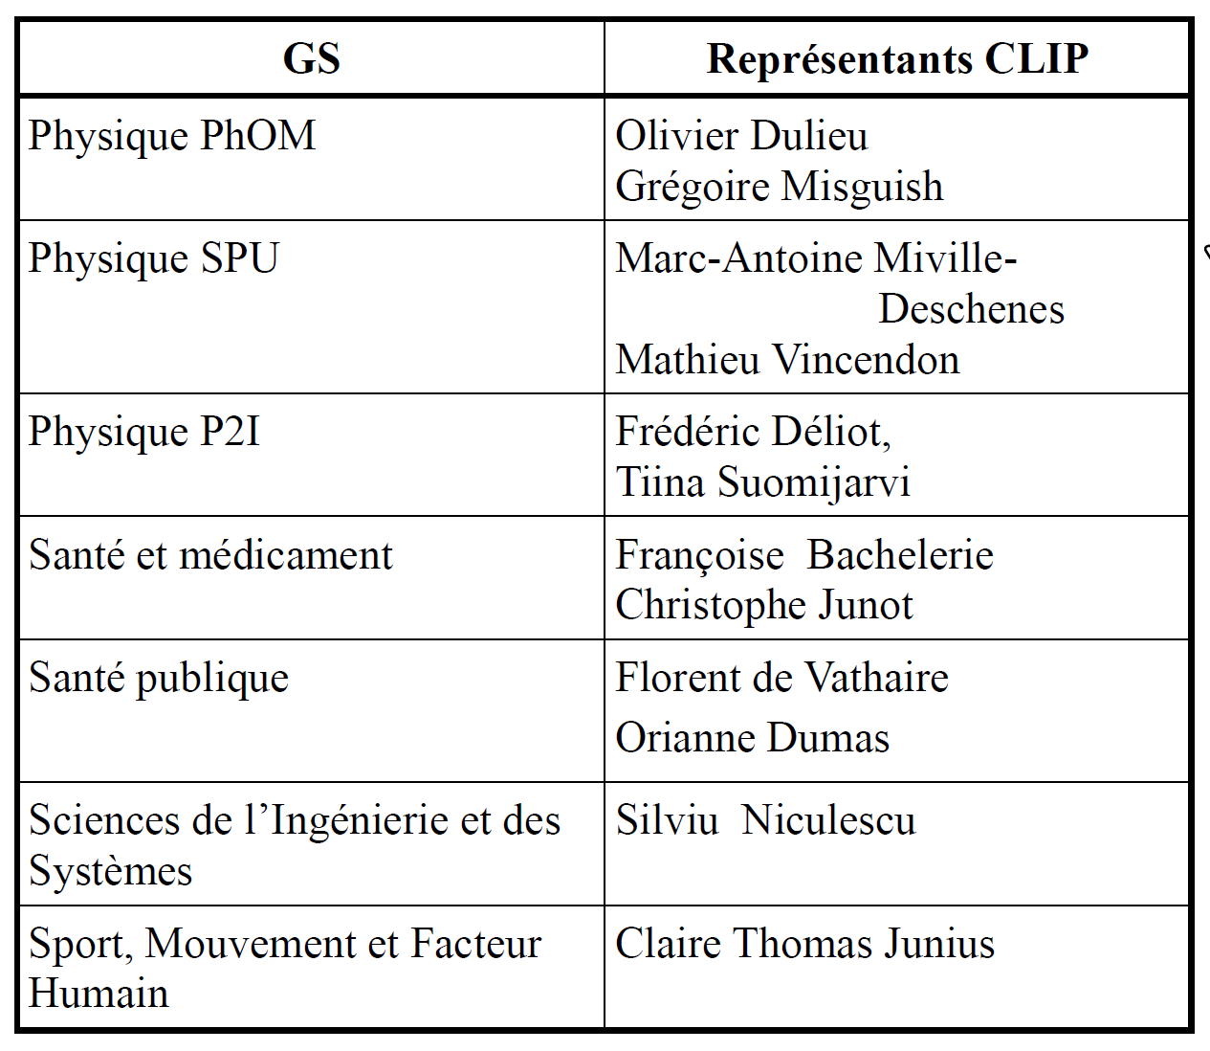
The IPa « structure »
The Local Council (CLIP)

Slide 10
IPa-2019 summary
8 thematic programs
INDICE : earth and climate science
Ecosystem Dynamics : mathematics / genetics
Learning to discover : data science / high energy
Urban mobility : data science / engineering science /sociology / geography
SoStar : astrophysics
APPTh : astrophysics / high energy
UPHC : high energy
DYMCOM : molecular physics

Slide 11
IPa-2019 summary
8 thematic programs
INDICE : earth and climate science
Ecosystem Dynamics : mathematics / genetics
Learning to discover : data science / high energy
Urban mobility : data science / engineering science /sociology / geography
SoStar : astrophysics
APPTh : astrophysics / high energy
UPHC : high energy
DYMCOM : molecular physics
IPa-2020 summary
Covid-19

Slide 12
Equipment for hybrid (remote/face-to-face) mode
Purpose :
In the short term : adapt to the Covid-19 pandemic situation
In the medium and long term : « decarbonation » of research
Equipment (installed one year ago)
Two connected amphitheater
Three connected rooms: These rooms (I107, I203, I217) are both physical rooms (for onsite participants) and virtual rooms (for remote participant). They are intended specifically for small group discussions in hybrid mode.
One connected informal space
Four DtenMe “collaboration device”
NB 1 : The Connected Rooms and DtenMe are more than nice video screens with a good sound and video system. Both are electronic white boards which can be written on both locally or remotely. They are not intended just as nice “zoom discussion set”, but to make possible hybrid discussion around a white board.
NB 2 : If you connect your personal computer within one of the connected room or amphitheater, please do not connect to audio.

Slide 13
IPa programmes 2021
Janvier
Mars
Mai
Juillet
Core2Disk (2 sem)
BootStat (4 sem)
Réseau Biblio
UPSaclay (2 jr)
AI (1 jour)
Réseau Biblio
UPSaclay (2 jr)
Juillet
Septembre
Novembre
Janvier 2022
Interstellar (3 sem)
Tagged (3 sem)
GDR (3j)
DISORDER
(3 sem)
QUANTUM (4 sem)
IRN (1 sem)
ECOGAL (2 sem)
Astroparticles (6 sem)
Innov.
Pédagoq
Prog. financé IPa
Hybride
Prog. autofinancé
Hybride
Durée écourtée
Formule modifiée
Short Event

Slide 14
Executive summary : 14 programs / 39 weeks
Thematic Programs 2022
Agenda
Janvier
Mars
Mai
Juillet
Learning 3 (2 sem)
Ecogal (4 sem)
DCS3 (2 sem)
AI (2 sem)
WholeSun (3 sem)
ISAPP (2 sem)
Reimagine (2 sem)
Mobility 2 (3 sem)
Water Cycle
Juillet
Septembre
Novembre
Janvier 2022
AI
Interstellar (3 sem)
Heavy Flavors
(3 sem)
BNano
WaterCycle (4 sem)
MLCQ4Dyn
(4 sem)
C&B* (1 sem)
Astroparticles (4 sem)
Prog. autofinancé
data sciences
low energy physics
astrophysics
climat sciences
high energy physics
educational sciences
Prog. financé IPa
*Ecole Changement climatique et Biodiversité
** Action Jointe MSH

Slide 15
Practicalities I : Covid or not Covid ?
Mandatory constraints due to Covid have been essentially completely relaxed, and the last covid wave seems to be over.
However we had covid case in most of the programs before the summer.
Thus, :
Wearing masks is clearly not mandatory, but clearly not forbidden either.
During groups discussions, it does not hurt to:
Keep windows open as much as possible.
Use the CO2 measuring devices in the discussion rooms
Weather permitting , to take advantage of the terrasses

Slide 16
Practicalities II : The program managers and you
Francesca is here to help
Francesca Sconfienza
(program manager)

Slide 17
Practicalities II : The program managers and you
Francesca is here to help
But there is only one of her, and a lot of you
Francesca Sconfienza
(program manager)
Read the participant handbook (either now or just before you feel the urge to drop in their office to ask a practical question).
Bring back your cup (/plate/glass/etc..) to the kitchen (or even better in the dishwasher)
Small print jobs (plane tickets, etc..) are fine, but try to repress the urge to print your Ph.D. thesis.
Follow what is going on on slack …

Slide 18
Practicalities II : The program managers and you
Francesca is here to help
But there is only one of her, and a lot of you
Francesca Sconfienza
(program manager)
Read the participant handbook (either now or just before you feel the urge to drop in their office to ask a practical question).
Small print jobs (plane tickets, etc..) are fine, but try to repress the urge to print your Ph.D. thesis.
Follow what is going on on slack …
Bring back your cup (/plate/glass/etc..) to the kitchen (or even better in the dishwasher)

Slide 19
Specificity of Heavy Flavors
Traditionally, for lunch, we organize only one buffet per week (on Mondays) and send people to the CESFO cafeteria the rest of the week.
In the case of Heavy Flavors, it has been preferred to have buffet or lunch boxes every days.
This changes significantly the amount of logistic work for the IPa team (setting up the buffet, handling trashes, etc..)
➔ Please be particularly careful to help the team as much as possible in this respect (sort food waste, bring packaging back to the recycling bin, etc..)

Slide 20
Practicalities III : sharing the space with the school ““Climate change and biodiversity"
This school is organized by the Math Institute of the CNRS
It will use the large amphi and the hall this week from Tuesday to Thursday

Slide 21
Practicalities IV : after the program
Feedback (for us and our supervising institutions) :
Just after the program → qualitative questionnaire (mainly for us)
A year after the program → a more quantitative questionnaire about the outcomes of the program (mainly for our supervising institutions)
➔In the mean time do not forget to insert the sentence “[..] "This work was made possible by Institut Pascal at Université Paris-Saclay with the support of the program “Investissements d’avenir” ANR-11-IDEX-0003-01 “ in the acknowledgment section of papers associated with the thematic program
« Cahier de l’Institut Pascal »
Possible publication associated with the thematic program.

Slide 22
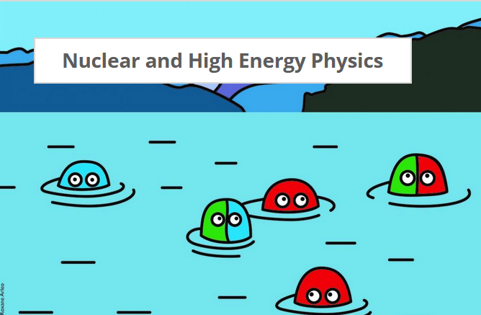
Welcome to the Institut Pascal !
Enjoy your program !

Slide 23
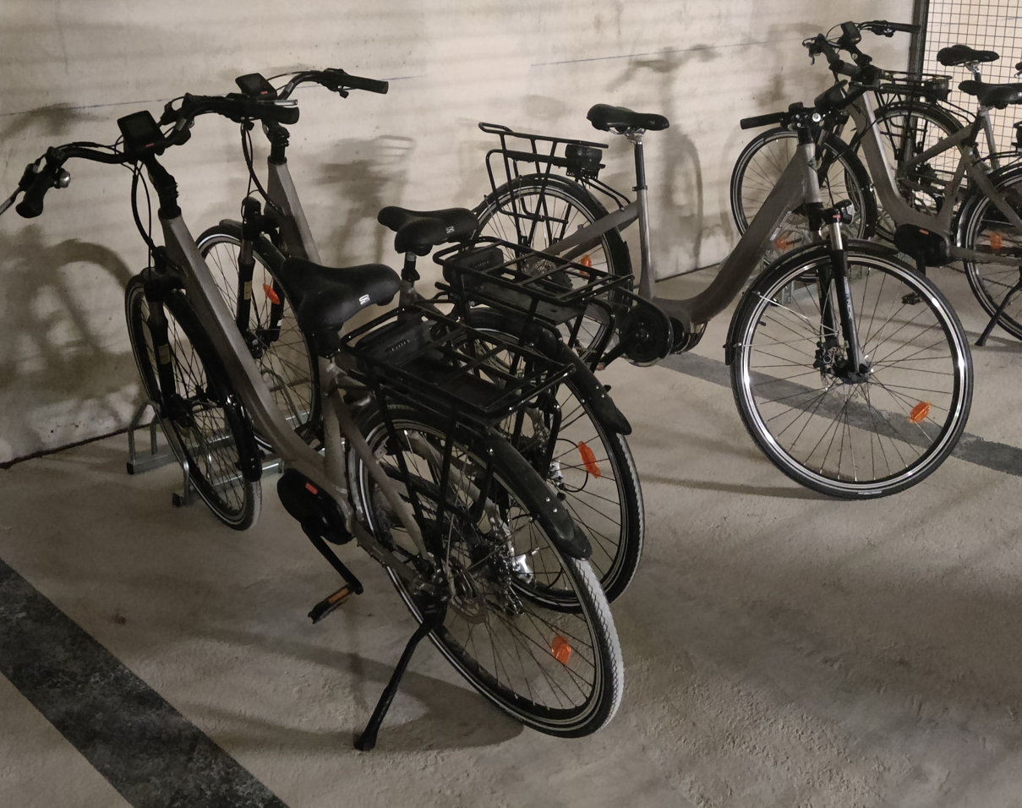
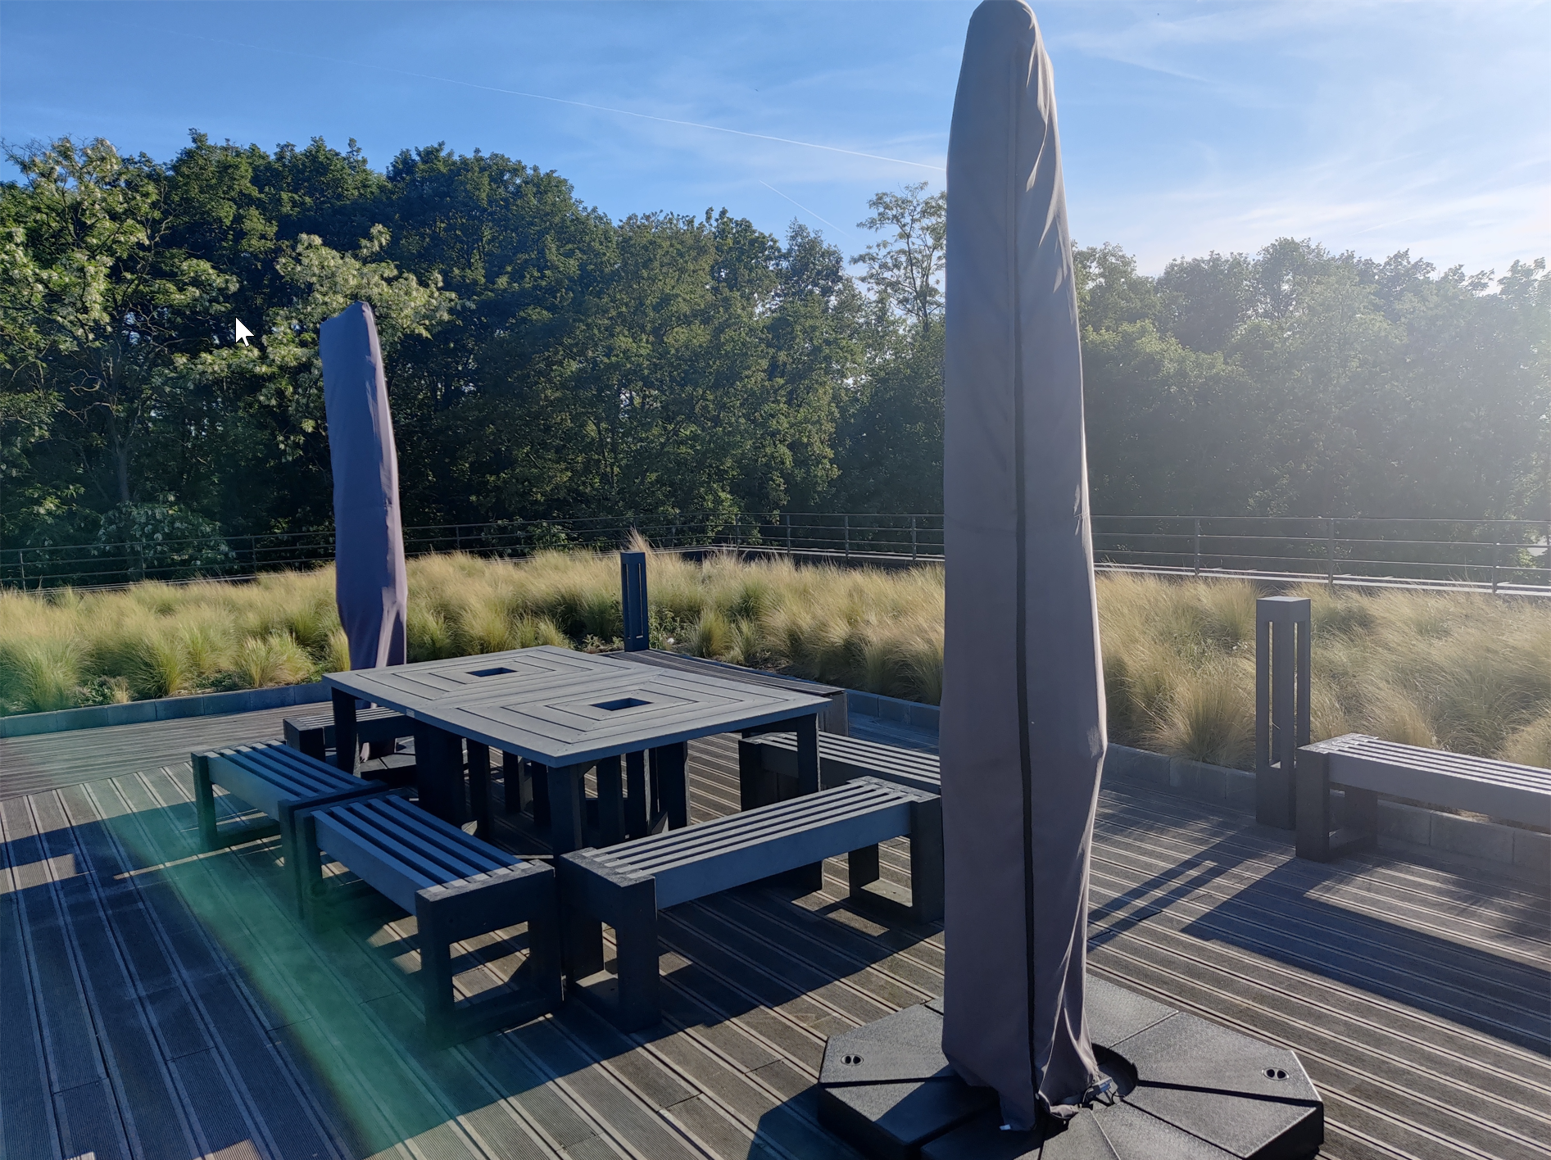
Practicalities III : electric bikes and umbrellas
We have a few electric bicycles that you can borrow (see Anna)
Use of the bikes are under your personal responsibility
If you are not really familiar with riding an e-bike, please let us know beforehand.
If you want some shade on the terrasse you are welcome to use the umbrellas.
Rule of the game : if you open it, you are in charge of closing it.
This responsibility can be transferred to a person, but not to a group.

