Slide 1

New Opportunities for Electroweak Baryogenesis
Higgs off
Higgs on
Higgs off
Higgs on
Higgs off
Higgs on
Marcela Carena
Fermilab/Uchicago
Higgs Hunting, September 13, 2022

Slide 2
Its discovery and subsequent study of its properties at the LHC has provided a first portrait of the electroweak symmetry breaking mechanism
It ensures the calculability of the SM at high energies
It offers us a powerful tool for the exploration of fundamental questions in particle physics, e.g. Baryogenesis, Dark Matter, Inflation?
The great success of the Higgs Boson
What is encoded in the Higgs potential?
- How is it generated?
- What determines the values of the Higgs mass parameter and quartic coupling?
- Is there an explanation for the apparent
metastability of the Higgs potential?
- Is it a part of a richer scalar potential ?
- If so, what is the dynamics of the electroweak
phase transition ?

Slide 3
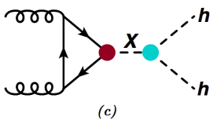
The Higgs boson: a lot to understand
With M_{H} = 125 GeV, its mass is at a lucky spot to maximally allow us to look for surprises
We have verified that the Higgs boson is related to the Higgs mechanism of electroweak symmetry breaking
We have verified that the Higgs boson couples most strongly to the heaviest SM matter particles
Enhanced di-Higgs production is now starting to be probed already at the LHC
HH → bbbb boosted
+ higher order EFT operators
This can shed light on understanding the Higgs potential and the EW phase transition
Explore: Do all fermions get their masses from the same Higgs field?
Do Higgs couplings conserve flavor/CP? What about exotic/inv. Higgs decays?
What is behind the EWSB mechanism: Radiative breaking? Compositeness?

Slide 4



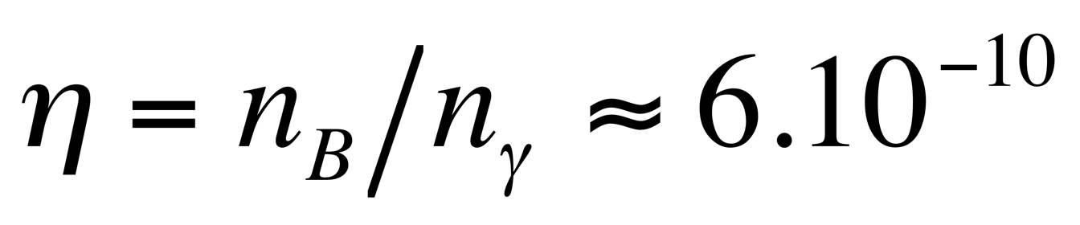
The Mystery of our Asymmetric Universe
Precision Cosmology: information on baryon abundance
Abundance of primordial elements
Predictions from Big Bang Nucleosynthesis
CMB
What generated the small observed baryon-antibaryon asymmetry?
Initial condition, or generated during the evolution of the universe?
Starting from a CPT conserving theory, the necessary Sakharov’s conditions for baryogenesis are
Baryon (or Lepton) number violation: if universe starts symmetric
C and CP violation: treat baryon/anti-baryon differently (to remove antimatter)
Out-of-thermal equilibrium: suppress inverse processes
All three requirements fulfilled in the SM – conditions are necessary but NOT sufficient to produced the OBSERVED asymmetry

Slide 5
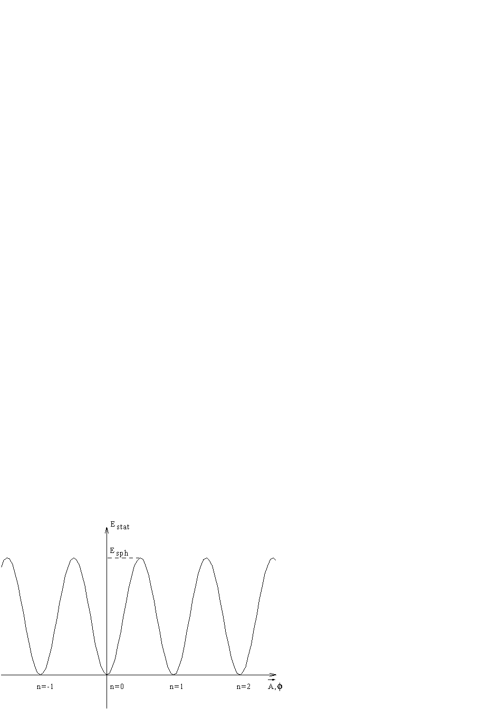
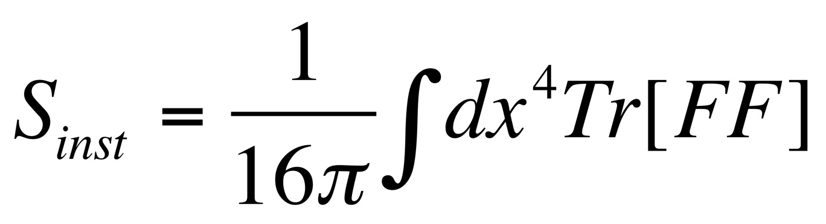
Baryon Number Violation: Anomalous Processes
In the SM, Baryon Number conserved at classical level but violated at quantum level
For gauge theories, one finds violation of classically preserved symmetries due to the quantization process: Anomalies
For the chiral weak interactions, gauge symmetry preservation yields the non-conservation of baryon and lepton currents
Adler, Bell, Jackiw; Bardeen
If
≠ 0
Anomalous processes violate both baryon and lepton number, hence violate B+L,
but they preserve B – L. They can proceed by the production of “sphalerons”
E_{sph} ~ 8π v(T) / g
➔ height of the barrier separating vacua with different baryon number
Static configuration: middle point in the instanton tunneling

Slide 6
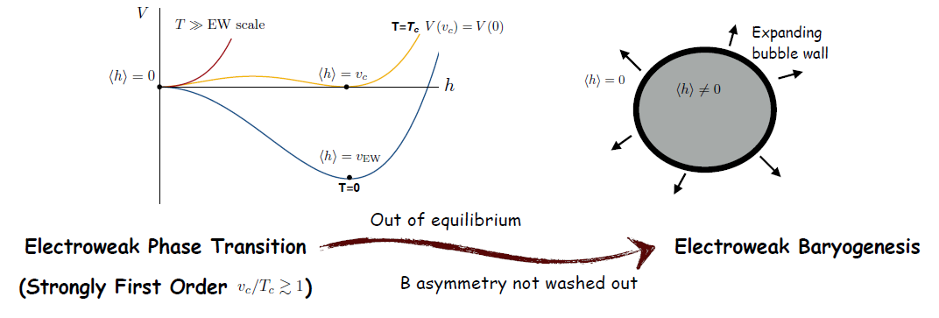
SM Baryon Number Violation at zero and finite Temperature
At T = 0, B-violating sphaleron processes exponentially suppressed
At very high temperatures they are unsuppressed,
At finite temperature they are Boltzmann suppressed
with S_{inst} = 8π/α_{w}
with E_{sph} ~ 8π v(T)/g
Klinkhammer and Manton’84; Arnold and Mc Lerran’88, Khlebnikov and Shaposhnikov ’88
Baryon number generation at the Electroweak phase transition
Start from B = L = 0 at T > T_{c}
Higgs off
Higgs
on
In a first order EW phase transition, universe tunnels from h = 0 to h≠ 0 vacuum via bubble nucleation.
Higgs off
Higgs
on
Higgs off
Higgs
on
Bubbles expand at near speed of light. Processes near the wall highly out of equilibrium
5

Slide 7
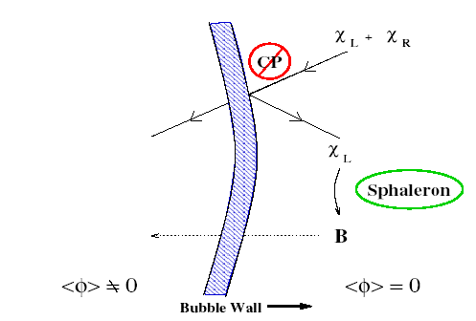
Effects of CPV and Baryon Number generation at the EWPT
Start with B = L = 0 at T>Tc
Particles flow into the expanding bubble wall and CPV implies that the wall exerts
different forces on particles and antiparticles creating a chiral asymmetry
-Δ
is slower than
antileptons
leptons
Outside the bubble, EW sphalerons allow a fraction “f” of the chiral asymmetry in quarks to be shared with leptons ➔ Sphalerons violate B+L, but conserve B-L
A net baryon asymmetry is generated this way
Marcela Carena | New Opportunities for Electroweak Baryogenesis

Slide 8
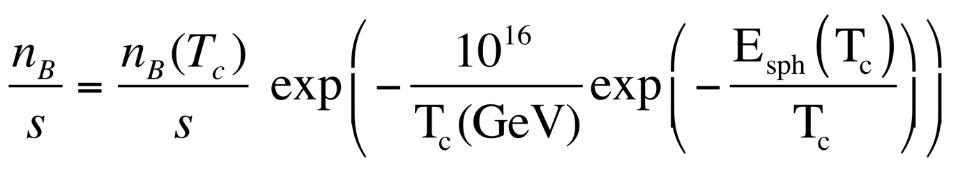
Baryon Asymmetry Preservation
For a short period, EW sphalerons work to generate the desired baryon asymmetry;
Then need to shut off quickly to prevent washout.
if n_{B} = 0 at T > Tc, independently of the source of baryon asymmetry
Recall:
If Γ_{ΔB ≠ 0} ≲ H ~ T²/ M_{Pl}
<< 1 ➔ v(T_{c}) /T_{c} ~ 1
∕
>
B processes frozen
To preserve the baryon asymmetry demands a Strong First Order EWPT
Transition does not occur at T_{c}, but rather at T_{n} (bubble nucleation temp.) [T_{n} < T_{c}]
➔ actual transition from false vacuum to real one requires S_{bounce}/T_{n} ~ 140
Marcela Carena | New Opportunities for Electroweak Baryogenesis

Slide 9
EW Baryogenesis in the SM fails
All three Sakharov’s conditions could have been fulfilled
Baryon number violation: Anomalous Processes/Sphalerons
CP violation: Quark CKM mixing
Non-equilibrium: At the Electroweak Phase Transition.
But
With the measured 125 GeV Higgs mass, lattice simulations show the EWPT is a cross over.
Contribution from CP violation
(CKM) is highly suppressed
High order loop effects needed to generate a complex contribution to the top quark mass
Gavela et al ‘86
Kajantie, Laine, Rummukainen, Shaposhnikov ‘88
Marcela Carena | New Opportunities for Electroweak Baryogenesis

Slide 10
Electroweak Baryogenesis demands new Physics/ New Scalars
Basic Questions:
What was the mechanism that triggered electroweak symmetry breaking? (SM gives a simple parameterization, not an explanation)
Does this mechanism involve an expanded “Higgs sector” with other scalar boson fields, new forces, new fermions, new sources of CP violation ?
Was the resulting phase transition strongly first order?
Was there just one phase transition or a multi-step transition?
Was there an electroweak phase transition at all?
The answers to these questions will inform whether electroweak baryogenesis is a viable explanation of the observed baryon excess in our universe

Slide 11
Higgs boson cousins may be the key to our Asymmetric Universe
To render the EWPT strongly first order and provide new sources of CPV
Many BSM scenarios have been studied which allow for EWBG
Singlet extensions of the SM
Two Higgs doublet Models
Supersymmetric models
MSSM: light stop scenario, ruled out by Higgs precision
NMSSM: through additional scalars, is an appealing possibility
  Importance of computing nucleation temperature
  EWBG possible but new scalar boson states are hard to probe at colliders
  due to alignment proximity (LHC information)
Models with Dark CP violation and gauged lepton/baryon number
Models with heavy Fermions
Models of EW symmetry non-restoration/delayed restoration, with multiple singlets and possibly with an inert doublet

Slide 12
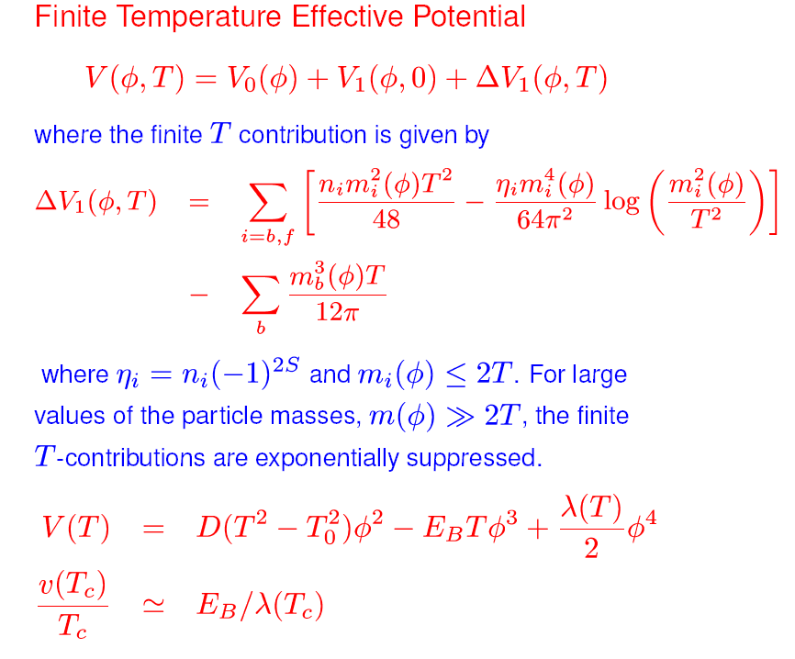
Finite temperature Higgs Potential: general considerations
Need to consider:
V(φ,Τ) = V₀(φ) + V₁^{CW}(φ,0) + V₁(φ,T)
V₁^{CW} yields renormalization scale independence, and V₁(φ,T) considers thermal contributions, e.g.
For m_{i}(φ) < 2Τ,
with η_{i} = n_{i} (-1)^{2S}
Review Standard Model example: ➔
D: contributions at one-loop proportional to the sum of the couplings of all bosons and fermions squared, responsible for symmetry restoration
E: contributions from to the sum of the cube of all light boson particle couplings:
Defining T_{c} and requiring that <φ(T_{c})> = v (T_{c}) is a minimum yields
v (T_{c}) / T_{c} ~ E / λ
that controls the strength of the phase transition
Perturbative result to be compared with lattice computations yielding m_{H} < 75 GeV
Since λ = m_{H}²/v² then

Slide 13



Finite temperature Higgs Potential: general considerations
Going beyond the Standard Model to allow for a first order phase transition, sufficiently strong, one needs to add new particles and look in the direction of the transition
V(φ,Τ) = V₀(φ,S, H_{BSM}) + V₁^{CW}(φ, S, H_{BSM},0) + V₁(φ, S, H_{BSM},T)
The scalar potential can have many fields
Tree-level Effects
New fields coupling directly with the Higgs, modifying the potential at tree level
V(h, S, H_{BSM}, …)
[ ]
Zero Temperature loop effects
Modifying the potential through radiative corrections involving new particles
Thermal effects
Modifying the thermal potential through thermal loops involving new particles
Higher order operators: if new particles heavy → V_{eff}

Slide 14


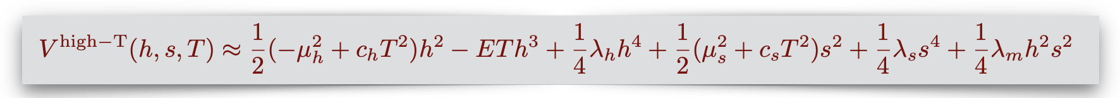
Enhancing the EWPT strength through a singlet scalar
Scalar couples to the Higgs and affects the tree level potential
We have separated out terms that explicitly break the Z₂ symmetry:
Explicit Z₂ breaking →
Z₂ - preserving (at T=0) →
Spontaneously Z₂ breaking →
Possible scenarios:
The last case follows naturally in scenarios where, e.g., the singlet is the Higgs-like boson of a complex scalar in the dark sector that spontaneously breaks a dark gauge symmetry
➔ Different thermal histories, with 1 or 2 step phase transitions and strong first order EWPT
To determine phase transition pattern requires finite temperature potential

Slide 15
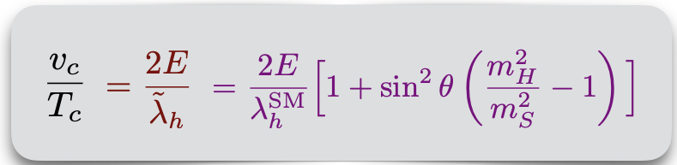
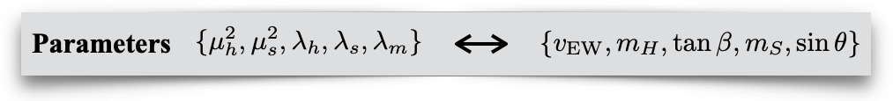
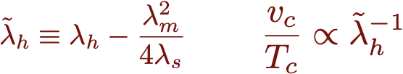
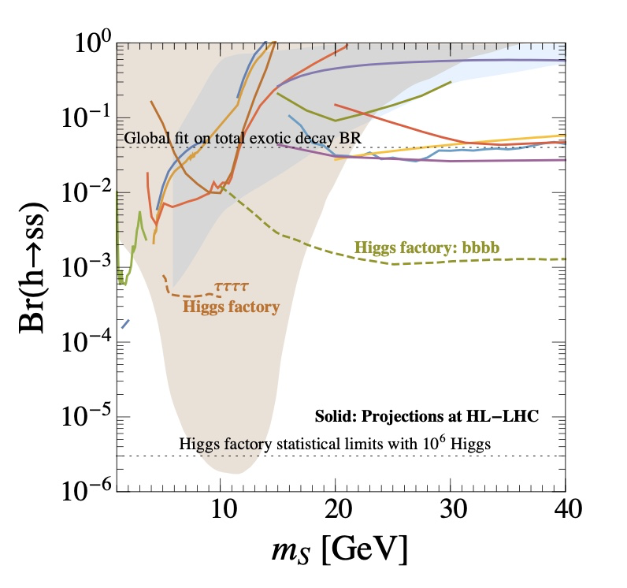
Exotic Higgs decays as a potent probe of viable EWBG models
The electroweak phase transition strength – Spontaneous Z₂ breaking scenario
Quartic mixing coupling proportional to mixing between mass eigenstates - strongly constrained by Higgs precision measurements ➔
Strength of the EWPT enhanced for small m_{S} - light singlet
Bounds on Br(h → ss) from Br(h → ss → XXYY)
Global fit:
BR[H→exotics] < 4%
Sizeable s² |H|² coupling needed for a strongly 1st order EWPT
➔ BR (H→SS) to be bounded from below
Z₂ spontaneous breaking with SFOEWPT
Exotic Higgs decays are a potent probe of Singlet extensions with viable EWBG
Ke-Pan Xie, Yikun Wang, et al, Snowmass WP ‘22

Slide 16
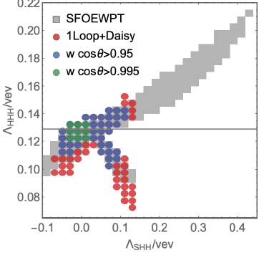
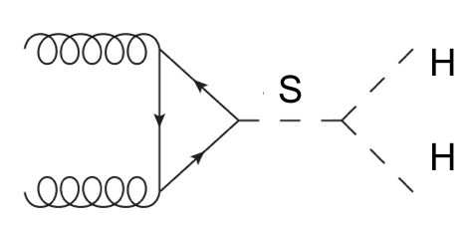
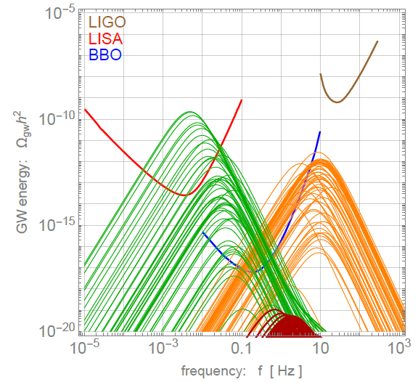
EWPT and Higgs Pair Production: Higgs Trilinear Coupling
Z₂ spontaneous Symmetry Breaking Scenario
M.C, Z. Liu, Y. Wang, ‘19
H
Beyond
HL-LHC reach, needs FCC-hh
Gravitational Waves:
May be too weak to be probed after including all radiative corrections (red curves)?
Bubble nucleation: expanding bubbles collide
and produce stochastic GW through:
sound waves propagation
magnetohydrodynamic turbulence
bubble collisions
Further RG improvement may help
Many parameters affect the GW signal

Slide 17


A SUSY example: the Next-to-Minimal Supersymmetric SM
A more extended Higgs sector: two Higgs doublets + a singlet
both charged under the EW gauge group
provides flexibility enhancing the PT strength
The NMSSM with the scalar potential
from Z3-NMSSM superpotential
Without loss of generality, we consider the 3-dim. field space
Higgs basis
The EW vacuum
After minimization conditions, replacing mass parameters by vev’s and suppress mixing of H^{NMS} and H^{S} with HSM to be consistent with Higgs 125 GeV phenomenology
Parameter space:

Slide 18
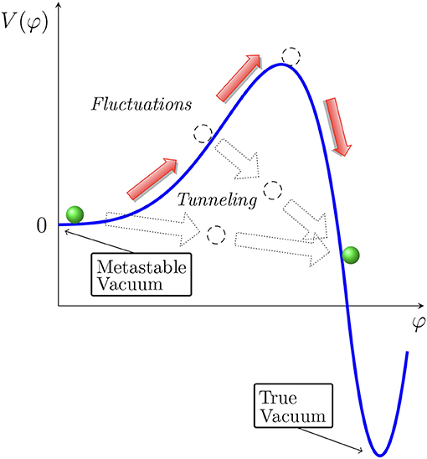
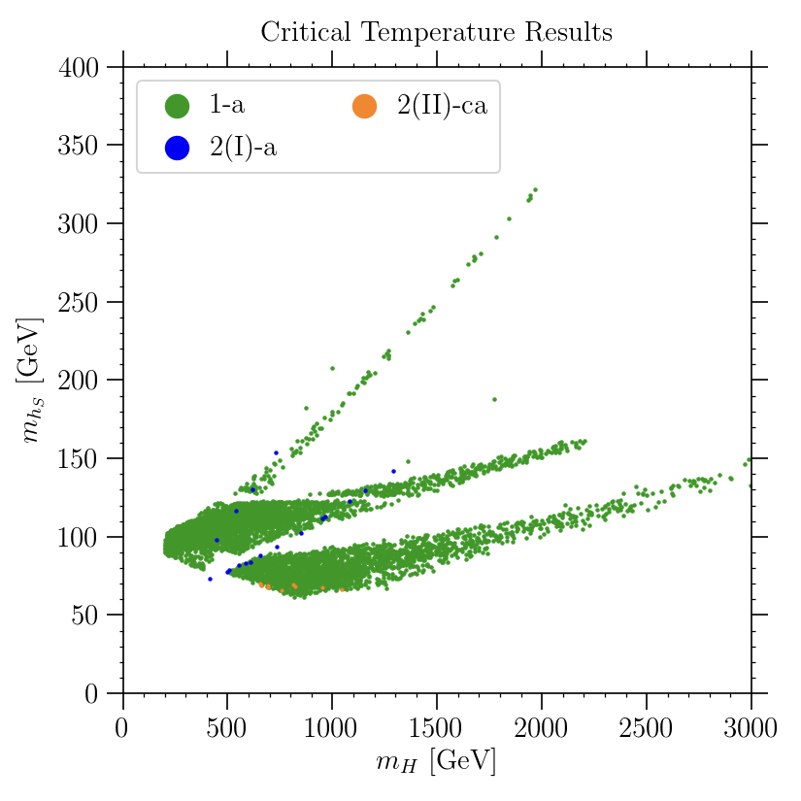
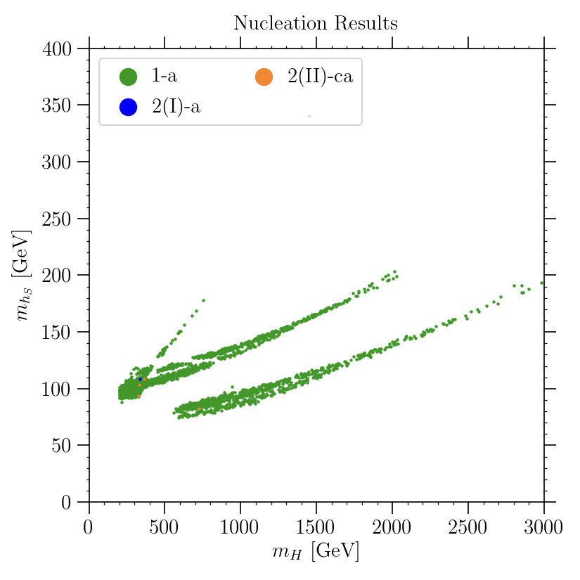
EWPT in the NMSSM - nucleation is more than critical
The vacuum structure gives little information about tunneling probability.
➔ the higher the barrier, and the larger the distance between the minima, the lower the nucleation probability
The bubble nucleation rate per unit volume:
requiring the nucleation probability to be approx. one per Hubble volume and Hubble time leads to the nucleation condition
M_{hs} [GeV]
M_{hs} [GeV]
T_{c} T_{n}
Baum, M.C, Shah, Wagner, Wang ‘19
vacuum structure
tunneling probability
M_{H} [GeV]
M_{H} [GeV]
Collider and Dark Matter opportunities
Strong EWPT consistent with light to heavy non-SM-like Higgs boson and a singlet
Despite light masses, these states are hard to probe at LHC ( best: H → h₁₂₅ + h_{S})
The most promising dark matter scenario is a bino-like lightest neutralino
Marcela Carena | New Opportunities for Electroweak Baryogenesis

Slide 19
The challenge of new CPV sources for EW Baryogenesis
The observed baryon asymmetry requires new CPV sources that are in usually in tension with Electric Dipole Moment experimental bounds
Electron EDM and the ACME experiment II
Weak scale CPV
NP
2018 electron EDM measurement ==>
Most New Physics models of EWBG require sinθ_{CPV} ≥ 10⁻²
Electron EDM can be suppressed if the CP violating fermion is a SM gauge singlet
- doesn’t couple to photons -
Shu, Y. Zhang,’13 Inoue, Ramsey-Musolf, Y. Zhang’14
Leading EDM arises at higher loops, naturally suppressed by one or two orders of magnitude below current limit for CPV sources of order one
Z₂ and EW Restoration
Z₂ and EW NON- R
How to transfer CP violation in the early universe?
Marcela Carena | New Opportunities for Electroweak Baryogenesis

Slide 20
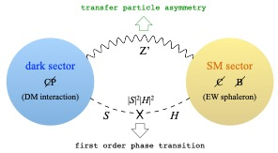
A new mechanism for EW Baryogenesis: Dark CP violation
A model with gauged lepton number
MC, Quiros and Yue Zhang.19
Higgs portal (sourcing CP violation & phase transition)
Z’ portal (for transfer of CP violation)
A dark fermion χ (DM) talks to the Higgs boson via a new SM singlet scalar S
EW sphalerons cannot touch the chiral charge asymmetries
in the χ SU(2) singlet
new U(1) gauge boson Z’ couples to the dark fermions and SM leptons and transfers CPV to SM sector
A varying mass m_{χ} along the z direction, together with the S vev, generates a chiral charge asymmetry in χ particles
This in turn generates a Thermal Equilibrium Asymmetry in SM leptons
Sphaleron processes yield ΔN_{L} = ΔN_{B}
SU(2)_{L} anomalons, besides DM, must decouple from thermal number density
A new scalar-Higgs interaction, λ_{SH}|S|²|H|², can trigger strong first order EWPT
Marcela Carena | New Opportunities for Electroweak Baryogenesis

Slide 21
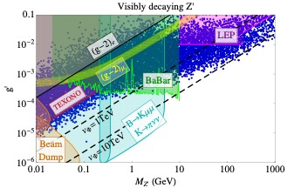
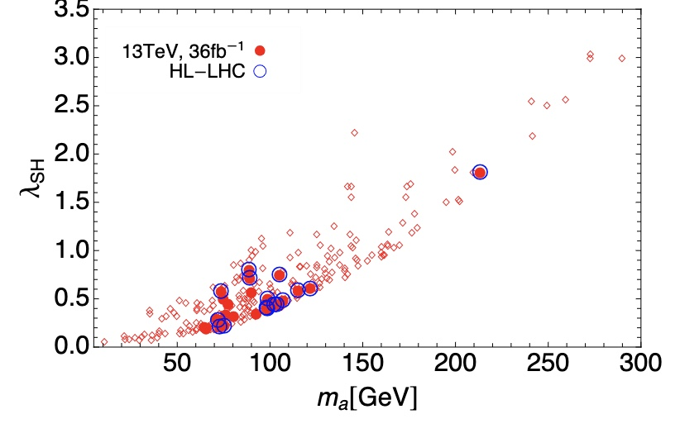
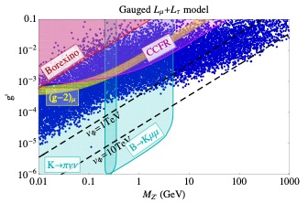
Dark CPV: Phenomenology
MC, Quiros and Yue Zhang’19
MC, Y-Y li, T. Ou, W. Wang, to appear
Predicts the existence of a new force carrier Z’, leptophilic ➔ Z’ searches.
Predicts very small EDM’s, but can be at reach in next round of experiments
Predicts a new Higgs portal scalar S, which could mainly decay into Z’ s.
The χ particle qualifies to be a thermal dark matter candidate
Leptophilic Z’:
Target and Searches
LHC searches for long-lived scalars
Marcela Carena | New Opportunities for Electroweak Baryogenesis

Slide 22
Outlook: Electroweak Baryogenesis
An appealing mechanism to explain the matter-antimatter asymmetry:
It requires a strongly first order electroweak phase transition and additional CPV beyond the SM.
It may come with interesting new collider signatures and may even accommodate DM
Gravitational wave signatures can be interesting probes of the nature of the phase transition at the reach of planned instruments
Some examples:
Singlet extensions to the SM can enhance the EWPT, which exhibits rich thermal history and collider phenomenology.
Extended Higgs sectors with large tree level barriers and multi dimensional field space: important differences between the critical temperature study versus the nucleation temperature study
Baryogenesis generation with CPV in a dark sector can circumvent EDM current restrictions and provide a novel mechanism for EWBG in models with gauged lepton (or quark number), with CPV transmitted by a new force
Marcela Carena | New Opportunities for Electroweak Baryogenesis

Slide 23
Merci !
Marcela Carena | New Opportunities for Electroweak Baryogenesis
22

Slide 24
Simplest Case:
A singlet extension of the Standard Model
Extras
Marcela Carena | New Opportunities for Electroweak Baryogenesis

Slide 25
Enhancing the EWPT strength through a Singlet extension
Simplest case: enhancing EWPT through a Singlet extension
A singlet scalar that couples to the Higgs and affects the tree level potential
Generic Potential: Explicit Z2 breaking →
Espinosa, Quiros ’93, Profumo, Ramsey-Musolf, Shaughnessy ’07, Choi, Volkas ’93,
Huang, Joglekar, Li, Wagner ‘16, Kozaczuk, Ramsey-Musolf, Shelton ‘19
Z2 - preserving (at T=0) →
Espinosa, Konstandin, Riva ’11, Curtin, Meade, Yu ’15, Barger, Chung, Long, Wang ’12, Kozaczuk, Ramsey-Musolf, Shelton ‘19
.
Spontaneously Z₂ breaking → M.C, Liu Wang ‘19
In connection with a dark gauge symmetry, spontaneously broken by a dark Higgs vev.
Different thermal histories, with 1 or 2 step phase transitions and strong first order EWPT –
➔ Distinct rich phenomenology at Colliders: Higgs precision, Higgs trilinear coupling, double Higgs production, direct new scalar searches, possible effects of CPV
Marcela Carena | New Opportunities for Electroweak Baryogenesis

Slide 26
Enhancing the EWPT strength through a Singlet extension
Simplest case: enhancing EWPT through a Singlet extension
A singlet scalar that couples to the Higgs and affects the tree level potential
Generic Potential: Explicit Z2 breaking →
Espinosa, Quiros ’93, Profumo, Ramsey-Musolf, Shaughnessy ’07, Choi, Volkas ’93,
Huang, Joglekar, Li, Wagner ‘16, Kozaczuk, Ramsey-Musolf, Shelton ‘19
Z2 - preserving (at T=0) →
Espinosa, Konstandin, Riva ’11, Curtin, Meade, Yu ’15, Barger, Chung, Long, Wang ’12, Kozaczuk, Ramsey-Musolf, Shelton ‘19
.
Spontaneously Z₂ breaking → M.C, Liu Wang ‘19
In connection with a dark gauge symmetry, spontaneously broken by a dark Higgs vev.
To determine phase transition pattern requires finite temperature potential
Marcela Carena | New Opportunities for Electroweak Baryogenesis

Slide 27
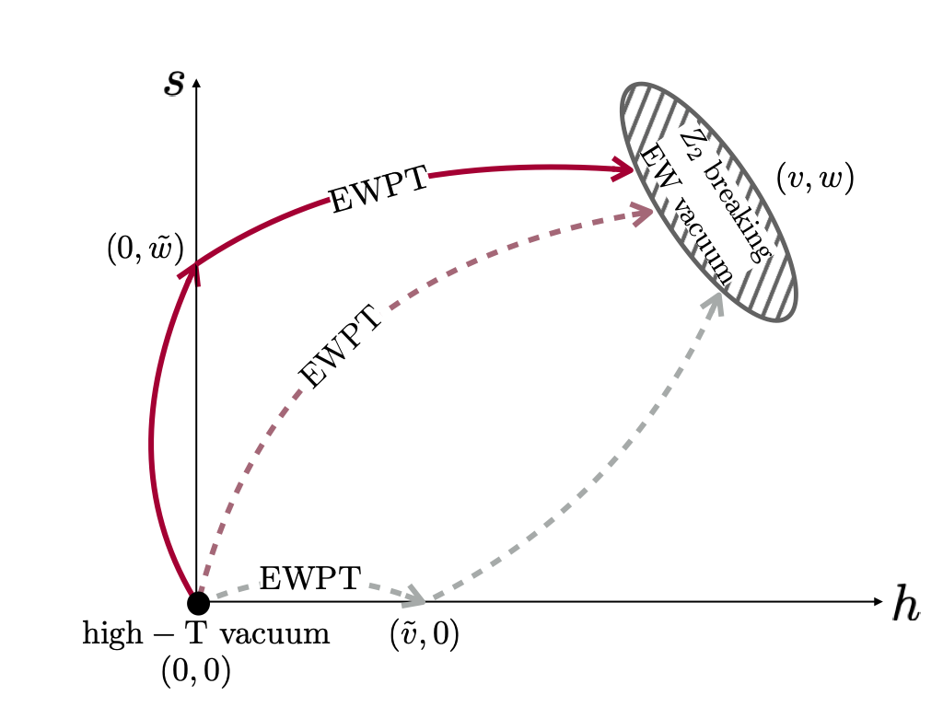
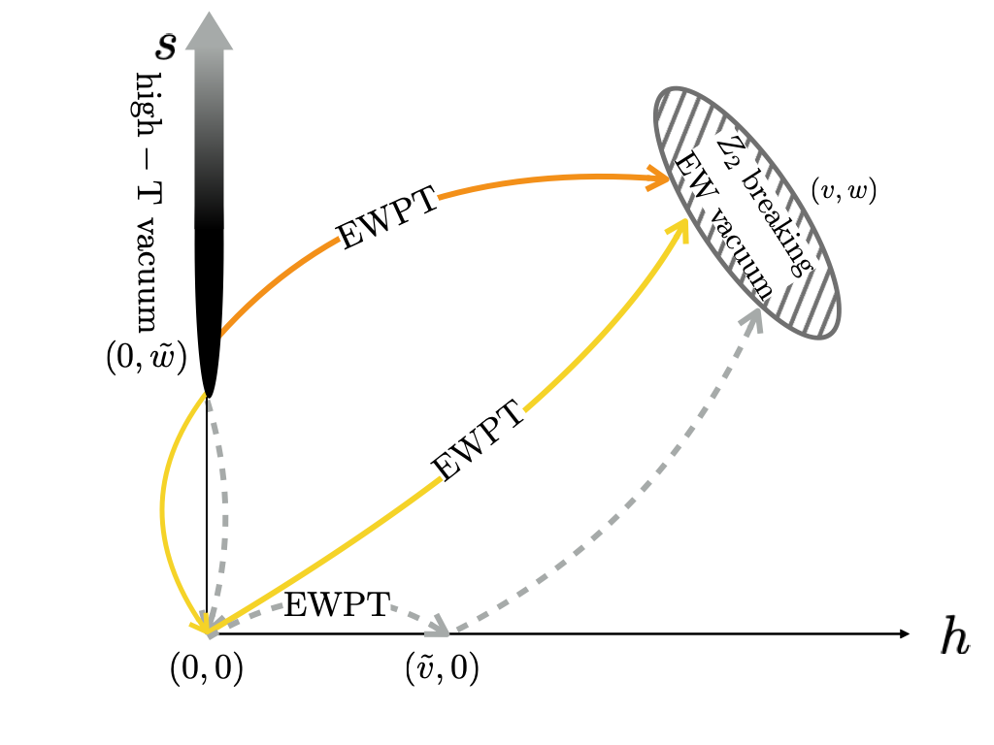
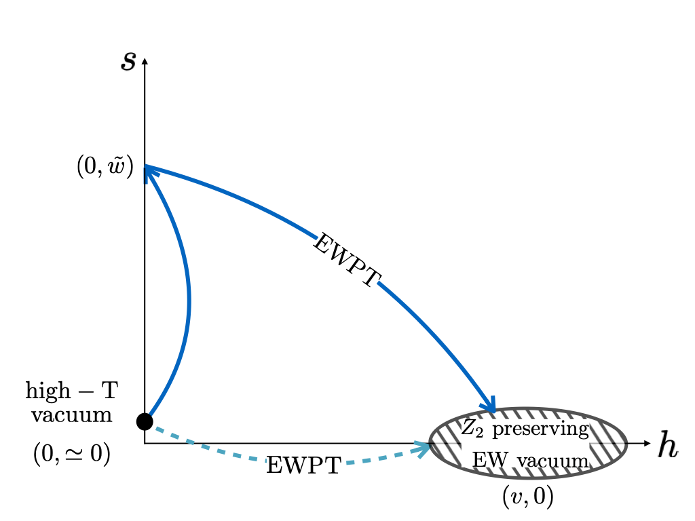
The SM singlet extension: EWPT paths for baryogenesis
Is it possible that the EW symmetry or/and the Z₂ symmetry is/are Non-Restored (NR)?
EW-NR demands many, many singlets (+ possibly an inert doublet) MC, Krauss, Liu, Wang ‘21
Z₂-NR: Yes
Solid lines: EWPT can be strongly first-order
Z₂ spontaneous breaking scenarios with symmetry
restoration at high T
Z₂ spontaneous breaking scenarios without symmetry
restoration at high T
Z2 preserving or explicit breaking scenarios
The step where the EW symmetry is first broken is required to be strongly first-order.
To enable a strongly first-order phase transition, the singlet should have significant couplings to the Higgs, to induce a sufficiently large deformation to the scalar potential in the early universe
Marcela Carena | New Opportunities for Electroweak Baryogenesis

Slide 28
EWPT with Spontaneous Z₂ Breaking: The full analysis
Tree-level Potential
Thermal potential
expanding the J_{B} and J_{F} functions in terms of small α =m²/T²
One Loop Coleman-Weinberg potential and daisy resummation also considered
Marcela Carena | New Opportunities for Electroweak Baryogenesis

Slide 29
EWPT with Spontaneous Z₂ Breaking: The full analysis
The electroweak phase transition strength
Bare parameters
Physical parameters
bounded by Higgs precision measurements
Small m_{S} renders SFOPhT: light singlet
Exotic Higgs decay bounds
Full one-loop effective potential with daisy resummation allows for all types of solutions shown in the thermal only analysis.
Results robust against the Nucleation calculation
Marcela Carena | New Opportunities for Electroweak Baryogenesis

Slide 30
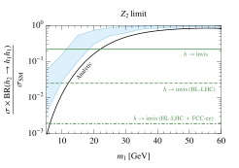
Phenomenology of SM plus Singlet models
Z₂-symmetric (at T=0) scenario: Invisible Decays
Lower bound on BR(H) _{inv}
or
pp →VSS (AP)
pp →SSjj (VBF)
Requires sizeable s² |H|² coupling for a 2 step strongly 1st order EWPT, [(0,0)→(0,v_{S}) →(v,0)], that calls for a careful treatment of perturbativity
No S-H mixing – S is stable (invisible decays)
m_{s} > m_{h}/2
Low mass singlet: m_{s} < m_{h}/2
λ_{HS} = λ_{m}/2
VBF pp→SSjj
Kozaczuk, Ramsey-Musolf, Shelton ‘19
Current bounds imply m_{S} < 20 GeV
EWBG scenario to be fully probed by full FCC or CLIC
Scenarios for EWBG based on EW symmetry non restoration can also be tested via Higgs invisible decays M.C, Krause, Z. Liu, Y Wang’21
Marcela Carena | New Opportunities for Electroweak Baryogenesis

Slide 31
Higgs Exotic Decay Phenomenology in Singlet models
If singlet sufficiently light ➔ BR (H→SS) to be bounded from below for a strongly 1st order EWPT that demands significant S-H couplings
➔ exotic Higgs decays are a potent probe of Singlet extensions with viable EWBG
Specifics of the exotic Higgs decays depend on Z₂ symmetry realization
Z₂ spontaneously breaking scenario
Requires sizeable s² |H|² coupling for a strongly 1st order EWPT
Only 3 parameters after defining Higgs mass and v.e.v
→ quartic mixing coupling proportional to S-H mixing – strongly constrained by
Higgs precision measurements
→ strength of the EWPT is enhanced for small m_{S} - light singlet -
λ_{HS} = λ_{m}/2
Z₂ explicitly breaking scenario
Not only the s² |H|² coupling is relevant for a strongly 1st order EWPT, but also terms in s³ and s |H|² play a role
(more free parameters; quartic mixing coupling independent of S-H mixing )
A strong 1st order EWPT and a small amount of H-S mixing compatible with Higgs properties, with a looser lower bound on BR[H→SS]
Marcela Carena | New Opportunities for Electroweak Baryogenesis

Slide 32
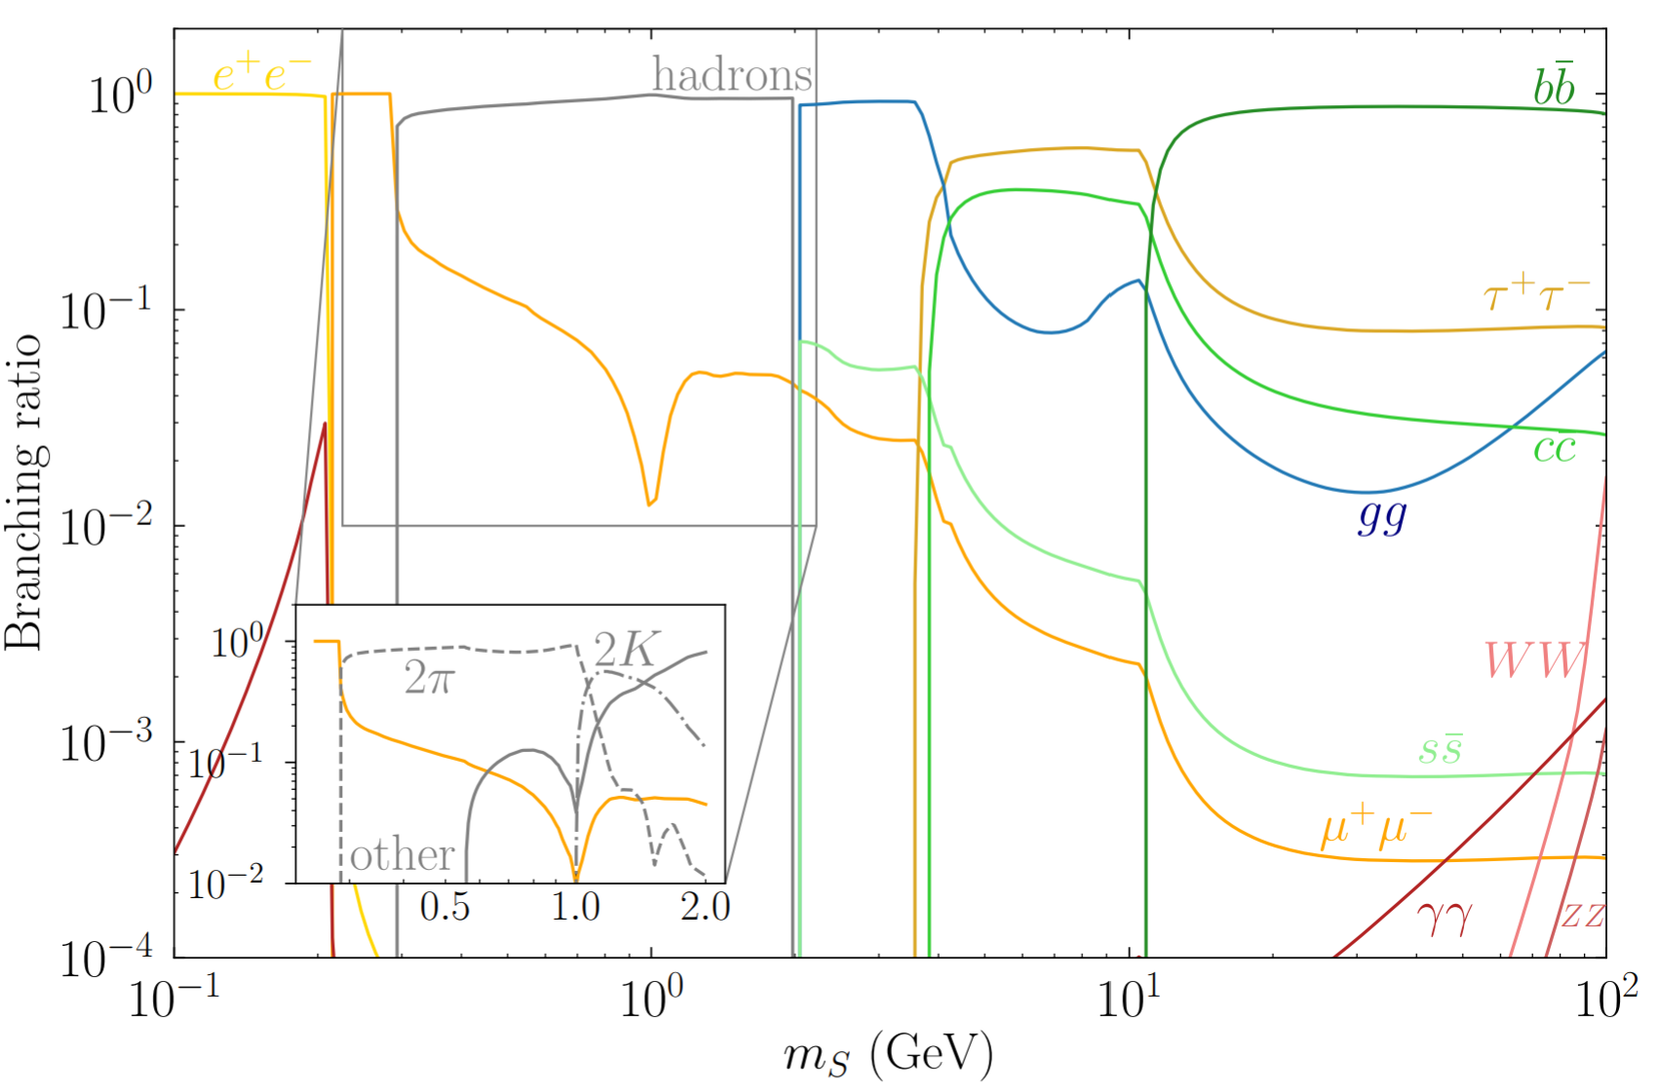
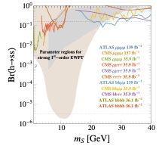
Probing Z₂ breaking Singlet Extensions via Higgs Exotic Decays
Currently: BR[H→ exotics] < 16%
H→ SS can lead to many final states with S inheriting Higgs-like hierarchical BR’s, mediated through mixing
Final state dominated by h → ss → bbbb for m_{s} > 2m_{b}, and by jjjj, jjττ, and ττττ for m_{s} < 10 GeV
Bounds on exotic Higgs decays
Bounds on Br(h → ss) from Br(h → ss → XXYY)
16%
16%
16%
Z₂ explicit breaking with SFOEWPT
Z₂ spontaneous breaking with SFOEWPT
Besides the 4b’s final state, the rest involves at least a pair of EW states
Ke-Pan Xie, Yikun Wang, et al, Snowmass WP ‘22
Marcela Carena | New Opportunities for Electroweak Baryogenesis

Slide 33
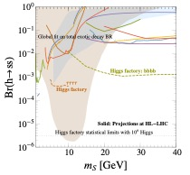
Probing Z₂ breaking Singlet Extensions via Higgs Exotic Decays
Currently: BR[H→ exotics] < 16%
H→ SS can lead to many final states with S inheriting Higgs-like hierarchical BR’s, mediated through mixing
Final state dominated by h → ss → bbbb for m_{s} > 2m_{b}, and by jjjj, jjττ, and ττττ for m_{s} < 10 GeV
Bounds on exotic Higgs decays
Bounds on Br(h → ss) from Br(h → ss → XXYY)
4%
Z₂ explicit breaking with SFOEWPT
4%
Z₂ spontaneous breaking with SFOEWPT
Besides the 4b’s final state, the rest involves at least a pair of EW states (same color coding)
Ke-Pan Xie, Yikun Wang, et al, Snowmass WP ‘22
Marcela Carena | New Opportunities for Electroweak Baryogenesis

Slide 34
Extended Higgs sectors: a SUSY example
The Electroweak Phase Transition in the NMSSM
Marcela Carena | New Opportunities for Electroweak Baryogenesis

Slide 35
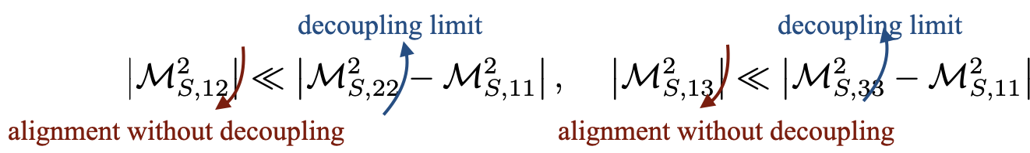

EWPT in the NMSSM: alignment limits and parameter space
Defining in the in the Higgs basis
To be consistent with the current Higgs phenomenology, the mass eigenstate h₁₂₅ needs to be dominantly composed of HSM - need to suppress mixing of H^{NMS} and H^{S} with HSM
The alignment conditions –without decoupling, imply
For small to moderate tanβ: λ ~ 0.6 - 0.7
The parameter space
Marcela Carena | New Opportunities for Electroweak Baryogenesis

Slide 36
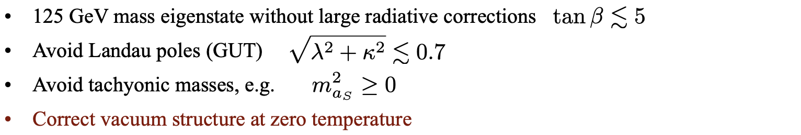

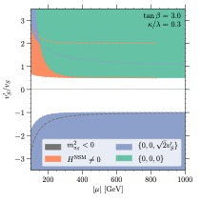
EWPT in the NMSSM: alignment limits and parameter space
The parameter space
Baum, M.C Shah, Wagner, Wang ‘19
Marcela Carena | New Opportunities for Electroweak Baryogenesis

Slide 37


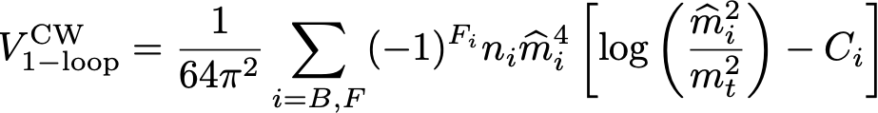

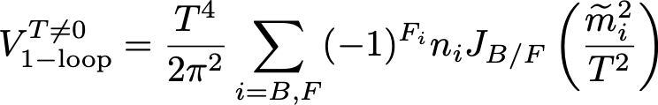
EWPT in the NMSSM - the effective potential
Radiative corrections (zero temperature)
Integrating out heavy degrees of freedom (sfermions, gluinos etc) are integrated out. A new operator by matching:
with fixed by 125 GeV Higgs mass
Light degrees of freedom: CW potential
Introducing counterterms to maintain boundary conditions
Finite temperature effective potential
with
Marcela Carena | New Opportunities for Electroweak Baryogenesis

Slide 38
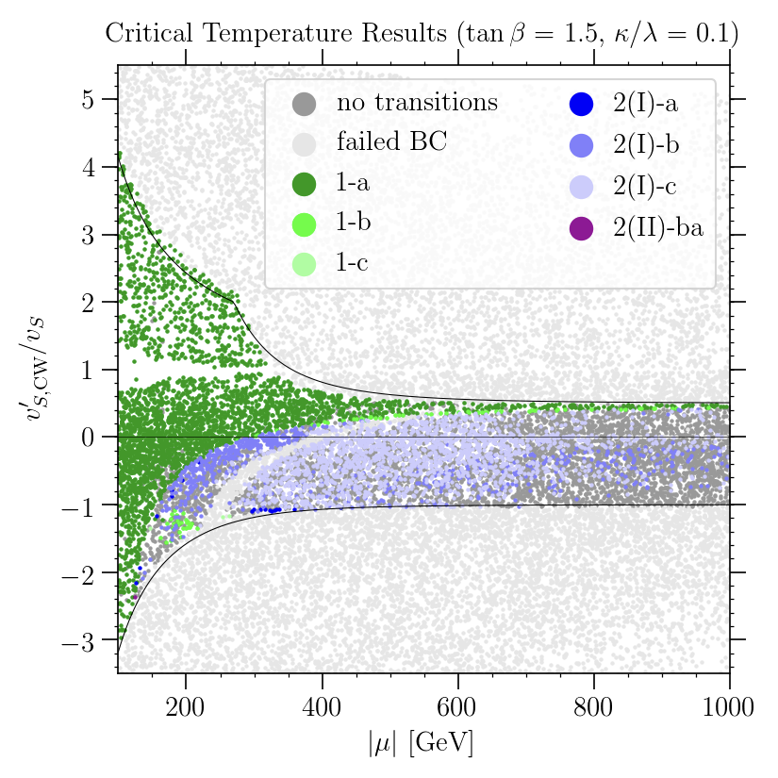
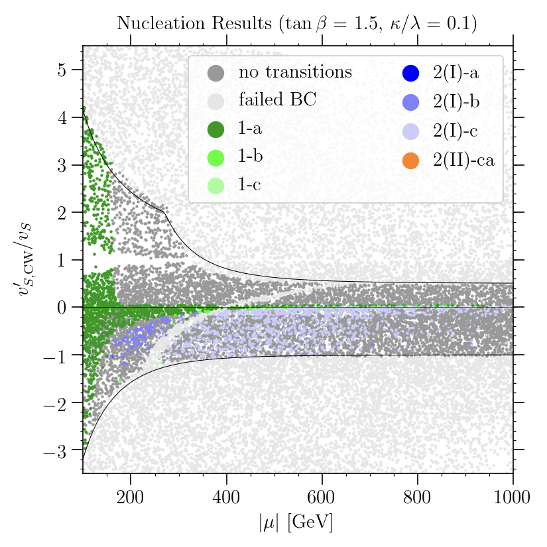
EWPT in the NMSSM - nucleation is more than critical
The phase transition proceeds by tunneling through the barrier separating local minima, the so-called bubble nucleation.
➔ the higher the barrier, and the larger the distance between the minima, the lower the nucleation probability
The bubble nucleation rate per unit volume:
requiring the nucleation probability to be approx. one per Hubble volume and Hubble time leads to the nucleation condition
T_{c} T_{n}
Integer : # of steps
Roman number:
Intermediate phase
(I): singlet-only direction
- (II): EWS broken phase
Lower case letter: Strength of the EWPT
a: SFOEWPT
b: weakly 1st order
c: 2nd order
vacuum structure
tunneling probability
Baum, M.C Shah, Wagner, Wang ‘19
Marcela Carena | New Opportunities for Electroweak Baryogenesis

Slide 39
EWPT in the NMSSM: collider and dark matter pheno
T_{c} T_{n}
M_{hs} [GeV]
M_{hs} [GeV]
M_{H} [GeV]
M_{H} [GeV]
Collider phenomenology:
The SFOEWPT consistent with light to heavy non-SM-like Higgs boson and a singlet
Despite the light masses, these states are hard to probe in colliders
  Production of the singlet-like state suppressed due to small NSM component
  Decay modes of the doublet-like states make it hard to be probed
  Promising channels to probe: final states containing at least one singlet-like boson
Dark Matter:
The most promising dark matter scenario is a bino-like lightest neutralino
  Small interaction cross sections
  well-tempered scenario for the correct relic density
Marcela Carena | New Opportunities for Electroweak Baryogenesis

Slide 40
Baryogenesis with Dark CP Violation:
A model with gauged lepton number
Marcela Carena | New Opportunities for Electroweak Baryogenesis

Slide 41
Dark CPV: The Higgs Portal
Sourcing CP Violation
MC, Quiros and Yue Zhang ‘19
The direct coupling between a SM gauge singlet fermion χ and the Higgs boson would be higher dimensional. To write a renormalizable theory introduce a new scalar S
Scalar S - also SM singlet - couples to dark fermion (DM)
In the presence of a relative phase between m₀ and y, a chiral charge asymmetry in χ particles can be generated
This requires m_{χ} to vary along the z direction, together with the S vev
A new EW phase transition
A new scalar-Higgs interaction,
λ_{SH}|S|²|H|², with λ_{SH} > 0,
can trigger strong first order EWPT
Z₂ and EW Restoration
Z₂ and EW NON- R
z is distance from bubble wall
Need at least to avoid CPV being redefined away
Espinosa, Konstandin, Riva, 1107.5441; MC, Y.Y Li, Ou and Wang, in prep.
Marcela Carena | New Opportunities for Electroweak Baryogenesis

Slide 42
Dark CPV: The role of the Z’ Portal
EW sphalerons cannot touch the chiral charge asymmetries in χ because it is an SU(2) singlet — must transfer such CPV effect in other ways to the SM sector
Introduce a new U(1) gauge boson couples to the dark fermions and SM leptons
If qχ_{L} ≠ qχ_{R} (required by anomaly cancellation), there is a net charge density, that generates a background for the Z’₀ component
(static electric potential analogue).
Δ
-Δ
α =0 component
Ζ’ couples to SM leptons
The Z’₀ background generates a chemical potential for them.
This in turn generates a Thermal Equilibrium Asymmetry in SM leptons
Marcela Carena | New Opportunities for Electroweak Baryogenesis

Slide 43
Dark CPV: Baryogenesis
Solving the corresponding Boltzman equation , considering sphaleron rate suppressed inside the bubble wall, one generates a lepton asymmetry ΔN_{L}
Γ_{sph} exponentially suppressed after the bubble wall has passed
Sphaleron processes conserve B-L ➔ equal asymmetries are generated ΔN_{L} = ΔN_{B}
➔ η_{Β} ≃ 0.9 10 ⁻¹⁰ as needed
Crucial Condition: Non-vanishing lepton asymmetry depends on the EFT at EW scale having an anomalous lepton number, but a gauged U(1)_{l} should be anomaly free
Anomalons in a gauged U(1)_{l}
Z’ couples to SU(2)_{L} current, governing L/B violating processes
e.g. l = e+μ+τ (N_{g} = 3)
SU(2)_{L} anomalons must decouple from thermal number density
Marcela Carena | New Opportunities for Electroweak Baryogenesis

