Slide 1
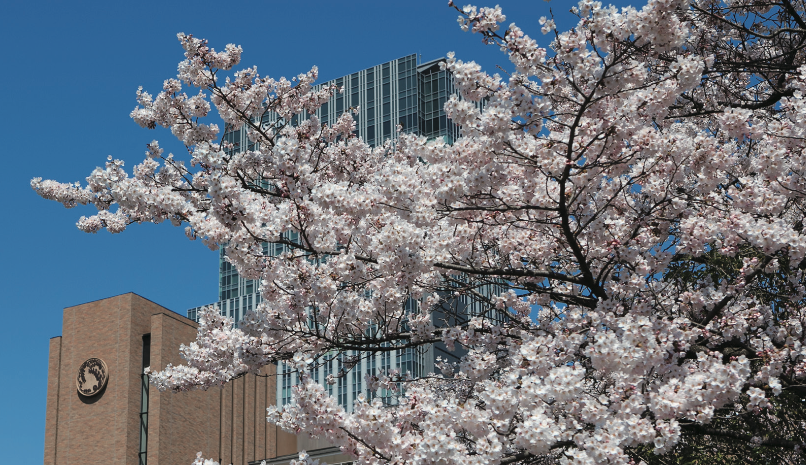
Boundary Conditions of
Studying in Japan
- Tohoku U. Faculty of Science -
Hitoshi Yamamoto
Tohoku University
23-Nov-2021

Slide 2
Agreements for Joint Studies
University Level General Agreement
- University of Paris-Sacley & Tohoku University
Faculty Level Double Degree Program
- Faculty of Science
Individual Level Double Degree Program
- needed for actual double degree (e.g. Okugawa)

Slide 3
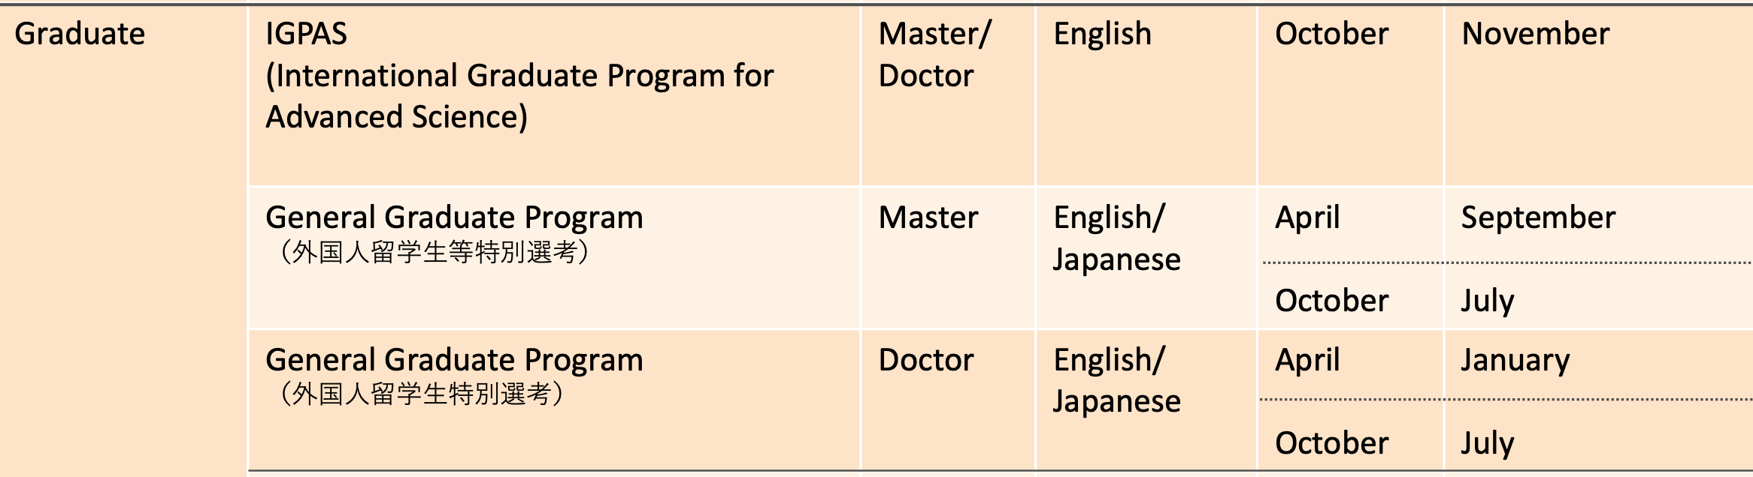
Tohoku U. Faculty of Science
Studies for Foreign Students
Degree Programs

Slide 4
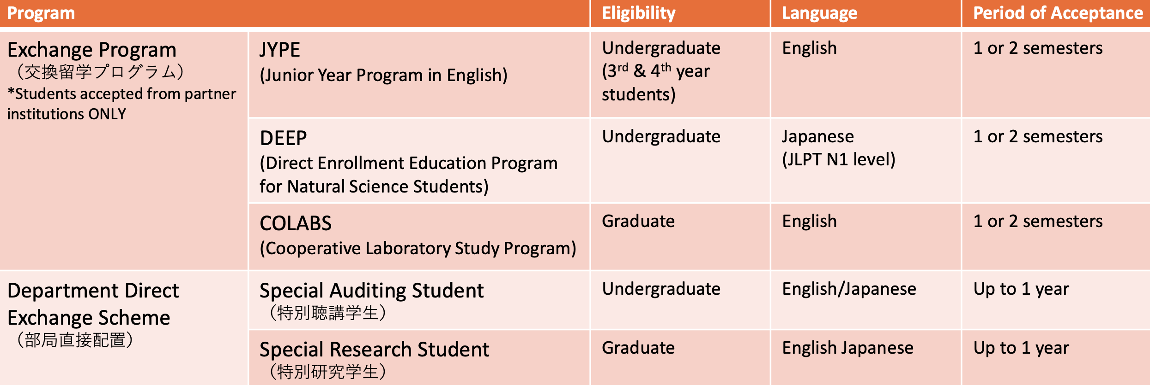
Non-Degree Exchange Programs

Slide 5
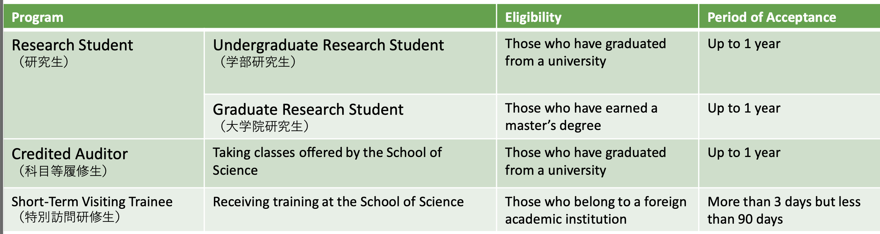
Non-Degree Programs
In all cases, find and contact your supervisor.

Slide 6
The International Graduate Program for Advanced Science
(IGPAS)
Five-year graduate program:
Two-year master's program + three-year doctoral program.
Three-year doctoral program is also available.
Mathematics, Physics, Astronomy, Geophysics, Chemistry, Earth Science.
Each department determines its own curriculum and course requirements,
and the availability of classes varies depending on the semester and departments.
IGPAS Courses are taught in English.

Slide 7
The International Graduate Program for Advanced Science
(IGPAS)
Eligibility
Master's Program 2020
Those who (will) have graduated from a university by September 30, 2022. OR 'equivalent'
Doctor's Program 2020
Those who (will) have earned a master's degree by September 30, 2022. OR 'equivalent'

Slide 8
Fees and Expenses (1 Euro ~ 130 JPY)
Application 30,000 JPY
Admission 282,000 JPY
Tuition 535,800 JPY / year
Overall living expenses (Sendai) including an apartment rent, utilities, food,
transportation, and so forth
80,000 ~ 150,000 JPY per month.
For visa application, incoming students may need to have a financial support
or enough savings to bear expenses incurred during their stay in Japan.

Slide 9
Financial Supports
Graduate Degree Programs
To join programs, you must pass the screening process conducted by each program.
Contact your prospective supervisor if you are interested in applying for the programs.
International Joint Graduate Programs
http://ijg.pgd.tohoku.ac.jp/english/index.html
● Graduate Program in Spintronics: GP-Spin
http://gp-spin.tohoku.ac.jp/en/index.html
● International Graduate Program in Earth and Environmental Sciences: GP-EES
https://gp-ees.tohoku.ac.jp/en/
● Graduate Program on Physics for the Universe: GP-PU
http://gp-pu.tohoku.ac.jp/
● Graduate Program in Data Science: GP-DS
http://gp-ds.tohoku.ac.jp/index_en.html
● International Joint Graduate Program in Materials Science: GP-MS
http://gp-ms.tohoku.ac.jp/en/index.html
Academic-Industry Collaborating Graduate Programs
http://aic.pgd.tohoku.ac.jp/english/index.html
● WISE Program for AI Electronics
https://www.aie.tohoku.ac.jp/english/
● WISE Program for Sustainability in the Dynamic Earth
https://syde.tohoku.ac.jp/english/

Slide 10
Financial Supports
Pioneering Research Support Project for PhD Students
Tohoku University supports excellent doctoral students who have a strong desire to pursue
research in interdisciplinary, international, or academic-industry collaborative fields.
The monthly stipend is 180,000 yen per month (on average) and the annual research
grant is 340,000 yen.
https://pgd.tohoku.ac.jp/english/rpc/next_generation.html
*The application guidelines for students who will enter Tohoku University in October 2022
will be announced around April 2023.

Slide 11
Financial Supports
Global Hagi Scholarship for Doctoral Students (Tohoku U)
600,000 yen per year for up to three years for doctoral students
with excellent character and academic standing.
Application information is released around April.
Many other scholarships:
Tohoku University President Fellowship
MEXT Honors Scholarship:
https://www.jasso.go.jp/en/study_j/scholarships/shoureihi/index.html
Scholarships by private foundations/organizations

Slide 12
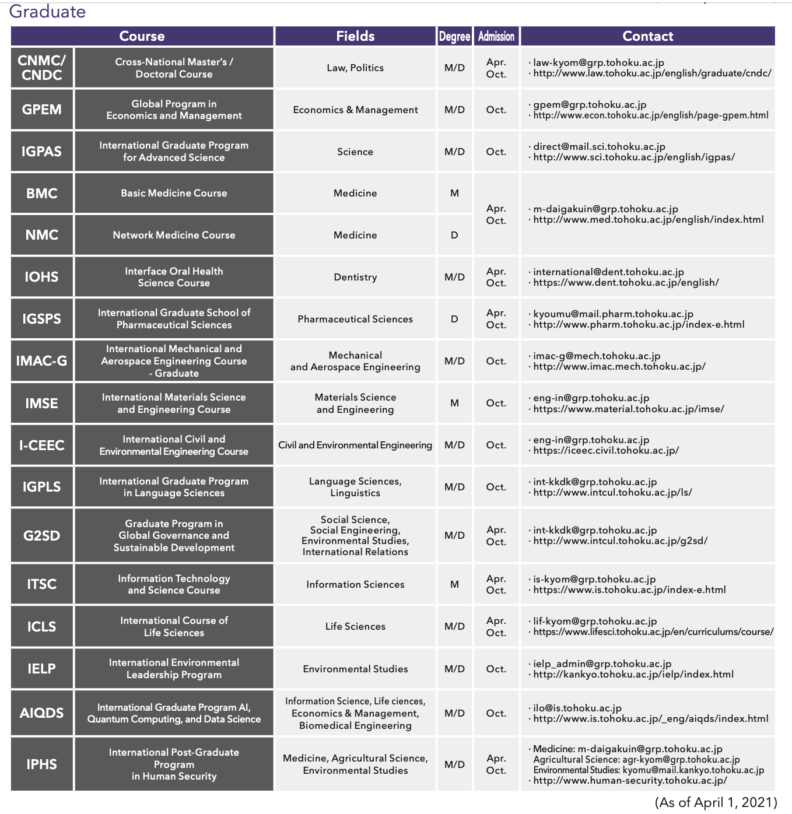
Graduate Programs - all faculties
http://www.tohoku.ac.jp/en/academics/graduate.html

Slide 13
Find and contact your prospective supervisor!
https://www.sci.tohoku.ac.jp/english/
https://www.tohoku.ac.jp/en/
And also
Student Exchange Division
Web: https://www.insc.tohoku.ac.jp
Contact form: https://www.insc.tohoku.ac.jp/english/tohoku_studyab_contact/
For faculty of science: direct@mail.sci.tohoku.ac.jp
Document: ‘Tohoku University for Prospective International Students’
https://www.insc.tohoku.ac.jp/english/wp-content/uploads/2021/03/TOHOKU-UNIVERSITY-GUIDE-2021-2022.pdf

