Slide 1
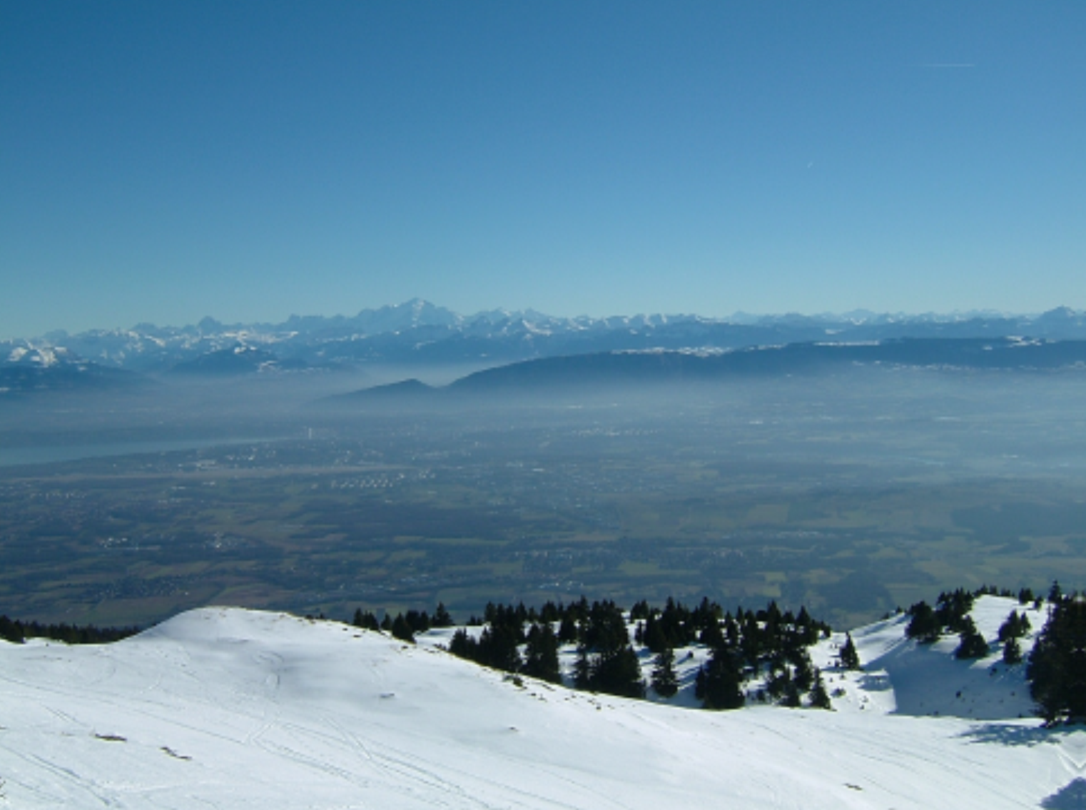
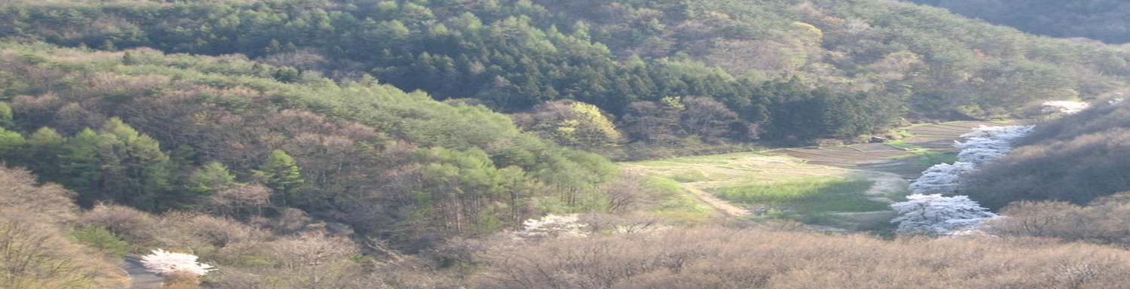
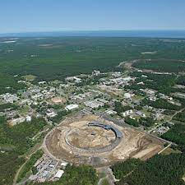
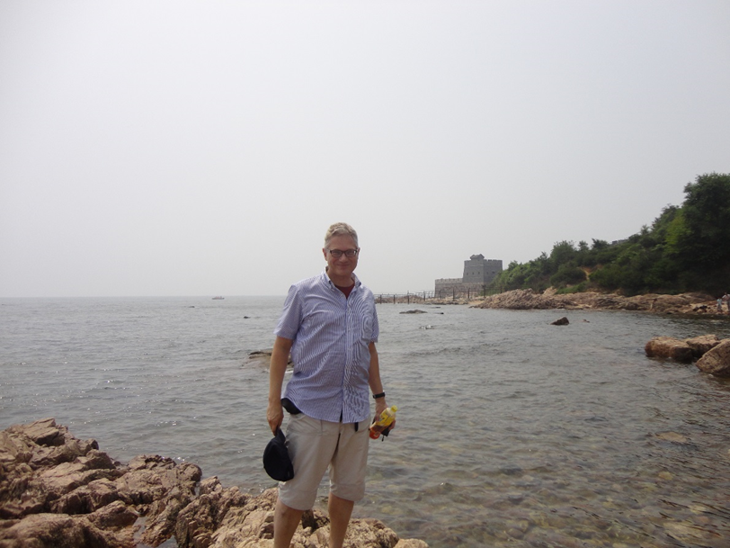


Future Colliders
Geneva
Frank Zimmermann, CERN
IJCLab, 22 October 2022
including slides from M. Benedikt, D. Contardo, A. Faus-Golfe, D. Kaplan,
K. Oide, M. Palmer, D. Schulte, V. Shiltsev, F. Willeke et al.
Kitakami
Long Island
Qinhuangdao
Work supported by the Eruopean Union’s Horizon 2020 Research and Innovation programme under Grant Agreement No. 101004730 (iFAST)

Slide 2
outline
history and physics motivation
key concepts of particle colliders
proposed next and next-next(-next) generation high-energy machines
  hadron colliders, both circular and linear electron-positron colliders, and muon colliders, along with some challenges and merits
  collider energy efficiency, including energy recovery
  elements of the recent Snowmass process
  approximate technical timelines
brief outlook to the far future

Slide 3
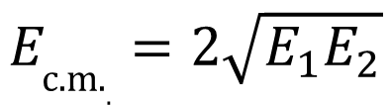
why colliders ? - energy
colliders were invented (1943) and patented (1953) by Rolf Wideröe
centre-of-mass energy:
beam hits
a “fixed target”
two equal
beams collide
colliding two beams against each other can provide much higher centre-of-mass energies than fixed target!
$$E_{\text{c}\text{.}\text{m}\text{.}.}=2\sqrt{E_{1}E_{2}}$$
for two high-energy beams
of unequal energy

Slide 4
colliders constructed and operated
A. Ballarino
Colliders with
superconducting RF system
Colliders with
superconducting arc magnet system
advances by new technologies and new materials
Colliders with
superconducting magnet & RF
Notes:
New slide from Davide.
Showing that conductor development is launched at international level, Russia, Japan, (Korea and Europe in preparation)
Underline importance of that development as main cost driver for the hadron collider machine.

Slide 5

colliders and discoveries
Standard Model
Particles and forces
A. Ballarino
powerful instruments for discovery and precision measurement
Notes:
New slide from Davide.
Showing that conductor development is launched at international level, Russia, Japan, (Korea and Europe in preparation)
Underline importance of that development as main cost driver for the hadron collider machine.

Slide 6
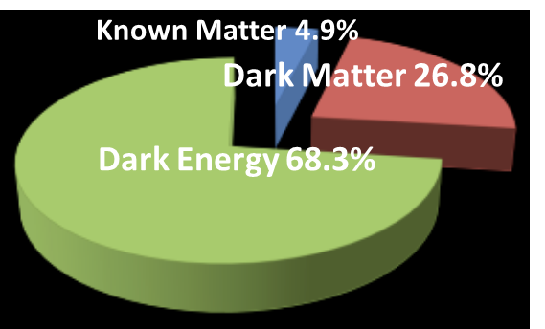
still many open questions
    Known matter is only 5% of universe!
F. Gianotti
    what is dark matter?
    what is dark energy?
    why more matter than antimatter?
    what about gravity?
also QCD,
quark-gluon plasma,
proton spin, etc.
Notes:
New slide from Davide.
Showing that conductor development is launched at international level, Russia, Japan, (Korea and Europe in preparation)
Underline importance of that development as main cost driver for the hadron collider machine.

Slide 7
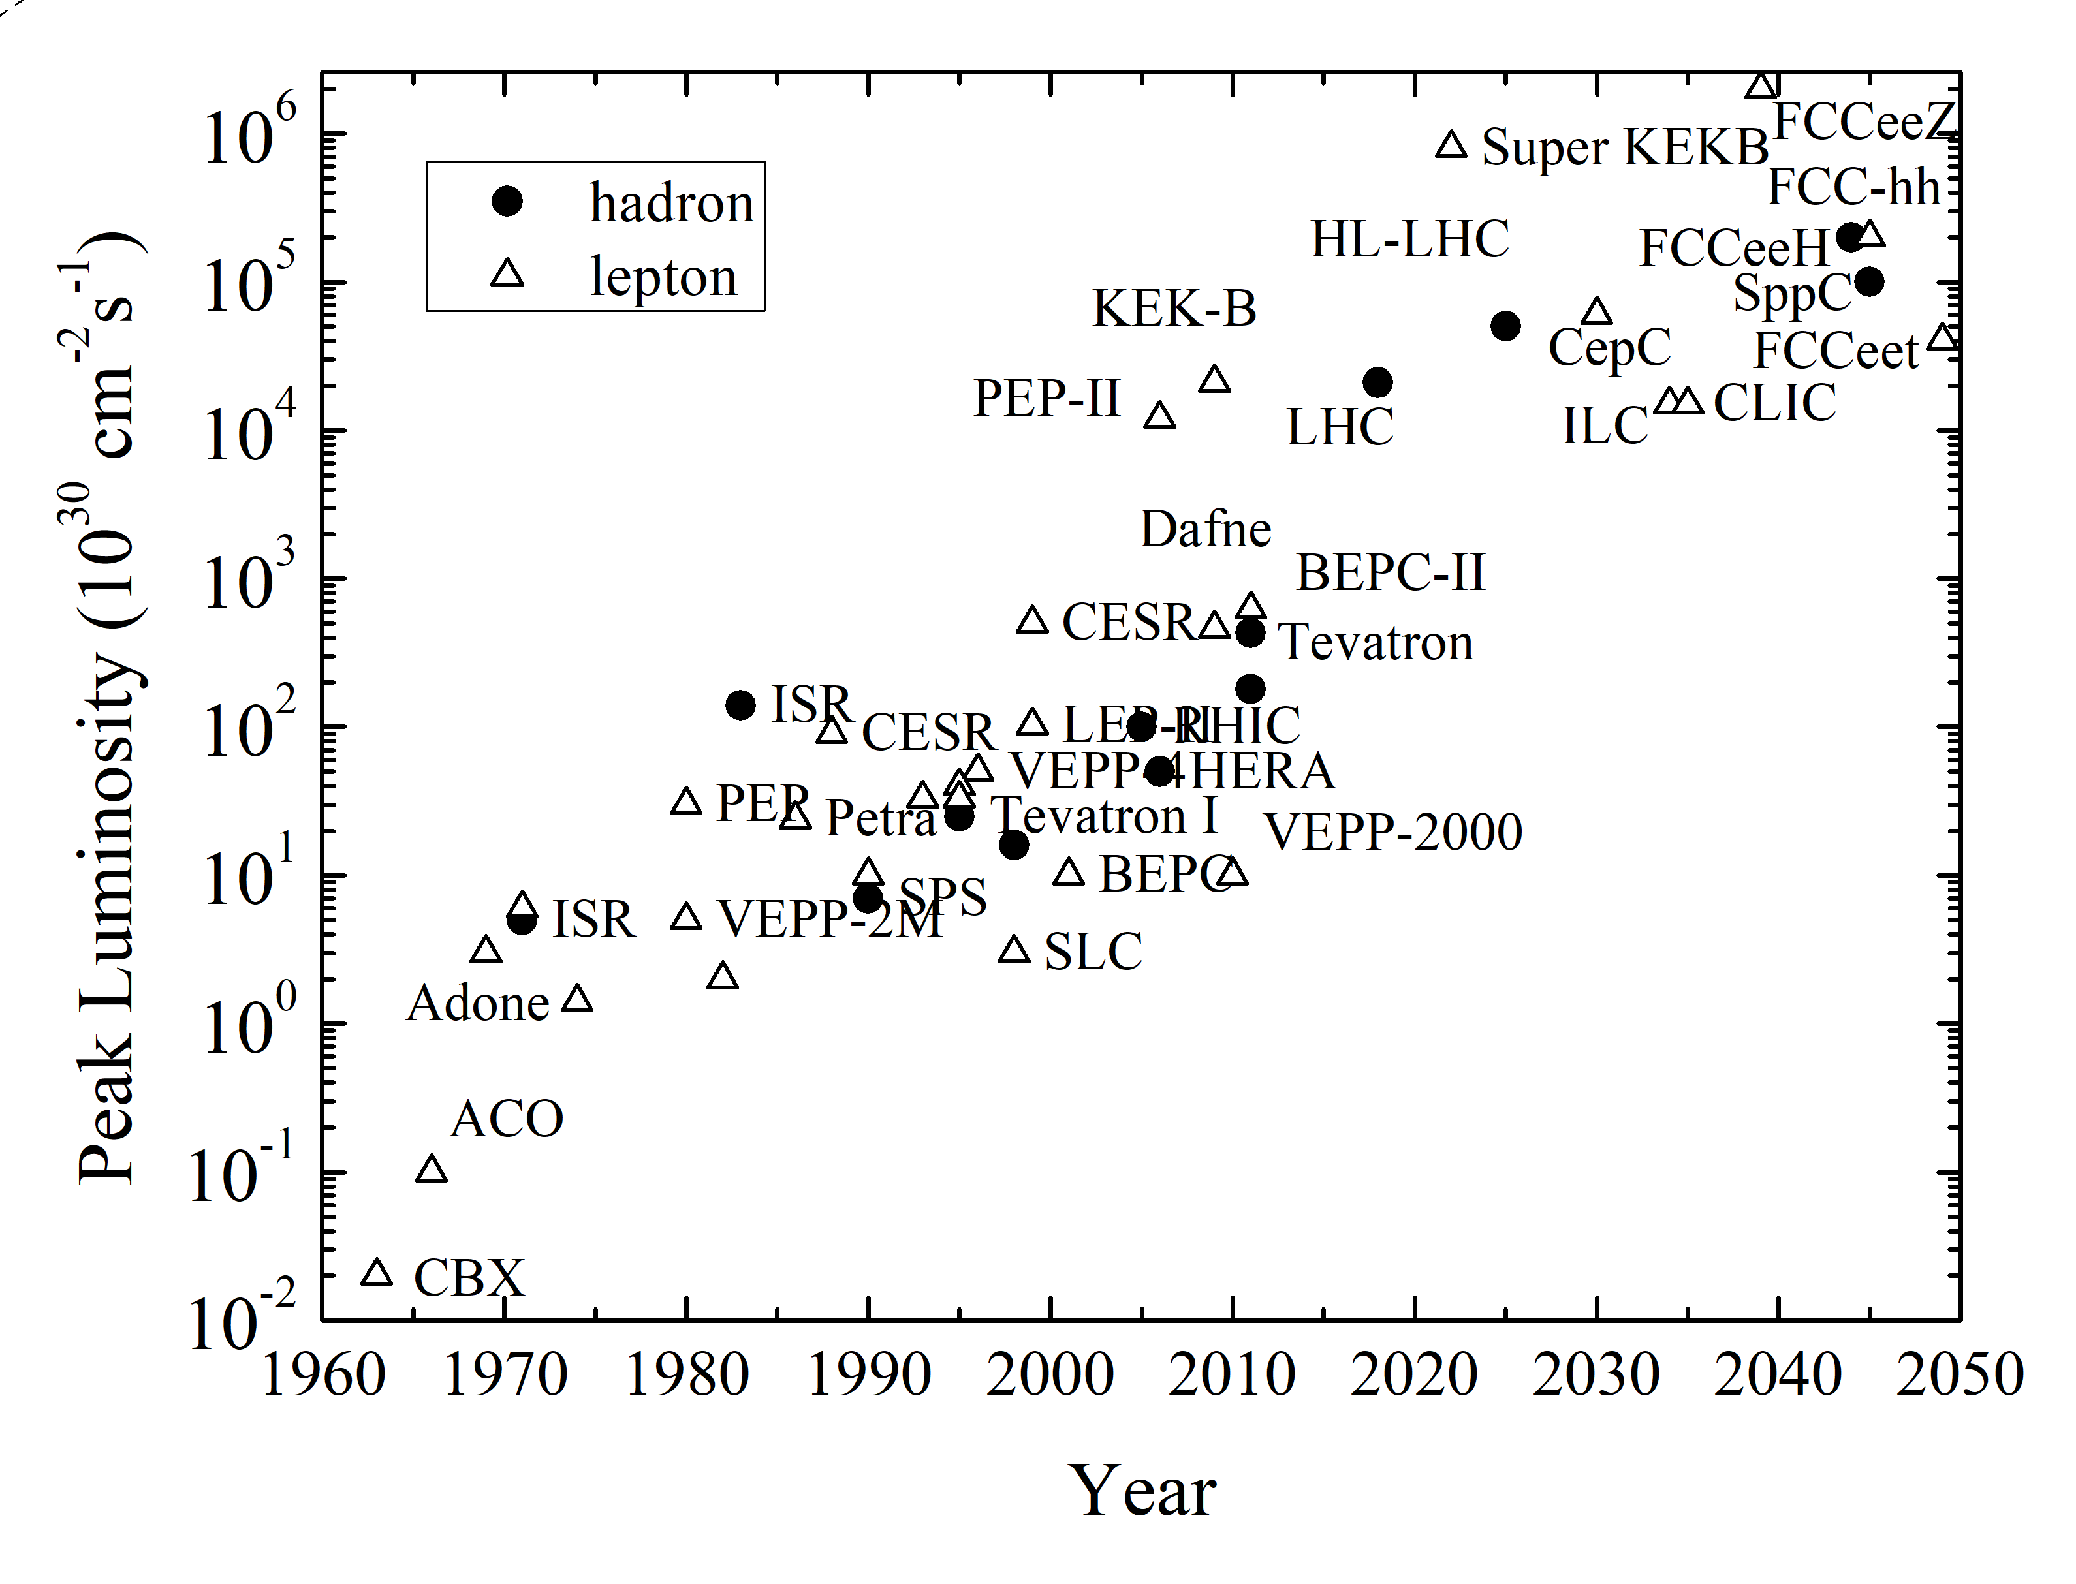
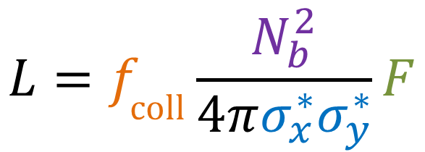
collider figure of merit: luminosity
R= σ L
tends to decrease as energy⁻²
luminosity
reaction rate
cross section
V. Shiltsev & F.Z., arXiv:2003.09084, submitted to RMP
geometric factor
(crossing angle,
hour glass, pinch, …)
bunch
population
$$L=f_{\text{coll}}\frac{N_{b}^{2}}{4πσ_{x}^{∗}σ_{y}^{∗}}F$$
peak luminosity increased by almost
7 orders of magnitude over 60 years
bunch
collision
rate
horizontal & vertical
rms beam size
at collision point

Slide 8
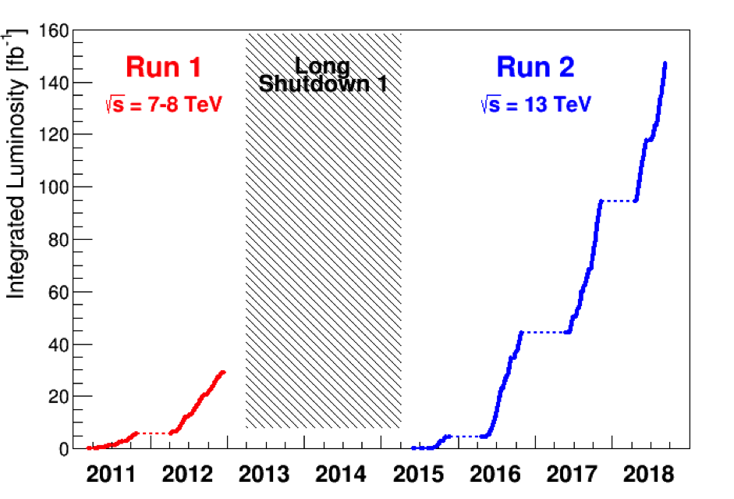
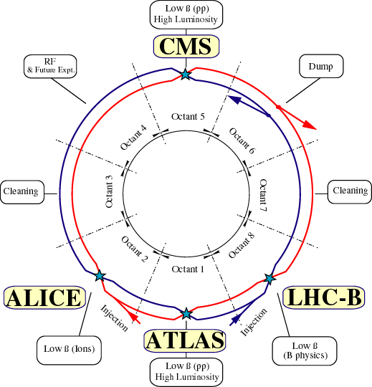
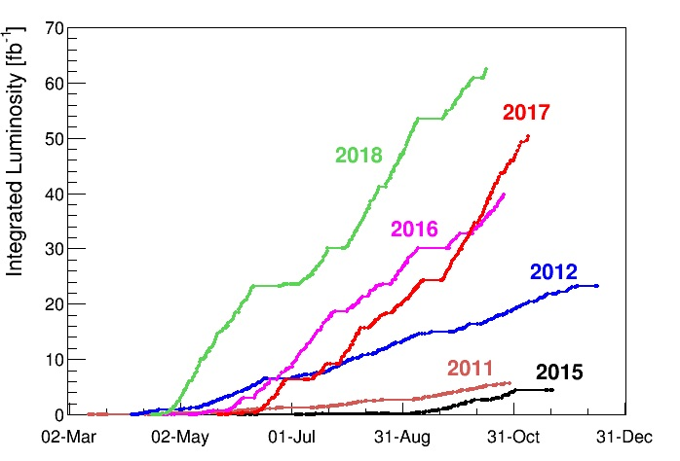
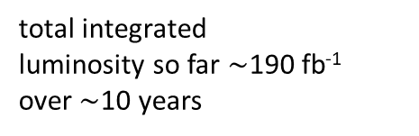
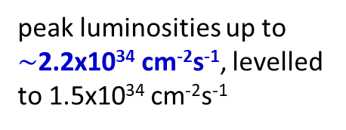
Large Hadron Collider (LHC)
circumference 27 km
world’s highest energy p-p collider at CERN/Geneva
running
extremely well
total integrated
luminosity so far $\sim$190 fb⁻¹
over$\sim$10 years
peak luminosities up to $\sim$2.2x10³⁴ cm⁻²s⁻¹, levelled to 1.5x10³⁴ cm⁻²s⁻¹

Slide 9
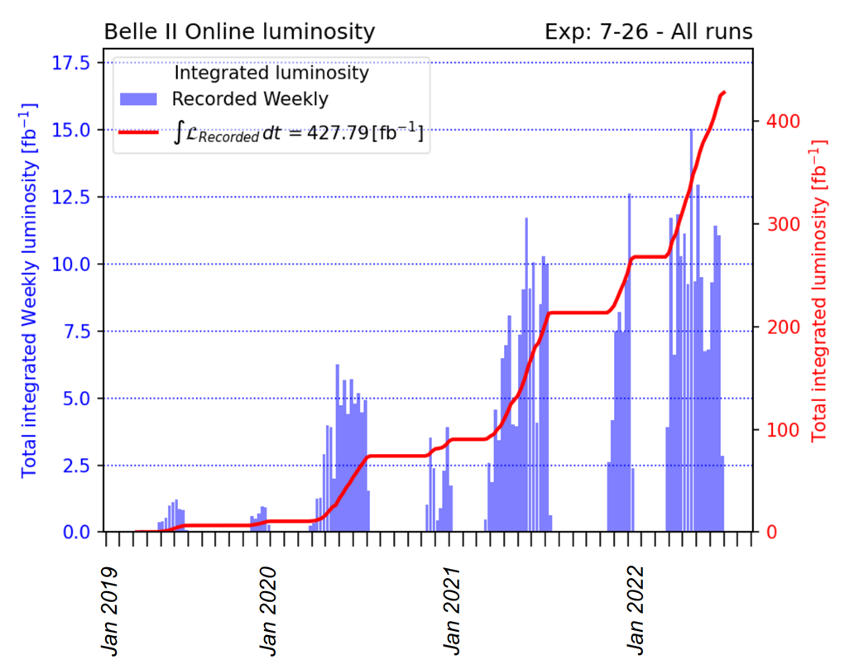

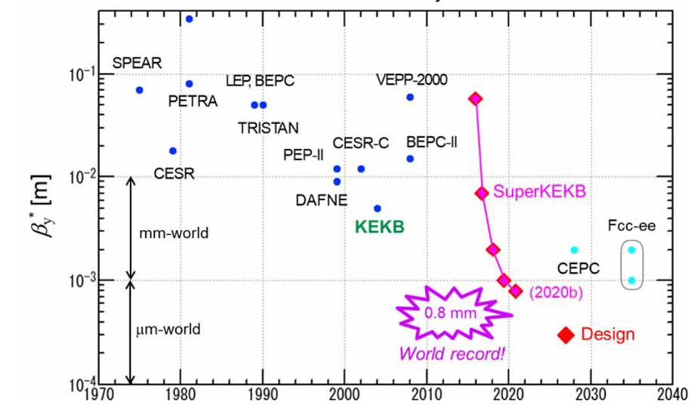
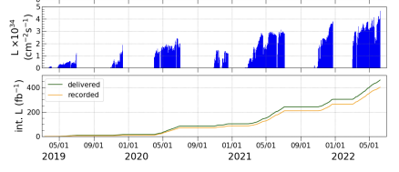
SuperKEKB
circumference 3 km
world’s highest luminosity & lowest β* e⁺e⁻ collider at KEK/Tsukuba
total integrated luminosity so far $\sim$430 fb⁻¹ over$\sim 3$ years
world record luminosity of 4.71x10³⁴ cm⁻²s⁻¹,
β_{y}* = 1.0 mm routinely, also β_{y}* = 0.8 mm shown – with “virtual” crab-waist collision scheme originally developed for FCC-ee (K. Oide)

Slide 10
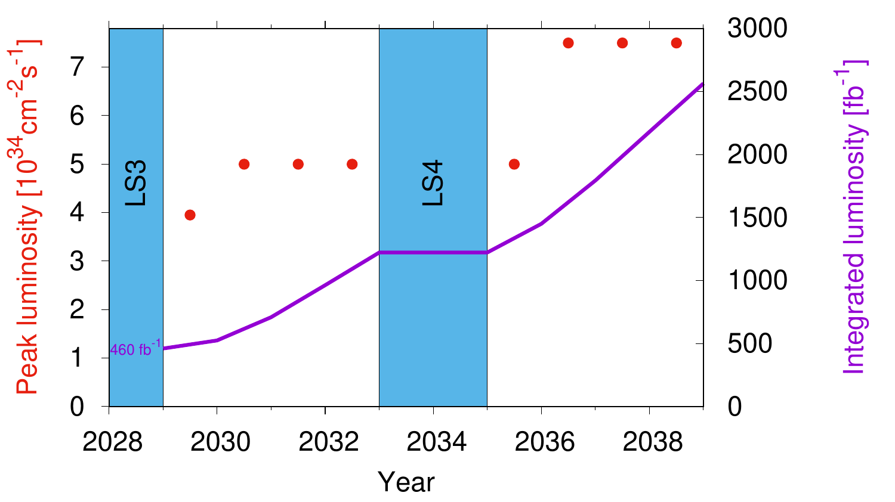

near-future collider 1: High-Luminosity LHC
High-Luminosity LHC at CERN: E_{p-p,cm}=14 TeV, L=5 or 7.5x10³⁴cm⁻²s⁻¹ levelled
goal: increase LHC integrated luminosity x10 to >3 ab⁻¹ around 2040
we are here
from $\sim$2027
\

Slide 11
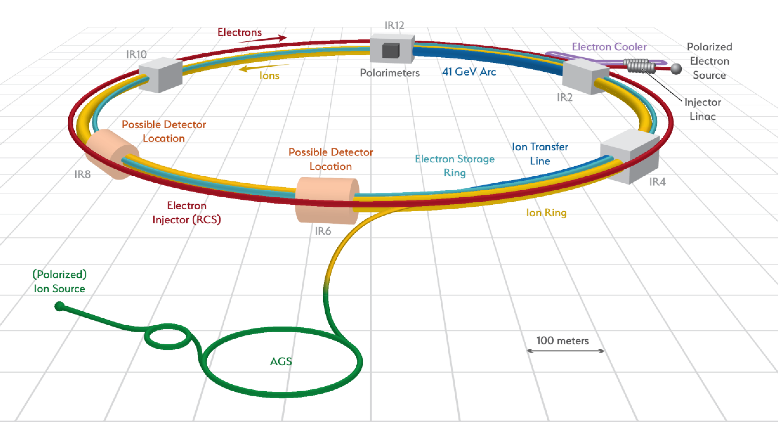
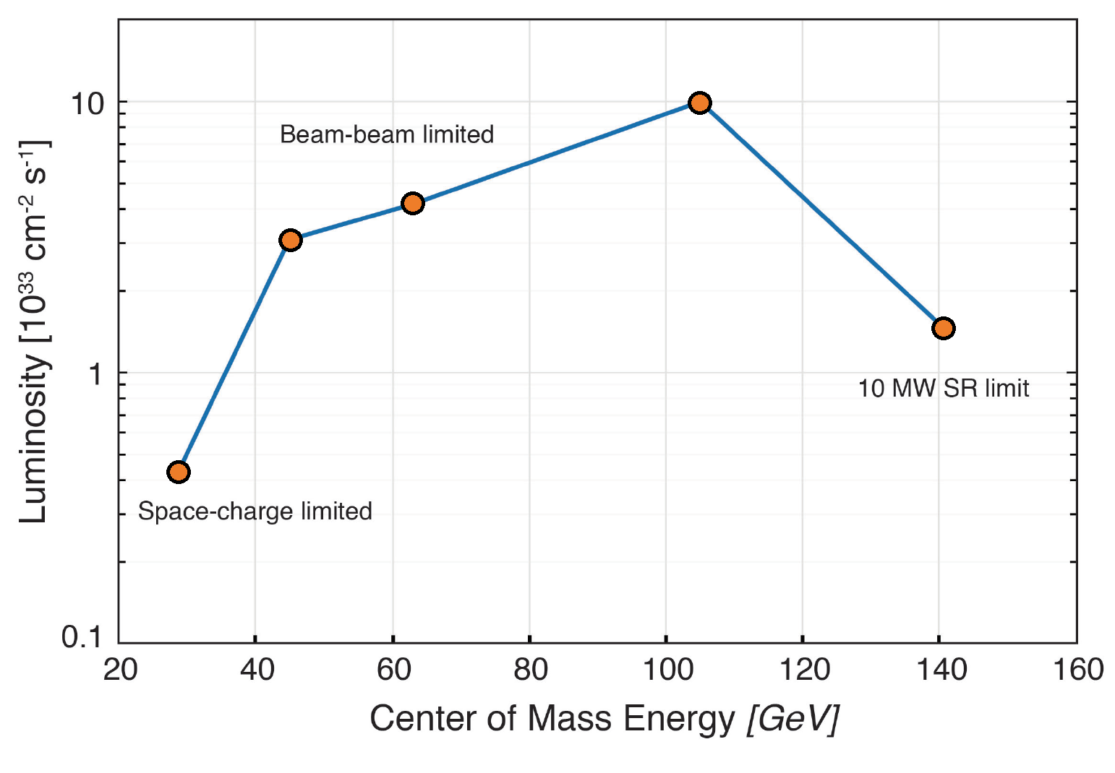
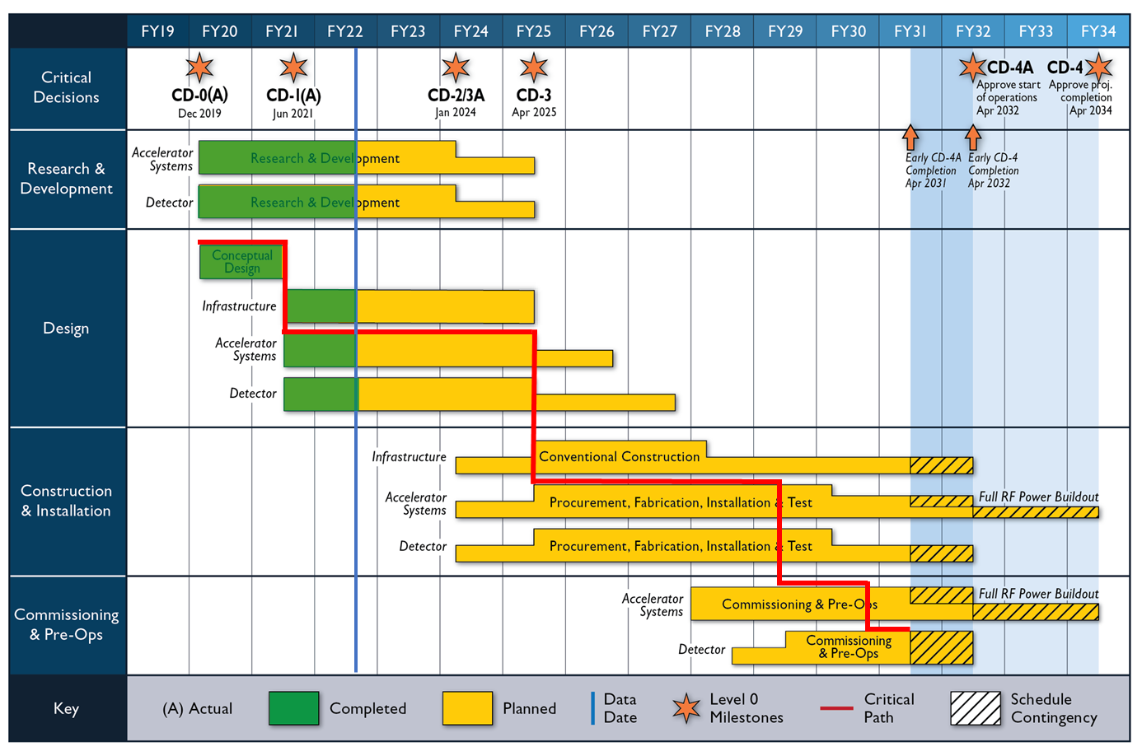
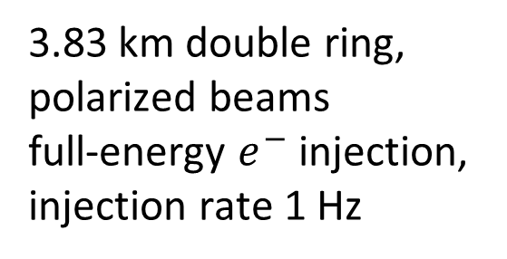
near-future collider 2: Electron-Ion Collider
3.83 km double ring,
polarized beams
full-energy $e^{−}$ injection,
injection rate 1 Hz

Slide 12
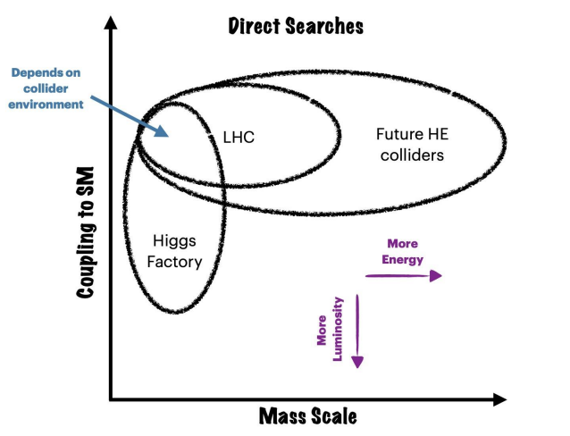
Energy Frontier Machines – Energy & Precision
L. Reina,
Snowmass’21 (22)

Slide 13
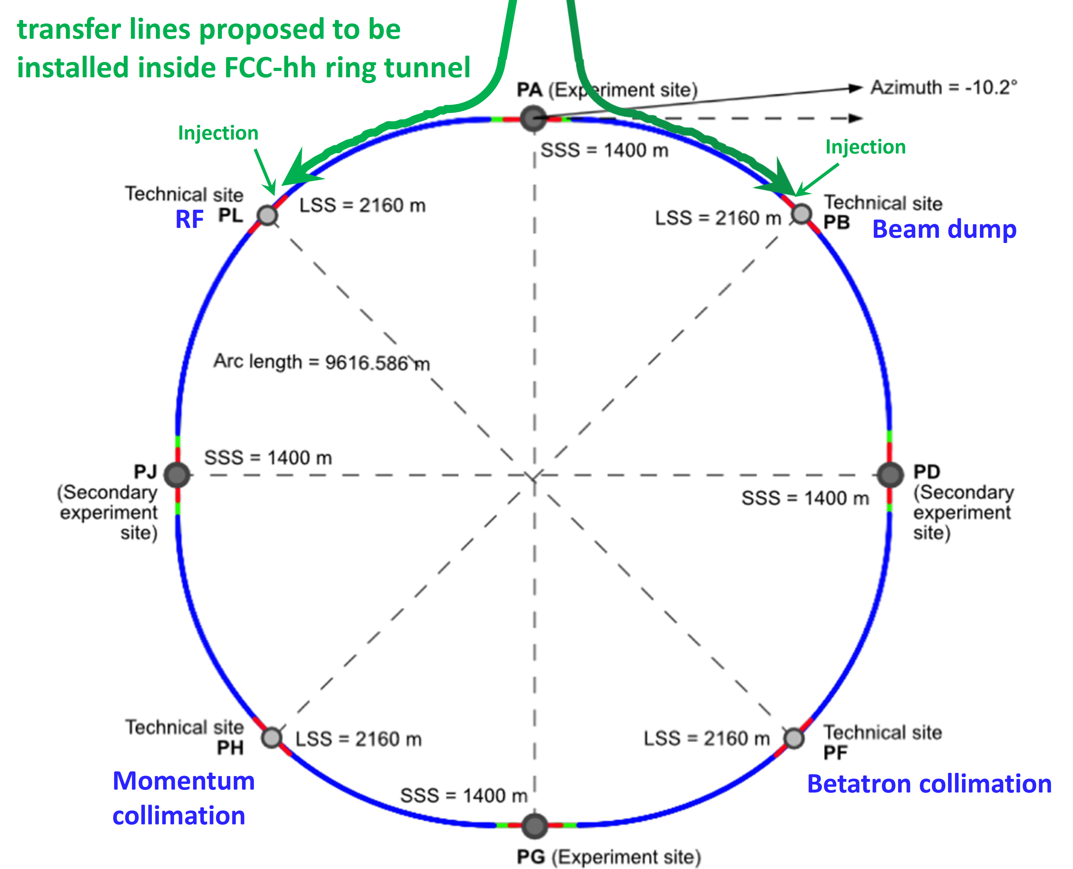
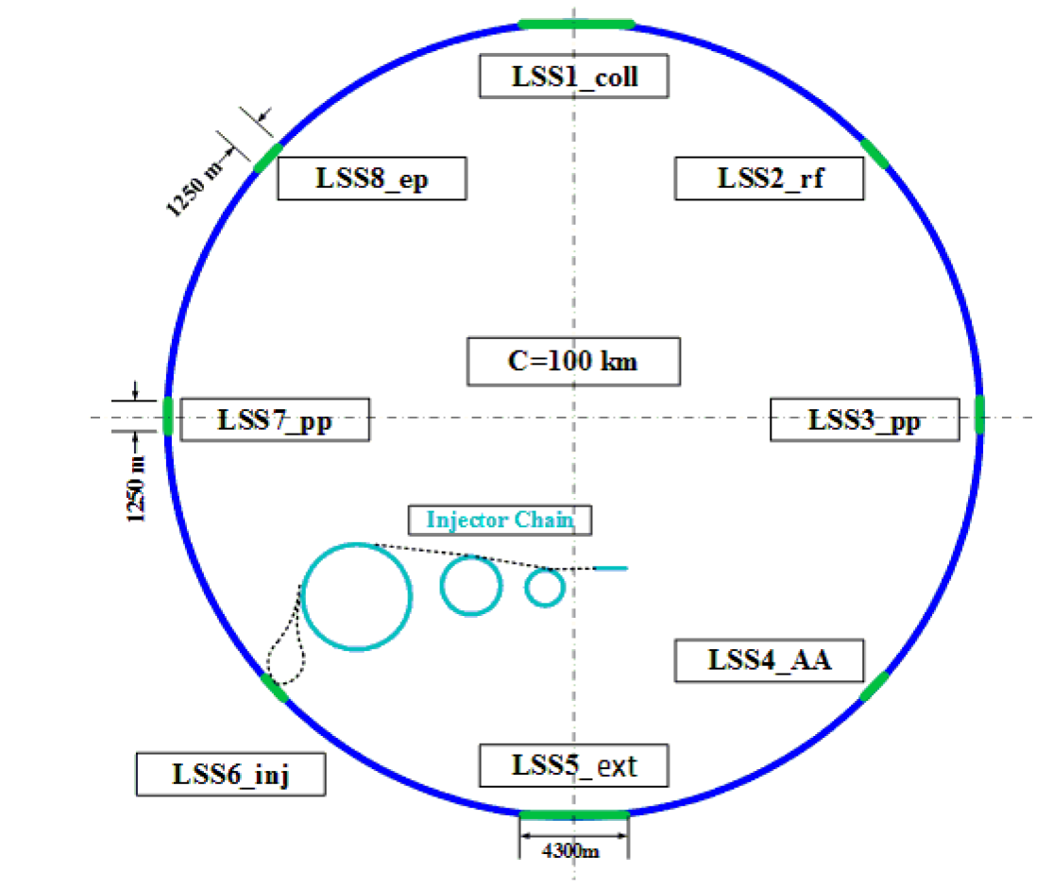
Proposed Higher-Energy Hadron Colliders
FCC-hh
SPPC
Snowmass ‘21

Slide 14
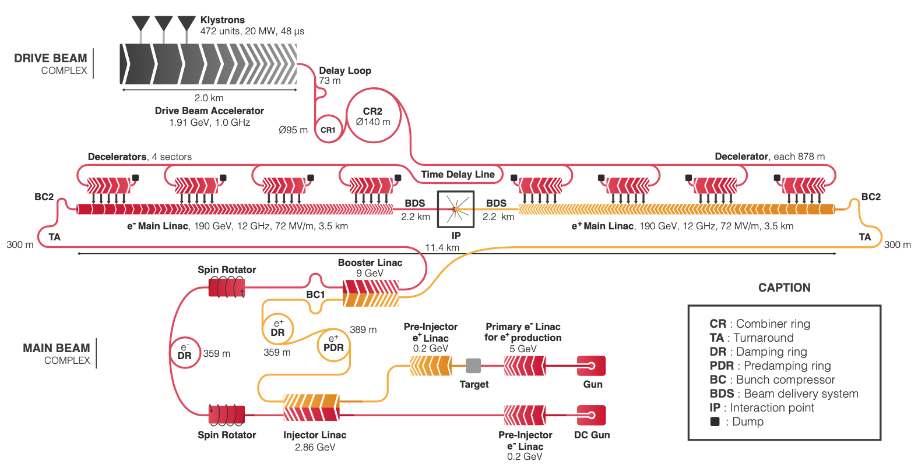
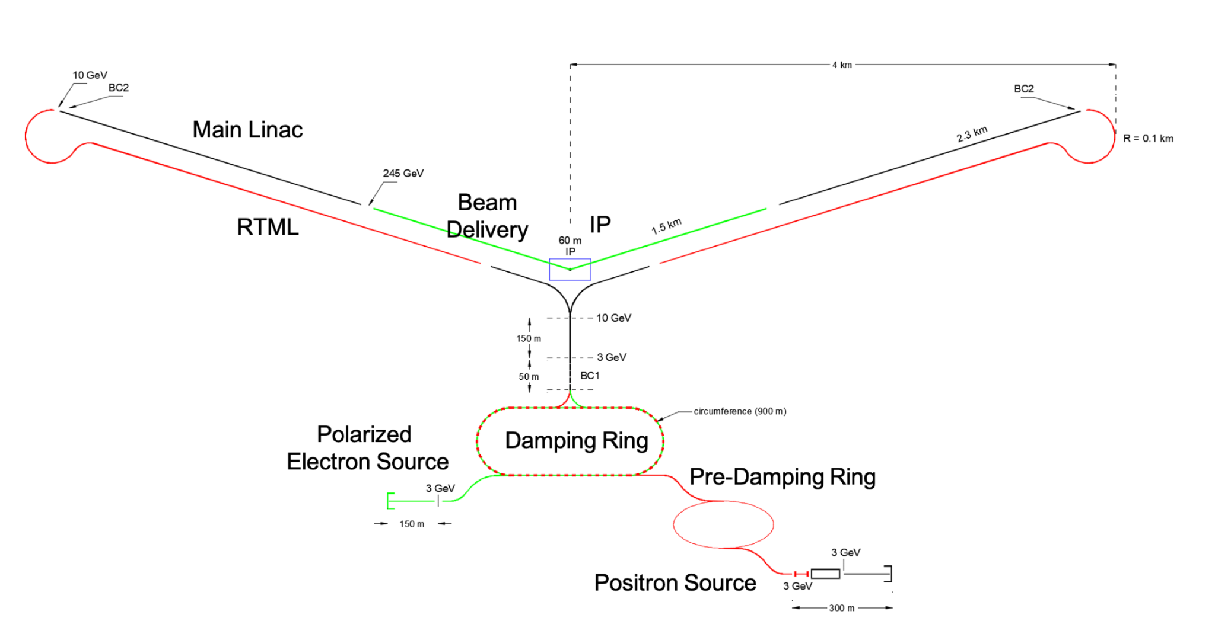
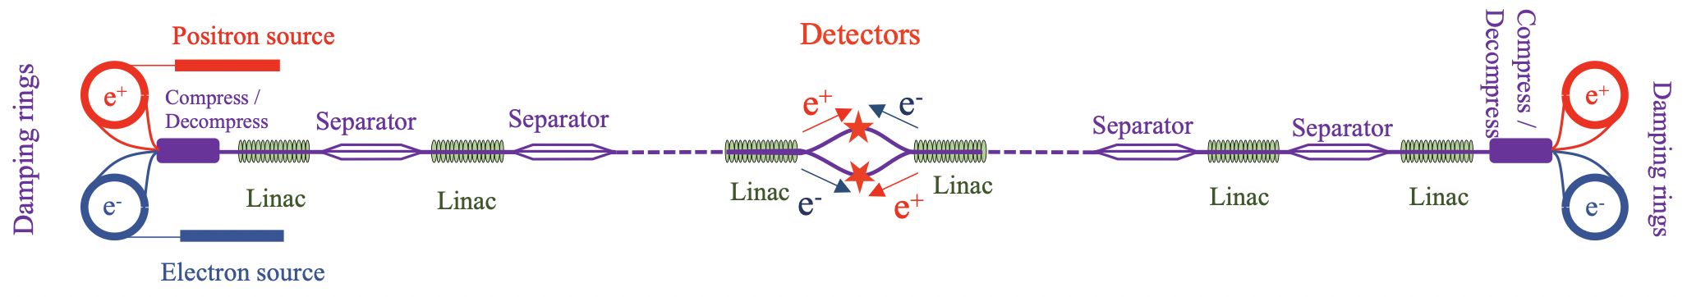
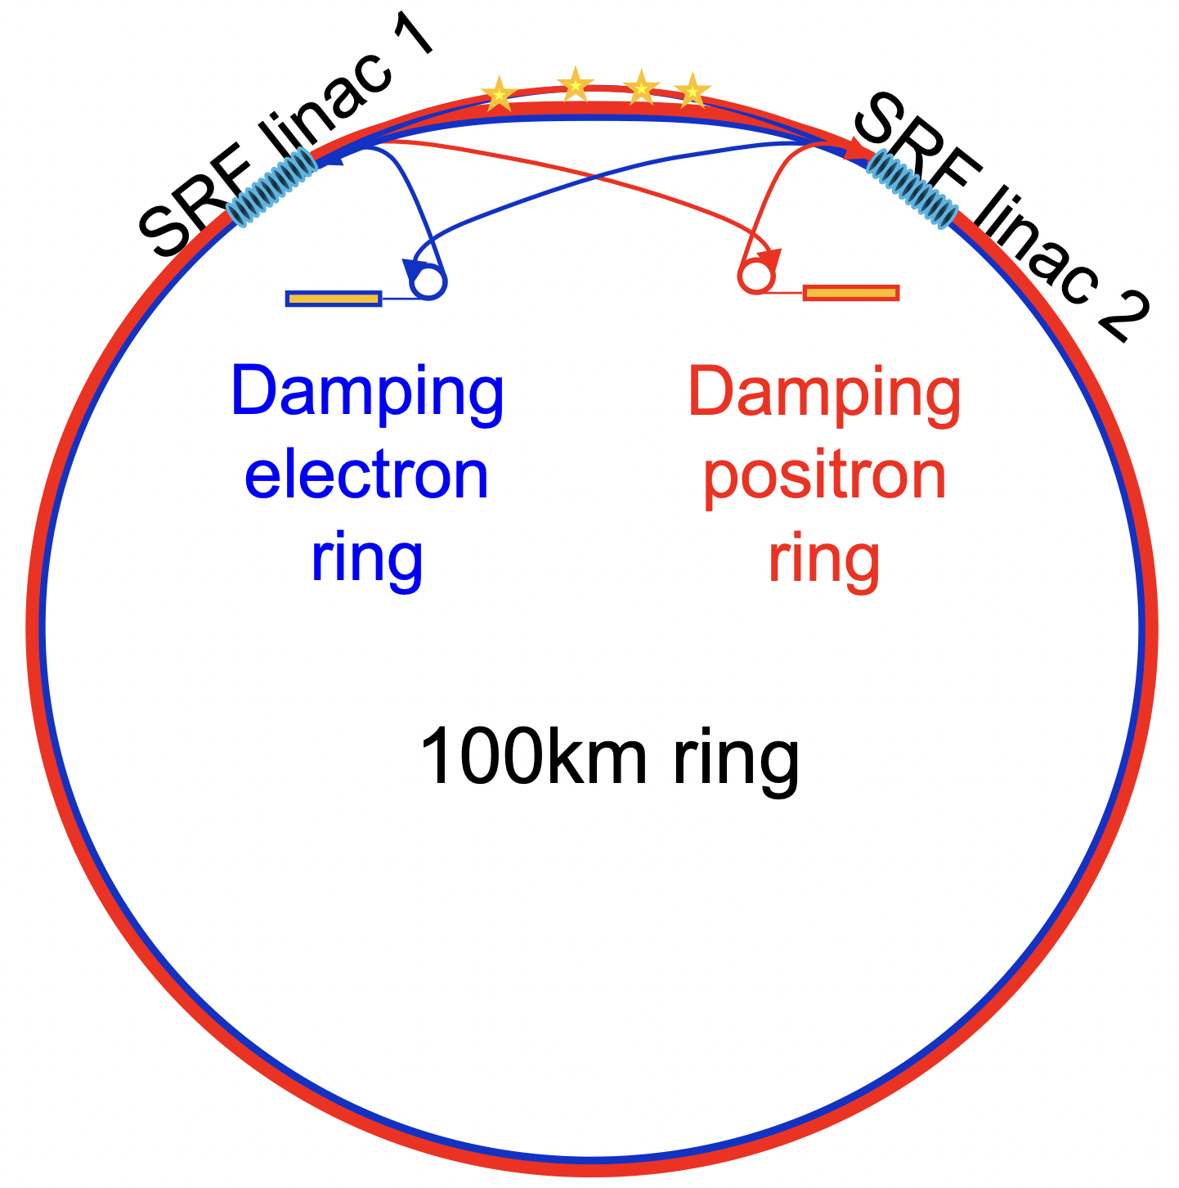
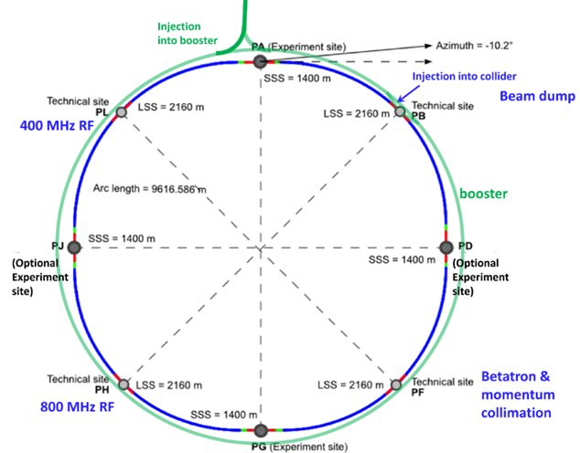
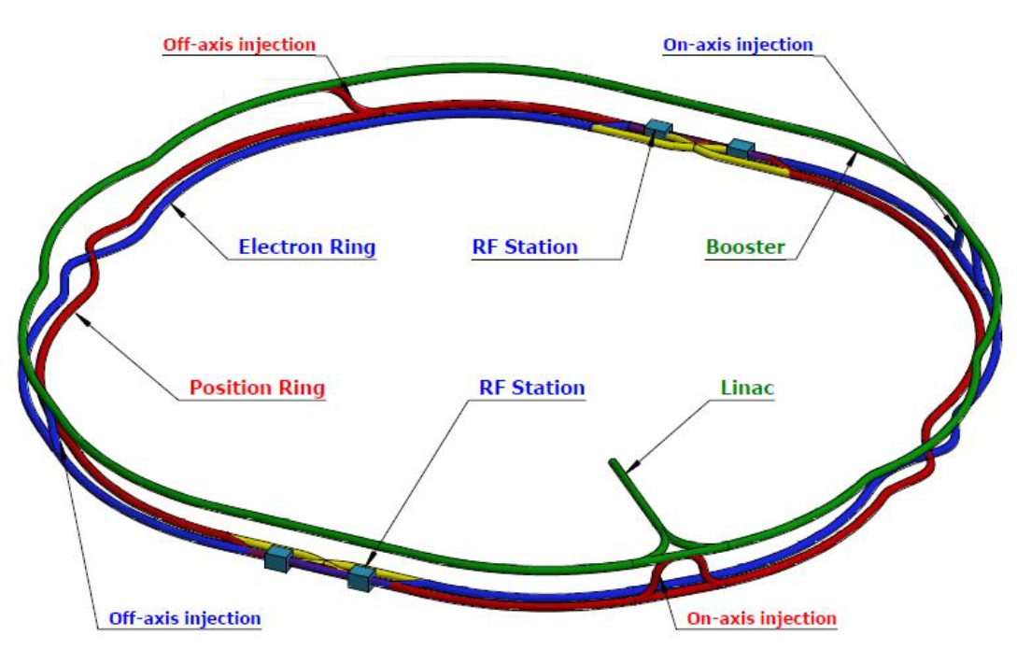
Proposed e⁺e⁻ Higgs & EW Factories
ILC
CLIC
C³
HELEN
RELIC
CEPC
CERC
FCC-ee
Snowmass ‘21

Slide 15
Towards the next, next-next and next-next-next generation of accelerators – main themes
Energy Recovery Linacs
γγ colliders
Muon Collider(s)
Advanced Accelerator Concepts
Sustainability
High-field magnets
SC Radiofrequency systems
Efficient RF power sources
e⁺ production
Gamma Factory
Monochromatization

Slide 16
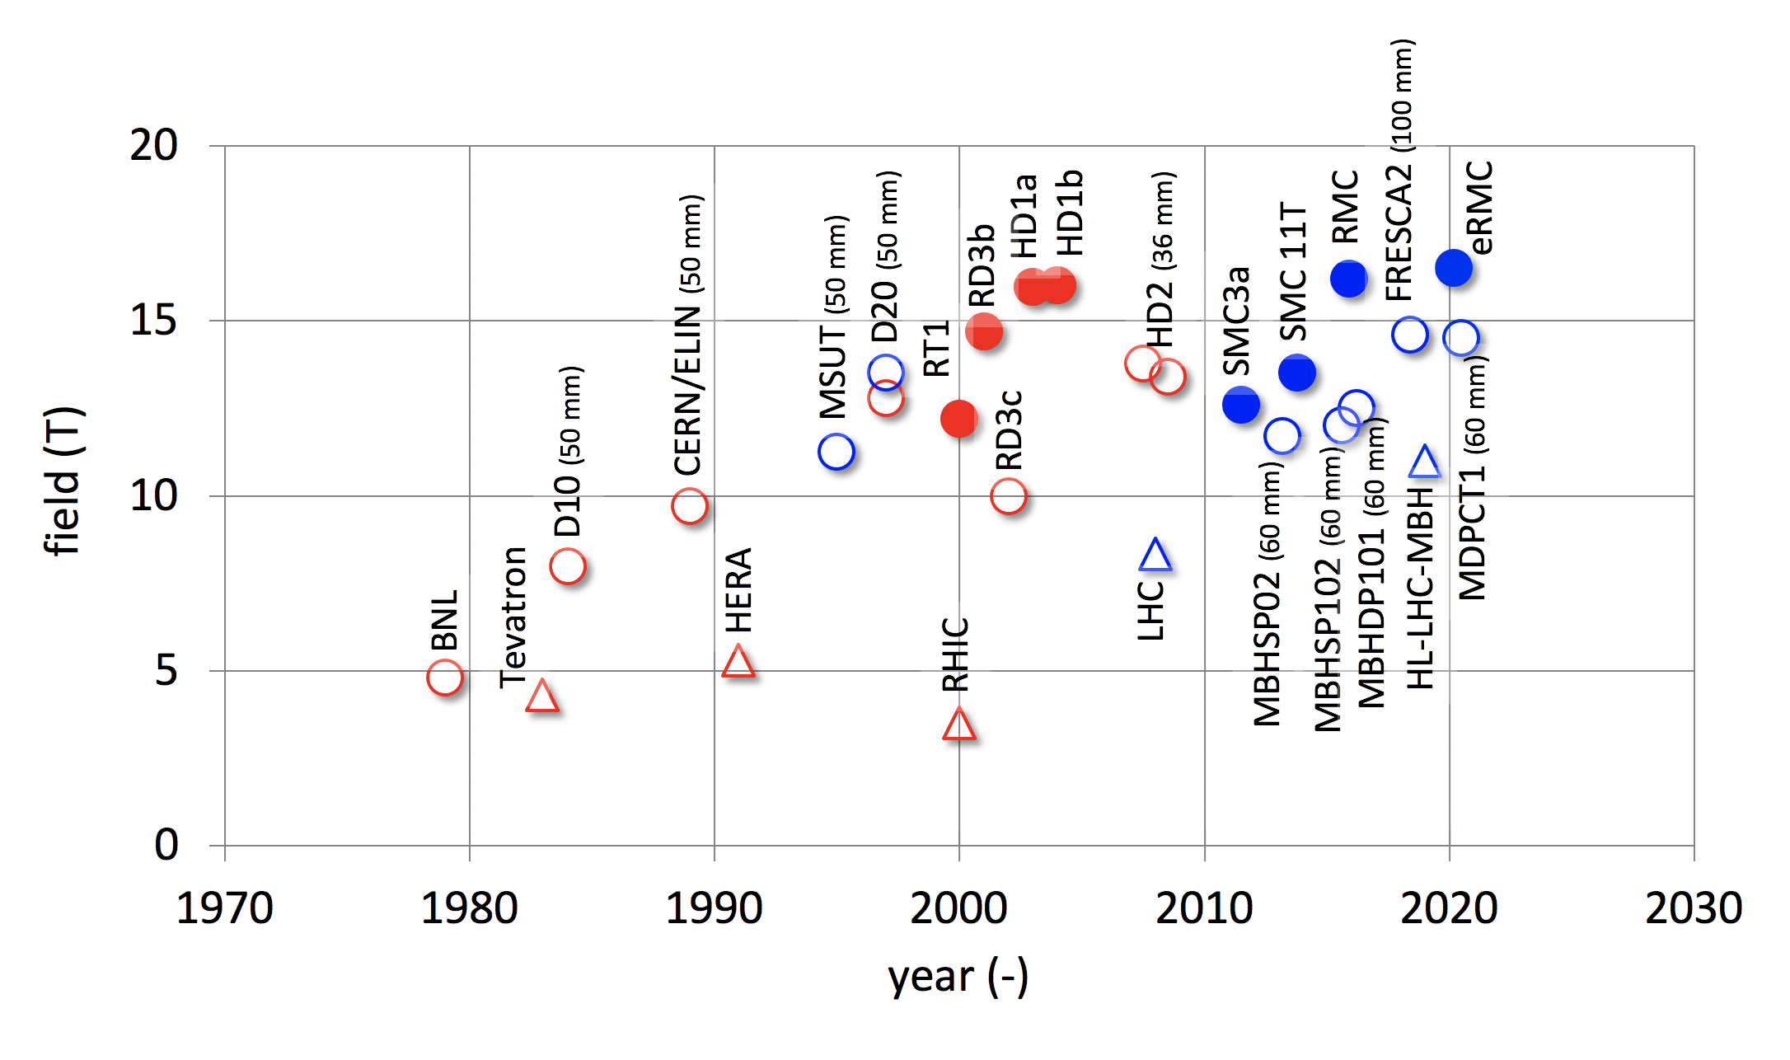
High-Field Magnet – historical progress
Luca Bottura

Slide 17
CERN High-Field Magnet Program
Development of robust and cost-efficient processes
LHC
Robust Nb₃Sn
HL-LHC QXF
Logical step for a next phase (2027-2034)
HL-LHC 11T
D20
Ultimate Nb₃Sn
Fresca2
MDPCT1
Exploration of new concepts and technologies
HTS
Luca Bottura

Slide 18
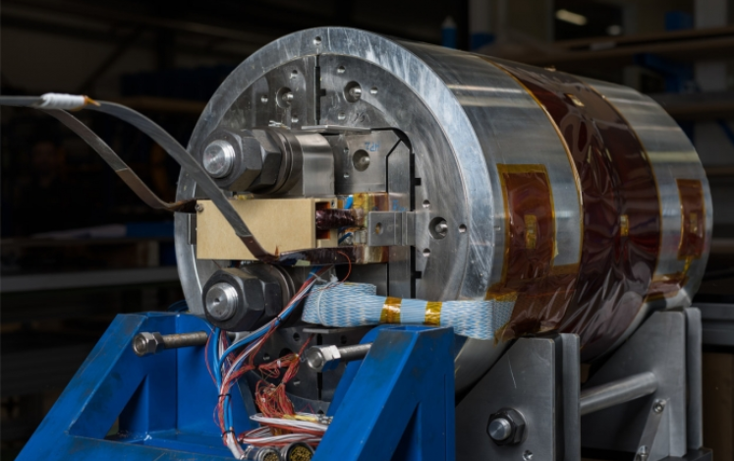
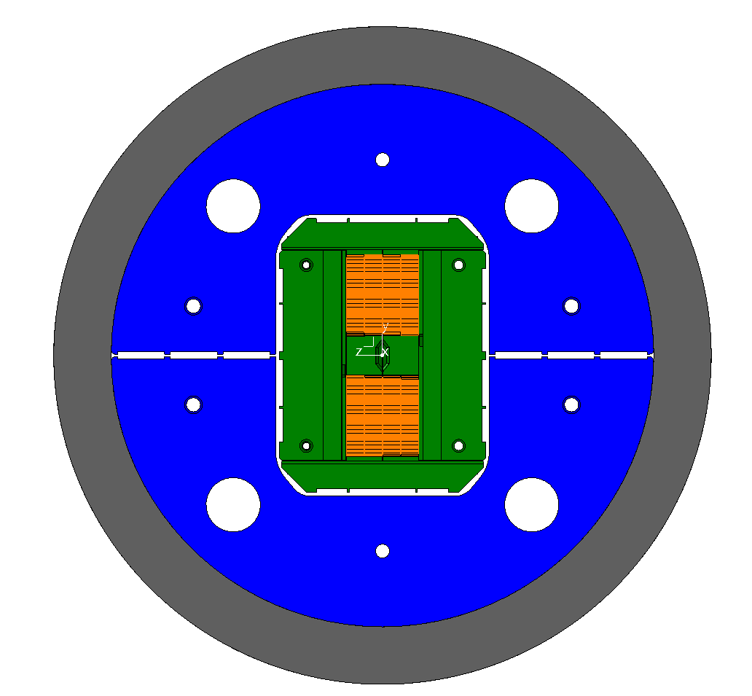
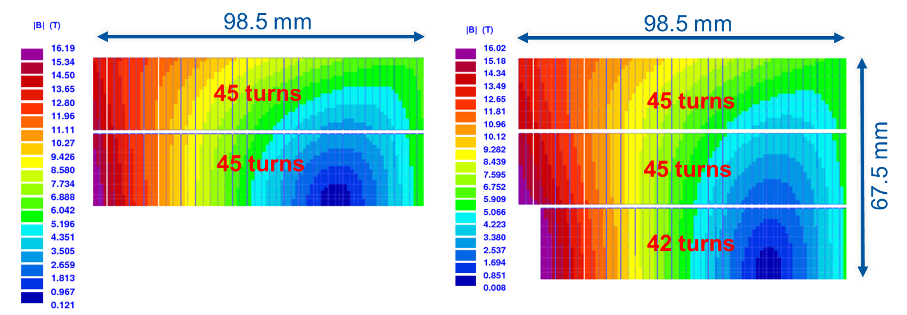
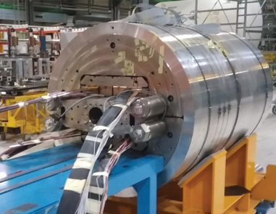
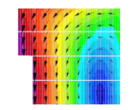
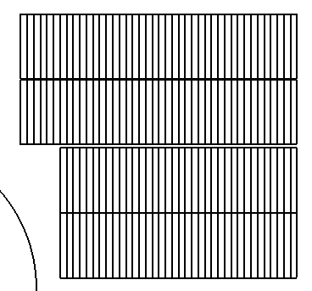
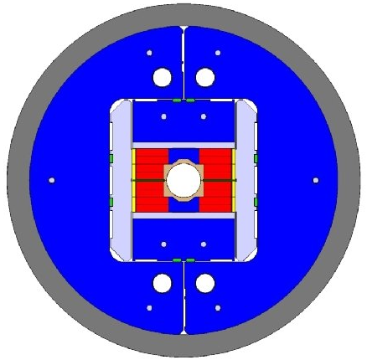
High-Field Nb₃Sn Magnets
CERN
FNAL
RMC/eRMC (2-decks, no aperture), 16.5 T
MDPCT1 (4-layer graded coil, 60 mm), 14.5 T
FRESCA2 (4-decks, 100 mm), 14.6 T

Slide 19
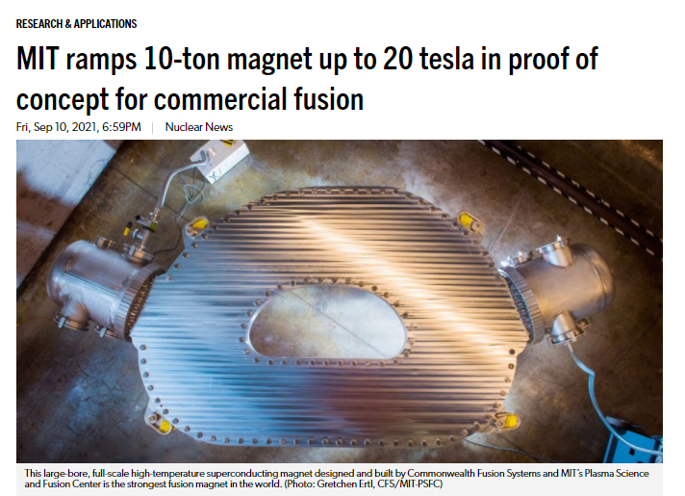
Nuclear Fusion HTS Magnet Progress
September 2021
toroidal model coil
HTS material:
REBCO
synergies
with accelerator magnet
developments

Slide 20
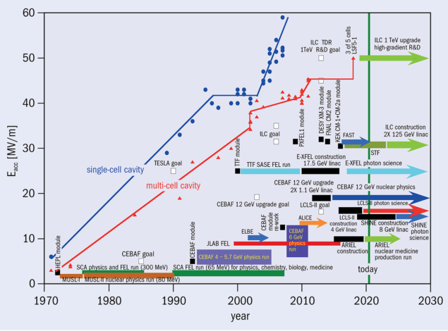
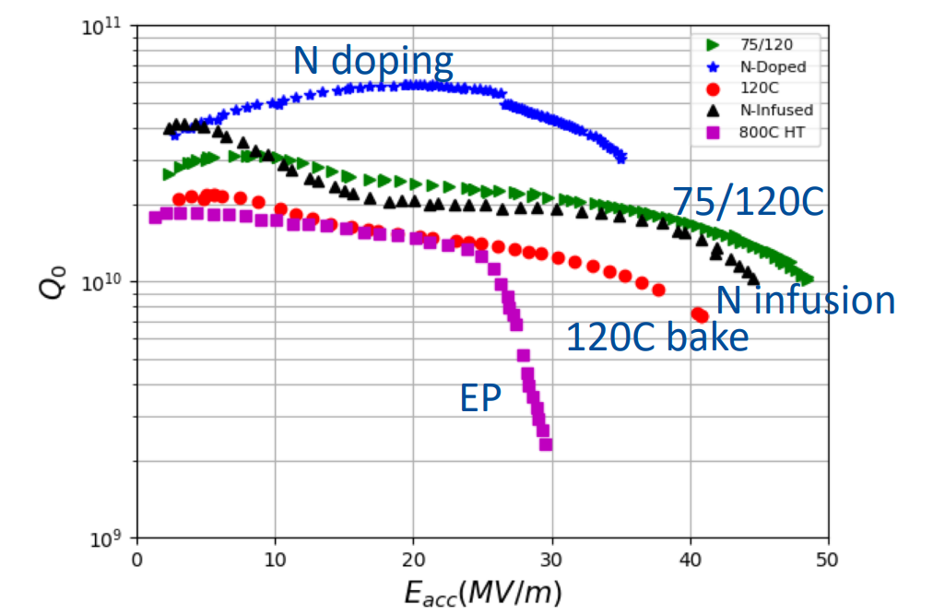
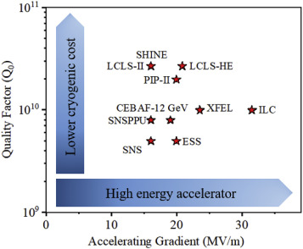
SC Radiofrequency Systems
Anna Grasselino
P. Dhakal
Gradient growth SRF linac accelerating gradient achievements and application specifications since 1970 (CERN Courier., Nov. 2020)

Slide 21
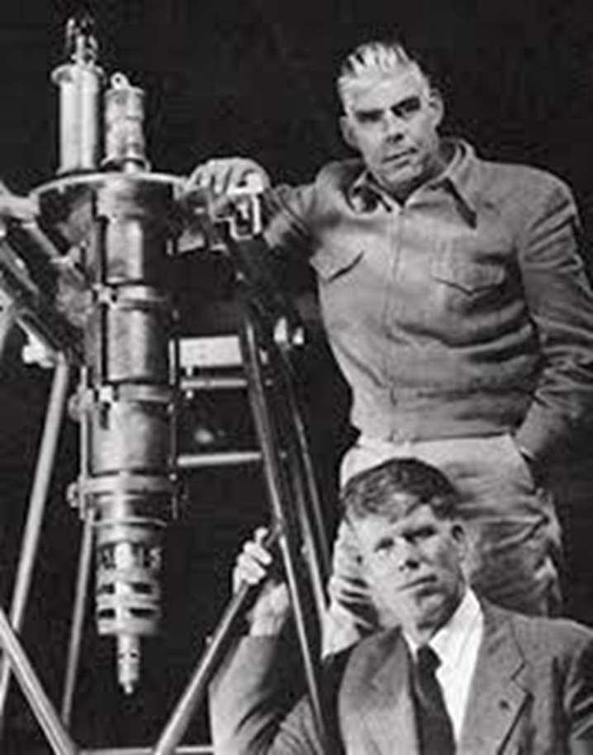
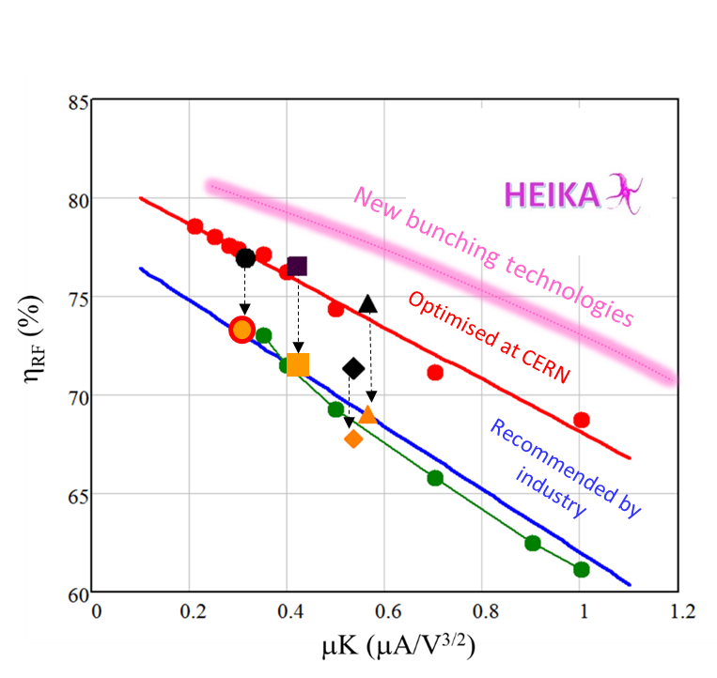
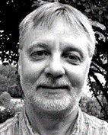
More Efficient RF Power Sources
1937: the Varian brothers
of Palo Alto invent
the klystron
80 years later, another breakthrough in klystron technology
I. Syratchev
New bunching technologies

Slide 22

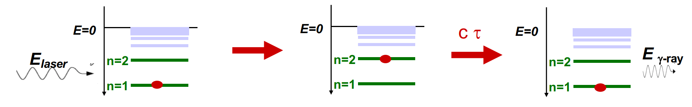

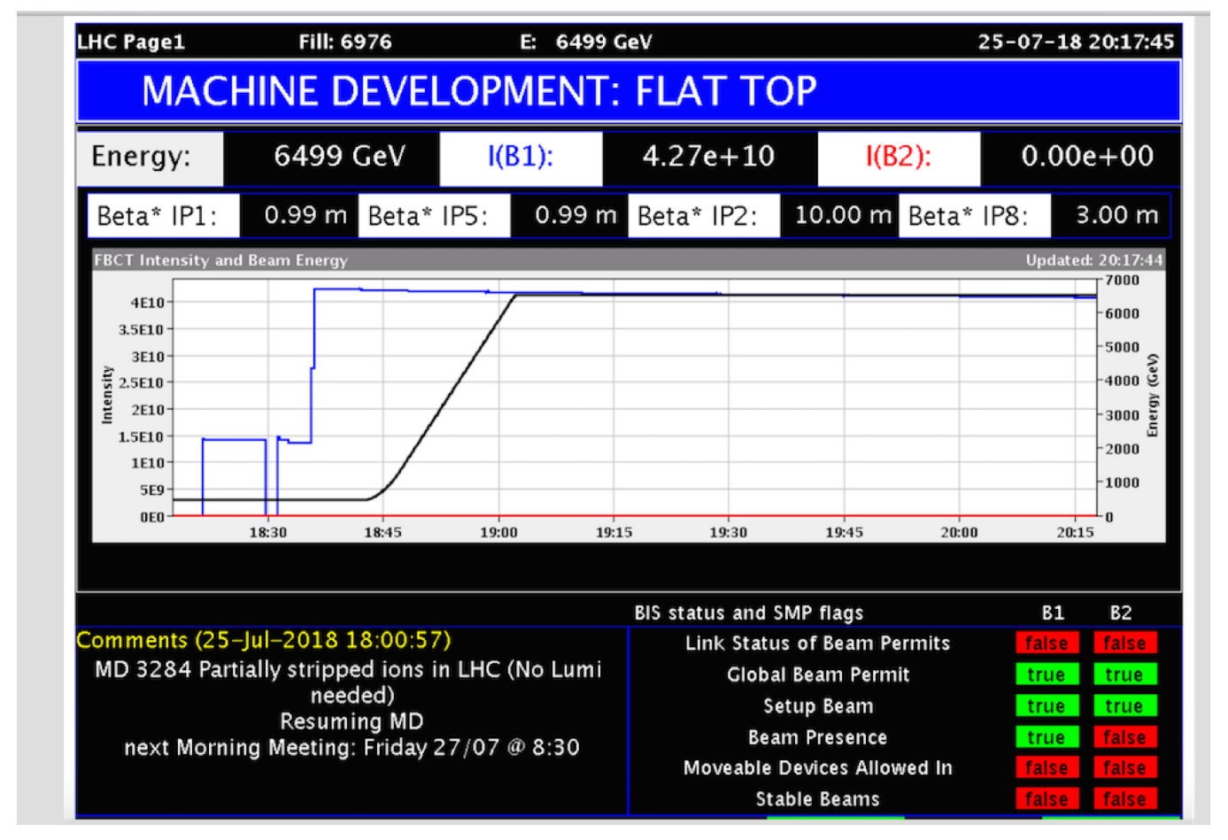
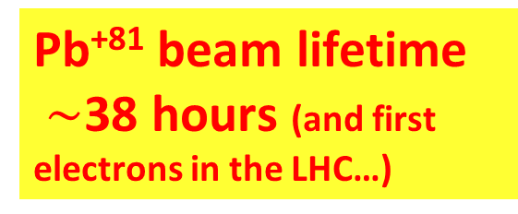
Gamma Factory concept
Witek Krasny
arXiv:1511.07794
partially stripped heavy-ion beam in LHC (or FCC):
resonant scattering of laser photons off ultrarelativistic
atomic beam; high-stability laser-light-frequency converter
Gamma Factory proof-of-principle experiment in the LHC
proposed applications:
intense source of e⁺ (10¹⁶-10¹⁷/s) , π, μ etc
doppler laser cooling of high-energy beams
HL-LHC w. laser-cooled isocalar ion beams
Pb⁺⁸¹ beam lifetime
$\sim$38 hours (and first electrons in the LHC…)

Slide 23
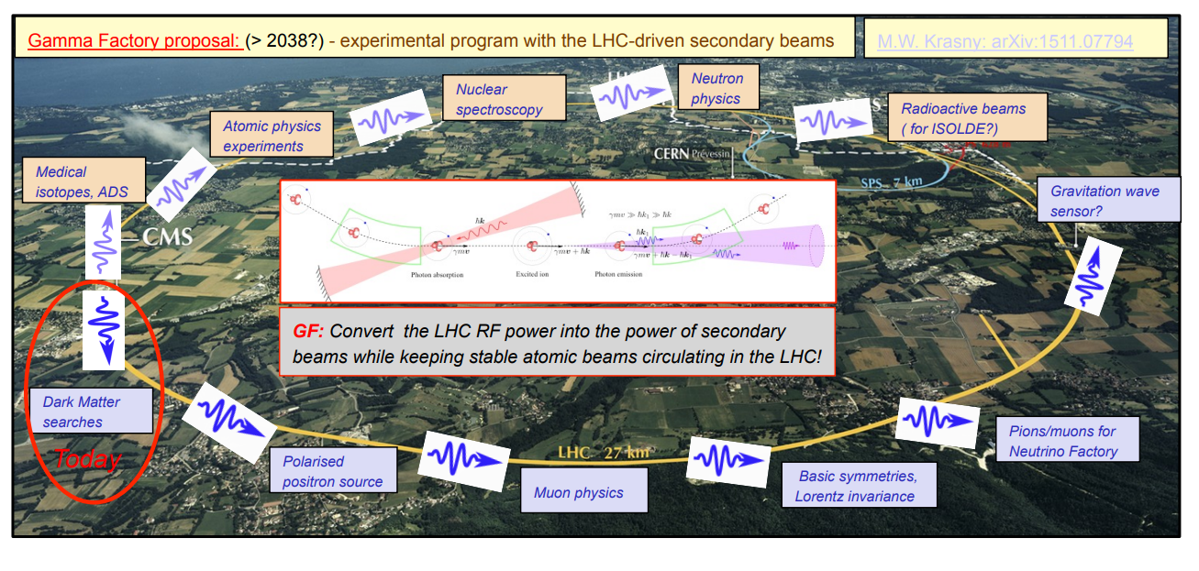
The LHC as a driver of secondary beams
Schematic transformation of the LHC into a Gamma-Factory-based driver of secondary beams [Witek Krasny].

Slide 24
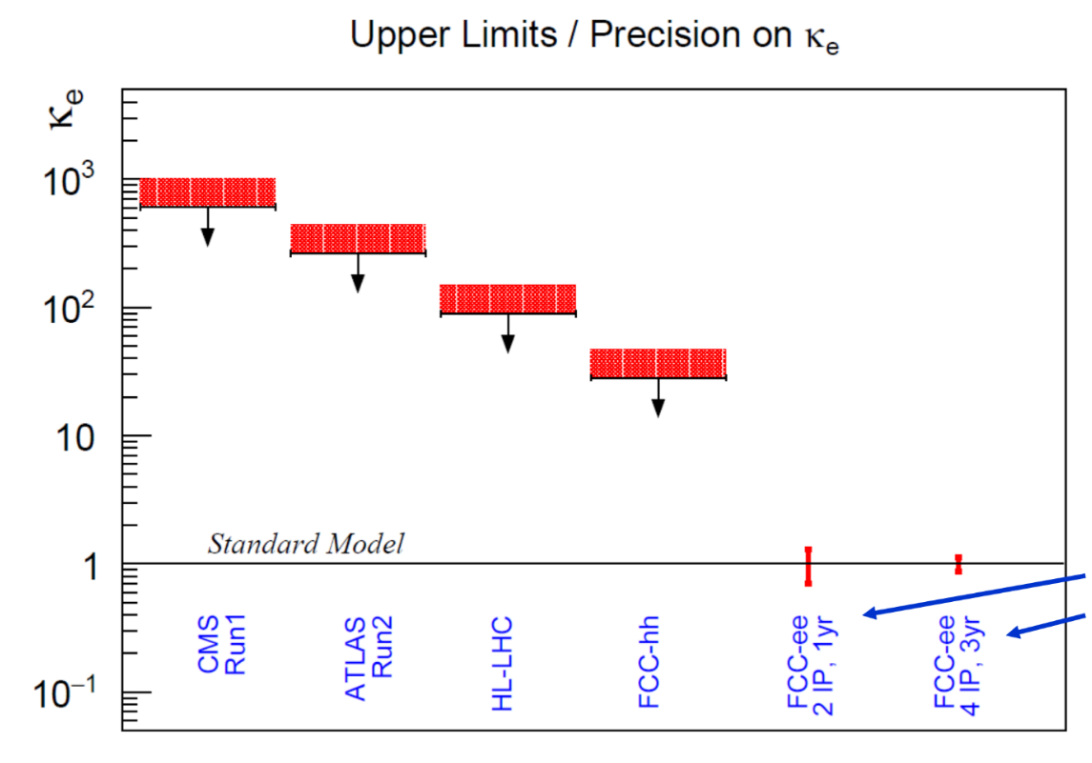





Monochromatization Schemes
nonvanishing IP dispersion
w crab cavities
e⁻ Yukawa coupling
$$D_{x}^{∗}≠0$$
w/o crab cavities
$$D_{x}^{∗}≠0$$
chromatic waist shift
Pantaleo
Raimondi
EPJ Plus 137,
31 (2022)

Slide 25


Energy Recovery Linacs - Historical Proposals 1960s & 70s
early linear-collider proposals
1-6 GeV c.m.
Maury Tigner, “A Possible Apparatus for Clashing-Beam Experiments”, Nuovo Cimento 37, 1228 (1965)
these early proposal always
recovered the energy of the spent beam!
Ugo Amaldi, “A possible scheme to obtain e-e- and e+e- collisions at energies of hundreds of GeV”, Physics Letters B61, 313 (1976)
300 GeV c.m.

Slide 26



Energy Recovery Linacs : Revival since 2019
European LDG roadmap
Main advances: flat instead of round beams, much smaller (vertical) beam sizes, higher beam current →$\sim$10,000x higher luminosity
650 MHz coll rate, 20 MV/m, Q~10¹¹
ReLIC
Litvinenko
L$\sim$4x10³⁶ , 21 km,
3 MHz coll rate
1.5 GHz RF, Q$\sim$10¹¹

Slide 27

ERL prospects & promises
V. Litvinenko, et al.

Slide 28


ERL landscape
V. Litvinenko et al.
LDG ERL report

Slide 29


PERLE
Multi-pass high-current ERL test facility for LHeC (and FCC-ee-ERL) under construction at IJClab
1 : 3 : 5
W. Kaabi,
A. Bogacz,
O. Bruning, M. Klein
injector
7 MeV
ΔE = 80 MeV
2 : 4 : 6
7 MeV
dump
ΔC = λ_{RF}/2
Footprint: 24 x 5.5 x 0.8 m³
arXiv:1705.08783

Slide 30




Muon Colliders
$\sim$1.6x10⁹ x less SR than e⁺e⁻, no beamstrahlung problem
two production schemes proposed
US-MAP (2015) p-driven
Italian LEMMA (2017) e⁺-annihilation
needs large 45 GeV e⁺ ring like FCC-ee, possible upgrade path to FCC-μμ
μ‘s decay within a few 100 - 1000 turns:
→ rapid acceleration
(perhaps plasma?)
→ ν radiation hazard
(limits maximum μ energy)
Bruce King 1999
$$σ_{ν}∝E, flux ∝E^{2} (Lorentz boost)$$
solution beyond 10 TeV unclear

Slide 31



Muon Colliders – Example Challenges
target design for p driven μ collider
plasma target for e⁺ driven μ collider
D. Schulte, IPAC’22
J. Farmer et al., IPAC’22

Slide 32


γγ colliders
XCC
HE - HL γγ Collider
E. Barzi, Snowmass ‘21
T. Barklow, Snowmass ‘21

Slide 33


Advanced Accelerators: Plasma
R. Assmann
A plasma cell compared with the superconducting accelerator FLASH (credit DESY)
R. Assmann, E. Gschwendtner, R. Ischebeck, LDG Draft

Slide 34


Advanced Accelerator “Demonstrator” EuPRAXIA
R. Assmann,
iFAST BWS2022
construction
at INFN-LNF

Slide 35



PALLAS : A cornerstone of EuPRAXIA
2020-22
2022-24
2024-26
phase 1
K. Cassou

Slide 36



Plasma Accelerator Challenge: Positron Acceleration
“ballistic injection”: a ring-shaped laser beam and a coaxially propagating Gaussian laser beam are employed to create donut and center bubbles in the plasma, resp.
Z.Y. Xu

Slide 37

Advanced Accelerator Types
Required parameters for a linear collider with advanced high gradient acceleration [R. Assmann]. Three published parameter cases are listed. This table is taken from the LDG report [N. Mounet (ed.), “European Strategy for Particle Physics - Accelerator R&D Roadmap”, arXiv:2201.07895 CERN-2022-001]
Dielectric Laser Accelerators (DLAs) may help explore the dark sector

Slide 38


Dielectric Laser Accelerators
The insets show the accelerating and deflecting gradients across the channel for illustrated optical phases 𝜃θ.
Scanning electron micrograph of the dual pillar accelerator structure.
The structure has 14 periods and its 15 μm long gratings are sitting on a 75 μm tall mesa.
Dual pillar dual-drive mode profiles with force vectors superimposed on the 𝐸𝑧 acceleration field color map at different relative drive phases.
Insets show accelerating and deflecting gradients across channel for illustrated optical phases 𝜃.
Kenneth J. Leedle, Dylan S. Black, Yu Miao, Karel E. Urbanek, Andrew Ceballos, Huiyang Deng, James S. Harris, Olav Solgaard, Robert L. Byer, "Phase-dependent laser acceleration of electrons with symmetrically driven silicon dual pillar gratings," Opt. Lett. 43, 2181-2184 (2018); https://www.osapublishing.org/ol/abstract.cfm?uri=ol-43-9-2181

Slide 39


ultimate limit on electromagnetic acceleration
Schwinger critical fields E_{cr} ≈10¹² MV/m, B_{cr}=4.4 x10⁹ T
Planck scale: 10²⁸ eV
0.8x10¹⁰ m
“not an inconceivable task for an advanced technological society”
P. Chen, R. Noble, SLAC-PUB-7402, April 1998
1.0x10¹⁰ m
circular & linear
Planck-scale colliders
$\sim$1/10th for distance earth-sun

Slide 40




stepping stone towards Planck scale collider ?
Very large hadron collider on the Moon (CCM), $C\sim$11 Mm, E_{c.m.}$\sim$14 PeV (1000x LHC’s), 6x10⁵ dipoles with 20 T field, either ReBCO, requiring ~7-13 k tons rare-earth elements, or IBS, requiring $\sim$a million tons of IBS. Many of the raw materials required to construct machine, injector complex, detectors, and facilities can potentially be sourced directly on the Moon. 11000-km tunnel a few 10 to 100 m under lunar surface to avoid lunary day-night temperature variations, cosmic radiation damage, and meteoroid strikes. Dyson band or belt to continuously collect sun power. Required: <0.1% sun power incident on Moon surface.
J. Beacham, F. Zimmermann, 2022 New J. Phys., https://doi.org/10.1088/1367-2630/ac4921

Slide 41





a timely consideration ?!
techeblog.com
CNRS News

Slide 42
back to the next generation

Slide 43
From Snowmass ITF report*
 | CME (TeV) | Lumi per IP (10^34) | Years, pre-project R&D | Years to 1st physics | Cost range (2021 B$) | Electric Power (MW)
FCCee-0.24 | 0.24 | 8.5 | 0-2 | 13-18 | 12-18 | 280
ILC-0.25 | 0.25 | 2.7 | 0-2 | <12 | 7-12 | 140
CLIC-0.38 | 0.38 | 2.3 | 0-2 | 13-18 | 7-12 | 110
HELEN-0.25 | 0.25 | 1.4 | 5-10 | 13-18 | 7-12 | 110
CCC-0.25 | 0.25 | 1.3 | 3-5 | 13-18 | 7-12 | 150
MC-Higgs | 0.13 | 0.01 | >10 | 19-24 | 4-7 | ~200
CLIC-3 | 3 | 5.9 | 3-5 | 19-24 | 18-30 | ~550
ILC-3 | 3 | 6.1 | 5-10 | 19-24 | 18-30 | ~400
MC-3 | 3 | 2.3 | >10 | 19-24 | 7-12 | ~230
MC-FNAL | 6-10 | 20 | >10 | 19-24 | 12-18 | O(300)
MC-IMCC | 10-14 | 20 | >10 | >25 | 12-18 | O(300)
FCChh-100 | 100 | 30 | >10 | >25 | 30-50 | ~560
*CEPC missing

Slide 44

Energy efficiency: Higgs factories
Total luminosity per electrical power. (Nature Physics vol. 16, 402, 2020)

Slide 45
Carbon Footprint - examples
TWh / year for the “Higgs factory” centre-of-mass energy
Patrick Janot
    √s = 240 GeV for CEPC/FCC-ee, 250 GeV for ILC/C³, 380 GeV for CLIC
CLIC | ILC | C³ | FCC-ee | CEPC
0.8 | 0.9 | 0.9 | 1.1 | 2.0
P. Janot and A. Blondel, The carbon footprint of proposed e+e− Higgs factories, arXiv 2208.10466 (2022); https://arxiv.org/abs/2208.10466
Energy consumption in MWh / Higgs
CLIC | ILC | C³ | CEPC | FCC-ee
30 | 20 | 21 | 10 | 3.3
      becomes 2 MWh / Higgs for FCC-ee with 4 IPs
Present carbon footprint for electrical energy in tons CO₂ / Higgs
CLIC@CERN | ILC@KEK | C³@FNAL | CEPC@China | FCC-ee@CERN
2.1 | 7.8 | 8.5 | 6.1 | 0.24
0.14 ton CO₂ / Higgs for FCC-ee with 4 IPs

Slide 46



Further sustainability considerations
Higher magnet temperature helps
1.9 K Nb-Ti or Nb₃Sn magnets
→ 4.5 K/20 K Nb₃Sn/HTS magnets
Future: fluctuating energy sources
Simulation for Germany 2050
varying #bunches
in circular colliders
still far from ideal Carnot efficiency
M. Seidel

Slide 47

Future e⁺e⁻ Collider Positron Requirements
?

Slide 48


Positron Production
Challenging demands
Innovative high-yield source
I. Chaikovska, P. Craievich, et al.
P³: PSI e⁺ production experiment with HTS solenoid at SwissFEL
planned for 2024/25

Slide 49


Snowmass’21 (2022) – maturity ranking
arXiv:2209.05827
A. Faus-Golfe et al.

Slide 50
A few conclusions
Great progress in SC RF and in high-field magnets
Accelerators & colliders getting ever more efficient
Synergies with other applications and other fields
Numerous innovative concepts and challenges for future colliders
Sustainability has become important design criterion
Several promising paths forward

Slide 51









surely great times ahead !
“Pief” Panofsky
Kjell Johnsen
thank you !
Helen Edwards
Mike Lamont
Steve Myers
Robert H. Wilson
Lyn Evans
Herwig Schopper
Satoshi Ozaki

