Slide 1
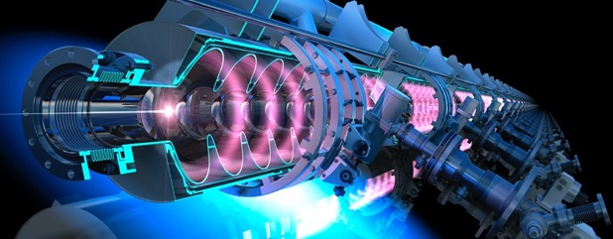






PERLE Collaboration Meeting 11-12/01/2022
Footprint & Infrastructure
PERLE: a Powerful Energy Recovery Linac @ Orsay

Slide 2
PERLE Collaboration Meeting 11-12/01/2022
Toward the footprint
Part 1
  List of the main components
  Associated equipment & infrastructure
Part 2
  Choice of building
Short term goals

Slide 3
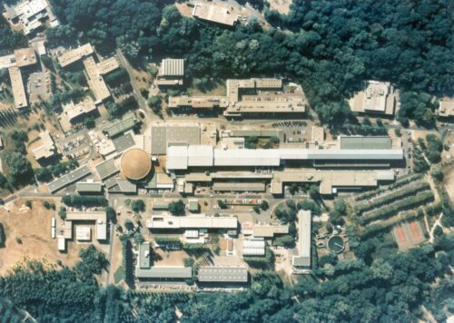
PERLE Collaboration Meeting 11-12/01/2022
Why a footprint ?
Define and find an area @ IJCLab for the PERLE facilities

Slide 4
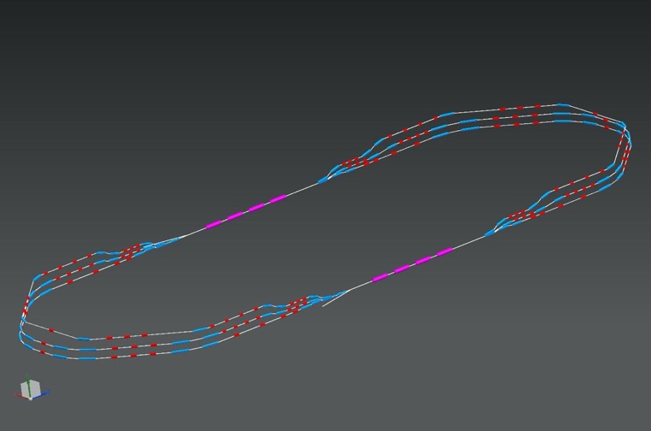
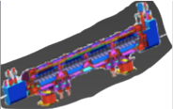
PERLE Collaboration Meeting 11-12/01/2022
Part 1 : The list of the components
2 Linacs (Four 5-Cell 801.58 MHz SC cavities)
3 turns (164 MeV/turn)
Max. beam energy 500 MeV
1 : 3 : 5
DE = 82.2 MeV
injector
7 MeV
7 MeV
2 : 4 : 6
1 : 3 : 5
ΔE = 82.2 MeV
DE = 82.2 MeV
5.5 m
Top view
2 : 4 : 6
29 m
7 MeV
ΔE = 82.2 MeV
dump
10 m
7 MeV
10 m
9 m
DC = l_{RF}/2
Footprint: 29 m × 5.5 m × 0.9 m
45 cm
Side view
45 cm
ΔC = λ_{RF}/2
IP
Notes:
puis le treillis
et les deux en même temps.

Slide 5
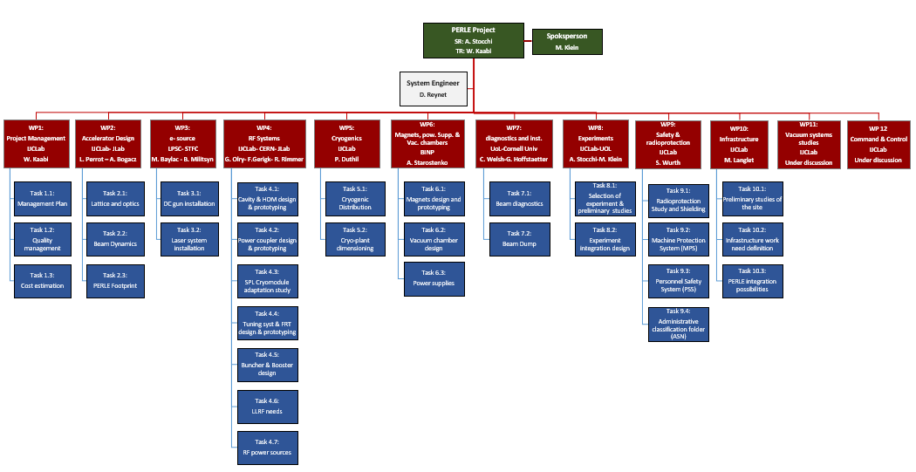
PERLE Collaboration Meeting 11-12/01/2022
The list of the main components (PBS)
With the support of the expert
Notes:
merci d’avance à tous les contributeurs

Slide 6
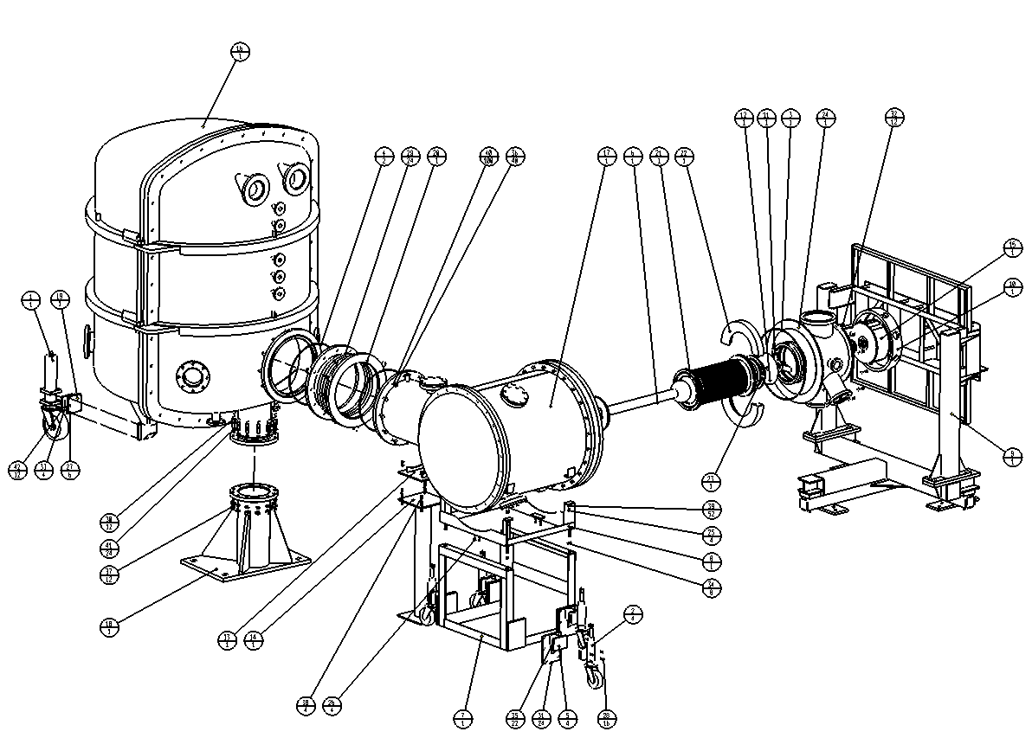
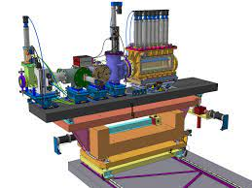
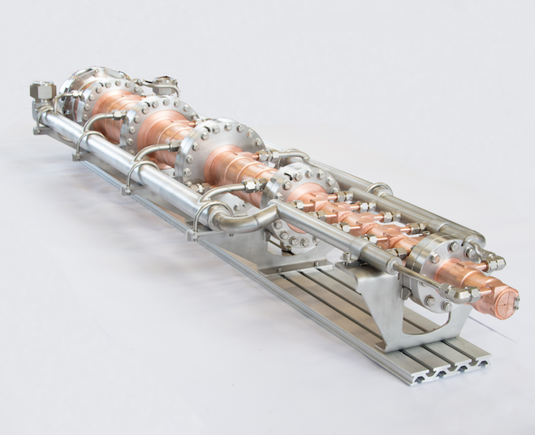
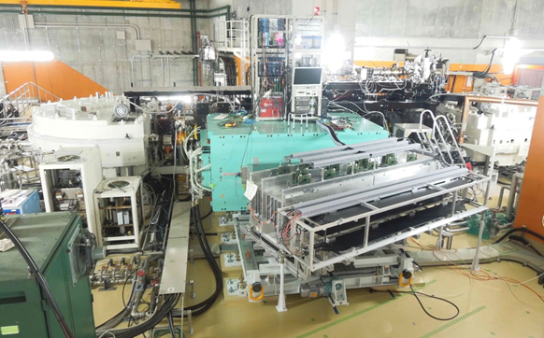
PERLE Collaboration Meeting 11-12/01/2022
Then list “precisely” the main components
Magnets, diagnostics chambers and supports
Area around IP
Injection line
Beam dump
Experimental site
Cryomodules
Photocathode gun
SRF booster
Buncher
Light box
Focusing solenoids

Slide 7
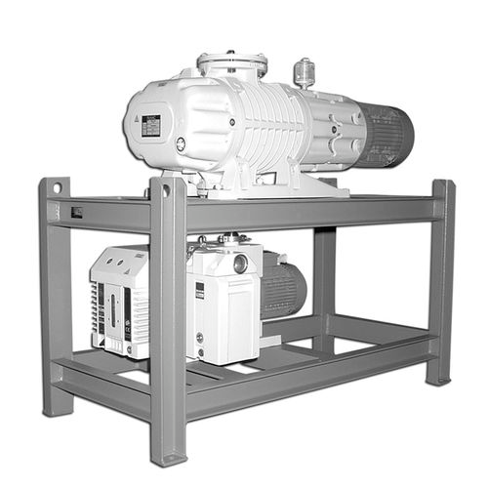
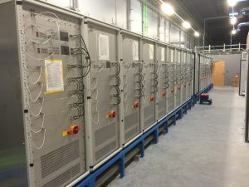
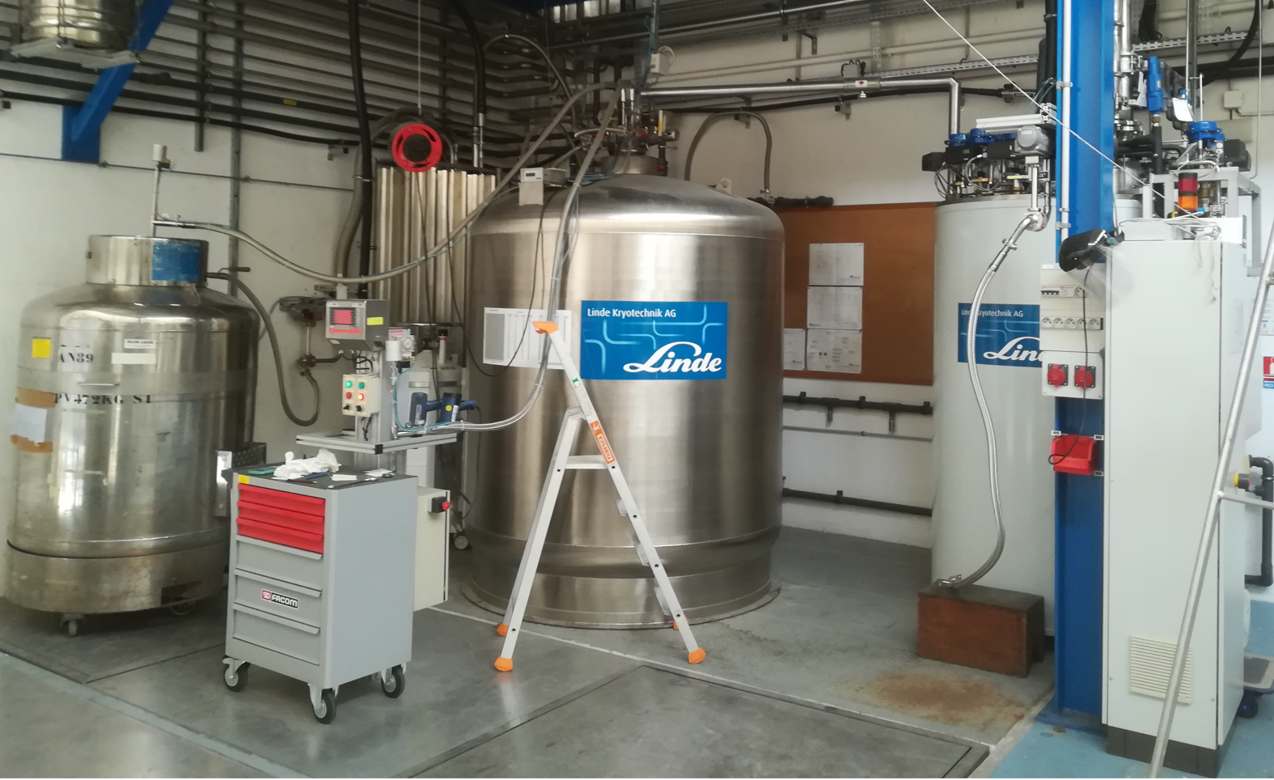
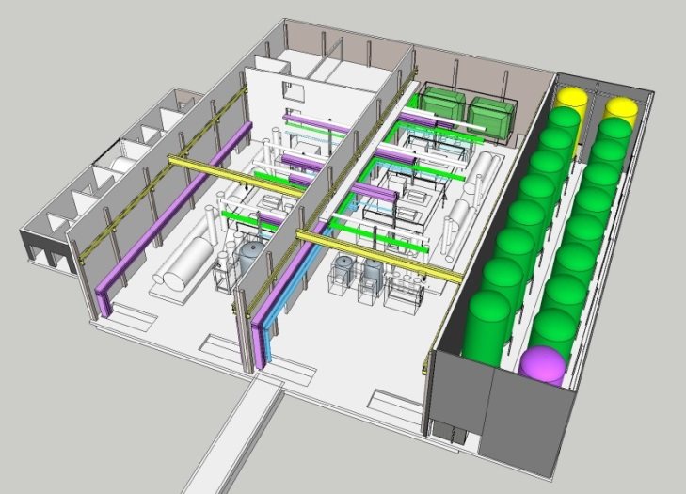
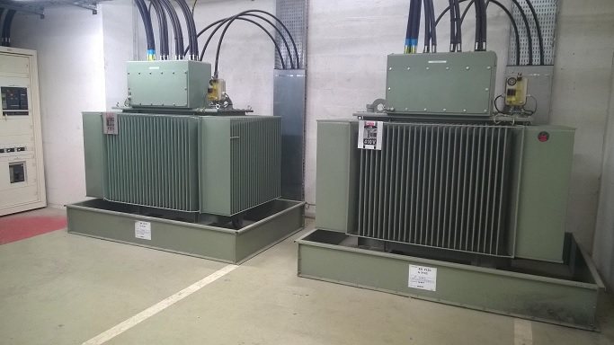
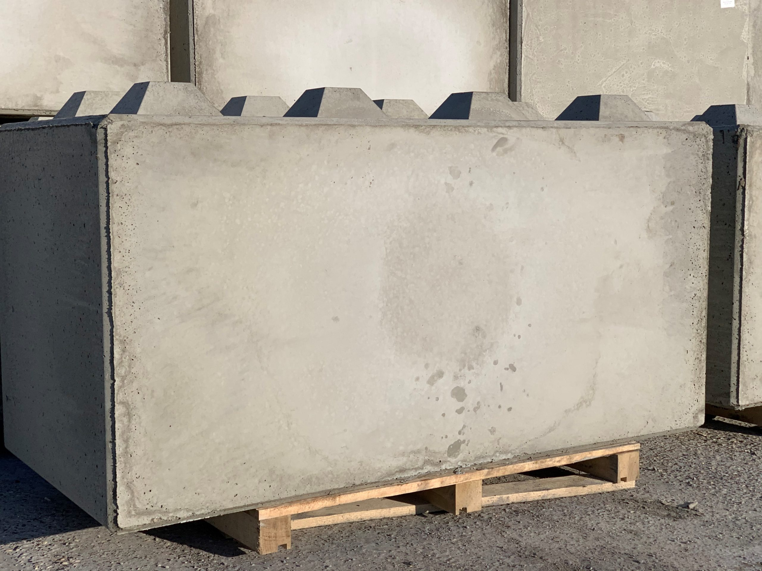
PERLE Collaboration Meeting 11-12/01/2022
List the equipment & infrastructure linked to the components
Power Supply
Cooling water
SF6 & Vacuum
RF supply
Cryoplant + Storage
Air conditioner
Shielding
etc…
+ Radioactive nuclear beam source
+ Equipped control room, living infrastructure, etc…

Slide 8
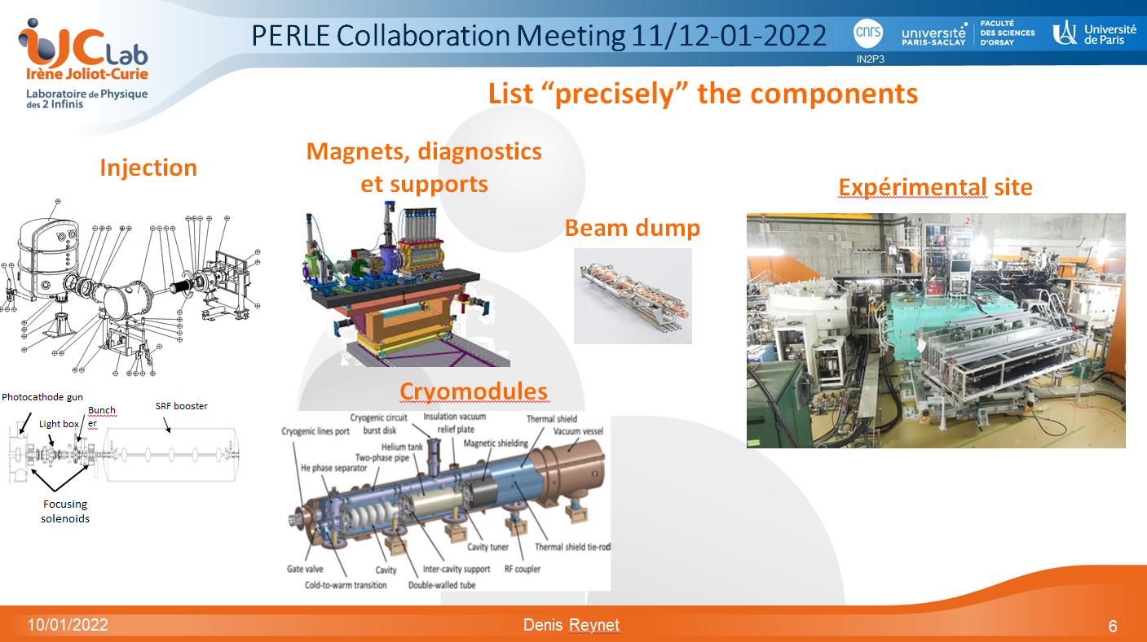
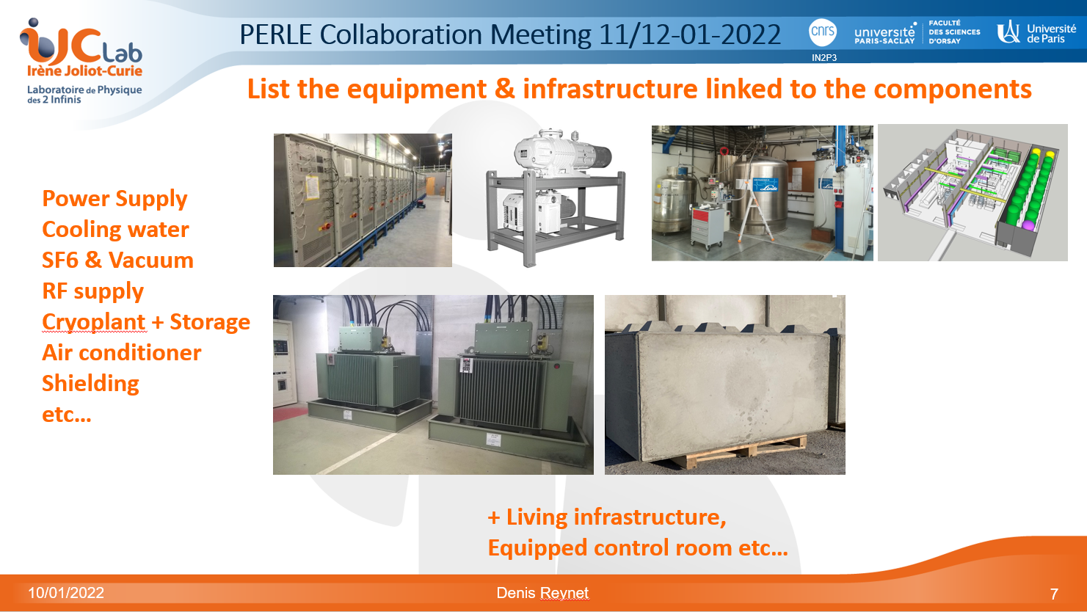
PERLE Collaboration Meeting 11-12/01/2022
Find an area
and
potentially a building
Surface, volume & Mass status
Financial budget estimate

Slide 9

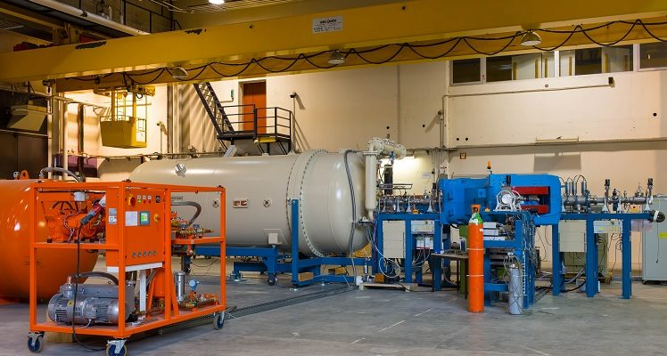
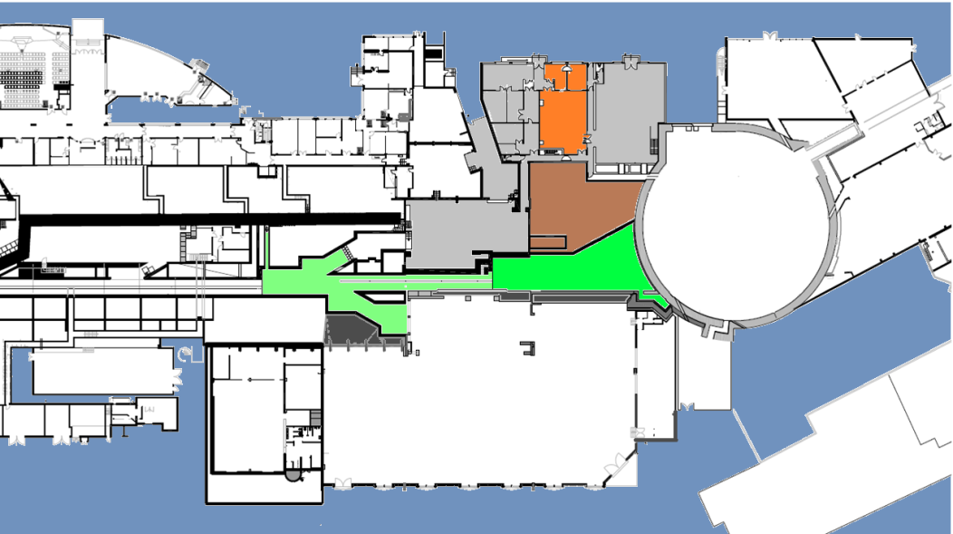
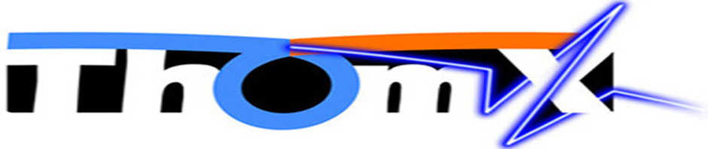
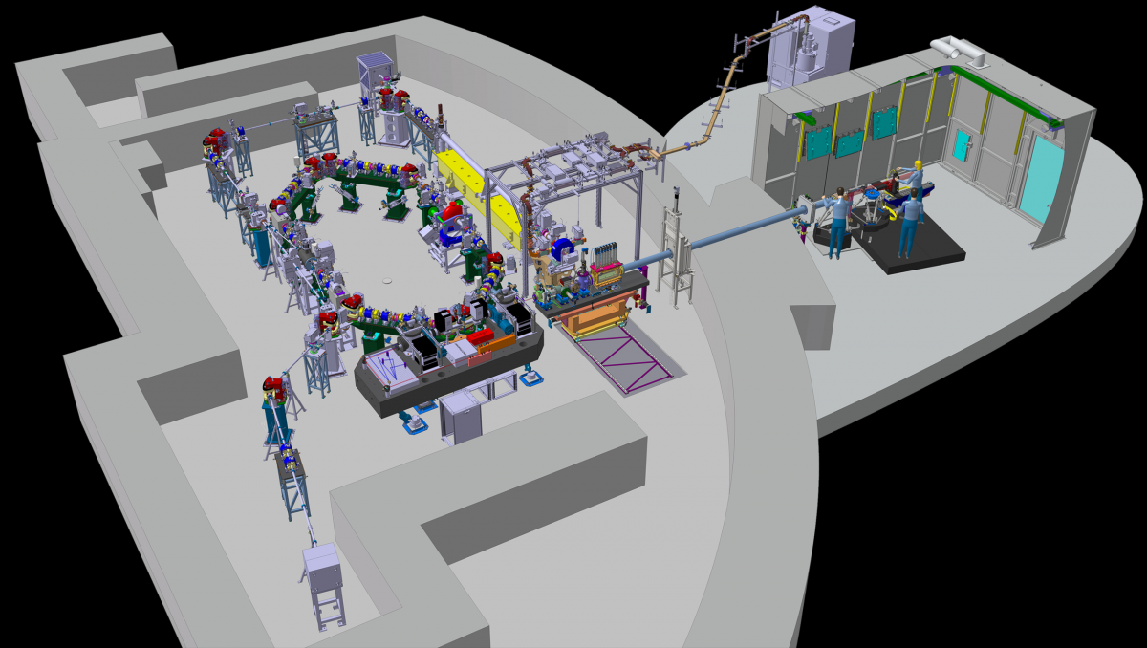
PERLE Collaboration Meeting 11-12/01/2022
      Meet the needs of scientists
      Have convenient access
      Become a large accelerator platform
Choice of building
« CHAPEAU DE GENDARME »
IGLOO
HALL SUPER ACO
FREE
FREE
FREE

Slide 10
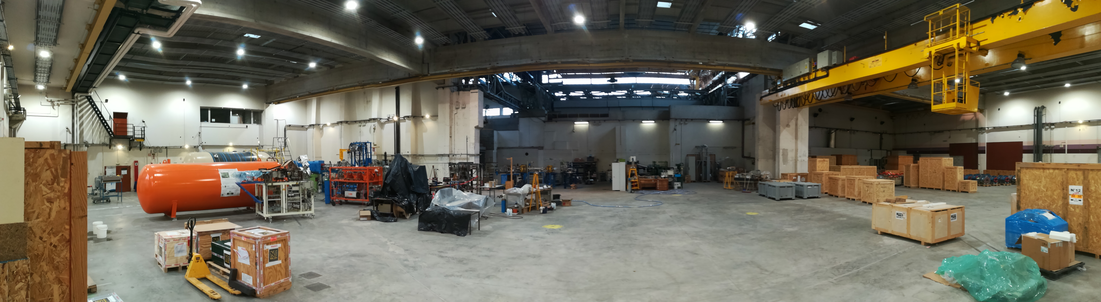

PERLE Collaboration Meeting 11-12/01/2022
Choice of building
Pros :
  A lot of space
  Radioprotected area « Chapeau de gendarme »
  Proximity to Thomx and Andromede facilities
FREE
Andromede
Cons :
  Old building requiring major rehabilitation work
FREE
ThomX
FREE

Slide 11
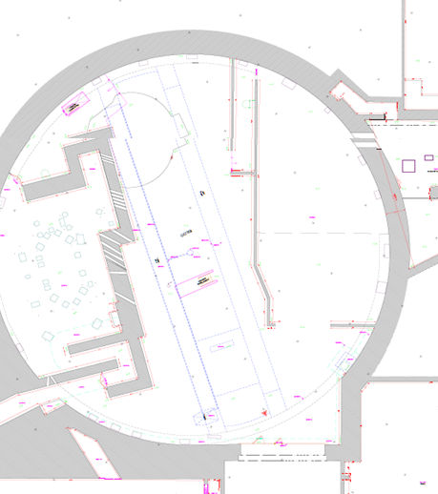
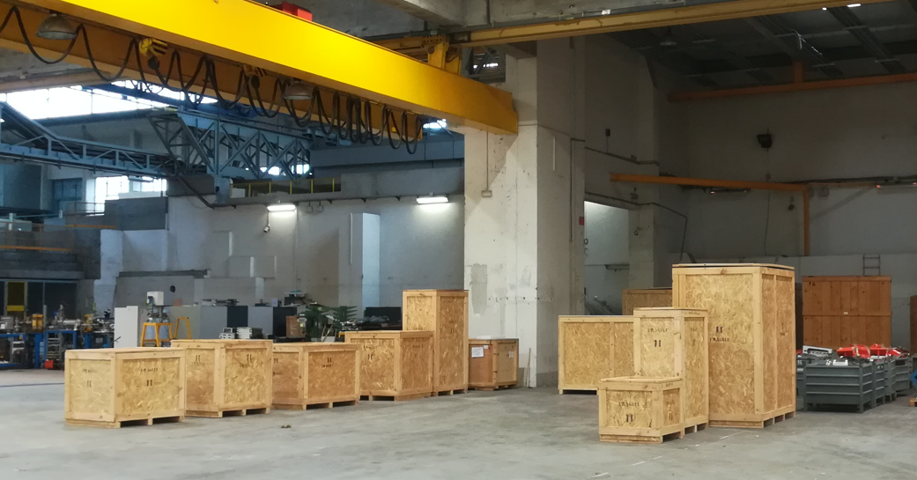
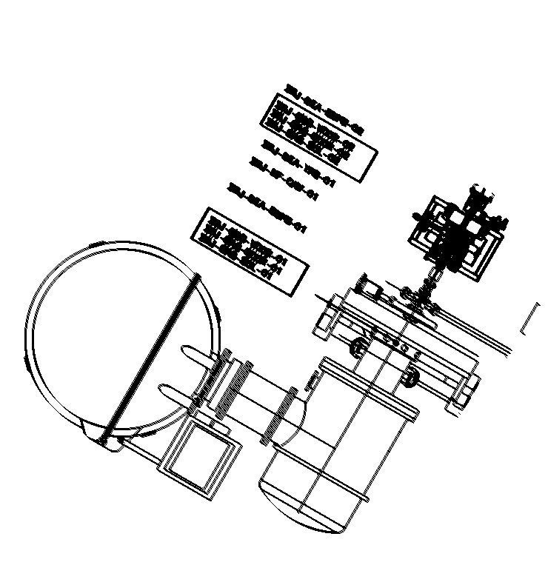
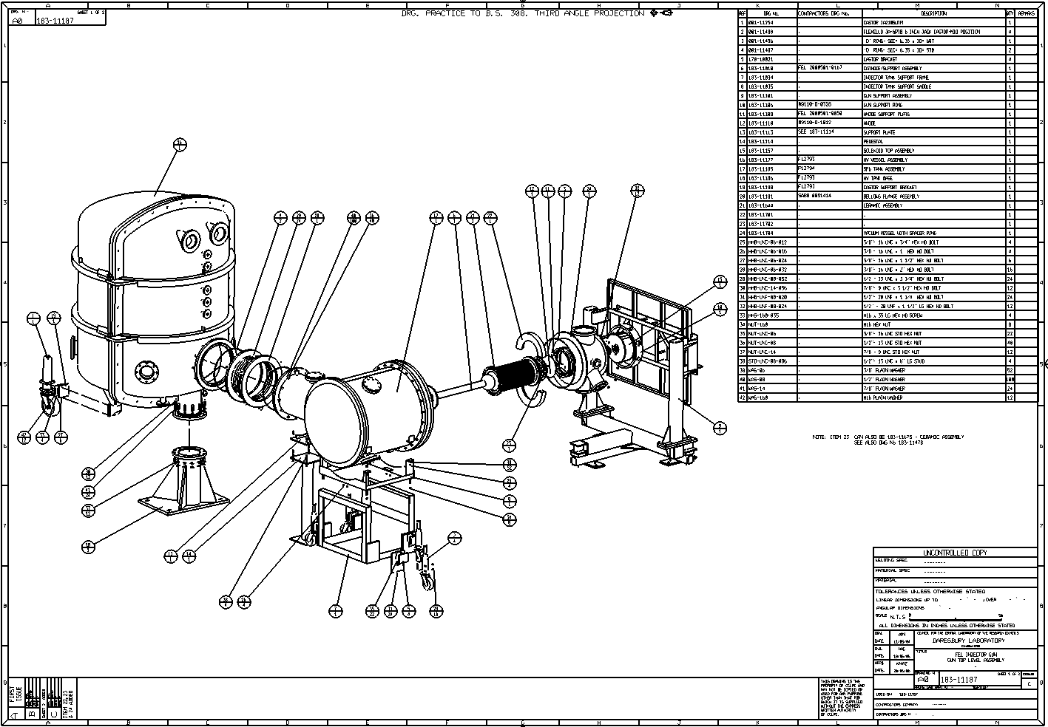
PERLE Collaboration Meeting 11-12/01/2022
Super ACO
Before final installation:
Assembly,
test and qualification
of the DC Gun
in the Igloo
(radioprotected and
equiped area)
ThomX
(Extended scale)

Slide 12
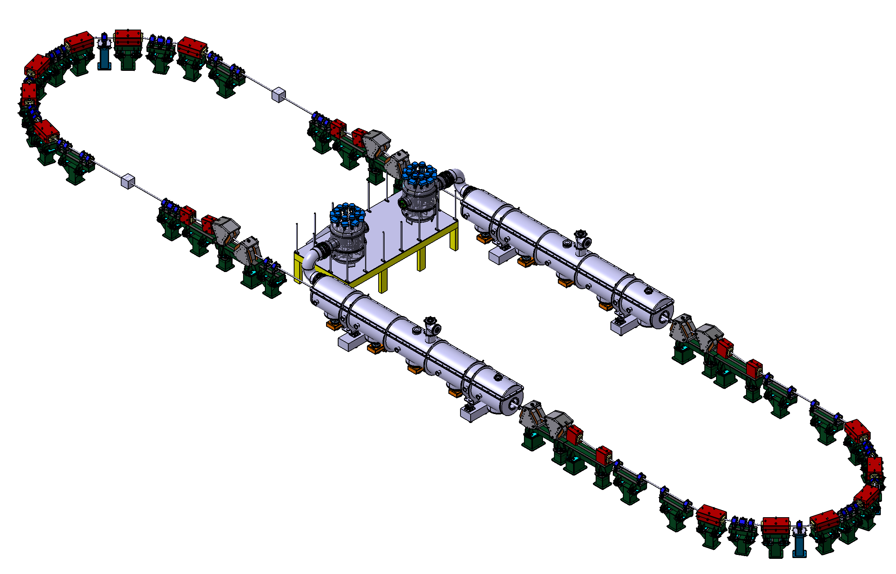
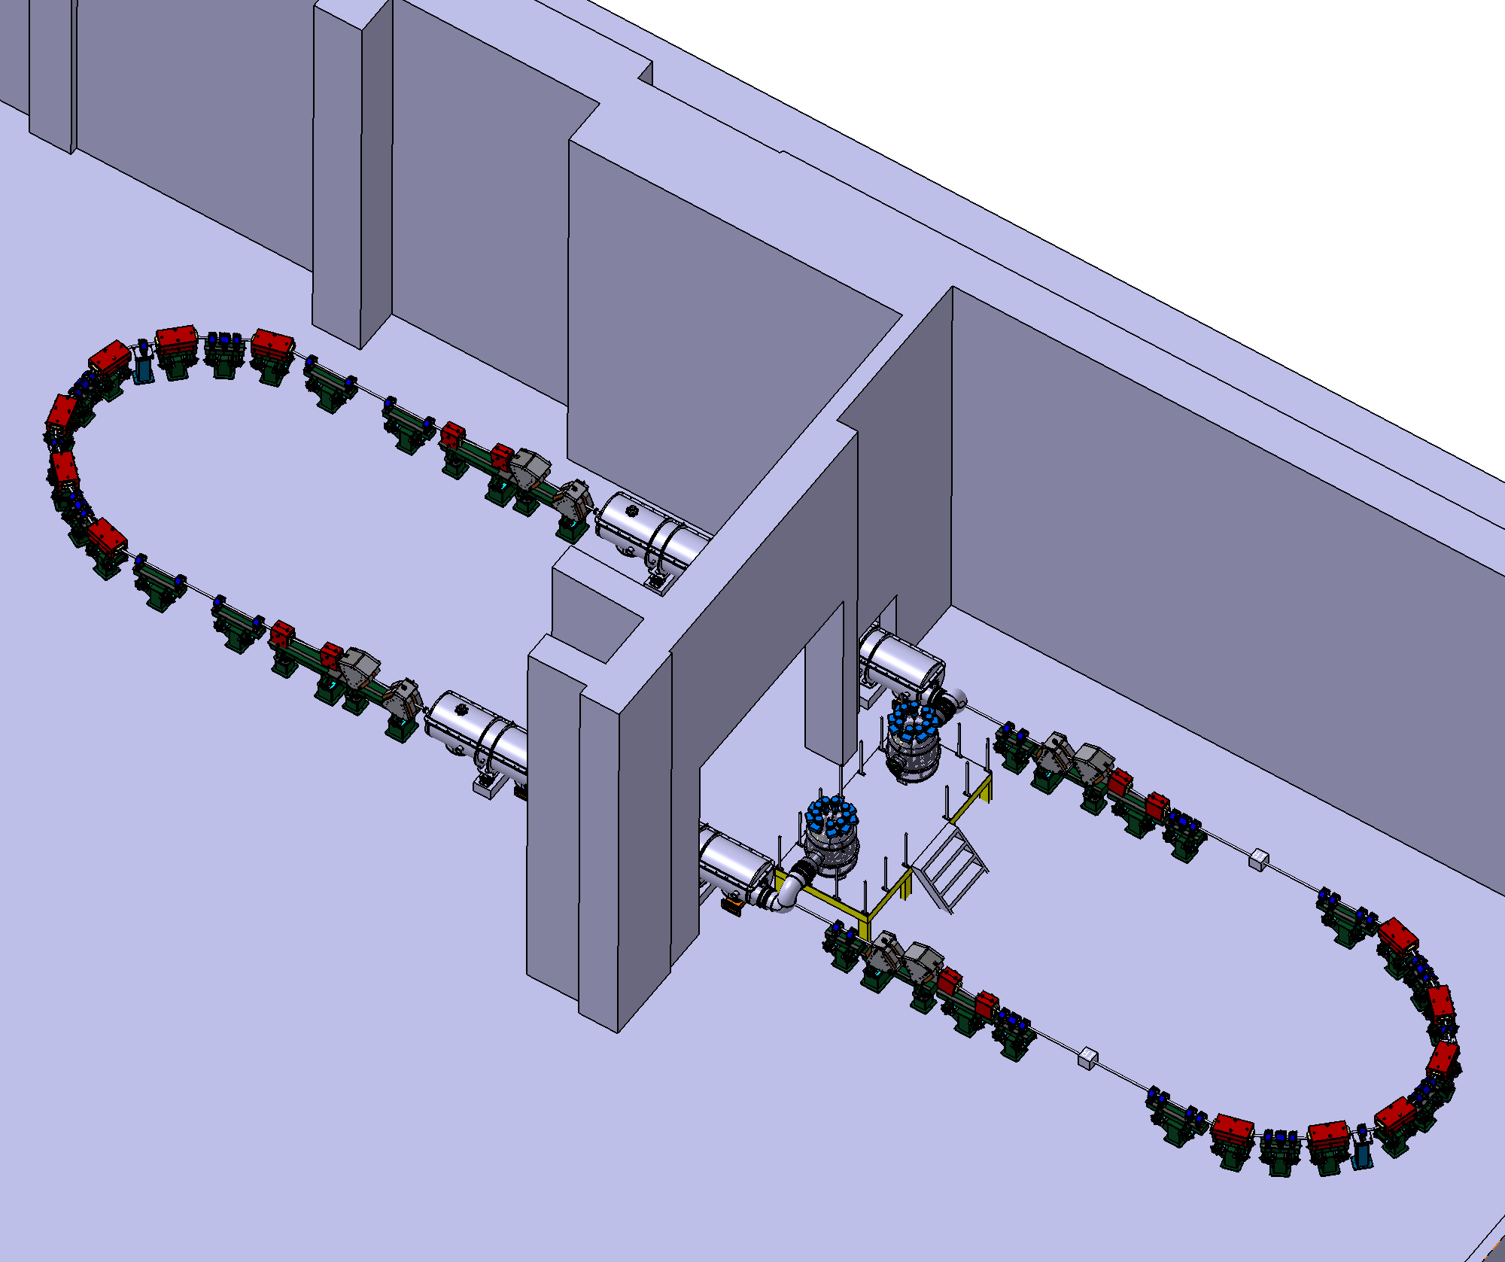
PERLE Collaboration Meeting 11-12/01/2022
7 MeV
2 : 4 : 6
1 : 3 : 5
ΔE = 82.2 MeV
5.5 m
Top view
Work in progress :
Level one footprint
of Perle
29 m
ΔE = 82.2 MeV
10 m
7 MeV
10 m
9 m
DRAFT
  « Chapeau de gendarme »
ASAP :
Realistic footprint of Perle @ Super ACO

Slide 13
PERLE Collaboration Meeting 11-12/01/2022
Thank you for your attention
!
Thank you in advance for your advice
!
Thank you for 3D models and drawings that can help us
!
11/01/2022

