Slide 1
Injector design
Ben Hounsell
PERLE collaboration meeting
11/01/22

Slide 2
Overview
Specification & injector overview
Electron gun
Cathode to booster exit
Longitudinal phase space & higher harmonic cavities
Merger
Conclusions & future work

Slide 3
Specification of the PERLE injector
ERLs such as PERLE are source limited. This means that the injector sets the lower bound for the emittance. The emittance produced at the cathode must then be preserved through the machine.
Due to the significant space charge forces involved the injector there is the potential for significant emittance growth.
The PERLE injector must be capable of delivering high average current beams with a bunch repetition rate of 40.1 MHz.
 | PERLE Parameters
Total injection energy | 7 MeV
Bunch charge | 500 pC
Bunch repetition rate | 40.1 MHz
Average current | 20 mA
RMS bunch length | 3 mm
Emittance | < 6 π∙mm∙mrad
Beta function | 8.6 m
Alpha function | -0.66

Slide 4
The PERLE injector
The PERLE injector consists of:
350 kV DC photoemission electron gun.
A bunching and focusing section consisting of a solenoid, a normal conducting buncher cavity and then another solenoid.
A superconducting booster linac with four 801.58 MHz cavities with individual control of the amplitudes and phases.
Merger to transport the beam into the main ERL.

Slide 5
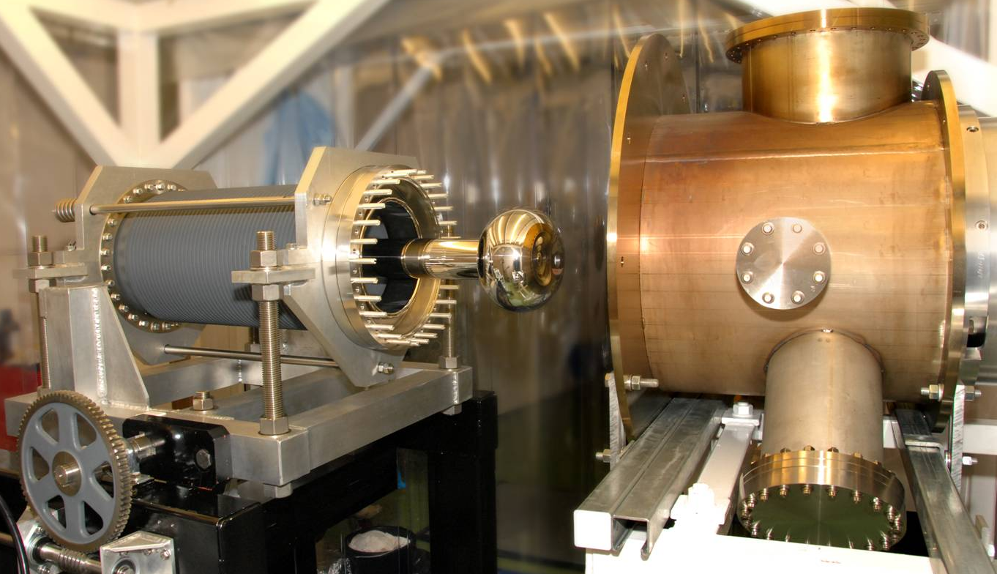
Optimisation of the electron gun electrodes
PERLE will use an upgraded ALICE electron gun.
The electrode will be replaced with a new design as PERLE has a much higher operational bunch charge of 500 pC compared to ALICE’s 80 pC
An optimisation was done simulating the gun electrostatics with POISSON and the beam dynamics with ASTRA.
Minimising beam size and slice emittance.
The many objective algorithms NSGAIII was used.

Slide 6
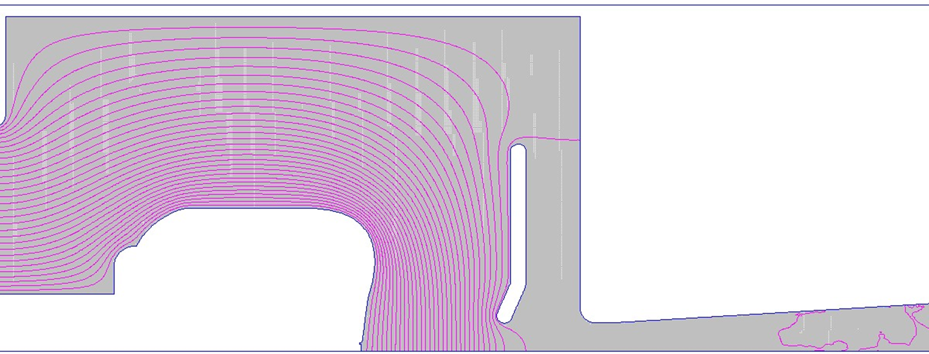
Optimisation and selected electron gun
At the time this gun optimisation was done there was an interest in potentially leaving open the option of an upgrade to polarised operation. As a result the electrode optimisation was done to find a compromise electrode between 350 kV and 220 kV operation.
The chosen electrode has a smaller focusing angle and higher cathode field than the original ALICE upgrade design.

Slide 7
Injector optimisation to the booster exit
The new gun design was then used as part of an optimisation of the injector up to the booster exit.
An existing JLAB/AES booster will be reused.
The optimisation was done using the many objective optimisation algorithm NSGAIII.
The optimisation had 5 objectives to minimise at the booster exit:
Transverse emittance
Longitudinal emittance
RMS energy spread
X halo parameter
Z halo parameter
An injector solution was selected from the Pareto front produced by the optimisation.

Slide 8
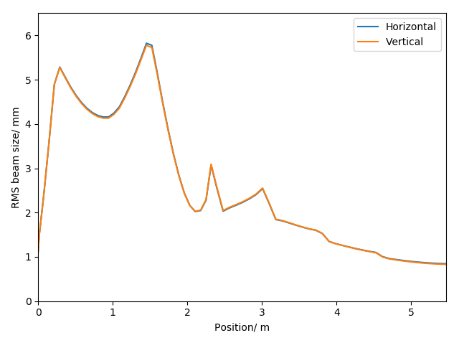
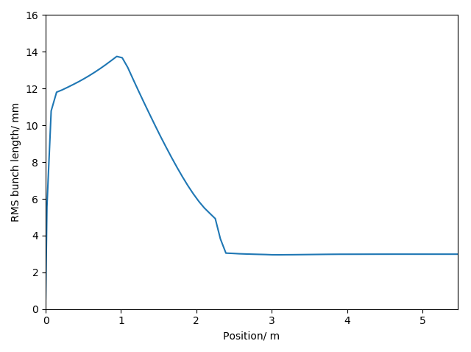
Beam sizes

Slide 9
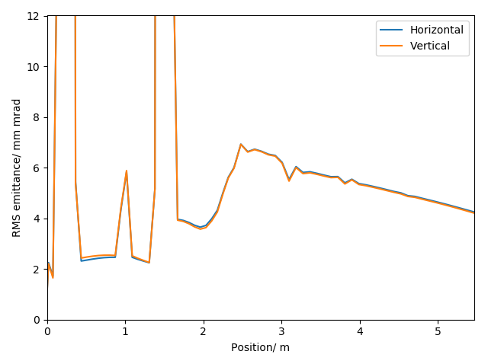
Transverse emittance and phase space
x momentum/ beta gamma
x position/ m

Slide 10
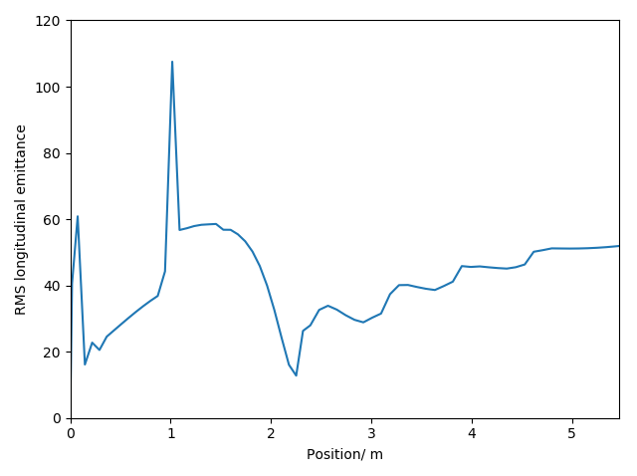
Longitudinal emittance and phase space
z momentum/ beta gamma
z position/ m

Slide 11
Longitudinal phase space
The longitudinal phase space at the exit of the booster forms an “M” shape.
This originates from two main sources:
The ballistic bunching due to buncher cavity leads to the formation of the central dip (and the tail of the bunch).
Second order RF distortion from the booster linac.
There are three options here:
Decide that the amount of non-linearity is acceptable.
Linearize in the injector using higher harmonic RF.
Linearize using T566 and U5666 in the arcs (or the merger but the space charge makes that less appealing).
z momentum/ beta gamma
Position/ mm

Slide 12
Linearization in the injector
Baseline
The addition of higher harmonic cavities to the injector can help mitigate the longitudinal phase space non-linearity.
Using higher harmonic cavities will add cost and complexity to the injector.
There are two locations they can be placed.
A cavity next to the buncher set to the opposite zero crossing phase to correct the central dip and tail.
An SRF cavity in the booster to fix the second order distortion.
These injector designs can meet the transverse emittance specification.
Normal conducting 3rd harmonic
With superconducting 3rd harmonic
Normal conducting & superconducting 3rd harmonic

Slide 13
Longitudinal phase spaces with linearization
Baseline
NC 3rd harmonic
SRF 3rd harmonic
NC & SRF 3rd harmonic
z momentum/ beta gamma
Position/ mm
The addition of the 3rd harmonic cavities does improve the linearity of the longitudinal phase space.
The NC 3rd harmonic has a significant effect on the longitudinal bunch profile.

Slide 14
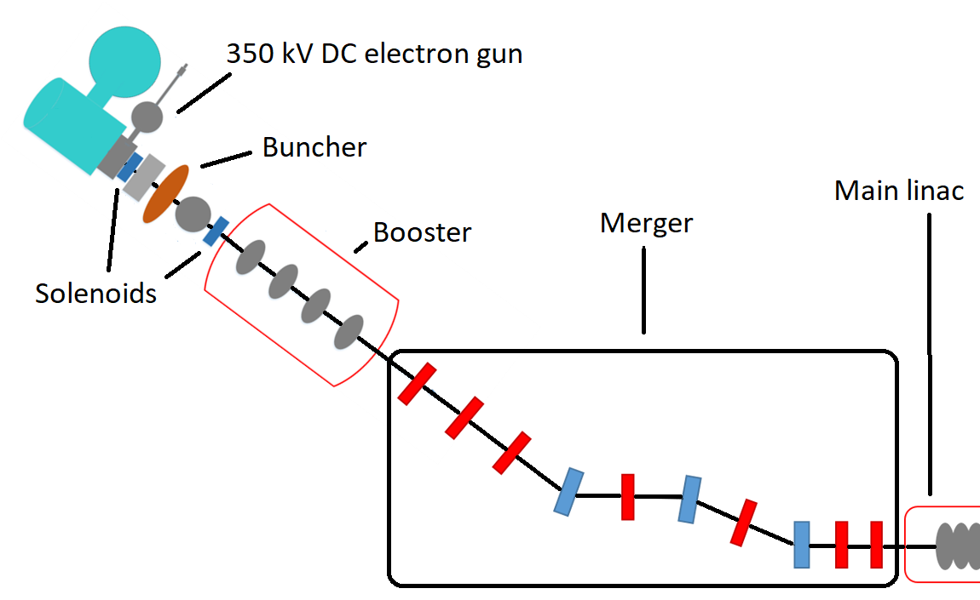
The PERLE merger
The merger is the beamline which transports the beam into the main ERL loop.
The merger presents significant opportunity for emittance growth:
Longitudinal space charge force induced shift in the dispersion
Potentially asymmetric emittance compensation.
There are a wide range of possible designs.
Generally shorter and smaller bending angles is better

Slide 15
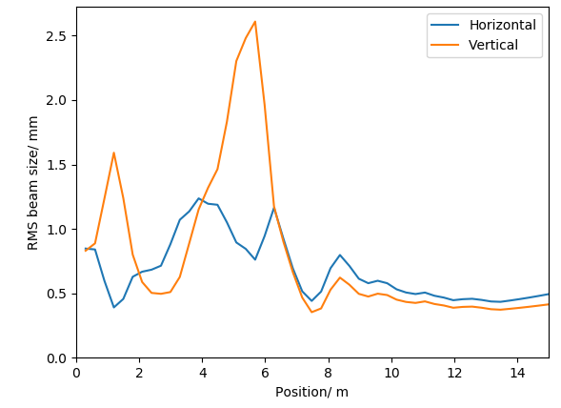
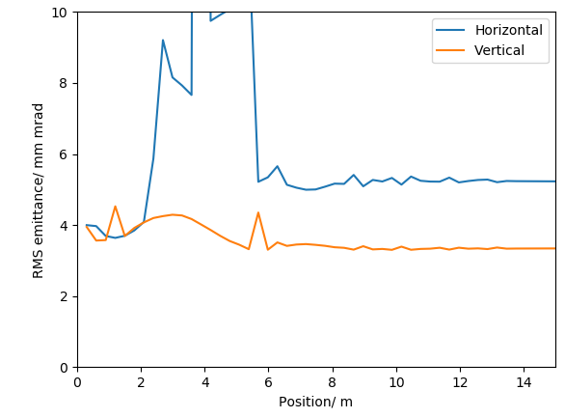
Transverse beam size and emittance

Slide 16
Transverse phase spaces
x momentum/ beta gamma
y momentum/ beta gamma
x position/ m
y position/ m

Slide 17
Achieved specification
 | Achieved values | Specification
Horizontal emittance | 5.23 mm mrad | < 6 mm mrad
Vertical emittance | 3.34 mm mrad | < 6 mm mrad
Bunch length | 3.22 | 3 mm
Kinetic energy | 86.1 MeV | 88.6 MeV
Horizontal beta function | 7.89 (mismatch 8.3 %) | 8.6
Horizontal alpha function | -0.74 (mismatch 11.6 %) | -0.66
Vertical beta function | 8.76 (mismatch 1.8 %) | 8.6
Vertical alpha function | -0.67 (mismatch 1.5 %) | -0.66

Slide 18
Final thoughts
The specification of the PERLE injector is achievable.
Simulations and tools for optimisation exist.
There is still work that needs to be done:
350 kV specific gun may be of interest.
Fine tuning
Longitudinal match between injector and main ERL loop.
A few effects not accounted for: CSR, phase slip in the main linac
Mechanical design
Placement of diagnostics
If the process of doing this there are opportunities to reduce bending angles or the distance between components they should probably be taken.

