Slide 1
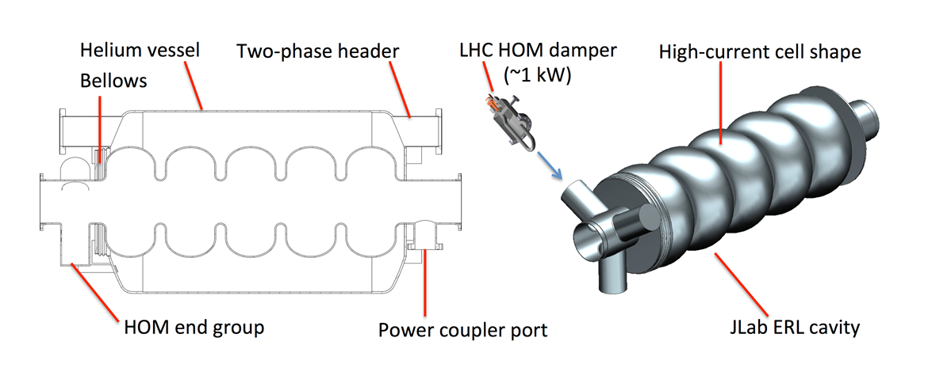
HOM, Cavity design and Prototyping
R. Rimmer
JLab
New
PERLE collaboration meeting 1/11/22

Slide 2
Outline
Jlab 802.5 MHz prototype
New variants:
Frank’s end group modifications
FCC 5-cell (Shahnam’s Thesis)
PERLE HOM study (Carmelo’s study)
EIC cooler ERL
ERL roadmap/path forward

Slide 3
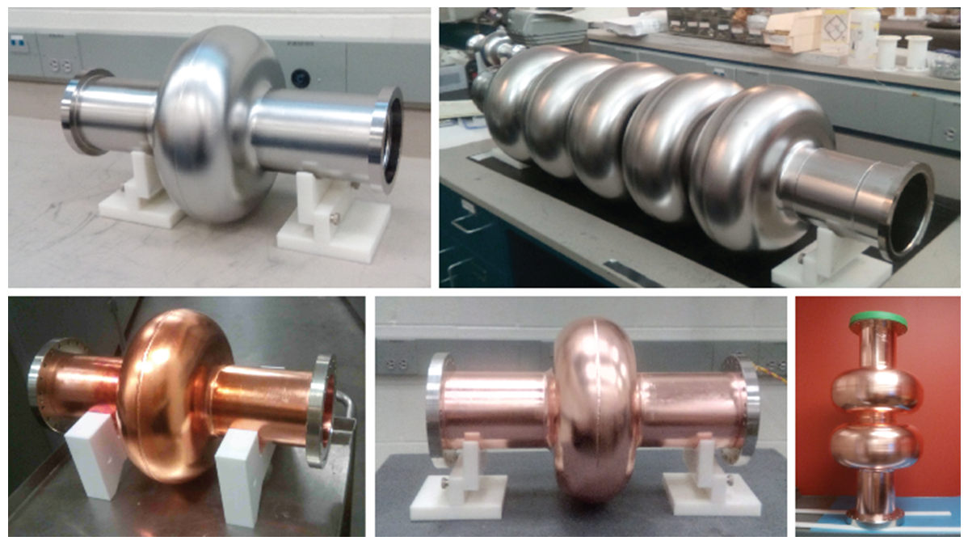
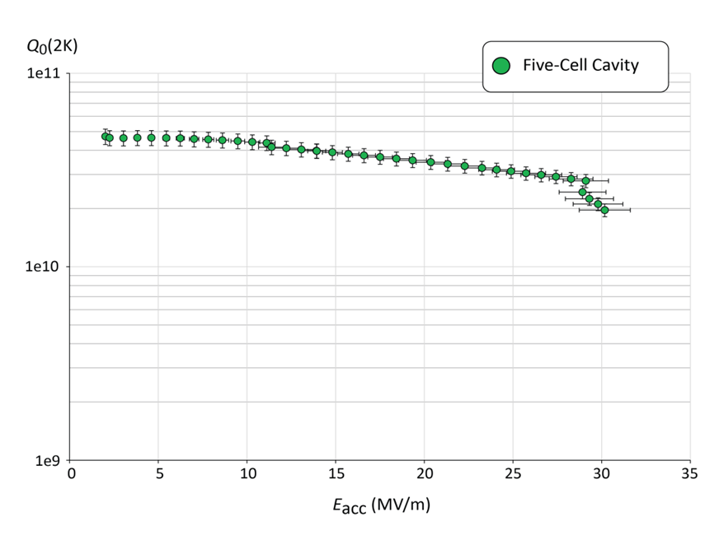
Jlab 802.5 MHz prototype (F. Marhauser et. al.)
Shared DNA with Jlab FEL, JLEIC cooler and CEBAF “C75” cavities
1-cell and 5-cell Nb prototypes
2x Cu 1-cells for thin film coating
2-cell Cu “kit” for further HOM development
End group design was to come from CERN
Most parts available for PERLE if useful
Dies and fixtures available at Jlab.
R. Rimmer et al. The JLab Ampere-Class Cryomodule. Proceedings of the 12th Workshop on RF Superconductivity (SRF’05), 2005.
[193] R.A. Rimmer, W. Clemens, D. Forehand, J. Henry, P. Kneisel, K. Macha, F. Marhauser, L. Turlington, and H. Wang. Recent Progress on High-Current SRF Cavities at JLab. Pro- ceedings of the International Particle Accelerator Conference (IPAC’10), 2010.

Slide 4
HOM-damping options
F. Marhauser
Wide survey of existing and new options
Also in context of JLEIC ERL and storage ring
  Waveguides selected for cooler ERL
  On-cell damper development started for ESR
F. Marhauser. Next generation HOM damping. Superconducting Science and Technology Topical
Review 30 (2017) 063002, 30(6):38, 2017

Slide 5
JLEIC 1-cell cavity with various HOM damper options
F. Marhauser
F. Marhauser. Next generation HOM damping. Superconducting Science and Technology Topical
Review 30 (2017) 063002, 30(6):38, 2017

Slide 6
HOM end group S-parameyer study
F. Marhauser
F. Marhauser. Next generation HOM damping. Superconducting Science and Technology Topical
Review 30 (2017) 063002, 30(6):38, 2017

Slide 7
HOM study extended to 5-cells
F. Marhauser
Frank Marhauser 2017 Supercond. Sci. Technol. 30 063002, 30(6):38, 2017

Slide 8
New Jlab variants
F. Marhauser
Modified end cell profiles
Reduction of TM011 and TM012 modes
Some increases in dipole modes

Slide 9
Example: 5-cell 650 MHz cavity in CEPC, 16.6 mA, 384 cavities
F. Marhauser
But is it needed? Depends on thresholds, for CEPC probably no, for FCC yes?

Slide 10
New variant: Shahnam’s thesis
Accelerating cavity and higher order mode coupler design for the Future Circular Collider
Dissertation zur Erlangung des akademischen Grades Doktor-Ingenieur (Dr.-Ing.)
der Fakulta ̈t fu ̈r Informatik und Elektrotechnik der Universita ̈t Rostock
vorgelegt von
Shahnam Gorgi Zadeh, geboren am 11.09.1986 in Shiraz aus Rostock
Eingereicht: Rostock, 05. November 2020 Verteidigt:
Modified cell profile to avoid flat end wall, different end cells
Multi-parameter optimization
Applied to 400 MHz 1 and 4 cells and 800 MHz 5-cell cavities

Slide 11
FCC 5-cell
Accelerating cavity and higher order mode coupler design for the Future Circular Collider, Shahnam Gorgi Zadeh

Slide 12
FCC HOM damping options
Multi-parameter optimization
Include DQW type
Include ridged WG
Beam pipe diameter is larger than JLab
Accelerating cavity and higher order mode coupler design for the Future Circular Collider, Shahnam Gorgi Zadeh

Slide 13
FCC 5-cell with various HOM options
Accelerating cavity and higher order mode coupler design for the Future Circular Collider, Shahnam Gorgi Zadeh

Slide 14
PERLE HOM study: Carmelo
HOM-damping studies of a 5-Cell Elliptical Superconducting Cavity for PERLE , Carmelo Barbagallo , PERLE SRF Meeting, 03 December 2021

Slide 15
PERLE HOM study: Carmelo
Experimental activities:
Cavity end-cell modifications? (improve the damping of TM011 and TM012 mode)
  Do we plan to do perform the modifications at JLab or at CERN, where and when?
  Measurements on the cavity
Tube modification to install HOM couplers
Realization of the HOM couplers and installation on the cavity
Integration of the PERLE cavity in the SPL cryomodule
Thermal treatments (Nitrogen doping) on the cavity?
Integration of the SPL Power Coupler
Test of the full dressed cavity on the vertical cryostat
Future perspectives:
Optimization of the cavity end-cells to improve the coupling of the TM012 π-mode to the beam tubes
Optimization of HOM couplers, and study of other HOM couplers (JLAB, TESLA)
Thermal studies for HOM couplers (HOM power and dissipation)
Planning of the experimental activities (CERN and JLab)
HOM-damping studies of a 5-Cell Elliptical Superconducting Cavity for PERLE , Carmelo Barbagallo , PERLE SRF Meeting, 03 December 2021

Slide 16
PERLE HOM study: Carmelo
Other suitable HOM-damping schemes :
Rectangular waveguide dampers (A)
JLab-Type coaxial couplers (B)
TESLA-Type coaxial couplers (C)
Add absorbers in cavity-interconnecting beam tubes (D)
Coupling through Fundamental Power Coupler (E)
HOM-damping studies of a 5-Cell Elliptical Superconducting Cavity for PERLE , Carmelo Barbagallo , PERLE SRF Meeting, 03 December 2021

Slide 17
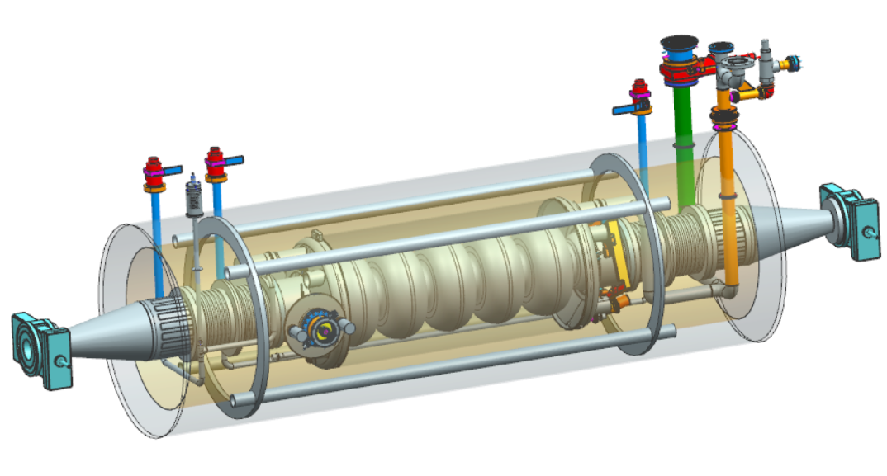
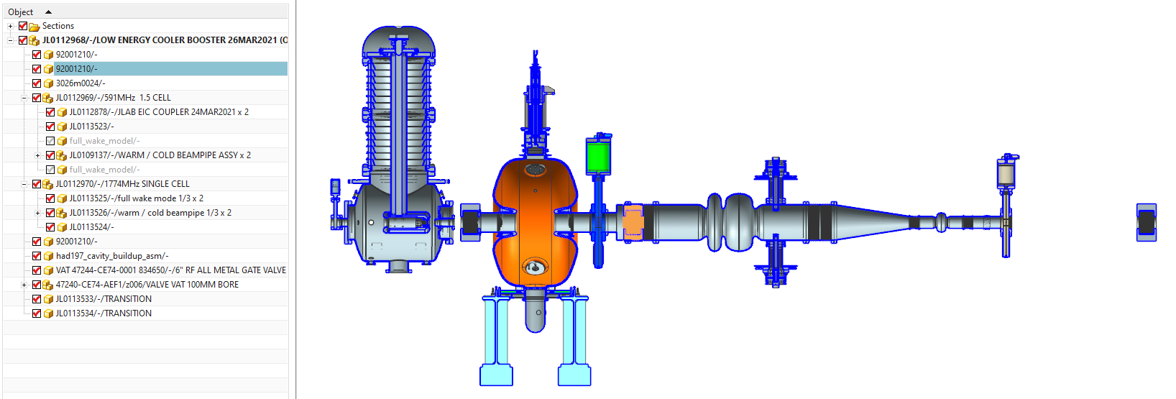
EIC high energy cooler
Work in progress
Single Pass 150 MeV ERL, 98.5 MHz bunch frequency
8 x 591 MHz, 5-cell elliptical + 1.77 GHz third harmonic
Maximum 180 MV installed voltage, Eacc 15.8 MV/m
8 x 591 MHz, 65 kW CW, SSA RF Power Amplifiers
1 nC per bunch, ~100 mA single pass current
Injector: DC photocathode gun, 197 MHz buncher, 591 MHz acceleration, 1.77 GHz linearizer.
Cooler- 591 MHz ERL cavity
Injector
“The accelerator design progress for EIC strong hadron cooling”, E. Wang et. Al., TUPAB036 Proc. IPAC21, Brazil.

Slide 18
ERL roadmap/path forward
Develop firm requirements for PERLE
  BBU thresholds
  Bunch parameters
  Fill pattern
Complete HOM study
  Carmelo to visit Jlab
  Determine if new end cells needed
Use Cu models to verify design
Finalize FPC interface
Modify Jlab prototype cavity
Fabricate prototype HOM couplers
Vertical test at Jlab or CERN
Integrate into He tank and SPL module
Build or procure 4 production cavities
New

Slide 19
Thank You

Slide 20
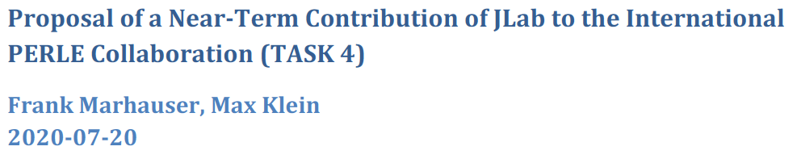
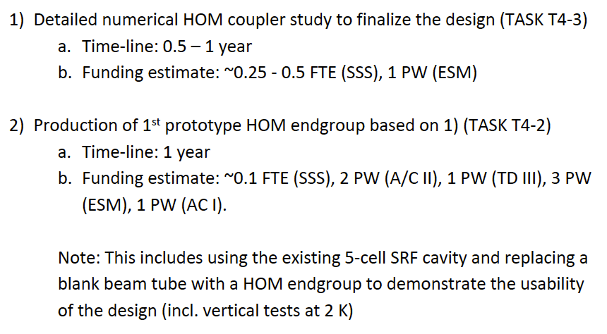
Recent progress and ideas: notes by Walid Kaabi and Max Klein, in contact with many of you, presented by MK, PERLE Collaboration Board Meeting, 24.7.2020
This was worked out in Consultation with Achille, Walid and Bob
It has been made known to Andrey, Andrew, Oliver on Wednesday .
Work would involve Collaboration of Jlab with IJCLab and CERN

Slide 21
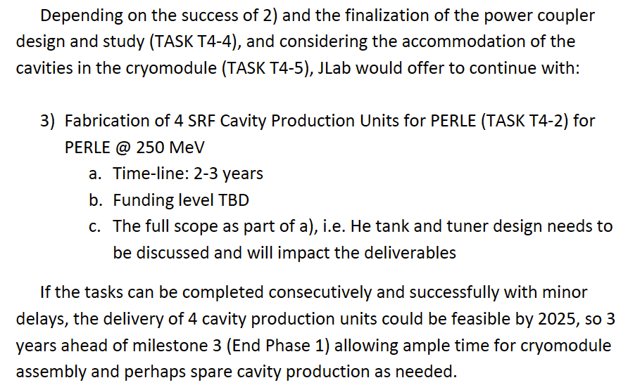
Recent progress and ideas: notes by Walid Kaabi and Max Klein, in contact with many of you, presented by MK, PERLE Collaboration Board Meeting, 24.7.2020
This was worked out in Consultation with Achille, Walid and Bob
It has been made known to Andrey, Andrew, Oliver on Wednesday .
Work would involve Collaboration of Jlab with IJCLab and CERN

Slide 22
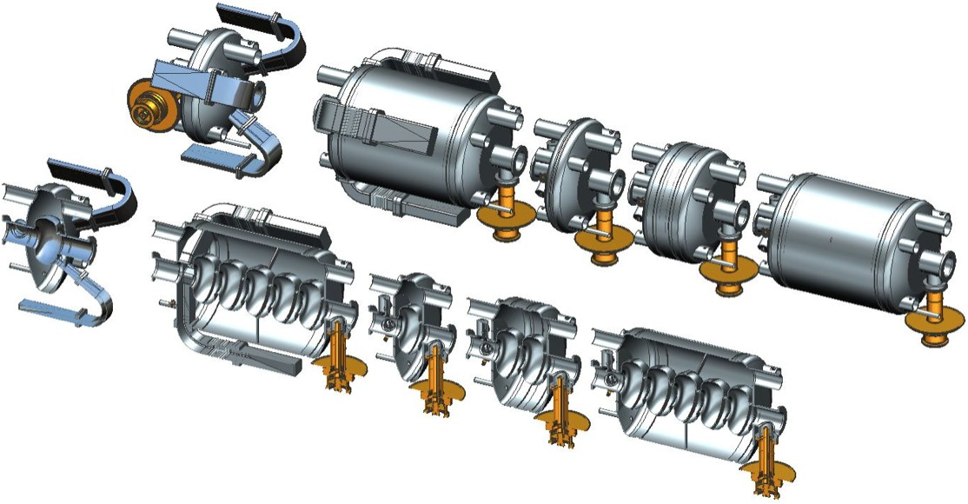
Jlab modular cryostat
Dimensions loosely based on SNS cryomodule

Slide 23
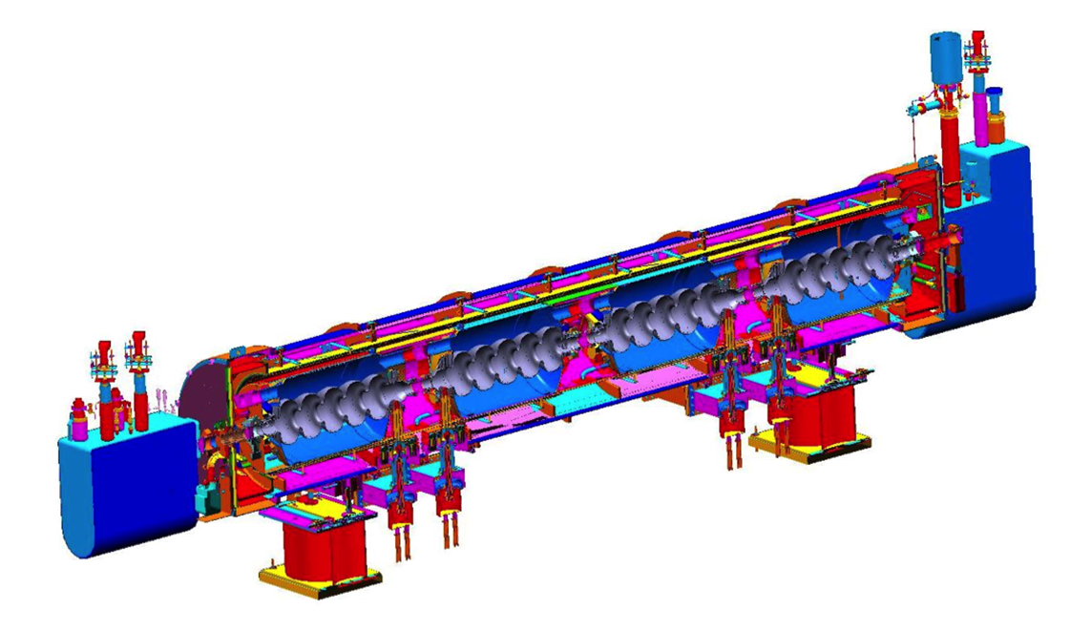
PERLE CM concept based on SNS cryostat

Slide 24
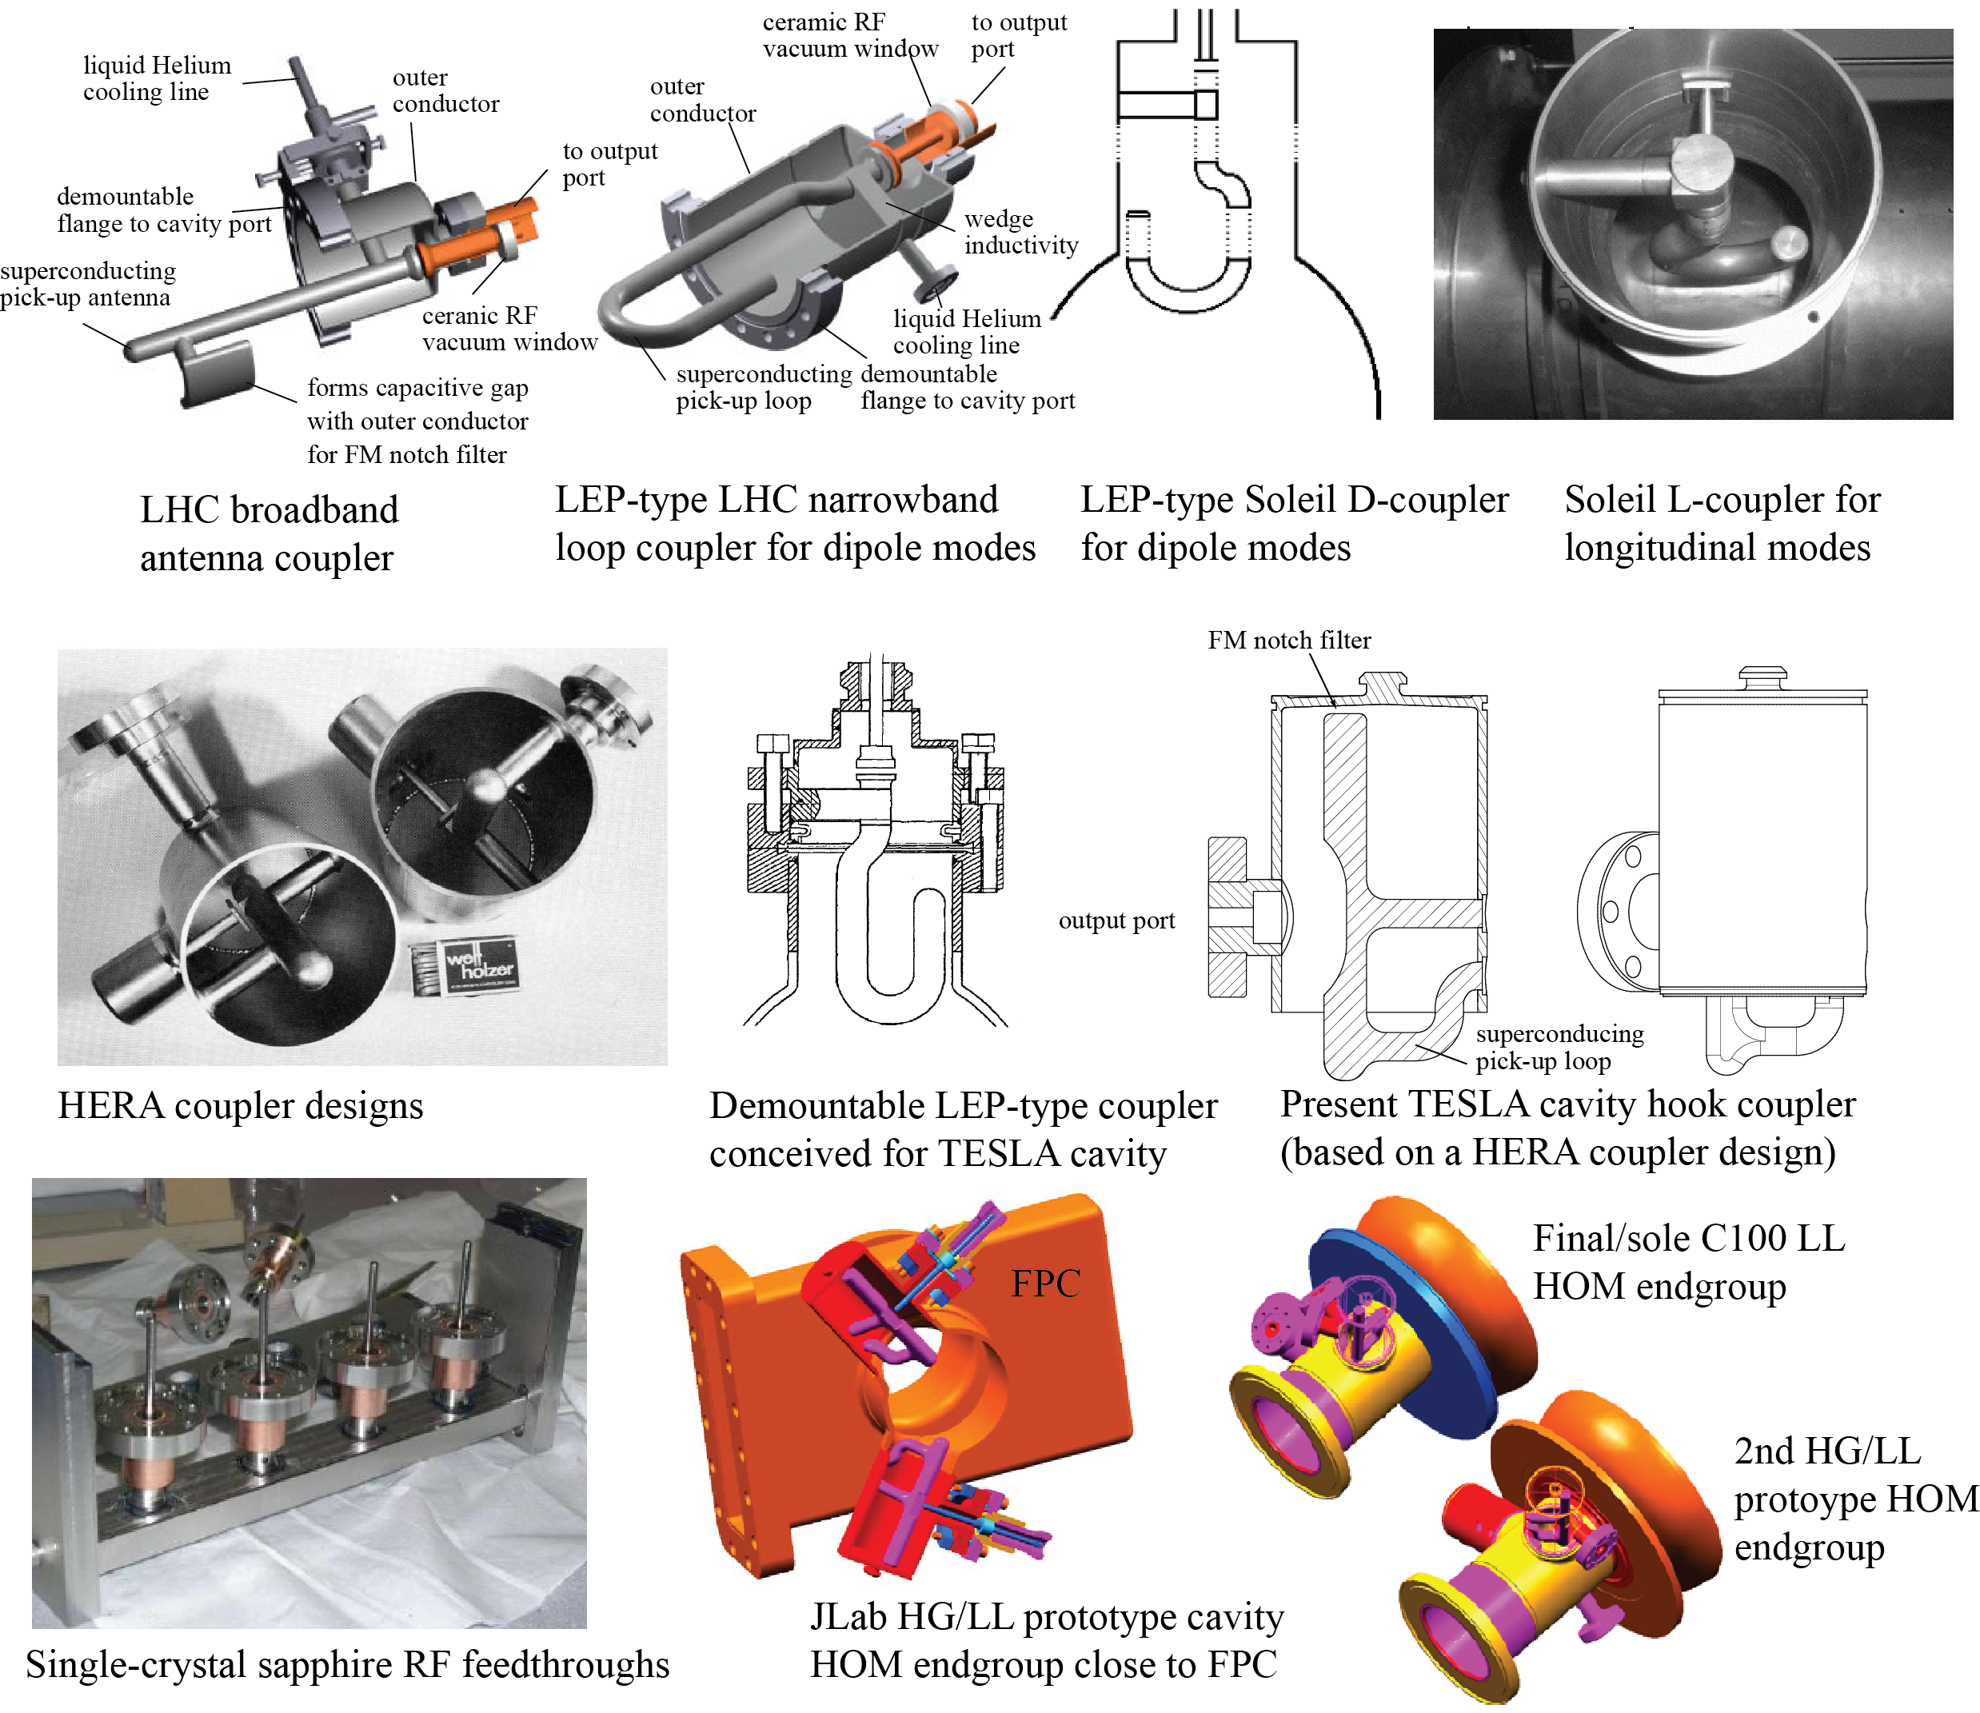
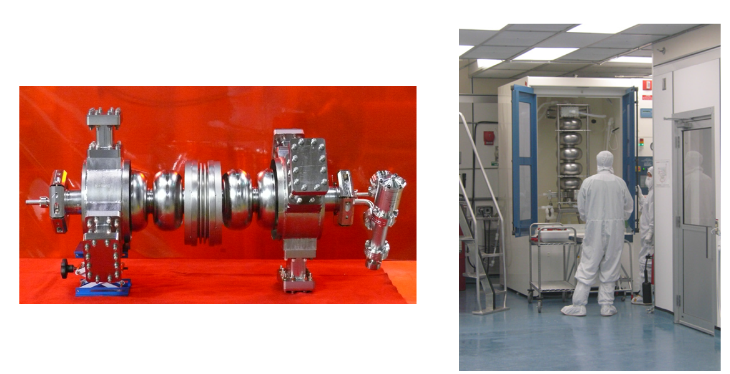
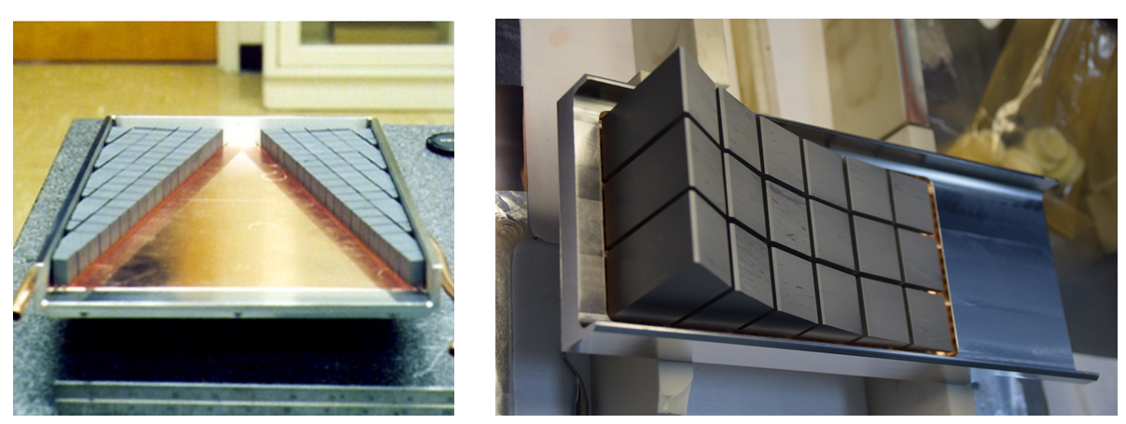
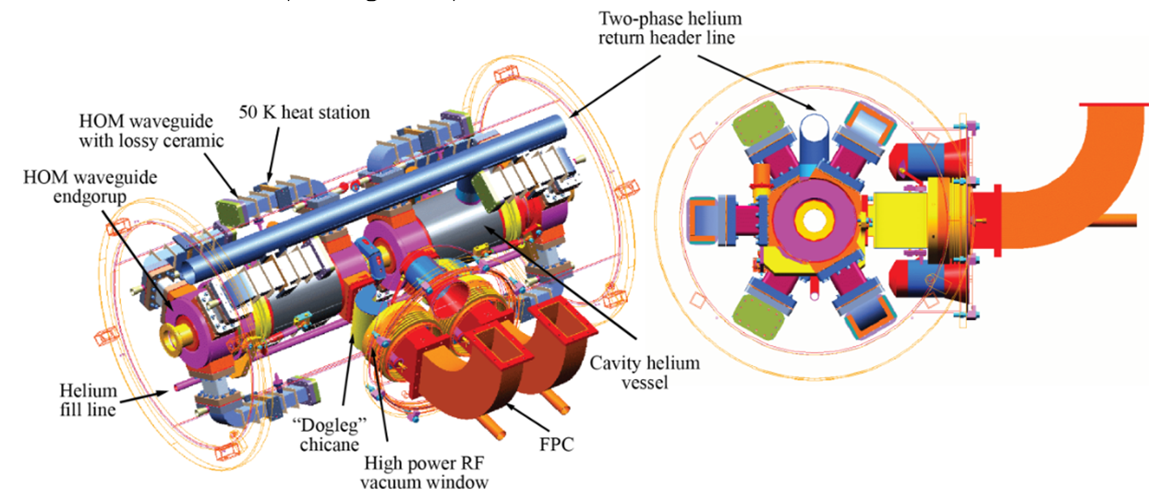
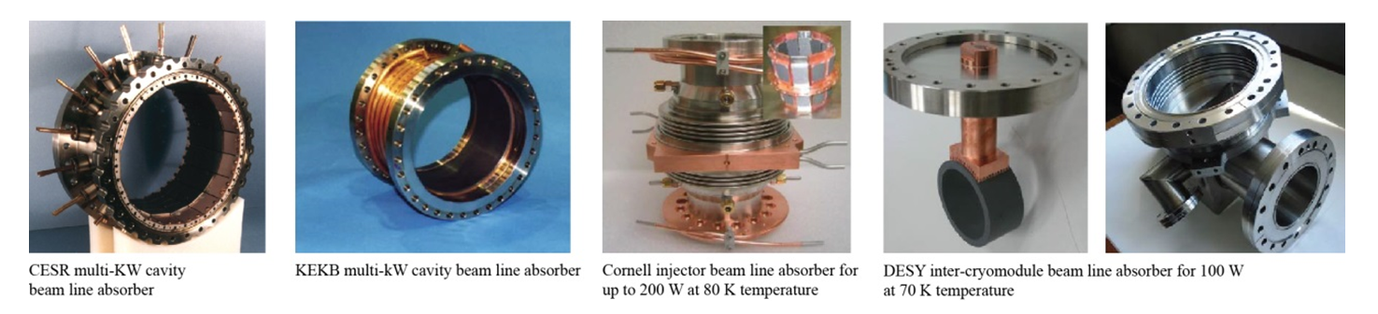
HOM damping options
HZB

