Slide 1
Preparation for commissioning of ALICE photocathode gun at IJCLab
Boris Militsyn, STFC ASTeC
PERLE collaboration meeting, 11-12 January 2022

Slide 2
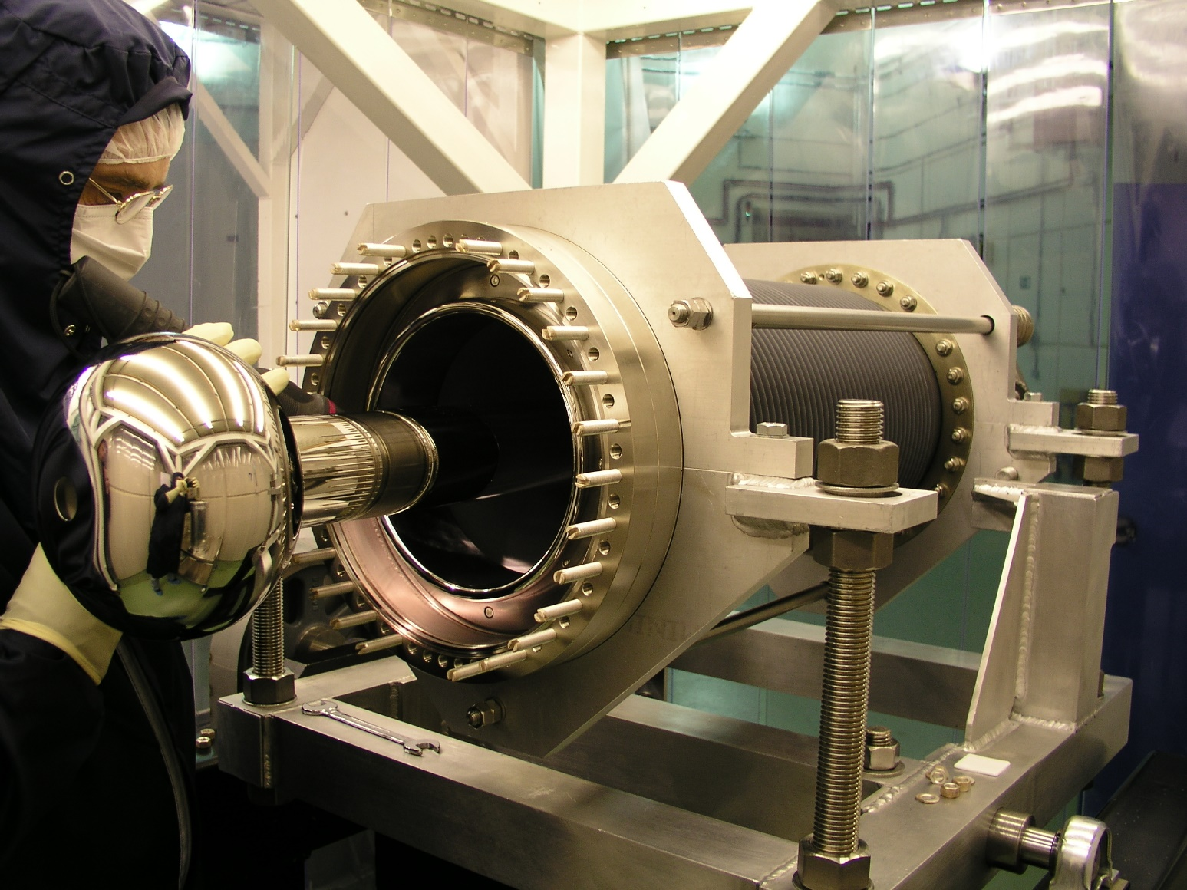
Outline
Goals of ALICE gun commissioning and gun operation modes during commissioning
ALICE photocathode gun and photocathode gun upgrade
Gun operational infrastructure
Photocathodes and photocathodes deposition
Laser system
Beam diagnostic line
Environmental requirements for gun operation
Conclusion
Image © STFC John Dawson
Notes:
PLEASE DELETE/REPLACE PHOTO CREDIT IF CHANGING THE IMAGE.

Slide 3
PERLE injector gun
PERLE electron injector is based on a DC photocathode electron gun as photocathode gun only is able to deliver required beam time structure and brightness
The basic of the injector is the ALICE gun operated with permanently installed GaAs photocathode. The gun has been transferred to IJCLab by Daresbury after decommissioning of the ALICE ERL
At the moment 3 options of the gun use are considered:
To use the gun as it is with non-interchangeable GaAs photocathode
Upgrade the gun for operation with interchangeable photocathodes that allows for operation under others with Sb-based photocathodes
Equip the gun with GaAs photocathode preparation system to deliver polarised beams

Slide 4
Gun operation modes during commissioning
Main goal – demonstration of the 500 pC bunches following with repetition rate 40 MHz. That means that at average beam current of 20 mA and a gun voltage of 350 kV beam power is 7 kW.
Main constrains:
HV PS maximum current – 8 mA, at 350 kV it will be 2.8 kW
Radiation protection of the gun commissioning area
Possible modes
500 pC bunches following with a frequency of 10 MHz – dynamic of 500 pC bunches
Short 20 mA DC pulses with a duty factor of 1/3 – delivery of 20 mA average current by the gun
Short train of 500 pC following with a repetition rate of 40 MHz (regime similar to ALICE) – dynamics of the beam with a structure required for PERLE

Slide 5
Design of the Jlab IR-FEL gun
The drawing is property of JLab

Slide 6
Design of the ALICE photocathode gun

Slide 7
The ALICE gun with high voltage power supply

Slide 8
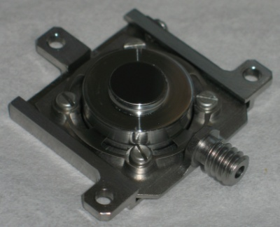
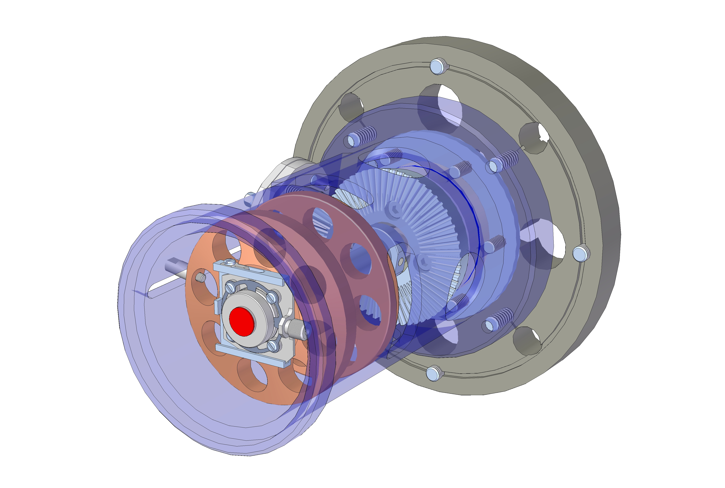
ALICE gun upgrade for operation with interchangeable photocathodes
Kovar cathode
holder
Photocathode layer
Inconel
spring
Titanium
base plate
Molybdenum
plug

Slide 9
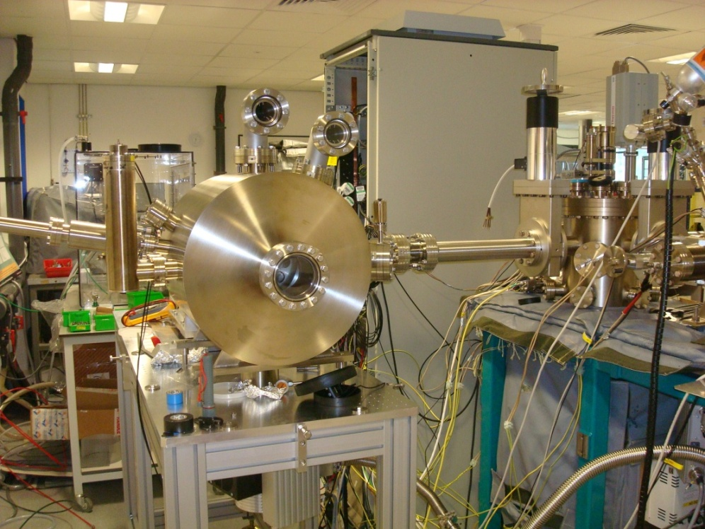
Photocathode transport in the gun upgrade prototype
Mock gun built to test the cathode transfer mechanism

Slide 10
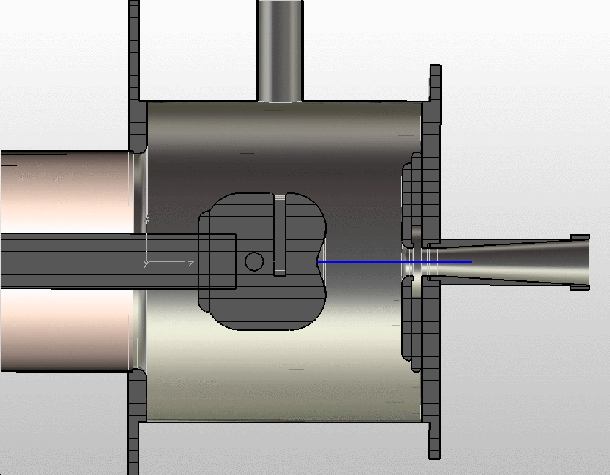
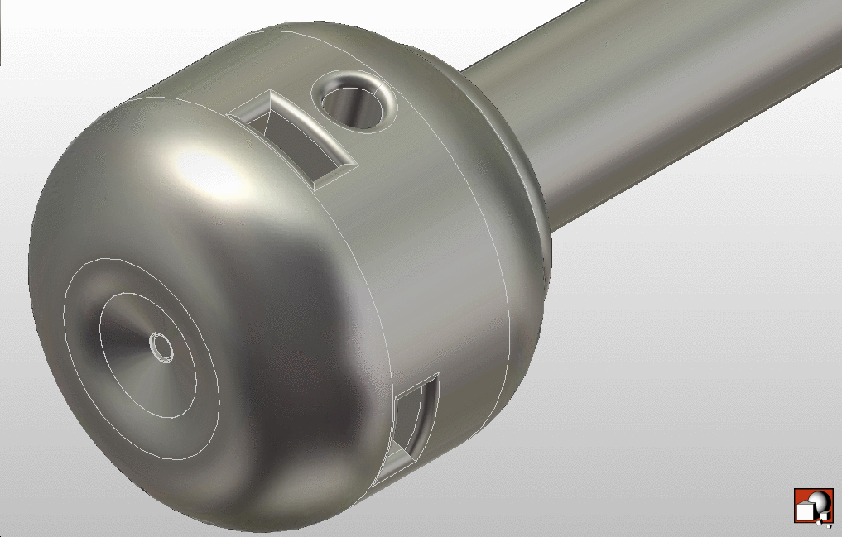
CST model of the gun electrodes
CST model of the photocathode ball
Ceramic insulator
XHV vacuum vessel
Photocathode
Cathode ball CST electrostatic simulation (350 kV)
Cathode ball
Anode plate
Electron beam
Cathode support stem

Slide 11
Operation of the gun with interchangeable photocathodes
As a baseline operation with Sb-based photocathodes is considered
Sb-based photocathodes such as Cs₂KSb are widely used in PMTs where demonstrate quantum efficiency at illumination by green light of up to 20% in transmission mode. Photocathodes are much more robust and faster than GaAs and are considered as a mainline for high average current electron injectors
Unfortunately maximum QE reached in accelerator laboratories for reflection mode photocathodes is in the range of 5-10%. Many efforts are concentrated to increase QE and hopefully this parameter will be improved. Even now these photocathodes are good enough to serve in PERLE injector
Operation with Sb photocathodes requires significant additional work on development of the infrastructure for photocathode preparation and transportation
In Europe work on photocathode deposition are in progress in INFN-Milano, HZDR in collaboration with BNL and LANL, and in RI in collaboration with Cornell University in the framework of photoinjector development for SMART project

Slide 12
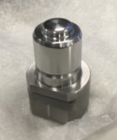
Alkali photocathode preparation system at Daresbury
Multiplug alkali photocathode preparation system at Daresbury designed for deposition of (multi)alkali photocathodes on different plugs.
Currently configured for deposition and characterisation of Cs₂Te photocathodes for CLARA (DESY/INFN type) plugs.

Slide 13
Laser system for 20 mA electron source with Sb-based photocathods
Lase wavelength, nm | 500-550
Laser pulse repetition rate, MHz | 10-40
Energy in the single pulse at photocathode Qe=1%, µJ | 0.12
Average laser power at photocathode Qe=1%, W | 4.7
Laser pulse duration, ps FWHM | 35
Laser pulse rise time, ps | 3.5
Laser pulse fall time, ps | 3.5
Spot diameter on the photocathode surface, mm | 3 mm
Laser spot shape on the photocathode surface | Flat top
Laser operation mode | CW/Train-pulsed
Train length, µs | 100/TBC
Train repetition rate, Hz | 10/TBC
* - at photocathode surface

Slide 14
Diagnostic of the gun beam
Minimum measurement parameters
Beam current
Beam energy
Beam emittance
If gun test beamline will be equipped with buncher at commissioning stage
Bunch length
Diagnostic components required
High speed current monitor to resolve charge of individual bunche
Low energy spectrometer
2-3 beam viewers
Ideally transverse deflecting cavity
Beam dump equipped with Faraday cup

Slide 15
PERLE gun test facility
ALICE gun upgraded for operation with Sb-based photocathodes prepared in a dedicated preparation facility.

Slide 16
Environmental requirements for the gun commissioning area
Electrical power – 16 kW for the gun
SF6 infrastructure
Water supply – cooling of the buncher
Area air conditioning
Radiation protection
Clean room for gun assembly

Slide 17
Thank you
Facebook: Science and Technology Facilities Council
Twitter:@STFC_matters
YouTube: Science and Technology Facilities Council

