Slide 1
CBETA: 4 Pass Energy Recovery Challenges Adam Bartnik

Slide 2
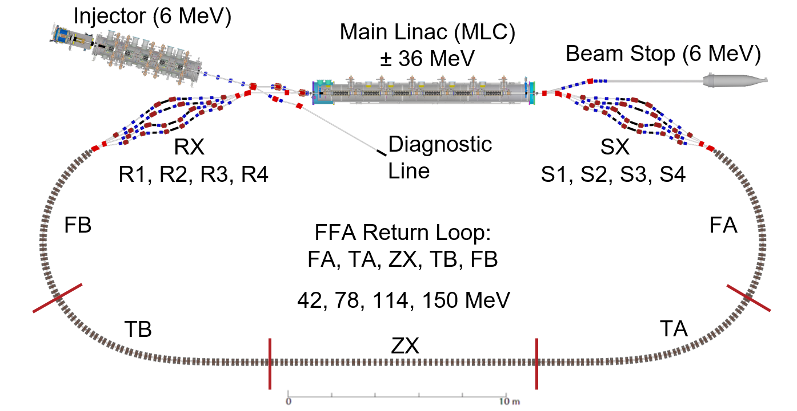
Quick CBETA Overview
Multi-pass ERL, with single return loop
7 beams of 4 energies in 1 pipe: 42, 78, 114, 150 MeV
Uses the wide energy acceptance of Fixed Field Alternating-gradient (FFA) permanent magnets
“R” Splitter
“S” Splitter
FFA Return Loop

Slide 3
4 Pass Commissioning Timeline
Primary goal:
4 pass ERL operation at the commissioning current of 1 nA (FFA radiation limit)
12 weeks of operation, ending Dec. 31st 2019
Progress was not steady, often determined by problem solving

Slide 4
Talk Organization
Problems & Solutions
What types of challenges did we face?
What types of solutions did we try?
Were we successful?
Results
example data from 4-pass operation
Expected challenges
Microphonics
BPMs for many beams
Multi-beam orbit correction
Stray fields
Dispersion/R56 correction
Laser leakage current
Machine reproducibility, degaussing
Unexpected challenges
Component failures
Magnet power supply instability
Path length adjustment
MLC slow energy drift
Beam arrival phase drift
Matching lattice optics
Microbunching instability
strikethrough = Included in extra slides

Slide 5
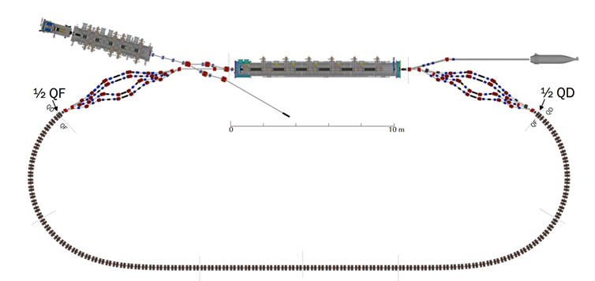
BPMs for Many Beams
One of the biggest challenges is the ability to measure up to 8 different beams at a single location, and to do it reliably when there is only ∼1 nA of current.
Two kinds of BPMs
“Time domain BPMs”: Position only
“RF BPMs”: Position and phase (arrival time)
= RF BPM

Slide 6
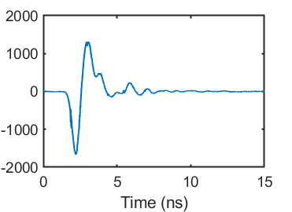
Time domain BPMs
Digitize BPM response
Single bunch response: ∼3 ns
ADC rate: 2.5 ns
Original plan: Synchronize BPMs to (every other) peak
Problems:
Time-consuming to set up
Each pass has different timing
Laser hiccups cause timing to be lost (extra slides)
Single bunch response
= ADC sampled points
Bunch spacing = 23.8 ns
8 bunches passing by BPM twice
Round-trip time = 264 ns

Slide 7
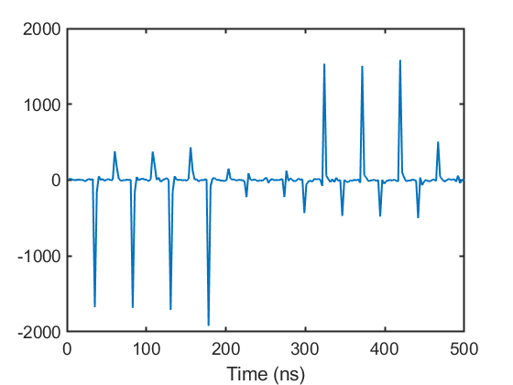
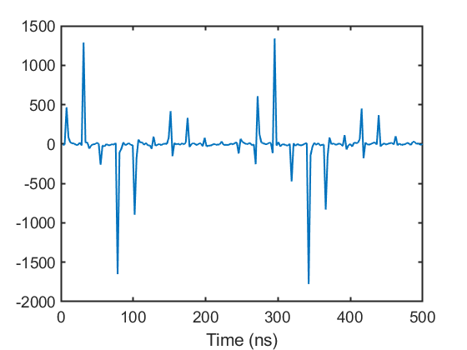
Time domain BPMs
Solution: Asynchronous timing : Sample random part of a bunch response
Synchronous BPM ADC: (1300/31)x(76/2)/4 = 398.4 MHz
Asynchronous BPM ADC: (1300/31)x(73/2)/4 = 382.6 MHz
Synchronous
Asynchronous
Bad: Lose about a factor of 5 in signal
Good: Simple, stable, details of timing no longer matter

Slide 8
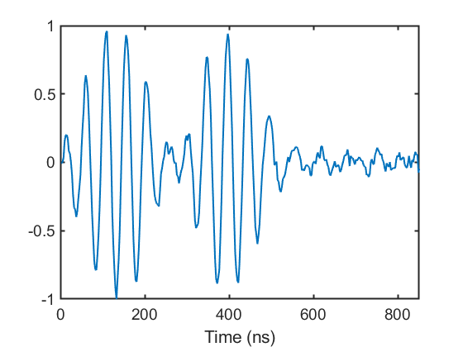
Phase (RF) BPMs
Original plan: Two frequency mixing (f₀ and 2 f₀) to measure 2 simultaneous beams
Commissioning plan: Use trains of ≤8 bunches, so that passes do not overlap in time
Good: single frequency (f₀) , same as injector BPMs (well understood)
Good: can use locations with more than 2 beams (e.g. linac entrance/exit)
Bad: cannot be used with long bunch trains, e.g. high current
1st pass
2nd pass

Slide 9
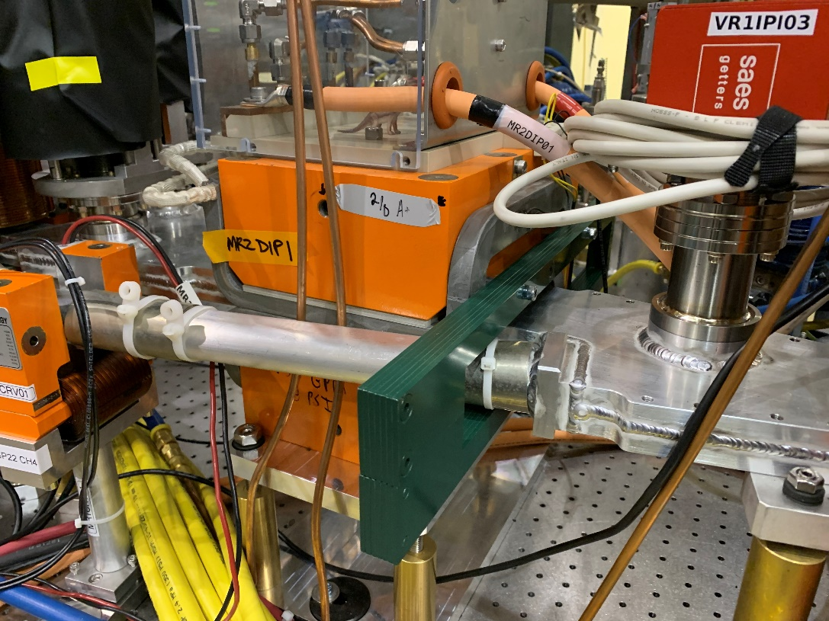
Stray fields
Splitter magnet density was expected to be a significant problem
Largest expected problems: septa magnets
Field clamps from detailed modeling, engineering
Reduced stray field effect by factor of 40
No time for engineering, nor space for clamps around other magnets…

Slide 10
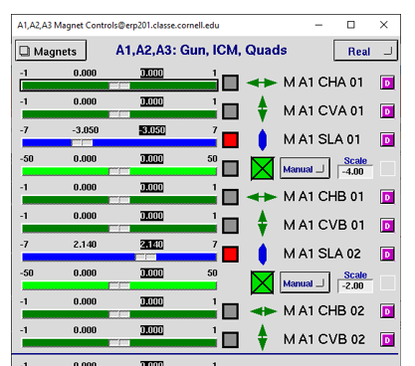
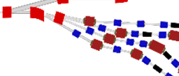
Stray fields
Splitter magnet density was expected to be a significant problem
Use linear combinations of magnets in other lines to best cancel stray fields
“Real” : actual magnet controls
“Corrected” : stray-field corrected
“VM” : online simulation (virtual machine)
e.g. this magnet is felt in adjacent (prior) beamline. Fix automatically using other nearby magnets.

Slide 11
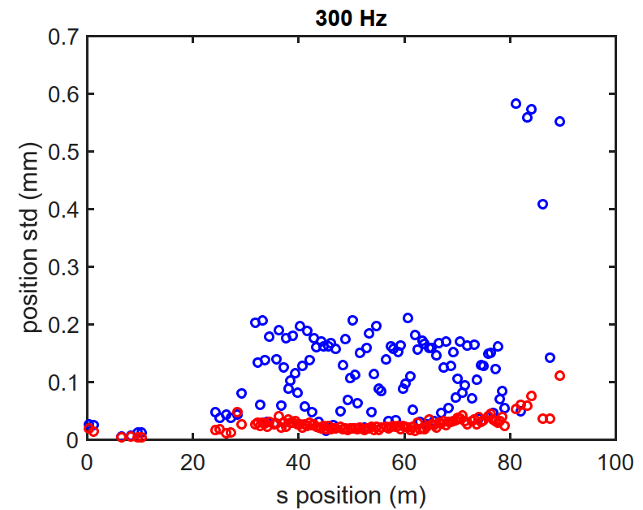
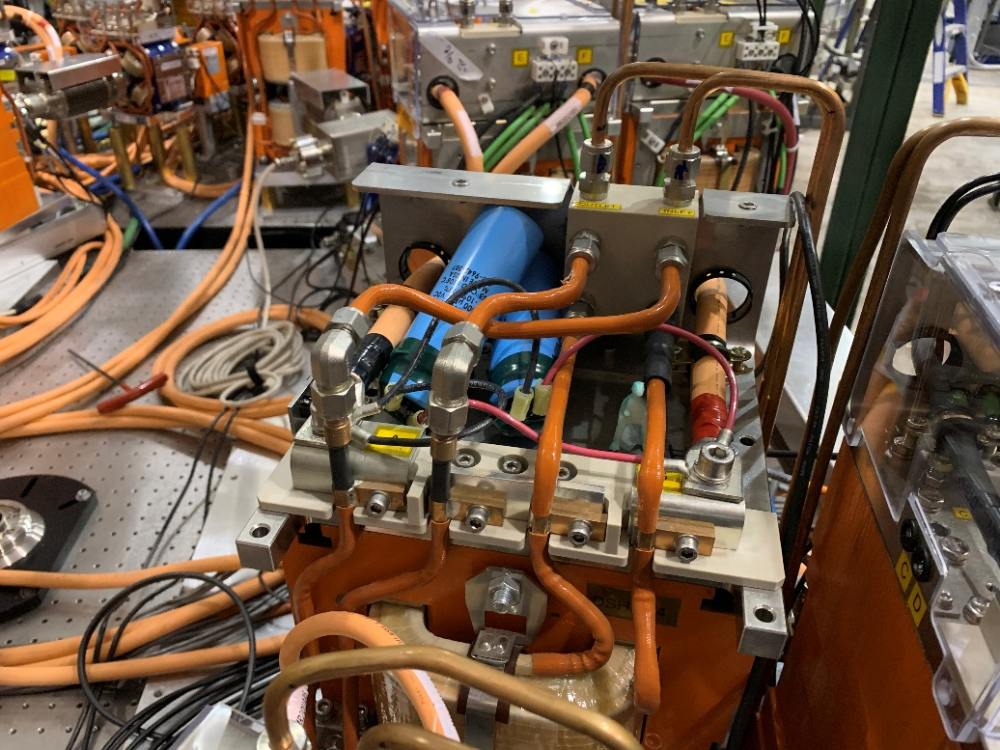
Power supply instability
15V/220A Genesys power supplies had an instability above ∼120 A
Up to ±10% oscillations!
Initially beam was moving purely from oscillating field in adjacent beamline
Two hallmarks to distinguish from other sources of jitter
18 Hz, sinusoidal
Does not follow trend of dispersion
Solved by adding one (or two) 3 mF capacitors in parallel with magnet
S1, R1 have roughly equal dispersion (η∼1 m)
FFA has η < 0.02 m

Slide 12
Power supply instability
Proved difficult to fully solve in one access
Single capacitor on each power supply wasn’t enough
Cannot directly measure residual problem field pickups / ammeter
Difficult to notice until well after bad supply (cannot pinpoint to single magnet)
Stray fields complicate diagnosis (possibly due to magnets in other beamlines)
Not a coincidence that new passes achieved after capacitor additions (green, above)

Slide 13
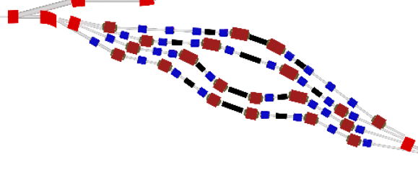
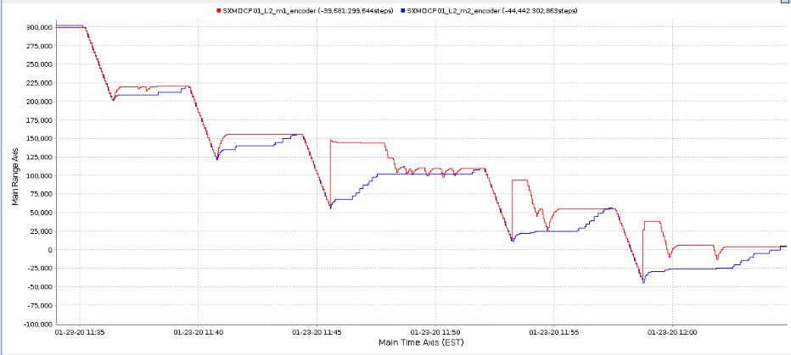
Path length adjustment
Some bellows would not reliably change their path length
Vibrations during bellows movement sometimes cause MLC to quench
Must turn off MLC to adjust path length, then wait for MLC to stabilize.
Very time-consuming!
No work-around. We tried to adjust phase as few times as possible.
Two bellows,
Must move synchronously to avoid damage
25 minute duration

Slide 14
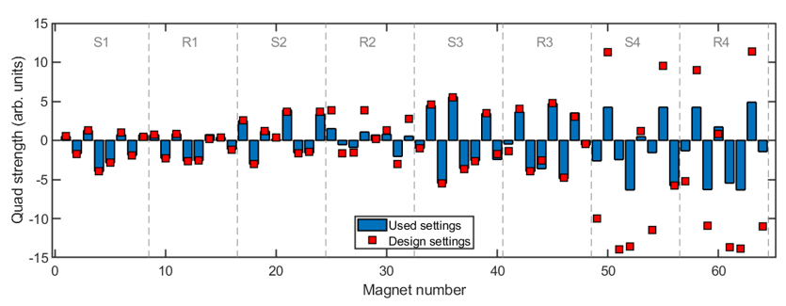
Beam Optics Matching
Primarily in R2 (2nd pass, 2nd splitter), we had optics problems.
Could not reach design quadrupole setpoints, without losing (most of the) beam
R2: could not reach design
S4,R4: No real attempt to reach design

Slide 15
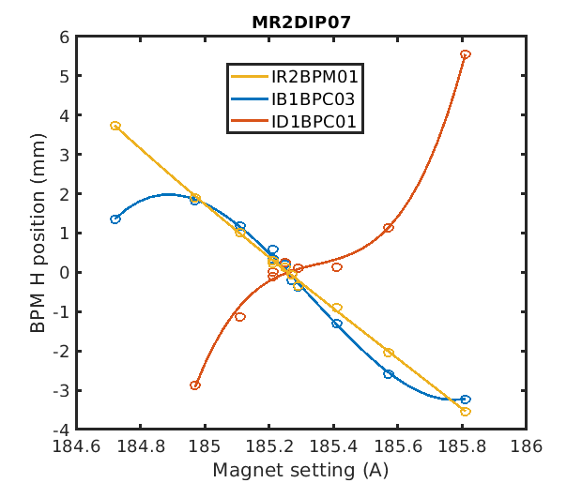
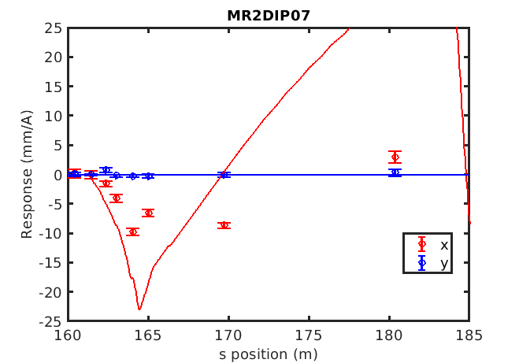
Problems in Splitter Line R2
Orbit response: linear errors throughout R2, nonlinearity after R2
Response to kick from R2 dipole 7
End of R2
Before MLC
After MLC
Beam appearance typically “odd” after R2
Here are some images taken during a dispersion response measurement, i.e. all images are related by relatively small R2 quad changes…

Slide 16
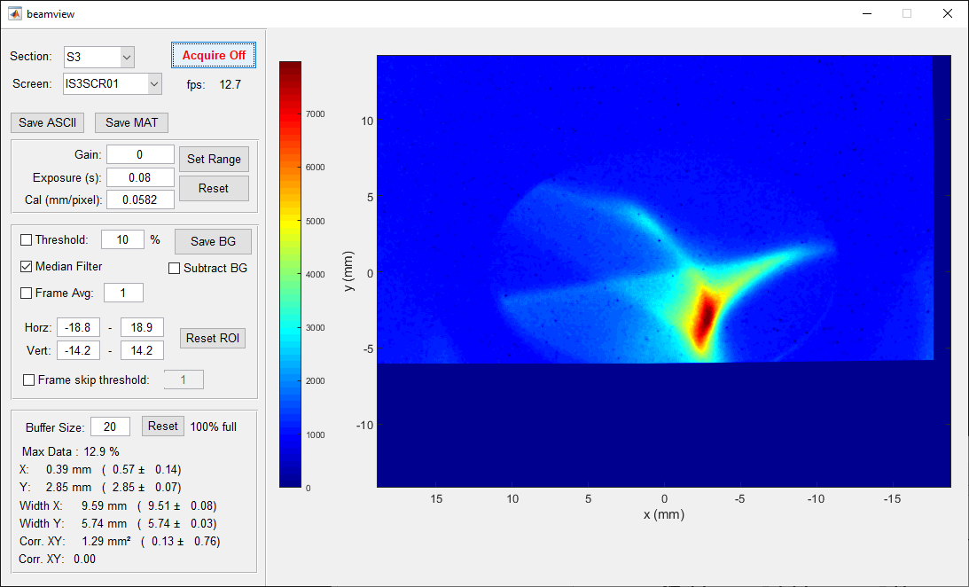
Peacock

Slide 17
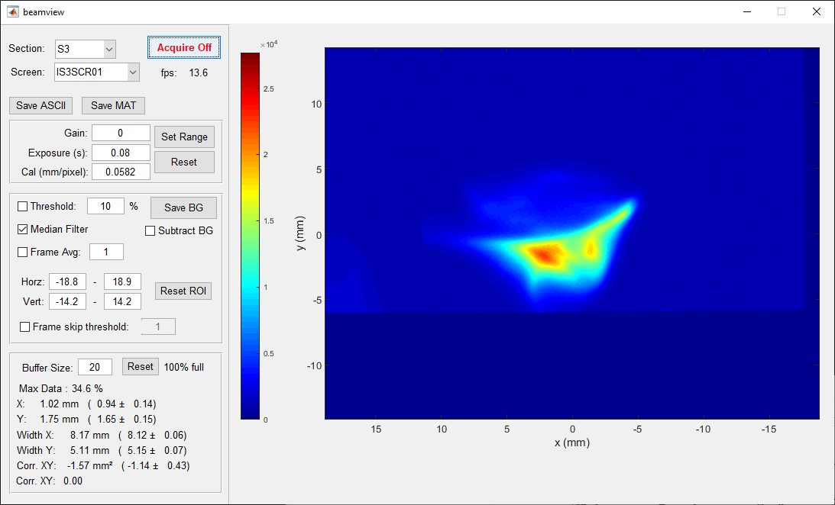
Sideways Bunny

Slide 18
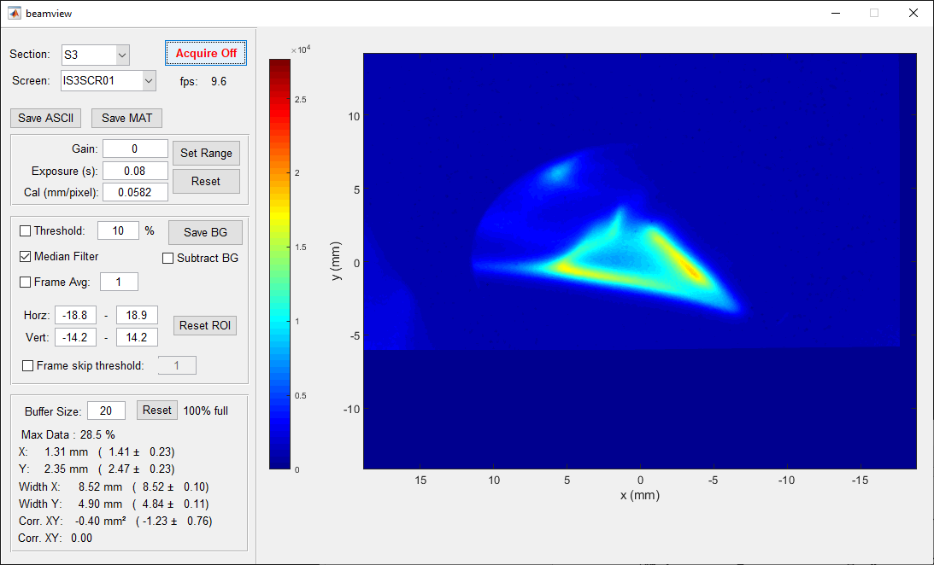
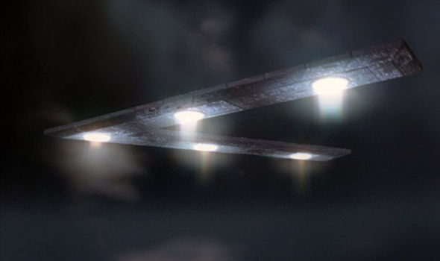
UFO

Slide 19
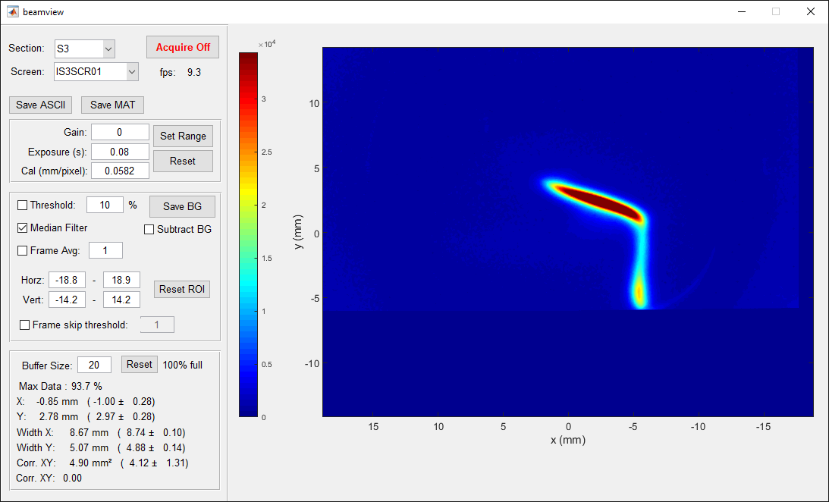
Salvador Dali Painting

Slide 20
R2 optics matching
It is no coincidence that we were often stuck after the second pass (red line, above)
Source of the problem remains unsolved

Slide 21
Conclusions
Path towards higher current
Many challenges solved during 12 week operation period
Significant challenges remain for improved 4-pass ER
Check Extra Slides for details on the remaining topics
Expected challenges
Microphonics
BPMs for many beams
Multi-beam orbit correction
Stray fields
Dispersion/R56 correction
Laser leakage current
Machine reproducibility, degaussing
Unexpected challenges
Component failures
Magnet power supply instability
Path length adjustment
MLC slow energy drift
Beam arrival phase drift
Matching lattice optics
Microbunching instability
strikethrough = Included in extra slides

Slide 22
Backup Slides

Slide 23
Results from 4-pass operation

Slide 24
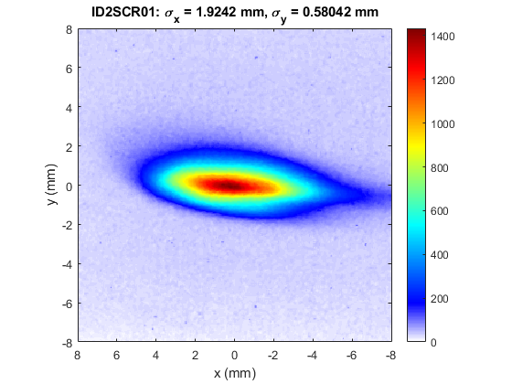
Beam on first dump screen

Slide 25
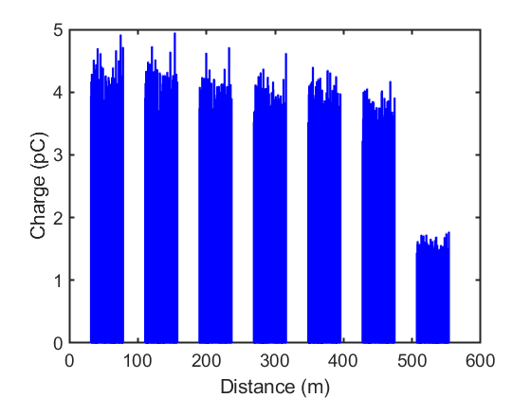
Transmission
10% loss
60% loss
Gradual 10% loss
Additional 60% loss after 2nd pass through R2
Percentages improve with lower initial charge (not shown)

Slide 26
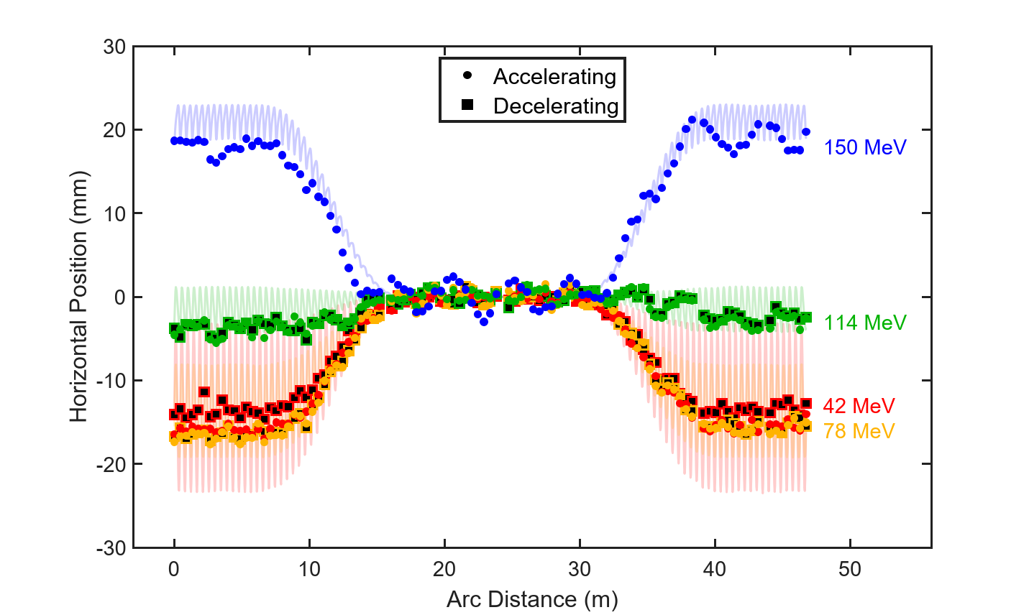
Horizontal Orbits
Note: Final 42 MeV orbit (red) has systematic error due to poor transmission

Slide 27
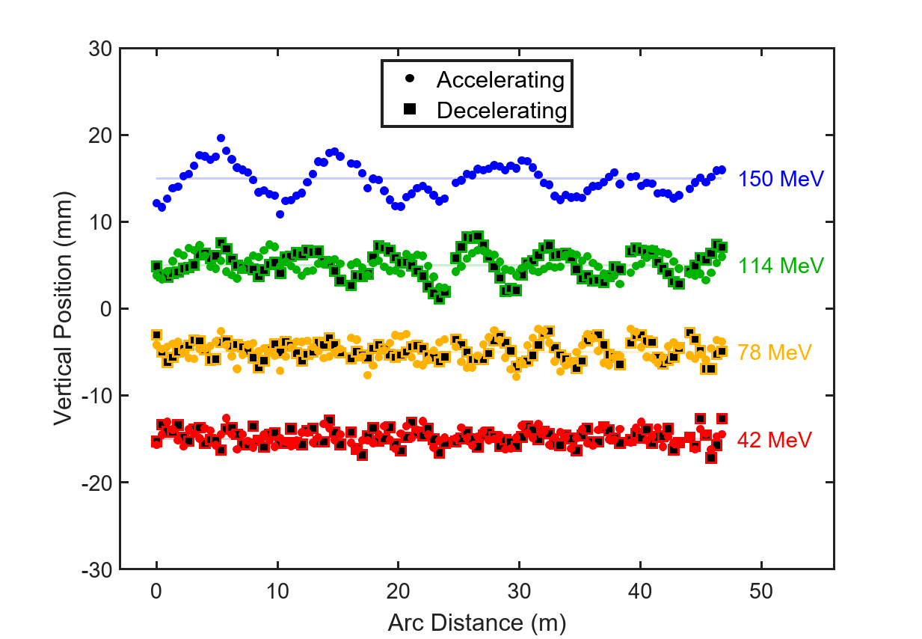
Vertical orbits
Offset Vertical Position (mm)

Slide 28
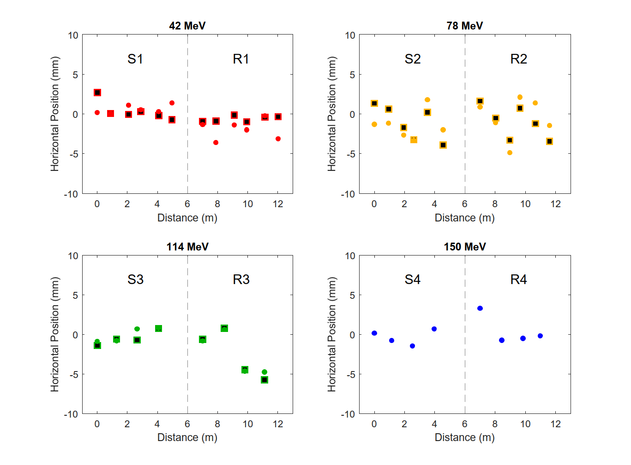
4-pass Splitter Orbits (Horizontal)

Slide 29
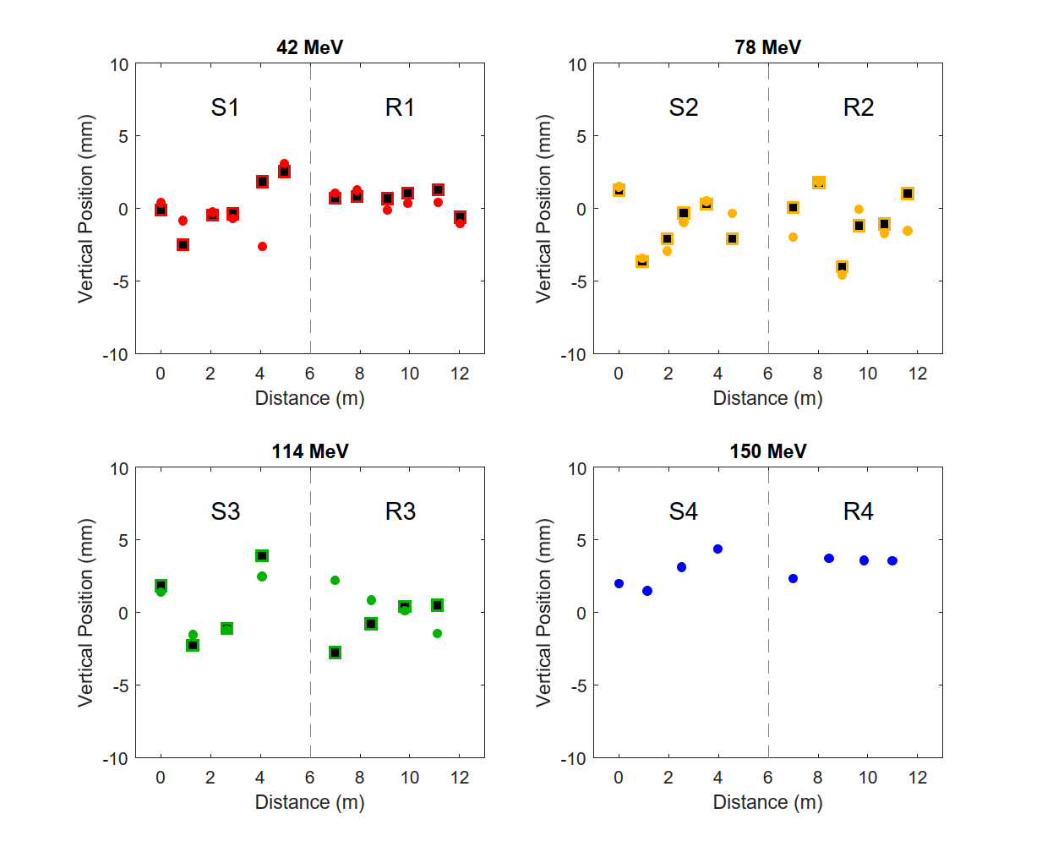
4-pass Splitter Orbits (Vertical)

Slide 30
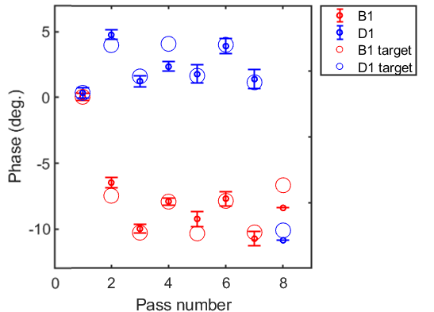
MLC arrival phase
Red = Before MLC
Blue = After MLC
Phases are shown relative to 1st pass for pass 1-4, and offset by 180º for pass 5-8
Circles are target values from an optimized BMAD simulation
Transmission seemed to require accuracy better than 2 degrees
Success would have been impossible without this diagnostic

Slide 31
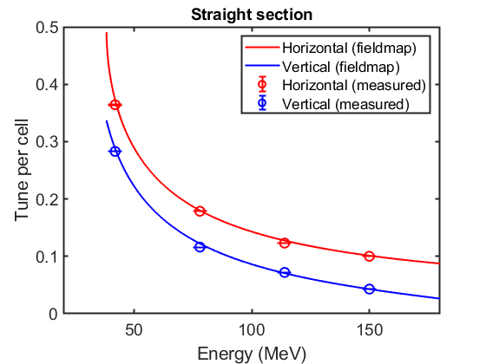
Tunes
Best fit to the MLC energy gain from this data
MLC energy gain = 36.5 MeV
Top energy = 152 MeV

Slide 32
Other challenges / omitted slides

Slide 33
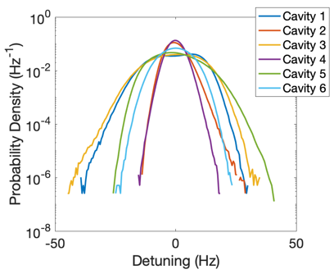
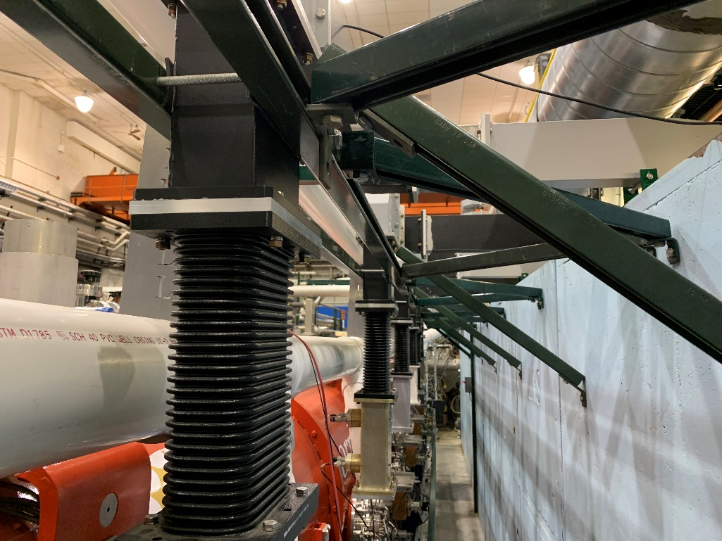
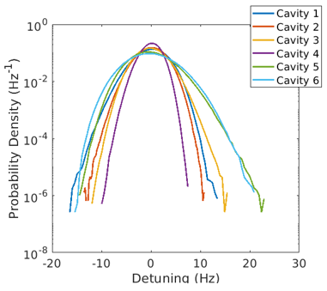
Microphonics
MLC stability was a concern during 1-pass operation
MLC waveguide support reinforced
Sorbothane used to absorb vibrations
Improved microphonics by a factor of 2
Before
After
Note the different scale

Slide 34
Microphonics
Ready before operation began
MLC Operation
Before: delicate, requires an on-hand expert staff 100% of the time
After: routine, requires only occasional expert staff

Slide 35
MLC Slow Energy Drift
MLC energy drifts ∼0.5-1% over first ∼30 minutes
Begins high, drifts lower
Drift occurs in fast, discontinuous jumps
Manual “fix” button added which finds orbit deviations in S1 along direction of dispersion, predicts energy change
Reproducible to few kV level, but not foolproof
Origin of problem never understood, remained occasional source of confusion throughout run

Slide 36
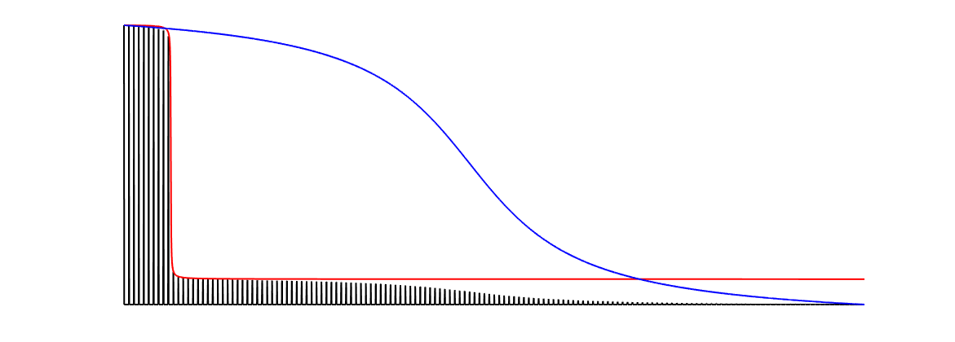
Laser Leakage Current
During single pass, laser “off” produced a worrisome amount of current
Leakage current ∼0.3-3 nA
FFA trip threshold: ∼1 nA
Added Acousto-optic modulator to further reduce leakage current
EOM: fast, leaves leakage current
AOM: slow, improves leakage
5x10⁵:1
5x10⁸:1
Time
Intended beam
Leakage beam

Slide 37
Laser AOM
Ready before operation began
Laser extinction ratio improved from 500,000 to 500,000,000
Leakage current now in pA

Slide 38
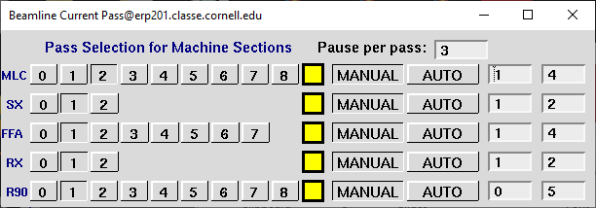
Time domain BPMs
Data is averaged in hardware in a window centered on a given pass
BPM positions only update in currently selected pass
Operators select pass manually, or choose “auto” to have it cycle through all passes
Can choose by BPM, by section, or in groups of sections
Timing window
Operator BPM Display Screen

Slide 39
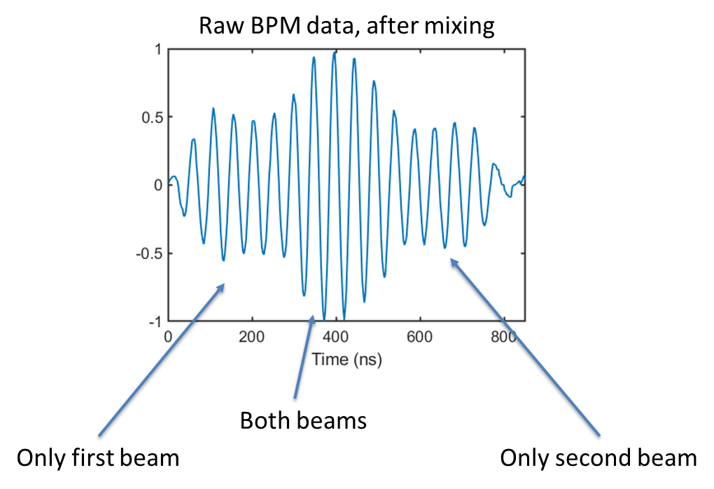
Phase (RF) BPMs
Original plan for beam positions / phases:
Mix with reference signal at frequency = f₀ – Δf
f₀ = 1.3 and 2.6 GHz (need two frequencies to disentangle two beams)
Requires solving coupled, nonlinear equations
16 adjustable parameters (cable attenuation, cable length) per BPM
Required fine-tuning of parameters
1-pass ER test was promising (extra slides), but ultimately too risky

Slide 40
BPMs for Many Beams
Firmware upgraded 10/22
Plan was in progress before operation began, but:
Major FPGA firmware upgrades on 10/22
Hardware swaps, wiring, software changes continued intermittently throughout run period (grey areas above)
Remaining issues:
5 pC, our operating charge, was near the lower measurable limit

Slide 41
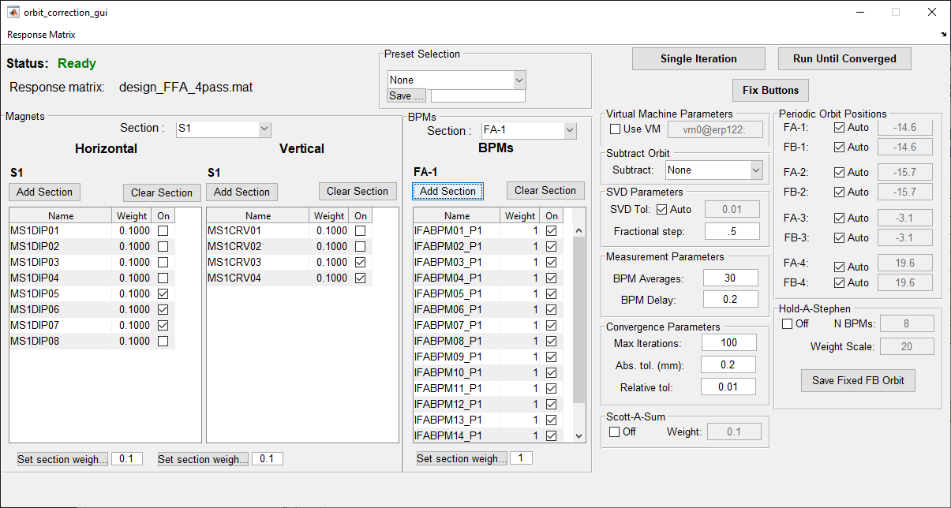
Multi-beam orbit correction
SVD-based tools ready well before operation began
Problem: Simple methods for response matrix were unsuccessful
Simulation
tight tolerance on tune (beam energy)
Measurement
beam is lost in splitters during response measurement
Auto/manual periodicity
=
Best fit unknown, but periodic, off-axis orbit
Convergence criteria
BPM selection, weights
Magnet selection, weights

Slide 42
Multi-beam orbit correction
Idea for orbit correction
Idea 1: Tune-based empirical
Measure experimental tunes for each energy
Create empirical response using only tunes (FFA only!)
Use SVD to hold orbit constant on last N FFA BPMs (to decouple passes)
Worked well through 3rd FFA pass (4th was already “good enough”, never tried)
Cannot adjust splitter entrance orbits from FFA

Slide 43
Multi-beam orbit correction
Idea for orbit correction (late Jan.)
Idea 2: Matrix refinement in closed-bump subspace
Measure 1st pass matrix with single magnets
Predict next pass closed-bump subspace
Re-measure and refine matrix in that subspace, iterate
Worked very well to correct exit FFA orbit through 4th pass
Promising to additionally correct vertical dispersion growth in FFA

Slide 44
Stray fields
IOC ready for use
“Linear Combinations” IOC ready by 12/12
Magnet linear combinations added to list throughout rest of run period
Remaining concerns
Combinations occasionally needed significant changes
Depend on bellows positions? Optics changes? Energy dependent? Nonlinearity?
Confusing hysteresis, not clear how best to degauss

Slide 45
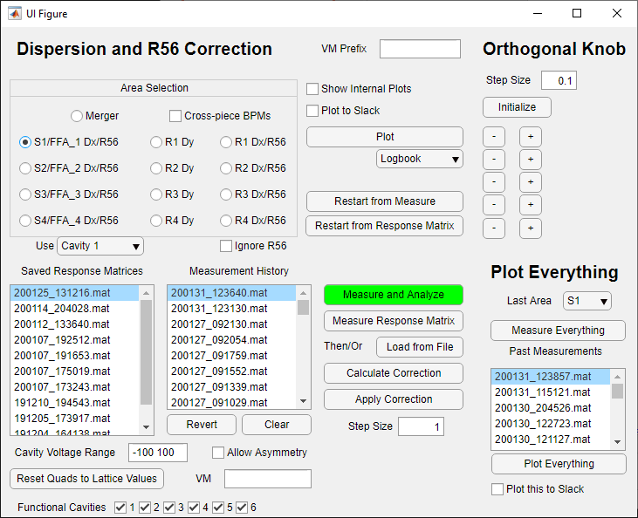
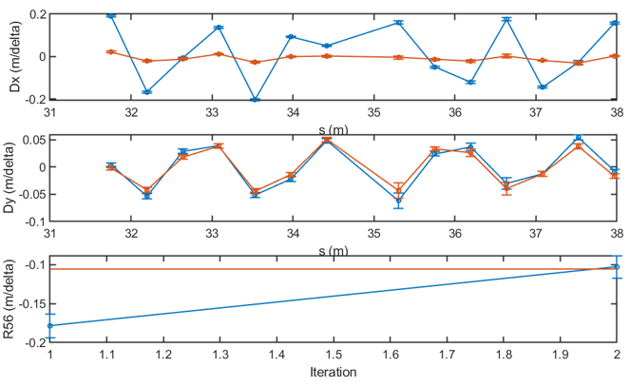
Dispersion R₅₆ Correction
Measured dispersion/R₅₆ response to splitter quads
Worked well for horizontal dispersion, R₅₆… except when it didn’t
Discovered subtle problem in method in last week of operation
Vertical dispersion cannot be corrected using splitter quadrupoles, requires correction within FFA
Method tested in last week of operation, seemed promising

Slide 46
Dispersion R56 Correction
Dispersion, R₅₆ GUI
GUI ready at the beginning of the run period
Ideas for vertical dispersion correction occasionally throughout run period, successful correction only at the end of January

Slide 47
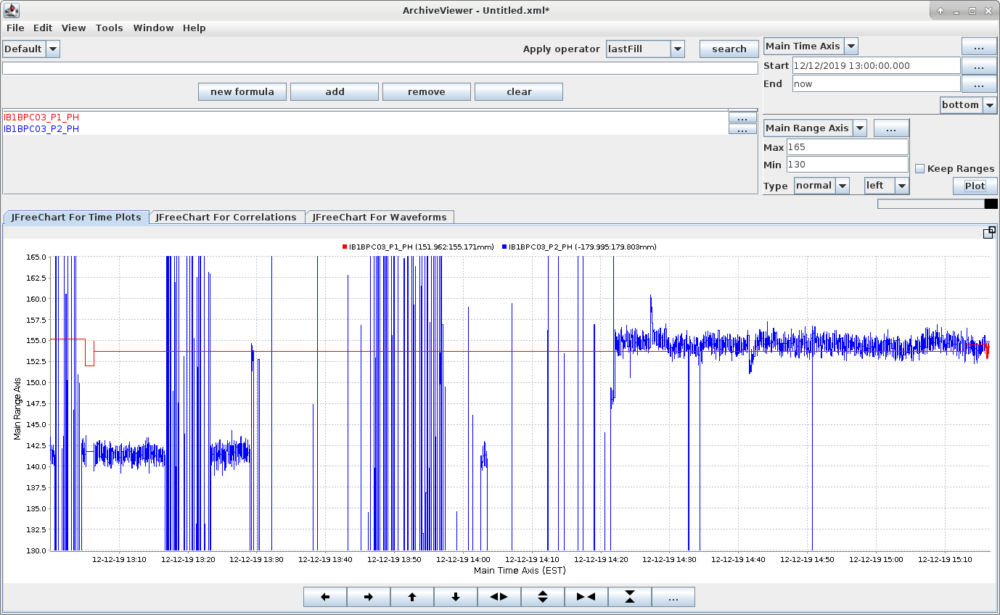
MLC arrival phase drift
Beam MLC arrival phase drifted many 10s of degrees
A static beam was never seen to change
During a shift, phase would seem to have sudden unexplained jumps.
Spent days investigating, looking for problems with BPM hardware / software
Sudden 15º change over 20 minutes

Slide 48
MLC arrival phase drift
Phases are real
Discovered that the readings were real, and caused by splitter orbit changes
Manual splitter orbit changes produced up to 50º of path length adjustment!
Red path longer than green due to arc length

Slide 49
Buncher failure
Switch to ICM bunching
The buncher RF power supply (IOT), rarely a source of previous trouble, was down for significant periods of time (red areas)
Initially, we stopped operation for repairs
In the end, we re-tuned the injector in a novel way to bunch using the ICM instead

Slide 50
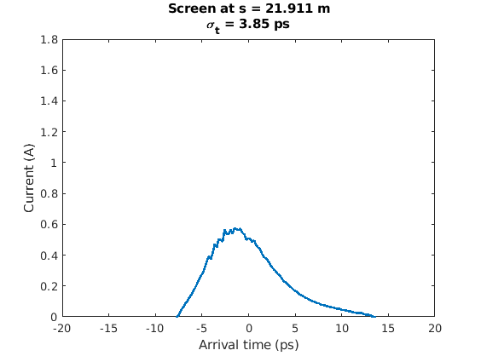
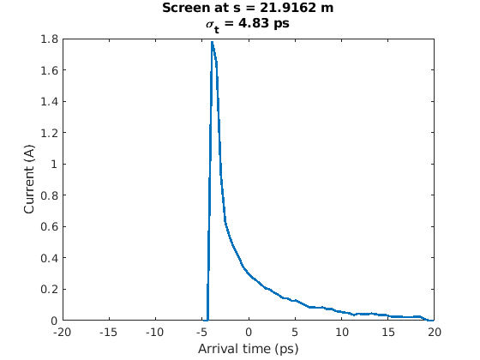
ICM bunching
In simulation, using the ICM to bunch leads to higher peak current and longer longitudinal tails
Not ideal, but good enough for the milestone
Baseline, with buncher
ICM bunching, no buncher

Slide 51
Dipole power supply failure
Power supply failure
R2 dipole 4: Power supply failed on 12/10, no spare
Power supply with similar specs found on shelf at BNL
Ready for beam in 2 days!
Transport to CU
Wiring
Control system changes for analog voltage control

Slide 52
MLC Cavity SSA Failure
SSA DC power supply failure
SSA #1 has an internal DC power supply failure, no spare
Ready for beam in 3 days!
During the wait, retuned MLC for 5 cavity operation
Achieved 4-pass ER milestone the next day

Slide 53
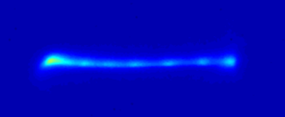
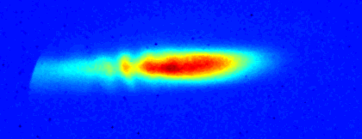
Microbunching Instability?
Occasionally, we would see a charge-dependent structure on the beam profile
As early as the beginning of the second pass
Charge dependent
Single bunch effect
Optics dependent
causing the instability or just accidentally letting us see it?

Slide 54
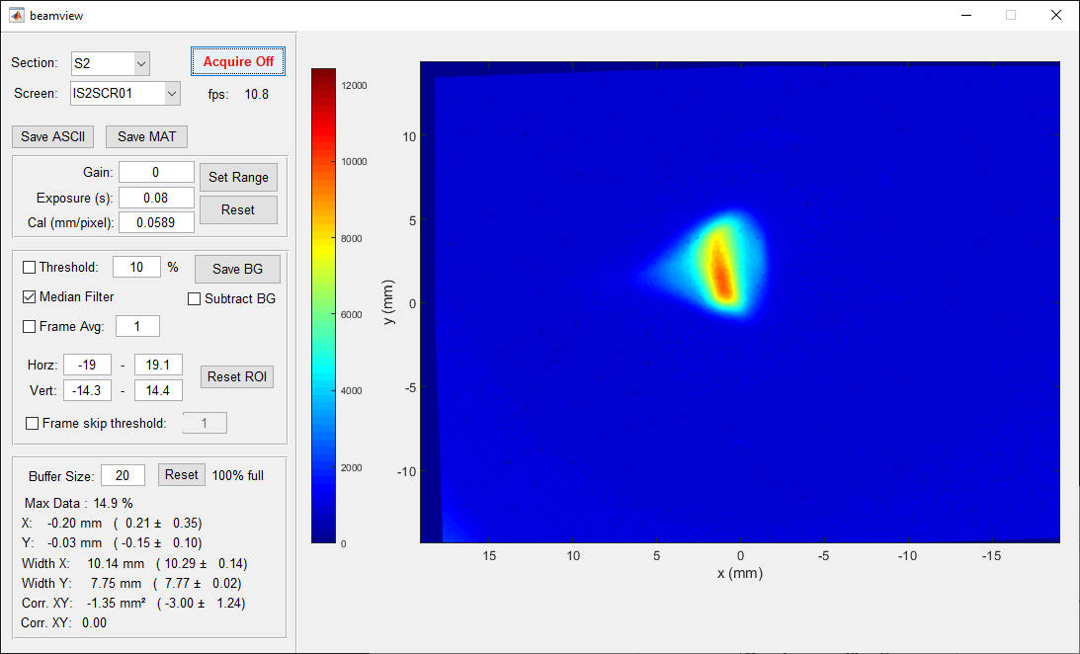
Microbunching Instability?
Entrance to S2: 1.3 pC

Slide 55
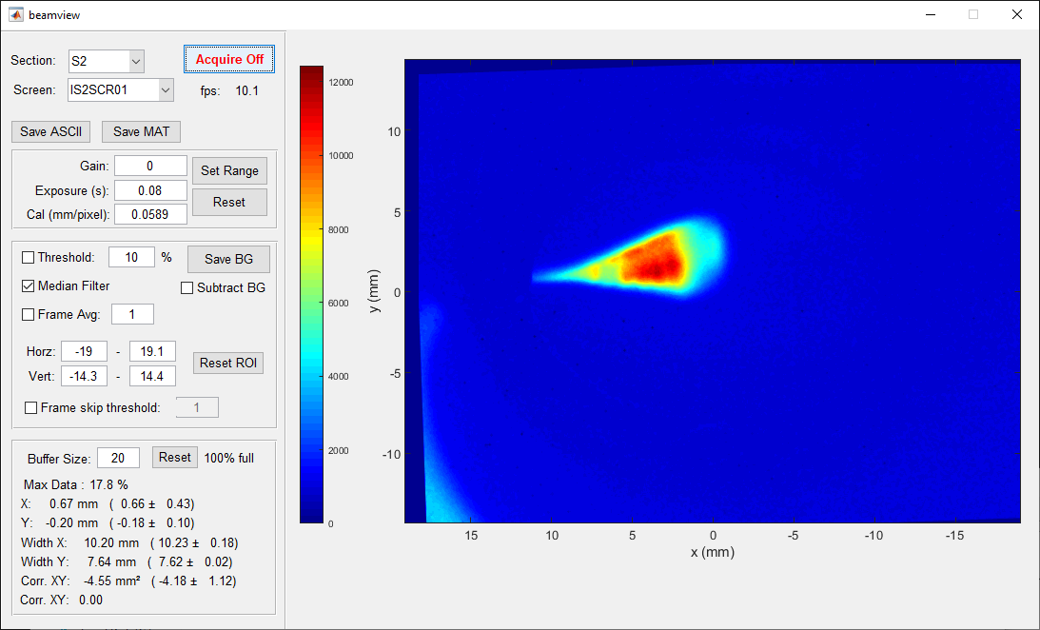
Microbunching Instability?
Entrance to S2: 1.9 pC

Slide 56
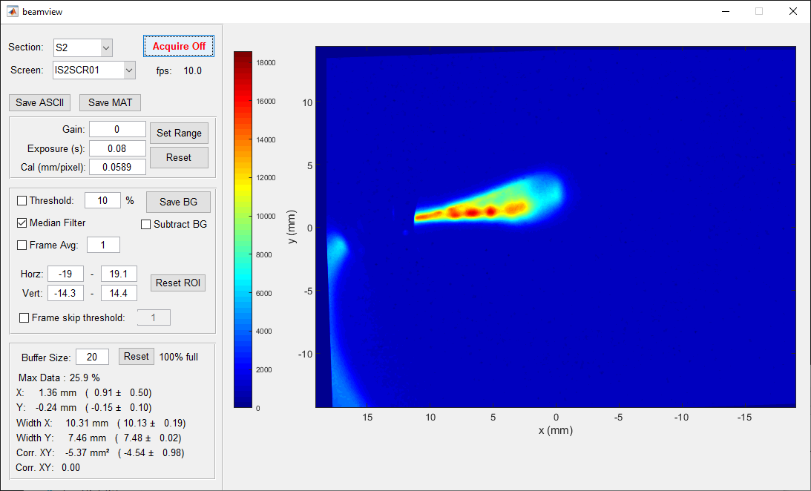
Microbunching Instability?
Entrance to S2: 2.5 pC

Slide 57
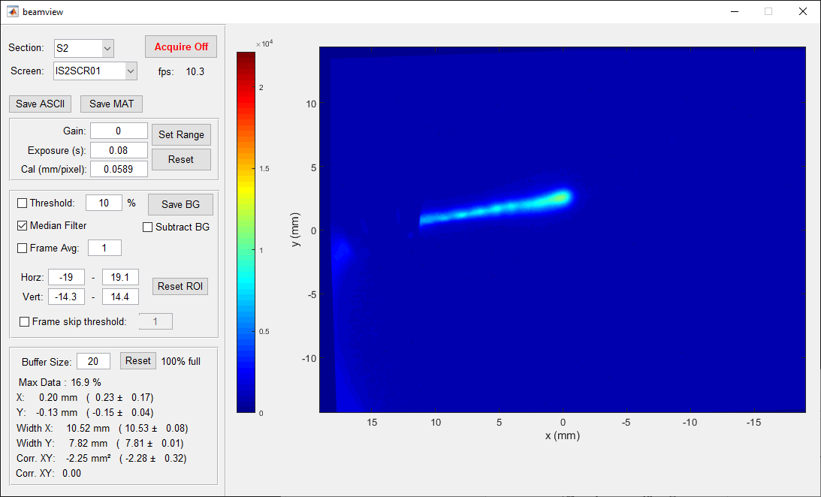
Microbunching Instability?
Entrance to S2: 5.0 pC

Slide 58
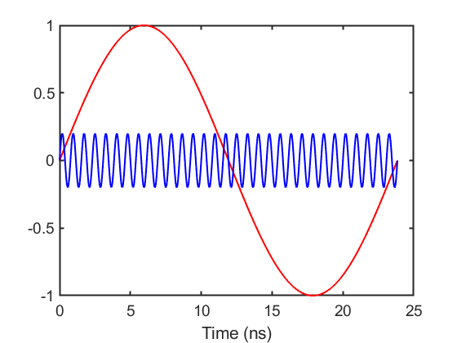
Laser loses BPM timing
Laser is only locked to 1300 MHz (RF rate), not 41.94 MHz (Bunch rate)
If laser loses lock, will come back in random 41.94 MHz “bucket”
Occasional timing error within 23.8 ns window
Synchronous BPM timing is ruined by this error
Laser picks random 1.3 GHz bucket

Slide 59
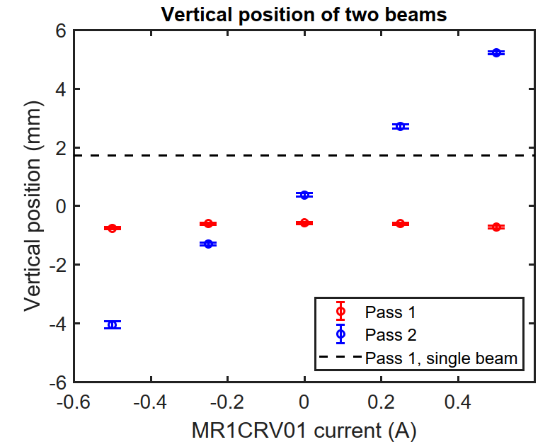
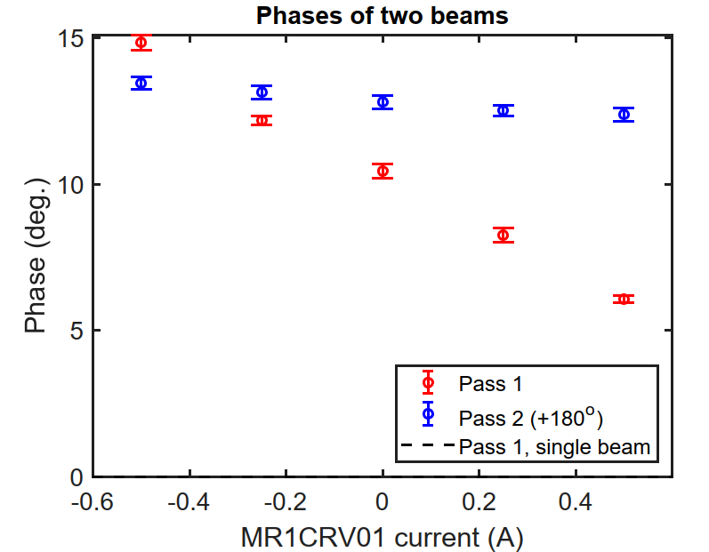
Two-frequency RF BPMs
Preliminary test from 1-pass operation: Two beams on BPM before MLC
Problem: Too many coupled adjustable parameters
Single frequency BPMs with single beam
2 adjustable scales
4 adjustable phase offsets
Position and phase are decoupled
Two frequency BPMs with two beams
8 adjustable scales
8 adjustable phase offsets
All parameters are coupled
Here, a vertical kick produces an unphysical phase change.
Promising, but unreliable. Cannot use this method!

