Slide 1






Binary neutron star mergers and nuclear physics
P.Hello
Groupe Ondes Gravitationnelles
Pôle A2C

Slide 2
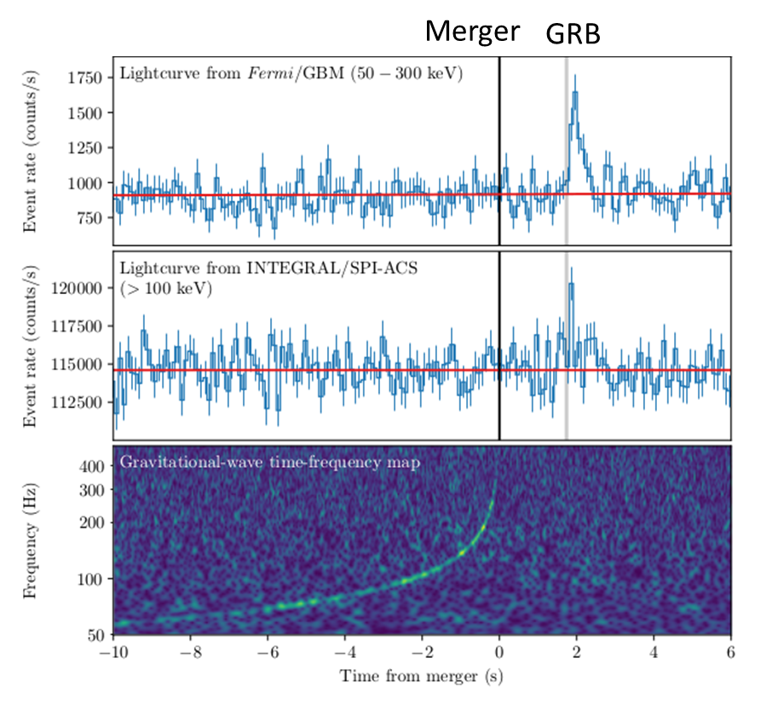
GW170817 : the (reconstructed) story
Binary neutron star (NS) merger.
Gravitational Waves (GW) signal detected by LIGO/Virgo.
Gamma Ray Burst (GRB) signal ~ 2 sec after.
Alerts sent (private alerts at this time)
« Gravitational waves and Gamma-rays from binary neutron star merger: GW170817 and GRB170817A », Abbott et al., ApJ, 2017

Slide 3
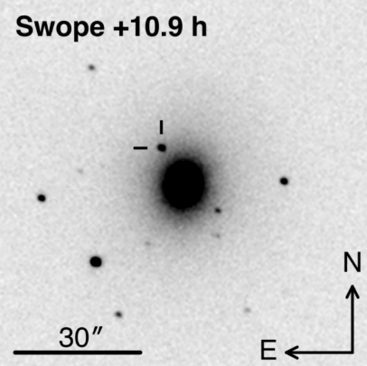
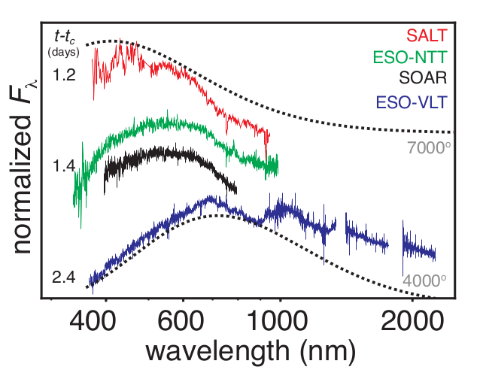
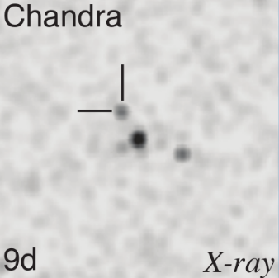

GW170817 and MultiMessenger Astronomy
T0
GW170817
+2 s
GRB170817A
+5h
Localisation with GW
Distance 40 Mpc
+11h
Discovery of kilonova
AT2017gfo by Swope
Find host galaxy : NGC4993
+1.2j
First spectra of the kilonova
+9j
Discovery of an X-ray counterpart
+16j
First radio signal found with VLA

Slide 4
Nuclear Physics?
GW signal itself
GRB physics
Kilonova (KN)

Slide 5
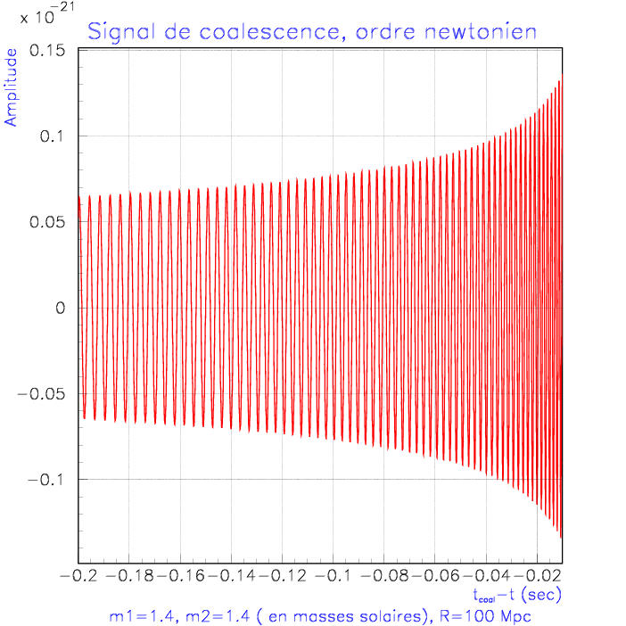
GW signal and deformability of Neutron Stars
GW signal
Phase ⬄ dynamics of the system:
newtonian at lowest order + GR corrections (so called PN expansion in power of v/c) + other corrections
Tidal effects: 5PN order correction proportional to the dimentionless deformability
compacity
Love number

Slide 6
GW signal and deformability of Neutron Stars
GW170817
More compact NS seem favored
by LIGO/Virgo observations

Slide 7
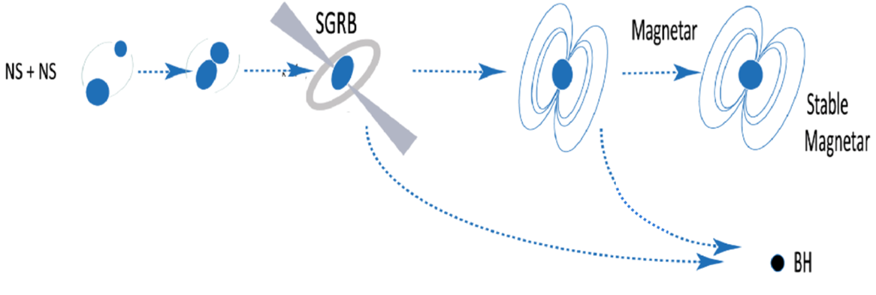
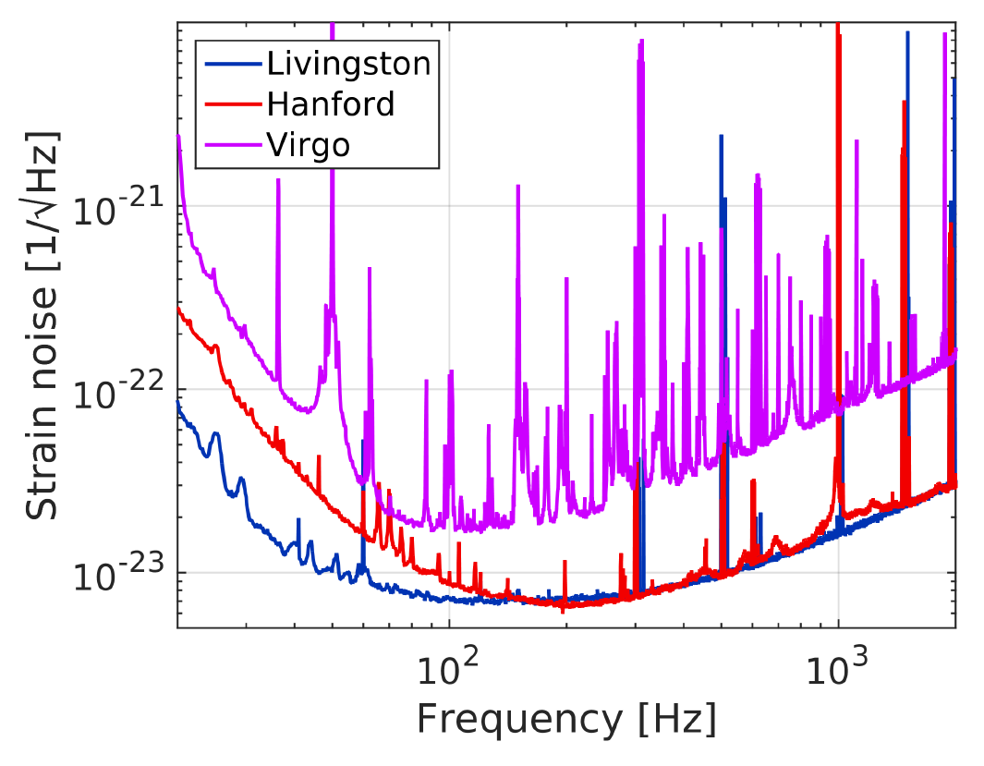
Post merger GW signal
Different possible scenarii
Observation of a post-merger signal => information about the final object (BH ? NS ?)
(e.g. mode oscillations of a newly formed NS)
GW 170817: no post-merger signal detected
(pb: high frequency signal)
O2 sensitivities

Slide 8
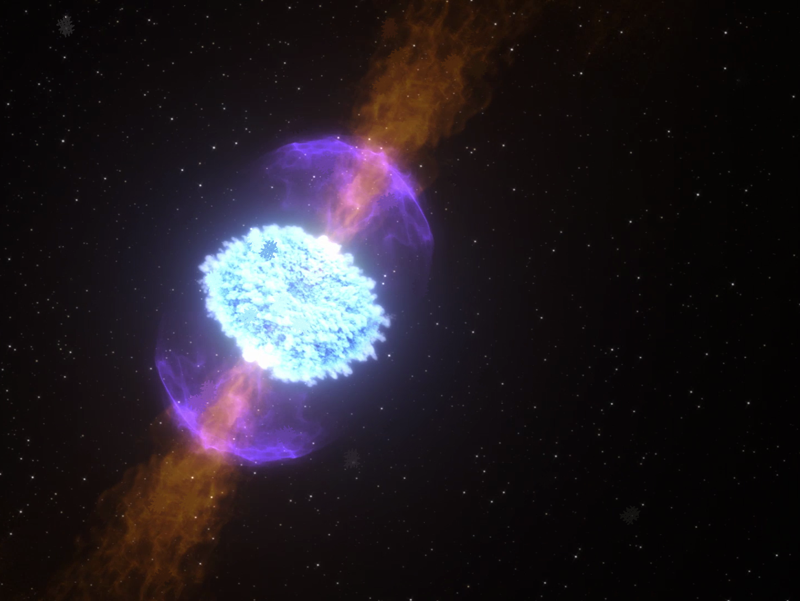
Kilonova
NS-NS mergers => ejecta M ~ 10⁻² – 10⁻¹ M_{ʘ}, v ~ 0.1-0.3 c
Nucleosynthesis of heavy elements (r-process)
Ejecta is
heated by radioactive decays,
cooled by expansion.
fast evolution from « blue » to « red ».
Black body spectrum.
Observed properties depend on mass ratio, equation of state of NS, lanthanide fraction,
nature of the post-merger…
A few KN candidates GRB080503, GRB130603B, GRB150101B…
One confirmed: GW170817/GRB170817A/AT2017gfo

Slide 9
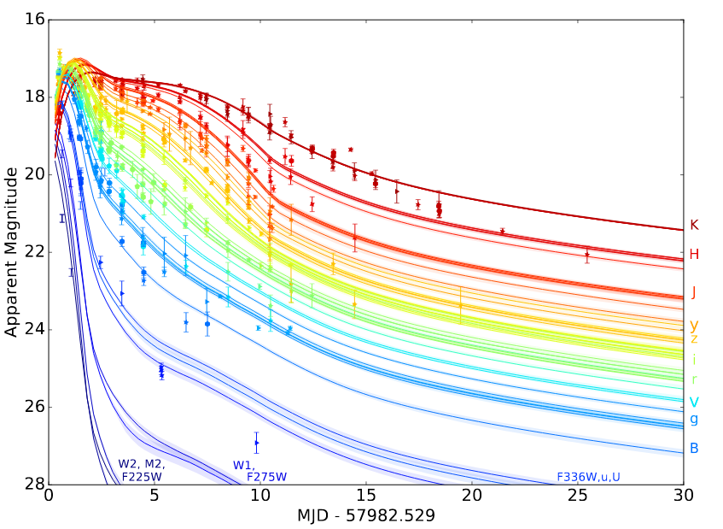
Kilonova
GW170817 and the associated kilonova AT2017gfo:
Host galaxy NGC4993, distance ~ 40 Mpc
Absolute magnitude ~ -16 (K band)
Peak magnitudes ~ 17-18
Rapidly fading ~0.5 mag/day
Spectra
(VLT/Xshooter)
1.4 day and
2.4 day after t0
Villar et al. ApJL21, 851, 2017
Smartt et al. Nature551, 75, 2017
RED KN
BLUE KN
2 componants
Light curves

Slide 10
Red and Blue KN
GRB axis
Lanthanide poor
lanthanide opacity: κ ~ 0.5 -1 cm²g⁻¹
Decay ~ 1 day
Lanthanide rich
lanthanide opacity: κ ~ 5 -10 cm²g⁻¹
Decay ~ 1 week

Slide 11
Red and Blue KN
Best fit to the data
Villar et al. 2017
BLUE KN
M ~ 1.6x10⁻² M_{ʘ}, v ~ 0.26 c
Decay ~ 1 day
RED KN
M ~ 4x10⁻² M_{ʘ}, v ~ 0.1 c
Decay ~ 1 week
Ejecta total mass ~ 6x10⁻² M_{ʘ} (lower value)

Slide 12
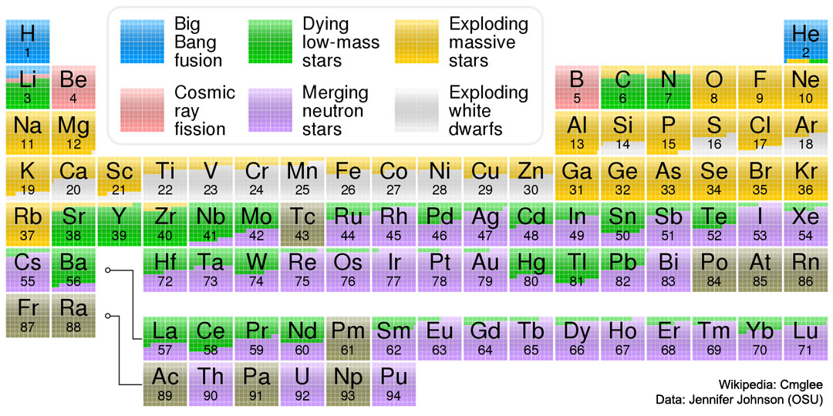

Slide 13

BNS in O3
One BNS : GW190425. No KN observed.
Distance ~ 160 Mpc ( ~4xdistance of GW170817)
=> Factor 16 on the flux => peak magnitude ~ 20-21
(+ effect of the viewing angle)
Other interesting events (NS-BH) : even further.
Unlucky during O3 (or lucky for O2?)

Slide 14

Other opportunities
Orphan KN (no GW signal, no GRB)
ZTF (then LSST) => FINK => rapid alerts for optical telescopes (e.g. GRANDMA network)
KN identified by its light curves in different bands
Possibly 10s of KN with LSST data => potential dramatic increase of our KN sample…
GRANDMA coll., GRANDMA observations of ZTF/FINK transients I. The first four months, to be submitted to MNRAS (2022)

Slide 15
Scientific outcomes
  Constraints on NS Equation of State
  R-process in action, heavy elements, lanthanides, actinides nucleosynthesis
  GRB physics, post-merger physics
  Stellar population studies
  Measurement of H0
  Measuring the Hubble constant with a sample of kilonovae, Coughlin et al. Nature Com. 11, 4129 (2020).
Towards a global picture of the phenomenon with multi-messenger astronomy

Slide 16
Conclusion
In the lab
LIGO/Virgo
SVOM
GRANDMA+FINK+LSST
PHENOMENOLOGY
GW
GRB
Optical counterparts, KILONOVAE
Physics interpretation
Quite unique opportunity!
Unlucky during O3 (or lucky for O2?)
Lucky again for O4?

