Slide 1
Hadronic physics and astrophysics at IJCLab ?
Heavy ion collisions as a probe of dense QCD matter

Slide 2
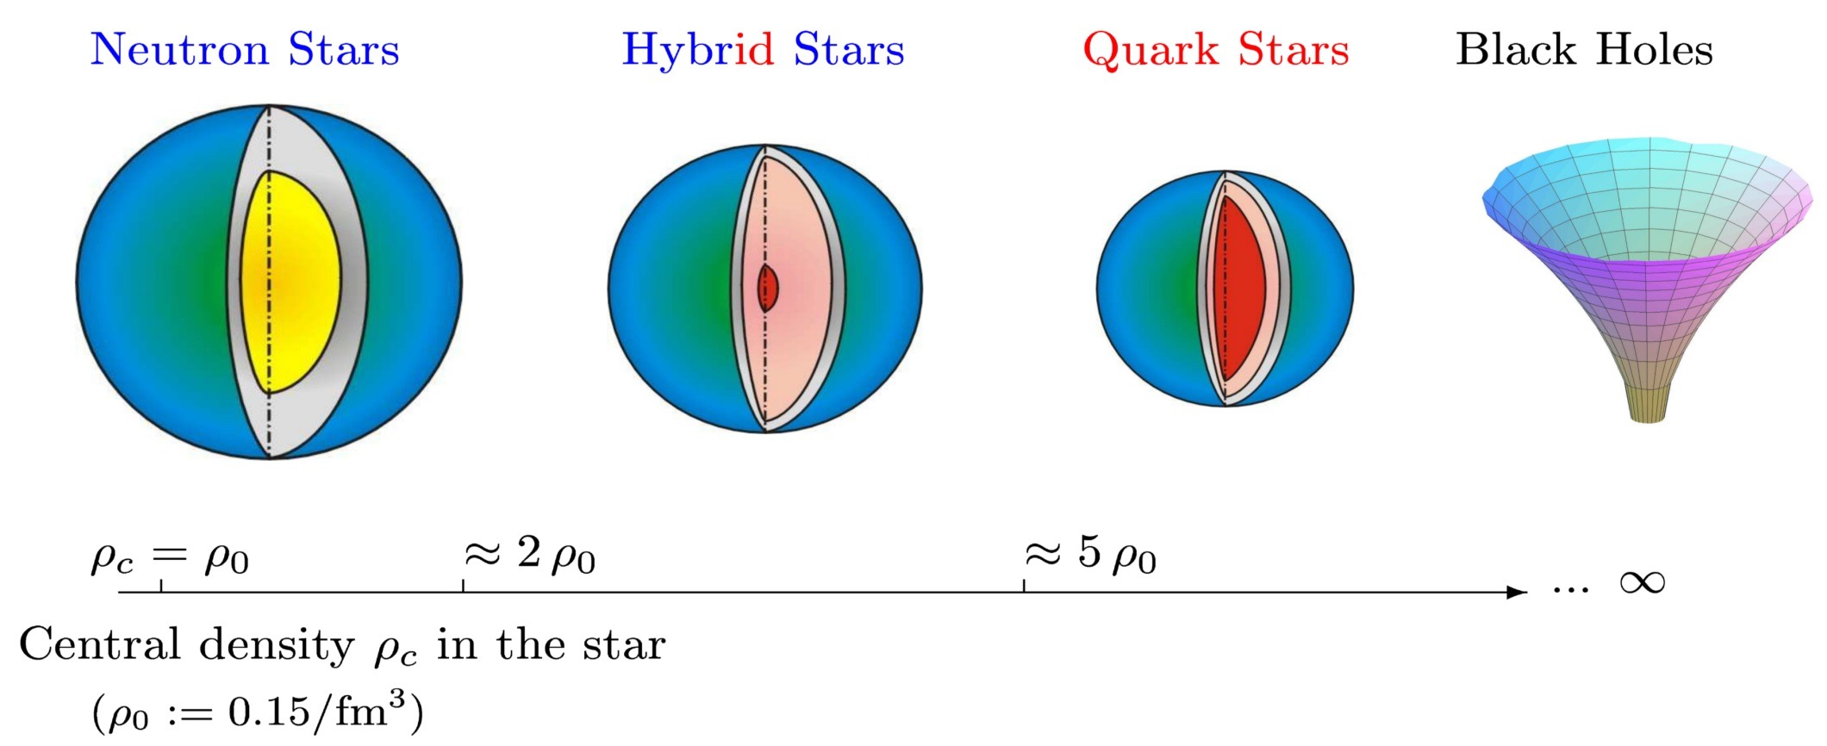
Nuclear physics in the cosmos: Where does hadronic physics come into play?
Microscopic composition of stellar objects:
Hadronic structure and interactions:
Baryonic resonances, hyperons, quark-gluon plasma,…
Equation of State of dense QCD matter

Slide 3
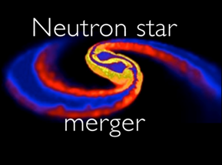
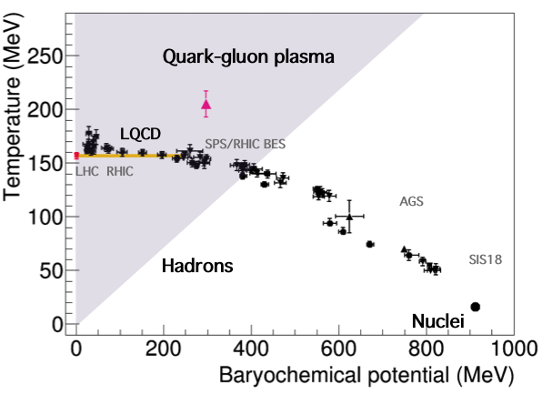
QCD phase diagram: open questions
High T, low μ_{B}
Lattice QCD calculations
2nd order transition between hadronicnand quark-gluon phase = cross-over
Chiral symetry restoration
Alice, LHCb
Low T, high 𝝁_{B}
Effective models are needed
First order transition ?
Search for a critical point
Chiral symmetry restoration ?
Microscopic structure of baryon rich matter.
Baryonic resonances, hyperons
Medium effects on hadron properties
NA60
HADES @ SIS18
A+A 1-2 AGeV
√s _{NN} < 2.5 GeV
T. Galatyuk, NPA-D-18-00411 (2018) QM18

Slide 4
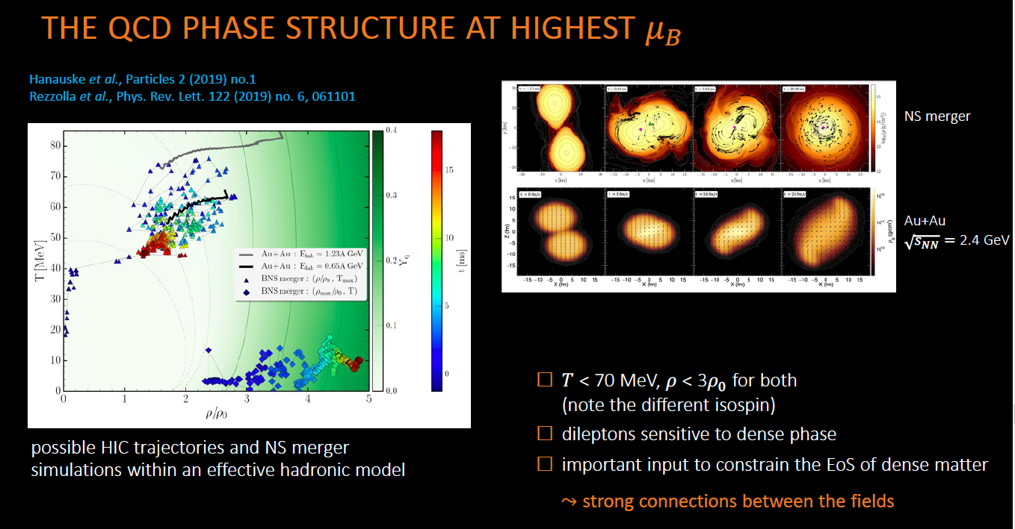
HADES Collab., Nature Phys. 15 (2019) 10, 1040-1045

Slide 5
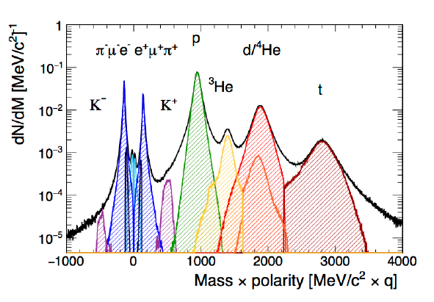
High Acceptance Di-Electron Spectrometer
Experiments (2004-2022)
Hadronic matter studies
C+C 1 and 2A GeV, Ar+ KCl 1.75A GeV,
Au+Au 1.25 AGeV, Ag+Ag 1.65A GeV
Cold matter:
p+Nb 3.5 GeV, π⁻+C/W 1.7 GeV/c
Elementary reactions:
p+ p 1.25, 2.2 , 3.5, 4.5 GeV, d+p 1.25 GeV/nucléon
π⁻+CH₂/C 0.7 GeV/c
HADES collaboration :
about 100 physicists,
20 institutes, Czech Republic, France, Germany, Poland, Portugal, Russia
recent new membership: Uppsala, Warsaw
Acceptance: Full azimuth, polar angles 18º - 85º
Momentum measurement
  Magnet: ∫Bdl = 0.1- 0.34 Tm
  MDC: 24 Mini Drift Chambers
  Leptons: Δx~ 140 μ per cell, Δp/p ~ 1-2 %
Particle identification: e⁺/e⁻, π⁺/π⁻ , K⁺/K⁻, p
RICH, Time Of Flight, Pre-Shower (pad chambers & lead converter) (also MDC (K⁻))
Trigger: ~ 50 kHz
On-going
observables
Correlations and fluctuations of conserved quantities
Collective effects (flow,..) for all possible particle species
Strangeness,
Dileptons

