Slide 1
Un groupement de recherche (GDR) pour les Détecteur
Giulia Hull, Mariangela Settimo
Version : 13 Janvier 2022

Slide 2
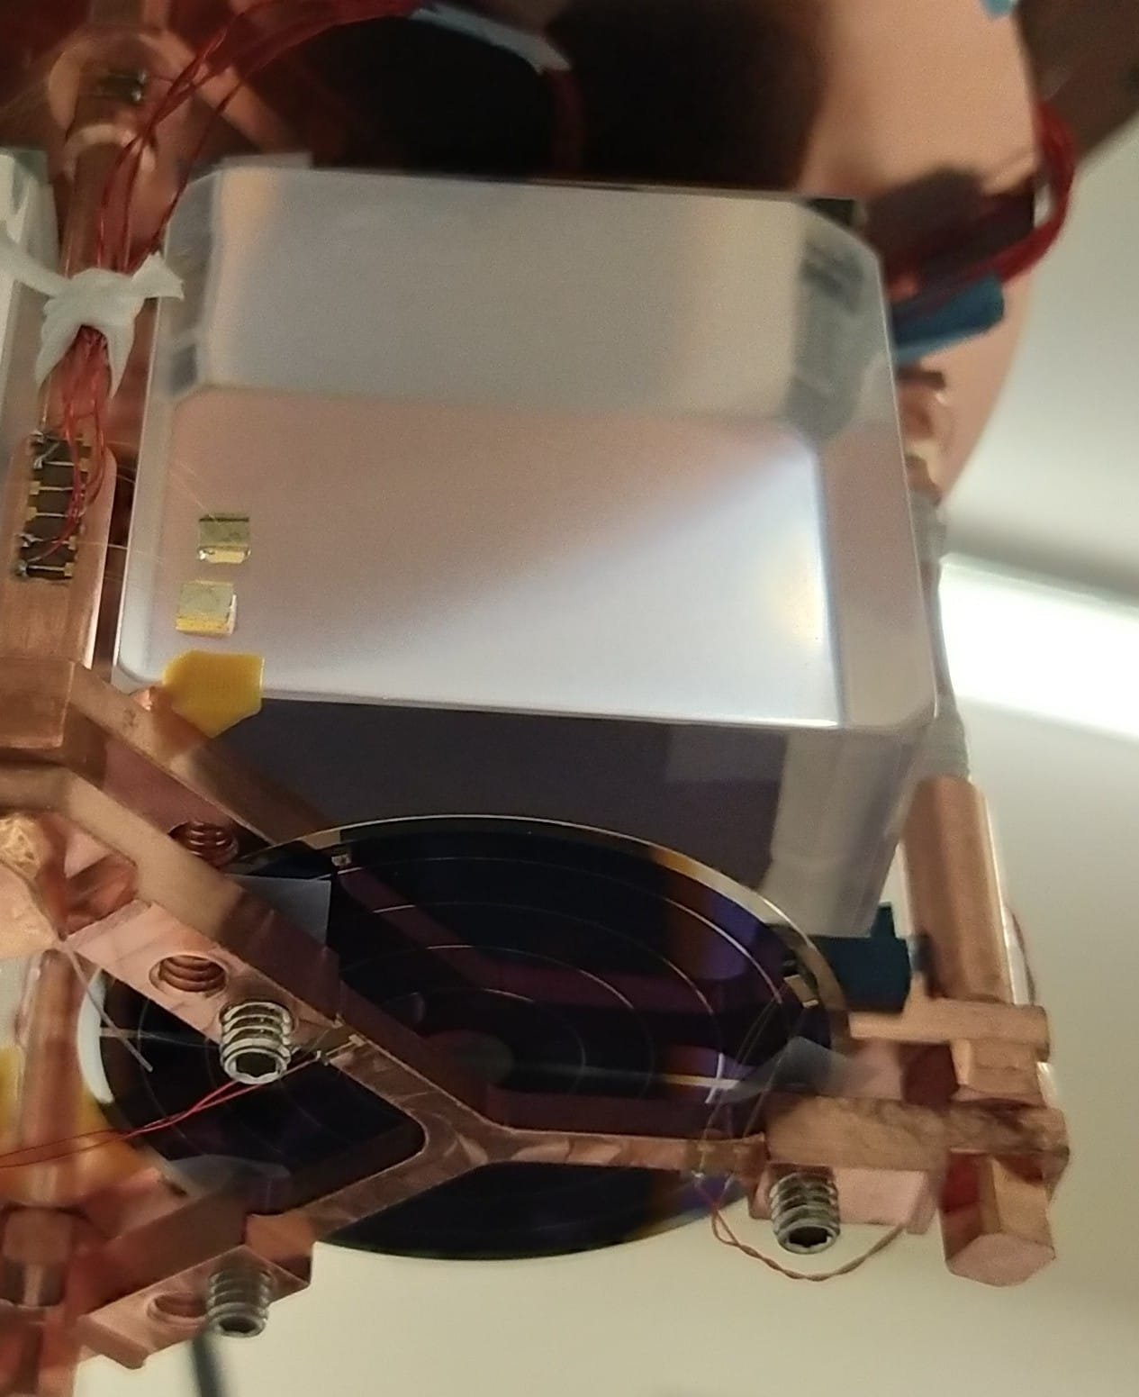
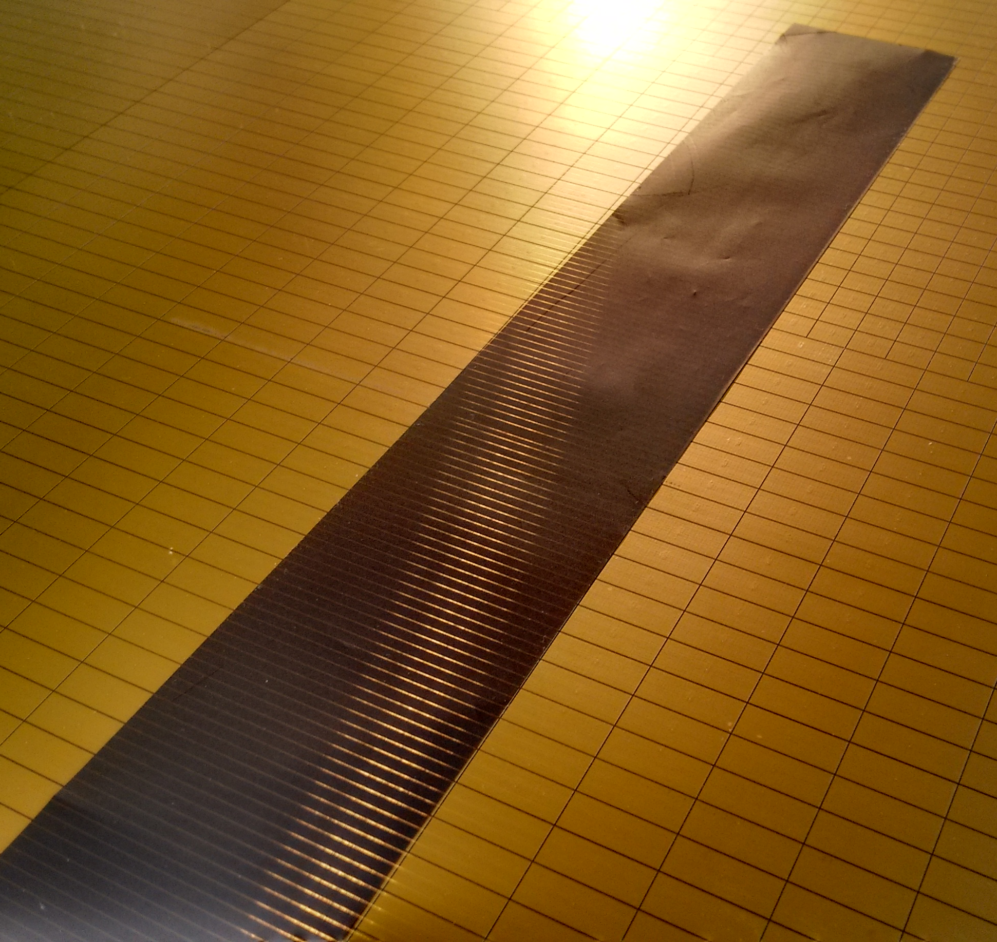
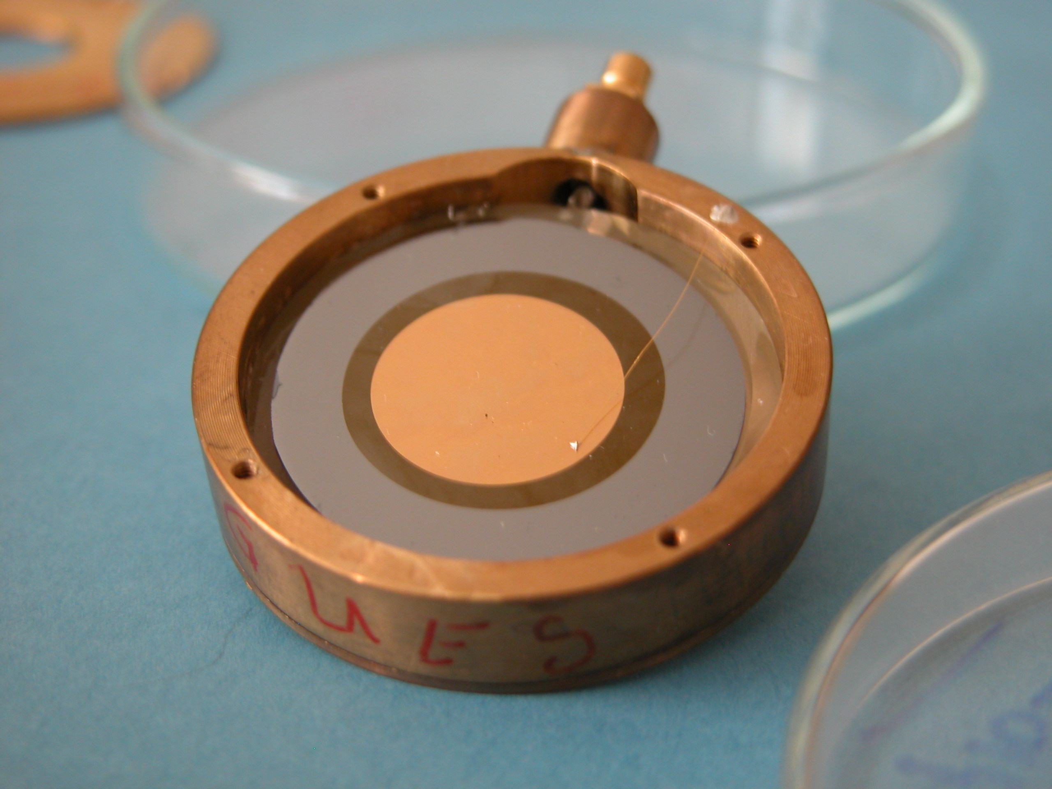
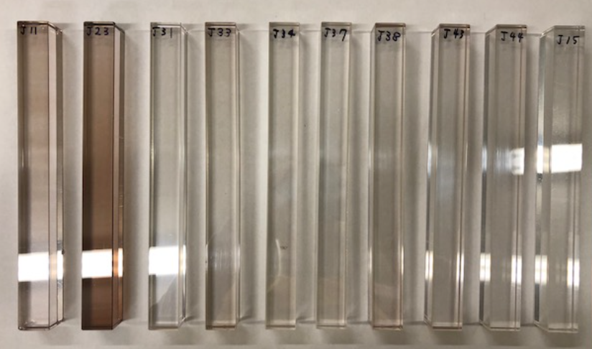
Expertise at the IN2P3
An outstanding expertise in the IN2P3 laboratories, both in the technical teams and in the physics research groups,
concerning the design/study/development of new detection systems in every detection domain.
2

Slide 3
Lab survey
Lab | Ville | R. Gaz | R. Semic. | R. Photodet | R. Cryo | R. Radiodet. | R. Det Faisc | R. Det Emerg
APC | Paris |  | x | x | x
CENBG | Bordeaux | x | x | x |  |  | x
CPPM | Marseill |  | x
GANIL | Caen |  | x |  |  |  | x
IJCLab | Orsay | x | x | x | x | x | x
IP2I | Lyon | x | x | x | x |  | x | x
IPHC | Strasbourg |  | x | x |  |  | x
L2IT | Toulouse
LAPP | Annecy | x | x | x |  | x | x
LLR | Palaiseau |  |  |  |  |  | x
LPC | Clermont-Ferrand | x |  | x |  | x
LPC | Caen | x | x | x |  |  | x
LPNHE | Paris |  | x | x
LPSC | Grenoble | x | x | x | x | x | x
LUPM | Montpellier
SUBATECH | Nantes |  | x |  |  | x | x
CC-IN2P3, OMEGA, Musée Curie not included in the table
Technological platforms with specific « detector » expertise, as LMA and C4PI, to be included in this survey

Slide 4
Why a GDR Détecteur
Réseaux «Détection et Instrumentation»
Groupement des Recherches
Common «Playground» for all the actors in Detection Physics
Technical teams
Research groups
For the study of new advanced detectors

Slide 5
The GDR at CNRS
The “Groupements des Recherches” are animation structures having the common objective of promoting exchanges between CNRS scientists, academic partners, companies and others
At present, IN2P3 coordinates and animates 9 GDRs on different domains:
Modélisation en instrumentation pour l'imagerie biomédicale
Neutrino
Terascale
Intensity frontiers
Ondes gravitationnelles
Sciences nucléaires pour l'énergie et l'environnement
Réactions, structure et astrophysique nucléaires : expériences et théories
Accélérateurs plasma pompés par laser
Deep undergroud laboratory physics
IN2P3-driven GDRs are opened to other institutes

Slide 6
A GDR Détecteur to :
Federate teams and create collaborations
Foster researchers/engineers together
Promote young researchers
Identify frontiers detectors and indicate a strategic roadmap
Encourage valorization and diffusions actions
GRD DePhIs: Detecteurs pour la Physiques des Infinis

Slide 7
Some history…
12/2020 – 01/2021: Request from the IN2P3 to drive the GDR and its construction
01-02/2021: First reflections (Mariangela and Giulia + exchanges with Rodolphe and Jean-Luc) on the structure of the GDR
03/2021: Discussion/exchange with the “Reseaux Détecteurs” leaders
22-24/06/2021: Workshop « Physique et détecteurs à la frontiere »
https://indico.in2p3.fr/event/23982/
5/10/2021: Agora during the workshop « Journées R&T IN2P3 »
https://indico.in2p3.fr/event/6256/
19-22/10/2021: Retour du GT08 au « Journées des perspectives de l’ IN2P3 »
Since November we are preparing the GDR proposal

Slide 8
GDR structure
Possible structuration du GDR Détecteur
GDR DePhIs
Steering Committee
GDR directors + 1 convener per WP + Appointed person for ET
WP1
Semiconductor detectors
WP2
Cryogenic detectors
WP3
Gaseous detectors
WP4
Photodetectors
WP5
Beam detectors
WP6
Quantum sensors
WP7
Physics driver
WP8
Detector system engineering
Task Force
Emerging technologies

Slide 9
GDR structure
Possible structuration du GDR Détecteur
GDR DePhIs
Steering Committee
GDR directors + 1 convener per WP + Appointed person for ET
Main Axes, following the scheme of the existing « Reseaux Detecteurs et Instrumentations »
+ Quantum Sensors
WP1
Semiconductor detectors
WP2
Cryogenic detectors
WP3
Gaseous detectors
WP4
Photodetectors
WP5
Beam detectors
WP6
Quantum sensors
Topics beyond a specific technology
to promote the exchanges between researchers and engineers
WP7
Physics driver
WP8
Detector system engineering
Task Force
Emerging technologies

Slide 10
Examples of activities within the WP
Possible structuration du GDR Détecteur
Organize meetings
Identify/promote technologies within the task
Identify innovative developments
Follow the national / international directions at scientific and detector level
Facilitate the discussions with other platforms
Contribute to the discussions on common problems (all)
Report on developments which may be helpful to any task
Provide supports for common practical problems
Animate discussions on scientific directions or on applications inter-axe

Slide 11
Examples of common activities
Possible structuration du GDR Détecteur
Organize school for PhD students and young researchers
Organize training/seminars for young and senior researchers and engineers
Overhaul of the detectors thematic school
Aware on valorization and patents
Encourage dissemination of results and valorization
Encourage the participation to international committee
Inform of upcoming conferences

Slide 12
To Conclude
Possible structuration du GDR Détecteur
The GDR proposal will be finalized during the first trimester of 2022 and hopefully the GDR will start soon after for 4 years
Your help is precious and your participation is crucial to make this new GDR successful

Slide 13
Examples of common activities
Possible structuration du GDR Détecteur

