Slide 1
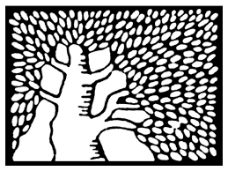
WE I Z MANN
I NST ITUTE
OF SCIENCE
Low divergence proton beams at
kHz repetition rate
Dan Levy
12.5.22
GdR APPEL – Assemblée Générale 2022

Slide 2
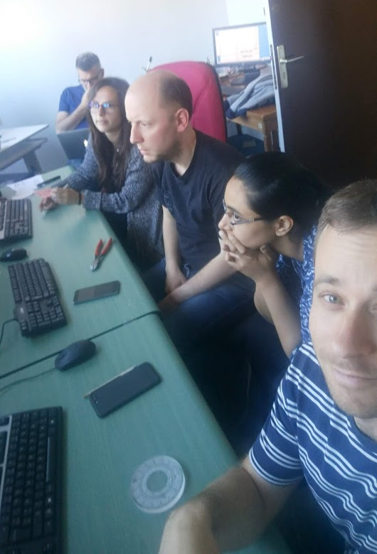
The team
Igor Andriyash
Stefan Haessler
Marie Ouillé
Jaismeen Kaur
Alessandro Flacco
Eyal Kroupp
Victor Malka
Rodrigo Lopez-Martens

Slide 3
Acceleration from thin foils: diverging ion beams
2001: TNSA
$$\sim 1 μm$$
Wilks et al., "Energetic proton generation in ultra-intense laser–solid interactions.“
Physics of plasmas (2001).
$$\sim 30°$$
Ions
Credit: Josefine Metzkes-Ng
Beam divergence:
$$\sim 30° FWHM$$

Slide 4
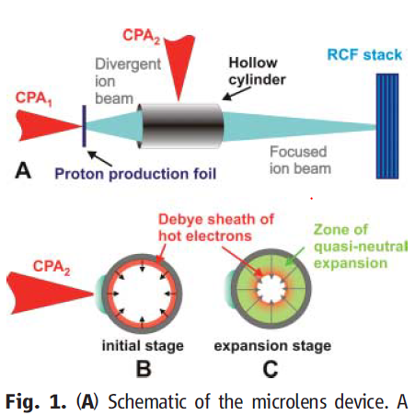
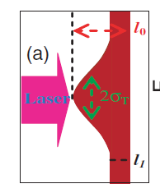
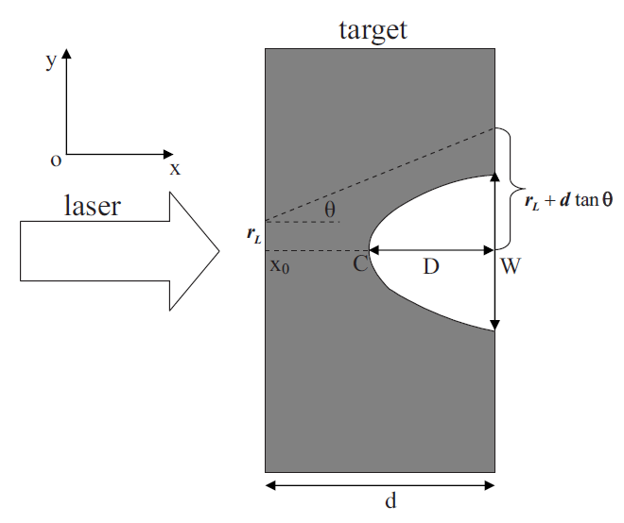
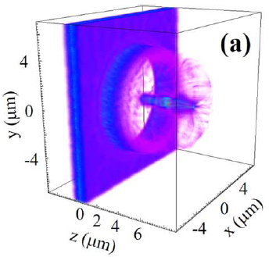
Reducing beam divergence: 20 years of efforts
Chen, M. et al.
Phys. Rev. Lett. 103, 024801 (2009).
Toncian, T. et al. Science 312, 410–413 (2006).
Liu, M.-P. et al.
Physics of Plasmas 15, 063104 (2008).
Pae, K. H. et al.
Plasma Phys. Control. Fusion 62,
055009 (2020).
Kar, S. et al.
Nat Comm. 7, 10792 (2016).

Slide 5
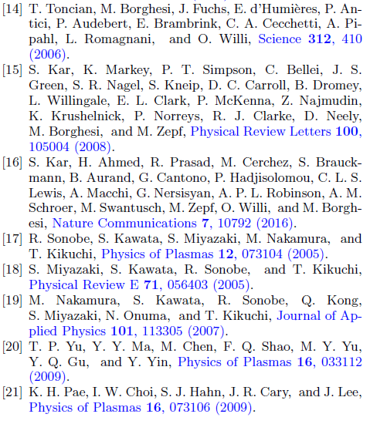
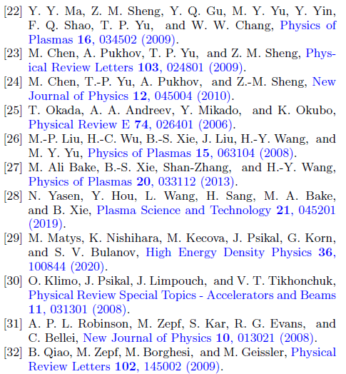
Reducing beam divergence: 20 years of efforts

Slide 6
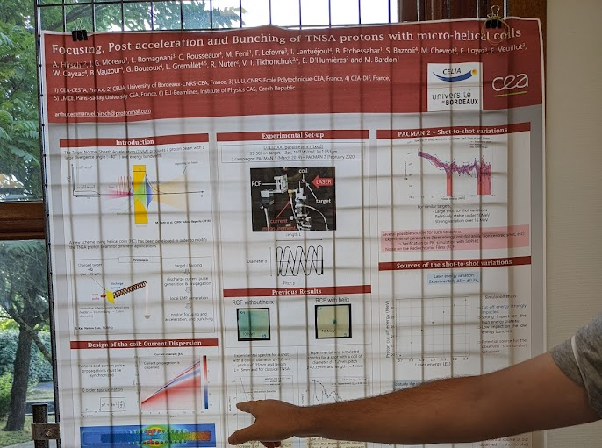
Reducing beam divergence: 20 years of efforts (and counting)

Slide 7
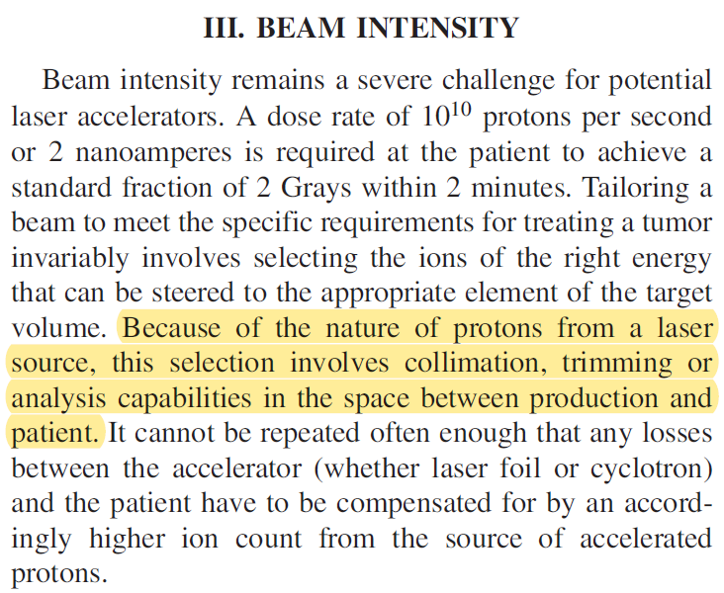
Robust low-divergence ion source still in demand
.
.
.
Linz, U. & Alonso, J., Phys. Rev. Accel. Beams 19, 124802 (2016).

Slide 8
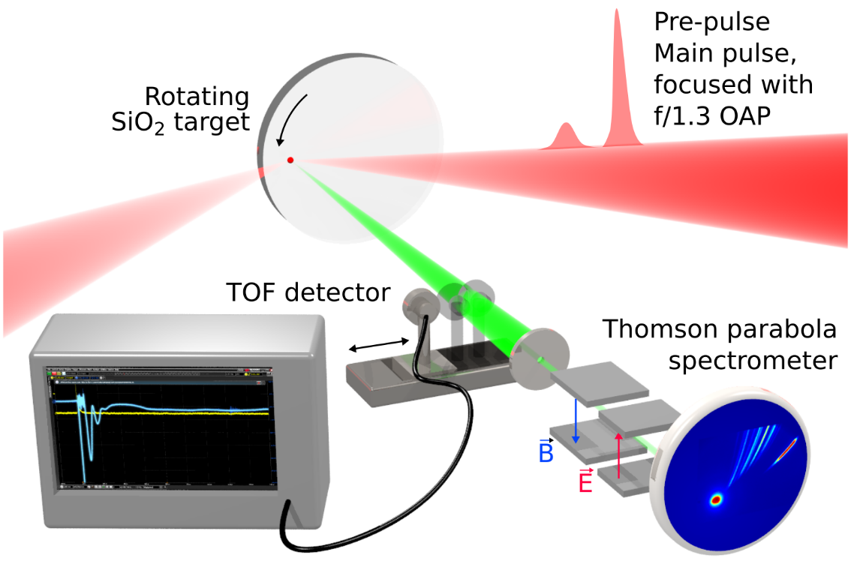
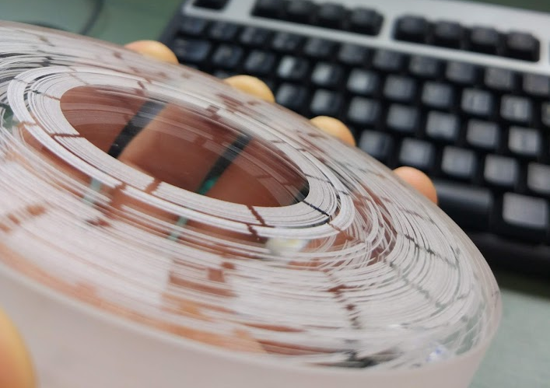
Experimental setup @ Salle Noire (LOA)
Levy, Andriyash, Haessler, Kaur, Ouillé, Flacco, Kroupp, Malka & Lopez-Martens,
arXiv:2112.12581 (2021).

Slide 9
The Salle Noire Laser
25–3.5 fs, 3.5 mJ, 1 kHz
>10¹⁰ contrast ratio

Slide 10
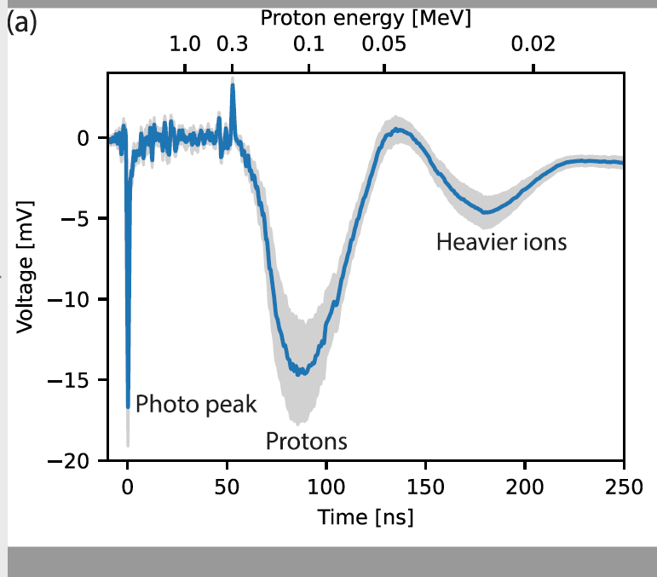
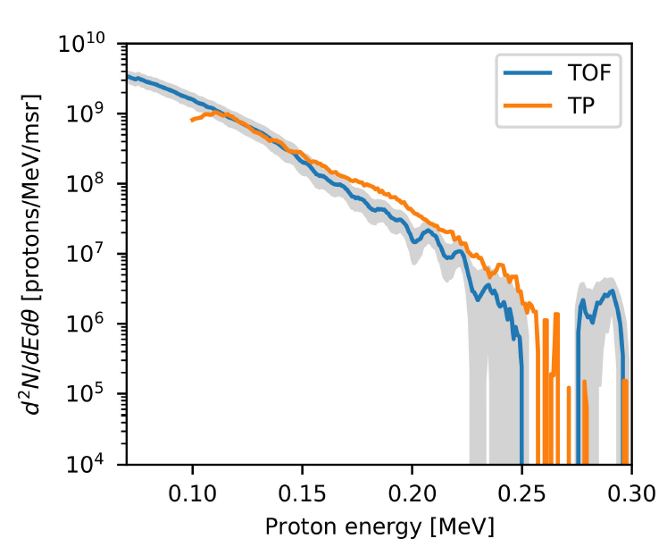
Scanning Time-of-flight (TOF) detector measures the angular spectrum
TOF measurement
fits well to TP measurement

Slide 11
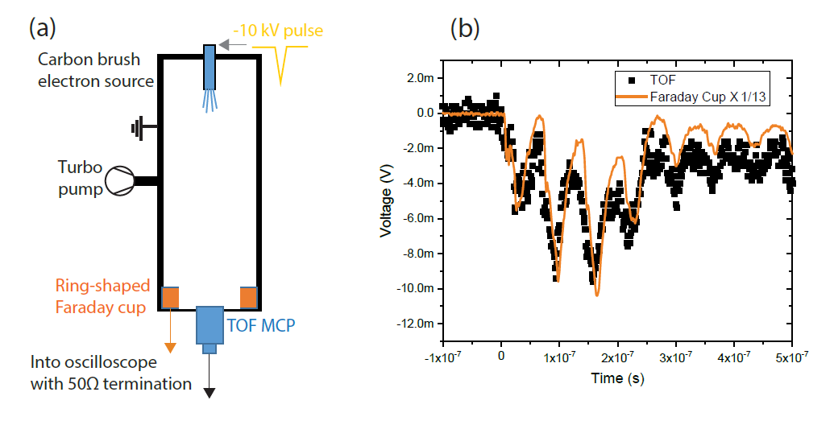
TOF MCP was charge-calibrated using a ring-shaped faraday cup

Slide 12
Acceleration best with shortest gradient possible, duration ~200 fs
Data from Thomson parabola spectrometer

Slide 13
Low divergence proton beams at kHz rate
4 fs
27 fs
200 fs
Experiment
Simulations
)WarpX)
Proton beam: $3°$FWHM, up 0.5 MeV and 100 pC (100 nA average)

Slide 14
Acceleration mechanism: expansion of surface proton disk
The laser pulls surface electrons (“Brunel electrons”) and pushes them into the overdense plasma which screens them.
A positive proton surface disk remains.
The disk expands into vacuum (“Coulomb explosion”).
Proton energy [keV]
Angle [degrees]
Overdense plasma
Interaction layer
Vacuum

Slide 15
A simple analytical model was developed
The laser evacuates surface electrons up to some point $z_{0}$, where the radiation pressure is balanced by the electrostatic pressure.
$$z_{0}≈L_{g}\ln\left(\frac{en_{p0}L_{g}}{2cosθ }\sqrt{\frac{c}{ε_{0}I_{las}}}\right)$$
The accelerating field can be estimated using Poisson’s equation. Assuming a thin positively charged disk,
$$E_{z}\left(t,z\right)=\frac{{\hat{E}}_{las}\left(t\right)\cos{θ}}{2}\left[1−\exp\left(−\frac{{z−z}_{0}}{L_{g}}\right)\right]$$
$$×\left(1−\frac{z}{\sqrt{z^{2}+R_{i}^{2}}}\right)$$
The equation of motion for the accelerated protons is solved numerically, treating them as “test particles” accelerated in the field.

Slide 16
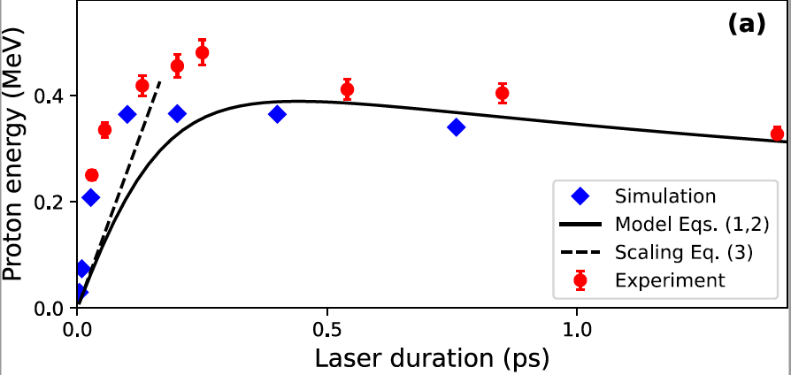
The model agrees well with experiment

Slide 17
Summary
Conclusions
A promising source of low-divergence proton beams @ kHz
Robust: demonstrated at wide range of laser and plasma parameters
Scanning TOF detector + kHz laser allows fast measurements
Acceleration process revealed in simulations and model
Perspectives
Further exploration and characterization
Experiment with joule-class lasers
Potential applications: radio-isotope production for medical use (enabled with few MeV)

Slide 18
Merci de votre attention

