Slide 1
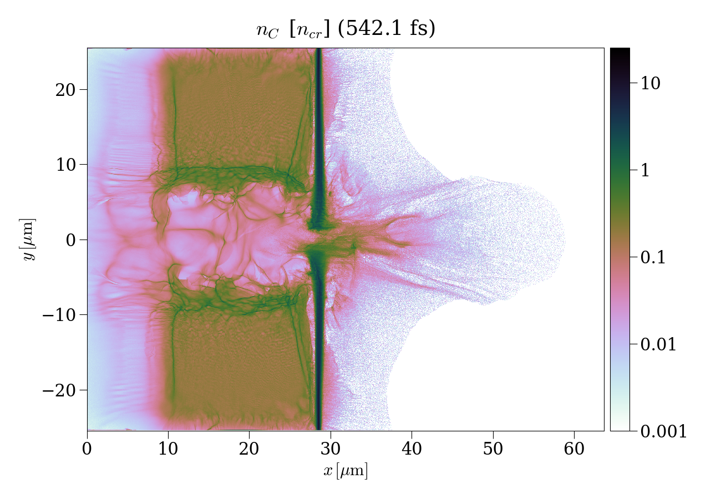
High-flux neutron generation by laser-accelerated ions from single- and double-layer targets
Vojtěch Horný
12th May 2022
Bordeaux, France
GDR APPEL 2022
My co-authors Julien Fuchs, Sophia N. Chen, Laurent Gremillet, Xavier Davoine

Slide 2
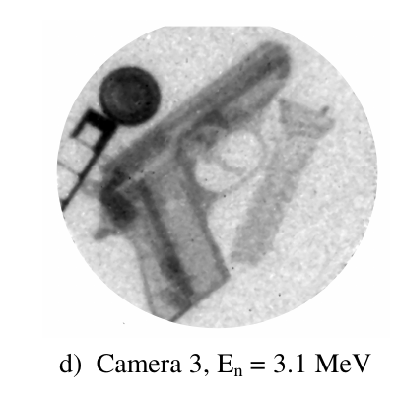
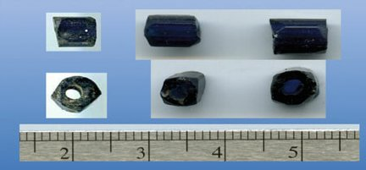
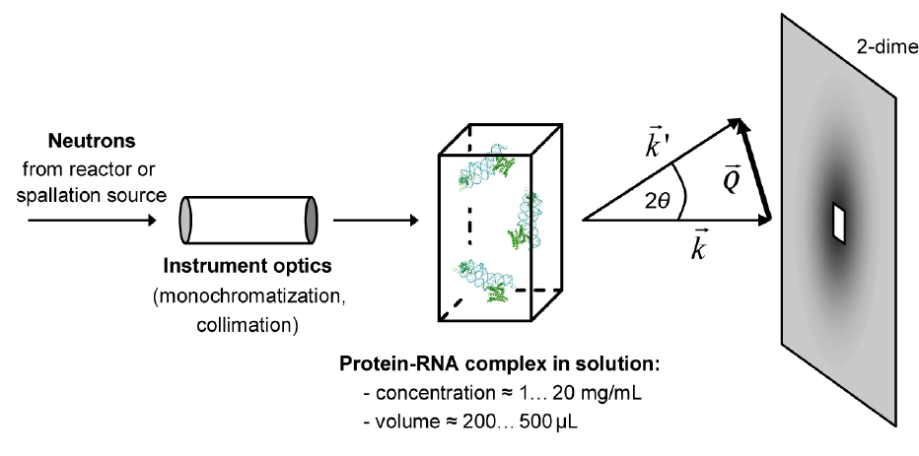
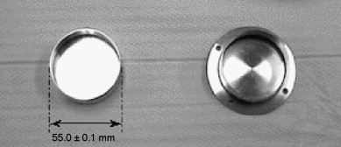
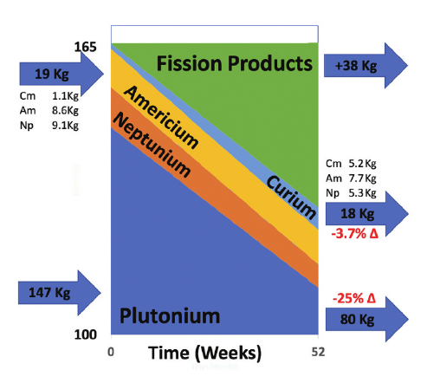
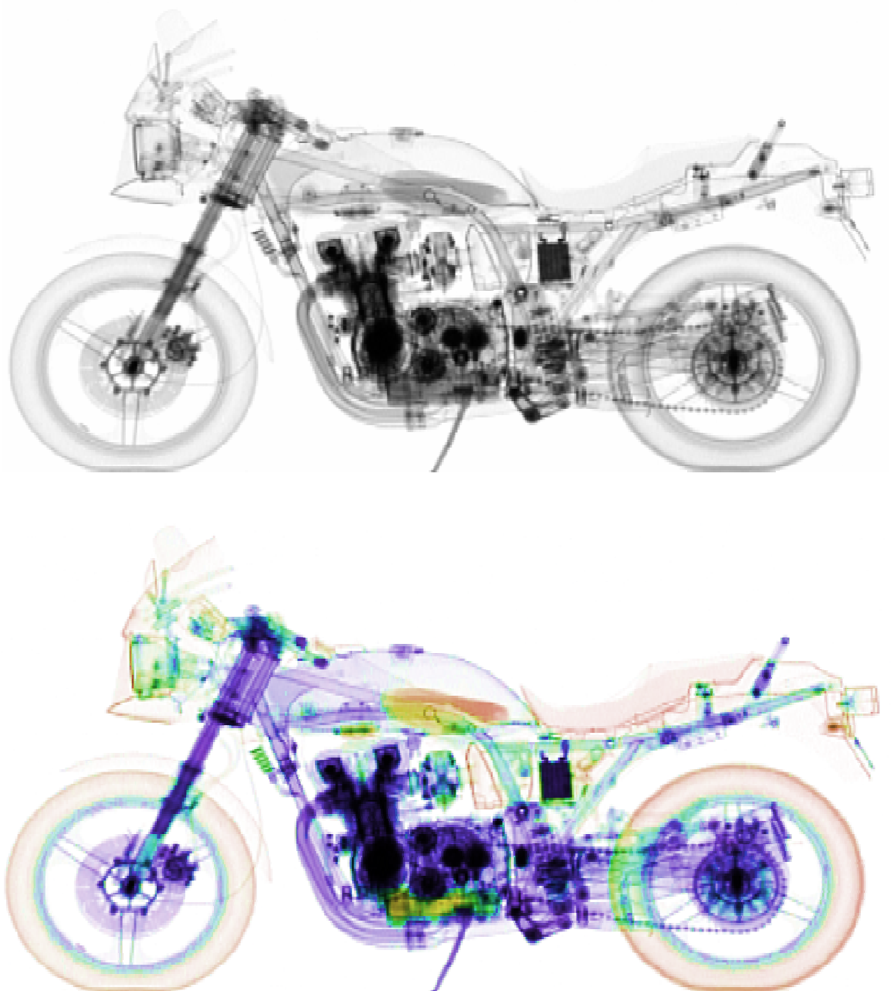
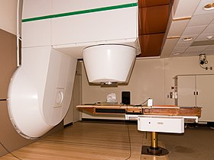
Application of neutrons
Mor, I. et al. Reconstruction of material elemental composition using fast neutron resonance radiography. Phys. Procedia
69, 304–313 (2015).
A very distinctive characteristics compared to ions, electrons or x-rays, making them unique tools to investigate or modify the properties of materials.
Moreau, J. F., et al. "The Dating of a Sixteenth Century Settlement in the Vicinity of Quebec City (Canada) by Means of Elemental Analysis of Glass Beads Through Thermal and Fast Neutron Activation Analyses." Proceedings of the 37th International Symposium on Archaeometry, 13th-16th May 2008, Siena, Italy. Springer, Berlin, Heidelberg, 2011.
Lapinaite, A., Carlomagno, T., and Gabel F. Small-angle neutron scattering of RNA–protein complexes. RNA Spectroscopy. Humana, New York, NY, 2020. 165-188.
Noguere, G. et al. Non-destructive analysis of materials by neutron resonance transmission. NIMA. 575, 476–488 (2007).
Tajima, T., Necas, A., Mourou, G., Gales, S. & Leroy, M. Spent nuclear fuel incineration by fusion-driven liquid transmutator operated in real time by laser. Fusion Sci. Technol. 77, 251–265 (2021).
Fast neutron therapy utilizes high energy neutrons typically between 50 and 70 MeV to treat cancer.
Method: Gray, L. & Read, J. Treatment of cancer by fast neutrons. Nature 152, 53–54 (1943).
Sowerby, B.D. (2007). CRP Report: Fast Neutron and Gamma-Ray Interrogation of Air Cargo Containers.

Slide 3
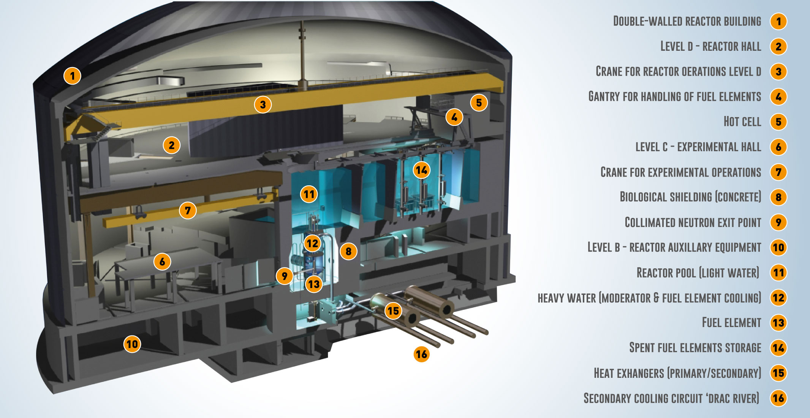
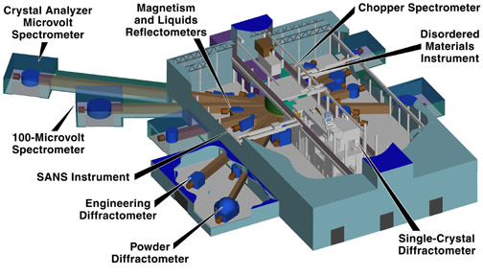
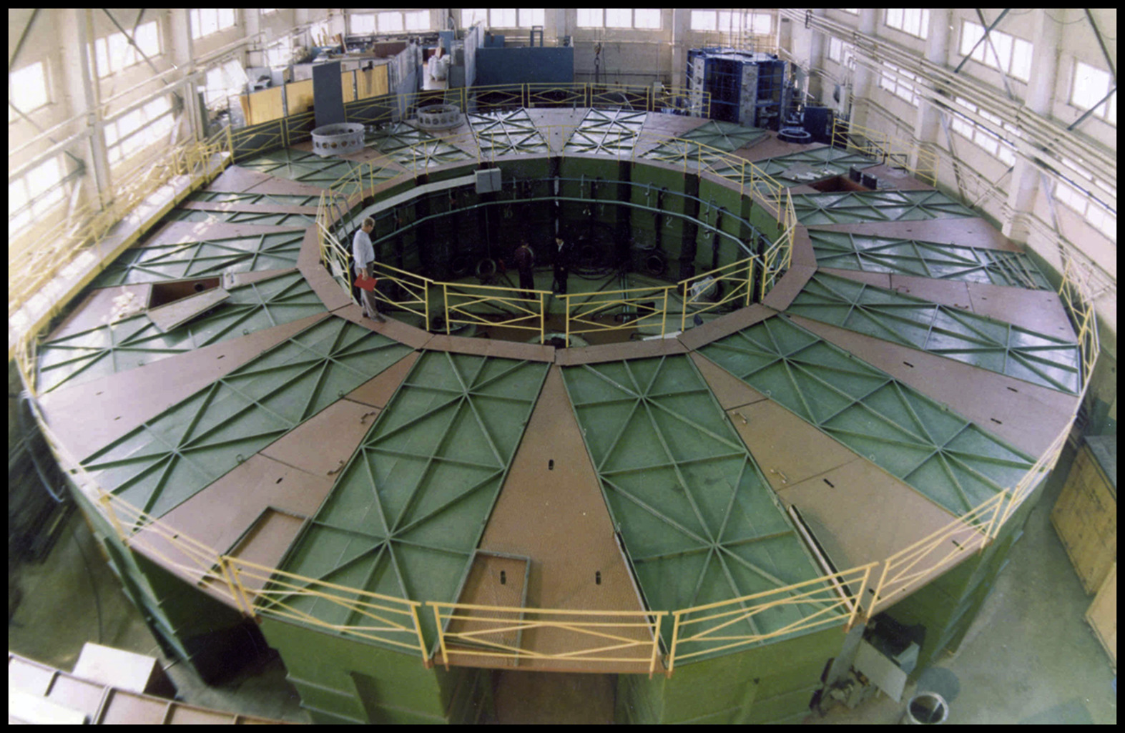
Contemporary neutron sources
Facility | Peak neutron flux [n cm⁻² s⁻¹] | Average neutron flux [n cm⁻² s⁻¹] | Neutron bunch duration | Repetition rate
Institut Laue–Langevin (reactor) | 10¹⁵ | 10¹⁵ | continuous | continuous
Spallation Neutron source (accelerator) | 10¹⁶ | 10¹² | 1 μs | 60 Hz
National Ignition Facility (fusion devoted laser) | 10²⁶ | 10¹⁰ | 100 ps | once a day
GIT-12 (Z-pinch) | 10¹⁸ | 10⁶ | 10 ns | once a day
Current lasers | 10¹⁸ | 10⁶ | 1 ns | once per hour
Cikhardt, J., et al. "Neutron fluence distribution in experiments with 3 MA deuterium gas-puff z-pinch." Physics of Plasmas 27.7 (2020): 072705.

Slide 4
Laser-driven neutron source
State-of-the-art results achieved at PHELIX@GSI, TRIDENT@LANL or LFEX@ILE Osaka.
 | E [J] | τ[fs] | f |  | F [N/sr] | F/E[N/sr/J] | fF [N/sr/s]
Roth, et al. PRL (2013) | 80 | 600 | once per hour | CD₂+Be | 4.40×10⁹ | 5.50×10⁷ | 1.22×10⁶
Kleinschmidt et al., Phys. Plasmas (2018) | 150 | 500 | once per 90 minutes | CD₂+Be | 1.42×10¹⁰ | 9.47×10⁷ | 2.63×10⁶
Huang et al., APL (2022) – new theoretical suggestion | 282 | 1000 | once per hour | CD2+Be | 1.70×10¹¹ | 6.03×10⁸ | 4.72×10⁷
Günther et al., Nat Com. (2022) | 20 | 700 | once per hour | CHO+Au | 4.93×10⁹ | 2.47×10⁸ | 1.37×10⁶
Mirfayzi et al., SciRep (2020) | 300 | 1200 | once per hour | CD₂+Be+H | 8×10⁵ cold

Slide 5
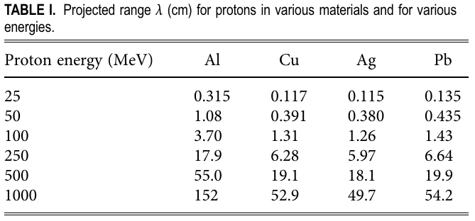
Spallation
A nuclear reaction in which the high-energy level of incident particles causes the nucleus to eject more than three particles, thus changing both its mass number and its atomic number.
cylinder
r = 50 cm
Martinez, B., et al. Numerical investigation of spallation neutrons generated from petawatt-scale laser-driven proton beams. Matter and Radiation at Extremes, 2022, 7.2: 024401.
Kelley, K. C., Gadolinium-148 and Other Spallation Production CrossSection Measurements for Accelerator Target Facilities, Dissertation, Georgia Institute of Technology, 2004.

Slide 6
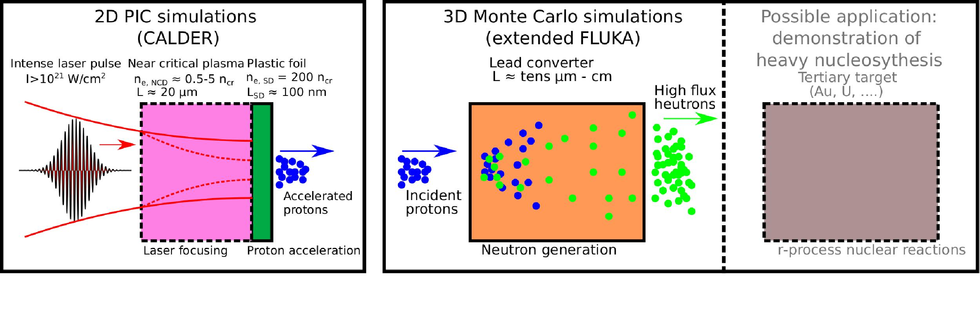
Ultraintense-laser-based neutron generation
High-energy protons from single-/double-layer targets driven by 1 PW Apollon laser
E = 22 J
$a_{0,d}=30.6$
$λ_{0}=0.8$ μm
$D_{0}=5$ μm (FWHM of intensity)
$τ=20$ fs (FWHM of intensity)
nm-thick solid CH foil target, n_{e}=200 n_{cr}
μm-thick near-critical plasma layer + nm-thick solid CH foil target, n_{e}=200 n_{cr}
Apollon-class system operates once per minute - it is rather a nuclear security concern.
In fact, they are capable to run at 10 Hz.
Notes:
NCD layer advantage: reduces the damage caused by prepulses.

Slide 7
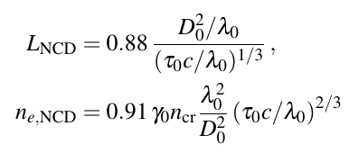
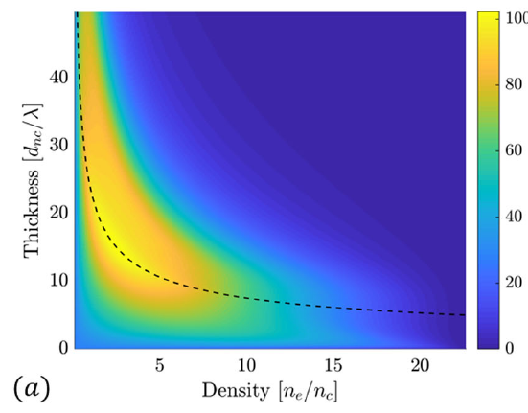
Light intensification in NCD layer
Thin lens approximation predicts optimal focusing for Apollon 1 PW laser parameters:
n_{e}=1.93 n_{cr}
D₀=0.73 µm
L = 14.1 µm
Pazzaglia, A., Fedeli, L., Formenti, A., Maffini, A., & Passoni, M. (2020). A theoretical model of laser-driven ion acceleration from near-critical double-layer targets. Communications Physics, 3(1), 1-13.

Slide 8
Light intensification in NCD layer
2D PIC CALDER simulation of laser propagation in an uniform plasma with n_{e}=0.74 n_{cr}.
Initial maximum intensity is 2×10²¹ W/cm².
After 25.2 µm of propagation in the NCD plasma, the laser reaches a
maximum intensity of 7.4×10²¹ W/cm², within a spot size of D = 1.33 µm.

Slide 9
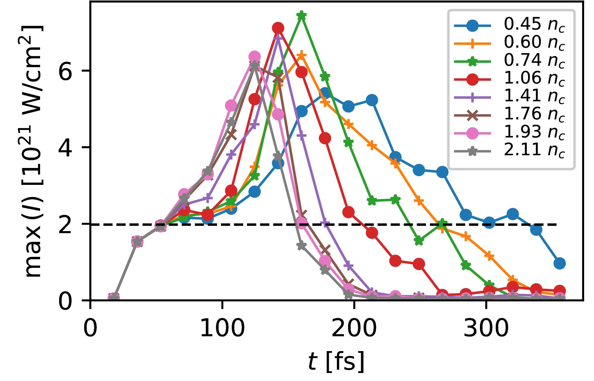
Light intensification in NCD layer
Maximum intensification is around factor of three for NCD densities in range (0.60,2.11) n_{cr}.
Optimum achieved for lower density of 0.74 n_{cr}.

Slide 10
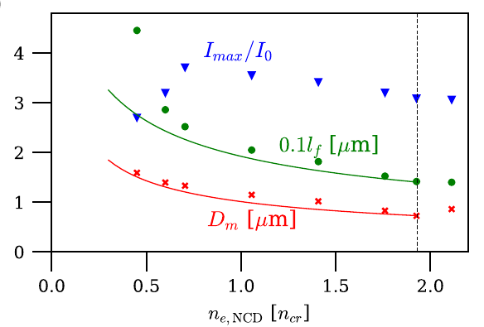
Light intensification in NCD layer
Maximum intensification is around factor of three for NCD densities in range (0.60,2.11) n_{cr}.
Optimum achieved for lower density of 0.74 n_{cr}.
Best focusing agrees with model.
The smallest laser spot does not necessarily lead to the highest intensity.
Pazzaglia, A., Fedeli, L., Formenti, A., Maffini, A., & Passoni, M. (2020). A theoretical model of laser-driven ion acceleration from near-critical double-layer targets. Communications Physics, 3(1), 1-13.
Notes:
Looses energy on the way.

Slide 11
Ultraintense-laser-based neutron generation
High-energy protons from single-/double-layer targets driven by 1 PW Apollon laser
E = 22 J
$a_{0,d}=30.6$
$λ_{0}=0.8$ μm
$D_{0}=5$ μm (FWHM of intensity)
$τ=20$ fs (FWHM of intensity)
nm-thick solid CH foil target, n_{e}=200 n_{cr}
μm-thick near-critical plasma layer + nm-thick solid CH foil target, n_{e}=200 n_{cr}
Apollon-class system operates once per minute - it is rather a nuclear security concern.
In fact, they are capable to run at 10 Hz.
Notes:
NCD layer advantage: reduces the damage caused by prepulses.

Slide 12
PIC simulations of proton acceleration
Brantov L
Other parameters are the same:
Plasma: n_{e,SD} = 200 n_{cr}
Laser: D₀ = 5 μm, a₀ = 30.6, τ = 20 fs
Last column shows total number of accelerated protons or deuterons with energy above 1 MeV.
Notes:
6: optimum case in terms of locusing

Slide 13
Proton acceleration with a single- and double-layer targets
Case #2
Case #6
Tight laser self-focusing in near-critical plasma leads to significantly faster protons but with reduced number and larger angular divergence!

Slide 14
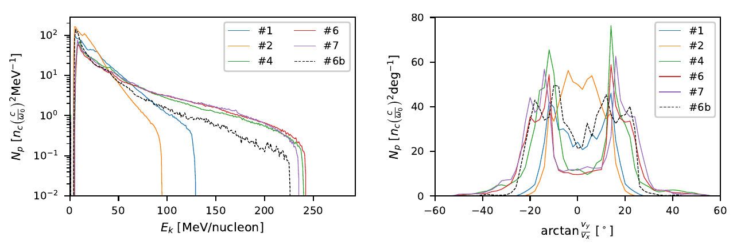
Ion acceleration with a single- and double-layer targets
NCD layer greatly enhances the final ion energy.
NCD decreases the total ion number and worsens the divergence.

Slide 15
Ultraintense-laser-based neutron generation
High-energy protons from single-/double-layer targets driven by 1 PW Apollon laser
E = 22 J
$a_{0,d}=30.6$
$λ_{0}=0.8$ μm
$D_{0}=5$ μm (FWHM of intensity)
$τ=20$ fs (FWHM of intensity)
nm-thick solid CH foil target, n_{e}=200 n_{cr}
μm-thick near-critical plasma layer + nm-thick solid CH foil target, n_{e}=200 n_{cr}
Apollon-class system operates once per minute - it is rather a nuclear security concern.
In fact, they are capable to run at 10 Hz.
Notes:
NCD layer advantage: reduces the damage caused by prepulses.

Slide 16
Monte Carlo simulation with FLUKA
Extensions of the FLUKA code
Loading of the primary particles from CALDER produced input
Transformation from 2D to 3D assuming the cylindrical symmetry
Each position (x,y) and momentum (p_{x},p_{y}) rotated by a random azimuthal angle
Particle weight divided by the radial distance from the axis
Implementation of the routine for the tracking of the particle flux temporal profile
Temporal profile considered both at the primary particles and all secondaries.
Simulation parameters
Always at least 3.6×10⁸ primary particles used.
Convergence tests conducted up to 3.6×10¹⁰ primaries.
Converter is a cylinder of r = 3 cm.
Further studies on the effect of the laser accelerated electrons and generated x-rays
their contribution to the final neutron yield is negligible.
Kudos to Bertrand Martinez for his contribution to the implementation of those routines.

Slide 17
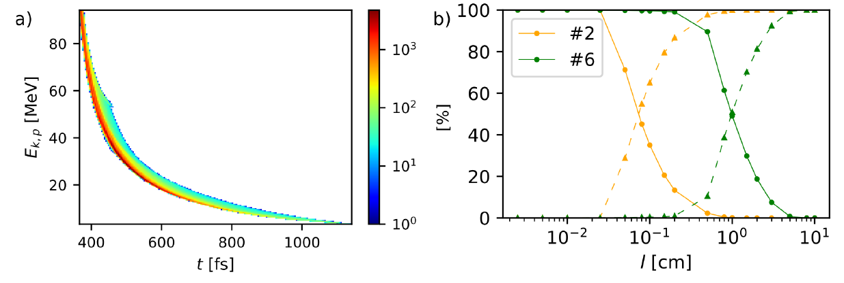
Proton transport through Pb converter
Incident proton spectrogram #2
Monte Carlo simulation
Transported
Absorbed
Thin converters: l ≤ 250 μm (#2) or 2 mm (#6), ≤ 1% of incident energy deposited
Thick converters: l > 0.5 mm (#2) or 5 cm (#6), all incident energy deposited

Slide 18
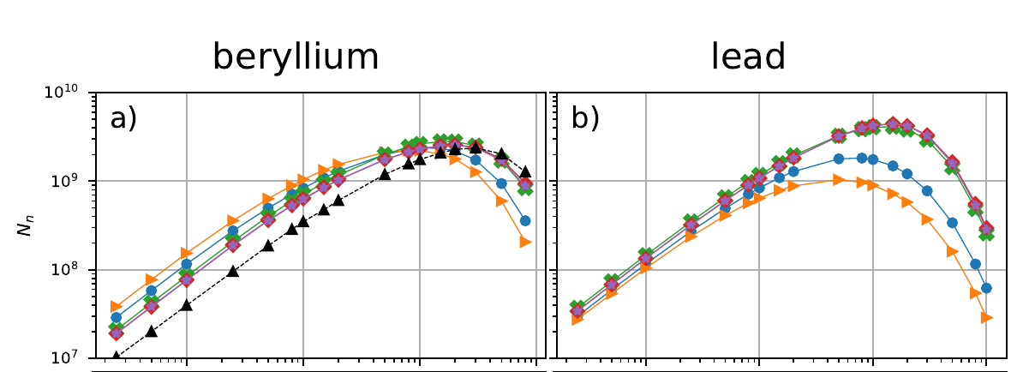
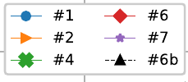
Neutron source features
Total neutron number emitted from the rear side of the converter (i.e. in 2π sr)
Highest neutron production already in primary double layer target and lead converter.
Only a weak dependence on the exact parameters of the front NCD layer.

Slide 19
Neutron source features
Neutron source FWHM at the rear side of the converter
The dependence $N_{n}\left(l,r\right)$ fitted by the Gaussian distribution.
For converter thicknesses higher than ~0.5 mm source size depends linearly on l.

Slide 20
Neutron source features
The highest immediate neutron flux
Single layer proton acceleration targets in combination with thin converters can provide immediate flux above 10²³ neutrons cm⁻²s⁻¹.
The strong dependence on the source size surpasses the relatively low neutron number.
Notes:
For such thin converters, their thickness l is lower than the proton mean free path. The protons do, in this case, experience at most one inelastic collision. On this reason, the highest peak neutron flux is
achieved for the proton acceleration configuration #2 having a thicker single-layer target and a 25 μm thick lead converter. It is a counter-intuitive result, as Figure 4a shows that this proton acceleration configuration corresponds to the generation of the lowest proton energies of all considered cases. The better performance in lead is due to its significantly higher neutron multiplicity, especially for the protons above ≳ 8 MeV.

Slide 21
Neutron fluence and energy-angle spectra
Proton acceleration #2 + 100 μm thick Pb converter
1.04 × 10⁸ neutrons emitted per shot
Transverse neutron source size ∼ 95 μm
Maximum immediate neutron flux ∼ 1.41 × 10²³ n cm⁻² s⁻¹
Maximum integrated neutron flux ∼ 1.27 × 10⁶ n sr⁻¹

Slide 22
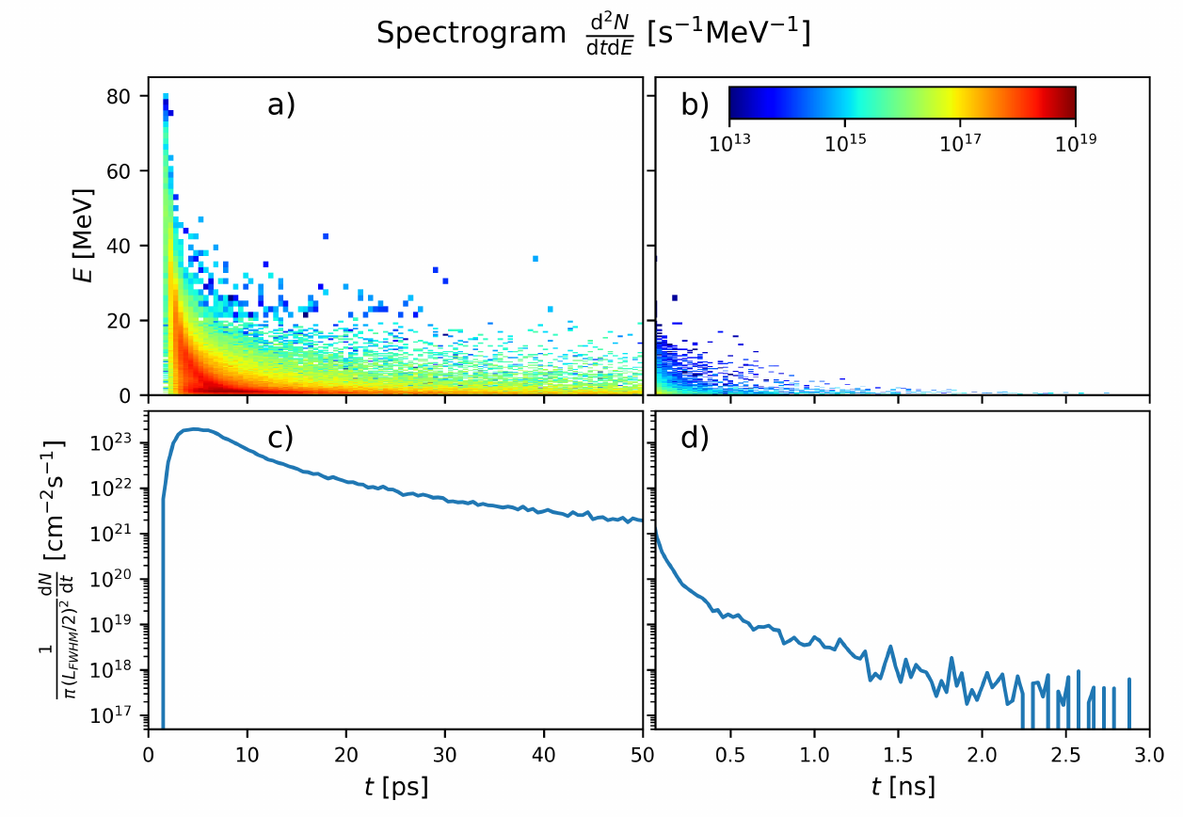
Neutron source features
A relatively high $N_{n}=1.54×{10}^{8}$
$F=1.98×{10}^{23}$ neutrons cm⁻²s⁻¹
The most energetic neutrons are delivered within a few ps.
After 1 ns, $F≈{10}^{19}$ neutrons cm⁻²s⁻¹,
The less energetic neutrons continuously arrive.
A flux higher than ${10}^{20}$ neutrons cm⁻²s⁻¹ is maintained for 240 ps in this case.
Notes:
For such thin converters, their thickness l is lower than the proton mean free path. The protons do, in this case, experience at most one inelastic collision. On this reason, the highest peak neutron flux is
achieved for the proton acceleration configuration #2 having a thicker single-layer target and a 25 μm thick lead converter. It is a counter-intuitive result, as Figure 4a shows that this proton acceleration configuration corresponds to the generation of the lowest proton energies of all considered cases. The better performance in lead is due to its significantly higher neutron multiplicity, especially for the protons above ≳ 8 MeV.

Slide 23
Neutron source features
The neutron flux at the axis: the quantity important for applications
In 1 PW regime, neutron generation is still slightly better for accelerated deuterons and a Be converter.
The strong forward directionality of the nucleons released by the deuteron break-up.

Slide 24
Neutron fluence and energy-angle spectra
Proton acceleration #6 + 2 cm thick Pb converter
4.25 × 10⁹ neutrons emitted per shot
Transverse neutron source size ∼ 1.74 cm
Maximum immediate neutron flux ∼ 1.27 × 10¹⁸ n cm⁻² s⁻¹
Maximum integrated neutron flux ∼ 8.40 × 10⁷ n sr⁻¹

Slide 25
Comparison to state-of-the-art
 | E [J] | τ[fs] | f |  | F [N/sr] | F/E[N/sr/J] | fF [N/sr/s]
Roth, et al. PRL (2013) | 80 | 600 | once per hour | CD₂+Be | 4.40×10⁹ | 5.50×10⁷ | 1.22×10⁶
Kleinschmidt et al., Phys. Plasmas (2018) | 150 | 500 | once per 90 minutes | CD₂+Be | 1.42×10¹⁰ | 9.47×10⁷ | 2.63×10⁶
Huang et al., APL (2022) – new suggestion | 282 | 1000 | once per hour | CD2+Be | 1.70×10¹¹ | 6.03×10⁸ | 4.72×10⁷
Günther et al., Nat Com. (2022) | 20 | 700 | once per hour | CHO+Au | 4.93×10⁹ | 2.47×10⁸ | 1.37×10⁶
#2 | 22 | 20 | once per minute | CH₂+Pb | 4.24×10⁸ | 1.93×10⁷ | 7.07×10⁶
#6 | 22 | 20 | once per minute | CH₂+Pb | 1.21×10⁹ | 5.50×10⁷ | 2.01×10⁷
#6b | 22 | 20 | once per minute | CD₂+Be | 3.09×10⁹ | 1.40×10⁸ | 5.15×10⁷
Commercially available PW systems could in principle operate at 10 Hz.
Number of neutrons per pulse energy is above 10⁸ n sr⁻¹ J⁻¹.
We expect the highest fF of 5.15×10⁷ n sr⁻¹ s⁻¹.

Slide 26
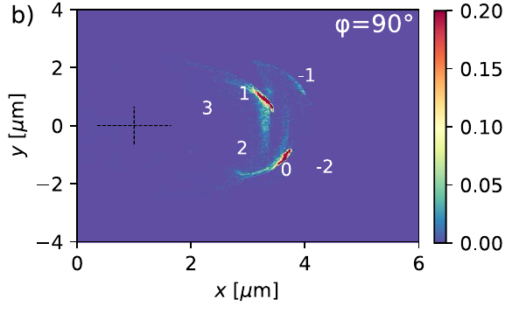
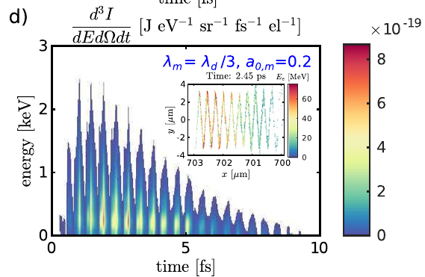
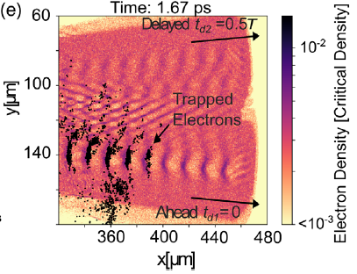
Conclusion
Advertisement
Horný, V., & Veisz, L. (2021). Generation of single attosecond relativistic electron bunch from intense laser interaction with a nanosphere. Plasma Physics and Controlled Fusion, 63(12), 125025.
Contemporary 1 PW, fs laser systems
Compact setup for high flux neutron sources.
non-destructive sampling of matter
investigation of the neutron damage in fusion devices
Front near critical density layer enhances the ion acceleration and the neutron yield.
1 PW power is just below the border where the spallation start to dominate over deuteron fusion → a promising scaling for 10 PW upgrade
Possible configurations should deliver:
neutron flux above 10⁹ n sr⁻¹
peak neutron flux above 10²³ n cm⁻²s⁻¹
time-averaged neutron flux of 10⁹ n sr⁻¹s⁻¹, with a simple thin foil as a primary target
time-averaged neutron flux above 10⁷ n sr⁻¹s⁻¹ is foreseen using double-layer targets with deuterated solid layer
Horný, V., Krůs, M., Yan, W., & Fülöp, T. (2020). Attosecond betatron radiation pulse train. Scientific Reports, 10(1), 1-8.
Chen, Q., Mašlárová, D., Wang, J., Li, S. X., Horný, V. & Umstadter D. (2022). Transient relativistic plasma grating to tailor high-power laser fields, wakefield plasma waves, and electron injection. Physical Review Letters, 128, 164801.
Dr Vojtěch Horný vojtech.horny@polytechnique.edu https://ft.nephy.chalmers.se/~vojtech

Slide 27
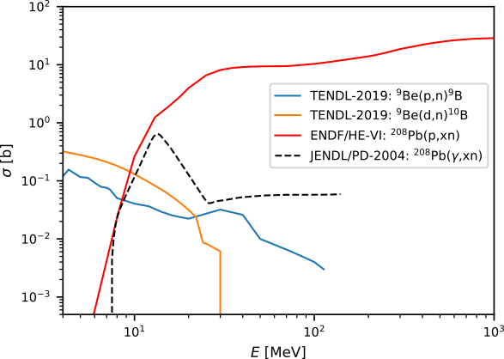
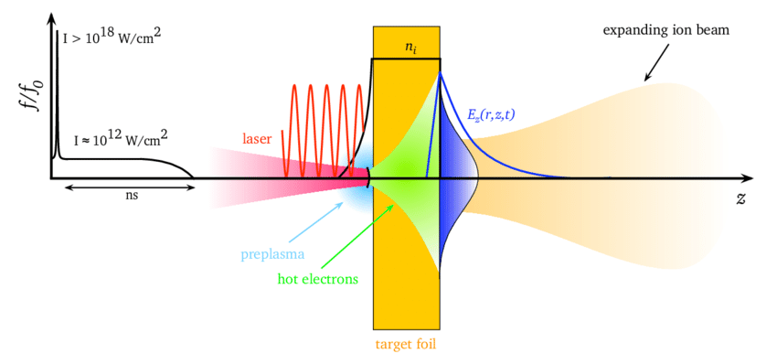
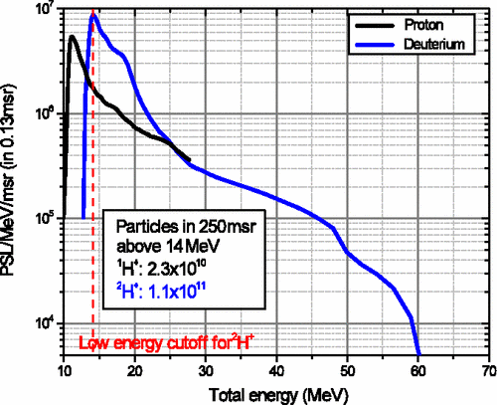
Be(d,n) reactions vs. spallation
TNSA accelerated deutrons
Roth, M, Schollmeier, M, Ion Acceleration—Target Normal Sheath Acceleration, e Proceedings of the CAS-CERN Accelerator School: Plasma Wake Acceleration, Geneva, Switzerland, 23–29 November 2014
Roth, M., et al. Bright laser-driven neutron source based on the relativistic transparency of solids. Physical review letters, 2013, 110.4: 044802.

Slide 28
Laser energy conversion to particles
Optimum near-critical plasma (NCP) can absorb over 40% of laser energy
Fast electrons from NCP enhance proton acceleration from solid foil
10 − 12 % laser energy conversion into protons
#2
#6

