Slide 1

Table Ronde SFP@150
`Les Grandes Questions Ouvertes et Enjeux Fondamentaux de la Physique’
Antoine Georges
Juillet 2023

Slide 2
Quantum Matter: Keys to Success
Experiments
Pushing the limits
New Instrumentation
New Techniques
Theory
Simple concepts
and basic mechanisms
Quantitative methods
The magic
Square
Devices and Control
Nanoscale devices
e.g gating
Atomic-scale synthesis
e.g. oxide MBE
`Synthetic materials’
e.g. TBLG/Twisted TMOs
Control by light:
Laser control, Cavities,…
Materials Science and Chemistry
New materials, bulk or `artificial’
High quality samples
New elaboration methods

Slide 3
Materials Discovery
(A never-ending story that keeps us alive and busy)
1930-1950
Classic correlated materials: TMs, Oxides/TMOs
Organic conductors (1D, 2D)
Heavy fermions
Cuprates
Renewal of interest in TMOs: Sr₂RuO₄, RNiO₃, Manganites, Iridates, and many many others…
Mott to superfluid transition of cold atomic gases in optical lattices
Topological Insulators
Oxide heterostructures, SC in LAO/STO
Fe-based superconductors
→ `Hund metals’ (New route to strong correlations)
SC in pressurized H₂S 155GPa → other hydrides
SC in twisted bilayer graphene
Twisted TMDCs
→ Interplay of correlations and topology/Flat bands
→ Strong coupling to light, excitonic physics
SC in infinite-layer RNiO₂
Low density metals (STO), kagome metals
1980’s
1986
2002
2005
2007
2008
2015
2018
AND
SO
ON…
2019

Slide 4
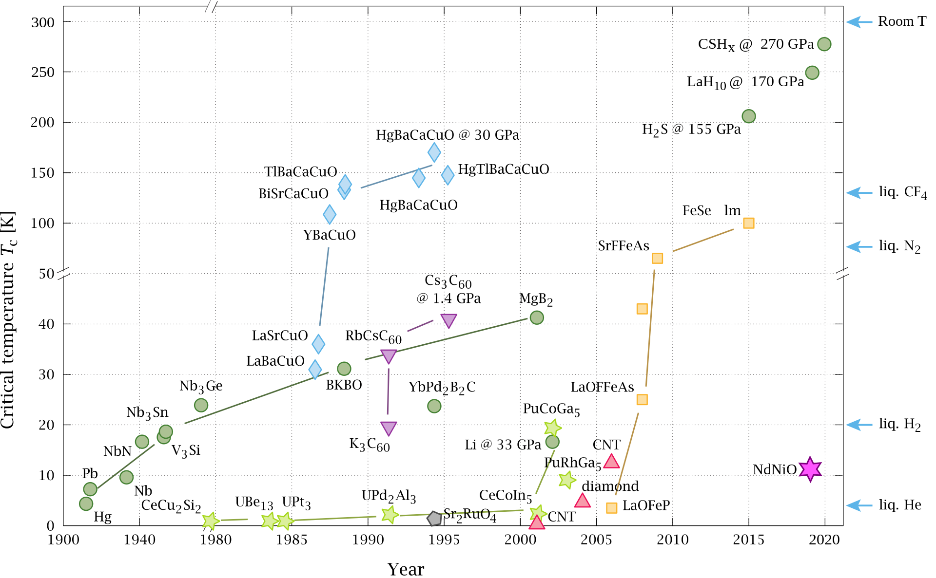
Timeline of Superconductor Discoveries (Wikipedia)

Slide 5
Novel Materials
- `Semi-synthetic’
- Devices
Novel forms of Quantum Matter:
- Cold atoms in optical lattices
- Arrays of trapped Rydberg atoms

Slide 6
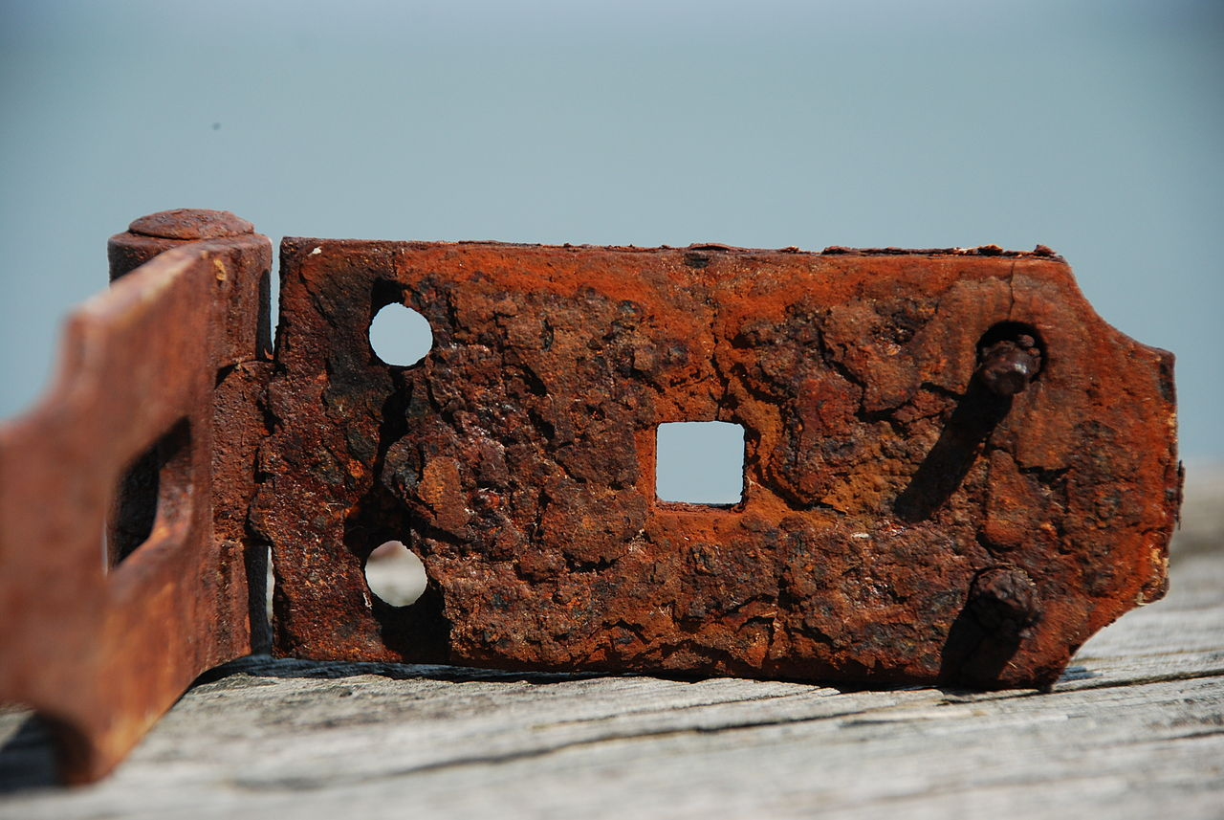
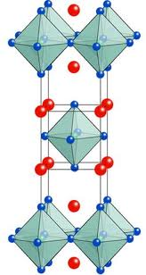
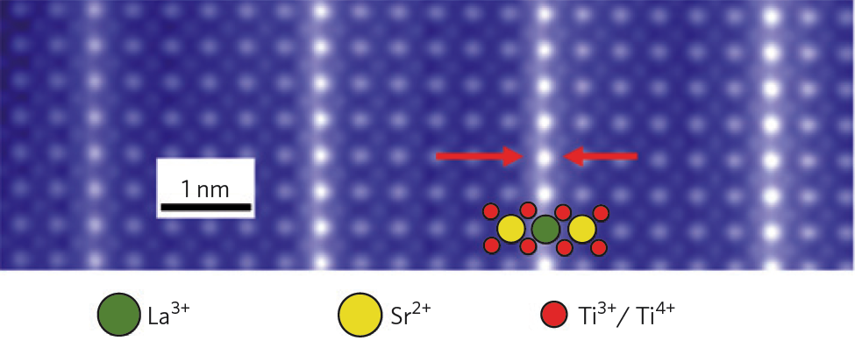
OXIDES:
Old and
New
Rust: oxyde/hydroxide. (wikipedia)
La_{2-x}Sr_{x}CuO₄
« Artificial materials »
MBE allows for
synthesis one atomic
layer at a time
Hétérostructure LaTiO₃/SrTiO₃

Slide 7
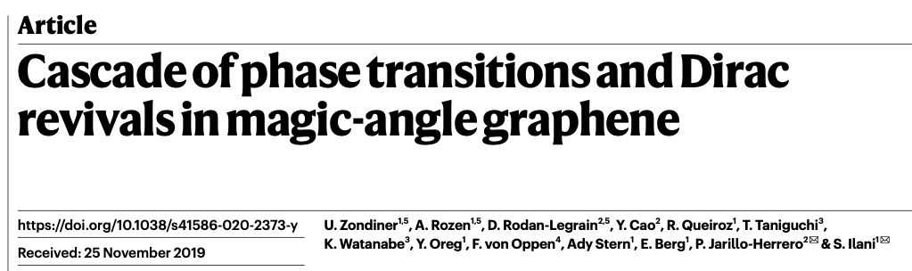
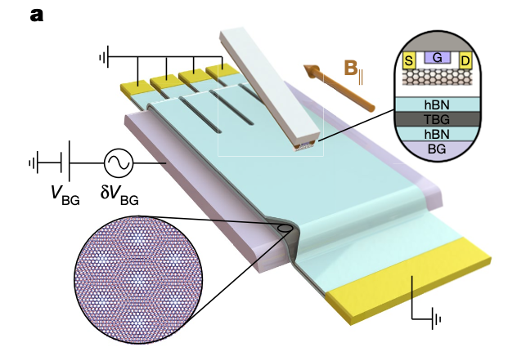
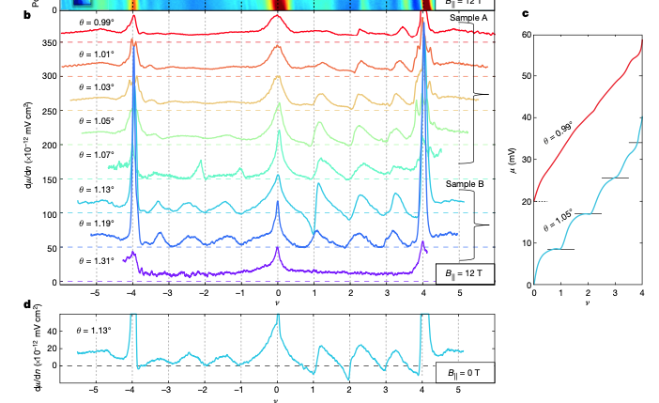
Example: Measurement of Electronic Compressibility

Slide 8
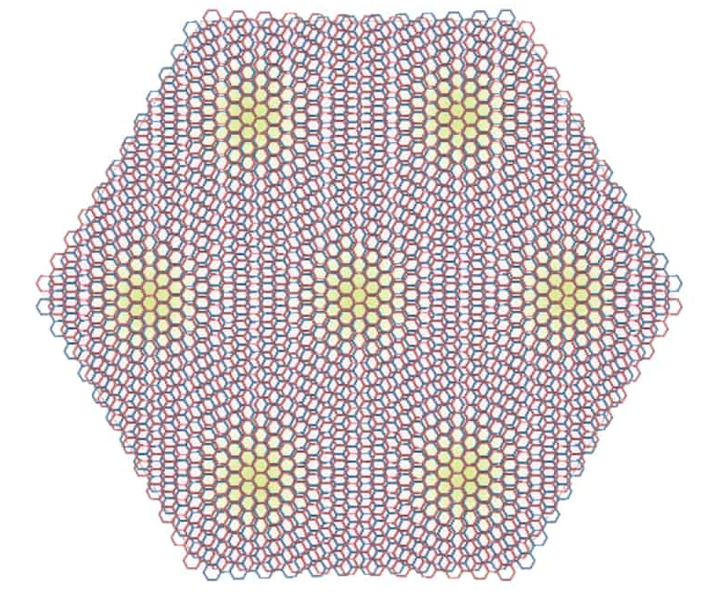
`Twistronics’
Image courtesy Pablo Jarillo-Herrero

Slide 9
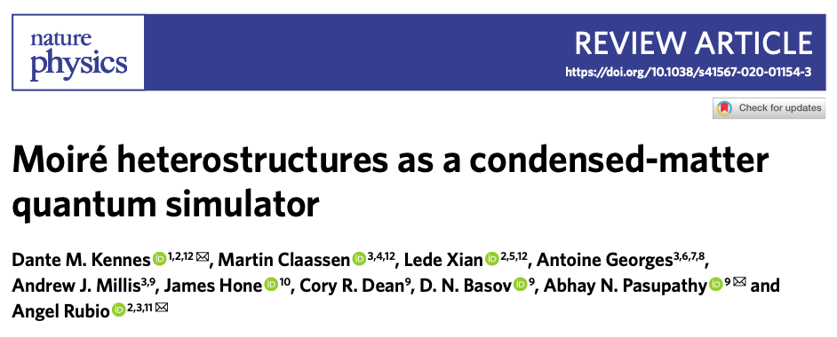
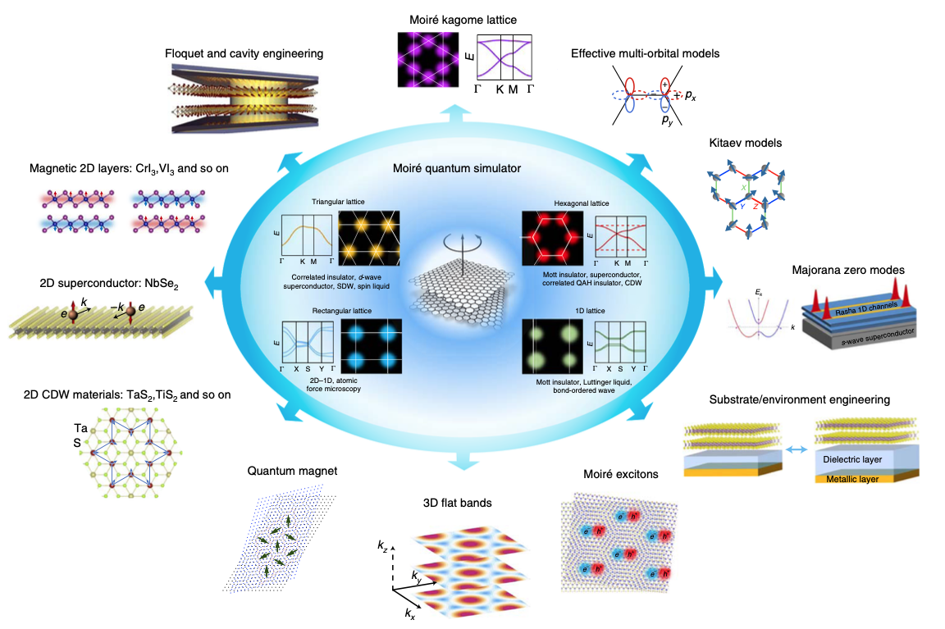

Slide 10
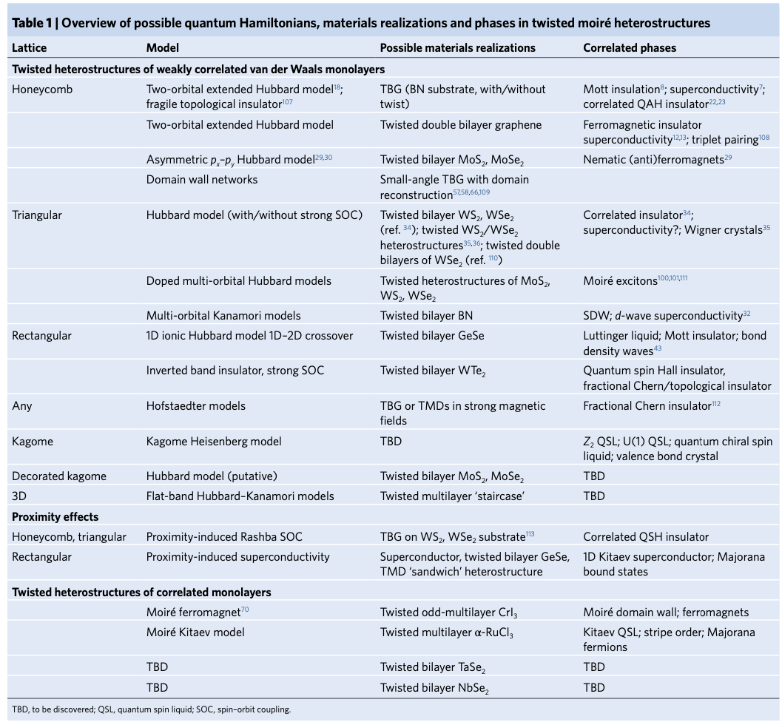

Slide 11
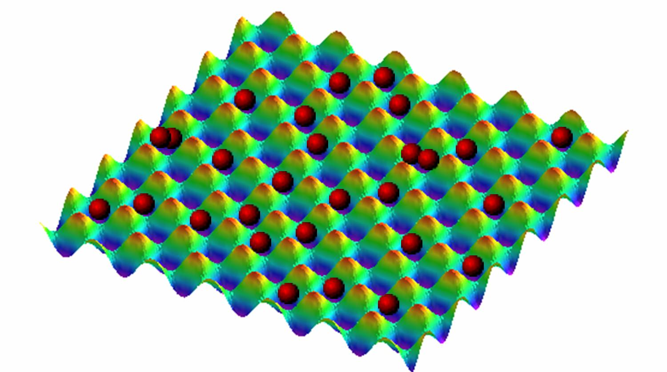
Crystals of Light and Atoms: cold atomic gases in optical lattices
At the frontier
of condensed matter physics
and quantum optics…

Slide 12
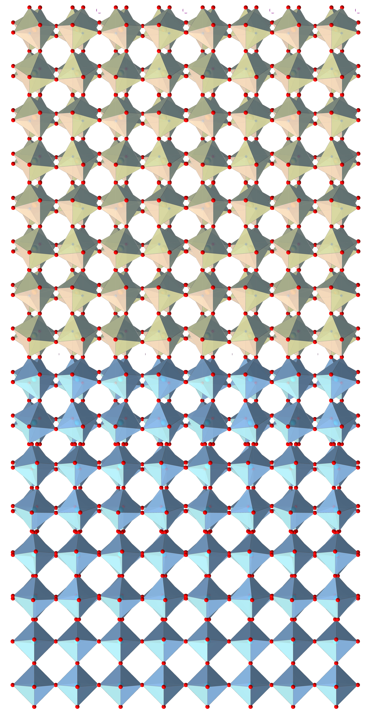
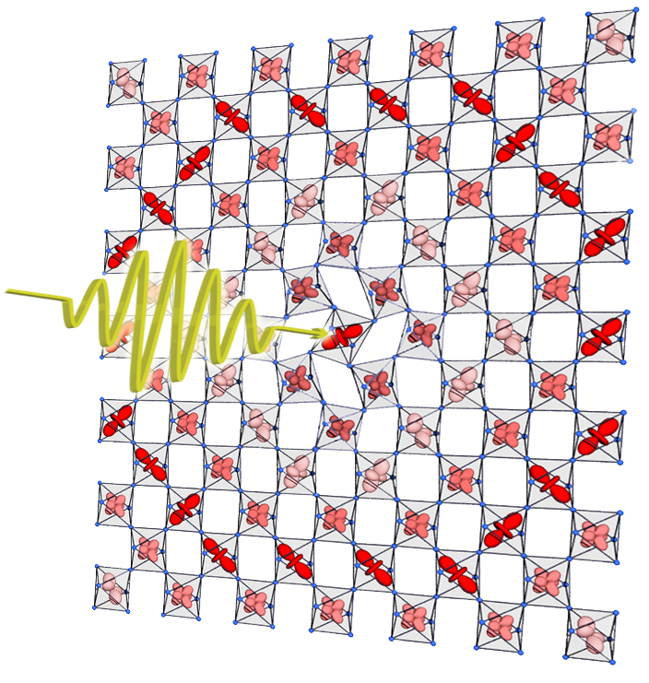
Two novel routes to Control
Selective control with LIGHT
Artificial Materials:
Strained films and
Heterostructures
“Oxytronics/Mottronics’’

Slide 13
CONTROL: Traditional and Novel routes
Bandwidth | Pressure Size of rare-earth Distortion Tolerance factor 3d,4d,5d metal | Strained thin films and heterostructures Light/non-linear phononics
Crystal field, Orbital degeneracy | Size of rare-earth Distortion Tolerance factor | - Same -
Filling of shell | Chemistry | Ionic liquids Gating
Doping | Sr,Ca²⁺ → La, R ³⁺
Interaction strength | 3d,4d,5d metal | Tunable dielectric gating ? Light ?
Charge-Transfer | Change apical oxygen distance Change ligand: O→ S, Se… | Light ?

Slide 14
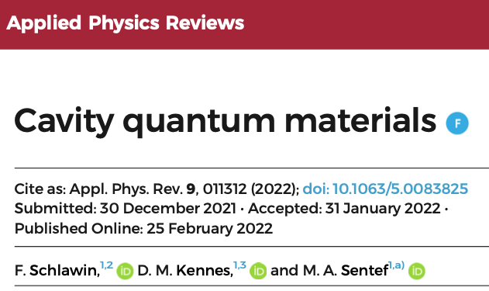
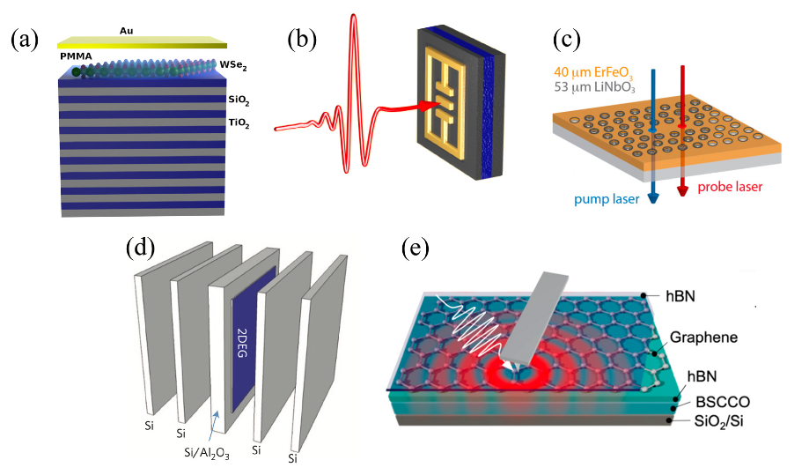

Slide 15
What About Theory?
Up to the late 1980’s our understanding of strong correlations was quite poor…
Huge progress in 30 year!
The raise of computational methods: theorists now have a right and a left hand (analytical/numerical)!
Currently: very exciting times/recent developments in computational methods
Merging of quantum many-body methods with realistic electronic structure → theory can be realistic (at last!)

Slide 16
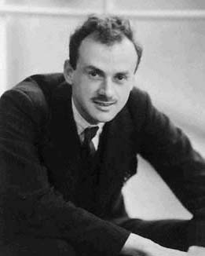
Paul Dirac, 1929
``Quantum Mechanics of Many-Electron Systems’’
``The general theory of quantum mechanics
is now almost complete (…).
The underlying physical laws necessary for the mathematical theory of a large part of physics
and the whole of chemistry
are thus completely known,
and the difficulty is only that
the exact application of these laws
leads to equations much too complicated to be soluble.''
P. A. M. Dirac, "Quantum Mechanics of Many-Electron Systems“,
Proceedings of the Royal Society of London, Series A, Vol.123,
April 1929, pp 714.

Slide 17
Quantum Mechanics of 10²¹ interacting particles !
Eigenstates (wave-functions)
and Eigenvalues (Energy spectrum)

Slide 18
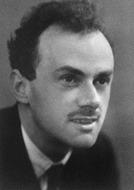
`Dirac’s program’ (same 1929 article):
`` It therefore becomes desirable that approximate practical methods of applying quantum mechanics
should be developed, which can lead
to an explanation of the main features
of complex atomic systems
without too much computation.’’
Dirac’s program is not yet fully implemented
but great progress is being made
we can hope that this will be
a major success of the 21st century!
[Note that ``without too much computation’’ has
an entirely different meaning now than in the 1930’s ☺]

Slide 19
Computational Methods: Handshake!
`Embedding’ Methods: DMFT and extensions
(cluster DMFT etc.) Organizing Principle: Locality
T/t
Monte Carlo
Methods:
DiagMC
AFQMC
…
Temperature
Handshake: current frontier /recent progress !
Finite-T extensions (e.g. METTS)
T=0 Methods: DMRG, Tensor Networks, MPS
Organizing principle: Entanglement.
Recently: Neural Quantum States
U/t
Coupling

Slide 20
Looking Immediately Ahead:
Flat band physics
Interplay of topology and correlations?
Twisted layered oxides
Light/Cavity control
Finalize understanding of `simple’ models
Pushing the combination of electronic structure + many body methods to the next step: predictive/design
Can we reach predictive ability for e..g superconductivity in strongly correlated materials

Slide 21
Two Big Challenges for the 21st Century
The Dirac program: computational solution of the `quantum many body problem’
Materials by Design (Solid-State and Molecules)

