Slide 1
immune cell chasing a bacteria
coordinated motion of bird flocks
How physics makes biology work
or
Statistical biological Physics
or
Statistical physics of Living Matter
Aleksandra M Walczak
Laboratoire de Physique - ENS, CNRS

Slide 2
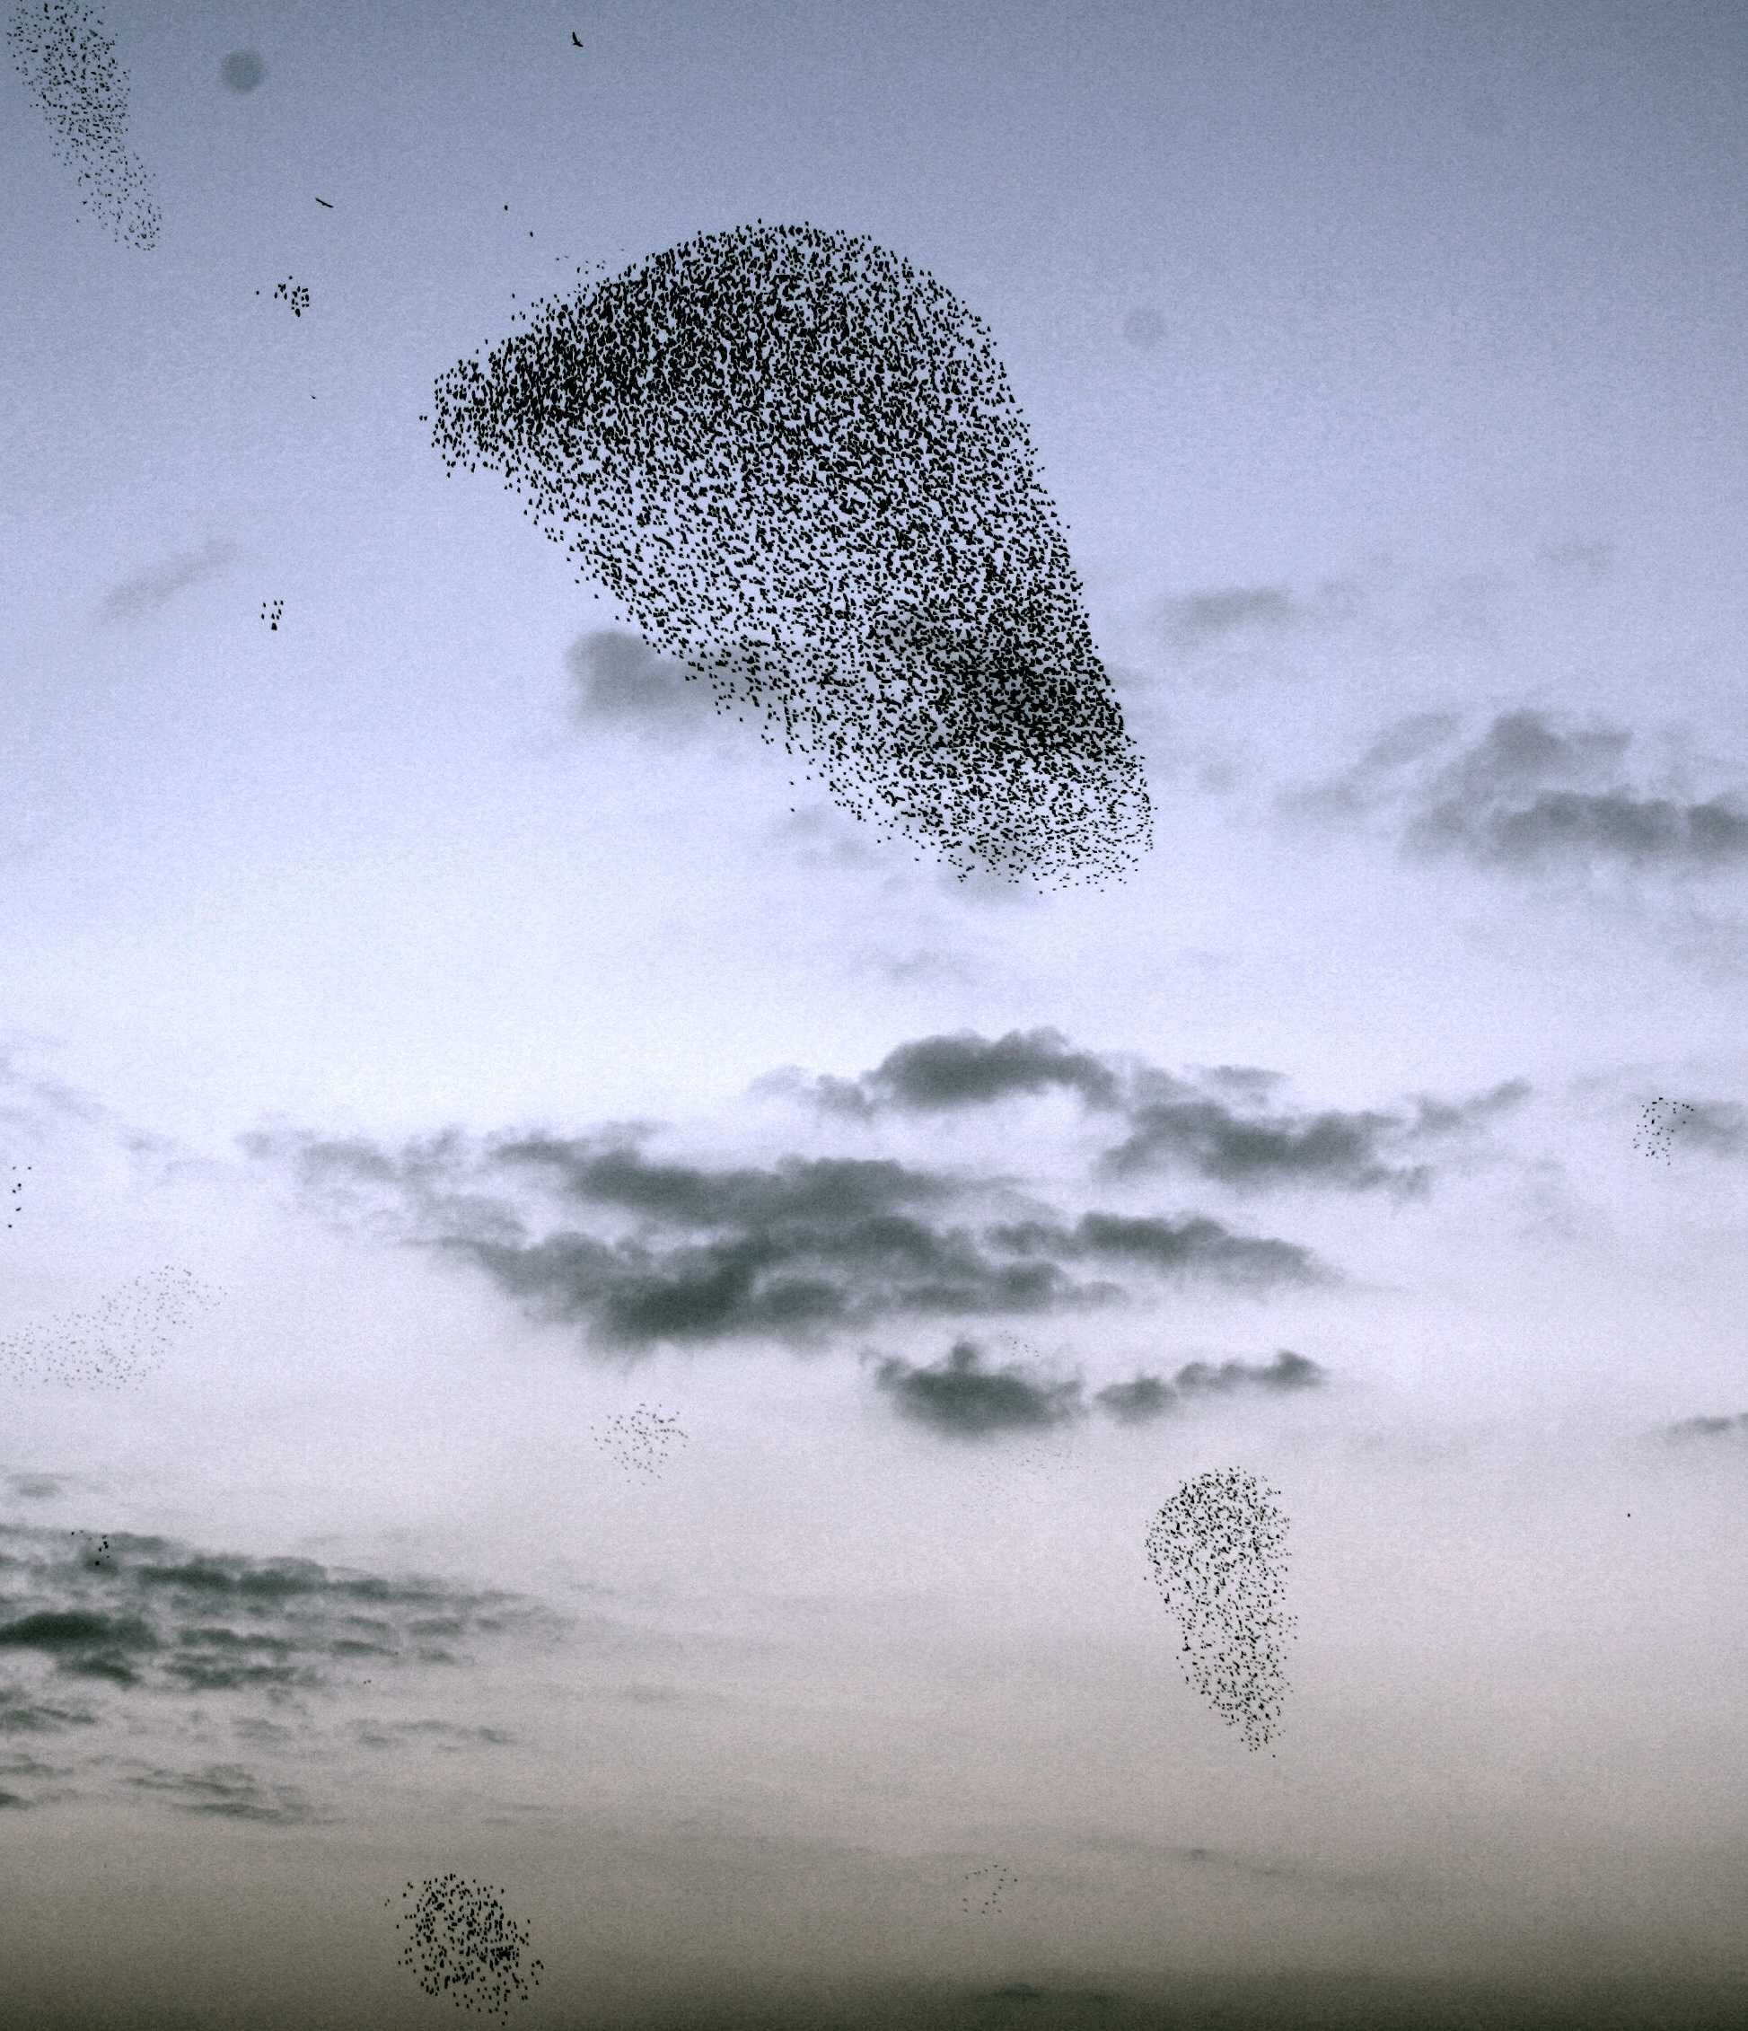
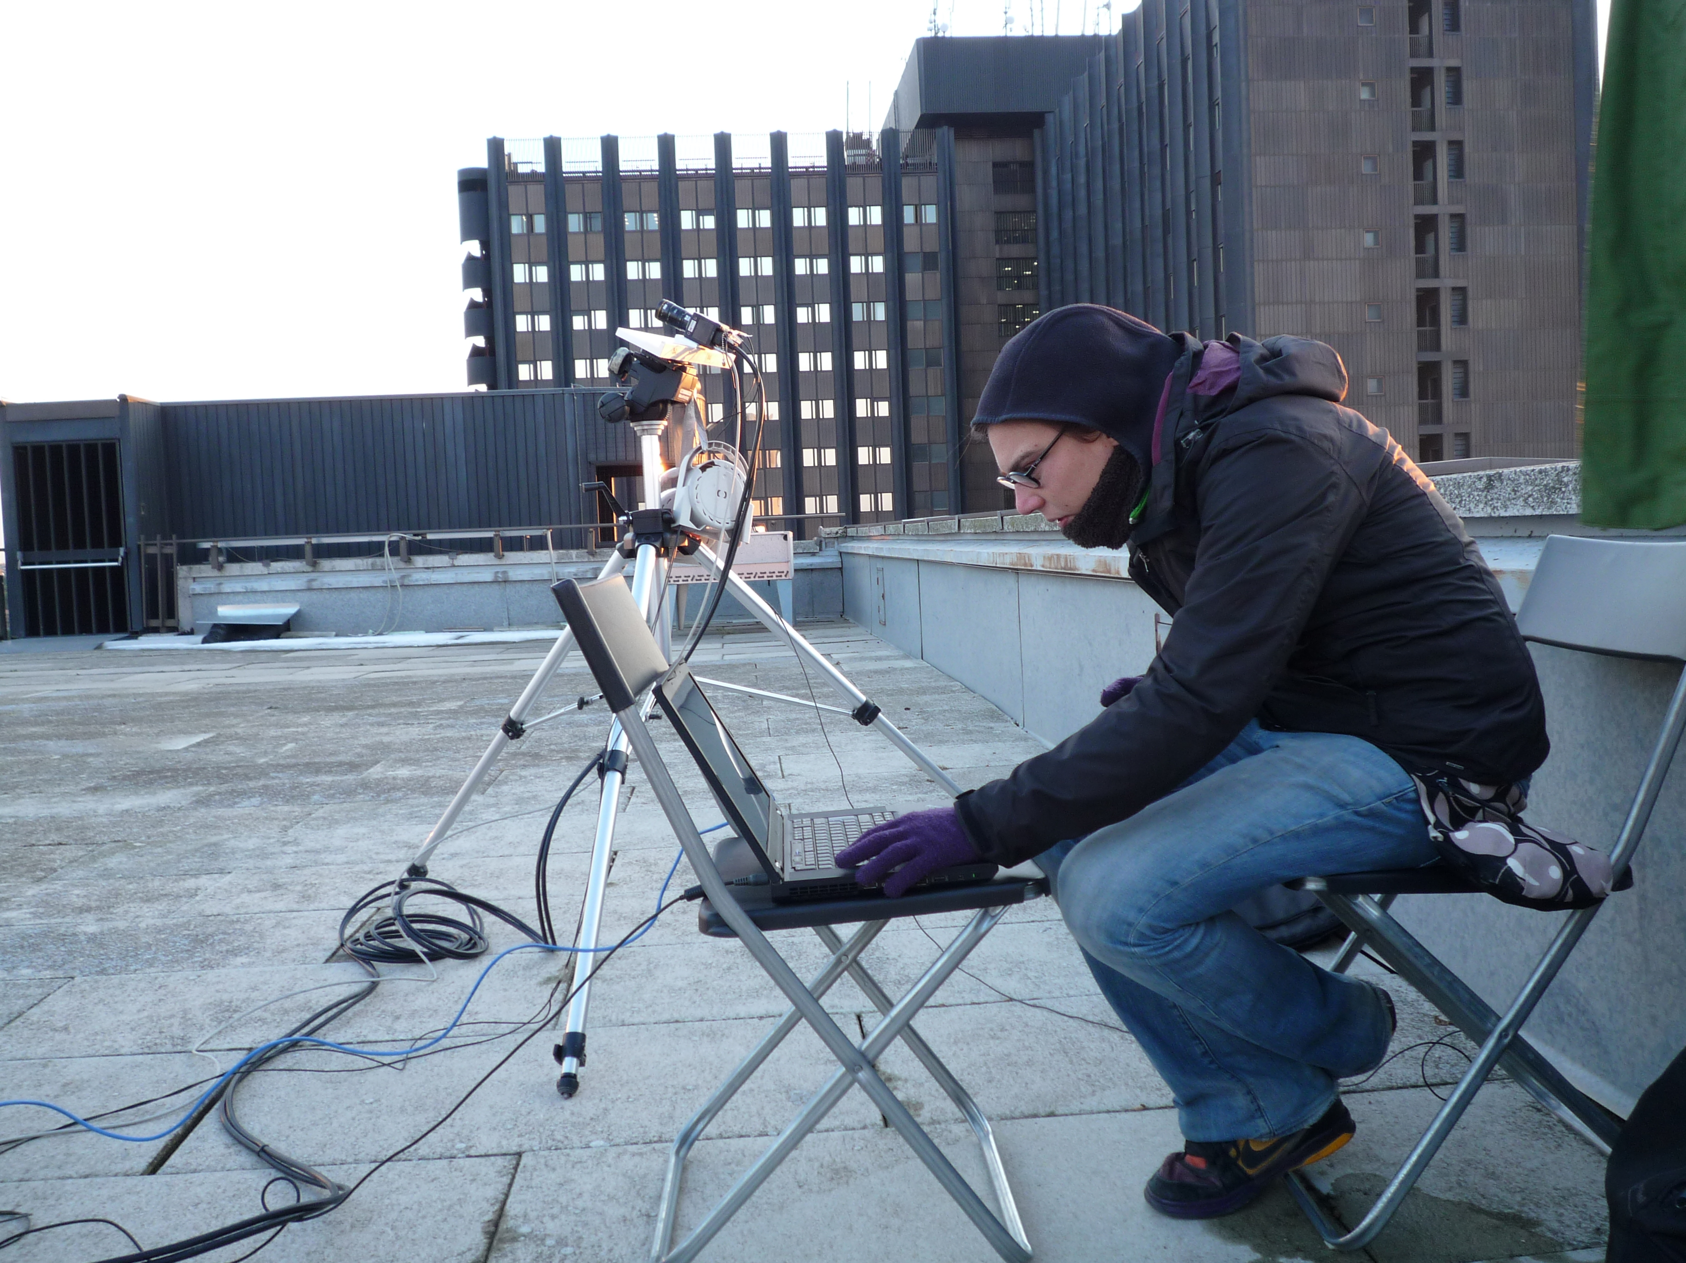
reproduce = evolve (rare events)
compute = integrate, differentiate
sense = transmit information
make decisions = irreversible (nonequilibrium) process
How do living organisms work?
work = live, reproduce, compute, sense, make decisions, communicate
do = physical constraints: noise, timescales, energetic costs, molecular costs, space

Slide 3
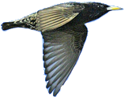
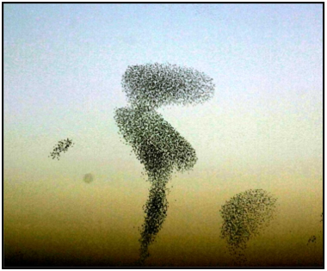
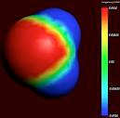
more is different
Phillip W Anderson, Science, 177, 393 (1972)
reproducibility vs randomness
critical phenomena
emergence
self-organization
effective interactions
Statistical Physics and Condensed Matter
More is Different
relevant scales
relevant variables
fundamentally new observed behaviour
effective models
abstraction

Slide 4
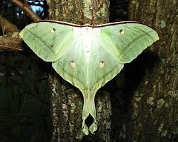
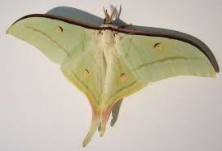
infotaxis or pushing physical limits
diluted concentrations
goal: reproduction
how can you find the source ?
goal: the female
make a probabilistic map of the sources
→ based on observations
turbulence
~1000 m
→ maximize entropy reduction rate
time ~ 3 nights
exploitation - max likeliood search
motion:
reduce entropy
the male
exploration - gathering data
update
Vergassola et al
Notes:
how biology deals with a physical turbulent flow?
bounds on precision given by physics - example of it.
physical constraint - you are just given the plumes, but you cannot measure the concentration.

Slide 5
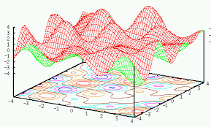
memory
neuron relaxation rate ~ 10 - 100 ms
point attractor
long term
~ days - years
Hopfield model
metastable states
memories
Hopfield
signals
activation state of a neuron
continuous attractor
response
short term
a continuum of solutions
~10 - 100 s
zero modes
Fiete, Sompolinsky, Seung et al
neural representations ?
neuron response
rat trajectory
how is the real world encoded in neural networks?
Notes:
in other cases physics comes not in the problem but in the solution a nonphysical problem - solution offered by physics
how do you fabricate long timescale from dynamics that are only short timescales:
- Hopfield: many metastable states
- continuous attractor: tune the system that you have a zero gap/mode - you can obtain long timescales for memory (state of the cells that encode your position) even though you have fast relaxation
and this is a well accepted model of what happens in the system for encoding of position in the brain (grid cells)

Slide 6
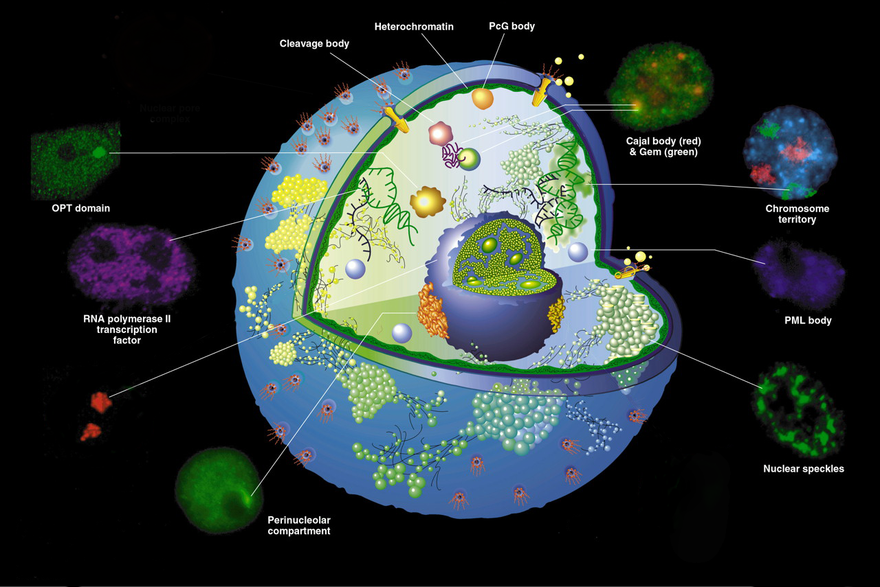
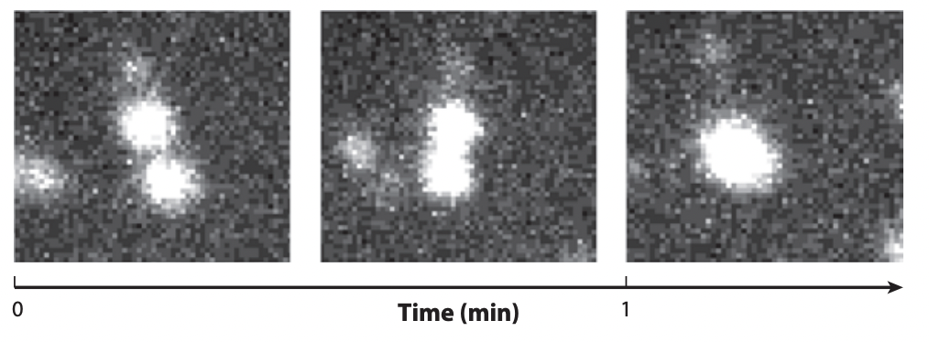
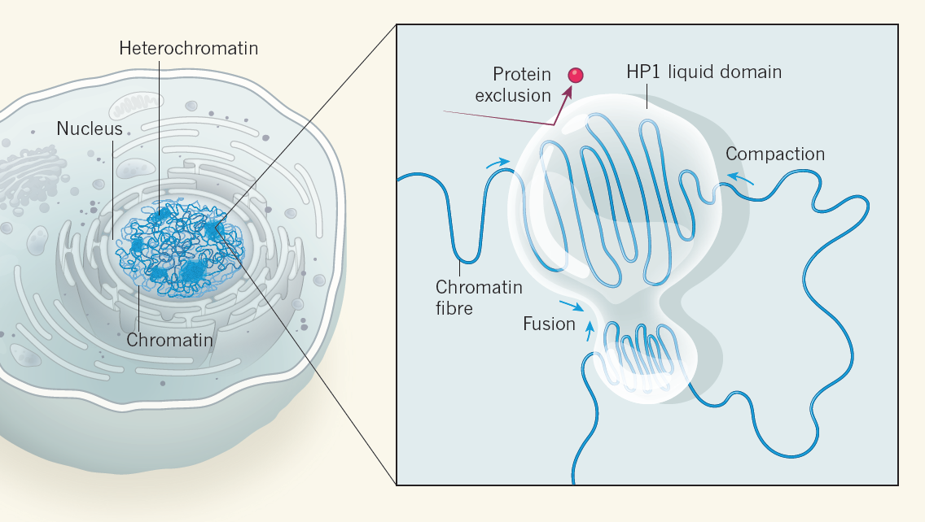
cellular membraneless self-organisation
many membraneless compartments
post-translational regulation hubs: first examples of droplets
granules P
spherical shape
possibility of rearranging the interior
can merge
→ liquid-like :
behavior of droplets in cells?
criteria for droplet formation ?
Hyman, Brangwynne, Jüllicher

Slide 7
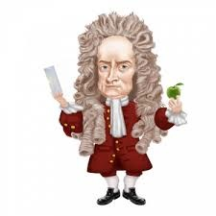
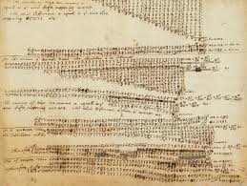
check against data
learn from data

Slide 8
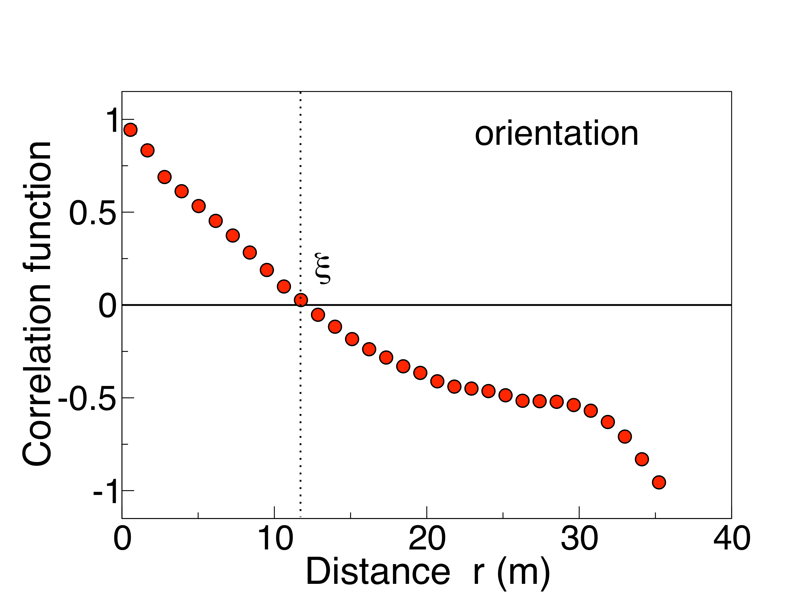
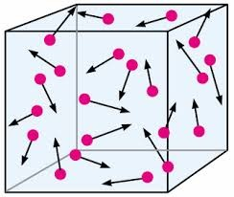
scale free bird flocking
local interactions → global order ?
statistical mechanics:
local interactions→scale-free correlations
lab frame
random flock direction → symmetry breaking → zero mode
amazing coordination
in flight direction
dynamically changing interaction network
→ stochastic eqs. of motion ⟷ social interaction model
Maxwell-Boltzmann distribution
topological defects
Cavagna, Giardina, Mora et al

Slide 9
evolution generates diversity
is the space of diverse solutions infinite?
evolution = rare events
co - evolution = constrained rare events
are evolutionary paths reproducible/predictable?

Slide 10
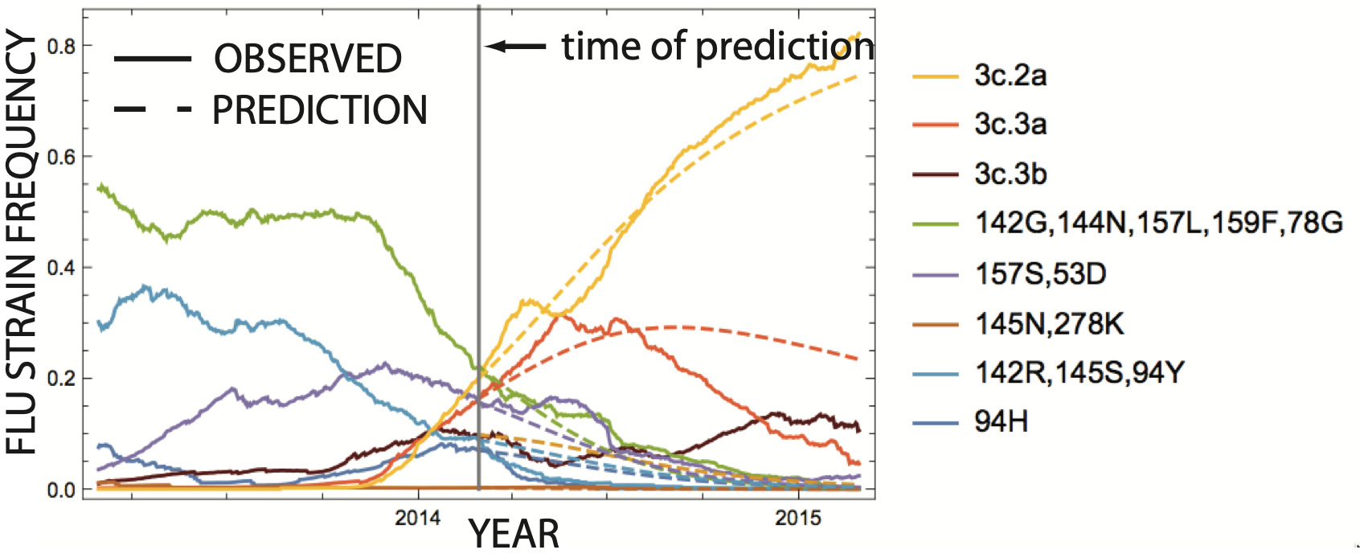
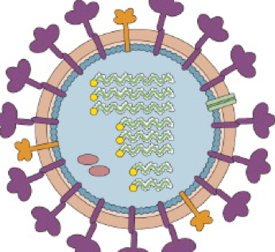
probabilistic flu prediction
prediction for winter 2014/2015
different strains
OBSERVATION
tion
prediction time
PREDICTION
strains
other strains
strains
co-evolution → timesales of constraints
Łuksza, Lässig, Neher, Shraiman

Slide 11
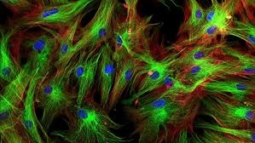
life across scales
molecular
cellular
organismal
ecological
cascading layers: can we understand one scale without the others?
same laws of physics
→
new laws ?
limits
↑
strategies
observations → phenomenology → theory → applications
strong interactions / stochasticity / non linearity
↓
reproducibility vs predictability?

