Slide 1
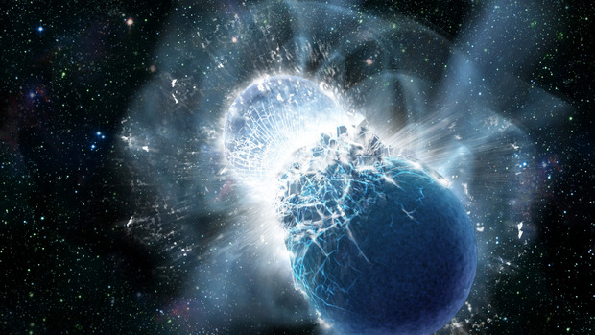


Unveiling the structure of ultra-dense matter
Credit: NASA/Swift Dana Berry
Synergy between nuclear physics and gravitational waves
Francesca Gulminelli - Université de Caen-Normandie
Congrès Général des 150 ans de la SFP, 3-7Juillet, 2023
Notes:
45’ total
Combined knowledge from nuclear physcs and astro can tell us

Slide 2
plan
Neutron stars and gravitational waves
Gravitational waves and the equation of state of dense matter
The contribution of nuclear physics
Future perspectives

Slide 3
plan
Neutron stars and gravitational waves
Gravitational waves and the equation of state of dense matter
The contribution of nuclear physics
Future perspectives

Slide 4
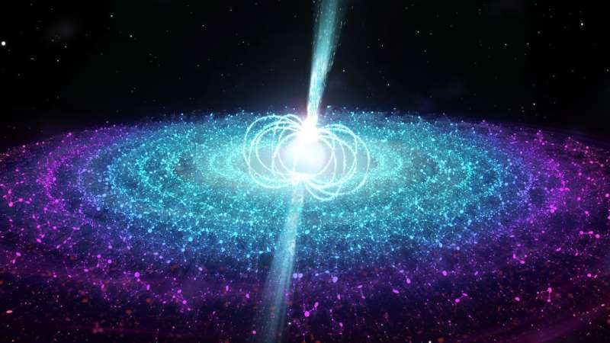
Neutron stars record list
Credit: ICRAR/Univ. Amsterdam.
The objects which spin
the fastest ν=716 Hz
=> v_{equator}~c/4
The highest speed of the
galaxy v=1083 km/s
The most intense magnetic fields H>10¹⁴ Gauss
The densest matter of the universe
ρ∼10¹⁴g/cm³
The only place where:
  neutrinos can be trapped
  quarks might be deconfined
Notes:
masse de la lune: 4 cuillères à café de NS! (density: 1 milliard tons per cm3)
First msmts of a binary system of two pulsars: 2004 spectacular confirmation of general gravity: the orbit period decay is in perfect agreement with the loss predicted by GR by emision of gravitational waves (=>indirect evidence of the existence of GW)
Mass measurement: gravitational effect on a companion (eg Shapiro effect on radio emission )
Mass measurement of X-ray binairies: less precise, from the doppler shift of x-ray and the doppler shift of the optical counterpart
Radius measurement: X-ray bursts (old N-star accreting material from a companion in a globular cluster): from the height of the peak infer T, the distance of the star is known since X-ray bursters come from globular clusters; the flux of the burst then gives the raius (black body radiation formula)
Champ magnétique terrestre: 0.5 gauss
Aimants supraconducteurs au LHC: 40000 gauss

Slide 5
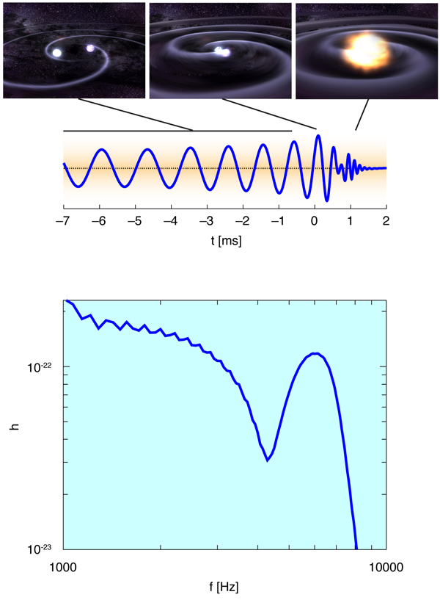
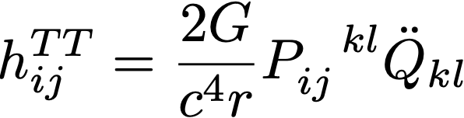
Neutron star binaries:
GW sources
Source: NASA&A.Stonebraker, adapted from PRL 104, 141101
Notes:
Ondes transverses en 1/r generees par la variation dans le temps du moment quadripolaire => il faut une source non spherique
Strain=amplitude du signal = 2 delta d /d = variation relative de la distance entre deux masses due a la variation du champ gravitationnel produit par le passage de l’onde;
le passage de l’onde gravitationnelle change le diametre de la terre de la dimension d’un atome
L’inspiral est determine par la gravite generale mais la forme du signal depend de la deformation quadripolaire des NS qui depend de l’EoS
Physicists sometimes call these gravitational waves "ripples on space-time," where space-time includes time as well as the 3 spatial dimensions we are used to. Relativity very accurately describes gravitation in this 4-dimensional universe. Since it is very difficult to visualize 4 dimensions, we can use a flexible surface such as a trampoline as a simplified model for space-time in 3 dimensions. Einstein stated that gravity is the result of the curvature of space-time (the surface of our trampoline in our visualization). If there is no mass on this surface to make depressions on it, then space-time is flat and a rolling ball on the surface will move in a straight line. But if there is a large mass that makes a depression on this surface, the rolling ball will be deflected toward the mass by the curvature of the surface, just as if there were a gravitational attraction between the two masses. Any change in position of the masses will make ripples on this surface representing our changing gravitational field - or gravitational waves.
Gravitational waves are created by moving masses, much as electromagnetic waves are created by moving charges. But because gravity is the weakest of the four fundamental forces (the others being the electromagnetic, weak nuclear, and strong nuclear), gravitational waves are exceedingly small. For physicists, a strong gravitational wave will produce displacements on the order of 10⁻¹⁸ meters - this is 1000 times smaller than the diameter of a proton. Waves of this strength will be produced by very massive systems undergoing large accelerations, like two orbiting black holes that are about to merge into one. Since systems like these are rare, these sources will be light-years away. Therefore, the search for gravitational waves is seeking the minute effects of some of the most energetic astrophysical systems from the depths of the universe.

Slide 6
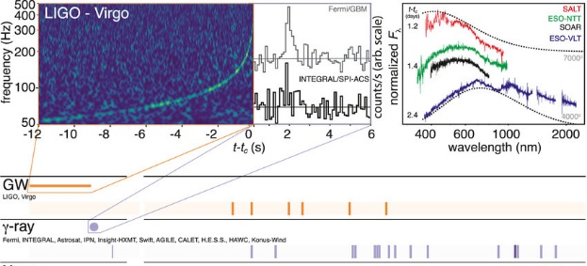
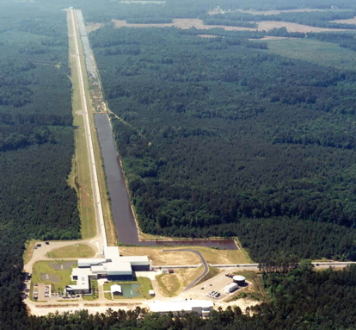
GW170817 by LVC
LIGO Livingston
https://www.ligo.org/detections.php
Notes:
90 detections pendant O3 dont 2BNS-2BHNS-1BH?
Deja ~5 alertes en O4
Figure 2b: Here we show the spectrograms from all three LIGO-Virgo detectors. You can see the characteristic "chirp", when the frequency increases, of a binary merger. Virgo ne montre pas de signal car sa sensitivité est moindre (la galaxie est trop lointaine)=> il a servi seulement pour la triangulation

Slide 7
plan
Neutron stars and gravitational waves
Gravitational waves and the equation of state of dense matter
The contribution of nuclear physics
Future perspectives

Slide 8
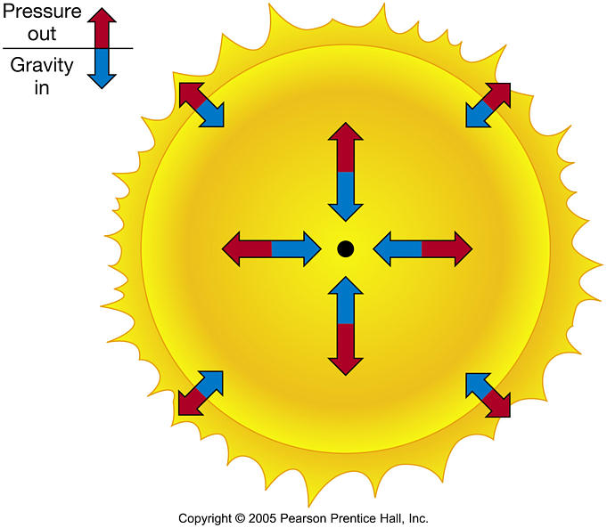
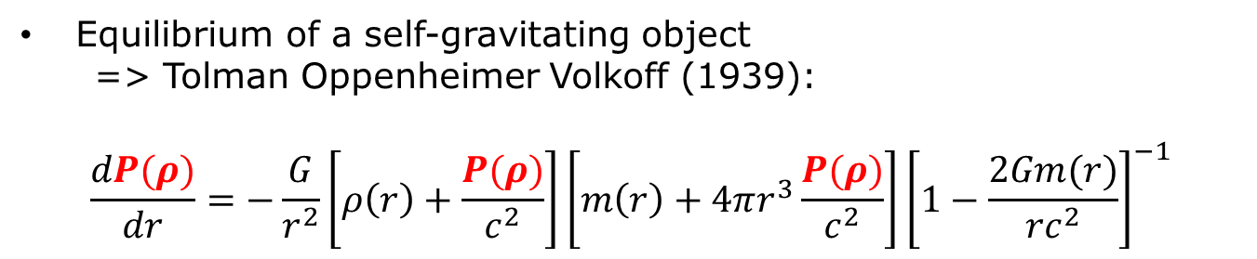

Modeling (neutron) stars: hydrostatics
Equilibrium of a self-gravitating object
=> Tolman Oppenheimer Volkoff (1939):
$$\frac{dP(ρ)}{dr}=−\frac{G}{r^{2}}\left[ρ\left(r\right)+\frac{P(ρ)}{c^{2}}\right]\left[m\left(r\right)+4πr^{3}\frac{P(ρ)}{c^{2}}\right]{\left[1−\frac{2Gm(r)}{{rc}^{2}}\right]}^{−1}$$
Equilibrium radius for each mass
Only depends on the EoS $P(ρ)$

Slide 9
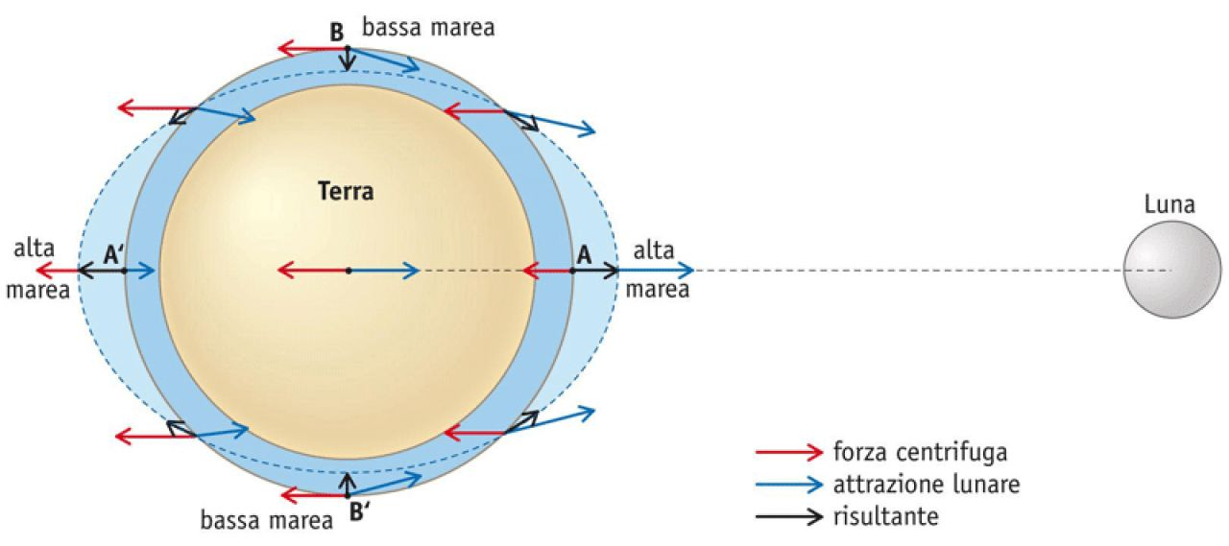

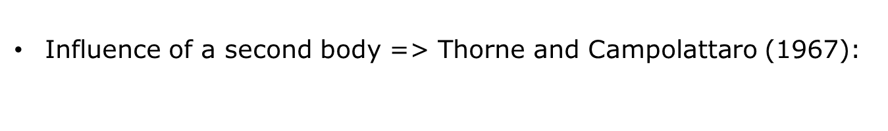

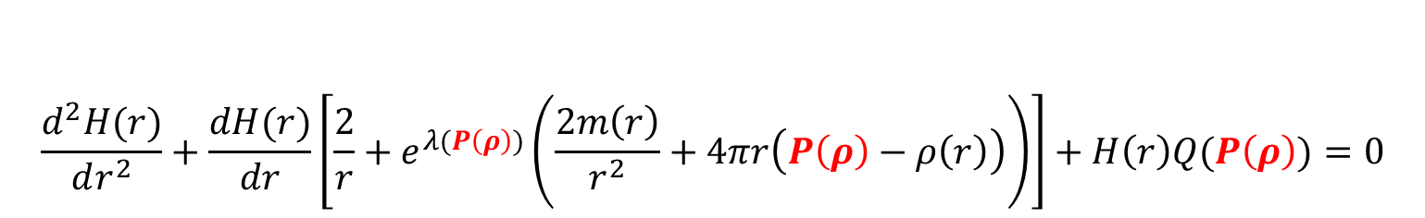
Modeling (neutron) stars: hydrostatics
Influence of a second body => Thorne and Campolattaro (1967):
$$\frac{d^{2}H(r)}{dr^{2}}+\frac{dH(r)}{dr}\left[\frac{2}{r}+e^{λ(P\left(ρ\right))}\left(\frac{2m\left(r\right)}{r^{2}}+4πr\left(P\left(ρ\right)−ρ\left(r\right)\right)\right)\right]+H\left(r\right)Q(P\left(ρ\right))=0$$
$$∀ρ_{c}$$
$Λ=\frac{2}{3}k_{2}\left(\frac{H′(r=R)}{H(r=R)}\right){\left(\frac{c^{2}}{G}\frac{R}{M}\right)}^{5}$
Tidal polarisability
$${\overset{̿}{Q}}^{(i)}=−Λ_{i}{\overset{̿}{ℇ}}^{(j)}$$
Only depends on the EoS $P(ρ)$
Notes:
There are also tidal coefficients for multipoles higher than the quadrupole (octupolar and hexadecapola)can be computed from
quasi–universal relations in terms of the quadrupole co-
efficients

Slide 10
BBH

Slide 11
NS-NS
LVC, PRX9 2019

Slide 12
plan
Neutron stars and gravitational waves
Gravitational waves and the equation of state of dense matter
The contribution of nuclear physics
Future perspectives

Slide 13
Neutron star EoS and nuclear physics
M~1.4M_{O}, R~12 km => density as the one inside the atomic nucleus=> nuclear degrees of freedom (hadrons or quarks) in strong interaction
The strong interaction is described by the standard model of particle physics, but no solution exists for dense matter
Effective models of neutrons and proton
JCAP03(2020)050
Science case for the Einstein Telescope

Slide 14
Jumping across the scales ?
L(m)
Observation
R(M),Λ(M)
P(ρ)
hydrostatics
10³
10⁻³
constraint
Thermo limit
prediction
10⁻⁹
Nuclear
data
Nuclear model
constraint
10⁻¹⁵
prediction

Slide 15
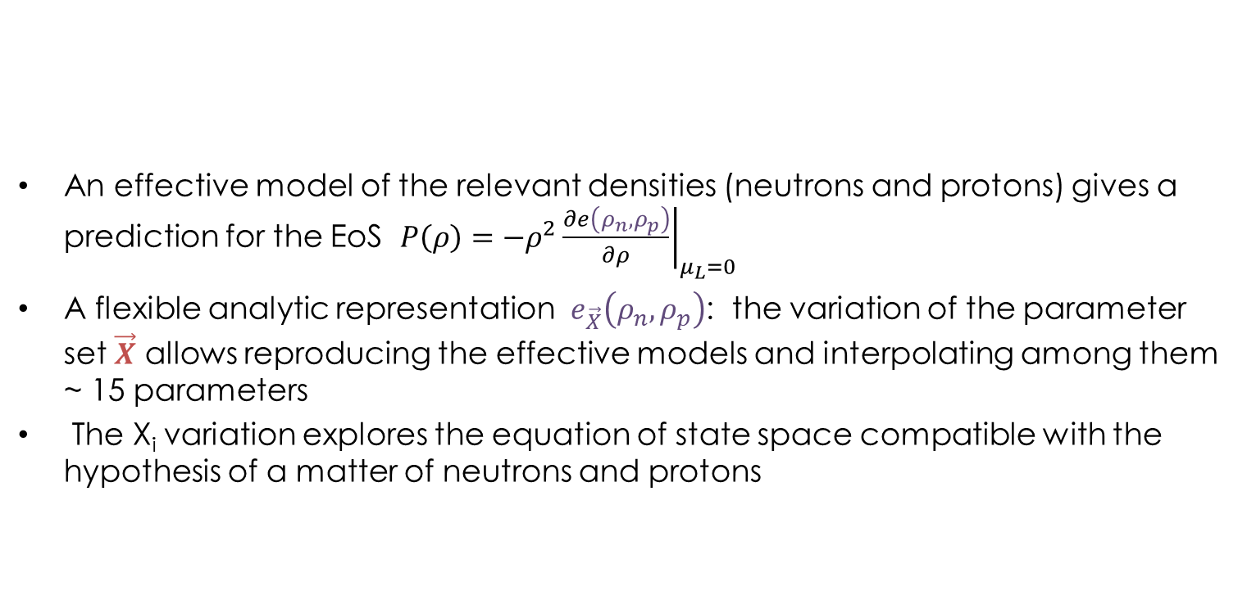

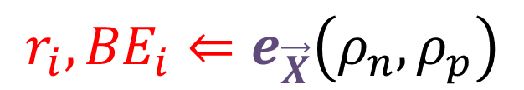
Jumping across the scales: the syllabus
An effective model of the relevant densities (neutrons and protons) gives a prediction for the EoS $P\left(ρ\right)=−ρ^{2}{\left.\frac{∂e\left(ρ_{n},ρ_{p}\right)}{∂ρ}\right|}_{μ_{L}=0}$
A flexible analytic representation $e_{\vec{X}}\left(ρ_{n},ρ_{p}\right)$: the variation of the parameter set $\vec{X}$ allows reproducing the effective models and interpolating among them ~ 15 parameters
The X_{i} variation explores the equation of state space compatible with the hypothesis of a matter of neutrons and protons
$${r_{i},BE}_{i}⇐e_{\vec{X}}\left(ρ_{n},ρ_{p}\right)$$
$$⇒M,R,Λ$$
EoS analytic
representation
Laboratory observables
Astronomical observables

Slide 16


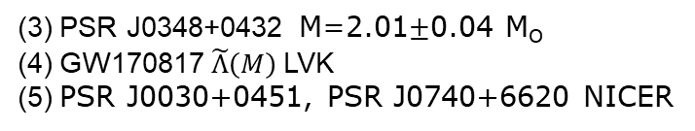
Bayesian Inference
  $$P\left(\vec{X} | \vec{f}\right)=\frac{P\left(\vec{X}\right)\prod_{i}{P\left(f_{i} | \vec{X}\right)}}{P\left(\vec{f}\right)}$$
  $\text{f}\text{1}\text{.} \text{nuclear} \text{data}$
  $\text{f}\text{2}\text{.}$ ab-initio theory
  $\text{f}\text{3}\text{.}$max.mass (radio)
  $\text{f}\text{4}\text{.}$ tidal polarisability (GW)
  $\text{f}\text{5}\text{.}$radius (X-ray)
Nuclear physics
Astrophysics
(1) Huang et al, 2016 AME mass table, Angeli&Marinova, ADNDT 2013
(2) χEFT Drischler et al PRC 2016
(3) PSR J0348+0432 M=2.01$±$0.04 M_{O}
(4) GW170817 $\tilde{Λ}\left(M\right)$LVK
(5) PSR J0030+0451, PSR J0740+6620 NICER

Slide 17
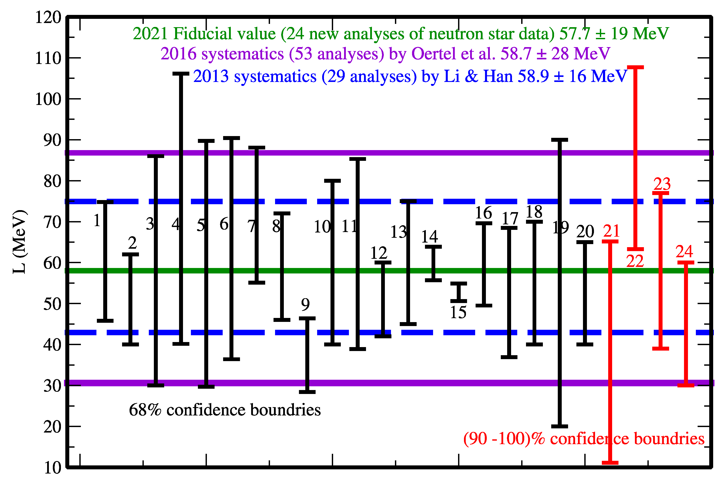
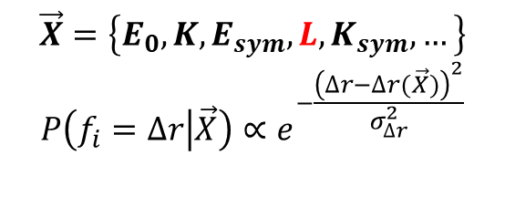
Laboratory experiments
example: neutron skin of ²⁰⁸Pb
$$\vec{X}=\left\{E_{0},K,E_{sym},L,K_{sym},…\right\}$$
$$P\left(f_{i}=∆r | \vec{X}\right)∝e^{−\frac{{\left(∆r−∆r(\vec{X})\right)}^{2}}{σ_{∆r}^{2}}}$$
B.An Li et al, Universe 2021, 7(6), 182
X.Roca-Maza et al PRL 2011

Slide 18
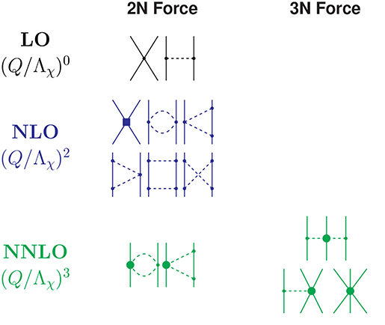
Chiral perturbation theory
The « ab-initio » nuclear theory
Perturbative expansion : controled truncation errors
Moment expansion! Only valid at low density
Machleidt R., Int J Mod Phys. (2017)
J0348+0432
I. Tews, T. Krüger, K. Hebeler, and A. Schwenk, Phys. Rev. Lett. 110, 032504 (2013).
C. Drischler, K. Hebeler, and A. Schwenk, Phys. Rev. C 93, 054314 (2016).
Notes:
the interactions are expanded in powers of the typical
momentum p over the breakdown scale Lambda, Q = p/Lambda,
where the breakdown scale denotes momenta at which the short
distance structure becomes important and cannot be neglected
and absorbed into contact interactions anymore.
High density: short range physics dominate and expansion breaks down
Among other methods, these include variational methods based on the cluster expansion [21], many-body perturbation theory [22], the coupled-cluster method [23], and Quantum Monte Carlo methods [24, 25]. In this paper, we will focus on recent results obtained with the Auxiliary Field Diffusion Monte Carlo (AFDMC) method, which was originally introduced by Schmidt and Fantoni [26], and is ideally suited to study neutron matter [27, 28].

Slide 19
The nuclear physics predictions
A neutrons and protons composition is compatible with the observations
Many models can be excluded
nuclear
constraints
astro
constraints
H.Dinh Thi et al, A&A 2021

Slide 20
The nuclear physics predictions
A neutrons and protons composition is compatible with the observations
Many models can be excluded
LVC, PRX9 2019
H.Dinh Thi et al, A&A 2021
And Universe 2021, 7(10), 373

Slide 21
plan
Neutron stars and gravitational waves
Gravitational waves and the equation of state of dense matter
The contribution of nuclear physics
Future perspectives

Slide 22
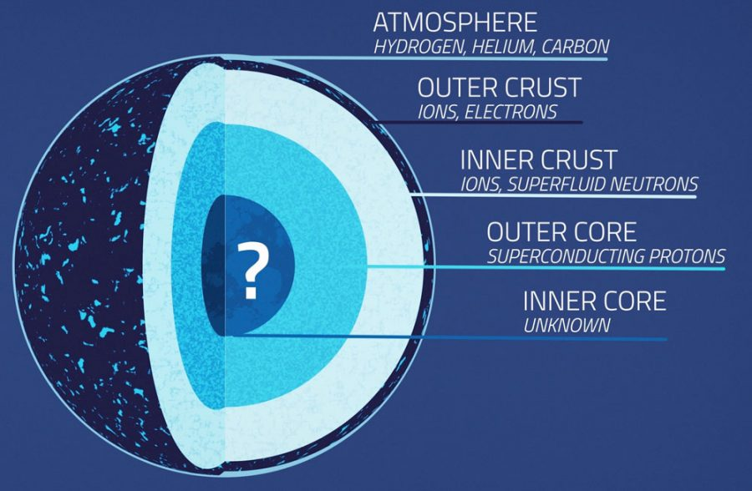
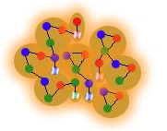
Quarks in the core of neutron stars?
At high density, matter could be deconfined
Grande incertitude dans les modèles
Hypothèse nulle: peut-on exclure une composition nucléonique?
JCAP03(2020)050
Science case for the Einstein Telescope
Notes:
Constant Sound Speed

Slide 23
Quarks in the core of neutron stars ?
At high density, matter could be deconfined
Big uncertainty in the models
Null hypothesis: can we exclude a nucleonic composition?
J.J.Li, A.Sedrakian, M.Alford, PRD101 (2020) 063022
Notes:
Constant Sound Speed

Slide 24
Quarks in the core of neutron stars ?
A neutrons and protons composition is compatible with the observations
But a great discovery potential
F.G., A.F.Fantina,NPN 2021
(GW190814)

Slide 25
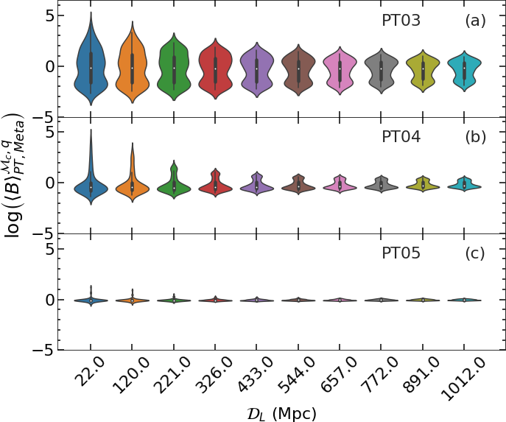
Quarks in the core of neutron stars ?
Only a very close detection would allow identifying deconfined matter, and only if the quark core is large
No PT
Need to reduce the uncertainties!
  New nuclear observables =>GANIL/Spiral2, FRIB
  Progress in theory
  New detections with better SNR=> Einstein Telescope, Cosmic Explorer

Slide 26
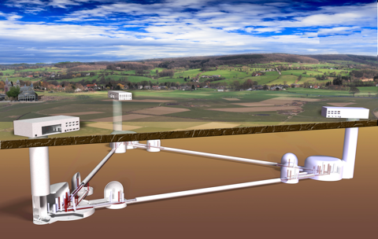
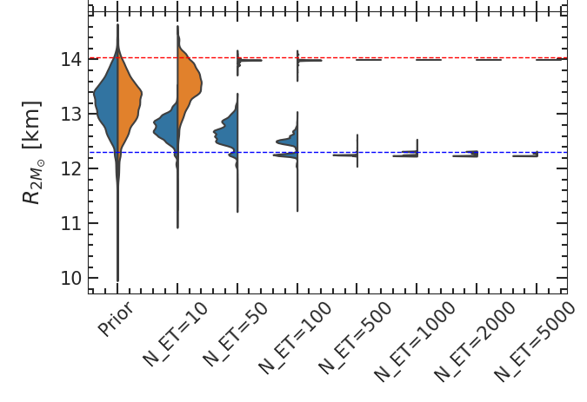
The Einstein Telescope project
Notes:
Feu vert de l’ESFRI en 2020
design study project supported by the European Commission under the Framework Programme 7 (FP7). It concerns the study and the conceptual design for a new research infrastructure in the emergent field of gravitational-wave astronomy.
10km triangle soit en Sardaigne, soit dans la region frontaliere Allemagne-Belgique-PaysBas
Sous terre (200m)

Slide 27
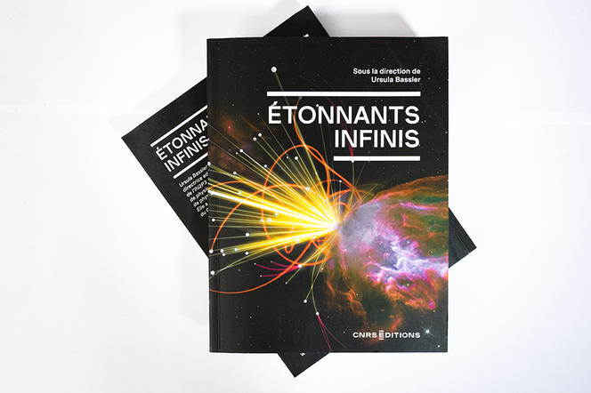
Conclusions
Gravitational waves: a new probe to explore ultra-dense matter
Important synergies between nuclear physics and astrophysics since the first observation of a neutron star merger GW170817
No evidence of deconfined matter (quark-gluon plasma) in the neutron star core, but exciting discoveries ahead
Cyril FRÉSILLON / CNRS Photothèque

Slide 29

L’histoire de(s) découverte(s)
1934: Prediction Baade&Zwicky
1967: Découverte des pulsars
Bell&Hewish (prix Nobel 1974)
Notes:
Square km array in south africa => 20000 new pulsars
Mass measurement: gravitational effect on a companion (eg Shapiro effect on radio emission )
Mass measurement of X-ray binairies: less precise, from the doppler shift of x-ray and the doppler shift of the optical counterpart
Radius measurement: X-ray bursts (old N-star accreting material from a companion in a globular cluster): from the height of the peak infer T, the distance of the star is known since X-ray bursters come from globular clusters; the flux of the burst then gives the raius (black body radiation formula)
Champ magnétique terrestre: 0.5 gauss
Aimants supraconducteurs au LHC: 40000 gauss

Slide 30
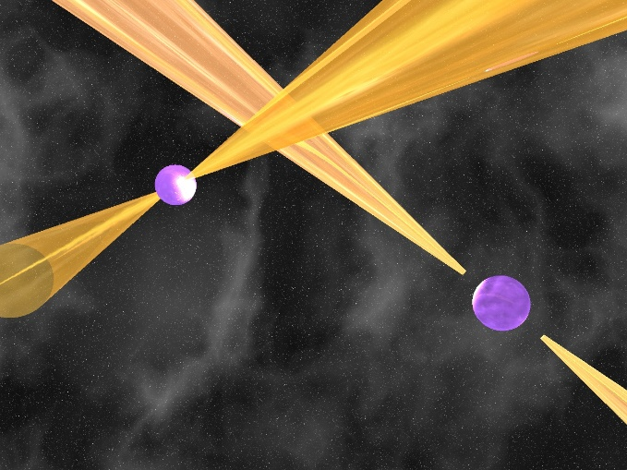
L’histoire de(s) découverte(s)
1934: Prediction Baade&Zwicky
1967: Découverte des pulsars
Bell&Hewish (prix Nobel 1974)
1974: Première détection d’une binaire de pulsar (Hulse-Taylor)
Credit: M. Kramer, Univ. Manchester
Notes:
Square km array in south africa => 20000 new pulsars
Mass measurement: gravitational effect on a companion (eg Shapiro effect on radio emission )
Mass measurement of X-ray binairies: less precise, from the doppler shift of x-ray and the doppler shift of the optical counterpart
Radius measurement: X-ray bursts (old N-star accreting material from a companion in a globular cluster): from the height of the peak infer T, the distance of the star is known since X-ray bursters come from globular clusters; the flux of the burst then gives the raius (black body radiation formula)
Champ magnétique terrestre: 0.5 gauss
Aimants supraconducteurs au LHC: 40000 gauss

Slide 31
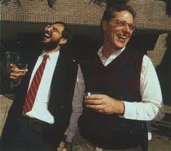
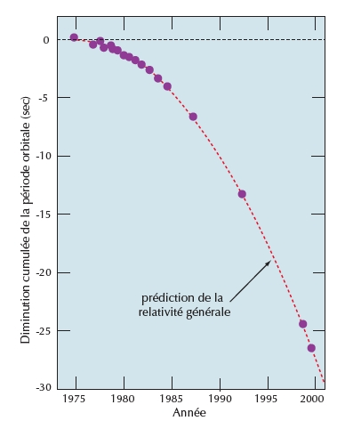
L’histoire de(s) découverte(s)
1934: Prediction Baade&Zwicky
1967: Découverte des pulsars
Bell&Hewish (prix Nobel 1974)
1974: Première détection d’une binaire
de pulsar (Hulse-Taylor)
1975- Mise en évidence indirecte
1993: d’ondes gravitationnelles (OG)
Hulse&Taylor (prix Nobel 1994)
Notes:
Square km array in south africa => 20000 new pulsars
Mass measurement: gravitational effect on a companion (eg Shapiro effect on radio emission )
Mass measurement of X-ray binairies: less precise, from the doppler shift of x-ray and the doppler shift of the optical counterpart
Radius measurement: X-ray bursts (old N-star accreting material from a companion in a globular cluster): from the height of the peak infer T, the distance of the star is known since X-ray bursters come from globular clusters; the flux of the burst then gives the raius (black body radiation formula)
Champ magnétique terrestre: 0.5 gauss
Aimants supraconducteurs au LHC: 40000 gauss

Slide 32
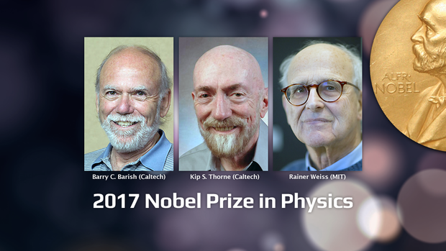
L’histoire de(s) découverte(s)
1934: Prediction Baade&Zwicky
1967: Découverte des pulsars
Bell&Hewish (prix Nobel 1974)
1974: Première détection d’une binaire
de pulsar (Hulse-Taylor)
1975- Mise en évidence indirecte
1993: d’ondes gravitationnelles (OG)
Hulse&Taylor (prix Nobel 1994
2015: Première détection d’OG d’une
binaire de trous noirs (LIGO
-Virgo, prix Nobel 2017)
2017: Première détection d’OG d’une
binaire d’étoiles à neutrons
2023: Début du quatrième run
d’observation LVK
Notes:
Square km array in south africa => 20000 new pulsars
Mass measurement: gravitational effect on a companion (eg Shapiro effect on radio emission )
Mass measurement of X-ray binairies: less precise, from the doppler shift of x-ray and the doppler shift of the optical counterpart
Radius measurement: X-ray bursts (old N-star accreting material from a companion in a globular cluster): from the height of the peak infer T, the distance of the star is known since X-ray bursters come from globular clusters; the flux of the burst then gives the raius (black body radiation formula)
Champ magnétique terrestre: 0.5 gauss
Aimants supraconducteurs au LHC: 40000 gauss

Slide 33
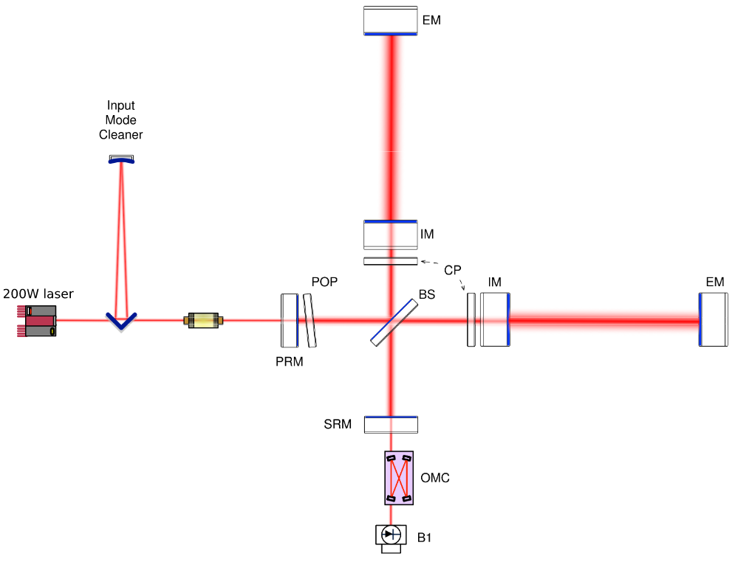

La détection d’OG interféromètre Michelson-Fabry-Perot
Mirror
Beam splitter
3–4 km
resonant cavity
Incoming GW
Photodetector

Slide 34
Contraintes expérimentales et théoriques

Slide 35
Tighter constraints from high energy experiments ?
J.Xu, PRC 2013
Elliptic flow @ HADES:
Transport model versus data
P.Hillmann et al., JPG 47 (2020) 055101

Slide 36
Strategy II: high precision
Isovector probes with stable nuclei:
Skin
IAS
GDR response
Isospin transport in HIC (INDRA/FAZIA)
Exp: Δr_{np}= 0,1318-0,3072
X.Roca-Maza, G.Colo, H.Sagawa (2018)
X.Vinas et al (2014)
P.G.Reinhard, W.Nazarewicz (2016)
J.Yang, J.Piekarewicz (2017)
Notes:
Skin:208Pb
IAS:124Sn

Slide 37
Strategy III: new probes
Isoscalar probes in exotic nuclei:
Soft monopole
SSRPA calculations
0.02
0.04
0.01
³⁴Si
neutrons
r²ρ_{ν}
0.02
protons
0
r²ρ_{ν}
0
-0.01
E=11 MeV
-0.02
E=22 MeV
-0.02
-0.04
0
5
10
r (fm)
0
5
10
r (fm)
D.Gambacurta, Phys. Rev. C 100, 014317 (2019)

Slide 38
« Reasonable » agnostic modeling of a 1st order phase transition including both LIGO/VIRGO and NICER data as constraints, predicts no transitions below densities ρ∼2,5ρ₀
Nuclear physics is valid, but ab-initio modeling is not…
Need of more constraining nuclear data for ρ₀ <ρ<2ρ₀
S.P.Tang et al., arXiv:2009.05719v1

Slide 39
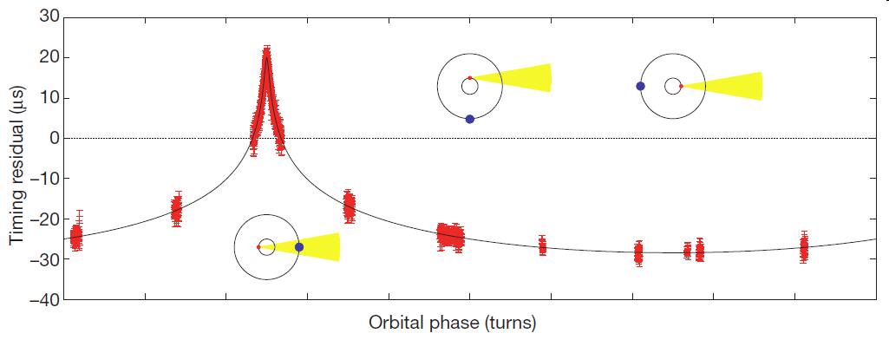
Neutron Stars: today
A
Today: about 2000 Neutron Stars known in the Milky Way and Large Magellanic Cloud
P. Demorest et al., Nature (2010)
M(PSR J1614)=1.97 +/- 0.04
J.Antoniadis et al., Science (2013).
M(PSR J0348)=2.01 +/- 0.04
H.Cromartie et al. Nature As. (2019)
M(PSR J0740)=2.14+/- 0.1
…supermassive objects: challenge for the strong interaction
N.Rea et al., ApJ (2013).
B(SGR 0418) = 6x10¹² G
…SGR,pulsar,magnetars: unified picture
Notes:
Anomalous X-ray Pulsar = magnetar
Soft Gamma Repeater
SuperNova Remnant
We report on the long-term X-ray monitoring of the outburst decay of the low magnetic field magnetar SGR 0418+5729 using all the available X-ray data obtained with RXTE, Swift, Chandra, and XMM-Newton observations from the discovery of the source in 2009 June up to 2012 August. The timing analysis allowed us to obtain the first measurement of the period derivative of SGR 0418+5729: s s^{–1}, significant at a ~3.5σ confidence level. This leads to a surface dipolar magnetic field of B _{dip} 6 × 10¹² G. This measurement confirms SGR 0418+5729 as the lowest magnetic field magnetar. Following the flux and spectral evolution from the beginning of the outburst up to ~1200 days, we observe a gradual cooling of the tiny hot spot responsible for the X-ray emission, from a temperature of ~0.9 to 0.3 keV.

Slide 40
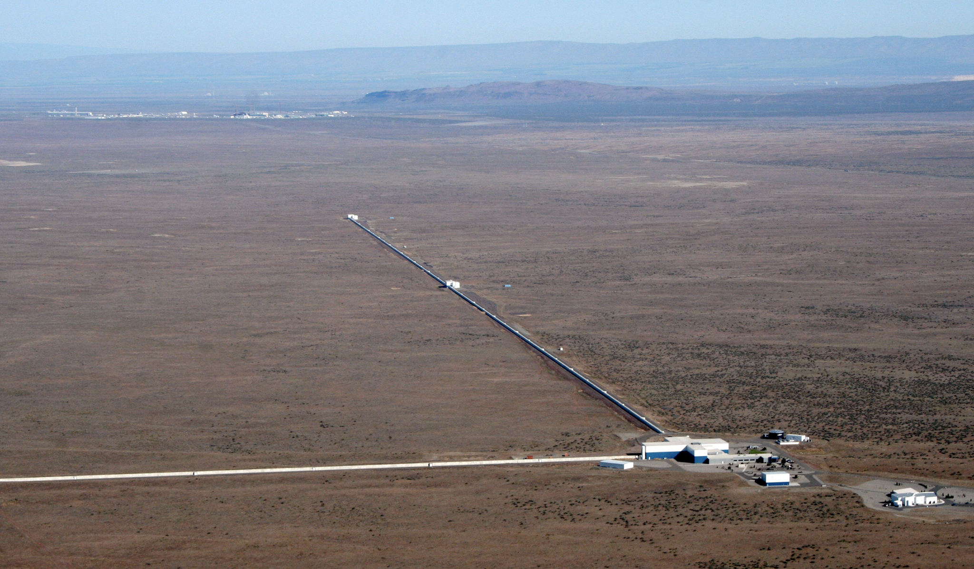
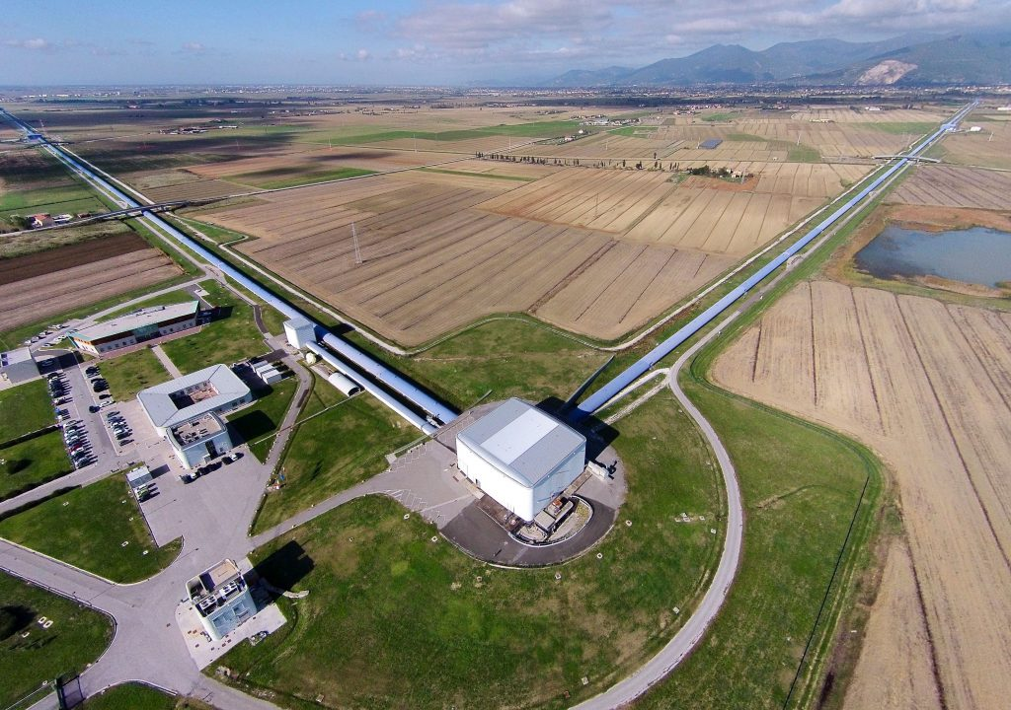
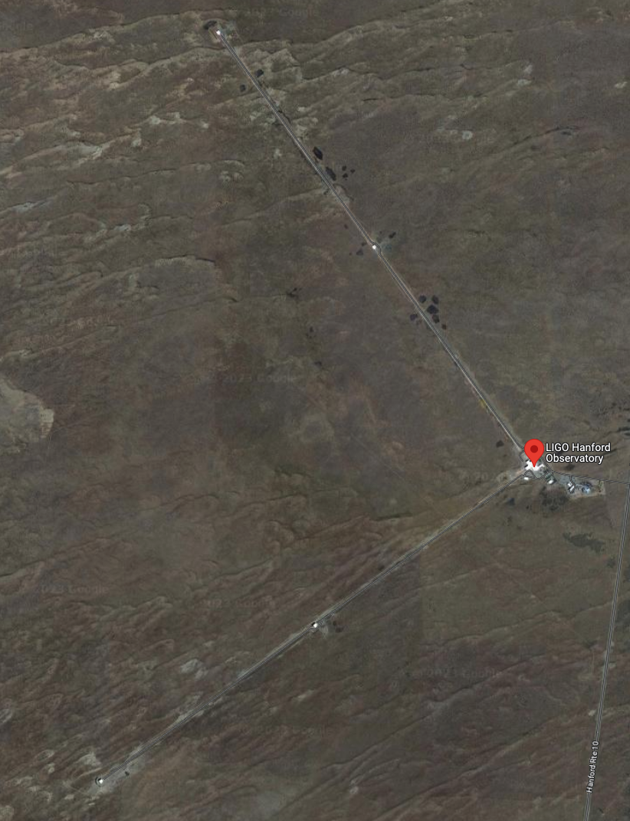
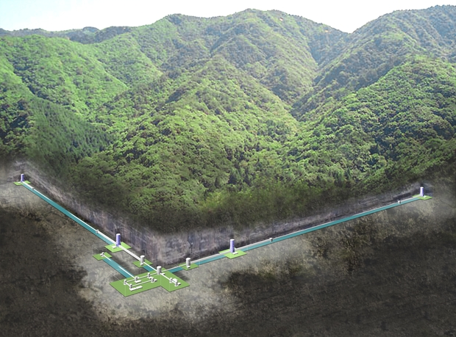
GW detectors: the present network
LIGO Hanford
Virgo
LIGO Livingston
KAGRA

Slide 41
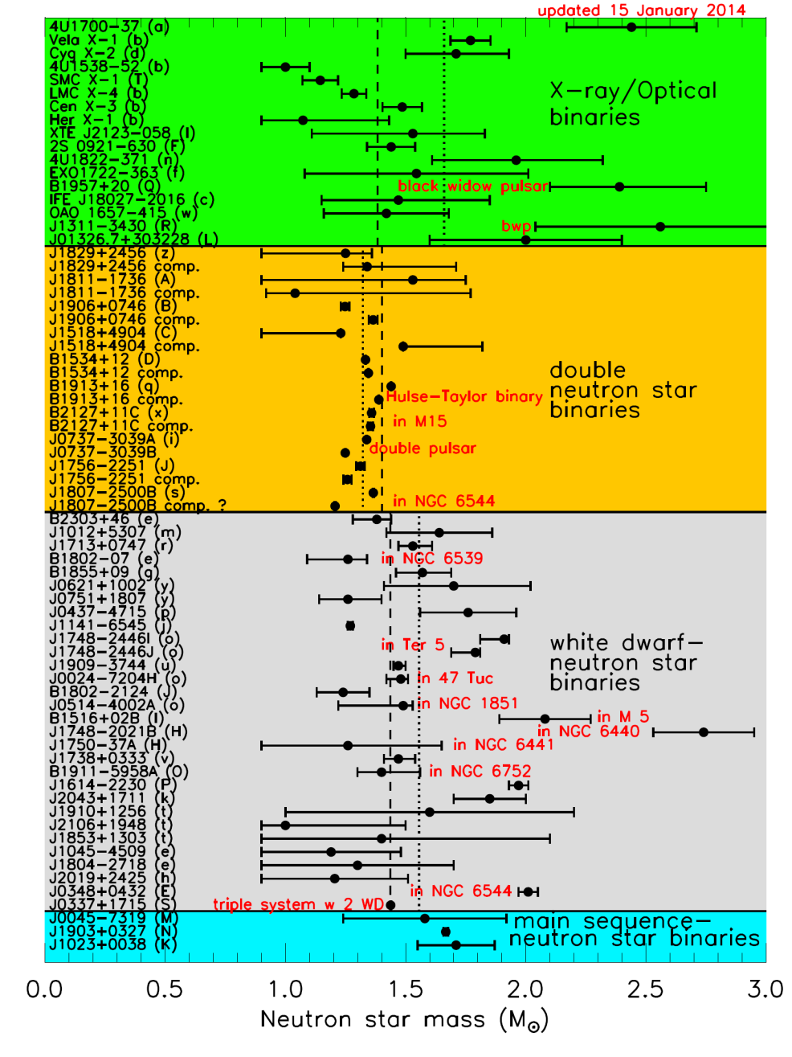
Jim Lattimer 2014
Notes:
1/3 des etoiles sont binaires (80% des etoiles massives)
Square km array in south africa => 20000 new pulsars
Mass measurement: gravitational effect on a companion (eg Shapiro effect on radio emission )
Mass measurement of X-ray binairies: less precise, from the doppler shift of x-ray and the doppler shift of the optical counterpart
Radius measurement: X-ray bursts (old N-star accreting material from a companion in a globular cluster): from the height of the peak infer T, the distance of the star is known since X-ray bursters come from globular clusters; the flux of the burst then gives the raius (black body radiation formula)
Champ magnétique terrestre: 0.5 gauss
Aimants supraconducteurs au LHC: 40000 gauss

Slide 42

$$log\left({\left\langle B\right\rangle }_{PT,nucl}^{ℳ_{0}{,q}_{0}}\right)=\int{d\tilde{Λ}}P_{0}^{GW}\left(\tilde{Λ}\right)log\left[\frac{P_{0}^{n_{t}}\left(\tilde{Λ}\right)}{P_{0}^{nucl}\left(\tilde{Λ}\right)}\right]$$
=> High detectability potential of a density jump with G3 detectors for an EARLY phase transition

Slide 43
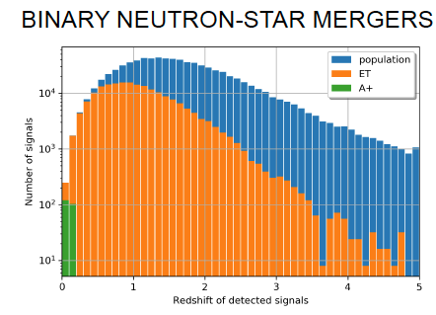
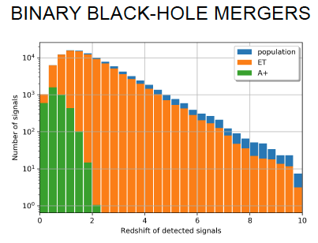
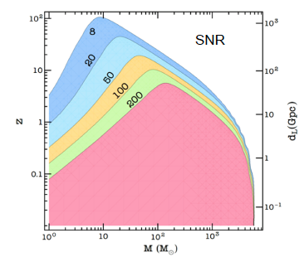
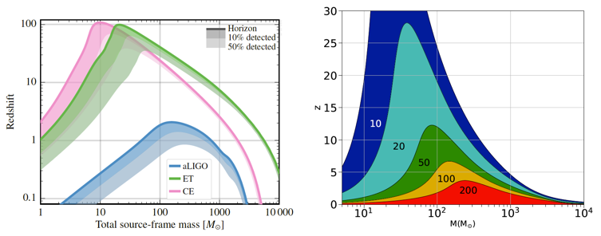
ET sensitivity
10⁵-10⁶ BBH detections per year
10⁴-10⁵ BNS detections per year among which ~10-100 with EM counterparts
High SNR events
Overlapping events
~1 detection every 30s

Slide 44
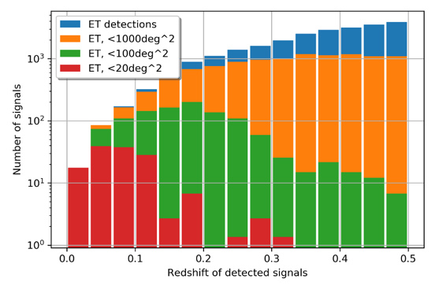
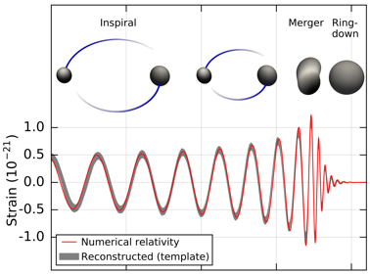
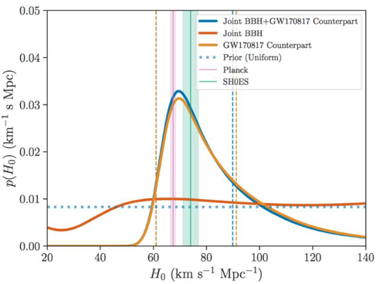
ET sensitivity
BNS detection with EM counterparts and localization precision < 20 deg² : o(10-100) per year
Overlap with many BBH signals
Potentially, very long signals
ET will be able to provide alerts few hours before the merger
And with ~500 BNS-EM detection, we can reach Planck resolution on H₀ measurement
Identify early the
inspiral …
… and provide alert
before the merger phase

